Slide 1

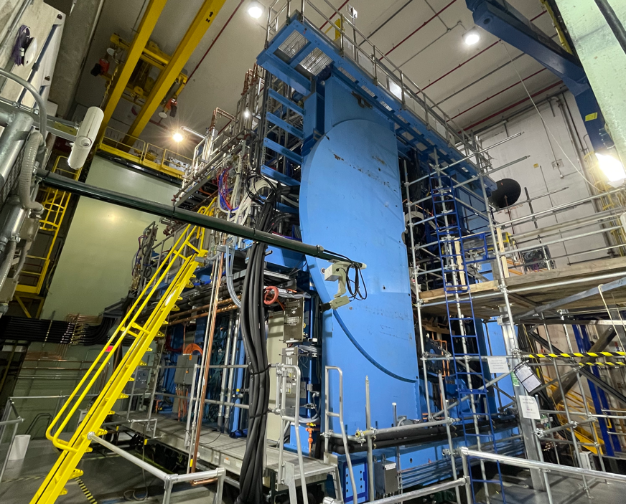



RHICにおける次世代ジェット検出器sPHENIXが展く
物理と現状
理研仁科センター
中川格

Slide 2
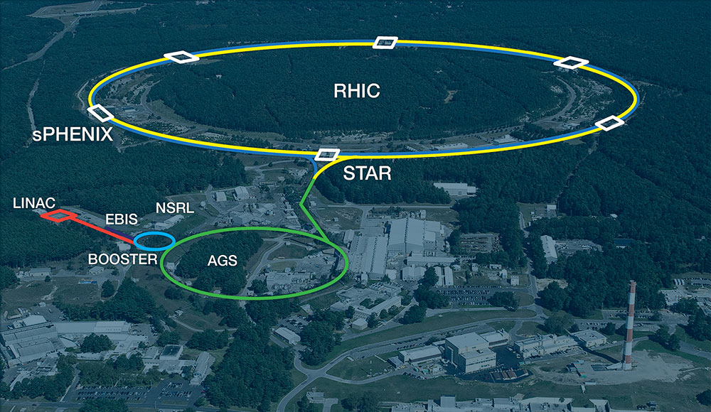
アウトライン
sPHENIXの物理
sPHENIX誕生の秘話
検出器の構成
建設とコミッショニングの現状
日本グループの貢献

Slide 3
sPHENIXの物理

Slide 4
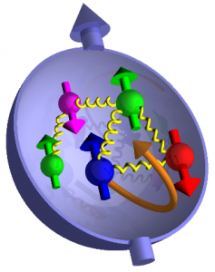
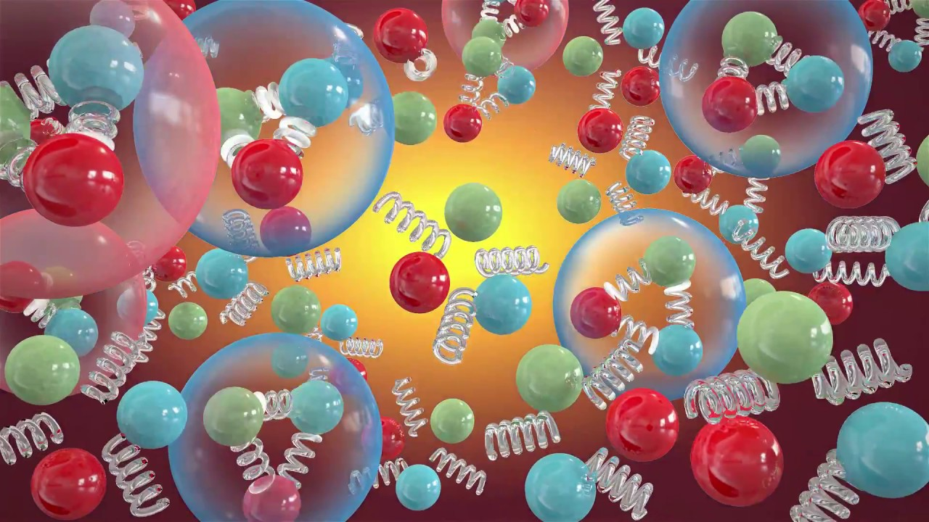

RHIC(2000~)の物理
QGP・グルーオン抑制
陽子スピン・ハドロン構造

Slide 5
QGPとプローブ
Courtesy of Paul Sorensen and Chun Shen
従来RHICではハドロン化を経たハドロンを主なプローブとしてQGPを観測してきた

Slide 6
RHICの４つの実験
いずれもハドロンに特化された検出器群

Slide 7
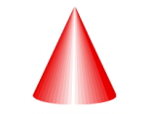
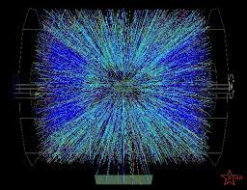
QGPとプローブ
重イオン衝突でジェットなんてムリムリ！
QM2019, Gojko Vujanovic
STARイベントディスプレー
QGP物性をより精密に測定するには、ジェットはゴールデンプローブ

Slide 8
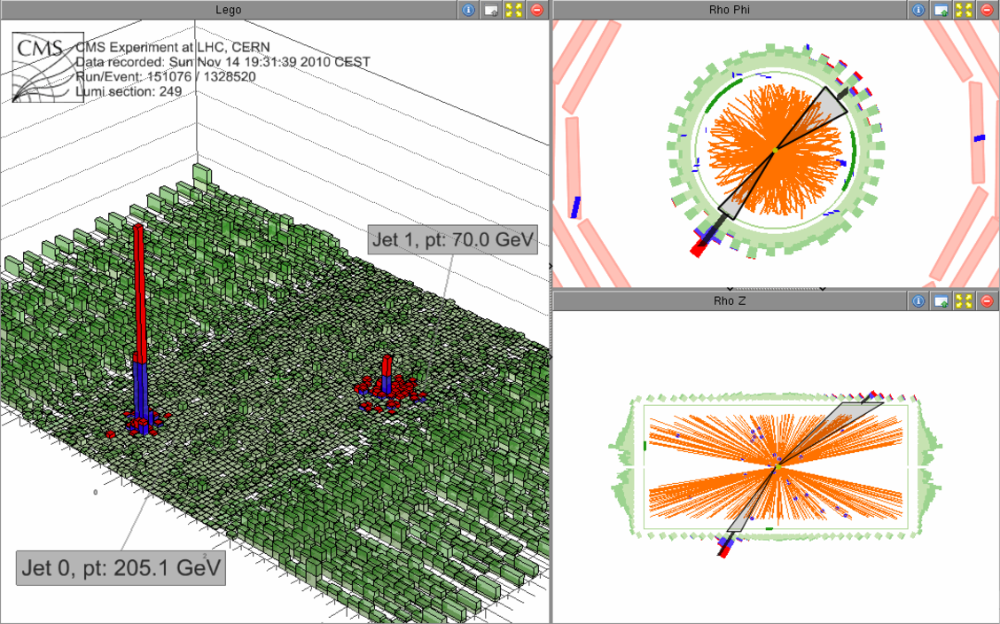
高エネルギー重イオン衝突とジェット測定
LHCで可能なことが証明された

Slide 9
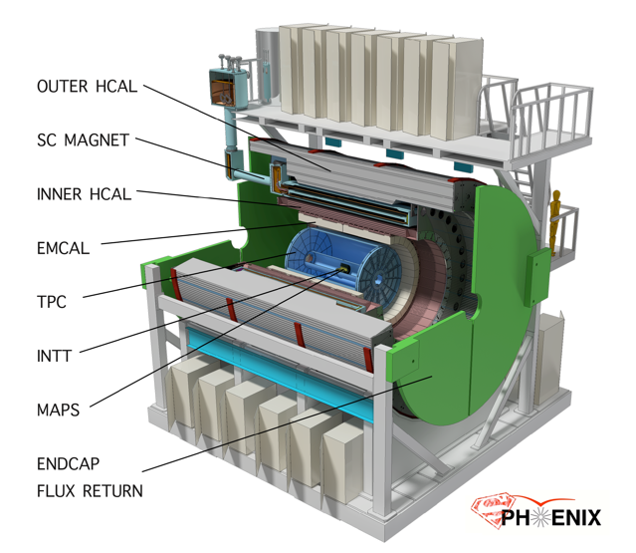

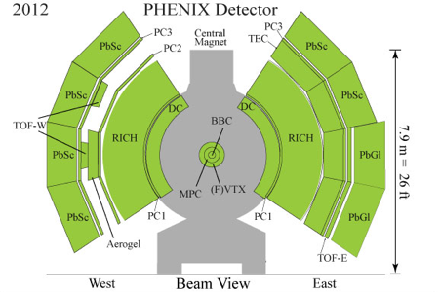

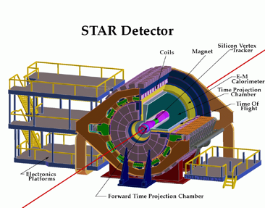

sPHENIX検出器のコンセプト
Jetの測定にはアクセプタンスが足りない
4π & -1<η<1 をHCALで覆う
Jetに特化した検出器
4π & -1<η<1だがHCAL無しのJet測定

Slide 10
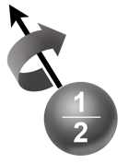

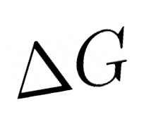

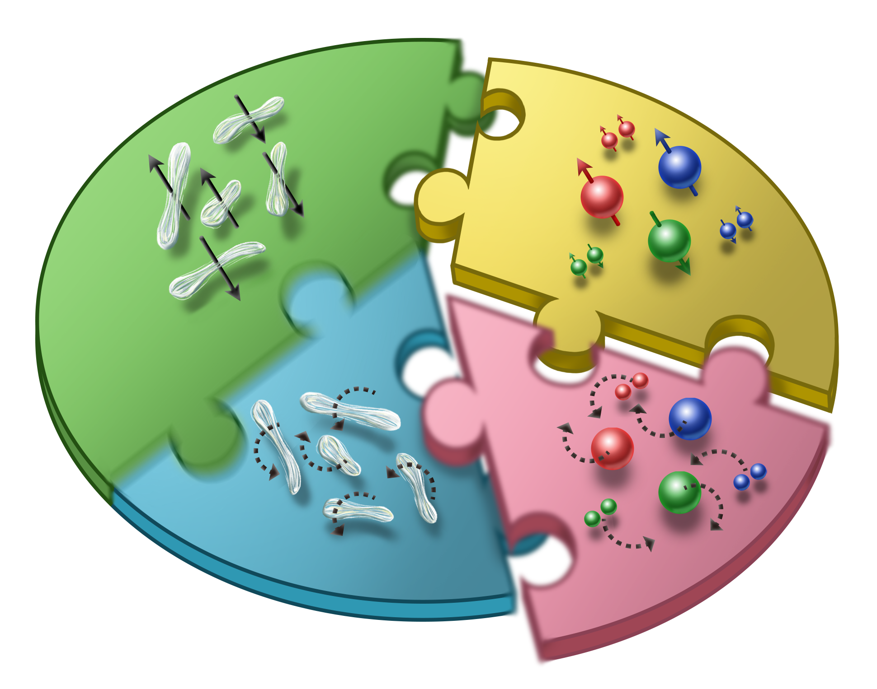





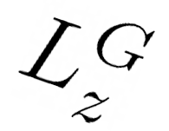
Cold-QCD: 陽子スピンのパズル（謎）
陽子スピン和則
~25%
~40%
??
1980’s
2000~2018

Slide 11
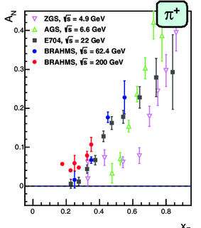
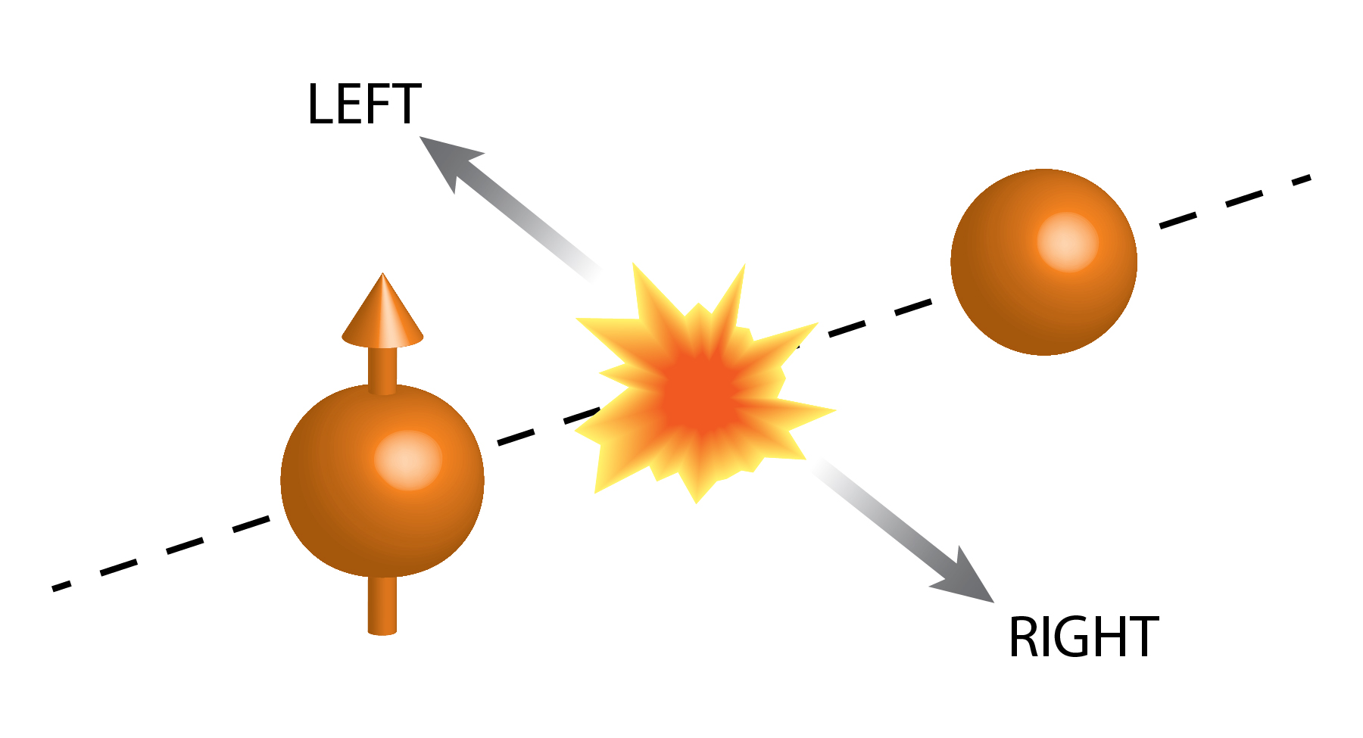
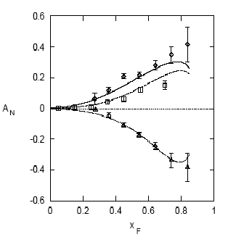

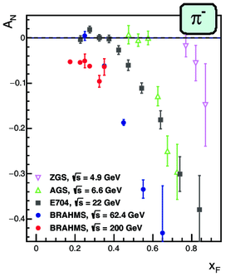
単偏極陽子衝突の生成ハドロン左右非対称性
E704: pion single spin asymmetry A_{N}
2000年代
RHIC
1980年代＠フェルミ研究所
前方に40%もの巨大な左右非対称性

Slide 12
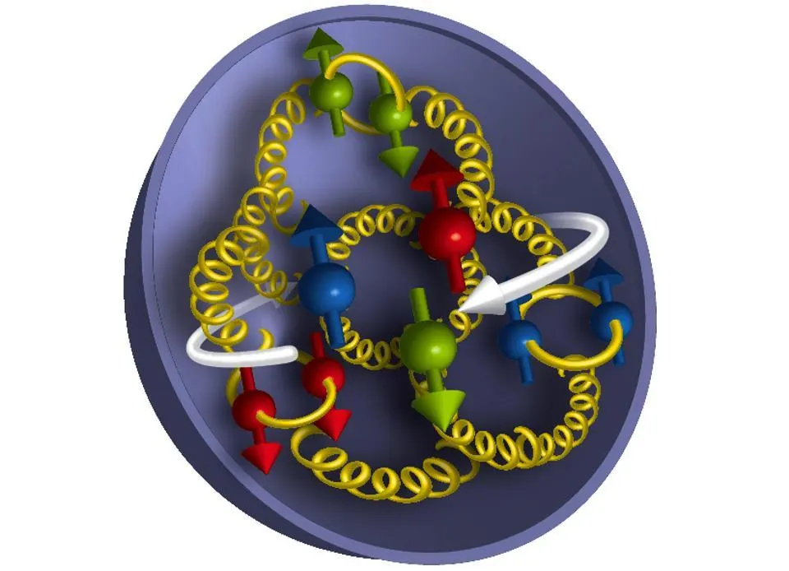
単偏極陽子衝突の生成ハドロン左右非対称性
パートンの横運動量
k_{T,q}
p
p
パートンの軌道角運動量〜パートンの横運動量

Slide 13
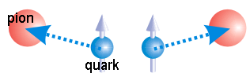
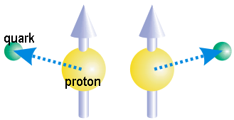
左右非対称性の起源
破砕関数のパートン・スピン依存
(終状態効果)
pQCD
Factorization
パートンの横運動量
(初期状態効果)
Transverse momentum
非対称度 ~ IS ✕ FS

Slide 14
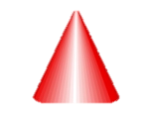
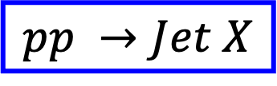
左右非対称性の起源
pQCD
Factorization
$$pp →Jet X$$
パートンの横運動量
(初期状態効果)
ジェットはやはり
ゴールデンプローブ！
Transverse momentum
非対称度 ~ IS

Slide 15
左右非対称性の起源
pQCD
Factorization
$$pp →Jet X$$
パートンの横運動量
(初期状態効果)
Transverse momentum
ジェット軸に対する
ハドロン生成左右非対称性~ FS

Slide 16
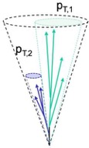
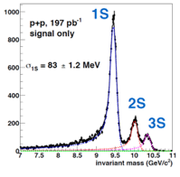
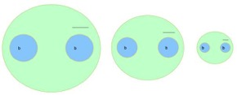
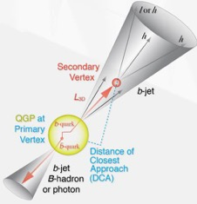



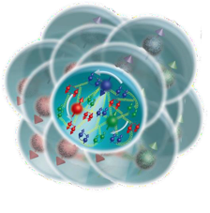
sPHENIXの目指す物理
Υ(1s) 0.28fm
_{Y(3s) 0.78fm} Υ(2s) 0.56fm
vary size of probe
Quarkonium spectroscopy
vary momentum &
angular scale of probe
Jet physics
Parton energy loss
vary mass & momentum of probe
u,d,s
Cold QCD
vary temperature of
QCD matter
study proton spin, transverse-momentum, and cold nuclear effects
c
photon
gluon
b

Slide 17
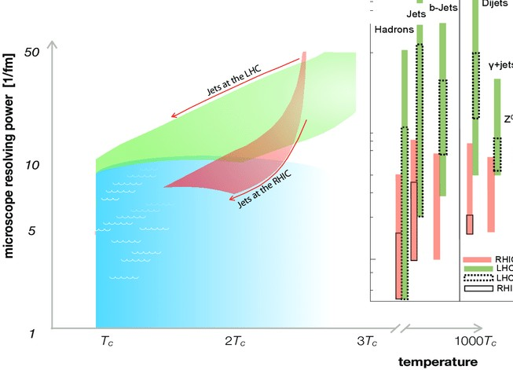
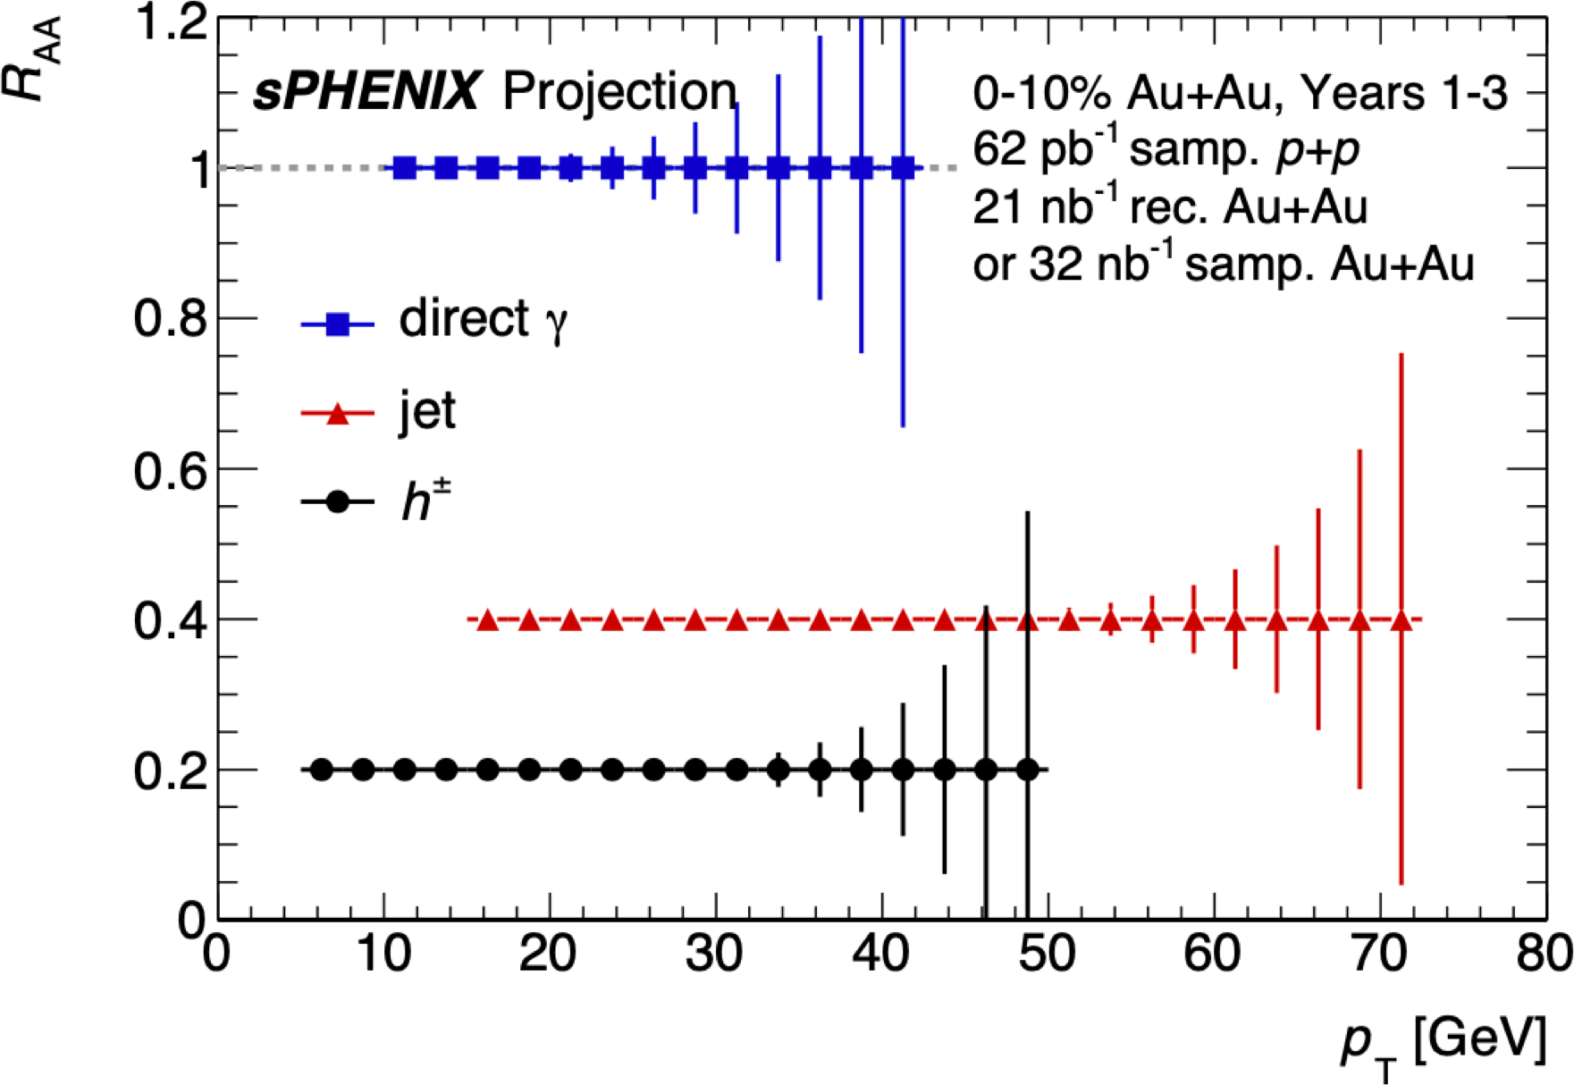


RHICでJet観測する意義
Overlapping region with LHC
LHCと相補的な理解
QGPの温度の違い
プローブの分解能
Unexplored region at RHIC and LHC

Slide 18
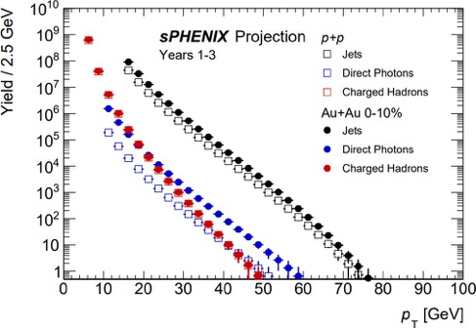
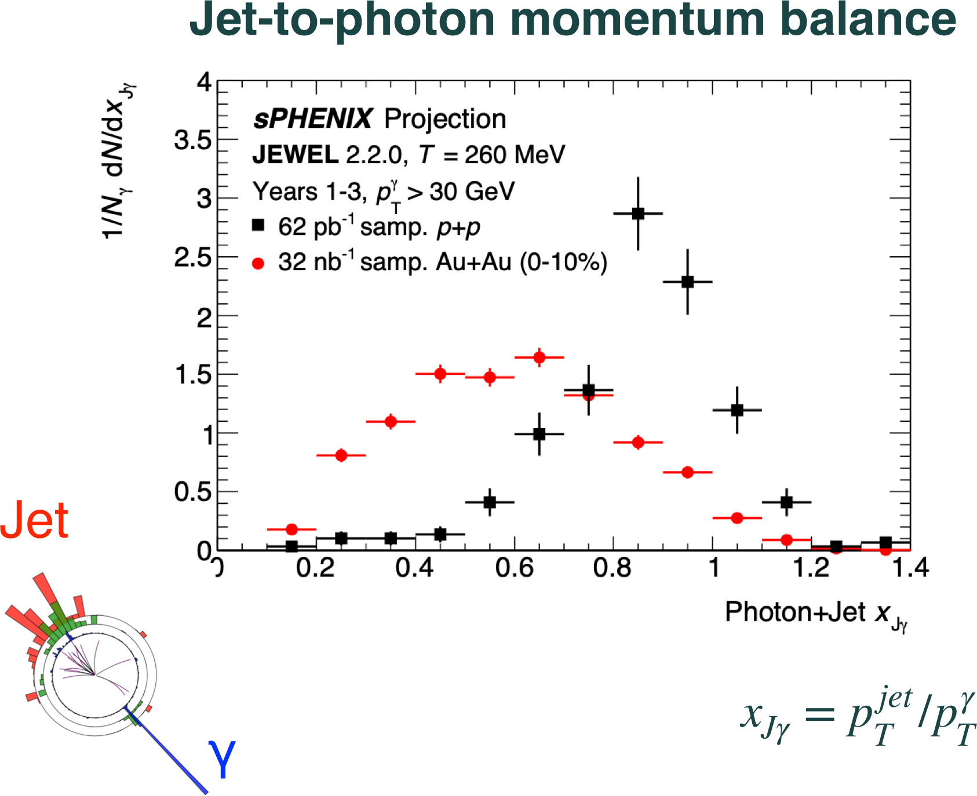
Jetで観るエネルギー損失

Slide 19
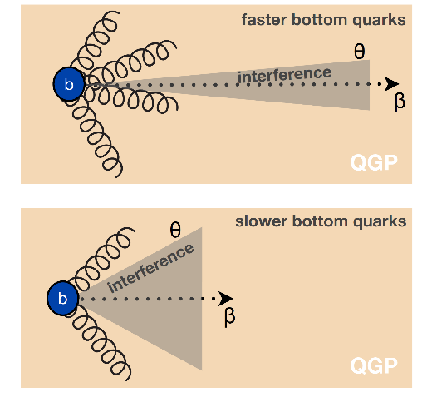
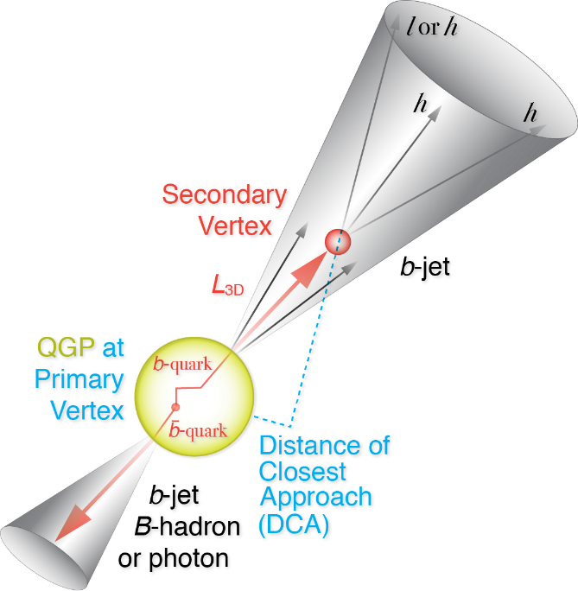
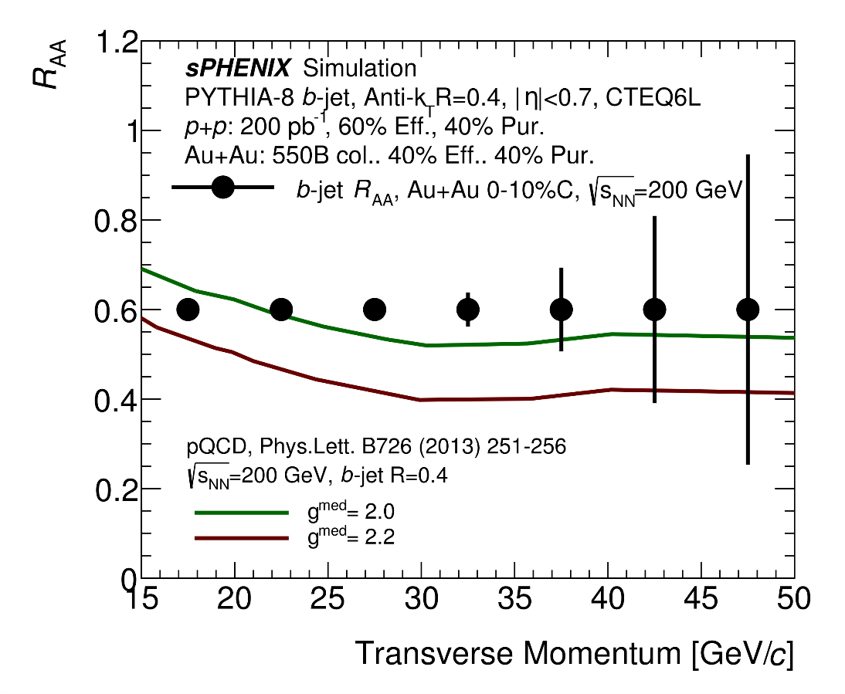
b-Jetの物理
b-jet + light jet:
differential sensitivity to radiative energy loss VS collisional energy loss.

Slide 20

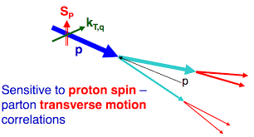
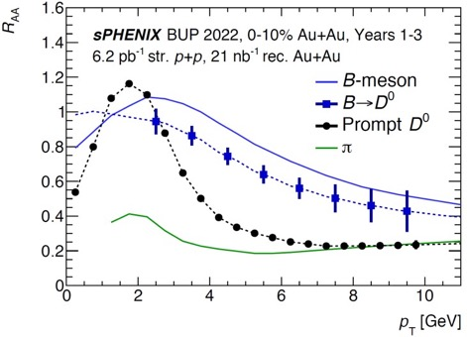

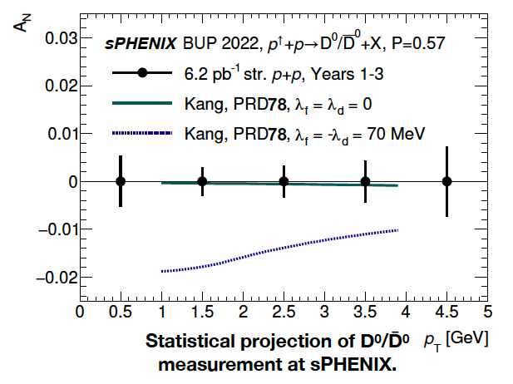
Open Heavy Flavor
陽子のスピンプログラム
Cleanly separate open bottom via DCA.
Study mass dependence of energy loss and collectivity.
Bottom quarks and light quarks are expected to be different for RAA and v2 for pT ≲ 15 GeV.
グルーオンの軌道運動に感度

Slide 21

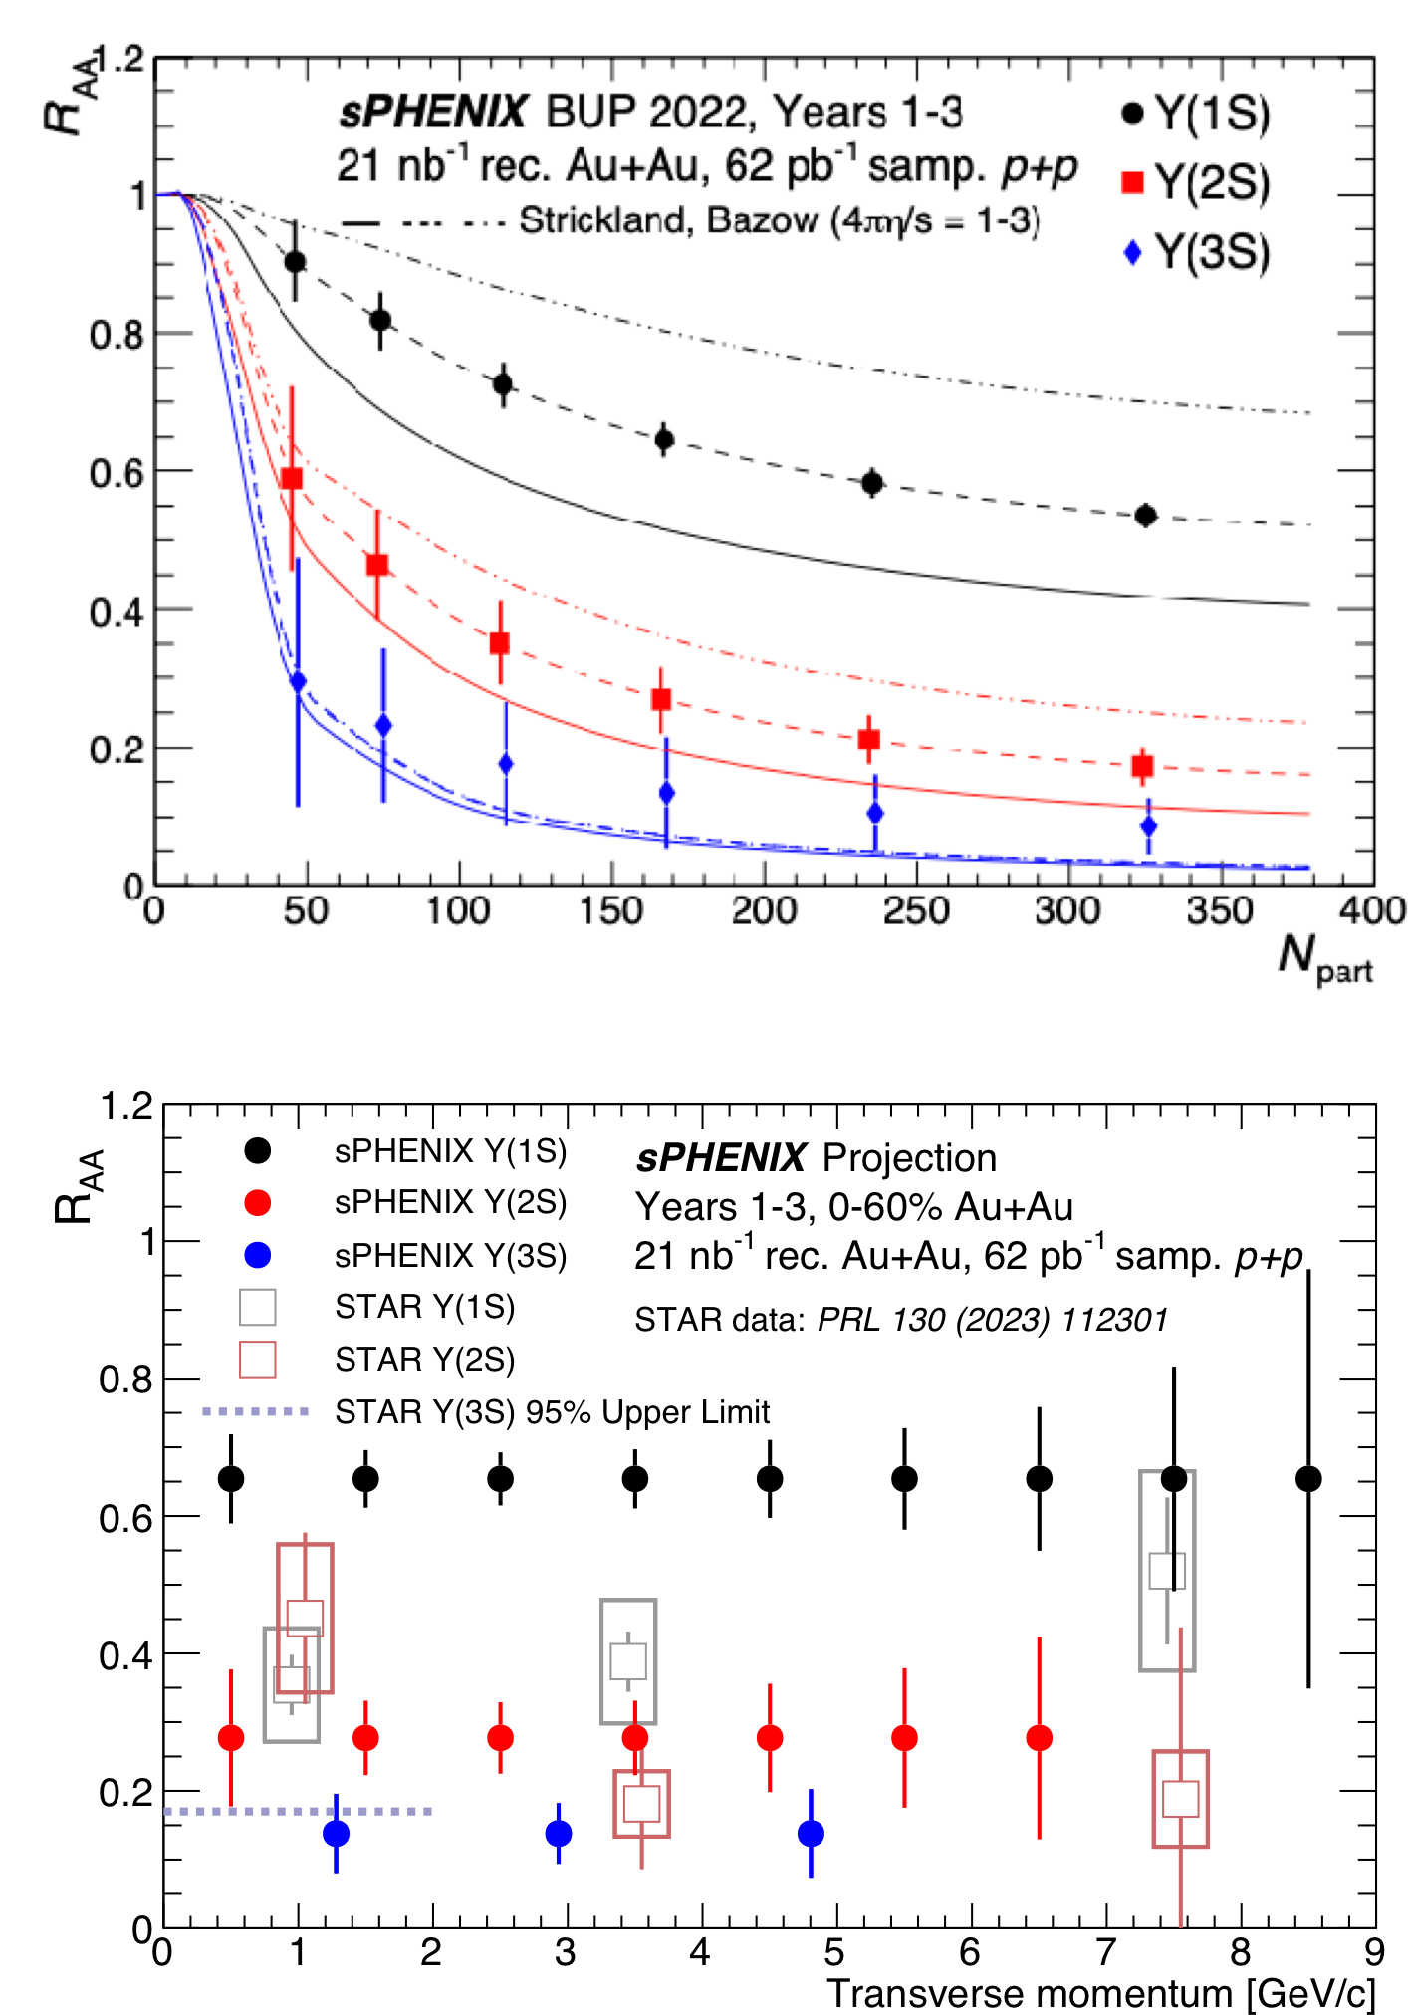
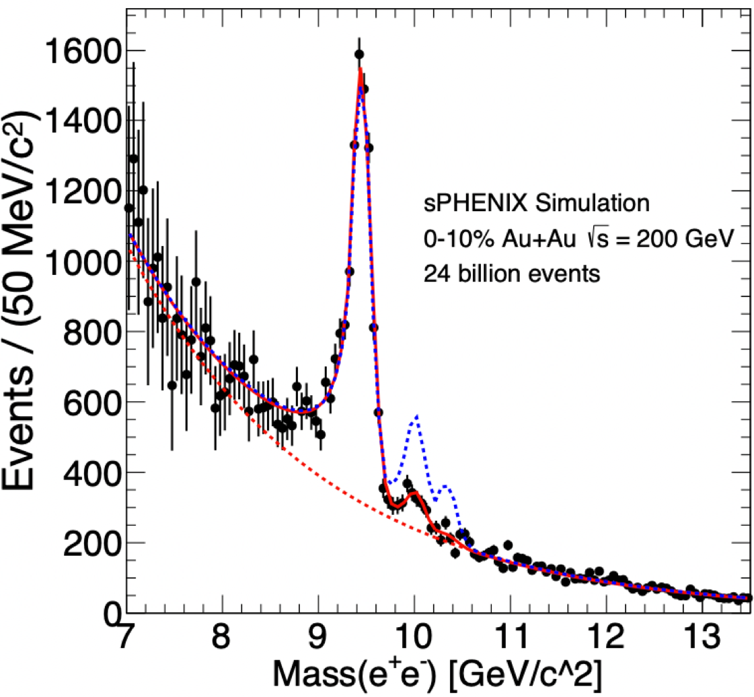
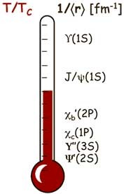


Quarkonium spectroscopy
Well separated three Upsilon states thanks to excellent mass resolution
Potential first clean measurements of
Υ(3s) at RHIC

Slide 22
sPHENIX誕生の秘話
2009〜2015年

Slide 23
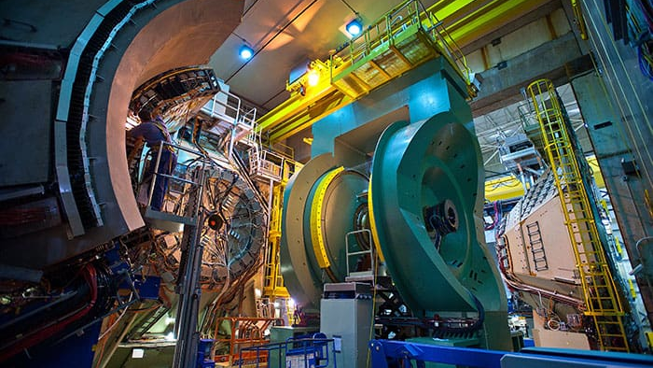
PHENIX実験の延命か終焉か
2000年〜
Upgrade?
New Detector?

Slide 24


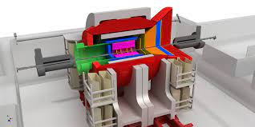
Upgrade?
New Detector?

Slide 25

BNLの思惑 ~EICサイトセレクション~
eRHIC@BNL
JLEIC@Jeffersion Lab
arXiv:1409.1633
arXiv:1504.07961
是非EICをBNLに誘致したい

Slide 26
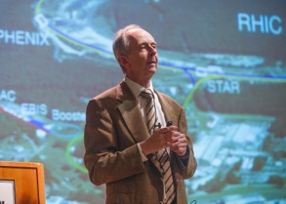
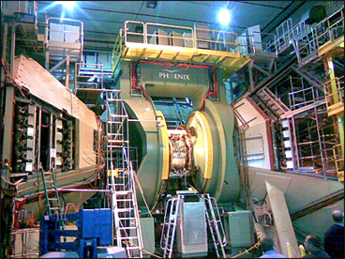
Berndt Mullerの描いたシナリオ
（BNL副所長）
100億円
”sPHENIXはEICのDay-1検出器“

Slide 27
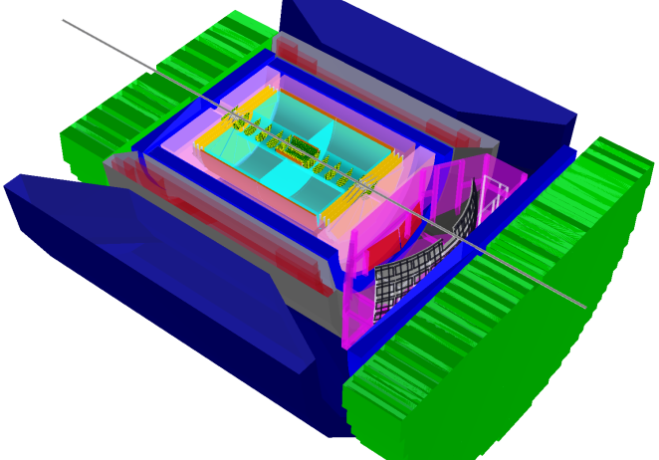
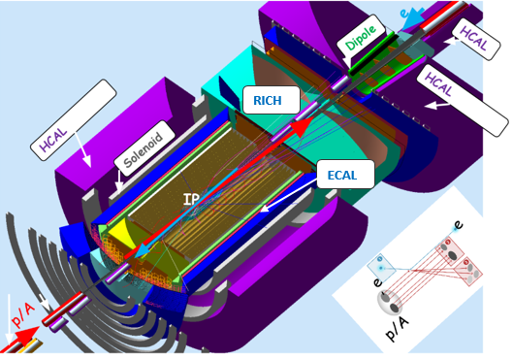
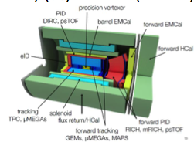
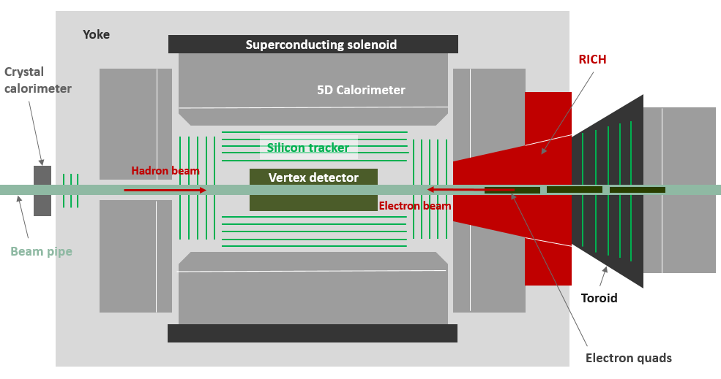
EICの４つの検出器案
Brookhaven concept: BEAST
Jefferson lab concept: JLEIC
$$$
$$$
ePhenix/eSTAR
Argonne concept: TOPSiDE
$!
$$$
sPHENIXの再利用により、EICのDay-1検出器が格安で作れる

Slide 28
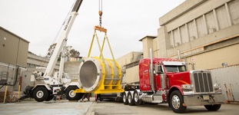

sPHENIX実現へ
BaBar電磁石
潮目が変わったのはSLACから1.5TのBaBar実験電磁石を無償で譲り受けたこと

Slide 29

sPHENIXロードマップ
〜50億円
*National Science Advisory Committee
西暦 | ステージ
2015年 | NSAC*で高い評価
2016年 | PHENIX 実験終了・CD0
2018年8月 | CD1/CD3
2019年 | PD2/3
2023年 | 実験開始
PHENIXの運転コストで建設費を賄う

Slide 30


sPHENIX計画の選択と集中
fsPHENIX
当時のsPHENIXデザイン
前方検出器は断念してバレルのみに

Slide 31




EIC Detector/Technology Choice
 | ATHENA | ECCE | CORE
Magnet | New 3T, ca 1.6m inner radius, ~4m length | BaBar 1.5T, ca 1.4m radius, 3.9m length | New 3T, 1m radius, 2.5m length
Central Tracking | 3+2 MAPS(ITS3), Mircromegas | 3+2 MAPS, 2 mRWell, AC-LGAD | 3+3 MAPS
FW /BWTracking | 5 discs , GEM, mRWell | 4/5 discs, AC-LGAD | 6 discs, mRWell
Hadron PID (BW/Cent/FW) | Aerogel/AC- LGAD+DIRC/dRICH | AC- LGAD+Aerogel/AC- LGAD+DIRC/AC- LGAD+dRICH | AC-LGAD TOF/DIRC/dRICH
EMCALS | PbW04/AstroPix Si+PbSciFi/W SciFi | PbWO4/SciGlass/P BSciFi Shashlik | PbW04/W Shashlik
HCALS | FeSci/FeSci/FeSci | -/FeSci/ Longitudinally separated | -/-/STAR FCS KLM only
2021年末の段階で候補は３つ
この中でDOE予算で建設される”Detector-1”は一つのみ
(ePHENIX)

Slide 32



Detector Choice (Decision)
Detector-1
Detector Proposal Advisory Panel
Co-chairs
  Rolf Heuer (CERN)
  Patty McBride (FNAL)
Members
  Sergio Bertolucci (INFN Sezione di Bologna)
  Daniela Bortoletto (Oxford University)
  Markus Diehl (DESY)
  Ed Kinney (University of Colorado, Boulder)
  Fabienne Kunne (CEA)
  Andy Lankford (University of California, Irvine)
  Naohito Saito (KEK)
  Brigitte Vachon (McGill University)
Scientific Secretary
  Tom Ludlam (BNL)
+ EIC Detector Advisory Committee (ongoing detector R&D)
満場一致でECCEをDetector 1として推奨する
2022/3/8

Slide 33


sPHENIXとEICの予定
2014 | 2015 | 2016 | 2017 | 2018 | 2019 | 2020 | 2021 | 2022 | 2023 | 2024 | 2025 | 2026 | 2027 | 2028 | 2029 | 2030
PHENIX
 |  |  | sPHENIX
 |  |  |  |  |  |  |  |  |  |  |  | EIC
Today
開発・建設
実験
PHENIX
sPHENIX
ECCE

Slide 34
sPHENIX検出器の構成

Slide 35





























sPHENIX Detector
sEPD
TPC
iHCal
EMCal
MVTX
MBD
MAGNET
INTT
oHCal
oHCal
TPOT

Slide 36



sPHENIX Detector
Calorimeter system
BaBar 実験の1.4テスラソレノイド電磁石
Hermetic coverage:
|η|<1.1, 2π in φ
大立体角をトラッカー＆ EM+ハドロンカロリメータで覆う
15 kHz の高データ収集レート
トラッキングシステムはストリーム読み出し
sEPD
TPC
iHCal
oHCal
EMCal
MVTX
MBD
iHCal
MAGNET
INTT
oHCal
oHCal
TPOT
Tracking
system
36

Slide 37

sPHENIX Detector
Calorimeter system
BaBar 実験の1.4テスラソレノイド電磁石
Hermetic coverage:
|η|<1.1, 2π in φ
大立体角をトラッカー＆ EM+ハドロンカロリメータで覆う
15 kHz の高データ収集レート
トラッキングシステムはストリーム読み出し
sEPD
TPC
iHCal
oHCal
EMCal
MVTX
MBD
iHCal
MAGNET
INTT
oHCal
oHCal
TPOT
2023 : Commissioning Au+Au
2024 : p+p
2025 : Au+Au
Tracking
system
$\sqrt{s}=$200GeV
2023 Jan
May
Aug
Oct
Install
Beam Commissioning
Physics

Slide 38

sPHENIX Detector
Calorimeter system
BaBar 実験の1.4テスラソレノイド電磁石
Hermetic coverage:
|η|<1.1, 2π in φ
大立体角をトラッカー＆ EM+ハドロンカロリメータで覆う
15 kHz の高データ収集レート
トラッキングシステムはストリーム読み出し
sEPD
TPC
iHCal
oHCal
EMCal
MVTX
MBD
iHCal
MAGNET
INTT
oHCal
oHCal
TPOT
2023 : Commissioning Au+Au
2024 : p+p
2025 : Au+Au
Tracking
system
$\sqrt{s}=$200GeV
2023 Jan
May
Aug
Oct
Install
Cosmic
Beam Commissioning
Physics

Slide 39
2023年ランの予期せぬ終了
RHICの超電導冷却システムの故障によりビーム運転維持が困難になった。短期的な修理が見込めず、やむを得ず2023年のランは終了。

Slide 40






sPHENIX 苦難の行進
1)
 | Despite the many success of sPHENIX, we had our own set of challenges, including: The COVID pandemic shutdown BNL as well as many collabora;ng ins;tu;ons for months followed by periods where only 25-­‐50% of the lab workforce was allowed on site. The supply-­‐chain crisis delayed many key sPHENIX components by months, especially electronics chips and circuit boards Our beam pipe was lost in a UPS warehouse ﬁre. Fortunately STAR had a spare that we used. The TPC gas was planned to be Ne/CF4. Interna;onal conﬂict created a huge shortage of neon. We switched to Ar/CF4 mix with similar gain and drim proper;es RHIC Run2023 ended 8 weeks early due to signiﬁcant damage to a cryo feed through in a valve box. | 4)
 |  | 5)
2)
3)
E. O’brien @ sPHENIX QM2023
6

Slide 41
建設とコミッショニングの現状

Slide 42



Hadron and EM Calorimeters
EMCal in position
Outer Hcal & Magnet
Outer HCal Installation
Inner HCal Installation
sPHENIX will have kinematic reach out to ∼ 70 GeV for jets, kinematic overlap with the LHC.

Slide 43





Hadronic Calorimeters
HCAL steel and scin;lla;ng ;les with wavelength shiming ﬁber
Outer HCal (outside the solenoid)
Inner HCal (inside the solenoid)
Δη x Δφ ≈ 0.1 x 0.1
1,536 readout channels each
Outer HCAL
SiPM Readout
Inner HCAL
σ 150%
_{E} <
E
9/4/23
sPHENIX QM2023
7

Slide 44





Hadronic Calorimeters
OHCal factory at BNL
9/4/23
sPHENIX QM2023
8

Slide 45







Electromagnetic Calorimeter (EMCal)
Sector are supported oﬀ the Inner HCAL
EMCAL
Sector
(~ 900 lbs)
EMCal Installa;on in progress
2D Projec;ve
Assembly of EMCal Sector
2500 scin;lla;ng ﬁbers/block
9/4/23
sPHENIX QM2023
10

Slide 46
sPHENIX EMCalの性能
 | PHENIX | STAR | sPHENIX
Rapidity Coverage | -0.35 < η < 0.35 | -1 < η < 1 | -1.1 < η < 1.1
Azimuthal Coverage | π | 2π | 2π
Segmentation Δη × Δφ | 0.008 × 0.008 (0.011 × 0.011) | 0.05 × 0.05 | 0.024 × 0.024
Molier Radius [mm] | 30 ~ 40 |  | 15
Shower Max | No | Yes | No

Slide 47
Hadron and EM Calorimeters

Slide 48




Gluon TMD by Direct-γ
TMD: Transverse Momentum Dependence
Much improved direct photon TSSA -> gluon TMD

Slide 49



Tracking Detectors
MVTX
INTT
TPC
TPOT
All Trackers installed in Position (March 30th, 2023)

Slide 50


Tracking System
Cosmic Ray Track Reconstruction
Silicon pixel detector (MVTX)
  29 um x 27 um, pixels
  2.5 cm < R < 4.5cm
  20 BLCK integration time
Silicon strip detector (INTT)
  78um, strip sensors
  7cm < R < 11cm
  1 BCLK timing resolution
Time projection Chamber (TPC)
  20cm < R < 78cm
  Spatial resolution, ~100um
  Long drift time, ~13us
TPC Outer Tracker (TPOT)
  Calibrate TPC
MVTX
preliminary
INTT
TPOT
preliminary
MVTX
INTT
TPOT
10um

Slide 51




Time Projection Chamber (TPC)
TPC Assembled at SBU
A next-­‐genera;on TPC operated in con;nuous readout mode using Gas-­‐Electron Mul;plier (GEM) avalanche w/ low Ion Back Flow (IBF).
Field cages are Kapton-­‐carbon ﬁber
End caps are aluminum
Central membrane is G-­‐10-­‐honeycomb
sandwich
Internal chamber volume is ﬁlled with Ar-­‐CF4
60/40 gas (4 m³ gas volume)
Electronics readout on each end
ASIC modiﬁed SAMPA chip from ALICE
sPHENIX Simulation
Upsilon 1s
Inside of TPC ﬁeld cage
AuAu:
Central
50 kHz
Charged Tracking in sPHENIX:
TPC provides momentum-­‐resolu;on
E. O’brien @ sPHENIX QM2023
13

Slide 52



sPHENIX Intermediate Tracker (INTT)
Two-­‐layer silicon-­‐strip detector.
Read Out Cards reused from PHENIX forward silicon detector
E. O’brien @sPHENIX QM2023
14

Slide 53




Monolithic Ac;ve Pixel Vertex Detector (MVTX)
The MVTX is a 230M channel, 3-­‐layer MAPS-­‐based pixel detector
The MVTX is a copy of inner 3 layers of the ALICE ITS w/ a custom design of service supports to meet sPHENIX needs
Staves and Readout Units produced at CERN w/ par;cipa;on from sPHENIX collaborators
E. O’brien @sPHENIX QM2023
15

Slide 54


Tracking Detector Commissioning
sPHENIX Simulation
TPC Event Display in Au+Au @ 200GeV
Multiplicity correlations between MBD-INTT-TPOT
MVTX correlation between different layers
More correlation hits in Zhaozhong Shi’s talk on Thursday 08/24
Clear separation between 2S and 3S states

Slide 55
日本グループの貢献
INTTシリコンストリップ検出器

Slide 56












































































INTT共同研究者
TIRI
Takashi Kondo
BNL
Rachid Nouicer,
Dan Cacace, Raul Cecato,
Donald Pinelli, Robert Pisani,
Nick Seberg, Steven Andrade,
Antonio Vederosa, Stephen Boose
Rikkyo Univ.
Kazuma Fujiki
Hikaru Imai,
Tomoya Kato,
Ryota Shishikura,
JAEA
Shoichi Hasegawa
Purdue Univ.
Wei Xie,
Milan Stojanovic,
Joseph Bertaux,
Han-Sheng Li
(former member)
National Taiwan Univ.
Rong-Shyang Lu, Jenny Huang,
Lian-Sheng Tsai, Ou-Wei Cheng
RIKEN, RBRC
Yasuyuki Akiba,
Itaru Nakagawa,
Genki Nukazuka
National Central Univ.
Chia-Ming Kuo, Kai-Yu Cheng,
Cheng-Wei Shih, Wei-Che Tang
Nara Women’s Univ.
Manami Fujiwara, Takashi Hachiya,
Misaki Hata, Maya Shimomura,
Runa Takahama, Mai Kano,
Yumika Namimoto, Yuka Sugiyama, Hinako Tsujibata, Mai Watanabe
Korea Univ.
Jaein Hwang, Byungsik Hong

Slide 57

INTTシリコンラダー
ビームテスト
Residual分布
2021年12月ビームテスト＠東北大ELPH
パフォーマンス
１ビームクロック以下の時間分解能を確認。
2021年ビームテストで検出効率(>99%) を確認
宇宙線測定＠奈良女でアクセプタンス中検出効率の勾配がないことを確認。
ほぼ設計通りのパフォーマンス。
シミュレーションモデルでResidual分布を完璧に再現
Analysis by Cheng-Wei Shih(NCU)
高熱伝導炭素繊維製ステーブ
46 cm
HDI-S
Sensor-B
Sensor-A
Sensor-A
Sensor-B
HDI-N
chips
chips
120ラダーの量産は2022年の3月にBNL+台湾にて完了

Slide 58


INTTバレル
Felix読み出しボード
ATLASのFelix読み出しボードベースのデータ収集。
2年目のランでsPHENIX飛跡検出器群はDeadtimelessのストリーム読み出しを目指す。

Slide 59



Vertex Reconstruction & Centrality
sPHENIX Simulation
INTT-MBD Z-vertex Reconstruction
MBD-ZDC Centrality
preliminary
Phys. Rev. C 71, 034908 (2005)
Published Centrality plot in PHENIX
Confirmed fairly consistent z-vertex reconstruction between two independent detectors

Slide 60

sPHENIXの文献（日本語）
原子核研究第63巻1号(2018)
日経サイエンス2023年6月号

Slide 61


sPHENIX Summary
Quarkonium spectroscopy
Jet Physics
Large and hermetic EM and hadronic calorimetry.
Highly precise tracking.
15kHz trigger rate and stream readout for trackers.
Wide range of physics covered in sPHENIX
A lot of progress in 2023 commissioning with Au+Au Collision at $\sqrt{s}=$200GeV and getting ready for 2024 Run.
Will address on cold QCD in 2024!
Heavy Flavor
Cold QCD

Slide 62




WIN-WIN-WINのシナリオ
新検出器でジェット物理
EICの誘致成功
懐を痛めない新計画

Slide 63
Backup Slides

Slide 64


Slide 65


Slide 66
Jet Physics
High-p_{T} Probes
Probing the QGP with precise jet, direct photon, and hadron measurements
High data rates & hermetic EMCal+HCal offer wide p_{T} range for jet reconstruction.
sPHENIX can precisely measure the low p_{T} region, which is challenging at the LHC.
sPHENIX will have kinematic reach out to ∼ 70 GeV for jets, kinematic overlap with the LHC.

Slide 67
Heavy Flavor
Polarized single spin asymmetry
Cleanly separate open bottom via DCA.
Study mass dependence of energy loss and collectivity.
Bottom quarks and light quarks are expected to be different for RAA and v2 for pT ≲ 15 GeV.
Explores gluon spin contribution to proton spin

Slide 68
Cold QCD : Gluon TMD with Direct photons
Much improved direct photon TSSA -> gluon TMD

Slide 69

First Data from Commissioning: EMCal
Clear pi0 peak seen in the di-photon invariant mass spectrum

Slide 70
Heavy Flavor
Polarized single spin asymmetry
Cleanly separate open bottom via DCA.
Study mass dependence of energy loss and collectivity.
Bottom quarks and light quarks are expected to be different for RAA and v2 for pT ≲ 15 GeV.
Explores gluon spin contribution to proton spin

Slide 71


Quarkonium spectroscopy
Upsilon R_{AA}
Mass reconstruction
Suppression with clear distinction of three Upsilon states. Color
dipoles probing the QGP at three length scales.
The centrality dependence and particularly the p_{T} dependence are critical measurements for comparison between RHIC and the LHC.
Signal enhancement with ML tools (BDT) is expected.

Slide 72




Slide 73

EIC スケジュール
2019–Dec.
CD0 Approval
2020–Jan.
Site Selection at BNL
2020
EICUG Yellow Report (physics/Detector)
2020–Nov.
Expression of Interest
2021
3 Call for Detector Proposal
ATHENA
ECCE
CORE
2021–July
CD1 Approval
2021–Mar.
Decision on Detector(s)
2023
CD2?
2024
CD4?
https://www.bnl.gov/eic/

Slide 74
スピンBackup

Slide 75


Slide 76

Naïve Sivers Interpretation

Slide 77

Sivers effect and Orbital Angular Momentum

Slide 78


Single Spin Asymmetry

Slide 79
Cold QCD : Gluon TMD with Direct photons
Much improved direct photon TSSA -> gluon TMD

Slide 80

Collins dominate?
A_{N} from twist-3 fragmentation functions (Kanzawa, Koike, Metz, Pitoniak, arXiv:1404.1033)
Describes data well !

