Slide 1
Weekly Update
Alessio Illari, Gursimran Kainth

Slide 2
Progress: ZDC Simulations
Installed and set up EIC environment to generate simulation data for the ZDC
Found where ZDC geometry is stored, how to compile it, how to modify it, and how to visually inspect current ZDC geometry
Successfully generated data for muon, neutron, double photon and lambda events with registered hits in the ZDC
Beginning work to find angular resolution of simulated data

Slide 3
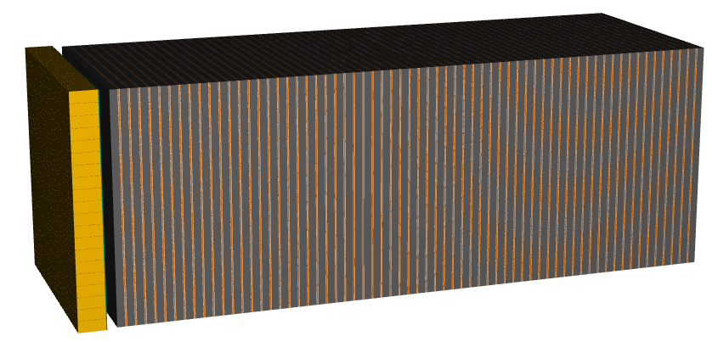
Progress: ZDC Visualization
Fig. 1: Visualization of ZDC geometry

Slide 4
Progress: TPC Hardware Build
Set up scintillator-PMT apparatus that we will use for a coincidence study. This same study will later be conducted for the TPC once built
Current apparatus consists of 3 scintillators connected to 4 PMT’s, an oscilloscope, wave generator and DAQ
Using the oscilloscope we have visually confirmed that each PMT is working and that each one has a different count rate due to differing scintillator geometry
Currently collecting data to determine the optimum threshold for the discriminator (in the DAQ) for each PMT. Optimum value will be found using a plot of the threshold vs. count rate.

Slide 5
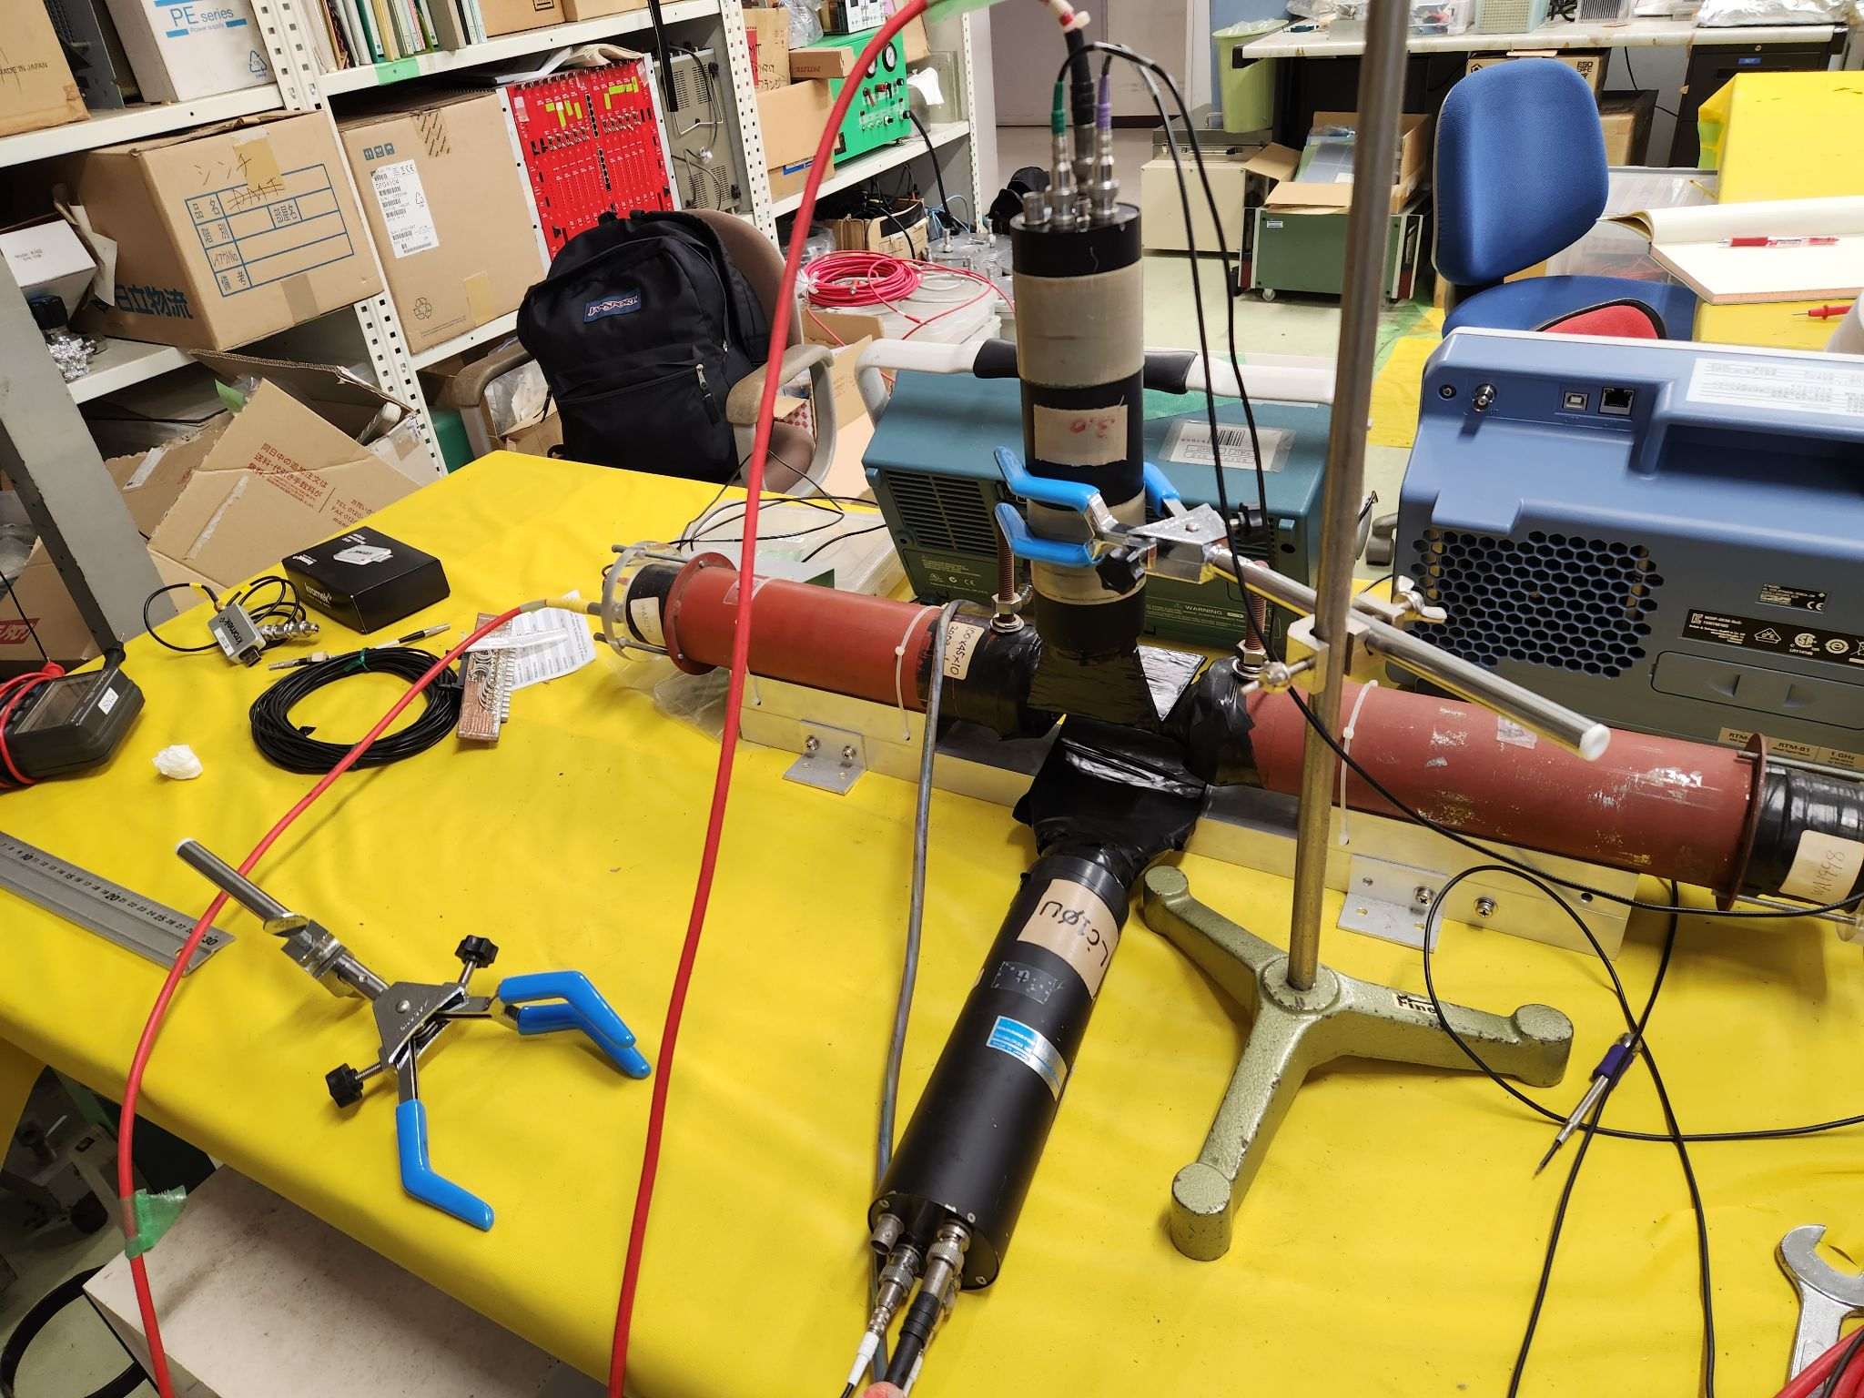
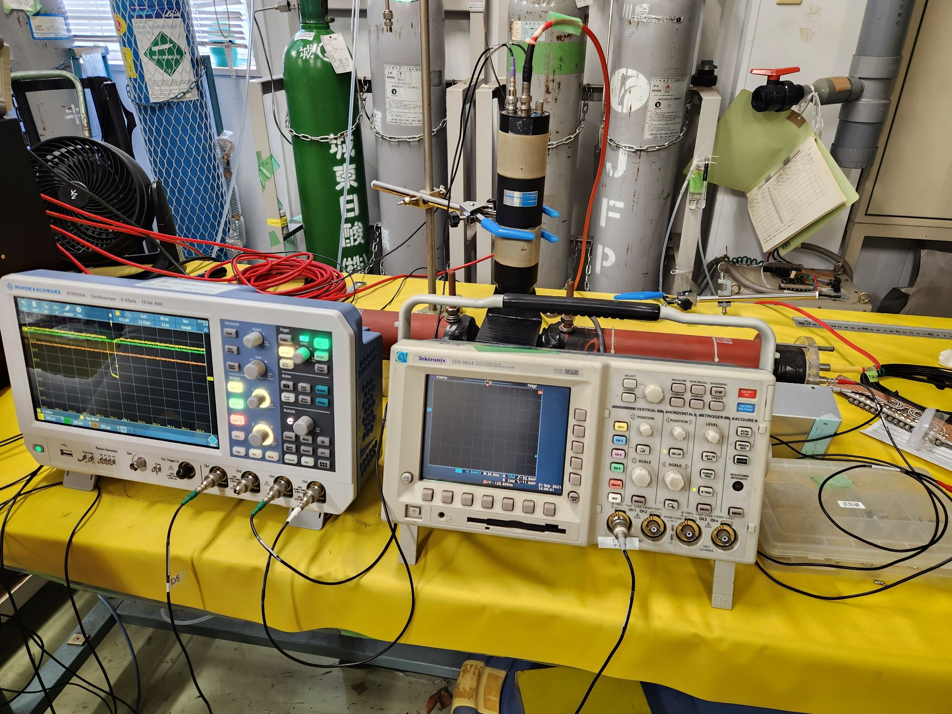
Progress: TPC Hardware Build
Fig. 2: Back view of Scintillator-PMT Apparatus
Fig. 3: Front view of Scintillator-PMT Apparatus

Slide 6
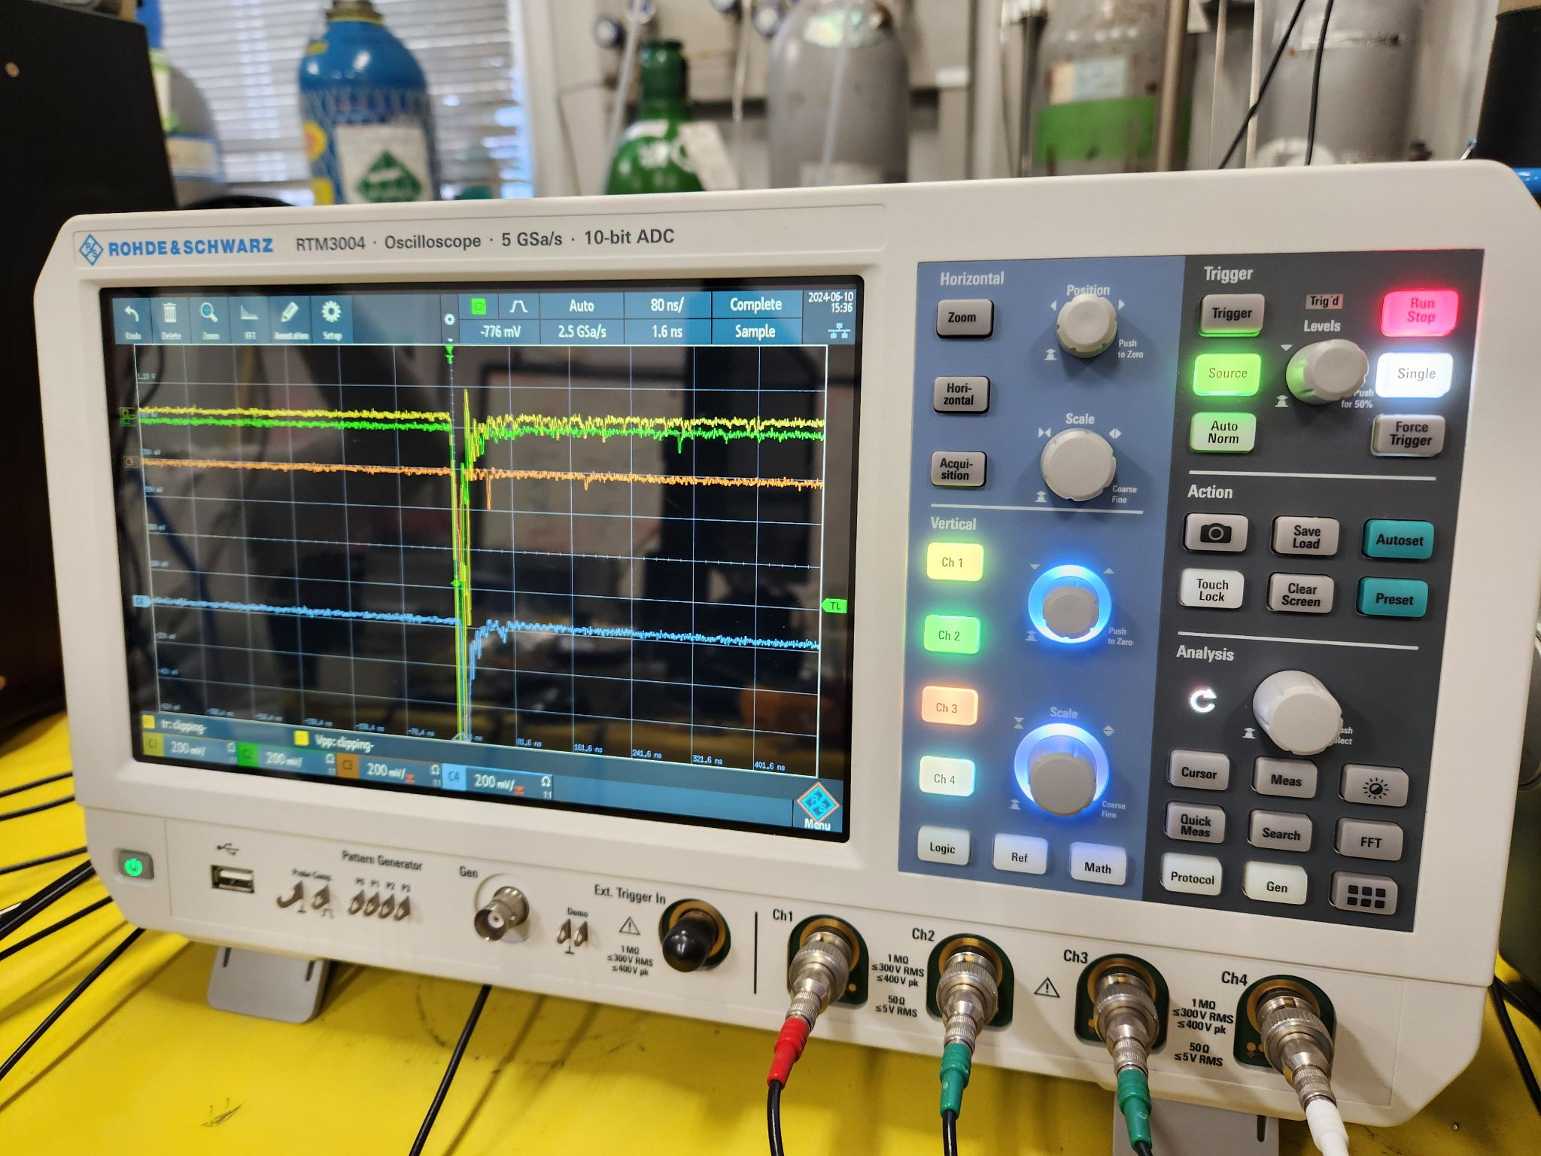
Progress: TPC Hardware Build
Fig. 4: Oscilloscope reading of possible muon

Slide 7
Plan for coming week
ZDC Simulation:
Continue to work on event display using GEANT4
Continue working on determining angular resolution
TPC Hardware Build*:
Continue working on coincidence study
*Prof. Taku will be out for most of this week, so hardware progress is expected to be a bit slower than last week.

