Slide 1
Week 5 Review
Alessio I., Gursimran K.

Slide 2
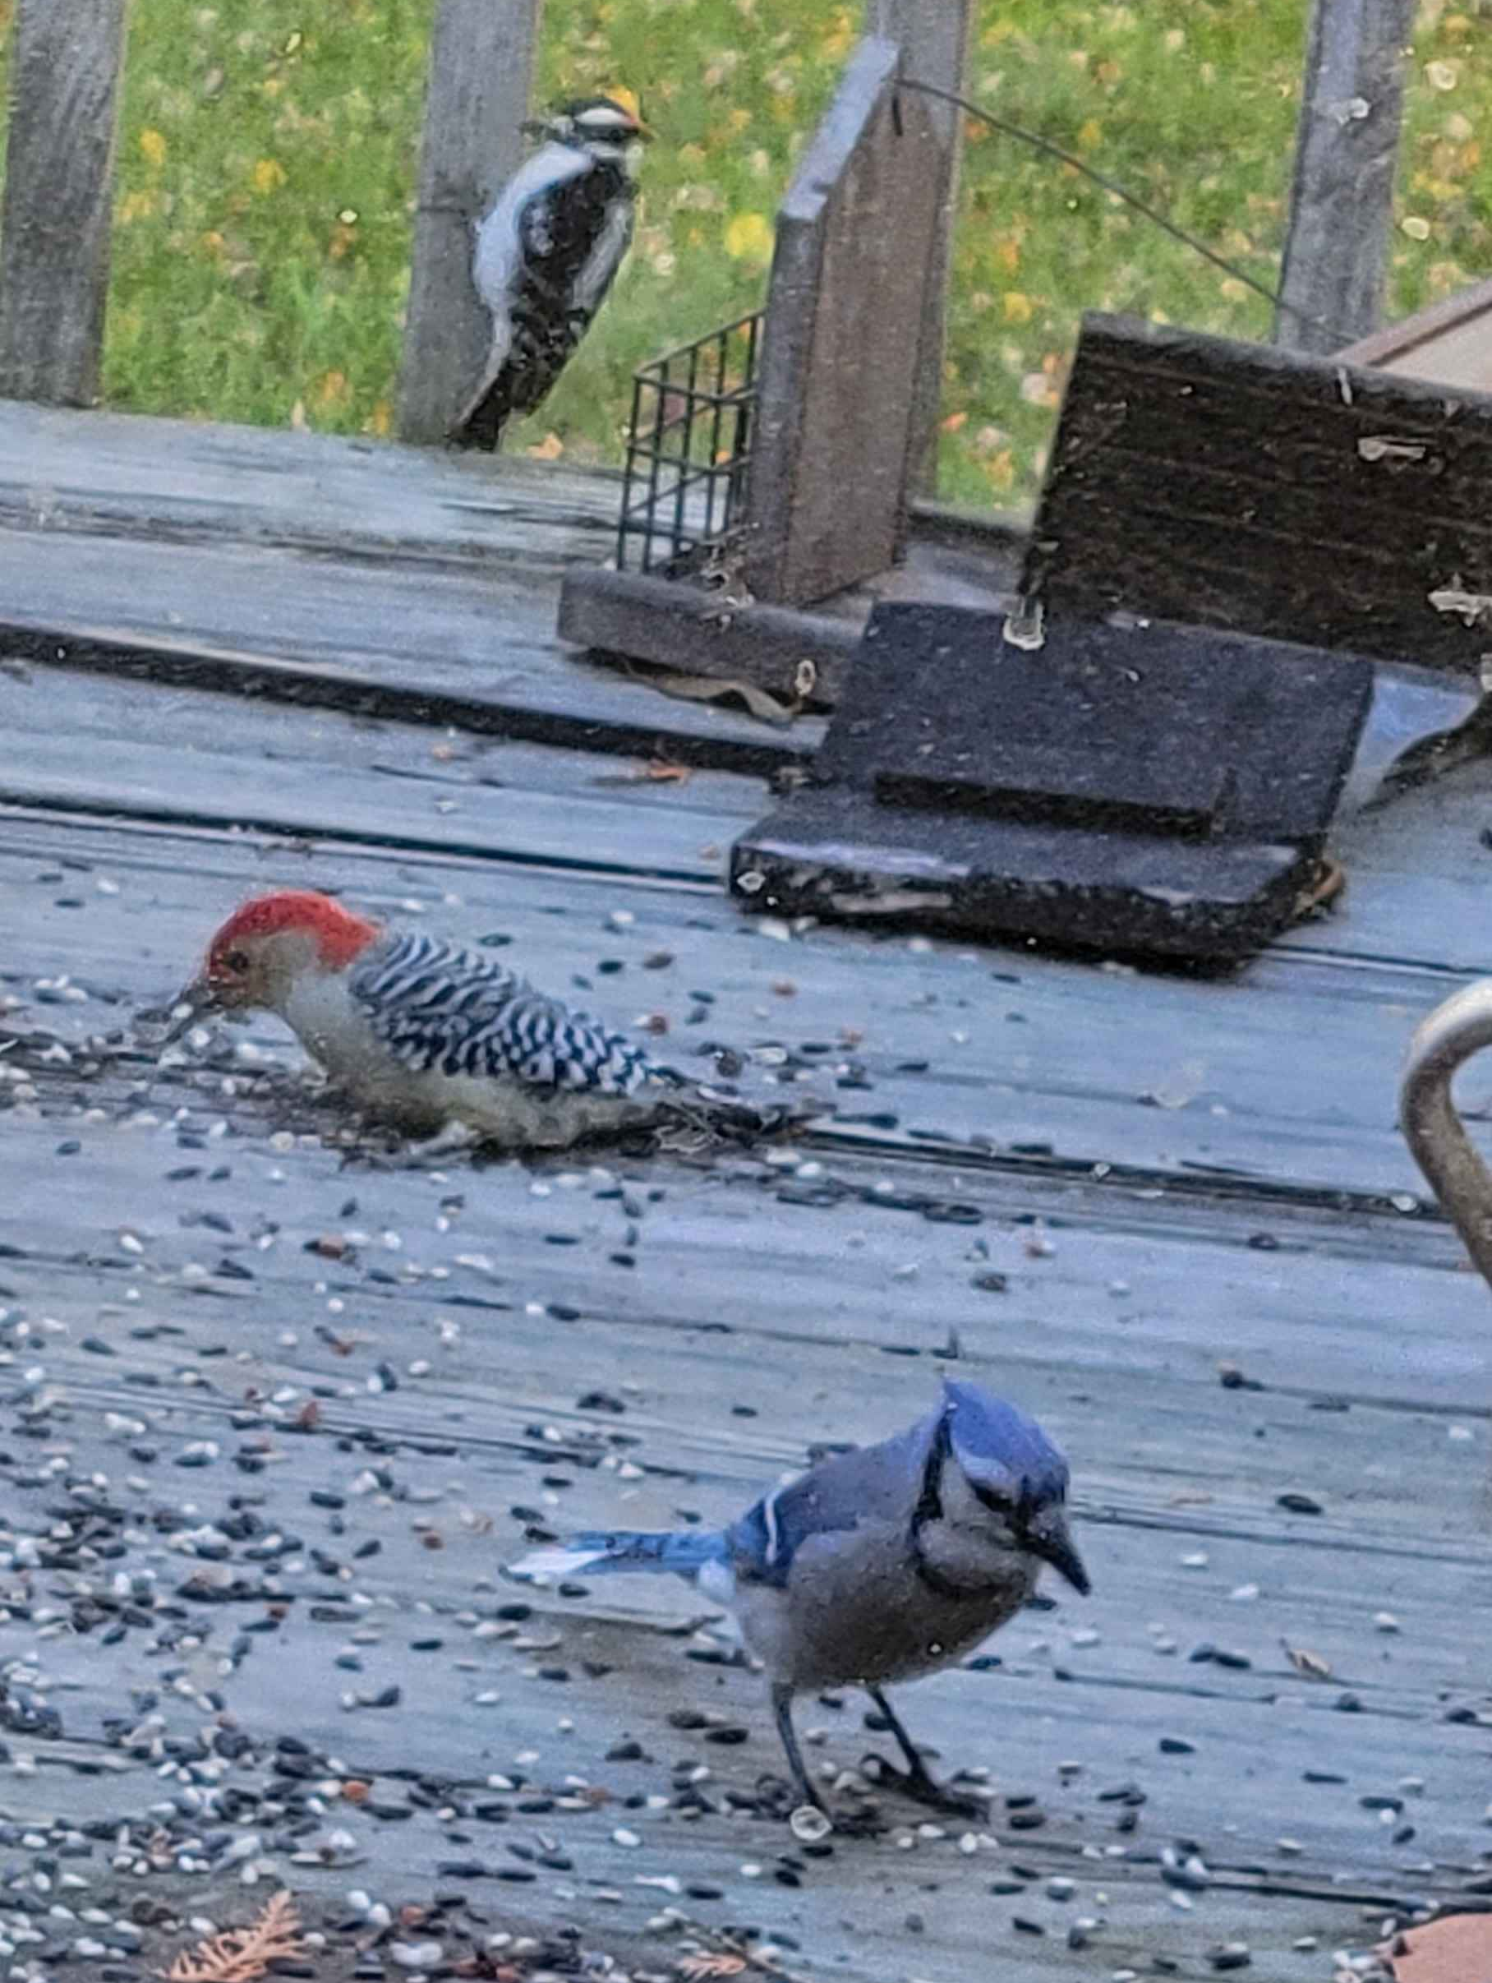
Self Intro: Alessio Illari
Education
UConn: Graduate student (1st year)
UConn: B.S. in Physics
I love
Bird watching
Reading books
Playing games
My cats back home

Slide 3
Self Intro: Gursimran Kainth
Education:
UCONN: Grad student (2nd year)
UCONN: B.S. in Enginering Physics
Hobbies:
Travelling
Reading
Walking my dog

Slide 4
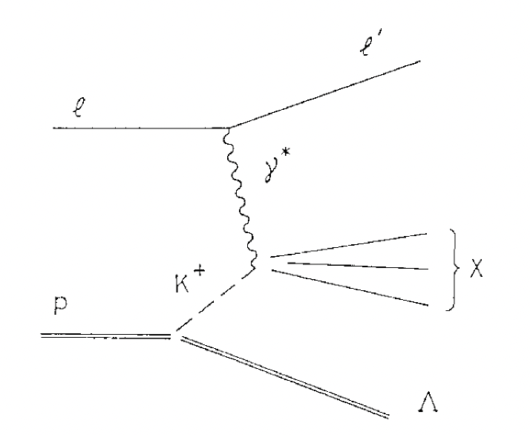
Overview of Summer Work
ZDC Simulation: Goal is to evaluate ZDC performance and reconstruct Lambda baryons produced through the Sullivan Process. The ZDC can detect the neutron and photons produced during the Lambda decay which can then be used to reconstruct it
This process is two step: understanding which lambda particles reach the ZDC and how to cluster those hits to reconstruct the vertex
Fig. 1: Semi-inclusive production of Lambda baryon via DIS of the proton by a charged lepton through the Sullivan process [1]

Slide 5
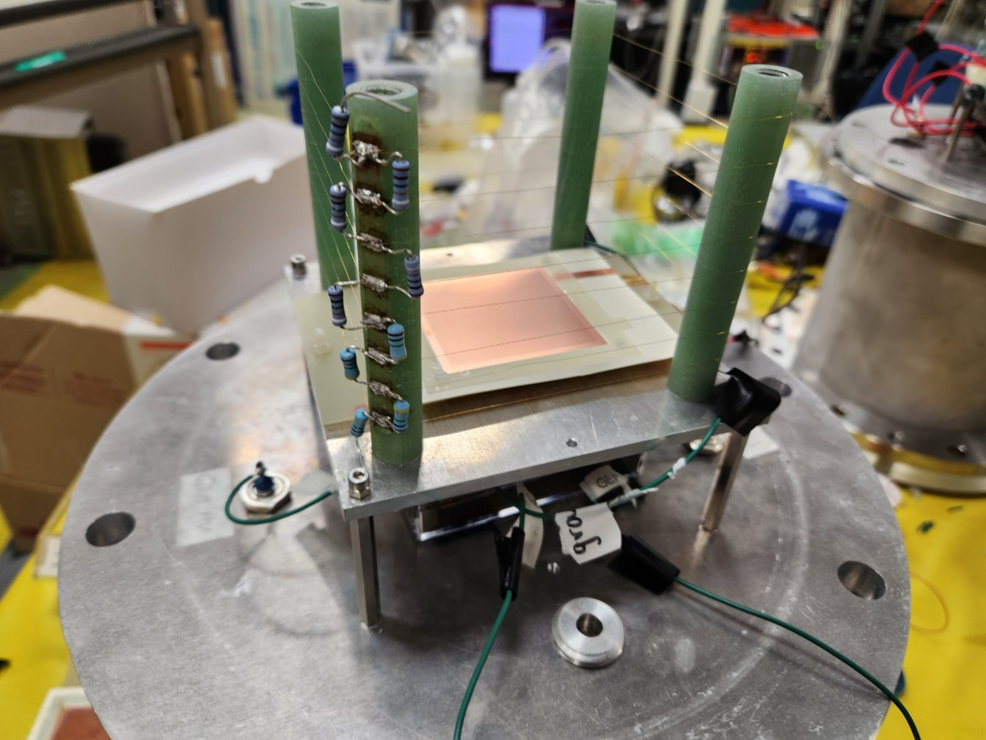
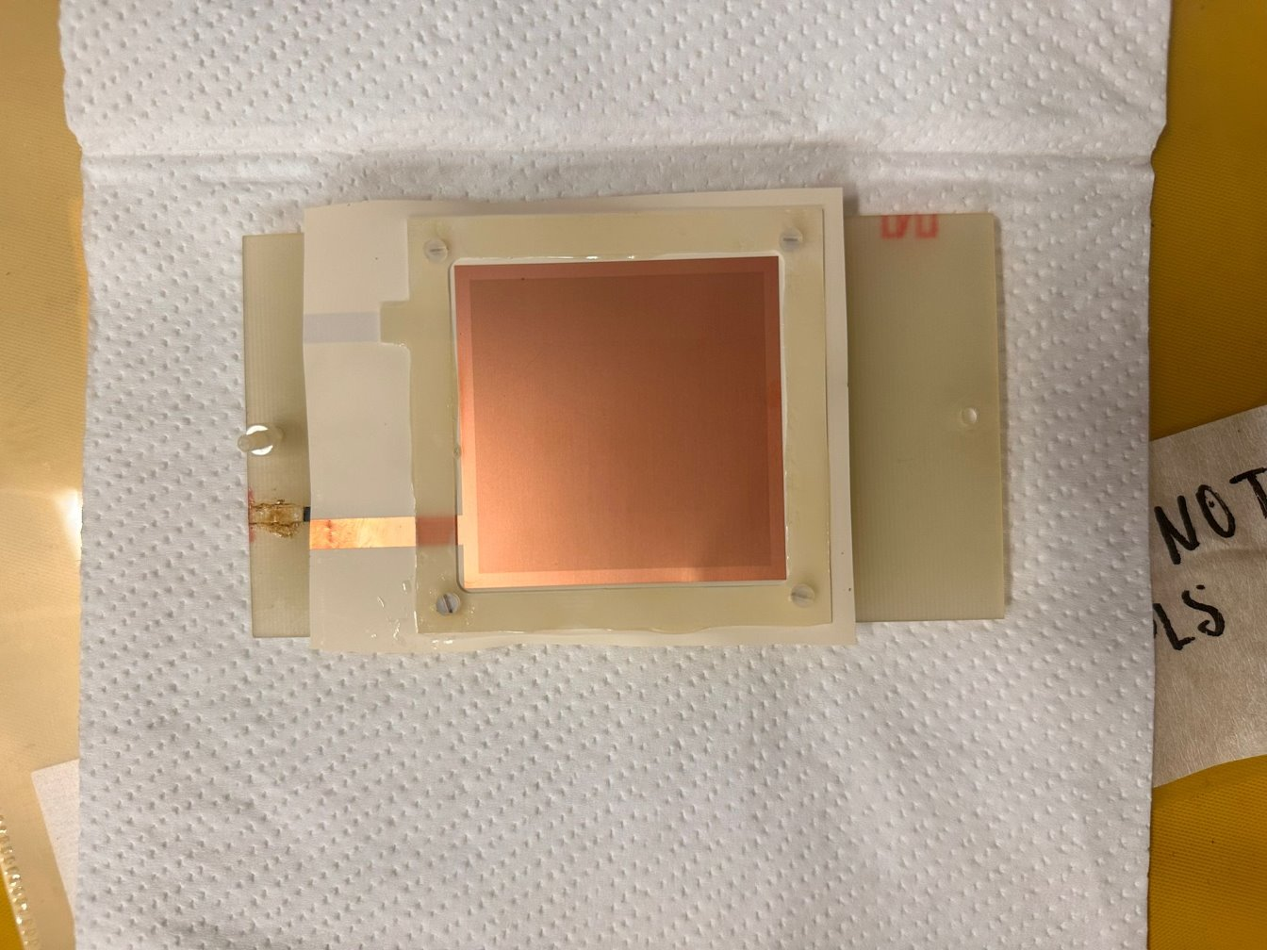
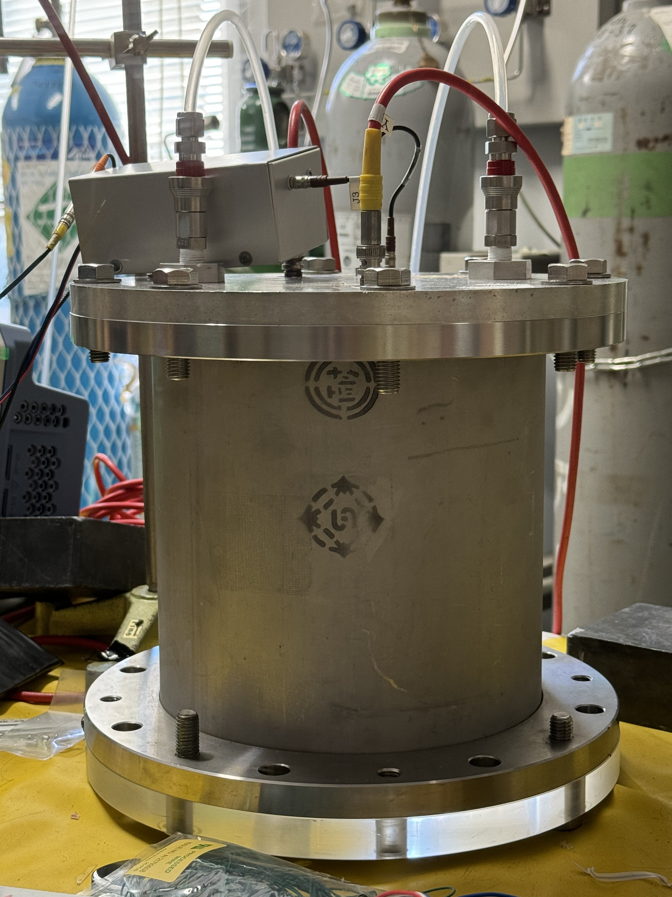
Overview of Summer Work
TPC Build: Goal is to build a Gas Electron Multiplier (GEM) Time Projection Chamber (TPC) and use it to collect and analyze data (cosmic rays and from a radiative source)
Fig. 2a: GEM Cage
Fig. 2b: GEM Foil
Fig. 2c: Complete TPC

Slide 6
ZDC Simulation:
Study to determine ZDC efficiency for lambda to neutron and neutral pion channel
Currently using Lambda gun from interaction site to test this
140k events (pre-cuts), 25mrad (directly at ZDC), 0 to 270 GeV Lambda momentum
Study acceptance as function of 2 parameters: Lambda momentum and decay position
Determined if events could be reconstructed if neutron and 2 gamma land in ZDC's Ecal

Slide 7
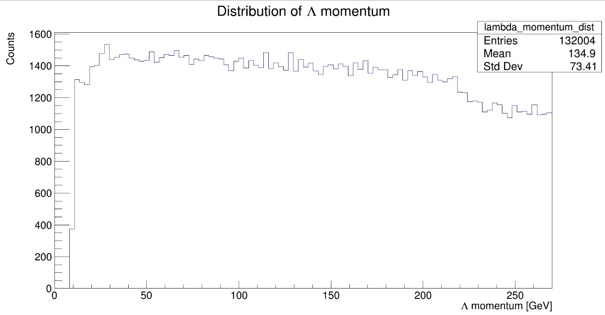
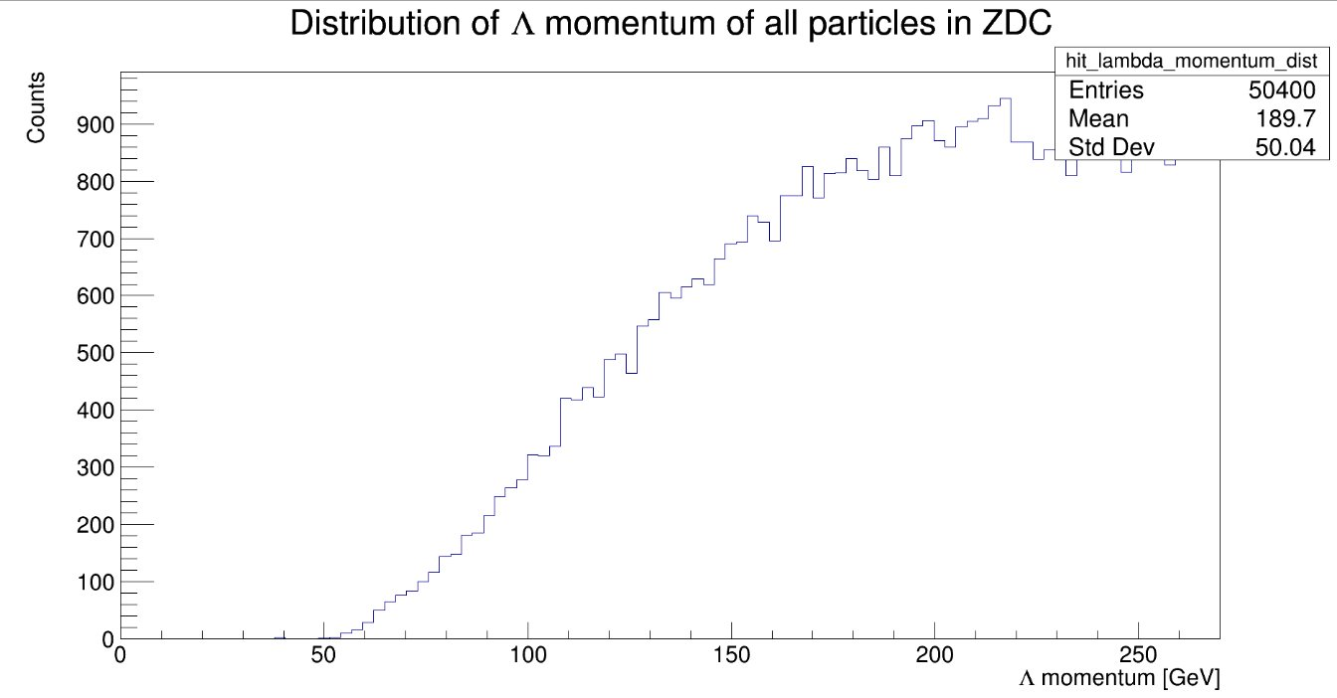
ZDC Simulation:
Momentum before and after cuts on all particles in ZDC
Enhancement of higher momentum lambda baryons

Slide 8
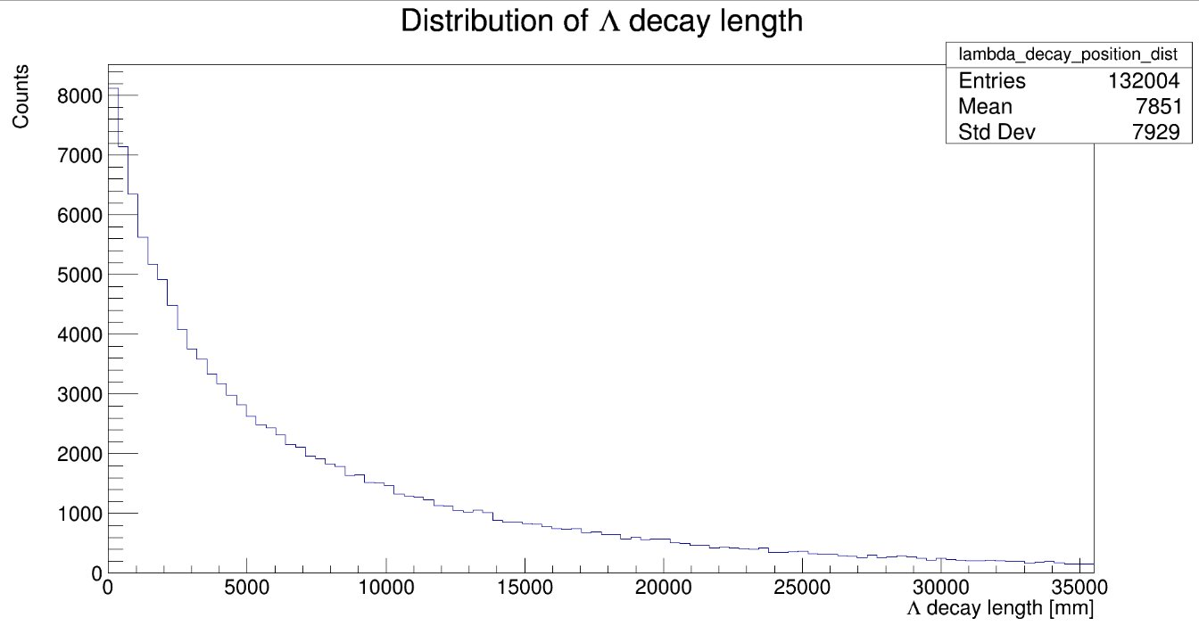
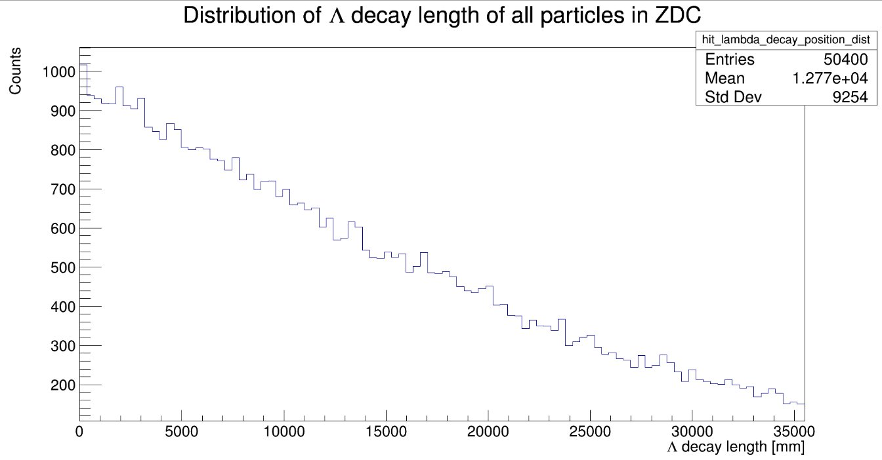
ZDC Simulation:
Decay distance before and after cuts on all particles in ZDC
Enhancement of higher decay distances lambda baryons

Slide 9
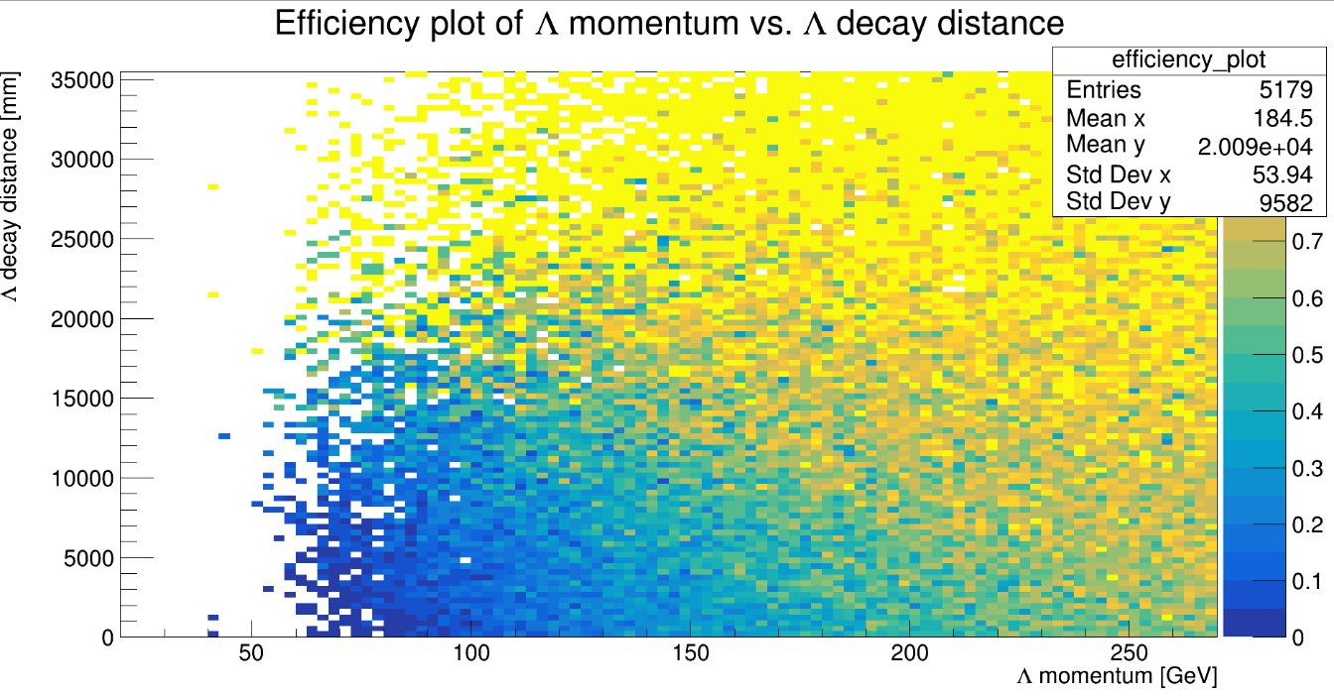
ZDC Simulation:
Efficiency plot of potential lambda reconstruction
Made by dividing momentum vs. decay position after cuts by the one before cuts

Slide 10
ZDC Simulation Outlook
Simulate data with slight lambda angle
Communicate with researchers working on meson structure simulation to see the status of Sullivan process simulation
Continue working on clustering algorithms to determine which events can be reconstructed and the angular resolution
Put it together to calculate the reconstructed invariant mass

Slide 11
TPC Build:
Completed the TPC build and are now working on understanding the TPC output, which is a mixture of real signal and discharge
Using the Kromek MCA/Oscilloscope to see the spectrum of the signal/signal for different GEM voltages (800 – 1200V) with the field voltage on and off
Flush TPC with N2 for two hours before filling it with P10
Remove moisture from the TPC
Opened TPC and retaped the circuitry
To prevent any unwanted discharge from circuitry

Slide 12
Sources:
[1] Hwang, WY.P., Wen, CY. Semi-inclusive Λ production and generalized sullivan processes. Z Phys A - Particles and Fields 358, 415–422 (1997). https://doi.org/10.1007/s002180050349

Slide 13
Extra Slides

Slide 14
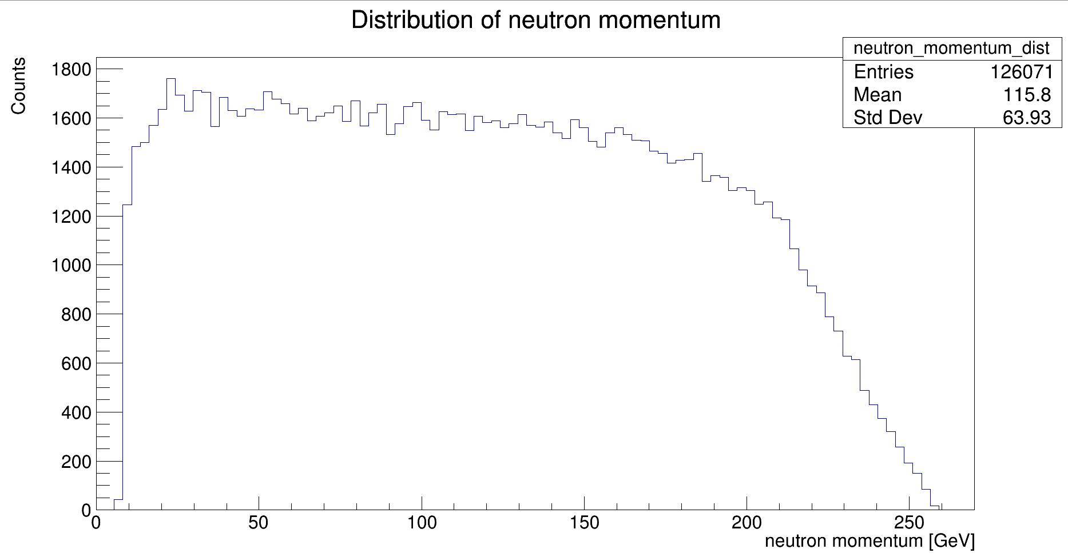
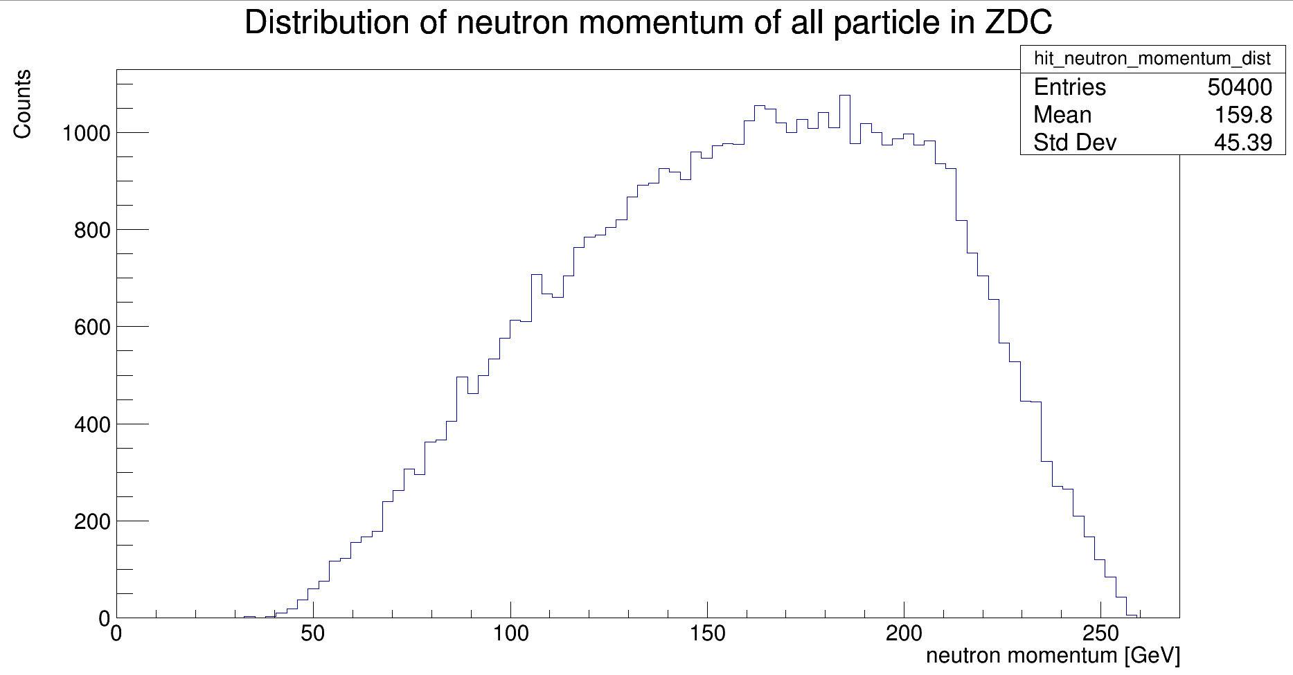
Neutron momentum

Slide 15
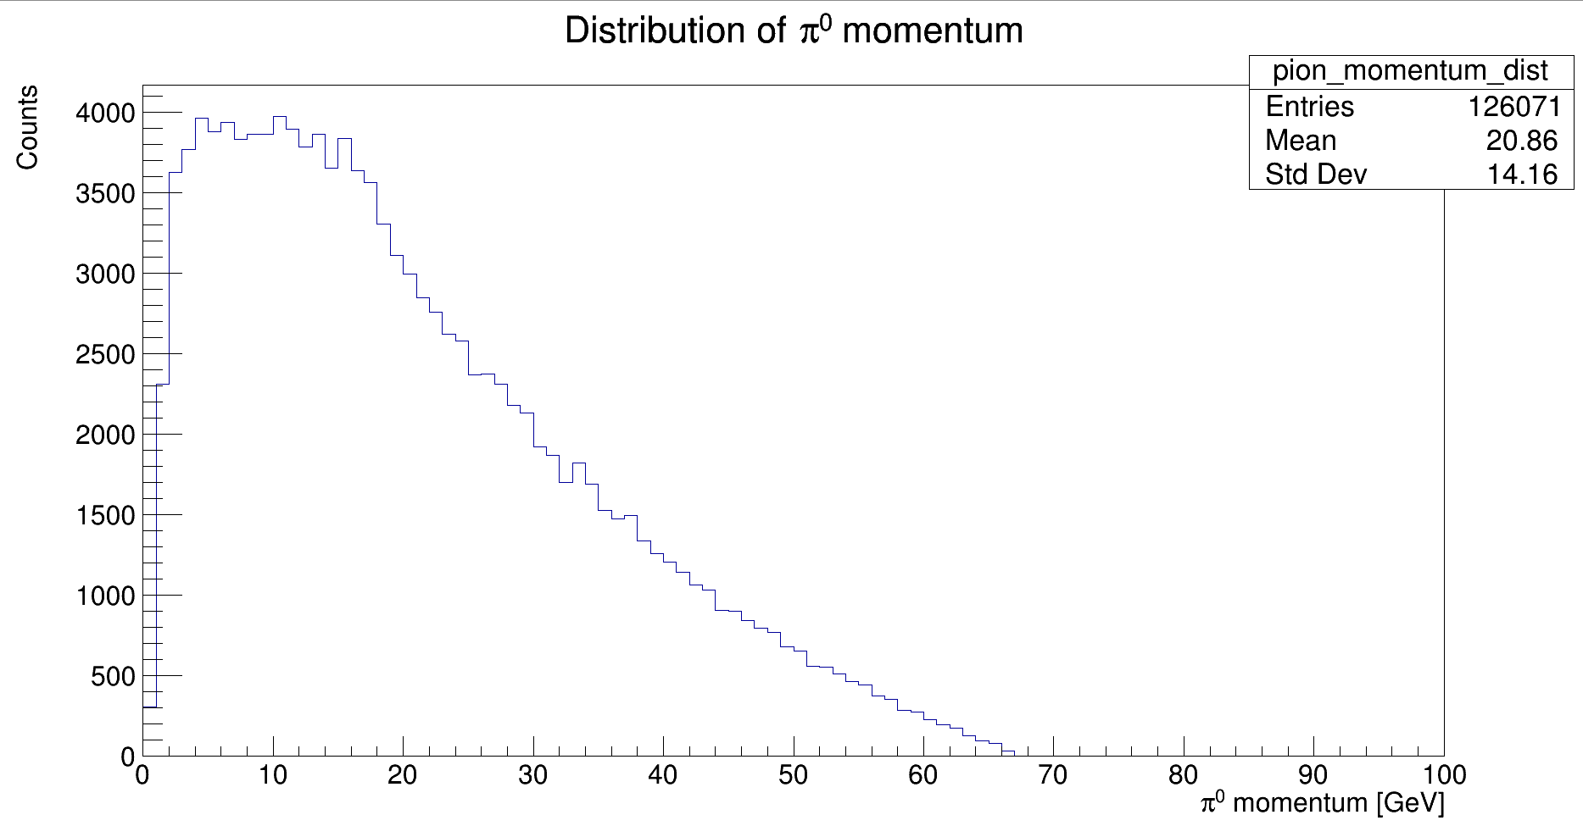
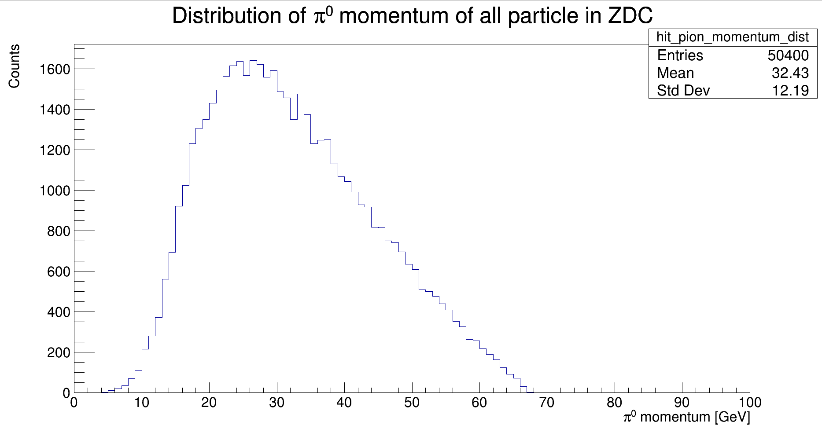
Pi0 momentum

Slide 16
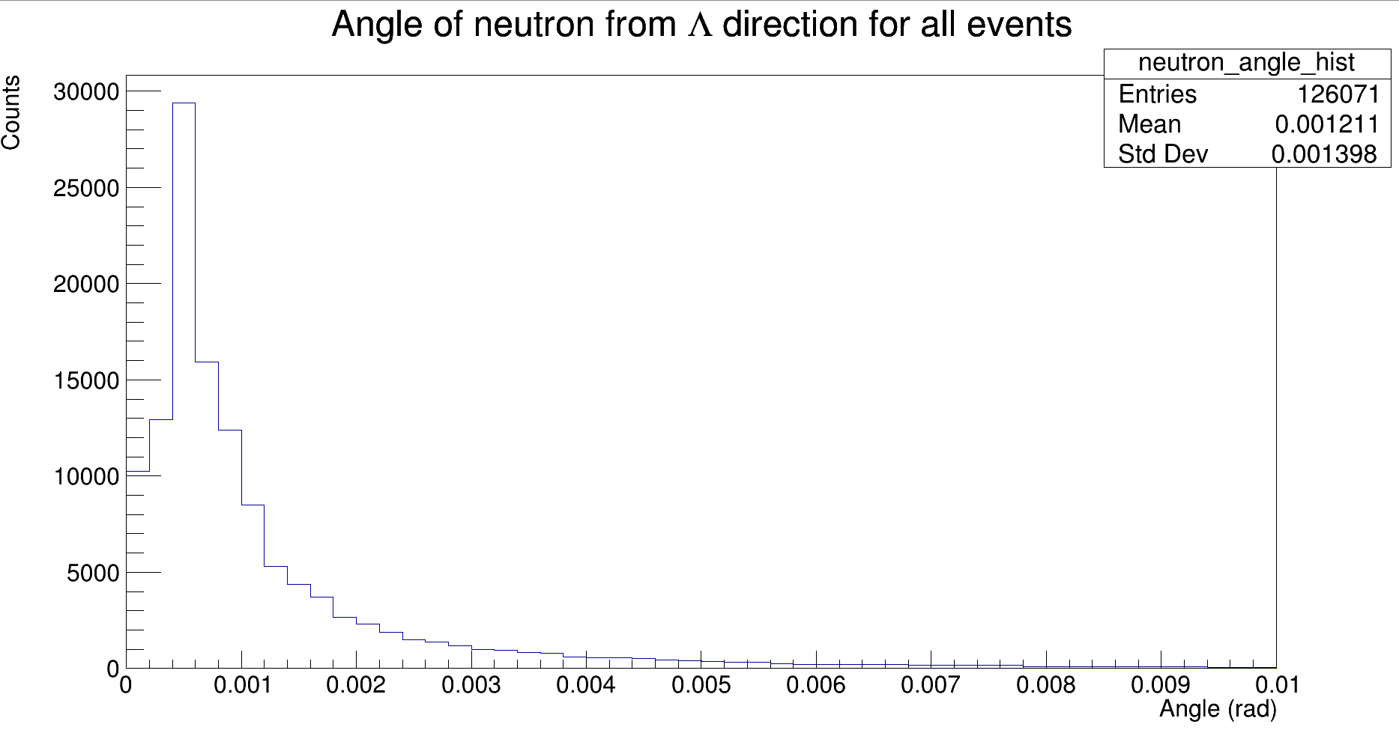
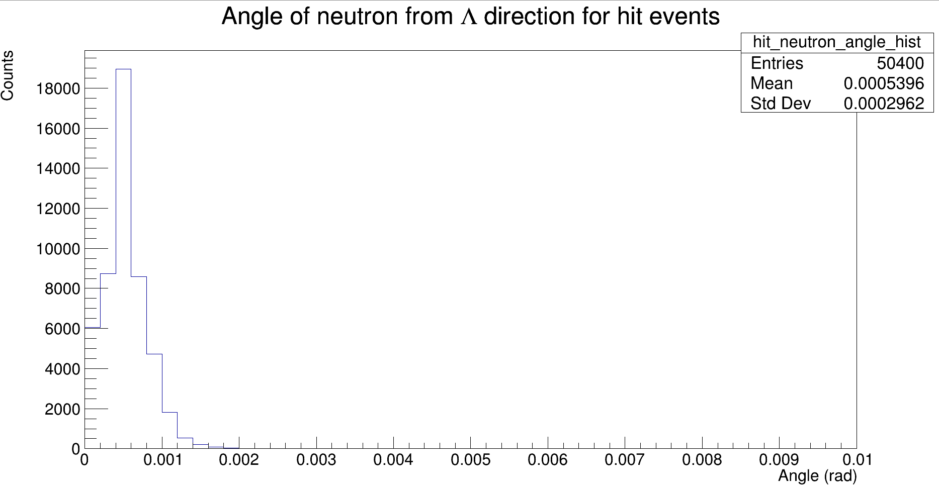
Neutron angle from Lambda direction

Slide 17
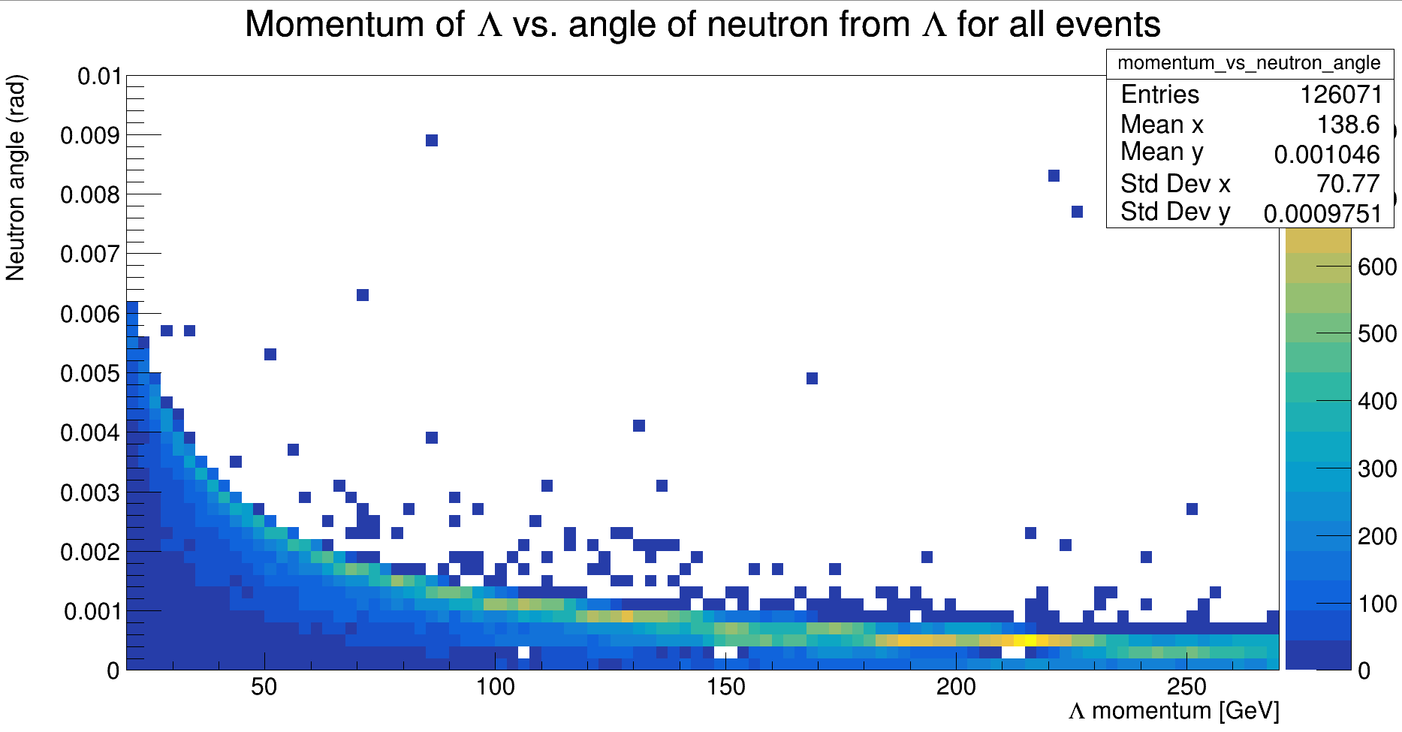
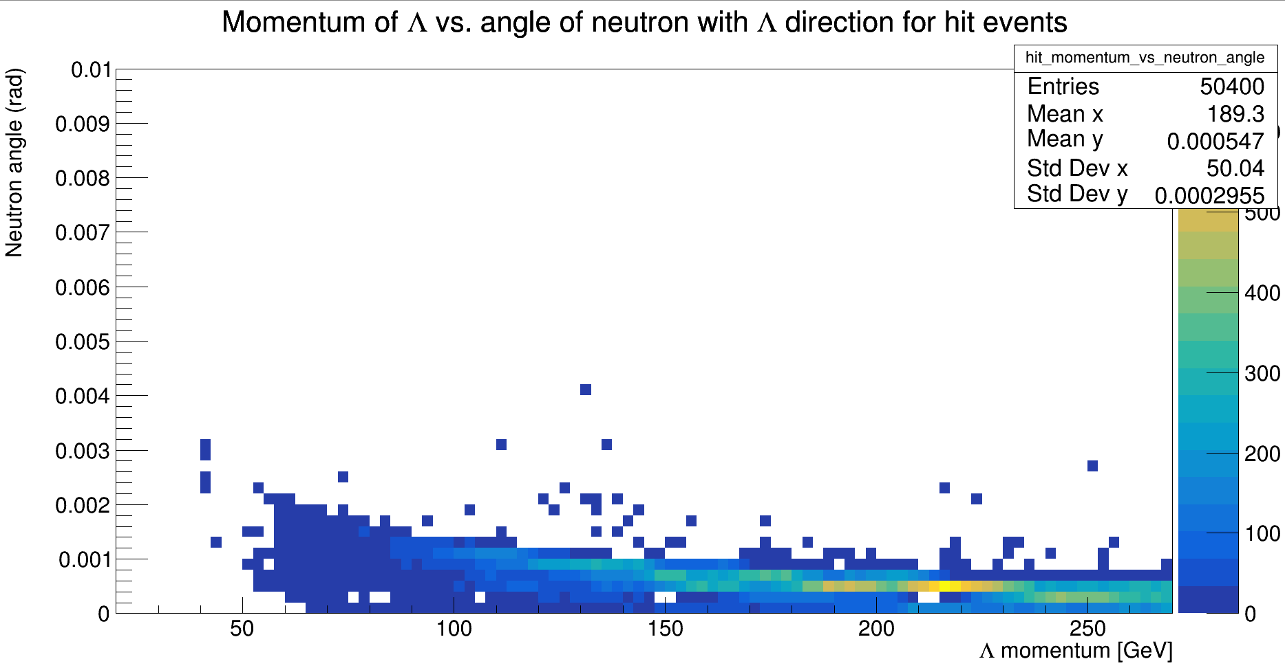
Neutron angle from Lambda direction, function of Lambda momentum

Slide 18
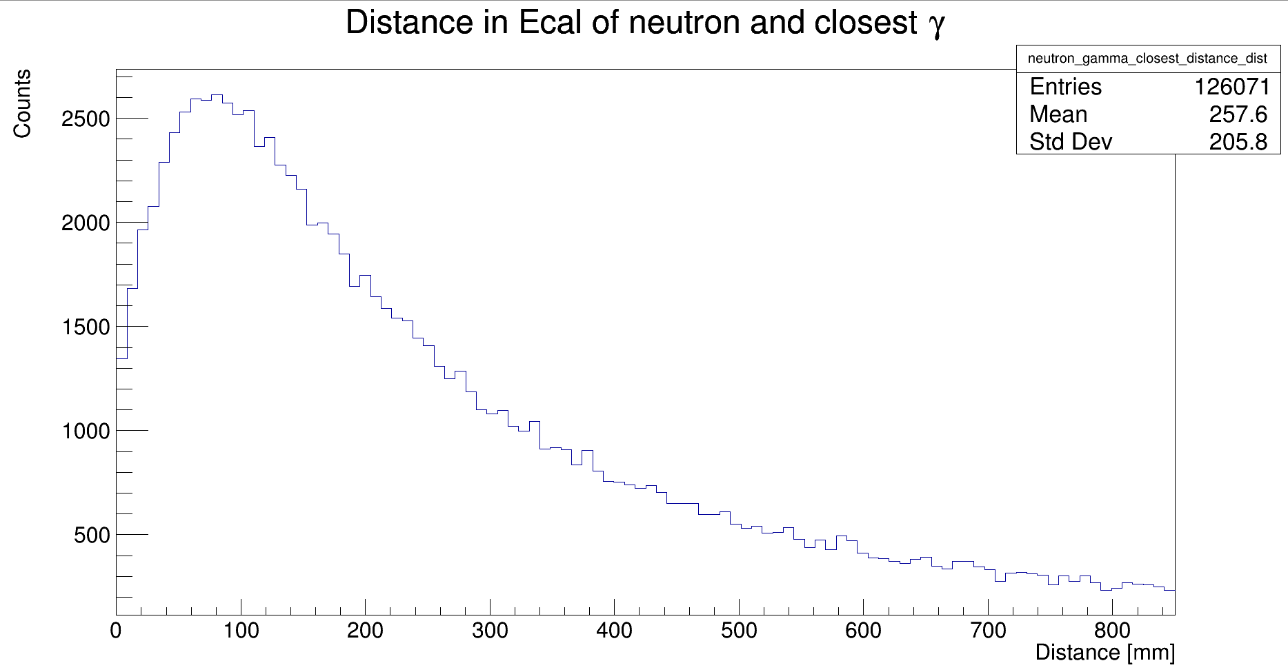
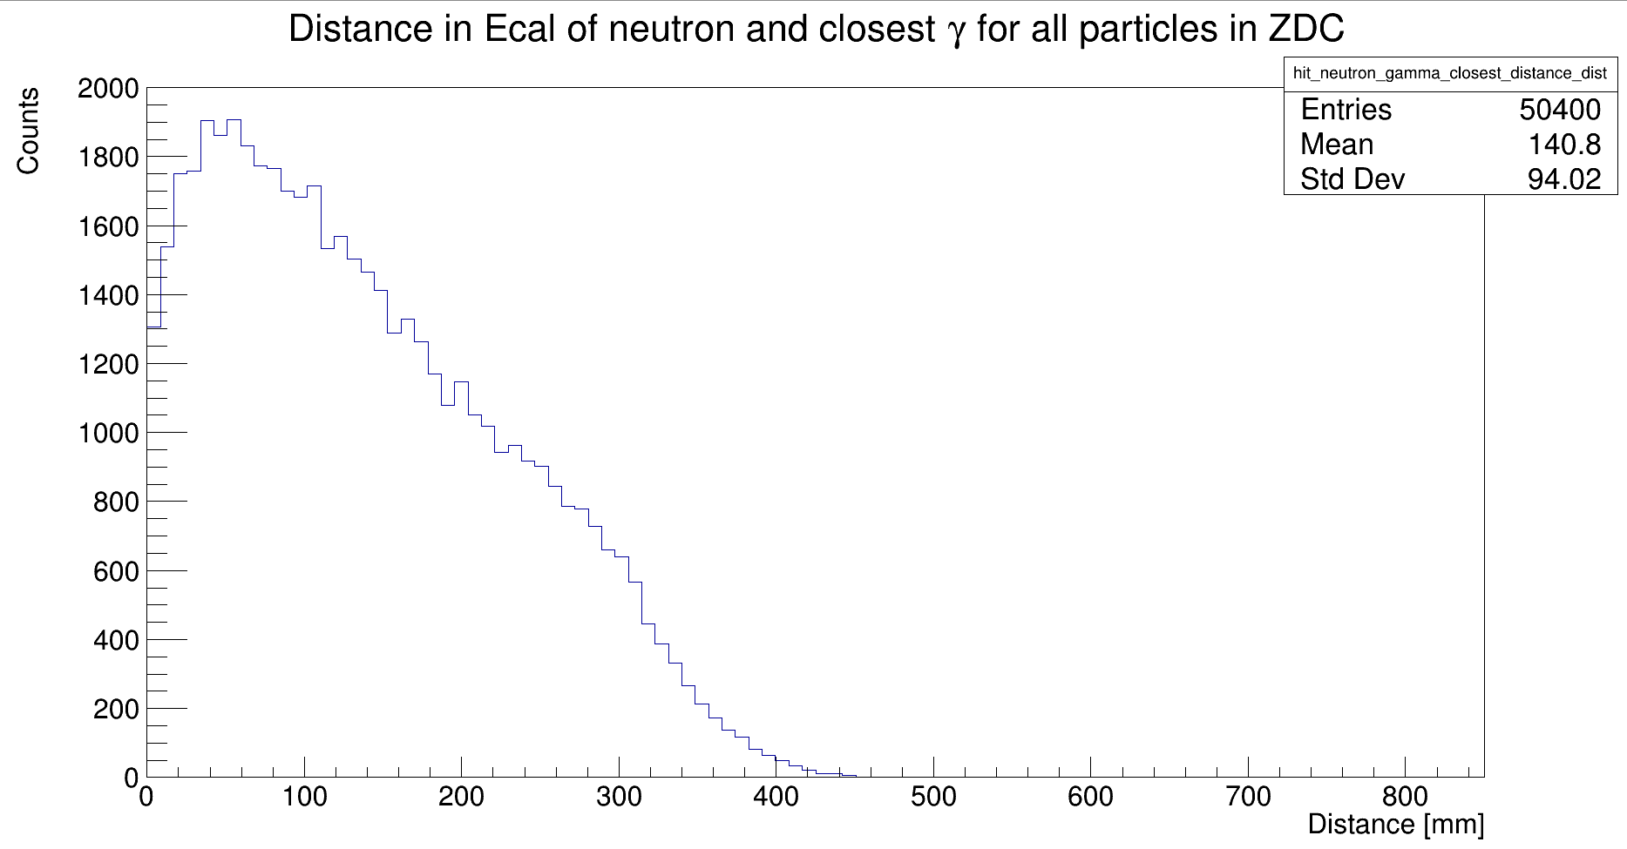
Distance between neutron and closest gamma

Slide 19
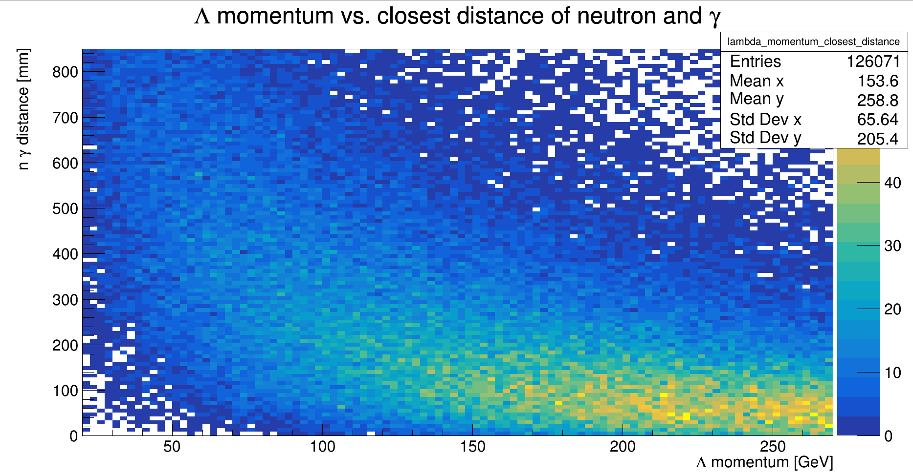
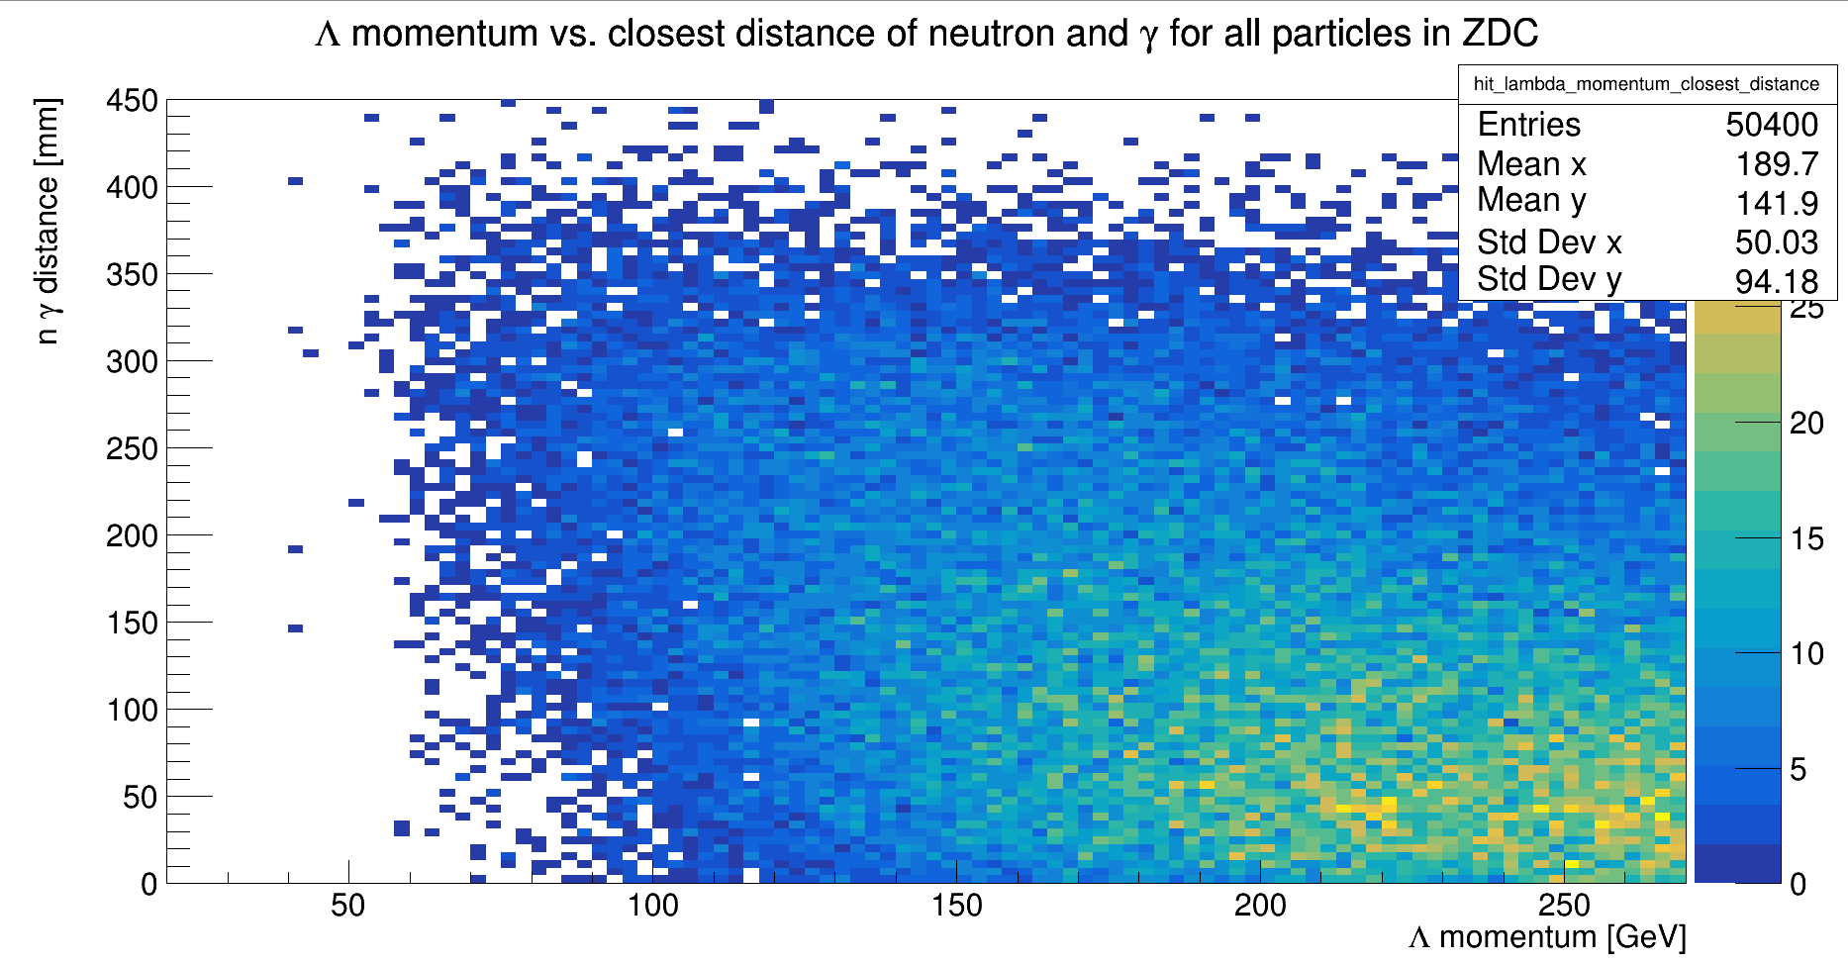
Closest distance of neutron to a gamma vs Lambda momentum

Slide 20
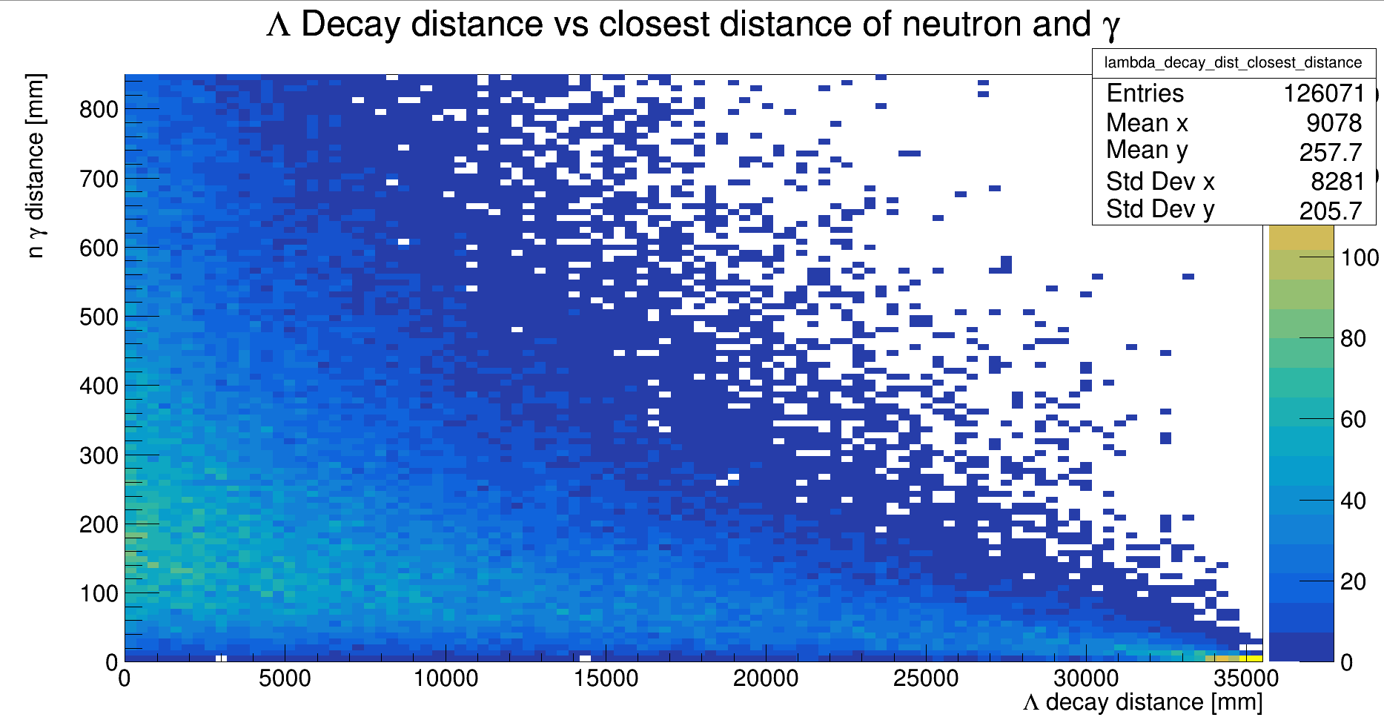
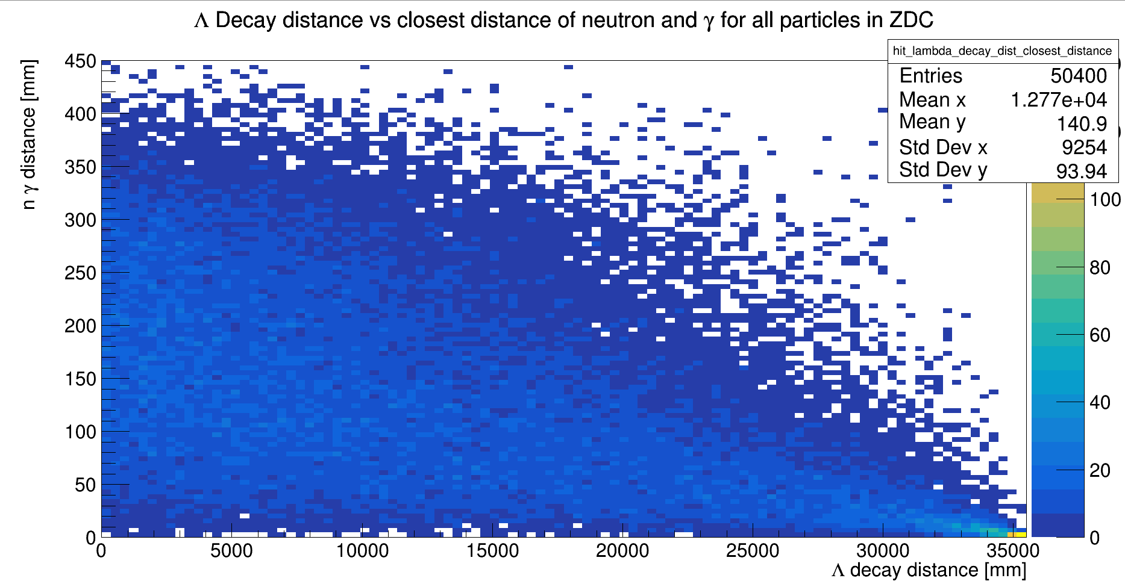
Closest distance of neutron to a gamma vs Lambda decay position

Slide 21
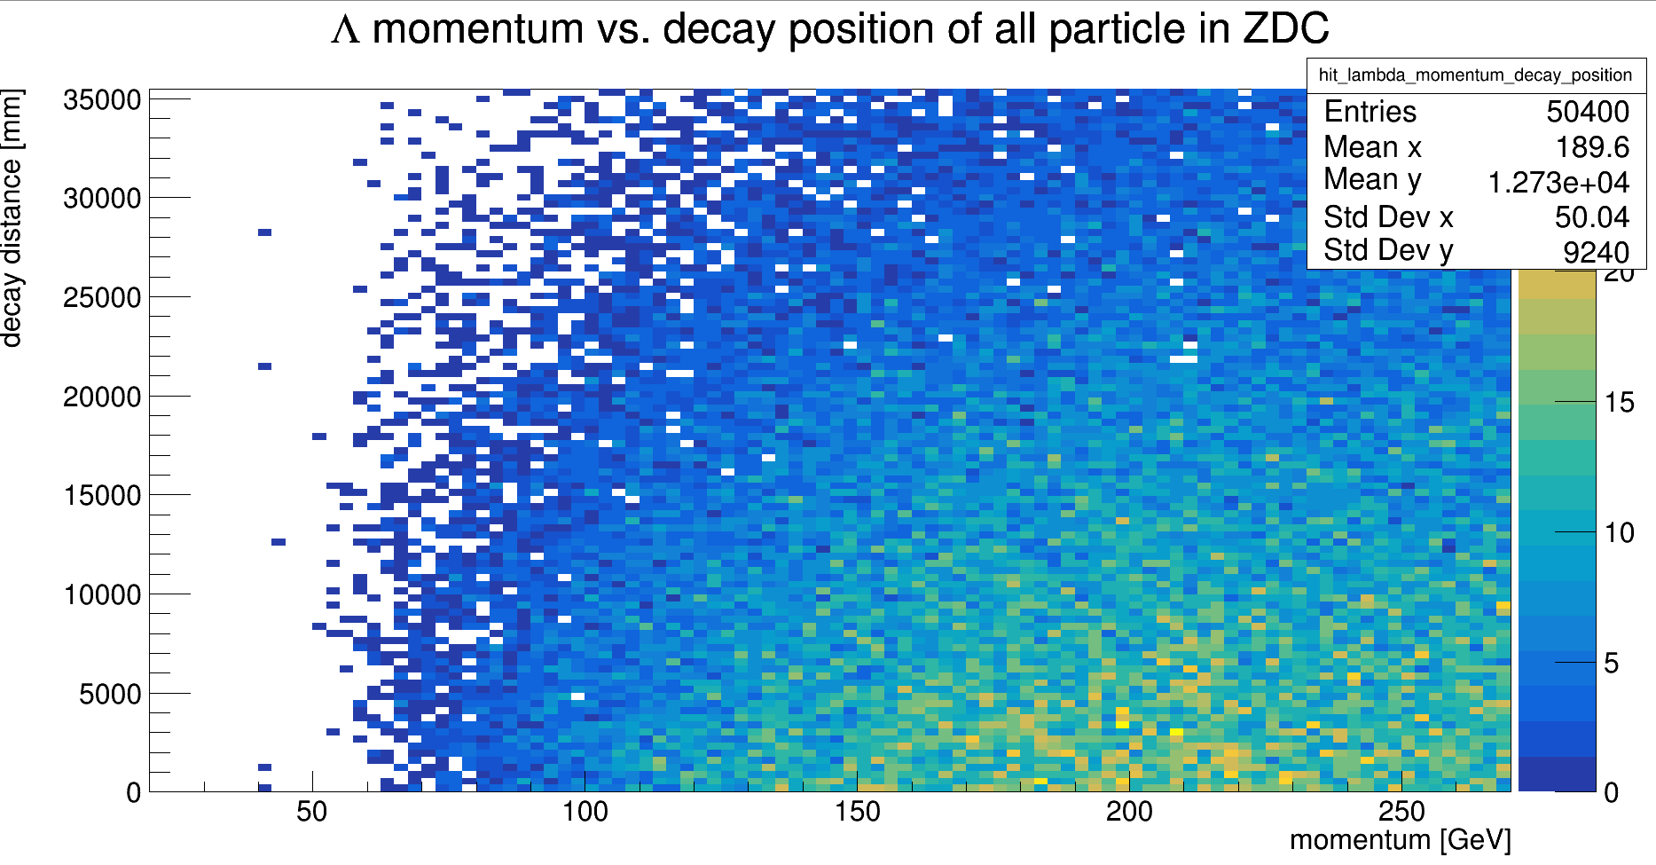
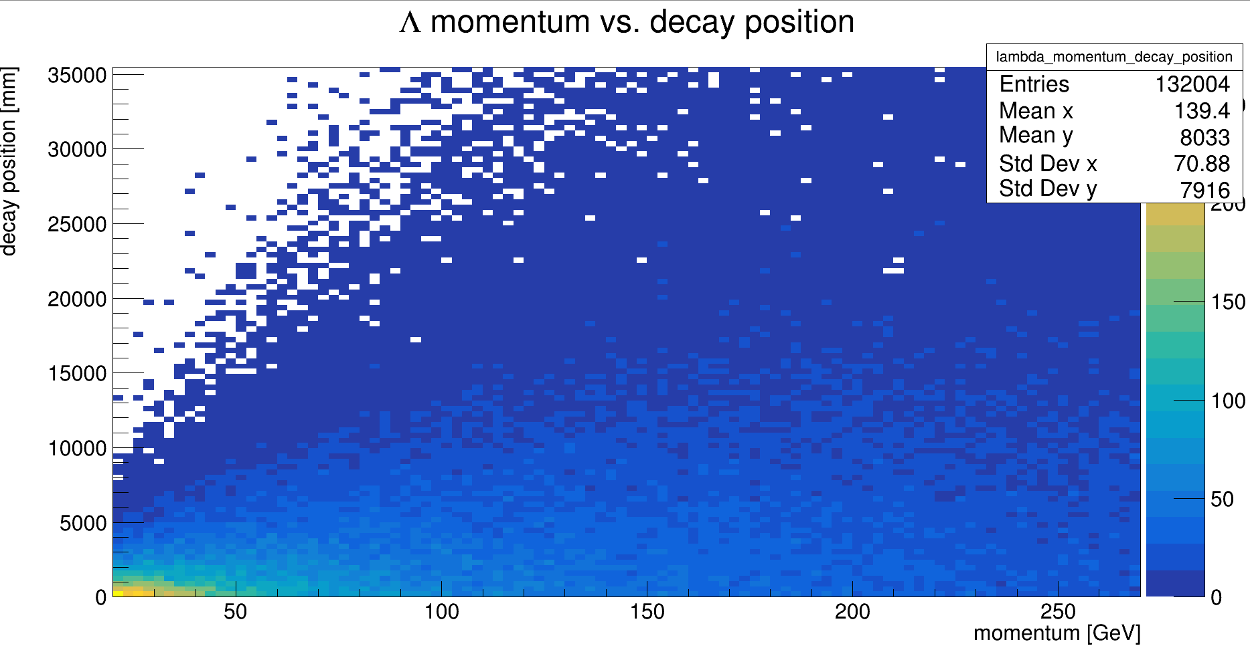
Momentum vs decay position

