Slide 1
J/ψ Production in pA collisions at J-PARC
Yuhei Morino(KEK IPNS)

Slide 2
J/ψ
Heavy(>>Λ)
→ hard process
different time scale
Tightly bound (2xM_{D} – M_{J/Ψ} >>Λ)
→ compact & stable
small interaction with nucleon
Different feature can be utilized for hadron & nuclear matter physics

Slide 3
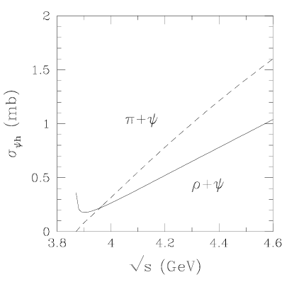
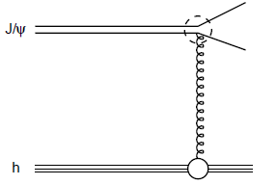
J/ψ dissociation
PRC58 2994
Tight bound & compact
→only hard gluon can break J/Ψ
Slow hadrons do not contain hard gluons
→Slow hadrons do not break J/Ψ
Slow J/Ψ is expected be transparent in nuclear matter
Notes:
I would like to explain a bit more about stability.

Slide 4
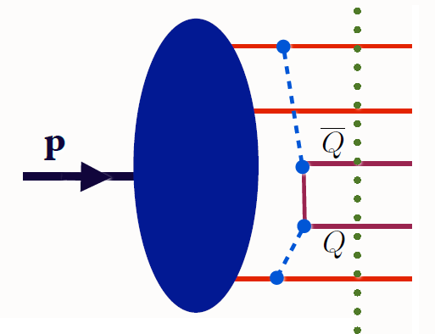
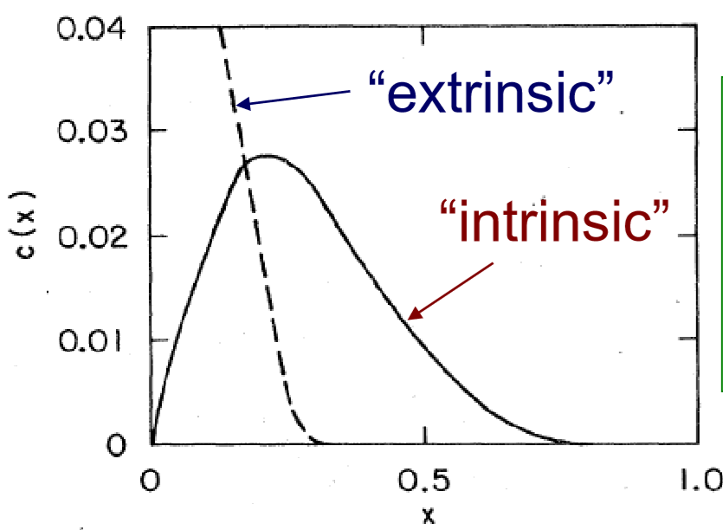
Intrinsic charm(IC)
The existence of |uudcc> in a nucleon, (intrinsic charm, IC),
was suggested to account for cross section of charm
at large x_{F} region in the 1980s.
intrinsic charm have valence-like features.
large x peak
c(x)=c(x) is not required
(normal sea quark, g->cc)
Notes:
introduction.
5quark fock state in nucleon including charm pair is called as intrinsic charm.
if we write this state in diagram, it will be like this.
historically, intrinsic charm is introduced to account for large cross section of charm particles at forward direction
about thirty or forty years ago.
xf is Feynman-x, it is normalized momentum along beam direction in center of mass frame.
intrinsic charm have these features like valence quark.
large x peak. it is to minimize the offshell component of protons.
secondly, charm distribution is not required to be the same as anti-charm distribution, since this distribution is ,so to say,
boundary condition.

Slide 5
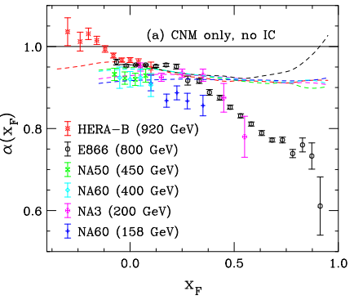
J/ψ suppression in p-A collisions
J/Ψ production puzzle
PRC 106 025201
If J/Ψ production is really
understood by pQCD,
becomes ～1(no suppression)
Nucler matter effect(PDF modification,
nuclear absorption, k_{T} broading)
could cause nuclear suppression(α<1).
However, nucler matter effect failed to reproduce
observed x_{F} dependance.
Soft J/Ψ production via intrinsic charm
CEM+
Nucler effect
Notes:
j/psi suppression in p-A collisions is striking phenomena related with intrinsic charm.
this plot shows nuclear dependence of J/psi cross section per nucleon as a function of xf.
alpha is defined as like that. so alpha less than one means yield suppression.
usually, these two things are believed. J/ψ is produced via hard scattering
J/ψ-N interaction is small due to the compactness of J/psi.
therefore, we can predict alpha to be near one naively. Indeed, alpha is almost one at midrapidity.
However, alpha becomes far from 1 at forward direction and reaches almost two over three.
Ον τηε οτηερ ηανδ, Δρελλ−ψαν ψιελδ ισ νοτ συππρεσσεδ. ψ−αξισ ισ νοτ αλπηα ϕυστ ρατιο.
Εϖεν ατ μοστ φορωαρδ ρεγιονσ, αλπηα ισ αβουτ 0.96.
Τηερεφορε, nuclear shadowing and initial energy loss can not account for J/ψ suppression
τηεσε τωο χονδιτιον μυστ βε ϖιολατεδ ατ ονλψ φορωαρδ ρεγιον.

Slide 6
“Soft” production of J/ψ
Intrinsic charm
c
c
U
U
u
c
d
U
U
U
c
u
U
U
c
c
c
u
U
U
U
U
c
d
U
u
U
U
|uudcc> Fock state emerges in the incident proton.
Fock state becomes |(uud)_{8c} (cc)_{8c}> configuration.
(uud)_{8c} interacts strongly with the surface. (A^{2/3} scaling)
remaining (cc)_{8c} hadronizes to J/ψ.
IC tends to have large x to minimize offshell component.
J/ψ from “soft” production have large x_{F.}
A^{2/3} scaling appears at forward & backward.
Notes:
One solution of j/psi suppression puzzle is an introduction of soft production of j/psi via intrinsic charm.
In this scenario, following process is assumed. first intrinsic charm state emerges in incident proton.
charm pair has similar kinematical value to minimize offshell component and forms compact color-octet.
intrinsic charm state becomes this configuration due to the large mass difference.
Since uud color octet have usual nucleon size, it will strongly interacts with the surface of the target nuclei.
finally remaining charm hadronizes to j/psi.
since intrinsic charm have large x, the fraction of this soft production increase at forward direction.
therefore, at forward regions, this scaling appears.

Slide 7
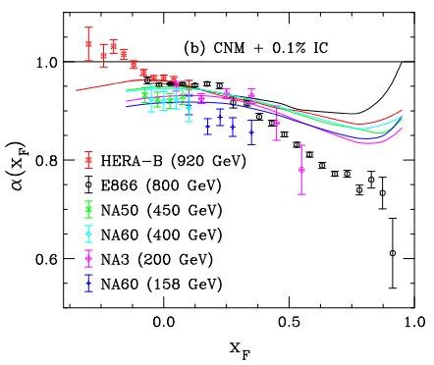
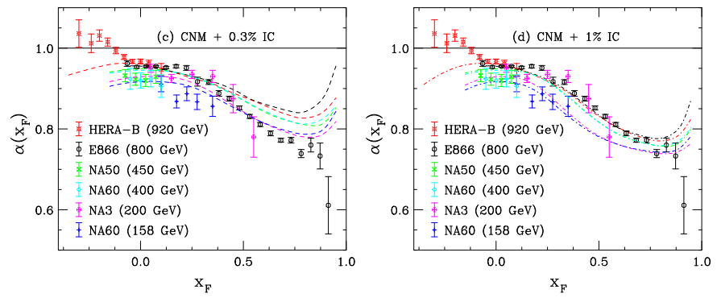
IC effect on suppression patern
CEM
+Nuclear effect
+IC
P_{IC}=0.1%
P_{IC}=0.3%
P_{IC}=1%
?
?
PRC 106 025201
Suppression patern@x_{F}>0 is well reproduced with P_{IC}=1%.
Usual nuclear effect is included.

Slide 8
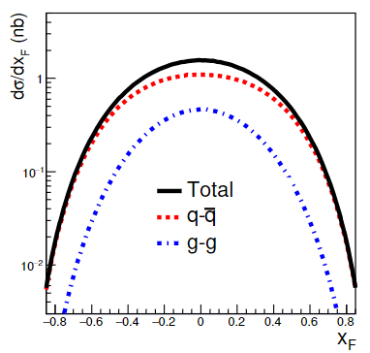
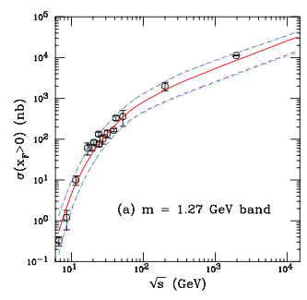
J/ψ production at 30GeV
LO pQCD+CEM
PRC 87 014908
Color Evapolation Model(CEM)
CEM
calc
Non-p part
(Constant)
pQCD part
30GeV proton beam is suitable for IC
effect on J/ψ production,
because hard contribution is small(<～1nb).

Slide 9
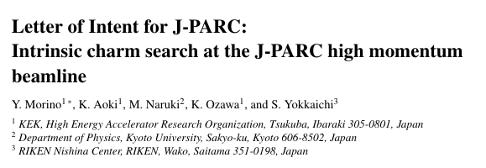
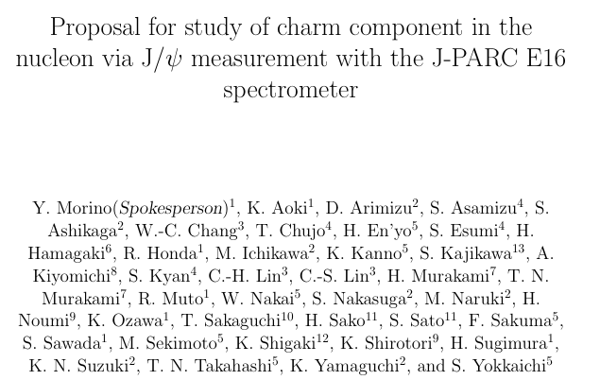
LOI
Jun 2018
Proposal
Feb 2022
For wide acceptance
Pb target use
Change target position
Change trigger logic

Slide 10
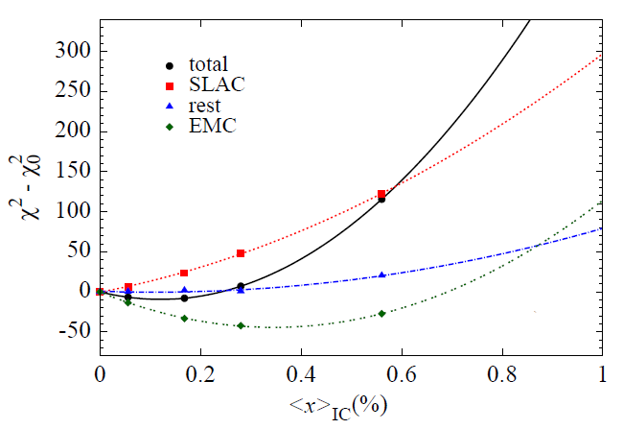
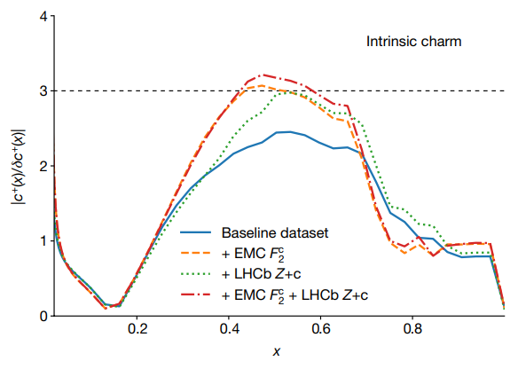
Current situation of IC
PRL114,082002
P_{IC}～1% is originally suggested.
chiral quark model: P_{IC}～0.5%
Global analysis for the PDF with IC
model dependence
data set dependence
Recently, NNPDF group stated IC@x～0.5
was found by the combination of LHCb Z+c jet
and EMC DIS.
momentum fraction
Nature 608, 483
Notes:
Then, I will review of current status of intrinsic charm briefly.
The probability of intrinsic charm is 1% originally.
chiral quark model predicted the probability to be 0.5%. and lattice calculation also gives similar results.
straight forward way to evaluate intrinsic charm from experimental results is global analysis for PDF.
It was performed by several authors. it is chisqure and IC magnitude plot.
Currently the results depend on data set and model. most negative result is here and most positive result is here.
Therefore, intrinsic charm is neither confirmed nor rejected.
clearly additional experimental results are necessary to confirm the intrinsic charm.
I think one way is the detection of a characteristic and clean phenomenon of IC.

Slide 11
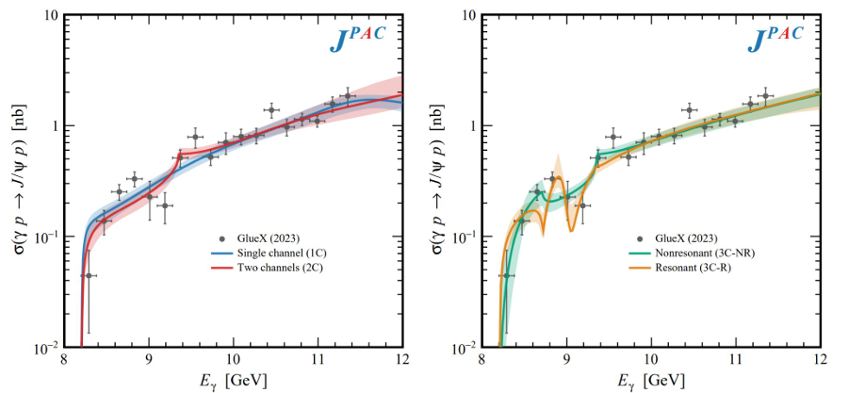
J/ψ photoproduction near threshold
PRC108 025201,
Nature 615 813,
PRD108 5
JLAB found dip-like structure instead of clear peak by pentaquark
Cross section is well reproduced by coupled channel contribution
with and without resonance.
By this study, large J/Ψp scattering length(O(1fm)!) is also extracted.

Slide 12
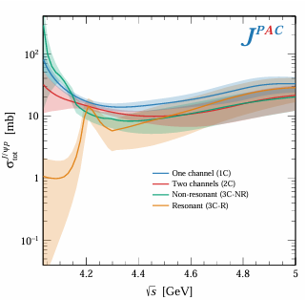
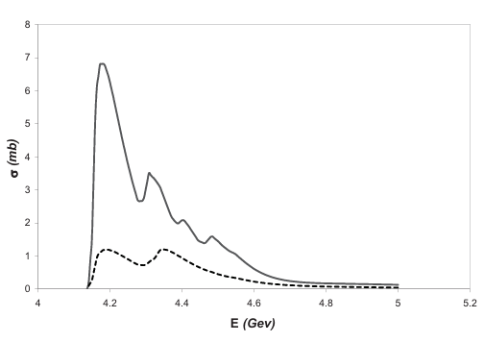
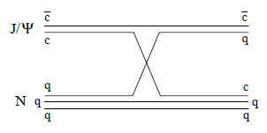
Is slow J/ψ transparent?
J/Ψ-p Total cross section
PRC75 064907
Quark exchange
Total cross section was also evaluated from JLAB data by optical theorem.
If quark exchange exists in short-range interaction, near threshold J/Ψ-p
dissociation will be no longer small (but could be rather large)
Transparency of slow J/Ψ is controversial

Slide 13
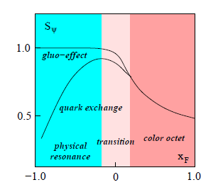
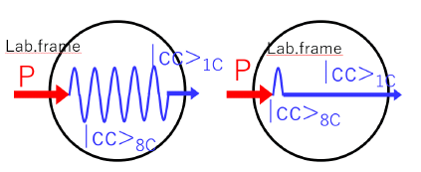
Feature of pA→J/Ψ production at 30GeV
Forward probe
Backward probe
IC IC
IC effect in production
Slow J/Ψ dissociation in nuclear matter (backward)
(Color octet)-hadron interaction (forward)
((J/Ψ)/(charm pair) modification in nuclear matter (backward))
Comprehensive study is important to access above physics
Notes:
considering the above situation, what is characteristic about J/Y production in pA collisions at 30 GeV?
It is that by choosing the kinematic region, we can choose which stage of the hadronic interaction we want to observe.

Slide 14
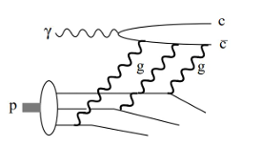
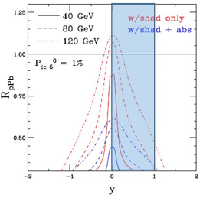
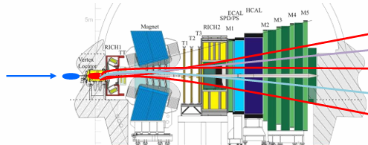
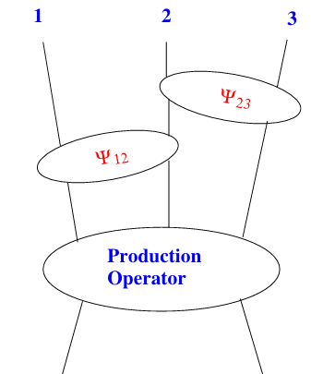
Comprehensive Study
Near threshold
photoproduction
@ JLAB
pA→J/Ψ
at J-PARC & NA60+
Almost full range can be covered.
Forward Z+c produciton
LHCb RUN3&4
J-PARC NA60+
Dalitz plot analysis
in pp→J/Ψpp reaction
CBM with proton beam

Slide 15
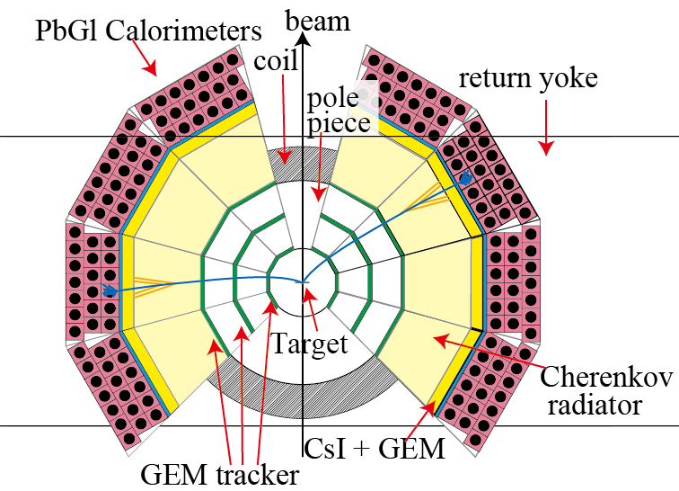
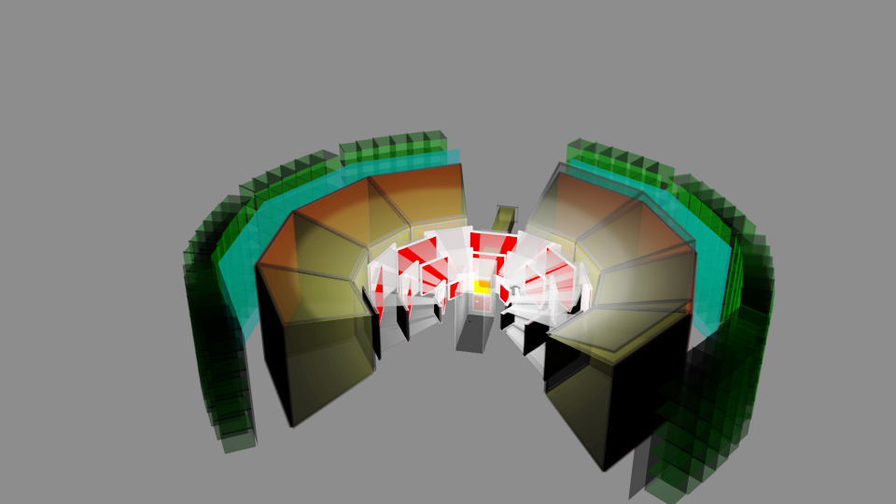
J-PARC E16 experiment
experimental study of spectral change of vector meson
in nuclear medium.
C and Cu target(RUN0&1)
high rate electron spectrometer
with large acceptance for backward
Commissioning run has been performed
RUN 1 (8 modules)
E16 spectrometer is suitable for J/ψ measurement
Notes:
J-PARC e16 experiment will be performed at high momentum experimental area for experimental study of spectral change of vector meson in nuclear medium.
here, just important features are listed.
various nuclear targets are necessary to study nuclear dependence.
this is skech of the e16 spectrometer. it is high rate electron spectrometer with large acceptance of backward.
this is staging plan of e16. physics run will start with 8 modules. then, the spectrometer will be upgrated to 26 modules and
the statistics will be improved.
e16 spectrometer can measure backward production of backward J/psi.
as already mentioned, the beam energy is low. therefore E16 experiment is suitable for IC search via J/ψ.
I will discuss about How much sensitivity has J-PARC E16 for IC.

Slide 16
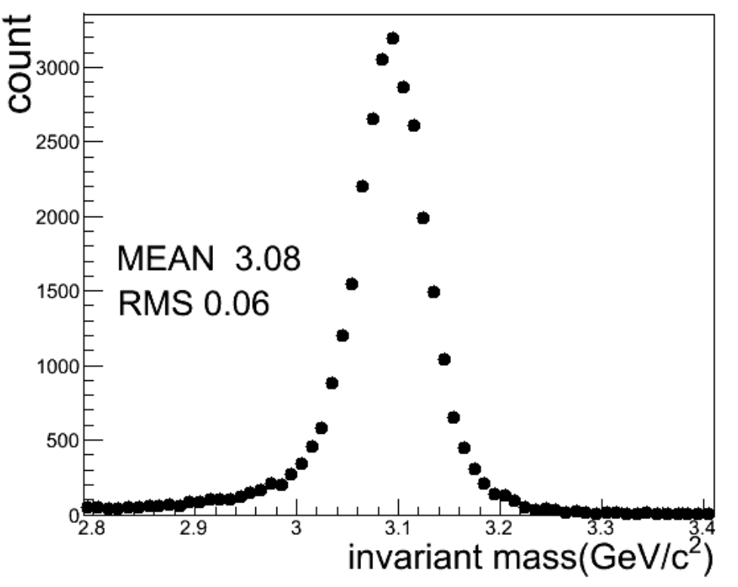
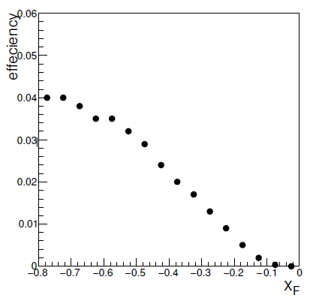
Reconstruction performance
Single J/Ψ was embedded in JAM p-Pb events.
J/Ψ track was reconstructed under background hits.(event overlap is not included)
Results of commission run were not implemented.
invariant mass distribution
Reconstruction acceptance
RUN1 configuration
J/ψ@(x_{F}～0) cannot be reconstructed, while the result at mid-rapidity
gives important baseline for the nuclear effects.
Notes:
A full detector simulation developed by e16 collaborations was performed to evaluate reconstruction performance.
single j/psi was embedded in JAM p-Pb events. and then geant4 based monte-carlo simulation was performed.
J/Ψ track was tried to be found under background hits.
realistic trigger cut and loose analysis cut were applied.
this is simulated invariant mass distribution. j/psi peak was reconstructed well.
this shows the reconstruction efficiency of j/psi as a function xf.
at backward the efficiency is rather good. however, j/psi at midrapidity can not be reconstructed.
the result at these regions is important for the baseline to extract the intrinsic charm effect.

Slide 17
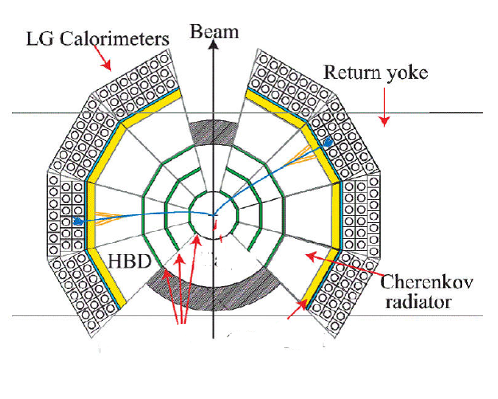
P91 experiment
A experiment is proposed to cope with the inefficiency of J/ψ@(x_{F}～0)
C and Pb targets are placed
near a vacuum film of the beampipe.
(～25cm upstream)
interaction length is the same
as the E16 RUN1
new target
beam pipe
Notes:
special run is proposed to cope with the inefficiency for j/psi at midrapidity.
the idea is very simple. just move to the target upstream.
targets will be placed near a vacuum file of the beampipe.
these targets are selected for effective data taking.
these interaction length is almost same as the original E16 target. but radiation length is 5 times thick.
it will increase trigger rate from gamma conversion.
therefore trigger login must be optimized for j/psi measurement for special run.

Slide 18
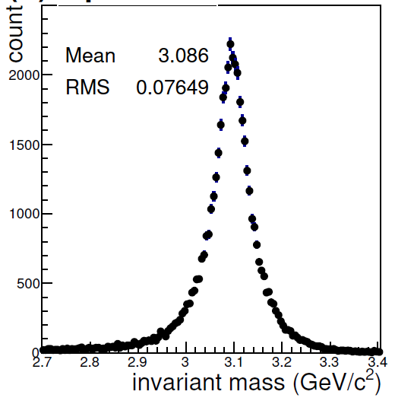
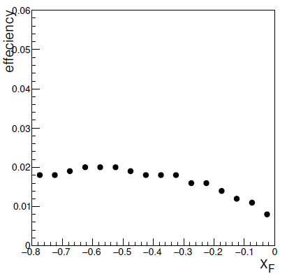
Reconstruction performance
Full detector simulation was also performed in the case of
trigger with (LG>0.7GeV) trigger condition.
invariant mass distribution
Reconstruction acceptance
RUN1 configuration
J/ψ@(x_{F}～0) can be reconstructed,
Notes:
trigger condition was fixed by the previous slide.
therefore, full detector simulation was also performed for the special run with the fixed trigger condition.
this is invariant mass distribution and reconstructed efficiency.
you can see j/psi at midrapidity can be reconstructed, while the value is not so well.

Slide 19
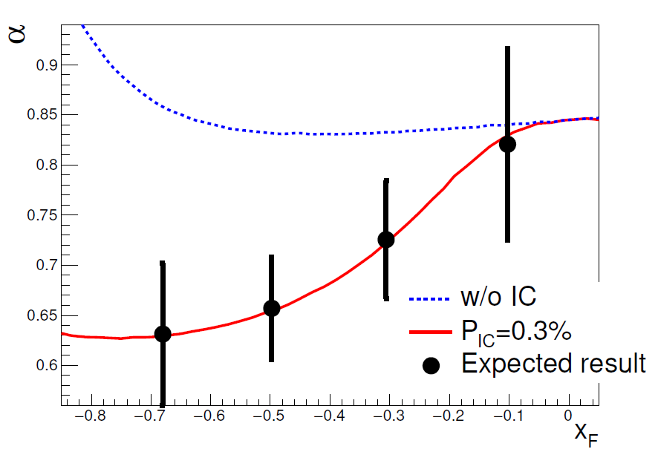
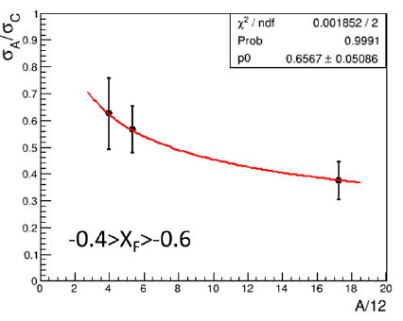
Expected result
The assumed production yield was still based on
my old calculation(not presented one)
.It should be updated.
eID efficiency and pair reconstruction efficiency
and DAQ efficiency were included.
It was based on E16 RUN0 proposal.
A dependance
50 days run
With 1x10¹⁰ppp
Notes:
expected experimental result can be obtained by model calculation results and reconstruction efficiency.
this table gives conditions of statistics normalization. normal run means run1 and run2 of e16 experiment.
special run assumed sixty shifts. pair reconstruction efficiency means reducing factor of reconstruction efficiency.
this figure shows expected experimental result. model calculations with these condition are also shown.
if expected result is compared with this black line, chisqure becomes this value. therefore,
the expected result will reject the model without intrinsic charm.
constant fit was also applied for the results.
it corresponds that try to reproduce result by using arbitrary absorption cross section without intrinsic charm resulting chisqure is here.
and absorption cross section becomes 37mb. it is rather large.
it means the expected result can not be reproduced without intrinsic charm even if such large absorption cross section. therefore, the IC effect with P_{IC}=0.2% can be indentified.

Slide 20
Summary
IC will have a large contribution to J/Ψ production at 30GeV
Then, we have chance to measure the effect easily
J/Ψp cross section at low energy is controversial. It will have also a large contribution for J/Ψ production in pA collisions
J-PARC E16 spectrometer is suitable for J/Ψ measurement.
We have chance to study the above physics.
P91 experiment was proposed to measure J/Ψ in p-Pb collisions
backward and mid-rapidity region.

Slide 21
backup

Slide 23
J/ψ cross section
Energy dependance of J/Ψ cross section was
reproduced by pQCD based effective models.
PRC 87 014908
Color Evapolation Model(CEM)
CEM
calc
Non-p part
(Constant)
pQCD part
The behaviour looks like pQCD.
J/Ψ production at high energy region has been
measured by many experiments.
On the other hand, at J-PARC energy range,
the experimental result is very limited.
CERN PS 24GeV (1978)

Slide 24
J/ψ production at 30GeV(J-PARC)
30GeV proton beam is suitable for IC effect on J/ψ
production,
because hard contribution is small(<～1nb).
LO pQCD+CEM
Espcially, in the case of backward production in
p-A collisions at J-PARC, above two puzzle solution
will predict different behavior.
Since βγ of the charm color octet is small in this case,
fleight length < medium volume of C,
then, the A dependance of the suppression due to the
energy loss will not appear.

Slide 25
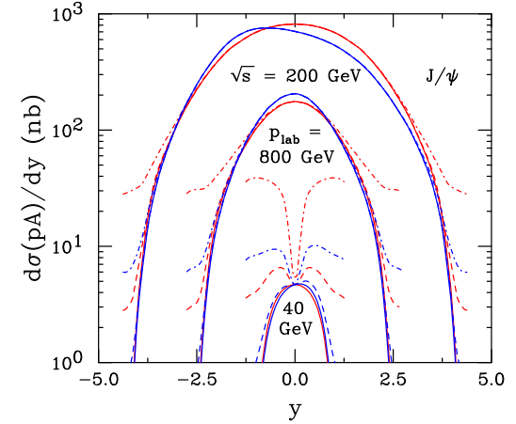
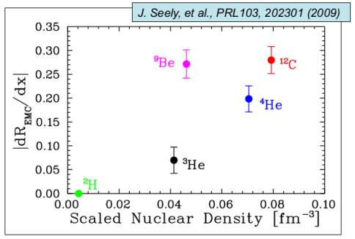
Backward J/ψ production
w/o energy loss
w/o aborption
w/o EMC for IC
Intrinsic charm
PRC 106 025201
p+p
p+Pb
cm.frame
P_{IC}=1%
c
c
c
u
P_{IC}=0.3%
U
U
U
U
c
d
U
u
U
U
P_{IC}=0%
α～2/3 for the production via IC
The EMC effect seems to depend on the local density (but average value).
IC of the nucleon at the surface is only relevant
→J/Ψ production via IC would be less affected
by the EMC effct.
Notes:
Then, let’s consider backscattering j/psi in center of mass frame.
in intrinsic charm scenario, similar process will occur as the forward scattering.
that is, intrinsic charm in the nucleon on the surface of the nuclei hadronizes to j/psi.
it also leads alpha to be two over three.
Then, consider energy loss model.
backscattering j/psi is slowly-moving in laboratory frame.
if it is slow enough, flight length of color-octet becomes so short.
in this case, energy loss of charm pair becomes little. it leads alpha to be one.
these two model will predict different behavior at backward direction.
therefore, suppression of backward J/psi is evidence of IC.
however, there is no results about slow-moving J/psi.
here is hera-b result. bad it is not so backward and charm octet is not so slow due to large energy of incident beam.
measurement of backward j/psi production is interesting.
Low energy and high intensity beam is necessary for such measurement .

Slide 26
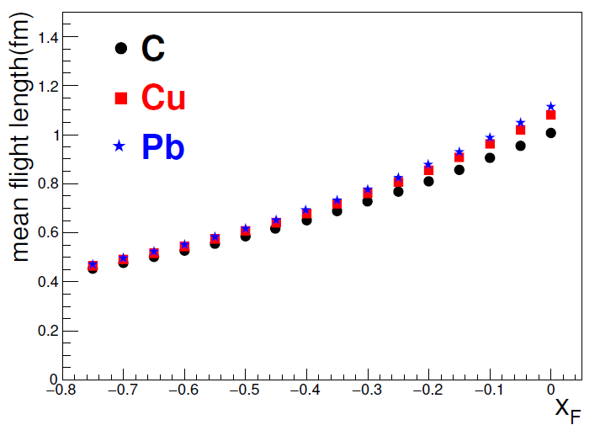
J/ψ production at 30GeV(J-PARC)
LO pQCD+CEM
30GeV proton beam is suitable for IC effect on J/ψ
production,
because hard contribution is small(<～1nb).
Espcially, in the case of backward production in
p-A collisions at J-PARC, above two puzzle solution
will predict different behavior.
Since βγ of the charm color octet is small in this case,
fleight length < medium volume of C,
then, the A dependance of the suppression due to the
energy loss will not appear.

Slide 27
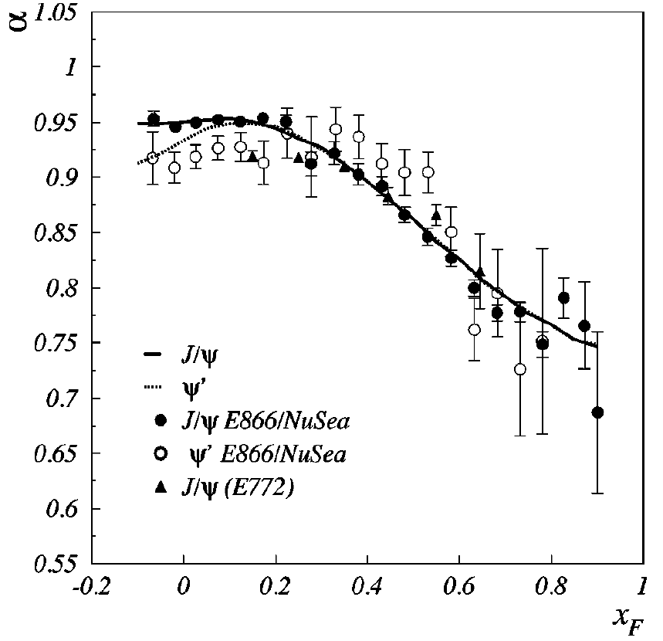
Energy loss of J/ψ
PRC61,054906
Lab.frame
|cc>_{8C}
P
|cc>_{1C}
cc pair is produced in a color octet via hard collisions.
cc pair hadronizes to J/ψ after the hadronization time(τ_{ψ}).
|cc>_{8C} interacts strongly with nuclear matter.
|cc>_{8C} with large βγ will lose significant energy in the nuclei
due to their long fleight length(Lorentz boost).
fleight length depends on nuclear size and their x_{F}
→ x_{F} dependence of α can be reproduced.
Notes:
another solution of j/psi suppression puzzle is energy loss model.
in this model, following issues are assumed.
cc pair is produced in a color octet via hard scattering.
cc pair hadronizes to J/ψ after the hadronization time(τ_{ψ}).
|cc>_{8C} interacts strongly with nuclear matter.
when betagamma of charm pair is large, color-octet charm pair will flight long distance and lose siginifant
energy in the target nuclei.
this model also can reproduce the experimental suppression pattern like this.
Since these two scenario can explain j/psi suppression well, j/psi suppression in not the characteristic phenomenon of intrinsic charm.

Slide 28
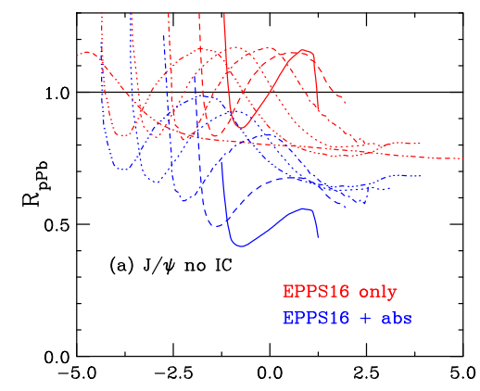
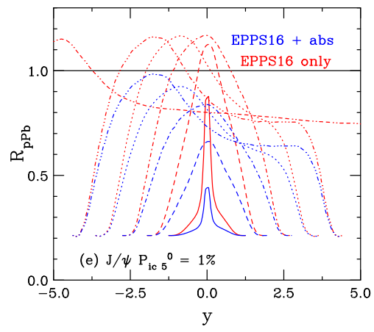
Backward J/ψ production(2)
P_{IC}=0%
P_{IC}=1%
w/o energy loss
w/o EMC for IC
800GeV
40GeV
PRC 106 025201
At J-PARC energy region, the IC will make clear suppression patern also for
backward production.
It will not be made by only nucler effect including the energy loss.
In addition, NA60+ will measure forward region with similar energy.
Then, all kinematic range will be covered
and it will solve the J/Ψ suppression puzzle.
Notes:
Then, let’s consider backscattering j/psi in center of mass frame.
in intrinsic charm scenario, similar process will occur as the forward scattering.
that is, intrinsic charm in the nucleon on the surface of the nuclei hadronizes to j/psi.
it also leads alpha to be two over three.
Then, consider energy loss model.
backscattering j/psi is slowly-moving in laboratory frame.
if it is slow enough, flight length of color-octet becomes so short.
in this case, energy loss of charm pair becomes little. it leads alpha to be one.
these two model will predict different behavior at backward direction.
therefore, suppression of backward J/psi is evidence of IC.
however, there is no results about slow-moving J/psi.
here is hera-b result. bad it is not so backward and charm octet is not so slow due to large energy of incident beam.
measurement of backward j/psi production is interesting.
Low energy and high intensity beam is necessary for such measurement .

Slide 29
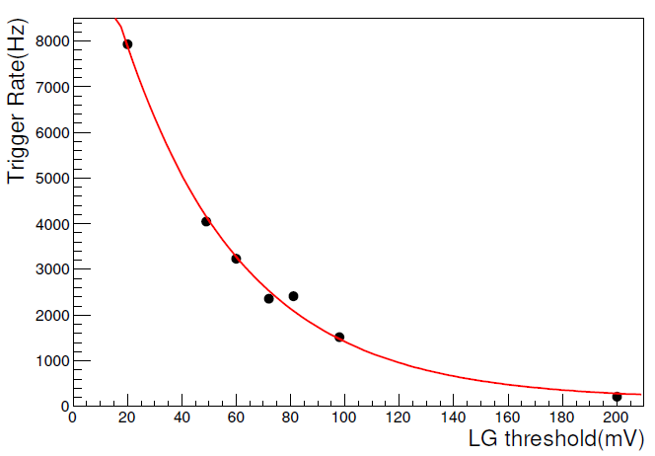
Trigger rate
1x10^10ppp trigger rate
@E16 commissioning run
Conversion electron will
increase due to Pb target
→increase LG threshold
MC study
～400Hz from target
@0.7GeV LG th
0.7GeV
corresponding
Commissioning run
～650Hz@0.7GeV LG th
1kHz of the trigger rate is assumed
→60% live time
(E16 RUN1 DAQ& w/o improvement of beam structure)
It depends on the beam structure
Notes:
purpose of special run is just measurement of j/psi at midrapidtiy.
the energy of decay electrons from such j/psi is much larger than background electrons.
high energy threshold for LG can reduce background rate and it will not loose the j/psi efficiency.
the trigger rate from background is estimated by JAM cascade code and monte-carlo simulation.
this figure shows the result. trigger rate as a function of lead glass threshold.
when the threshold is above 0.7GeV, the trigger rate will below 1kHz.
it is within the planned performance of the e16 read-out system

Slide 30
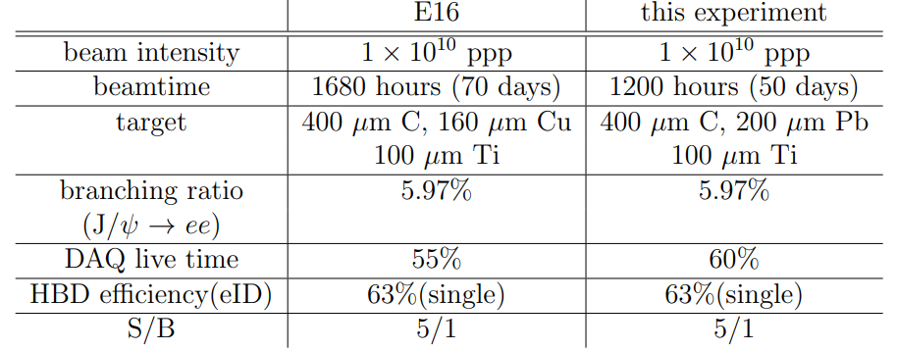
Yield normalization
Summary of conditions to calculate expected statistics
DAQ LT is based on E16 status report
(depends on BT structure, w/o improve case)
Combined results of E16 RUN1 and P91
experiment were evaluated.
Notes:
To evaluate experimental statistics, normalization parameters such as
Beamtime and efficiency were assumed.
This table is summary of normalization parameters used to evaluate statistics.
This is beamtime.
And DAQ livetime. Livetime is based on the E16 evaluation.
It depends on beamtime structure.
This number is in the case of without improvement for beamtime structure.
The eID efficiency of HBD in MC simulation differs from the test experiment.
Then here the discrepancy is corrected.
For statistics, we use Combined results of E16 RUN1 and the proposed
experiment were evaluated.

Slide 31
Wide range measurement
Summary of fixed target experiment with wide acceptance
Data for J-PARC energy range is missing.
Data for backward region is also missing.

Slide 32
Yield Estimation
initial effect
nPDF: EPS09
J/Ψ production
hard process: LO pQCD + color evaporation model(CEM)
(PLB344,1)
intrinsic charm: [PRC 61, 035203 and PLB349, 569]
charm production
via IC
charm →J/ψ conversion is estimated by CEM
A^{2/3} scaling is assumed for J/ψ production via IC
J/Ψ absorption in nuclei
J/ψ survival probability:
L is determined by toy geometry model.
Notes:
To evaluate the yield of j/psi, following model calculation was performed.
it includes these effect.
as initial effect, nuclear PDF was considered.
for J/psi production, hard process and soft process via intrinsic charm were considered.
as final state interaction, j/psi absorption in nuclei is considered.
for hard process, Leading order pqcd calculation and color evaporation model were used.
soft process via intrinsic charm was evaluated according to these reference.
charm production via intrinsic charm is given by this phenological equation.
probability of intrinsic charm is given by offshell component.
and then, conversion charm to j/psi conversion is estimated by CEM.
this scaling was assumed for this process.
finally, j/psi survival probability is given this equation. absorption is assumed to be 10mb. it is just assumption.
Flight length was determined by toy geometry model used at previous slide.

Slide 33
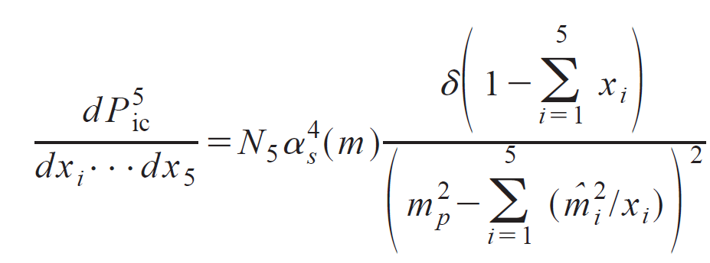
J/Ψ from intrinsic charm
ref. R.vogt Phys.Rev.C 61(2000) 035203, R.vogt et al, Nucl.Phys.B360(1991) 67,
R.vogt, S.J.Brodsky Phys.Lett.B349(1995) 569.
|uudccbar>の確率分布
charm production from IC
ICからcharm対へ移行する時の束縛条件
CEM
Mccbar<2*MD
以上の条件を使って、J/Ψ from ICの断面積を計算

