Slide 1
other (not new) thoughts
K. Ozawa (KEK)

Slide 2
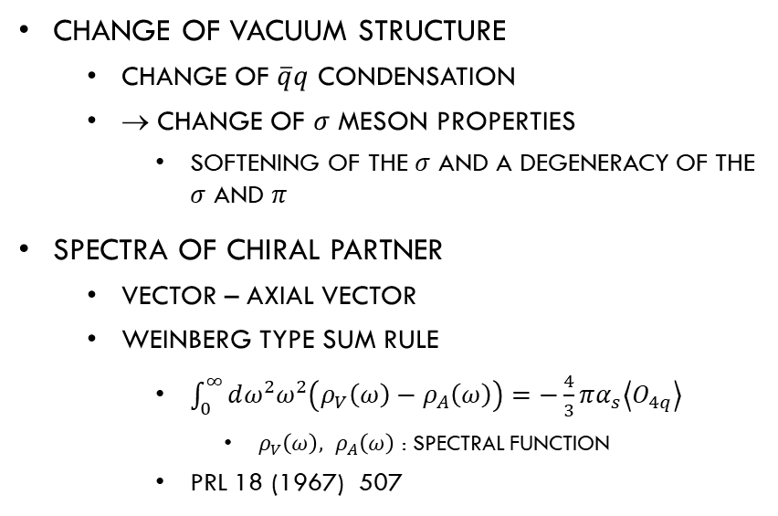
Signals of chiral restoration
T. Hatsuda and T. Kunihiro, PRL55(1985)158
Change of vacuum structure
  Change of $\overline{q}q$ condensation
  → change of $σ$ meson properties
    Softening of the $σ$ and a degeneracy of the $σ$ and $π$
Spectra of chiral partner
  Vector – Axial vector
  Weinberg type Sum rule
    $\int_{0}^{∞}{dω^{2}ω^{2}\left(ρ_{V}\left(ω\right)−ρ_{A}\left(ω\right)\right)}=−\frac{4}{3}πα_{s}\left\langle O_{4q}\right\rangle$
      $ρ_{V}\left(ω\right), ρ_{A}\left(ω\right)$ : Spectral Function
    PRL 18 (1967) 507

Slide 3
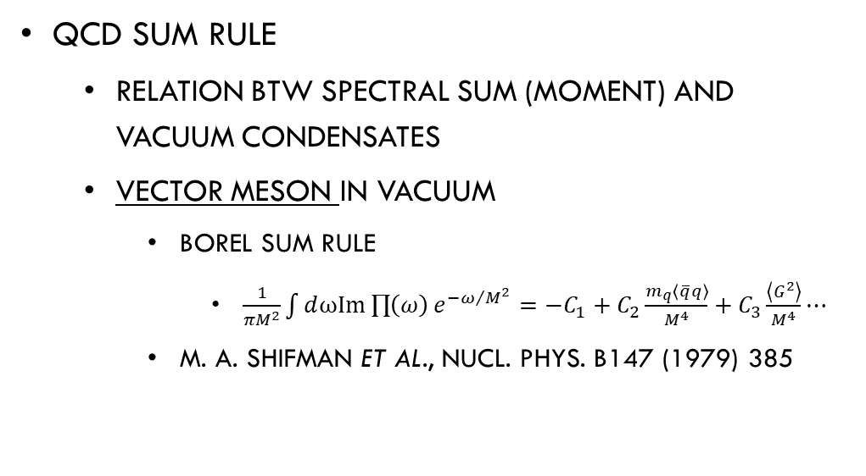
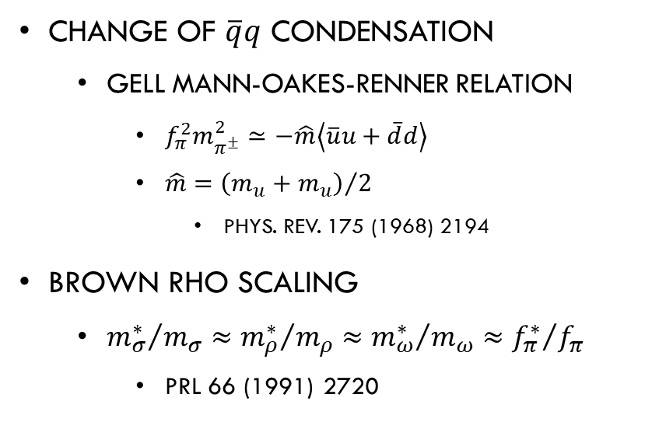
Signals of chiral restoration (cont’d)
Change of $\overline{q}q$ condensation
  Gell mann-Oakes-Renner relation
    $f_{π}^{2}m_{π^{±}}^{2}≃−\hat{m}\left\langle \overline{u}u+\overline{d}d\right\rangle$
    $\hat{m}={\left(m_{u}+m_{u}\right)}/2$
      Phys. Rev. 175 (1968) 2194
Brown rho scaling
  ${m_{σ}^{∗}}/{m_{σ}}≈{m_{ρ}^{∗}}/{m_{ρ}}≈{m_{ω}^{∗}}/{m_{ω}}≈{f_{π}^{∗}}/{f_{π}}$
    PRL 66 (1991) 2720
QCD sum rule
  Relation btw spectral sum (moment) and vacuum condensates
  Vector meson in vacuum
    Borel sum rule
      $\frac{1}{πM^{2}}\int{ⅆω\text{I}\text{m}\prod{\left(ω\right)}e^{{−ω}/{M^{2}}}}=−C_{1}+C_{2}\frac{m_{q}\left\langle \overline{q}q\right\rangle }{M^{4}}+C_{3}\frac{\left\langle G^{2}\right\rangle }{M^{4}}⋯$
    M. A. Shifman et al., Nucl. Phys. B147 (1979) 385

Slide 4
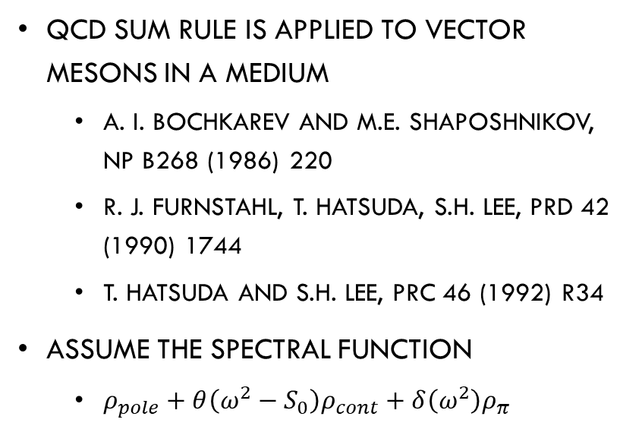
Vector meson as a signal
ρ meson case
PRD 42 (1990) 1744
QCD sum rule is applied to vector mesons In a medium
  A. I. bochkarev and m.e. Shaposhnikov, nP B268 (1986) 220
  R. J. Furnstahl, T. Hatsuda, S.H. Lee, PRD 42 (1990) 1744
  T. Hatsuda and S.H. Lee, PRC 46 (1992) R34
Assume the spectral function
  $ρ_{pole}+θ\left(ω^{2}−S_{0}\right)ρ_{cont}+δ\left(ω^{2}\right)ρ_{π}$
(i), (ii), (iii): different assumption for expansion coefficient

Slide 5
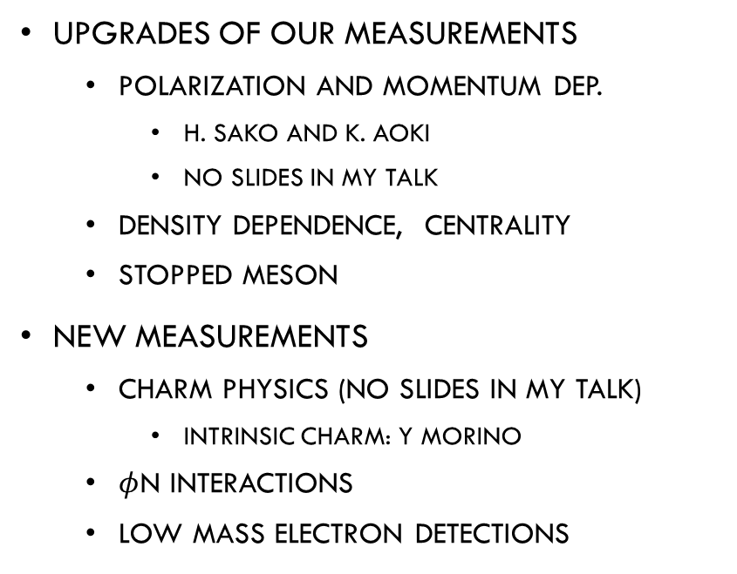
topics
Chiral Symmetry related measurements
  Chiral partner
    Mixing: C. Sasaki, R. Ejima
  K* and K₁ Mesons
    S. H. Lee
  Sigma meson
  Baryon Chiral symmetry
new physics
  Hadron-quark crossover
  Dark photon
upgrades of our measurements
  Polarization and momentum dep.
    H. sako and K. aoki
    No slides in my talk
  Density dependence, centrality
  Stopped meson
new measurements
  Charm physics (no slides in my talk)
    Intrinsic Charm: Y Morino
  $φ$N interactions
  Low mass electron detections

Slide 6
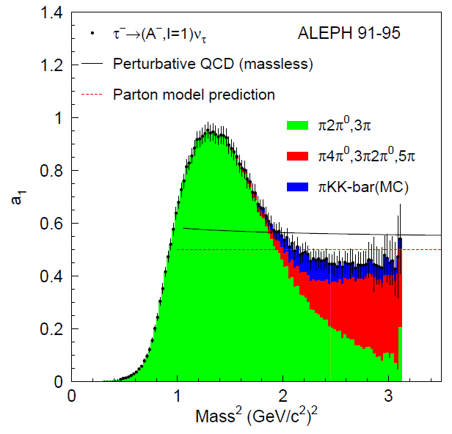
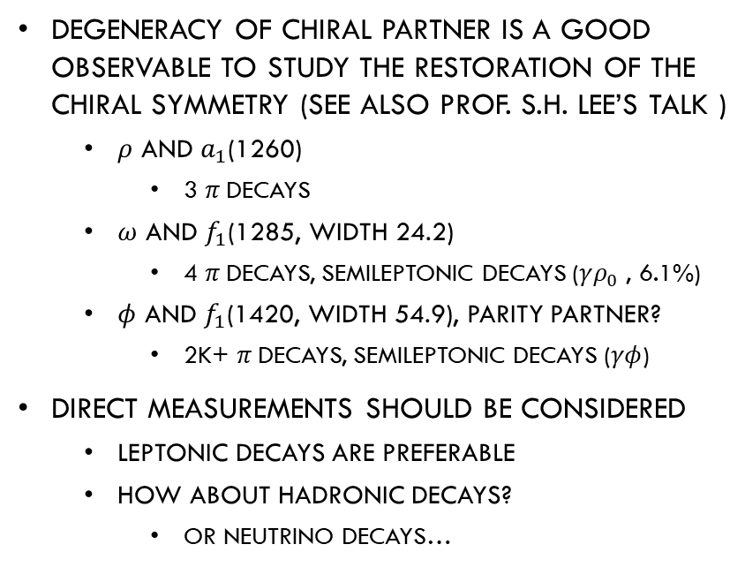
Chiral partners
ALEPH, Phys. Rep. 421(2005) 191
Degeneracy of chiral partner is a good observable to study the restoration of the chiral symmetry (See also Prof. S.H. Lee’s talk )
  $ρ$ and $a_{1}$(1260)
    3 $π$decays
  $ω$ and $f_{1}$(1285, width 24.2)
    4 $π$decays, Semileptonic decays ($γρ_{0}$ , 6.1%)
  $φ$ and $f_{1}$(1420, width 54.9), parity partner?
    2k+ $π$decays, Semileptonic decays ($γφ$)
direct measurements should be considered
  Leptonic decays are preferable
  How about hadronic decays?
    Or neutrino decays…

Slide 7
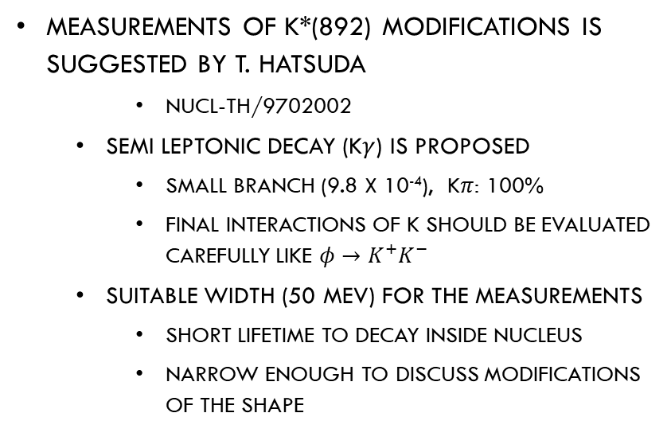
K* and K₁
measurements of K*(892) modifications is suggested by T. Hatsuda
    Nucl-th/9702002
  Semi leptonic decay (K$γ$) is proposed
    Small branch (9.8 x 10⁻⁴), K$π$: 100%
    Final interactions of K should be evaluated carefully like $φ→K^{+}K^{−}$
  Suitable width (50 MeV) for the measurements
    Short lifetime to decay inside nucleus
    Narrow enough to discuss modifications of the shape
Later, K* and K₁ measurements are proposed
    T. Song, T. hatsuda, S.H. Lee, PLB792(2019)160
    S. H. Lee, Nucl. and Part. Phys Proc, 309-311(2020), 111
  In this workshop, prof. S.H. Lee pointed out advantages of measurements of K* and K1
    K* (892, width 50.3) and K₁ (1270, width 90)
      Hadronic decays ( semi-leptonic decay seen)
    K* (1410, width 236) and K₁ (1400, width 174)
      Hadronic decays ( semi-leptonic decay seen)
    Effects of final state interactions should be evaluated carefully

Slide 8
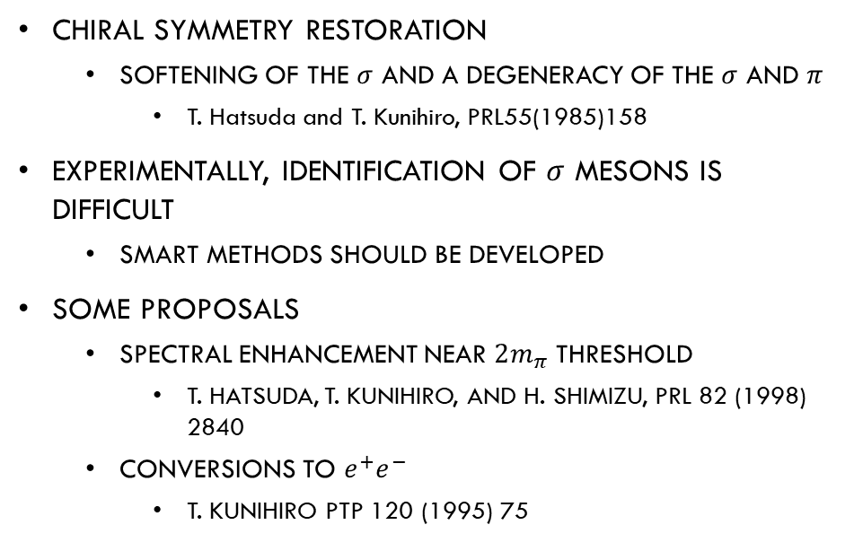

Sigma meson
Chiral symmetry restoration
  Softening of the $σ$ and a degeneracy of the $σ$ and $π$
    T. Hatsuda and T. Kunihiro, PRL55(1985)158
Experimentally, identification of $σ$ mesons is difficult
  Smart methods should be developed
Some proposals
  Spectral enhancement near $2m_{π}$ threshold
    T. Hatsuda, T. Kunihiro, and H. Shimizu, PRL 82 (1998) 2840
  Conversions to $e^{+}e^{−}$
    T. Kunihiro PTP 120 (1995) 75
$$ω\left(\text{GeV}\right)$$

Slide 9
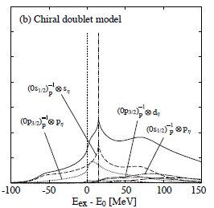
Baryon and Chiral symmetry
H. Nagahiro, D. Jido, S. Hirenzaki,
PRC 80(2009)025205
Chiral symmetry in baryon sector may be also interesting
  For me, It’s complicated
Example:
  N*(1535) is considered as a chiral partner of nucleon in the Chiral doublet model
  Properties of N* in nucleus can be studied using meson-baryon interactions

Slide 10
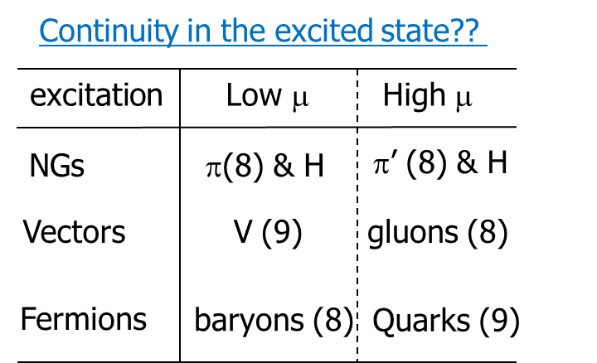

New physics
New phenomena in high density region
Searching for Dark photon
Hadron-quark continuity
  T. Schaefer and F. Wilczek, PRL82(1999)3956
Hadron-quark crossover
  N. Yamamoto, M. Tachibana, T. Hatsuda, G. Baym, PRD76(2007)074001
Using $e^{+}e^{−}$ invariant mass spectra
HADES, PLB732(2014)265
Decay of massive gluon can be measured?

Slide 11
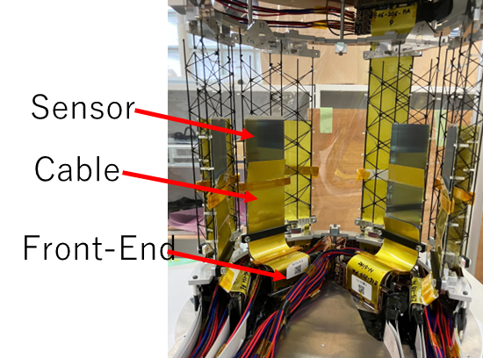
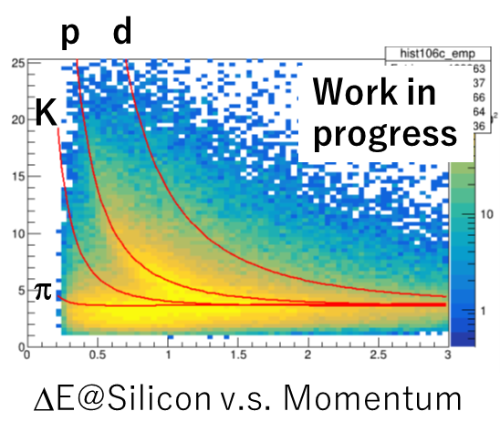
upgrades of our measurements
A Density dependence of mass modifications
  Though nuclear density is saturated,
  Reactions with nuclear surface region, which has a smaller density, can be selected using multiplicity of slow protons
  New silicon detectors are useful
Plot in the original Proposal by Prof. K. Shigaki

Slide 12
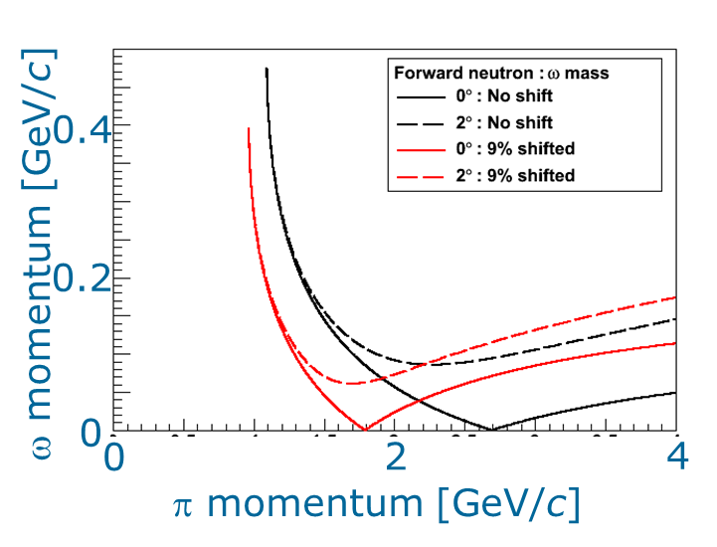
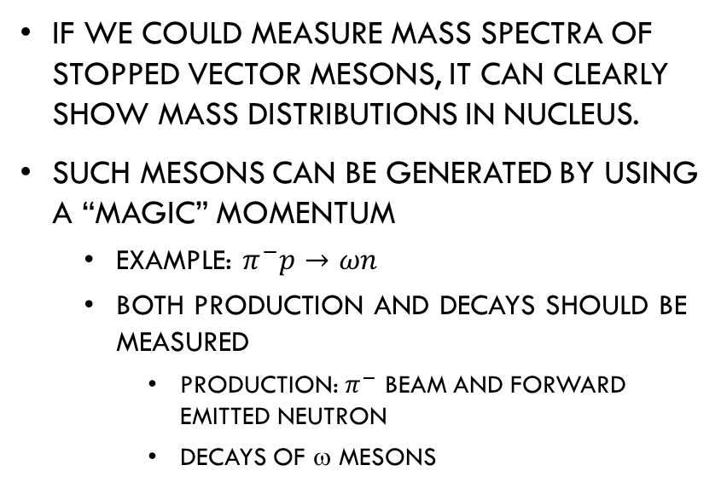
Stopped mesons
If we could measure mass spectra of stopped vector mesons, it can clearly show mass distributions in nucleus.
Such mesons can be generated by using a “magic” momentum
  Example: $π^{−}p→ωn$
  Both production and decays should be measured
    Production: $π^{−}$ beam and forward emitted neutron
    Decays of ω mesons

Slide 13
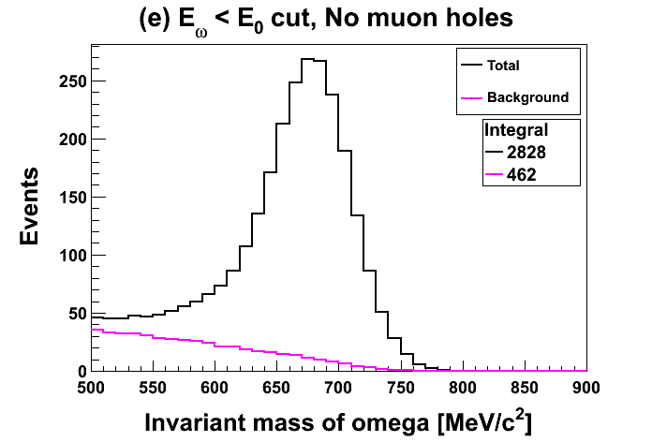
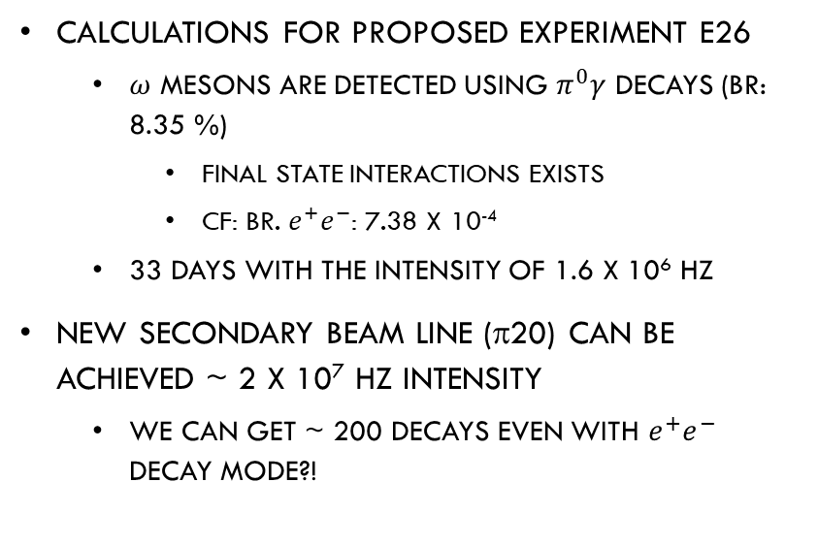
Some calculations for stopped meson
Stopped ω meson mass spectra
Calculations for Proposed experiment E26
  $ω$ mesons are detected using $π^{0}γ$ decays (Br: 8.35 %)
    Final state interactions exists
    Cf: BR. $e^{+}e^{−}$: 7.38 x 10⁻⁴
  33 days with the intensity of 1.6 x 10⁶ Hz
New secondary beam line (π20) can be achieved ~ 2 x 10⁷ Hz intensity
  We can get ~ 200 decays even with $e^{+}e^{−}$ decay mode?!

Slide 14
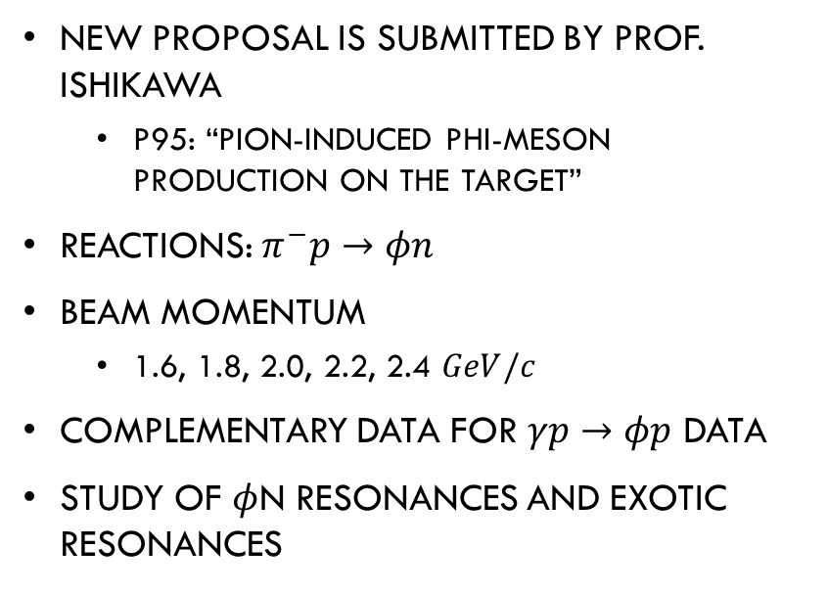

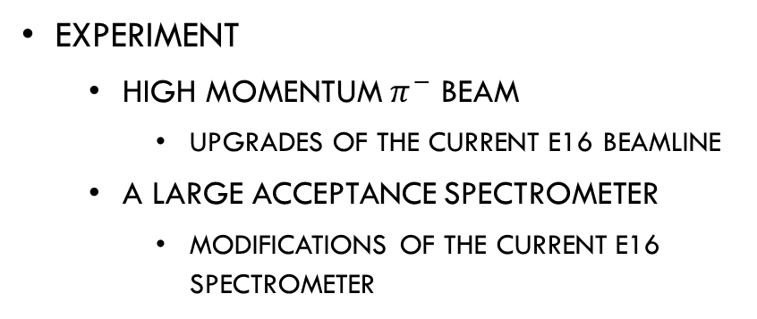
$φ$N interactions
New proposal is submitted by Prof. Ishikawa
  P95: “Pion-induced phi-meson production on the target”
Reactions: $π^{−}p→φn$
Beam Momentum
  1.6, 1.8, 2.0, 2.2, 2.4 $GeV/c$
Complementary data for $γp→φp$ data
Study of $φ$N resonances and exotic resonances
Experiment
  High momentum $π^{−}$ beam
    Upgrades of the current E16 beamline
  A large acceptance spectrometer
    Modifications of the current E16 spectrometer

Slide 15
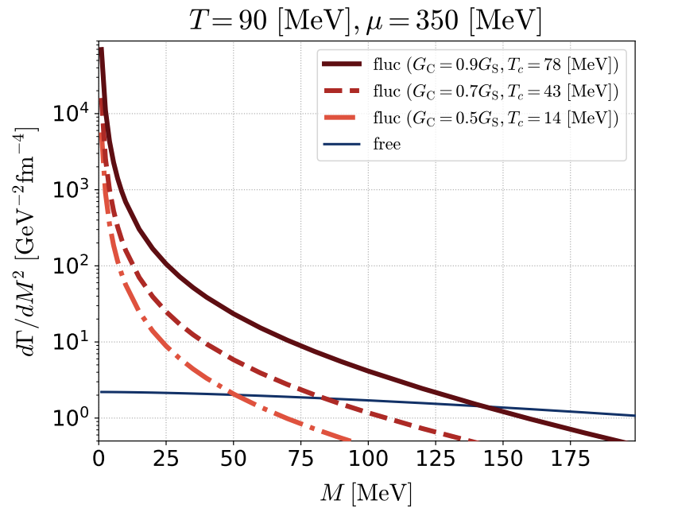
Interests in Low mass region
T. Nishimura, M. Kitazawa, T. Kunihiro, PTEP 2022, 093D002
S.Floerchinger, C.Gebhardt, K.Reygers, PLB 837 (2023) 137647 093D002
Di-electron pair emission in phase transition for super conductivity
Effects of electrical conductivity on the spectrum
Y. Morino is thinking about experimental realization

Slide 16
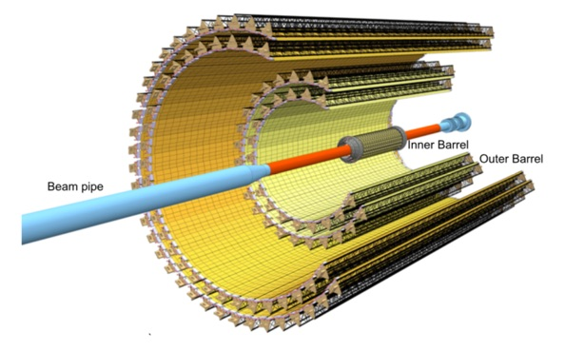
Detectors candidates for low mass measurements proposed by Y. Morino
Identification:
  Energy Loss @ TPC and Time Of Flight
Identification:
  Energy Loss @ Silicon
Large acceptance & Low momentum meas. would help measurements of polarization also.
sPHENIX TPC
ALICE ITC
Data Acquisition system for high-rate counting and large amount data is also essential.
Detector R&D should be performed.

Slide 17
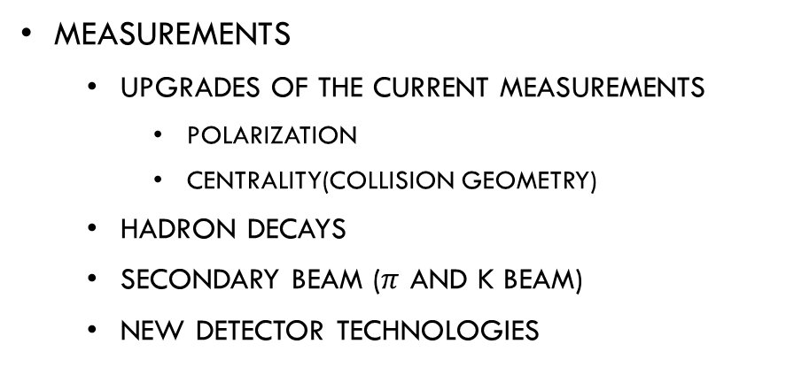
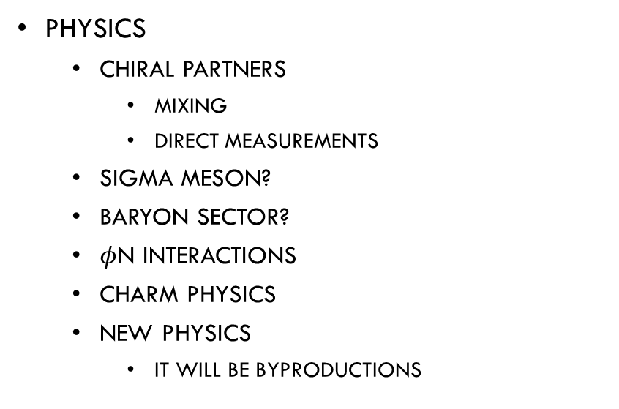
outlook
Physics
  Chiral partners
    Mixing
    Direct measurements
  Sigma meson?
  Baryon sector?
  $φ$N interactions
  Charm physics
  New physics
    It will be Byproductions
Measurements
  upgrades of the current measurements
    Polarization
    Centrality(collision geometry)
  Hadron decays
  Secondary beam ($π$ and K beam)
  New detector technologies
Although I haven’t yet prepared enough information, This workshop is a really good starting point.
THANK YOU, Wen-Chen!

Slide 18
Back up

Slide 19
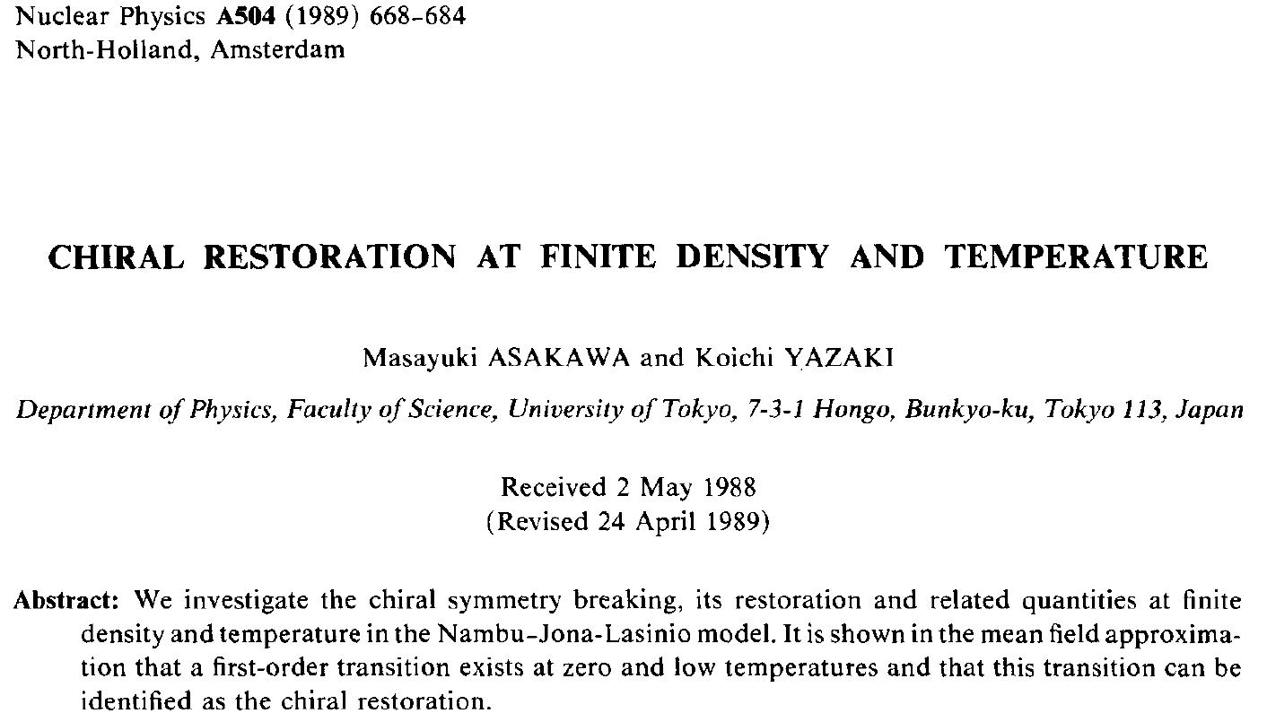
Importance of chiral symmetry
Case of zero temperature and finite chemical potential
Critical Point: Asakawa and Yazaki
It is shown in the mean field approximation that a first-order transition exists at zero and low temperatures and that this transition can be identified as the chiral restoration.
Case(I): T. Hatsuda and T. Kunihiro, PTP Sup. 91(1987) 284

Slide 20
further Predictions
M. Asakawa and C. M. Ko, PRC 48 (1993) R526
M. Asakawa and C. M. Ko, PLB 322 (1994) 33
ρ meson
φ meson
Resonance shape:

Slide 21
Comments on QCD sum rule
(Many Approximations)
Linear density approx.
M. Asakawa and C. M. Ko, NP A572 (1994) 732
Calculations for φ meson
Expansions up to 6th order
Mean field approx.
Comments in this paper

