Slide 1
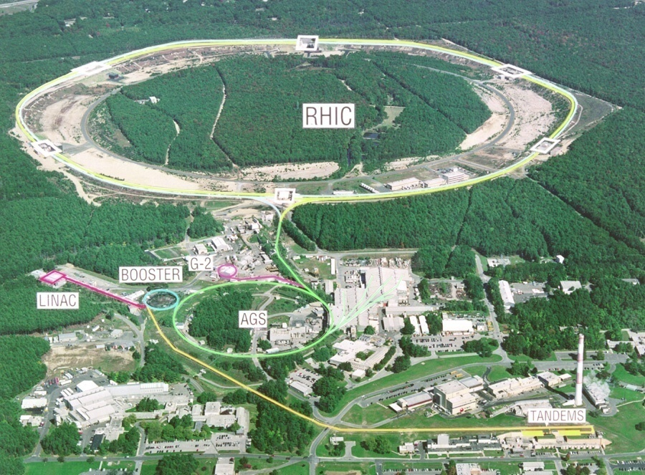

Quark Gluon Plasma
Y. Akiba

Slide 2
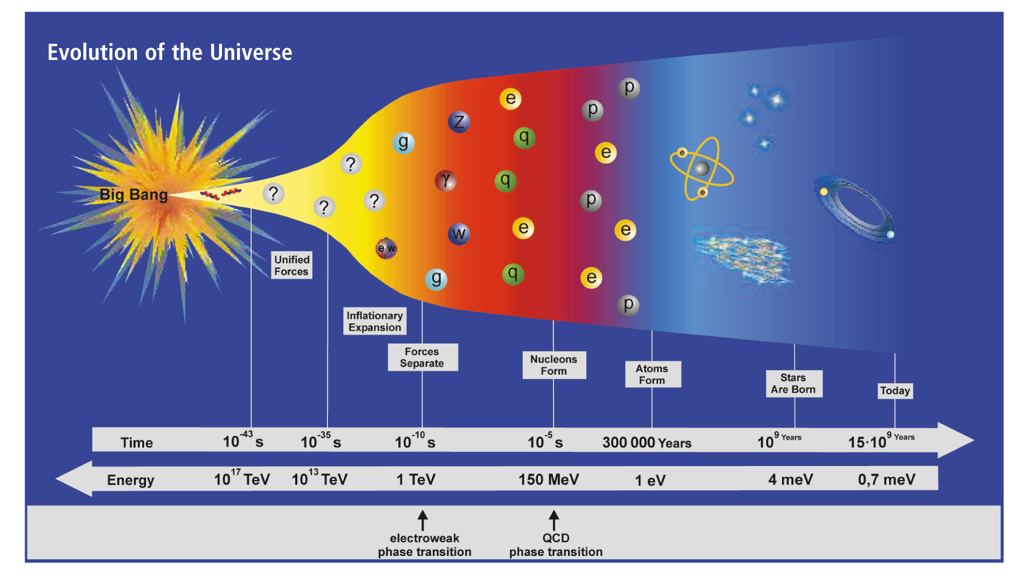

Evolution of Universe
Soup of quarks and gluons
Formatin of nucleons
Formation of stars and galaxies
Formation of Atoms
10$μsec$ after Big Bang
T~ 2 trillion K
It is believed that the universe was created 13.8 billion years ago.The early universe was filled with a superheated soup of quarks and gluons (quark-gluon plasma).
One hundred thousandth of a second after the creation of the universe, this soup cooled and froze to form protons and neutrons.
Recently, it has become possible to produce this quark-gluon plasma in the laboratory.

Slide 3
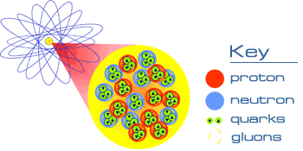
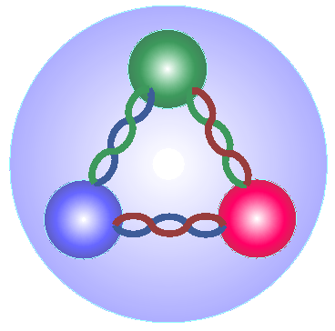
Structure of matter
Atom
Matter is made of Atoms
An atom is made of an atomic nucleus and electrons orbiting it.
An atomic nucleus is made of nucleons (protons and neutrons)
A nucleon is made of quarks and gluons.
Atomic nucleus
proton
neutron
クォーク
グルーオン
proton
gluon
quark
A proton is made of
two u quarks,
one d quark, and
gluons that bind them.

Slide 4
Elementary particles
Particles of matter
Particles of force
quark
γ
u
Protons and neutrons are composed of u and d quarks
Electromagnetic interactions
up
Photon
d
down
g
lepton
“ghost”particle
w only weak interactions
Strong interactions
ν_{e}
gluon
Electron neutrino
W
Z
Weak interactions
e
Orbiting
the W boson and the Z boson
electron
Ordinary matter is made of u, d quarks and electrons
All everyday phenomena are determined by the EM interactions

Slide 5


Elementary particles(standard model)
Particles of matter
(fermions)
Particles of force
(gauge particles)
quark
u
c
t
γ
H
up
charm
top
photon
Higgs particle
Discovered at CERN LHC in 2012
2013 Noble prize
d
s
b
g
down
strange
bottom
lepton
gluon
ν_{e}
ν_{μ}
ν_{τ}
e neutrino
$μ$ neutrino
$τ$ neutrino
W
Z
e
μ
τ
the W and the Z
electron
mu
tau

Slide 6
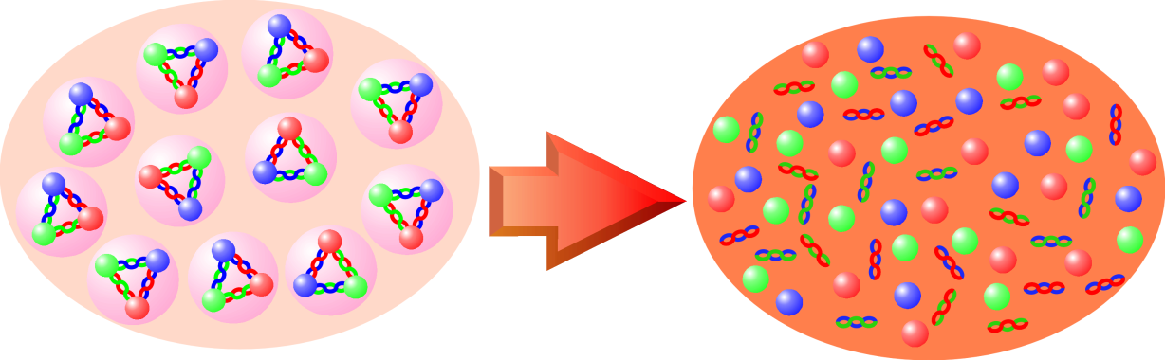
Re-create the initial states of the Universe
The early universe, up to about 1/100,000 of a second immediately after the Big Bang, was a superheated soup of quarks and gluons, quark-gluon plasma.
By colliding heavy nuclei with each other at ultra-high energies, we can create an ultra-high temperature state of over 2 trillion degrees Celsius, the same temperature as in the early universe.
Ordinary matter
Hot soup of quark and gluons
Heating and compression by collision
In the normal state of matter, quarks and gluons are trapped inside "ice grains" called protons and neutrons 。
At temperatures above 2 trillion degrees Celsius, "ice grains" called protons and neutrons melt into a soup composed of quarks and gluons
Just as ice grains melt and become water, protons/neutrons melt and become quark soup
Quark Gluon Plasma(QGP)

Slide 7
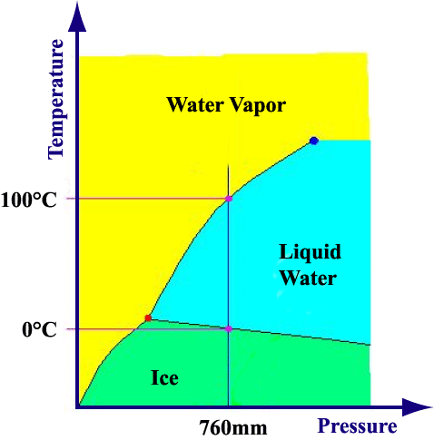
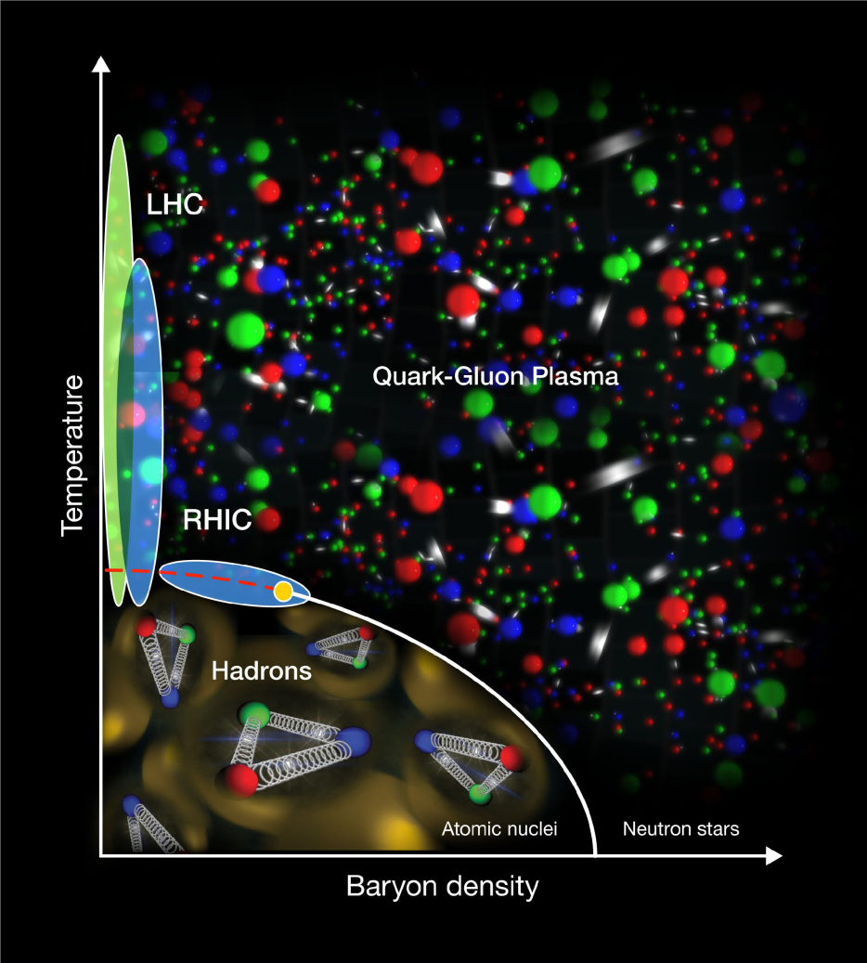
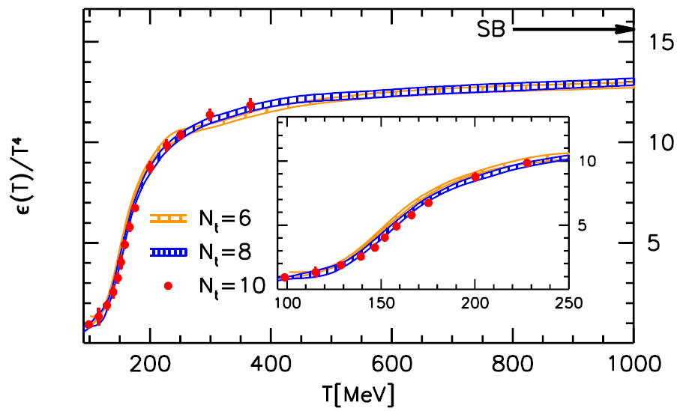

QCD phase diagram
Phase diagram of water
Τ
JHEP11(2010) 77
Stefan Boltzmann formula
$$ε_{SB}=\frac{π^{2}}{30}\left(N_{B}+\frac{7}{8}N_{F}\right)T^{4}$$
LHC
QGP phase
Quark Gluon Plasma
Temperature
RHIC
Hadron phase
According to lattice QCD,
T_{c} ~ 160 MeV; ε ~ 1 GeV/fm³
Baryon density
μ_{Β}
The QGP phase transition is the only experimentally reproducible phase transition in the early universe.

Slide 8

RHIC
Relativisitc ＝ near the speed of light
Heavy Ion
Collider
Device that accelerates heavy ions to nearly the speed of light and collides them
RHIC
60 miles
New York
JFK Airport

Slide 9
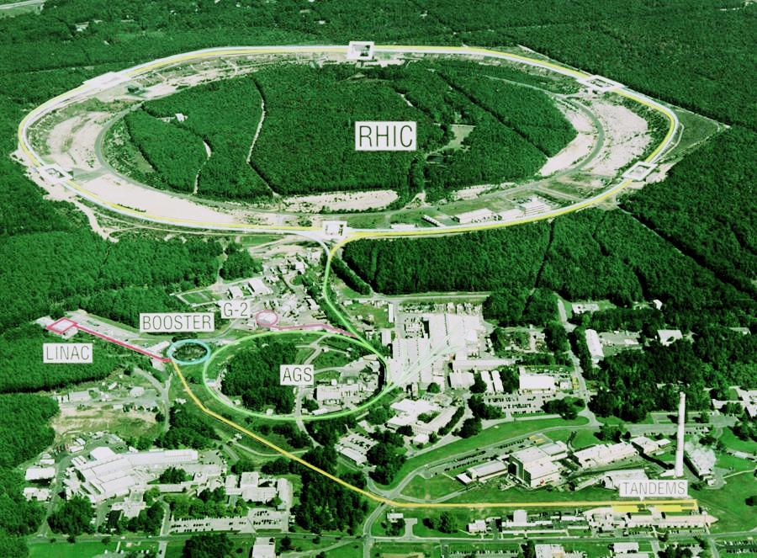
RHIC加速器
PHENIX->sPHENIX

Slide 10
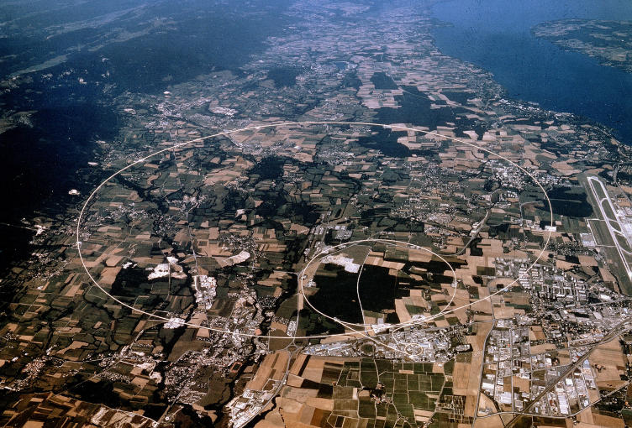
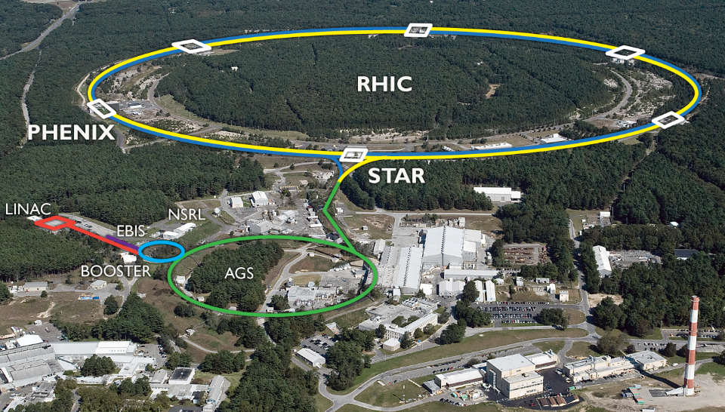
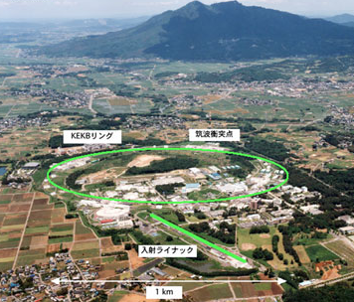

Colliders in the world
Europe：LHC
US: RHIC
27km p+p collider
3.8km heavy ion collider
LHC is the largest collider in the world
2012 Discover Higgs boson
→ 2013 Nobel prize
RHIC discovered quark gluon plasma
Japan KEKB（Tsukuba）
KEKB studies CPV of B mesons
Confirm CKM model
→ 2008 Noble prize
3km $e^{+}e^{−}$ collider

Slide 11
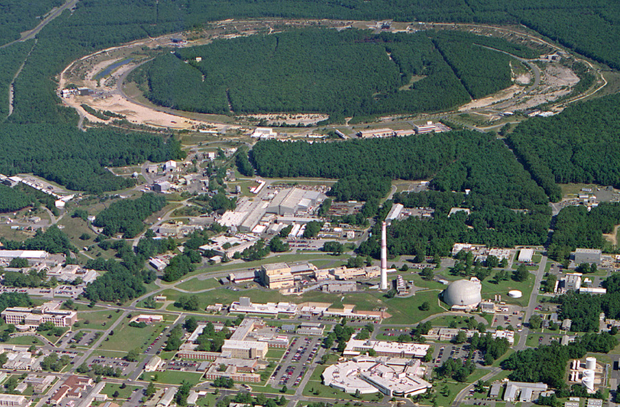
Relativistic Heavy Ion Collider (RHIC)
加速
RHIC
衝突
入射
PHENIX
STAR
LINAC
Booster
EBIS
AGS
Tandems

Slide 12

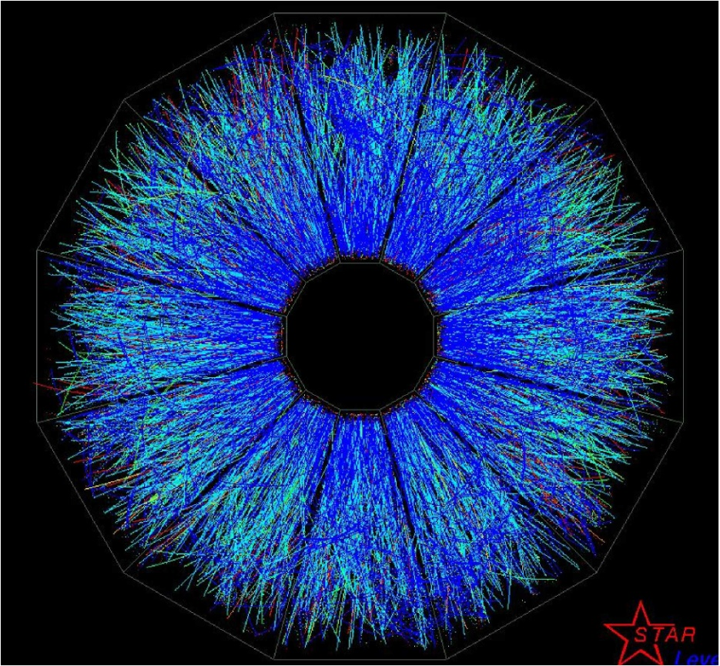
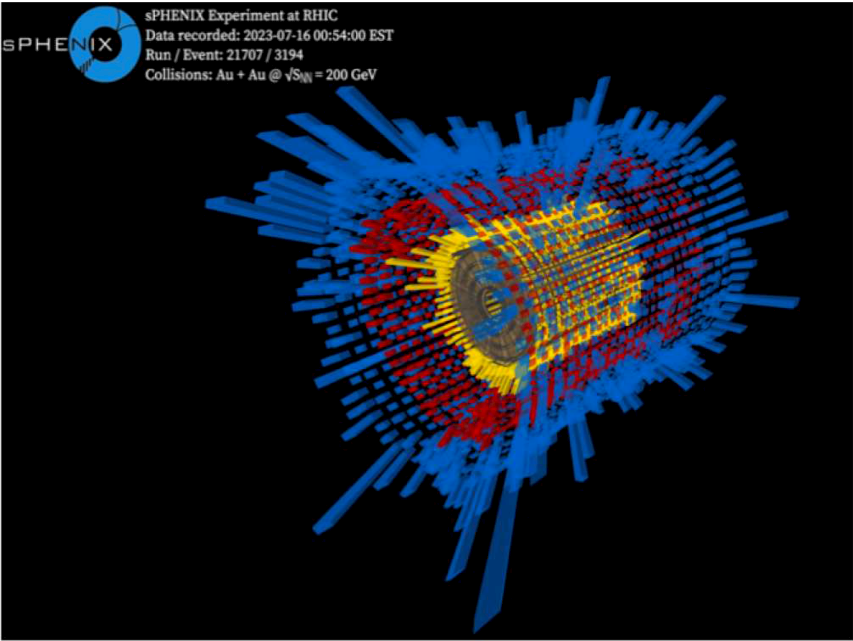
Au+Au collision at RHIC
RHIC's gold nucleus collisions produce several thousand particles in one collision event. These particles are measured on a large instrument and then analyzed to see what is happening in the early stages of the reaction

Slide 13
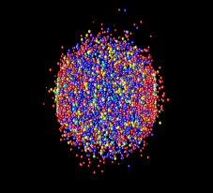
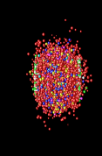
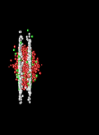


Time evolution of nuclear collision
γ
γ
π
Time
π
φ
p
K
π
π
Final state particles
K
time
Hadron gas
expansion
Quark gluon plasma
Initial hard scattering
Study the initial state from the observation of particles in the final state and their correlations.
Space
Au
Au

Slide 14
What did we find out at RHIC
High-energy nuclear collisions at RHIC create high-energy density matter (=QGP)
QGP is a "perfect fluid" with almost zero viscosity
Initial temperature of the QGP at RHIC is approximately 4 trillion K

Slide 15
What did we find out at RHIC
High-energy nuclear collisions at RHIC create high-energy density matter (=QGP)
QGP is a "perfect fluid" with almost zero viscosity
Initial temperature of the QGP at RHIC is approximately 4 trillion K

Slide 16
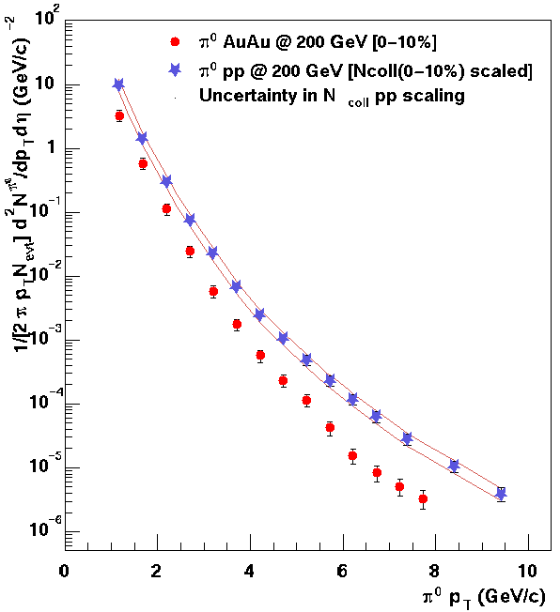

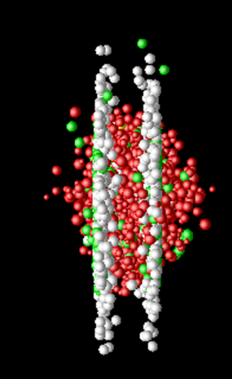
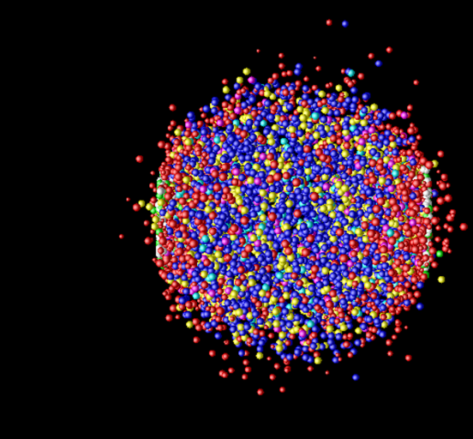





Formation of high density matter
Scattered parton doesn’t lose energy
$${10}^{8}$$
p＋p
$${10}^{6}$$
p+p collsions
The scattered parton must pass through high-density matter and thus suffer energy losses.
Yield of particle
Au+Au
$${10}^{4}$$
$${10}^{2}$$
Au+Au collision
(corrected for a
N-N collision)
Energy loss
１
time
The yield of energetic particles produced in Au-Au collisions is significantly lower. This is an evidence that a high energy density quark-gluon plasma is produced in Au + Au collisions.
$p_{T}$ (energy) of particle
low
high

Slide 17
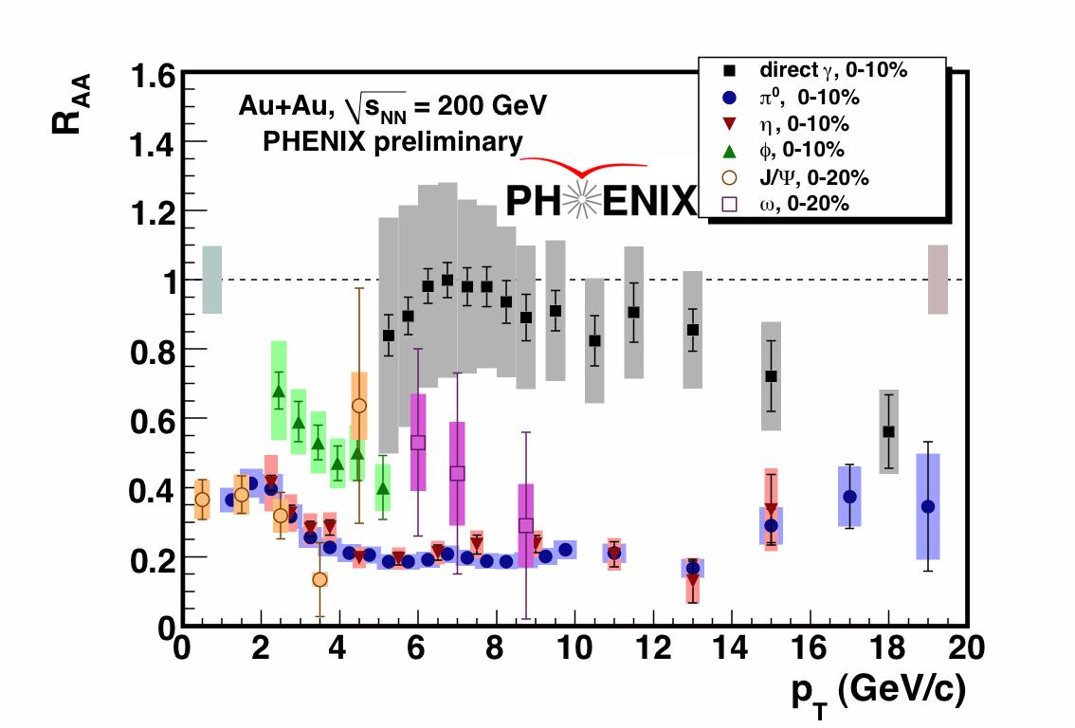
R_{AA} (suppression by QGP) of various particles
Suppression ratio compared with p+p
π⁰ yield is strongly suppressed as R_{AA}~1/5
R_{AA} of π⁰ and η are similar◊ energy loss occurs at the parton level
direct γ is not suppressed → suppresion is due to the medium effect (QGP)

Slide 18
What did we find out at RHIC
High-energy nuclear collisions at RHIC create high-energy density matter (=QGP)
QGP is a "perfect fluid" with almost zero viscosity
Initial temperature of the QGP at RHIC is approximately 4 trillion K

Slide 19
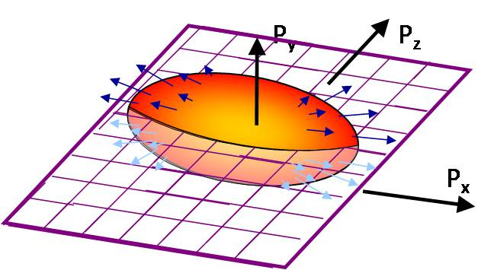
Viscocity of the matter is almost zero
z
x
y
The QGP created by the collision is elliptical in shape.
When it expands due to internal pressure, a strong collective flow (flow) occurs in the lateral direction with a large pressure gradient.
If there is any viscosity, the flow is disturbed and becomes very weak.
In the experiment, a very strong flow is observed, indicating that the viscosity of the QGP is almost zero.

Slide 20
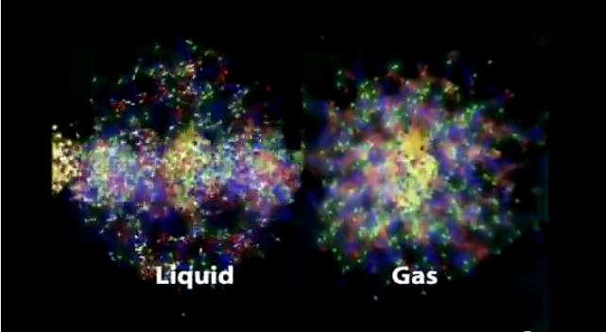
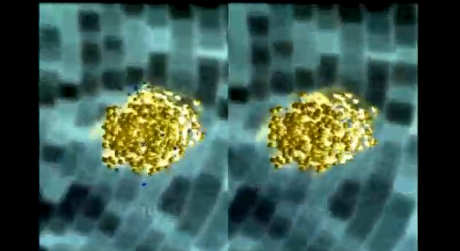
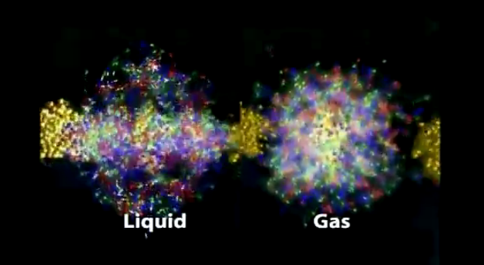
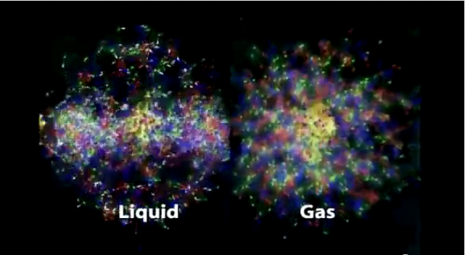
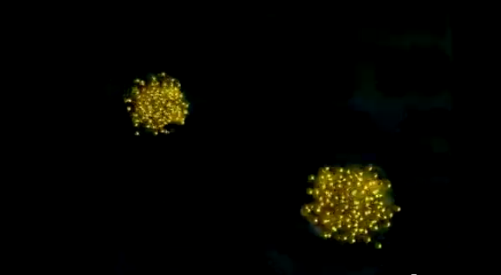
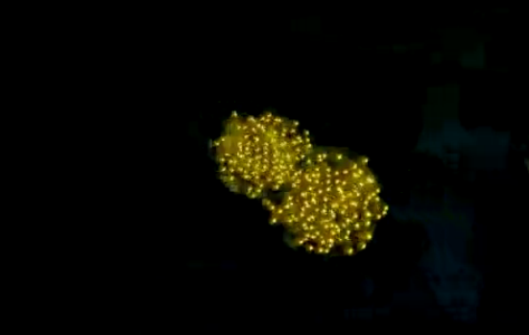
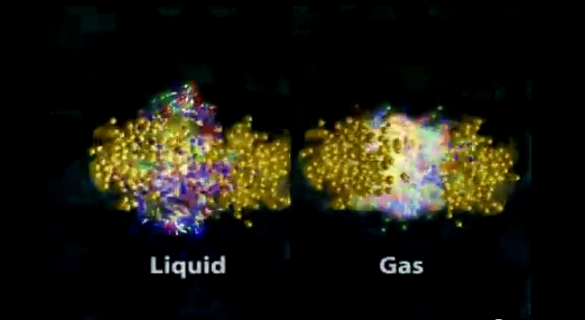
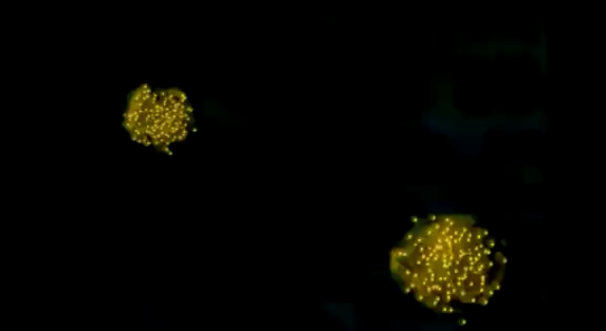
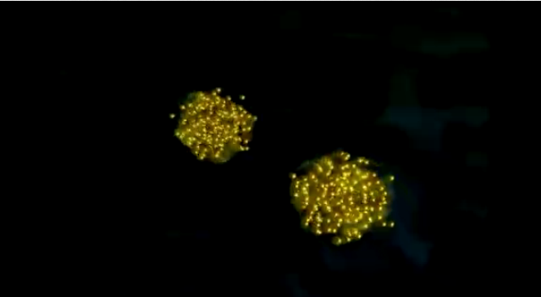
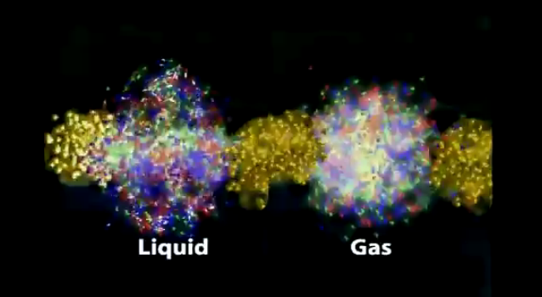
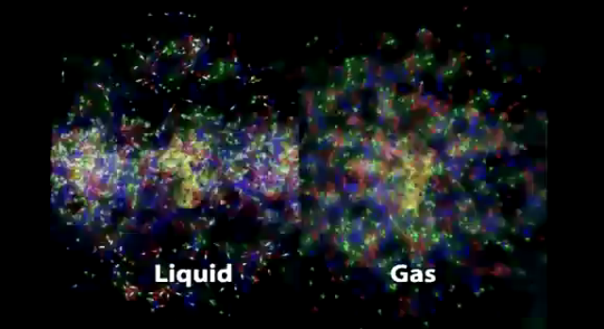
ＱＧＰ is a “perfect fluid”
Elliptical flow does not occur with gases with large viscosity.
Strong elliptical flow occurs because QGP is a fluid with almost zero viscosity

Slide 21
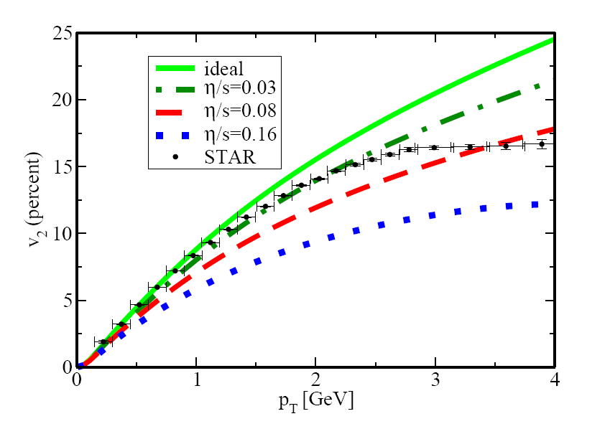
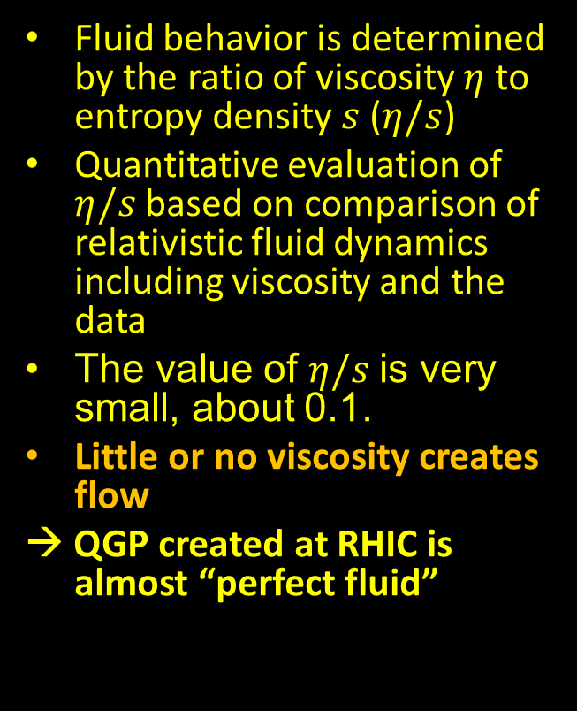
Comparison with theory (relativistic hydrodynamics)
Fluid behavior is determined by the ratio of viscosity $η$ to entropy density $s$ ($η/s$)
Quantitative evaluation of $η/s$based on comparison of relativistic fluid dynamics including viscosity and the data
The value of $η/s$is very small, about 0.1.
Little or no viscosity creates flow
→ QGP created at RHIC is almost “perfect fluid”
P. Romatschke and U. Romatschke、PRL99,172301(2007)

Slide 22
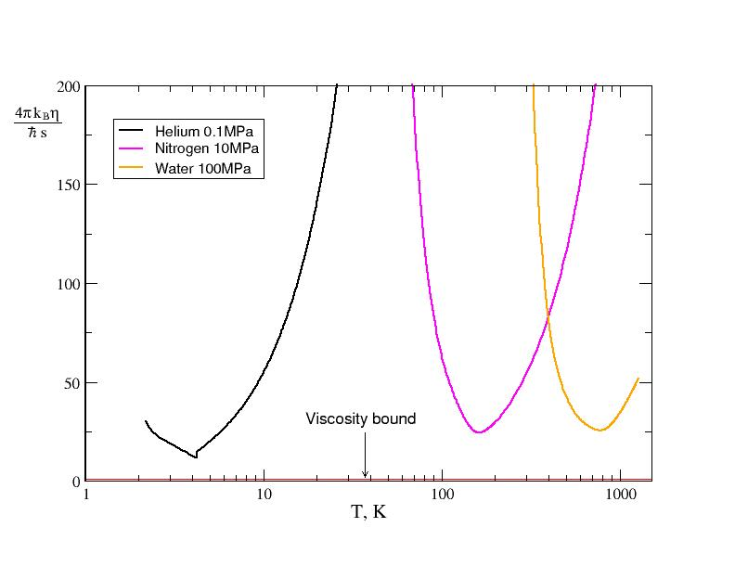
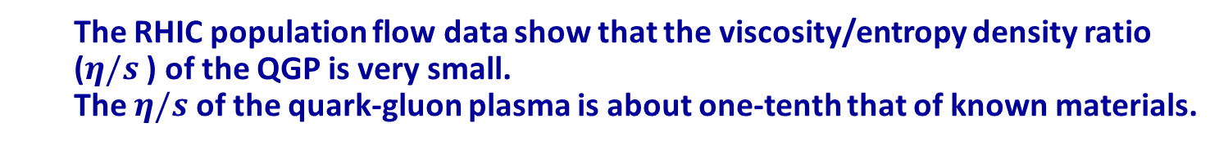
QGP is almost "fully fluid
  The RHIC population flow data show that the viscosity/entropy density ratio ($η/s$ ) of the QGP is very small.
  The $η/s$ of the quark-gluon plasma is about one-tenth that of known materials.
(4πη/s)
ヘリウム
窒素
水
ＱＧＰのη/s
Temperature of the QGP formed at RHIC is hihger than 2 trilion K
Temperature(K)

Slide 23
What did we find out at RHIC
High-energy nuclear collisions at RHIC create high-energy density matter (=QGP)
QGP is a "perfect fluid" with almost zero viscosity
Initial temperature of the QGP at RHIC is approximately 4 trillion K

Slide 24
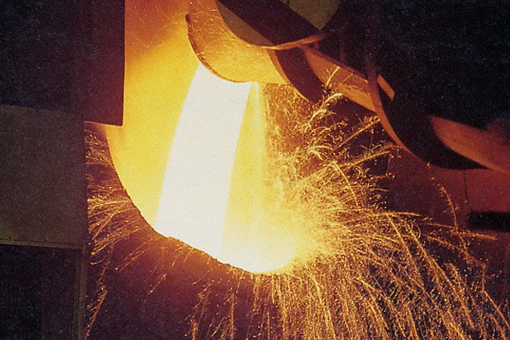
How to measure high temperature
What is the temperature of a QGP made by RHIC?
High-temperature matter emits light.
The color of that light (energy distribution) can be used to determine the temperature.

Slide 25
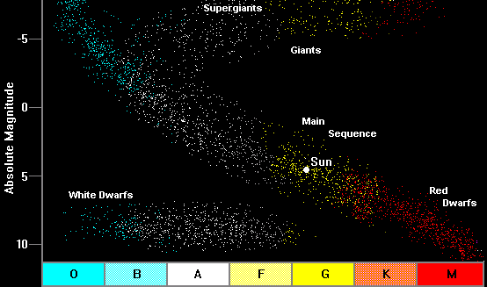
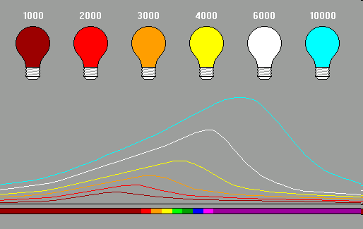
Color and Surface Temperature of Stars

Slide 26
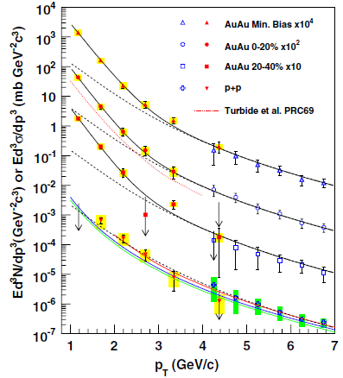
Initial temperature is ~4 trillion K
PHENIX PRL104, 132391 (2010)
A large number of high-energy photons were found to be produced from Au + Au collisions
The photon energy distribution and intensity are consistent with thermal radiation from a QGP with an initial temperature of about 4 trillion degrees

Slide 27
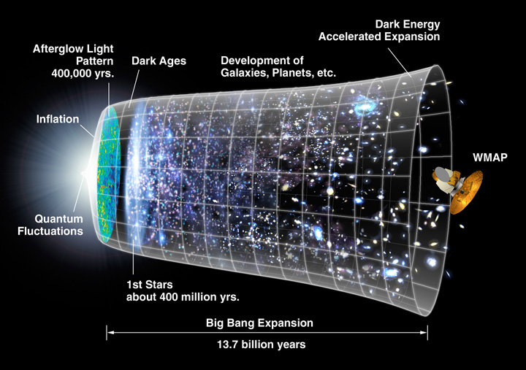
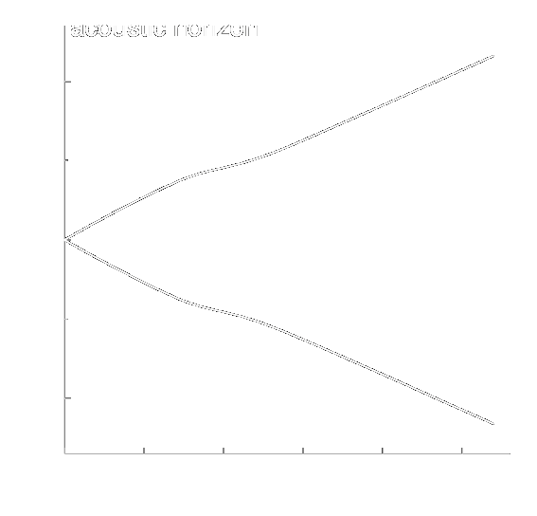

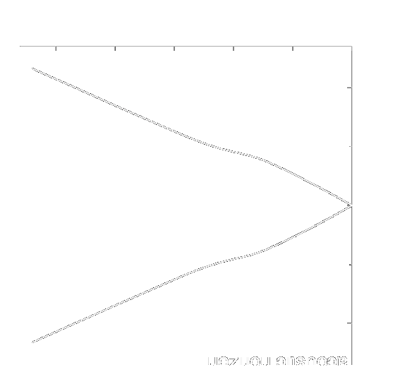

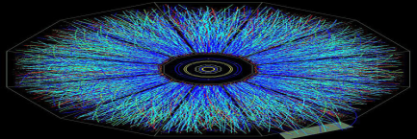

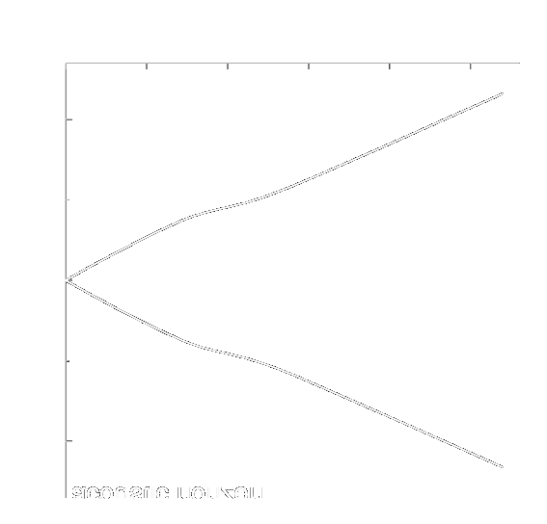
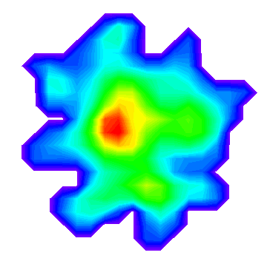
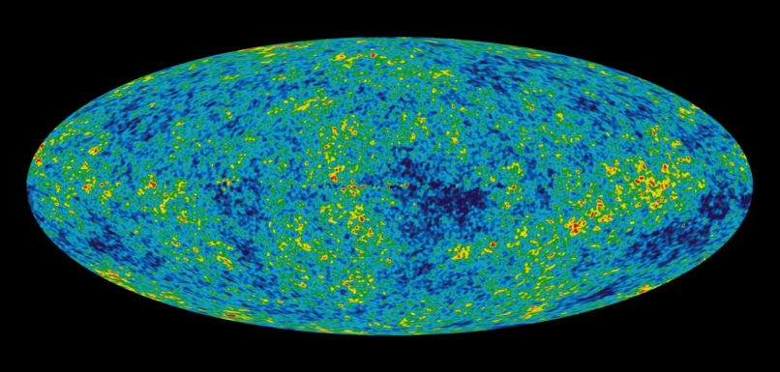


The Big Bang vs the Little Bangs
The Universe
kinetic
freeze-out
distributions and correlations of produced particles
HIC
lumpy initial energy density
hadronization
QGP phase
quark and gluon degrees of freedom
Credit: NASA

Slide 28
Summary
Τ
Quark-Gluon Plasma Reproduced in RHIC Nuclear Collisions
  Jet Quenching
  Strong Elliptical Flow
  Thermal Photons
QGP production confirmed in nuclear collisions at the LHC
QGP properties are being studied at RHIC and LHC
LHC
Quark Gluon Plasma
温度
RHIC
バリオン密度
μ_{Β}

Slide 29


For more inforation (if you can read Japanese)

