Slide 1
Week 6 Review
Alessio I., Gursimran K.

Slide 2
General Notes on ZDC simulation
We spoke to the meson structure group, they don't plan to have simulations ready until September, end of Fall by latest
Still no message back from software team about event visualization . . .

Slide 3
ZDC Acceptance - Lambda with no angular variance
Simulated unpolarized lambda events using particle gun
All spawned at origin, shot directly at ZDC (25mrad) with no angular variation
20 GeV to 270 GeV momentum range
Determine if an event could be reconstructed by checking if all particles land in Ecal
~210k total events down to ~84k events when all particles make it to the ZDC
These plots are the same as the ones I have presented several times, they serve as the baseline to compare to the data with angular variation (after this)

Slide 4
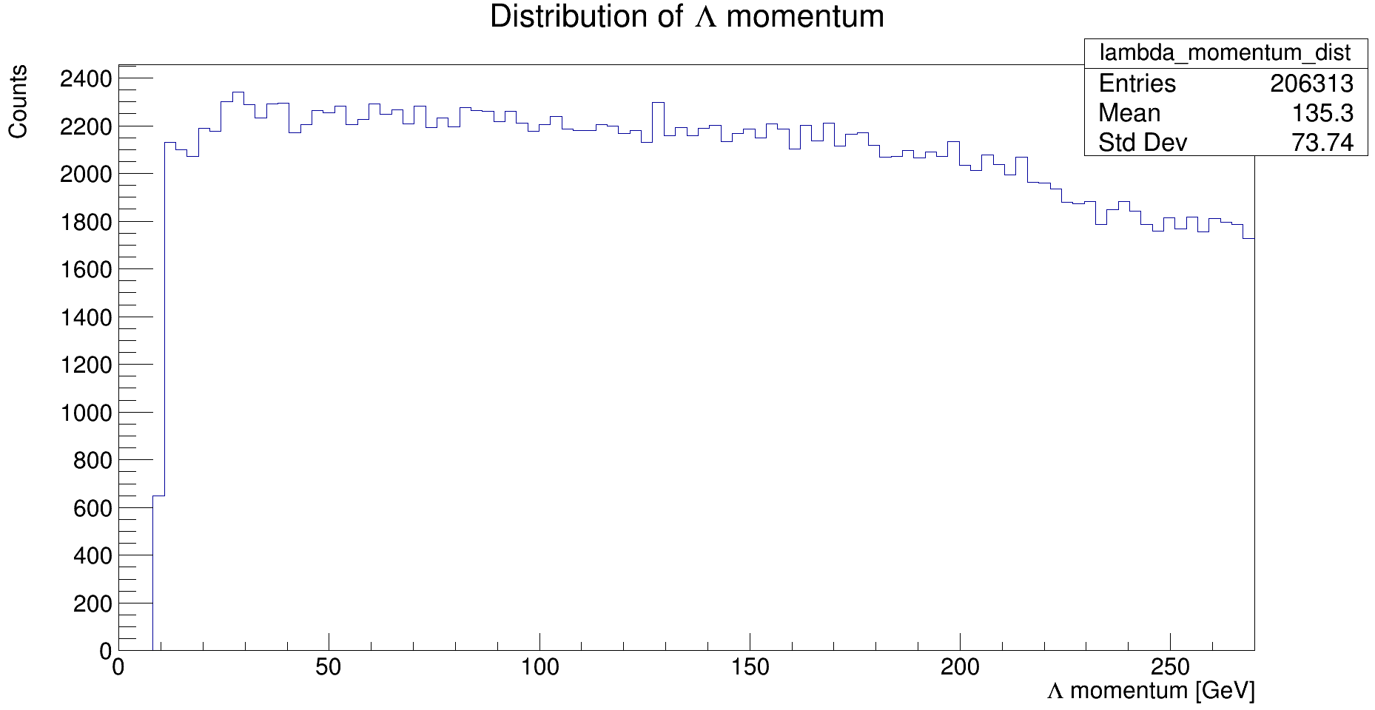
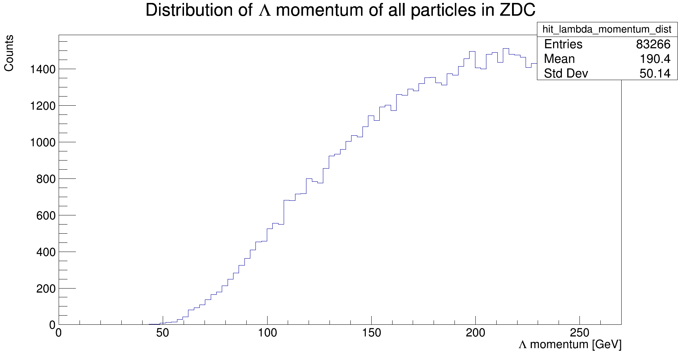
Momentum Distribution

Slide 5
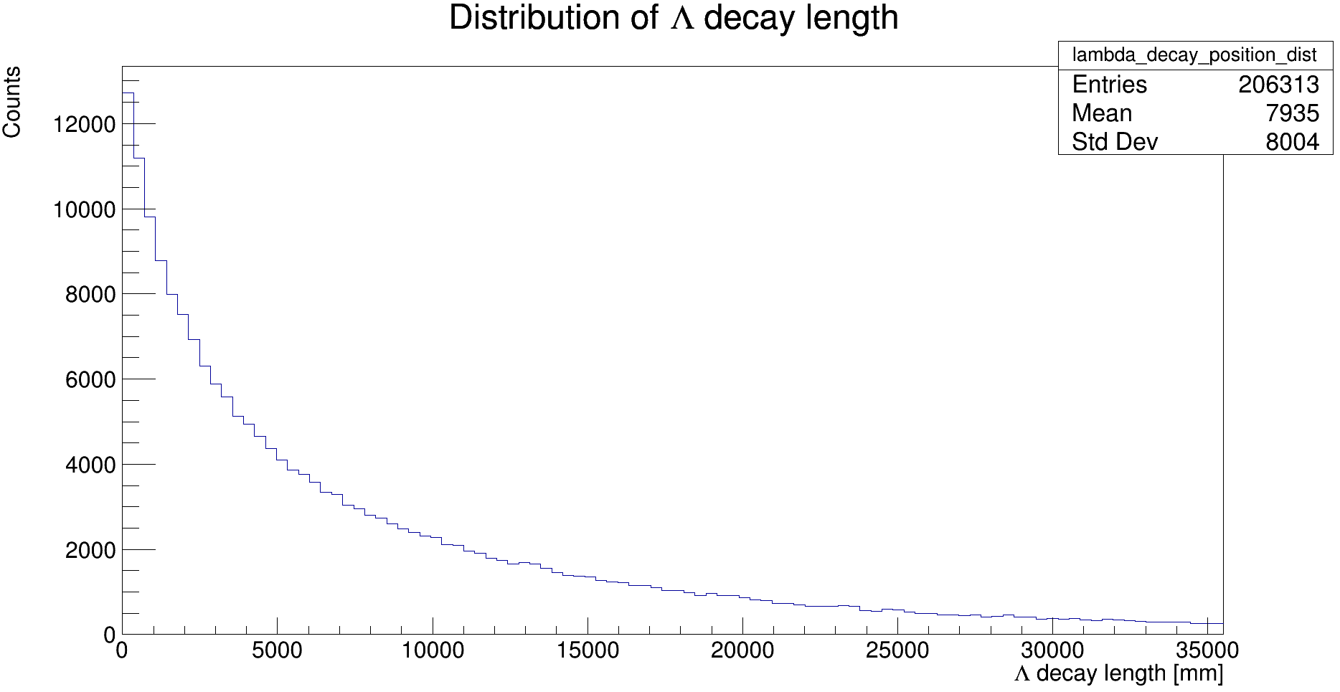
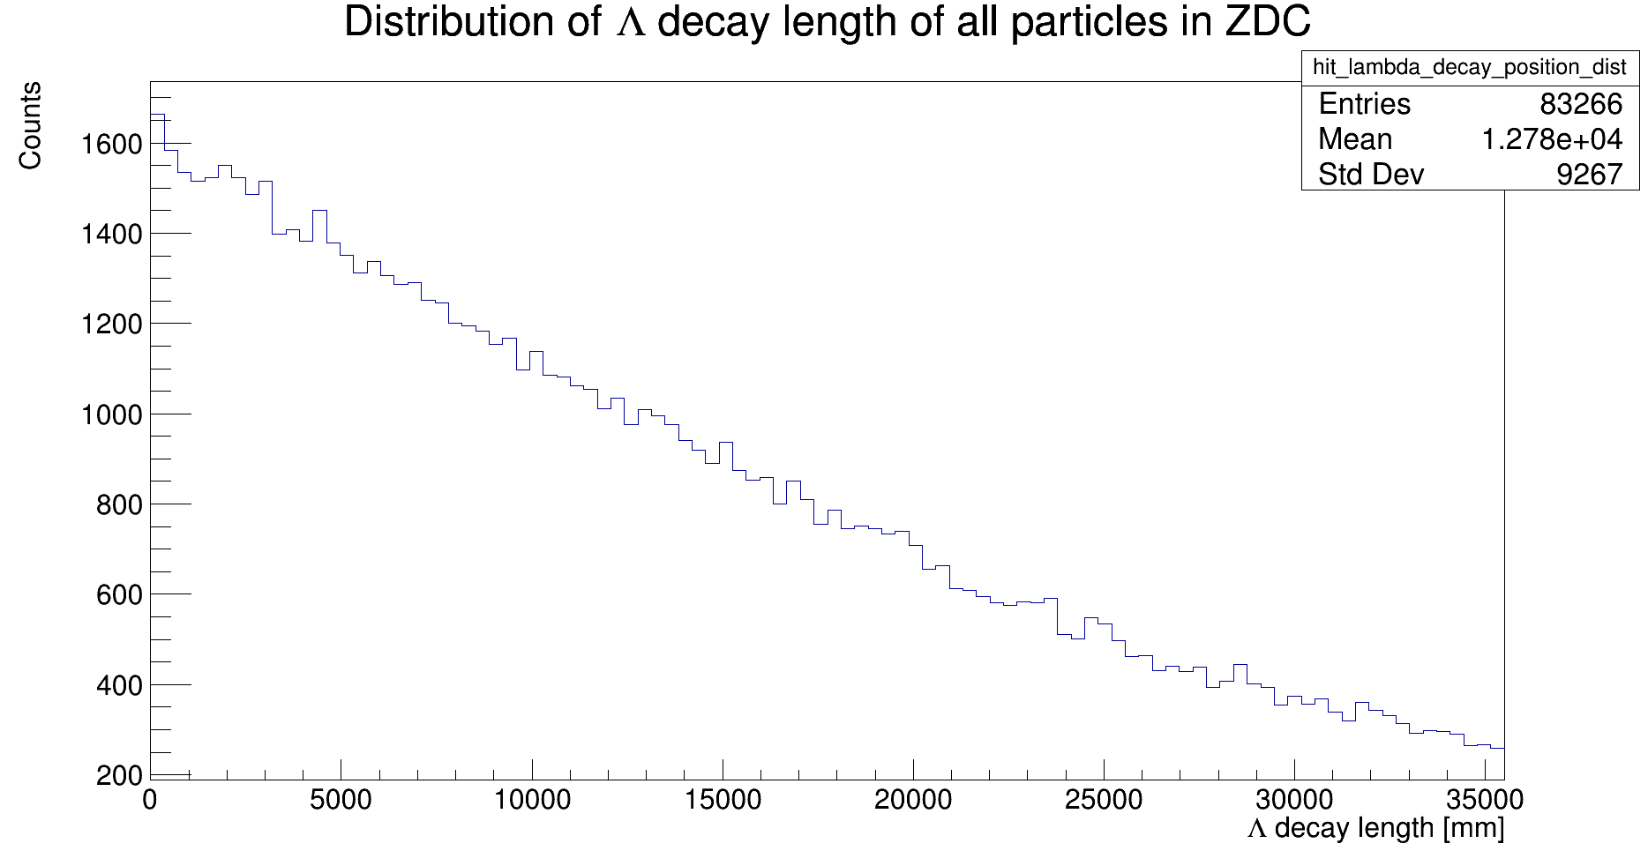
Decay Position Distribution

Slide 6
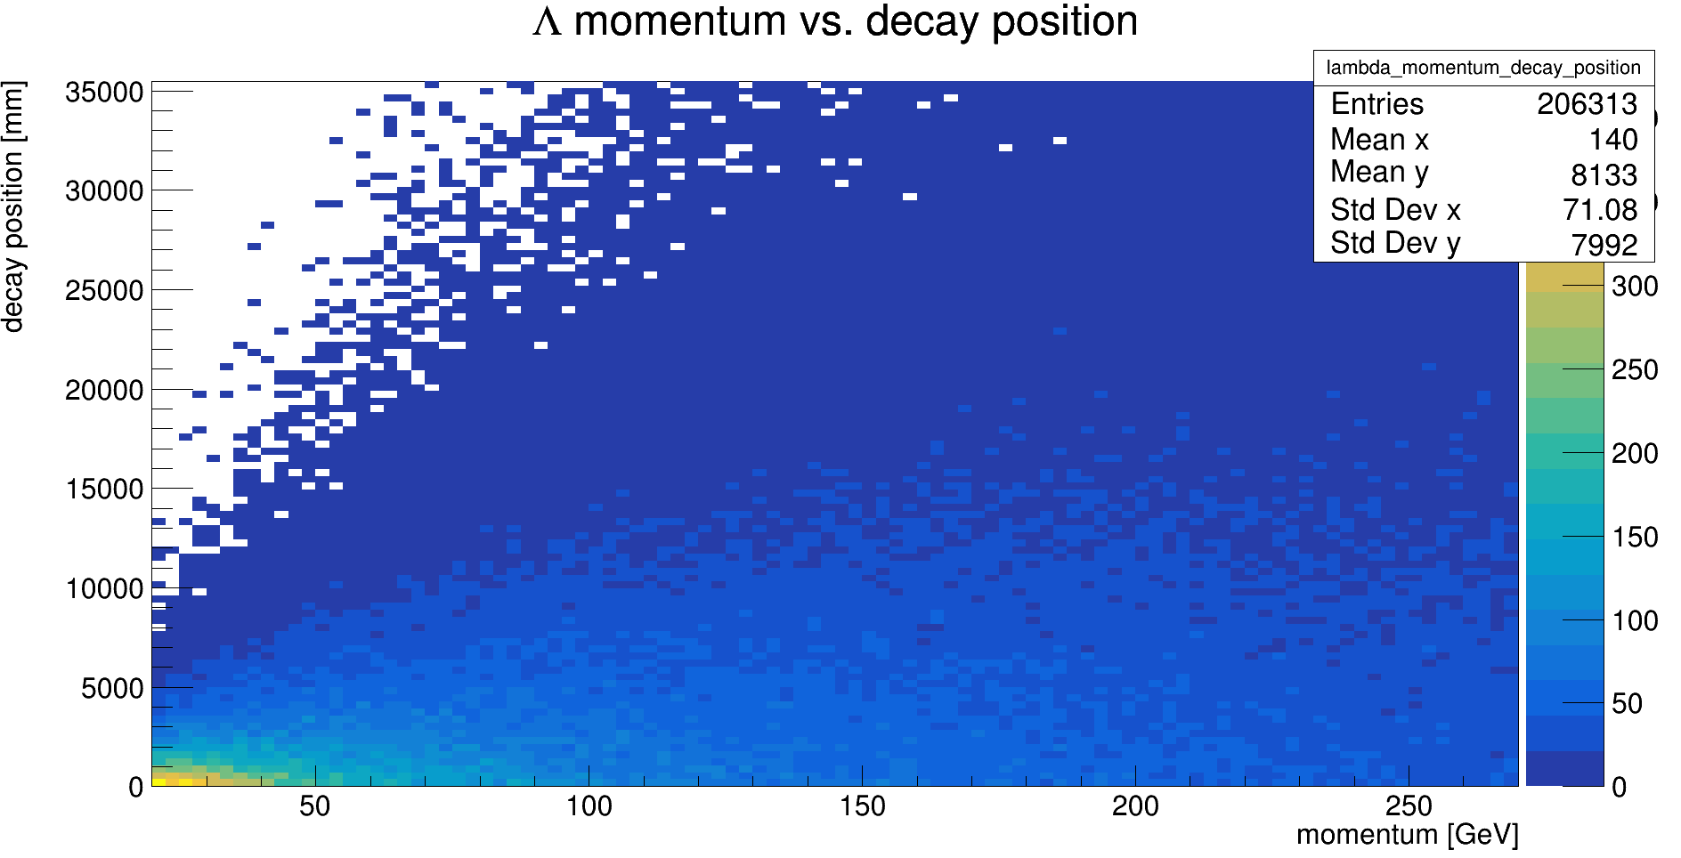
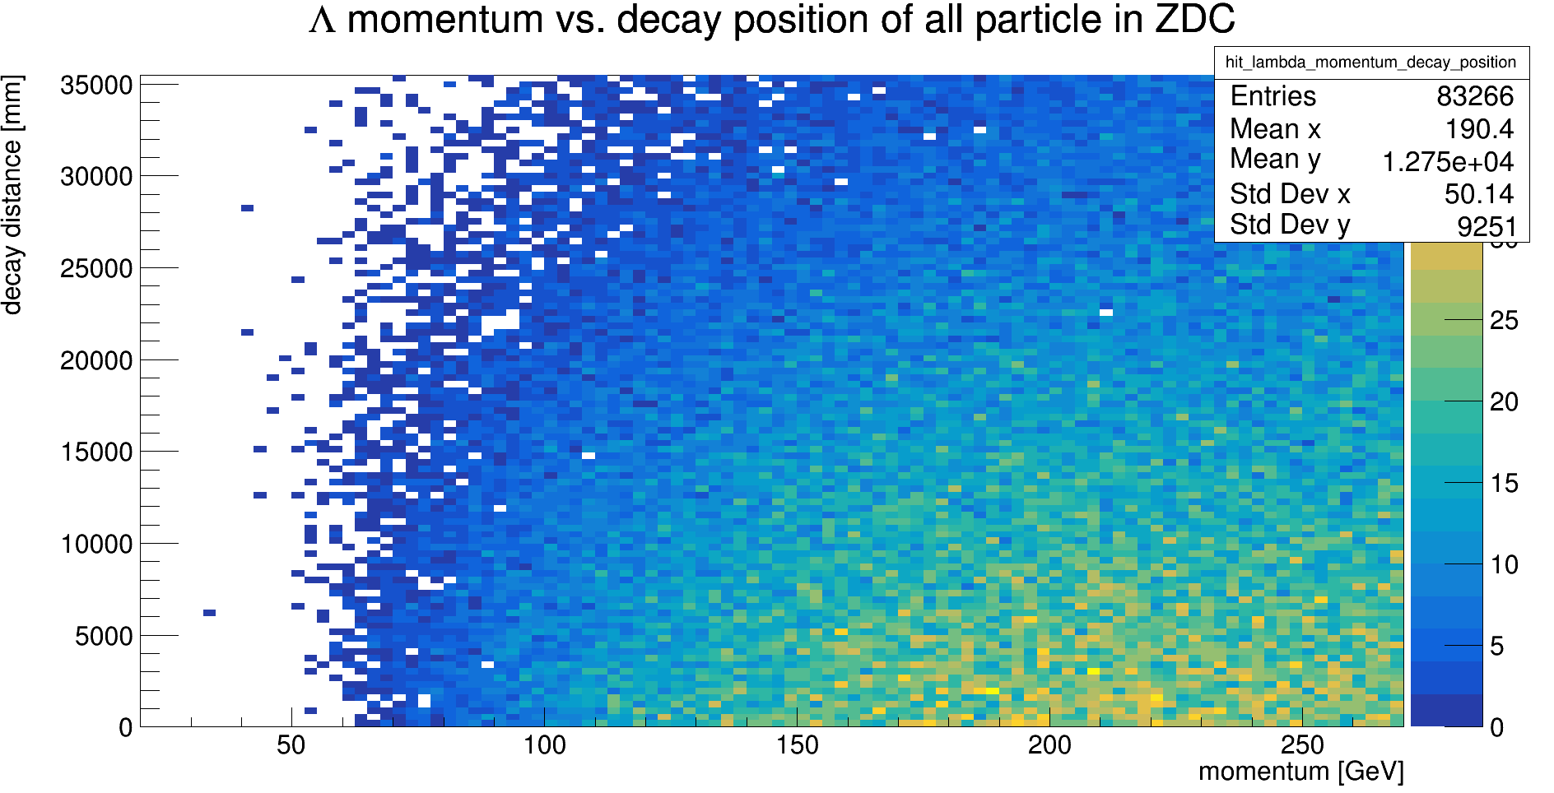
Momentum vs. Decay position

Slide 7
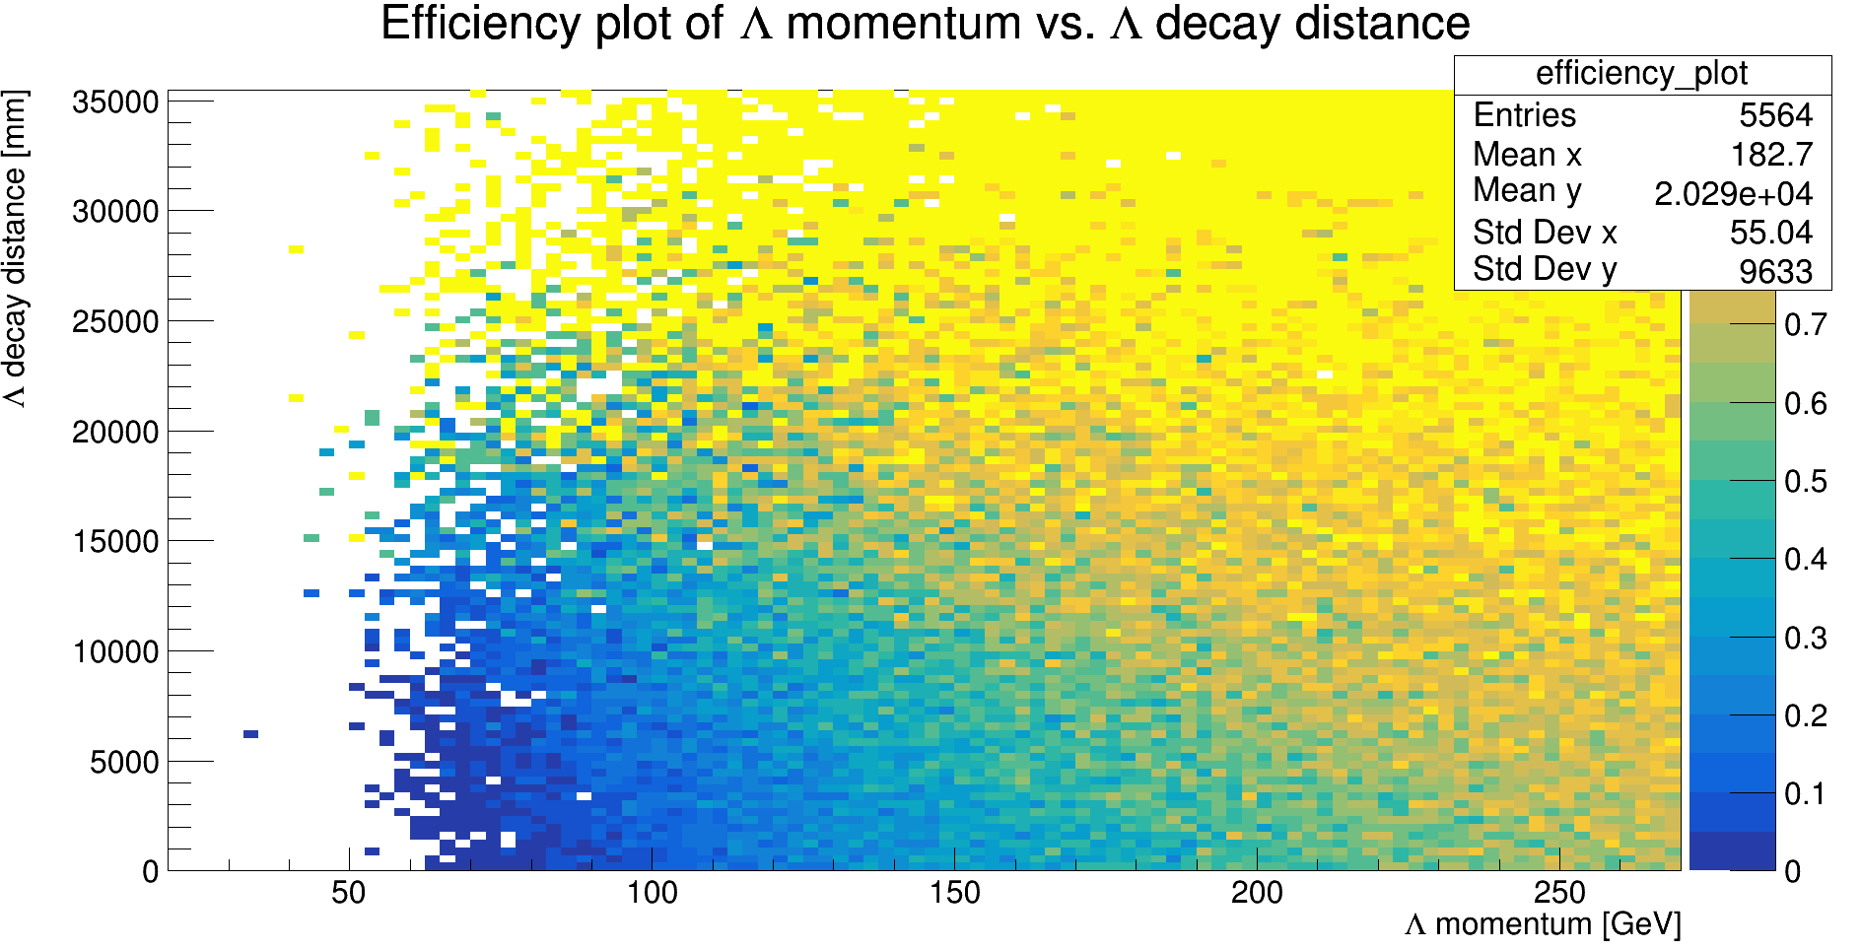
Efficiency Plot
Made by dividing the previous two plots
True efficiency will have to be determined by clustering

Slide 8
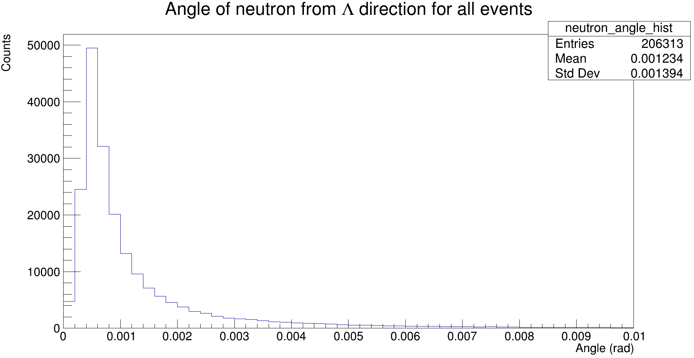
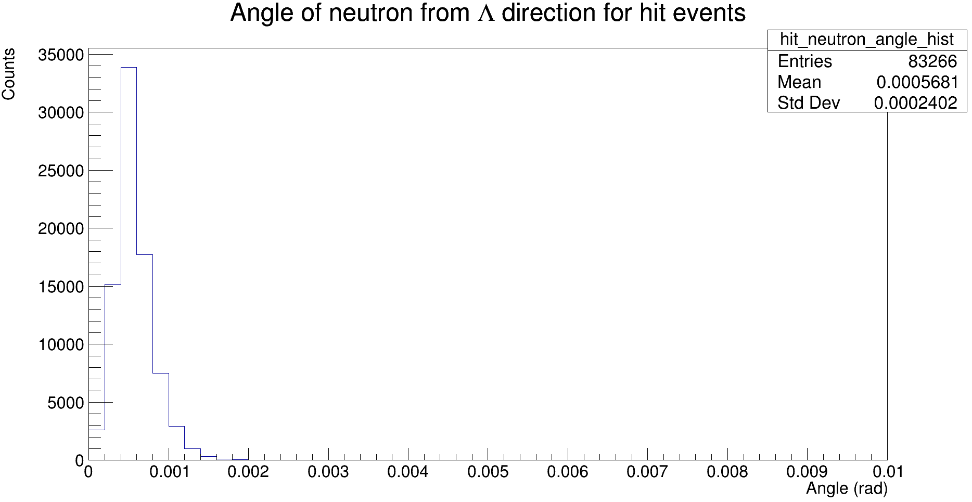
Neutron Angle

Slide 9
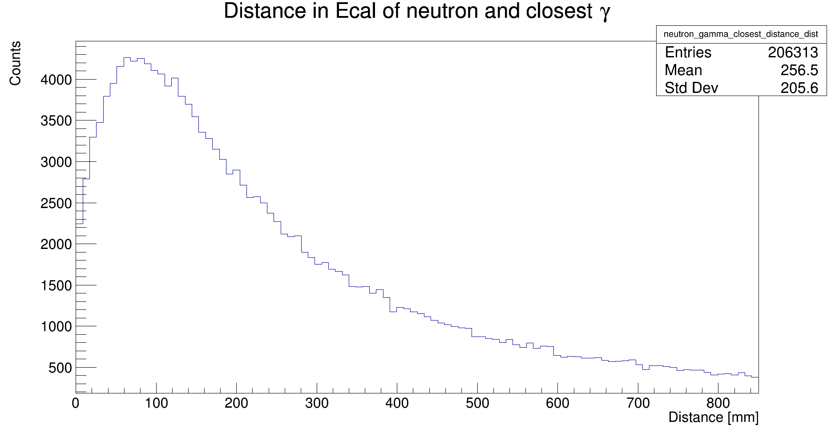
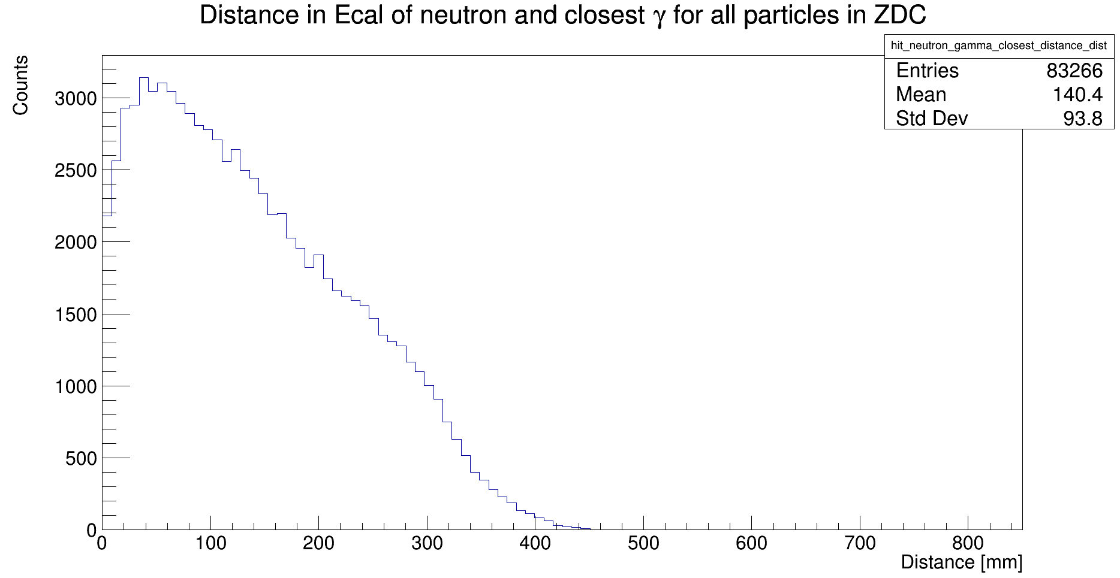
Neutron to closest gamma

Slide 10
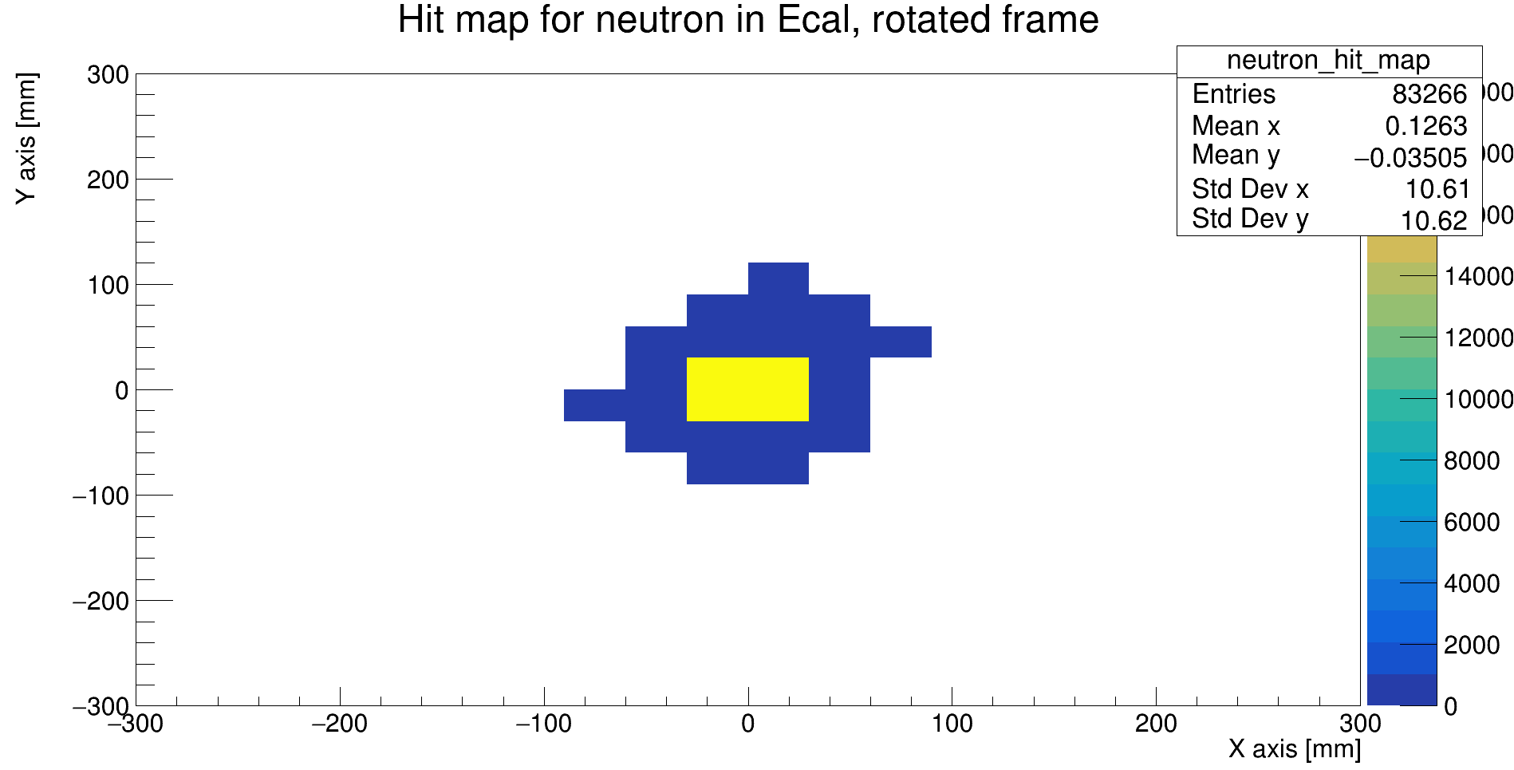
Neutron hit map

Slide 11
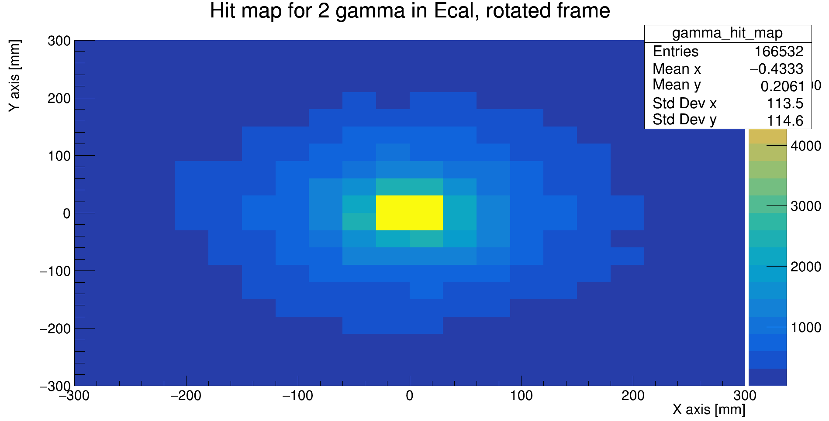
2gamma hit map

Slide 12
ZDC Acceptance - Lambda with angular variance
Simulated unpolarized lambda events, all spawned at origin, shot with theta and phi angles to cover the whole front face of ZDC
20 GeV to 270 GeV momentum range
Determine if an event could be reconstructed by checking if all particles land in Ecal
~140k total events down to ~15k events when all particles make it to the ZDC
Added kinematic variable: lambda angle from proton beam pipeline
Bins have been reduced from 100 to 25 for many due to lack of statistics

Slide 13
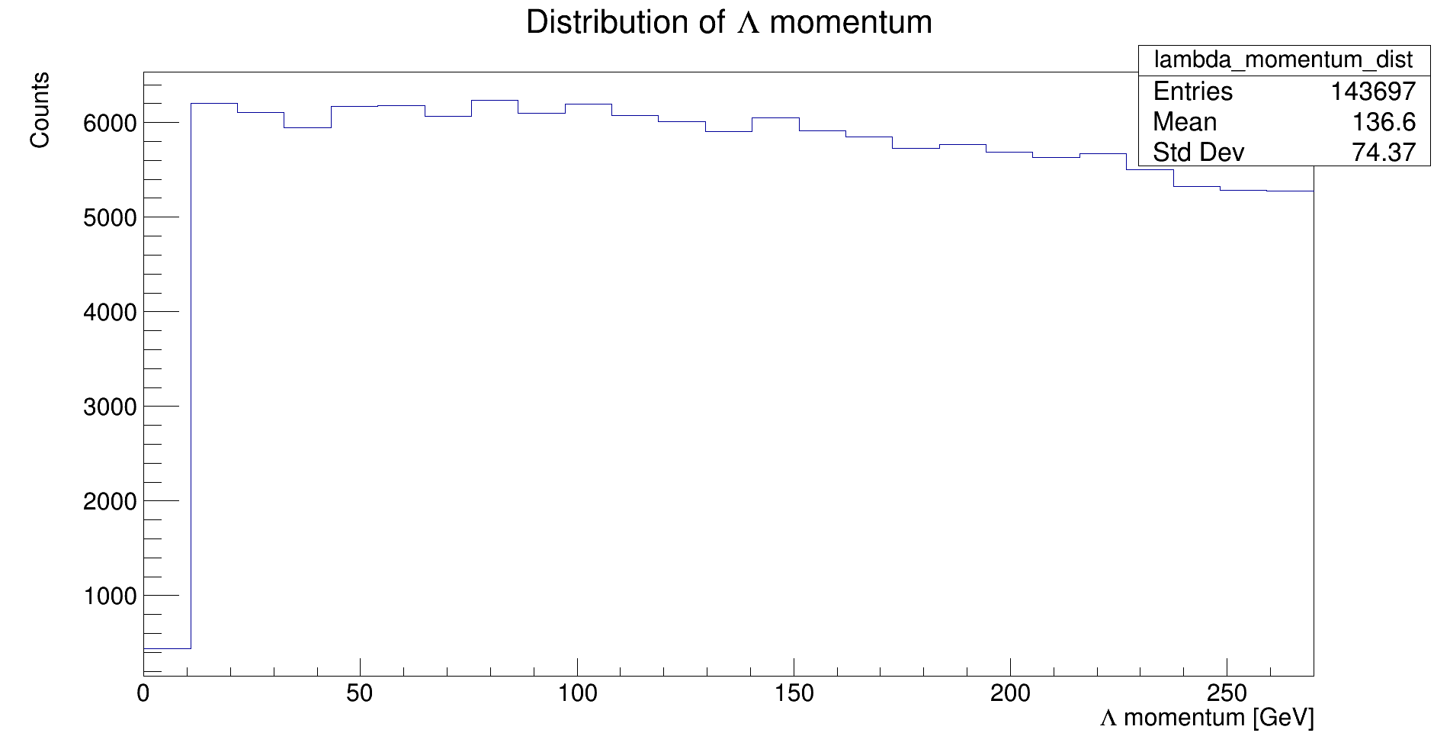
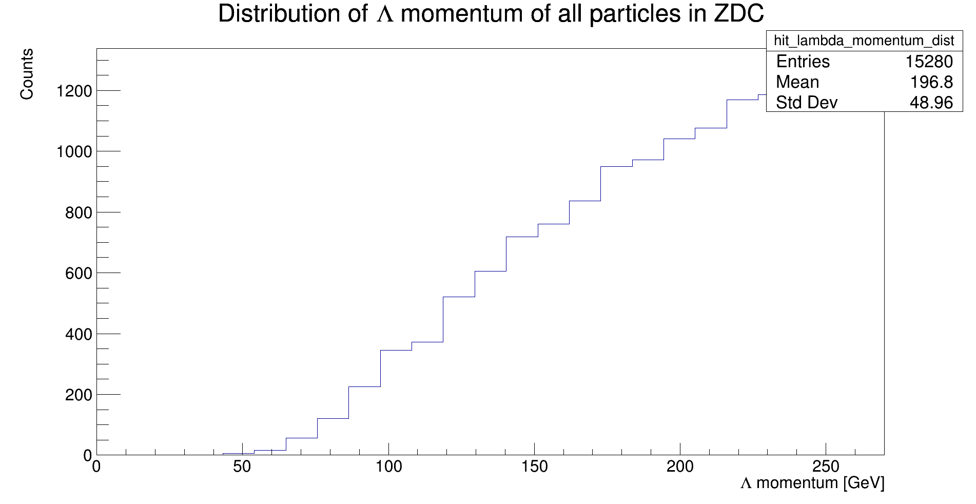
Momentum Distribution

Slide 14
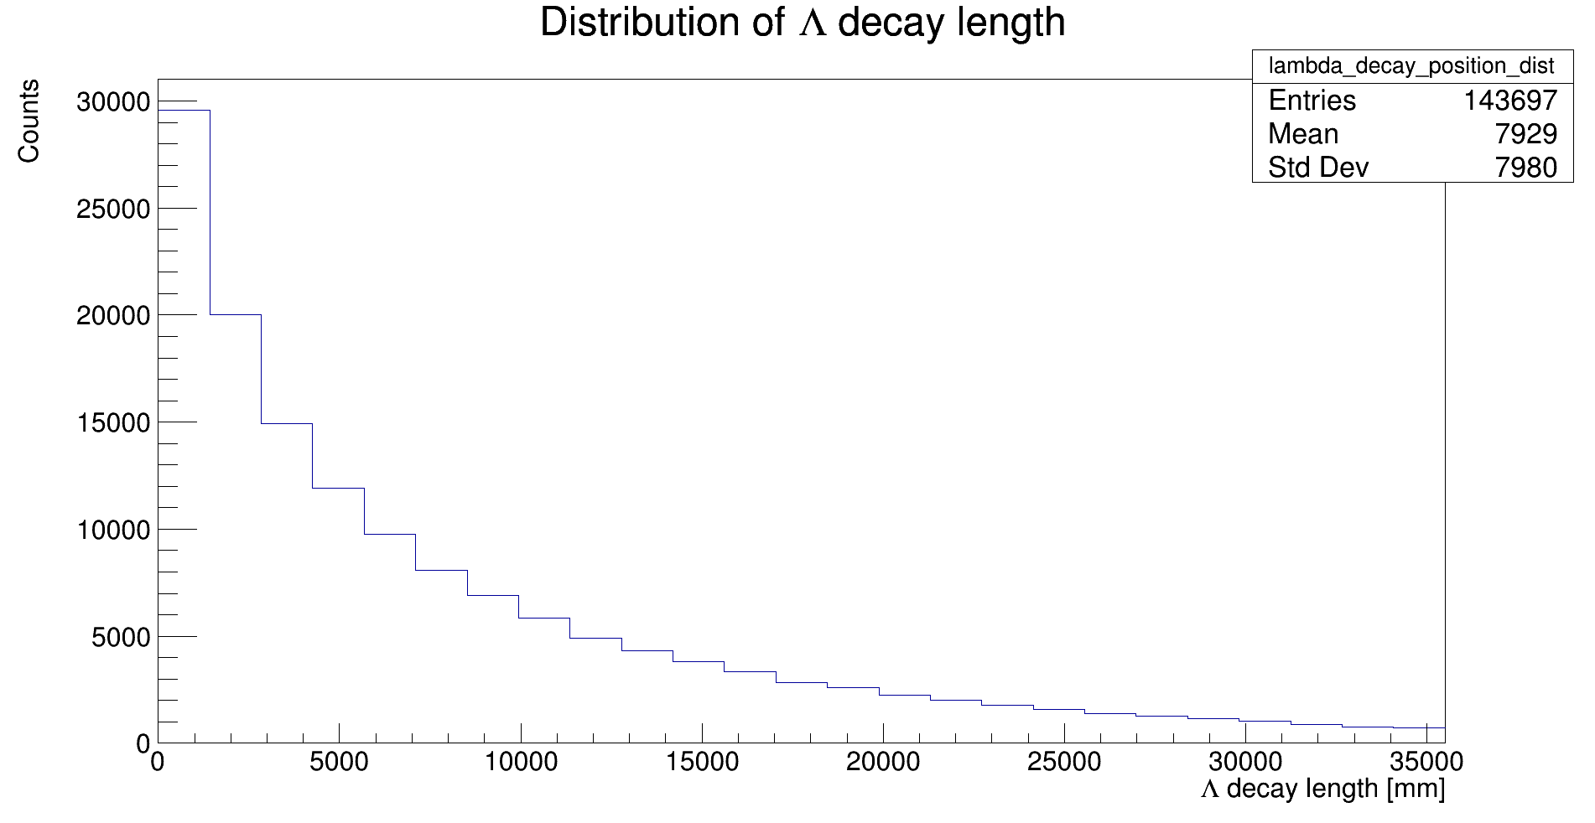
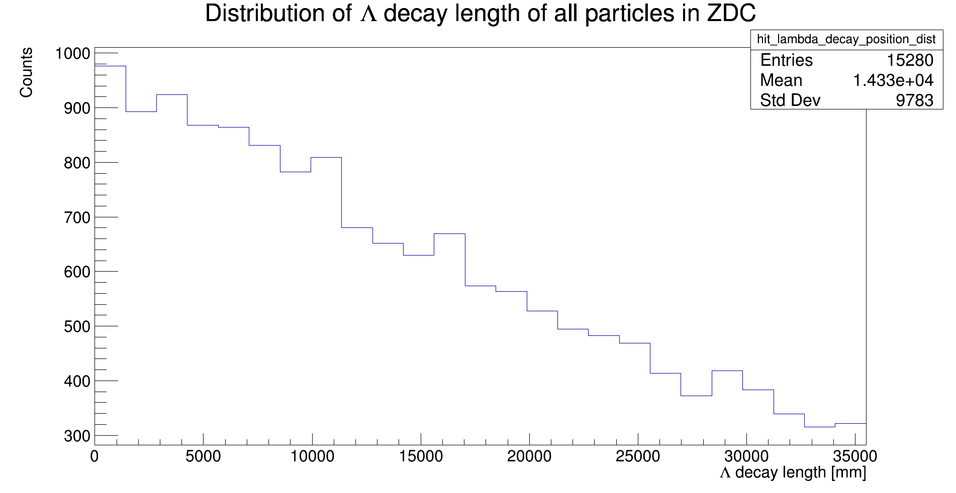
Decay Position Distribution

Slide 15
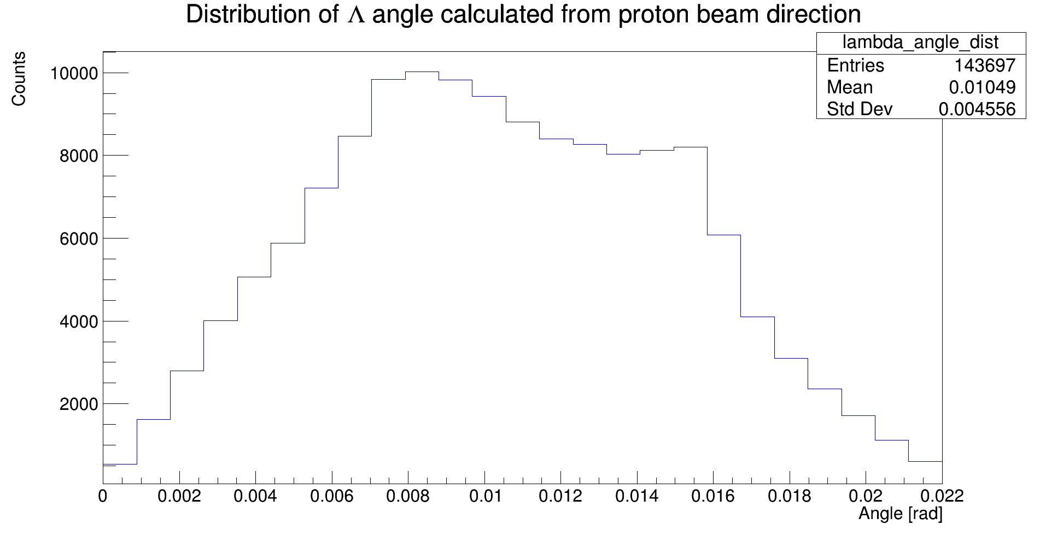
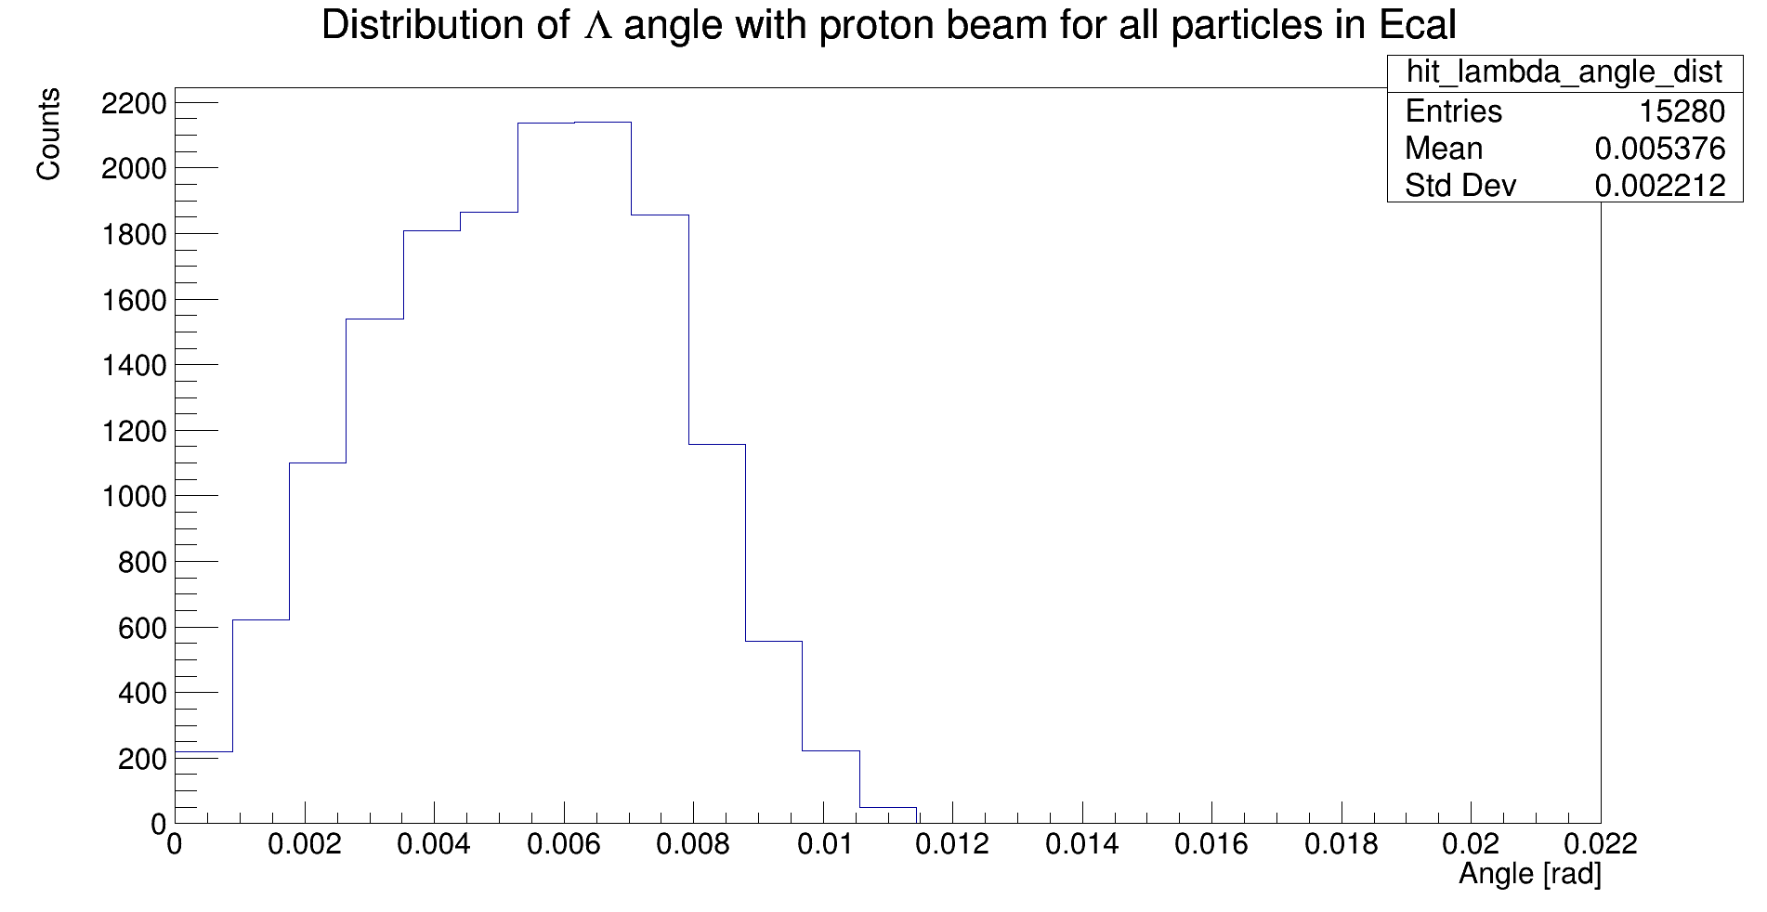
Angular Distribution

Slide 16
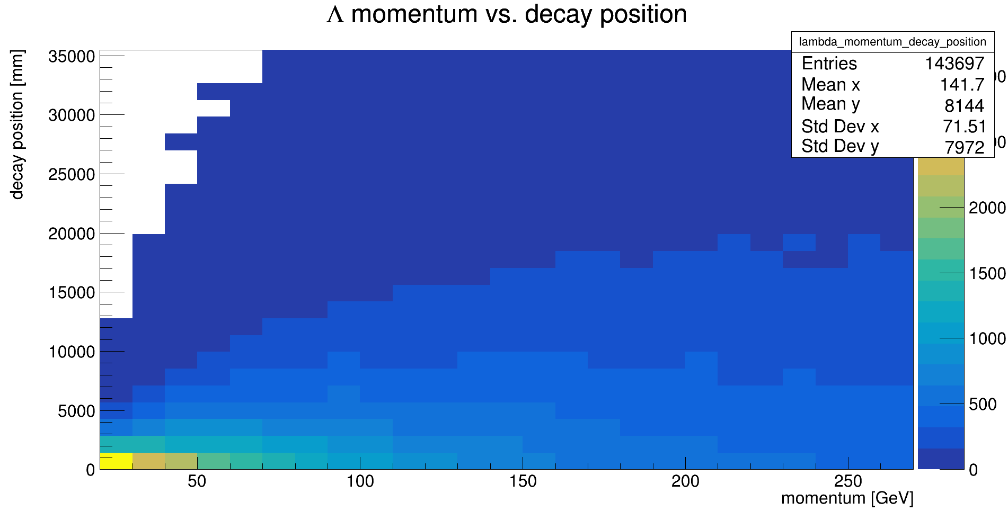
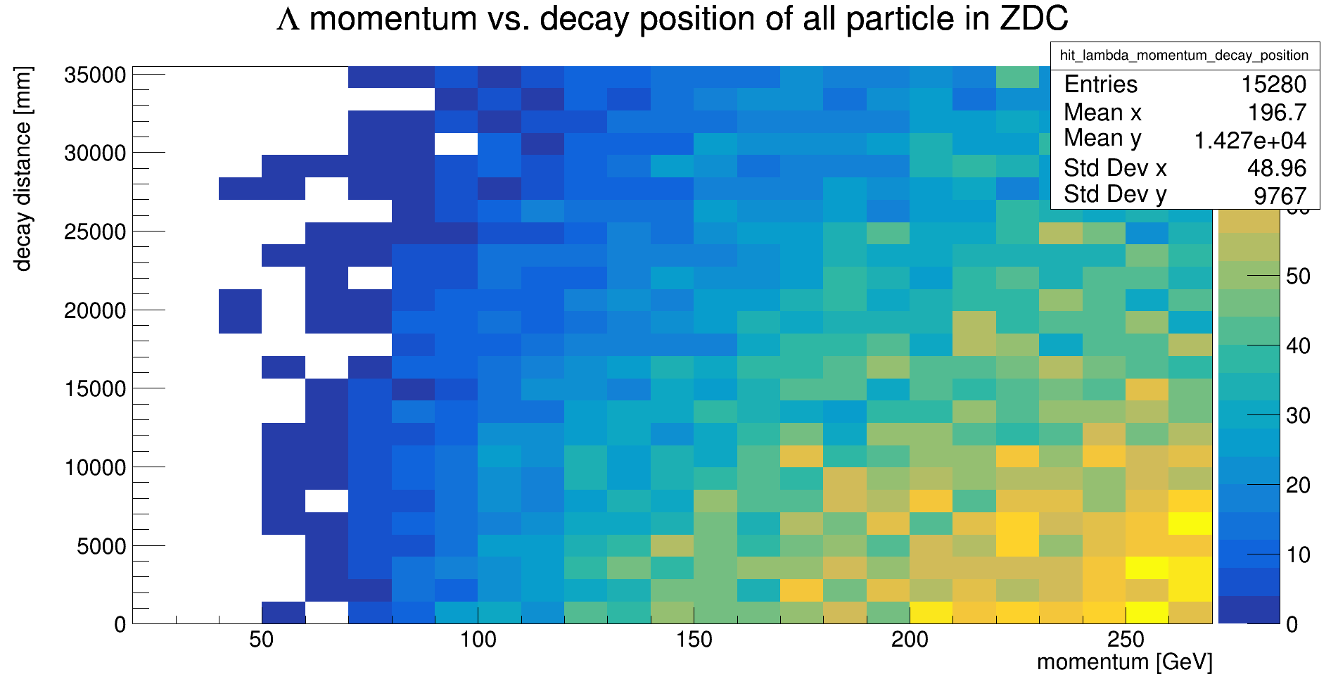
Momentum vs. Decay position

Slide 17
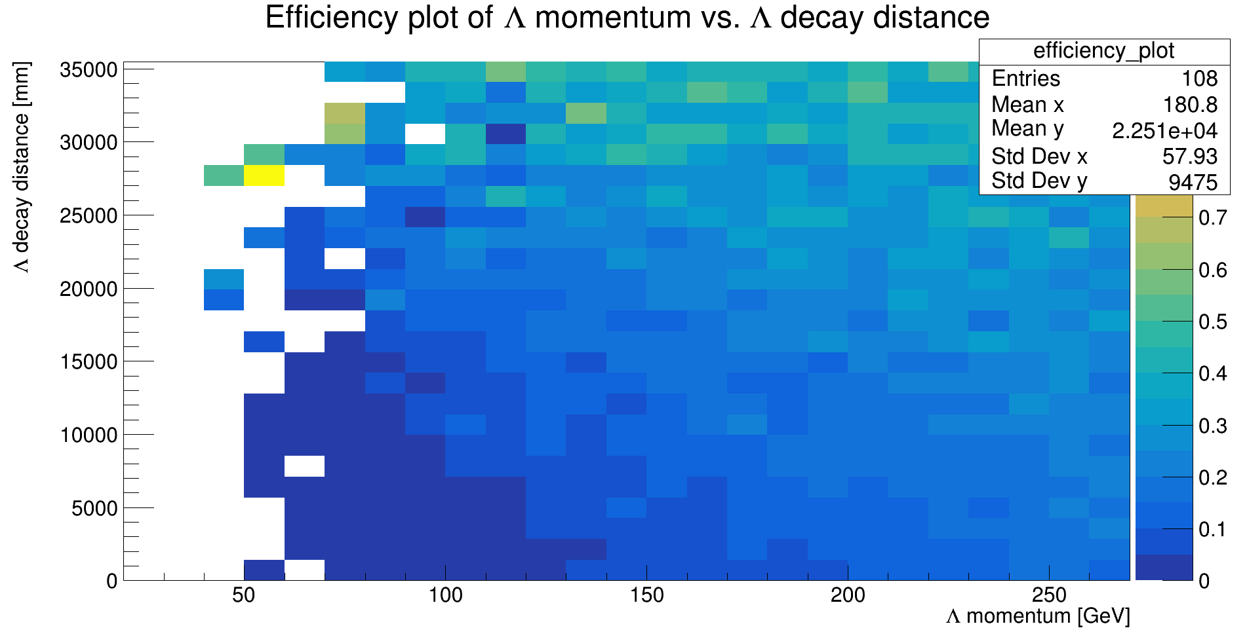
Efficiency Plot for momentum vs. Decay position
Made by dividing the previous two plots

Slide 18
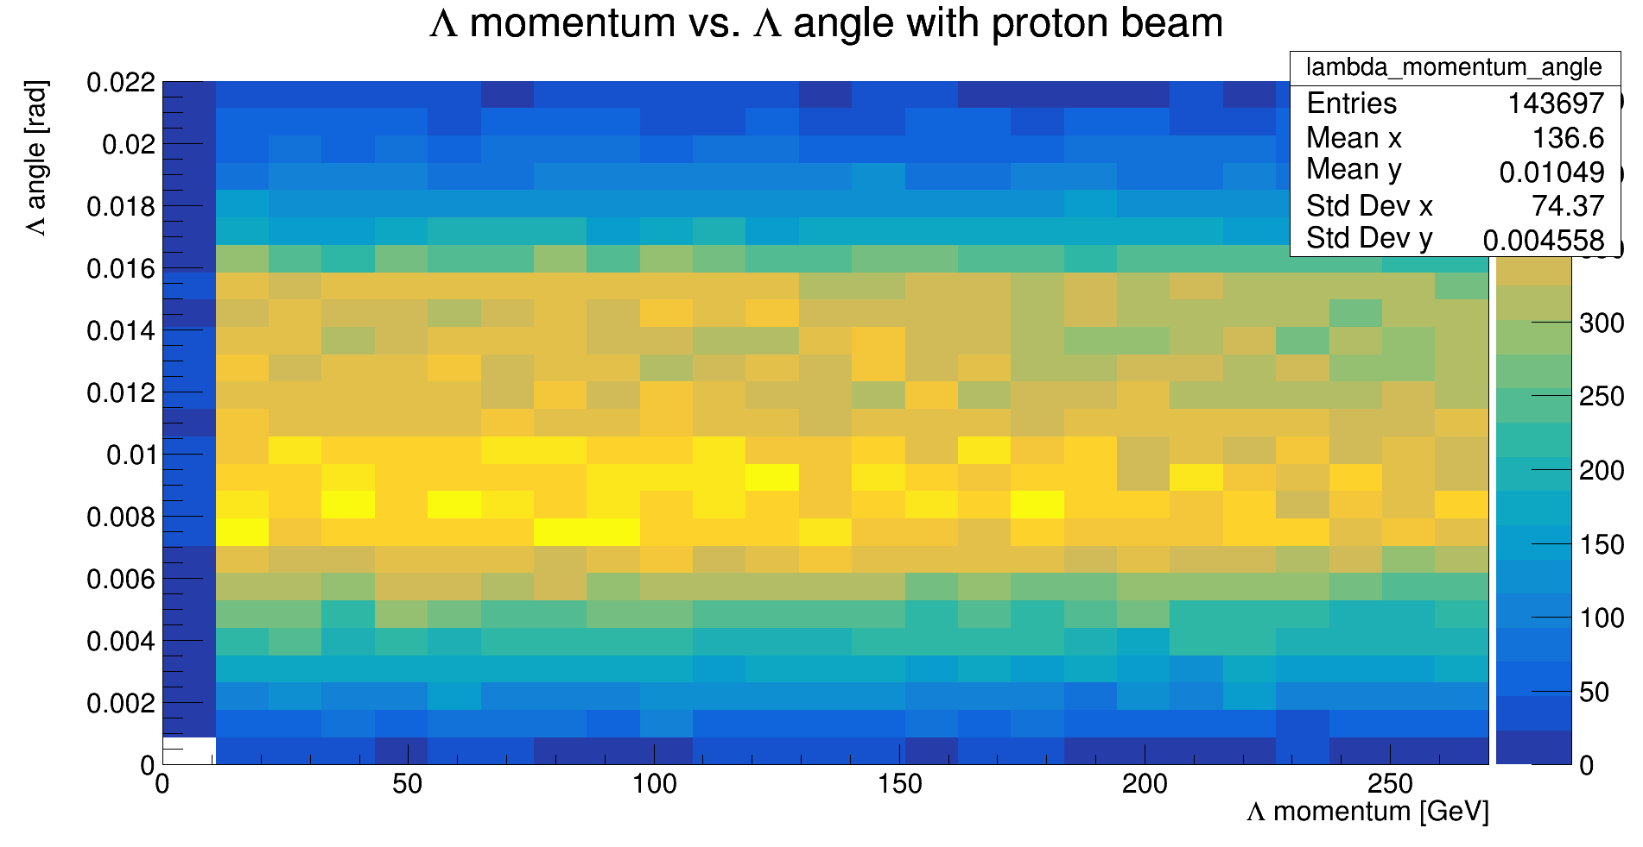
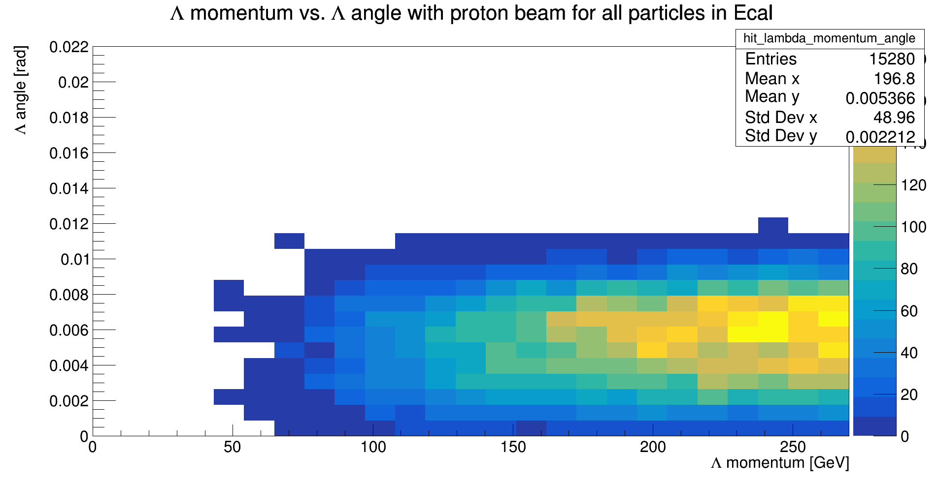
Momentum vs. Angle

Slide 19
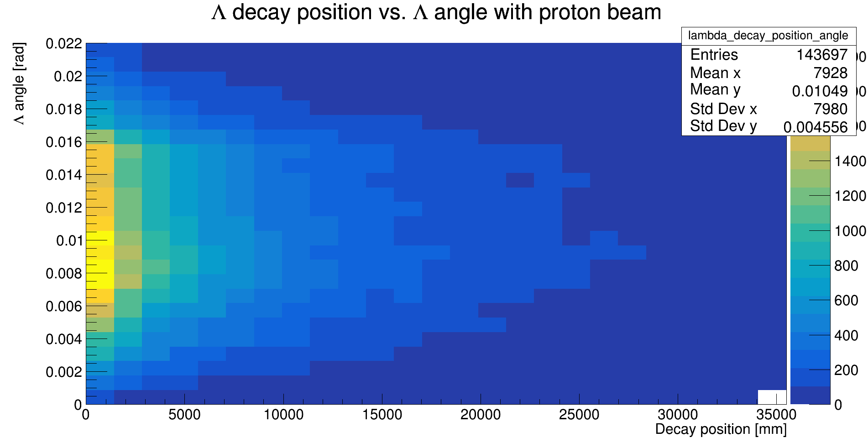
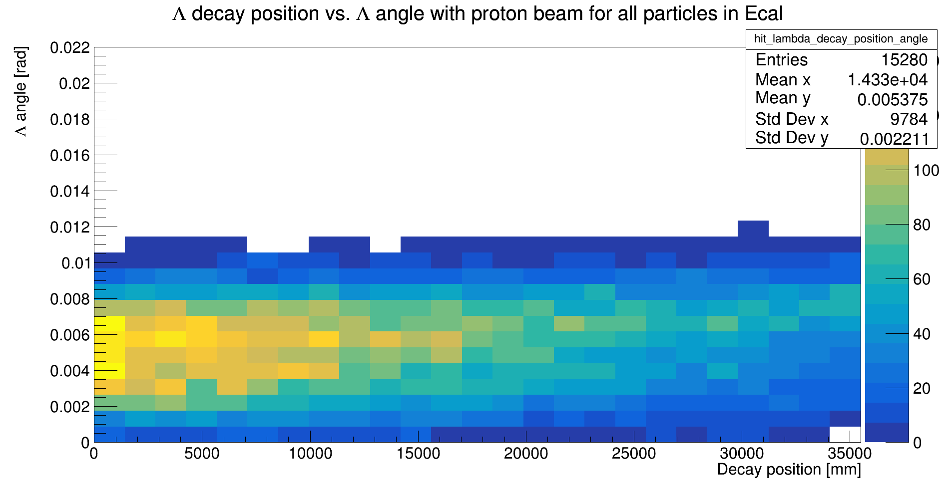
Decay position vs. Angle

Slide 20
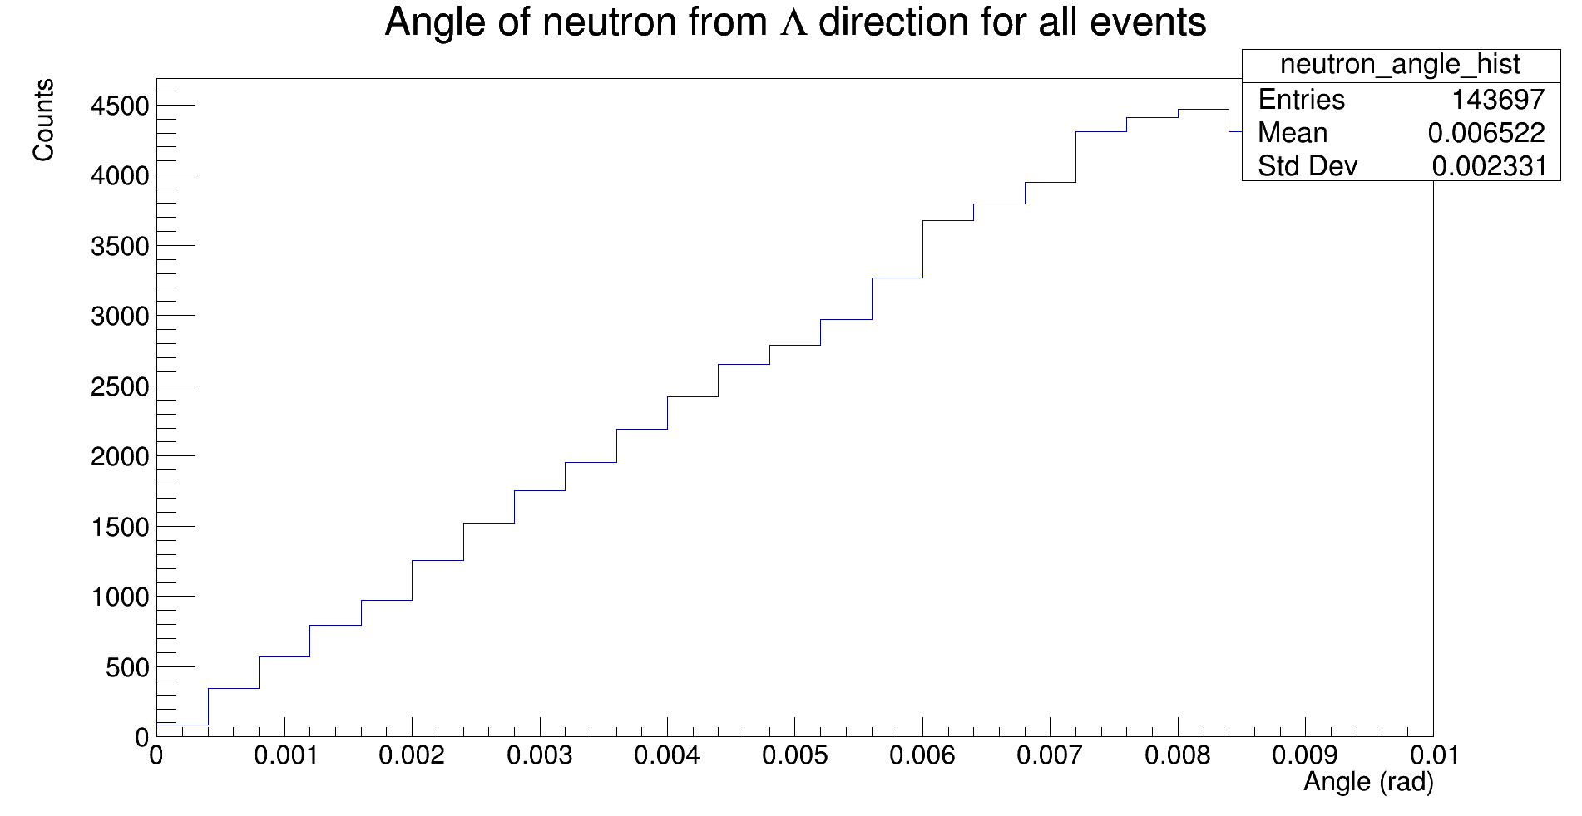
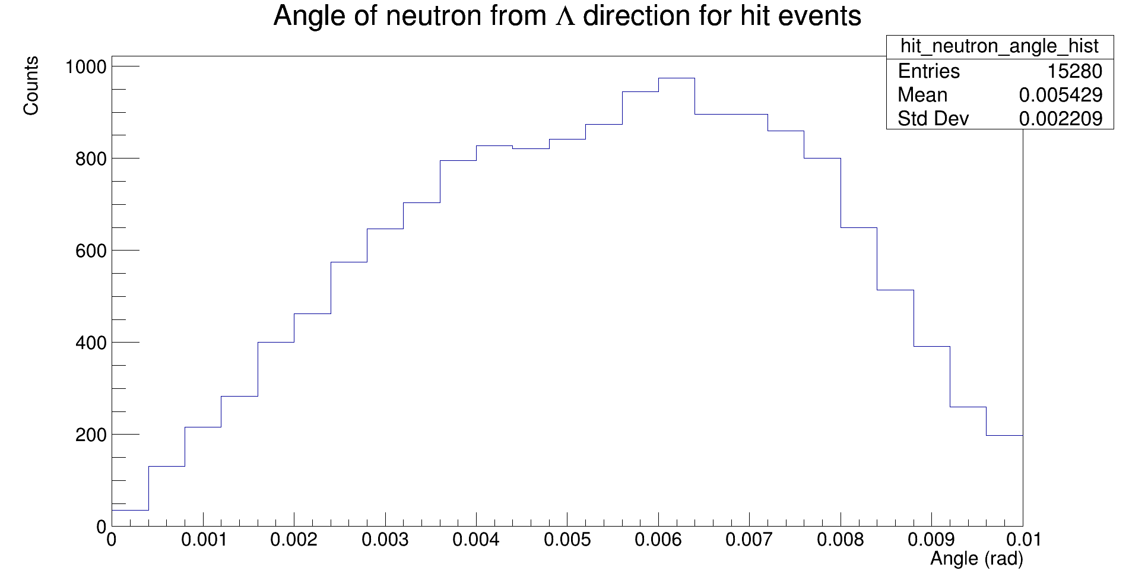
Neutron Angle

Slide 21
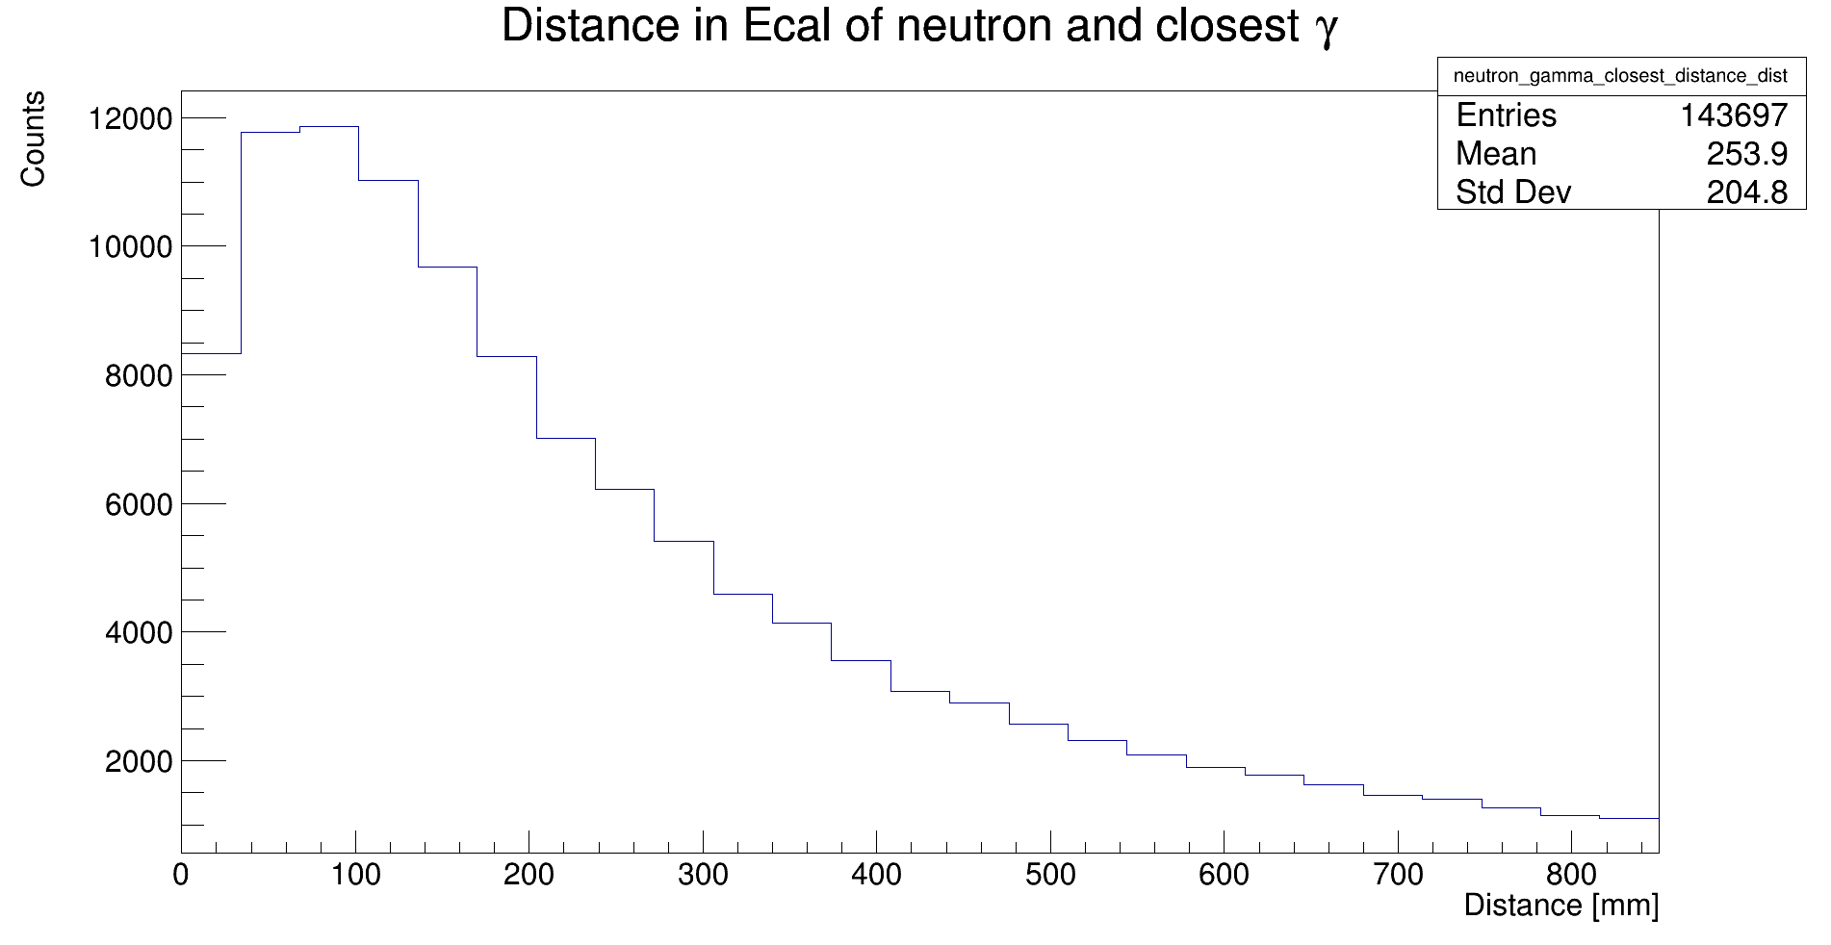
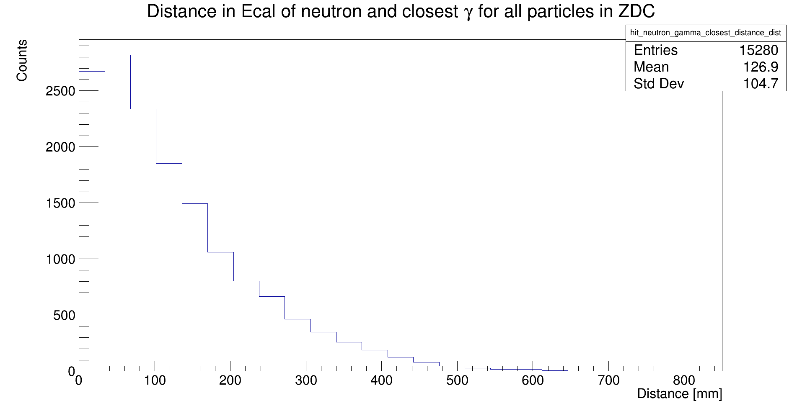
Neutron to closest gamma

Slide 22
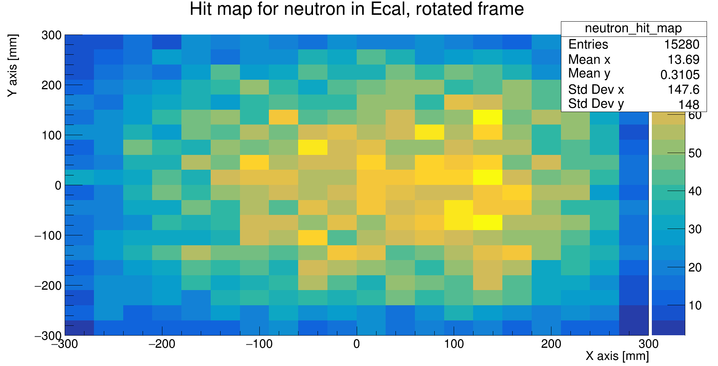
Neutron hit map

Slide 23
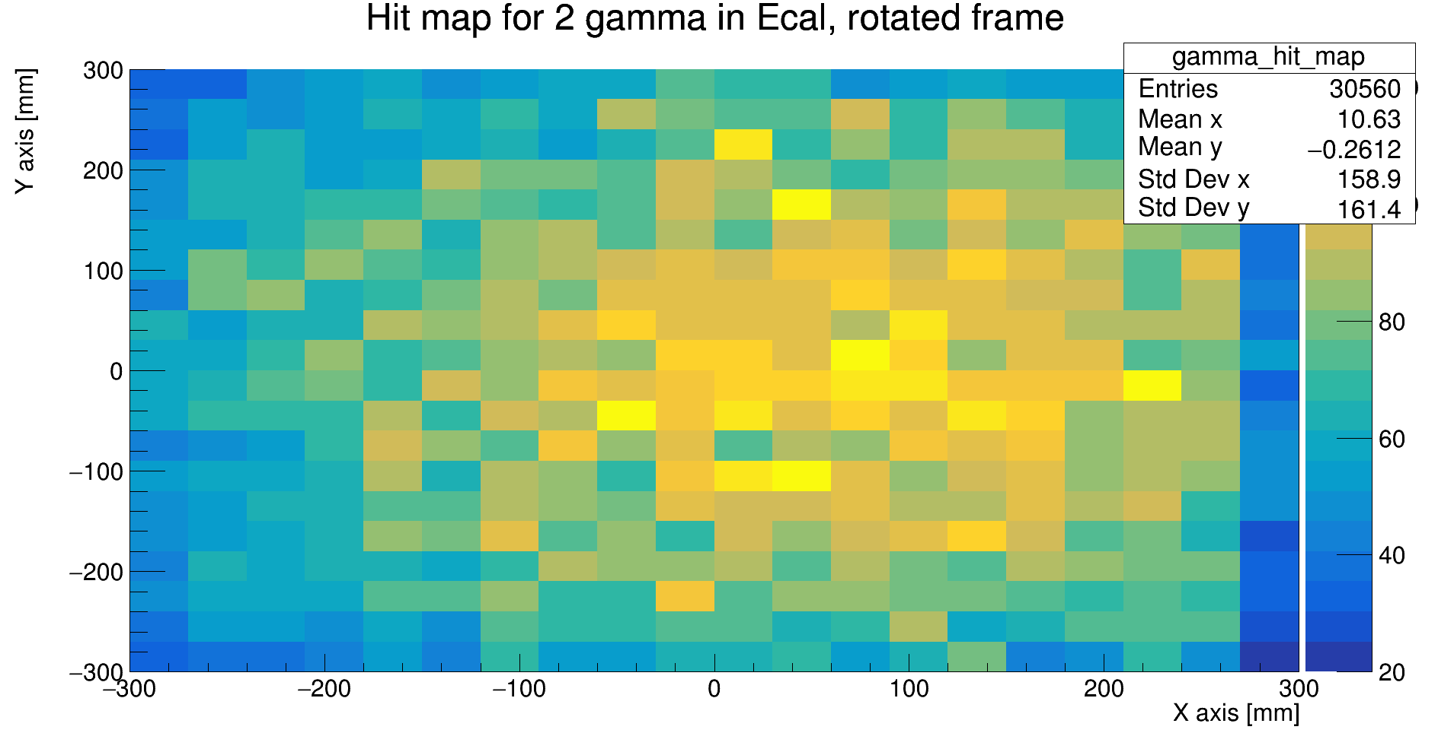
2gamma hit map

Slide 24
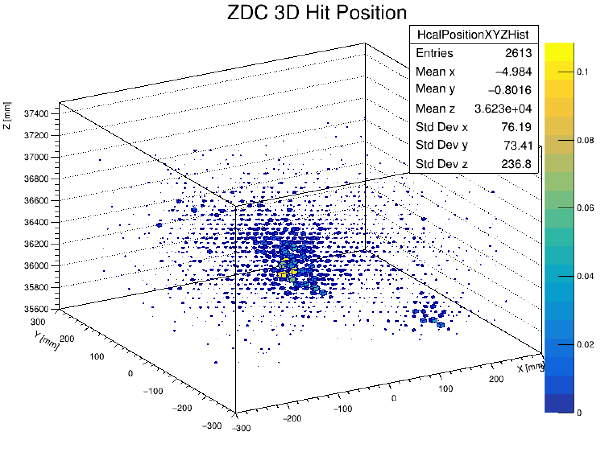
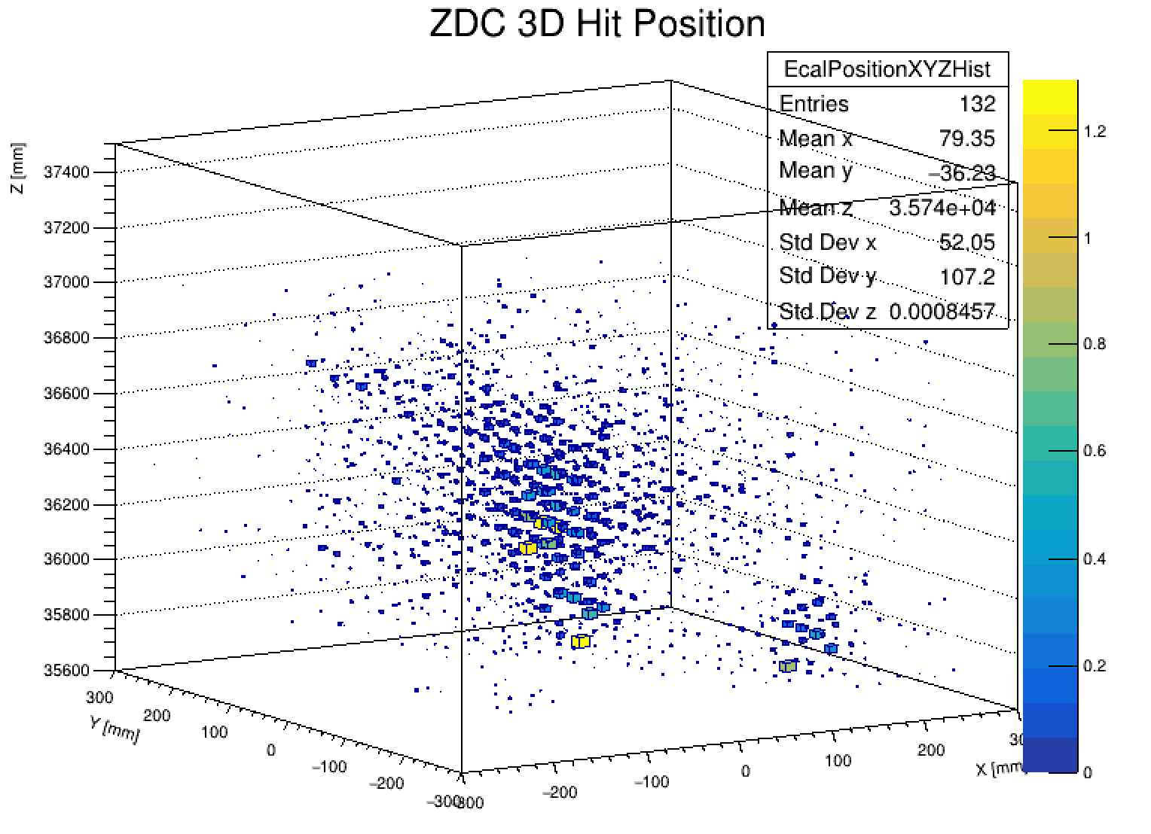
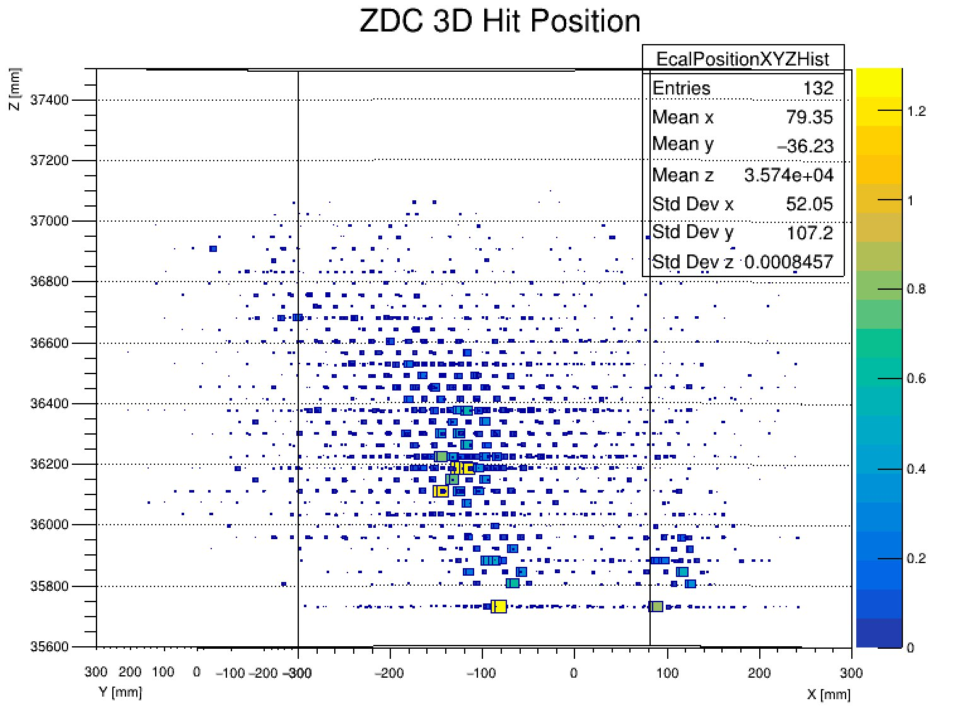
ZDC Clustering - 3D Event View
Interactive event view where we can get a 3D hitmap for any event for full ZDC and HCal only
Full ZDC
HCal only

Slide 25
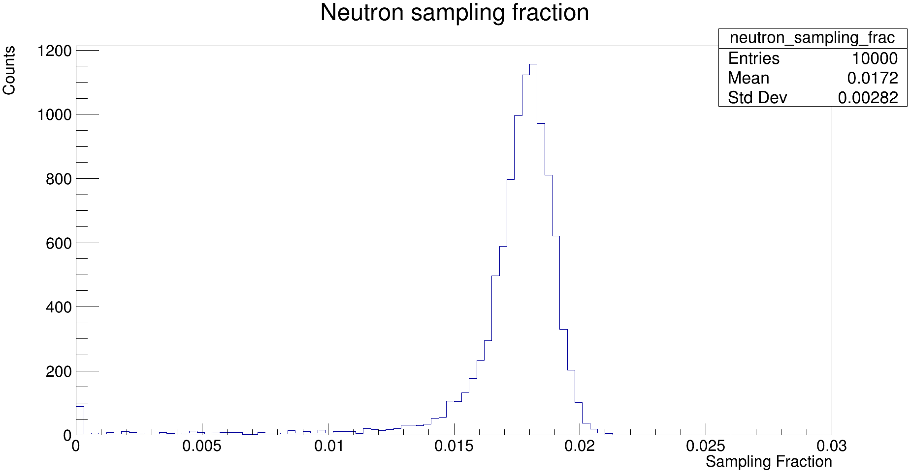
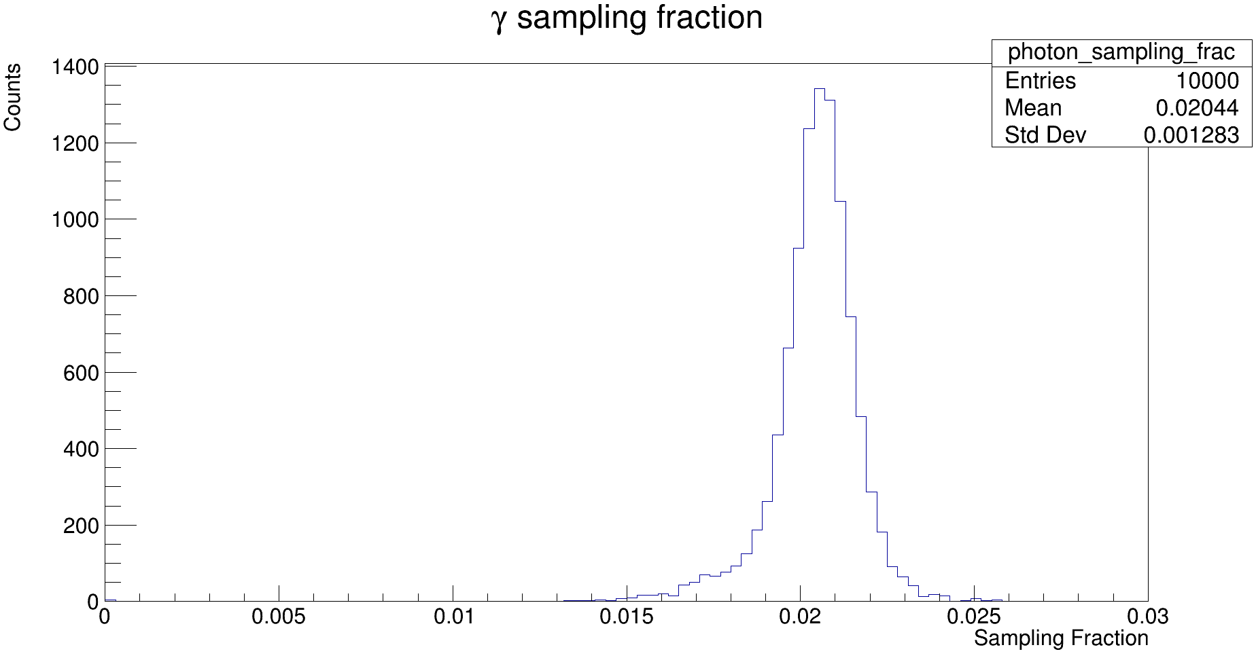
ZDC Clustering - Sampling Fractions
Calculated sampling fractions for the Hcal for 10k 20-220 GeV neutrons hitting just the Hcal and10k 5 GeV to 50 GeV single photons hitting both the Ecal and Hcal
For photon, I summed up total energy deposited in Ecal and subtracted that from original photon energy

Slide 26
ZDC Clustering - ML Efforts Overview 1
CSM, ATLAS and BELLE 2 work for calorimeter clustering has been with Graph Attention Networks (GAT)
GATs work by turning each event into a graph and then treating those graphs as inputs to an attention convolution network
Graphs are composed of nodes which have two aspects: features (x,y,z,E) and edges which connect nodes (determined by detector geometry)
This lets us capture the geometric relation of neighboring cells, specifically between different geometries (Ecal, Hcal, WSi)

Slide 27
ZDC Clustering - ML Efforts Overview 2
Attention convolution is a generalization of convolution to the graph structure (rather than the typical grid structure for pictures)
Attention mechanism works by determining attention coefficients for neighboring node's features to every node which are then used in a linear transform to make new features

Slide 28
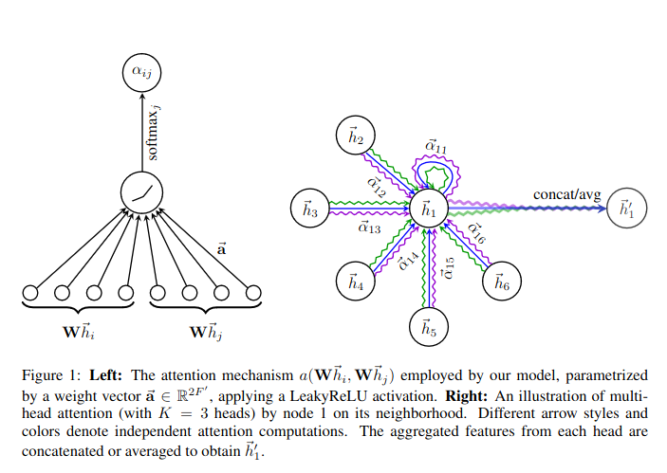
ZDC Clustering - ML Efforts Overview 3
Veličković, P., Cucurull, G., Casanova, A., Romero, A., Liò, P., & Bengio, Y. (2018). Graph Attention Networks. arXiv [Stat.ML]. Retrieved from http://arxiv.org/abs/1710.10903

Slide 29
ZDC Clustering - ML Efforts Overview 4
Other experiments have focused on supervised models: MC data is prepared with known labels (which cluster the hit belongs to) and the model is evaluated by how well it predicts the label
Alternative approach is using self-supervising methods: MC data is prepared without labels and the model is evaluated by how well it can reconstruct the data by extracting latent features
This works by expanding the input features and then restricting them to see if the model can encode the latent features into a space where we can extract them
I have successfully tested the model's reconstruction ability one single events and am currently moving onto batching the events to see if it can generalize
From there, I can examine if latent features can be extracted

Slide 30
ZDC Clustering - Algorithm Clustering
Objective is to develop a modified version of the DBSCAN (Density-Based Spatial Clustering of Applications with Noise) to perform clustering
DBSCAN works by separating regions of high density from those that are sparser. Want to modify it so that it also accounts for the energy of the hits as well as the density
Two parameters: epsilon (distance between points), min points (minimum number of points needed to make a cluster)
Currently able to implement unmodified DBSCAN algorithm to perform clustering in the HCal in 3D but it needs to be tuned and modified in order to work well

Slide 31
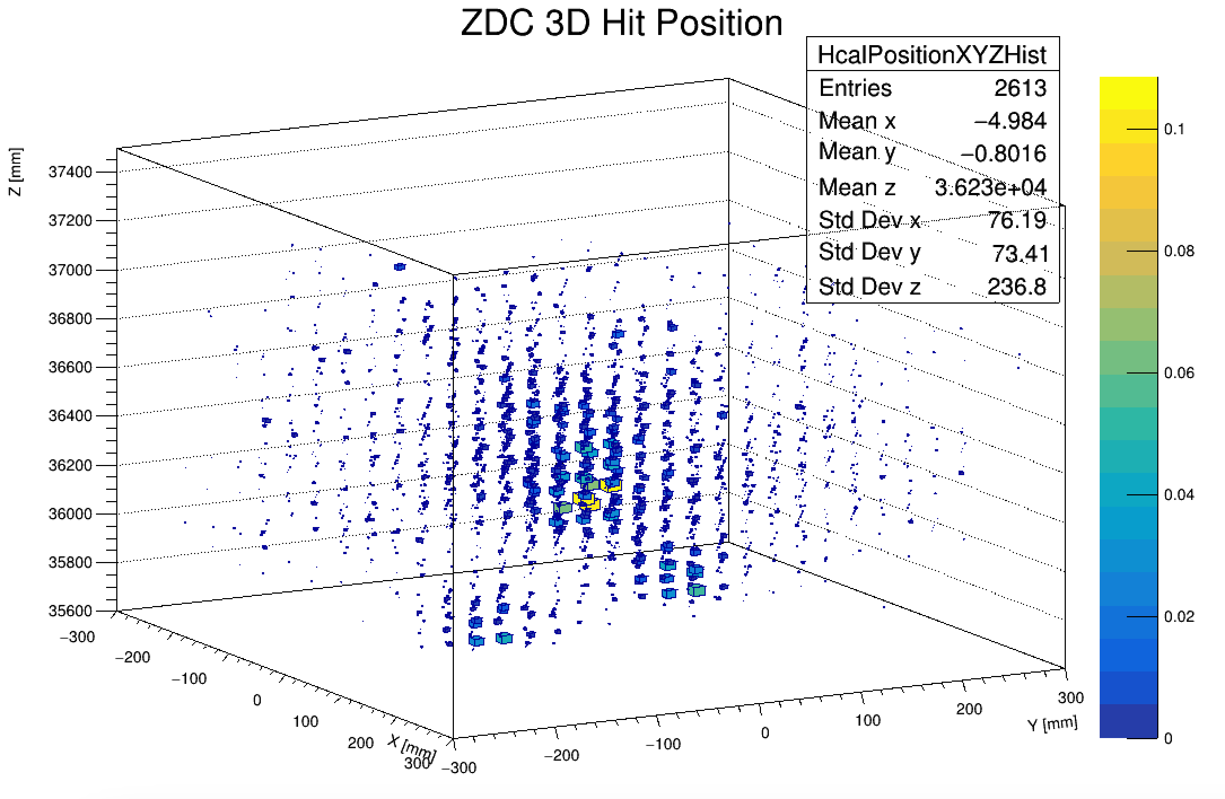
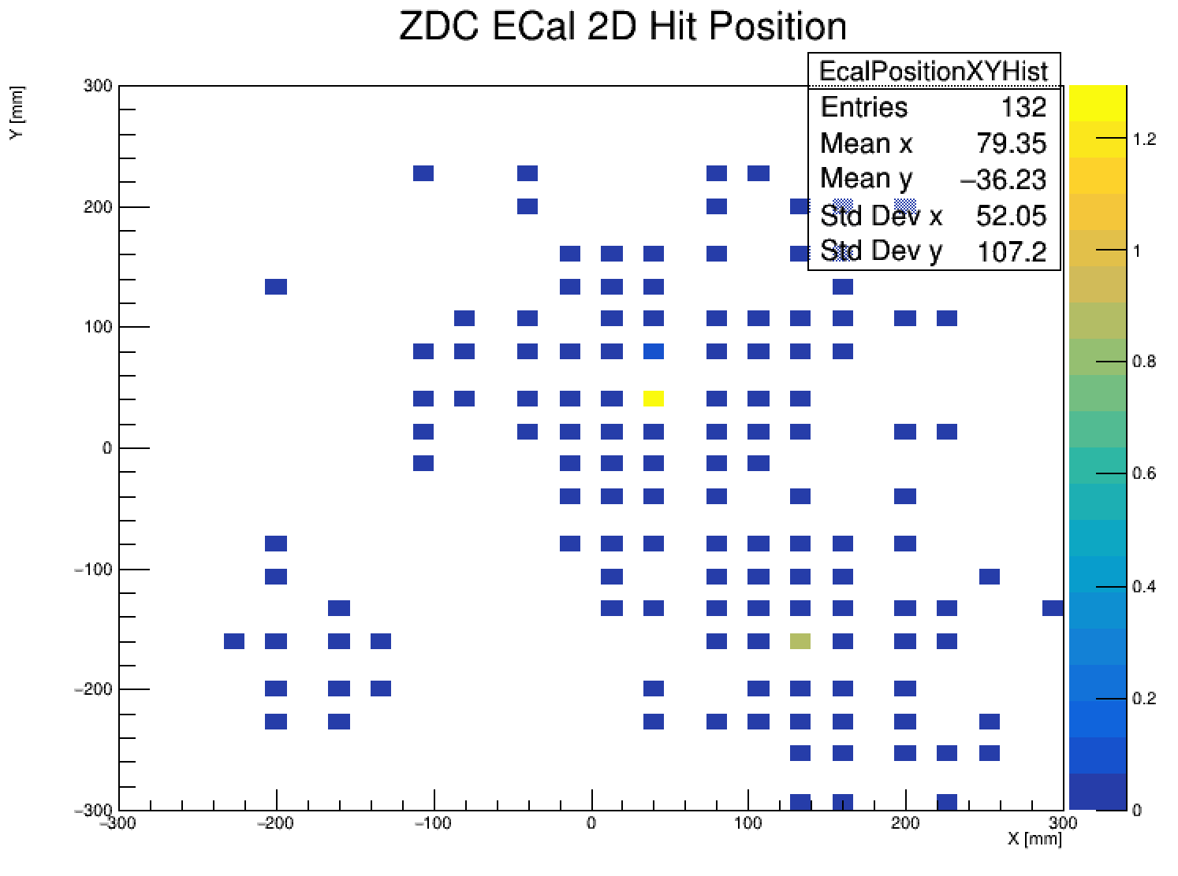
ZDC Clustering - Algorithm Clustering
Event 1: 3 Distinct clusters in the HCal and we can see hits from neutron and both photons in the ECal

Slide 32
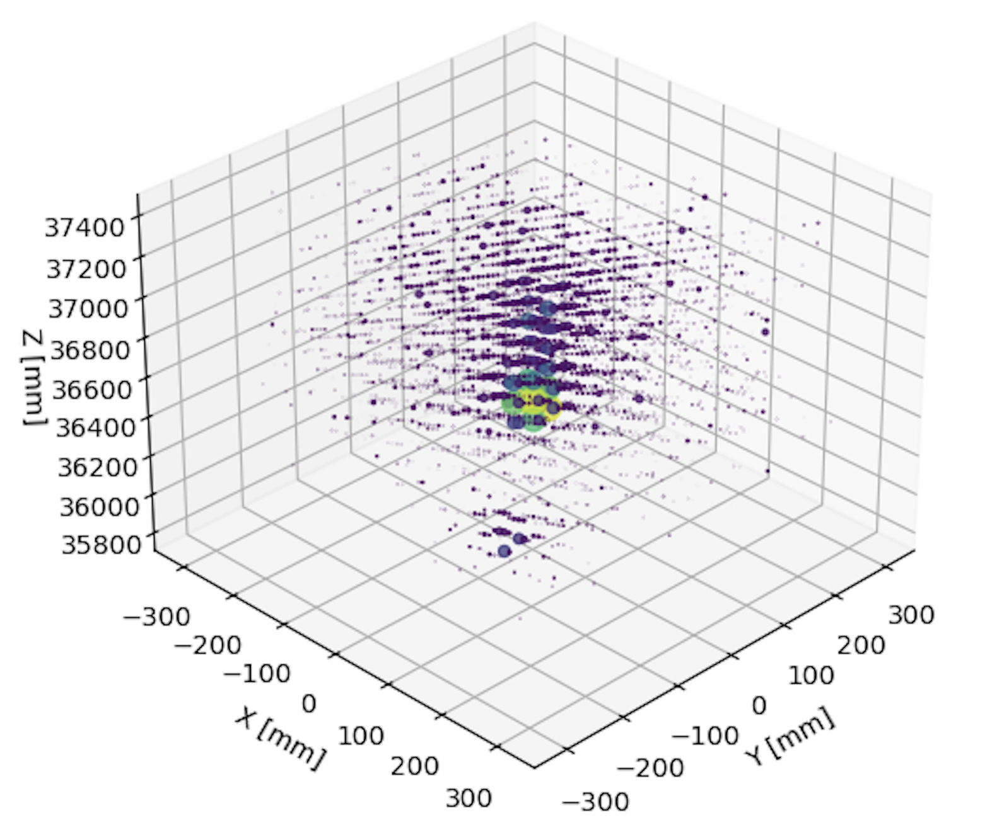
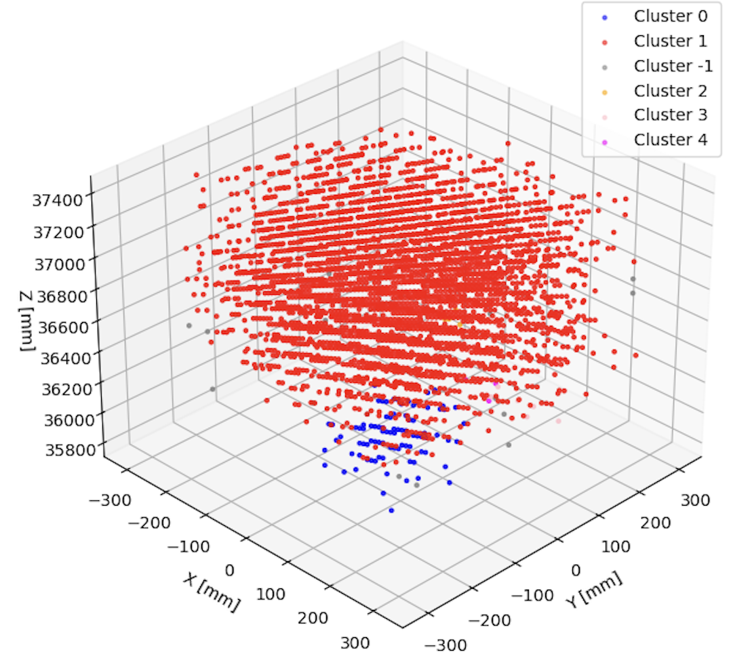
ZDC Clustering - Algorithm Clustering

Slide 33
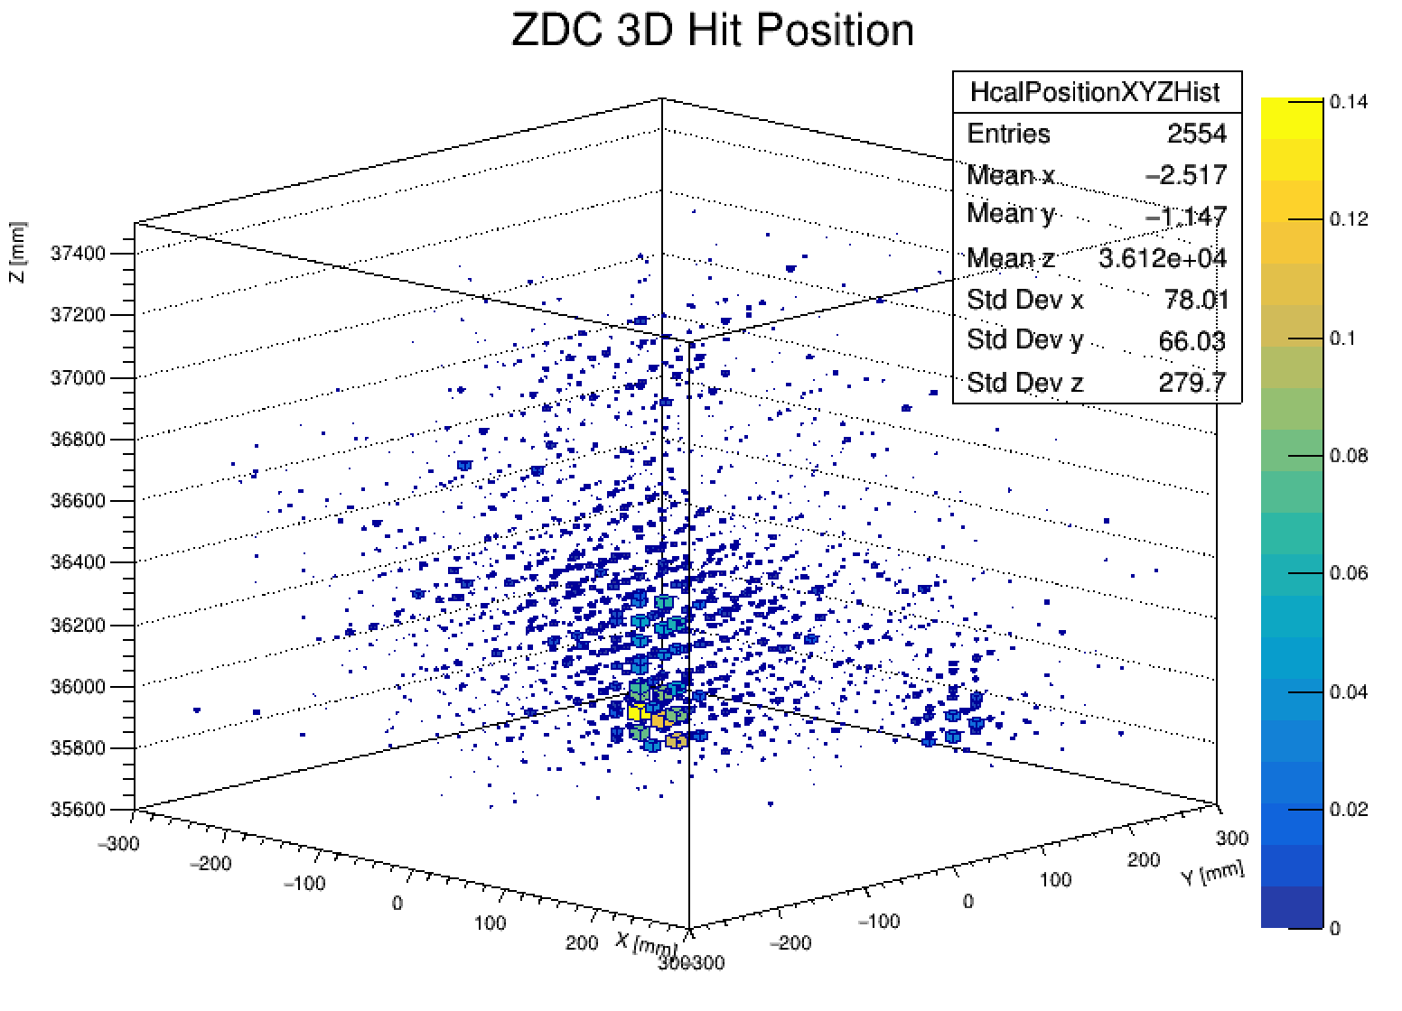
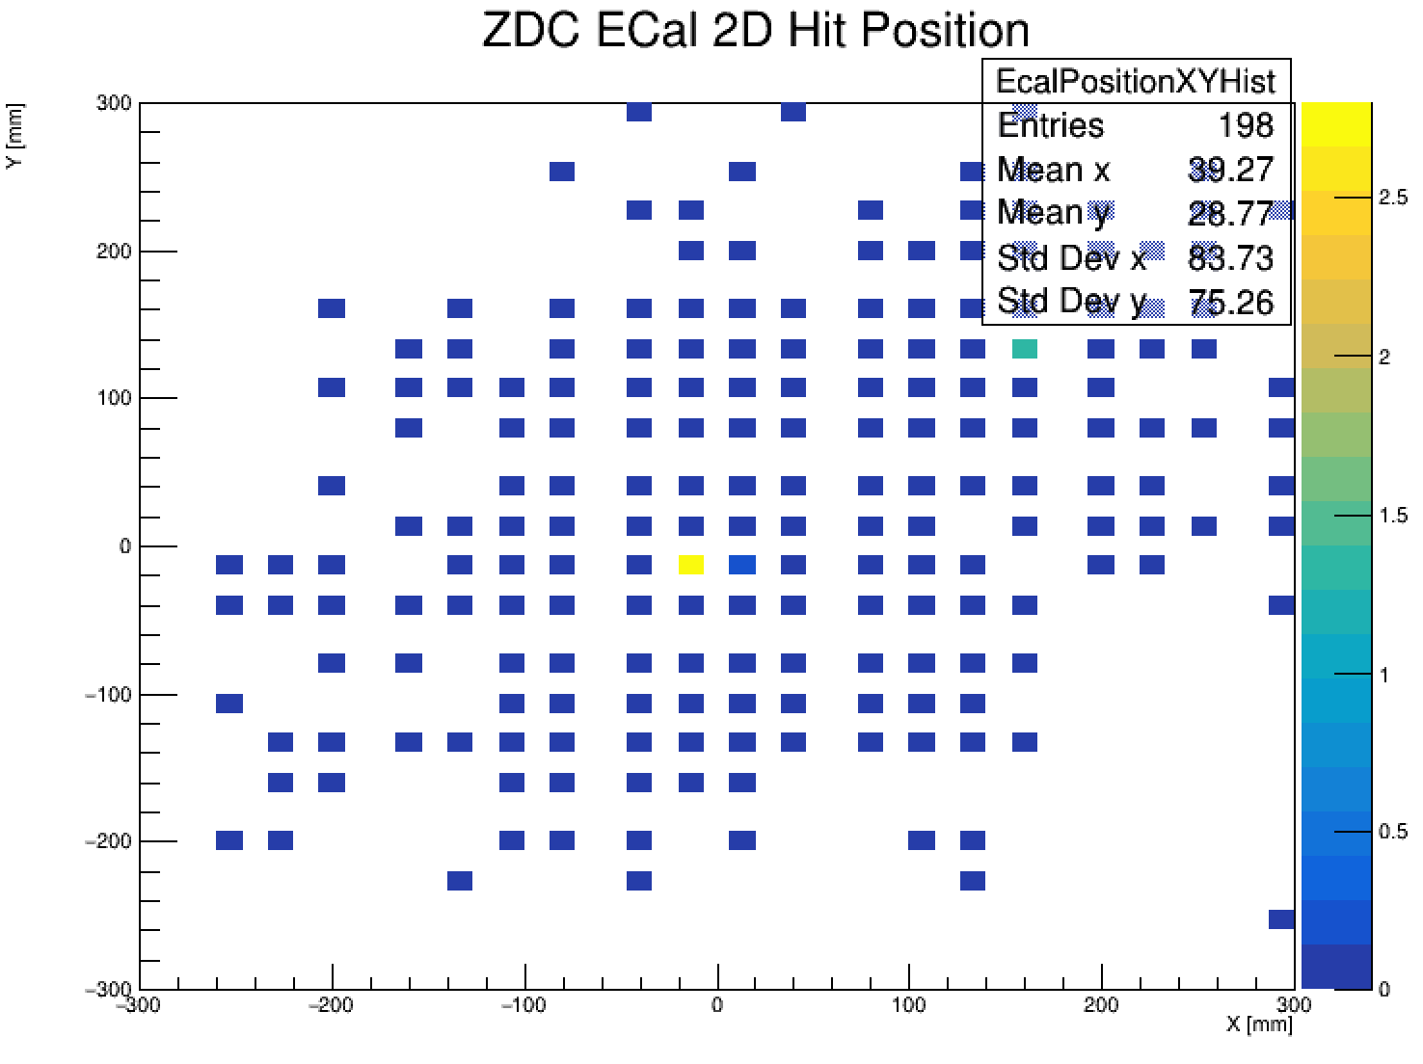
ZDC Clustering - Algorithm Clustering
Event 2: 2 Distinct clusters in the HCal but we cannot really distinguish neutron and both photon hits well

Slide 34
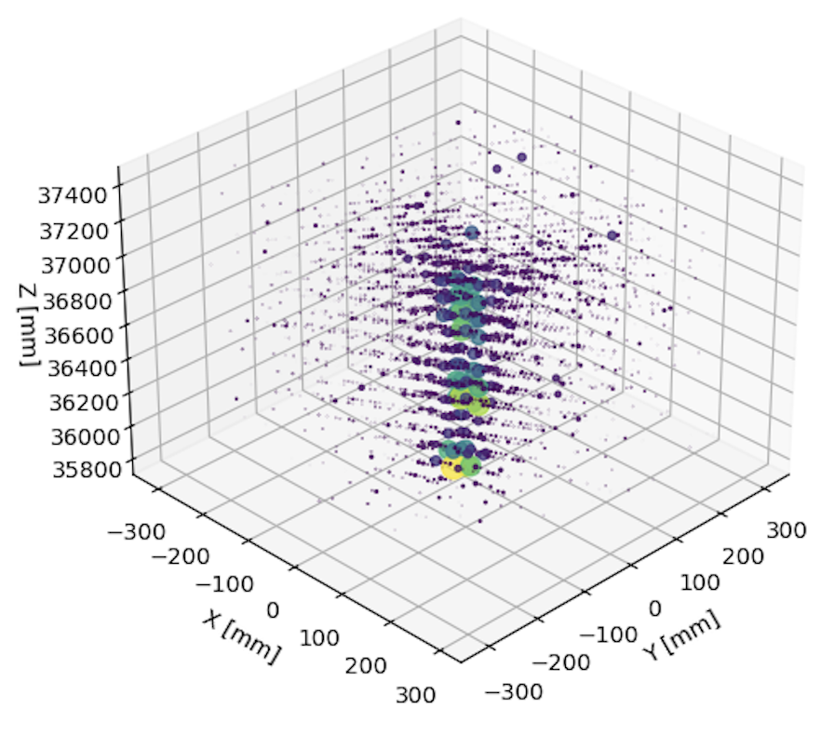
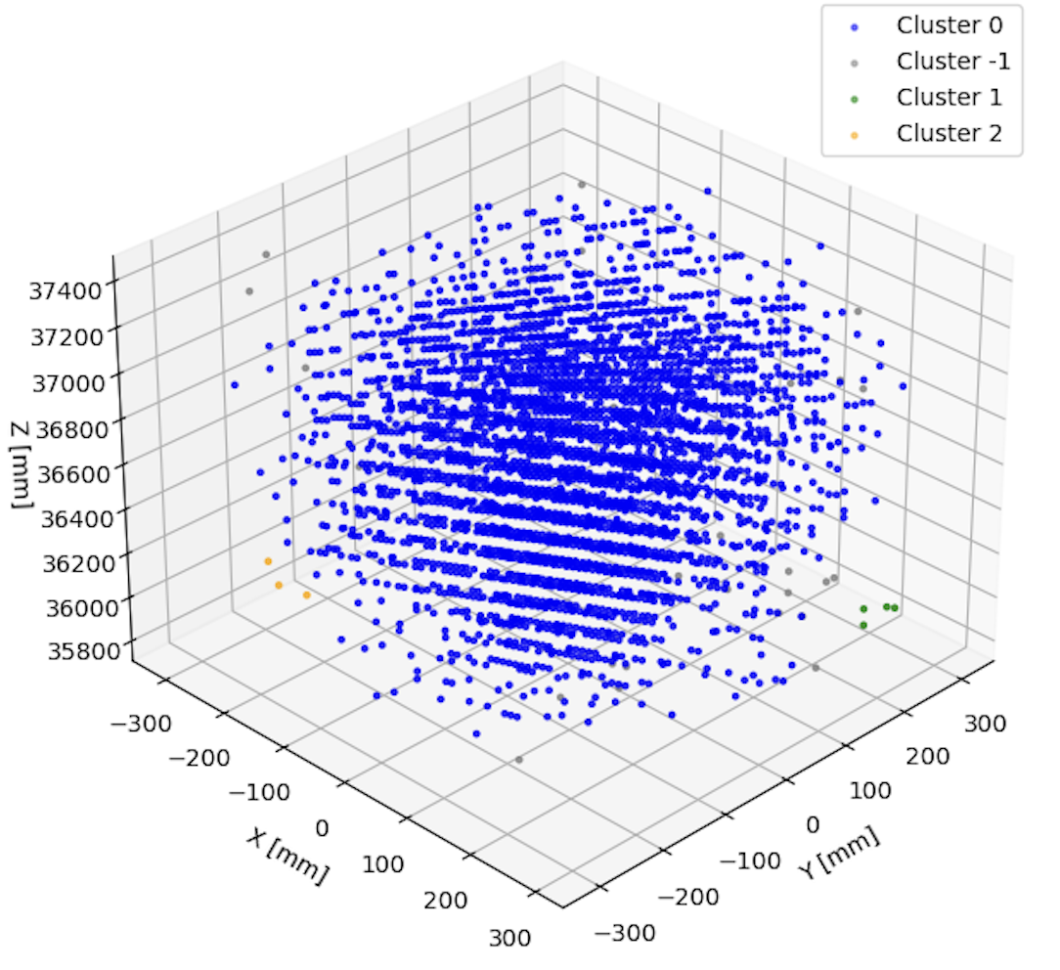
ZDC Clustering - Algorithm Clustering

Slide 35
ZDC Clustering - Algorithm Clustering
Next Steps:
Tune the parameters
Modify algorithm so that it also accounts for the energy of the hits
Need to be careful here as the energy deposited by the neutron is different than the photons in both the ECal and HCal
Implement the algorithm for the full ZDC (currently implemented only for the HCal)
Potentially use ECal hits as "seeds" to better determine the number of clusters and guess core points

Slide 36
TPC Efforts
Debugging continues:
We removed the euxenite stone, and tested cosmics for an evening
We observed less hits
We found a problem with the voltage divider and resoldered wires
Then we placed iron-55 into the TPC and took data at several GEM voltages
We collected some good data before sparking destroyed the GEM
GEM condition is unstable, it constantly sparks and can't hold high voltages anymore
New GEM is currently drying

Slide 37
TPC Efforts
Damaged GEM foil

Slide 38
TPC Iron 55 Plots
Plots for spectrum: x-axis is channel and y-axis is counts
Top plot is for GEM voltage 1250V and field voltage -900V, bottom plot is for GEM voltage 1230V and field voltage –900
Top peak is located at channel 138 -> 84.2mV
Bottom peak is located at channel 105 -> 64.1mV
Unfortunately, the GEM died before we could collect more data

Slide 39
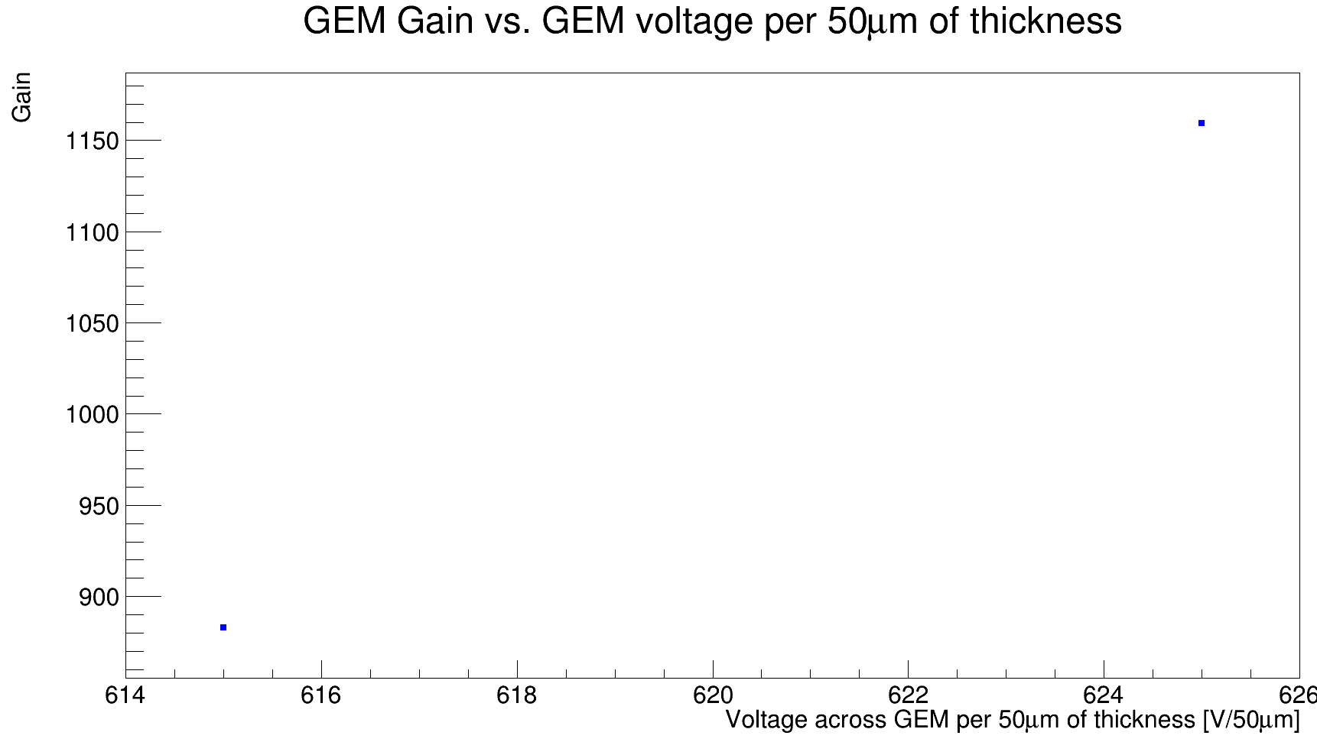
TPC Iron 55 Plots 2
With the previous data, we may calculate the gain of the GEM
Calculated using the known energy of the larger peak

