Slide 1
Sept. 9th ZDC Resolution Study
Alessio I. and Gursimran K.

Slide 2
Overview
Last week we discussed looking at the angular data and lambda reconstruction methods
Today we will show some results for
Reconstruction of the photon vectors and pion using ECal + HCal
Statistics after cuts of data
Clusterability of angular data

Slide 3
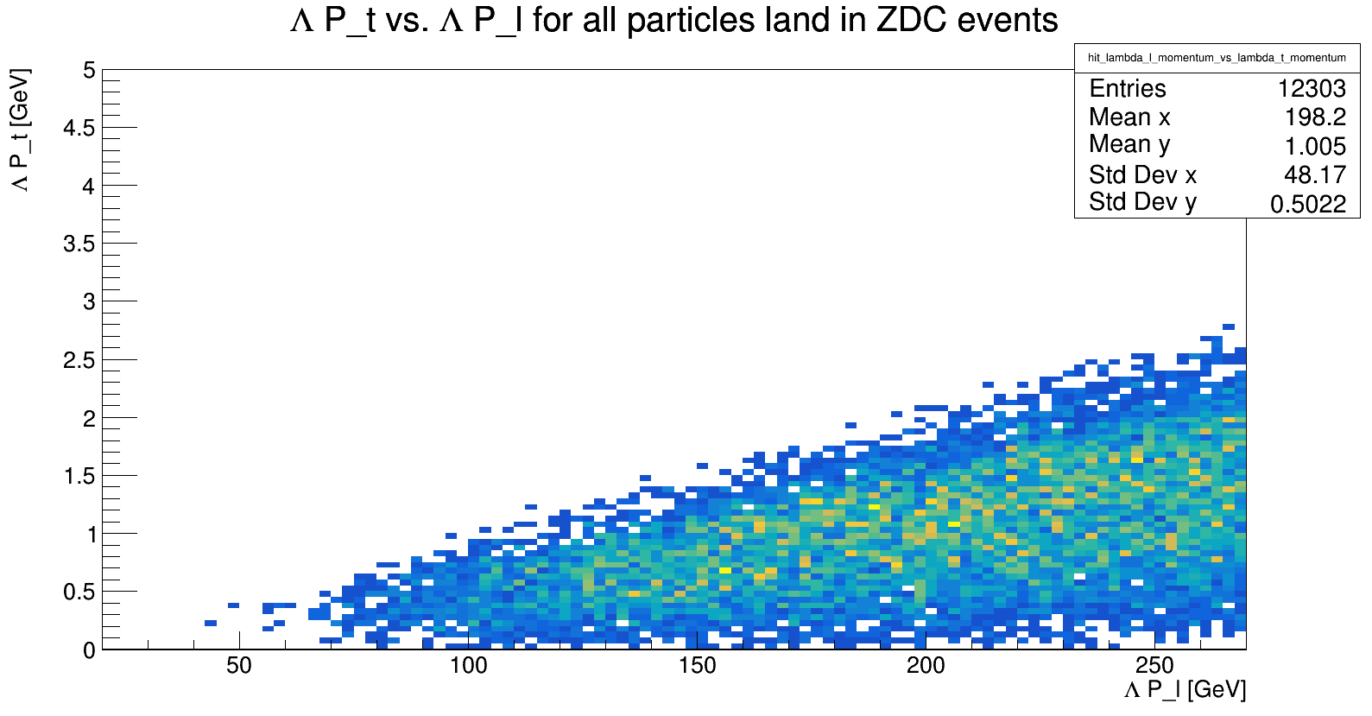
P_t vs P_l
This is only for events where all three particles land in ZDC

Slide 4
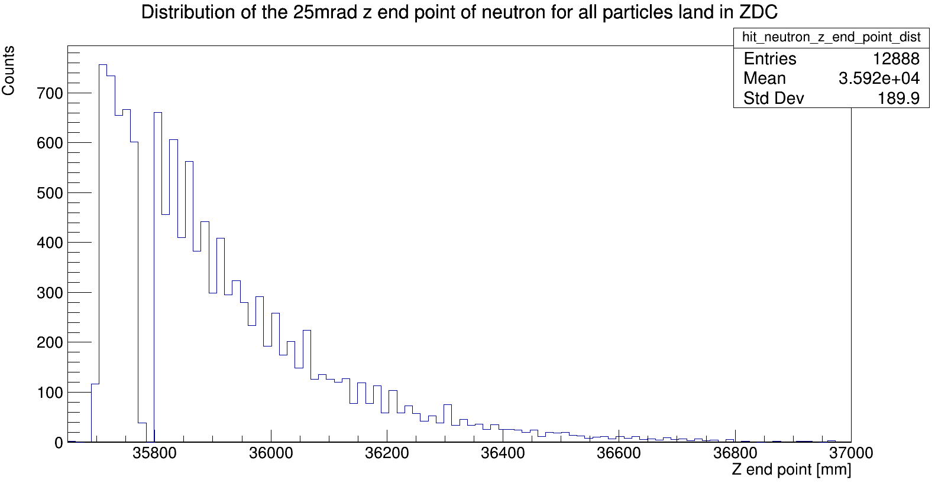
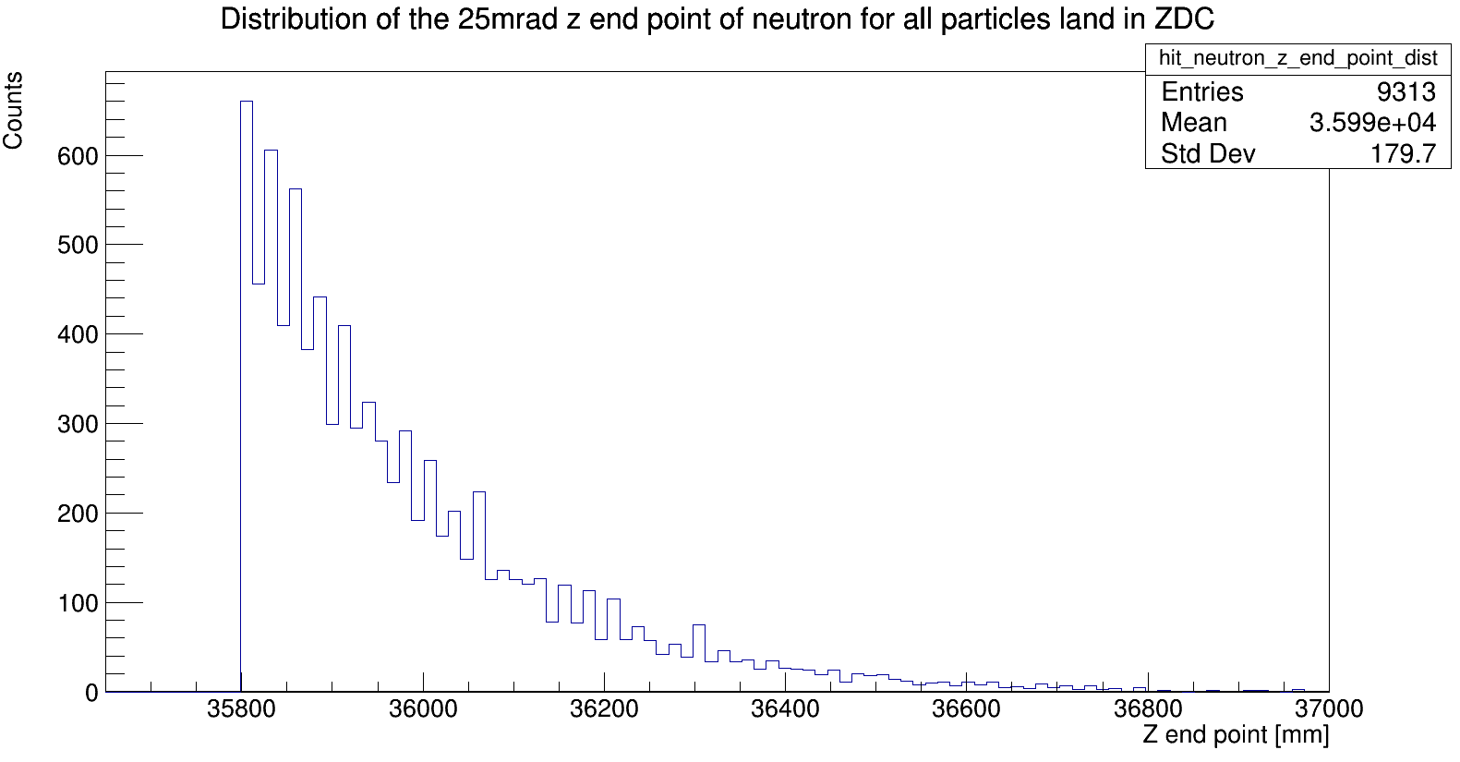
Angular data before and after depth cuts
This is only for events where all three particles land in ZDC
Reduces 140k events to 12k to 9k
Non-angle data goes from 200k to 74k to 30k
Not every deep event can be reconstructed, but most can
Cut at 35800, but it is better to cut at 36000

Slide 5
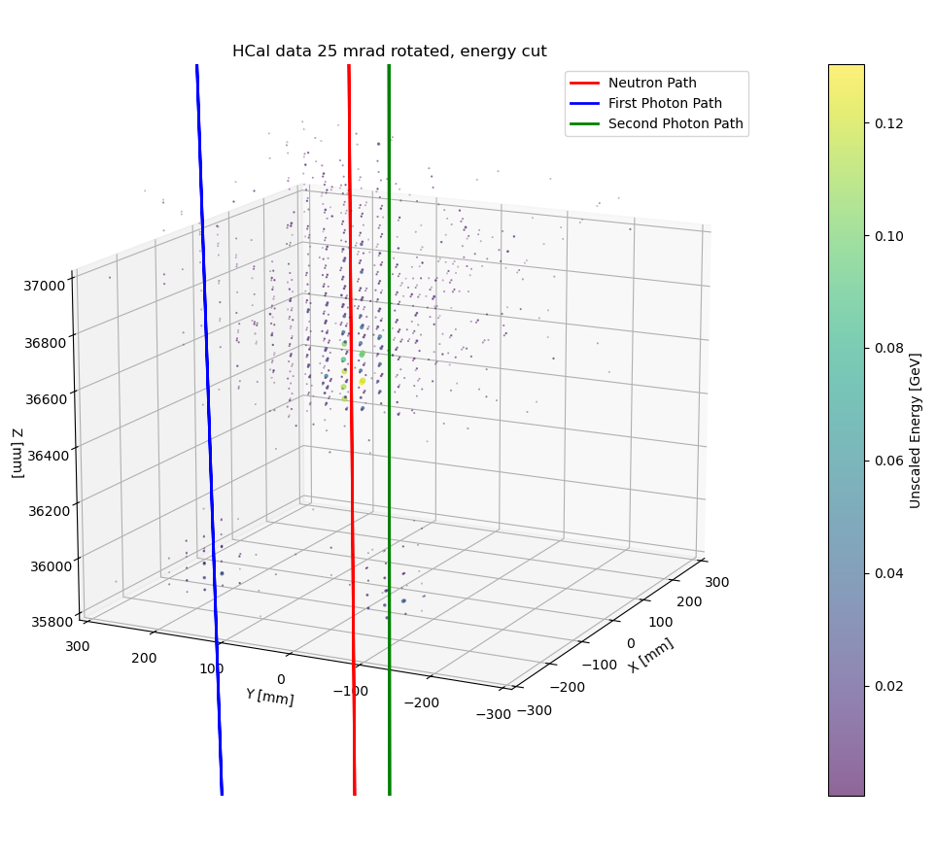
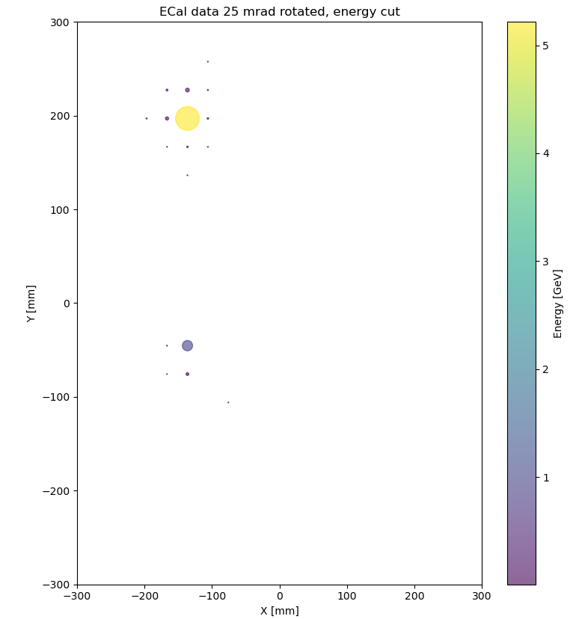
Event Display for deep neutron angular events

Slide 6
Unusual Events
The angle events look very similar to the no angle events, very few changes have to be made to cluster angular data
A few common categories of problems are:
Neutron and photon showers touch/over-lap in either ECal or HCal
No photon marks/small marks in the ECal (lower limit to photon energy)
Neutron shower leaves the ZDC (too close to the edges)
Photon overlap
The most common type of event is one photon close to the neutron, one far away
The photon shower often extends into the beginning of the neutron shower

Slide 7
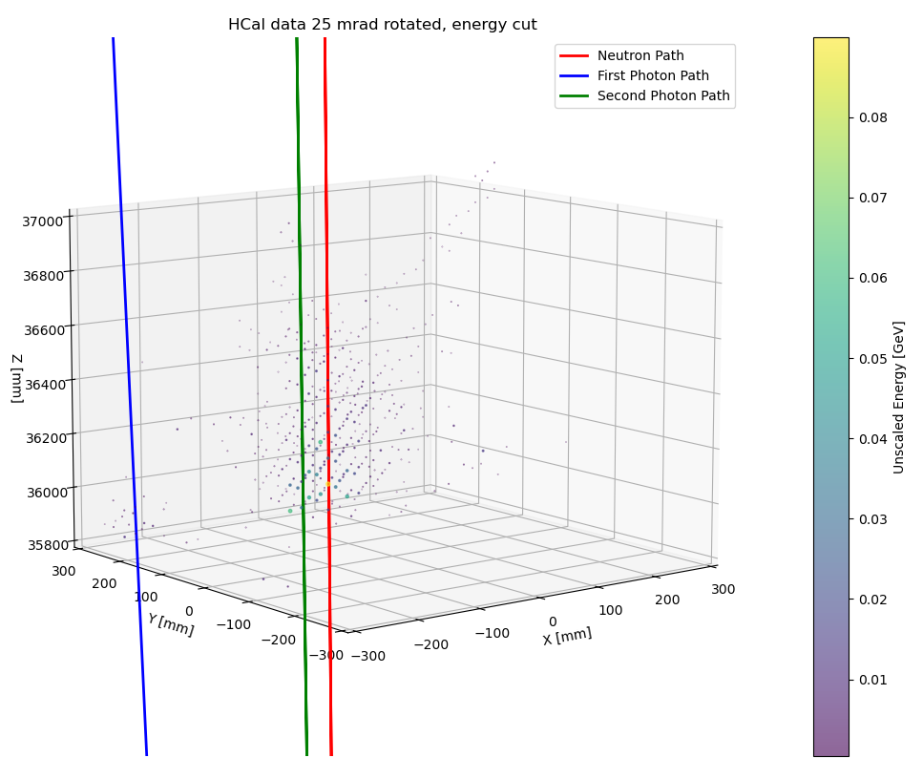
The most common problem: overlap
The most common is the overlap of neutron shower and photon shower
Sometimes the overlap is so bad, you can't tell a photon is there at all
Some cases can be clustered, some can't

Slide 8
Methods to separate these events
The easiest and most effective solution is to make the depth cut very deep (>36000 mm), but we quickly run out of statistics
If we do make restrictive depth cuts, we are left with 3k events in the angular data
Cutting on the distance between neutron endpoint and gamma endpoint removes some bad events, but does not entirely fix the problem

Slide 9
Peak Finding to Select Events
Used with the depth finding check
Search through ECal and HCal data to find all local maximums
Discard all events without 2 or 3 peaks in the ECal
Discard all events without atleast 2 or 3 matching peaks in HCal
Removes the most of the bad overlap events, but there is no guarantee the photon cluster will be distinct enough
Very sensitive to parameter selection

Slide 10
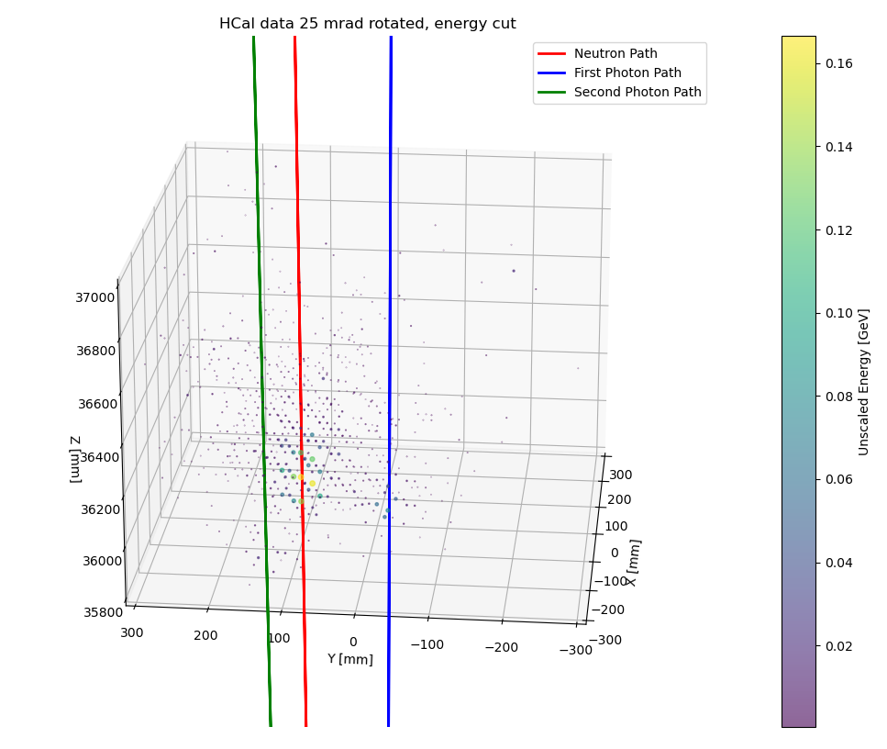
Slight Overlap
The noise between the neutron and the photon stumps algorithms
The only current way to solve it is to make a box around the photon center and only add lower energy hits

Slide 11
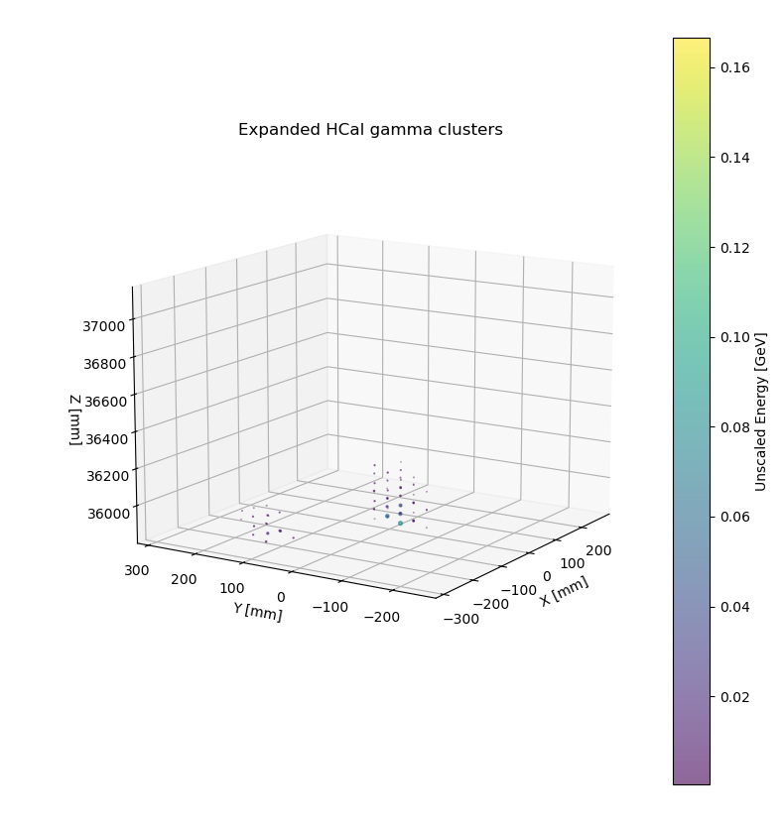
Slight Overlap clustering
Low tech clustering is done by taking the peak and making a cylinder around it
Only add hits with similar or lower energy than the core point
The algorithm cannot distinguish neutron shower from photon shower so it needs to be restrictive

Slide 12
Pi0 Vertex Reconstruction: Overview
Overview:
Use average hit position weighted by energy in the ECal and HCal to define position vectors for the photons using two points
Goal is to find the intersection point of both photon position vectors to determine the decay vertex of the pi0
Have been able to reconstruct the position vectors and determine the vertex of the pi0 though it is not currently a good estimate of actual pi0 vertex
Still working modifying the error estimation so that it accounts for energy as well as standard deviation

Slide 13
Pi0 Vertex Reconstruction: Method
Use average hit position weighted by energy in the ECal and HCal to define position vectors for the photons using two points (1 in ECal and 1 in HCal)
Determine the points on each vector when the vectors are closest together and use the midpoint of these points as the estimated vertex (The reconstructed vectors are likely skew so will not intersect exactly, this is the closest we can get to finding the pi0 vertex)

Slide 14
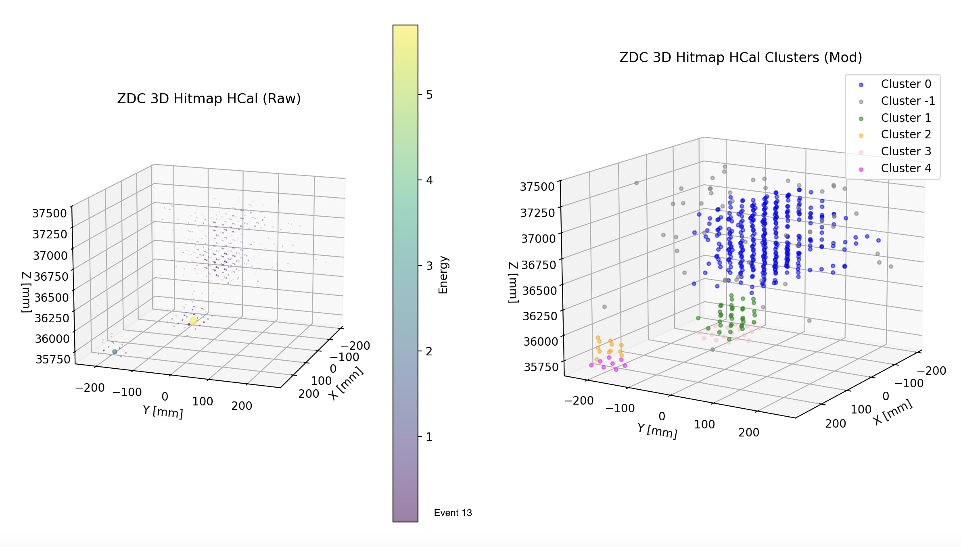
Pi0 Vertex Reconstruction
ZDC 3D Hitmap
ZDC 3D Hitmap Clusters

Slide 15
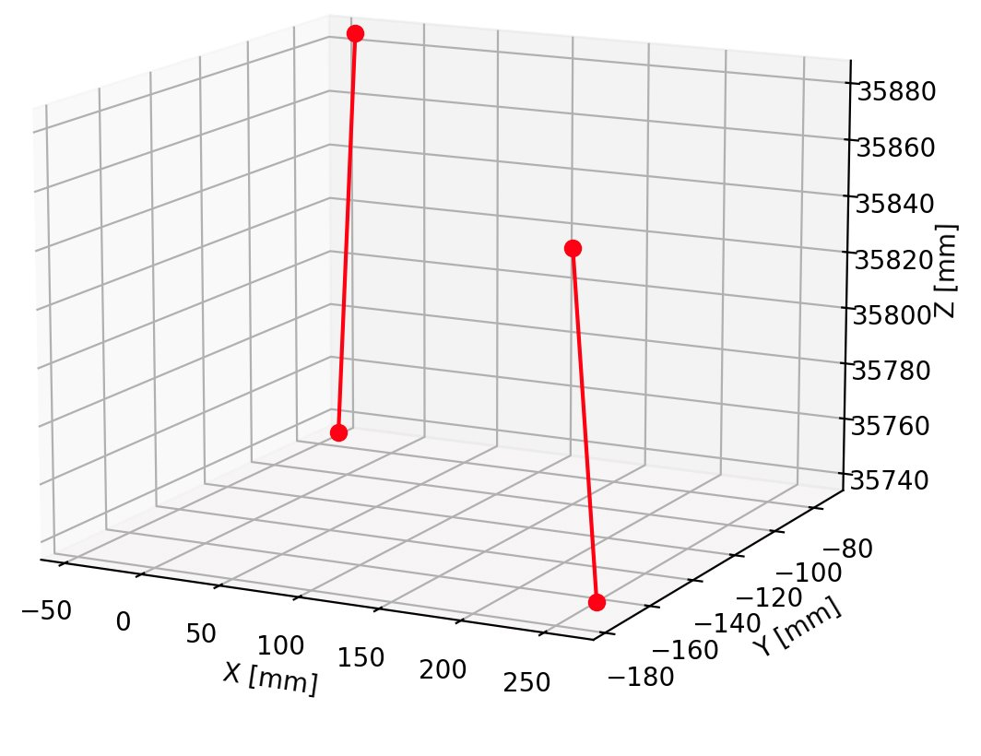
Pi0 Reconstruction
Reconstructed Photon Position Vectors
Estimated Pi0 vertex: [ 120.97403711 , -143.53297353, 36478.81265729]
True Pi0 vertex: [-98.68033482131233, -2.3103131354947007e-06, 3946.391048331116]
Current HCal hit estimate is not good. It should extend the position vector outwards but is doing the opposite making the estimated vertex beyond the ZDC when it should be in front of it
The HCal and ECal hit estimates are also too deep in the ZDC

Slide 16
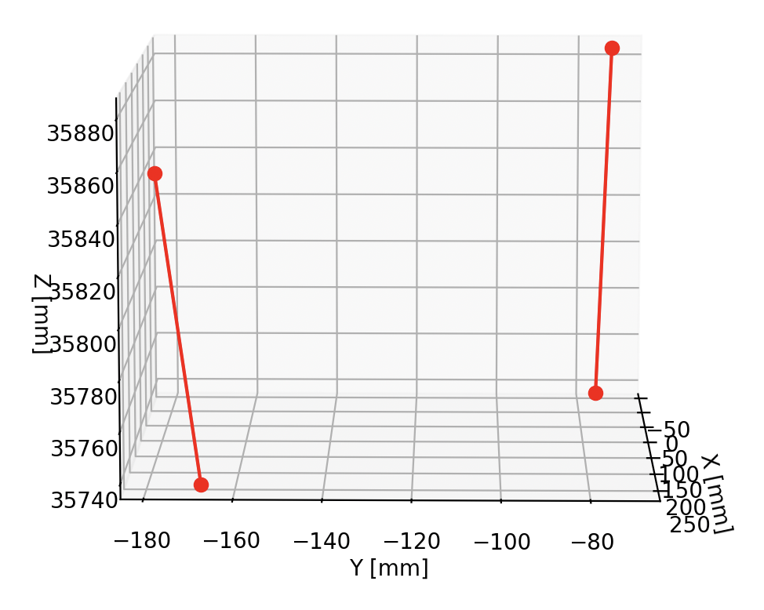
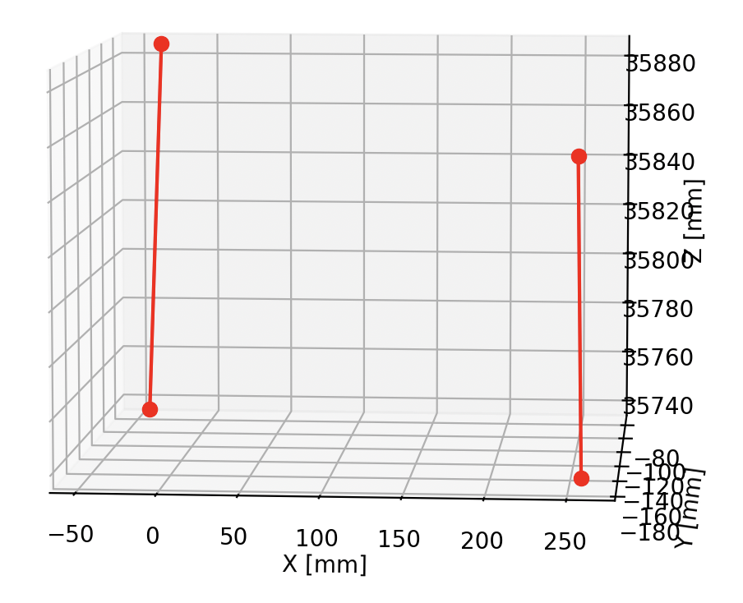
Pi0 Reconstruction
Reconstructed Photon Position Vectors (different angles)

Slide 17
Pi0 Reconstruction
Reconstructed Photon Position Vectors
Estimated Pi0 vertex: [ 120.97403711 , -143.53297353, 36478.81265729]
True Pi0 vertex: [-98.68033482131233, -2.3103131354947007e-06, 3946.391048331116]
Current HCal hit estimate is not good. It should extend the position vector outwards but is doing the opposite making the estimated vertex beyond the ZDC when it should be in front of it
The HCal and ECal hit estimates are also too deep in the ZDC

Slide 18
Pi0 Vertex Reconstruction: Next Steps
Correct average hit position calculation (normalizing energy weights from 0 to 1 might help)
Use energy weighted stdev to more accurately determine the error for estimated average hits
Find the average hit position layer by layer in the HCal (similar to the neutron) and use the point with the lowest error along with the ECal hit to reconstruct the position vector
Try and use relationship between photon distance in the ECal and the opening angle to more accurately estimate HCal hits ​
The position vectors need to be coplanar to intersect at an exact point. Should we ensure this before trying to estimate the decay vertex?

Slide 19
Backup

Slide 20
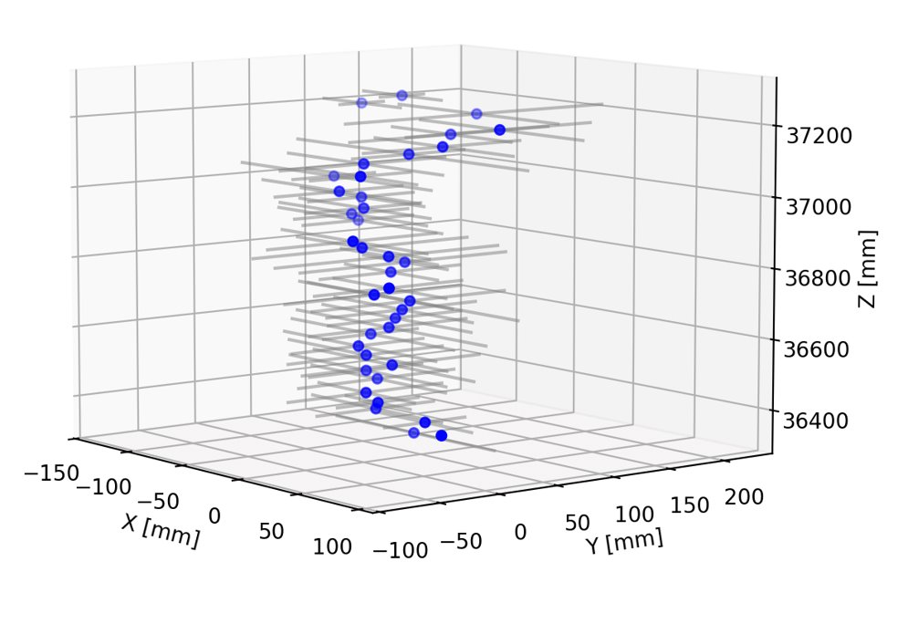
Neutron Reconstruction
Reconstructed Neutron hits with Error (stdev only)

Slide 21
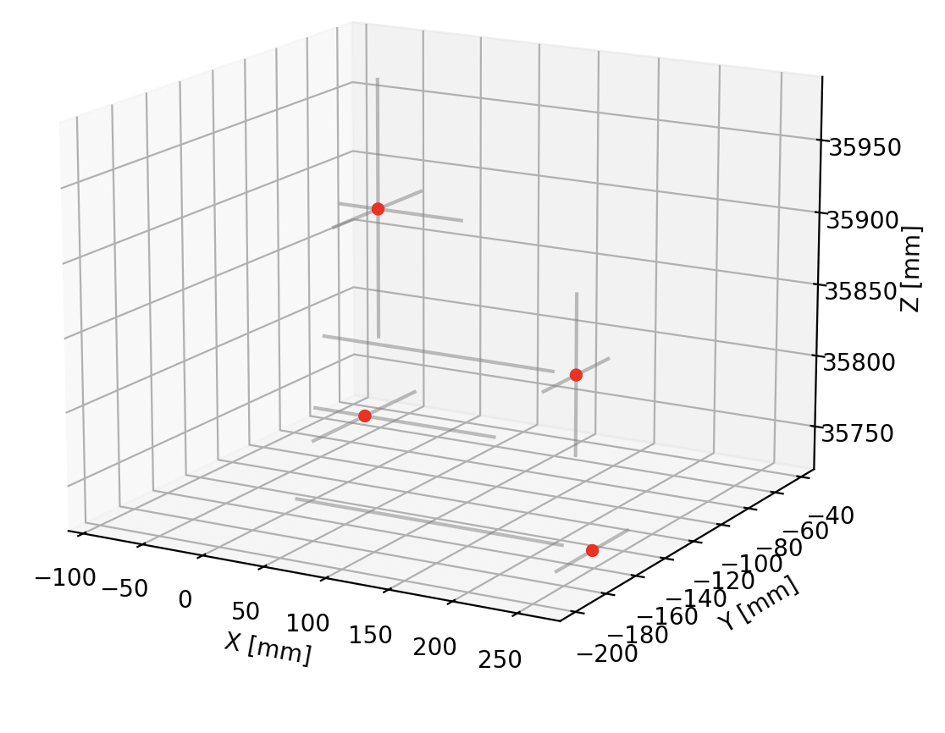
Pi0 Vertex Reconstruction
Reconstructed Photon Hits with Error (stdev only)

Slide 22
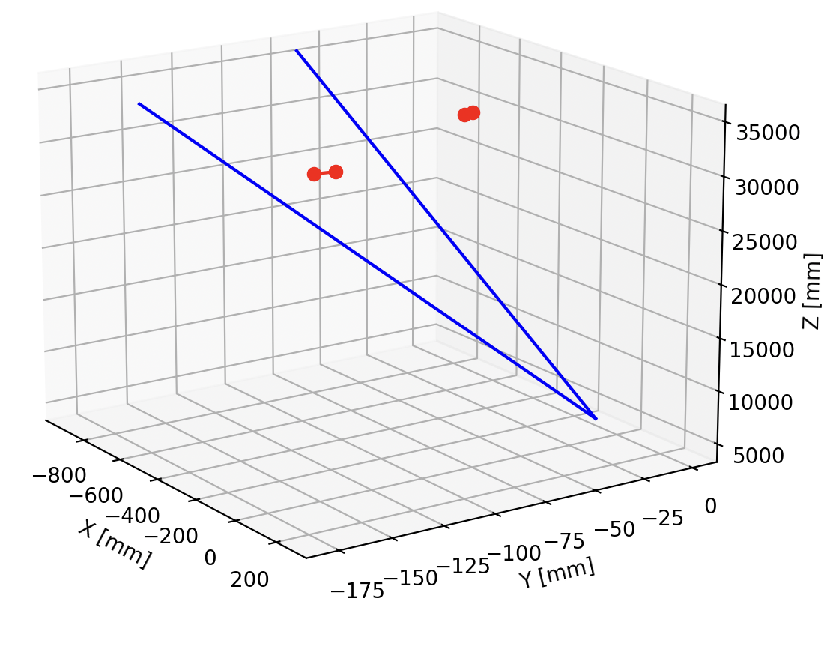
Pi0 Vertex Reconstruction
Reconstructed Photon Vectors (red) and True Photon Vectors (blue)

