Slide 1
Estimation of ADC Value
6X0 LYSO + APD
6X0 PbWO4 + SiPM
With
50MeV electron, 800MeV electron
1GeV gamma, 40GeV gamma

Slide 2
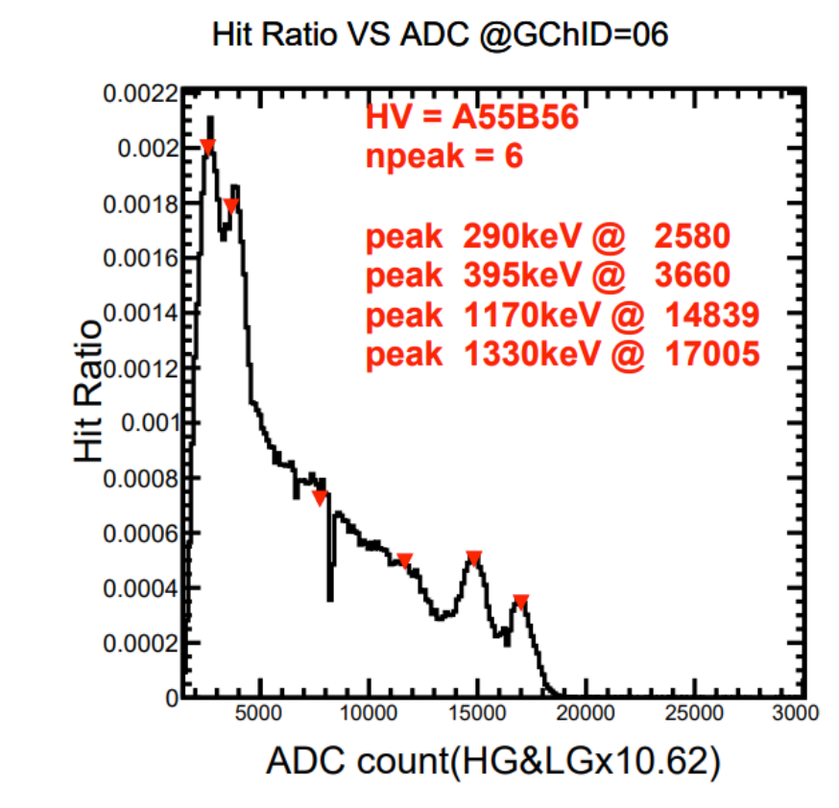
SiPM + LYSO + AS ADC + Co60
From the calibration study with Co60
27V, 2580/0.29 (digits/MeV)
ADC dynamic range upper limit: 11, 000
@HV = 27.00V
Check if the estimated ADC value is within the ADC dynamic range:
ADC_{est.} = $\frac{2580 (ADC)}{0.29 (MeV)}×F_{scale}×E_{max}$
Conversion factor, using LYSO+SiPM
Provided by MC
Scale factor, accounting for the use of LYOS/PbWO₄ or SiPM/APD

Slide 3
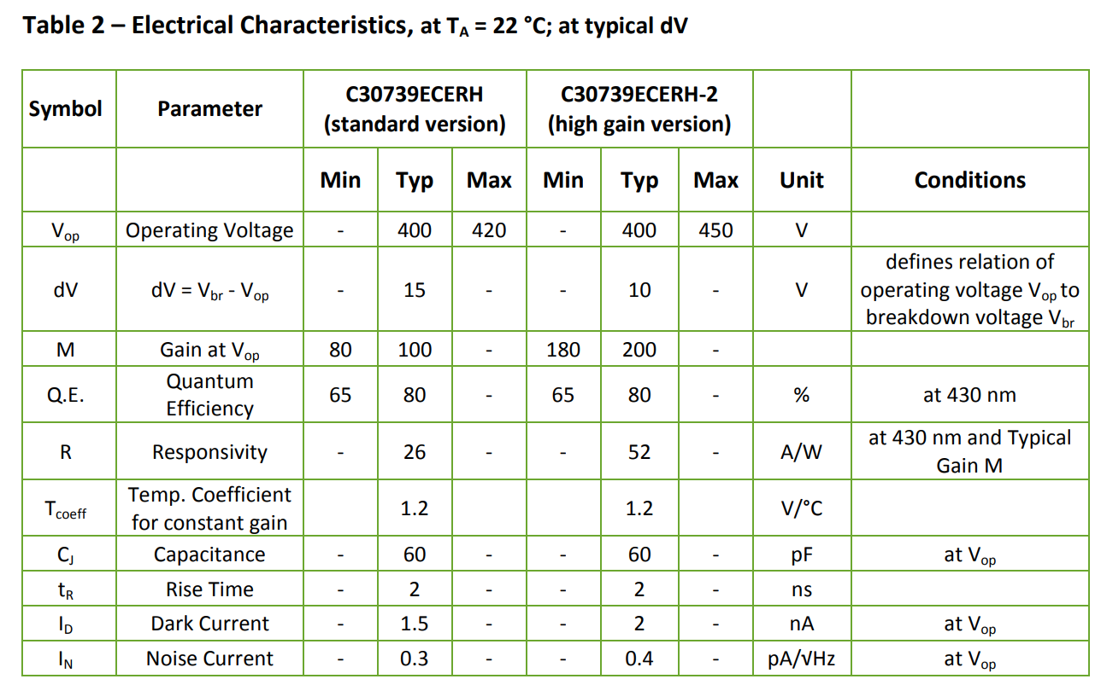
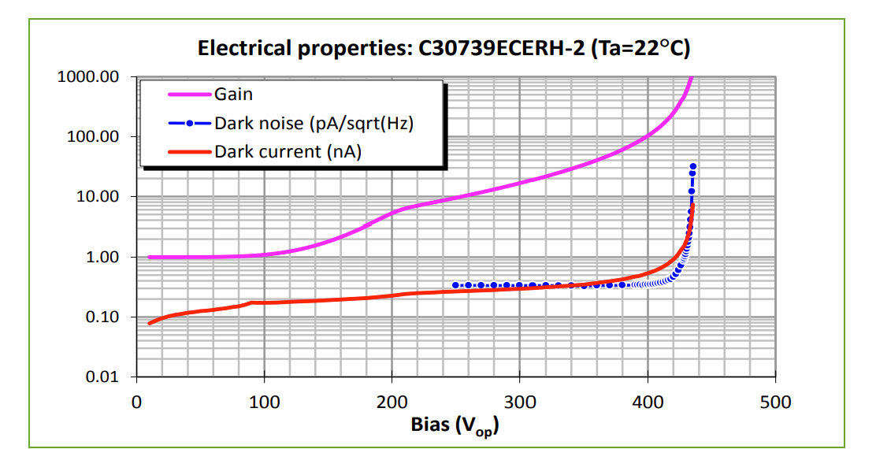
Gain of APD
https://www.excelitas.com/product/c30739ecerh-2-si-apd-ceramic-carrier-high-gain
Gain
1 @ 100V
100 @ 400V
Notes:
Operating voltage around 400V

Slide 4
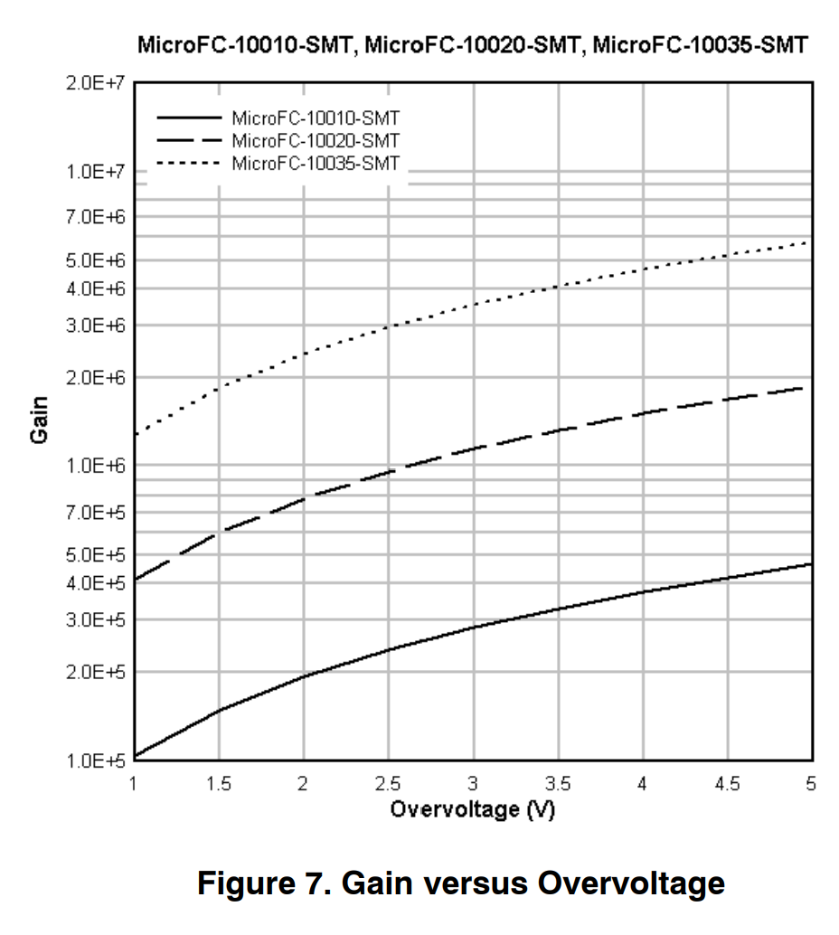
Gain of SiPM
https://www.onsemi.com/pdf/datasheet/microc-series-d.pdf
Gain = 1e6 to 5e6
Depends on temperature and HV applied

Slide 5
Estimation of ADC Value
//============== Inputs ===================
LYSO + SiPM : 2580/0.29 (digits/MeV)
SiPM gain = 1e6 ~ 5e6 (here use 1e6)
APD gain = 1 ~ 100 (here use 100)
LYSO Light yield = 25e3-35e3 photons/MeV (here use 3.0e4 photons/MeV)
PbO4 light yield = 1e2-2e2 photons/MeV (here use 1.5e2 photons/MeV)
//============== 6X0 LYSO + APD ===================
ADC digits = [(2580/0.29)/1e6*1e2]*Emax = 0.89*Emax
ADC dynamic range = 11, 000
50MeV electron , Emax = 21.5 , ADC = 19.18 => might be too low, close to noise level
800MeV electron, Emax = 240.1, ADC = 213.689
1GeV gamma , Emax = 248.6, ADC = 221.254
40GeV gamma , Emax = 3190, ADC= 2839.1
//============== 6X0 PbWO4 + SiPM ===================
ADC digits = [(2580/0.29)/3e4*1.5e2]*Emax = 44.48*Emax
ADC dynamic range = 11, 000
Saturation of SiPM ~ 3000 ADC
50MeV electron , Emax = 22.43, ADC =997.8
800MeV electron, Emax = 266.7, ADC = 11,862.8 => out of linear range of SiPM
1GeV gamma , Emax = 284.0, ADC = 12,632.32 => out of linear range of SiPM also ADC dynamic range
40GeV gamma , Emax = 4198 , ADC = 18,6727 => out of linear range of SiPM also ADC dynamic range

