Slide 1
Physics of Lambda Baryon Detection at the ePIC ZDC
Gursimran Kainth
University of Connecticut
October 10, 2024

Slide 2
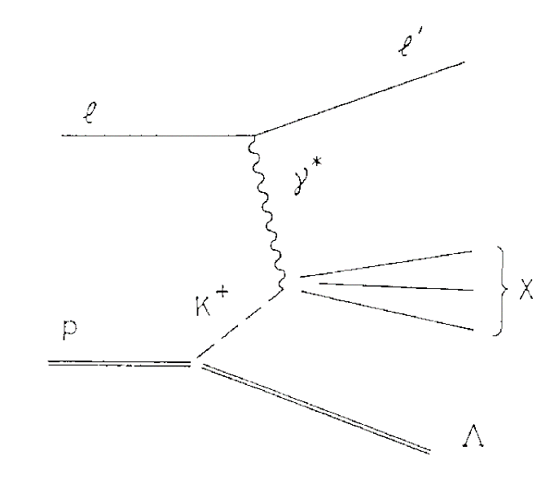
Physics at EIC and the Sullivan Process
EIC offers opportunity for visualization of nucleon/nuclei structure and study role of gluons in matter via electron-proton/ion collisions
Sullivan process: virtual photon scatters off virtual meson emitted by target proton
One goal of the ZDC is to reconstruct vertex/energy of neutral channel Lambda baryons produced via the Sullivan process to study Kaon structure
Neutral Channel:
Hwang, WY.P., Wen, CY.
"Semi-inclusive Λ production and generalized sullivan processes". Z Phys A - Particles and Fields 358, 415–422 (1997).
Notes:
Electron Ion Collider (EIC) and ePIC (enhanced Particle Identification and Calorimetry)

Slide 3
Event Selection and Data Generation
Data Generation:
MC data generated via Geant4 ddsim particle gun
Kinematic Study: ~200k unpolarized Lambda baryons (10-270 GeV) shot at ZDC center
Resolution Study: ~1k photons (0-50 GeV) shot at various angles on ZDC face
True MC hit data (no EIC reconstruction software used)
MC hit data shows integrated energy in scintillating pads (summed and reported at pad center)
No background from beam or Sullivan process
Cuts:
Remove beampipe interaction events
Exclude non-neutral channel decays (Lambda, Pi0)
Acceptance cut (Event Selection Cut): All three daughter particles must hit and shower in ZDC (allowing the reconstruction of Lambda baryons)

Slide 4
Event View
ZDC 3D Hit map (MC Data)*
ZDC 3D Hit map (Clustered MC Data)
Left plot: True MC energy weighted hits for a single Lambda event.
neutrons shower deep in HCal (top cluster)
photons shower early in ECal (bottom two clusters)
Right plot: Same True MC hit information but unweighted and clustered using a modified DBSCAN algorithm.
*Energy for the MC HCal hits has not been scaled using the sampling fraction

Slide 5
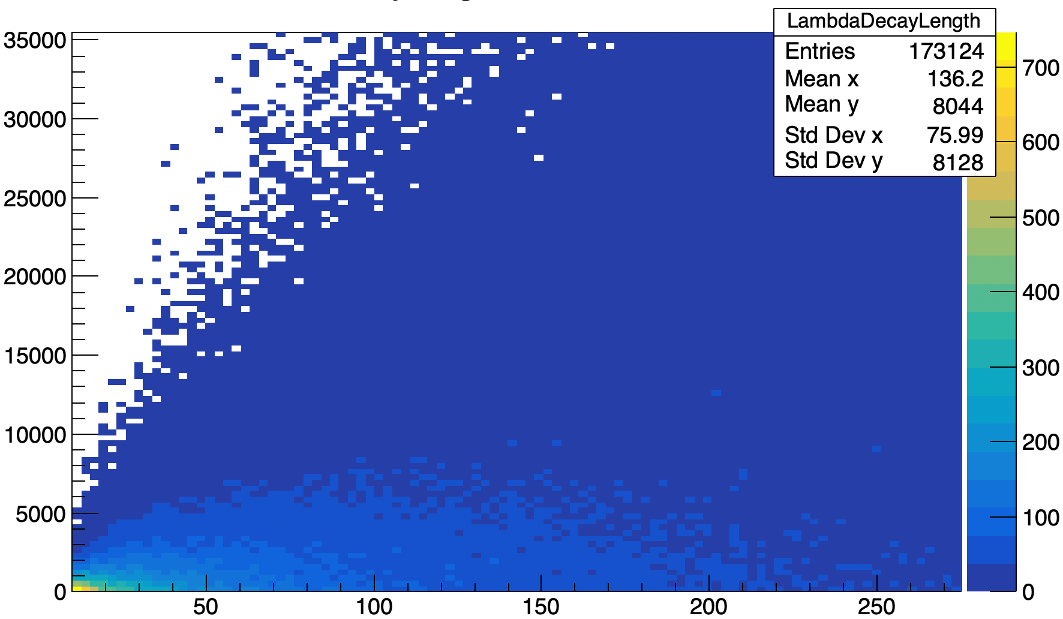
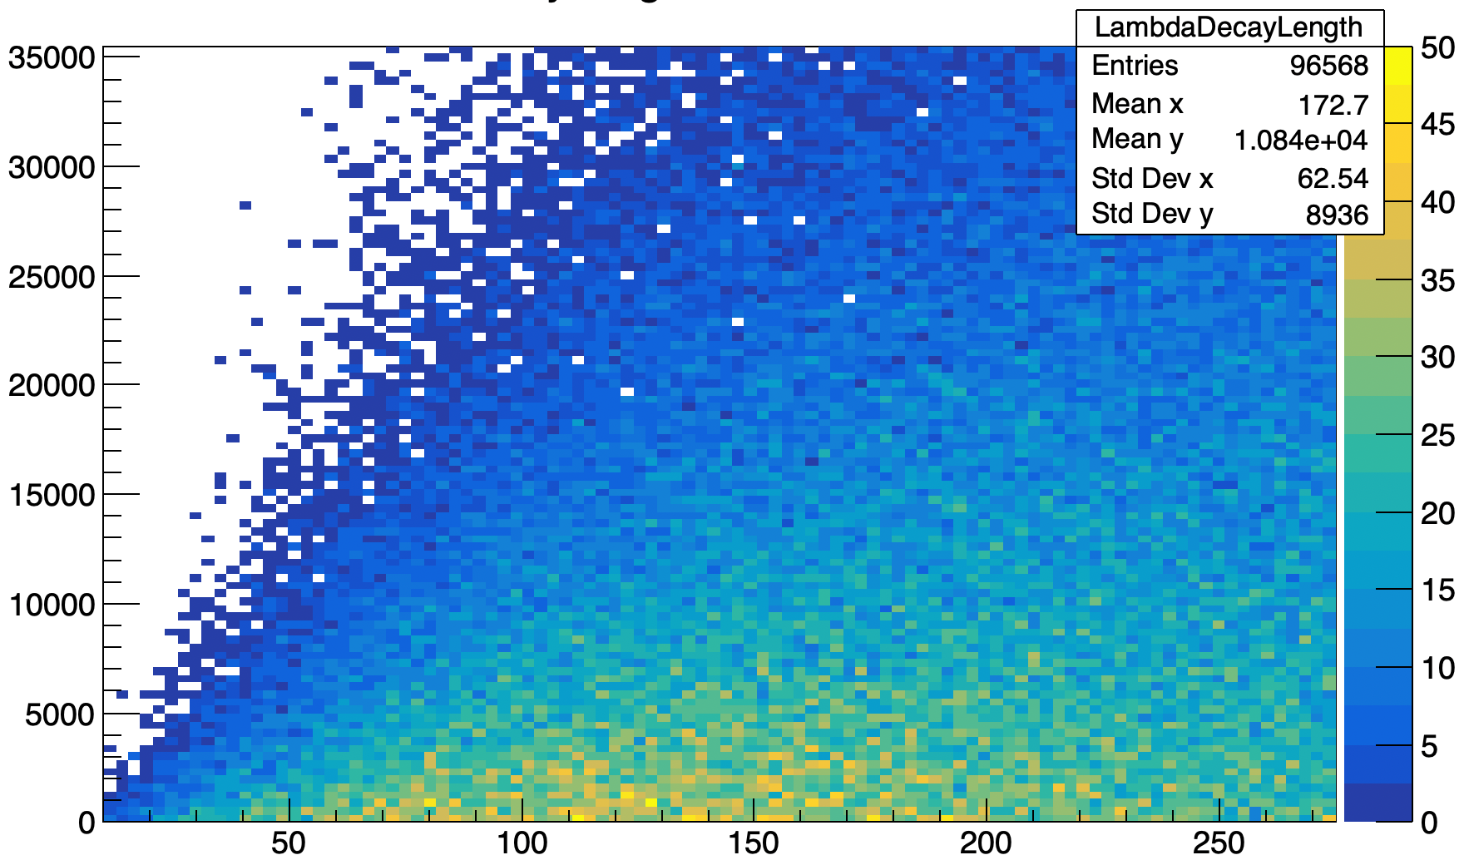
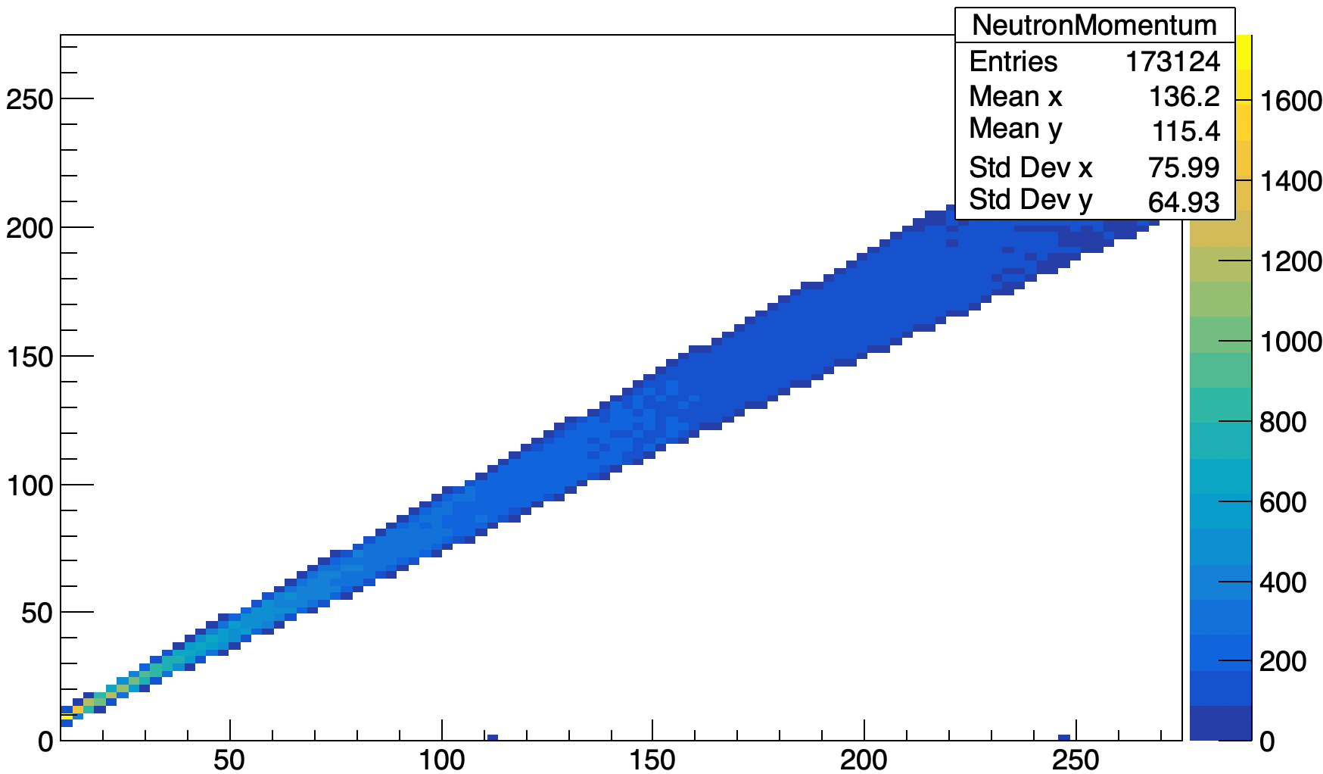
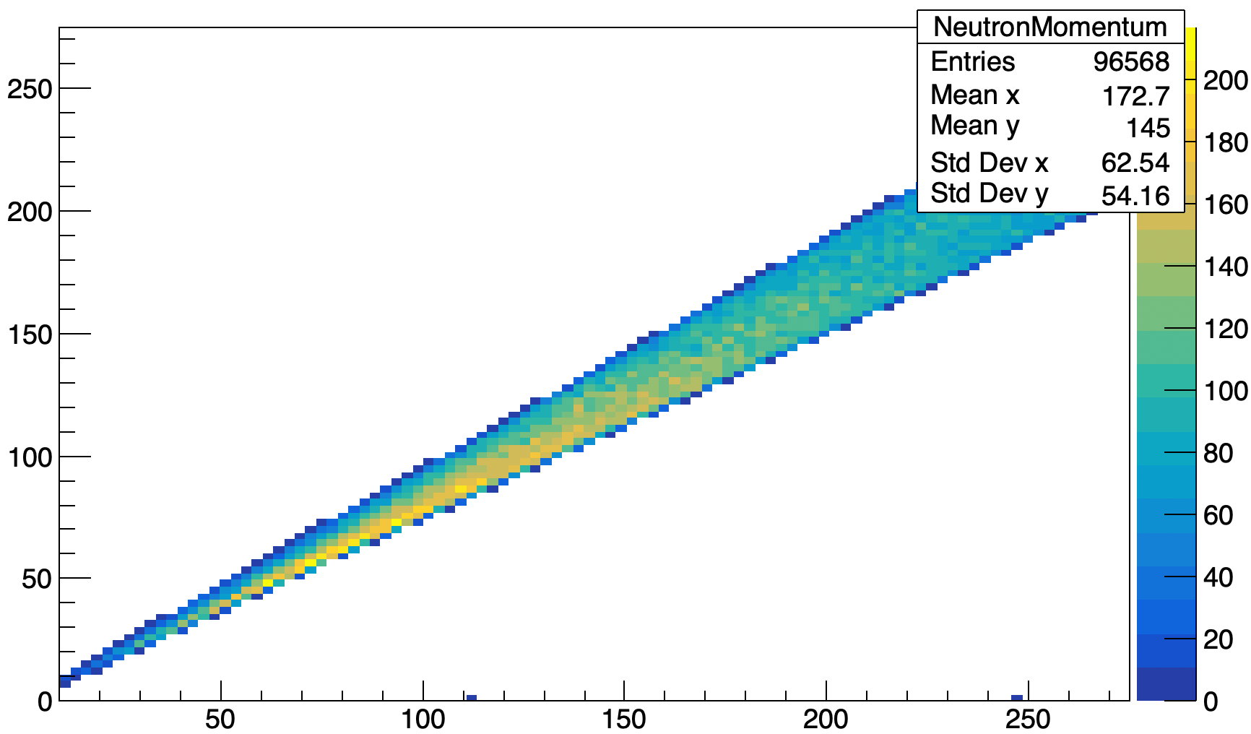
ZDC Acceptance
Λ Decay Length vs. Λ Momentum
Λ Decay Length vs. Λ Momentum (Acceptance Cut)
*Left plots: All events
*Right plots: Events that pass selection criteria
Λ Decay Length [mm]
Λ Decay Length [mm]
Acceptable kinematics:
The majority of Lambda baryon decays happens within 15m of the interaction point
Decay length follows an exponential decay pattern
Neutron momentum of 50-150 GeV
Λ Momentum [GeV]
Λ Momentum [GeV]
n Momentum vs. Λ Momentum
n Momentum vs. Λ Momentum (Acceptance Cut)
n Momentum [GeV]
n Momentum [GeV]
Λ Momentum [GeV]
Λ Momentum [GeV]

Slide 6
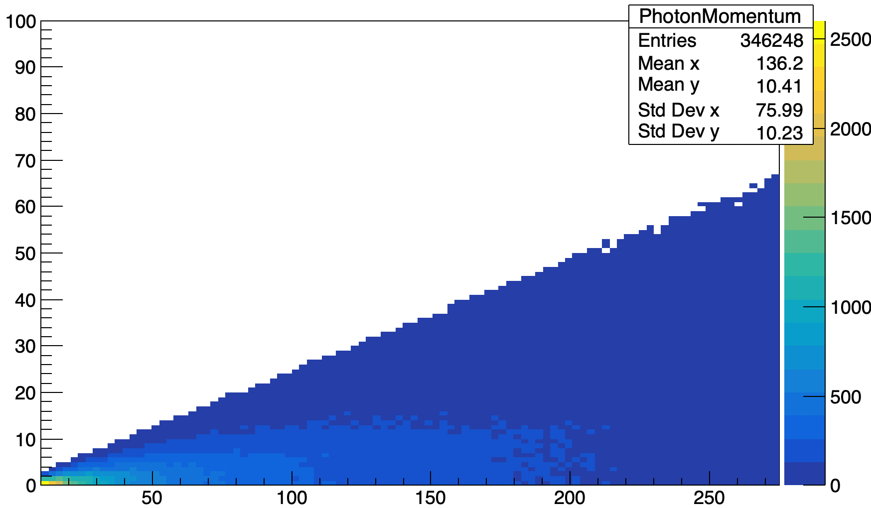
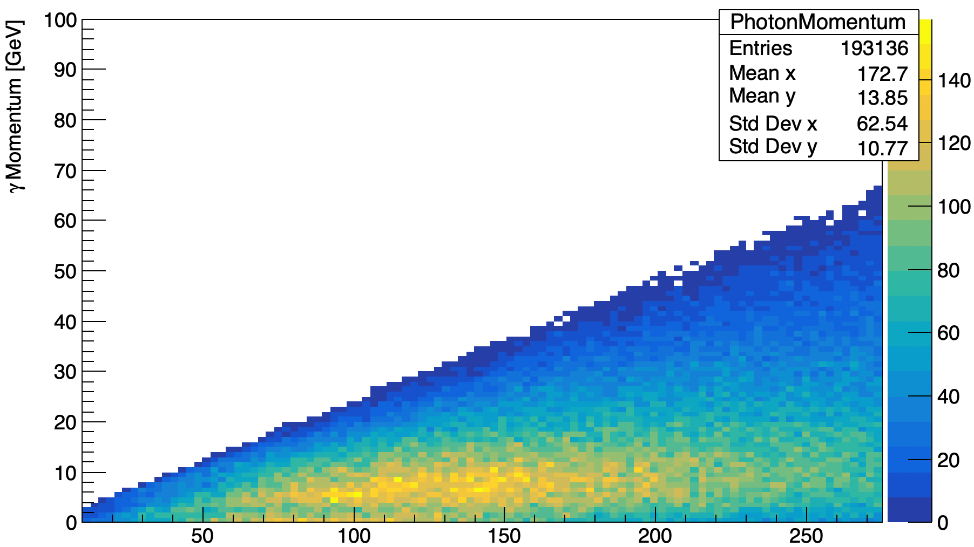
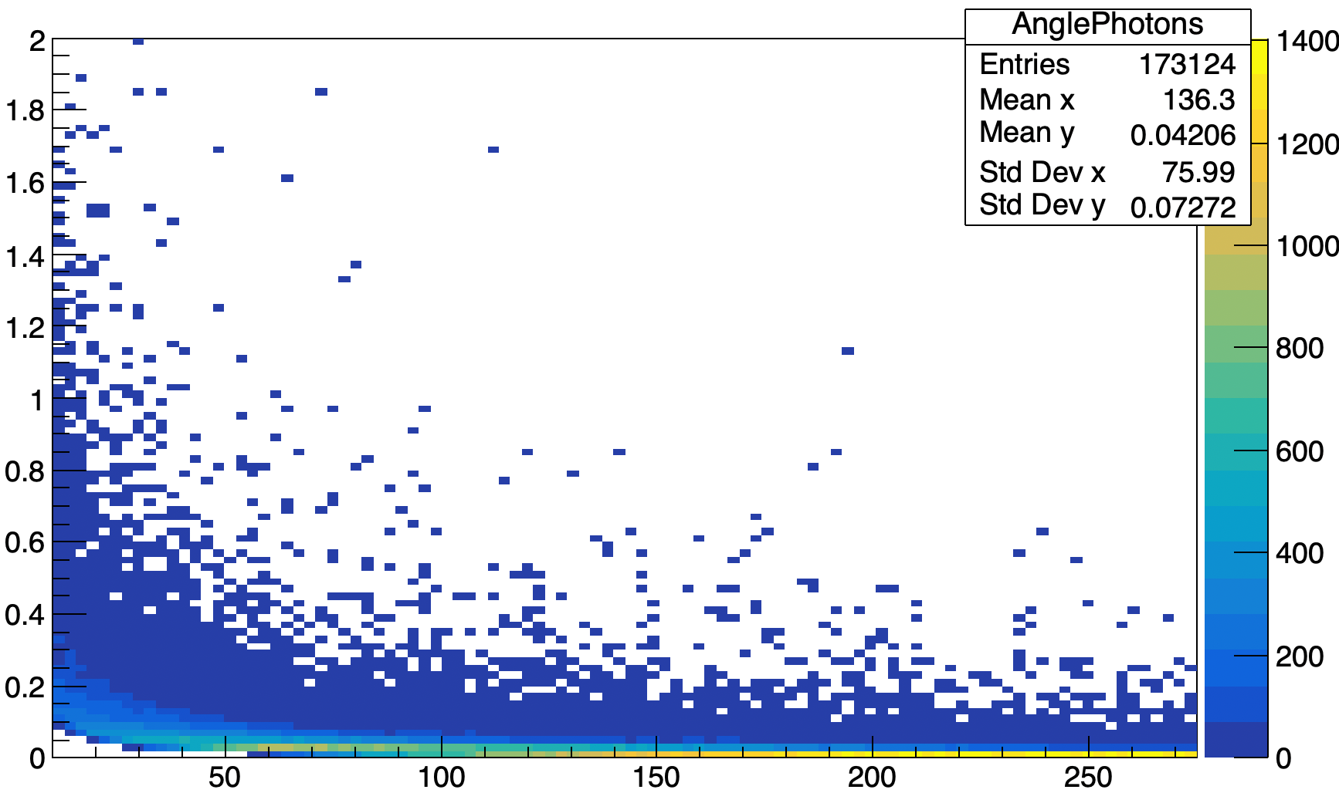
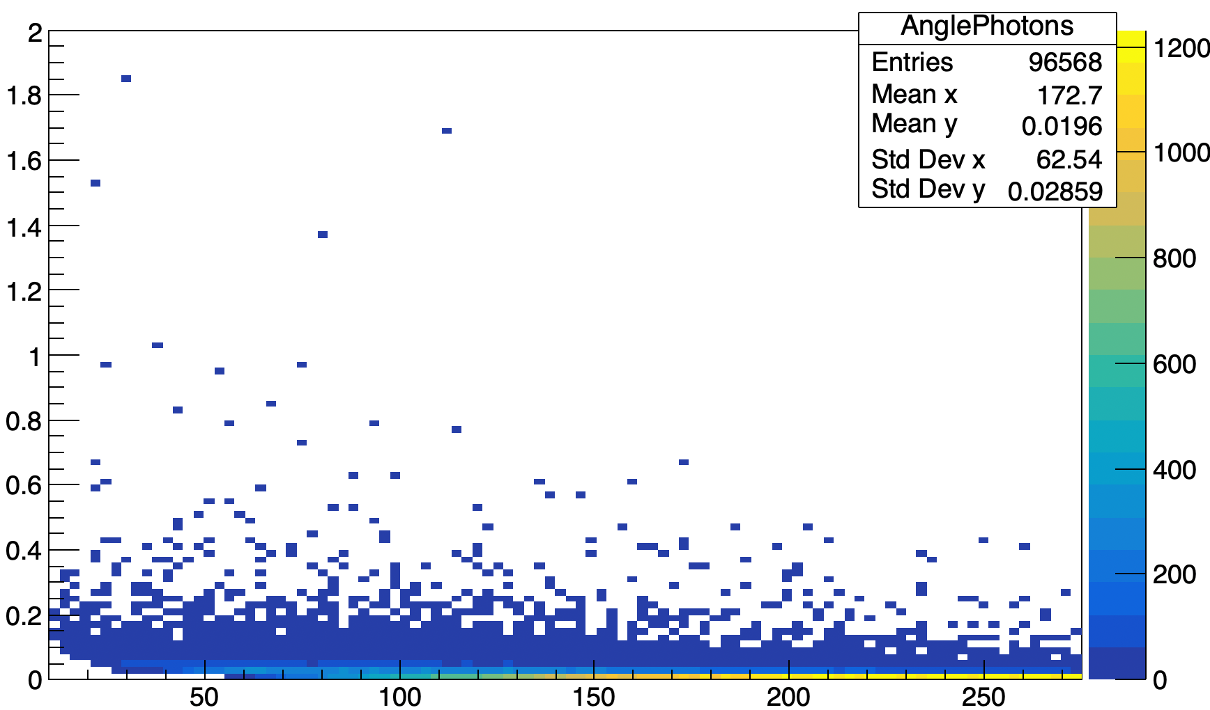
ZDC Acceptance
γ Momentum vs. Λ Momentum
γ Momentum vs. Λ Momentum (Acceptance Cut)
*Left plots: All events
*Right plots: Events that pass selection criteria
γ Momentum [GeV]
γ Momentum [GeV]
Acceptable kinematics:
Photon momentum under 20 GeV
*Angle between photons under 0.2 rad
Λ Momentum [GeV]
Λ Momentum [GeV]
Angle between γ’s vs. Λ Momentum
Angle between γ’s vs. Λ Momentum (Acceptance Cut)
Angle [Rad]
Angle [Rad]
*Angle between photons indicates if their showers are contained within the ZDC
Λ Momentum [GeV]
Λ Momentum [GeV]

Slide 7
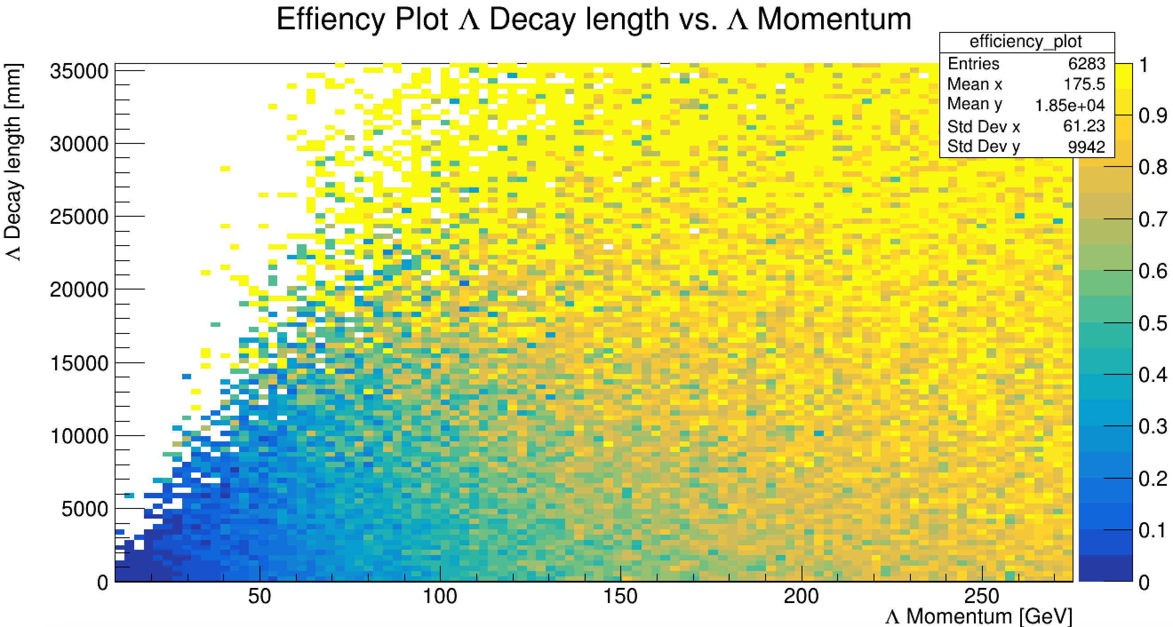
ZDC Acceptance
Efficiency Plot Λ Decay Length vs. Λ Momentum
Highest Efficiency:
Lambda baryons with higher momentum and later decays have a higher change of reaching the ZDC
Reconstruction:
Result in overlapping showers from neutron and photons
Λ Decay Length [mm]
Λ Momentum [GeV]
"Lambda decay length vs momentum" after acceptance cut divided by "Lambda decay length vs momentum" before cut

Slide 8
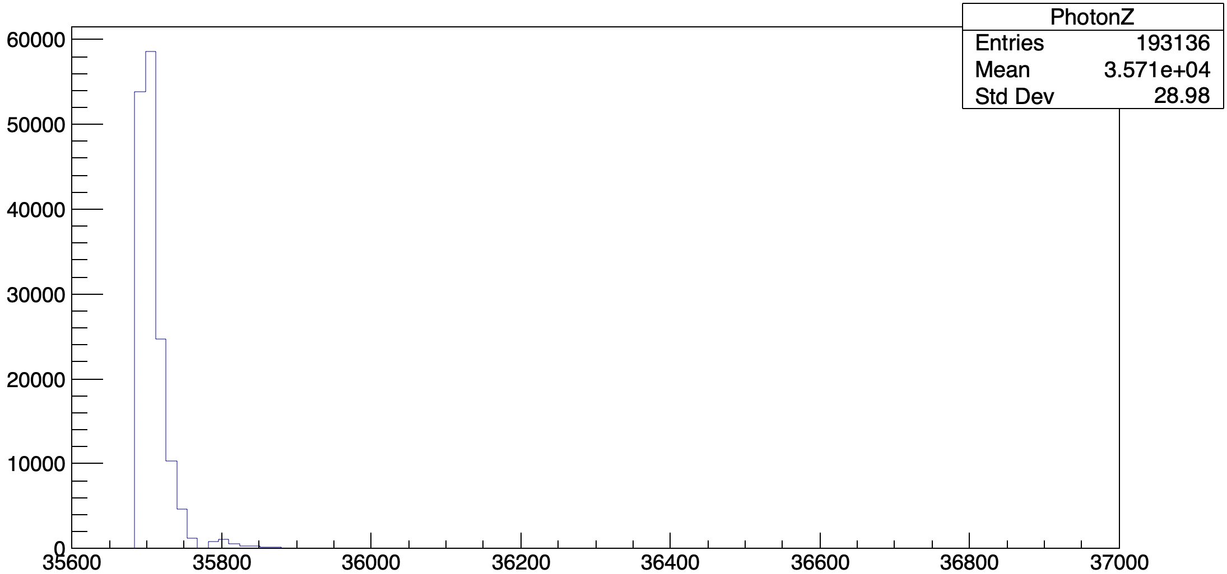
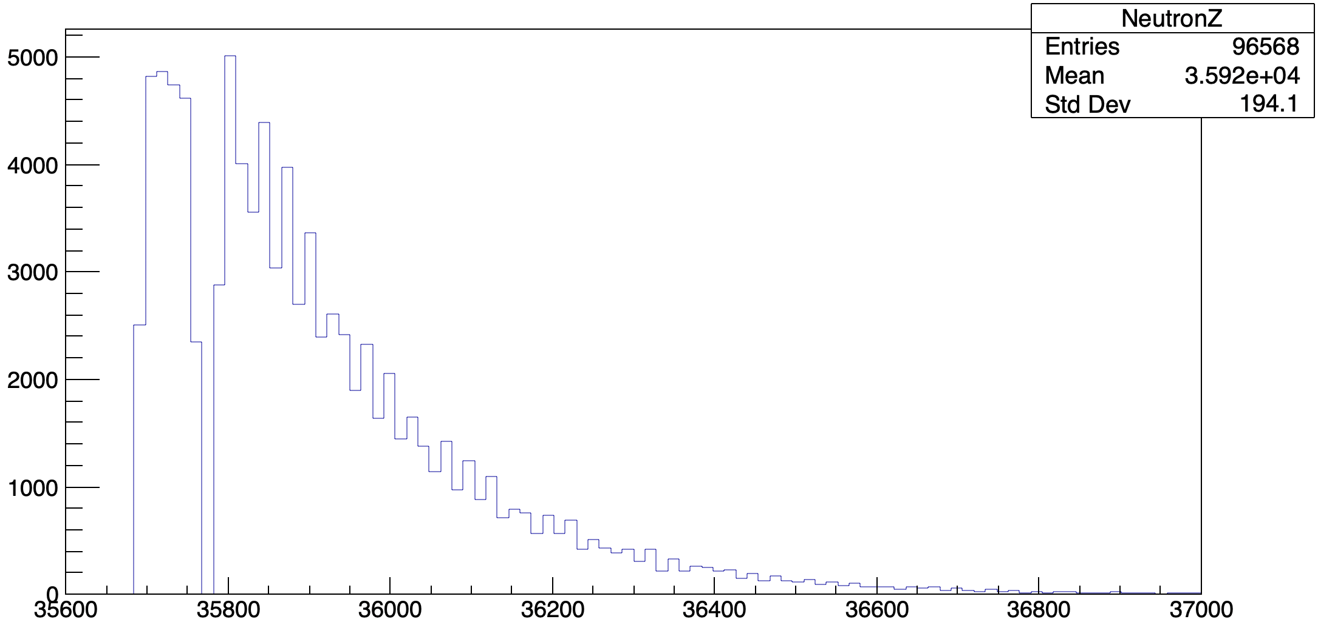
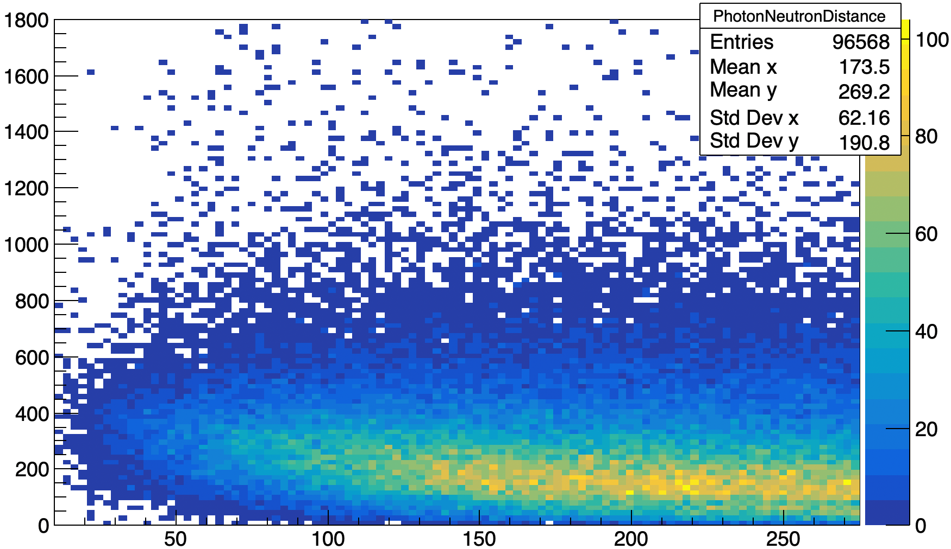
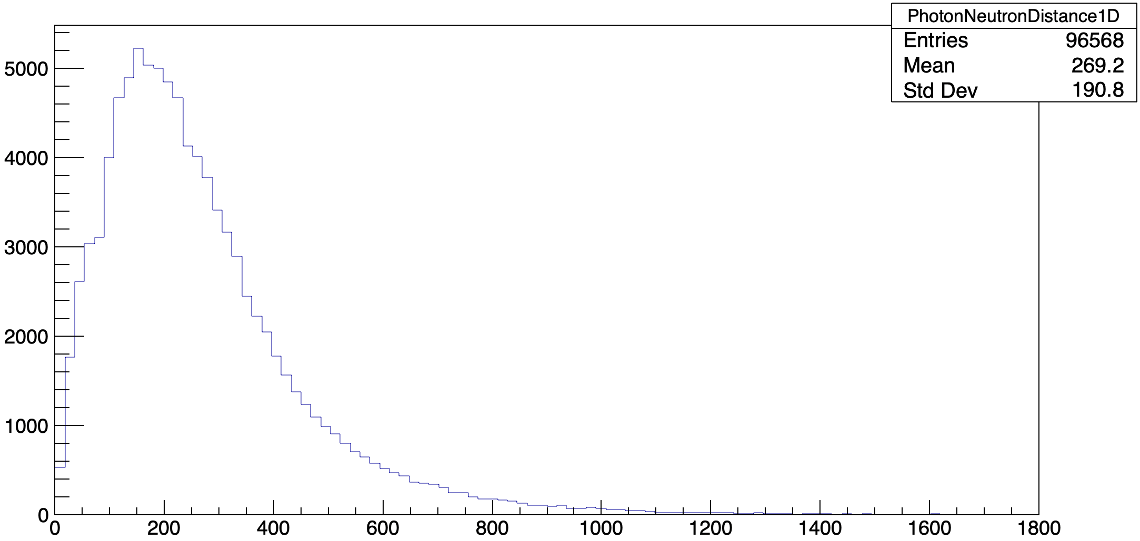
ZDC Acceptance
γ Endpoint (Z) (Acceptance Cut)
n Endpoint (Z) (Acceptance Cut)
*All plots show events that pass selection criteria
Count
Count
Reconstruction kinematics:
Photons showers mostly in ECal
Neutrons shower in ECal and HCal
Neutrons typically shower within 200 mm of closest photon – shower overlap is common
Endpoint (Z) [mm]
Endpoint (Z) [mm]
Distance between closest γ and n vs. Λ Momentum (Acceptance Cut)
Distance between closest γ and n (Acceptance Cut)
Distance [mm]
Count
Λ Momentum [GeV]
Distance [mm]

Slide 9
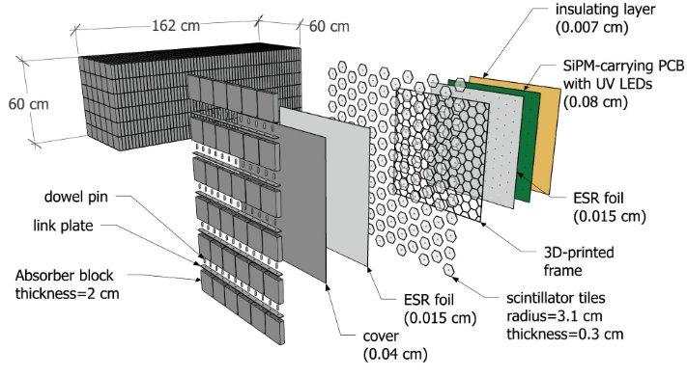
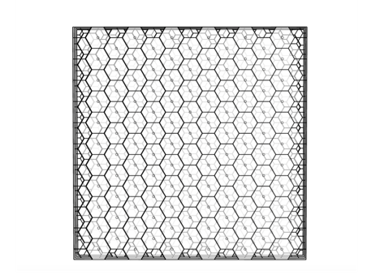
HCal Angular Resolution
HCal:
Steel absorber layers
Staggered scintillator layers coupled with the SiPMs
Overlap in four consecutive layers forms rhombus-shaped sub-cells, each 1/12 the area of hexagonal cells, enhancing position resolution
Source: arXiv:2406.12877
Source: arXiv:2406.12877

Slide 10
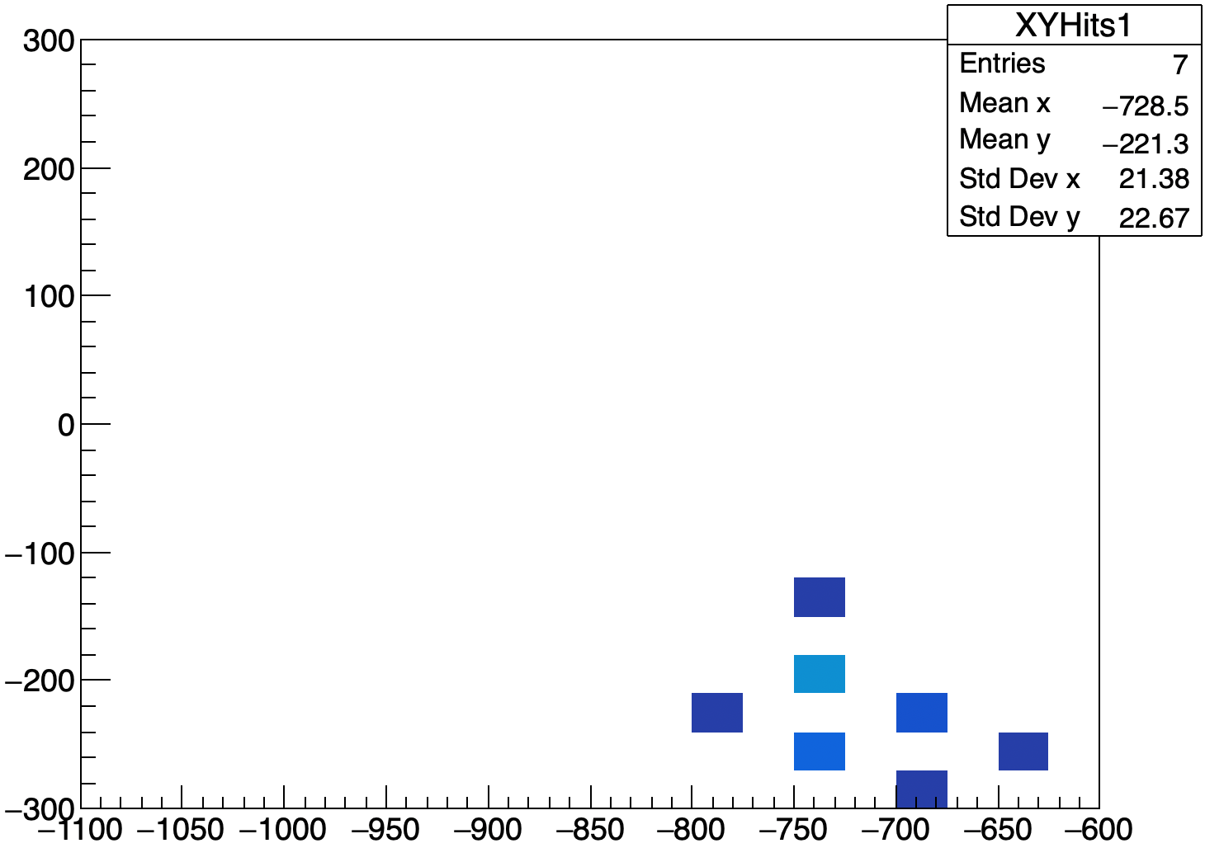
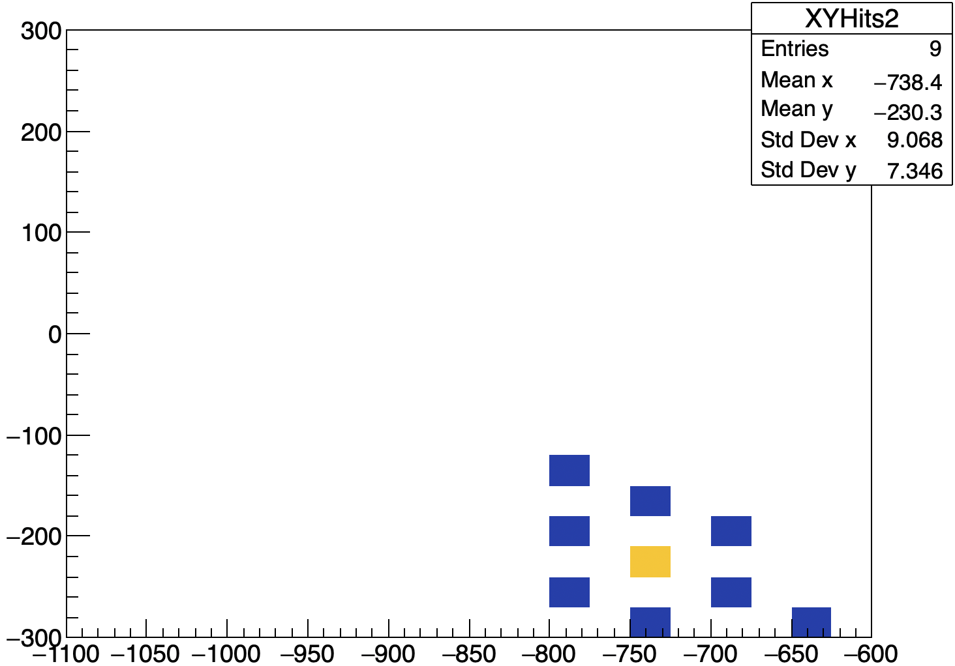
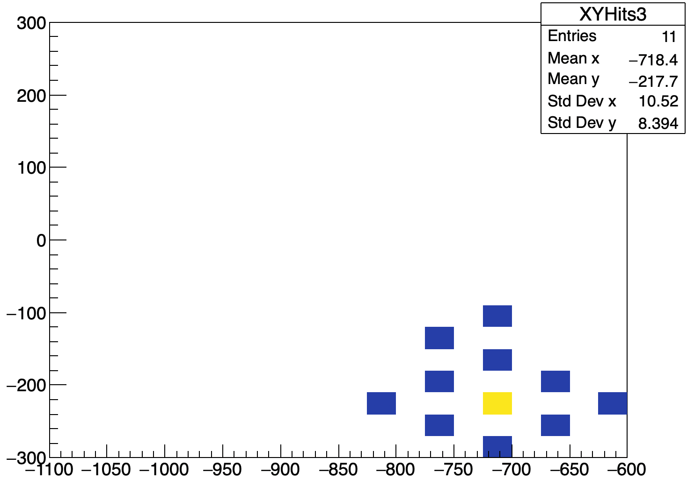
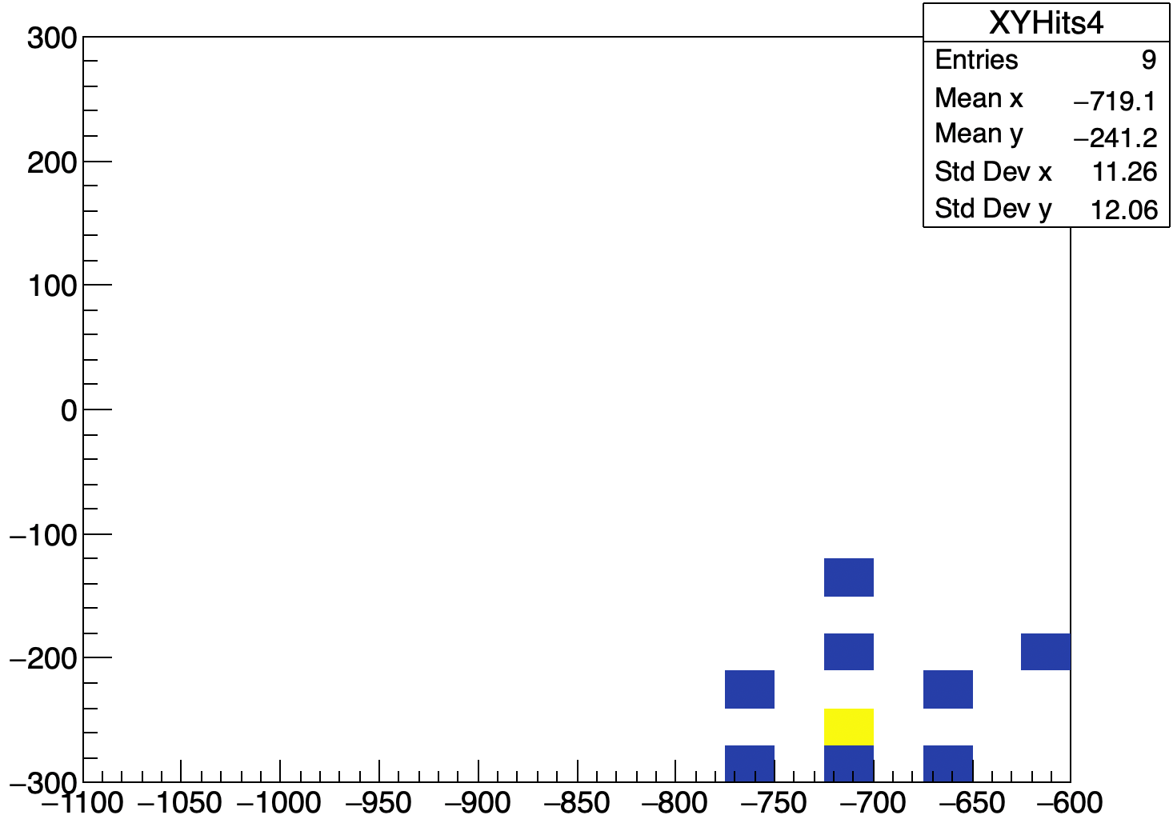
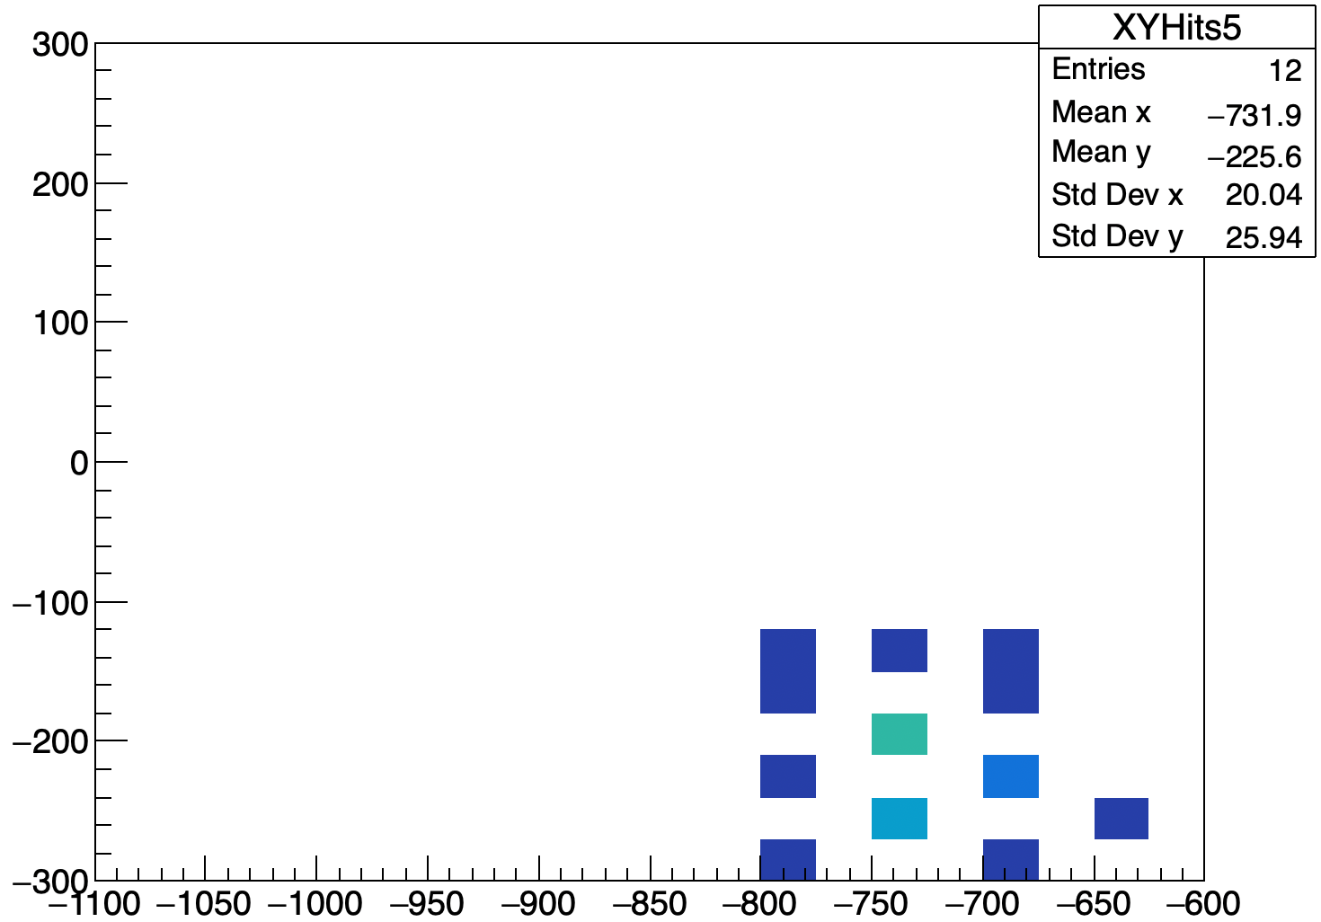
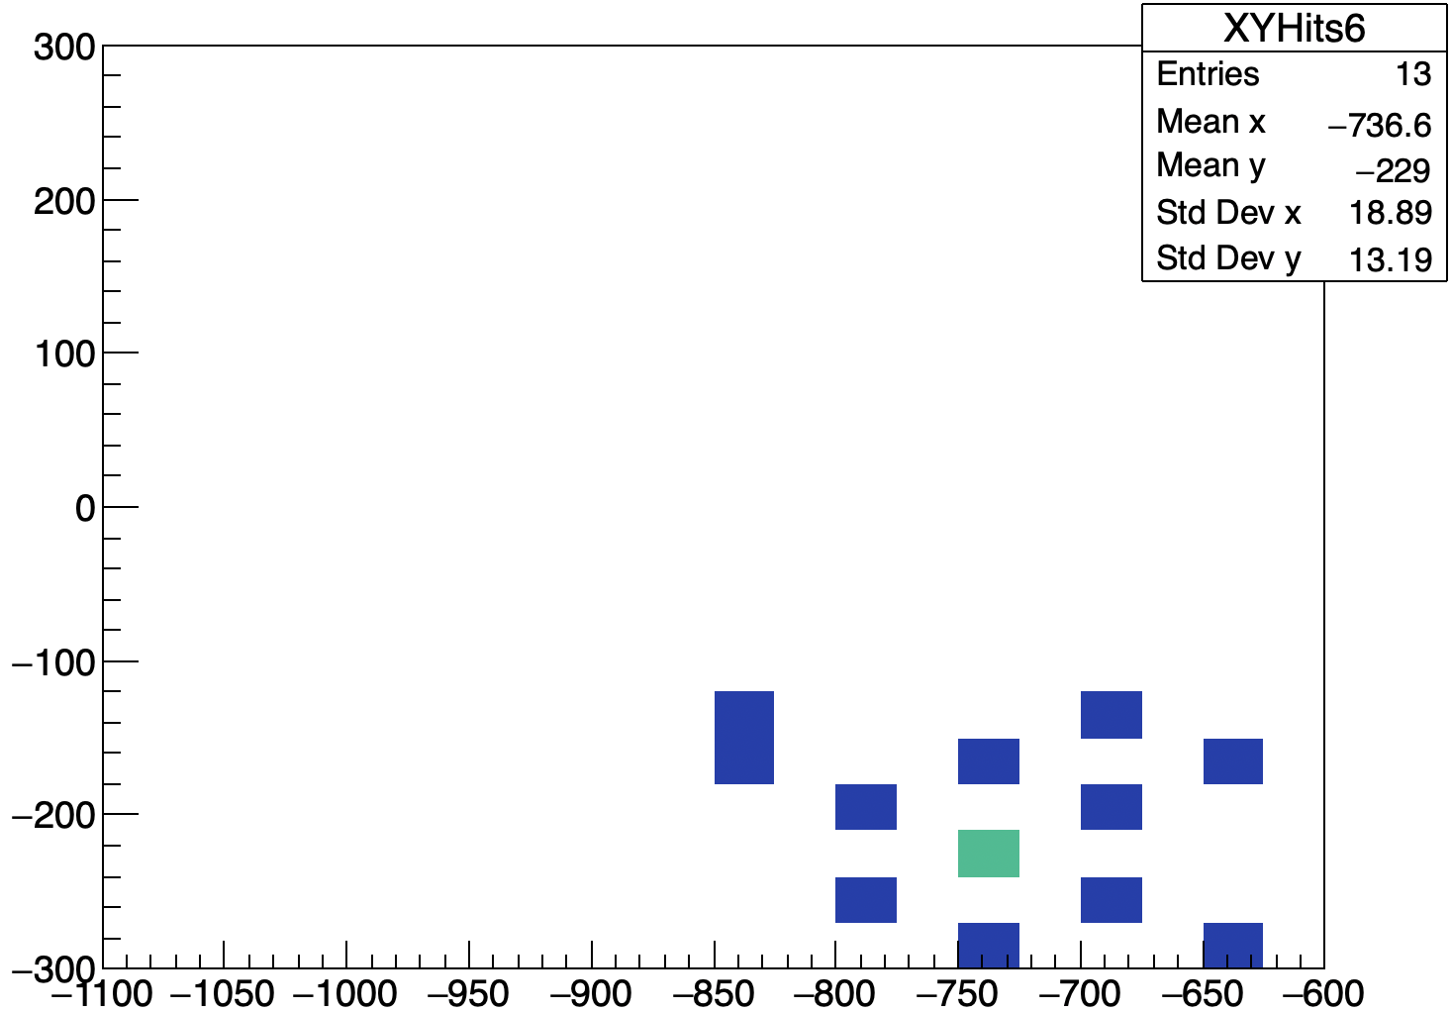
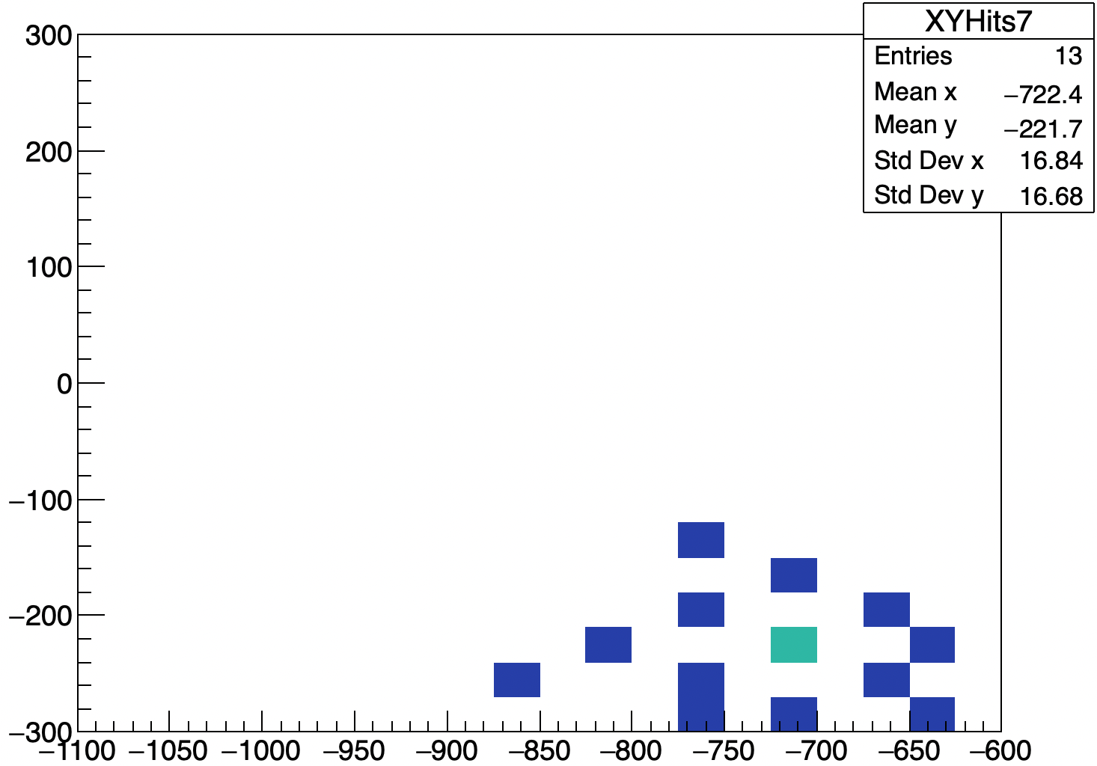
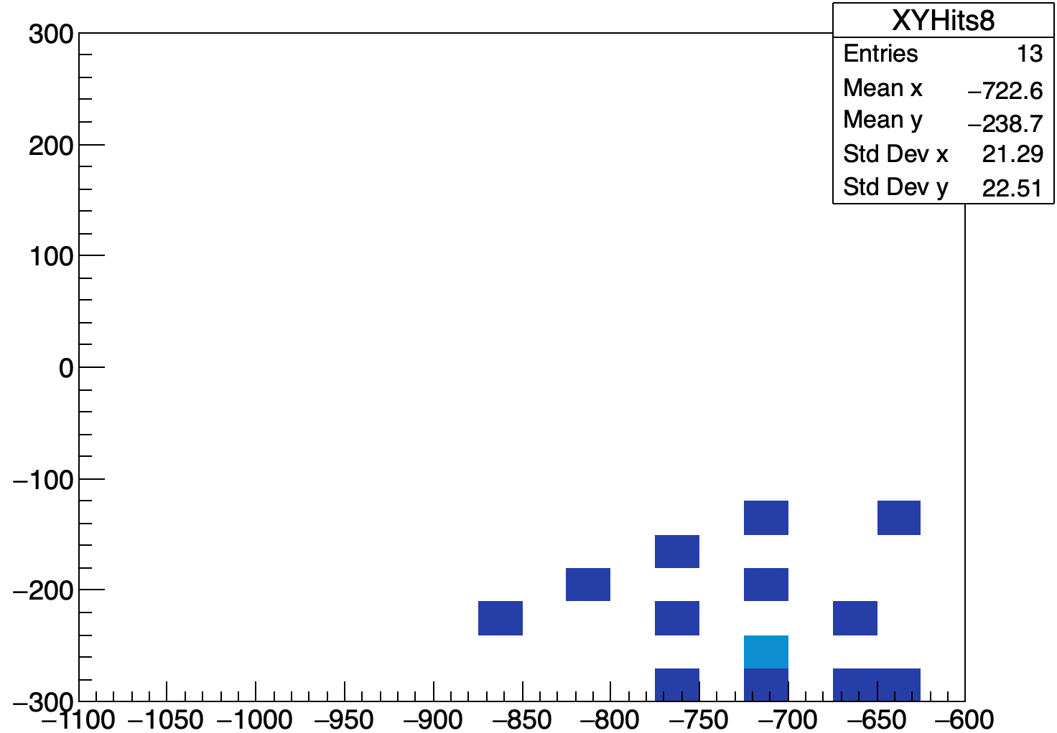
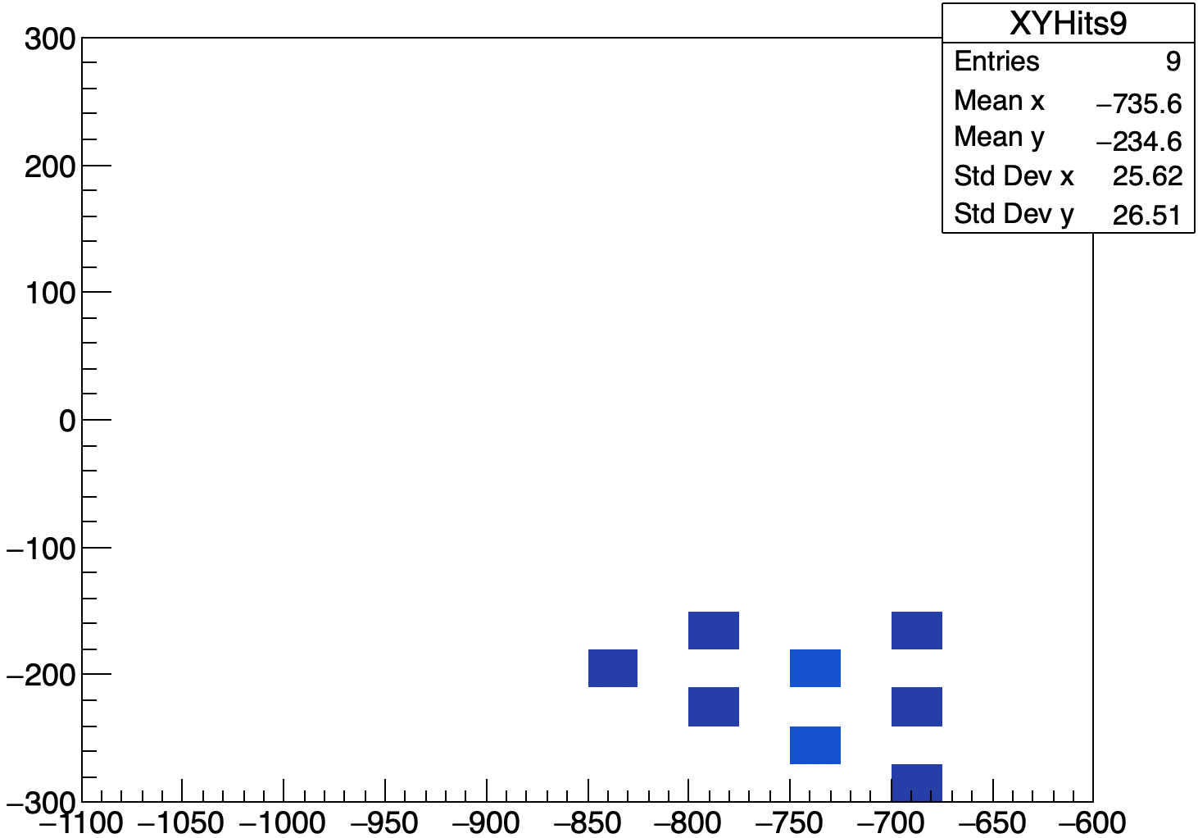
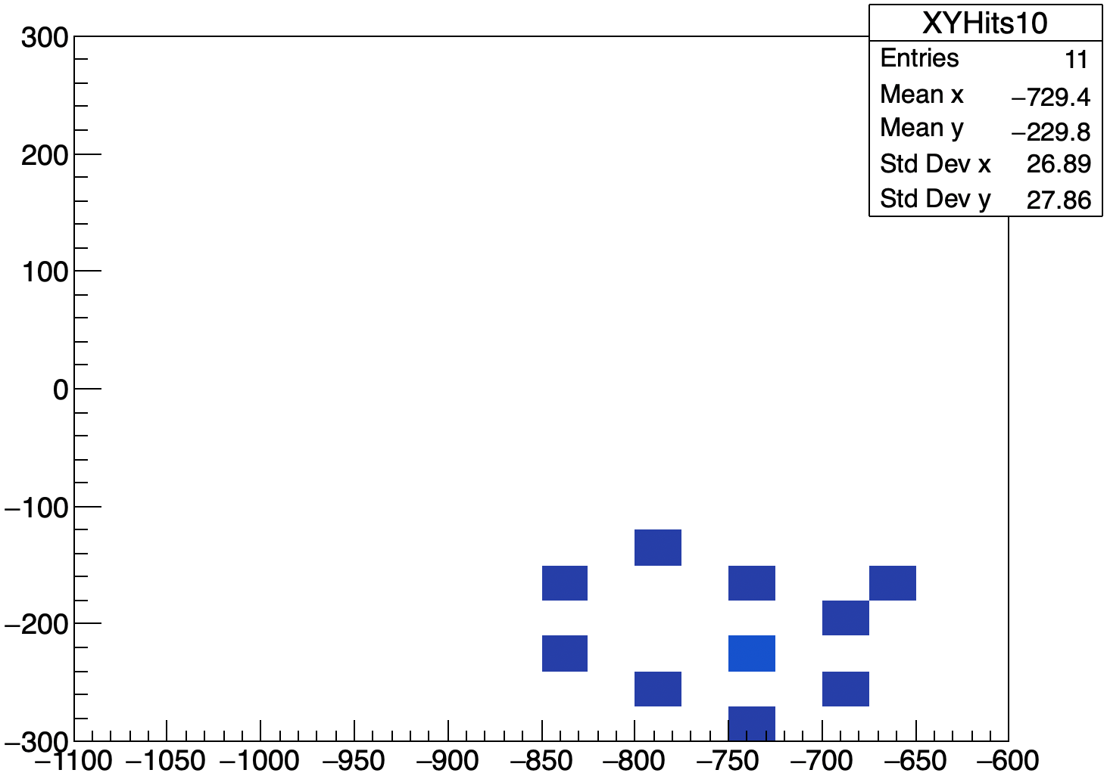
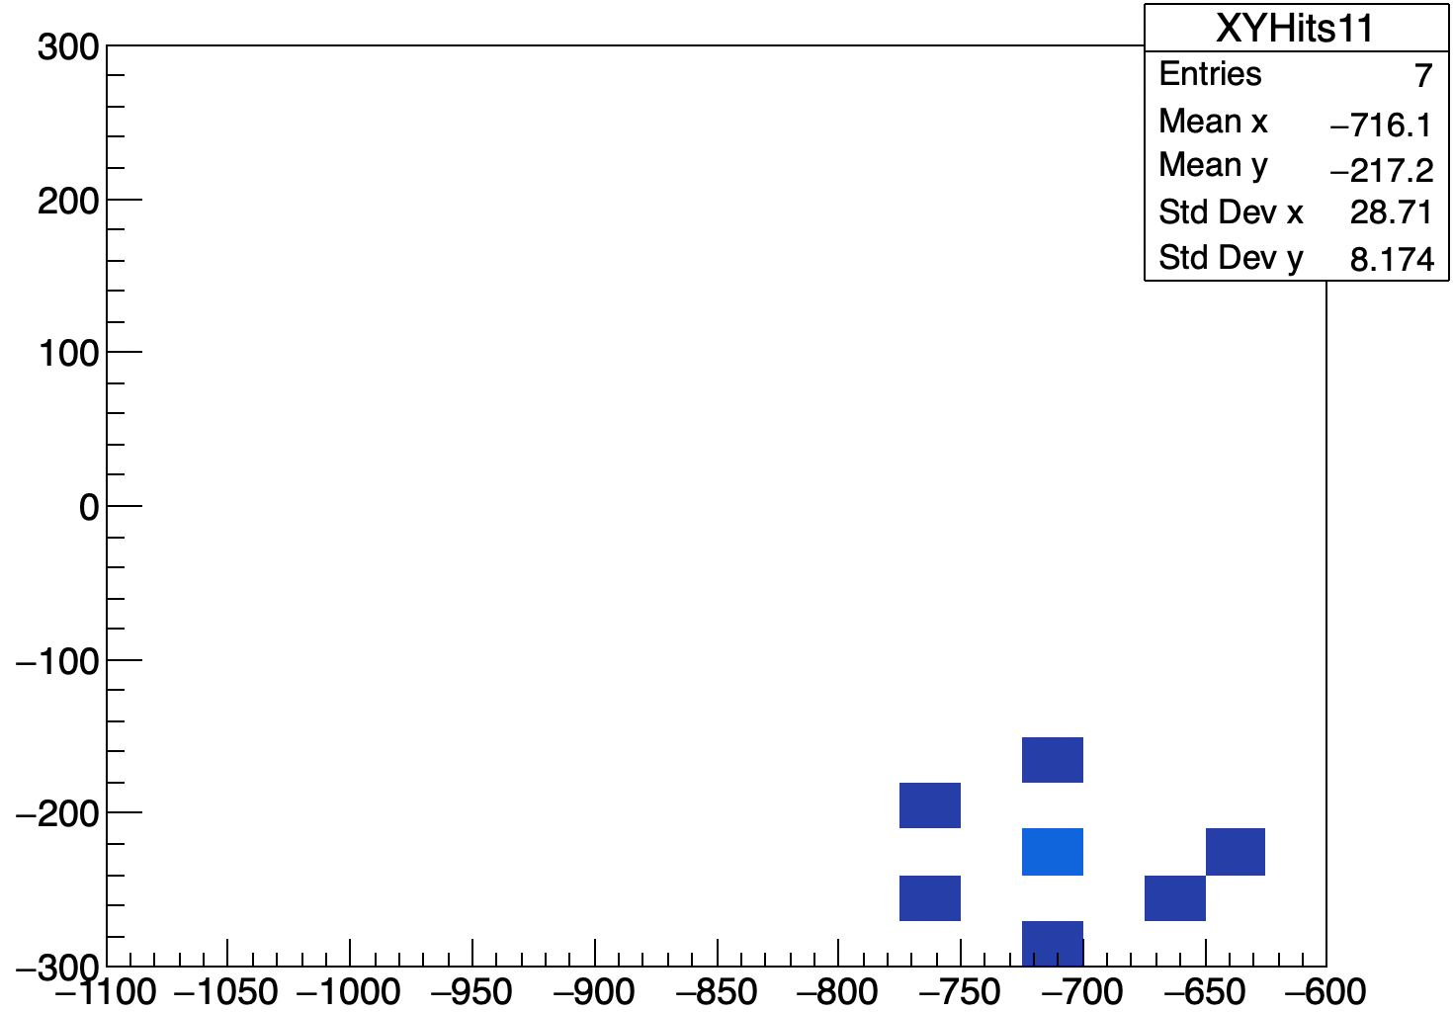
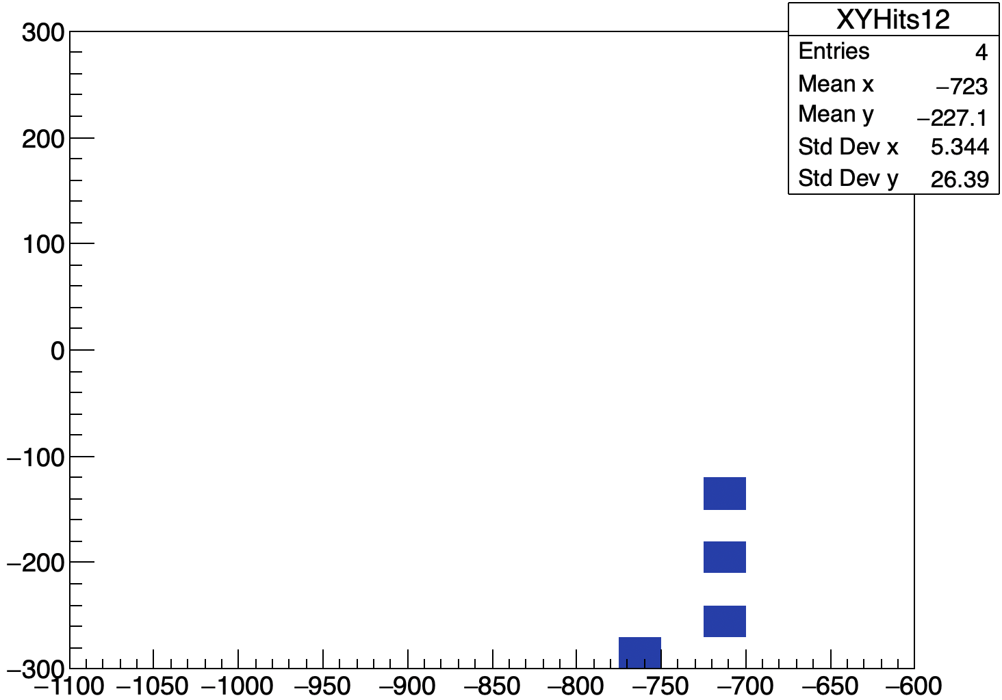
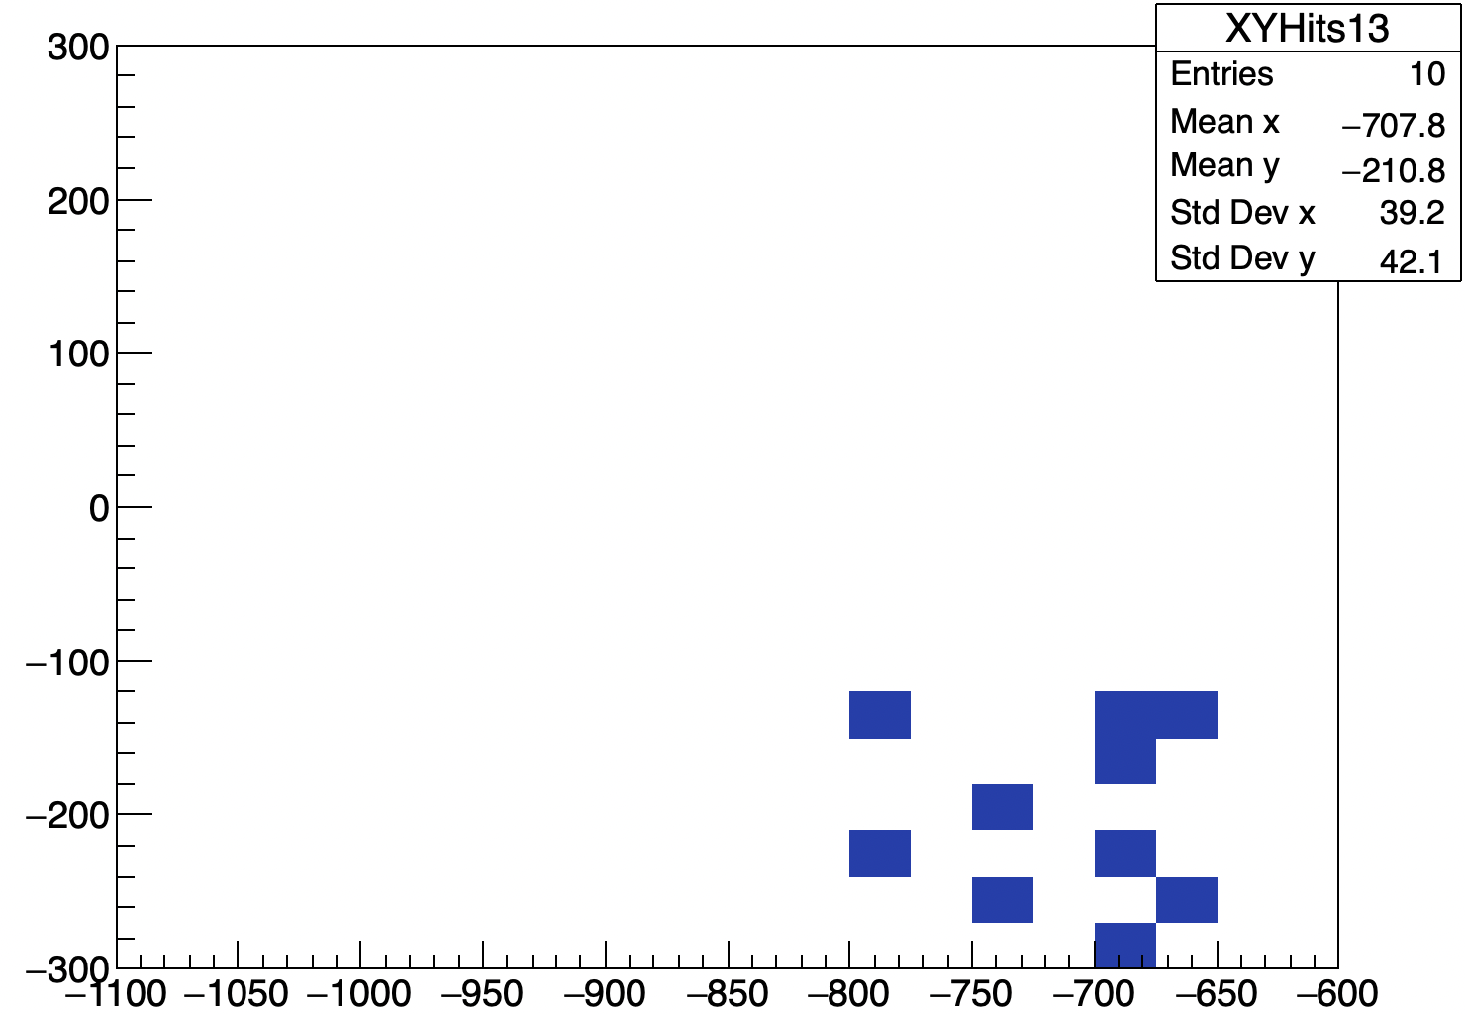
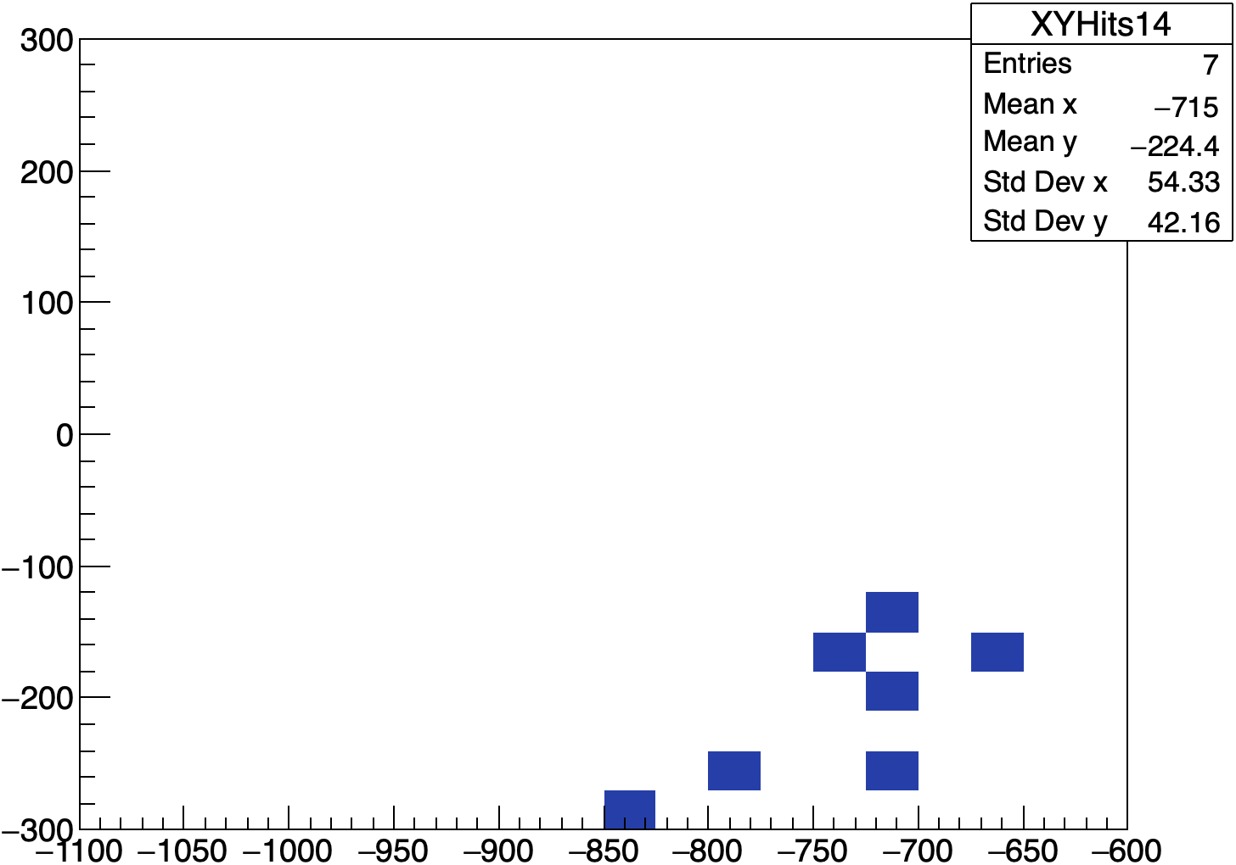
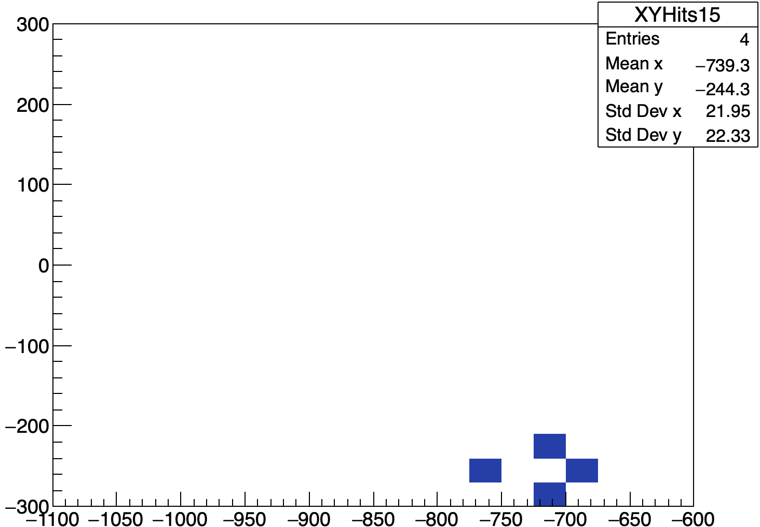
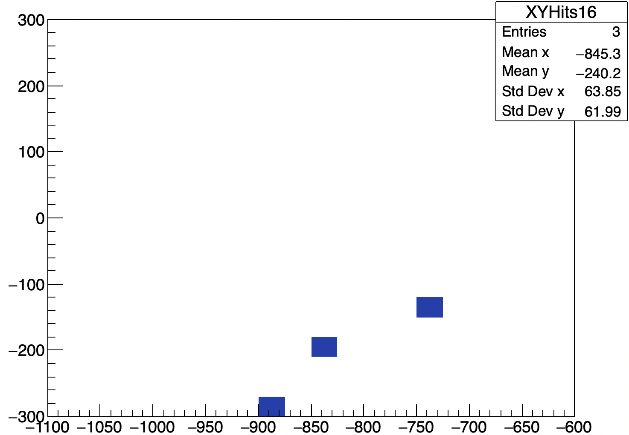
HCal Angular Resolution
Energy Weighted XY Hit maps by HCal Layer (33 GeV photon hitting the right corner of ZDC)
XY Hit map HCal Layer 4
Layer 1
Layer 2
Layer 3
Layer 4
Y [mm]
Layer 5
Layer 6
Layer 7
Layer 8
Layer 9
Layer 10
Layer 11
Layer 12
X [mm]
Studying this type of event allows us to determine how good the angular resolution of the HCal is for reconstructing tracks when we have less hit information with lower energy.
Layer 13
Layer 14
Layer 15
Layer 16

Slide 11
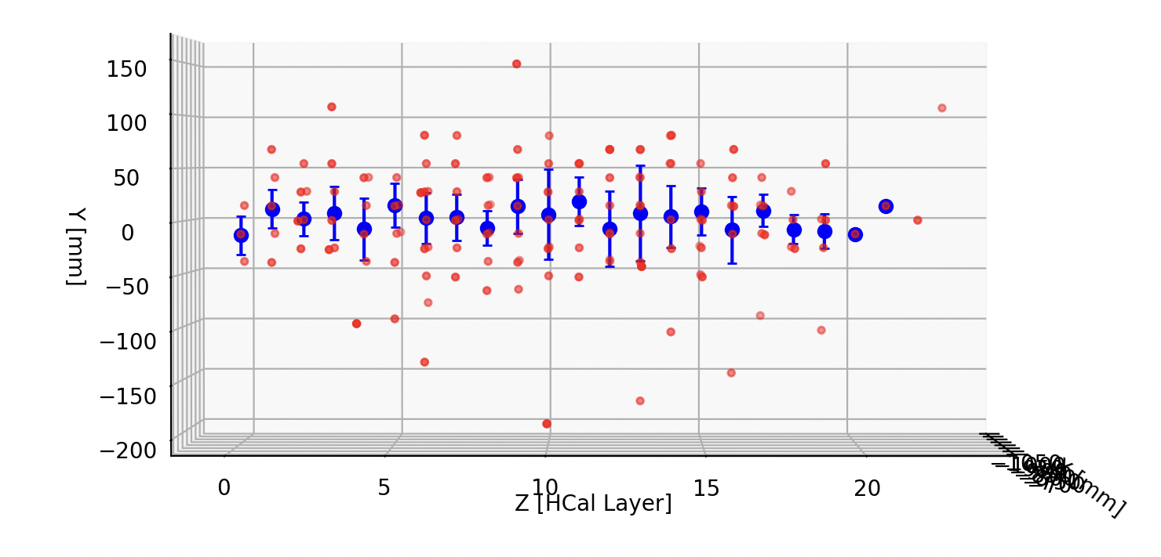
HCal Angular Resolution
Z [HCal Layer]
Plots are for a single photon hitting the center of ZDC
Photon track shows a wave-like pattern due to HCal layer offsets
Offset pattern enhances position resolution for track reconstruction

Slide 12
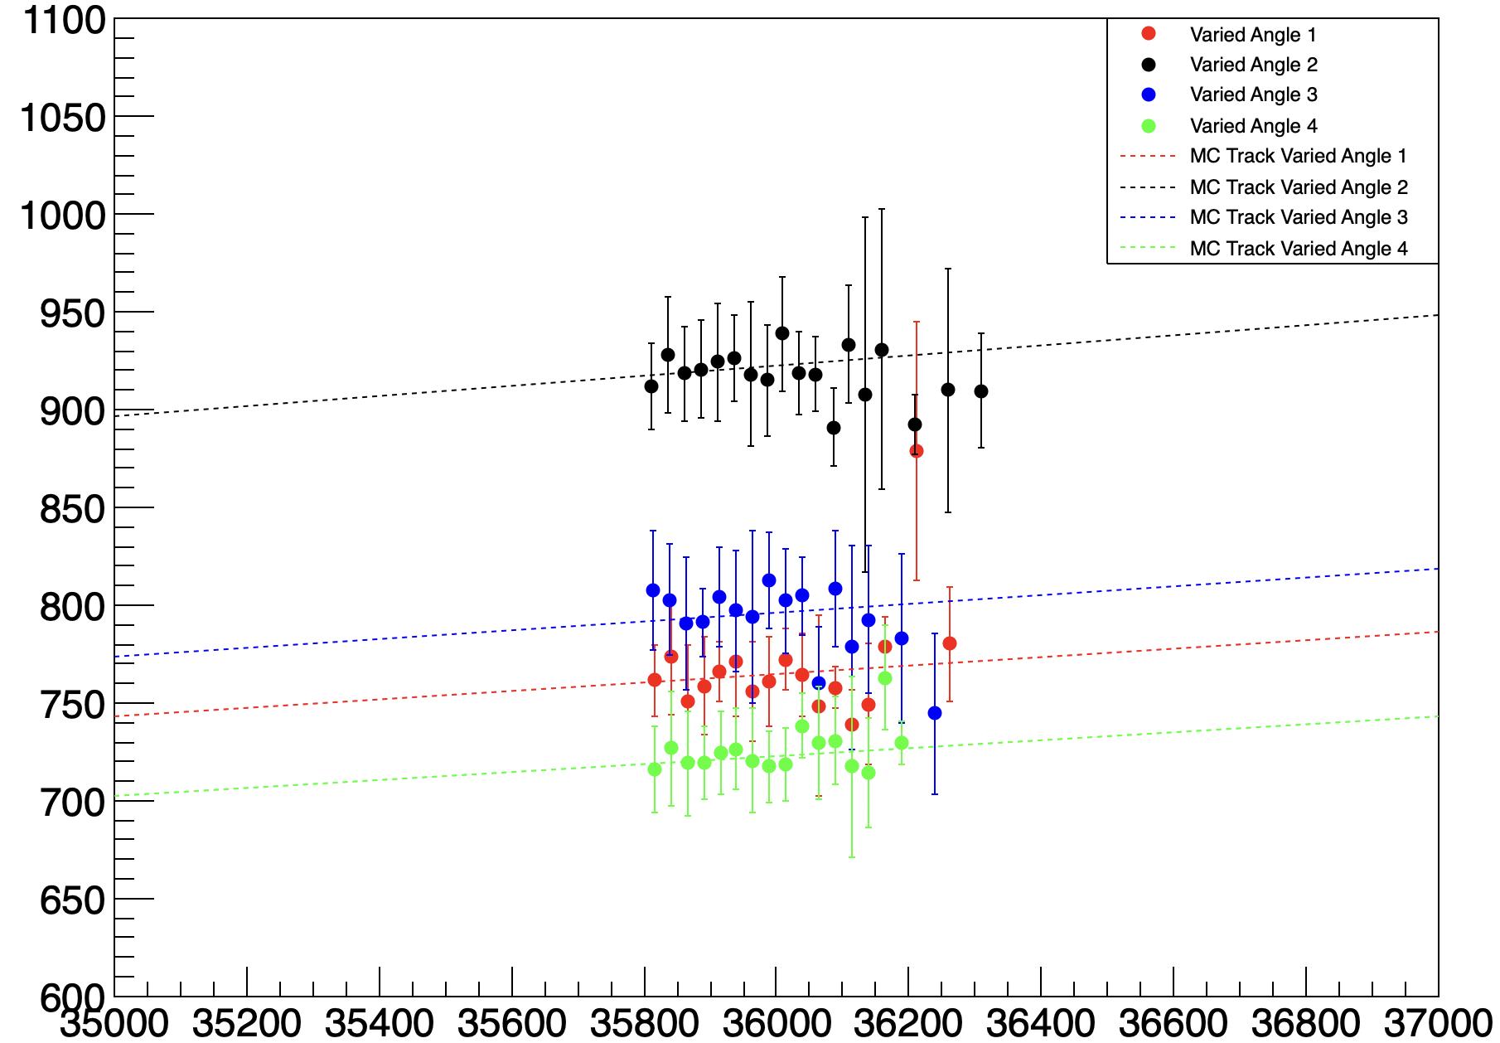
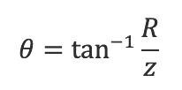
HCal Angular Resolution
Average HCal Hit Position ​
The reconstructed hit position in x and y for each layer is calculated using an energy weighted average
R is the absolute distance to the average hit
R [mm]
Z [mm]
Photon 1: theta = 0.02124 rad, phi = 3.4476 rad
Photon 2: theta = 0.02562 rad, phi = 2.9672 rad
Photon 3: theta = 0.02211 rad, phi = 2.9001 rad
Photon 4: theta = 0.02007 rad, phi = 3.0709 rad

Slide 13
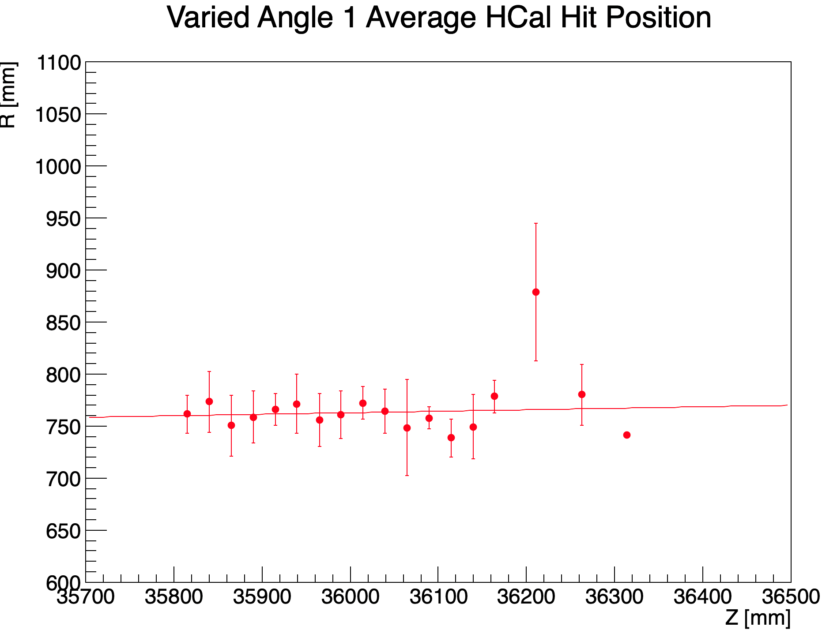
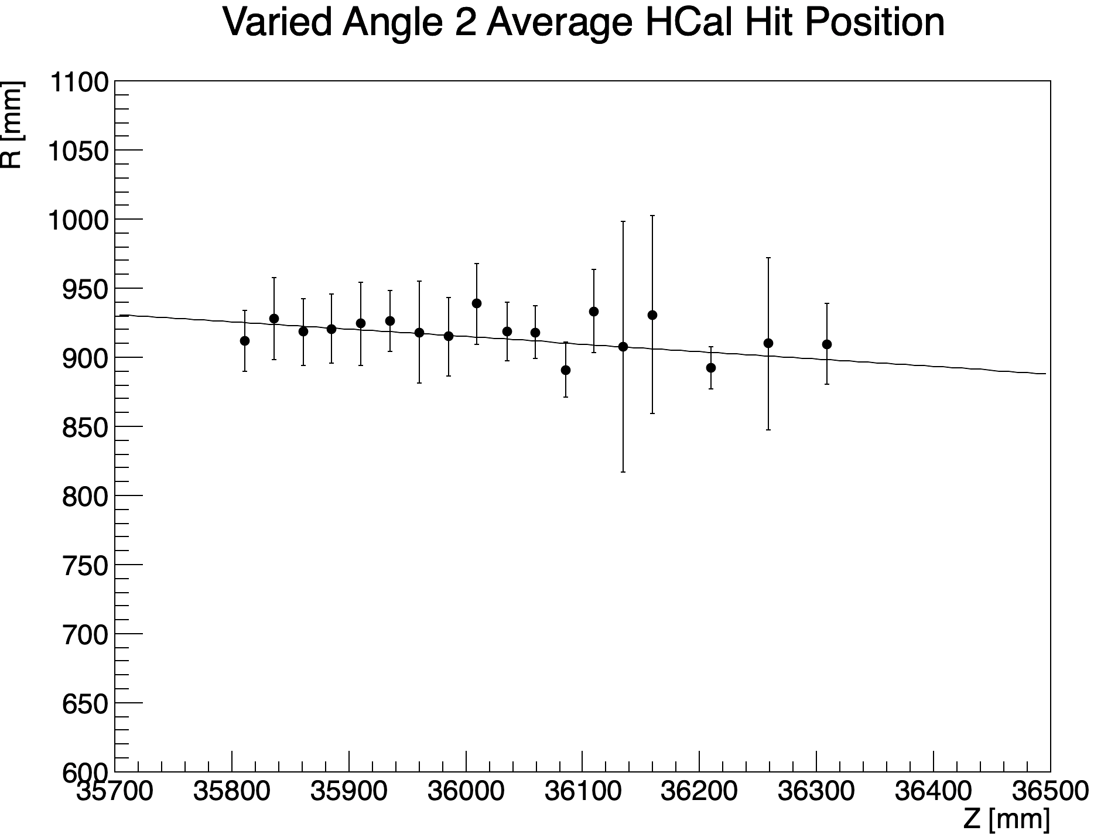
HCal Angular Resolution
MC theta = 0.02124 rad
MC phi = 3.4476 rad
The data for all layers with more than two hits is fit using a first-degree polynomial function. This fitted data can then be used to determine the theta angle of the reconstructed track.
MC theta = 0.02562 rad
MC phi = 2.9672 rad
Minimizer is Minuit2 / Migrad
Chi2 = 7.48945
NDf = 15
Edm = 9.78274e-07
NCalls = 59
p0 = -245.218 +/- 1558.39
p1 = 0.014378 +/- 0.0432623
Minimizer is Minuit2 / Migrad:
Chi2 = 3.87392
NDf = 16
Edm = 3.61713e-12
NCalls = 65
p0 = 2864.24 +/- 1570.19
p1 = -0.0541467 +/- 0.0435858

Slide 14
Summary and Overview
EIC offers opportunity to study nucleon/nuclear structure as well as the role of gluons in matter
One physics goal of ZDC is to reconstruct vertex/energy of neutral channel Lambda baryons to study the Sullivan process
Current ZDC design prefers higher momentum Lambda baryons though this can lead to overlap between neutron and photon showers
Initial HCal angular resolution study results show promise that HCal can be used for track reconstruction
This work is supported by the US Department of Energy under grant DE-SC0021359 "U.S.-Japan Hadronic Physics Exchange Program for Studies of Hadron Structure and QCD".

Slide 15
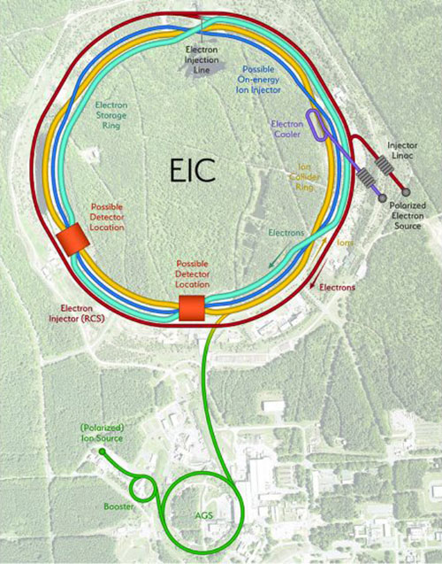
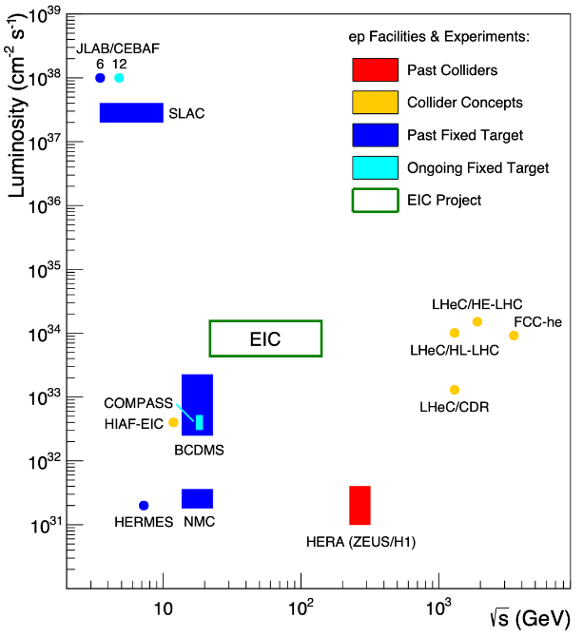
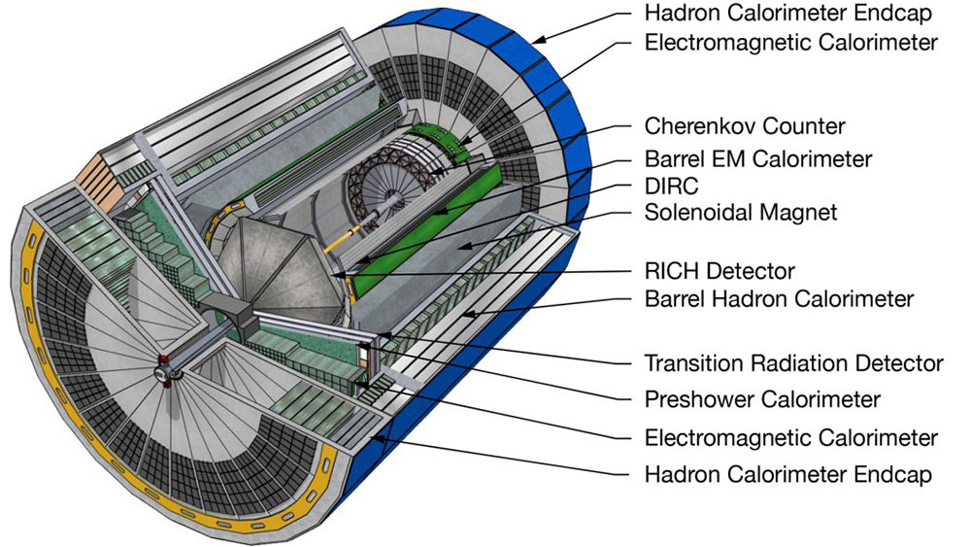
Overview of the EIC
Electron Ion Collider (EIC):
First high luminosity and polarized e-p collider
First electron-nucleus collider
Electron-Proton/Ion Collider (ePIC) experiment will be installed at the Interaction Point at 6 o'clock (IP-6)
IP-8
IP-6
“The Electron-Ion Collider: A Precision Tool for Studying the ‘Glue’ That Binds Visible Matter.” 2022. Brookhaven National Laboratory. March 4, 2022.

Slide 16
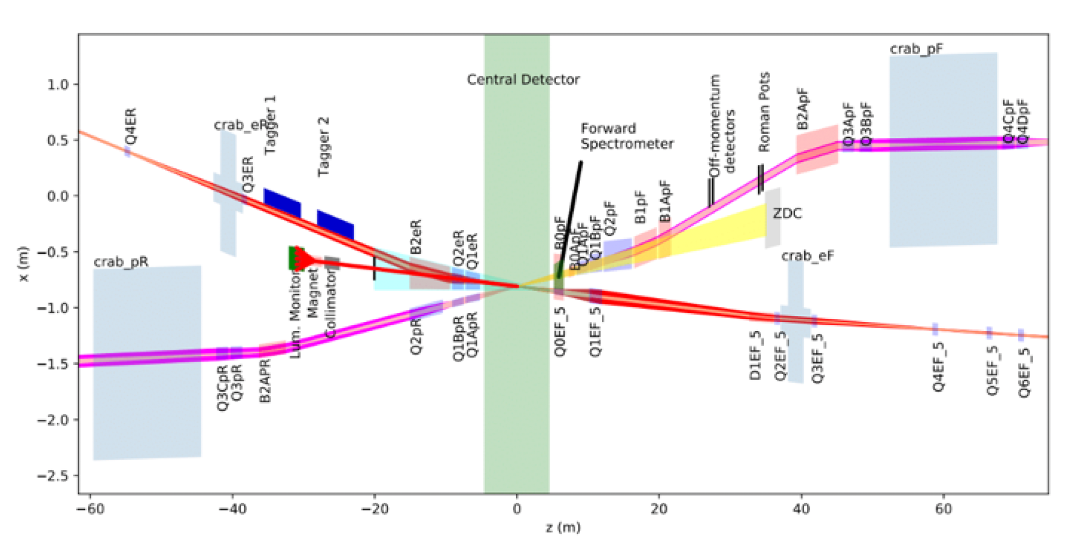
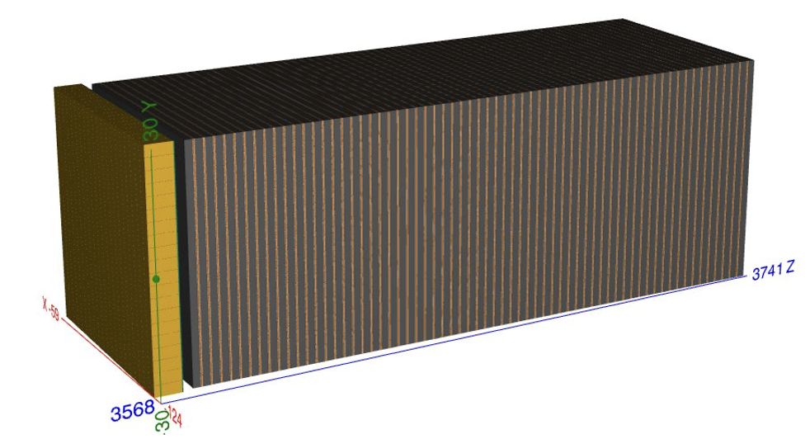
Zero Degree Calorimeter (ZDC) at ePIC
Abdul Khalek, R., A. Accardi, J. Adam, D. Adamiak, W. Akers, M. Albaladejo, A. Al-bataineh, et al. ‘Science Requirements and Detector Concepts for the Electron-Ion Collider’. Nuclear Physics A 1026 (October 2022)
Source: EIC ePIC Geometry
ZDC Geometry
ECal: LYSO Crystals (yellow)
HCal: SiPM sampling calorimeter (brown)
Full EIC baseline layout (EIC Yellow Report)
*The B0 magnet (right outside of the Central Detector) will bend tracks for any charged particles preventing them from hitting the ZDC
Notes:
The ZDC is a calorimeter located along the proton beamline in the far forward region of the ePIC detector that will be used to reconstruct the energy and vertex of neutral particles (low t regime).
It's composed of a thin LYSO crystal electromagnetic calorimeter (ECal) followed by a SiPM hadronic sampling calorimeter (HCal)

Slide 17
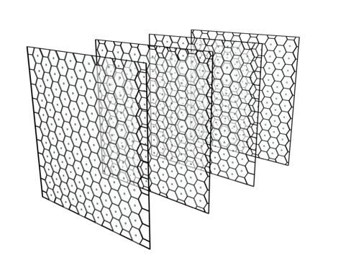
Zero Degree Calorimeter (ZDC) at ePIC
30 mm
30 mm
ECal is a single 70 mm thick layer of crystal cells
31 mm
Source: EIC ePIC Geometry
Source: arXiv:2406.12877
HCal geometry:
64 layers 27 mm thickness each
Each layer is composed of an air gap, steel plate, scintillator (with aluminum cover) and PCB
Scintillators are organized in hexagonal SiPM tiles, ~130 in each layer.
Notes:
The ECal is a single layer of crystal cells (3cm by 3cm), primarily designed for low energy photons from nuclear breakups
The HCal sits behind the ECal and is composed of 64 layers of hexagonal SiPM tiles with ~130 tiles per layer .

Slide 18
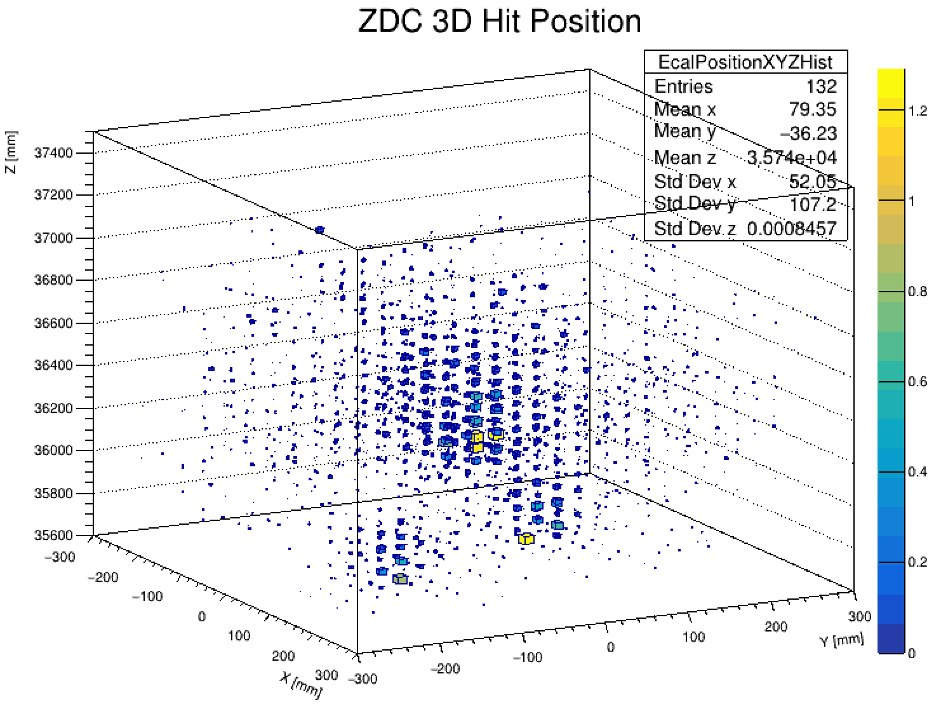
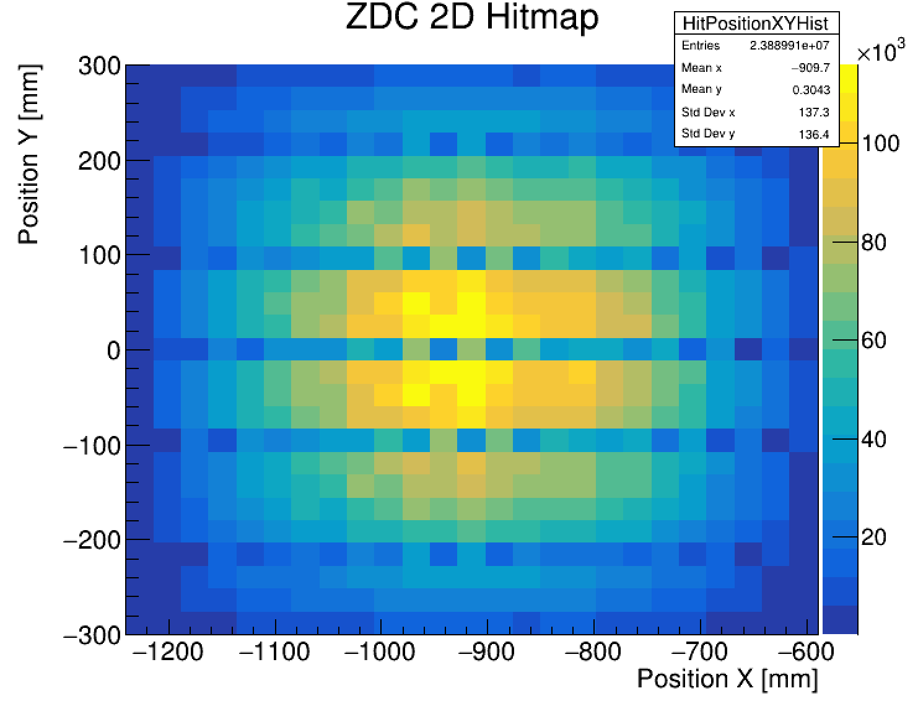
Event View
OLD SLIDE – REFERENCE ONLY
Describe the event on the left and the hitmap above

Slide 19
HCal Angular Resolution
Studying this type of event allows us to determine how good the angular resolution of the HCal is for reconstructing tracks when we have less hit information with lower energy.
OLD SLIDE – REFERENCE ONLY
MC theta = 0.02124 rad​
MC phi = 3.4476 rad
XY Hit maps by HCal layer for a single 33 GeV photon hitting the ZDC at an angle

