Slide 1
UConn-RIKEN Update 10/31
Alessio I., Gursimran K.

Slide 2
Overview UConn-UC Riverside Meeting
UC Riverside team explained their two approaches to clustering
Low level: Topological clustering
High level: GNN (ML) Clustering
Suggested our algorithms would be good midpoint between the two; high level, but human intelligible
No easy answers for the question of separating photons from neutrons
UC Riverside group warned off selecting neutron cluster based on average shape
Concerns about non-linearity with EM energy in SiPM on tile detector
They have done work on reconstructing lambda using pi0 missing mass

Slide 3
EIC Recon
We can integrate our algorithm with or without the HEXPLIT algorithm
Some interest in seeing if HEXPLIT improves our algorithms
* https://doi.org/10.1016/j.nima.2023.169044
**https://doi.org/10.1140/epjc/s10052-017-5004-5
Source: Sebouh Paul, UC Riverside

Slide 4
Current Algorithms – Pros and Cons
Modified DBSCAN
Peak Finding
PROS:
Flexible: can cluster regardless of cluster shape or size
Physics independent
Can produce any number of clusters
CONS:
Computationally heavy
Is not always able to separate all clusters
6 parameters that need to be manually tuned
PROS:
Physics and detector informed
Integrates ECal with HCal
Simple algorithm, easy to modify, similar to existing algorithms
Always finds 3 clusters (2 photon and neutron)
CONS:
Very rigid algorithm
Struggles with significant overlap
Relies on sklearn packages

Slide 5
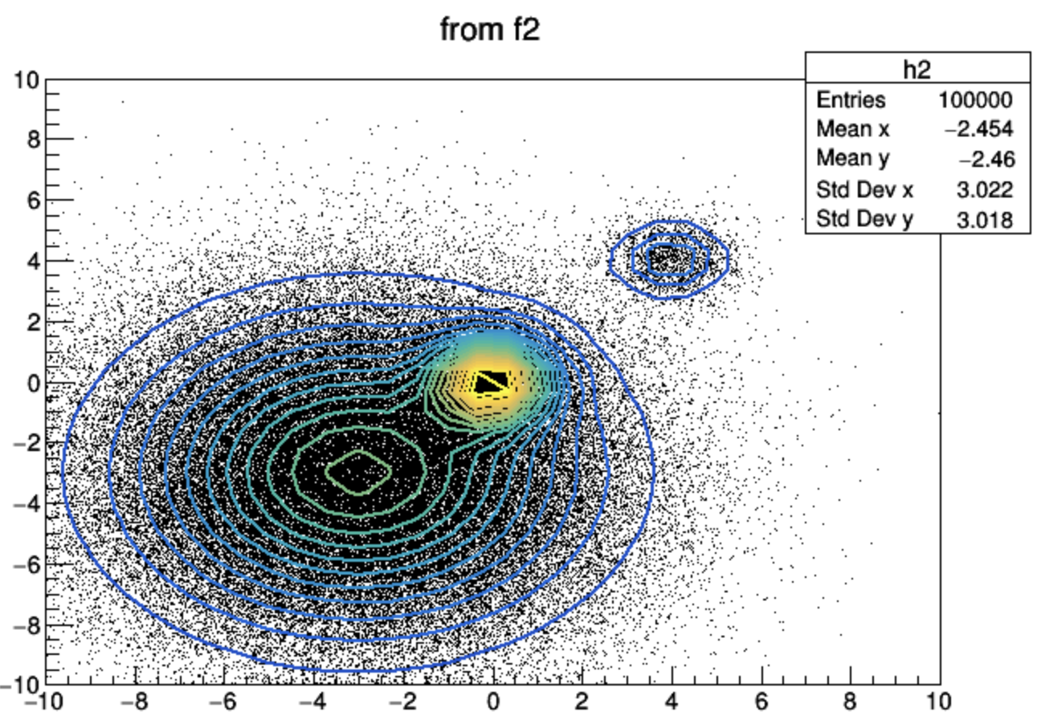
Idea of new Algorithm
Might be best to take the lessons so far and create a new algorithm then put that in EICRECON
Can try a hierarchical algorithm that determines how we want to attempt clustering based on hit distribution
L1: Quick hit distribution check to choose clustering method
L2: DBSCAN like algorithm (clusters with less overlap)
L2: 2D Histogram Fitting (clusters with some overlap)
L2: Cannot cluster due to too much overlap
https://root.cern/doc/v612/fit2_8C.html

