Slide 1
Discussion for Test Beam
Wen-Chen Chang, Kai-Yu Cheng, Tatsuya Chujo, Yuji Goto, Chia-Yu Hsieh, Motoi Inaba, Subaru Ito, Kentaro Kawade, Yongsun Kim, Chia Ming Kuo, Chih-Hsun Lin, Po-Ju Lin, Rong-Shyang Lu, Jen-Chieh Peng

Slide 2
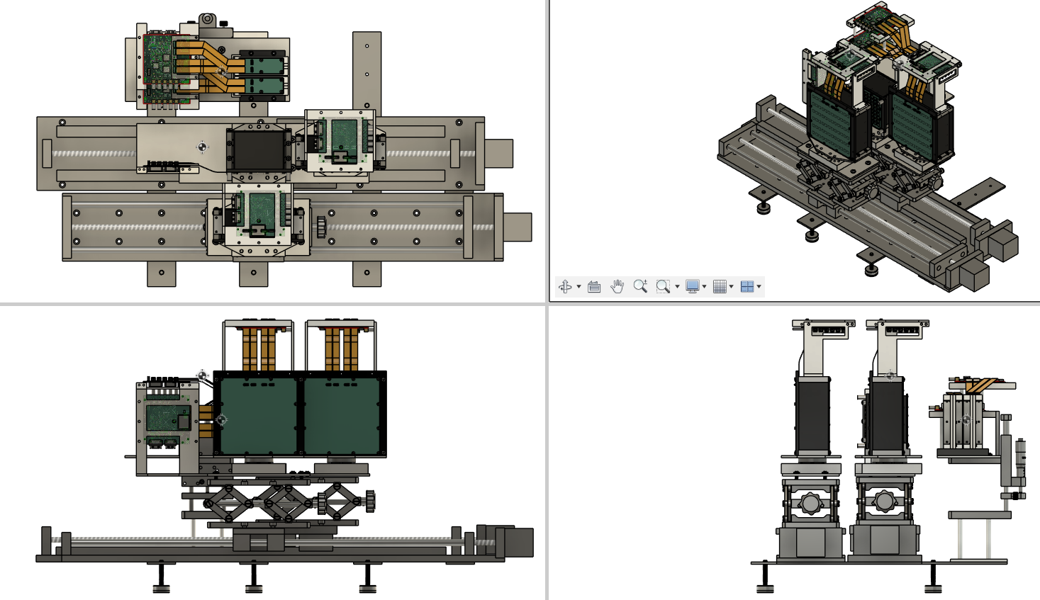
Design of 2nd Prototype
Detector | Crystal | Sensor | Size of one cell | Length | Array | Note
ZDC ECal 2nd LYSO + APD | LYSO | APD C30739ECERH | 1cm*1cm | 6.6cm (6X0) | 8x8
ZDC ECal 2nd PbWO4 + SiPM | PbWO4 | SiPM MICROFC-60035 | 2cm*2cm | 5.3cm (6X0) | 6x6 | Two sensors for one crystal
Beam Monitor | Plastic Scintillator | SiPM MICROFC-10010 | 2mm*2mm | 8cm | 32ch in X 32ch in Y | Two sets
Beam monitor
CITIROCs
detectors
Rotation stage
5, 10 degree
Height stage
Y-dir 0-2.5cm
Linear
Stage
X-dir
0-40cm
LYSO + APD
PWO+SiPM
Legs to keep horizental

Slide 3
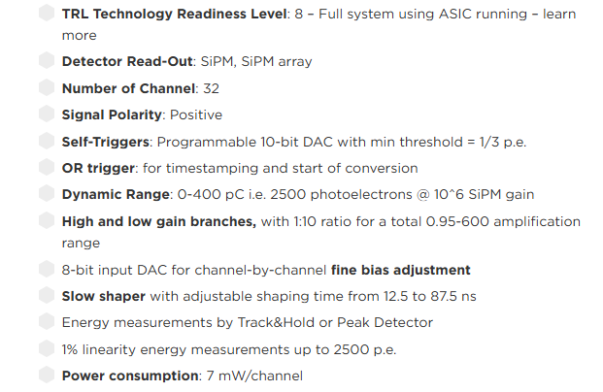
Setup of Electronics
CITIROC_A (32ch) CITIROC_B (32ch)
Data
Laptop
Data taking
Control
Monitor
Detectors (64ch)
SpaceWire Mk4
Control
UART
Low voltage (12V)
Temperature
CITIROC spec.
All the detectors share the same structures : LYSO+APD, PbWO4+SiPM, and beam monitor. During the test beam we will prepare two systems as drawn above to control/readout all the detector.
CITIROC is is a 32-channel front-end ASIC designed to readout silicon photo-multipliers.

Slide 4
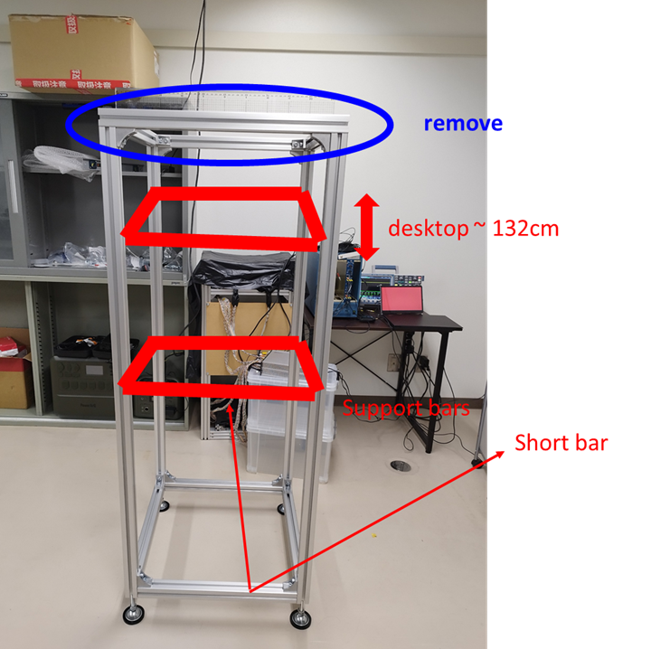
Setup in Test Beam
Platform
Height = 132 (minimum)
Size = 50cm*50cm
Many tanks to Kentaro-san.
Shipping of Packages
Items : Linear moving system, else?
Shipping date : 2025 Jan. 2nd
Shipping Address?
Tax of Japanese custom?
How about the setup for HCal?

Slide 5
Manufacture Status
Color code
Designing | Production | Ready | Testing
 | Parts | Progress@2024/12/17 | Progress@2025/01/06
LYSO 1cm*1cm*6.6cm 8x8 array | LYSO Cryatal | ready | ready
 | APD (C30739ECERH) | ready | ready
 | APD Readout PCB | ready | ready
 | LYSO Housing | ready | ready
 | LYSO Base support | ready | ready
2. PbWO4 2cm*2cm*5.3cm 6x6 array | PbWO4 | production | ready
 | SiPM (MICROFC-60035) | ready | ready
 | APD (C30739ECERH) | ready | ready
 | SiPM Readout PCB | designing | production
 | APD Readout PCB | designing | X
 | PbWO4 Housing | designing | ready
3. Beam monitor 2mm*2mm*8cm 32ch in X 32ch in Y XY layers/set Two sets | scintillator | ready | ready
 | SiPM | ready | ready
 | SiPM Readout PCB | ready | ready
 | scintillator Housing | ready | ready
 | trigger Base support | ready | ready
4. GTM | GTM firmware | ready | ready
 | GTM base support | ready | ready
 | cable | ready | ready
5. Moving stage | base plate | designing | ready
 | slide rail | ready | ready
 | remote control | ready | ready
Testing
Testing

Slide 6
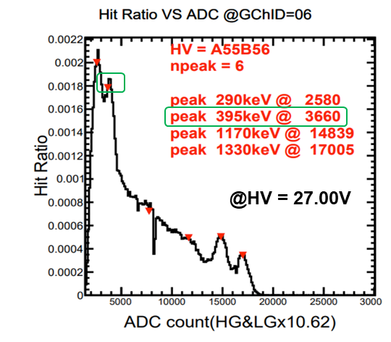
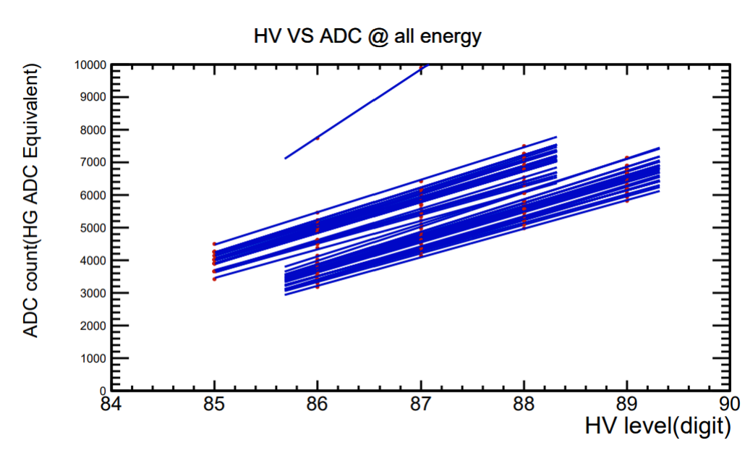
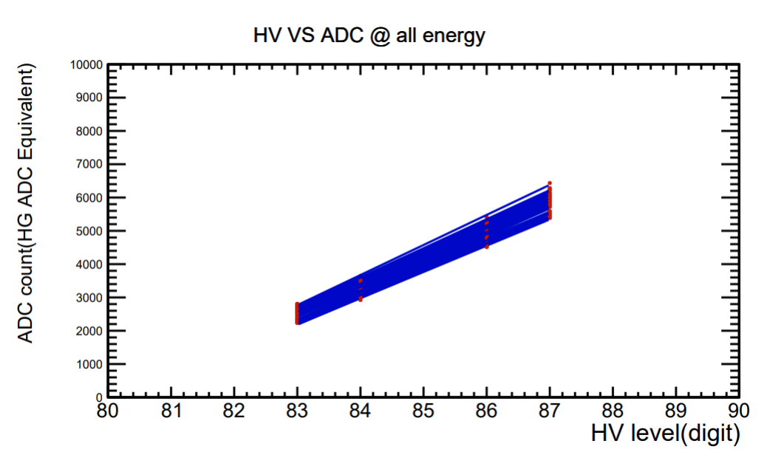
Lab Test of LYSO + APD
To do list :
Find pedestal (done)
Gain Calibration
Temperature Calibration
ADC to MeV mapping
Test status :
Baseline noise of all channels are observed. Observe cosmic ray signal. Large current observed at breakdown voltage of APD. (make sure APD functions).
However, we have problem with radiation source test. Failed to see signal of source because the energy is too low. (Expected : Gain of APD is too low.)
We will setup LED system to test. If we can’t manage with LED system. We will have to use beam to calibrate.
Example of calibration with 1st prototype : LYSO + SiPM

Slide 7
Estimation of ADC Value (2024 Sept.)
//============== Gain values ===================
LYSO + SiPM : 2580/0.29 (digits/MeV)
SiPM gain = 1e6 ~ 5e6 (here use 1e6)
APD gain = 1 ~ 100 (here use 100)
LYSO PDE = 25e3-35e3 photons/MeV (here use 3.0e4 photons/MeV)
PbO4 PDE = 1e2-2e2 photons/MeV (here use 1.5e2 photons/MeV)
Note : Polystyrene 1e4
//============== 6X0 LYSO + APD ===================
ADC digits = [(2580/0.29)/1e6*1e2]*Emax = 0.89*Emax
ADC dynamic range = 11, 000
50MeV electron , Emax = 21.5 , ADC = 19.18 => might be too low, close to noise level
800MeV electron, Emax = 240.1, ADC = 213.689
1GeV gamma , Emax = 248.6, ADC = 221.254
40GeV gamma , Emax = 3190, ADC= 2839.1
//============== 6X0 PbWO4 + SiPM ===================
ADC digits = [(2580/0.29)/3e4*1.5e2]*Emax = 44.48*Emax
ADC dynamic range = 11, 000
Saturation of SiPM ~ 3000 ADC
50MeV electron , Emax = 22.43, ADC = 997.8
800MeV electron, Emax = 266.7, ADC = 11862.8 => out of linear range of SiPM
1GeV gamma , Emax = 284.0, ADC = 12632.32 => out of linear range of SiPM also ADC dynamic range
40GeV gamma , Emax = 4198 , ADC = 186727 => out of linear range of SiPM also ADC dynamic range

Slide 8
Lab Test of PbWO4 + SiPM
To do list :
Find pedestal
Gain Calibration
Temperature Calibration
ADC to MeV mapping
Status :
Assembling is not yet finished.

Slide 9
Lab Test of Beam monitor
To do list :
Find pedestal level (undergoing)
Timing synchronization between two sets (offline, through PPS signals)
Timing synchronization between ZDC ECal and beam monitors (offline, through PPS signals)
Status :
We are checking the pedestal now.

Slide 10
Test Beam List
02/14~02/16 (preparation)
  Setup
    position alignment between beam monitor and detector
    test all the moving stages and its moving range
  Calibration w/ PbWO4 + SiPM w/ Na22
    Gain and temperature calibration w/ Na22
    Cosmic ray test (check signals from both beam monitor and ZDC)
02/17 ~ 02/20 (beam time)
  LYSO + APD (PbWO4 + SiPM)
    Gain and temperature calibration w/ beam (>50MeV)
    Beam energy scan
    HV scan
    Position scan in XY
    Rotation scan w/ 5, 10 degree

