Slide 1
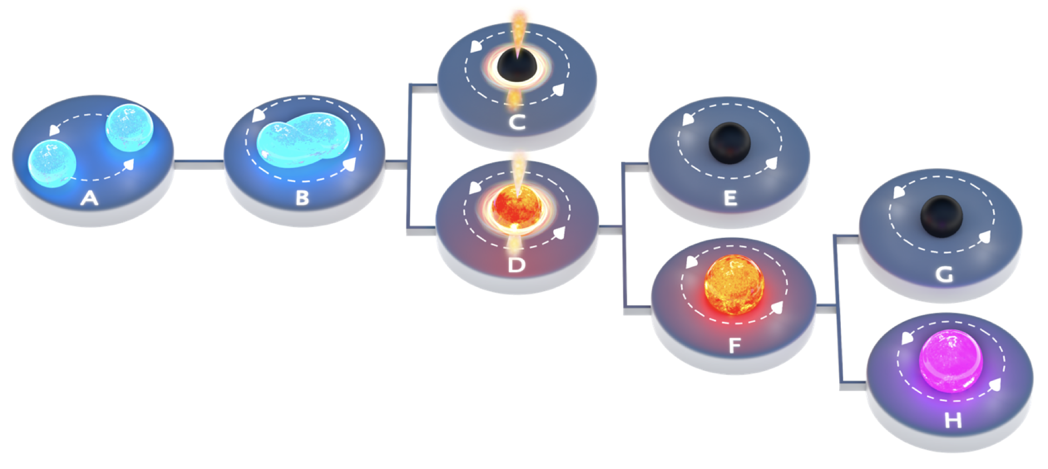

Image: Carl Knox​
Appears in Sarin & PL 2021
Astrophysics and fundamental physics with NEMO:
A kHz gravitational-wave observatory
Paul Lasky

Slide 2
Take-home messages
1. In 2020, we all thought building a kHz observatory with “NEMO” sensitivity would give certain science outcomes
2. It’s 2025 now; we need to rethink the designs, and it’s much more complicated. Need to consider broader science cases
3. Should we still build a dedicated kHz facility? Yes, but it requires collective input from observers, modellers, data analysts, and instrumentalists

Slide 3




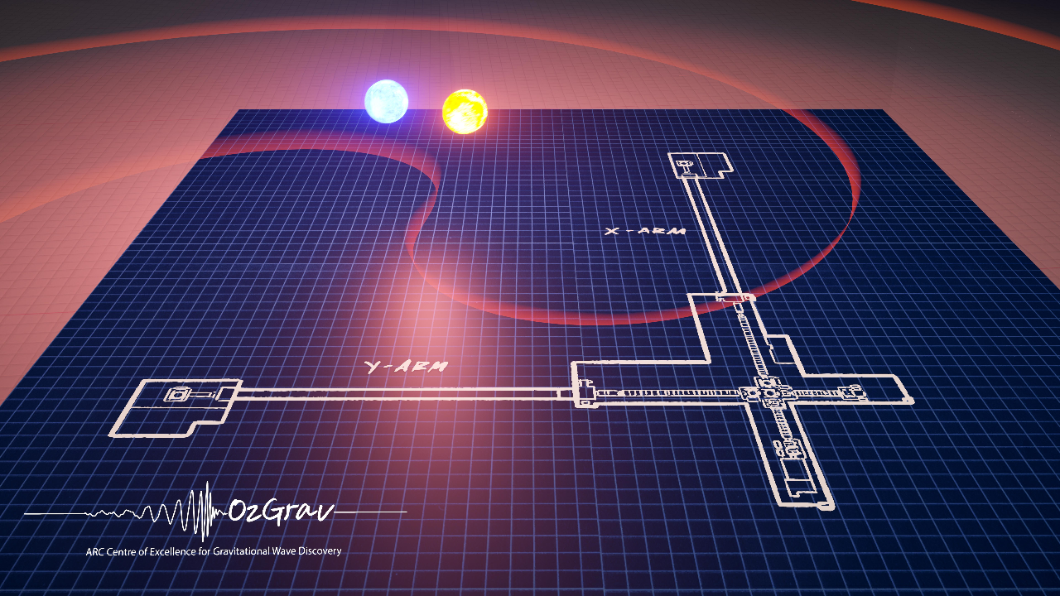
NEMO
1. an adorable but timid clown fish who lives off the coast of Australia before his life is turned upside down.
2. A 1989 animated musical in which a young boy named Nemo journeys each night to the magical realm of Slumberland
3. Neutron-star Extreme Matter Observatory: a 2.5-generation kHz gravitational-wave observatory with relatively poor low-frequency sensitivity. Main science drivers are neutron star extreme matter.
Ackley et al. (2020)

Slide 4
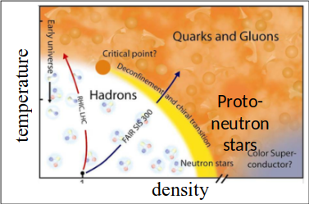
Image: Carl Knox​
Appears in Sarin & PL 2021

Slide 5
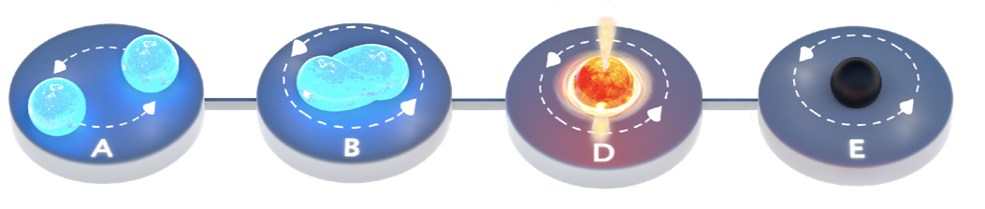
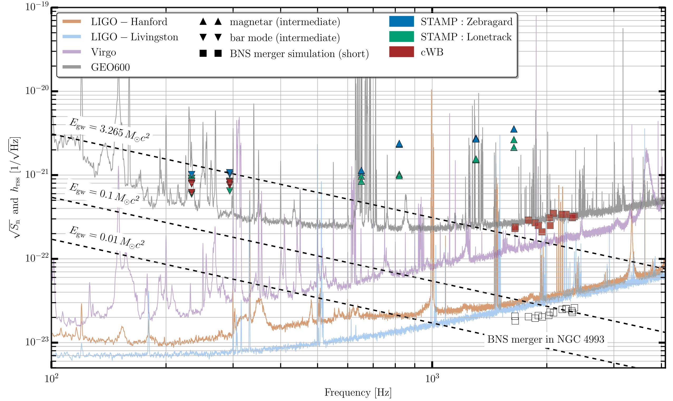
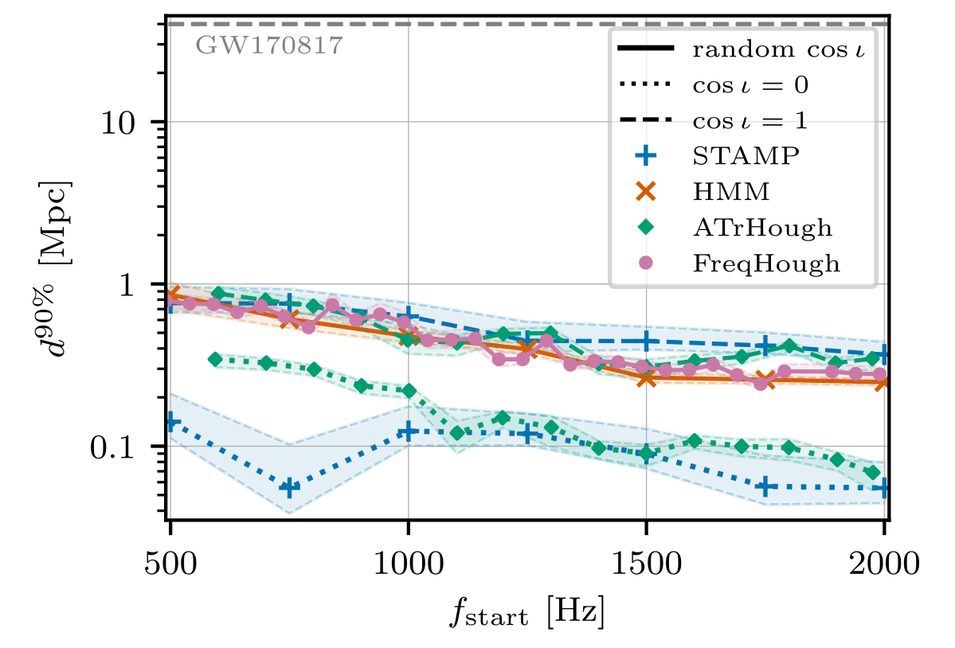
GW170817: Post Merger
LVK 2017, 2019
5
5

Slide 6
GW170817: Post Merger
LVK 2017, 2019
No Gravitational Waves
(not surprising)
6
6

Slide 7
GW170817: Post Merger
LVK 2017, 2019
7
7

Slide 8
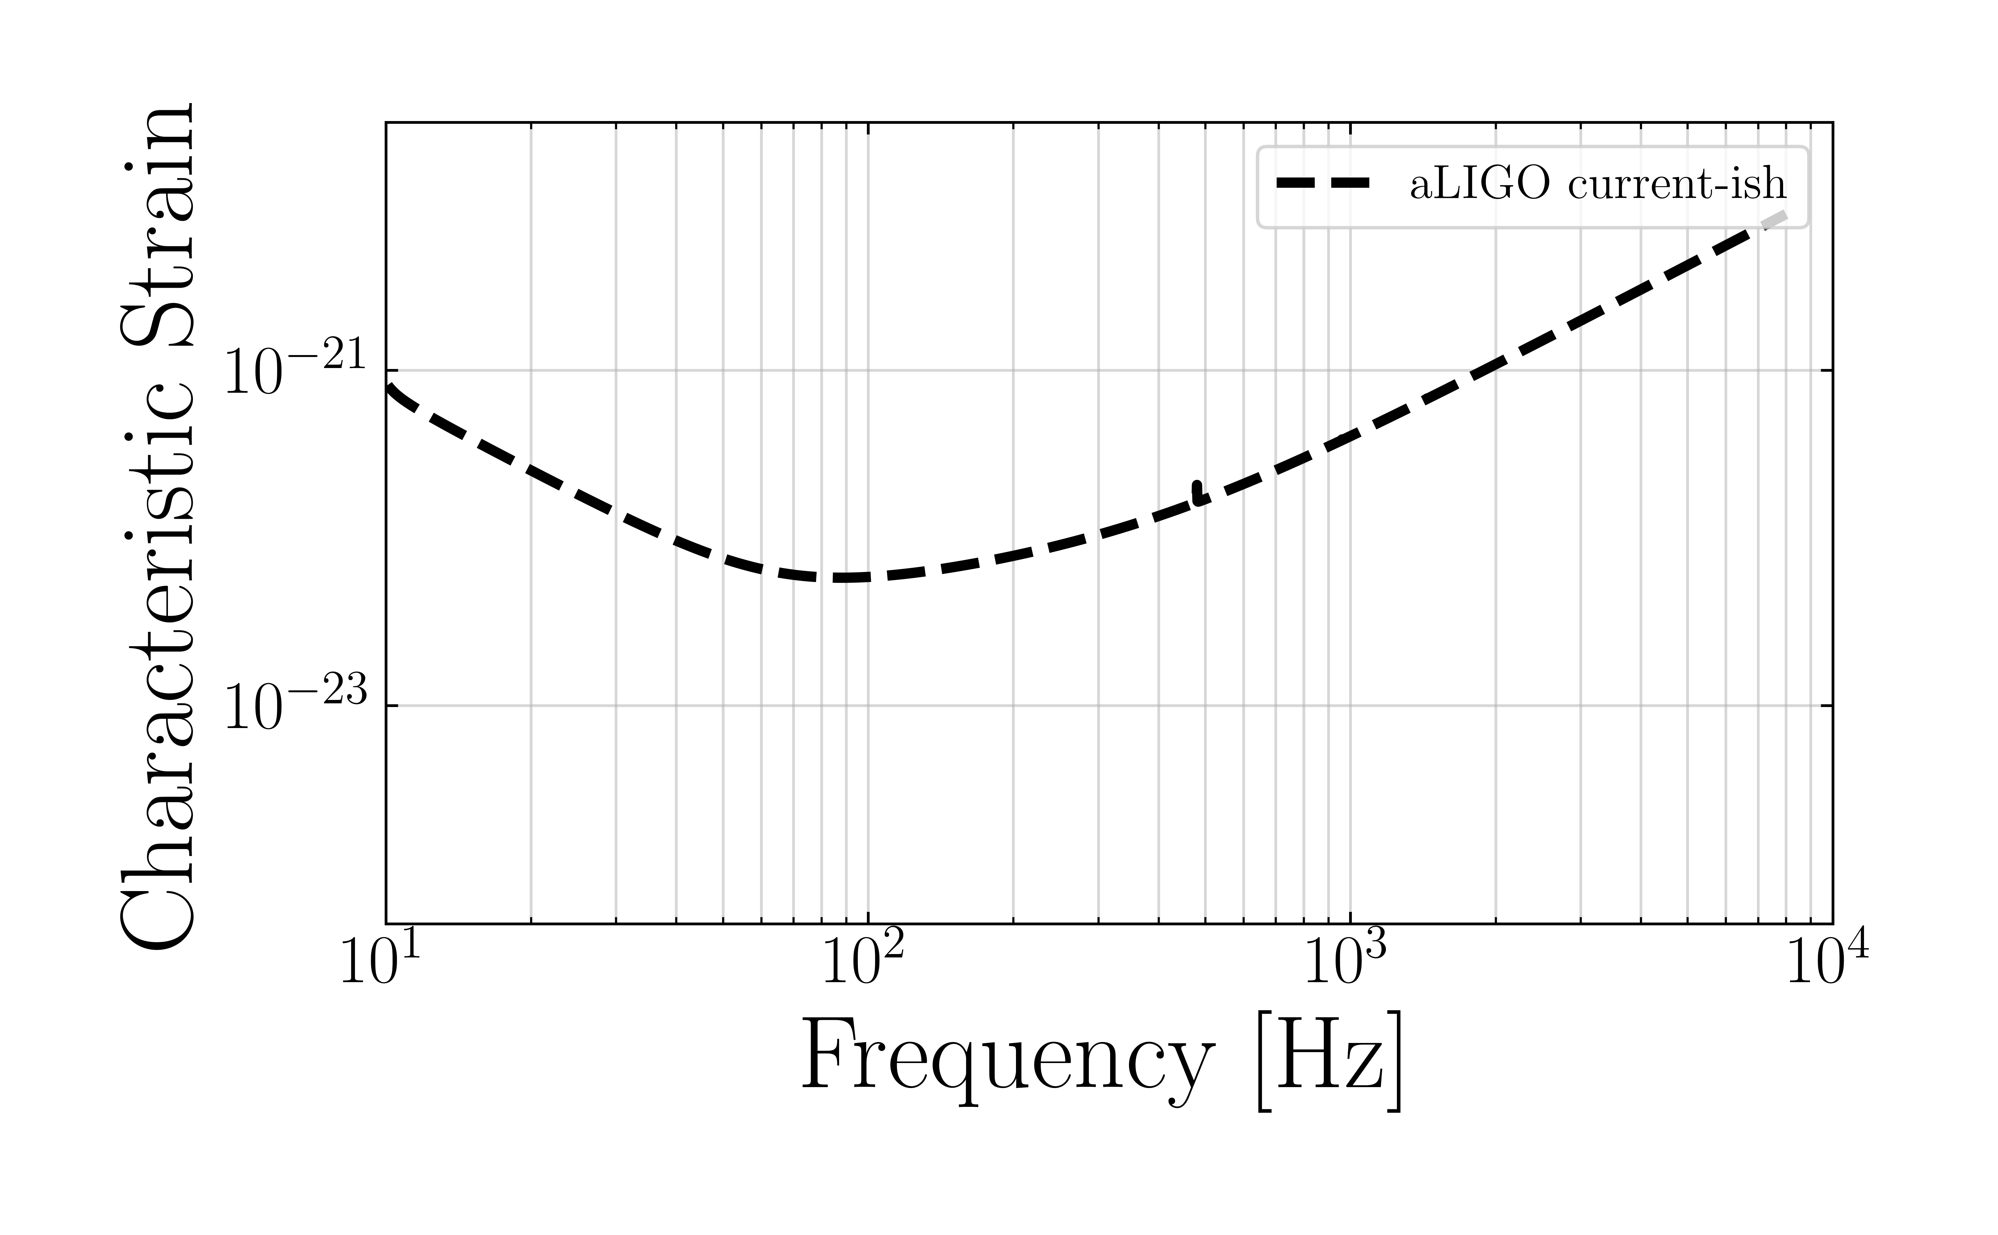
What’s next in gravitational-wave astronomy?
8
8

Slide 9
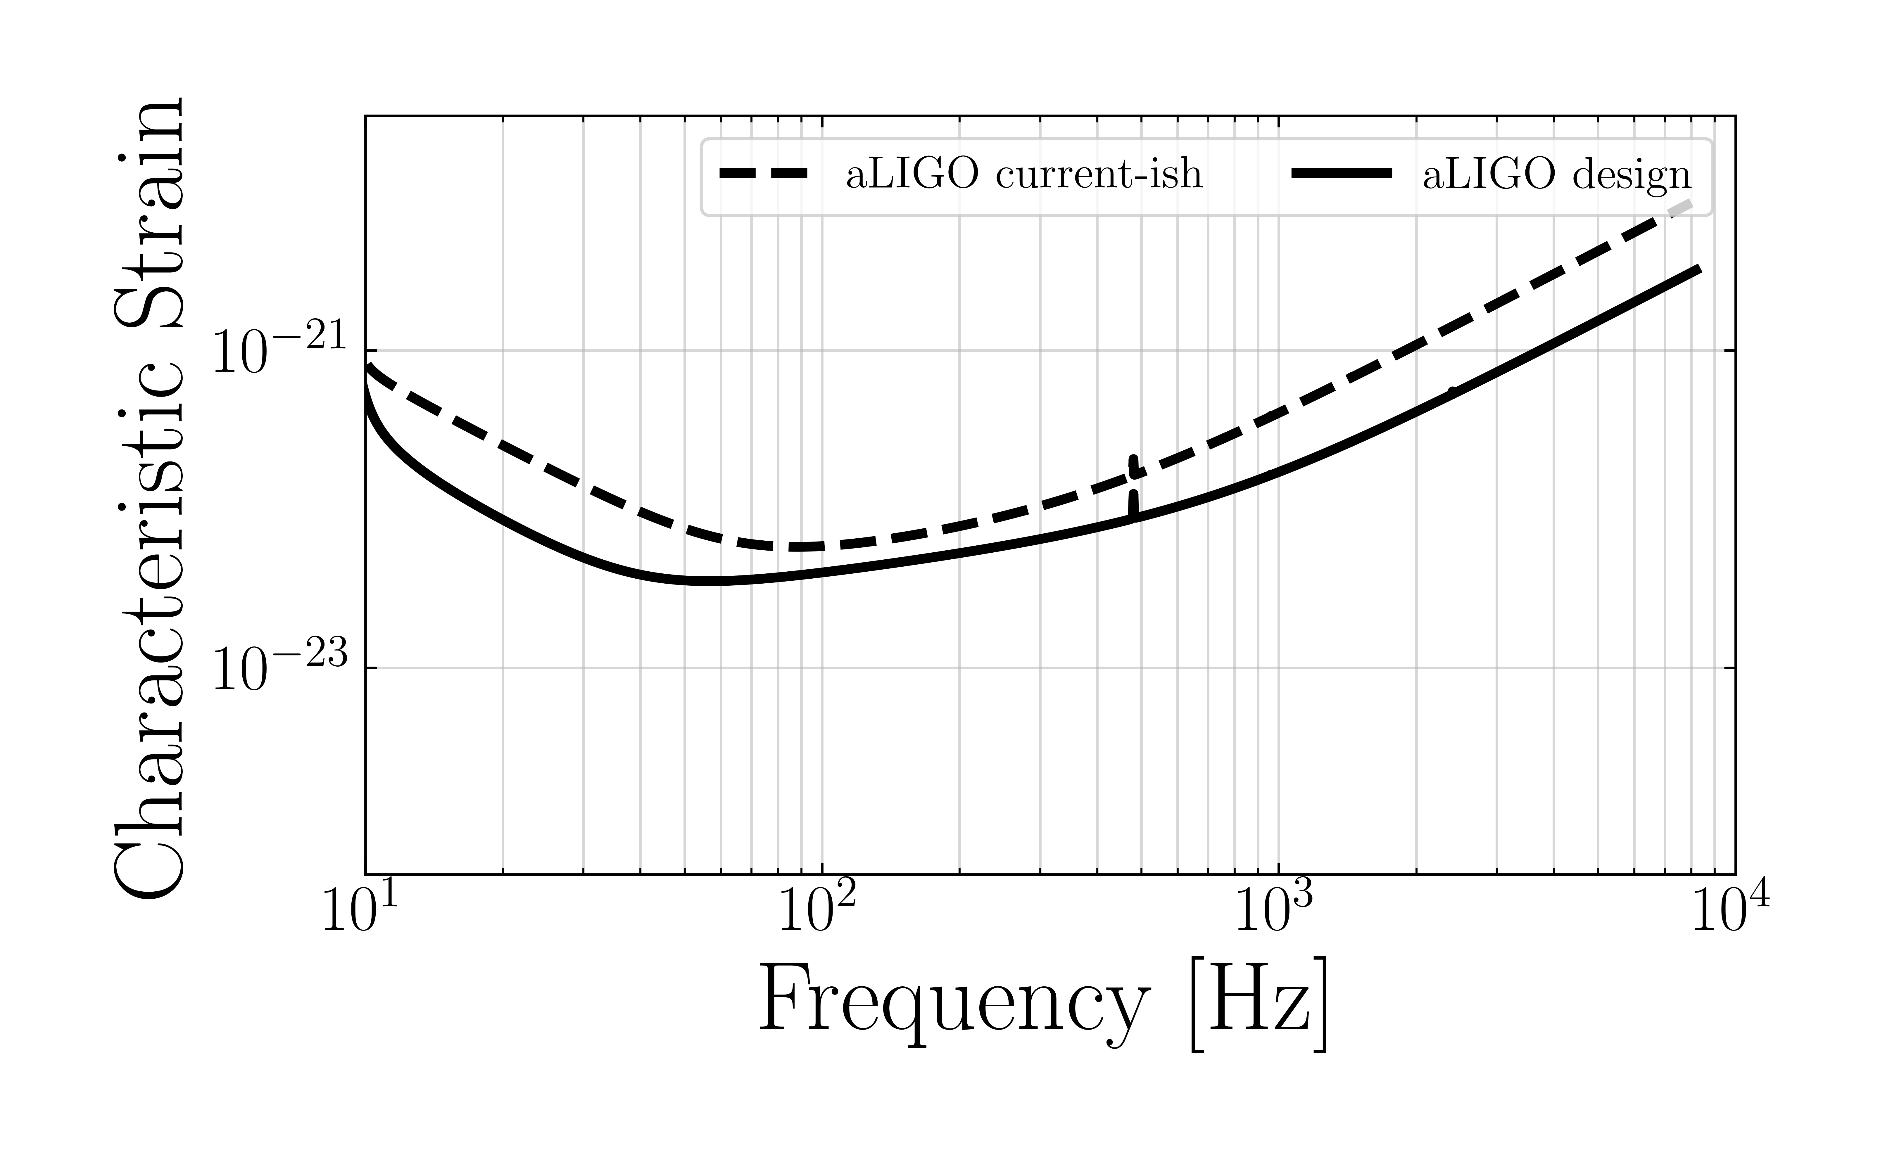
What’s next in gravitational-wave astronomy?
9
9

Slide 10
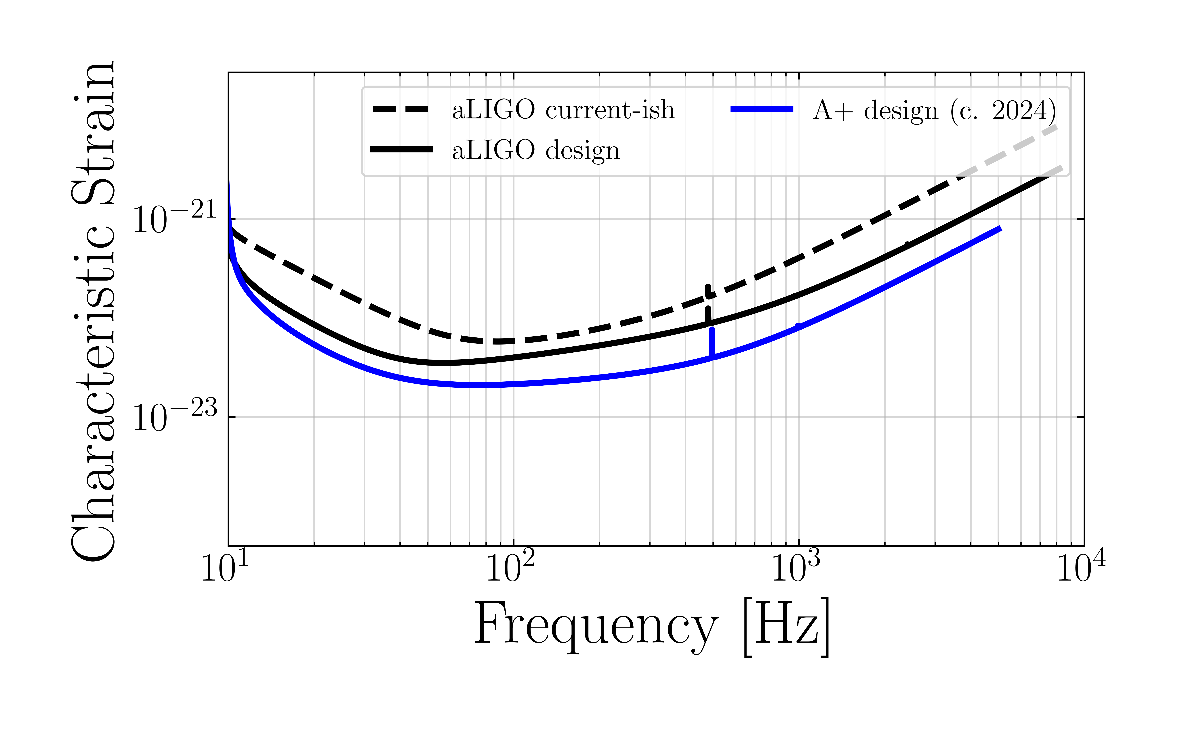
What’s next in gravitational-wave astronomy?
2028
Mostly funded,
minimal technology risk
10
10

Slide 11
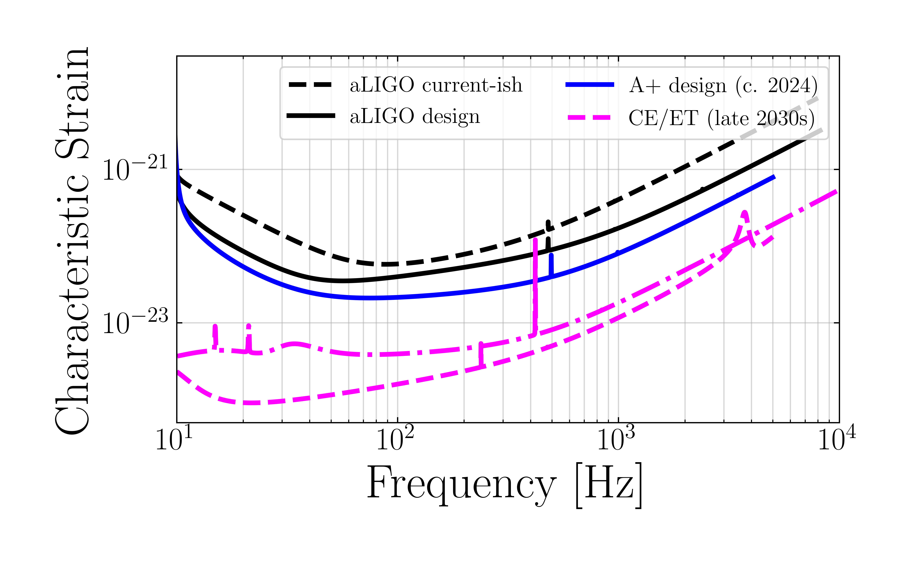
What’s next in gravitational-wave astronomy?
2028
Mostly funded,
minimal technology risk
Not funded,
Unchartered territory in terms of technology
11
11

Slide 12
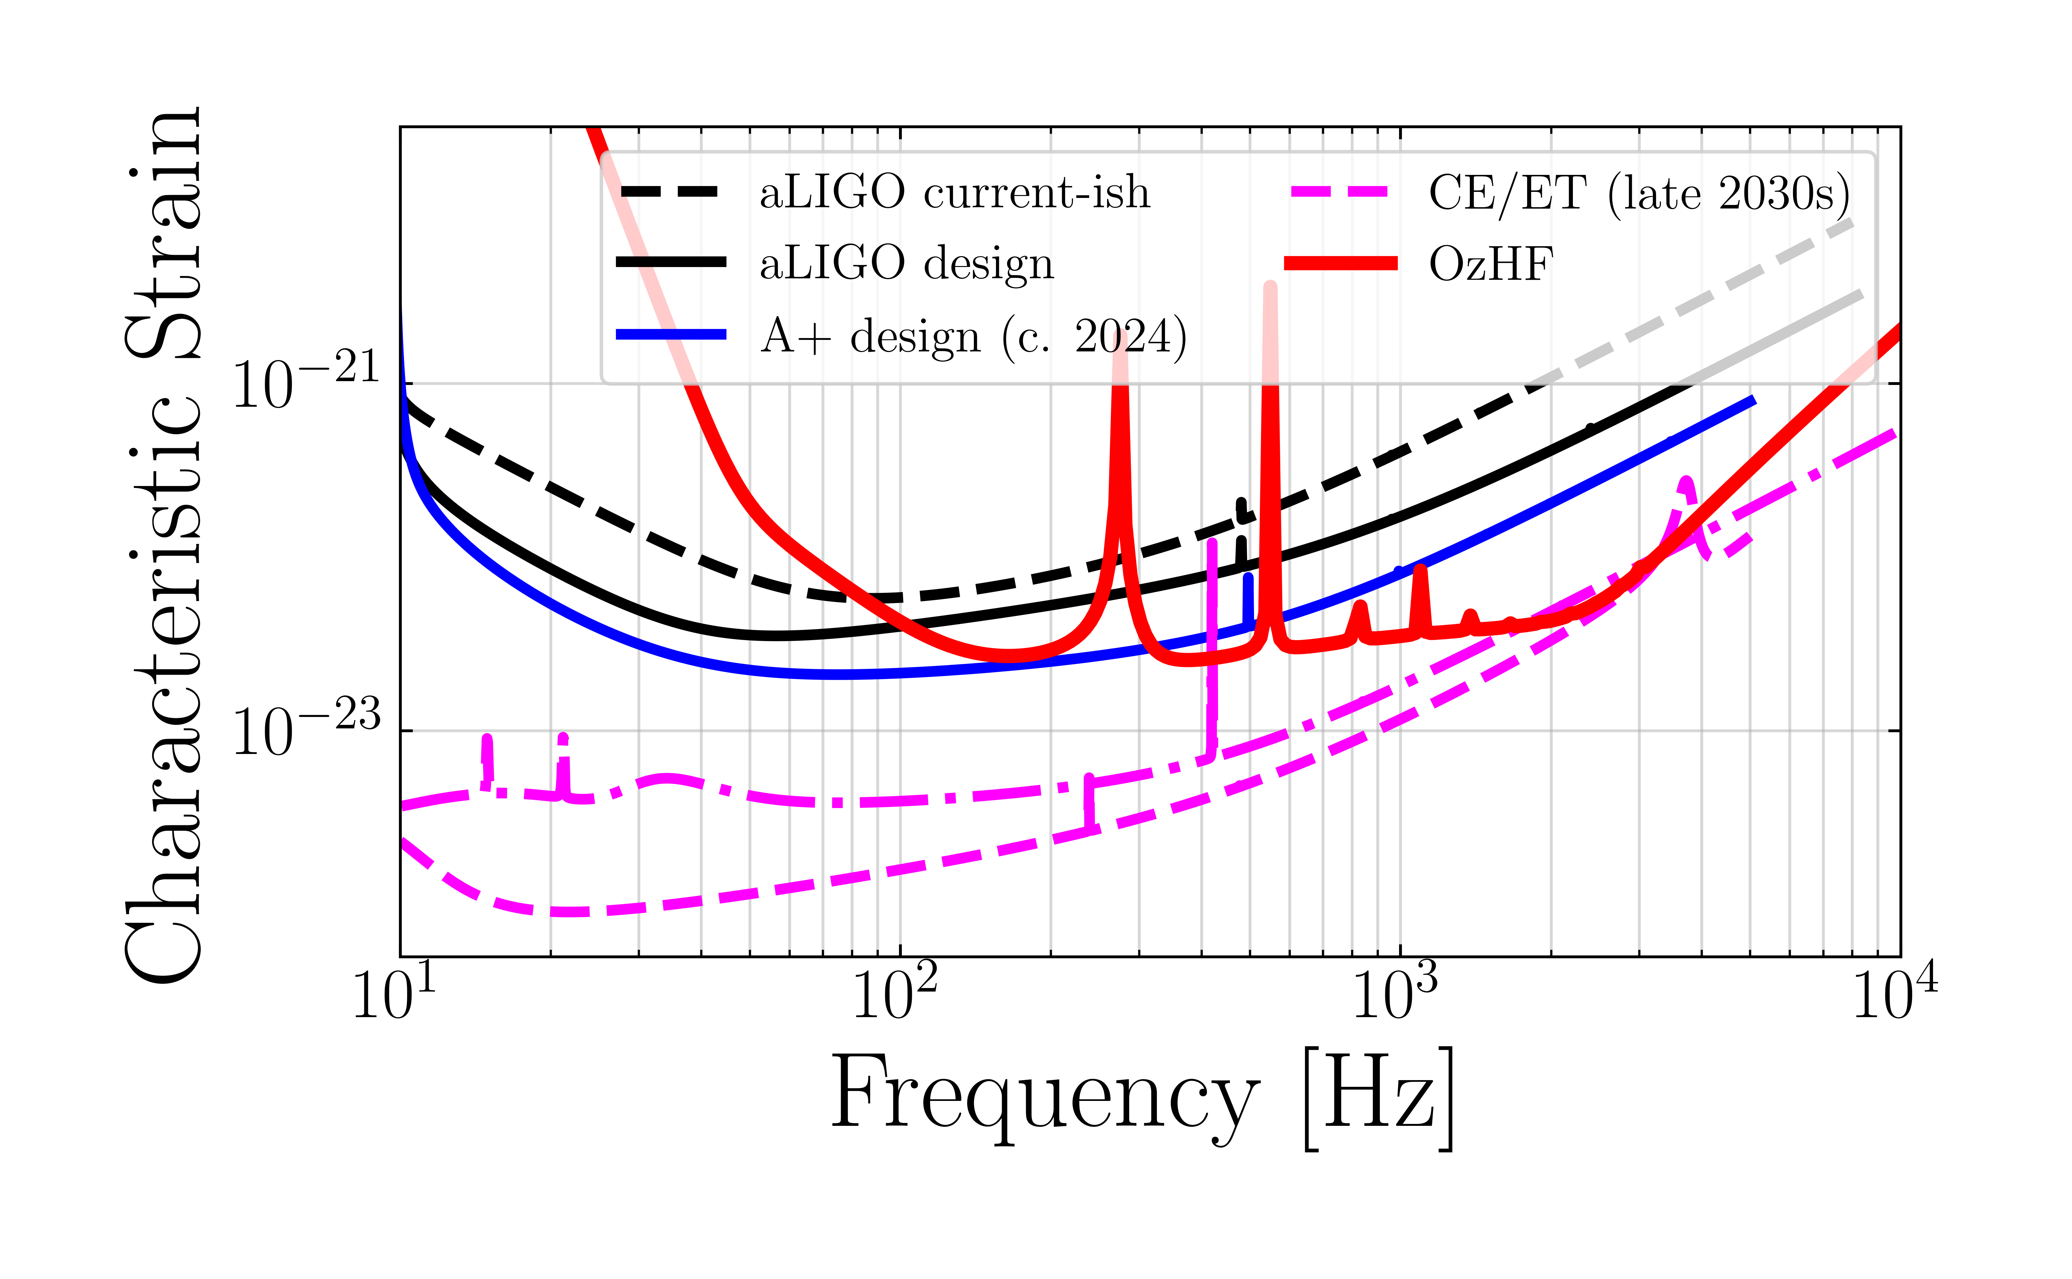

What’s next in gravitational-wave astronomy?
NEMO
2028
Mostly funded,
minimal technology risk
Not funded,
Unchartered territory in terms of technology
Scale: ~$500 M (cf. >>$3B for CE)
Dedicated science goals:
  Build the detector around the science case: neutron stars
Technology development for full 3G detectors
12
Ackley et al. (2020)
12

Slide 13
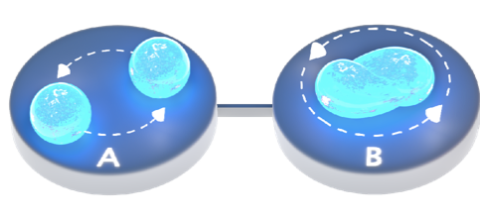
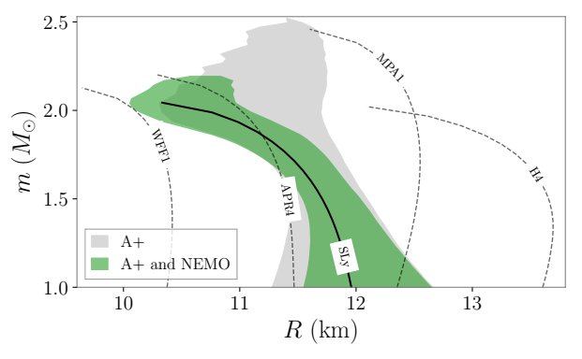

NEMO: tidal deformability
Ackley+2020
BNS rates
2 x A+: 44 BNS with SNR > 20
2 x A+ + NEMO: 61 BNS with SNR > 20
Marginal improvement
on EOS
13
13

Slide 14
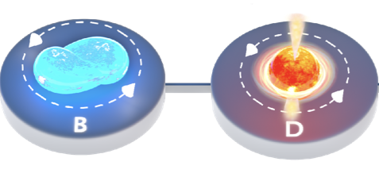
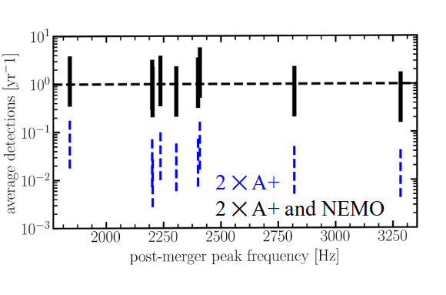
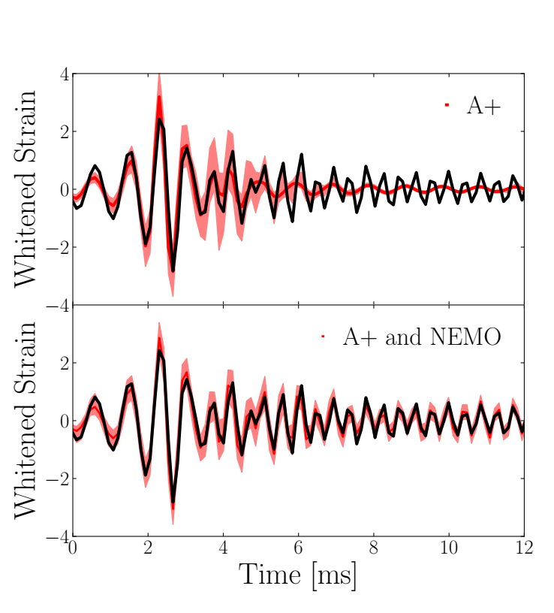

NEMO: post-merger
Ackley+2020
Potential first post-merger! First hot EOS measurement!
14
14

Slide 15
NEMO: post-merger
Ackley+2020
Equation of state (phase transitions?)
Cosmology
GRBs (jet-launching, BH formation, r-process)
Potential first post-merger! First hot EOS measurement!
15
15

Slide 16
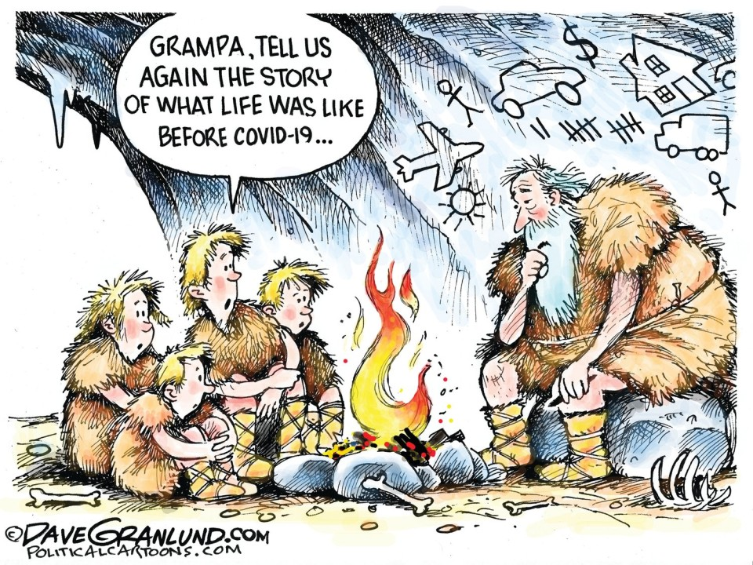
A detour: life before 2020
16
16

Slide 17
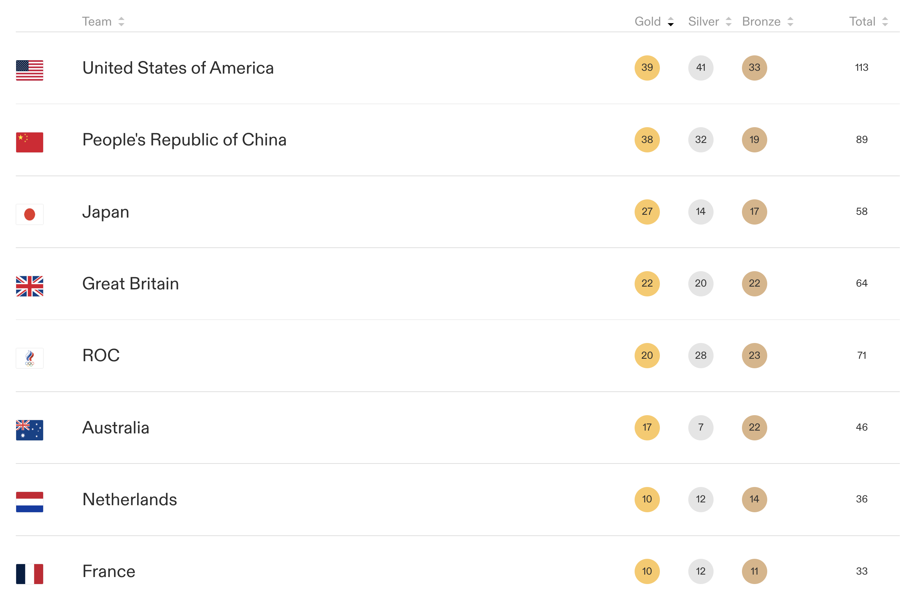

A detour: life before 2020
17
17

Slide 18
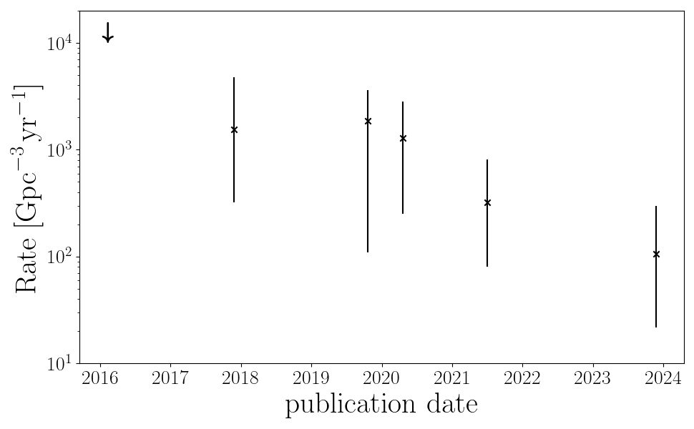
A detour: life before 2020
18
18

Slide 19

post-merger remnants
Ackley+2020 – 2019 rates

Slide 20
post-merger remnants
Ackley+2020 – 2024 rates

Slide 21
post-merger remnants
Conclusion:
We might detect a post-merger remnant tomorrow!

Slide 22
post-merger remnants
Conclusion:
We might detect a post-merger remnant tomorrow!
… joking; even CE/ET/NEMO may get < 1 yr ⁻¹

Slide 23
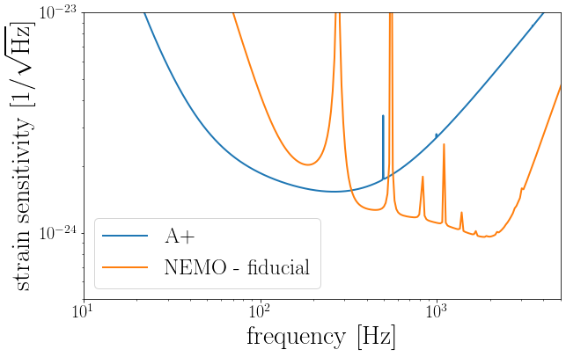
Detuning, sensitivity dips, and science
Sensitivity curves courtesy Vaishali Adya

Slide 24
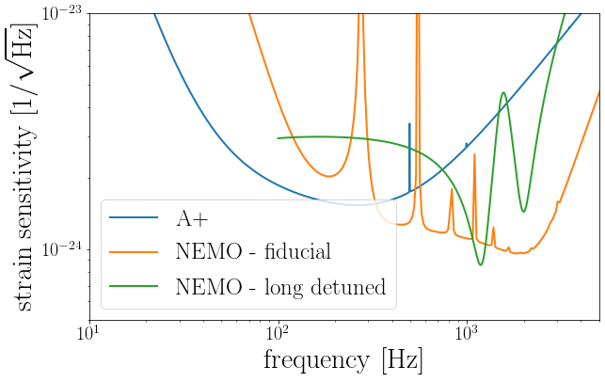
Detuning, sensitivity dips, and science
Sensitivity curves courtesy Vaishali Adya
Also relevant for 3G detector “new” detector designs
e.g., Zhang + 2023

Slide 25
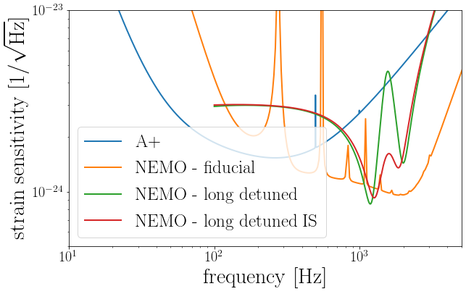
Detuning, sensitivity dips, and science
Sensitivity curves courtesy Vaishali Adya
Also relevant for 3G detector “new” detector designs
e.g., Zhang + 2023

Slide 26
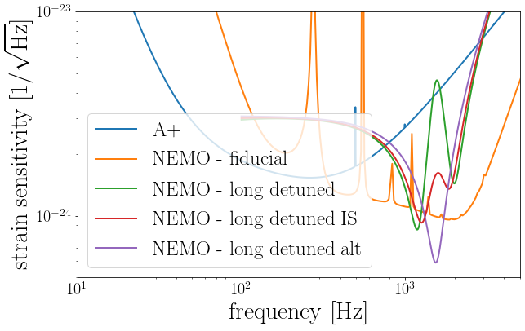
Detuning, sensitivity dips, and science
For each science goal:
Where should the dip be?
How wide?
How deep?

Slide 27
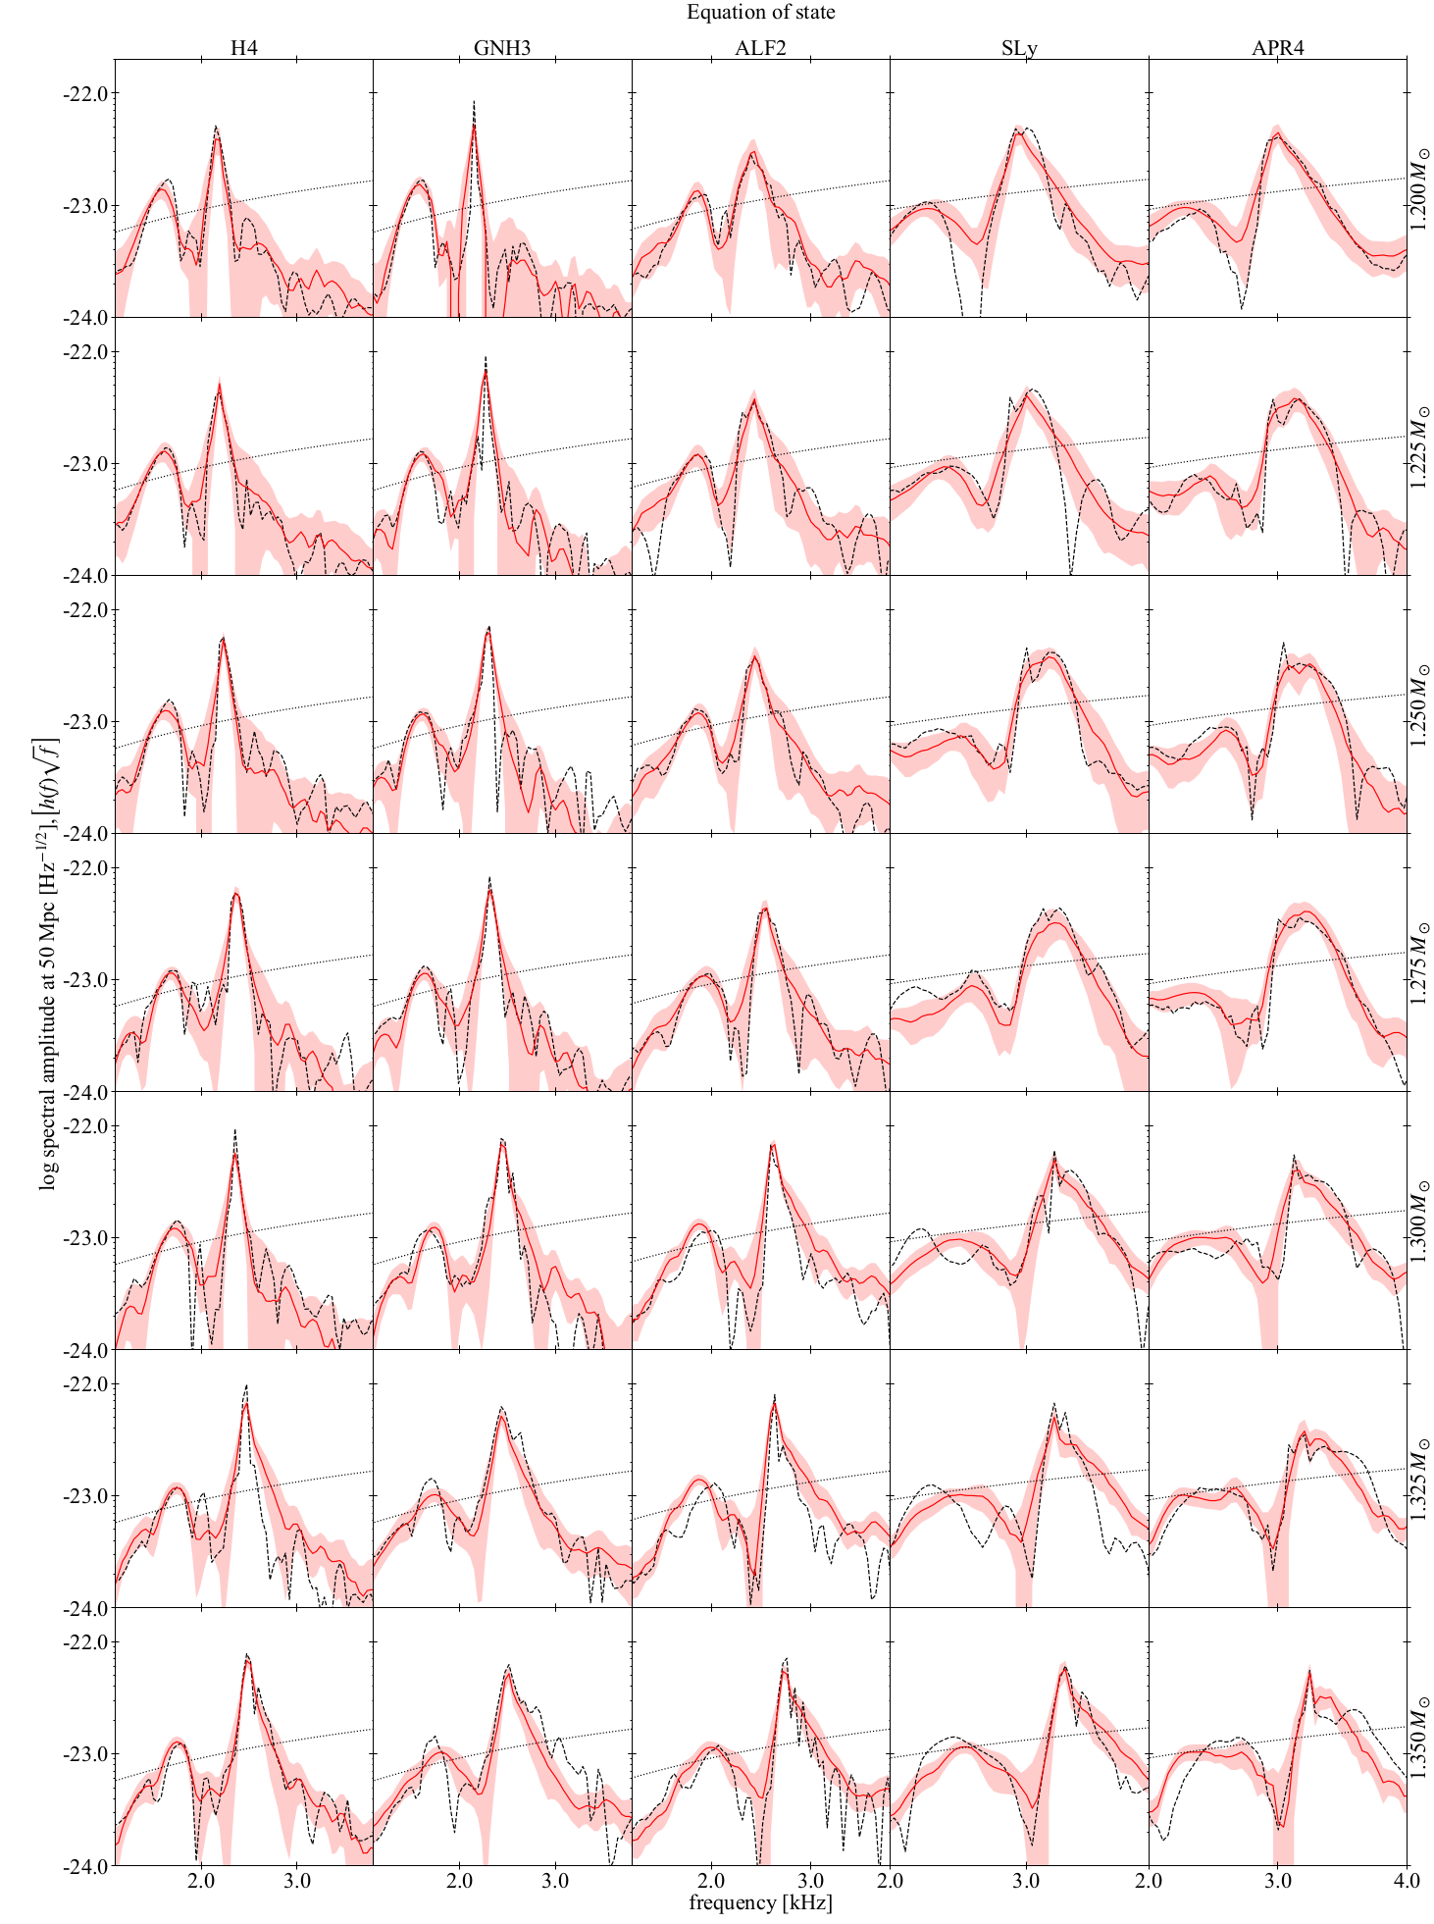
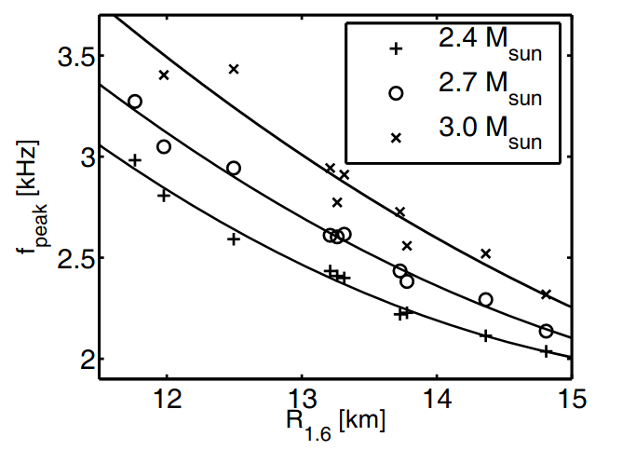
Easter, PL+2019, Baiotti & Rezzolla 2017
Bauswein+2016
require
bandwidth.

Slide 28
Take-home messages
1. In 2020, we all thought building a kHz observatory with “NEMO” sensitivity would give certain science outcomes
2. It’s 2025 now; we need to rethink the designs, and it’s much more complicated. Need to consider broader science cases
3. Should we still build a dedicated kHz facility? Yes, but it requires collective input from observers, modellers, data analysts, and instrumentalists

Slide 29

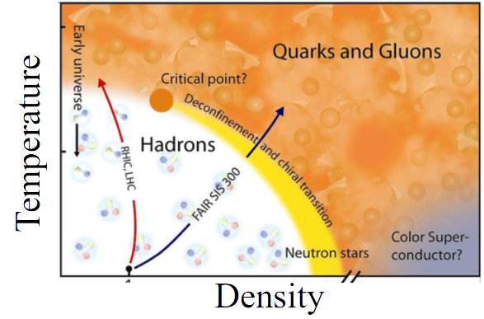

Science Case
Binary neutron star mergers:
Inspiral (cold equation of state, populations, cosmology, …)
Post-merger (detectability, hot equation of state, jet-launching, …)
Multimessenger – inspiral (don't require network; Sarin & PL 22!)
29
29

Slide 30

Multimessenger Case Study:
GRB 211211A & GRB 230307A

Slide 31
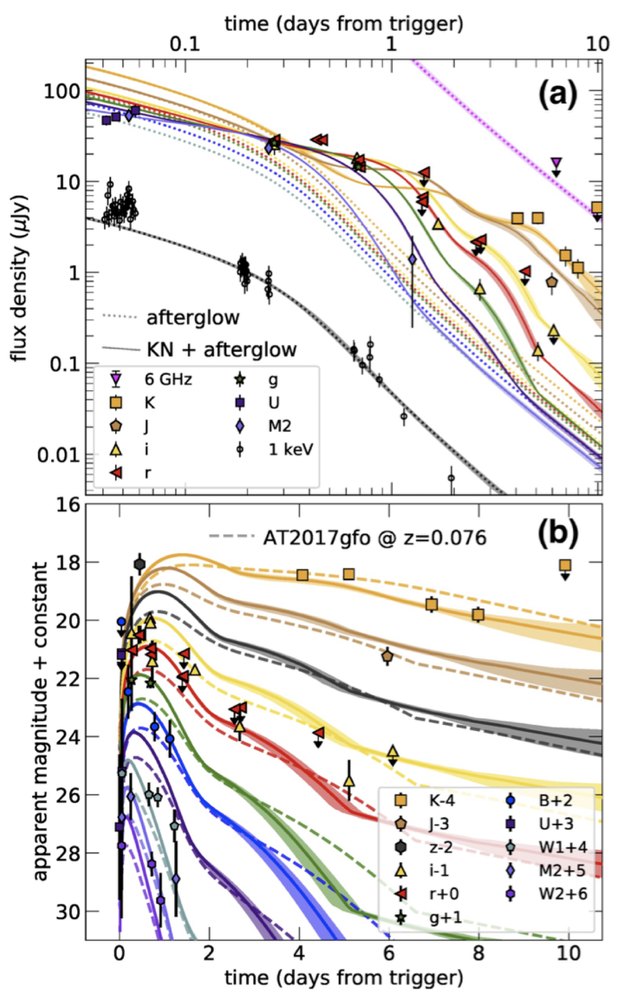
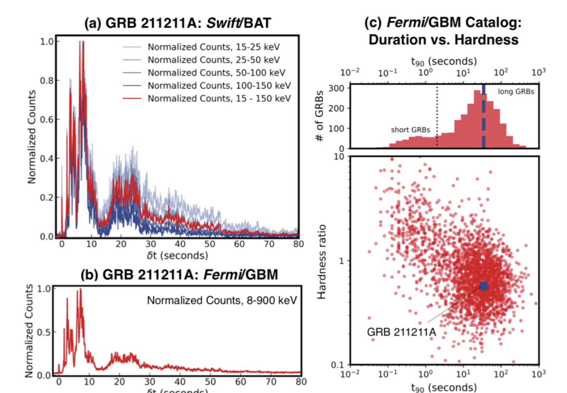
GRB 211211A
Long GRB with IR excess consistent with kilonova
Rastinejad+2022

Slide 32
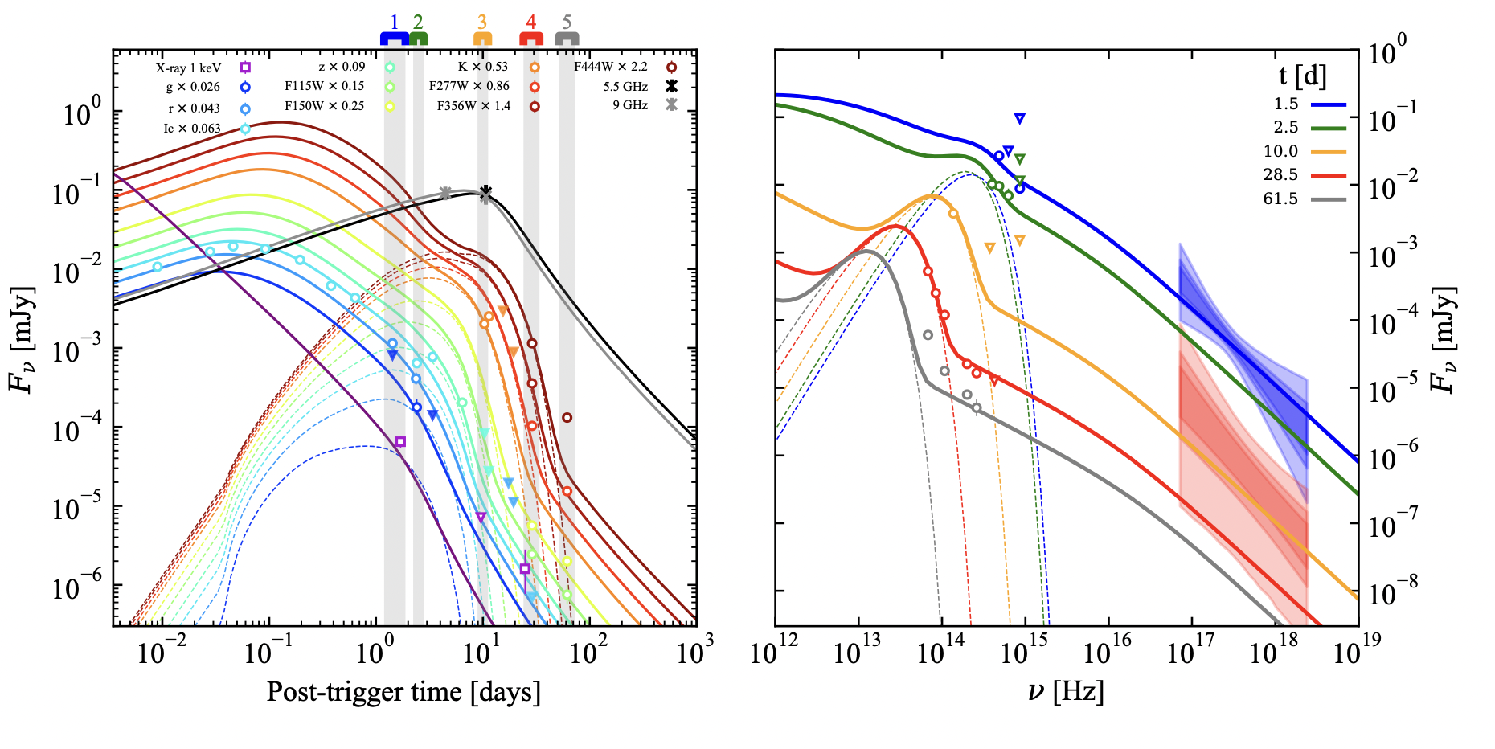
GRB 230307A
Another long GRB with IR excess consistent with kilonova
Levan+2023
See Kenta’s talk yesterday

Slide 33
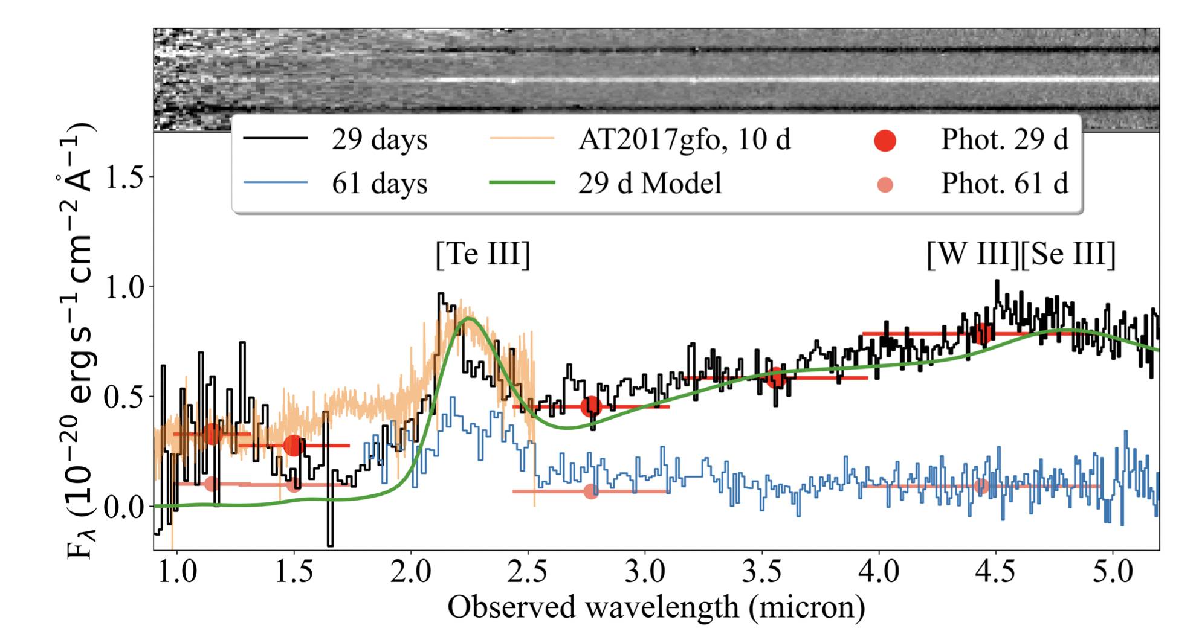
GRB 230307A
Another long GRB with IR excess consistent with kilonova
This time with JWST spectra.
Conclusively r-process nucleosynthesis!
Levan+2023
See Kenta’s talk yesterday

Slide 34
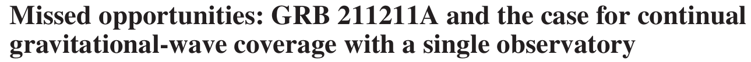
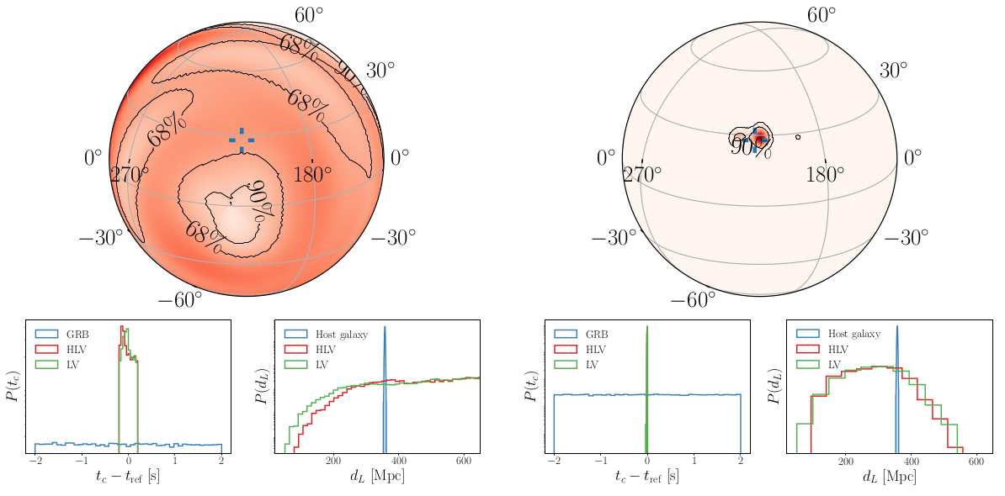
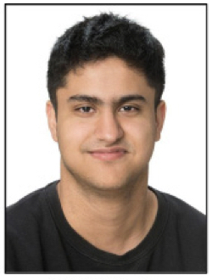
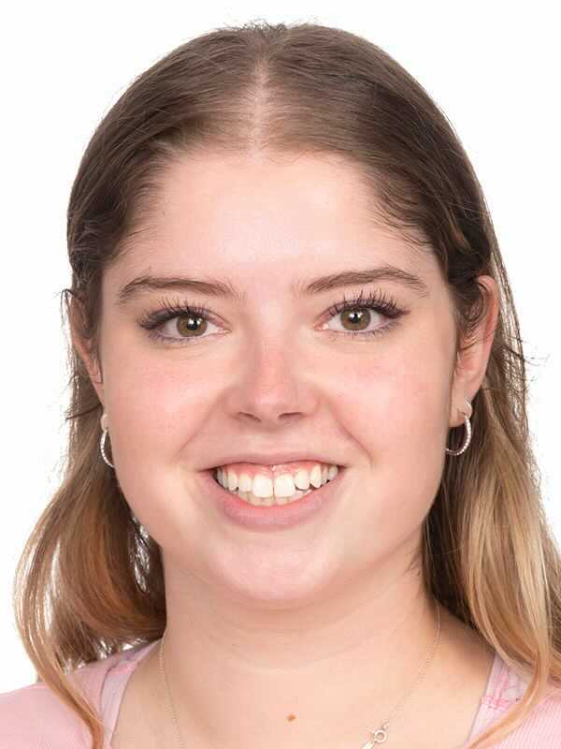
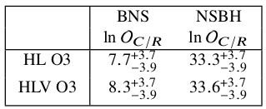
Sarin, PL & Nathan 2023
34
LVK O3
BNS O3: 350 Mpc
NSBH O3: 350 Mpc

Slide 35
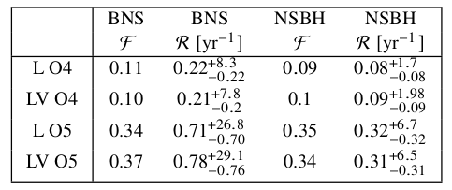
Sarin, PL & Nathan 2023
Populations of events
Once you detect the GWs, the odds become dominated by the time of coalescence

Slide 36
Sarin, PL & Nathan 2023
Populations of events
Numbers do not depend sensitively on number of detectors; one is enough!
Once you detect the GWs, the odds become dominated by the time of coalescence

Slide 37
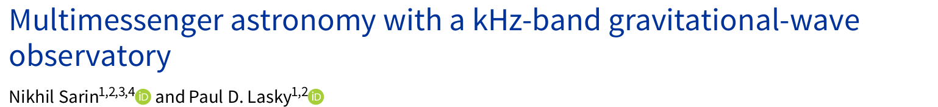
UV/Optical:
    JWST, Rubin, TMT/GMT, ZTF, Evryscope
    100% of KNe within 450 Mpc (Rubin)
x/gamma-ray
    ATHENA, Theseus, SVOM, eROSITA
    All on-axis bursts beyond NEMO horizon
radio
    SKA, FAST, CHIME, ...
    Radio afterglows (jet structure etc), FRBs (?)

Slide 38
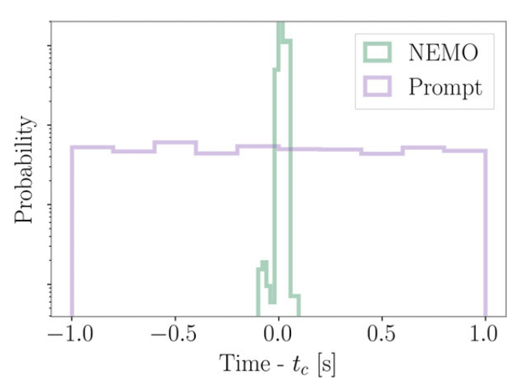
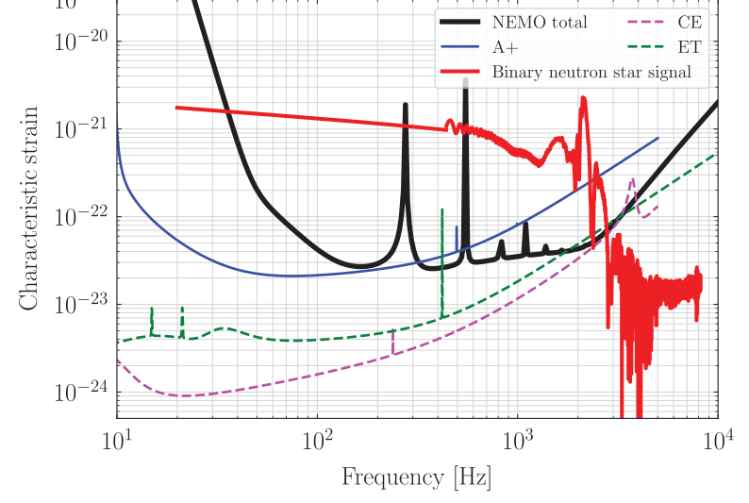
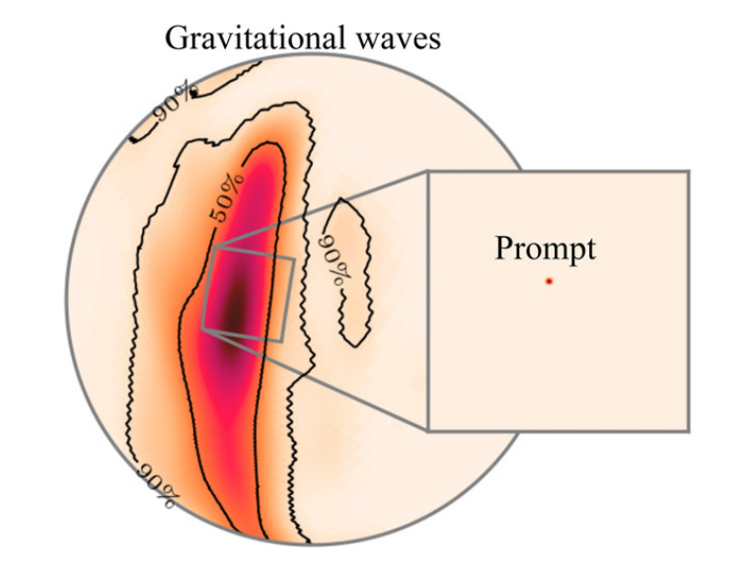
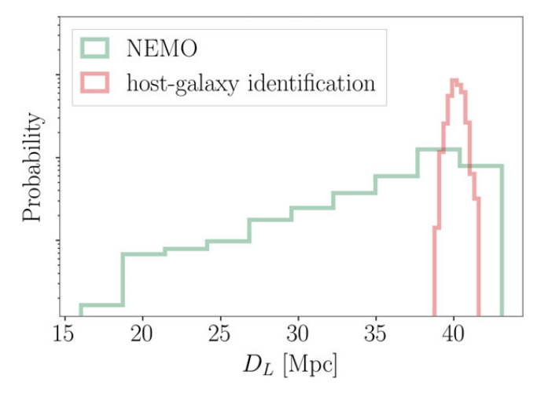
Ackley+20
Overlap calculation: Ashton+18

Slide 39
Multimessenger science (even with a single detector)
GRB211211A
  NSBH or BNS?
  Long vs. short?
  GRB central engine and extended emission.
Hubble – 90% CI for BNS at ~200 Mpc (conservative; no inclination angle assumptions)
Constraints on speed of gravity – coalescence time well measured; comparable to GW170817
Equation of state: relatively accurate mass measurements from GW signal. Combine with KNe modelling to get EOS inference (e.g., Coughlin+19, Nicholl+21) – maybe….
GRB physics:
  Accurate measurement of jet launch/propagation times.
  Get approx. viewing angle from distance to host galaxy → infer jet structure.

Slide 40
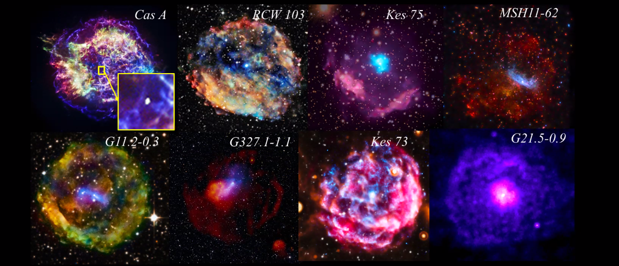
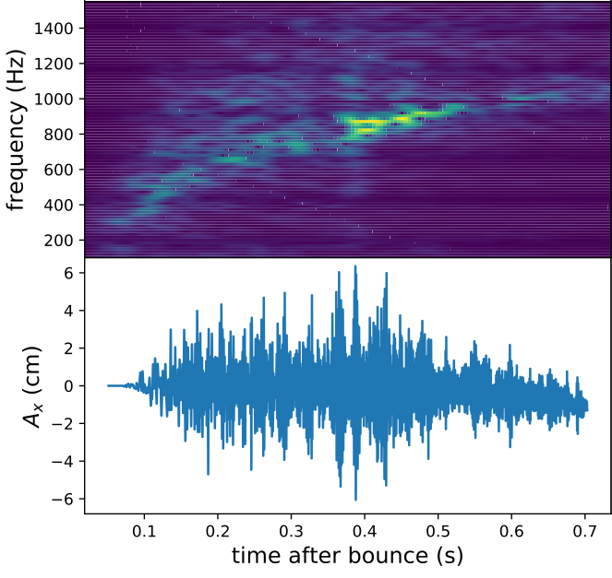
Science Case
Binary neutron star mergers
Supernovae
Powell & Mueller (2019)
Stolen from Katie Auchettl!
40
40

Slide 41
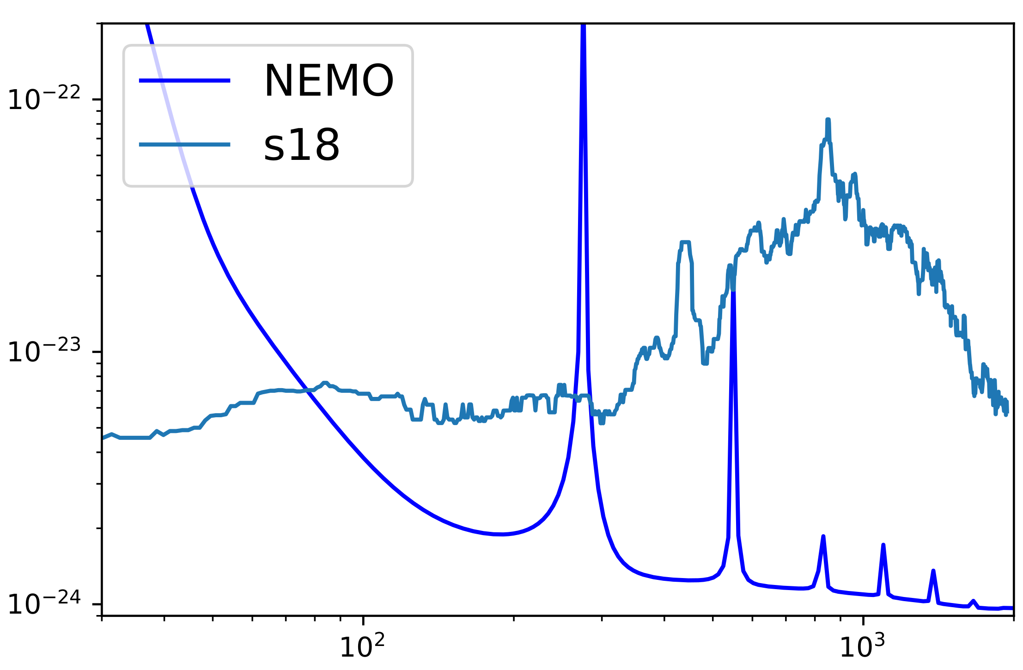
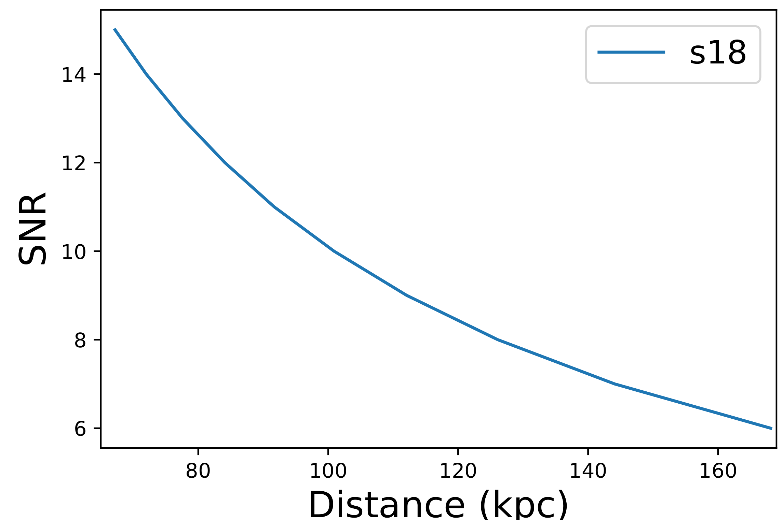
Supernovae
Courtesy: Jade Powell
ASD [1/rtHz]
Frequency [Hz]
What do we need?
"Realistic" (best guess) amplitude and rate estimates
"optimal" frequency windows
​
​
​
What do we have?
See Kei’s talk yesterday
​
​
​

Slide 42
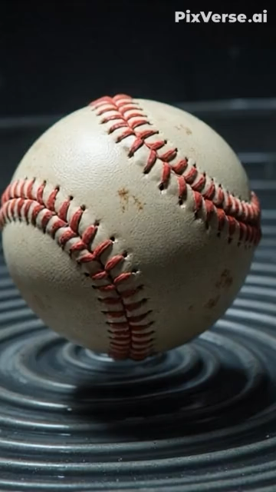
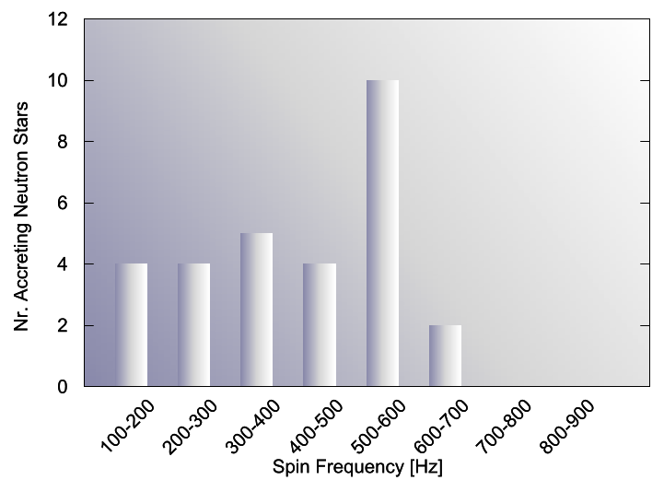
Science Case
Binary neutron star mergers
Supernovae
Continuous Waves
How elliptical are millisecond pulsars? ¯\_(ツ)_/¯
Is torque balance a thing?
Etc...
Patruno+2017
42
42

Slide 43
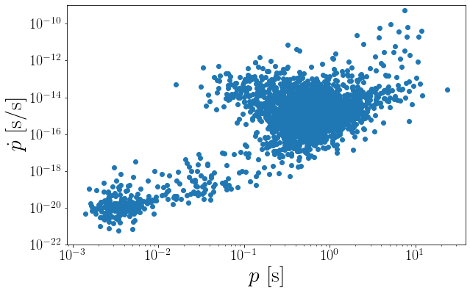

Slide 44
“Observational evidence for a minimum ellipticity in millisecond pulsars”
????
Woan, Pitkin, Haskell, Jones, PL 2018

Slide 45
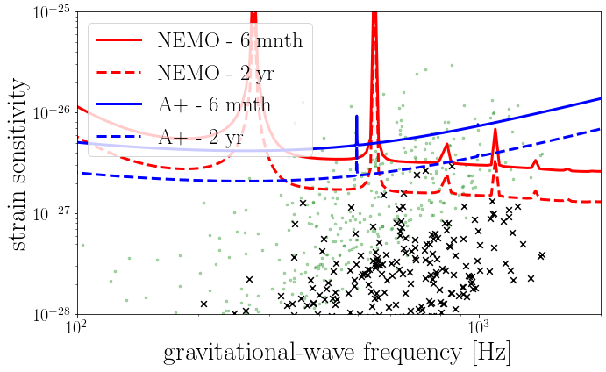
PL, Adya et al (in prep… since 2021)

Slide 46
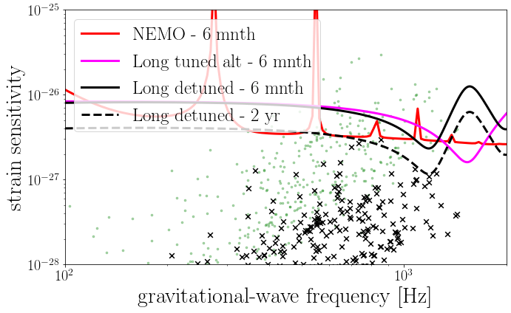
PL, Adya et al (in prep… since 2021)

Slide 47

PL, Adya et al (in prep… since 2021)

Slide 48

Accreting systems – torque balance
“Realistic” magnetic field burial
PL, Adya et al (in prep… since 2021)

Slide 49


Science Case
NASA
Binary neutron star mergers
Supernovae
Continuous Waves
Other burst sources
Magnetar flares (kHz, unknown amplitude)
Fast radio burst progenitors
Neutron star glitch recovery
….
astronomy.swin.edu.au
49
49

Slide 50



Towards an Australian gravitational-wave observatory

Slide 51
Why Australia? Why now?
OzGrav
  Guaranteed funds: 2024 - 2031
  $42M; ~300 people
  Instrumentation, data, astrophysics

Slide 52

Why Australia? Why now?
OzGrav
  Guaranteed funds: 2024 - 2031
  $42M; ~300 people
  Instrumentation, data, astrophysics
Australian Gravitational-Wave Observatory Project
Executive Committee:
Yeshe Fenner, Paul Lasky (Chair), Ju Li, David McClelland, David Ottaway

Slide 53

Steps:
Landscape assessment:
  Facilities and fundamental research landscape
  Key alignments – e.g., SKA, ESO, etc
  Aus-based R&D capacity and capabilities
  ….

Slide 54
Steps:
Landscape assessment:
  Facilities and fundamental research landscape
  Key alignments – e.g., SKA, ESO, etc
  Aus-based R&D capacity and capabilities
  ….
Go/No-Go
  Are there any showstoppers?

Slide 55
Steps:
Landscape assessment:
  Facilities and fundamental research landscape
  Key alignments – e.g., SKA, ESO, etc
  Aus-based R&D capacity and capabilities
  ….
Go/No-Go
  Are there any showstoppers?
What comes next?
  (deliberately vague, because we need to finalise 2)
  Cost-benefit analysis
  Governance
  Funding routes
  ….

Slide 56
International partnerships
Build and grow collaboration through Asia Pacific e.g., Japan-Australia ASPIRE

Slide 57
Take-home messages
1. In 2020, we all thought building a kHz observatory with “NEMO” sensitivity would give certain science outcomes
2. It’s 2025 now; we need to rethink the designs, and it’s much more complicated. Need to consider broader science cases
3. Should we still build a dedicated kHz facility? Yes, but it requires collective input from observers, modellers, data analysts, and instrumentalists

Slide 58
What are we thinking?
Ultimately - full 3G (e.g., CE-South) in 2040s (?)
How do we get there?
NEMO-like (not necessarily original NEMO tech, but high-frequency sensitivity)
10(ish)-km A+/A#
Subsystem contribution(s) to A#

Slide 59
Image: Carl Knox​
Appears in Sarin & PL 2021
extra slides

Slide 60
Science Case
NASA
Binary neutron star mergers
Supernovae
Continuous Waves
Other burst sources
Magnetar flares (kHz, unknown amplitude)
Fast radio burst progenitors
Neutron star glitch recovery
….
astronomy.swin.edu.au
60
60

Slide 61

NEMO: preliminary design
4km arms
74 kg Silicon test masses
Cooling: 123K
2 micron wavelength
500 W input power
4.5 MW in arms
7 dB Squeezing
Suspension: steel
Neglect low frequency isolation
Ackley et al. (2020)
61

Slide 62

NEMO: preliminary design
Ackley et al. (2020)
62

Slide 63



NEMO: scoping study
Carl Blair et al
You are here
Potential sites all over Aus,
including Gingin near Perth
Flythrough

Slide 64



Ronchini+2022
ET only
ET + CE
One year of operation!
See Gardner+ (inc. PL; 2023) to include AU observatory

Slide 65

Which path?
Depends on progenitor masses (which we know) and
Maximum non-rotating mass of neutron stars (which we don’t know)
    Measure M_{TOV}
Measure path with gravitational waves and/or electromagnetically

Slide 66


Strain [1/rtHz]
strain [10⁻²¹]
GW frequency [Hz]
Time [s]

Slide 67

Potential to “see” phase transitions etc.
See Bauswein+2019, Luca’s talk
and references therein

Slide 68


NEMO: post-merger
Can we measure the collapse?
Easter, PL, Casey 23
68
68

Slide 69

NEMO: post-merger
Can we measure the collapse?
Easter, PL, Casey 23
No...
69
69

