Slide 1
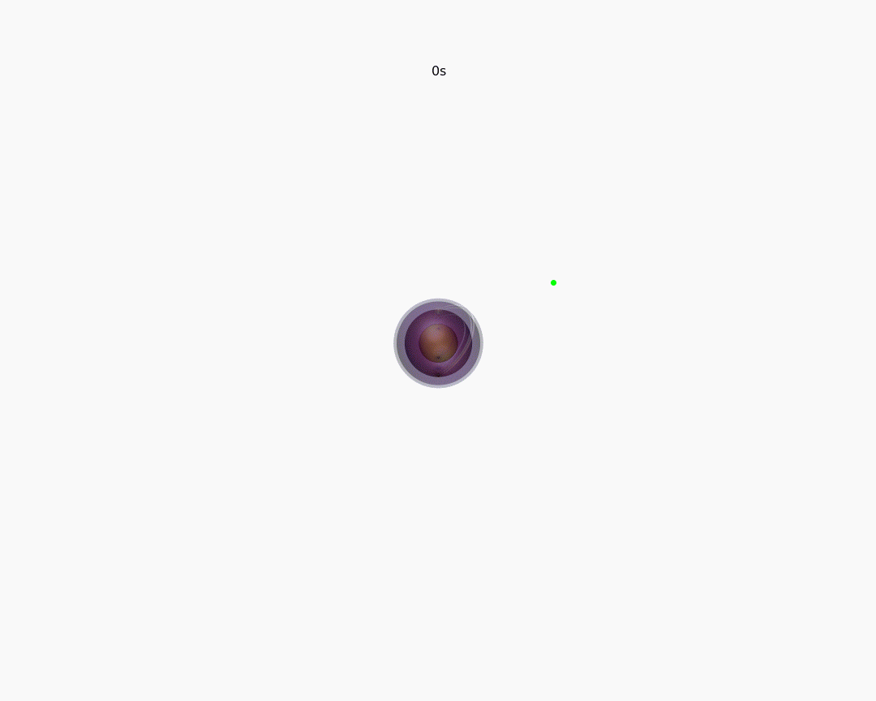
連星系内での中性子星の誕生
Collaborators
Philipp Podsiadlowski (Oxford)
Alex Heger (Monash)
Hiroki Nagakura (NAOJ)
Ilya Mandel (Monash)
平井遼介
理化学研究所・モナッシュ大
～中性子星の観測と理論～ 研究活性化ワークショップ 2025@ 理化学研究所 20/5/2025

Slide 2
中性子星連星の形成
Collaborators
Philipp Podsiadlowski (Oxford)
Alex Heger (Monash)
Hiroki Nagakura (NAOJ)
Ilya Mandel (Monash)
平井遼介
理化学研究所・モナッシュ大
～中性子星の観測と理論～ 研究活性化ワークショップ 2025@ 理化学研究所 20/5/2025

Slide 3
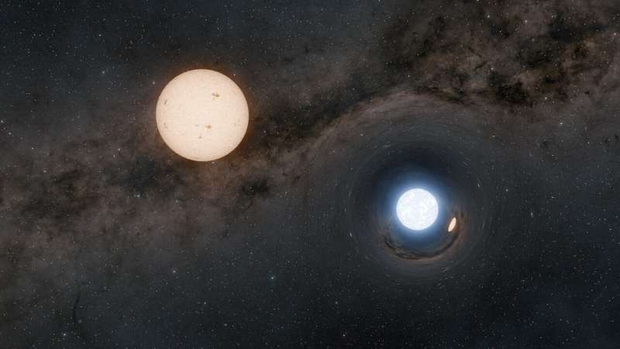
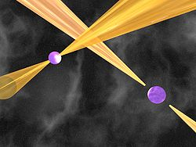
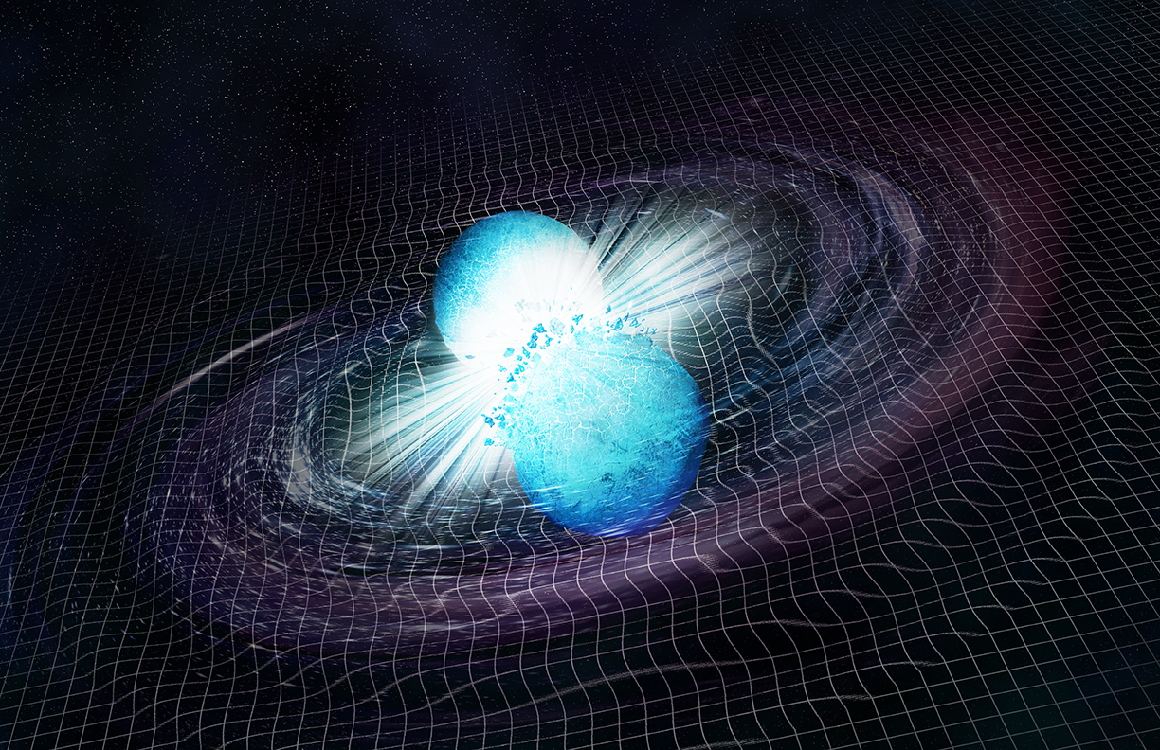
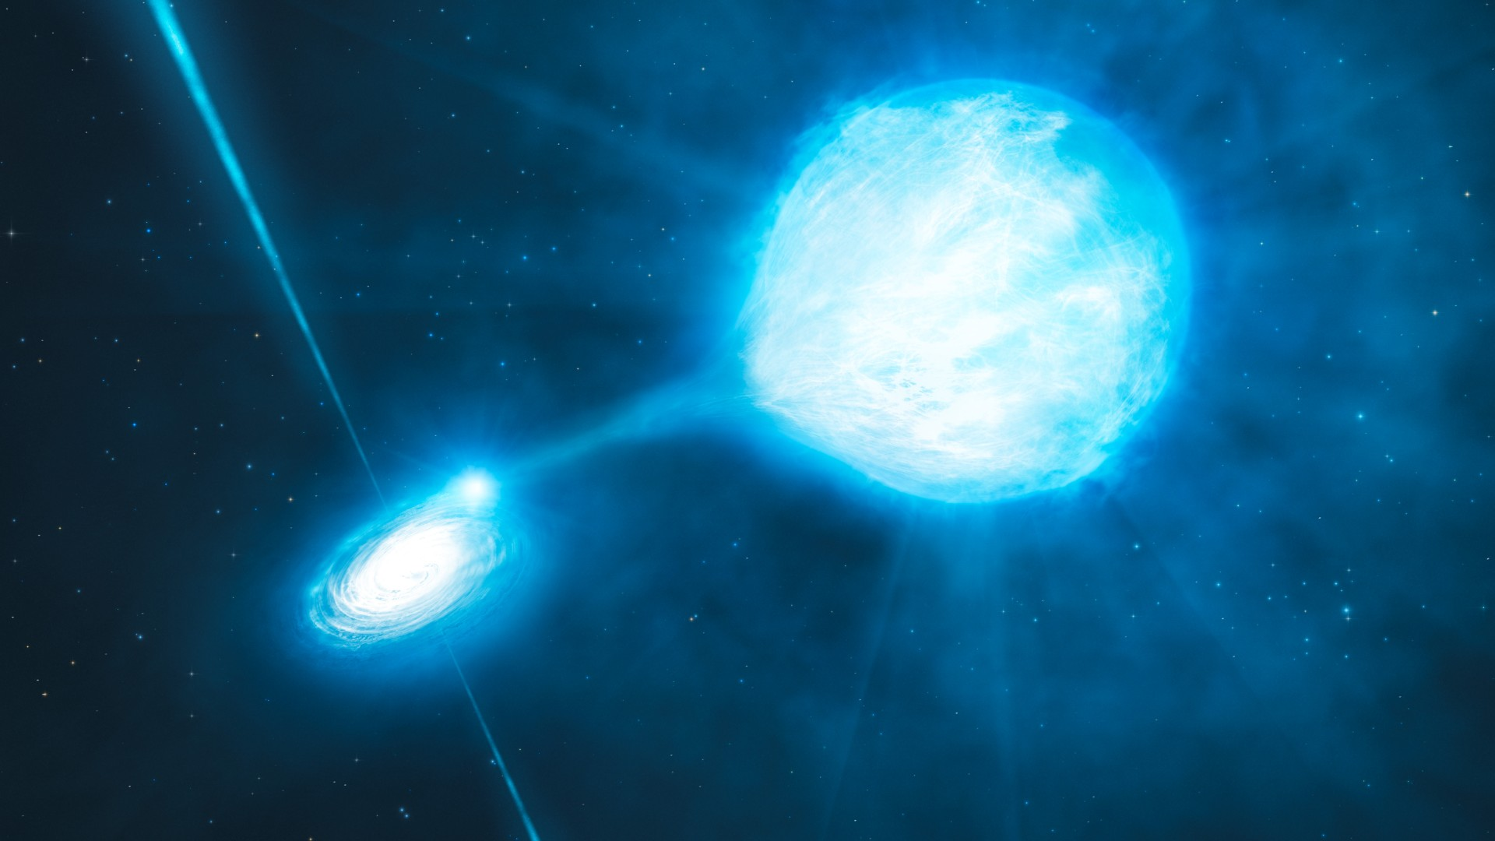
Variety of neutron star binaries
LMXB
Astrometric binary
Binary pulsar
HMXB
GW sources

Slide 4
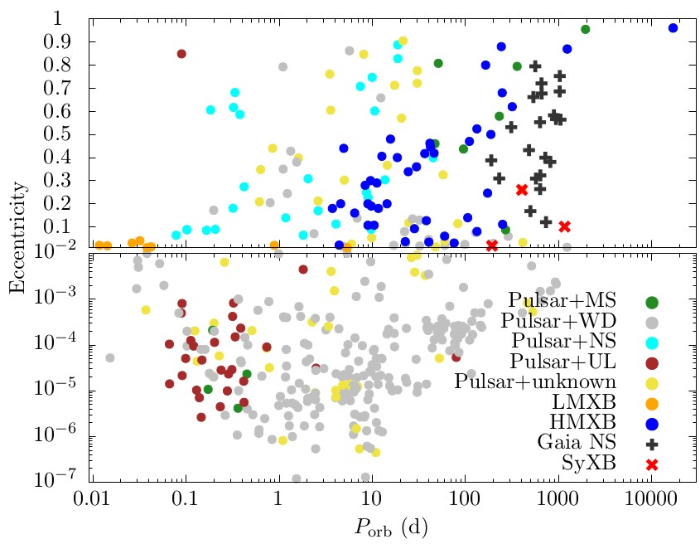
Variety of neutron star binaries
LMXB
Supernova
????
Astrometric binary
Tidal circularization
Binary pulsar
HMXB
GW sources

Slide 5
Formation of neutron star binaries
Can the binary survive the common envelope phase?
Can the binary survive the supernova?
Can the binary survive the supernova?
Can the binary survive the common envelope phase?

Slide 6
Common envelope phase
The greatest “excuse” for binary evolution modelers not getting things right

Slide 7
Common envelope phase
A mechanism to simultaneously remove the envelope and tighten the orbit
Lau, RH et al. 2022

Slide 8
What do we want to know?
Goal: Predict final state from initial conditions
companion
Donor core
companion
donor
separation
separation
Initial conditions
$$M1,i, M2,i, ai, ei, \\ R1,i, R2,i, t1,i, t2,i , \\ etc…$$
Common Envelope
Final state
$$M1,f, M2,f, af, ef, \\ R1,f, R2,f, t1,f, t2,f , \\ etc…$$
$$α, γ, etc…$$
Some sort of parameterization is often applied to predict the final state

Slide 9
Energy formalism
“α-formalism” (Webbink 1984)
$$E_{env}=α_{CE}∆E_{orb}$$
$$∆E_{orb}=E_{orb,i}−E_{orb,f}=−\frac{Gm_{1}m_{2}}{2a_{i}}+\frac{Gm_{1,c}m_{2}}{2a_{f}}$$
$$a_{i}$$
Common envelope
$$m_{1,c}$$
$$a_{f}$$
$$m_{2}$$
$$m_{2}$$
$$m_{1}$$
$α_{CE}$: efficiency of envelope ejection
$E_{env}, α_{CE}$ should be determined from theory or observations
$E_{env}$: binding energy of the envelope

Slide 10
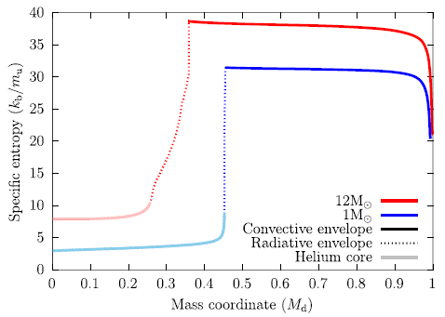
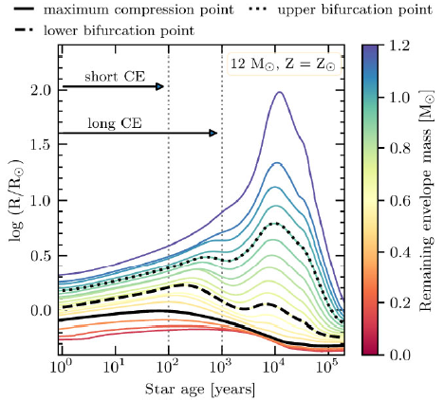
Massive stars should be treated differently
Shorter thermal timescales
The energy formalism assumes the CE phase is an adiabatic process (≒ the CE phase is much shorter than the thermal timescale) This assumptions partially breaks down for massive stars
Stellar structure is qualitatively different
Low-mass red giants have clear core-envelope structures High-mass red supergiants have a radiative intershell
intershell
Unlike convective layers, radiative layers only expand on thermal timescales
Vigna-Gomez et al. 2022

Slide 11
A two-stage formalism for common envelopes
Classical α-formalism
Two-stage formalism
Convective
Massive donor + companion
core
Intershell
Stage I: Rapid inspiral
Common-envelope phase
Stage II: Stable mass transfer
Donor core + companion

Slide 12
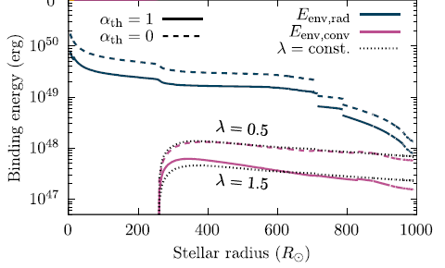
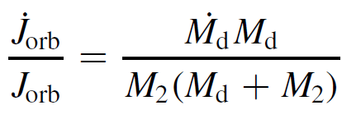
A two-stage formalism for common envelopes
Stage I: Rapid inspiral
We treat the rapid inspiral through the convective envelope as an adiabatic process
→ Energy formalism
Stage II: Stable mass transfer
The subsequent stable mass transfer phase should not be treated adiabatically so we treat it based on angular momentum loss arguments
For our demonstration, we assume the so-called “isotropic re-emission” mode for angular momentum loss

Slide 13
Example with a $12 M_{⊙}$ red supergiant
Two-stage formalism
Our new formalism
Classical α-formalism
Energy formalism
RH & Mandel 2022

Slide 14
2-stage formalism vs α formalism
α~4-300, is much higher than the typical values employed for population synthesis studies
The generally large and strong mass dependence of post-CE separations predicts
No BBH mergers through the CE channel
Much higher BNS/BBH merger ratios
Higher LMXB formation rates
Our formalism naturally predicts a variable α
RH & Mandel 2022
Picker, RH et al. 2024

Slide 15
Supernovae in binaries
How supernova explosions impact binary evolution

Slide 16
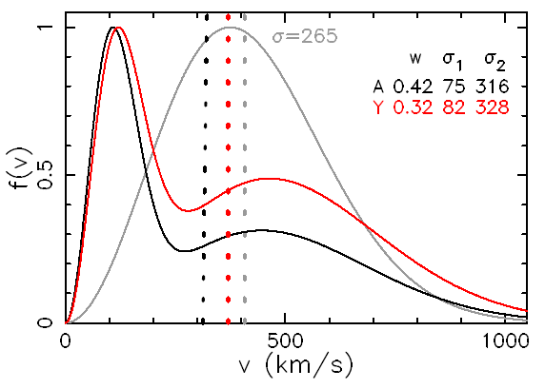
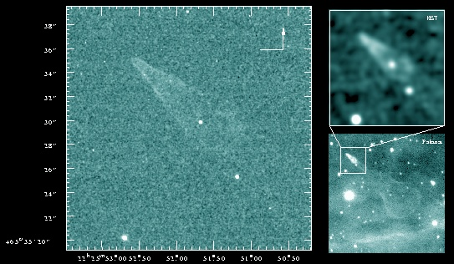
Neutron stars kicks
Pulsars are known to be born with high proper motions
SNR S147
Guitar nebula
Verbunt et al. 2017
Typical velocities range between 100-1000 km/s

Slide 17
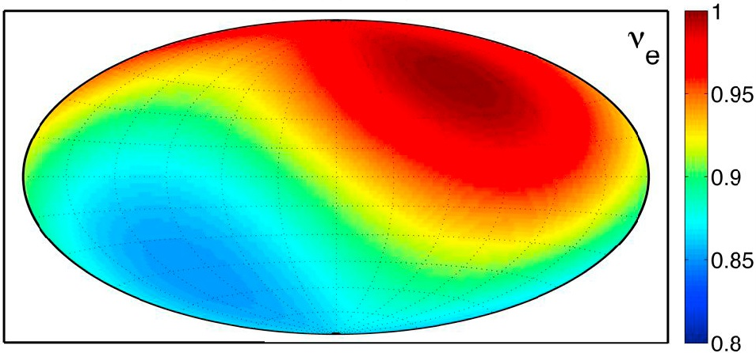
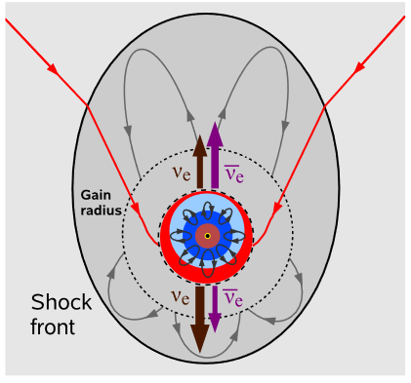
Mainstream NS kick mechanisms
Hydrodynamical instabilities
Neutrino emission asymmetries
Tamborra et al. 2013
Acceleration timescale: $τ_{acc}\sim 1−10$ s
Takiwaki et al. 2012

Slide 18
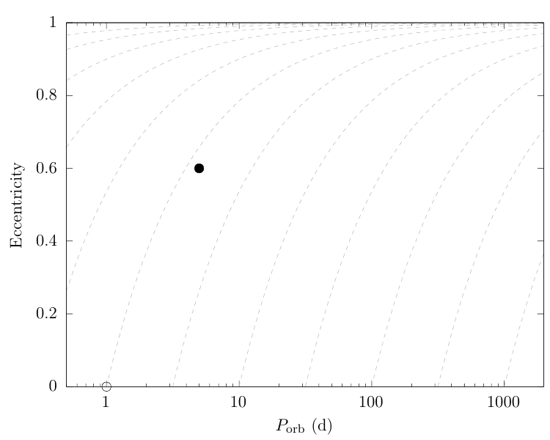
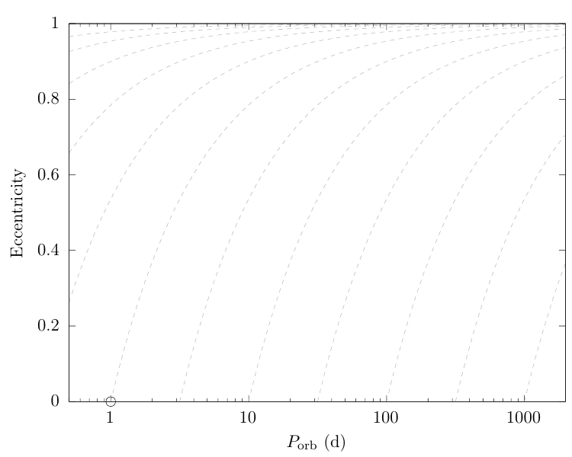
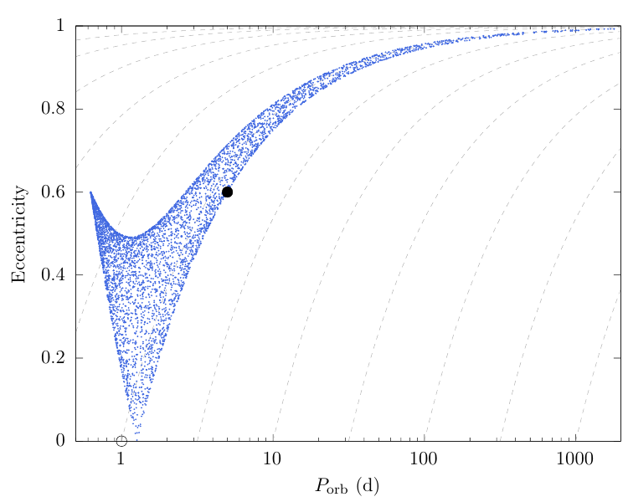
Supernova kicks in binaries
The main result of a supernova in a binary is that the orbit is perturbed
Rapid natal kick
Mass loss

Slide 19
Variety of neutron star binaries
LMXB
Supernova
????
Astrometric binary
These are almost impossible to form
Tidal circularization
Binary pulsar
HMXB
GW sources

Slide 20
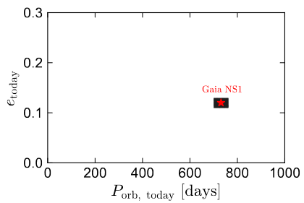
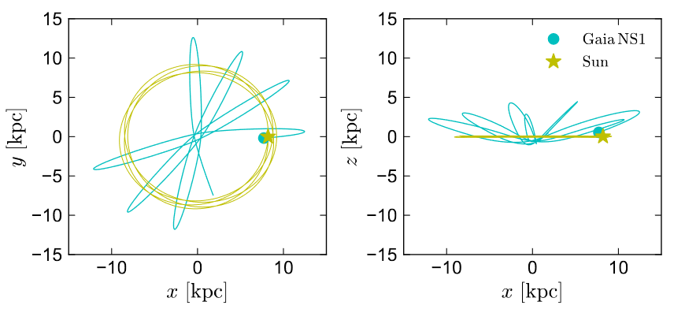
Problems with the kick paradigm
Gaia NS1 is a recently discovered NS binary
El-Badry et al. 2024
Galactic orbit
Wide+low-eccentricity binary
Very eccentric Galactic orbit
Implies extremely weak kick
Implies relatively strong kick

Slide 21
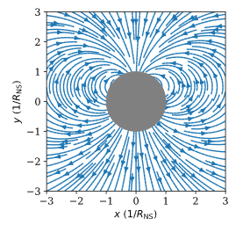
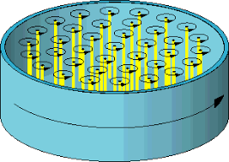
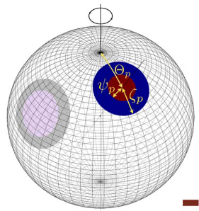
Other NS kick mechanisms
Electromagnetic rocket
(Harrison & Tademaru 1975)
Neutrino rocket
(Peng et al. 1982)
$${\overline{ν}}_{e}$$
$$ν_{e}$$
$${\overline{ν}}_{e}$$
$${\overline{ν}}_{e}$$
$$ν_{e}$$
$$ν_{e}$$
$$ν_{e}$$
$${\overline{ν}}_{e}$$
Acceleration timescale: $τ_{acc}\sim 0.1−100$ yr
Spin axis
NICER
Superfluid vortices

Slide 22
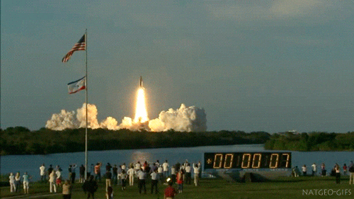
Are NS kicks instantaneous?
NS binary periods from the ATNF catalogue
Mainstream kick models
Most NS binaries have orbital periods less than ~1 yr
$τ_{acc}≪P_{orb}$
(~s)
Rocket-like models
$τ_{acc}≫P_{orb}$
(~yr)
Orbital period (d)
What happens if the kick is not instantaneous?

Slide 23
Analytic solution for rocket binaries
$$a_{roc}$$
RH+2024
Equation of motion
$$m_{1}{\ddot{r}}_{1}=F_{12}+m_{1}a_{roc} \\ m_{2}{\ddot{r}}_{2}=F_{21}$$
$$r_{1}$$
O
$$m_{2}$$
$$m_{1}$$
$$r_{2}$$
$$F_{12}$$
$$F_{21}$$
$$\ddot{r}≡{\ddot{r}}_{1}−{\ddot{r}}_{2}=\frac{F_{12}}{μ}+a_{roc}$$
$$F_{ij}=\frac{Gm_{i}m_{j}}{{\left|r_{i}−r_{j}\right|}^{2}}{\hat{r}}_{ij}$$
$$μ≡\frac{m_{1}m_{2}}{m_{1}+m_{2}}$$
⇒
“Accelerated Kepler problem” or “Classical Stark problem”
Assuming
$|a_{roc}|≪\frac{\left|F_{12}\right|}{m_{1}}$, (rocket acceleration is a perturbation)
$\frac{\left|a_{roc}\right|}{\left|{\dot{a}}_{roc}\right|}≫P_{orb}$, (rocket acceleration is constant over an orbital period)
we can make the secular approximation (= adiabatic evolution)

Slide 24
Analytic solution for rocket binaries
Orbital angular momentum
$$a_{roc}$$
RH+2024
$$r_{1}$$
O
$$m_{2}$$
$$m_{1}$$
$$r_{2}$$
$$l≡\frac{{\overline{v}}_{orb}}{G(m_{1}+m_{2})} r×\dot{r}$$
$$F_{12}$$
$$F_{21}$$
Laplace-Runge-Lenz vector
EOM:
$$\ddot{r}≡{\ddot{r}}_{1}−{\ddot{r}}_{2}=\frac{F_{12}}{μ}+a_{roc}$$
$$e=\frac{1}{Gm_{1}m_{2}}\dot{r}×L−\frac{r}{|r|}$$
Post-rocket orbit is determined by rotating both vectors around $a_{roc}$
We define a new set of vectors
$$h_{±}≡e±l$$
Angular momentum and Runge-Lenz vector changes only in direction perpendicular to rocket
$${h′}_{±}=R_{z}\left(±\frac{3Δv_{roc}}{2{\overline{v}}_{orb}}\right)h_{±}$$
Orbital torque
Orbit average
$$\left\langle \dot{h_{±}}\right\rangle =∓\frac{3}{2{\overline{v}}_{orb}}h_{±}×a_{roc}$$
$$e^{′}=\frac{h_{+}+h_{−}}{2}, l^{′}=\frac{h_{+}−h_{−}}{2}$$

Slide 25
Numerical experiments
As a demonstration, we performed 2-body integrations with rockets attached
The orbital period does not change
The orbit precesses about the direction of acceleration
The eccentricity oscillates as the orbit rocks around
The oscillation depends on $τ_{osc}\sim 2Δv_{roc}/{\overline{v}}_{orb}$
The maximum and minimum eccentricity depends on (1) initial eccentricity and (2) rocket direction
$$τ_{acc}=50 P_{orb}$$
RH+2024

Slide 26
The “full” post-SN orbital solution
The long-duration kicks do not alter the orbit unless there is
initial non-zero eccentricity
misalignment between orbit and rocket
The requirements can be provided from the other forms of natal kicks
Mass loss
(Blaauw kick)
Rapid natal kick
Rocket-like kick
Eccentricity increase
Period increase
Eccentricity change
Period change
Eccentricity change
Period fixed

Slide 27
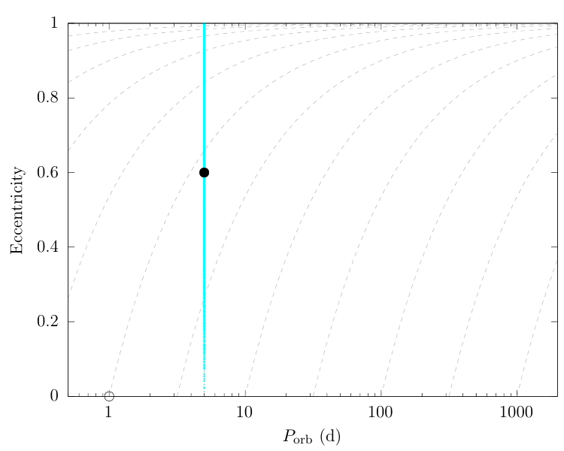
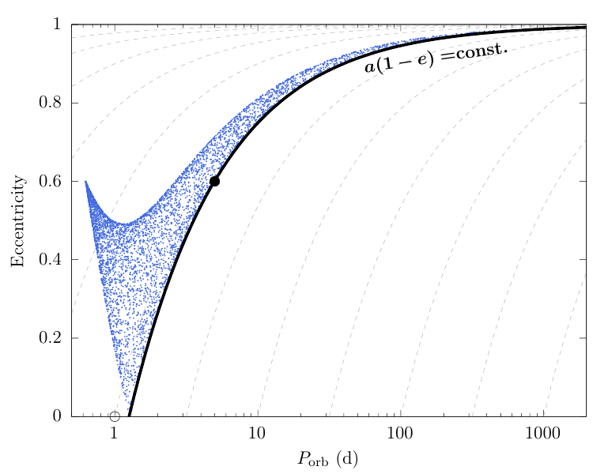
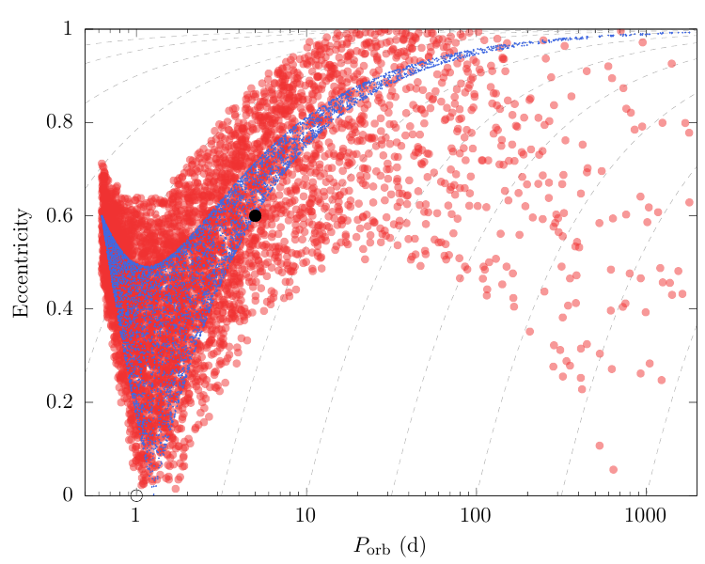
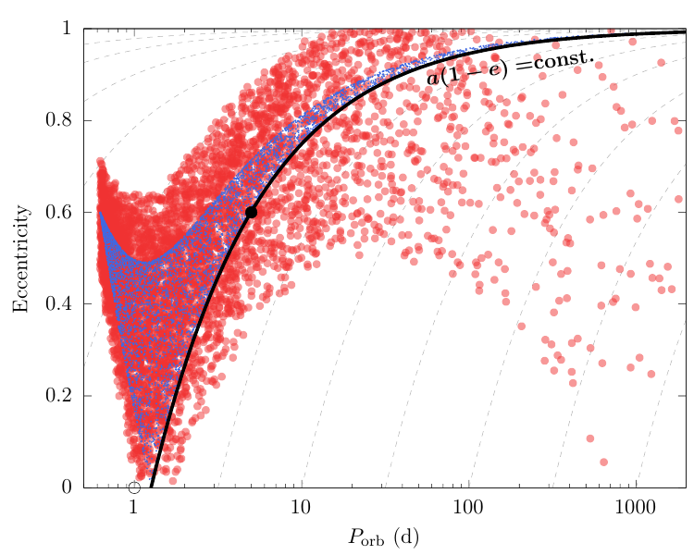
Post-SN orbital property distribution
An example of how the kick+rocket can alter the orbit
Rapid natal kick
Mass loss

Slide 28
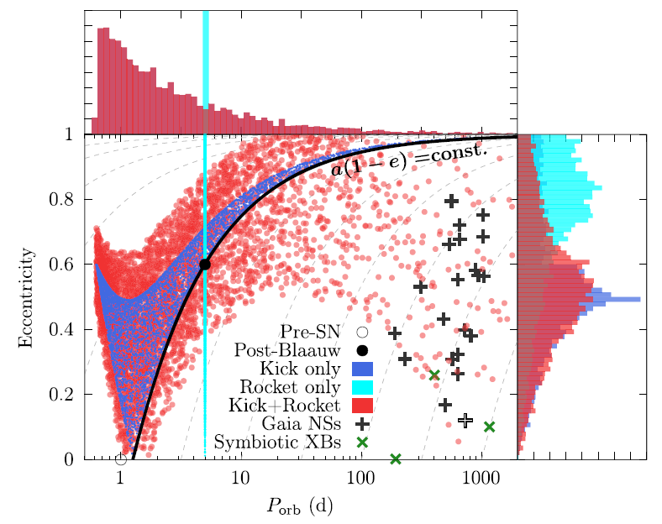
Gaia NS1 and Symbiotic X-ray binaries
Gaia NSs are impossible to form in traditional kick scenarios nor the dynamical channel
Kicks+rockets may be the only solution to explain the existence of these systems
We find that just a modest amount of rocket (~30km/s) is sufficient to explain Gaia NSs
$v_{kick}=180$ km/s
$v_{roc}=30$ km/s
GX 1+4
RH+2024

Slide 29
Induced mergers?
Rockets not only circularize but can raise eccentricity depending on the direction
Depending on the rocket angle, it is possible to reach e~1
The NS will inevitably merge with the companion at sufficiently high eccentricities
star
TZO
SN
Rocket phase
Unknown transient?
WD
NS
GW+GRB+KN?

Slide 30
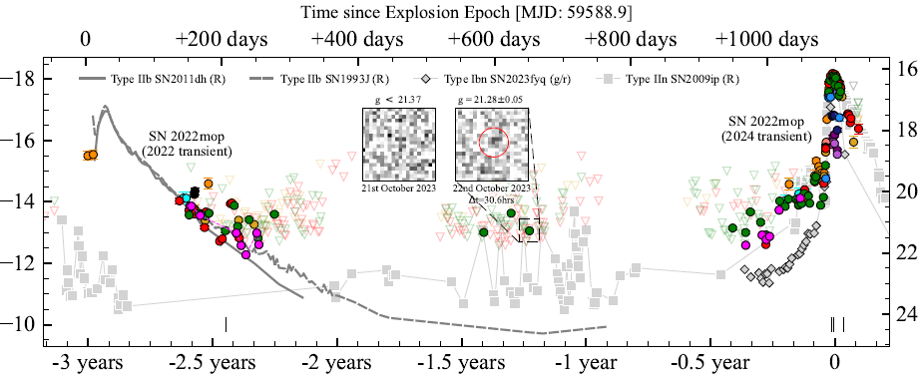
Induced mergers?
Could SN2022mop be an example of rocket-induced NS+star merger?
SN
star
Brennan,…,RH et al. 2025
Rocket phase
Unknown transient?

Slide 31
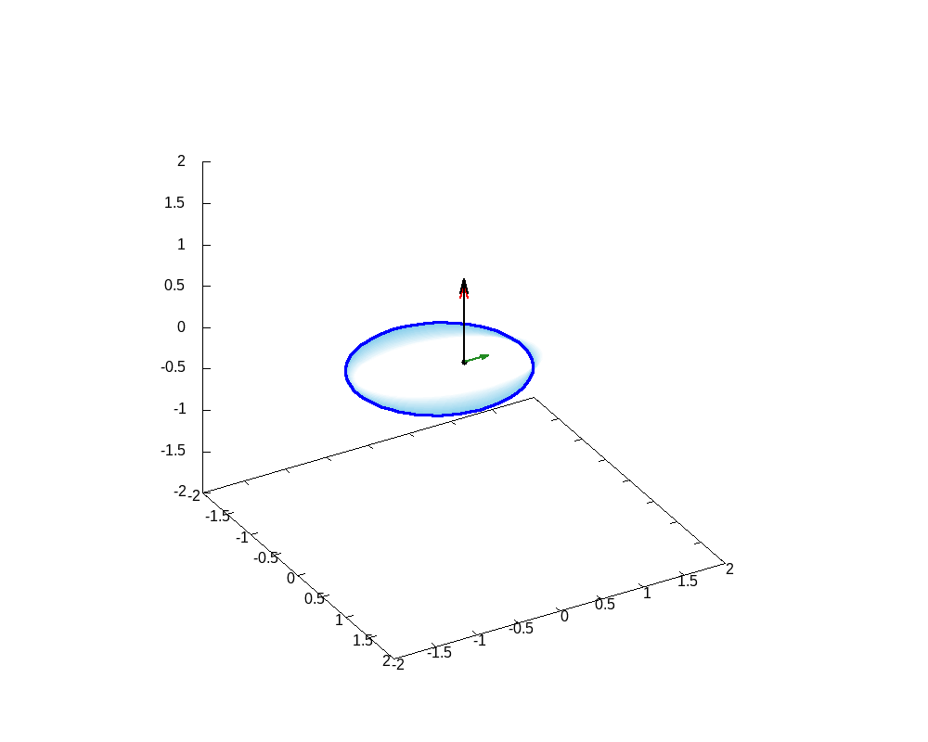
Summary
共通外層期と超新星爆発は中性子星連星の形成にとって特に重要なフェイズ
共通外層は従来、エネルギー保存を使って議論されていたが、大質量連星には不適切。我々は2-stage formalismを新たに提唱している。
超新星爆発では中性子星キックが重要視されている。今回我々は、中性子星ロケット機構が、キックと組み合わせることで従来思われていたよりはるかに連星軌道に大きな影響を与えることを示した。
これらのモデルは中性子星連星の形成を論じる上で新たなパラダイムとなるか。

