Slide 1
Extended Thomas-Fermi 模型による中性子星内殻パスタ相の自己無撞着計算
東京科学大学 原子核理論研究室
中邨陽
共同研究者 関澤一之

Slide 2
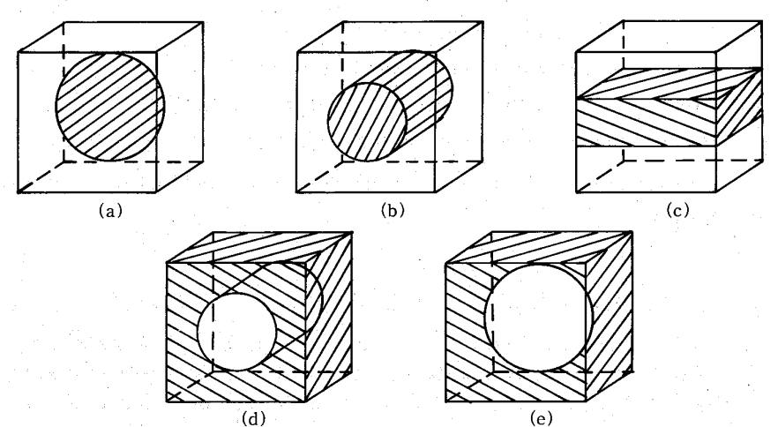
What is nuclear pasta?
Nuclear pasta: Phases of nuclear matter whose shape is quite different from ordinary nuclei.
Typical shapes of nuclear pasta:
(a): sphere (gnocchi)
(b): cylinder (spaghetti)
(c): slab (lasagna)
(d): tube (anti-spaghetti)
(e): bubble (anti-gnocchi)
M Hashimoto, et al. Prog. Theor. Phys., vol 71, 1984
In NSs, nuclear pasta may appear at the bottom of the inner crust.

Slide 3
Possible effects on celestial phenomena
The EOS of nuclear matter is only slightly affected. →MR relation is not affected so much.
The transport and elastic properties of nuclear pasta is different from that of ordinary nuclei.
High electrical resistivity of nuclear pasta may affect the time evolution of magnetic field of neutron stars.
The elastic property of nuclear pasta may affect the quasi-periodic oscillation.
José A. Pons et al. Nature Physics volume 9, pages431–434 (2013)

Slide 4
Characteristics of ETF
Many models are used to study nuclear pasta: (HF, TDHF, RMF+TF, MD, etc.)
Hartree-Fock (HF)
Extended Thomas-Fermi (ETF)
Fully quantum
Accurate but need much computational resources
Suitable for precise calculation at a certain situation
Semiclassical approximation to HF
Not so accurate but need less computational resources
Suitable for thorough study for many situation (density, temperature, proton fraction)

Slide 5
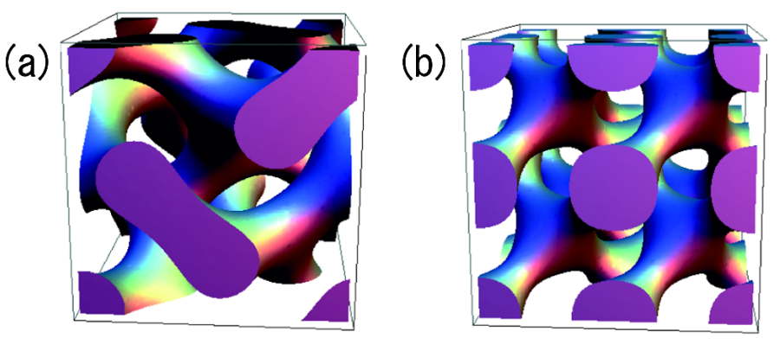
Previous study
Previous studies based on ETF assumed certain forms of density distribution with a few parameters.
J. M. Pearson, N. Chamel, and A. Y. Potekhin
Phys. Rev. C 101, 015802(2020)
Many studies suggest the shape of nuclear pasta which cannot be represented such a function.
K. Nakazato, K. Oyamatsu, and S. Yamada
Phys. Rev. Lett. 103, 132501 (2009)
Gyroid
Double diamond

Slide 6
The purpose of this research
Our purpose is to calculate the nucleon density distribution in the nuclear pasta phase without any assumptions about the form of density distribution using ETF.
Self-consistent calculation in the 3D mesh
Notes:
視覚的にわかりやすく（図を使うなど

Slide 7
Extended Thomas-Fermi model
$ρ_{q}$:nucleon density ($q=n,p$) $τ_{q}$:kinetic density ($q=n,p$) $\vec{J_{q}}$:spin orbit density ($q=n,p$)
In Skyrme-HF, energy is functional of $ρ_{q}$ , $τ_{q}$and $\vec{J_{q}}$.
$$E=E\left[ρ_{q},τ_{q},{\vec{J}}_{q}\right]$$
In the ground state, kinetic density$τ_{q}$ and spin orbit density ${\vec{J}}_{q}$ can be approximated as the functional of nucleon density $ρ_{q}$ : $τ_{q}\left(\vec{r}\right)=\frac{3}{5}{\left(3π^{2}\right)}^{\frac{2}{3}}ρ_{q}^{\frac{5}{3}}+\frac{1}{36}\frac{{\left(\vec{∇}ρ_{q}\right)}^{2}}{ρ_{q}}+\frac{1}{3}Δρ_{q}+\frac{1}{6}\frac{\vec{∇}ρ_{q}⋅\vec{∇}f_{q}}{f_{q}}+\frac{1}{6}ρ_{q}\frac{Δf_{q}}{f_{q}}−\frac{1}{12} ρ_{q}{\left(\frac{\vec{∇}f_{q}}{f_{q}}\right)}^{2}+\frac{1}{2} {\left(\frac{2m}{ℏ^{2}}\right)}^{2}ρ_{q}{\left(\frac{\vec{W_{q}}}{f_{q}}\right)}^{2}$ $\vec{J_{q}}\left(\vec{r}\right)=−\left(\frac{2m}{ℏ^{2}}\right)\frac{ρ_{q}\vec{W_{q}}}{f_{q}}$
$$E\left[ρ_{q},τ_{q},{\vec{J}}_{q}\right]=E[ρ_{q}]$$
Energy becomes functional of only $ρ_{q}$

Slide 8
Skyrme energy density functional
$$ρ=ρ_{p}+ρ_{n} \\ \vec{J}=\vec{J_{p}}+\vec{J_{n}} \\ τ=τ_{p}+τ_n$$

Slide 9
Total energy and its variation
Total energy in a certain volume: $E_{total}=E_{nucl}\left[ρ_{p}(\vec{r}),ρ_{n}\left(\vec{r}\right)\right]+E_{electron}\left(ρ_{e}\right)+E_{Coulomb}\left[ρ_{p}\left(\vec{r}\right),ρ_{e}\right]$
Skyrme energy density functional
Uniform Fermi gas
To get the ground state, we introduce $φ_{q}≡\sqrt{ρ_{q}}$, and calculate the variation of $E_{total}−μ(N_{p}+N_{n})$ : $\frac{δ}{δφ_{q}}\left(E_{total}−μ\left(N_{p}+N_{n}\right)\right)=2\left[−\frac{1}{9} \frac{ℏ^{2}}{2m_{q}}\vec{∇}⋅f_{q}(\vec{r})\vec{∇}φ_{q}+U_{q}(\vec{r})φ_{q}−μ_{q}φ_{q}\right] \left(q=n,p\right)$
Here,$μ_{n}=μ, μ_{p}=μ−μ_{e}$ and $U_{q}(\vec{r})$ and $f_{q}( \vec{r})$ are functional of $φ_{q}(\vec{r})$
(☆)

Slide 10
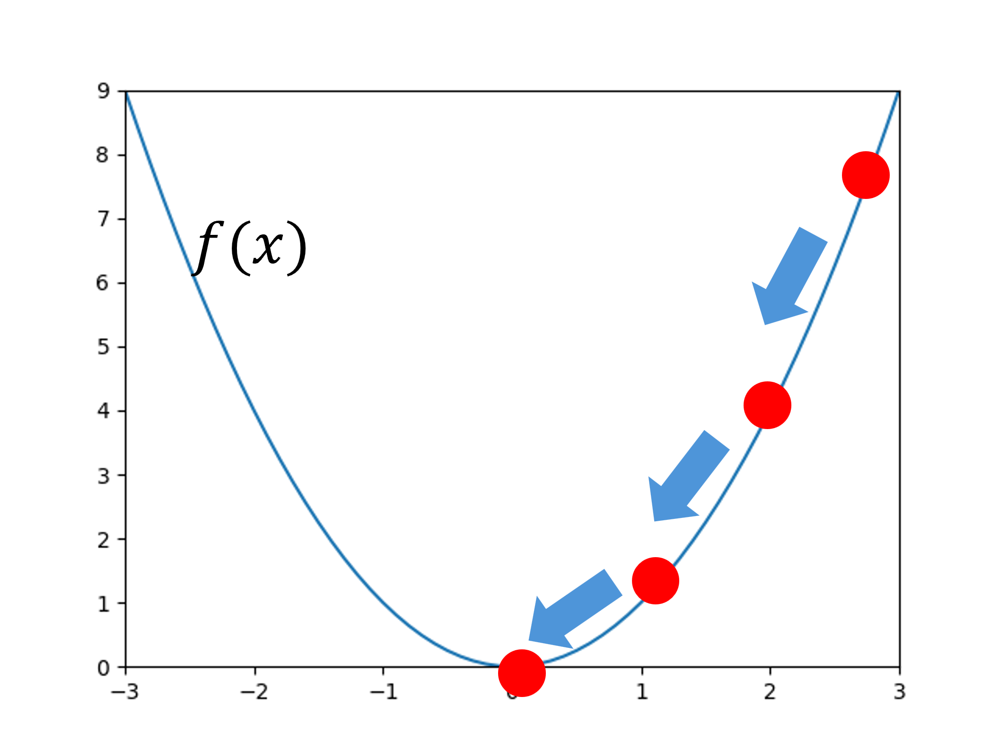
Numerical calculation
To minimize $E_{total}−μ(N_{p}+N_{n})$, the gradient descent method is used.
Gradient descent
Search for the minimum point by
$$x_{new}=x_{old}−εf^{′}\left(x_{old}\right)$$
($ε$ is sufficiently small constant)
Prepare the initial state by randomly distributing the gaussians.
Update $φ_{p}\left(\vec{r}\right), φ_{n}(\vec{r})$ as follows $φ_{q}^{new}=φ_{q}^{old}−\frac{ε}{2}\frac{δ}{δφ_{q}}\left(E_{total}−μ\left(N_{p}+N_{n}\right)\right){\left.​\right|}_{φ_{q}=φ_{q}^{old}} (q=n,p)$
Repeat the step 2 until $φ_{q}$ converges.
(☆)
Calculation is conducted on cubic meshes whose size is L=16fm and $dx=0.8fm.$ SkM* parameter set is used.

Slide 11
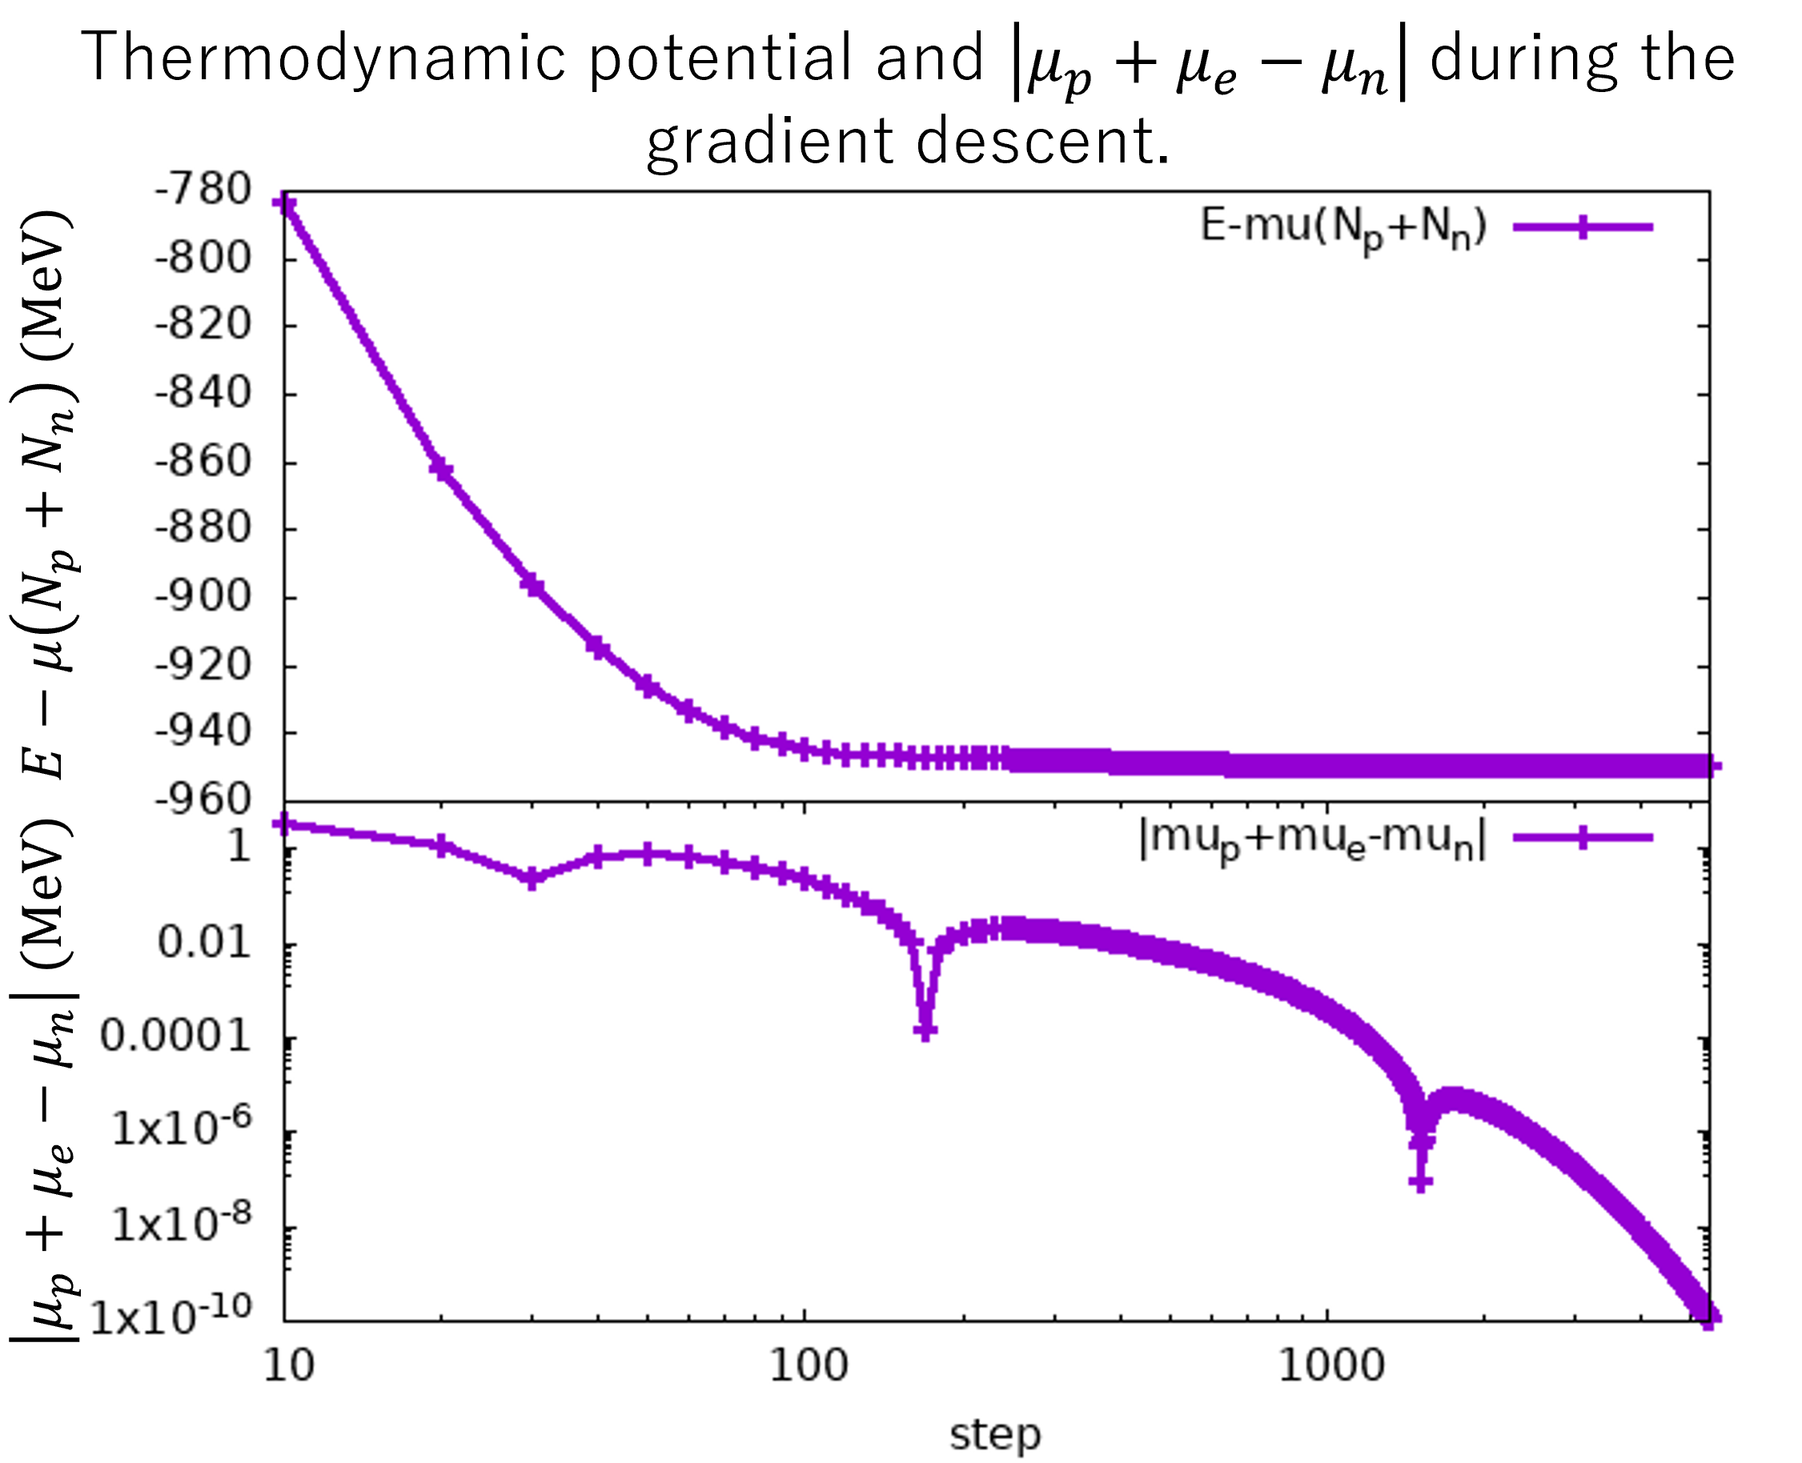
Result (L=16fm,$μ=10MeV,$ $ρ=0.0589fm^{−3}$ )
Preliminary
$E−μ(N_{p}+N_{n})$ decreases monotonically during the gradient descent.
The beta equilibrium condition $μ_{p}+μ_{e}=μ_{n}$ is satisfied with good accuracy.

Slide 12
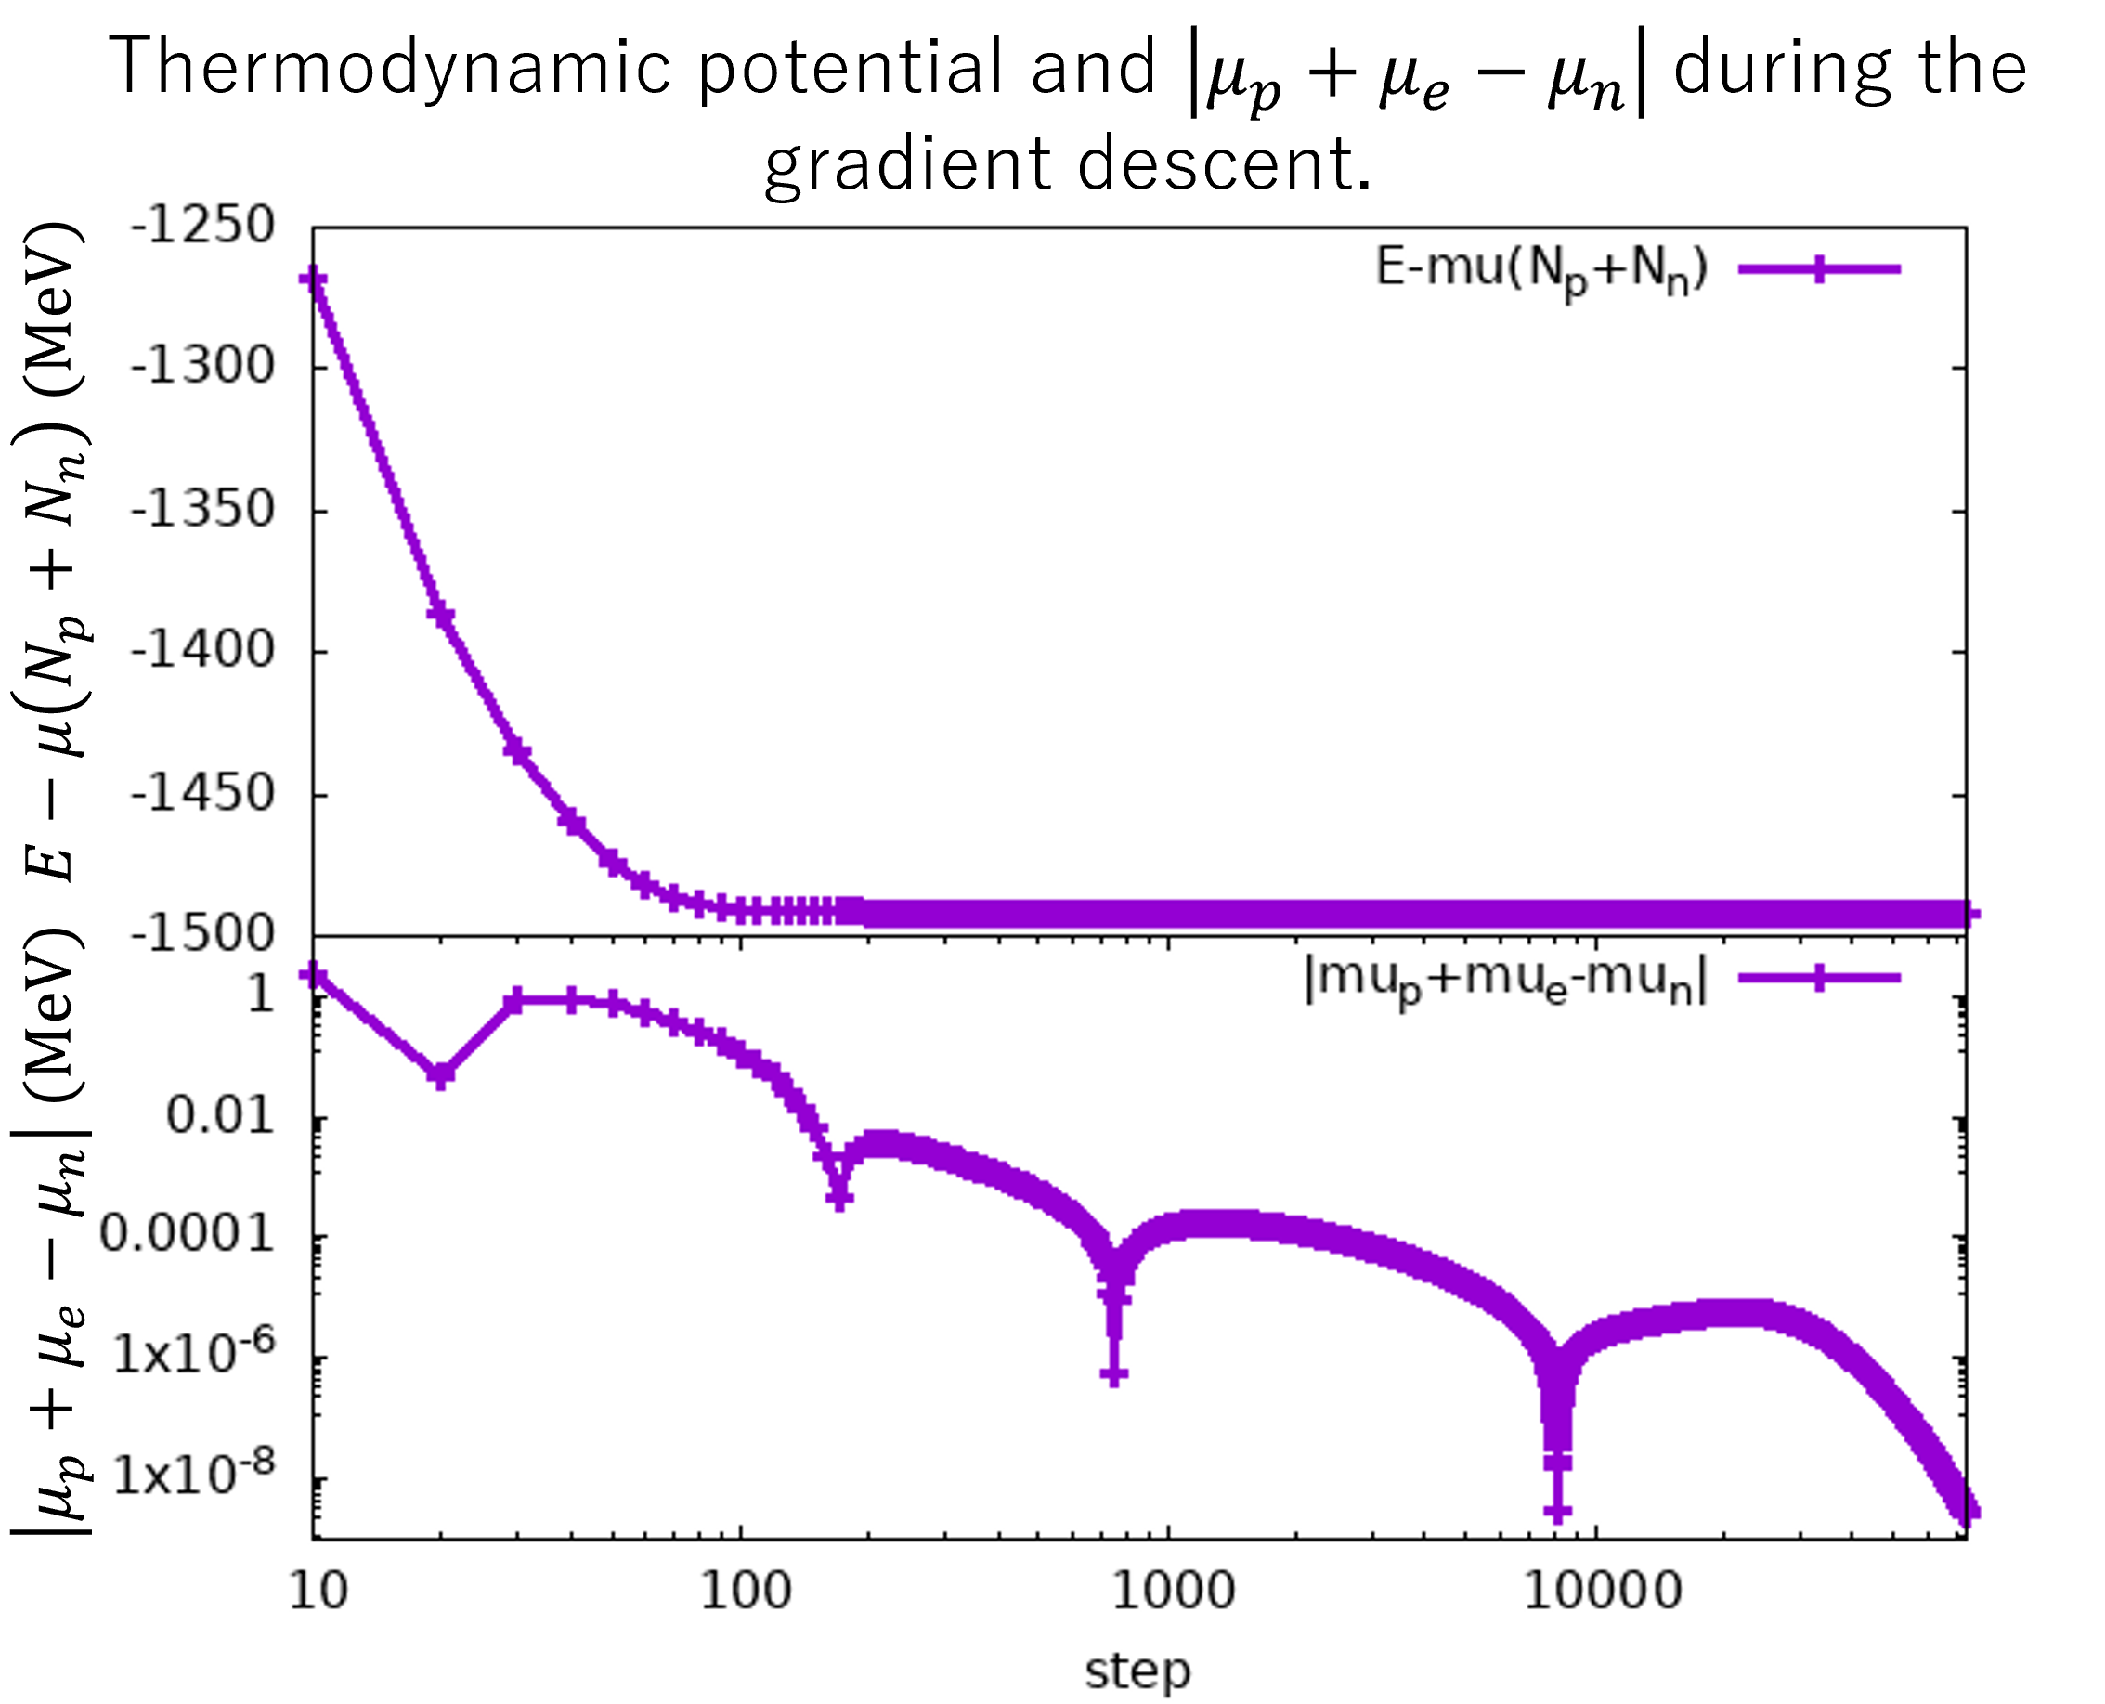
Result (L = 16fm, $μ=12 MeV,$ $ρ=0.0736 fm^{−3}$)
Preliminary

Slide 13
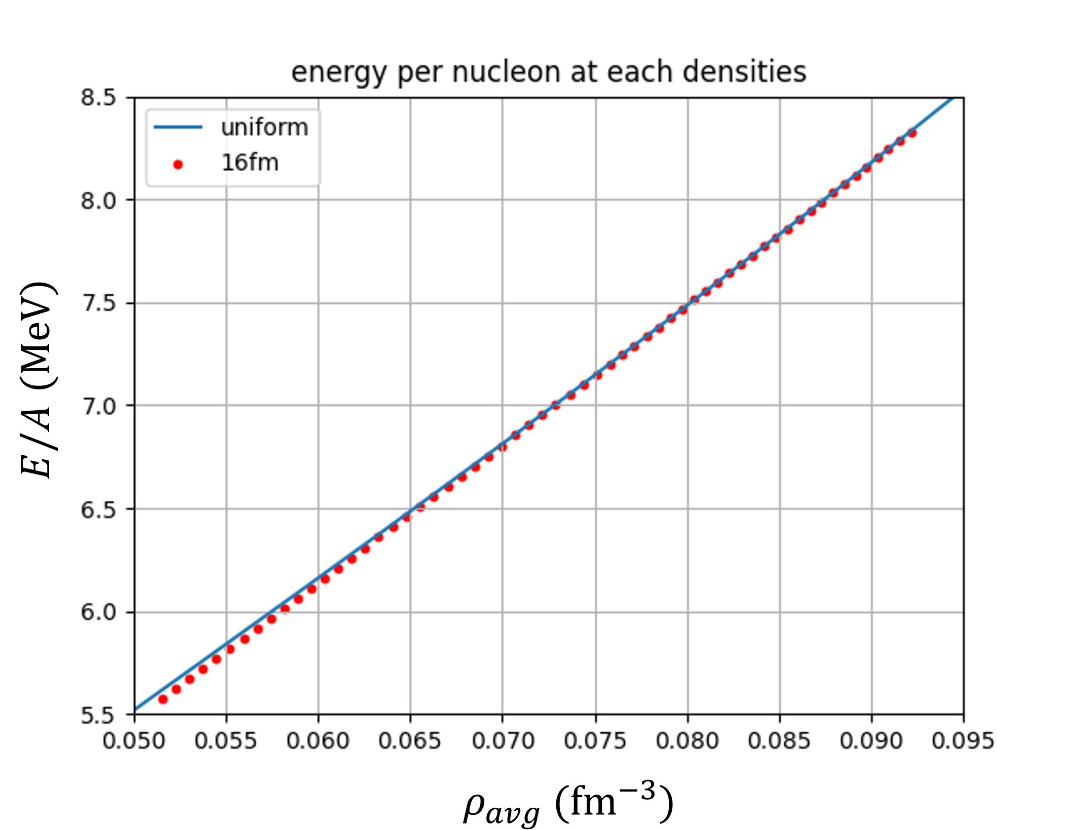
Result
Preliminary
Energy per nucleon is almost same as that of uniform nuclear matter.
Y_p (proton fraction) is slightly higher than that of uniform nuclear matter.
$0.0515fm^{−3}≤ρ≤0.0662fm^{−3}$:sphere
$0.0670fm^{−3}≤ρ≤0.0751fm^{−3}$:cylinder
$0.0758fm^{−3}≤ρ≤0.0922fm^{−3}$:uniform

Slide 14
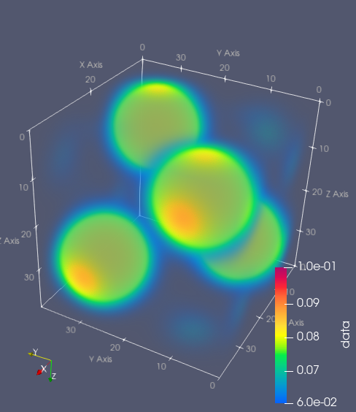
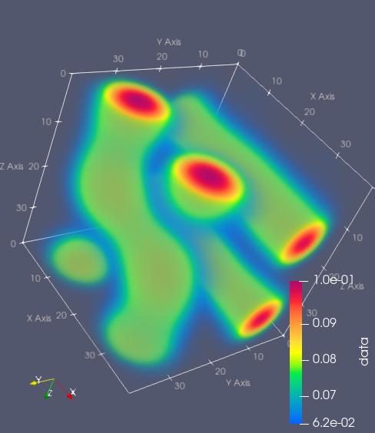
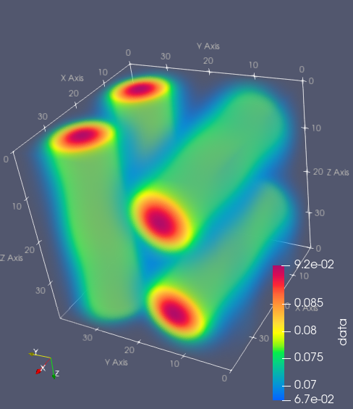
Summary and future work
We develop a code to calculate the pasta structure self-consistently using the ETF model.
We calculate the pasta structure for L = 16fm.
We will conduct same calculation for larger box size.
The calculation was carried out at the Yukawa Institute Computer Facility.
Possible structures which may appear for larger boxes.

