Slide 1
2025/05/21
Fitting the observations of MAXI J1752-457 with ocean Urca process
Hao Huang
huangh@impcas.ac.cn
Affiliation
IMP, CAS/RIKEN
Notes:
Good afternoon, before I star my talk, I want to appreciate Dohi-san and also the local committee for providing this chance to introduce this work. My talk is the fitting work on the observations of MAXI J1752-457 with ocean Urca process.

Slide 2
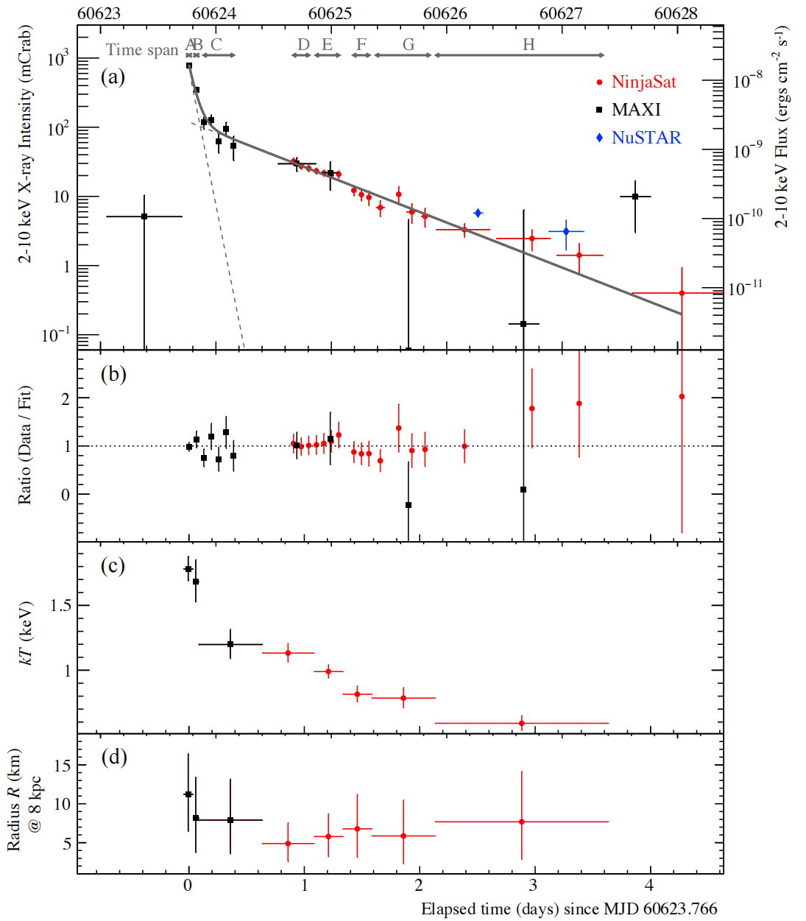
Observations of MAXI J1752-457
Aoyama et al., 2025
Aoyama-san’s Talk
High temperature;
(Ts-Tb relation)
=> Hot NS crust?
=> Ts-Tb relation?
Two decaying components;
(Physics in the outer layer)
=> Variations of the thermal conductivity in the neutron star crust?
=> The reason for the change of thermal conductivity?
MAXI J1752-457
huangh@impcas.ac.cn
2
Notes:
As we have learnd from Aoyama-san’s talk that MAXI J1752-457 is assigned as the superburst. The observations are the tail of a superburst with high temperature. Thus the relation valided at high temperature to describe the surface temperature and the crust temperature is needed. With a further analysis by Aoyama-san, it’s found this source requires two decaying components which may suggest the existence of some special thermal structures in the neutron star out layer. In this talk, I will first simply introduce the Ts-Tb relation applied in this calculation and then focus on the understanding of the two decaying components.

Slide 3
Observations of MAXI J1752-457
Aoyama et al., 2025
Aoyama-san’s Talk
High temperature;
(Ts-Tb relation)
=> Hot NS crust?
=> Ts-Tb relation?
Two decaying components;
(Physics in the outer layer)
=> Variations of the thermal conductivity in the neutron star crust?
=> The reason for the change of thermal conductivity?
MAXI J1752-457
huangh@impcas.ac.cn
3

Slide 4
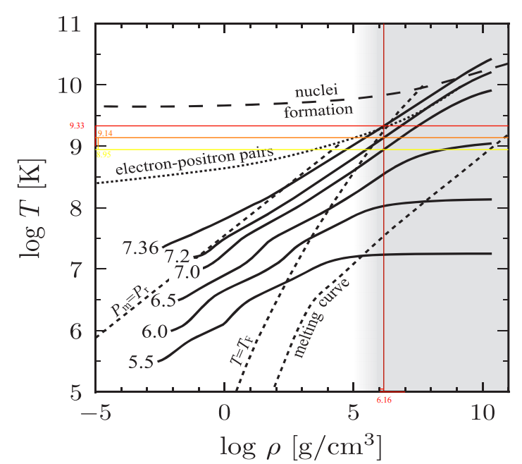
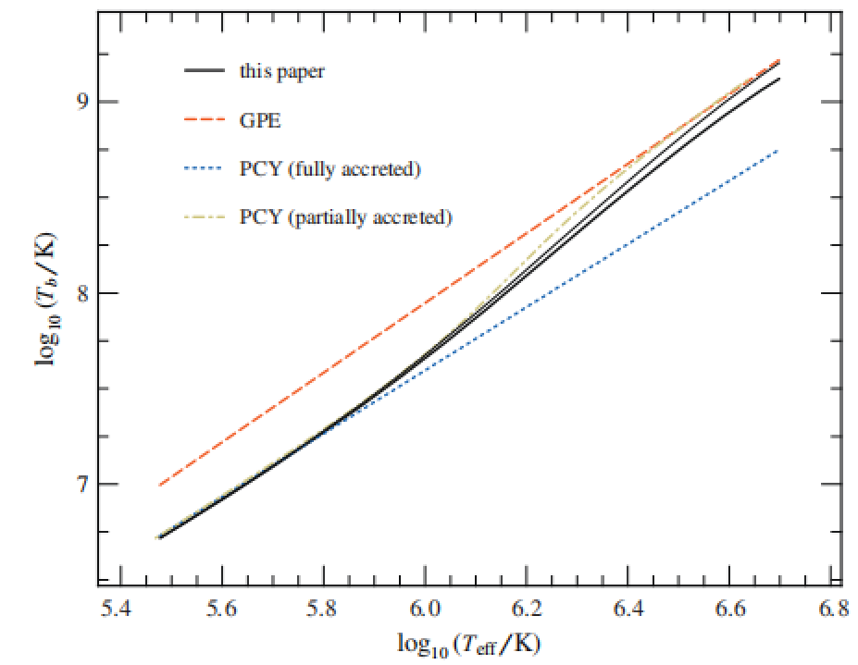
Ts-Tb relation from Beznogov 2020
BROWN & CUMMING, 2009
Beznogov et al., 2020
High Ts
Ts-Tb relation from Beznogov 2020 [log(rho) = 6.16]
Ts | Tb
7.36 | 9.33
7.20 | 9.14
7.00 | 8.95
Limitation on the Ts, log(Ts) < 6.7. In the observations of MAXI J1752-457, log(Ts) ~ 7.3
The outermost mesh density(ρ) in dStar code
MAXI J1752-457
huangh@impcas.ac.cn
4
Notes:
What is Ts-Tb relation and why we consider the Ts-Tb relation from Beznogov et al., 2020.

Slide 5
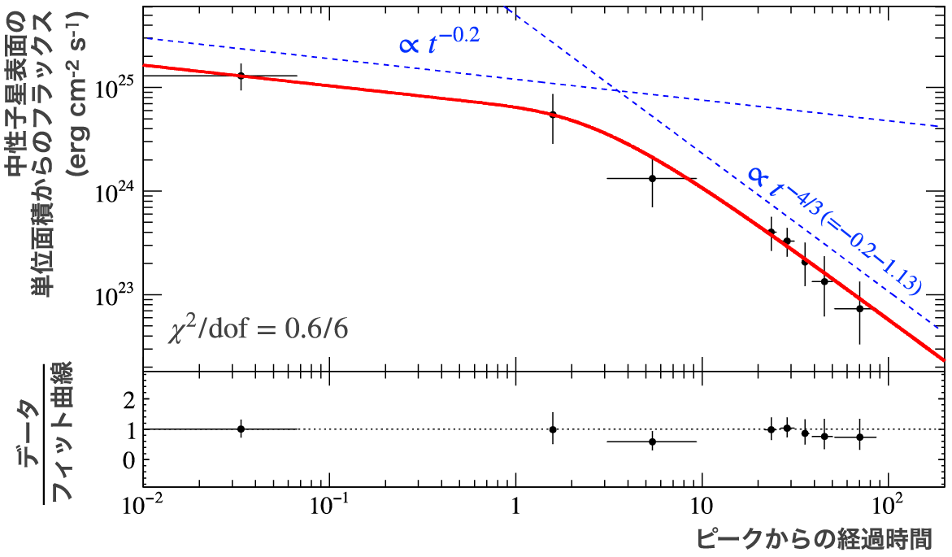
Observations of MAXI J1752-457
Aoyama-san’s Talk
High temperature;
(Ts-Tb relation)
=> Extremely hot NS crust?
=> Ts-Tb relation?
Two decaying components;
(Physics in the outer layer)
=> Variations of the thermal conductivity in the neutron star crust?
=> The reason for the change of thermal conductivity?
MAXI J1752-457
huangh@impcas.ac.cn
5

Slide 6
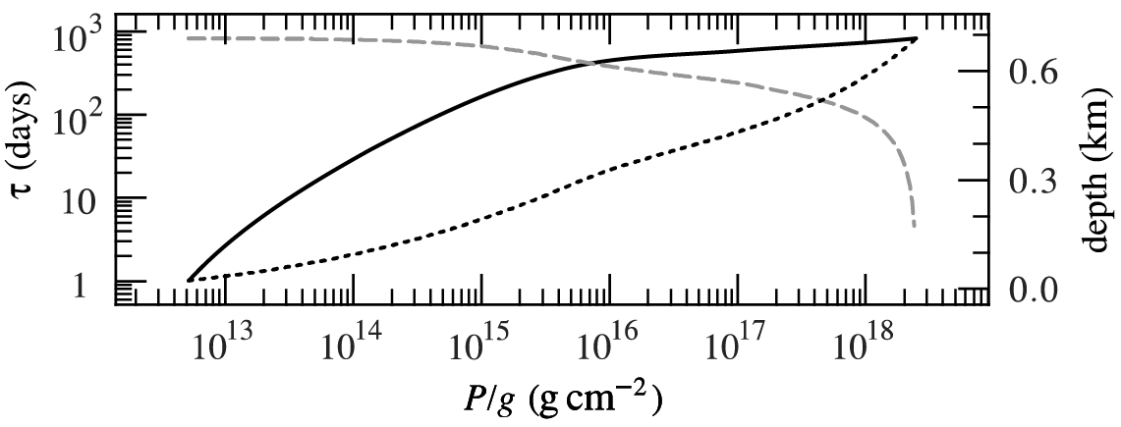
Two decaying components of MAXI J1752-457
Aoyama-san’s Talk
Cumming & Macbeth, 2004
Two exponential decays are required
Unique thermal structure in the NS out layer
the change of thermal conductivity
BROWN & CUMMING, 2009
Why the thermal conductivity changed?
The observed light curve indicates the thermal structures in the out layer
Ocean Urca (cooling) process ?
MAXI J1752-457
huangh@impcas.ac.cn
6
Notes:
Well, the observed light curve actually indicates the thermal structure inside the neutron star. And generally, the cooling curve follows the rules of exponential decay. However, the observation of MAXI j1752-457 shows two decaying components, which indicates some unique thermal inside the neutron star.
In Aoyama-san’s work, the unique thermal structure is thought to be the change of the thermal conductivity. Now the question is, why the thermal conductivity changed or how the thermal structure be changed? Since I perviously have some work on Urca cooling process, and the light curve indeed breaks the rules of exponential decay if we consider the Urca process. So here I introduce Urca process to the cooling model and tried to explain the two decaying components.

Slide 7
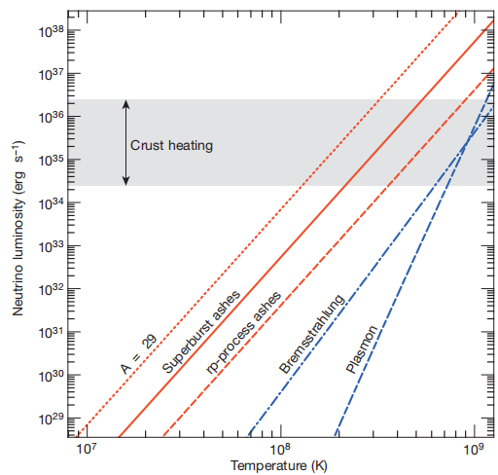
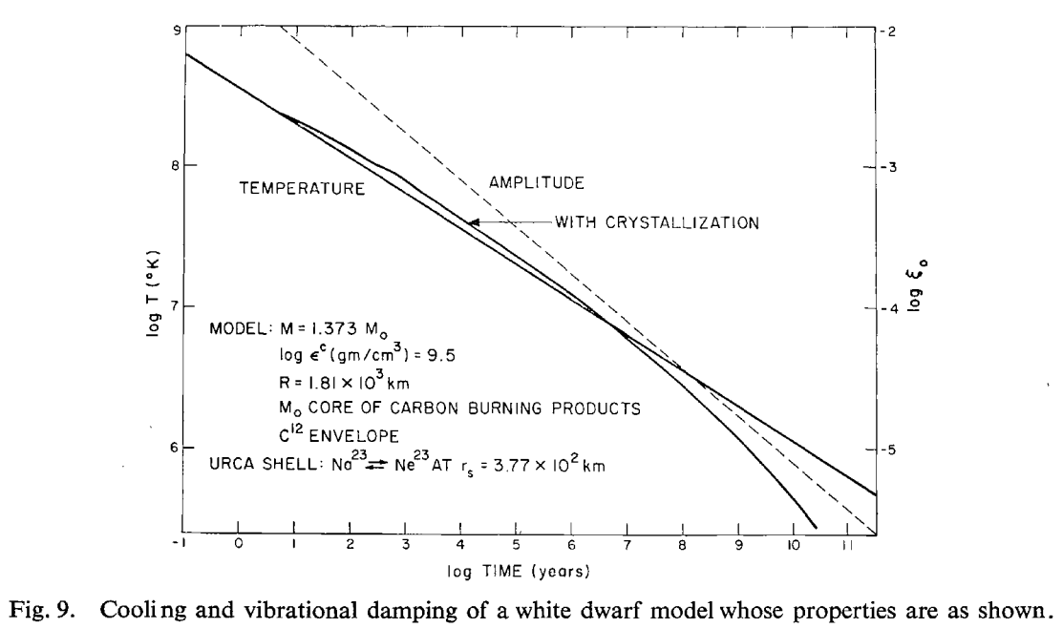
What’s Urca
What’s Urca process:
Urca process is a cooling mechanism of stars.
How:
By releasing neutrinos and antineutrinos.
EC
proton
neutrino
electron
(A, Z-1)
proton
neutron
Nuclear Urca process (ocean - crust)：
$$N_{1}+N_{2}→N_{1}^{’}+N_{2}^{’}+ν_{e}+{\overline{ν}}_{e}$$
(A, Z-1)
(A, Z)
neutron
antineutrino
(A, Z)
H. Schatz, et al., 2014
S. Tsuruta & A. Cameron, 1969
β⁻ decay
electron
MAXI J1752-457
huangh@impcas.ac.cn
7
Notes:
The Urca process is the key to understand the two decay components, so I will firstly give a brief introduction to the Urca process.
Urca process is a cooling mechanism of stars. It just a cycle of electron capture and beta- decay. The two nuclei participate in the cycle are the Urca pair. In this cooling process, a parent nucleus with proton number Z undergoes beta- decay, transforms to the daughter nucleus, and relasing an antineutrino. Following the electron capture from the daughter nucleus backing to the parent nucleus, a neutrino released. So the energy lose by releasing neutrinos and the star cools.
Since the Urca process was proposed in 1942, it has been widely applied in the cooling of white dwarf. And in 2014 Hindric Schatz proposed the Urca process in the out layer of neutron stars. Here the Urca process is the one in the neutron star.

Slide 8
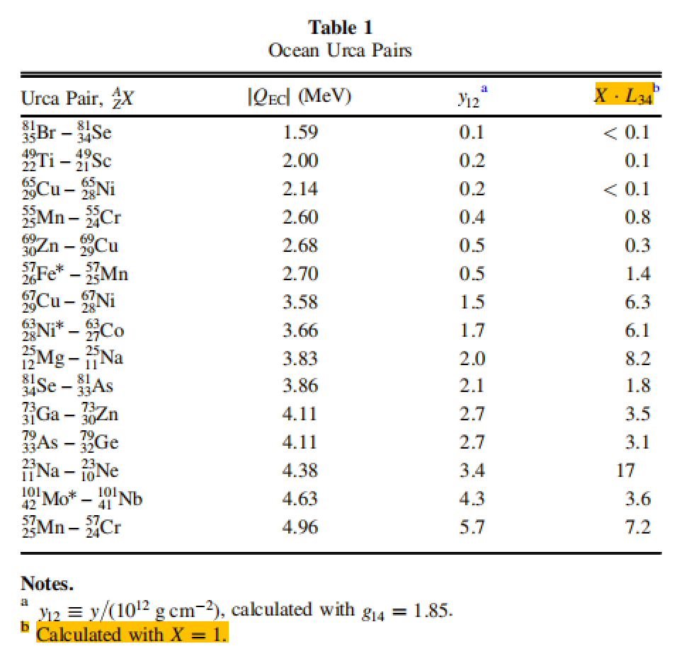
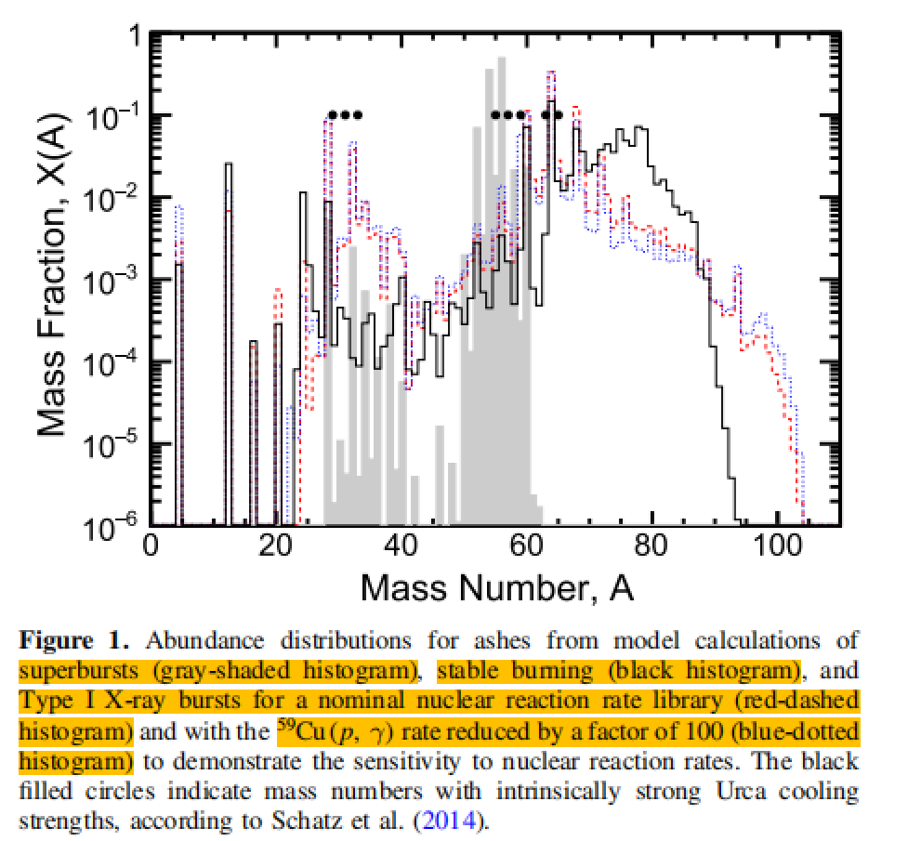
Ocean Urca process
Neutrino luminosity：
$$L_{ν} ≈ L_{34} × {10}^{34} erg s^{−1} X(A) T_{9}^{5} {\left(\frac{g_{14}}{2}\right)}^{−1}R_{10}^{2}$$
cooling strength
Urca pair abundance
Z. Meisel & A. Deibel, 2017
Ocean Urca process
Location: y12 ~ 0.1-10
(typcial Ignition depth for triggering superburst!)
In this calculation, we set the cooling parameter:
Urca_str1: 2.5e-3 [L₃₄∙X, 10³⁶ erg s⁻¹]
Urca_loca1: 25.8 [logP, g cm⁻¹ s⁻²]
Urca_str2: 5.0e-3 [L₃₄∙X, 10³⁶ erg s⁻¹ ]
Urca_loca2: 26.5 [logP, g cm⁻¹ s⁻²]
Ocean Urca cooling strength
Ocean Urca pair abundance
MAXI J1752-457
huangh@impcas.ac.cn
8
Notes:
Well in this talk, we are interested in the ocean Urca process. This Urca process proceed in the shell with y12~1. This is exactlly the depth for triggering superburst. So it seems make sense that the ocean Urca process have some effects on the cooling curve of a superburst.
The neutrino luminosity is used to decribe the cooling strength of the Urca process. The L34 is the cooling strength associated with the nuclear property of the Urca pair. and X is the Urca pair abundance in the NS ocean. Also it’s associate to the fifth power of temperature.
In the left figures, the top panel shows the location of each Urca pairs and the raidus of the cycle describe the cooling strength of the corresponding pair. The bottom table shows the cooling strength of part of the Urca pairs and the bottom panel shows the abundance of the Urca pair.

Slide 9
Ocean Urca process
Neutron luminosity：
$$L_{ν} ≈ L_{34} × {10}^{34} erg s^{−1} X(A) T_{9}^{5} {\left(\frac{g_{14}}{2}\right)}^{−1}R_{10}^{2}$$
cooling strength
Urca pair abundance
Z. Meisel & A. Deibel, 2017
Large
Uncertainties
Ocean Urca pair
Location: y12 ~ 0.1-10
(typcial Ignition depth for triggering superburst!)
In this calculation, we set the cooling parameter:
Urca_str1: 2.5e-3 [L₃₄∙X, 10³⁶ erg s⁻¹]
Urca_loca1: 25.8 [logP, g cm⁻¹ s⁻²]
Urca_str2: 5.0e-3 [L₃₄∙X, 10³⁶ erg s⁻¹ ]
Urca_loca2: 26.5 [logP, g cm⁻¹ s⁻²]
Ocean Urca cooling strength
Ocean Urca pair abundance
MAXI J1752-457
huangh@impcas.ac.cn
9
Notes:
However, neigher the cooling strength nor the pair abundence is well determinded, so, in this calculation, we just set two Urca typical cooling parameters as is shown in the right.

Slide 10
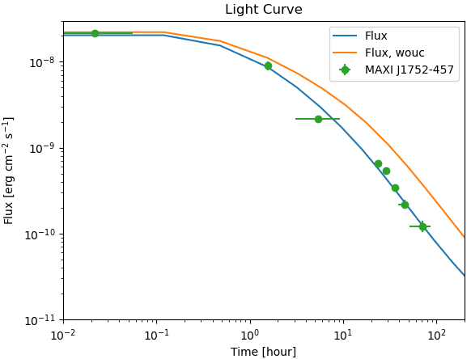
Flux fitting with ocean Urca process
Fixed parameters:
Mdot: 5e17 [g/s]
Accretion time: [0.1 d]
Tcore: 5e8 [K]
Urca_str1: 2.5e-3 [L₃₄∙X, 10³⁶ erg s⁻¹]
Urca_loca1: 25.8 [logP, g cm⁻¹ s⁻²]
Urca_str2: 5.0e-3 [L₃₄∙X, 10³⁶ erg s⁻¹ ]
Urca_loca2: 26.5 [logP, g cm⁻¹ s⁻²]
Urca cooling parameter
Free parameters:
heating parameter
Qout: 3.4e3
Qout_range: 23-26.41
[logP, g cm⁻¹ s⁻²]
Mcore: 1.70 [M⊙]
Rcore: 12.47 [km]
E₁₇: 3.7 [erg g⁻¹]
y₁₂: 1.67 [g cm⁻²]
Ts-Tb relation from Beznogov 2020
mass and radius
MAXI J1752-457
huangh@impcas.ac.cn
10
Notes:
So here is the fitting results. the parameter set is shon on the right. In the fitting process, we fixed the accretion rate together with the accretion time. The core temperature and the cooling parameter are also fixed. We adjust the heating parameter, the heating strength Qout and heating region Qout_range. Also we set the core mass and raidus as the free parameters and adjust them in the fitting process. The fitting curve is shown in the left. We show the flux evolution with time. Blue curve shows the flux with ocean Urca process, and it looks that the observations are well reproduced. If we exclude the Urca process, we then obatined the orange curve, which deviates from the observations.

Slide 11
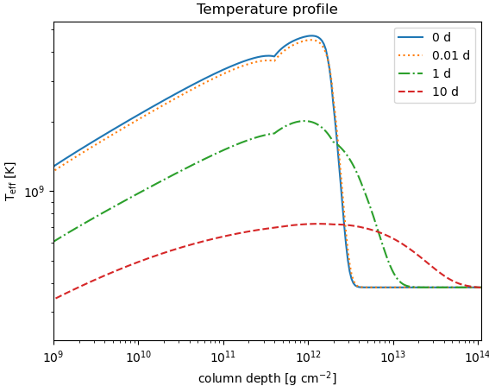
Flux fitting with ocean Urca process：Thermal profile
Knee feature
Ocean Urca
E₁₇: 3.7 [erg g⁻¹]
y₁₂: 1.67 [g cm⁻²]
Ts-Tb relation from Beznogov 2020
heating source 1
urca cooling shells
MAXI J1752-457
huangh@impcas.ac.cn
11

Slide 12
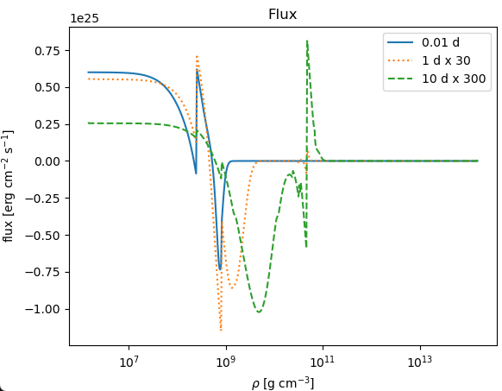
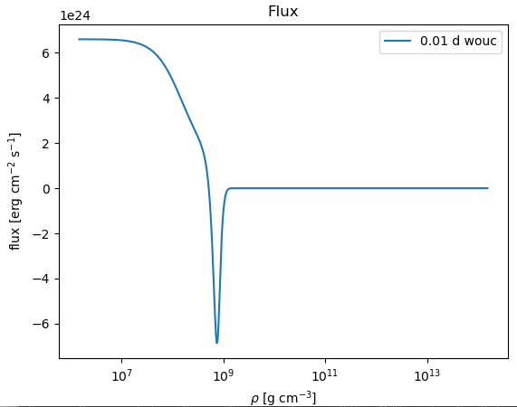
Flux fitting with ocean Urca process: Flux profile
Ocean Urca
heating region
flux profile without Urca
E₁₇: 3.7 [erg g⁻¹]
y₁₂: 1.67 [g cm⁻²]
Ts-Tb relation from Beznogov 2020
MAXI J1752-457
huangh@impcas.ac.cn
12

Slide 13
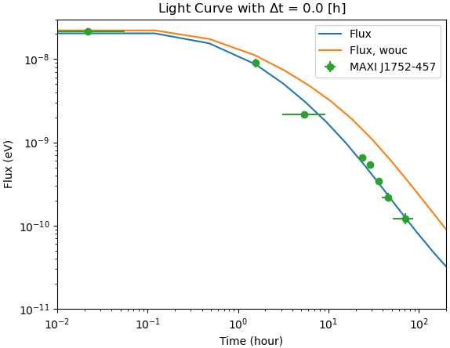
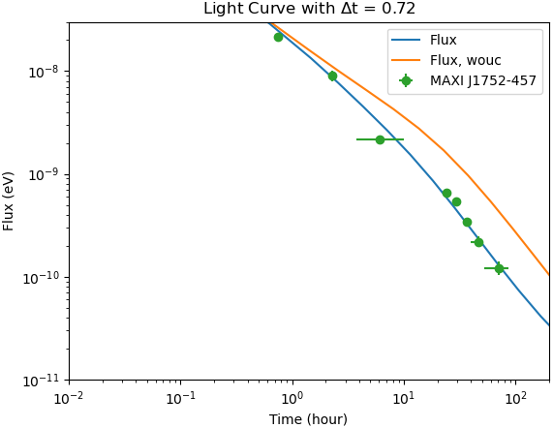
Flux fitting with ocean Urca process: E₁₇-y₁₂ relation
∆t = 0.24
∆t = 0.72
∆t = 0
∆t = 0.48
When ∆t > 0.72, the constraint on the E₁₇ would be very weak!
E₁₇: 3.7 [erg g⁻¹]
y₁₂: 1.67 [g cm⁻²]
Ts-Tb relation from Beznogov 2020
MAXI J1752-457
huangh@impcas.ac.cn
13

Slide 14
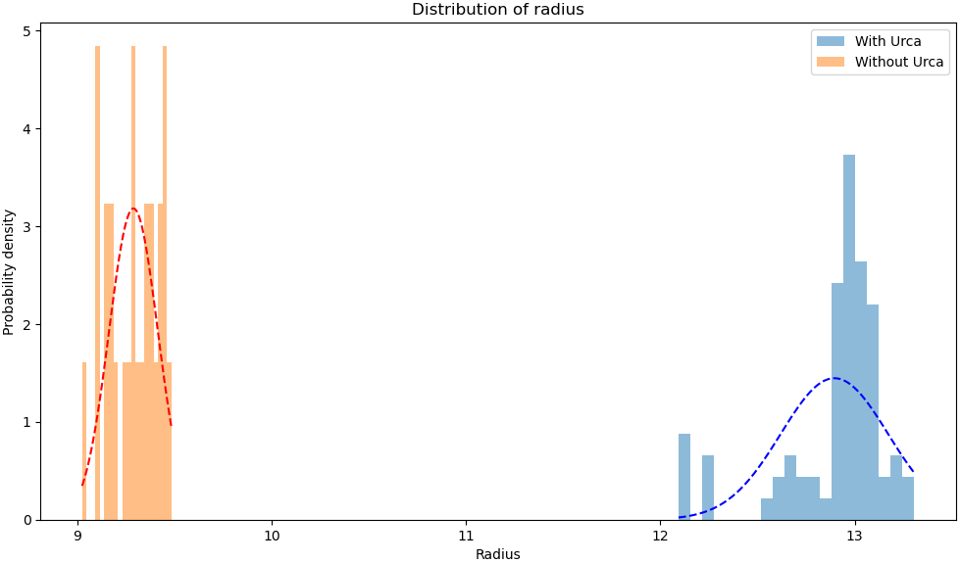
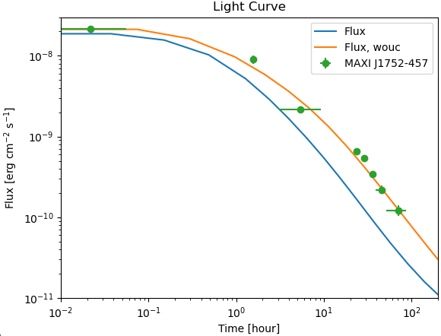
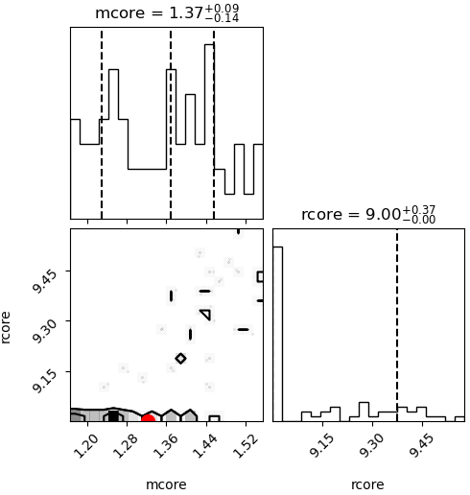
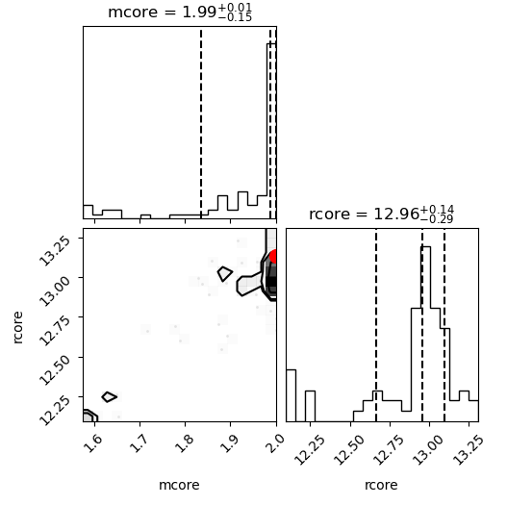
Flux fitting without ocean Urca process
Without Urca
With Urca
Fit without Urca process
E₁₇: 5 [erg g⁻¹]
y₁₂: 1.01 [g cm⁻²]
Ts-Tb relation from Beznogov 2020
MAXI J1752-457
huangh@impcas.ac.cn
14
Notes:
To comfirm the two decaying components are attributed to the ocean, we have to fit the flux without Urca process.
Unluckily, the fitting results without Urca can also reproduce the observations of MAXI j1752-457.

Slide 15
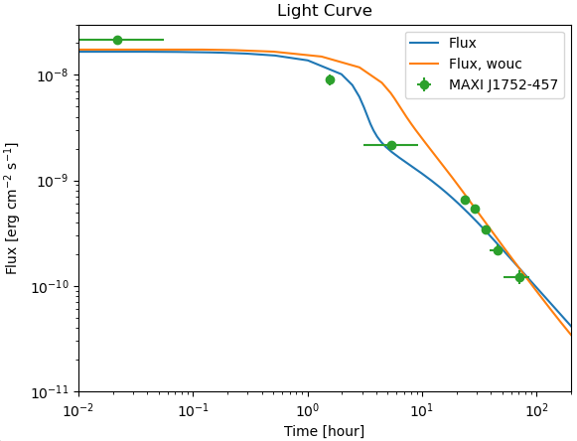
Ts-Tb relation from Potekhin 1997
Using the Ts-Tb relation from the extention of PCY (fully accreted)
$$log(Teff) = f(Tb)$$
BROWN & CUMMING, 2009
Ocean Urca process is necessary
MAXI J1752-457
huangh@impcas.ac.cn
15

Slide 16
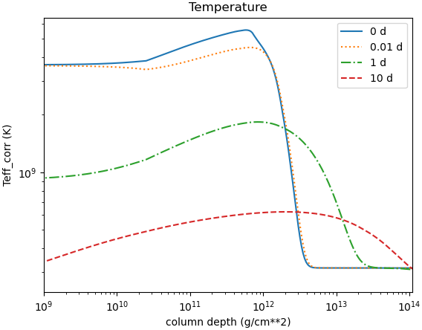
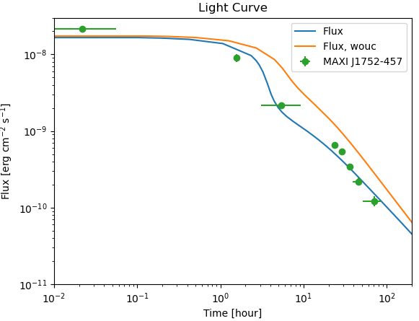
Ts-Tb relation from Potekhin 1997：Ocean Urca process
heating source 1
Ocean Urca process is necessary
urca cooling shells
MAXI J1752-457
huangh@impcas.ac.cn
16

Slide 17
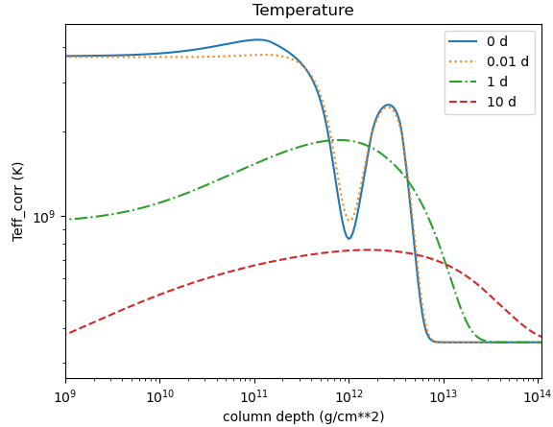
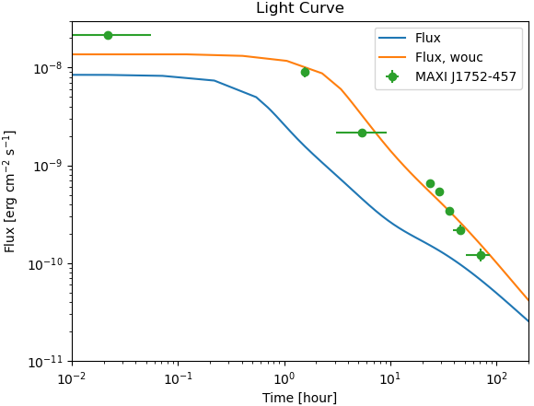
Ts-Tb relation from Potekhin 1997: Shallow heating
This fitting is not good
Fit with shallow heating and without Urca process
E₁₇: 14.41 [erg g⁻¹]
y₁₂: 0.3 [g cm⁻²]
Ts-Tb relation from PCY (FULL)
heating source 1
heating source 2 (shallow heating?)
Including shallow heating?
MAXI J1752-457
huangh@impcas.ac.cn
17

Slide 18
Conlcusion
With the Ts-Tb relation from Beznogov 2020
Flux curve of MAXI J1752-457 could be well reproduced both with and without ocean Urca process:
Without ocean Urca process, the observed flux is reproduced by including a thick heating region from the outermost crust to column depth y₁₂ ~ 1;
With Ocean Urca process, the flux curve of MAXI J1752-457 could be reprodeced as well. However, the mass and radius of the accretion stars shows a different perference (larger mass and radius).
With the Ts-Tb relation from Potekhin 1997
Flux curve of MAXI J1752-457 could be reproduced with ocean Urca process:
By including the ocean Urca process, crust temperature rapidly decreases around Urca shell. The two decaying components occurred at 5.5–7.7 hours could be explained.
Shallow heating might be an other method to explain the two decaying components. Since, the temperature rapidly changed around the overlap region between these two heating source. However, the nature of the shallow heating remains unknown.
High temperature: Ts-Tb relation at high temperature is required;
Two decaying components: Ocean Urca pair leads to the change of thermal conductivity and some unique thermal structure.
MAXI J1752-457
huangh@impcas.ac.cn
18

Slide 19
Fitting the observations of MAXI J1752-457 with ocean Urca process
Thanks for listening!!
Thanks Dohi-san,
Aoyama-san,
Takeda-san,
for the support of this work!!

