Slide 1
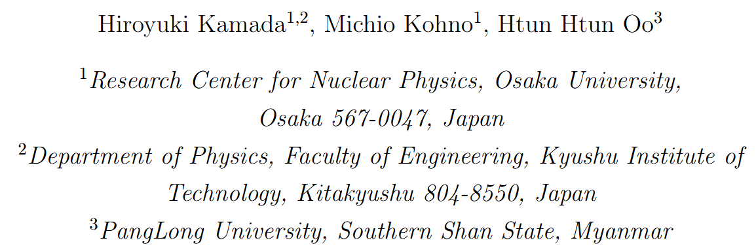




Slide 2
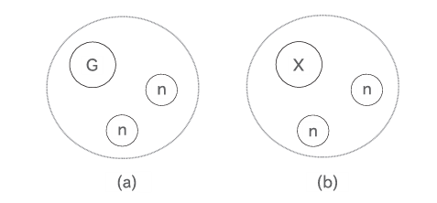

Core－Excitation Three-Cluster Model
Our calculation is based on the Faddeev three-body theory.
Ground state of the core nucleus
Excited state of the core nucleus

Slide 3
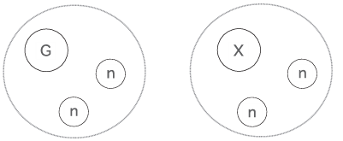



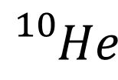

$${}_{}^{10}{He}$$
$${}_{}^{8}{He}+n+n$$
$${}_{}^{8}{He}(0^{+})$$
$${}_{}^{8}{He}(2^{+})$$

Slide 4
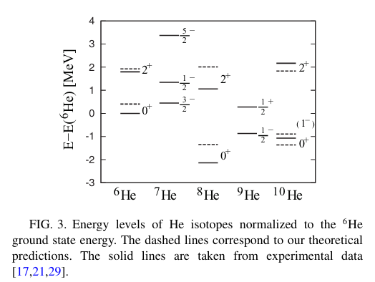
Core－Excitation Three-Cluster Model

Slide 5









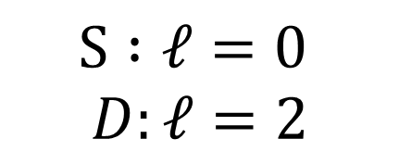






$$(0^{+})$$
$${}_{ΛΛ}^{10}{Be}$$
$${}_{}^{8}{Be}+Λ+Λ$$
$$S :ℓ=0$$
$$D:ℓ=2$$
$${}_{}^{8}{Be}(0^{+})$$
$${}_{}^{8}{Be}(0^{+})$$
$$S$$
$$D$$
$$D$$
$$S$$
$$S$$
$$S$$
$${}_{ΛΛ}^{10}{Be}(0^{+})$$
$${}_{ΛΛ}^{10}{Be}(2^{+})$$

Slide 6





$$\left(0^{+}\right),$$
$$(2^{+})$$
$${}_{ΛΛ}^{10}{Be}$$
$${}_{}^{8}{Be}+Λ+Λ$$
$$S :ℓ=0$$
$$D:ℓ=2$$
$${}_{}^{8}{Be}(0^{+})$$
$${}_{}^{8}{Be}(2^{+})$$
$$S$$
$$S$$
$$S$$
$$S$$
$$S$$
$$S$$
$${}_{ΛΛ}^{10}{Be}(0^{+})$$
$${}_{ΛΛ}^{10}{Be}(2^{+})$$

Slide 7

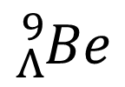



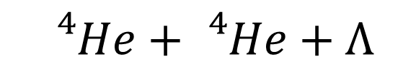




$${}_{Λ}^{9}{Be}$$
$${}_{}^{4}{He}+{}_{}^{4}{He}+Λ$$
$$S :ℓ=0$$
$$D:ℓ=2$$
$${}_{}^{8}{Be}(2^{+})$$
$${}_{}^{8}{Be}(0^{+})$$
$$α$$
$${}_{}^{8}{Be}(0^{+},2^{+})$$
$$S,D$$
$${}_{Λ}^{9}{Be}$$
$$S$$
$$α$$
$$Λ$$
$$S$$
$$S$$
$$S$$
$$Λ$$
$${}_{ΛΛ}^{10}{Be}(0^{+})$$
$${}_{ΛΛ}^{10}{Be}(2^{+})$$

Slide 8
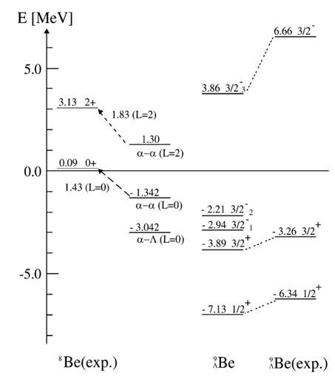



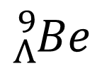





$${}_{Λ}^{9}{Be}$$
$${}_{}^{4}{He}+{}_{}^{4}{He}+Λ$$
$${}_{}^{8}{Be}(2^{+})$$
$$α$$
$${}_{}^{8}{Be}(0^{+},2^{+})$$
$$S,D$$
$${}_{Λ}^{9}{Be}$$
$$α$$
$$Λ$$
$$S$$

Slide 9
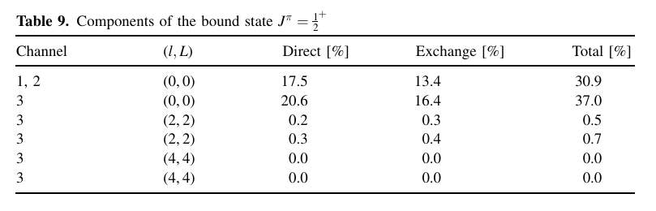
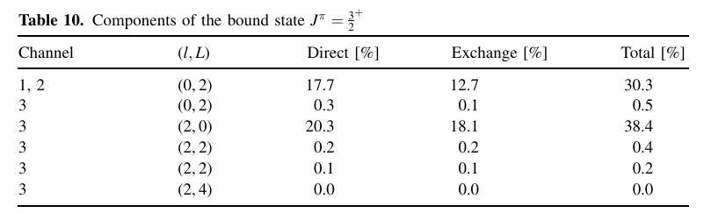
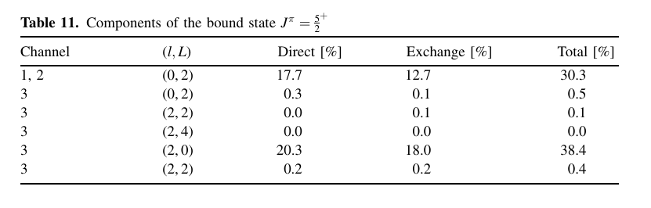


$${}_{Λ}^{9}{Be}$$
$${}_{}^{4}{He}+{}_{}^{4}{He}+Λ$$
$${}_{}^{8}{Be}(2^{+})$$
$$α$$
$${}_{}^{8}{Be}(0^{+},2^{+})$$
$$S,D$$
$${}_{Λ}^{9}{Be}$$
$$α$$
$$Λ$$
$$S$$
$$S$$

Slide 10
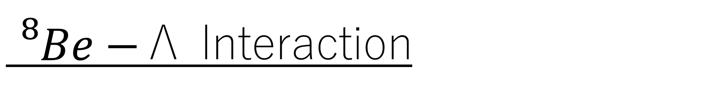
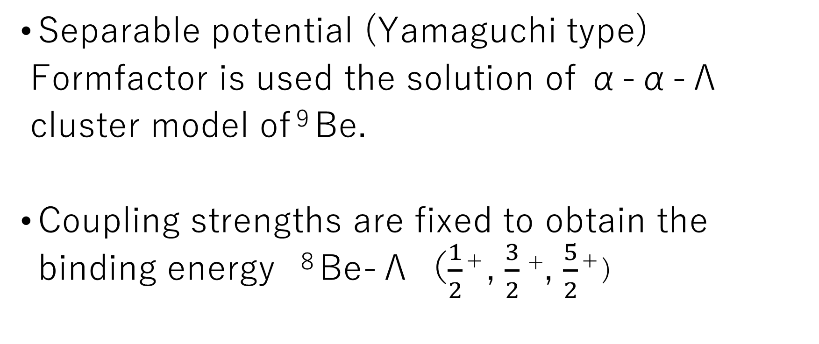
${}_{}^{8}{Be}−$Λ Interaction
Separable potential (Yamaguchi type)
Formfactor is used the solution of α-α-Λ
cluster model of^{９}Be.
Coupling strengths are fixed to obtain the binding energy ^{８}Be-Λ（$\frac{1}{2}$＋, $\frac{3}{2}$⁺, $\frac{5}{2}$＋)
Λ

Slide 11
Λ-ΛInteraction
Coupled Channels
ΛΛ, ΞN, ΣΛ, ΣΣ
Phenomenological
Meson theoretical
Chiral Effective Field Theoretical
HAL-QCD interpretation

Slide 12

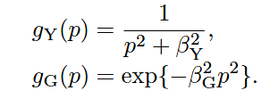

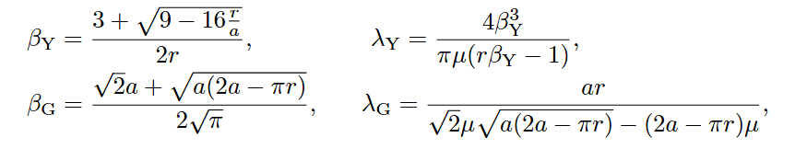
Parameter β and coupling constant λ
Afnan, I. R., Gibson, B. F., Phys. Rev. C 92 (2015)054608
H.H. Oo, H.K., Few-Body Syst (2022) 63:9

Slide 13
Scattering Length a and Effective Range r
[1] Th.A. Rijken, Nucl. Phys. A 691,322c (2001). [ESC00]
[2] D.H. Davis, J. Pniewski, Contemp. Phys. 27 (1986) 91. [ND(G)]
[3] K. Tominaga et al., Nucl. Phys. A642, 483 (1998). [A]
[4] H. Nemura, Y. Suzuki, Y. Fujiwara, C. Nakamoto, Prog. Theor. Phys. 103 (2000) 929.
[5] K. Tominaga et al., Nucl. Phys. A642, 483 (1998). [B]
[6] K. Tominaga et al., Nucl. Phys. A642, 483 (1998). [2]
[7] I.N. Filikhin, A. Gal, Nucl. Phys. A 707 (2002) 491. [ND1]
[8] I.N. Filikhin, A. Gal, Nucl. Phys. A 707 (2002) 491. [ND4]
[9] J. Haidenbauer, U.-G. Meißner, Nucl. Phys. A 881, 44 (2012).

Slide 14
[10] K. Sasaki et al., Nucl. Phys A998, 121737 (2020) [HAL-QCD Sasaki-11]
[11] K. Sasaki et al., Nucl. Phys A998, 121737 (2020)[HAL-QCD Sasaki-13]
[12] K. Sasaki et al., Nucl. Phys A998, 121737 (2020)[HAL-QCD Sasaki-12]
[13] I.N. Filikhin, A. Gal, Nucl. Phys. A 707 (2002) 491. [ND2]
[14] M. M. Nagels, Th. A. Rijken, and Y. Yamamoto, https://arxiv.org/abs/1504.02634
[15] J. Haidenbauer and U.-G. Meißner, EPJ A55, 23 (2019). [NLO chiral]
[16] T. Inoue et al, AIP Conf. Proc. 2130, 020002 (2019). [HAL-QCD Inoue]
[17] J. Haidenbauer, Nucl. Phys. A 981, 1 (2019).
[18] V.B. Belyaev, S.A. Rakityansky, W. Sandhas, Nucl. Phys. A803 210 (2008).
[19] I.N. Filikhin, A. Gal, Nucl. Phys. A 707 (2002) 491. [ND3]
[20] V. G. J. Stoks and Th. A. Rijken, Phys. Rev. C 59, 3009 (1999).[NSC97e]
[21] M. M. Nagel et al. , Phys. Rev. C 99, 044003 (2019). [ESC16]
[22] V. G. J. Stoks and Th. A. Rijken, Phys. Rev. C 59, 3009 (1999). [NSC97b]
[18.5] E. Hiyama et al., Phys. Rev. C 66 024007 (2002).
[7.5] E. Hiyama et al., Prog. Theor. Phys. 97, 881 (1997).

Slide 16
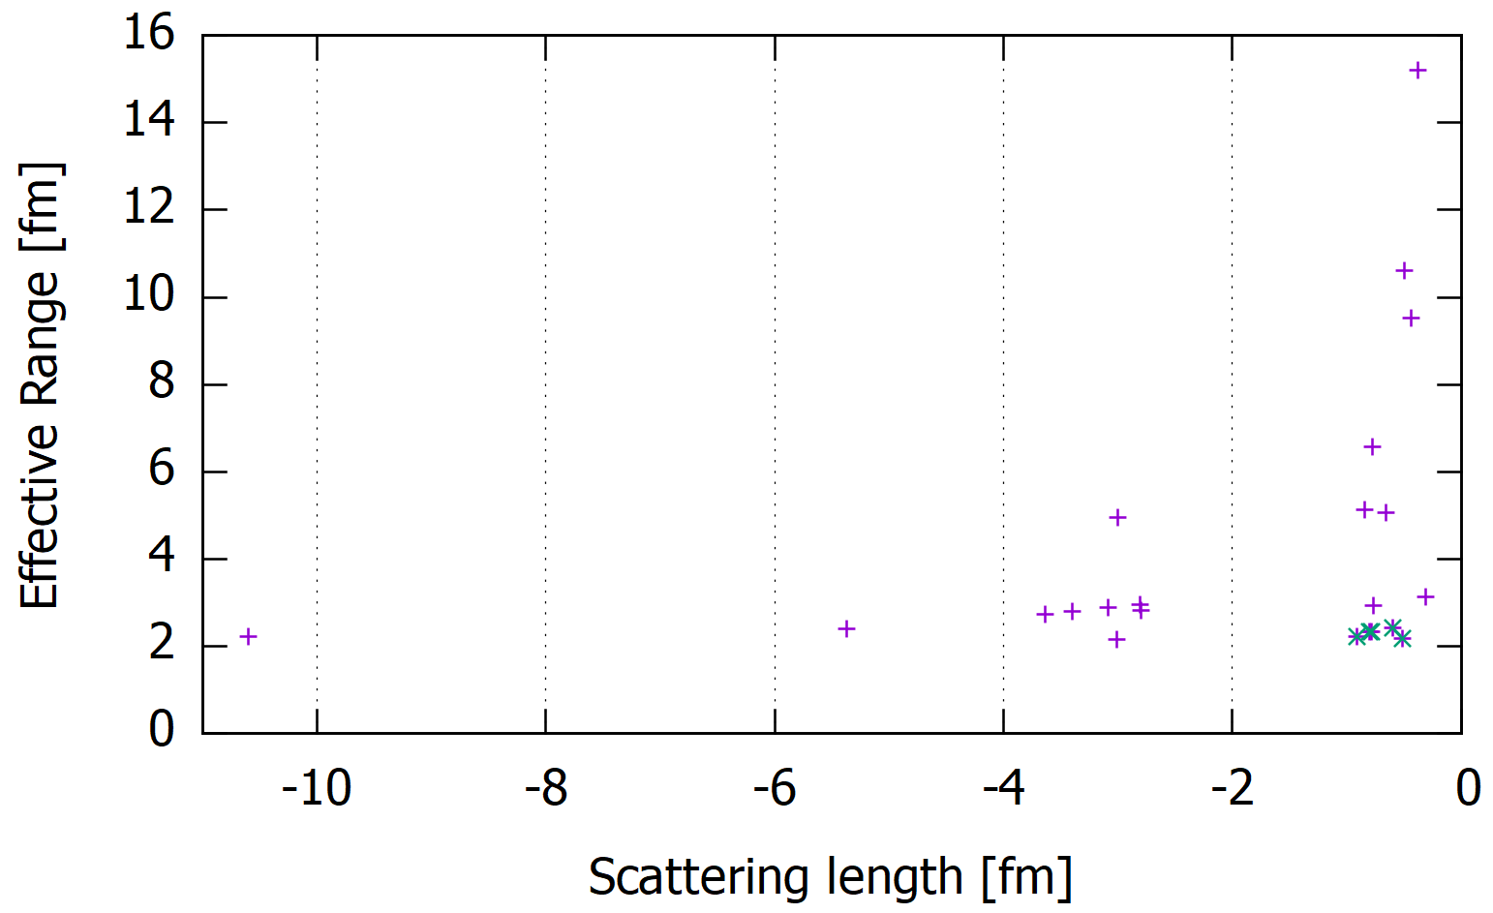

Slide 17
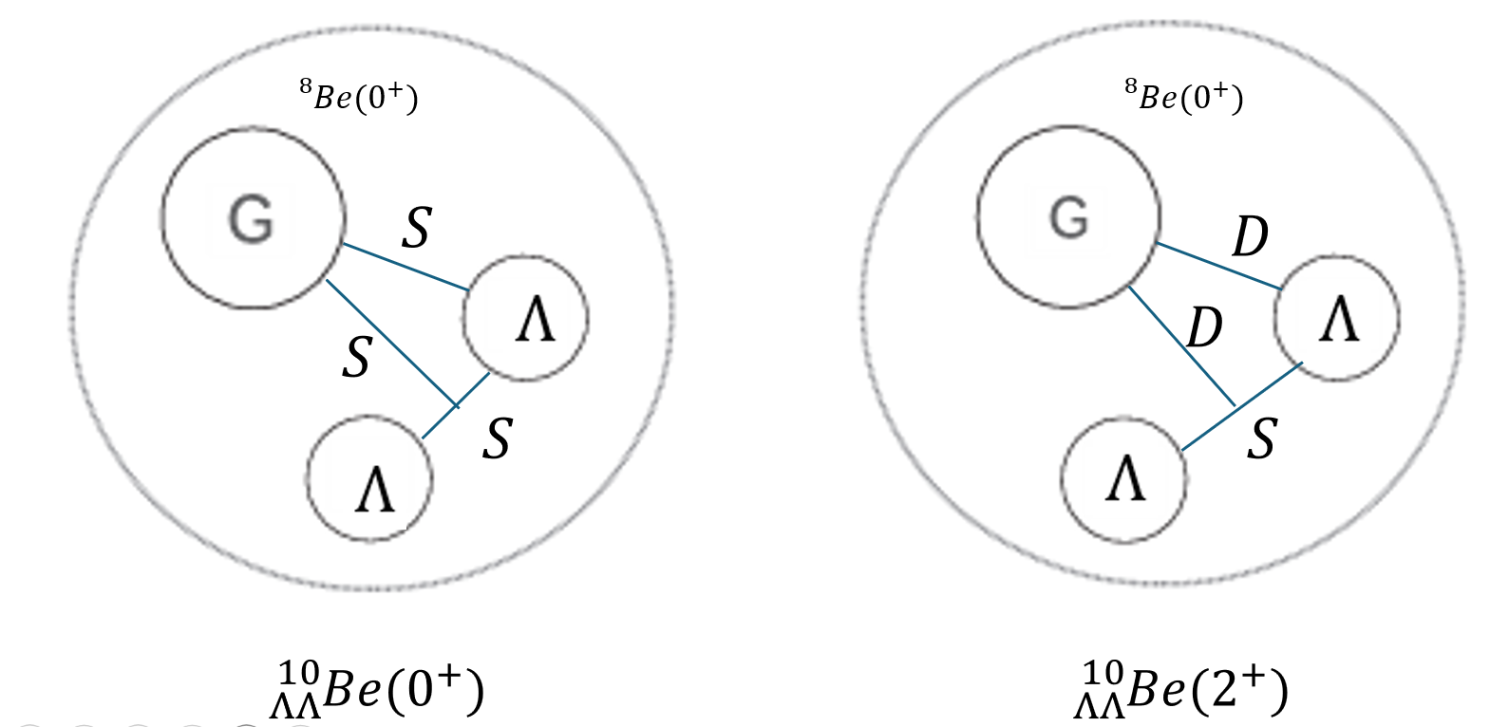
Usual three-cluster model

Slide 18
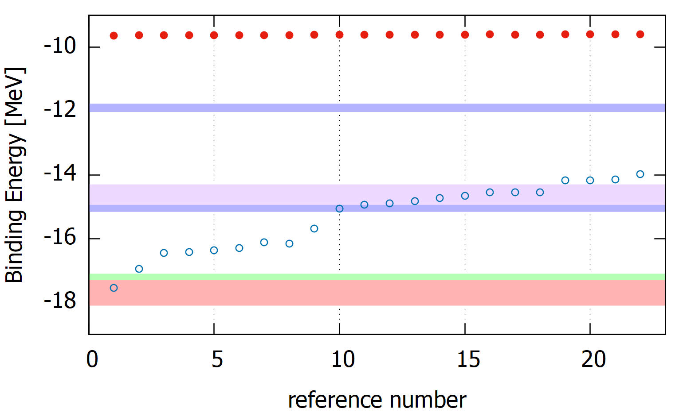


$$2^{＋}$$
DEMACHIYANAGI event (2001)
Danysz＋Davis （2005）
MINO event (2019)
$$0^{＋}$$
Danysz＋Dalitz（1989）
Danysz（1973）

Slide 19
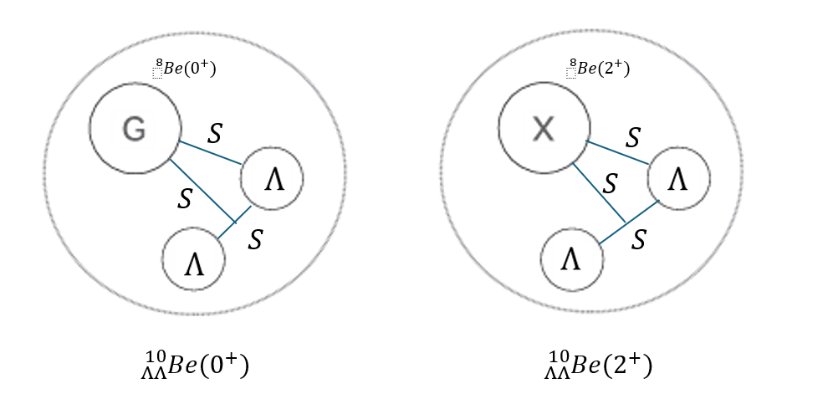
Core-excitation three-cluster model

Slide 20
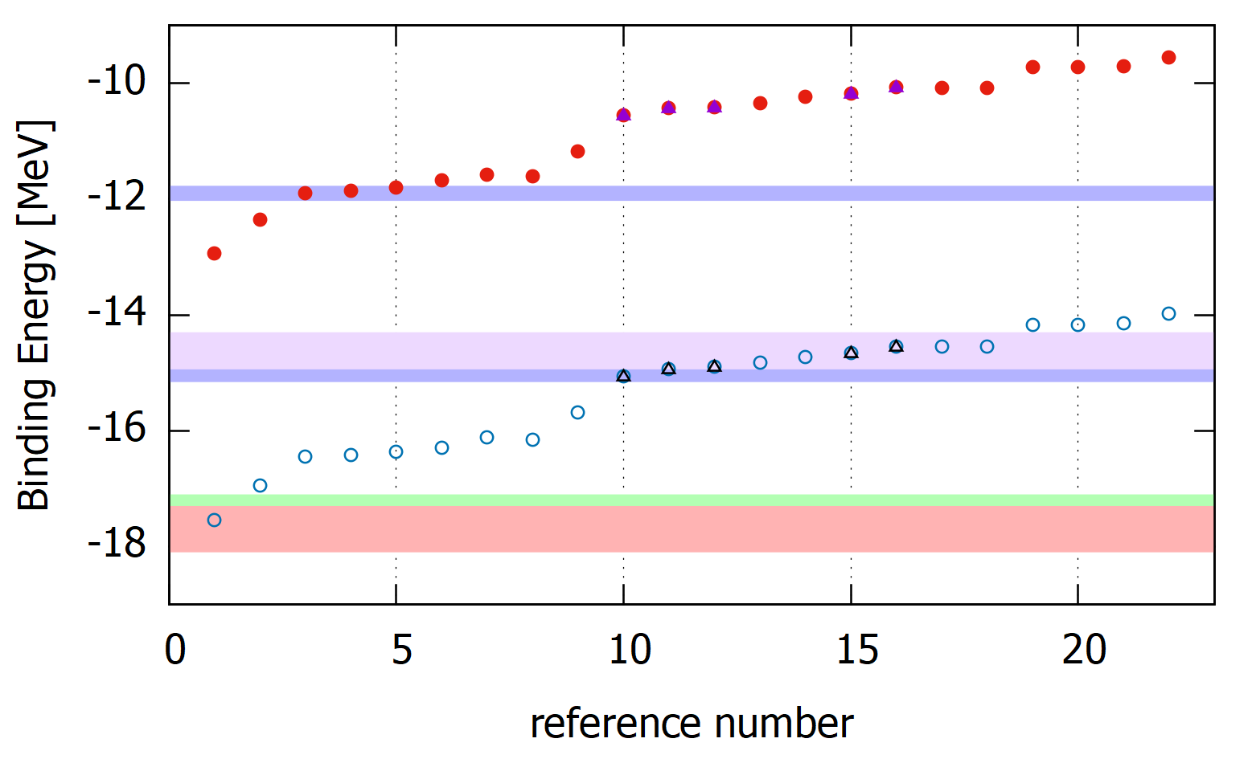
$$2^{＋}$$
DEMACHIYANAGI event (2001)
HAL-QCD Sasaki-13
HAL-QCD Sasaki-11
HAL-QCD Sasaki-12
Danysz＋Davis （2005）
MINO event (2019)
$$0^{＋}$$
HAL-QCD Inoue
NLO chiral
Danysz＋Dalitz（1989）
Danysz（1973）
Group A
Group B

Slide 21

Binding Energies of

Slide 22
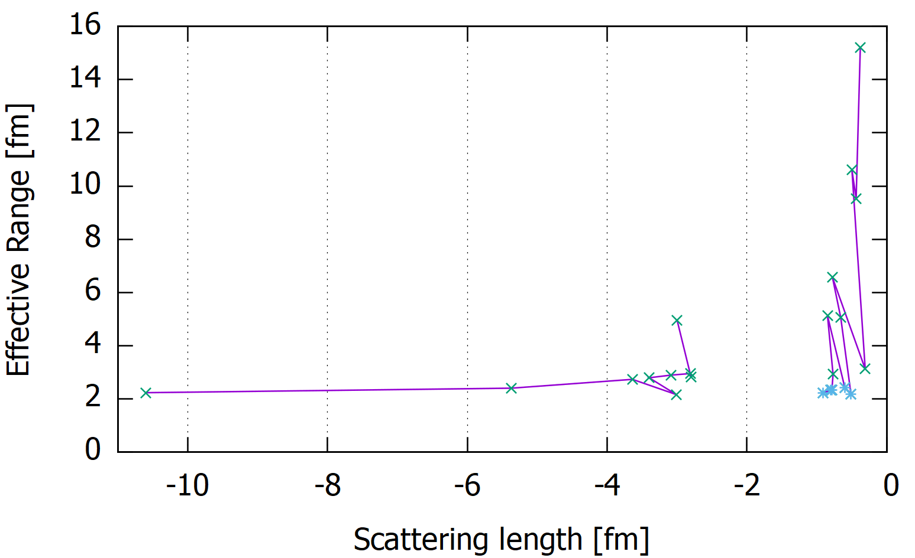
Group B
Group A

Slide 23
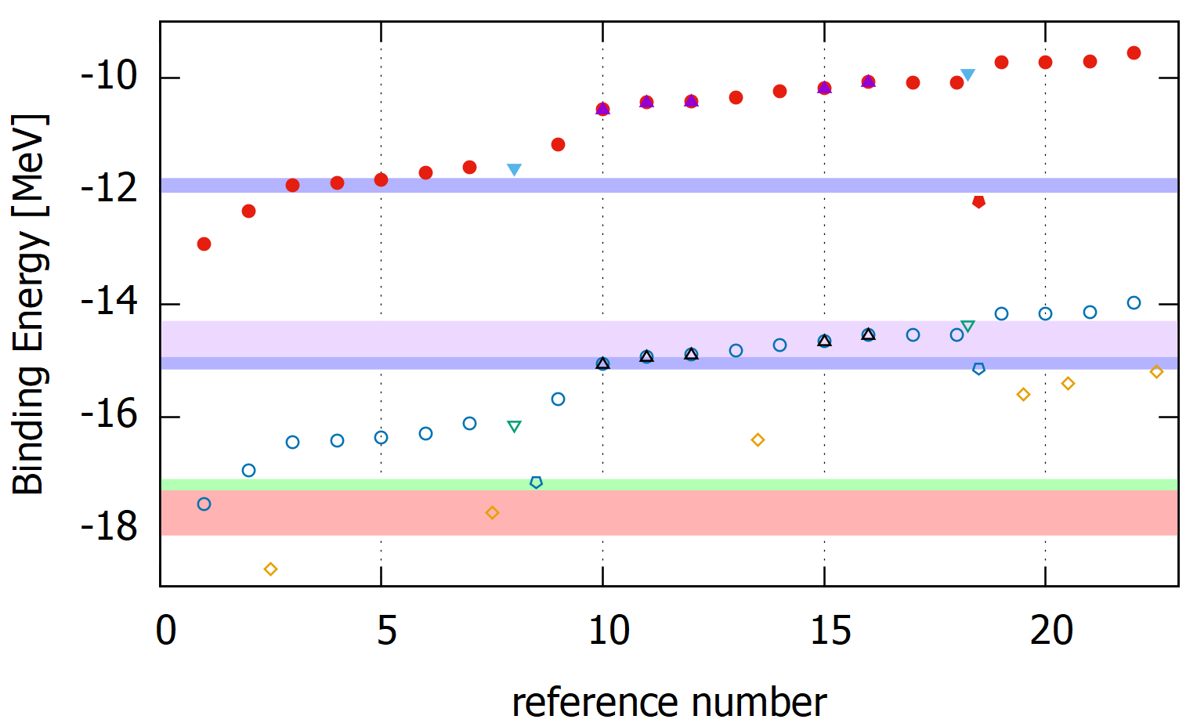
$$2^{＋}$$
DEMACHIYANAGI event (2001)
Hiyama (1997)
Hiyama (2002)
Danysz＋Davis （2005）
MINO event (2019)
$$0^{＋}$$
Filikhin-Gal (2002)
Danysz＋Dalitz（1989）
Danysz（1973）
Group A
Group B

Slide 24
Summary
There are many theoretical predictions for the scattering length and the effective range.
Out of the scattering length and the effective range we have many ΛΛseparable potentials.
We solve Faddeev equations using the separable potential by the core-excited three-cluster model.
When sorted by the magnitude of the ground state binding energy, it was found that (a,r) can be roughly classified into two groups.

Slide 25
Thank you for your attention.

