Slide 1
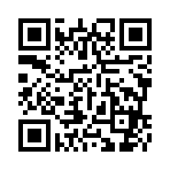
国立研究開発法人理化学研究所 仁科加速器科学研究センター
第338回 RIBF核物理セミナー
RIKEN Nishina Center for Accelerator Based Science
The 338th RIBF Nuclear Physics Seminar
MR-ToF Devices at CERN-ISOLDE
Dr. Lukas Nies (CERN)
Nuclear observables, such as binding energies, electromagnetic moments, and charge radii, arise from various effects that govern nuclear properties. Studying these properties often requires fast measurement techniques due to the short half-lives of the isotopes of interest. In recent years, the Multi-Reflection Time-of-Flight (MR-ToF) device has become a key instrument in the investigation of nuclear binding energies of isotopes with half-lives in the order of a few tens of milliseconds and is now also used to perform colinear laser fluorescence spectroscopy. In this seminar, we will explore the latest results of the MR-ToF devices at CERN-ISOLDE, including precision mass measurements and beam composition studies at ISOLTRAP, colinear laser spectroscopy at MIRACLS, and plans for employing a high-energy MR-ToF device for the antiproton-unstable matter annihilation experiment PUMA.
Apr. 25th(Mon), 2025 15 : 30 ～ via RIBF Hall
* The talk will be given in English language.
Contact: Nuclear Physics Seminar Organizing Committee
npsoc@ribf.riken.jp
http://ribf.riken.jp/~seminar/

