Slide 1
ZDC Simulation
May 15th, 2025
Yeonwoo Park, Gyeongjun Kim, Saehanseul Oh, Yongsun Kim
Sejong University

Slide 2
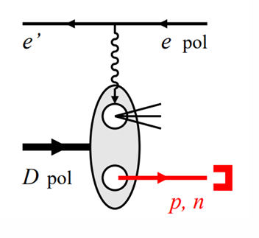
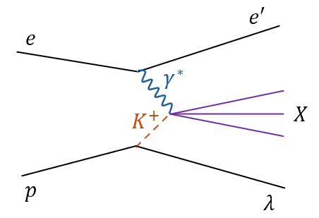
What we can do in ZDC
Spectator tagging in e + d/3He
Distinguishing between coherent diffractive scattering and incoherent scattering
Sullivan process

Slide 3
Sullivan process
We can study internal structure of K meson by interacting K with $γ$
Neutral Λ decay is connected to Sullivan process
(33%) Λ → n + π⁰ → n + $γ$ + $γ$
To reconstruct the invariant mass of $π^{0}$
*$M_{π^{0}}=M_{γγ}=\sqrt{2E_{γ}E_{γ}(1−cosθ)}$
We need to reconstruct the secondary vertex

Slide 4
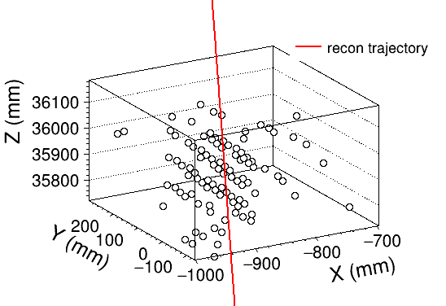
Single-particle tracking
Simulation setting
Gun particle : $γ$
Gun energy : 10 GeV
Gun theta : 0 rad
Gun position : random
(between the primary vertex and center of Ecal 1st layer)
Ecal+Hcal setup
Using a tracking method based on hit positions and hit energies
Without using the primary vertex (=(0,0,0)) assumption
Using Least Squares Method
$min∑{\left(\hat{r_{0}}×\vec{r_{i}}\right)}^{2}∙E_{i}$
$$\vec{r_{0}}$$
$$\vec{r_{i}}$$

Slide 5
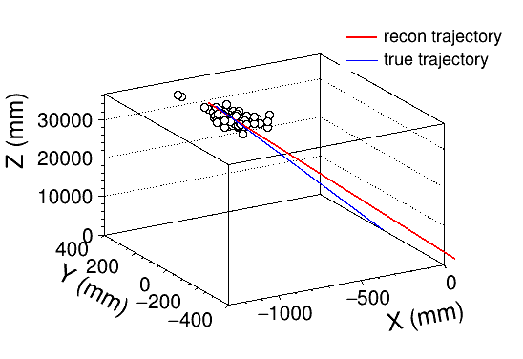
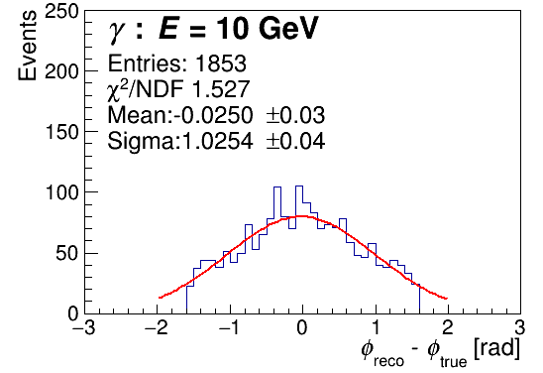
Single-particle tracking
$$φ_{reco}−φ_{true}$$
$$θ_{reco}−θ_{true}$$

Slide 6
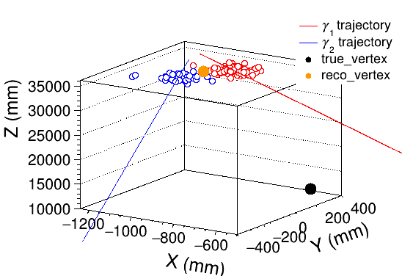
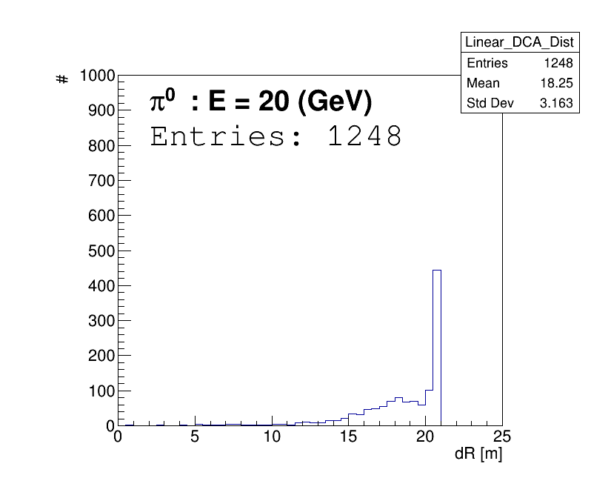
Secondary vertex reconstruction
Simulation setting
Gun particle : $π^{0}$
Gun energy : 20 GeV
Gun theta : 0 rad
Gun position : (-400, 0, 16000)
(~about 21 m from center of Ecal 1st layer)
true trajectory
Poor resolution for finding the secondary vertex position with Ecal+Hcal setup
We tried to add silicon detector layers for secondary vertex reconstruction

Slide 7
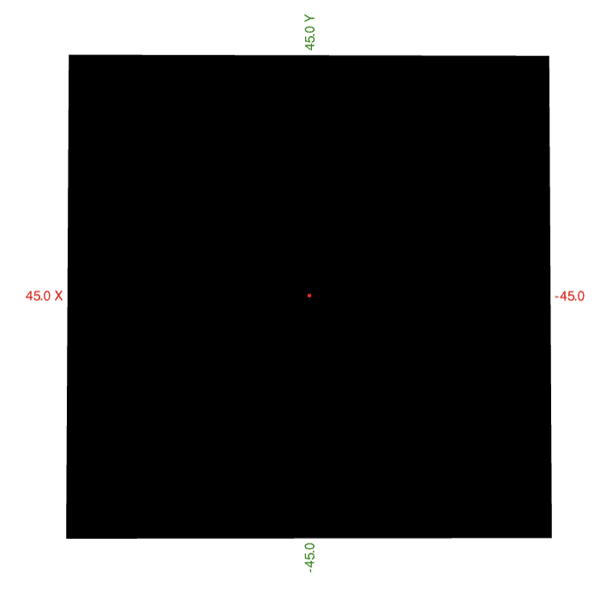
W+Si 18 layers detector (Mocking-up ALICE FoCal)
1cm
Width: 90cm
Height: 90cm
1-layer thickness
: W(3.5mm) + Si(0.3mm) + PCB(1.6mm) = 5.4mm
x position: -45.0 ~ 45.0cm
y position: -45.0 ~ 45.0cm
z position: 3000 ~ 3010cm
* Perpendicular to the z axis

Slide 8
$γ$ simulation setting
#: 2000
Energy: 10GeV
Gun position: (0, 0, 0)
Theta: 0.003radCrossing angle boost: 0 rad (to detector direction)
beam
10cm
z axis, 30m
0.003rad

Slide 9
How to get $Δθ$
CM positions
$$CM position= \frac{(x, y)∙Energy}{(x, y)}$$
(0, 0, 0)
$$∆θ$$
for particle path
11th layer(#: 2000)
The red line got from CM positions, by using linear regression

Slide 10
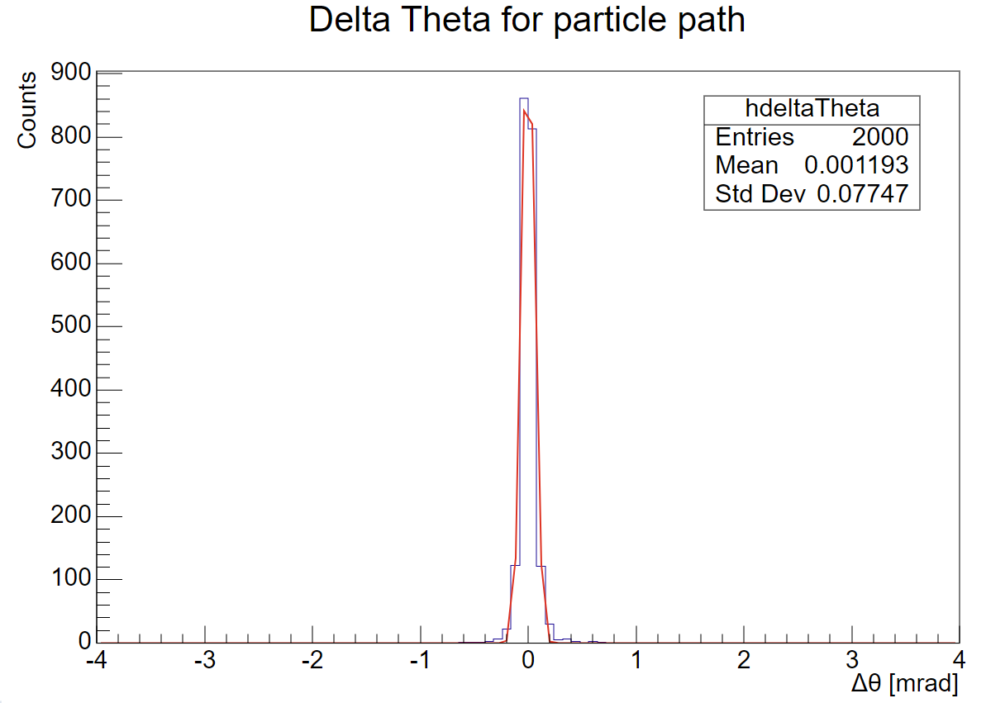
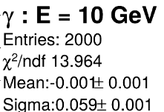
$θ$ resolution
Theta resolution : 0.059 mrad

Slide 11
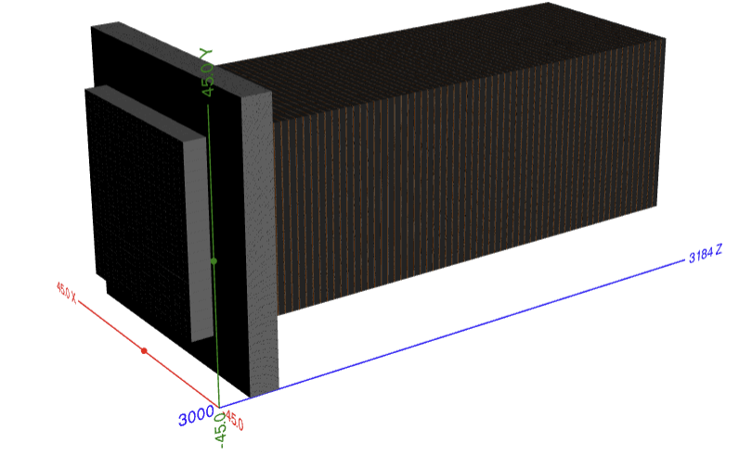
EM calorimeter + W-Si detector + Hadronic calorimeter
Next step:
Hadronic calorimeter
We will test various silicon layer configurations, and optimize them for the secondary vertex reconstruction
EM calorimeter
W-Si detector
air gap(3cm, 2cm)

