Slide 1
Status of SCRIT Electron Scattering Facility
Physics of Rare RI Ring, RIKEN, Nov.10-12, 2011
M. Wakasugi, and SCRIT Collaborators
RIKEN Nishina Center
Rikkyo University
Tohoku University
Nagaoka University of Technology
Contents:
Overview of SCRIT Facility
Recent Achievements
Schedules

Slide 2
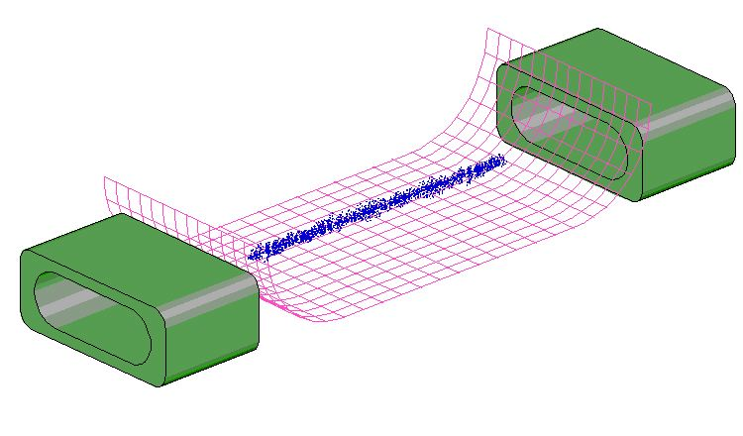
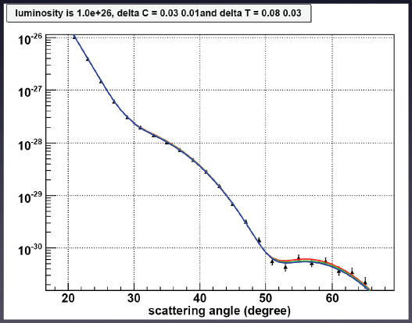
SCRIT (Self-Confining RI Ion Target)
Electron scattering ⇨ Charge density distribution
Target Ions
Required Luminosity > 10²⁶/(cm²s)
Yield Estimation for Sn isotopes
Electron Energy 300MeV
Scattering Angle 20°-65°
Azimuthal Angle 90°
Measurement Time 1week
Target Luminosity > 10²⁷ /(cm²s)
up to 2nd. Maximum

Slide 3
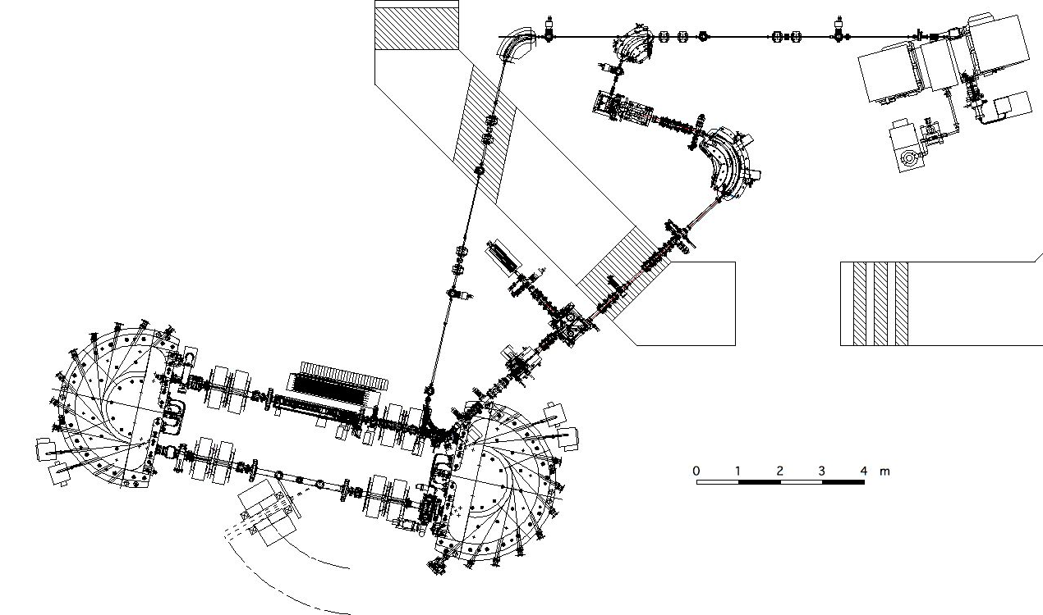
Equipment Configuration
RTM
Ion Source
ISOL
Construction 2009
Energy 150MeV
Upgrade 10W → 3kW
Construction 2009
Circum. 21 m
Energy 150-700MeV
(under construction)
SR2
e-Detectors
SCRIT
e-Spectrometer
(under construction)

Slide 4
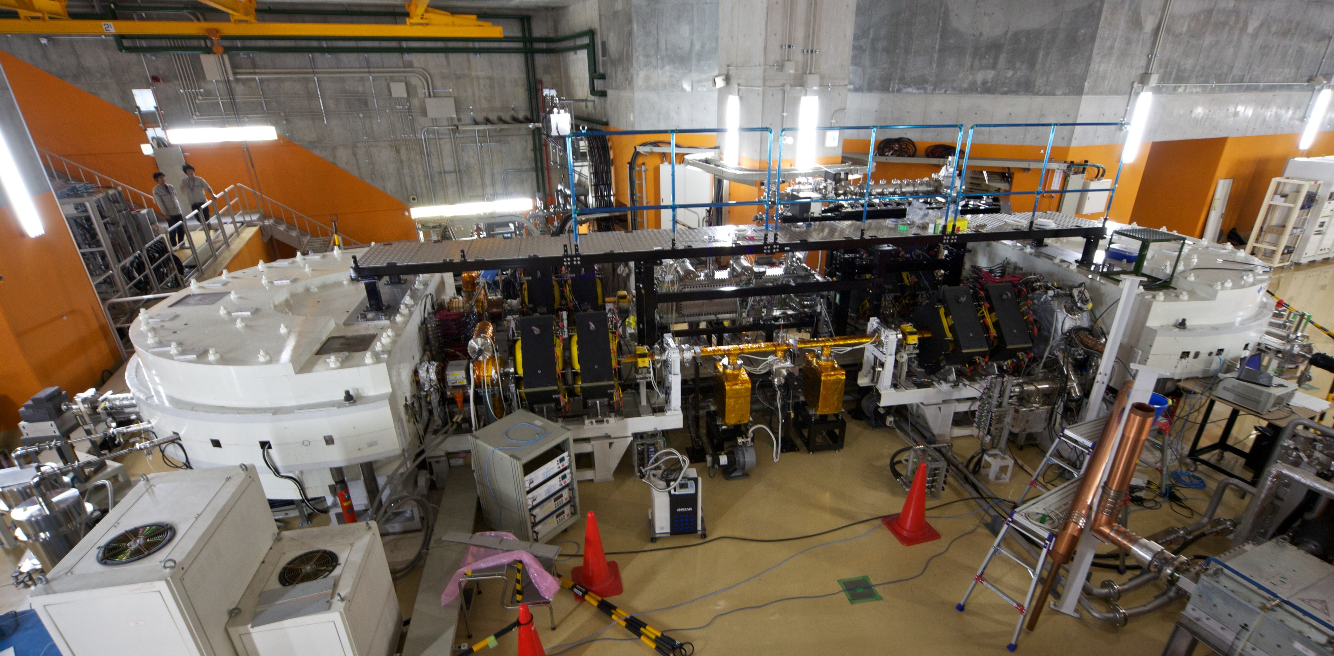
SR2 (SCRIT-equipped Riken Storage Ring)
SCRIT device
Current Performances
Current
250mA
500mA
Lifetime
0.5 AH
>1.0 AH
Vacuum (on beam)
6×10⁻⁸ Pa
10⁻⁸ Pa

Slide 5
SCRIT Device
SCRIT Electrodes

Slide 6
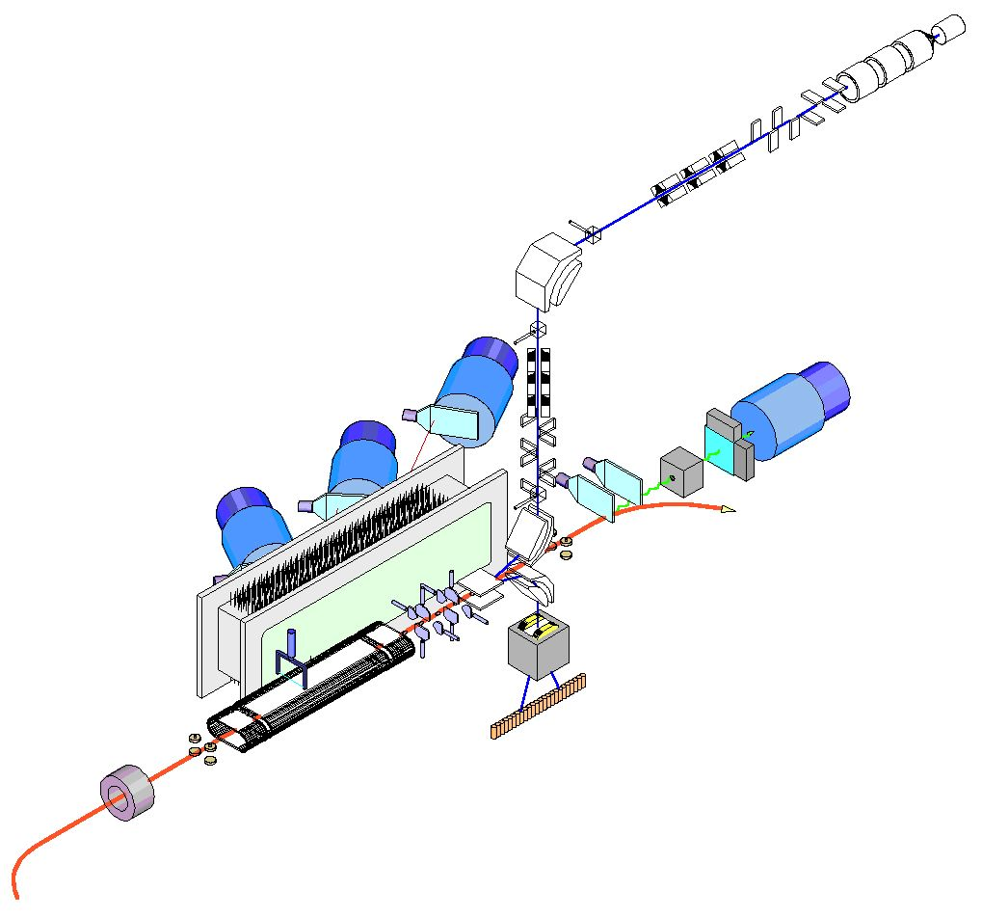
Current Setup for test experiments
Test (Cs) Ion
Source
for Luminosity
Pb-glass Cerenkov
Scintillator
Caloriemeters
for Scattered
Electrons
2D Fiber Scintillators
Forward
Scintillators
Drift Chamber
SCRIT
Electrode
E×B Analyzer
for Trapped Ions
e-Beam
DCCT

Slide 7
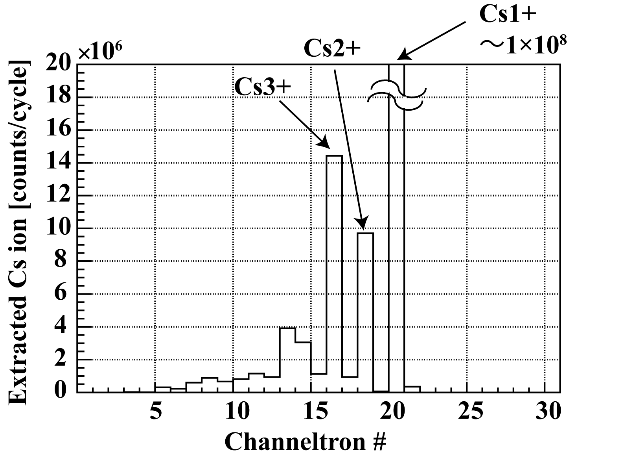
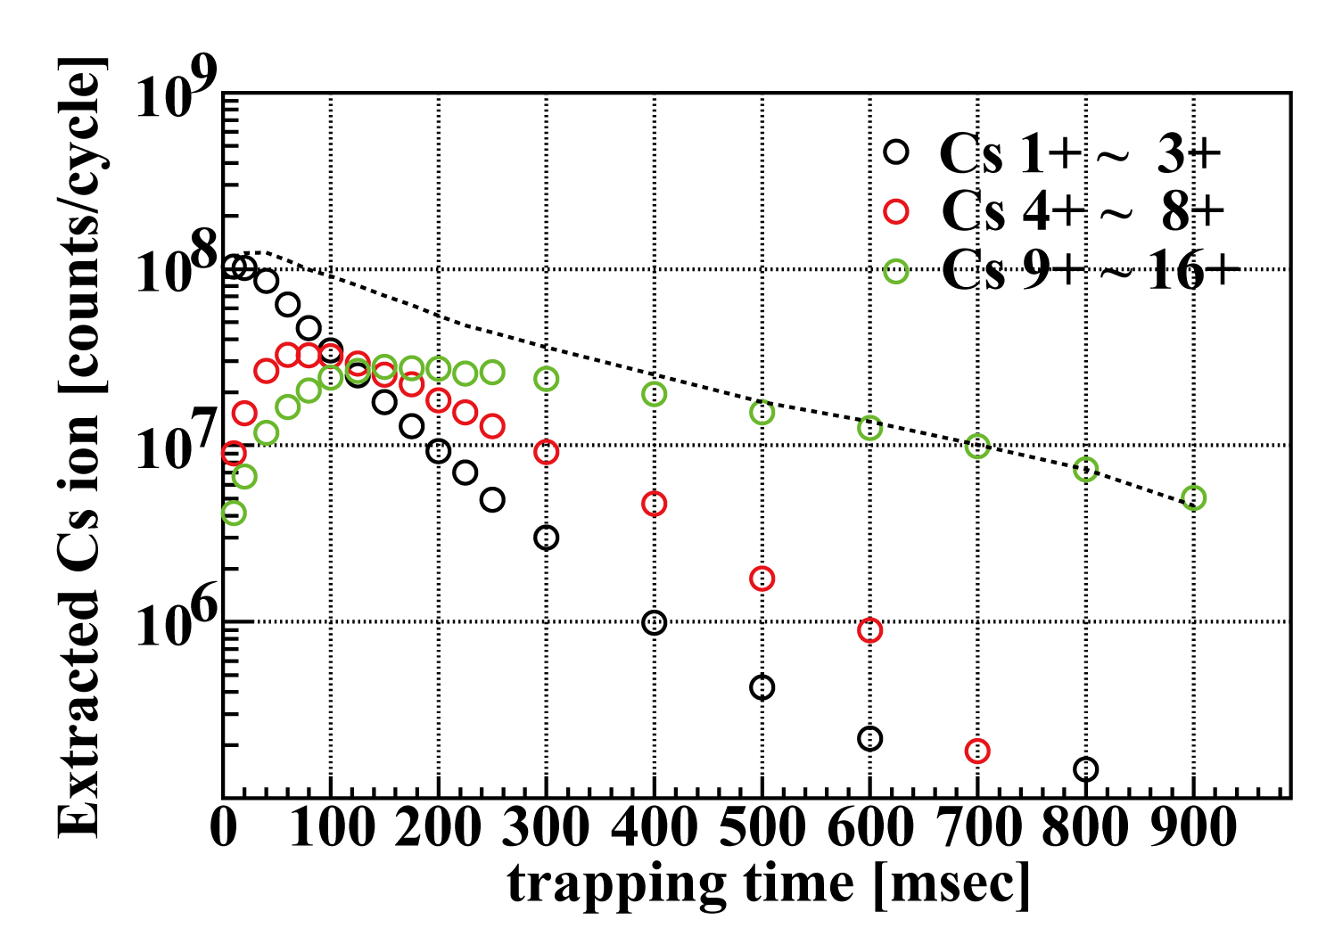
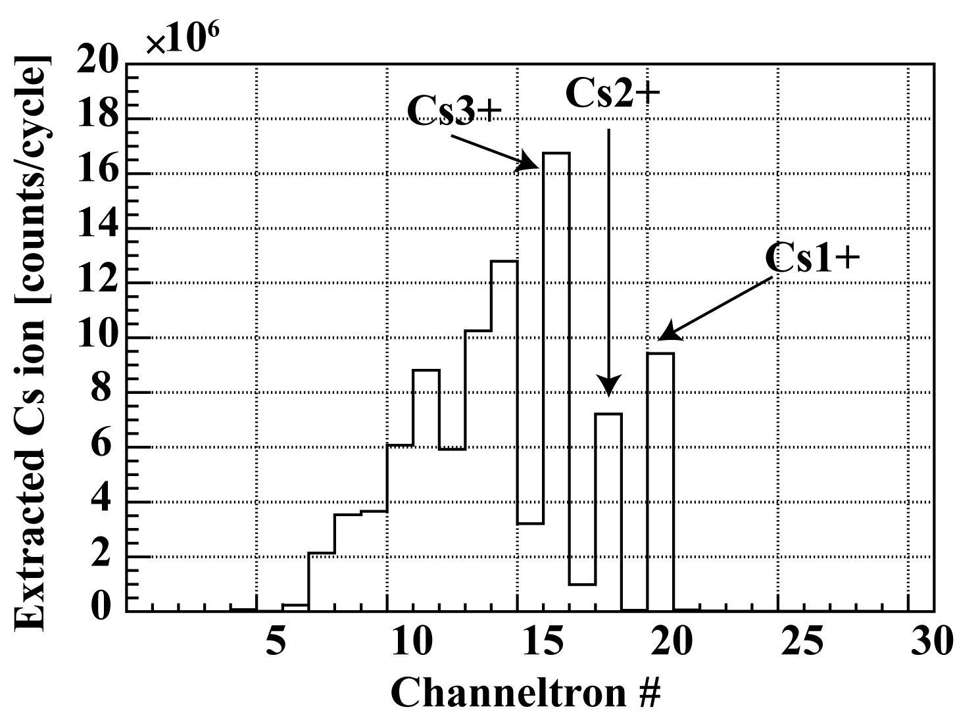
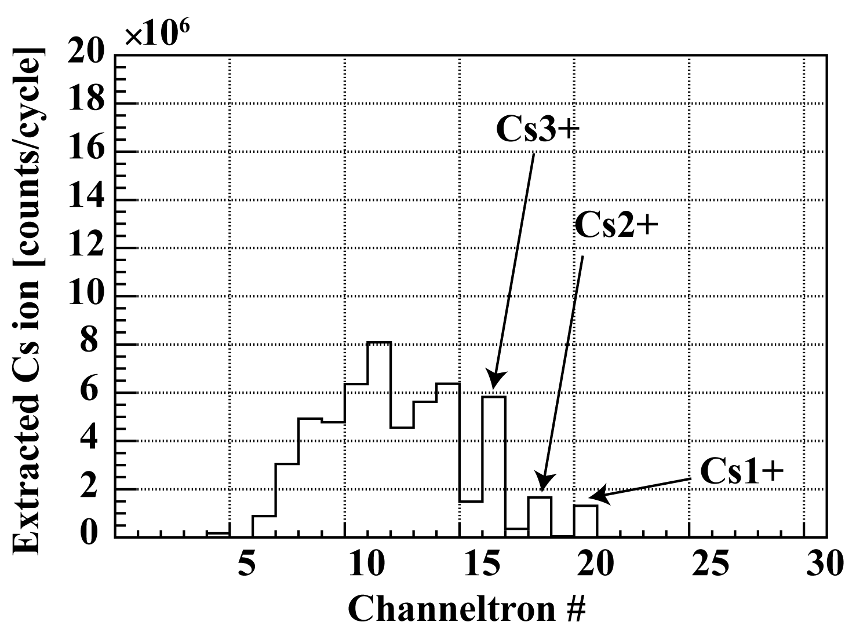
Ion Trap in SCRIT
Charge State Distribution
Change of Number of Trapped Ions
10ms
100ms
Preriminary
Ie=200mA
200ms
～16+
Trapping Lifetime ~0.3 sec

Slide 8
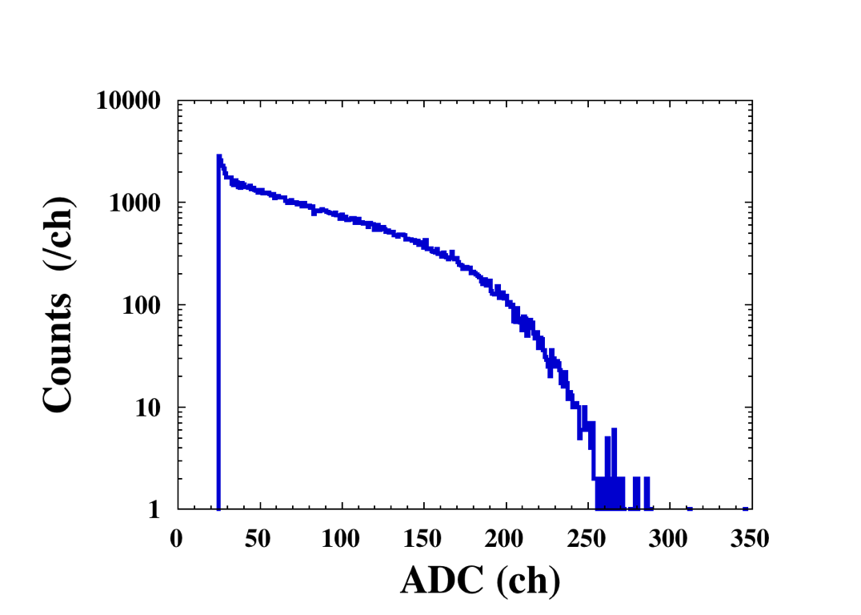
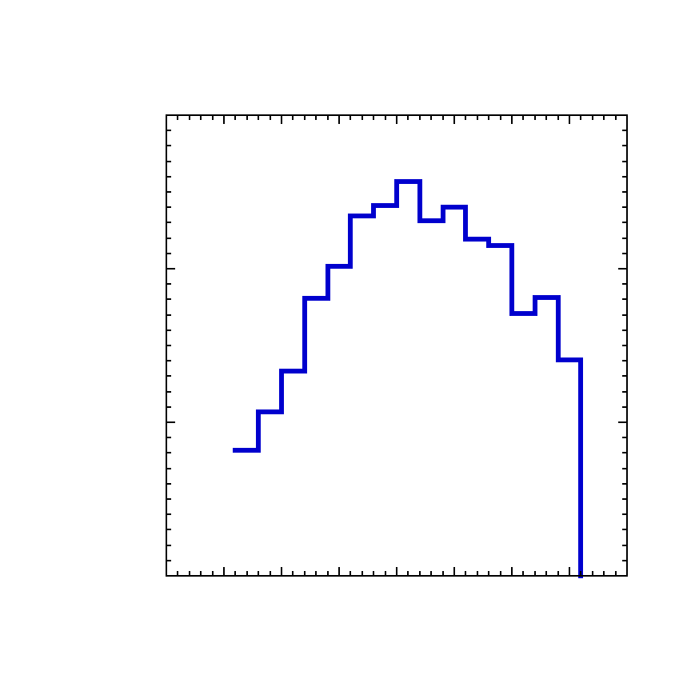
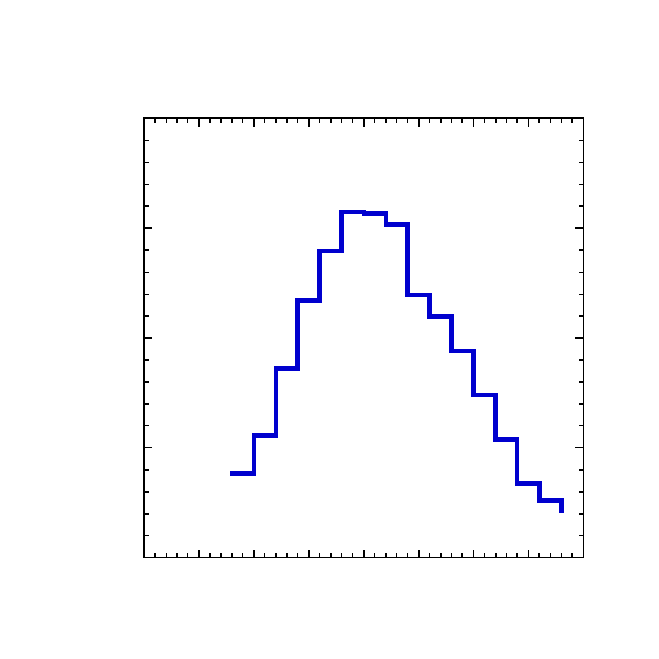
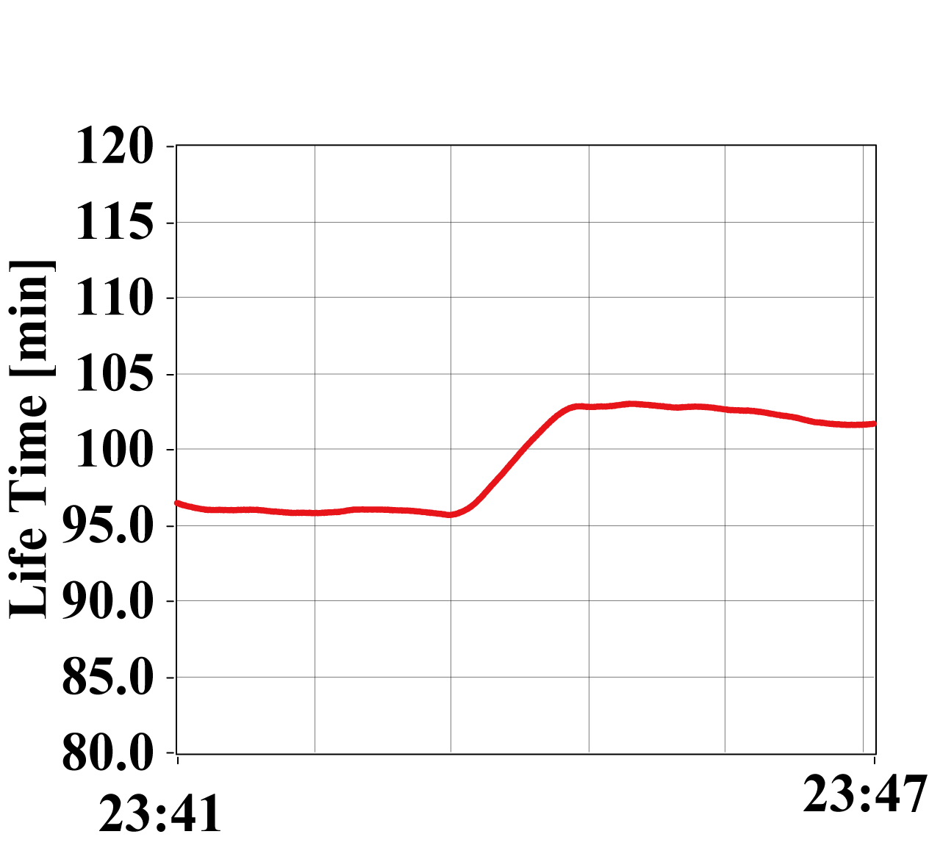
Luminosity Measurements
Relative Values :
Absolute Values :
from Forward Scintillators
from Fiber Scintillators & Pb-glass Cerenkov
Preriminary
Eγ=150 MeV
τ ~ 1.1 s
10²⁶/(cm²s)
from Lifetime measurement by DCCT
τ ~ 0.3 s
τ ~ 0.3 s
I_{e}=200mA
without Cs
with Cs
Recently Achieved Luminosity ~ 10²⁷ /(cm²s)

Slide 9
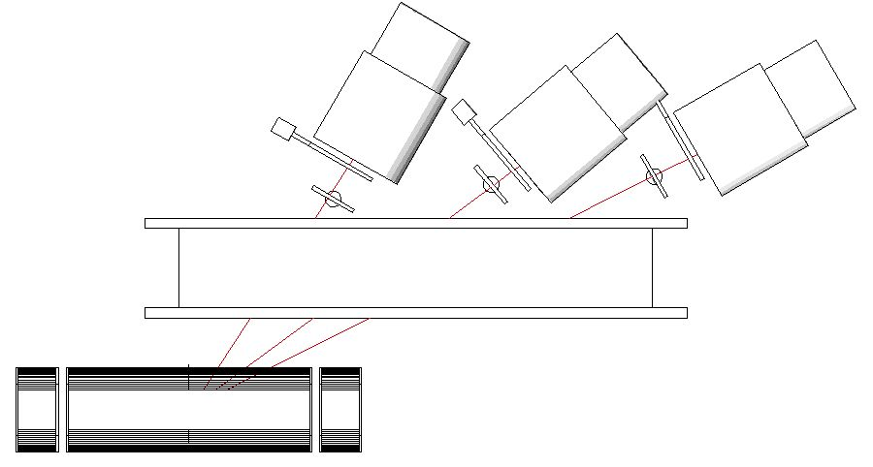
Elastic scattering from Trapped Cs ions
Vertex gated spectrum
Energy gated vertex distribution
Preriminary
with Cs
37deg.
24deg.
without Cs
SCRIT
E_{e} = 150 MeV
I_{e} = 150 ~ 200 mA
Drift Chamber
Calorimeters

Slide 10
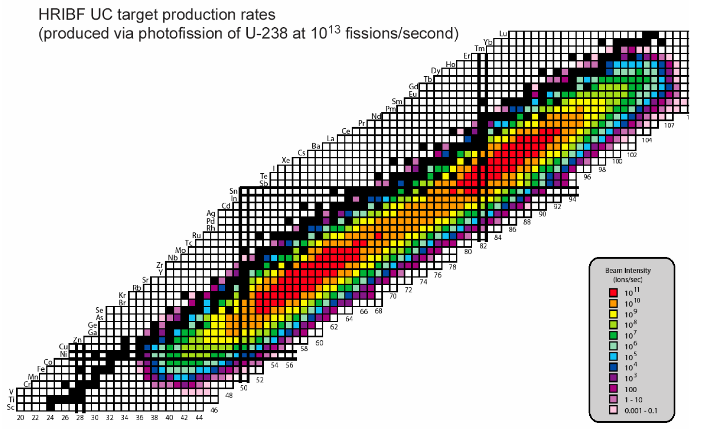
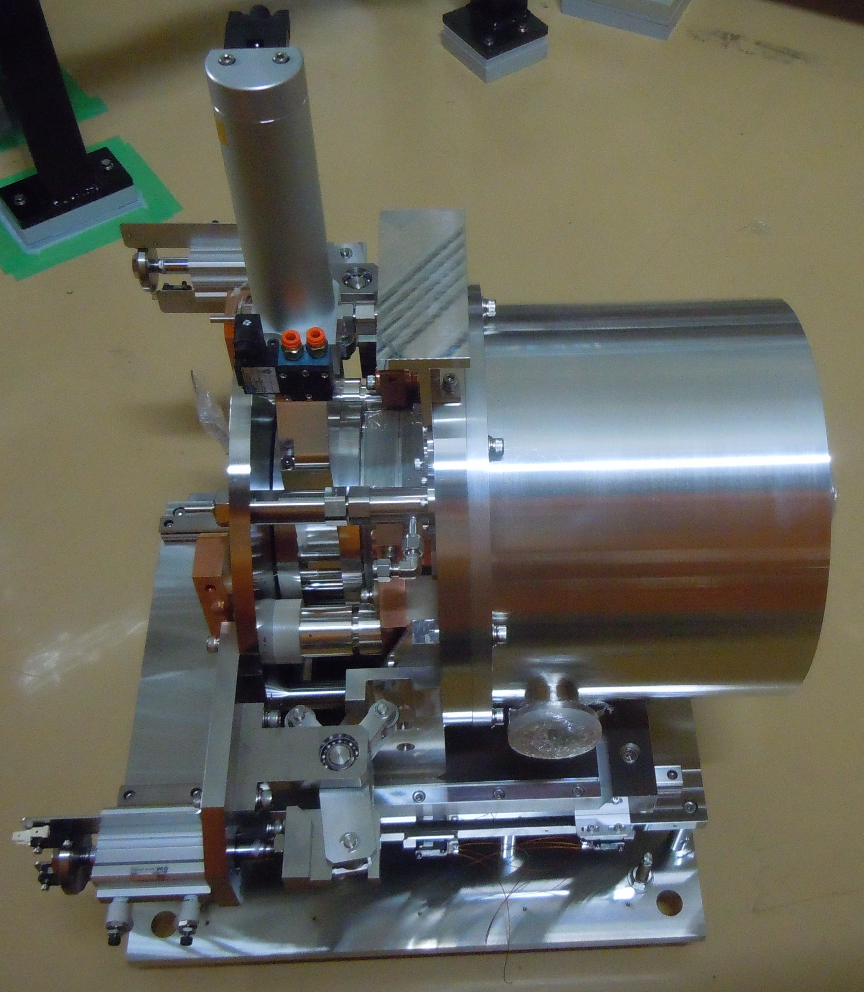
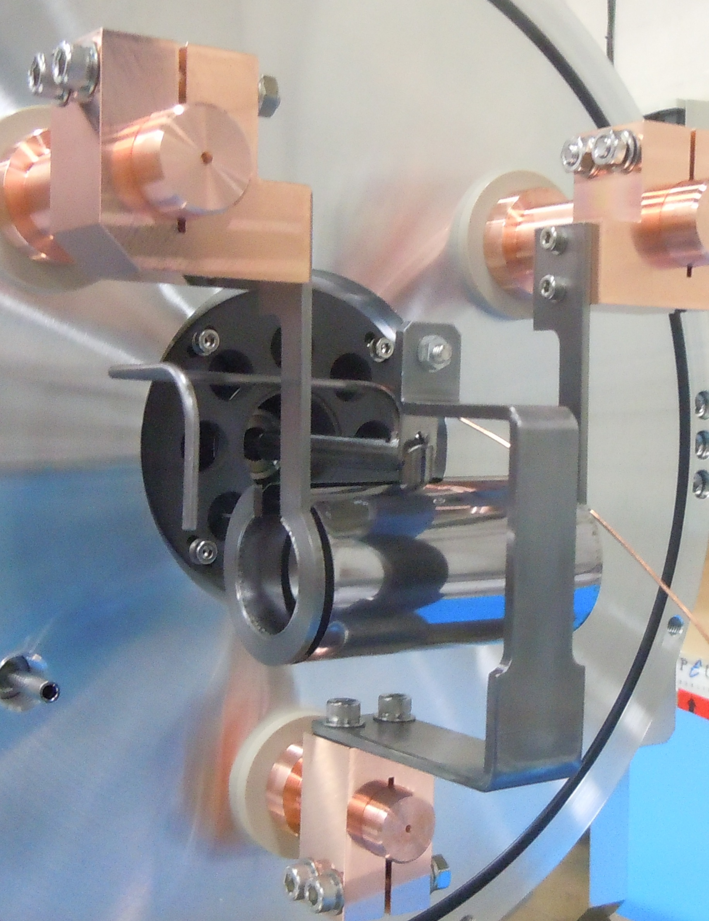
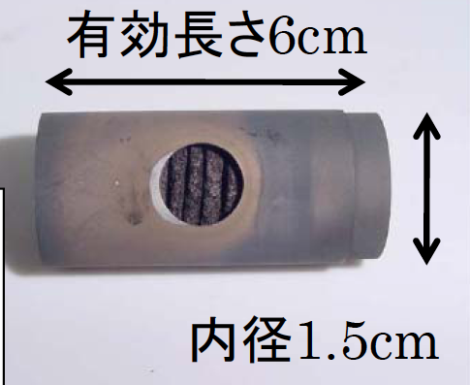
RI Production for SCRIT Experiments
U photo-fission
e-Beam
γ
²³⁸U
P50
2~3×10¹¹ fissions/s
( RTM > 1kW )
N82
> 10⁹ ¹³²Sn/s
P28
N50
N28
UCx Target
60mm length
~ 50g U contained

Slide 11
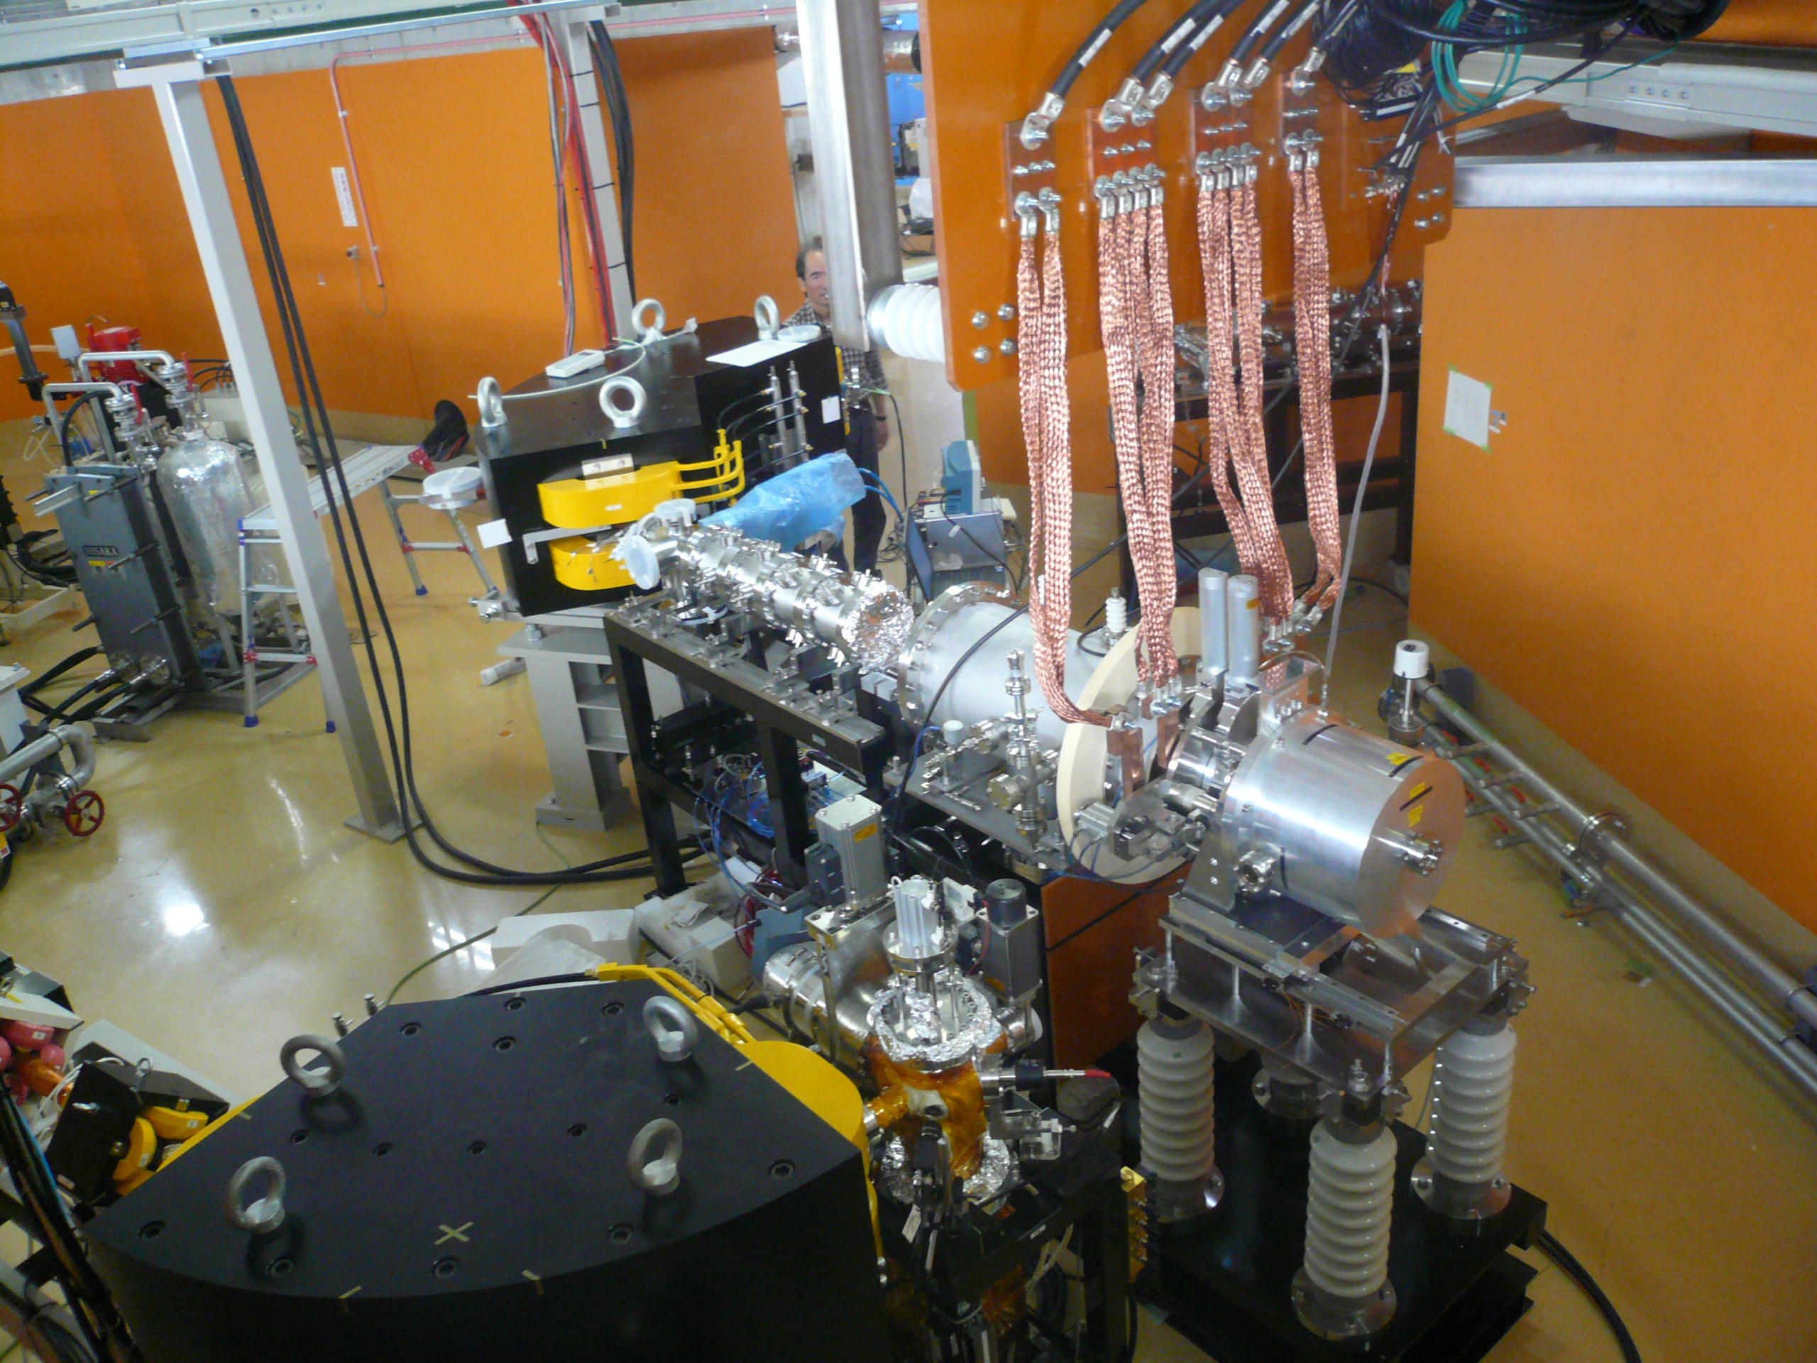
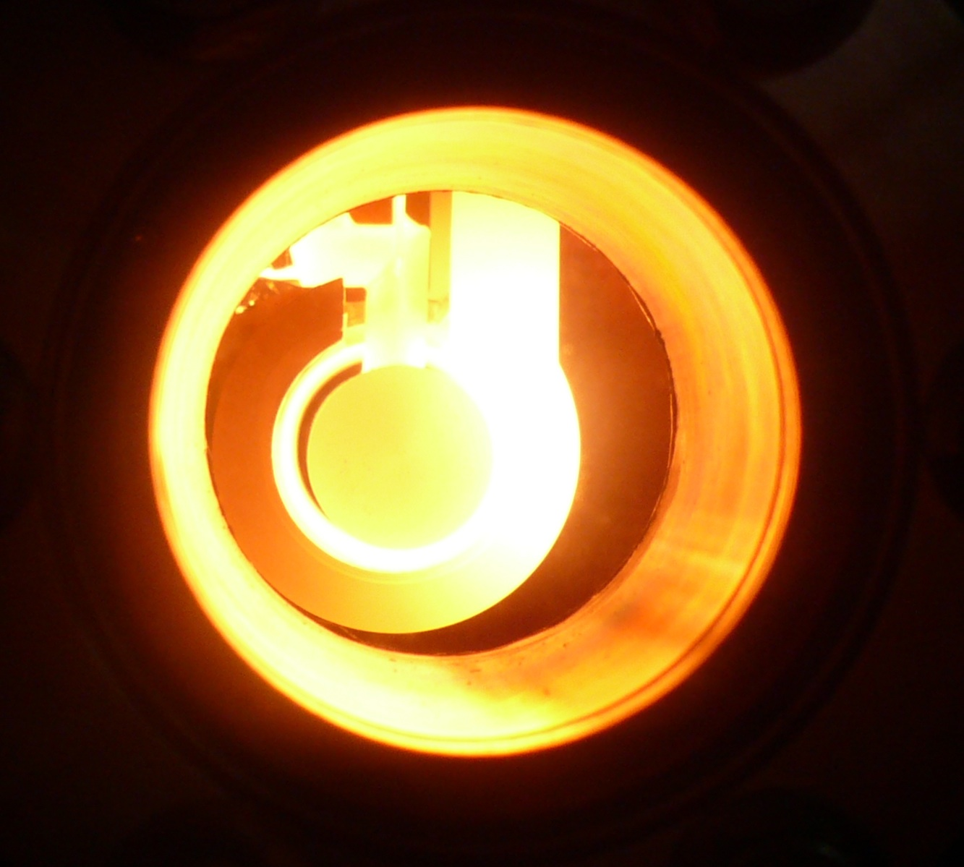
RI Ion Source and ISOL
120 deg.
Analyzing Magnet
Ion Source
e-Beam
from RTM

Slide 12
Schedule
Experiment will be started in FY2013

