Slide 1







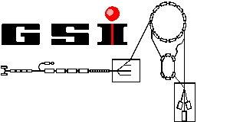



Mass Measurements at ISOLTRAP
Sarah Naimi
SLOWRI (RIKEN), CSNSM (IN2P3/CNRS)

Slide 2
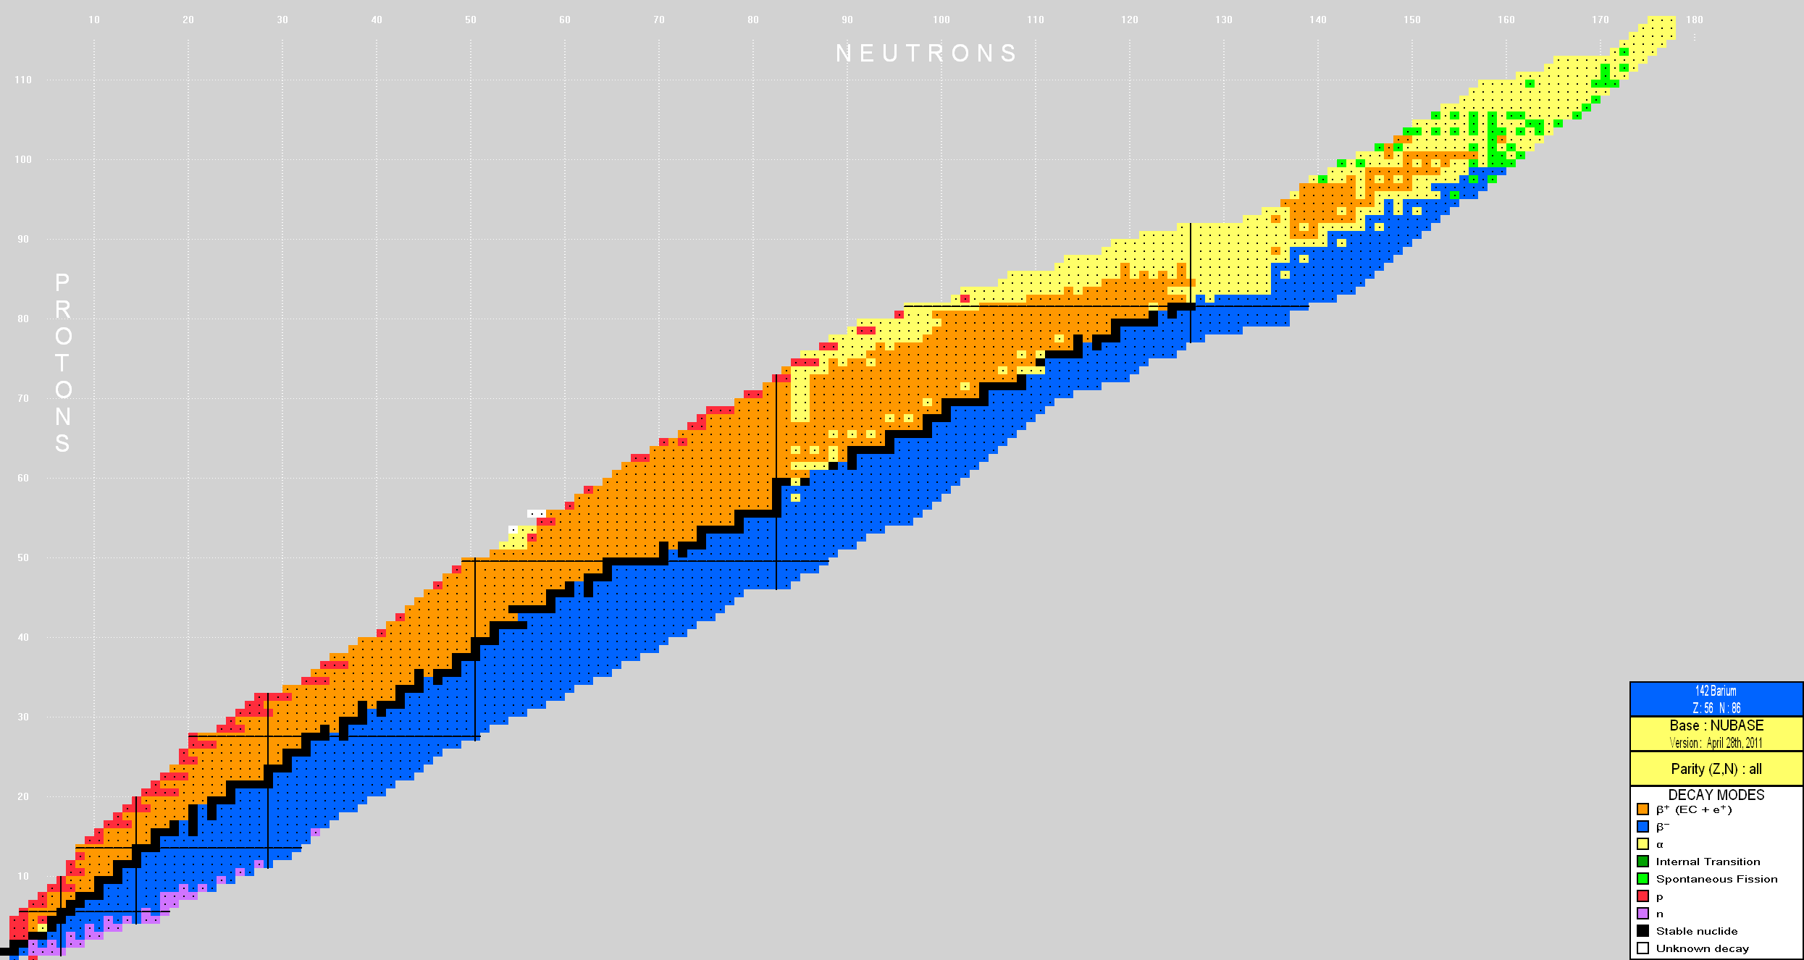
Recent mass measurements from ISOLTRAP
2 isotopes discovered in 3 years!!!
²²⁹Rn (2008) & ²³³Fr (2011)
²²²⁻²²⁹Rn
N = 134 subshell
^{96,97}Kr
Quantum nuclear phase transition
⁶¹⁻⁶³Fe, ⁵⁷⁻⁶⁶Mn
New island of inversion at N = 40

Slide 3
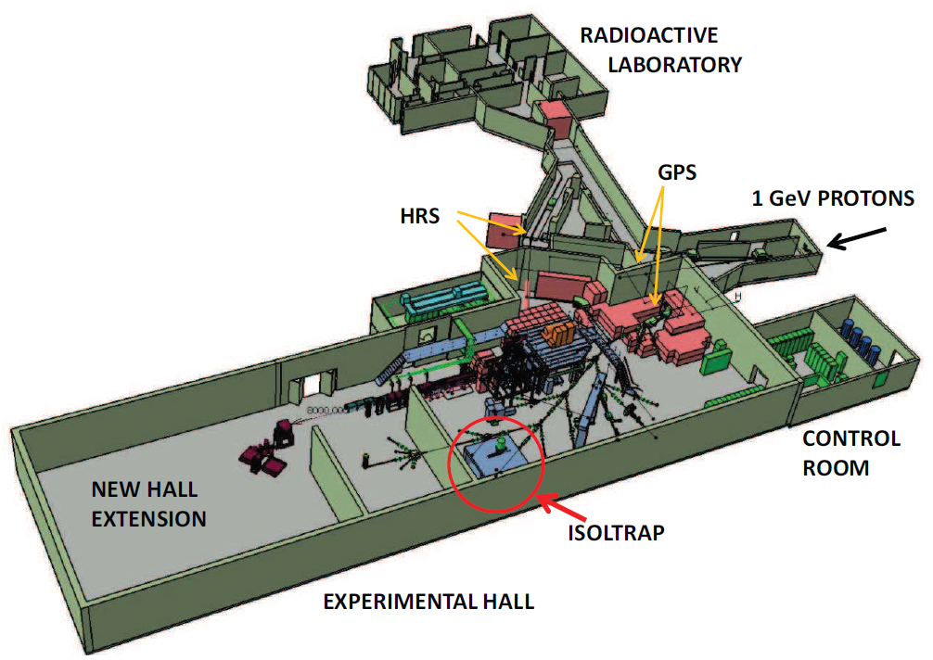
ISOLDE/CERN

Slide 4
Principle of mass determination in Penning trap
B
Superposition of strong magnetic field and weak electrostatic field
+
q/m
Measurement of cyclotron frequency

Slide 5
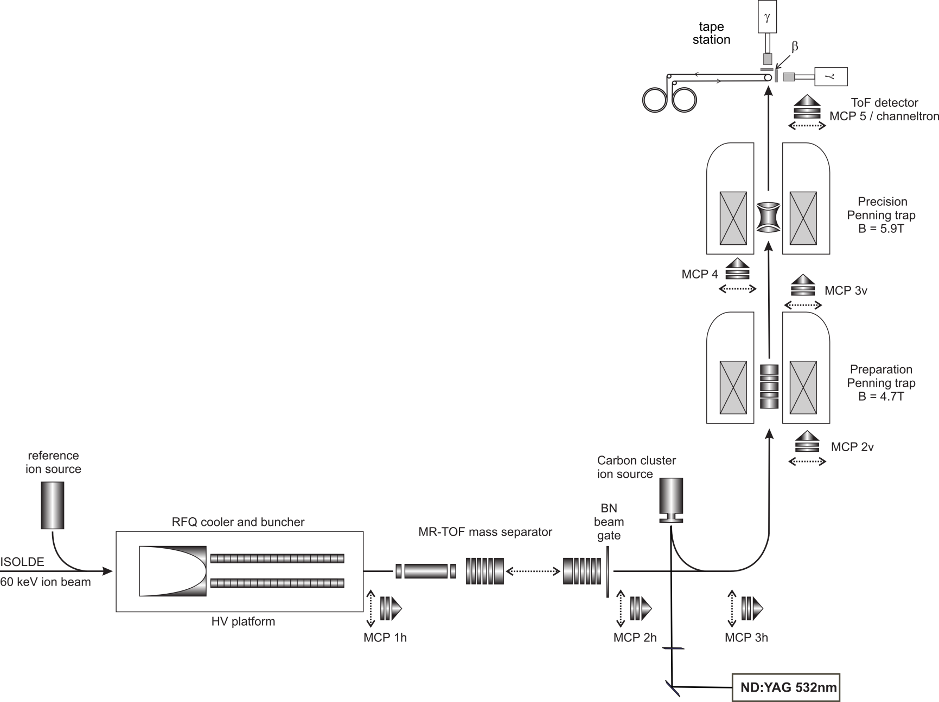
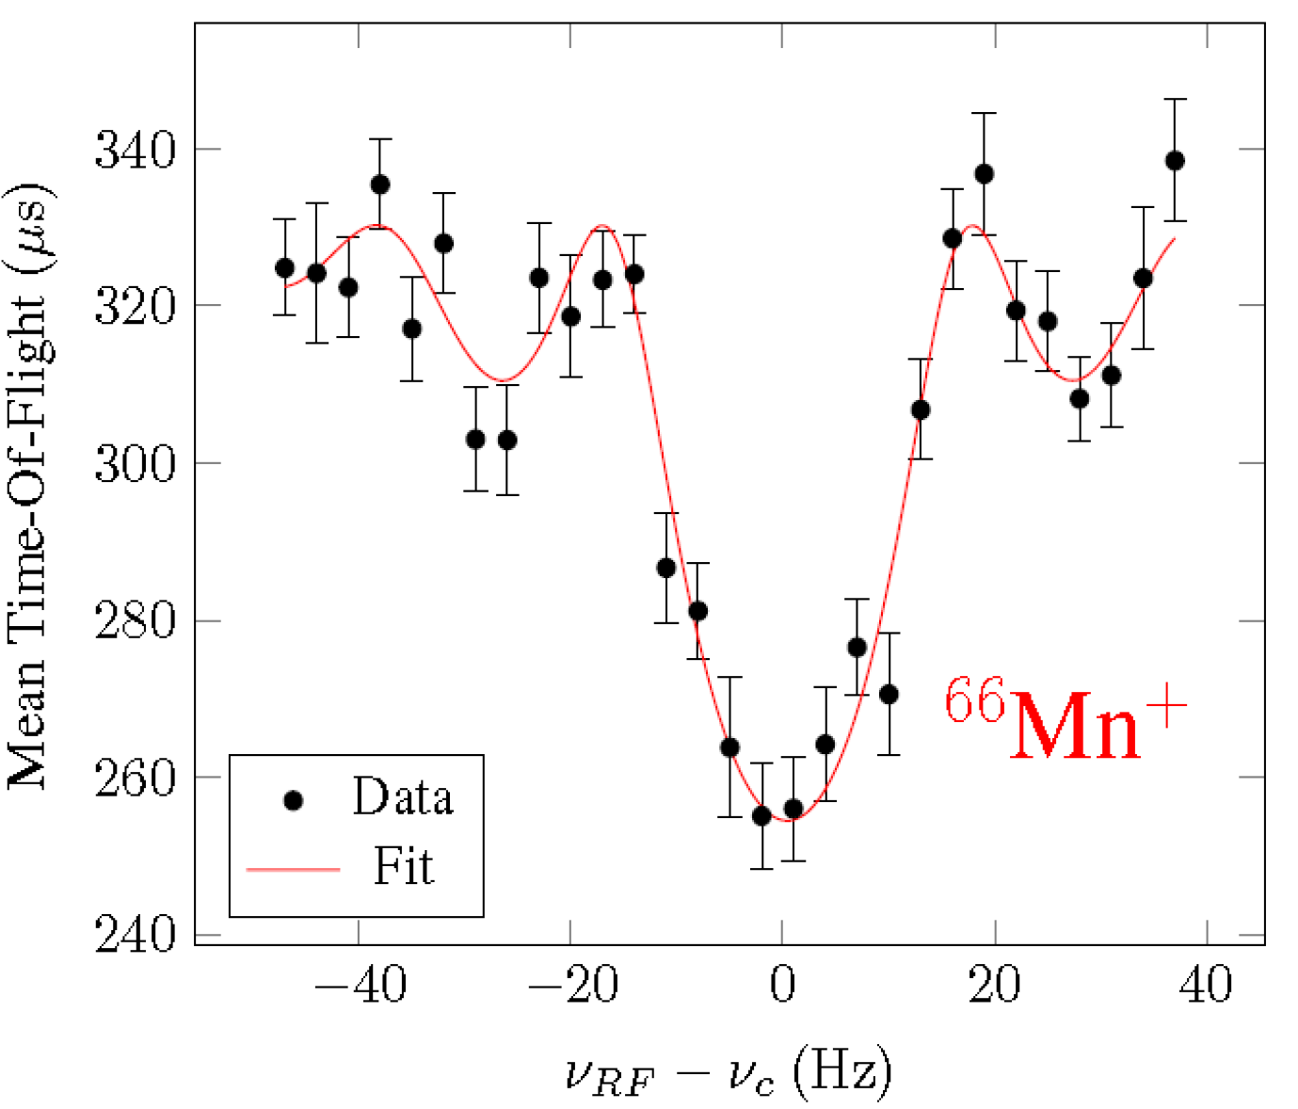
ISOLTRAP experimental setup
⁹⁷Kr : 63(3) ms (preparation trap)
⁶⁶Mn : 64.4(1.8) ms (Record at Isoltrap!!!)
determination of cyclotron frequency
(R = 10⁷)
removal of
contaminant ions
(R = 10⁵)
Mukherjee et al., Eur. Phys. J. A 35, 1 (2008)

Slide 6
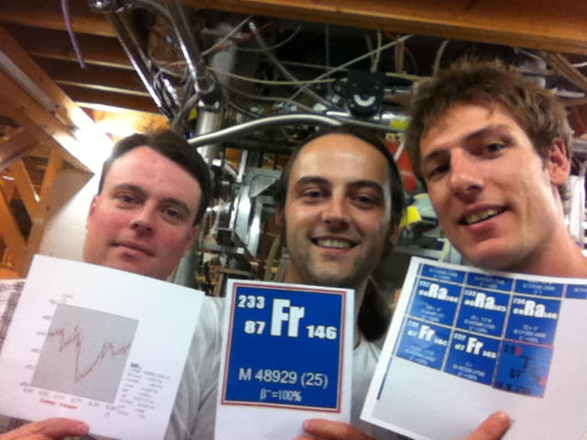
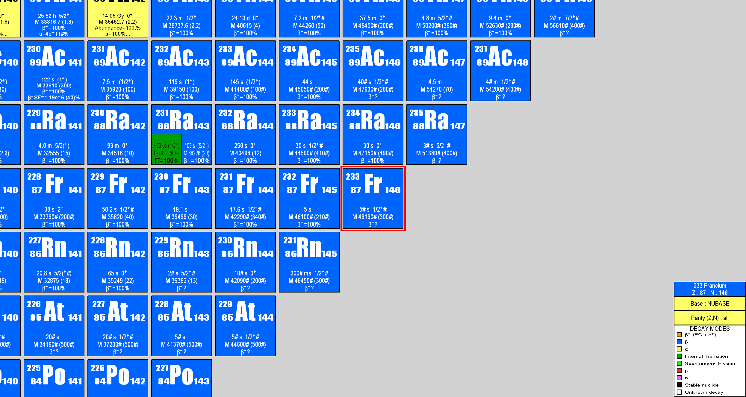
²³³Fr discovery (summer 2011)

Slide 7
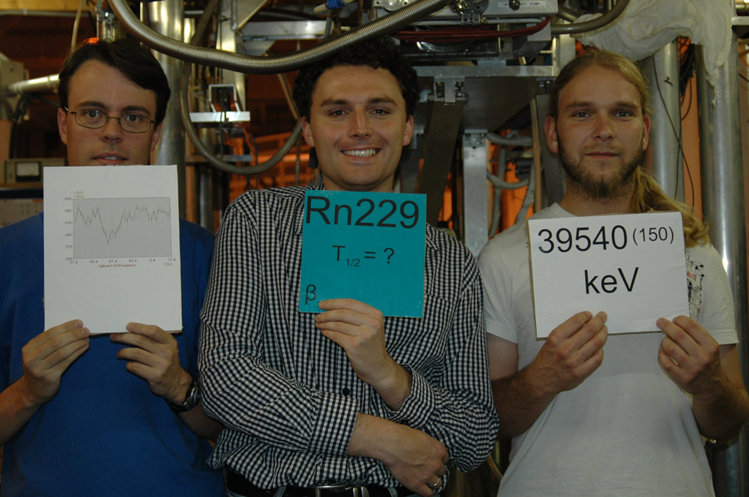
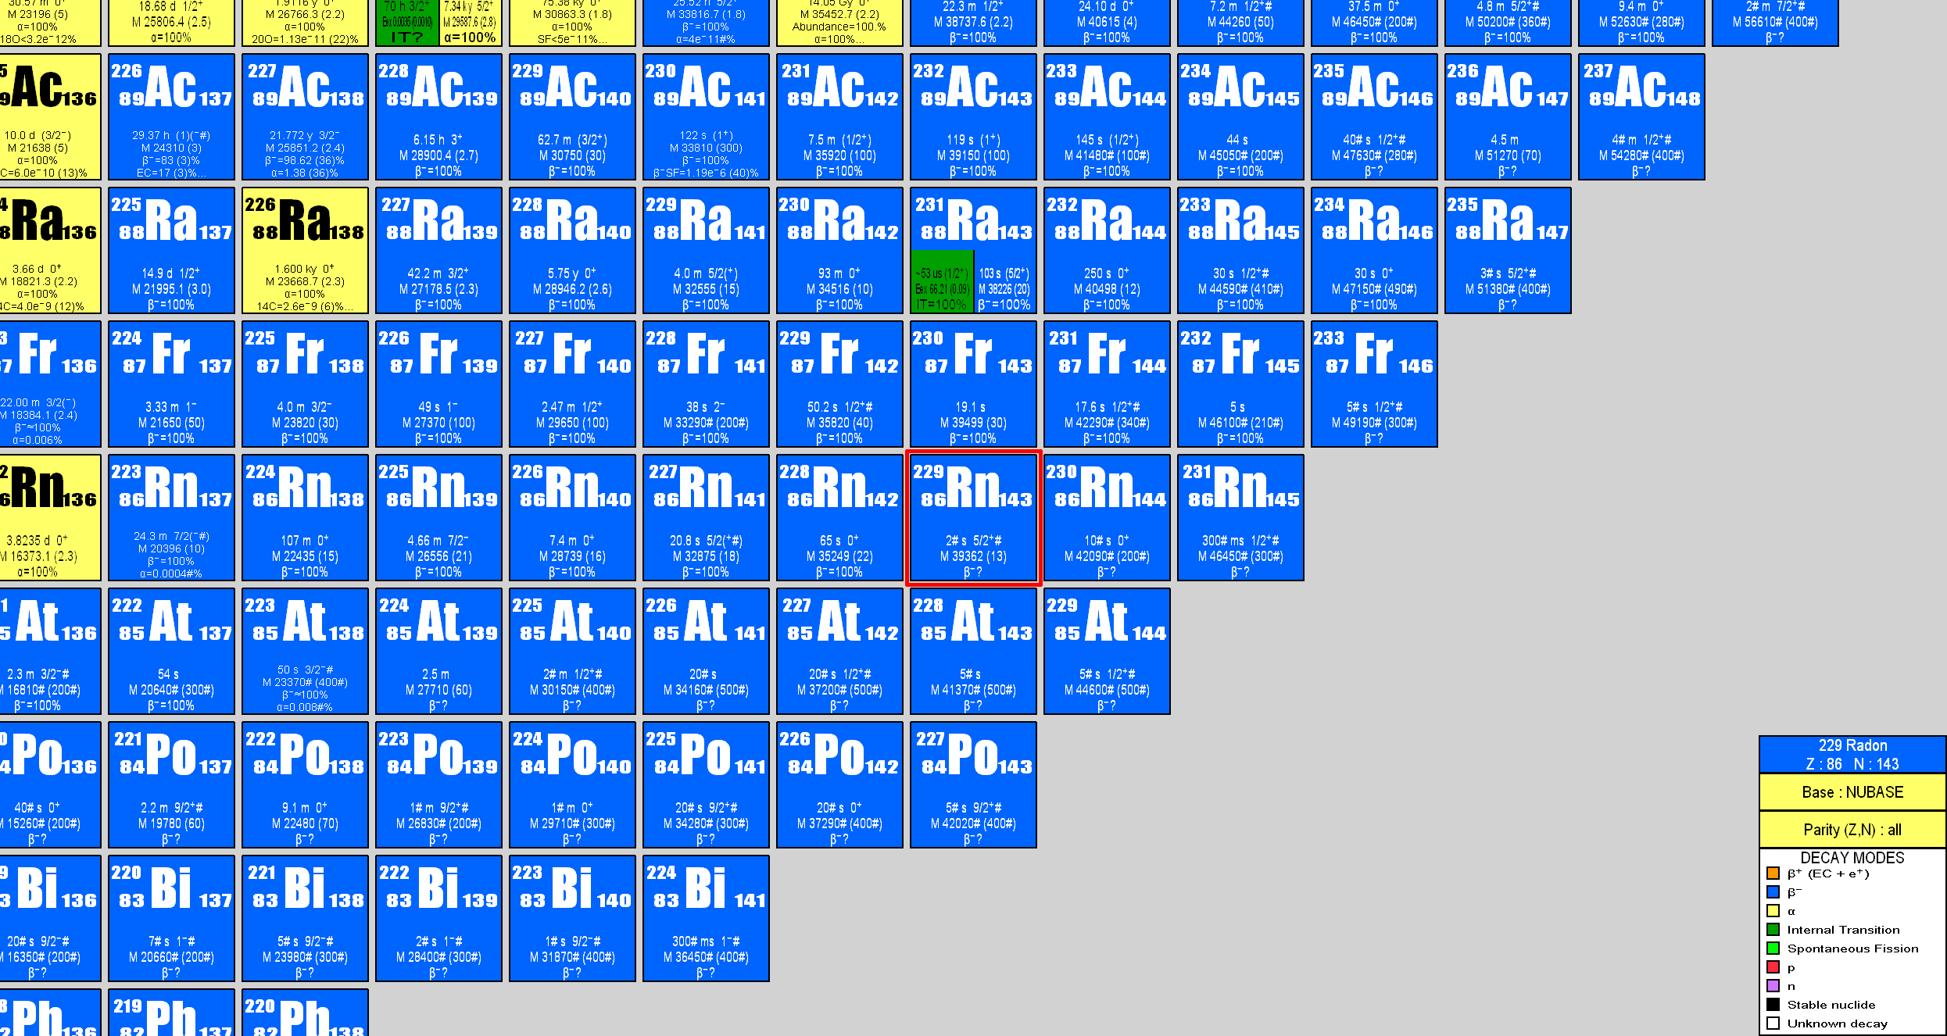
²²⁹Rn discovery (summer 2008)

Slide 8
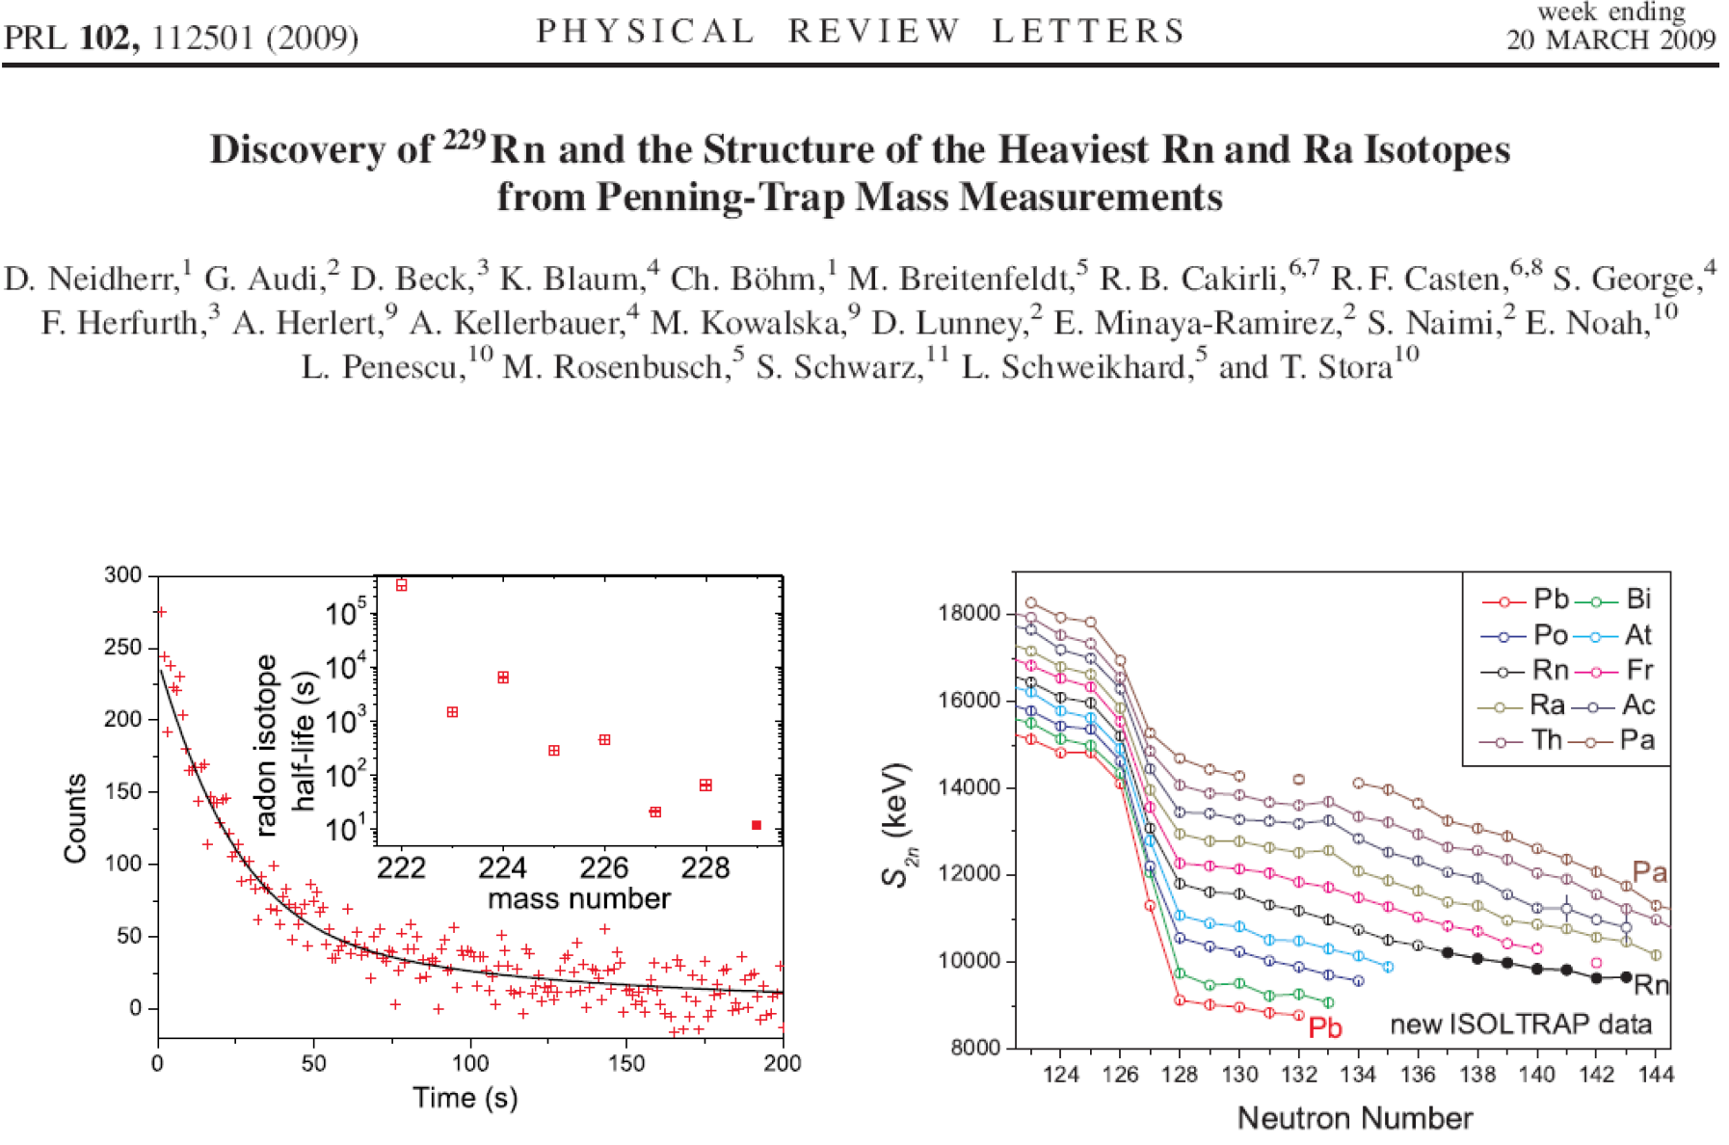
Confirm the singularity of odd-even δV_{pn} in the region of octupole correlations and subshell effect at N = 134

Slide 9
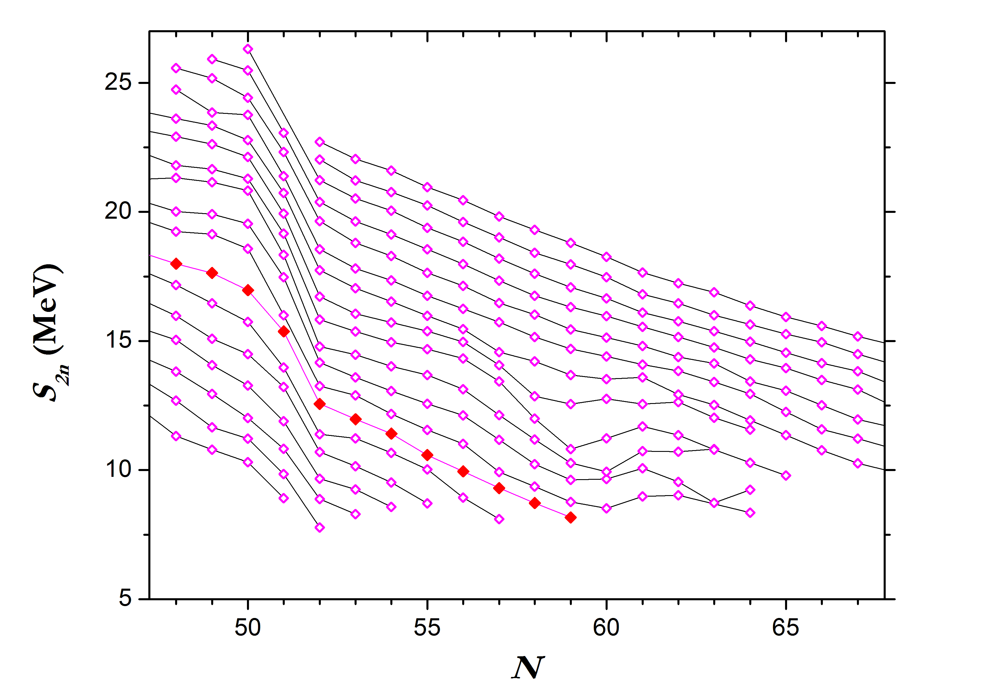
^{96,97}Kr: deformation at N = 60 ?
AME 2008
JYFL: Hakala et al. (2008)
ISOLTRAP:
Delahaye et al. (2006)
Baruah et al. (2008)
Kr
Quantum nuclear phase transition in IBM
Se
Ge
Zn
#
?

Slide 10
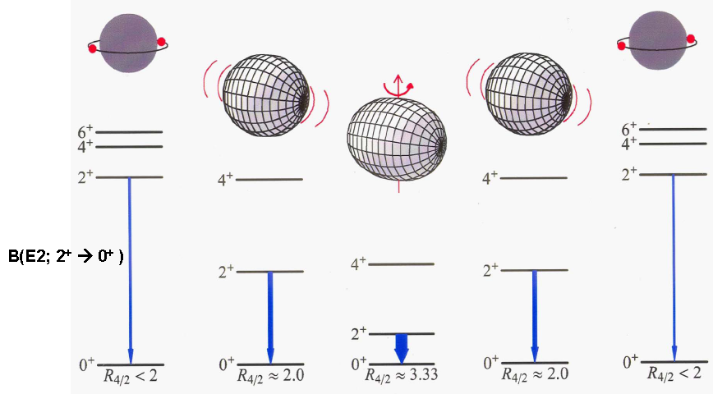
^{96,97}Kr: deformation at N = 60 ?
Experimental results
spectra from CLARA and PRISMA spectrometer
N. Mărginean et al. PHYSICAL REVIEW C 80, 021301(R) (2009)
241-keV gamma ray : 2⁺₁ 0⁺_{g.s} transition
⁹⁶Kr deformed

Slide 11
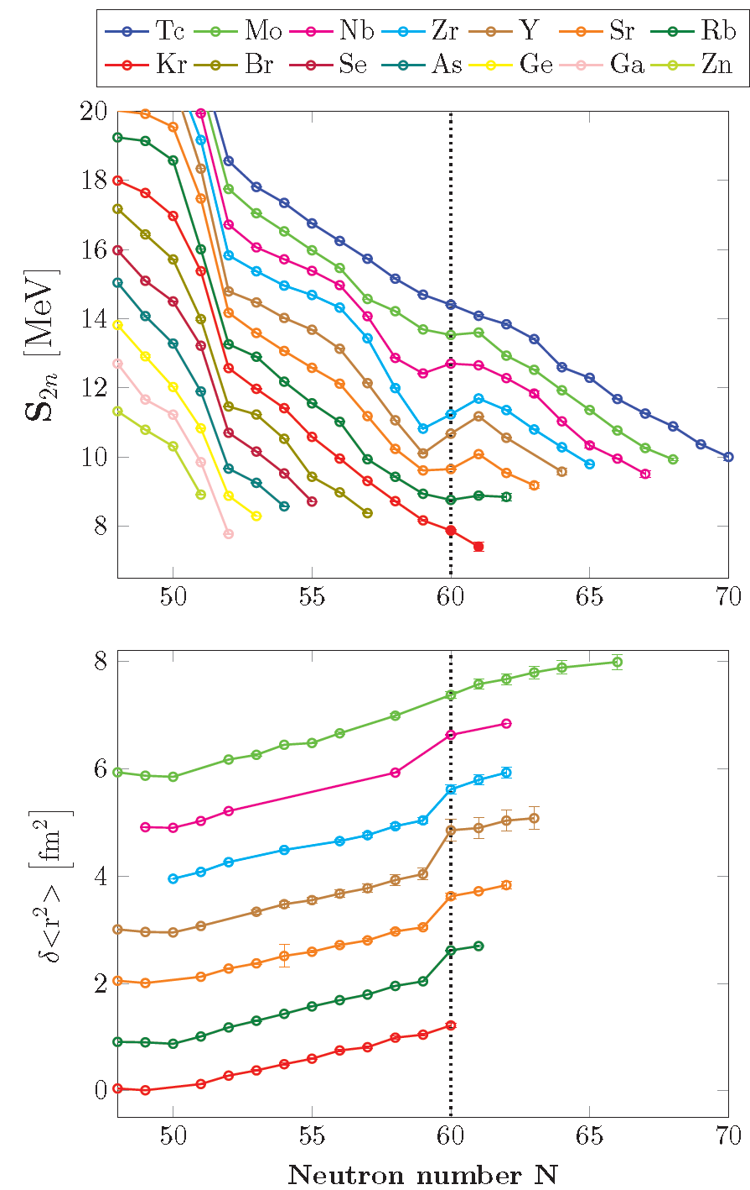
^{96,97}Kr: deformation at N = 60 ?
Kr isotopic chain marks the end of the quantum nuclear phase transition.
Naimi et al. PRL 105 (2010).
Our result is consistent with laser spectroscopy measurement:
Keim et al. Nucl. Phys. A 586 (1995).

Slide 12
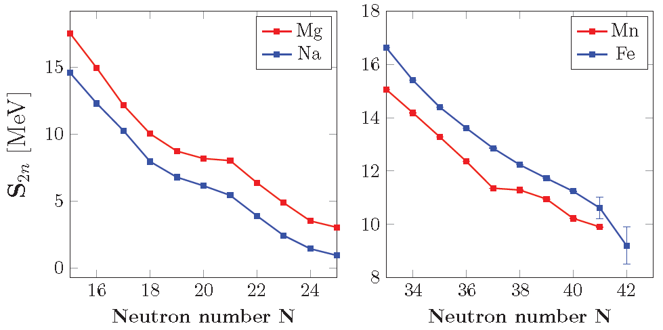
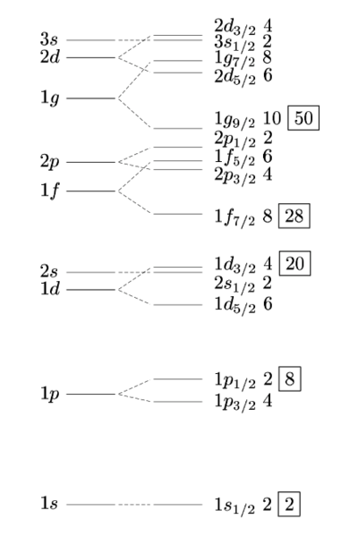
New island of inversion at N = 40
Promotion of neutrons to higher shell.
Vanishing of N = 20 shell closure.
C. Thibault et al. Phys. Rev. C 12, 644 (1975).
Same phenomenon around N = 40.
Ljungvall et al. Phys. Rev. C 81 (2010).
Lenzi et al. Phys. Rev. C 82 (2010).

Slide 13
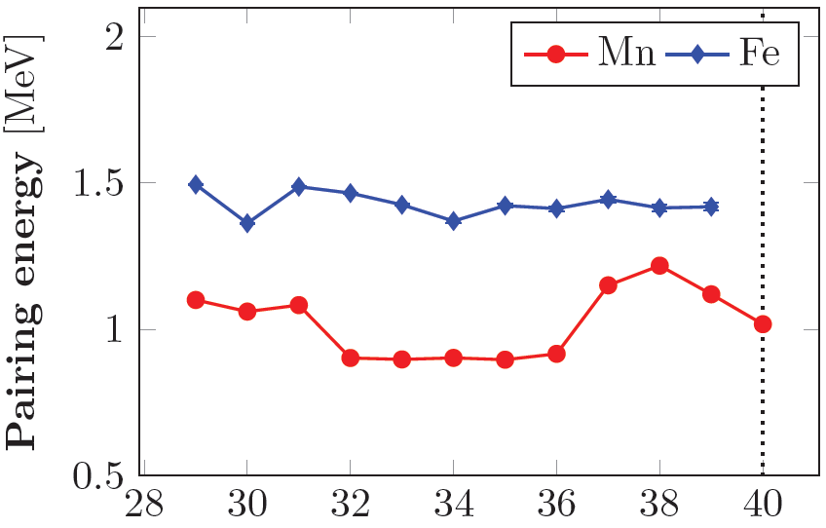
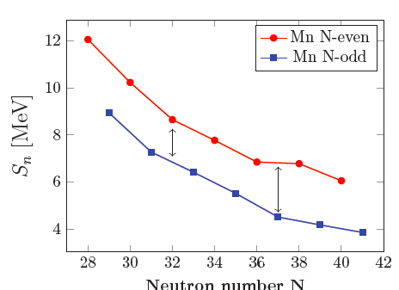
New island of inversion at N = 40
Gaudefroy et al. Eur. Phys. J. A 23 (2005)
Mn T_{1/2} longer than expected when
using only the pf shell to reproduce
the experimental half-lives.
0.5 MeV
g 9/2
40
p 3/2
f 5/2
P 1/2
p 1/2
f 5/2
p 3/2
28
f 7/2
f 7/2
protons
neutrons
Pair scattering to higher shell favored by pairing effect.

Slide 14
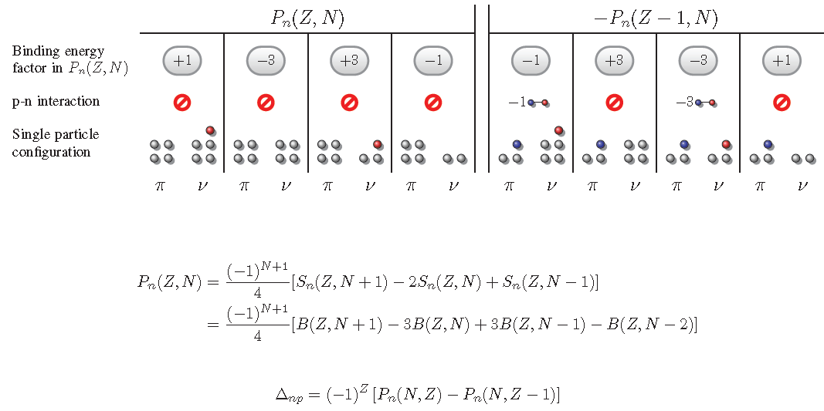
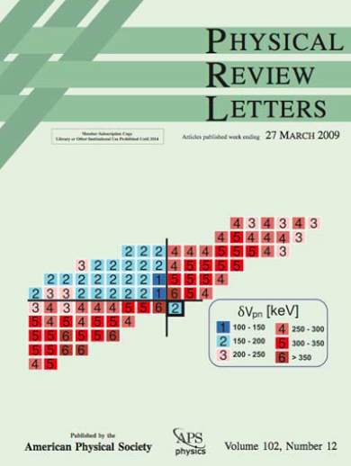
Pairing and proton-neutron interaction
Fe
Mn
In collaboration with G. Audi, M. Wang and X. Xu

Slide 15
Summary and outlook
²³³Fr & ²²⁹Rn discoveries thanks to ISOLDE development.
²²³⁻²²⁹Rn: interesting region of octupole correlations & N = 134 subshell.
^{96,97}Kr: end of the quantum shape/phase transition region around N = 60.
⁶¹⁻⁶³Fe & ⁵⁷⁻⁶⁶Mn: New island of inversion at N = 40.
“Recycled” proton-neutron interaction formula -> new window on the contribution of nuclear masses to the nuclear structure.
Pushing the frontier further:
  ISOLDE developments -> new/pure beams available.
  MR-ToF mass separator: very fast mass measurements, enhancement of the beam purity.
  Tape station: beta-gamma spectroscopy on isobaric and isomeric pure beam.

Slide 16






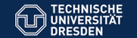

Thanks to ISOLDE and ISOLTRAP collaboration
G. Audi, D. Lunney, V. Manea, M. Wang
K. Blaum, Ch. Böhm, Ch. Borgmann, R. B. Cakirli,
S. Eliseev, S. Kreim
D. Beck, F. Herfurth, J.-H. Kluge, E. Minaya-Ramirez, D. Neidherr
G. Marx, M. Rosenbusch, L. Schweikhard, F. Wienholtz, R. Wolf
T. E. Cocolios, A. Herlert, M. Kowalska
J. Stanja, K. Zuber
S. George, S. Schwarz
M. Breitenfeldt

