Slide 1
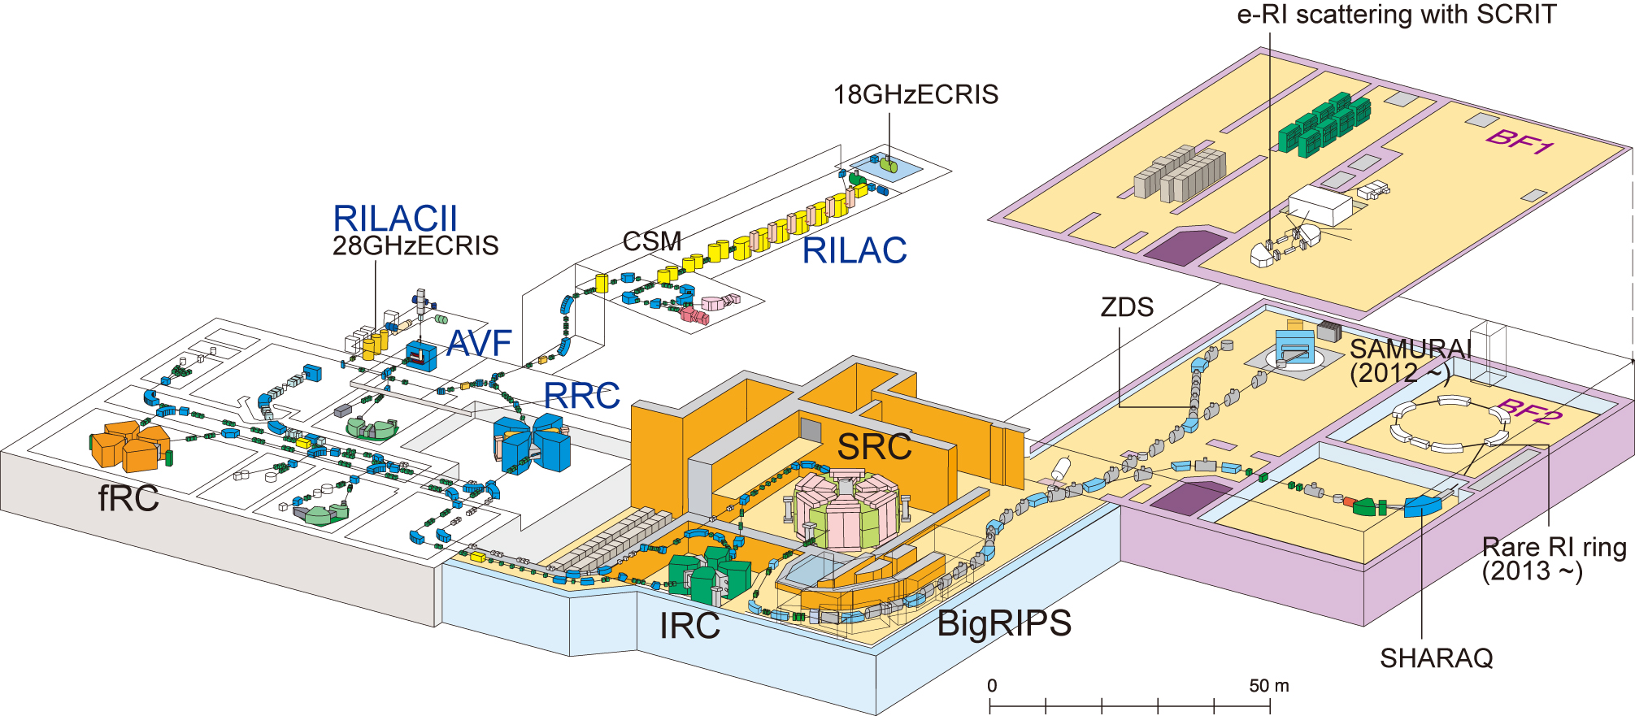
Design of Rare-RI Ring
A/Z=3
- measurable with one particle
- 1ms for measurement time
Rare-RI Ring
Yoshitaka Yamaguchi

Slide 2
Conceptual design
1. Self-trigger individual injection
2. Precise isochronous condition
transmission cable
identification
dE, E
SRC
trigger signal
power
supply
Kicker
Isochronous
ring
δB₀/B₀ ~ 10⁻⁶
F0
selection
Bρ, TOF
F3
particle
magnet
BigRIPS
β measurement
δβ/β ~ 10⁻⁴
δT/T < 10⁻⁶
Injection line
200 MeV/u
1. Fast response kicker system
2. Precisely tuned isochronous ring

Slide 3
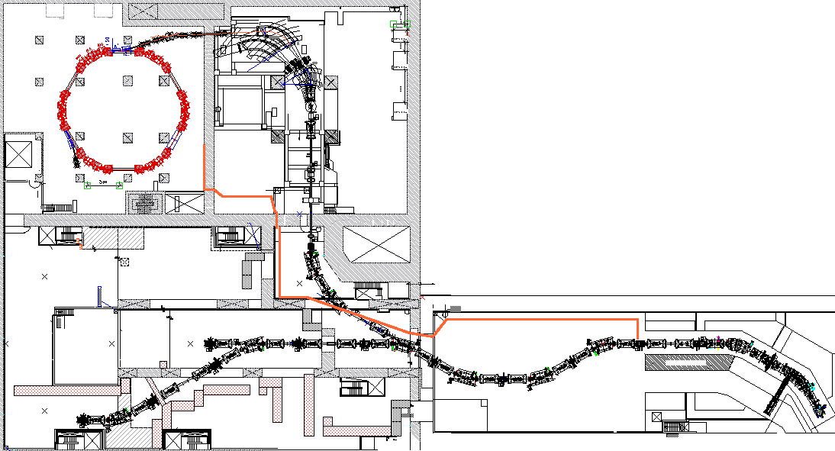
Overall design
Self-trigger individual injection condition
SHARAQ
Flight time : 945ns (200MeV/u,161.5m)
Time taken for kicker excitation : 930ns
kicker
FH10
Response time of kicker power supply : 275ns.
Delay from thyratron out
to flat-top center : 230ns
→ A. Tokuchi
370ns (105m)
55ns
BigRIPS
F3
F0

Slide 4
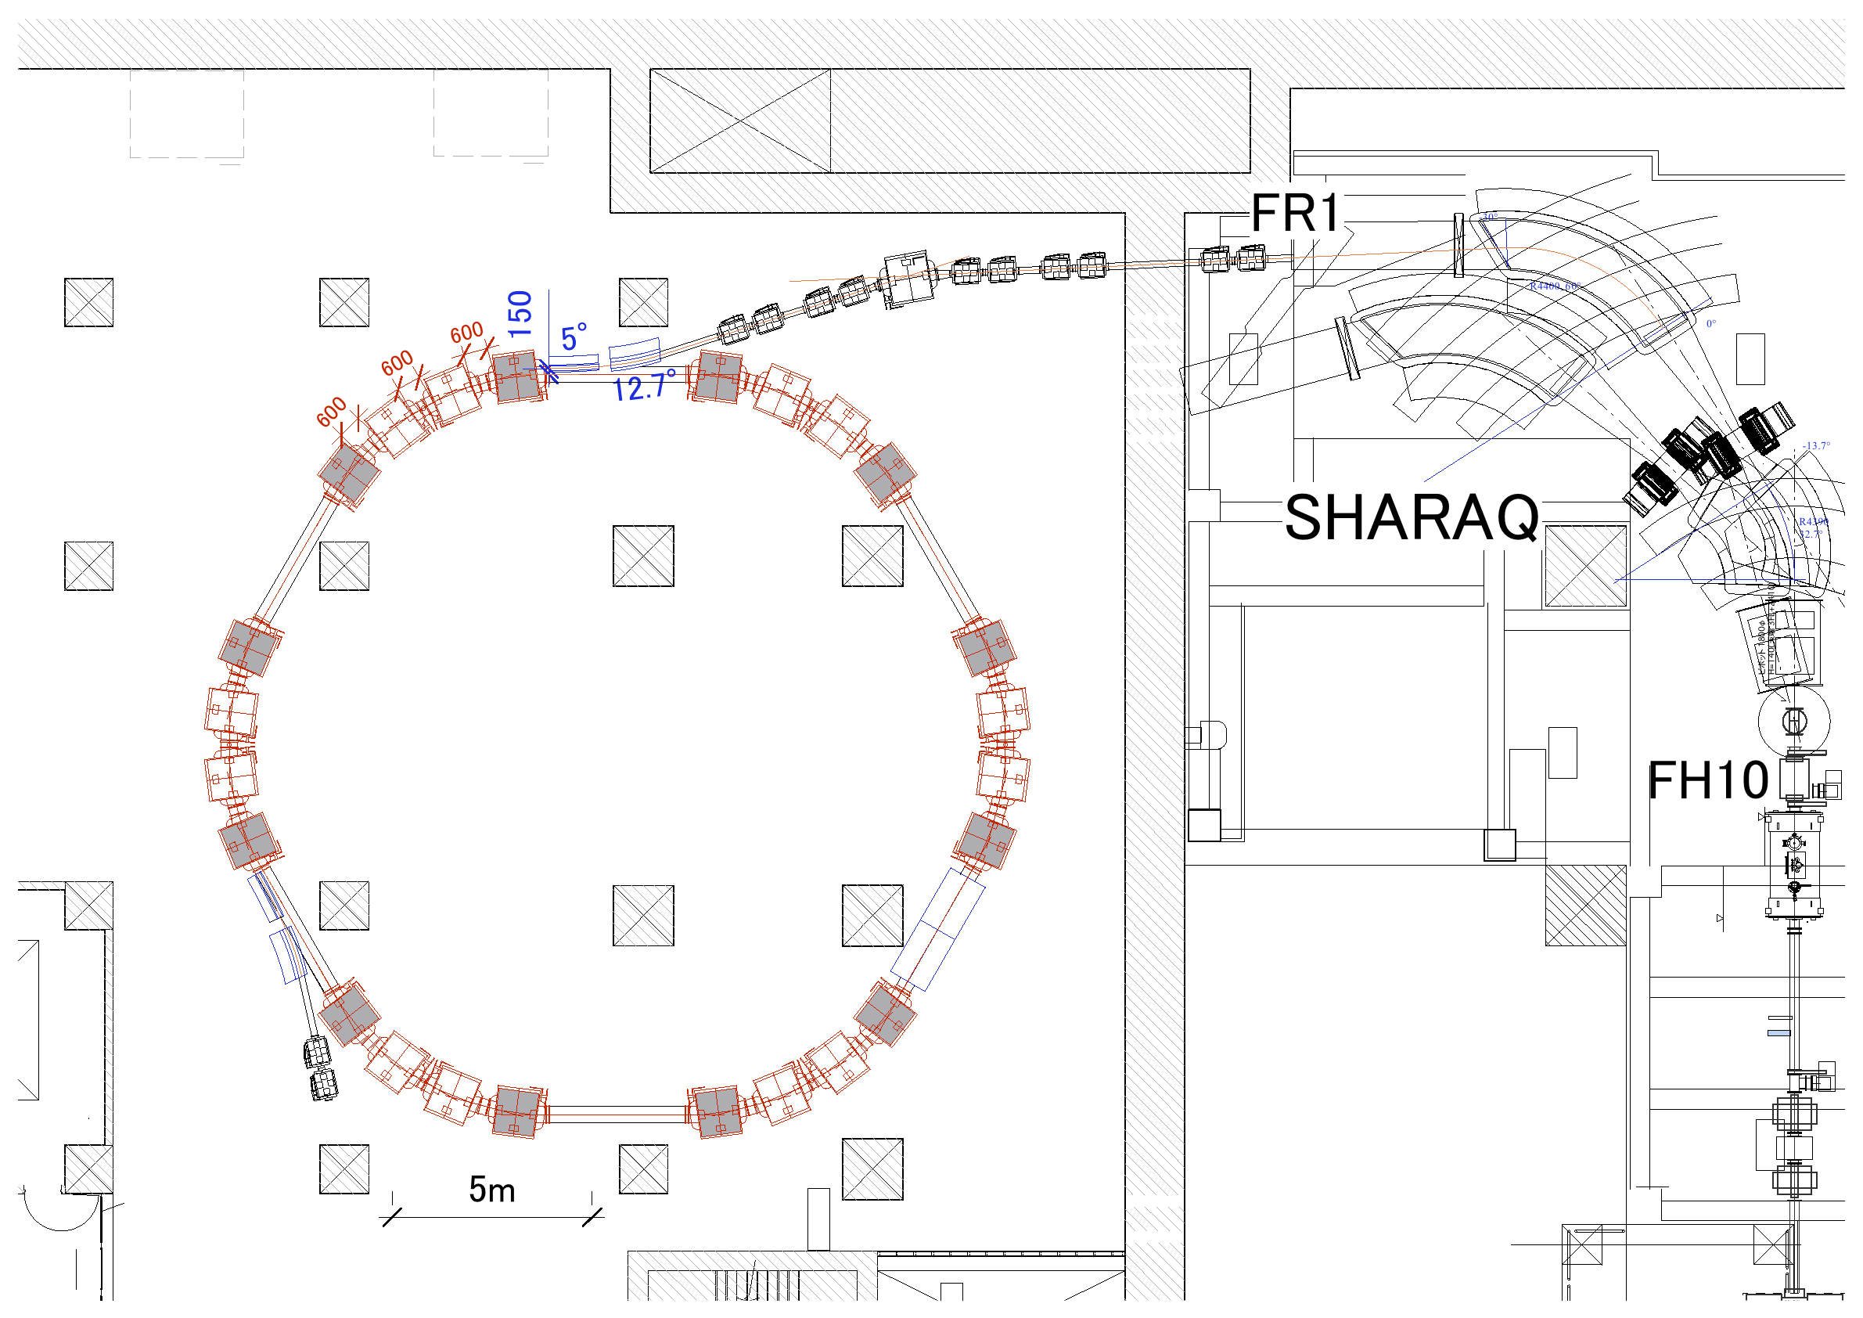
Floor arrangement plan
Injection line
2
1
Septum
SHARAQ
Isochronous Ring
Kicker

Slide 5
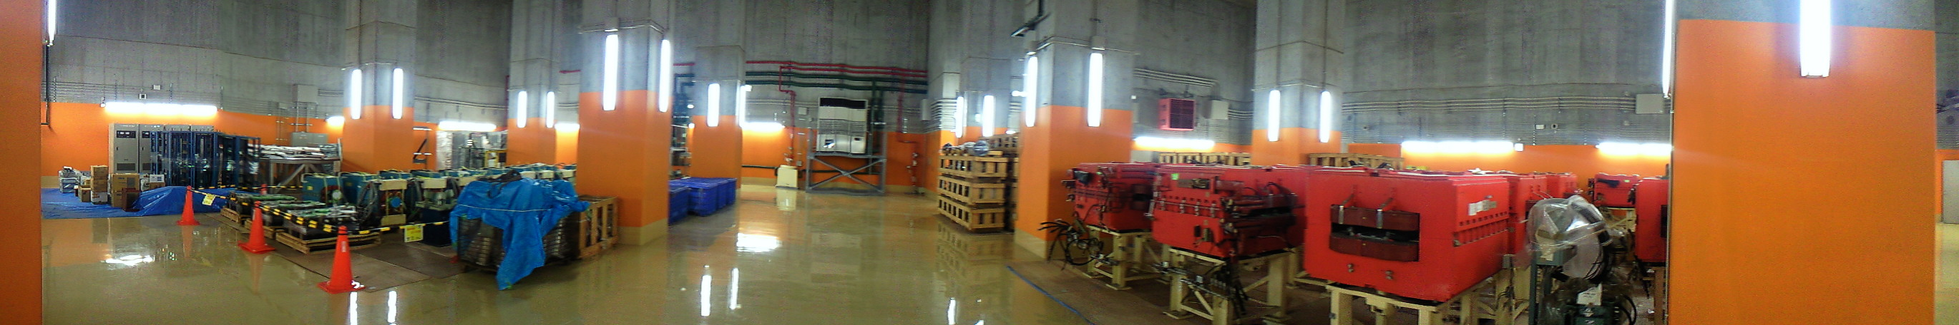
Specification for magnets
TARNII-D KEK-PS-Q
- Gap, Bore Diameter (mm) : 80 100
- Length (m) : 1.0 0.6
- B (T) , B’ (T/m) : 1.6 18.0
Main
Power Supply
- Type : septum-1 2
- Bending angle (degree) : 12.7 5.0
- Radius of curvature (m) : 5.73 14.3
- B (T) : 1.12 0.45
- Current (A) : 2750 2750
Sub PS
Septum-1
Septum-2

Slide 6
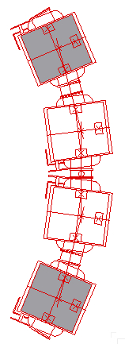
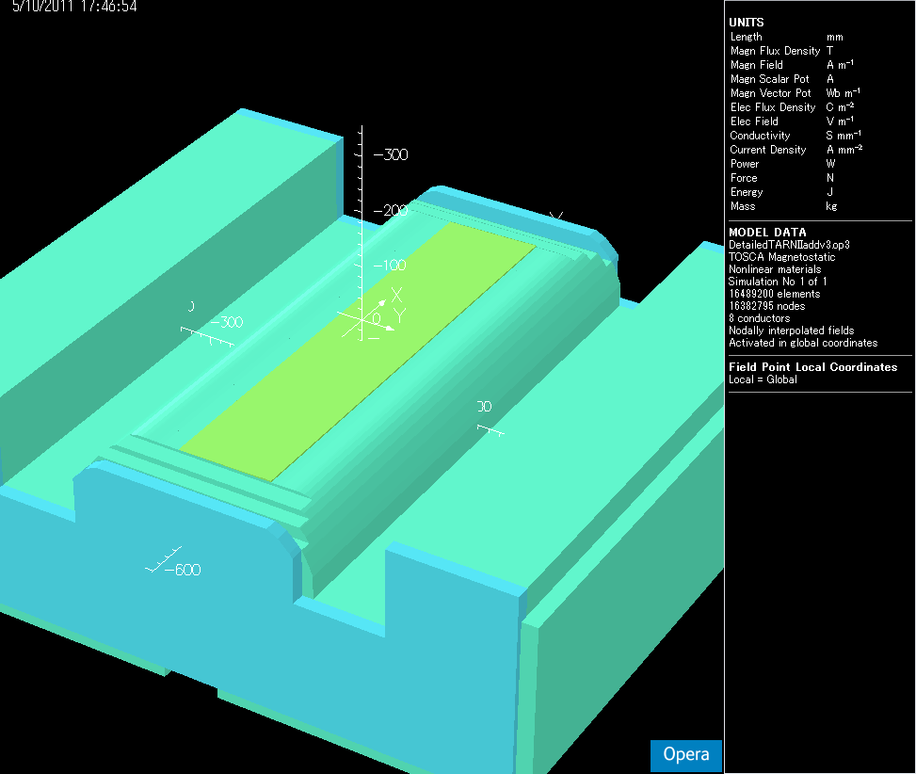
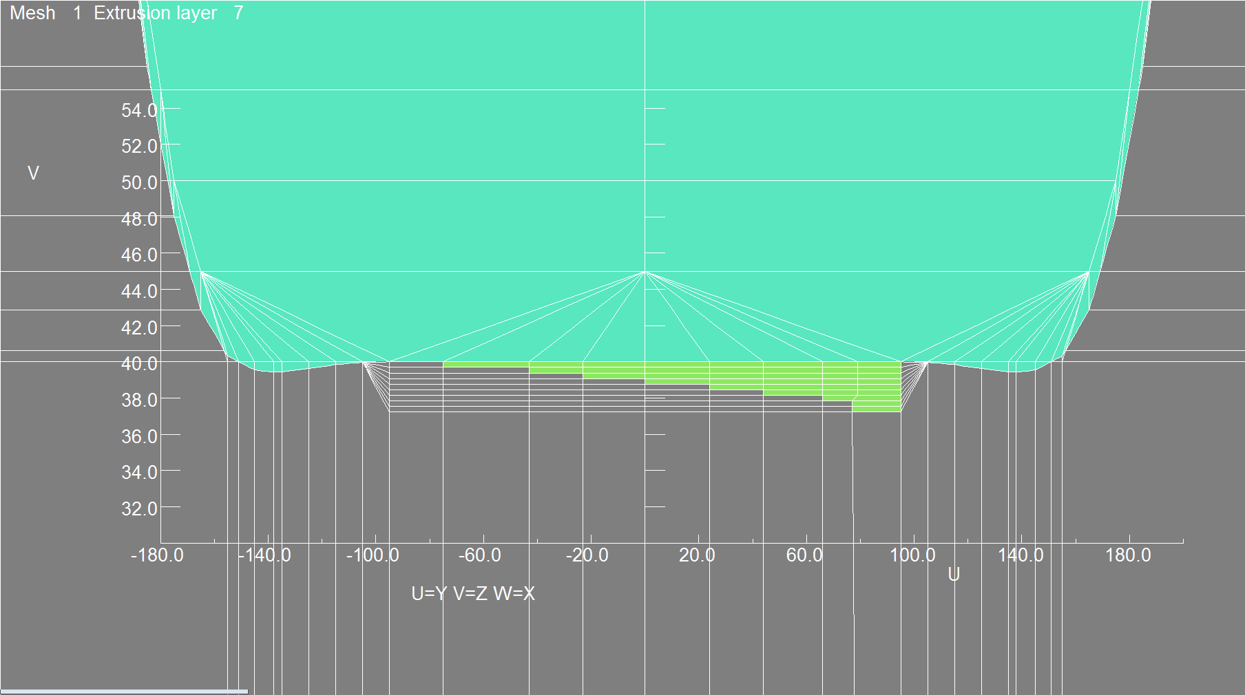
Isochronous design
Key components :
・ Laminated iron plate
・ Trim-coils
For two outer dipoles
Laminated iron plate
Laminated iron plate
40mm
- thickness of 0.3mm
- 9 layers

Slide 7
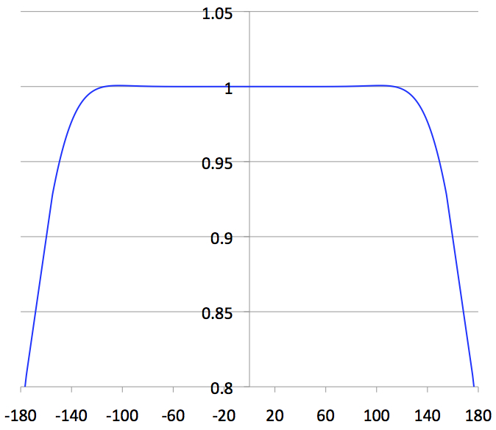
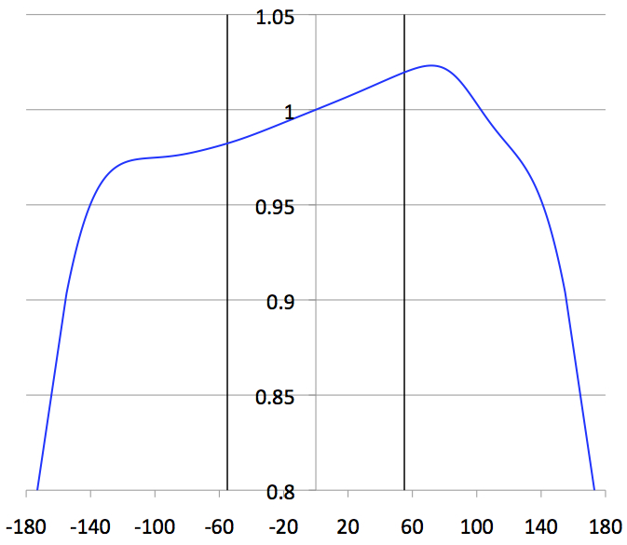
Isochronous design
normal
B(r)/B₀ [T]
modified
B(r)/B₀ [T]
r [mm]
r [mm]
Radial distributions of magnetic field strength

Slide 8
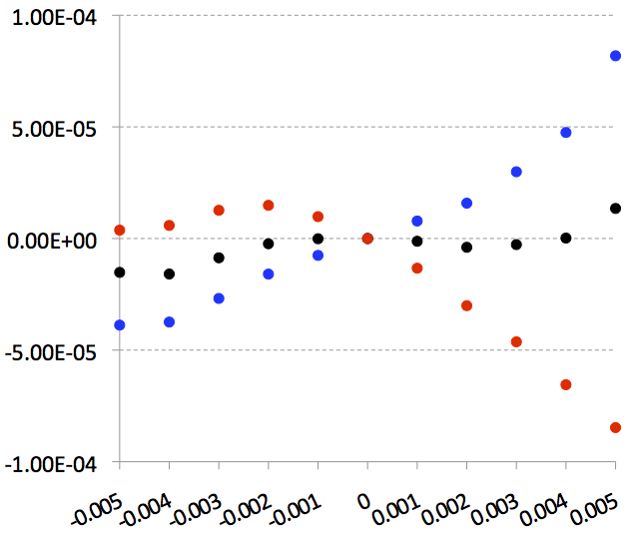
Isochronous design
Shape of laminated iron plate is optimized at 1.5 Tesla.
δT/T₀
m/q= 2 ~ 3
B₀: 1.0T ,1.6T
after 2000 turns
dp/p
δB₀/B₀ < 10⁻⁴ at 1% momentum spread

Slide 9
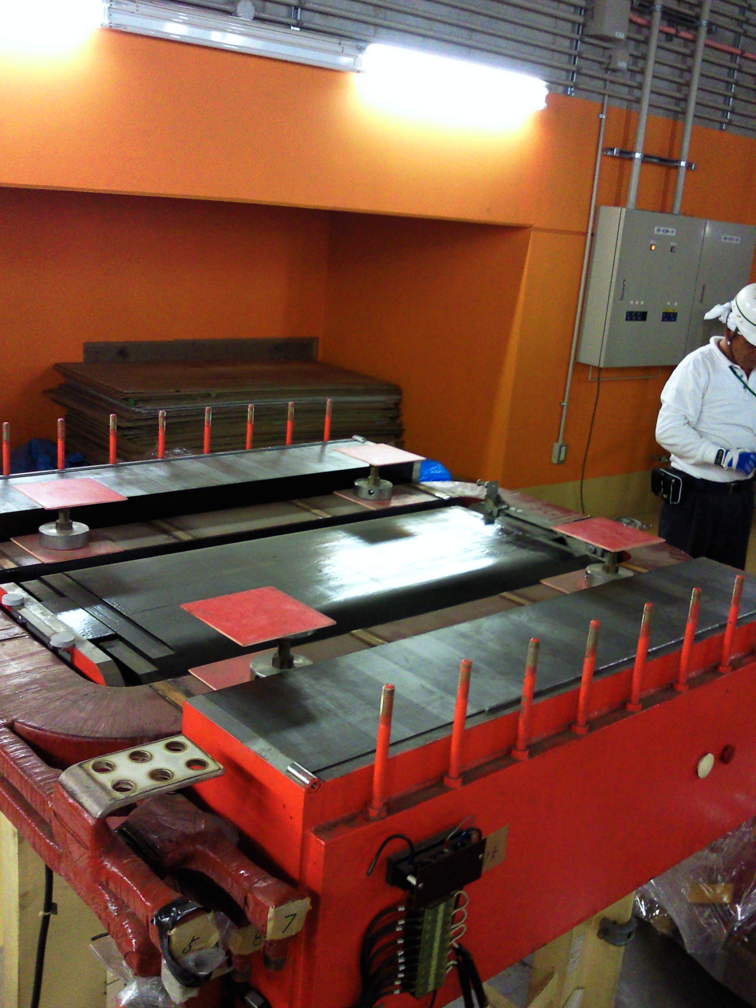
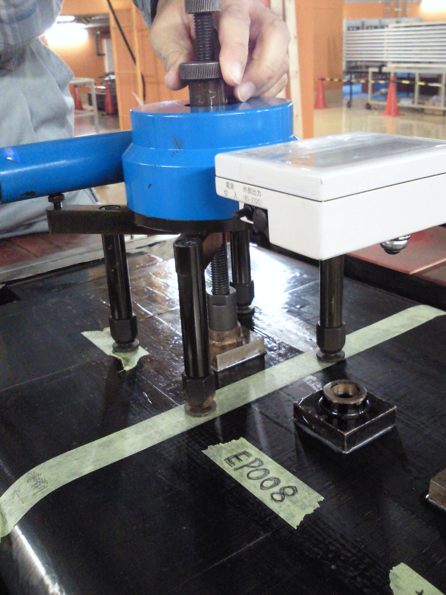
Field measurement preparation
Test of tensile strength of Epoxy resin adhesive (EP007, EP008) with CEMEDINE CO., LTD.
- Tensile strength : ~ 10 N/mm²
- Magnetic attraction force
in 1.6 Tesla : 1.02 N/mm²

Slide 10
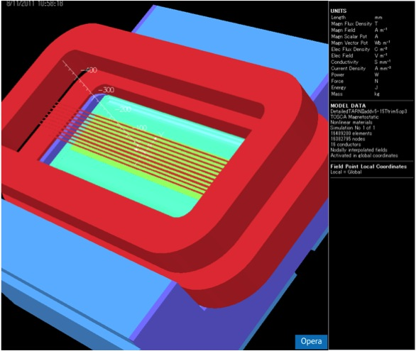
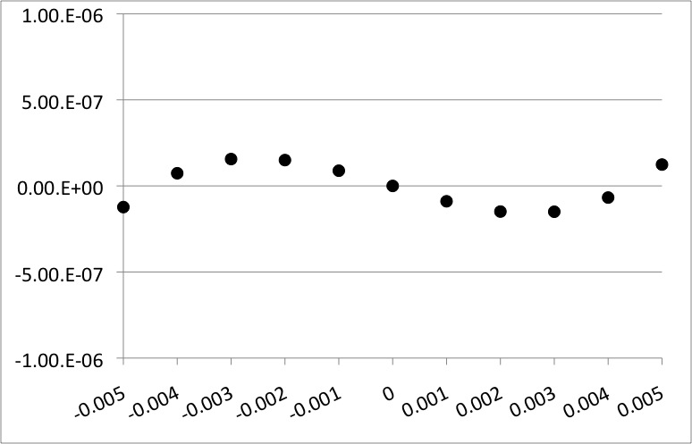
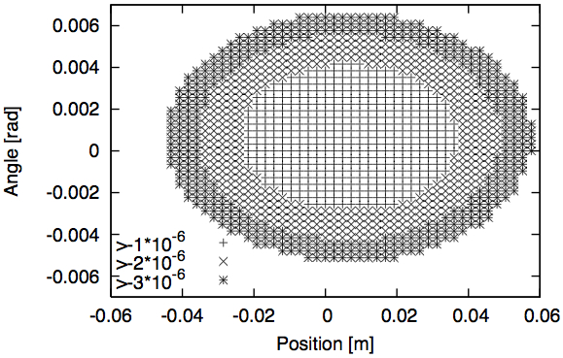
Isochronous design
Trim-coils
The placement is not yet decided !
Simulation result (in ideal case)
→ H. Suzuki
δT/T₀
~100π mm mrad
(vertical ~25π)
dp/p
δB₀/B₀ < 10⁻⁶
at 1% momentum spread
eigen-ellipse
Ensure δB₀/B₀ ~ 1x10⁻⁶ at any momenta

Slide 11
Specification of isochronous ring
- Beam energy : 200 MeV/u
- Lorentz factor γ : 1.2147
- Circumference : 60.3507 m
- Momentum acceptance : 1.0%
- Harmonics : 13
- Revolution frequency : 2.82 MHz
- Revolution time : 355 ns
- Betatron tune : Q_{x} = 1.22 , Q_{y} = 0.88
- Max. β fuction : β_{x} = 8.1 m , β_{y} = 12.5 m
- Dispersion of straight part : 66.91 mm/%

Slide 12
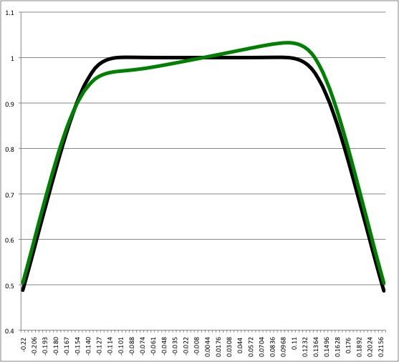
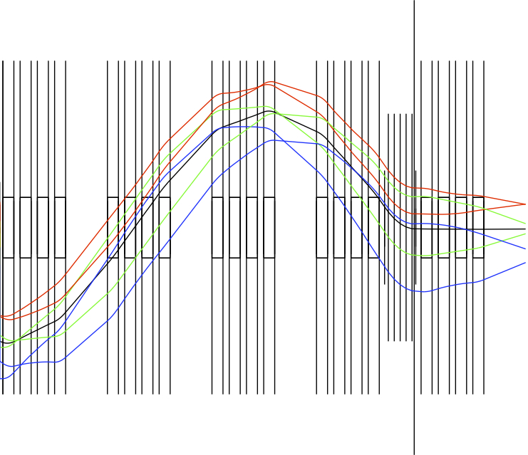
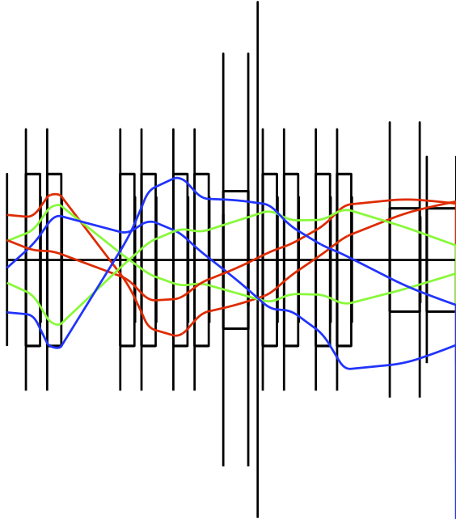
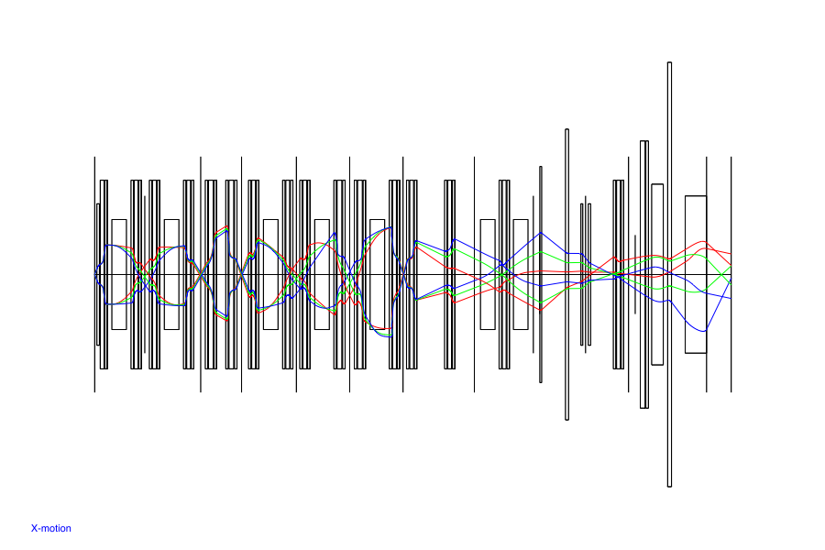
Optics design for injection
B(r)/B₀ [T]
a₀ = ±15mrad
dp/p = -0.5%, 0.0%, 0.5%
(200MeV/u,m/q=3)
2 outer dipoles
2 inner dipoles
radial distributions
of magnetic field strength
Injection point
SHARAQ
High-resolution
beam line
BigRIPS
Kicker
F0
F3
F5
FH7
FH10
FR1
Injection line
Septum
1,2
FR1
- Kick angle is 19mrad
- Dispersion matching
Isochronous ring

Slide 13
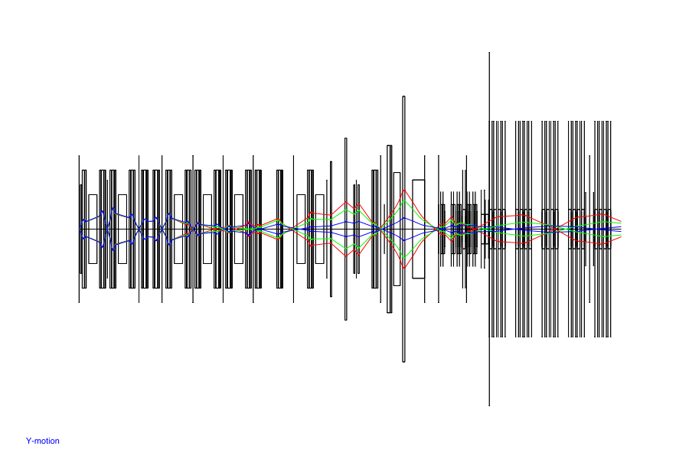
Optics design for injection
SHARAQ
Kicker
High-resolution
beam line
Injection line
b₀ = ±10mrad
BigRIPS
F0
F3
F5
FH7
FH10
FR1
Isochronous ring

Slide 14
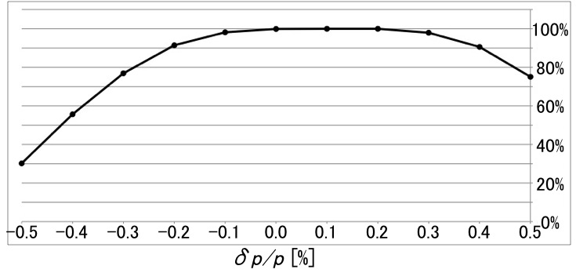
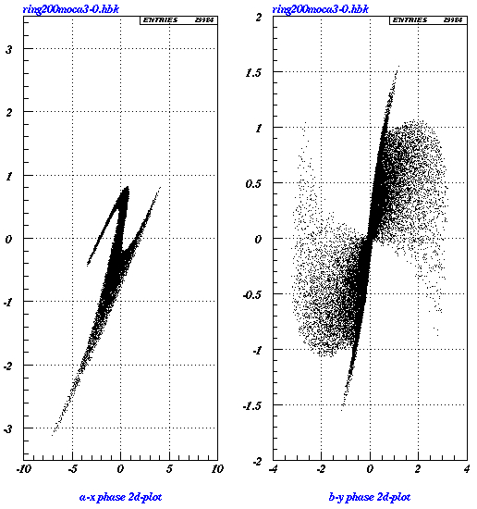
Optics design for injection
for dp/p=0 particles
10π mm mrad
Optical transmission efficiency
30π mm mrad
a [mrad]
b [mrad]
eigen-ellipse
~100π mm mrad
eigen-ellipse
~25π mm mrad
x [cm]
y [cm]

Slide 15
Specification of kicker magnet
- Type : distributed type
- Kick angle : 19 mrad
- Number of Kicker : 5
- Kick angle / 1kicker : 3.8mrad
- Field strength : 0.05818 Tesla
- Aperture : h=50 mm, w=150 mm
- Impedance : 12.5 Ω
- Number of cell / 1kicker : 14
- Effective length / 1kicker : 0.42 m
- Inductance / 1cell : 57 nH
- Capacitance / 1cell : 230 pF
- Propagation time / 1cell : 5.06 ns (including stray 25%)
- Propagation time / 1kicker : 70.84 ns
- Charging voltage : 60 kV
- Current : 2400 A
- Repetition : 1Hz ~ 100Hz

Slide 16
Summary
- We developed the fast response kicker system. Because the
time taken for kicker excitation faster than the flight-time of
particle, we will be able to use the self-trigger individual
injection method with an energy of 200 MeV/nucleon.
- We decided the ring design which ensure the isochronism
of 10⁻⁶ at 1% momentum spread. The shape of the laminated
iron plate is decided. The remaining task is to ﬁx the
placement of trim-coils.
Thank you very much for your attention !

