Slide 1
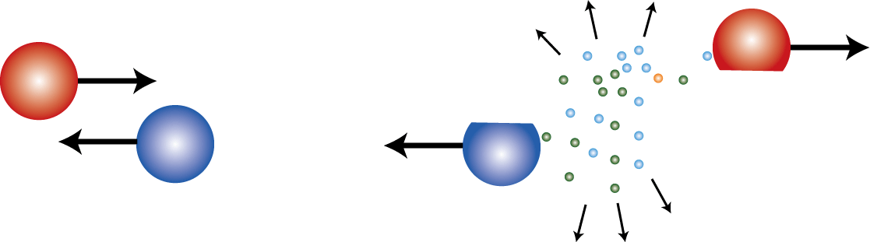
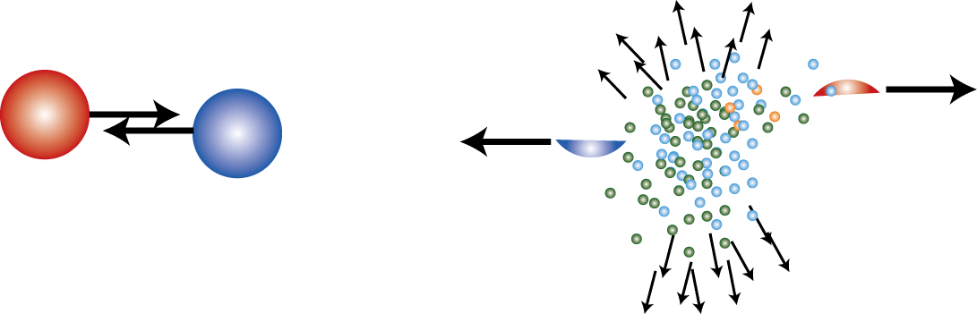
パイ測定と対称エネルギー
Pion Ratios and ESYM
Department of Physics
Kyoto University
Tetsuya MURAKAMI

Slide 2
状態方程式を語るときに
Useful Notations

Slide 3
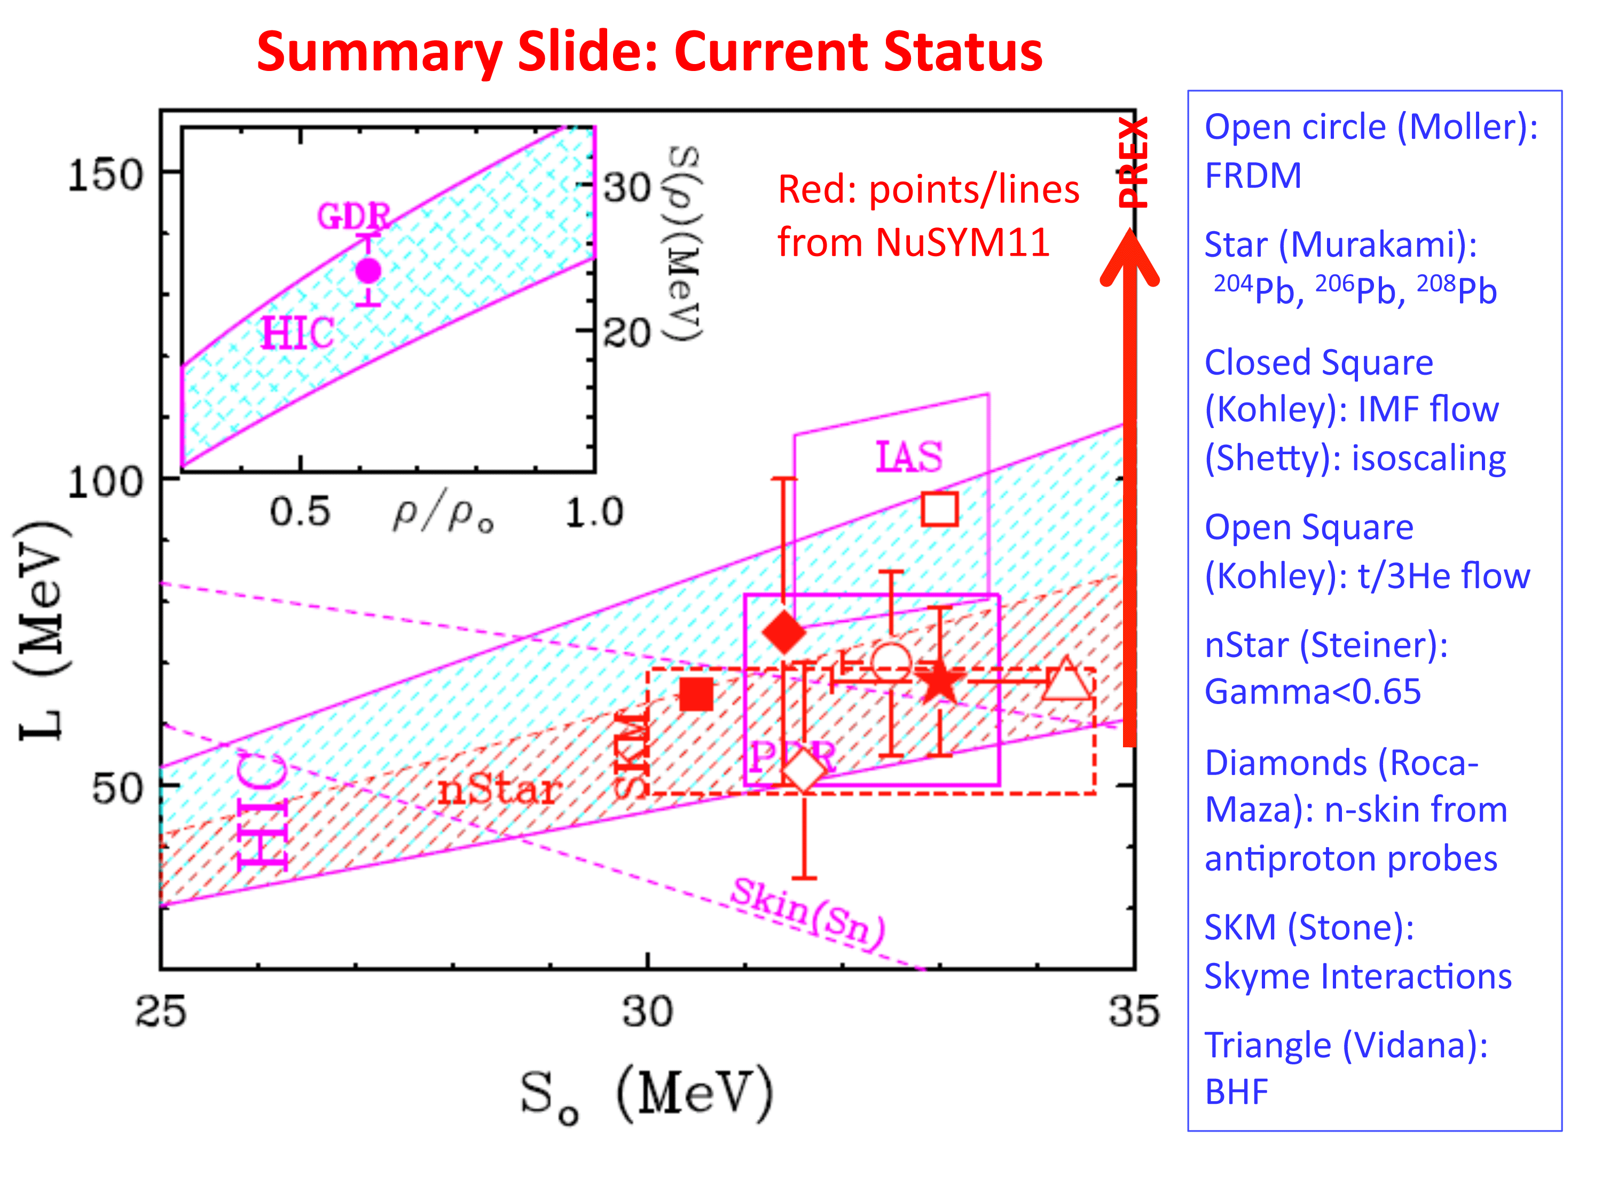
Summary of NUSYM11 at Smith College

Slide 4
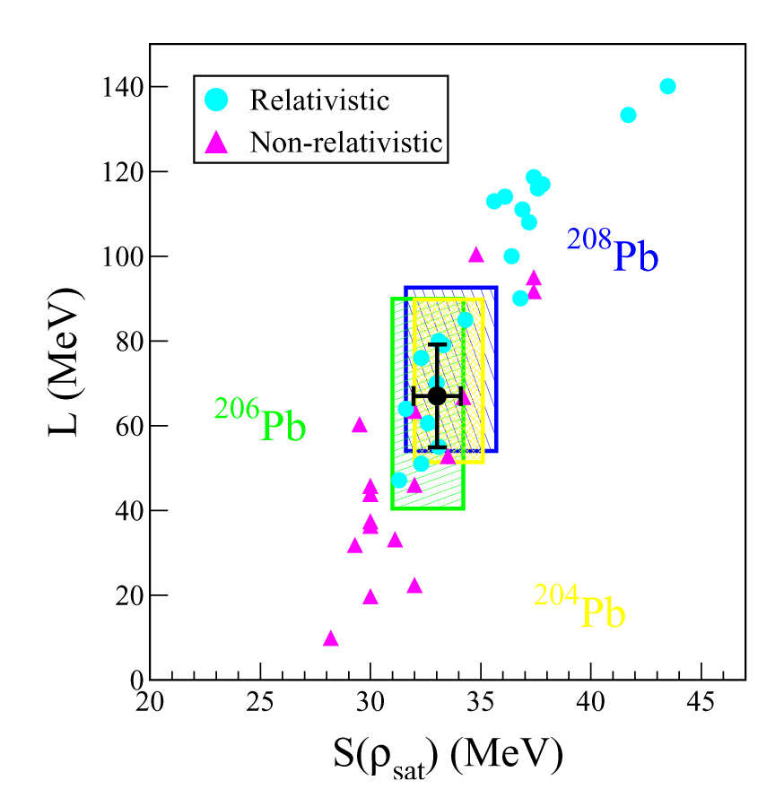
Ｎeutron skin thickness measurements by Zenihiro et al.
PhD thesis 2011 PRC82, 054607 (2010)
S=33.0±1.1 MeV
L=67.0±12.1 MeV

Slide 5
RIBF
?
S=33.0±1.1 MeV
L=67.0±12.1 MeV
K_{sym}=-148±124 MeV
GSI
MSU
Isospin diffusion, n-p flow
Au+Au
Xiao, et al., arXiv:0808.0186 (2008)
Reisdorf, et al., NPA 781 (2007) 459.
Pion production

Slide 6
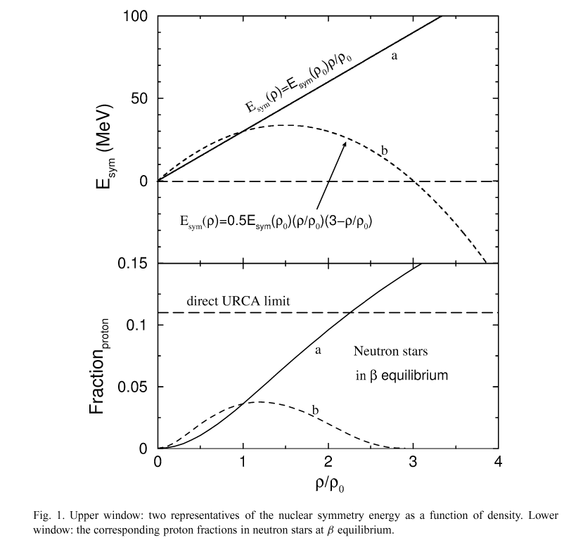
According to Bao-An’s calculation from NPA 708 (2002) 365.

Slide 7
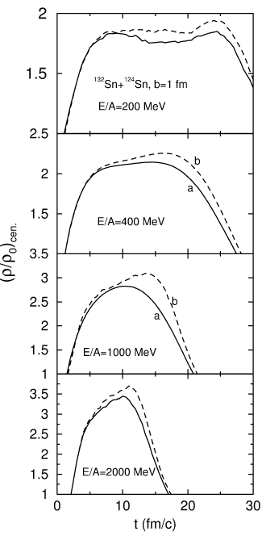
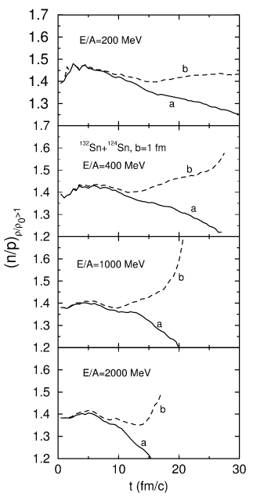
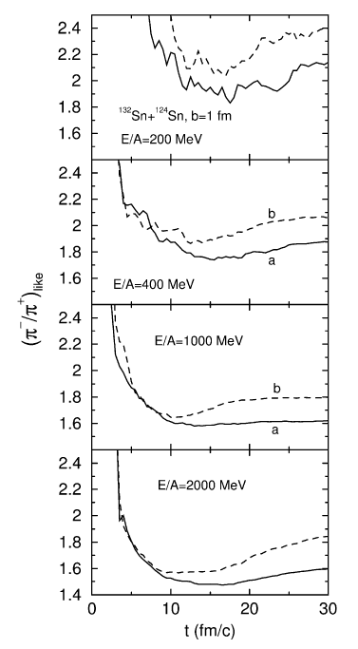

Slide 8
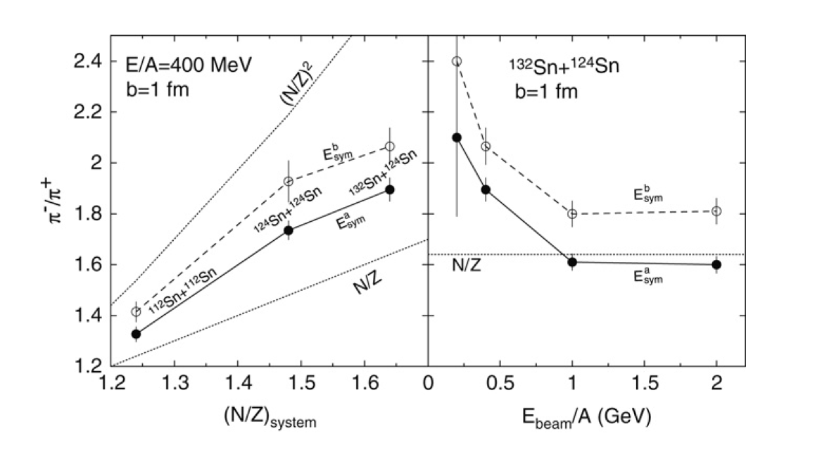
Possible Probe for symmetry energy
π⁺−π⁻ ratio
Proton-neutron ratio
Light ion ratio (t-³He)
Particle flow of pions, protons, neutrons and light ions

Slide 9
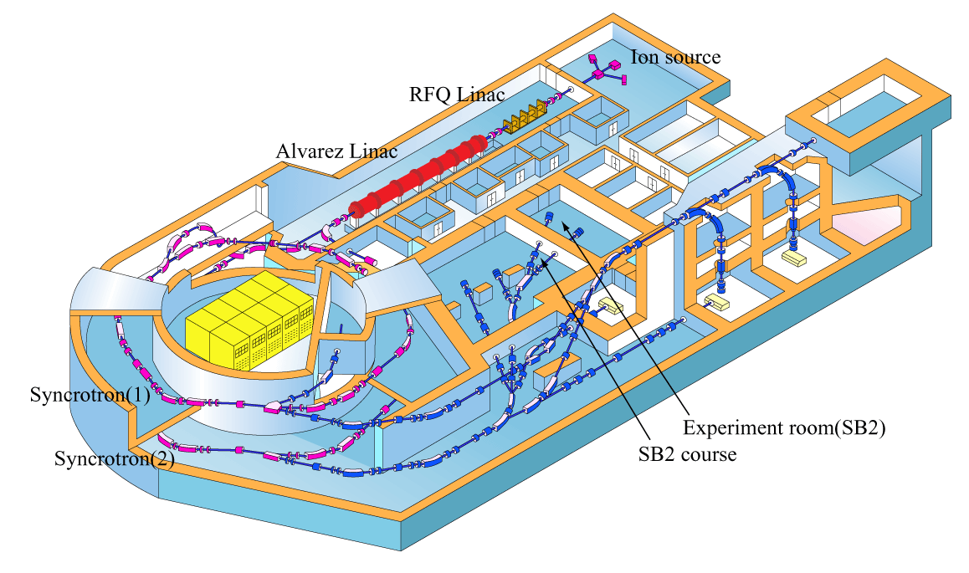
HIMAC Pion Experiments

Slide 10
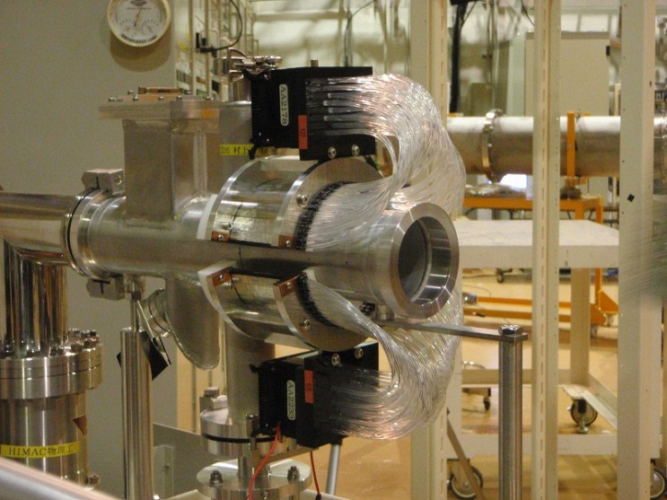
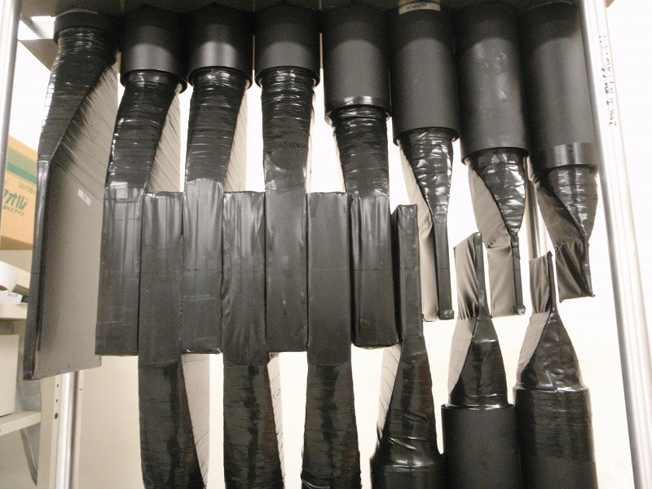
Experimental Setup
Multiplicity Array
Multiplicity Array
Ion Chamber
Target
Vacuum
Beam
θ_{lab}
Air
Target
50cm
Vacuum
Target : In ~ 390 mg/cm²
Typical Intensity : ~ 10⁷ ppp
Range Counter : 14 layers (+2) of Sci.
measured angle (θlab)
: 30, 45, 60, 75, 90, 120 degree
solid angle : 10 msr
Beam | ²⁸Si | ¹³²Xe
Energy(AMeV) | 400, 600, 800 | 400
Range Counter
Notes:
About our experimental setup.
Beam is 28Si,
intensity is about 10 to 7th (pawer) particles per spil
and beam energies are 400, 600, 800 MeV/nucleon
Target is In , thickness is 390 mg/cm2 located in the vacuum.
We use 3 type counters located in the air.
First one is “Pion Range Counter”.
This is composed of 14 layers of scintillators.
Particles enter from this direction.
These two are for trigger and this little big scintillator is for veto of through charged particles.
There are 11 counters between trigger and veto counters, which measure the range of particles.
Measured angles are 30,45,60,75,90, and 120 degrees in the laboratory frame
Solid angle is 10 msr
Second one is Multiplicity Array. This is composed of 60 scintillators Which is set in cylindrical shape around the beam duct.
We want to know the impact parameter information using this counter but analysis is not finished.
3.Ion Chamber measures beam intensity
From next slide, I explain the analysis procedure of pions.

Slide 11
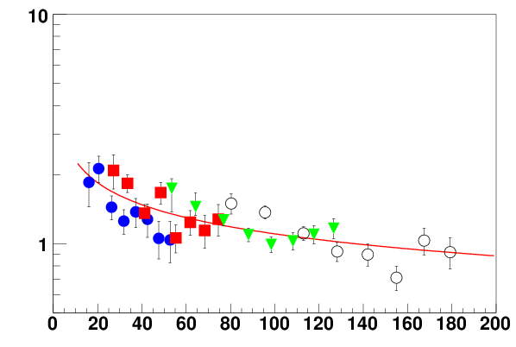
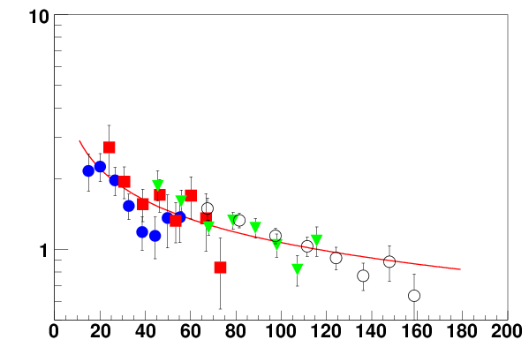
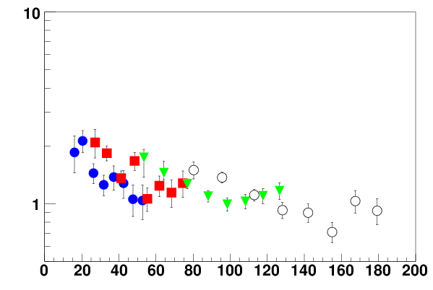
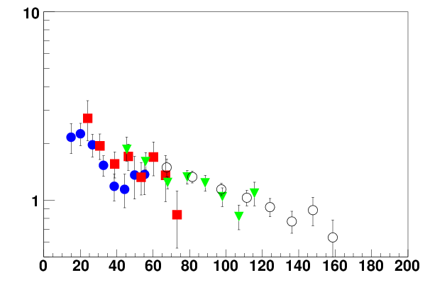
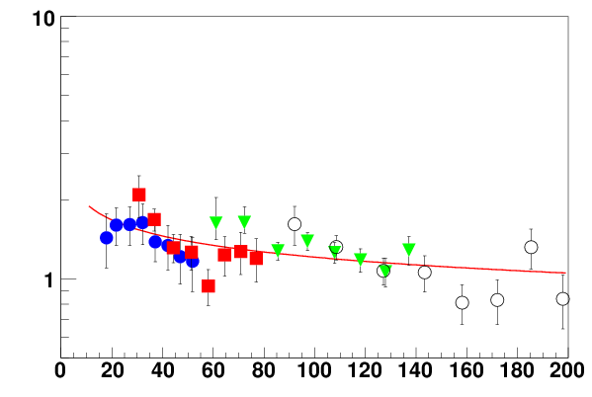
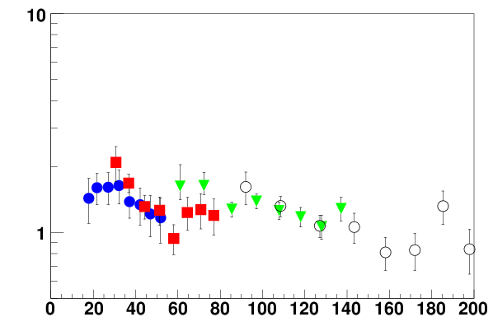
Beam Energy Dependence : Si
400 MeV
600 MeV
log scale π⁻/π⁺
Fitting : C*X^{-α}
log scale π⁻/π⁺
800 MeV
slope α:
400 : (4.5±0.5)×10⁻¹
600 : (3.2±0.5)×10⁻¹
800 : (2.0±0.5)×10⁻¹
● 45deg
■ 60deg
▼ 90deg
○ 120deg
log scale π⁻/π⁺
Slopes depend on Beam Energy
E_{rapπ} (MeV)
Notes:
This is the mid rapidity frame.
Horizontal axis is pion kinematic energy in mid rapidity frame and vertical axis is pion ratio in log scale.
I put the every angle data by beam energy.
circle is 45deg data, square is 60deg, triangle is 90deg, and open triangle is 120deg.
We can see some dependence in beam energy.
Slope of data point is decrease with beam energy
When we fit the data with exponential function.
we got the slope parameter like this
When we compare between 400 and 800 MeV data,
slope parameter is twice as high.
We think that the ratio at high energy is almost one and then the ratio at low energy is different between three data.

Slide 12
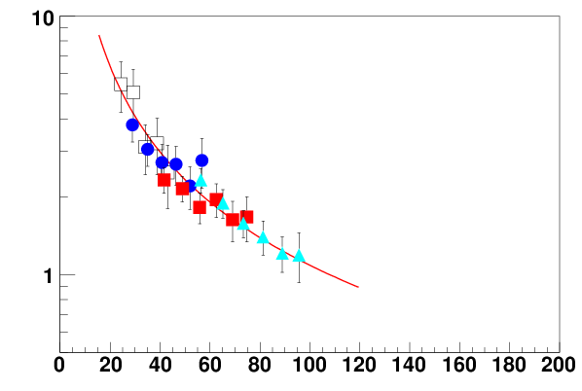
N/Z dependence : Si and Xe beam
Si + In 400 MeV
Xe + In 400 MeV
● 45deg
■ 60deg
▼ 90deg
○ 120deg
□ 30deg
● 45deg
■ 60deg
▲ 75deg
log scale π⁻/π⁺
log scale π⁻/π⁺
E_{rapπ} (MeV)
E_{rapπ} (MeV)
Fitting : C*X^{-α}
slope α Si + In : (4.5±0.5)×10⁻¹
Xe+In :(11.0±0.8)×10⁻¹

Slide 13
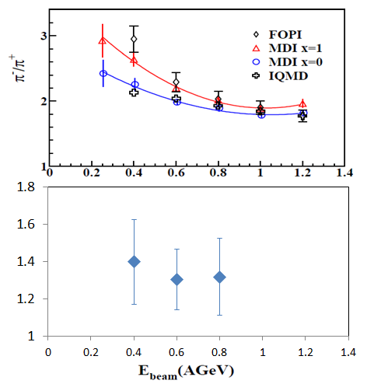
The integrated-yield ratio
Sum the data point
like this formula
Xe+In
Si+In

Slide 14
Now we are almost ready for new pion measurements from ^{129,132,136}Xe on CsI reactions at 400 MeV/u .
CsI ~¹³⁰Xe : <Z>=54 <N>=76 → N/Z= 1.41
^{129,132,136}Xe N/Z=1.39-1.52

Slide 15
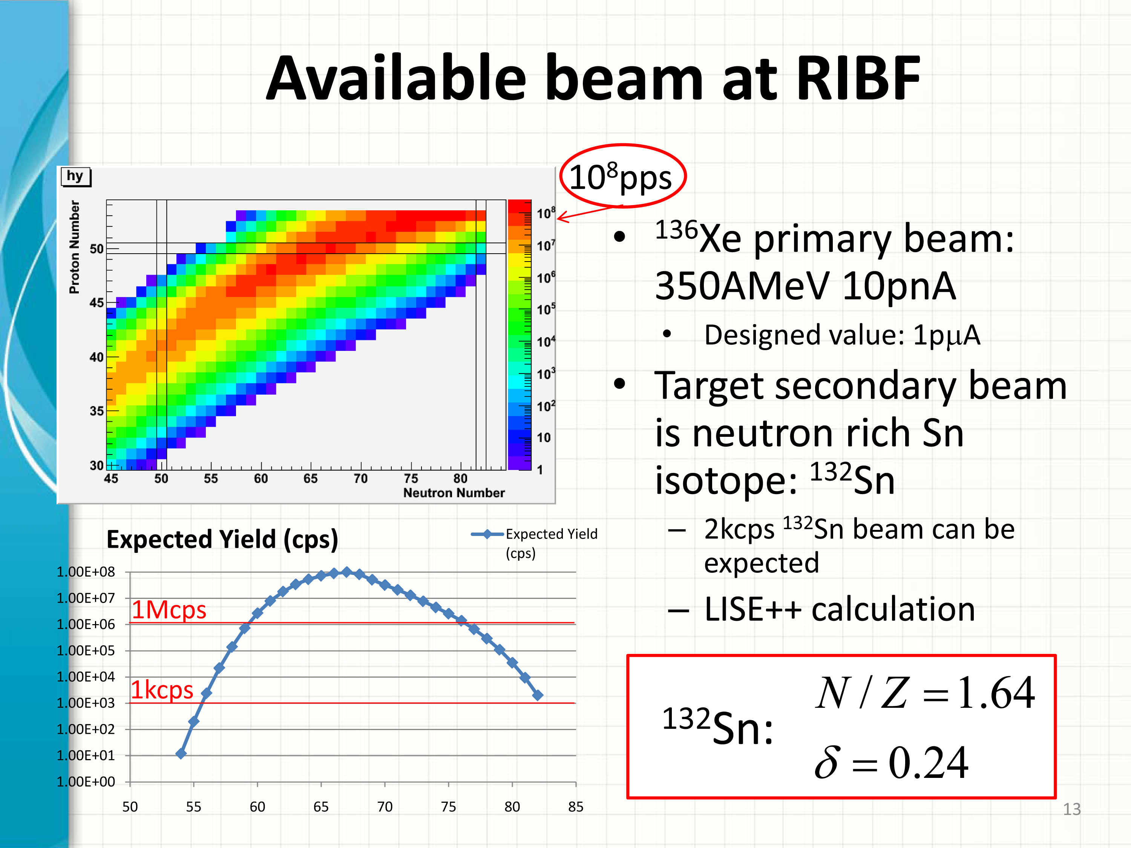
Next generation experiments
Wider N/Z range

Slide 16
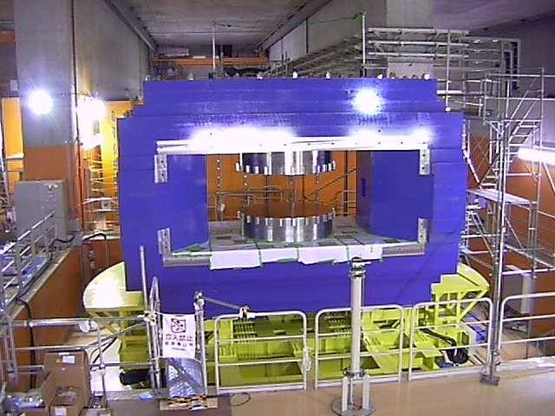
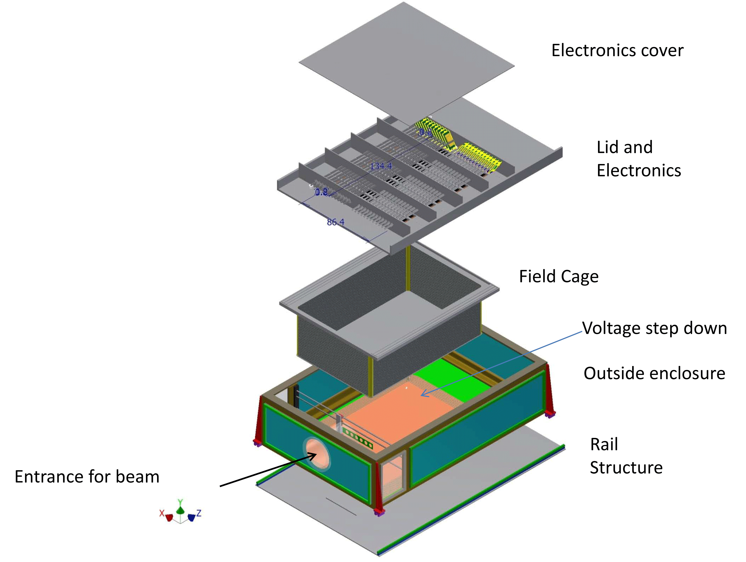

Slide 17
TPC properties
SAMURAI TPC parameters
Pad plane area | 1.3m x 0.9 m
Number of pads | 11664 (108 x 108)
Pad size | 12 mm x 8 mm
Drift distance | 55 cm
Pressure | 1 atmosphere
dE/dx range | Z=1-3 (Star El.), 1-8 (Get El.)
Two track resolution | 2.5 cm
Multiplicity limit | 200 (large systems absolute pion eff.)
GEANT simulation
¹³²Sn+¹²⁴Sn collisions at E/A=300 MeV
Initial design is based upon EOS TPC, whose properties are well documented.
Isobe-san has started simulations.

Slide 18
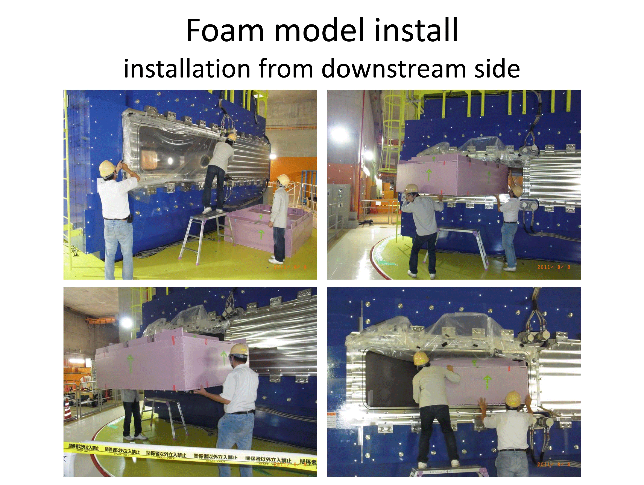

Slide 19
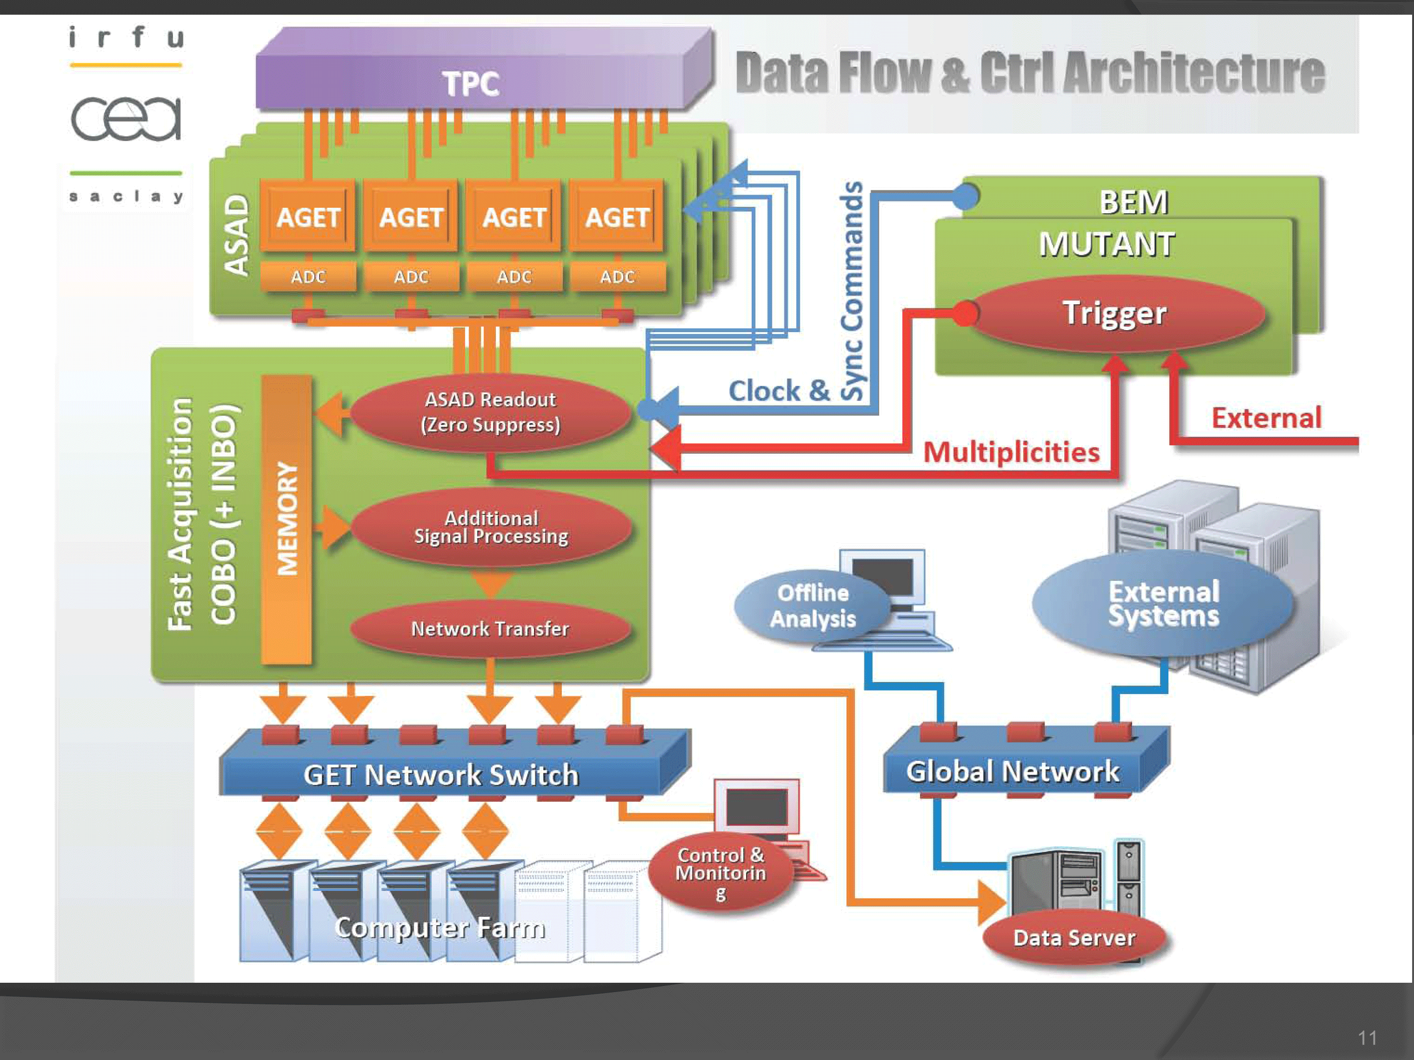
Ｐｌｅａｓｅ ｓｔａｙ ｔｕｎｅｄ

