Slide 1
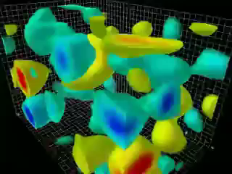

Electron Ion Collider
(An Overview)
Precision study & understanding the role of
gluons (& sea quarks) in QCD
http://arxiv.org/pdf/1108.1713v1
Abhay Deshpande
October 21, 2011
Future Directions in High Energy QCD

Slide 2
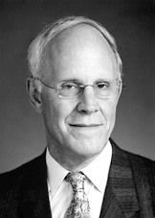



QCD: The SM of Strong Interactions
“Folks, we need to stop “testing” QCD
and start understanding it”
Yuri Dokshitzer
1998, ICHEP Vancouver, BC , Conference Summary Talk
2004 For the discovery of asymptotic freedom in QCD
Notes:
While no body doubts QCD any more, some over-arching and extremely important questions remain….

Slide 3
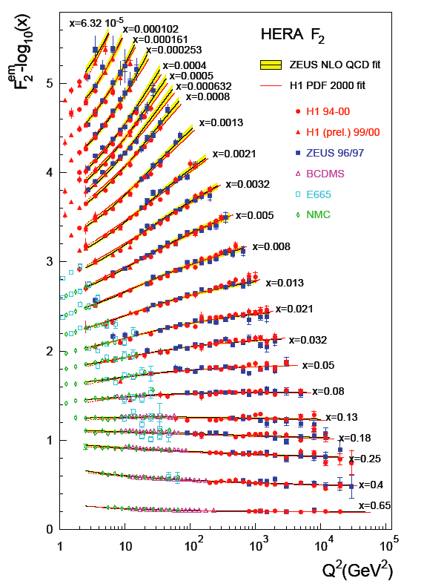
Success of pQCD at High Q: Jet Cross section
Input:
  F₂(x,Q²) structure function from HERA
  Next to Leading Order perturbative QCD

Slide 4
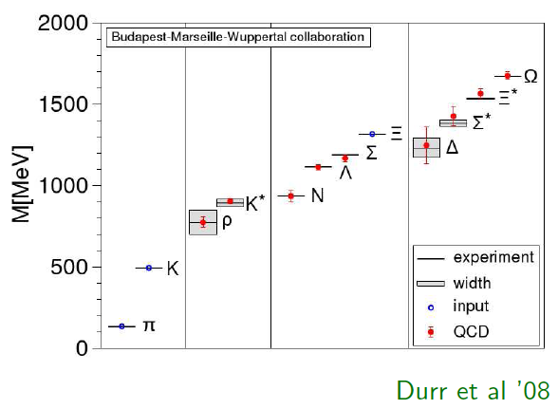
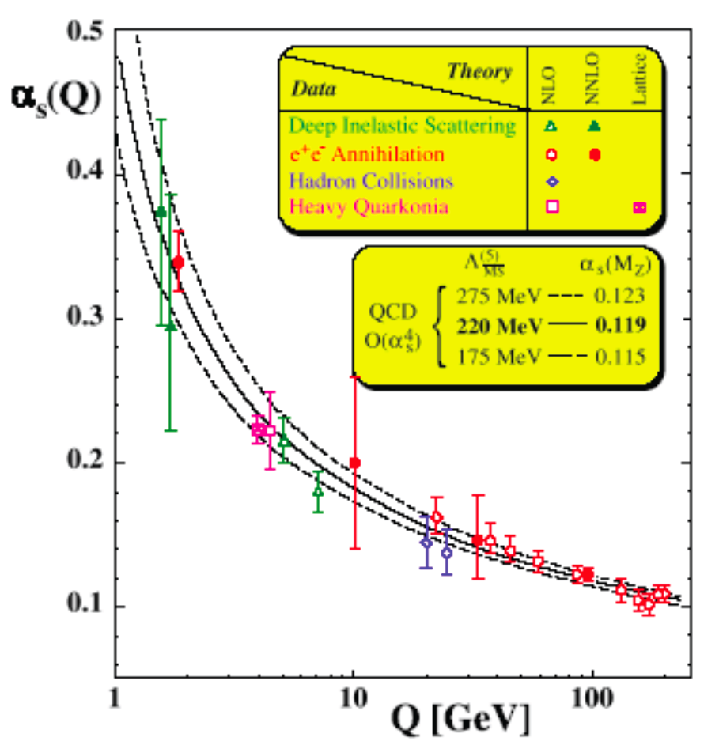
QCD definitely correct, but…
Lattice QCD
Starting from QCD lagrangian → Static properties of hadrons: hadron mass spectrum
No guidance on partonic dynamics
Perturbative QCD
Calculations possible in when coupling is small, at high Q
Problematic at low Q → fast rise of α_{S}(Q)

Slide 5

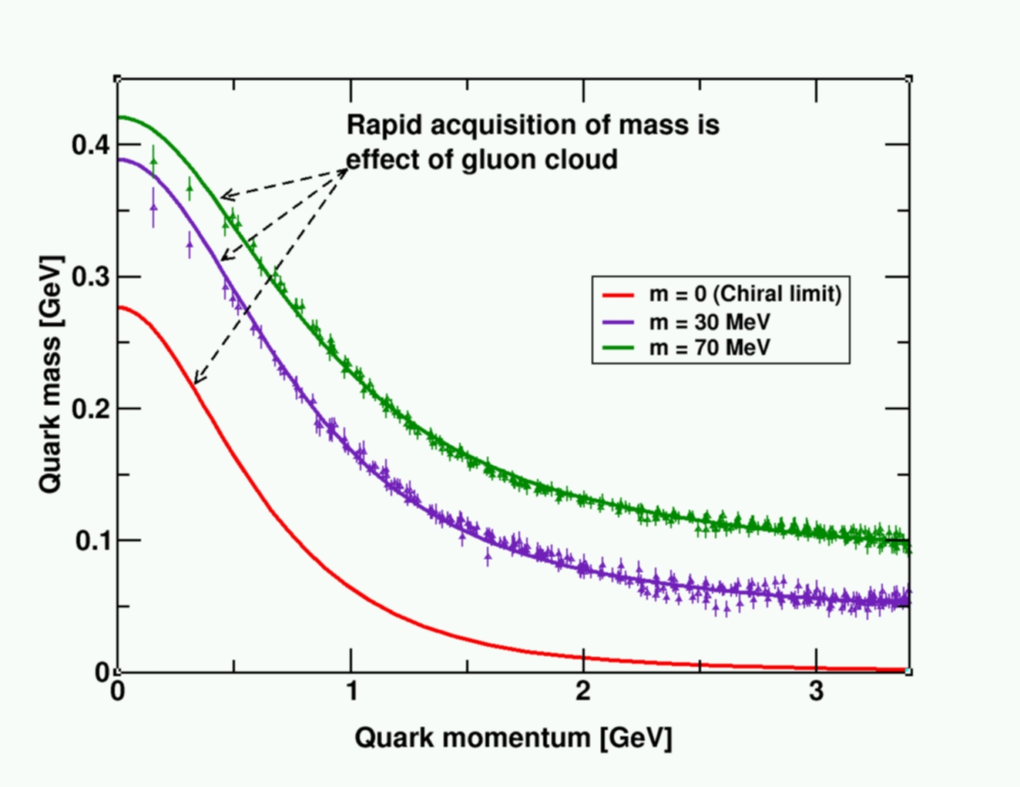
Generation of Mass – Gluons in QCD
Protons and neutrons form most of the mass of the visible universe
99% of the nucleon mass is due to self generated gluon fields
  Similarity between p, n mass indicates that gluon dynamics is identical & overwhelmingly important
Lattice QCD supports this
Bhagwat et al.
Higgs Mechanism, often credited with mass generation, is of no consequence
Notes:
And yet, how well do we understand gluons, their interactions and their broader impact on the QCD? –The answer unfortunately is: Very little!

Slide 6
Gluon self-interaction in QCD
Dynamical generation & self-regulation of hadron masses
F. Wilczek in “Origin of Mass”
Its enhanced coupling to soft radiation… means that a ‘bare” color charge, inserted in to empty space will start to surround itself with a cloud of virtual color gluons. These color gluon fields themselves carry color charge, so they are sources of additional soft radiation. The result is a self-catalyzing enhancement that leads to a runaway growth. A small color charge, in isolation builds up a big color thundercloud….theoretically the energy of
the quark in isolation is infinite… having only a finite amount of energy to work with, nature always finds a way to short cut the ultimate thundercloud”
Color charge gluons
Electric charge, lines: photons
e
Q

Slide 7
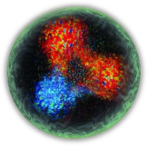
What limits the “thundercloud”?
Partial cancellation of quark-color-charge in color neutral finite size of the hadron (confinement) is responsible, but
Saturation of gluon densities due to gg→ g (gluon recombination) must also play a critical role regulating the hadron mass
Need to experimentally explore and study many body dynamics
a) regions of quark-hadron transition and
b) non-linear QCD regions of extreme high gluon density

Slide 8
How well do we understand gluons?
What is the role of gluons at high energy?

Slide 9
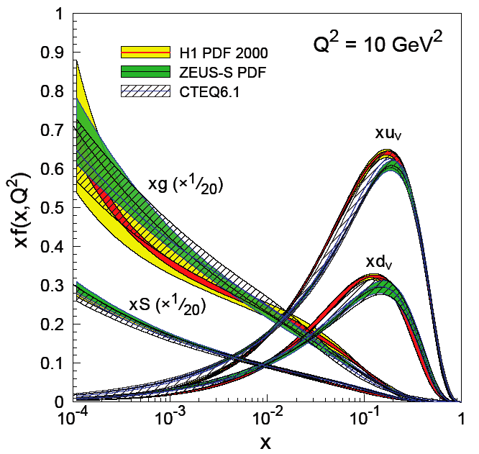
Measurement of Glue at HERA
Scaling violations of F₂(x,Q²)
NLO pQCD analyses: fits with linear DGLAP* equations
Gluon
dominates
*Dokshitzer, Gribov, Lipatov, Altarelli, Parisi

Slide 10
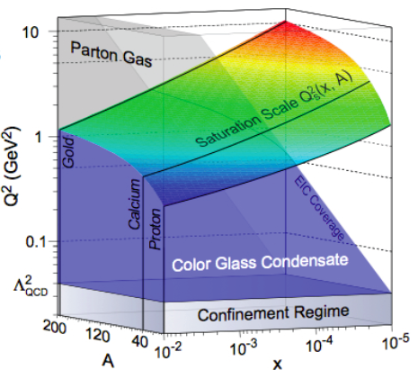
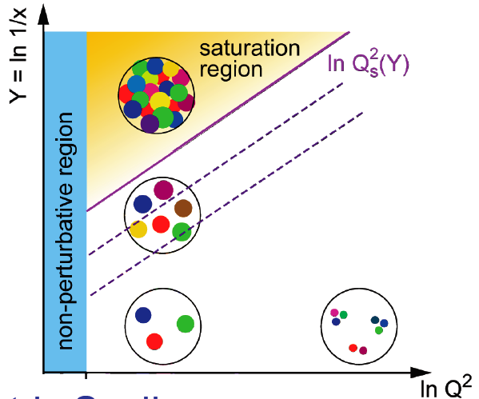

Low-x, higher twist & Color Glass Condensate
McLerran, Venugopalan… See Review: F. Gelis et al., , arXiv:1002.0333)
Method of including non-linear effects in DGLAP equation ➔ Small coupling, high gluon densities → Saturation Scale Q_{S}(x,Q²,A)
→ Some form of saturation, including Color Glass Condensate
No unambiguous experimental evidence yet, but many smoking guns (HERA, RHIC & now LHC!)
Kowalski
Teany
PRD 68:114005
Could be explored cleanly in future with a high energy
electron-Nucleus Collider

Slide 11
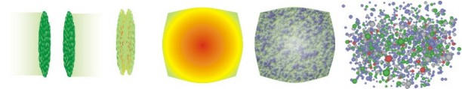
EIC and RHIC/LHC (Heavy Ion)
Initial state
freezout
QGP
Pre-
equilibrium
hadronization
EIC
RHIC/LHC
EIC
A decadal plan is being launched to characterize the “QGP”
To understand “QGP” fully, we need to understand:
  The initial state i.e. the nucleus & hadronization
  Deeper Connection: many body interactions of parton in QCD

Slide 12

Understanding
Nucleon spiN:
What role do gluons play?

Slide 13
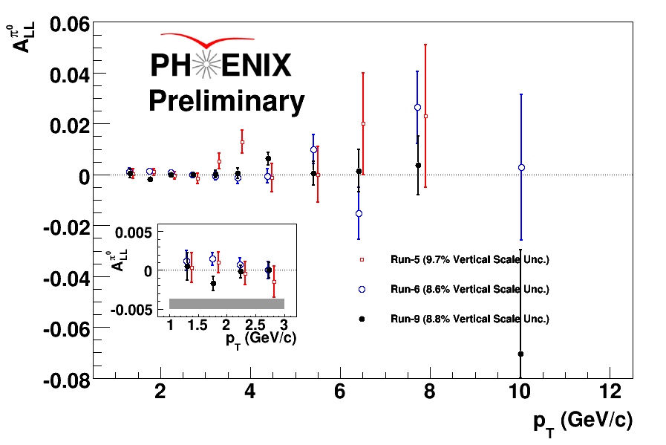
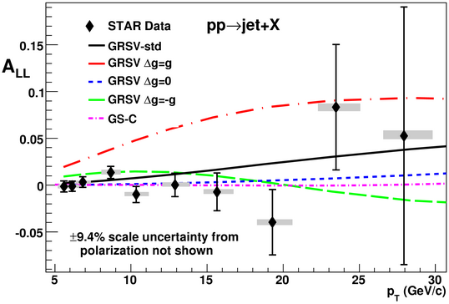
Status of “Nucleon Spin Crisis Puzzle”
We know how to determine ΔΣ and Δg precisely: data+pQCD
  ½ (ΔΣ) ~ 0.15 : From fixed target pol. DIS experiments
  RHIC-Spin: Δg not large as anticipated in the 1990s, but measurements & precision needed at low & high x
Run5
Run6
Run9

Slide 14
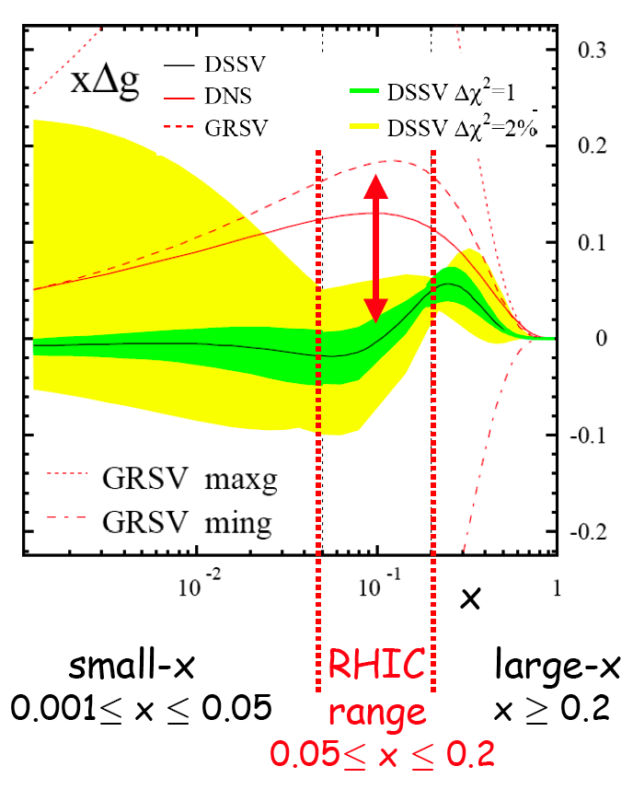
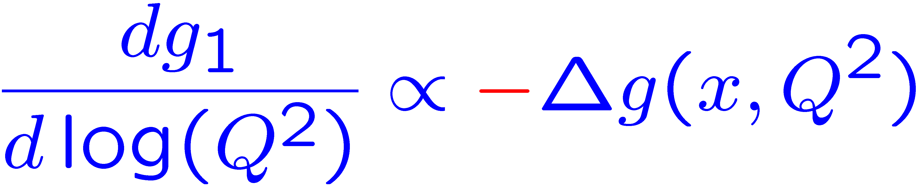
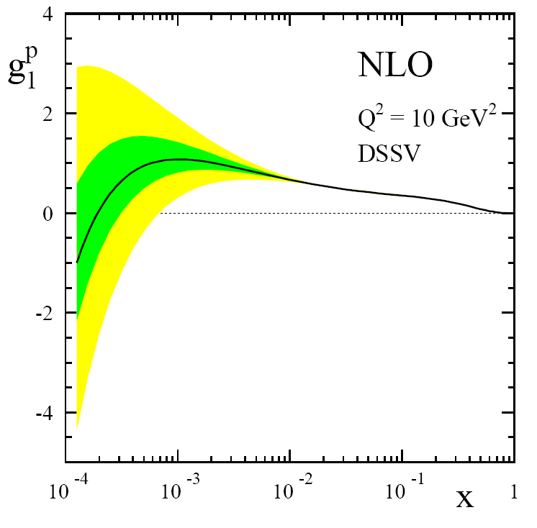
Δg(x) @ Q²=10 GeV²
de Florian, Sassot, Stratmann & Vogelsang
Global analysis: DIS, SIDIS, RHIC-Spin
Uncertainly on ΔG large at low x
positive Δg
Low x measurements
=Opportunity!
Present

Slide 15
Status of “Nucleon Spin Crisis Puzzle”
We know how to measure ΔΣ and ΔG precisely using pQCD
  ½ (ΔΣ) ~ 0.15 : From fixed target pol. DIS experiments
  RHIC-Spin: ΔG not large as anticipated in the 1990s, but measurements & precision needed at low & high x
Generalized Parton Distributions: H,E,E’,H’ → Connection to partonic OAM
  Quark GPDs → J_{q}: 12GeV@JLab & COMPASS@CERN
  Gluons @ low x → J_{g} → will need the future EIC!
(2+1)D tomographic image of the proton…. Transverse Mom. Distributions
  2: x,y position and +1:momentum in z direction
Towards Full understanding of transverse and longitudinal hadron structure including spin!

Slide 16
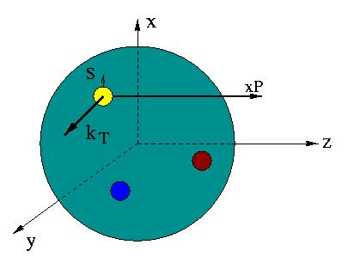
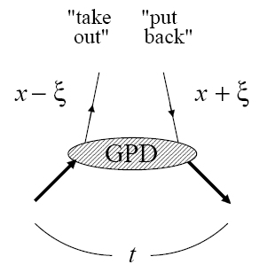
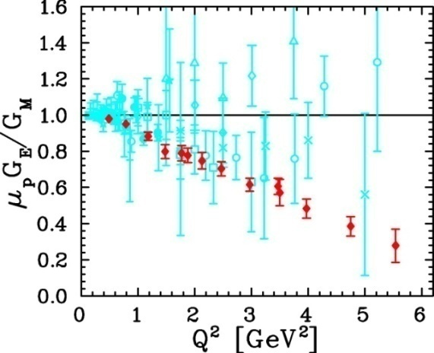
Unified View of Nucleon Structure
W_{p}^{u}(x,k_{T},r ) Wigner distributions
6D Dist.
d³r
d²k_{T} dr_{z}
TMD PDFs
f₁^{u}(x,k_{T}), .. h₁^{u}(x,k_{T})‏
GPDs/IPDs
3D imaging
dx &
Fourier Transformation
d²k_{T}
d²r_{T}
Form Factors
G_{E}(Q²),
G_{M}(Q²)‏
PDFs
f₁^{u}(x), .. h₁^{u}(x)‏
1D

Slide 17
Do we really “understand” QCD?
While there is no reason to doubt QCD, our level of understanding of QCD remains extremely unsatisfactory: both at low & high energy
Can we explain basic properties of hadrons such as mass and spin from the QCD degrees of freedom at low energy?
What are the effective degrees of freedom at high energy?
How do these degrees of freedom interact with each other and with other hard probes?
What can we learn from them about confinement & universal features of the theory of QCD?
After ~20+ yrs of experimental & theoretical progress, we are only beginning to understand the many body dynamics of QCD

Slide 18
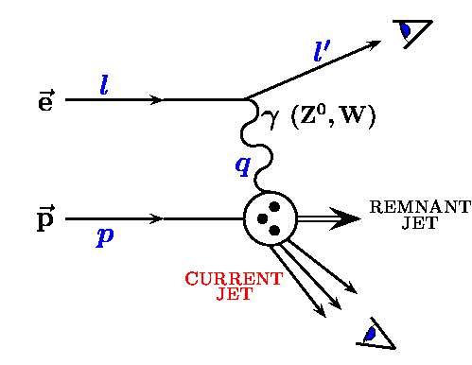
The Proposal:
Future DIS experiment at an Electron Ion Collider: A high energy, high luminosity (polarized) ep and eA collider and a suitably designed detector
[1]
Measurements:
[1] → Inclusive
[1] and [2] or [3] →Semi-Inclusive
[1] and [2] and [3] →Exclusive
Inclusive → Exclusive
Low → High Luminosity
Demanding Detector capabilities
[3]
[2]

Slide 19

Inclusive & Semi-Inclusive DIS
Kinematics:
Measure of resolution power
Measure of inelasticity
Measure of momentum fraction of struck quark
Inclusive events:
e+p/A → e’+X
detect only the scattered lepton in the detector
Semi-inclusive events:
e+p/A → e’+h(π,K,p,jet)+X
detect the scattered lepton in coincidence with identified hadrons/jets in
the detector
with respect to γ

Slide 20
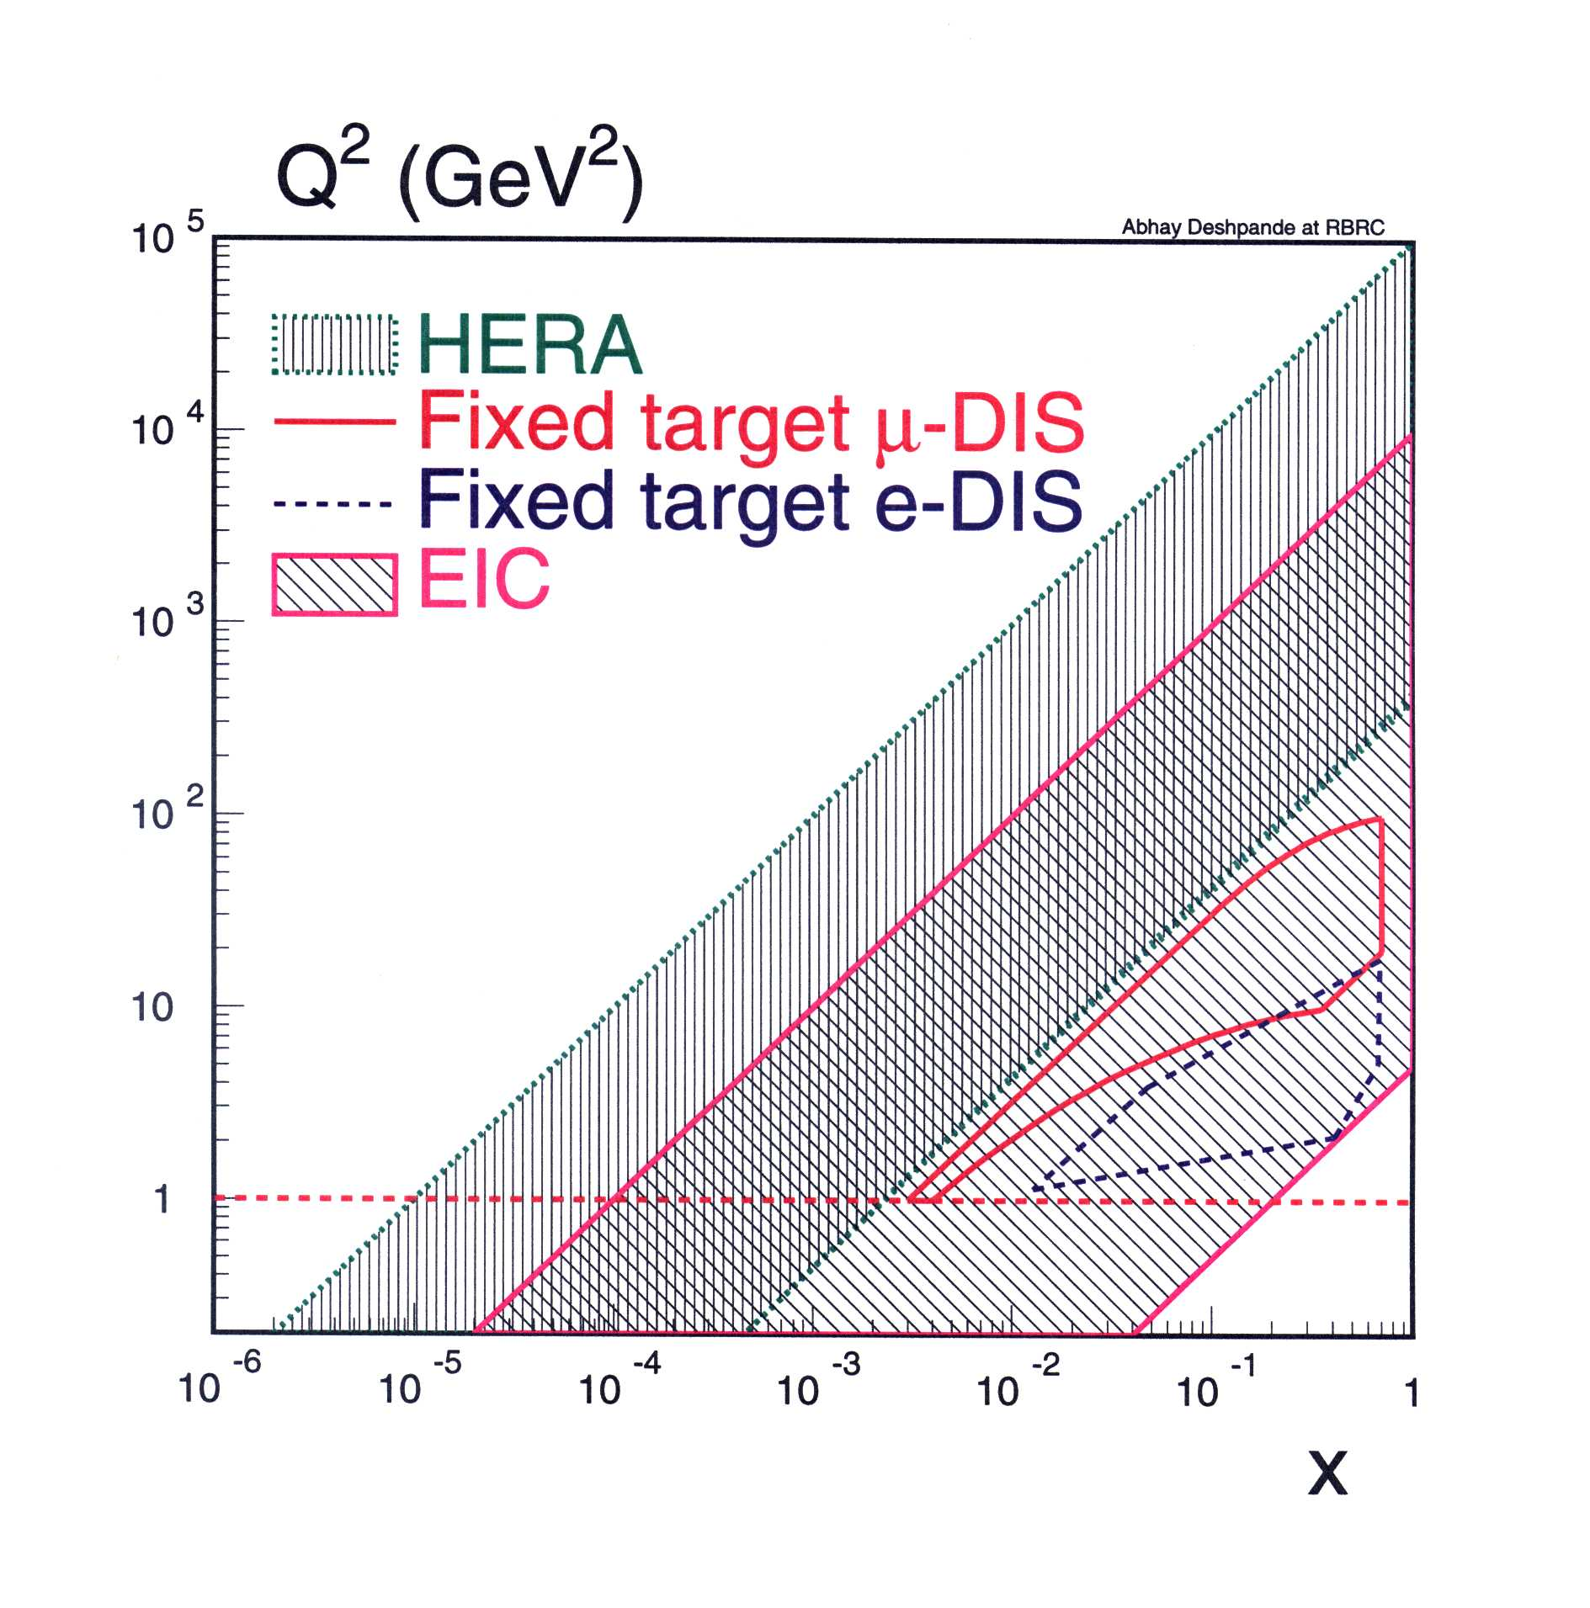
EIC : Basic Parameters (e-p)
E_{e}=10 GeV (5-30 GeV variable)
E_{p}=250 GeV (50-275 GeV Variable)
Sqrt(S_{ep}) = 100 (30-180) GeV
x_{min} ~ 10⁻⁴ ; Q²_{max}~ 10⁴ GeV
Polarization ~ 70%: e,p, D/³He
Luminosity L_{ep} = 10³³⁻³⁴ cm⁻²s⁻¹
Minimum Integrated luminosity:
  50 fb⁻¹ in 10 yrs (100 x HERA)
  Possible with 10³³ cm⁻²s⁻¹
  Recent projections much higher

Slide 21
EIC : Basic Parameters (e-A)
E_{e}=10 GeV (5-30 GeV variable)
E_{A}=100 GeV (20-110 GeV Variable)
Sqrt(S_{eA}) = 63 (20-115) GeV
x_{min} ~10⁻⁴ ;
Q²_{max} ~ 8 x10³ GeV
Nuclei:
Proton → Uranium
L_{eA}/N = 10³³⁻³⁴ cm⁻²s⁻¹
eRHIC (5+100) GeV

Slide 22
Machine Designs
eRHIC at Brookhaven National Laboratory using the existing RHIC complex
ELIC at Jefferson Laboratory using the Upgraded 12GeV CEBAF
Both planned to be STAGED

Slide 23

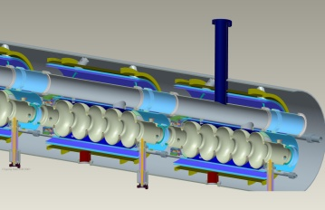
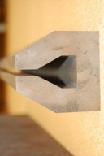

Staging of eRHIC: E_{o} : 5 -> 30 GeV
23
E/Eo
0.0200
0.1017
0.1833
0.2650
0.3467
0.4283
0.5100
0.5917
0.6733
0.7550
0.8367
0.9183
1.0000
All energies scale proportionally by adding SRF cavities to the injector
0.02 Eo
Polarized
e-gun
0.6 GeV
Beam
dump
27.55 GeV
New
detector
ERL: 6 electron beam passes thru SRF linacs precede (accel) and follow (decel) e-p/e-A collisions
Linac
Coherent e-cooler
0.9183 Eo
Linac 2.45 GeV
Eo
0.8367 Eo
0.7550 Eo
0.6733 Eo
0.5917 Eo
0.5100 Eo
0.4286 Eo
eRHIC design has evolved to make optimal use of existing RHIC infrastructure, and to permit straightforward (multi-step) upgrades from Phase 1 to eventual full electron energy
0.3467 Eo
0.2650 Eo
0.1017 Eo
Roser’s talk
0.1833 Eo
30 GeV
All magnets would be installed from DAY ONE and we would be cranking power supplies up as energy is increasing
ePHENIX
100 m
Technical design review
Aug. 1-3, 2011; Aim for
cost review Jan. 2012
eSTAR
30 GeV
Notes:
We returned to developing cost effective and ECO-friendly eRHIC option with ERL located in the existing RHIC tunnel. We plan to install all magnets for 6 passes and 30 GeV from the start and then build up SRF linac from 1 GeV to 5 GeV per pass.
In this case electrons will pass through the detector halls in the way to the top energy, will collide in up to 3 IRs. Then they will be decelerated to the injection energy and damped.
23

Slide 24
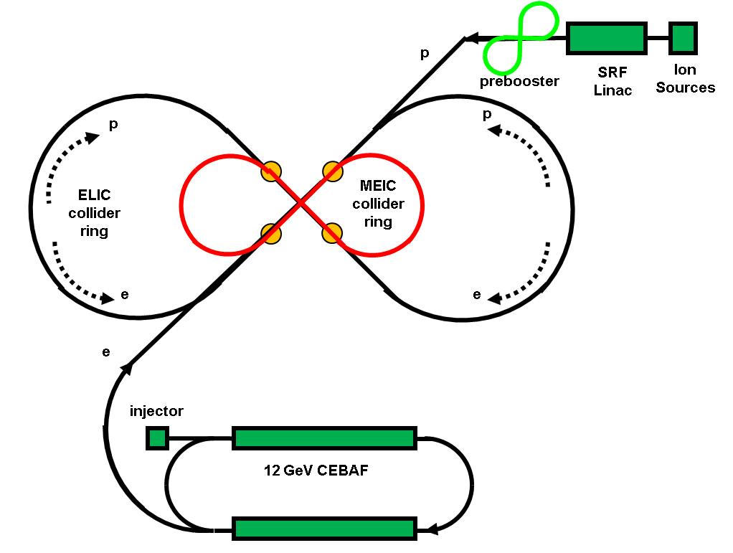
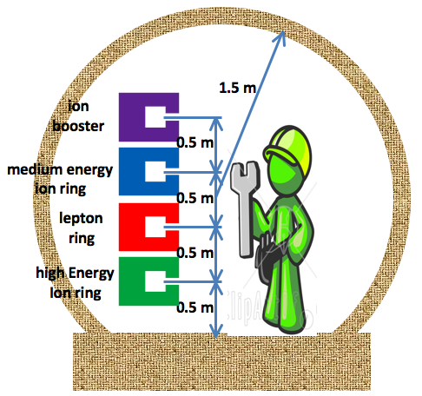
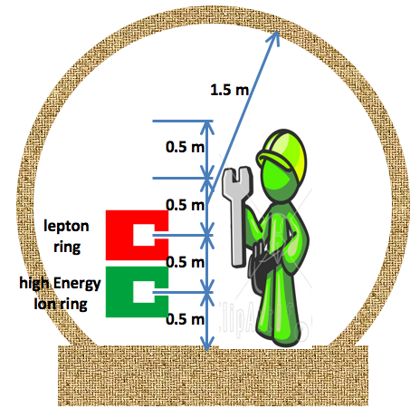
ELIC: High Energy & Staging
Straight section
Serves as a large booster to the full energy collider ring
Arc
Stage | Max. Energy (GeV/c) |  | Ring Size (m) | Ring Type |  | IP #
 | p | e |  | p | e
Medium | 96 | 11 | 1000 | Cold | Warm | 3
High | 250 | 20 | 2500 | Cold | Warm | 4
Hutton
Notes:
24

Slide 25
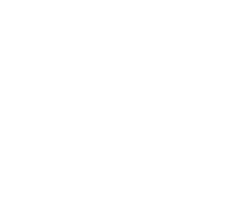
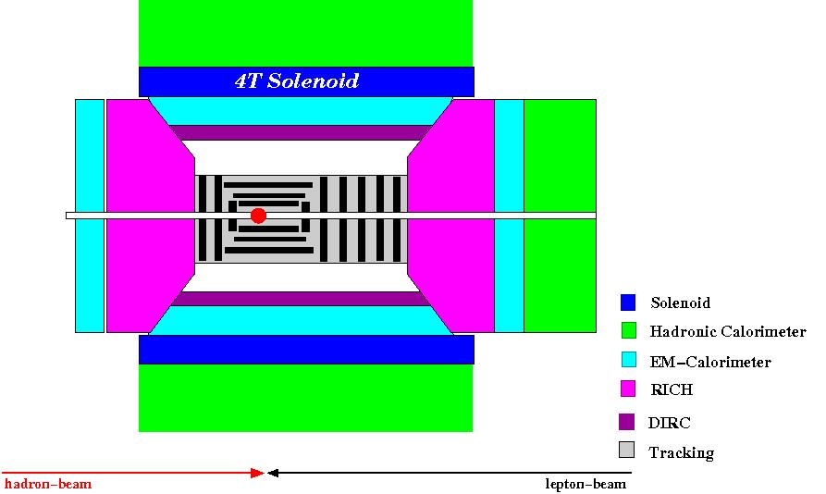
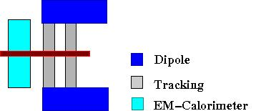
Emerging eRHIC Detector Concept
R. Ent’s Talk
1.5 m
Forward / Backward
Spectrometers:
3.5 m
BNL EIC Task Force &
EIC Collaboration
high acceptance -5 < η < 5 central detector
good PID and vertex resolution (< 5μm)
tracking and calorimeter coverage the same → good momentum resolution, lepton PID
low material density → minimal multiple scattering and brems-strahlung
very forward electron and proton detection → maybe dipole spectrometers

Slide 26
Detector & IR Design: ELIC
R. Ent’s Talk
solenoid
detectors
ion dipole w/ detectors
ion FFQs
0 mrad
IP
ions
50 mrad
electron FFQs
electrons
2+3 m
2 m
2 m
Central detector
Detect particles with angles down to 0.5º before ion FFQs.
Need 1-2 Tm dipole.
Detect particles with angles below 0.5º beyond ion FFQs and in arcs.
Solenoid yoke + Muon Detector
TOF
RICH or DIRC/LTCC
EM Calorimeter
Tracking
RICH
Very-forward detector
Large dipole bend @ 20 meter from IP
(to correct the 50 mr ion horizontal crossing angle) allows for very-small angle detection (<0.3º)
4-5m
HTCC
Muon Detector
Hadron Calorimeter
EM Calorimeter
Solenoid yoke + Hadronic Calorimeter
JLab EIC WG and EIC Collaboration
2m
3m
2m
Notes:
26
26

Slide 27
EIC: the Machines, IR and Detector
Both BNL and JLab machine designs have progressed significantly.
In spite of very different starting points for collider concepts:
Both designs are now converging to similar luminosities:
  Few x 10³³⁻³⁴ cm⁻² sec⁻¹ for high energy
  ~5 x 10³²⁻³⁴ cm⁻² sec⁻¹ for low energy
  Exchange of ideas over the last year very useful
  Both plan a staged realization
Both designs have settled on more than one IR point
Both machine designs integrate detector design in to the machine lattice
Detectors concepts include a central solenoid and forward dipole, extensive low mass tracking for low x and good particle ID
Notes:
Lots of communication between Lab Physics Groups and the Accelerator groups.

Slide 28
A set of meetings on the Physics of EIC: 1999-2010
http://web.mit.edu/eicc/Meetings.html
A series of Users Workshops at Jefferson Lab in 2010:
Users Workshops Organizer by the Users of Jeff Lab:
httpp://michael.tunl.duke.edu/workshop
httpp://www.physics.rutgers.edu/np/2010rueic‐home.html
http://www.phy.anl.gov/mep/EIC‐NUC2010/
https://eic.jlab.org/wiki/index.php/Electroweak_Working_Group
An International Group met at the INT September – December 2010 to define: The Science of EIC “Golden Measurements”
Institute of Nuclear Theory (INT) at U. of Washington: Sep-Nov 2010
Organizers: D. Boer, M. Diehl, R. Milner, R. Venugopalan, W. Vogelsang
See the INT WebPage for details of all studies:
http://www.int.washington.edu/PROGRAMS/10-3/
INT Workshop Write-up: http://arxiv.org/abs/1108.1713

Slide 29
Science of EIC:
Precise Investigations of the “Glue & Sea Quarks”
Precision measurements of Sea Quarks and Gluon’s Spin via inclusive and semi-inclusive DIS including EW probes of the hadron structure
Measurement of (gluon) GPDs & TMDs: via semi-inclusive and exclusive DIS → wide range in x and Q²
  3D momentum and position (correlations) of the nucleon → Possibly leading to orbital angular momentum
Study of extreme high gluon densities via inclusive and sem-inclusive DIS off a wide range of nuclei and energies
High energy, beam polarization, and a full acceptance detector: why not explore precision electroweak physics and EW (spin) structure functions
Burkardt, Prokudin, Yuan
M. Burkardt, Prokudin
K. Itakura, T. Ullrich, J. Qiu

Slide 30
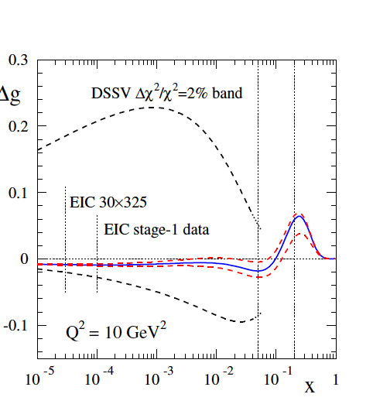
Nucleon Spin: Precision measurement of ΔG
Sassot & Stratmann
Yellow band (left) reduces to the
band shown with red dashed line (right)

Slide 31
Science of EIC:
Precise Investigations of the “Glue & Sea Quarks”
Precision measurements of Sea Quarks and Gluon’s Spin via inclusive and semi-inclusive DIS including EW probes of the hadron structure
Measurement of (gluon) GPDs & TMDs: via semi-inclusive and exclusive DIS → wide range in x and Q²
  3D momentum and position (correlations) of the nucleon → Possibly leading to orbital angular momentum
Study of extreme high gluon densities via inclusive and sem-inclusive DIS off a wide range of nuclei and energies
High energy, beam polarization, and a full acceptance detector: why not explore precision electroweak physics and EW (spin) structure functions
Burkardt, Prokudin, Yuan
M. Burkardt, Prokudin
K. Itakura, T. Ullrich, J. Qiu

Slide 32
EIC Luminosity vs. Time (Detector)
Inclusive
Semi-Inclusive
Exclusive
Luminos I ty
eRHIC/ELIC detector with good
PID & full acceptance
Stage 1 Physics
ePHENIX/eSTAR
MEIC Detector
Time & Detector

Slide 33
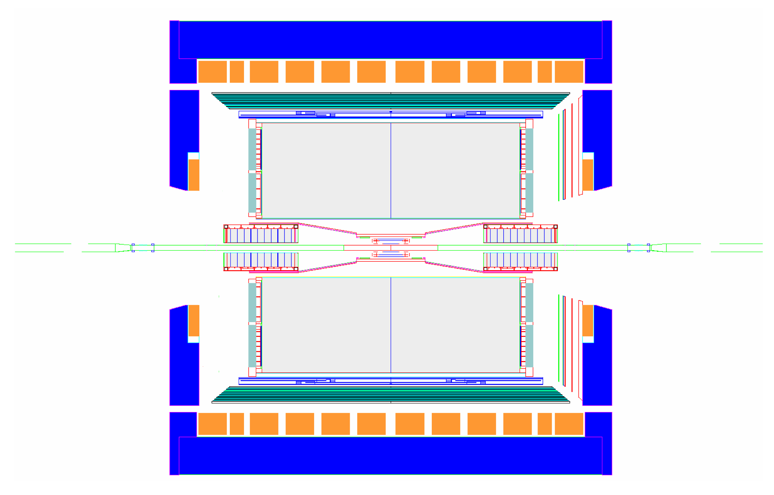
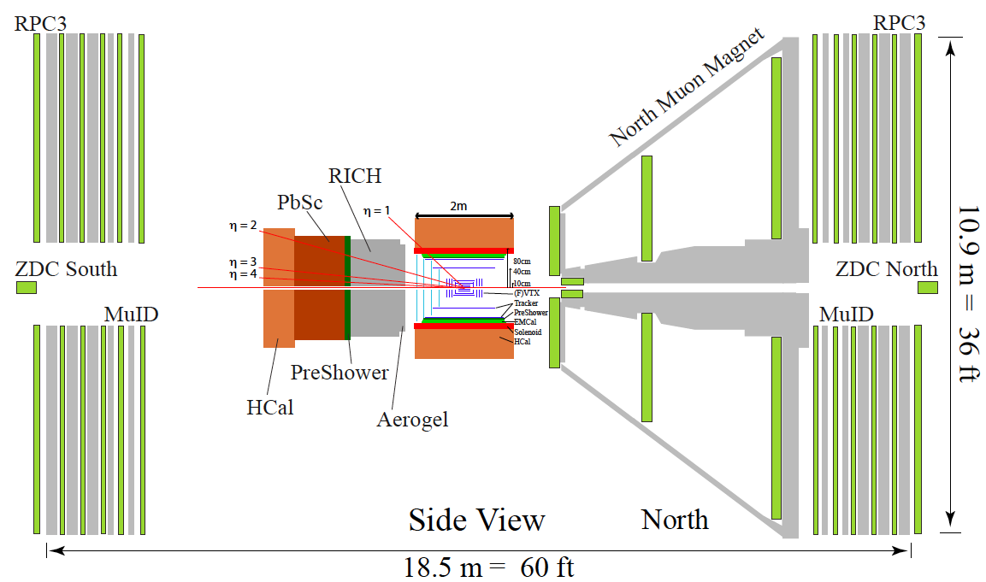
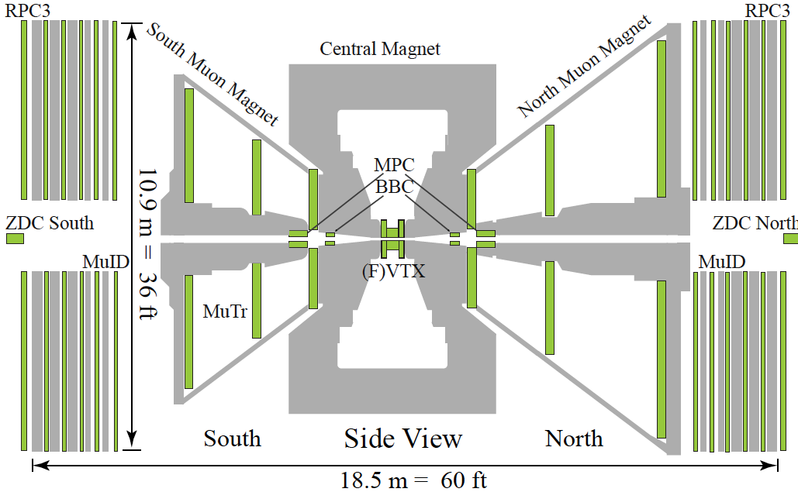
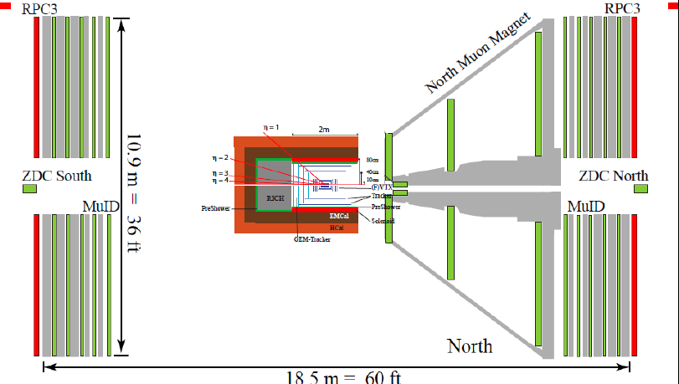
proton
nucleus
eSTAR
J. H. Lee
nucleus
electron
s/ePHENIX
B. Jacak

Slide 34
Science of EIC: Stage 1
Nucleon (spin) structure
  Precision measurements of ΔQ, ΔQbar and ΔG via inclusive and semi-inclusive DIS
Start the measurement of (gluon) GPDs & TMDs: 3D momentum and position (correlations) of the nucleon, possibly leading to orbital angular momentum(?)
Start the study of extreme high gluon densities via inclusive and sem-inclusive DIS off a wide range of nuclei
High energy, beam polarization, and a full acceptance detector: why not explore precision electroweak physics and EW (spin) structure functions?

Slide 35
EIC Project status and plans
A “collaboration” of highly motivated people:
  EIC Collaboration Web Page: http://web.mit.edu/eicc/
  100+ dedicated physicists from 20+ institutes
  Task Forces at BNL (Aschenauer & Ullrich) and at Jefferson Laboratory (Ent)
  Steering Committee (co-ordinators: A. Deshpande & R. Milner)
EIC International Advisory Committee formed by the BNL & Jlab Management to steer this project to realization: W. Henning (ANL/RIKEN, Chair), J. Bartels (DESY),A. Caldwell (MPI, Munich) A. De Roeck (CERN), R. Gerig (ANL), D. Hetrzog (U of W), X. Ji (Maryland), R. Klanner (Hamburg), A. Mueller (Columbia), S. Nagaitsev (FNAL), N. Saito (J-PARC), Robert Tribble (Texas A&M), U. Wienands (SLAC), V. Shiltev (FNAL)
A White for NSAC Long Range Plan 2012/2013 to be produced by early 2012
Writing Group: E; Aschenauer, M. Diehl, H. Gao, A. Hutton, T. Horn, K. Kumar, Y. Kovchegov, M. Ramsey-Musolf, T. Roser, F. Sabatie, E. Sichtermann, T. Ullrich, W. Vogelsang, F. Yuan
Senior Advisors: A. Mueller, R. Holt
Co-Chairs/Editors: A. Deshpande, J. Qiu, Z.E. Meziani

Slide 36
Generic Detector R&D for an EIC
Community wide call for R&D Detector proposals for EIC
Program run from BNL (RHIC R&D funds), NOT site specific
New detector technology for fiber sampling calorimetry for EIC and STAR.
UCLA, Texas A&M, Penn State
Front end readout modules for data acquisition and trigger system.
Jefferson Lab
DIRC based PID for EIC Central Detector.
Catholic U. of America, Old Dominion U., JLab, GSI (Darmstadt)
Liquid scintillator calorimeter for the EIC.
Ohio State U.
Test of improved radiation tolerant silicon PMTs.
Jefferson Lab
Letter of Intent for detector R&D towards an EIC detector (Low mass tracking and PID).
BNL, Florida Inst. Tech., Iowa State, LBNL, LANL, MIT, RBRC, Stony Brook, U. of Virginia, Yale U.
Seeds for possible future experimental collaboration…. Attracting new collaborators….
Next round of applications and updates requested in November, 2011

Slide 37
H. Montgomery, Jeff. Laboratory Director
EIC Realization Possible Time Line
eRHIC, Vigdor’s time line similar
Activity Name | 2010 | 2011 | 2012 | 2013 | 2014 | 2015 | 2016 | 2017 | 2018 | 2019 | 2020 | 2021 | 2022 | 2023 | 2024 | 2025
12 Gev Upgrade
FRIB
EIC Physics Case
NSAC LRP
CD0
Machine Design/R&D
CD1/D’nselect
CD2/CD3
Construction
Construction Schedule Highly Site Dependent

Slide 38
Summary
Science Case for EIC: → “Understand QCD” via
“Precision study of the role of gluons & sea quarks in QCD”
The Collaboration & the BNL+Jlab managements are moving (together) towards realization: Milestoe: NSAC approval 2013
Machine R&D, detector discussions, simulation studies towards making the final case including detailed detector design and cost considerations
INVITATION: Ample opportunities to get involved and influence this exciting quest for understanding of QCD!
RIKEN’s investment in RHIC has had a DISPROPORTIONATELY LARGE IMPACT on RHIC science: Understanding QCD: Experiment, Theory & Lattice QCD
EIC is the opportunity to do the same or better in the next decade

Slide 39
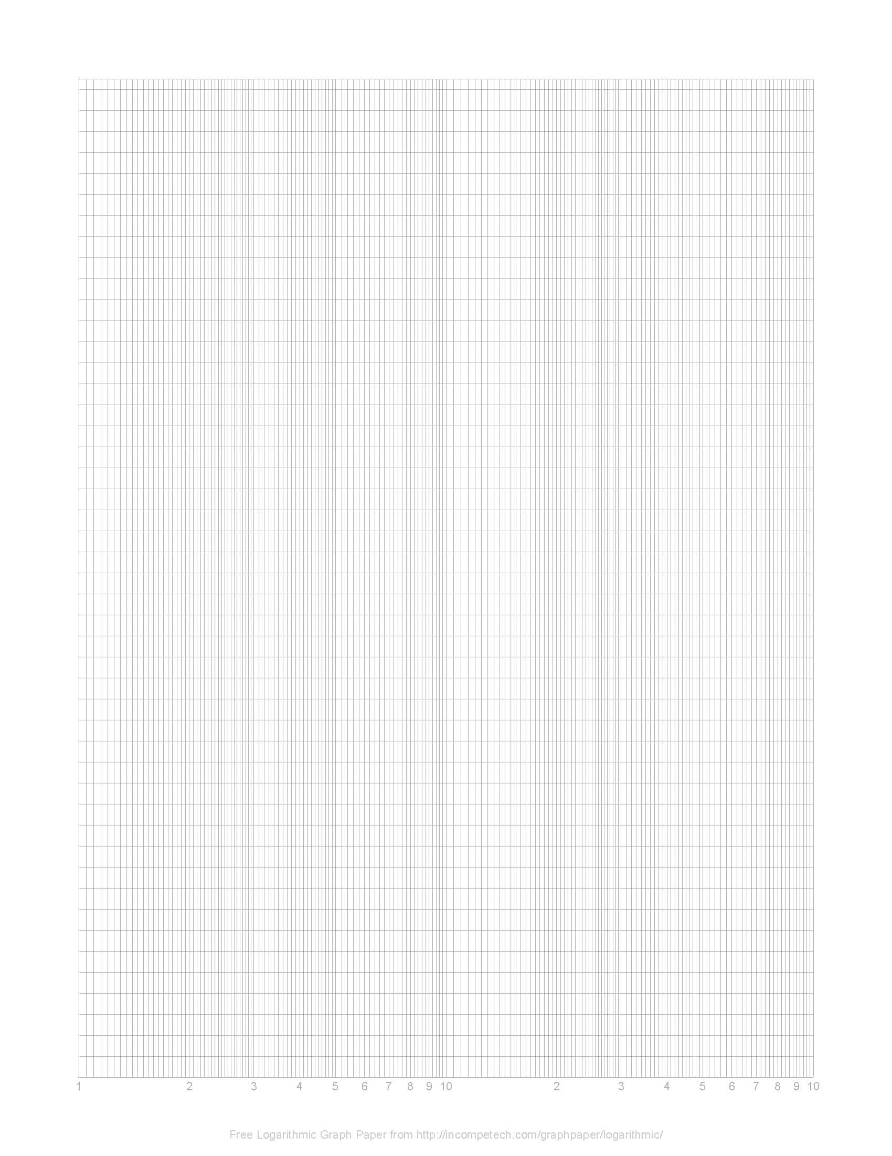
Physics Opportunities at the EIC
EIC Physics Landscape
50 fb⁻¹
E_{CM} (GeV)
120
DIS
nucleon
structure
100
x_{min} ~ 10⁻⁴
gluon saturation
Electroweak & BSM processes
80
quarks, gluons in nuclei
60
exclusive
processes
40
x_{min} ~ 10⁻³
sin²θ_{W}
20
x_{min} ~ 10⁻²
0
∫L dt (fb⁻¹)
1
10
100

Slide 40
Electroweak & beyond….(?)
BNL LDRD: Deshpande, Marciano, Kumar & Vogelsang
High energy collisions of polarized electrons and protons and nuclei afford a unique opportunity to study electro-weak deep inelastic scattering
  Electroweak structure functions (including spin)
  Significant contributions from W and Z bosons which have different couplings with quarks and anti-quarks
Parity violating DIS: a probe of beyond TeV scale physics
  Measurements at higher Q² than the PV DIS 12 GeV at Jlab
  Precision measurement of Sin²Θ_{W}
New window for physics beyond SM?
  Lepton flavor violation search
arXiv: 006.5063v1 [hep-ph]
M. Gonderinger et al.

Slide 41
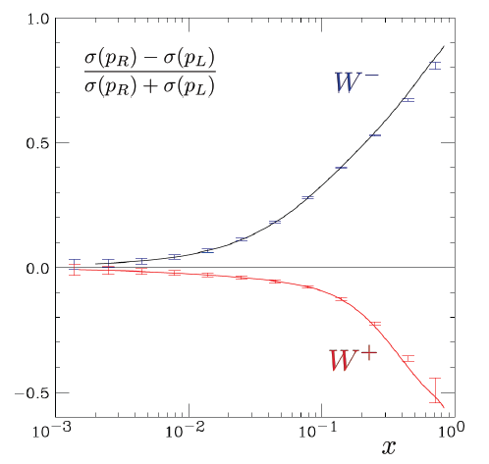
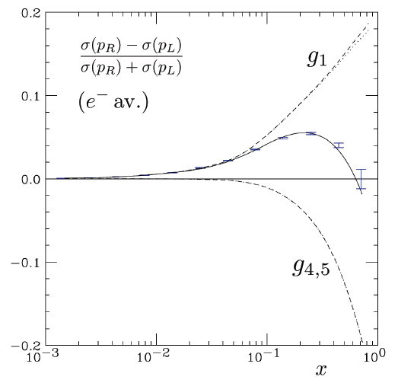
EW Physics Highlights
Deviations from the curve may hint at existence of BSM scenarios including: Lepto-Quarks, RPV SUSY extensions, E₆/Z’ based extensions of the SM
Electroweak CC and NC structure functions: access to spin properties of quarks and anti-quarks over a wide x, Q² range.
NC
CC

Slide 42
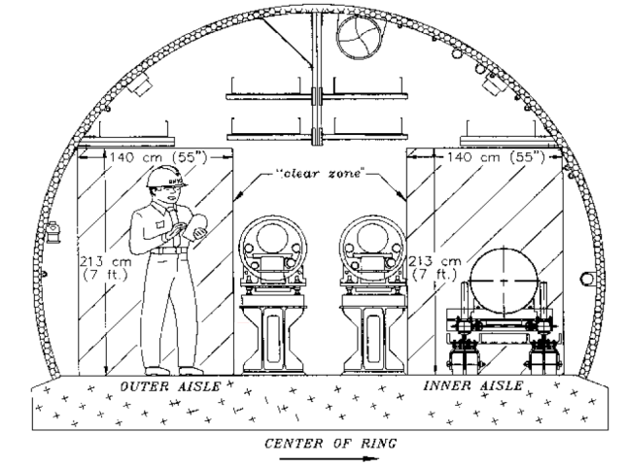
S. Vigdor, BNL Associate Director
eRHIC-I physics
RHIC-II science by-passing RHIC-II project
Opportunity for up-grade* or 1st EIC stage (eRHIC-I)
EIC = Electron-Ion Collider; eRHIC = BNL realization by adding e beam to RHIC
Luminosity upgrade:
Staged approach to eRHIC
Further luminosity upgrades (pp, low-E)
Further luminosity upgrades (pp, low-E)
LHC HI starts
electron recirc-ulation mag-nets
eRHIC will add electron ERL inside RHIC tunnel, going from 5 to 30 GeV in stages
© V. Litvinenko
* New PHENIX and STAR Decadal Plans provide options for this period.
Notes:
42

Slide 43
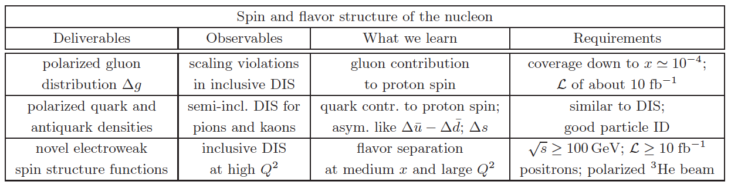
Golden Measurements (1)
Spin & flavor structure of the nucleon

Slide 44
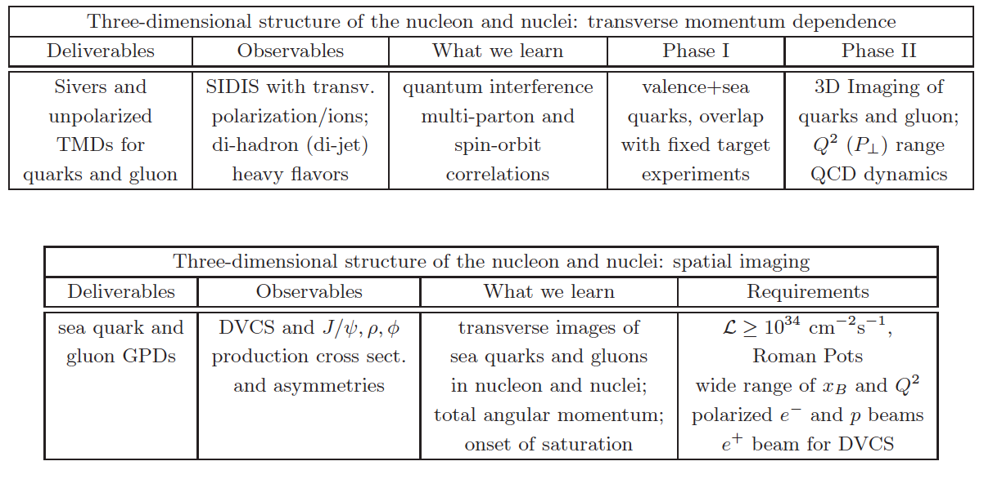
Golden Measurements (2):
TMDs & GPDs of nucleons & nuclei

Slide 45
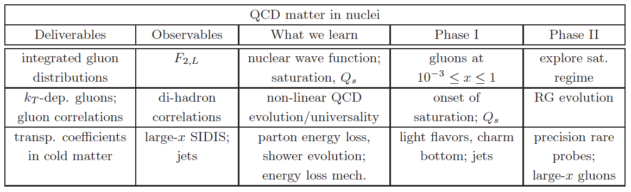
Golden Measurement (3):
QCD matter in Nuclei

Slide 46
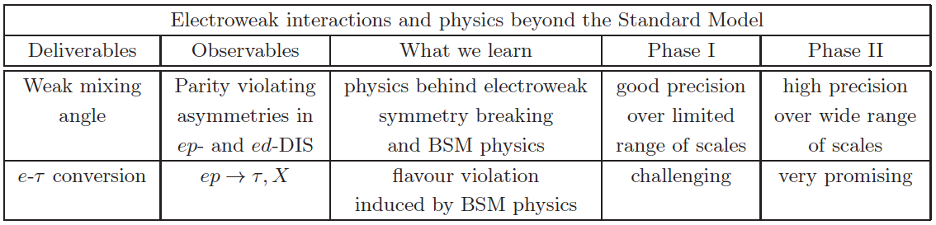
Golden Measurements (4):
EW interactions & BSM

Slide 47
sPHENIX → ePHENIX → eRHIC
My Cartoon !
South Side
North Side
p, ³He, A Beam direction
Electron Beam Direction

Slide 48
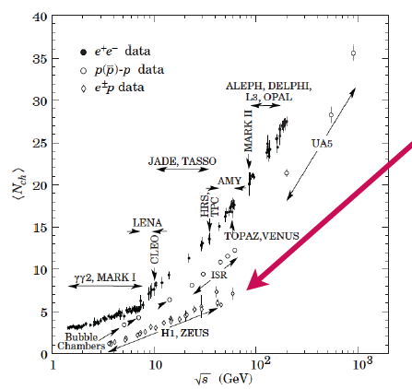
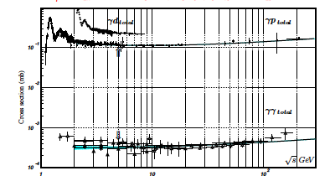
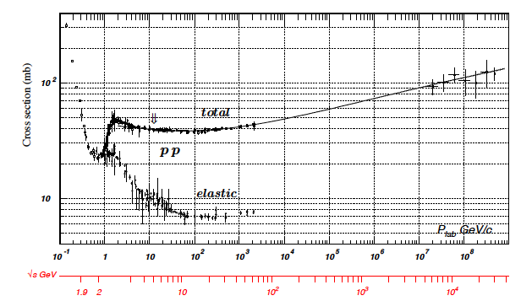
Some thought about rates
low multiplicity
4-6 √s = 40-65 GeV
N_{ch} (ep) ~ N_{ch} (eA) < N_{ch}(pA)
→ no occupancy problem
Cross section:
Pythia σ_{ep}: 0.030 – 0.060 mb
Luminosity: 10³⁴ cm⁻¹ s⁻¹ ⁼ 10⁷ mb⁻¹ s⁻¹
Interaction rate:
300 -600 kHz

