Slide 1
Heavy ion physics with PHENIX upgrades
Takao Sakaguchi
Brookhaven National Laboratory
For Future direction in High Energy QCD, RIKEN, Oct 20, 2011

Slide 2
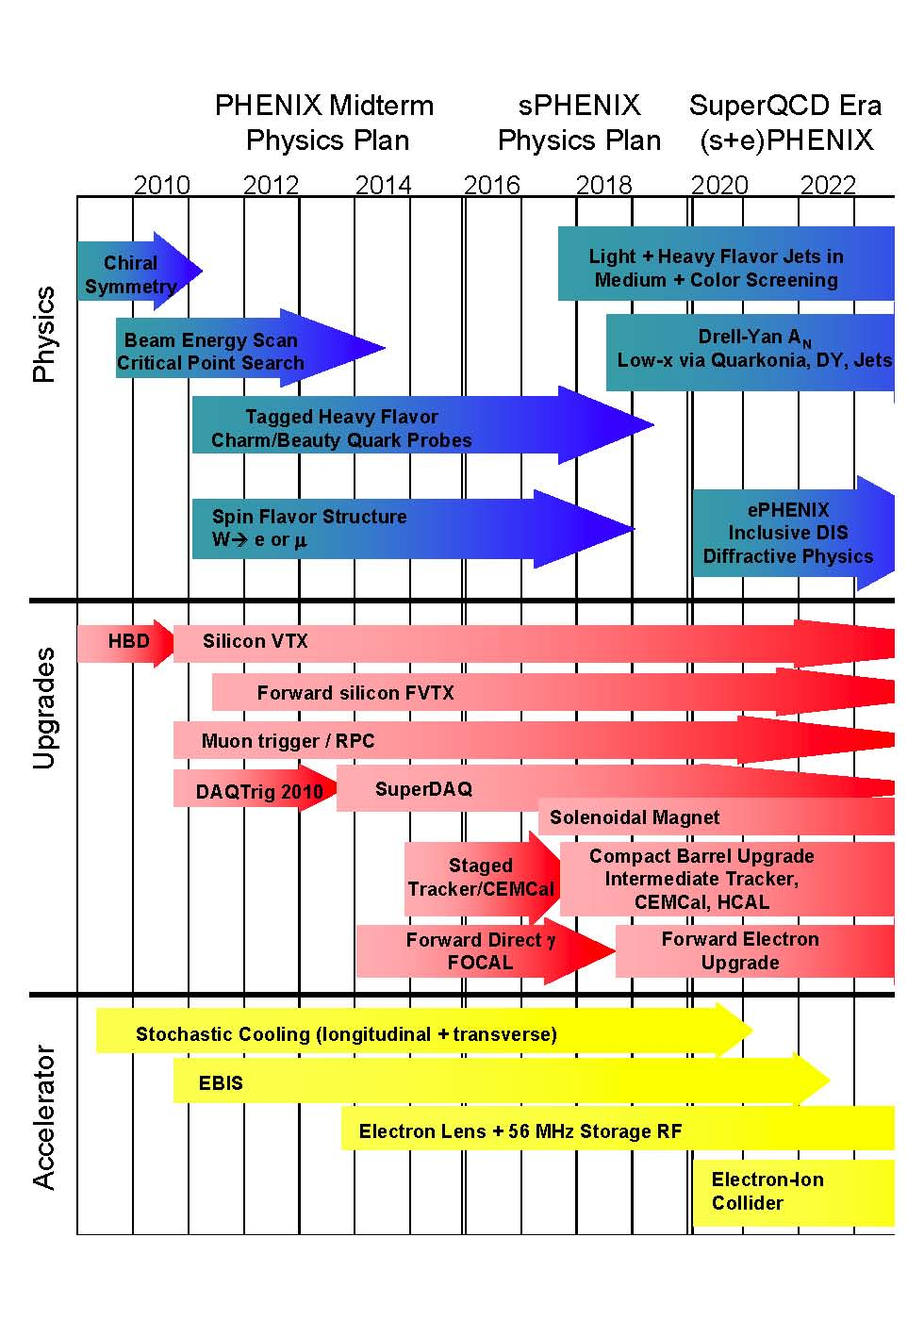
PHENIX upgrade plans

Slide 3
Major upgrades for next ~5 years
Hadron Blind Detector (HBD)
  Tag and reject electron-pairs that have small opening angles (likely due to conversions or Dalitz decay)
  Installed in Run-10 and completed mission
Resistive Plate Chamber (RPC) & Muon Trigger upgrade
  Installed in Run-11 in Muon Arm. Measure timing of muons in order to select muons from a same bunch-crossing.
Silicon Vertex Detector (VTX)
  Measure DCA of tracks, and tag D, B originated electrons
  Installed in Run-11. Now in repair for Run-12
Forward Vertex Detector (FVTX)
  Measure DCA of tracks in forward rapidity region
  To be installed in Run-12
Muon Piston Calorimeter extension (MPC-EX) (3.1<|η|<3.8)
  Shower max detector in front of existing MPC
  Measure direct photons/π⁰ in forward rapidity region

Slide 4
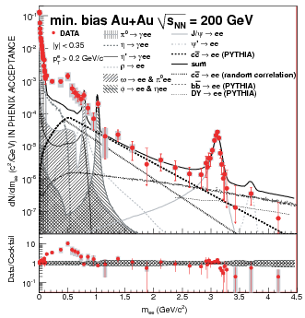
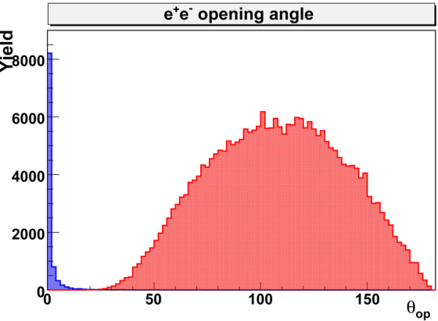
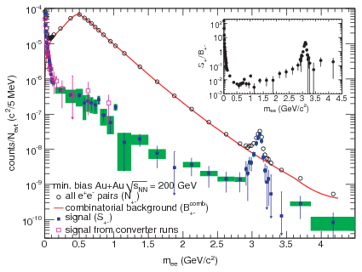
Low mass dilepton issue
*Phys.Rev.C81, 034911 (2010)
Results* from RHIC Run-4:
Yield in m_{ee} = 0.15 - 0.75 GeV/c² larger by a factor 4.7 +/- 0.4(stat.) +/- 1.5(syst.) +/- 0.9(model) compared to the expected hadronic contribution
S/B in this mass region is 1/200
combinatorial background should be reduced!
One way is to look at the opening angle
of electron-pairs
Simulation
π⁰->e⁺e⁻γ
φ ->e⁺e⁻
θ_{op}
Notes:
Dileptons (dielectrons) interact only electromagnetically, so their path from the interaction region to the detectors is almost undisturbed
They can give information about the properties of the H&D nuclear matter in the early stages of the collisions where deconfinement and chiral symmetry restoration are expected to take place.
Effects of chiral symmetry restoration can be manifested as in-medium modification of the low mass vector mesons
The results show enhancement, but with large B/S ratio
In order to make progress, comb. background should be reduced.

Slide 5
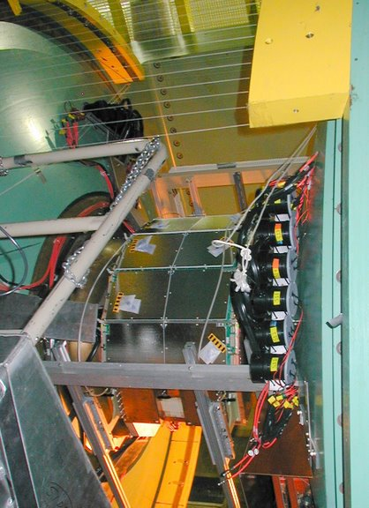
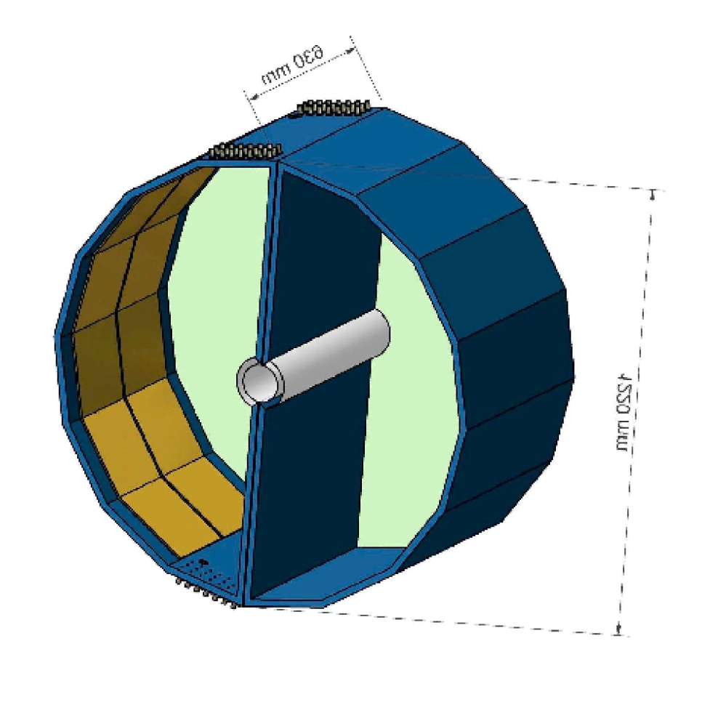
Hadron Blind Detector
Designed for low-mass dileptons in A+A
  Operated in Run-9 and 10
Removes Dalitz and conversion pairs
  Reduce background γ*
signal electron
e⁻
partner positron
needed for rejection
Cherenkov
blobs
e⁺
θ_{pair}
opening
angle
~ 1 m
Windowless Cerenkov detector with CF4 avalanche/radiator gas (2 cm pads)
CsI photocathode covering triple GEMs

Slide 6
HBD performance
N₀ ideal value | 714 cm⁻¹
Optical transparency of mesh | 88.5 %
Optical transparency of photocath. | 81.0 %
Radiator gas transparency | 89.0 %
Transport efficiency | 80.0 %
Reverse bias and pad threshold | 90.0 %
N₀ calculated | 328 +/- 46 cm⁻¹
N_{pe} expected | 20.4 +/- 2.9
N_{pe} measured | 20
N₀ measured value | 330 cm⁻¹
The average number of photo-electrons N_{pe} in a Cherenkov counter:
with:
  bandwidth: 6.2 eV (CsI photo-cathode threshold) - 11.5 eV (CF₄ cut-off)
The highest ever measured N₀!
The high photoelectron yield →excellent single electron detection efficiency:
→ Single electron efficiency using a sample of open Dalitz decays: ε ~ 90 %
→ Single electron efficiency derived from the J/Ψ region: ε = 90.6 ± 9.9 %
Notes:
N0 is a figure of merit depending on the detector properties (radiator and system
transparency, geometrical acceptance of photons (area and
angle), quantum efficiency, photoelectron collection efficiency…)
for ideal detector it is obtained by integrating the detector response over Cherenkov energy spectrum
gamma_th is the average Cherenkov threshold over the sensitive bandwidth of the detector
L is the radiator length
Generally for Cherenkov counters N0 is the figure of merit, defined by:
N = N0 L sin(th_c)^2

Slide 7
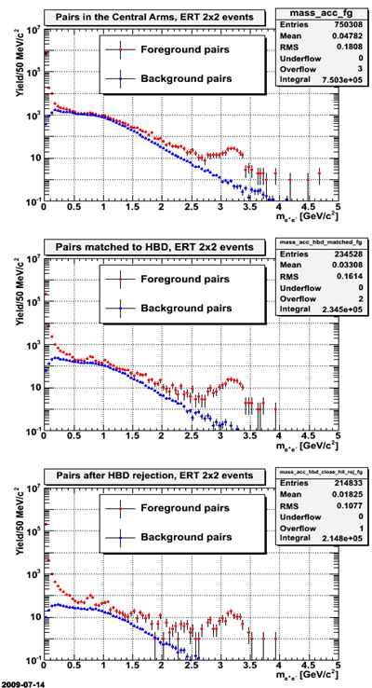
Background rejection in p+p
Pairs in Central Arms
Present status from Run-9 p+p:
Background reduction in m_{ee} > 0.15 GeV/c²
(not fully optimized)
Pairs matched to HBD
 | Step | Bckg. reduction factor
1 | matching to HBD | 7.1
2 | double hit cut close hit cut | 6.5
Pairs after HBD reject.

Slide 8
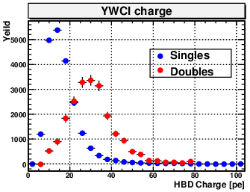
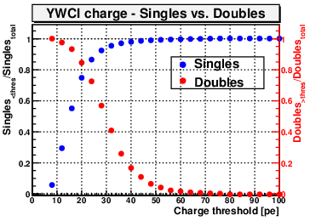
The HBD analysis in Au+Au (Run-10):
Single vs. double charge
Rejection of upstream conversions and π⁰ Dalitz pairs is achieved with single/double charge cut
This requires good gain calibration throughout the entire run
Single electrons hits studied using MC electrons from φ->e⁺e⁻ embedded in Au+Au data
Double electron hits studied using MC π⁰−>γγ embedded in Au+Au data
Single efficiency vs. double rejection
Singles efficiency
Doubles rejection

Slide 9
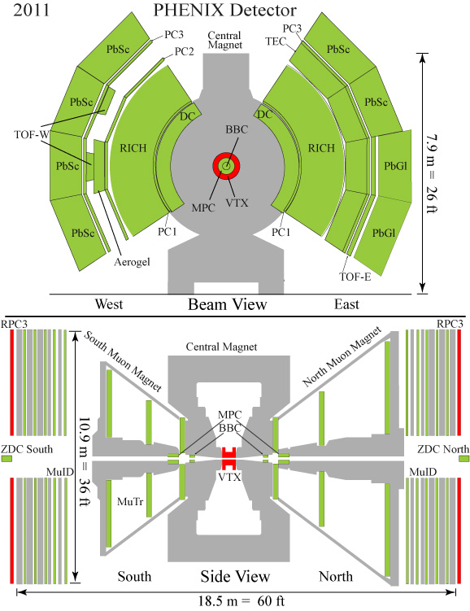
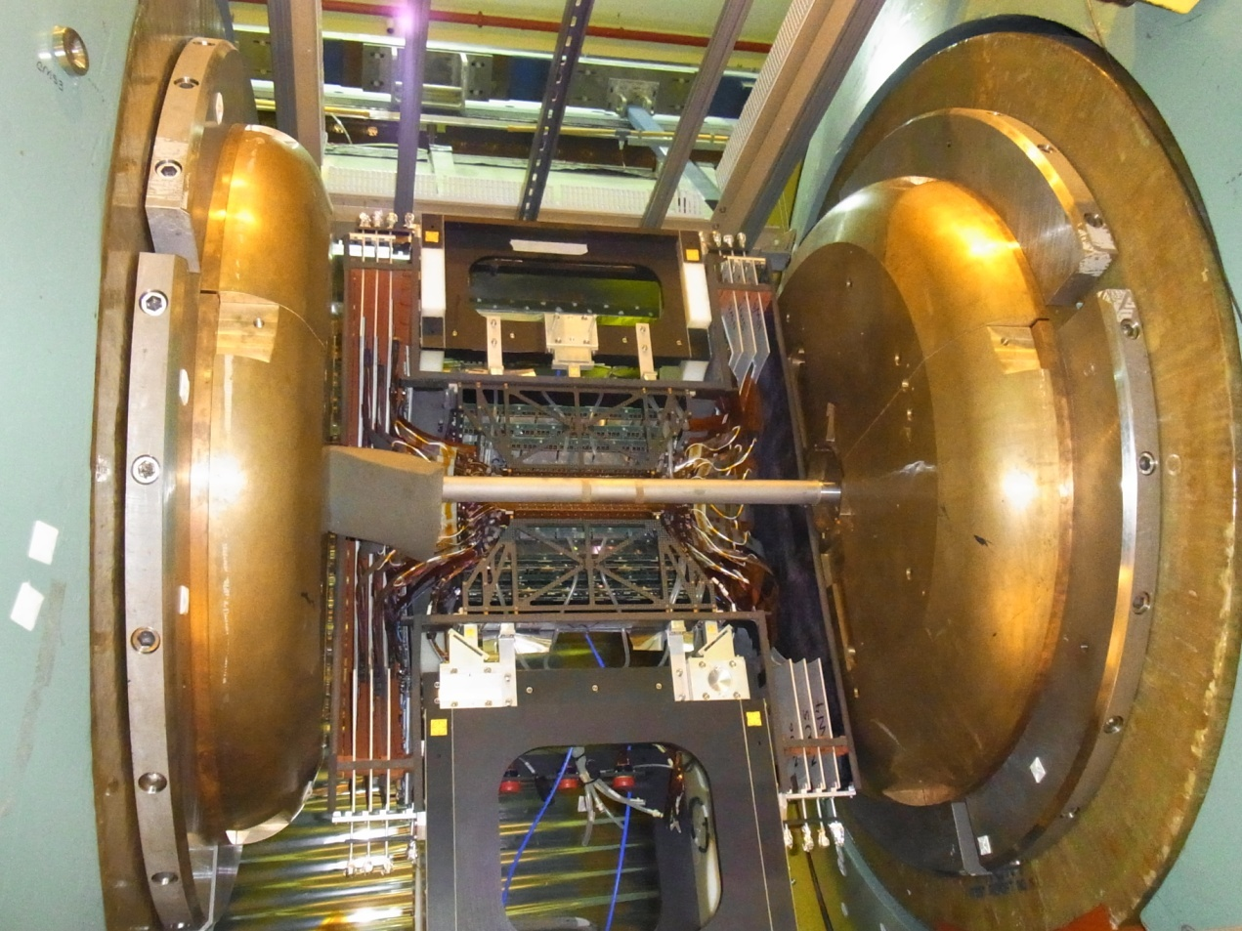
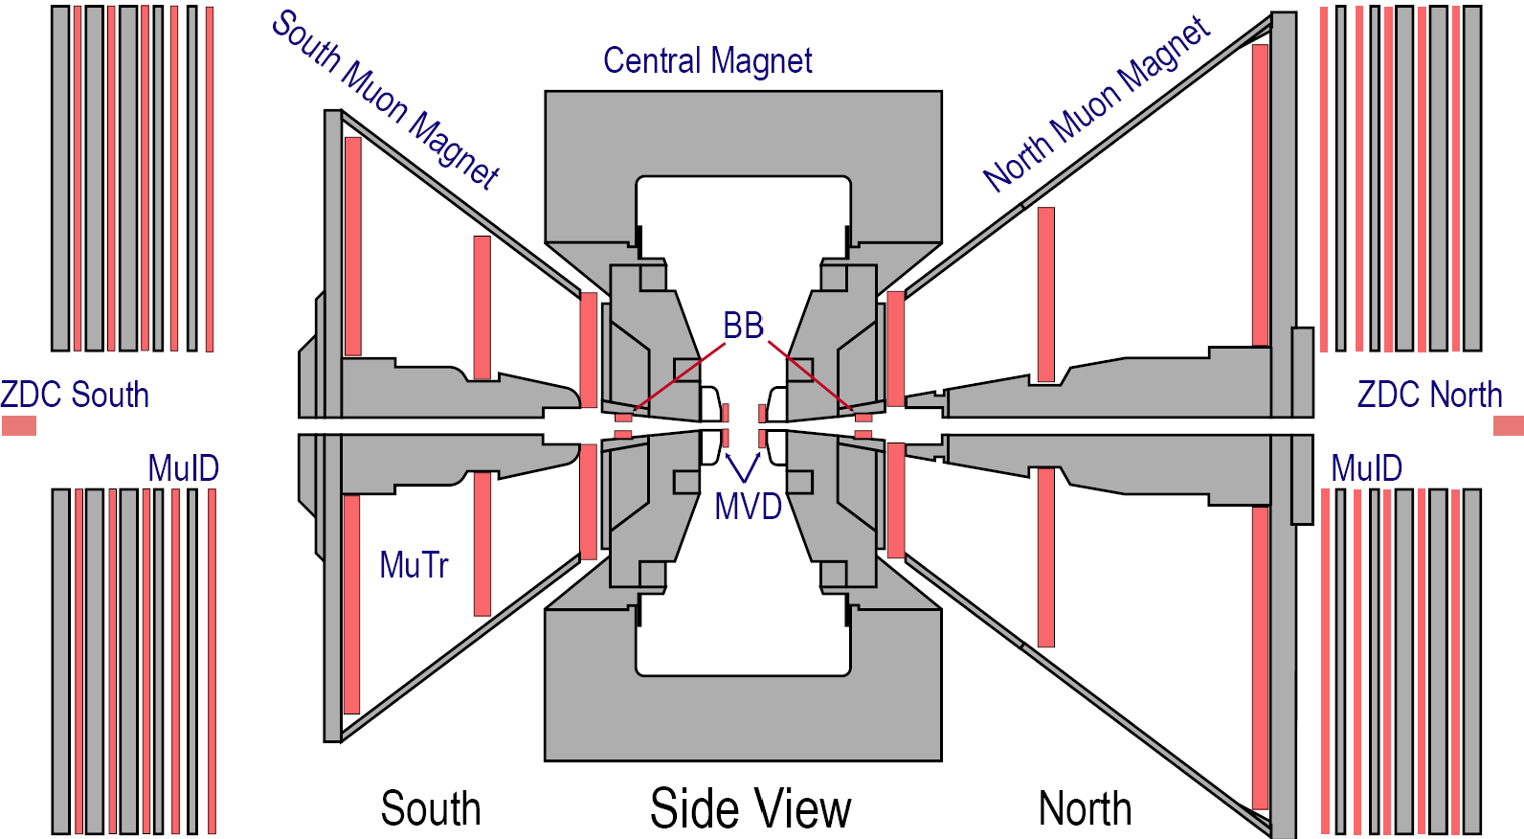
Run-11 PHENIX detector
e^{+/-}
Central Arms:
hadrons, photons, electrons
|η| < 0.35
Δφ = π (2 arms x π/2)
Global Detectors:
Beam-Beam Counter (BBC)
Zero Degree Calorimeter (ZDC)
muTr north
muTr south
Muon Arms:
muons
1.2 < |η| < 2.2
Δφ = 2π
μ^{+/-}
muID
south
muID
north
MPC 3.1 < | η | < 3.9
RPC1(a,b)
RPC3
RPC3

Slide 10
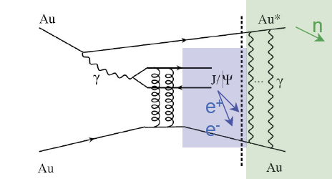
Triggering muons from W
In order to measure W at 500 GeV, a first level trigger rejection of a factor 10000 is needed
For heavy ion physics:
Extend capability of accepting ultra peripheral collisions
Previous Muon Trigger at PHENIX

Slide 11
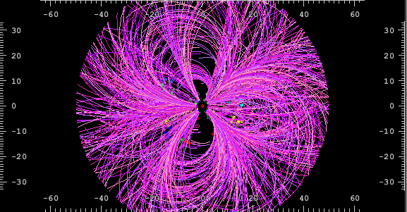
Run-11: Single event from Au+Au at 200 GeV
VTX event display
Run # 343450-0014 Event 13

Slide 12
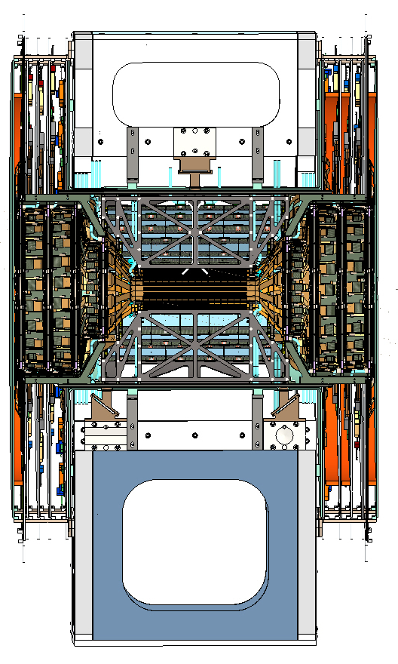
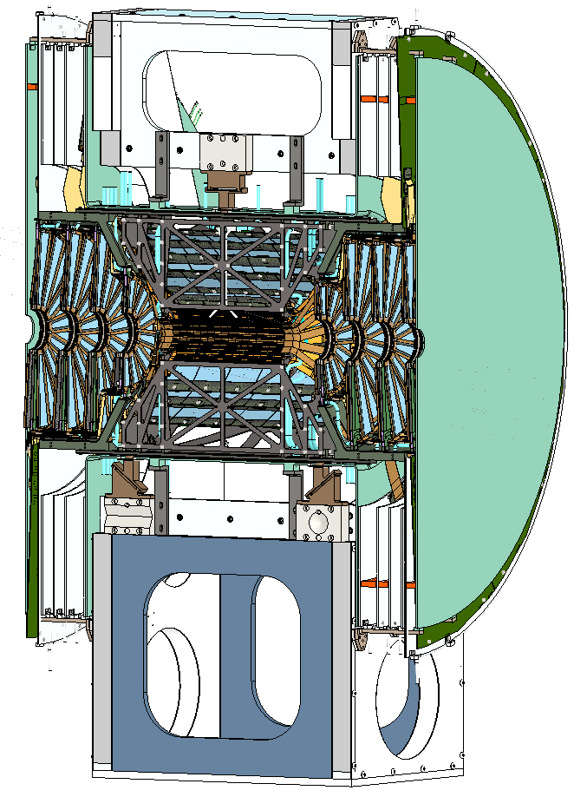
VTX with FVTX (Run-12 goal)

Slide 13
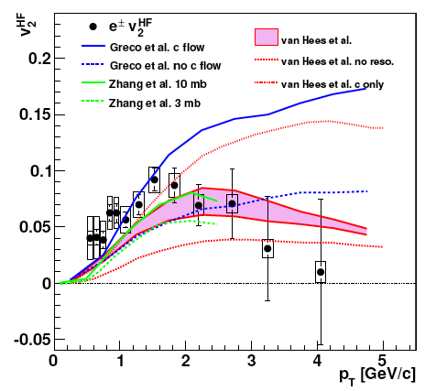
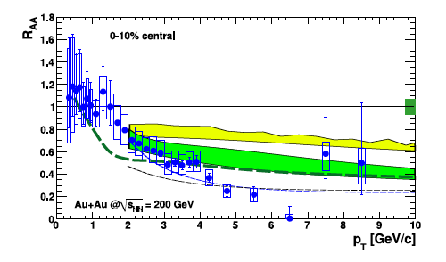
Heavy quark suppression & flow?
FVTX/VTX physics
Collisional energy loss?
v₂ decrease with p_{T}?
role of b quarks?
PRL.98: 172301,2007
arXiV: 1005.1627

Slide 14
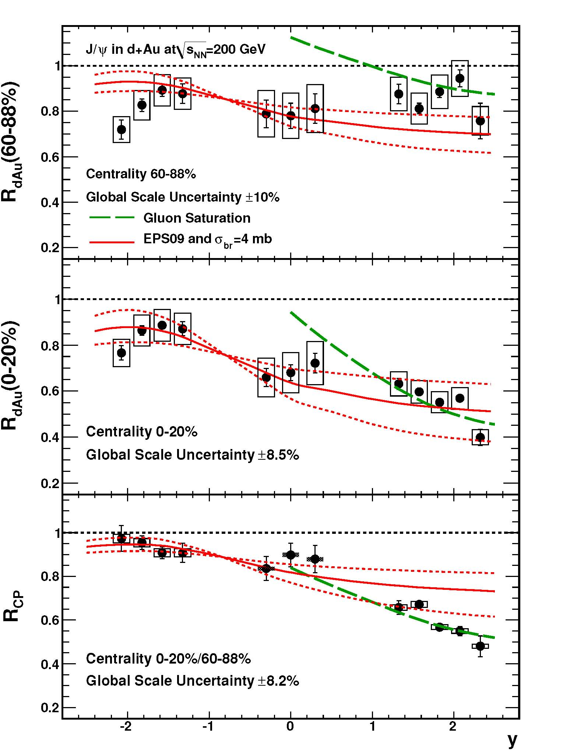
FVTX specific
arXiv:1010.1246
d + Au → J/ψ
As far as heavy ion physics is concerned, we might focus on cold nuclear matter (CNM) effect
Resolving J/ψ and ψ’ in Muon arms
Direct measure of B meson through displaced J/ψ
Drell-Yan or J/ψ Measurements in dAu at both forward rapidity
  Detect quark distribution in nuclei
  Combining with mid-rapidity results

Slide 15
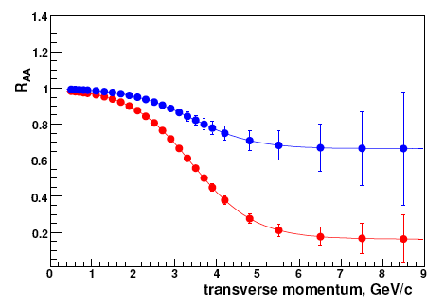
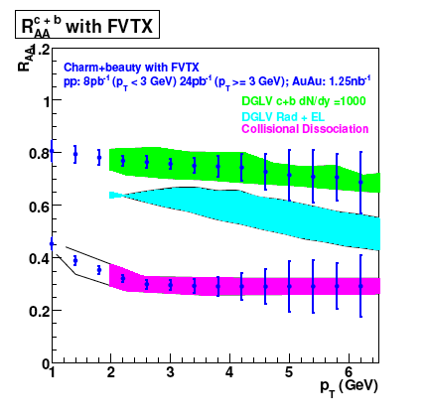
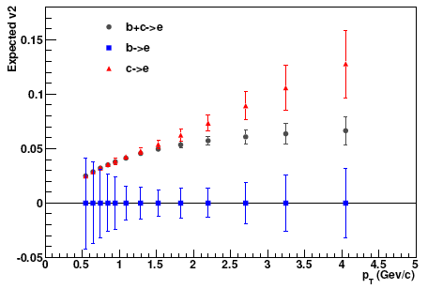
VTX/FVTX physics capabilities
8 weeks Au+Au w/VTX
In Run-11 ~ two good weeks for VTX Au+Au data taking
Run-12 Goal for FVTX: Commission

Slide 16
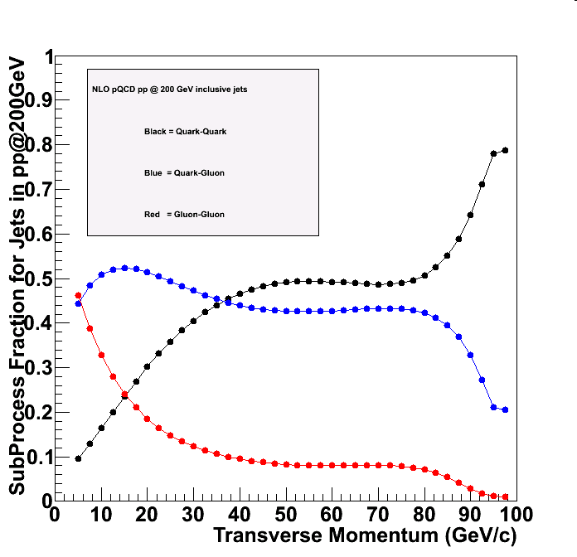
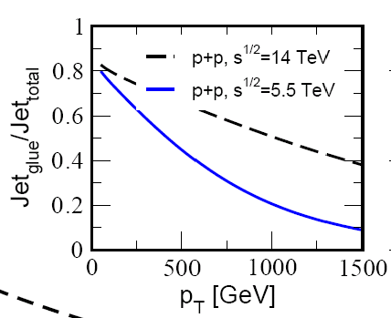
RHIC (hard) studies in LHC era
Hard probe difference
  More quark jets instead of gluon jets
  PHENIX can select pure sample of quark jets via γ-jet correlation (demonstrated in our paper in p+p measurement, PRD82, 072001 (2010))
Medium difference
Key machine flexibillity
  pA, light AA, asymmetric systems such as Cu+Au.
LHC ~ 50-75% gluon jets
RHIC ~ 75% quark jets

Slide 17
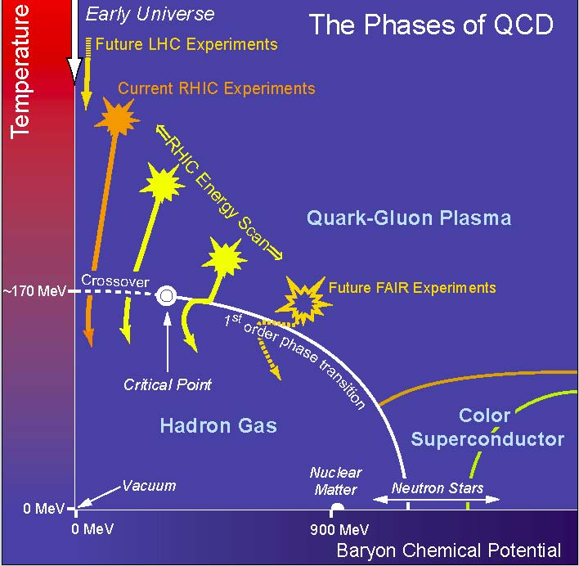
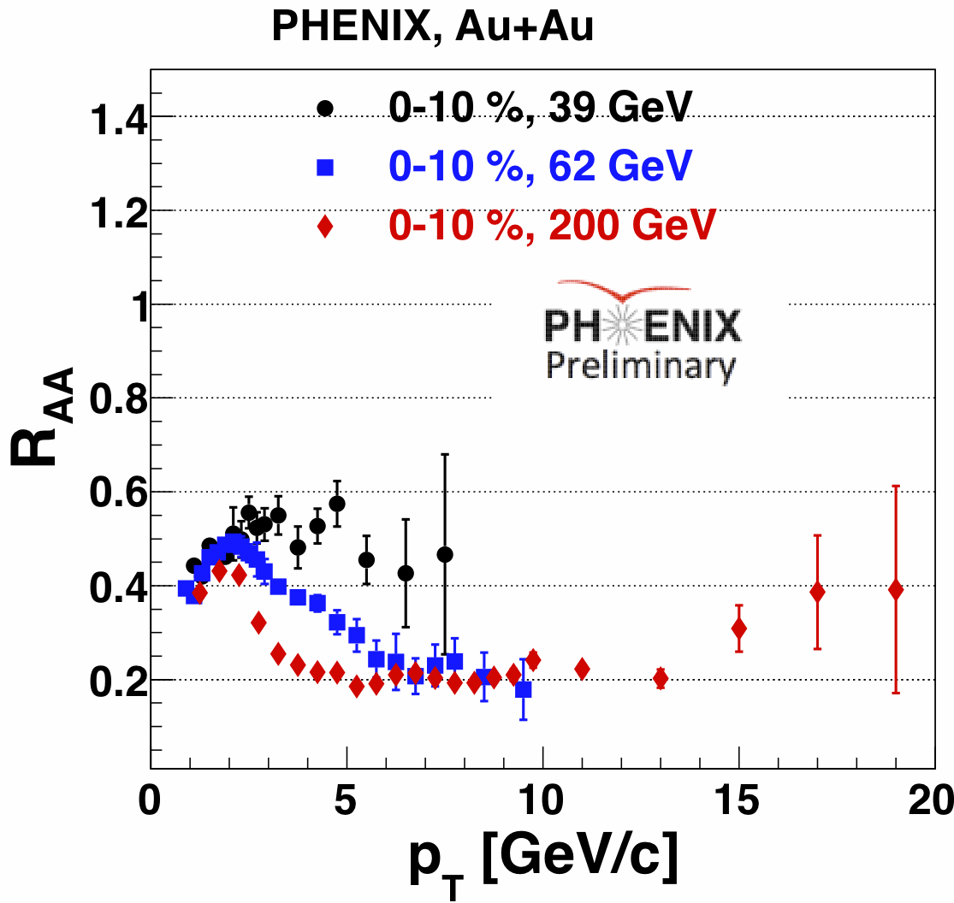
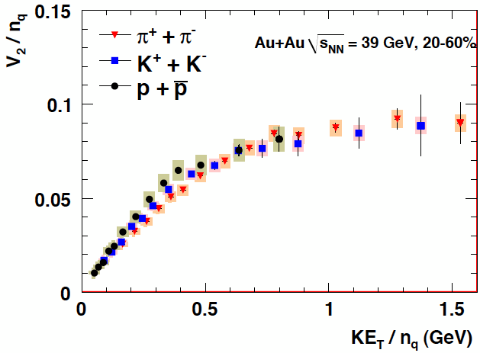
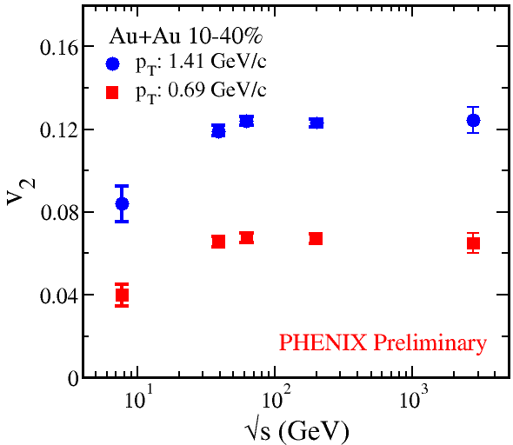
Finding the QCD Critical Point
Singular point in phase diagram that separates 1st order phase transition (at small T) from smooth cross-over (at small μ_{b})
Quark-number scaling of V₂
  saturation of flow vs collision energy
  η/s minimum from flow at critical point
Critical point may be observed via:
  fluctuations in <p_{T}> & multiplicity
  K/π, π/p, pbar/p chemical equilibrium
  R_{AA} vs √s, ….
VTX provides large azimuthal acceptance & identification of beam on beam-pipe backgrounds

Slide 18
A thing we don’t want to throw out

Slide 19
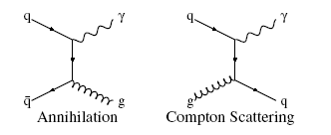
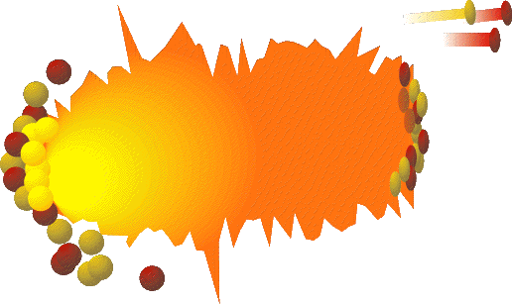
Electromagnetic probes
Photon Production: Yield ∝ αα_{s}
Production Process
  Compton and annihilation (LO, direct)
  Fragmentation (NLO)
  Escape the system unscathed
Carry dynamical information of the state
Temperature, Degrees of freedom
  Immune from hadronization (fragmentation) process at leading order
  Initial state nuclear effect
    Cronin effect (k_{T} broardening)
e⁺
e⁻
γ∗
γ

Slide 20
Possible sources of photons
hard scatt
jet Brems.
parton-medium interaction
jet-thermal
sQGP
hadron gas
hadron
decays
γ* → e+e-
virtuality
log t
0.5
1
10
10⁷
(fm/c)
1
By selecting masses, hadron decay backgrounds are significantly reduced. (e.g., M>0.135GeV/c²)
Mass
(GeV/c²)
Notes:
20

Slide 21
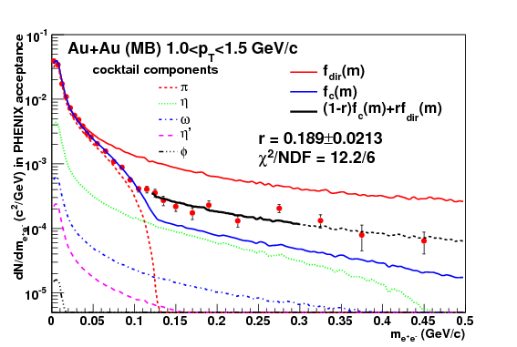
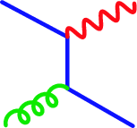
Low p_{T} photons with very small mass
PRL104,132301(2010), arXiv:0804.4168
Focus on the mass region where π⁰ contribution dies out
For M<<p_{T} and M<300MeV/c²
  qq ->γ* contribution is small
  Mainly from internal conversion of photons
Can be converted to real photon yield using Kroll-Wada formula
  Known as the formula for Dalitz decay spectra
One parameter fit: (1-r)f_{c} + r f_{d}
f_{c}: cocktail calc., f_{d}: direct photon calc.
Internal conv.
Compton
e⁺
γ∗
e⁻
q
g
q
Notes:
21

Slide 22
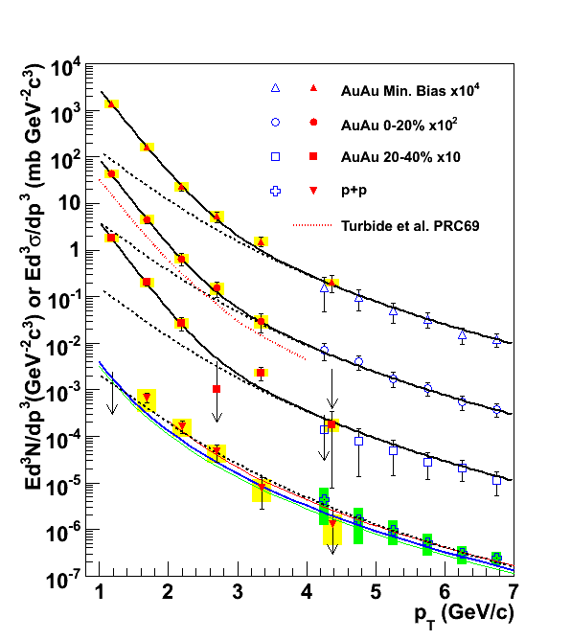
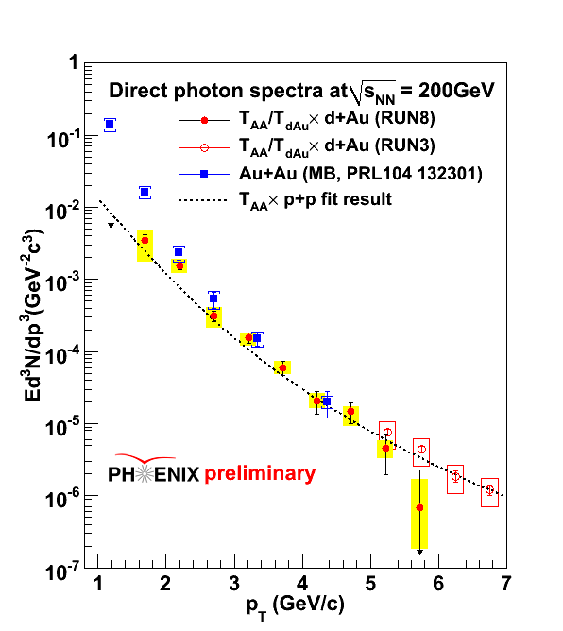
Low p_{T} photons in Au+Au (thermal?)
Inclusive photon × γ_{dir}/γ_{inc}
Fitted the spectra with p+p fit + exponential function
  T_{ave} = 221 ± 19^{stat} ± 19^{syst} MeV (Minimum Bias)
Nuclear effect measured in d+Au does not explain the photons in Au+Au
PRL104,132301(2010), arXiv:0804.4168
Au+Au
d+Au Min. Bias

Slide 23
Photon source detector
Depending the process of photon production, path length dependence of direct photon yield varies
  v₂ of the direct photons will become a source detector
  Later thermalization gives larger v₂
jet fragment photon
annihilation
compton
scattering
jet
v₂ > 0
Bremsstrahlung
(energy loss)
v₂ < 0
For prompt photons: v₂~0
Notes:
23

Slide 24
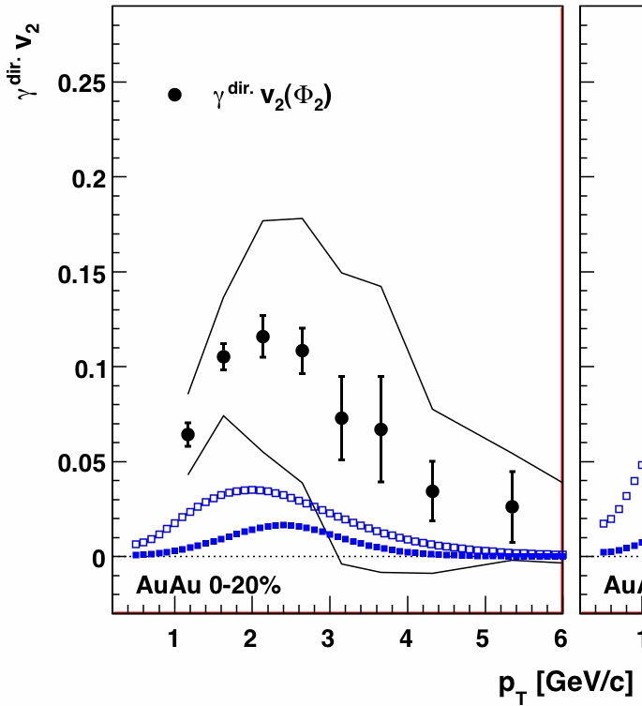
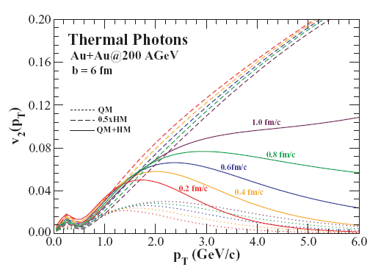
What we learn from model comparison
Later thermalization gives larger v₂ (QGP photons)
Large photon flow is not explained by models
Hydro after τ₀
Curves: Holopainen, Räsänen, Eskola., arXiv:1104.5371v1
thermal
diluted by prompt
Chatterjee, Srivastava PRC79, 021901 (2009)

Slide 25
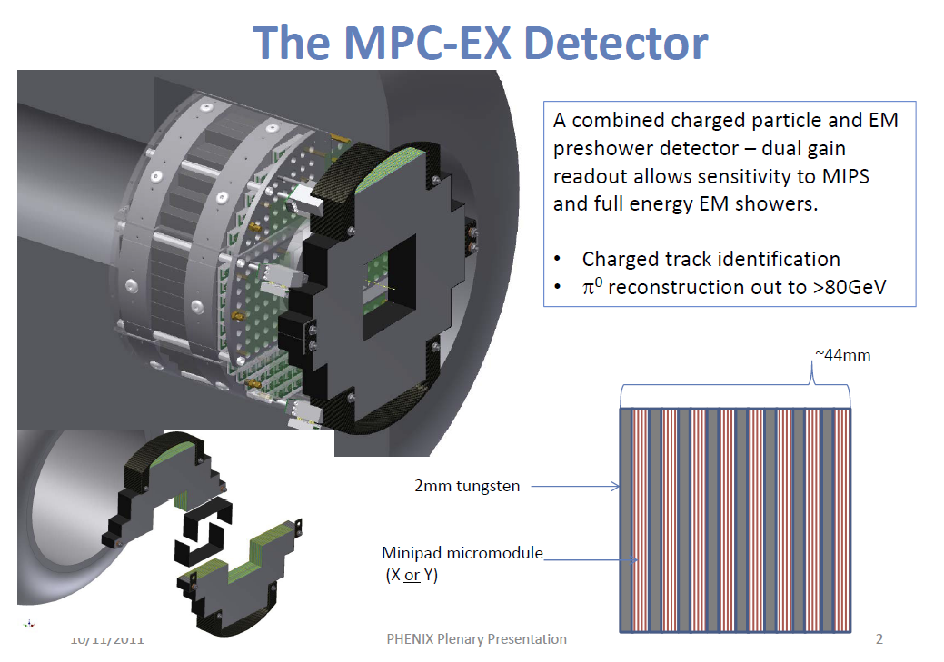
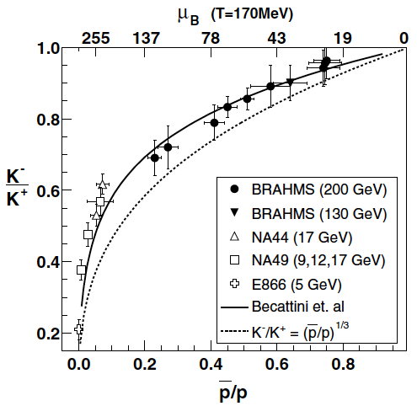
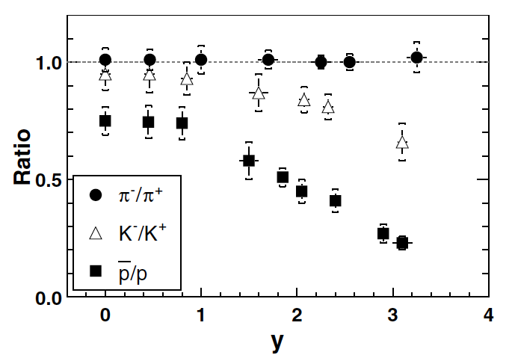
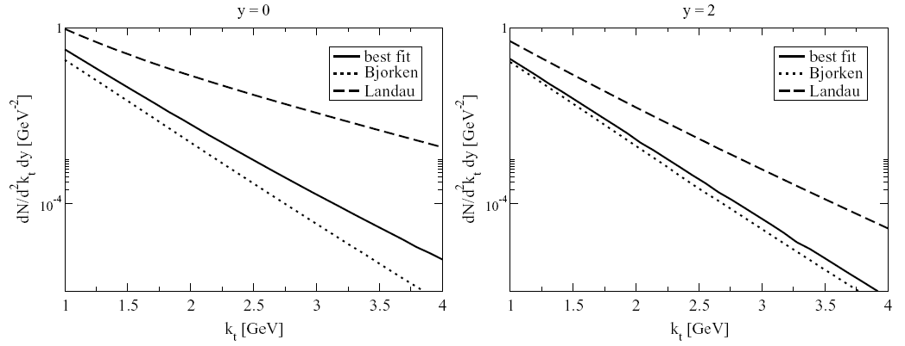
Another interest ~rapidity dependence~
Forward direct photons may shed light on time evolution scenario
  Real photons, γ*->ee, γ*->μμ
Higher rapidity goes, earlier the stage we may be able to explore
  e.g., priv. comm. K. Itakura. Glasma dynamics, through photons
Higher the rapidity goes, higher the baryon density we may be able to reach
  BRAHMS plot. Another good way to access to the critical point?
MPC-EX and/or Muon arm upgrades in PHENIX (Covering 1<|y|<3)
  Needs serious studies of how high in centrality we can go
T. Renk, PRC71, 064905(2005)
BRAHMS, PRL90, 102301 (2003)

Slide 26
My LHC favorite
A calculation tells that even in low pT region(pT~2GeV/c), jet-photon conversion significantly contributes to total
What do we expect naively? (or guessively?)
  Jet-Photon conversions ∝ Ncoll × Npart × (s^{1/2})⁸ × f(xT), “8” is xT-scaling power
  Thermal Photons ∝ Npart × (equilibrium duration) × f( (s^{1/2})^{1/4} )
  Bet: LHC sees huge Jet-photon conversion contribution over thermal?
Together with v₂ measurement, the “thermal region” would be a new probe of medium response to partons
Jet-photon
conversion
LHC
Thermal
pQCD
Turbide et al.,
arXiv:0712.0732
~6GeV?
~15GeV?

Slide 27
Summary
PHENIX has major upgrades in the near term future (~five years)
  HBD to tag and reject electron-pairs that have small opening angles. Installed in Run-10 and completed mission. Analysis on going.
  RPC & Muon Trigger to measure timing of muons in order to select muons from a same bunch-crossing. Installed in Run-11
  VTX to measure DCA of tracks, and tag D, B originated electrons Installed in Run-11. Now in repair for Run-12
  FVTX to measure DCA of tracks in forward rapidity region. To be installed in Run-12
  MPC-EX to measure direct photons/π⁰ in forward rapidity region
Many studies to be done at RHIC in LHC era
Direct photon measurement is very important at RHIC.
  Should explore new degrees of freedom: Elliptic flow has been measured.
  Rapidity dependence of direct photon production is a key to understand time evolution of collision system.
  High rapidity to find critical points?

Slide 28
Backup

