Slide 1
Small-x phenomenology
K.Itakura
KEK theory center
21st Oct. 2011 @ RIKEN
“Future directions of high-energy QCD”

Slide 2
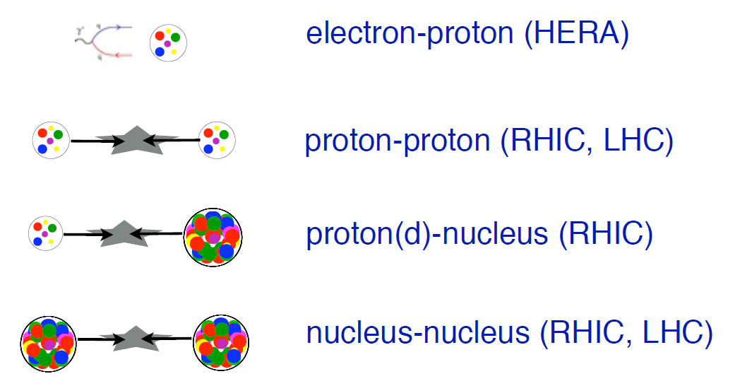
Plan
Introduction of small-x physics and CGC
Then
Then
then

Slide 3
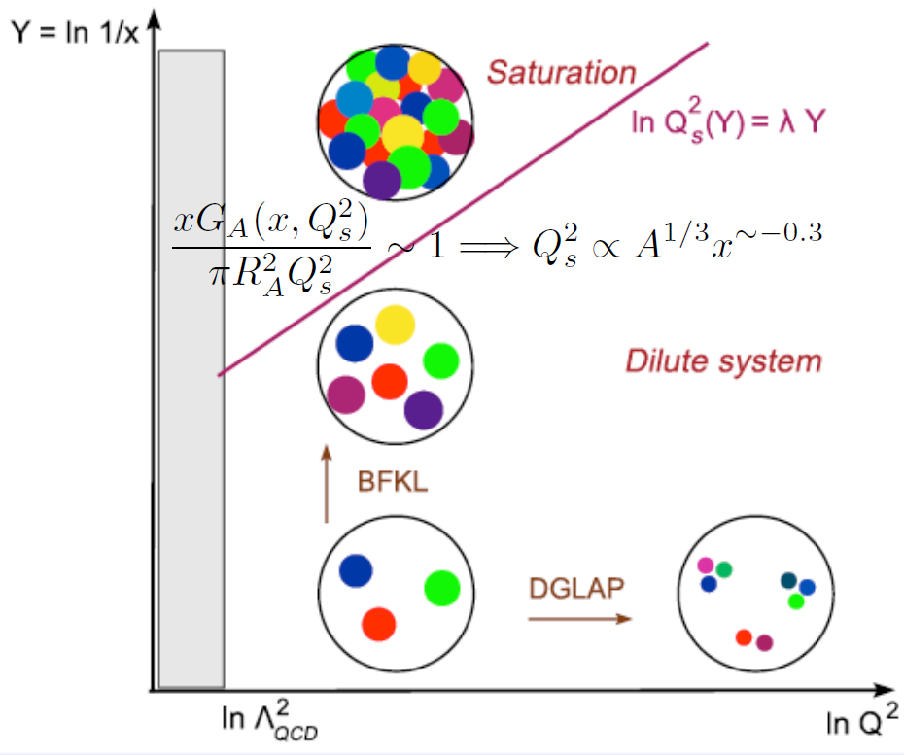

“Phase diagram” of a proton/nucleus
DGLAP : summation of ln Q²
BFKL : summation of ln 1/x
CGC : BFKL + nonlinear effects
(strong classical fields )
Qs(x,A) : boundary btw saturated and NON-saturated regimes
Structure/topology will not
change with improved
descriptions (beyond LO)
→ slope, straight /curve, etc
Higher energies →
Higher resolutions →

Slide 4
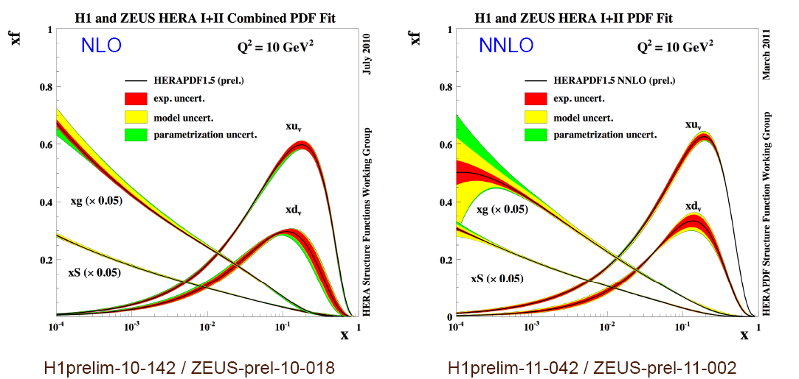
High density gluons are indeed seen in a proton
HERA H1 + ZEUS combined results
DGLAP
DGLAP
Gluons must
be multiplied
by 20.
At small-x, dominant degrees of freedom are not valence quarks, but GLUONS .

Slide 5
Geometric Scaling: existence of Qs
DIS (ep, eA) cross sections scale with Q²/Qs²
Stasto, Golec-Biernat, Kwiecinski Freund, Rummukainen, Weigert, Schafer Marquet, Schoeffel
PRL 86 (2001) 596 PRL 90 (2003) 222002 Phys. Lett. B639 (2006) 471
ep
eA
Diffractive ep
γ*p total
Q²/Q_{s}²(x)
Q²/Q_{s}²(x,A)
Existence of saturation scale Qs
Can determine x and A dependences of Qs
Extends outside of the saturation regime k_{t} < Q_{s}²/Λ_{QCD} (Iancu,Itakura,McLerran)
Q²/Q_{s}²(x_{P})

Slide 6
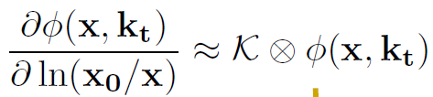
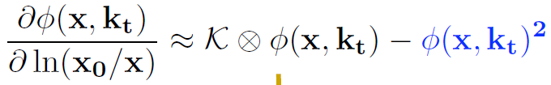
Going up higher energies: evolution eqs.
Evolution wrt x (or rapidity y = ln 1/x)
BFKL (LO : (α_{s} ln 1/x)^{n} , NLO: α_{s} (α_{s} ln 1/x)^{n} )
BK (includes the nonlinear effects)
Multiple gluon
emissions
K : gluon splitting g→ gg
φ : unintegrated gluon distr.
Recombination of gluons
Unitarity
[Balitsky, Gardi et al. ,
Kovchegov-Weigert]
Known up to full NLO accuracy. [Balitsky, Chirilli 2008]
But for practical purposes, we use BK with running coupling → “rcBK”
LO

Slide 7
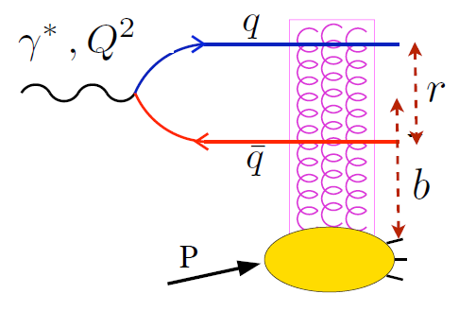
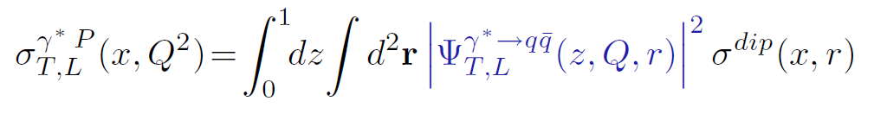
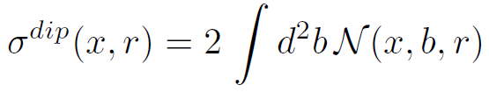
Phenomenology in DIS at small-x
Dipole formalism
Phenomenology (“global” fit, x < 0.01) :
How to parametrize dipole cross section?
- use approximate solution to BK
LO-BK → IIM [Iancu-KI-Munier 2004], Soyez (with heavy quarks) [2007]
u, d, s + c, b
parameters : Energy dependence and magnitude of Qs, radius of a proton
(theory ambiguity) (non-perturbative effects)
- use numerical solution to BK
rcBK → AAMQS [Albacete-Armesto-Milhano-Quiroga-Salgado,2009,2011]
parameters : characterizing initial conditions (MV, modified MV)
LC wf : known
dipole cross
section
Dipole scatt. amplitude
← Solution to BK eq

Slide 8
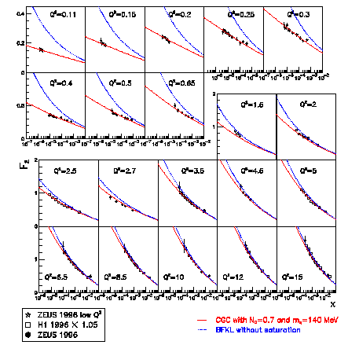
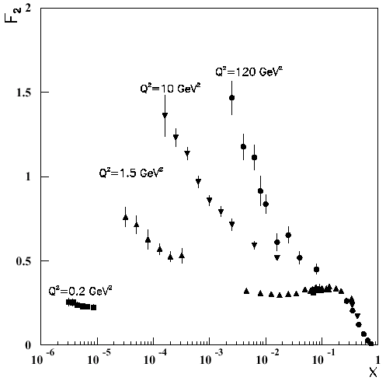
Fit to HERA data: “IIM” model
[Iancu,KI,Munier ‘04]
Fit to the data with small x
and moderate Q²
x < 0.01 & 0.045 < Q² <45 GeV²
Analytic solutions to BK built in:
geometric scaling & its violation,
saturation.
Only 3 parameters:
proton radius R, x₀ (nonpert.)
and λ for Q_{S}²(x)=(x₀/x)^{λ} GeV²
- Good agreement with the data
x₀ = 0.26 x 10⁻⁴, λ = 0.25
Also works well for vector
meson (ρ, φ ) production,
diffractive F₂, F_{L}
[Forshaw et al, Goncalves, Machado ’04]
Red line : the CGC fit
Blue line : BFKL w/o saturation

Slide 9

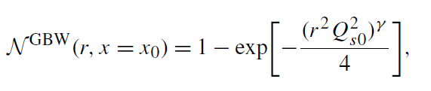
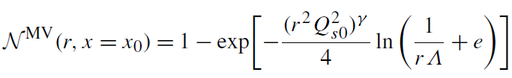
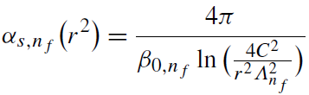
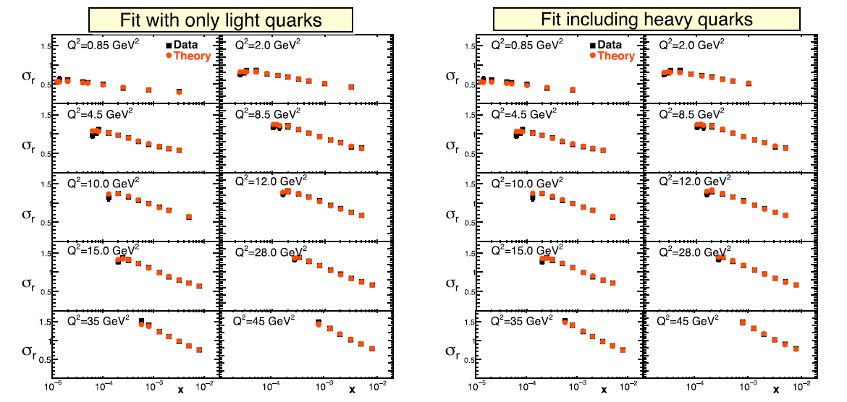
Fit to HERA data: AAMQS₂₀₁₁
Initial Conditions : modified GBW/MV models
IR regularization for 1-loop running coupling
freeze the coupling at α_{s}^{fr} =0.7
or
(γ=1 : ordinary GBW)
(γ=1 : ordinary MV)
← Modified GBW
(Left) γ=0.971
Qs₀²=0.241
(Right) γ=0.959
Qs₀²=0.240
There are two more parameters (C,σ₀)
m_{uds}=140MeV
m_{c}=1.27GeV, m_{b}=4.2GeV

Slide 10

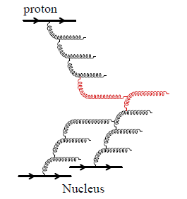

Hadron collisions (pp/pA): two formulae for single hadron spectra
k_{t} factorization
φ_{A}
A
B
- proved for pp, pA at LO
- good when both A and B are saturated
(mid rapidity at very high energy)
- used in various calculations e.g. multiplicity distribution, etc
p_{T}
φ_{B}
DHJ formalism [Dumitru-Hayashigaki-Jalilian--Marian 2006]
“Large-x / small-x” reactions: valid at forward rapidity
x₁~1, x₂ <<1
f_{i/p}(x) : pdf for valence partons in a projectile
D_{h/k}(z) : frag. func. for outgoing hadron h from a parton k
N : un-integrated gluon distribution in a target
A1
i
j k
A2

Slide 11
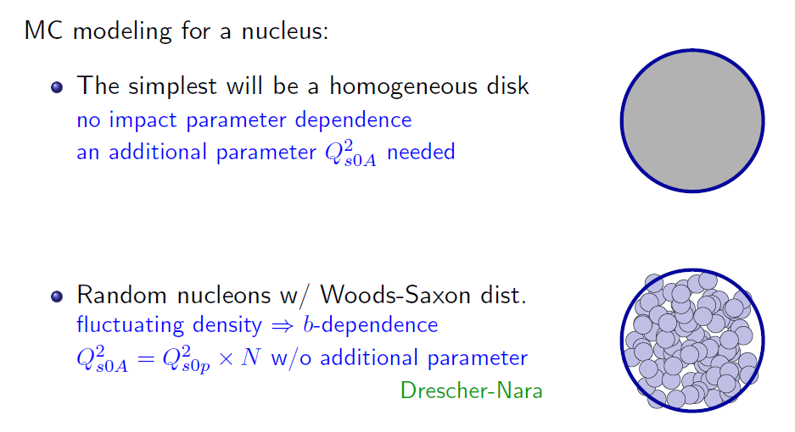
How to treat nuclei?
may use a simple parametrization by KLN,
or numerical solution to rcBK
Nucleons are described as disks or Gaussians.
- Can be used for IC in AA collisions

Slide 12
Towards better description of pA at forward rapidities
Xsec formula vs nuclear modeling
how to parametrize gluon distribution
→ KLN or rcBK
forward
 | kt factorization | DHJ formalism
Homogeneous disk | “KT/KLN” Kharzeev, et al. | “DHJ/rcBK” Albacete-Marquet 2010
MC model (randomly generated) | “MC-KT/KLN” Drescher-Nara, Albacete- Dumitru-Nara | “MC-DHJ/rcBK” Fujii-KI-Kitadono-Nara 2011
Less
parameters
In the DHJ formalism (looking at forward rapidity), target nucleus is generated randomly, and the gluon distribution is given by rcBK

Slide 13
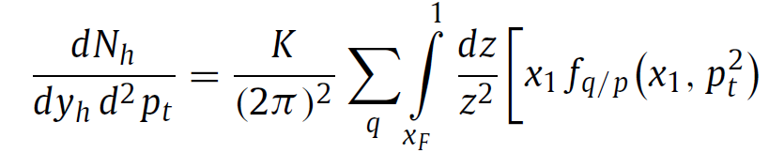
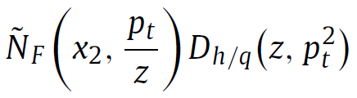
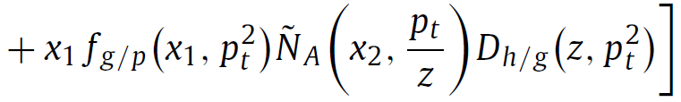

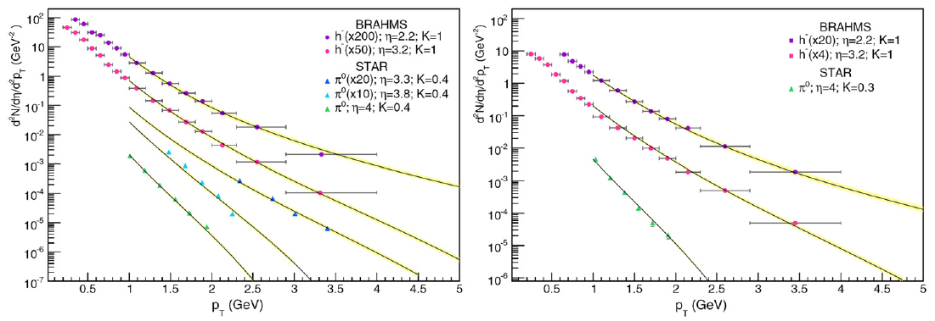



DHJ/rcBK
[Albacete-Marquet 2010]
Single hadron spectra at forward rapidity in RHIC
quark
gluon
For f_{i}(x,p_{t}), use CTEQ6 NLO pdf
For D_{i}(z,p_{t}), use DSS NLO FF
For N_{F/A} , use solution to rcBK with
MV model (x₀,Q_{s0}) as I.C.
gluon scattering amplitude
pp
dAu
Very good agreement with the data. But they fit pp and dAu independently.

Slide 14
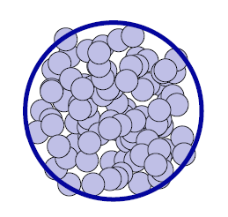
MC-DHJ/rcBK
[Fujii,KI,Kitadono,Nara,
arXiv:1107.1333]
To reduce ambiguity
- construct a nucleus by randomly placing nucleons
- use AAMQS parameters for proton IC optimized for DIS at small-x
- quantum evolution is performed “locally” in b space
(to avoid IR div. in b-dep BK)
Fragment into hadrons
(DSS NLO)
Large x partons
f_{i}(x,k_{t}) : CTEQ6M NLO
b_{t}
local rcBK
evolution
AAMQS

Slide 15
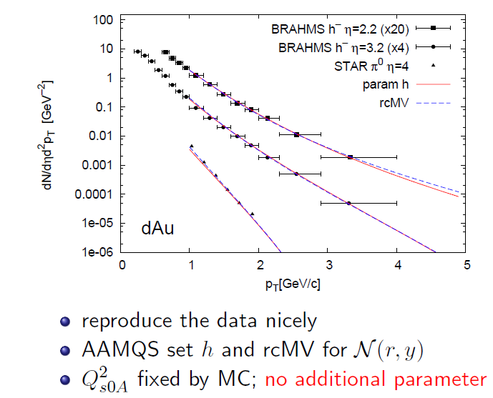
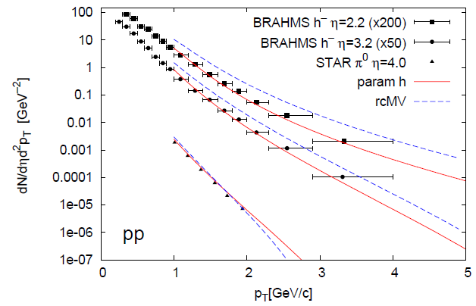
MC-DHJ/rcBK : results
modified MV model (γ = 1.118)
“running coupling” version of MV
model [Iancu-KI-Triantafylopoulos] : to
be consistent with rcBK evolution
Set h works well even in pp, but not
as good as Albacete-Marquet
rcMV is not “tuned” (similar param as MV)
However, both work quite well in dAu
(IC dependence reduces at high rapidity)
Best results from theoretical point of view, but still needs better (global) description including pp data (tuning of rcMV is necessary)

Slide 16
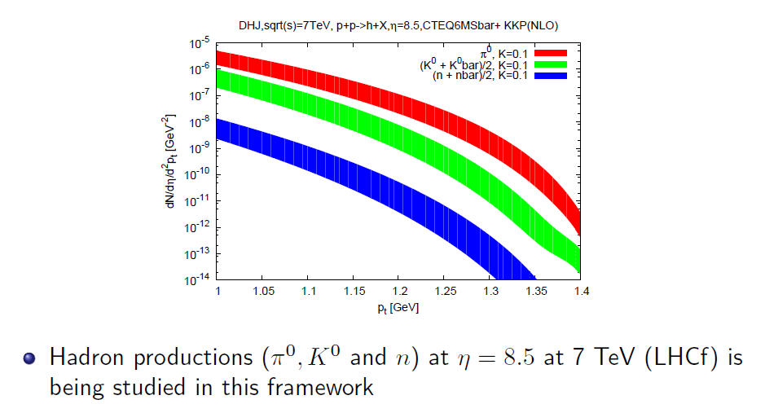
MC-DHJ/rcBK extrapolated to LHC
Scale ambiguity
Very forward region could be dominated by soft interaction, but still necessary to understand how much hard contribution exists.

Slide 17



Towards further improvements?
Two formula (KT and DHJ) are derived in LO
← not consistent with the use of rcBK
Running-coupling corrections to LOKT [Horowitz-Kovchegov, 2011]
so far, there is no phenomenological anaysis based on this.
Next, we need running-coupling DHJ !!
LO
“rcKT”
Some scale defined by k,q

Slide 18
Summary
Theoretical description of high-energy hadron scattering based on CGC is now (almost) established up to leading log accuracy with running coupling corrections. → rcBK paradigm
In particular, phenomenological analysis with rcBK has been making a progress enough to be compared with experimental data. → HERA DIS at small-x, RHIC dAu at forward rapidity
Nontrivial steps (I didn’t mention):
→ multiparticle (dihadron) correlations
→ AA collisions (Better description of the dAu at forward rapidity provides useful information for IC of AA collisions.)

