Slide 1
Z-alignment
Hidemitsu Asano

Slide 2
analysis setup
run 349369
-10 <zvtx<10
no bbc charge cut

Slide 3
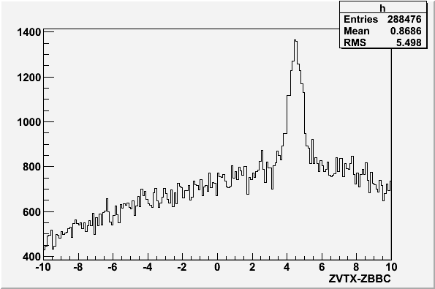
During run11 , we noticed mean of bbcz and Z- VTX( z-vertex measured by VTX) had a large difference (~4.5cm)
VTX group asked BBC
experts to move bbcz
mean position, because
VTX lost BBC narrow trigger
events around 10 %.
After June 7th 2011, bbcz mean is roughly adjusted to Z-VTX (next slide)
unit:cm

Slide 4
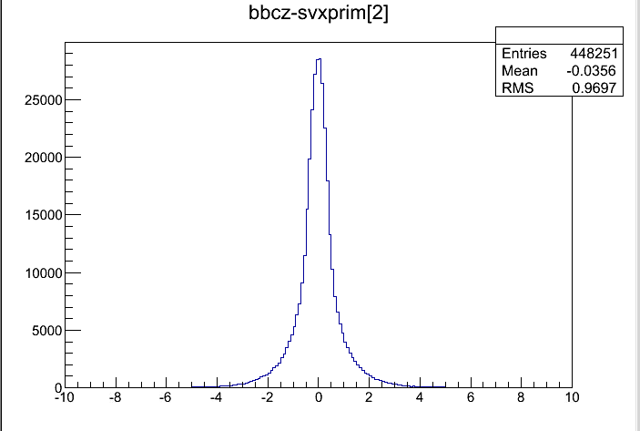
bbcz – svx primary (Z)
RUN# 349369
Au+Au 200 GeV
date : Jun,18th 2011
This is a difference btw
bbcz and primary z_vertex position calculated by VTX.
bbcz mean is in good agreement with VTX_Z
after Jun. 7th
unit:cm

Slide 5
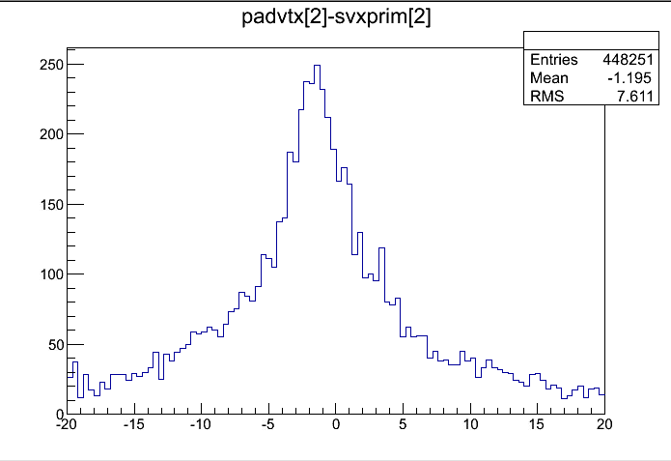
padvtx[2]-svx primary z
but,in the same run,
Z_vertex calculated from pad chamber
is off from VTX_Z
(~1 cm)
There is a discrepancy between pad chamber coordinate and VTX coordinate in z-direction.
unit:cm
padvtx is obtained from vtxout

Slide 6
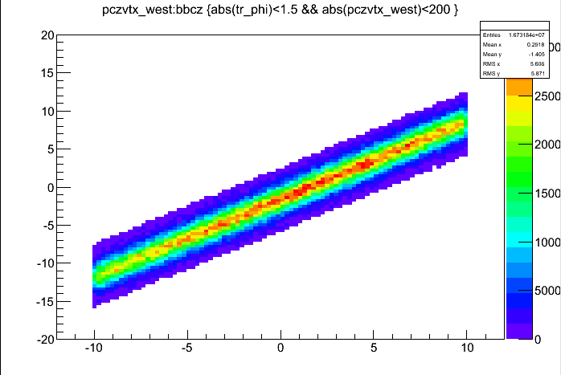
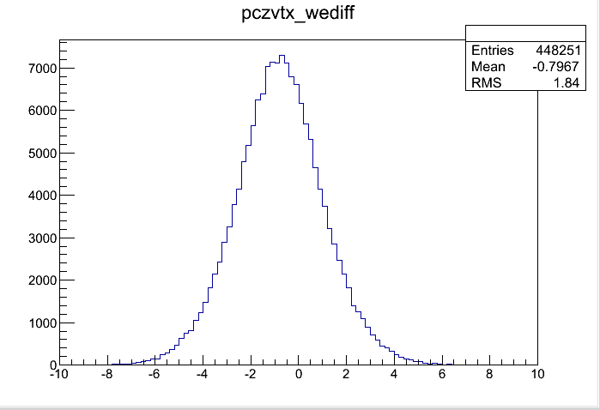
PC3
1.select pc1,3 clusters associated with CNT track
2. straight line projection to (x,y)=(0,0)
3. cut z_vertex far from bbcz (>4cm)
4. calculate mean of zvtx from 3. on east and west arm individually event by event.
PC1
search window from bbcz
padvtx
padvtx_west
bbcz

Slide 7
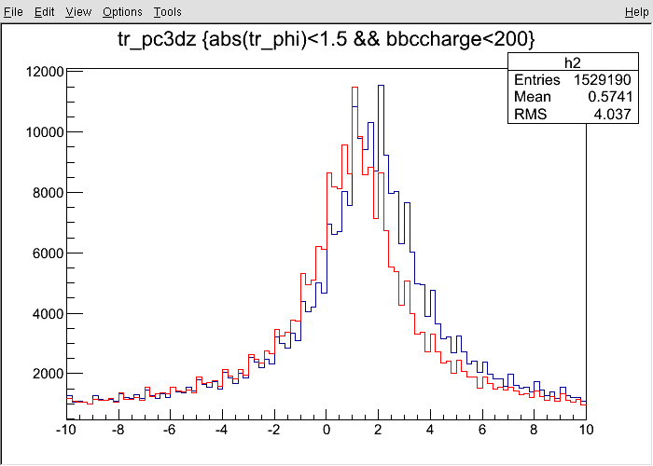
pc3dz
PC3
2.4m
PC1
2.5m
pc3dz=
(cluster position – CNT projected point)
CNT track
bbcz
There is also a discrepancy btw
EAST arm and WEST arm.
This plot is pc3dz for west arm only(blue) and pc3dz for east arm only (red).
(bbc charge <200 cut is applied.)
The difference is ~1cm.
blue:west pc3dz
red:east pc3dz
unit:cm

Slide 8
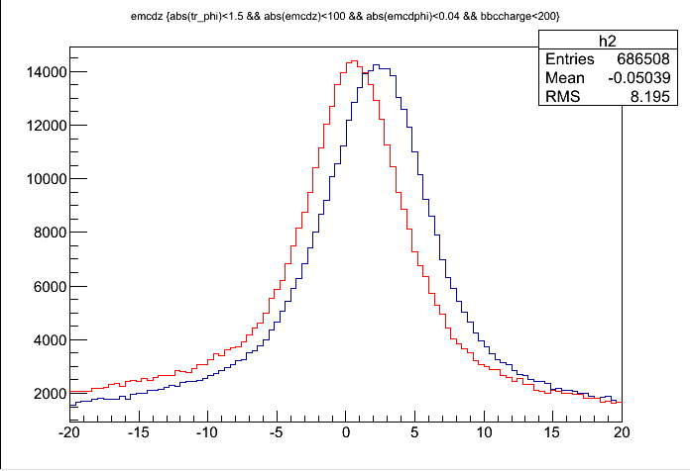
EMCal cluster
PC1
CNT track
bbcz
There is another evidence of EAST-WEST discrepancy.
This plot is emcdz for west arm only(blue) and emcdz for east arm only (red).
The difference is ~2,3cm.
blue:west emcdz
red:east emcdz

Slide 9
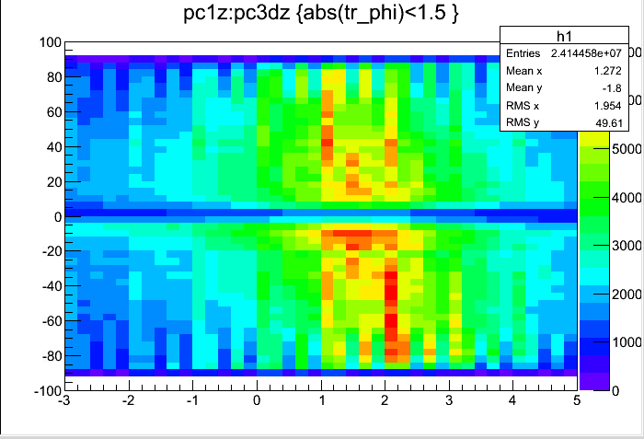
pc1z vs pc3 dz (west)
PC1 z (associated with CNT track)
pc3dz

Slide 10
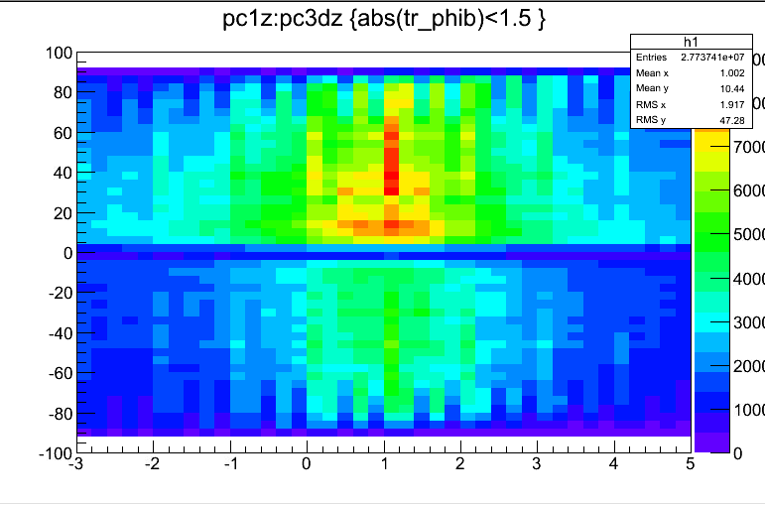
pc1z vs pc3 dz (east)
PC1 z (associated with CNT track)
pc3dz
????

Slide 11
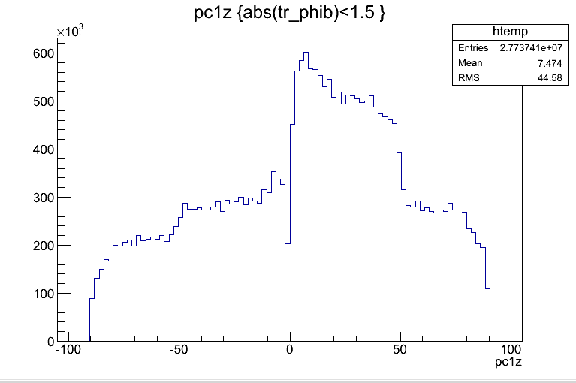
pc1 z (east)
??????

Slide 12
Summary and outlook
Our original plan is to align VTX ladders in the central arm coordinate. In x-y plane, all ladders are aligned in DCH coordinate.
In z direction, there is a large (~1cm) discrepancy between VTX coordinate and central arm coordinate , and between west arm and east arm also.
We don’t think actual location of VTX is off around 1cm from the center of central magnet.
We need to match central arm coordinate system and VTX coordinate system for the alignment and global tracking .
We will discuss with central arm detector experts about this coordinate problem.

Slide 13
ところで VTX のアライメントどうしよう？
(1mm以下のスケールで)
Lei さんのスライドより
vtx west east gap
今CNTを使うとカオスになりはしまいか？

Slide 14
idea 1. internal にどうにかする
pixel のsurveyを信じて、stripを動かしてみる。
(ただしVTXwest-VTXeastはあると想定)
pixel-zvtx

Slide 16
variables
・(central arm west – central arm east) Z offset
・(central arm west - svx west )Z offset
・(svx west – svx east )Z offset
・ladder by ladder z position in svx coordinate.
(written in svxPISA.par ,should not be changed by access)
Z

