Slide 1
Software Update
Takashi HACHIYA
RIKEN

Slide 2
Remaining Issues
Status : 1st version code is in the CVS.
basic functions work well.
CNTtrack – VTX hit association
DCA calculation
There are still remaining issues listed below.
Issue | Status | Expected time to finish
Memory leaks | One big leak is fixed at last week. But another big leaks still remain. | 1week 2days
Improve Chi2 calculation | Using real data, currently working on this issue. | 2 or 3 days 2days
Improve DCA calculation | Second (or more) hits are used for the DCA calculation. Not start yet | 2 or 3 days
Parameter tuning | Used for speed-up. Not start yet | 2 or 3 days
Speed up | Apply tigher cut (now too much wider). | 1week
Efficiency Study using simulation | Correlated with parameter tuning. | 1week
Event Display for Run 12 | Prepare for run 12 | Ready (1day)

Slide 3
Memory Leak Issue
Memory leak in SvxCentralTrackReco
1st Leak is fixed (last week)
2nd leak is fixed (this week)
3rd leak is about to be fixed.
From stl vector in DST node. TClonesArray can not handle vector completely. I will use a fixed length array instead of vector.
There are still a lot of leaks in the svxDetectorGeo, SvxReco, SvxStripixel, SvxStandaloneReco,

Slide 4
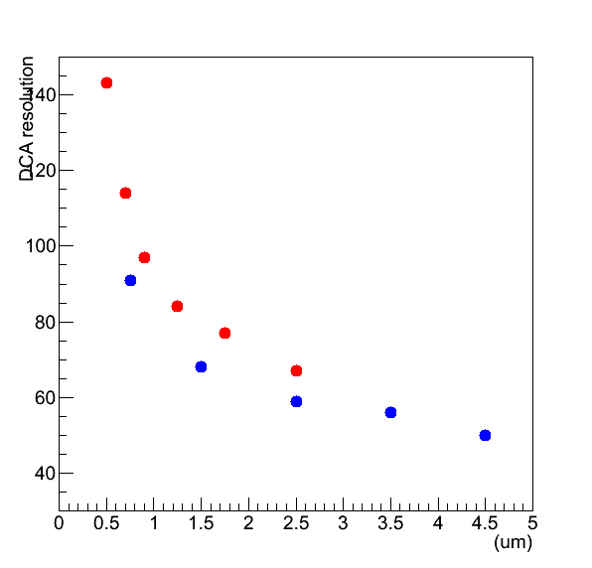
pT dependence of DCA resolution (homework)
(um)
DCA resolution between data and simulation is compared.
DCA resolution = gaussian sigma
Simulation : Alan’s Talk at Review 2009. (values are taken by eye from his slide)
pT dependence looks similar, but the resolution in the data is slightly worse.
Data
Simulation
pT(GeV/c)

Slide 5
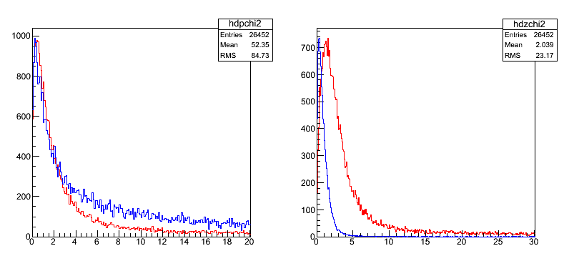
Chi2 distribution
chi2(dphi)
Data
Sim
Data
Sim
Chi2(dphi, dz) in data and simulation are compared:
Data : Run 349679 10k events
Simulation: Single pi+/pi-, Sigma_Vtx(x,y) = 1mm, z=5cm
Sigma in chi2 calculation which obtained by data is used for both data and simulation.
Chi2 (dphi) Looks similar, but chi2(dz) in simulation is smaller than that in data. This imply that the alignment in dz is needed.

Slide 6
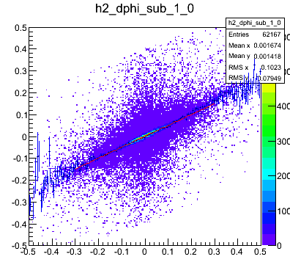
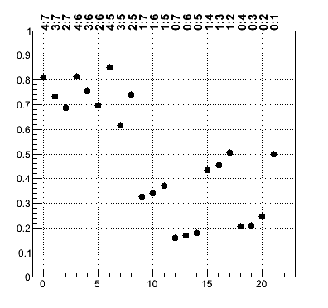
Check the correlation of dphi slope sublayer by sublayer
B2-B3
Nodata
B1-B2
B0-B1
B1-B3
B0-B2
B0-B3
Correlation btw layers → btw sublayers
B3, B2… 6 types → B3(7),B3(6), … 22 types

Slide 7
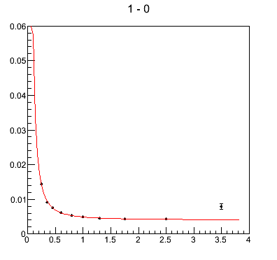
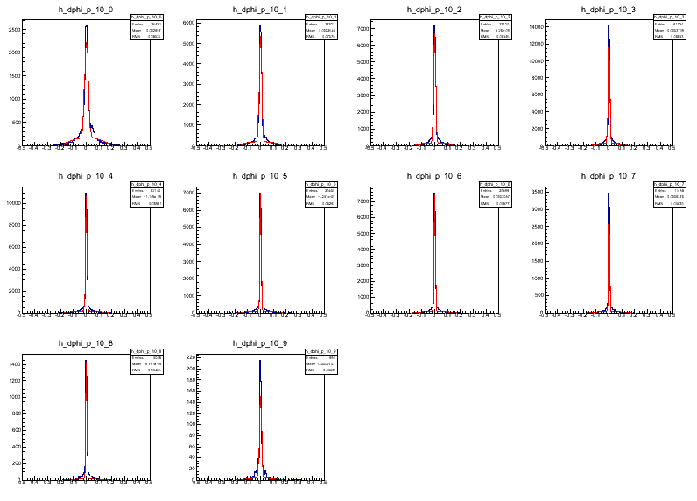
pT dependence of sigma
Sigma vs pT
0.2-0.3
0.3-0.4
0.4-0.5
0.5-0.6
Sigma(cm)
(cm)
(cm)
(cm)
(cm)
0.6-0.8
0.8-1.0
1.0-1.5
1.5-2.0
(cm)
(cm)
(cm)
(cm)
2.0-3.0
3.0-4.0
pT(GeV/c)
Residual distritubion is Fit by gaussian
Sigma vs pT is fit by
f(p) = a + b/p^c
Currently dphi is considered.
for a while, dphi is well aligned.
(cm)
(cm)

Slide 8
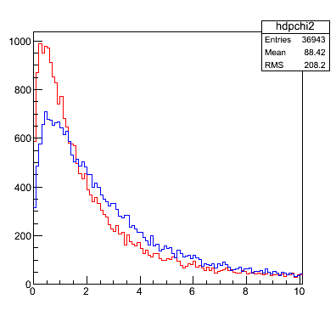
Chi 2 distribution is updated
Normalized by Ncount within 0-30
Old calculation
Updated calculation
Chi2 (dphi) is improved.
Chi2(dz) is not studied yet in detail.

Slide 9
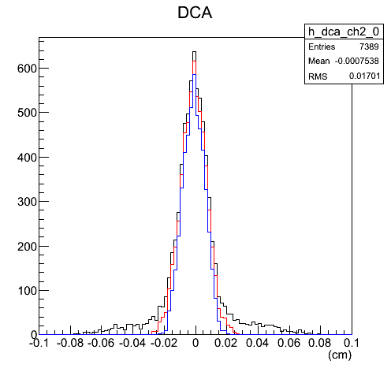
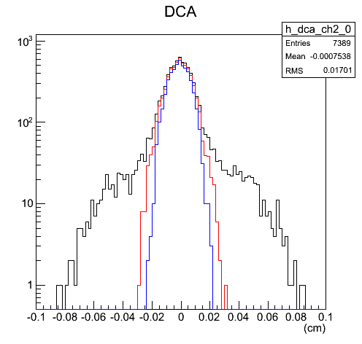
DCA distribution with chi2(dphi) cut
Chi2(dphi)<100
Chi2(dphi)<10
Chi2(dphi)<5
Selection:
|dphi3|<0.5, |dz3|<0.5, chi2 (dphi) cut, pT>1GeV/c
The tail reduces significantly with tighter chi2(dphi) cut

Slide 10
Back up

Slide 11
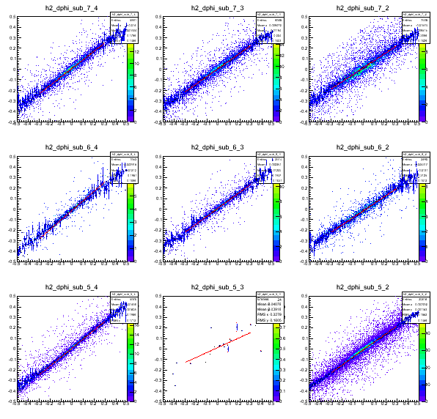
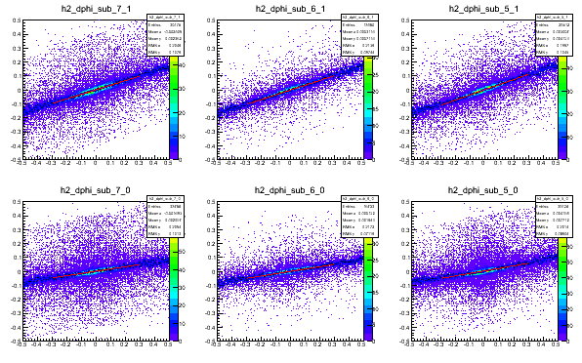
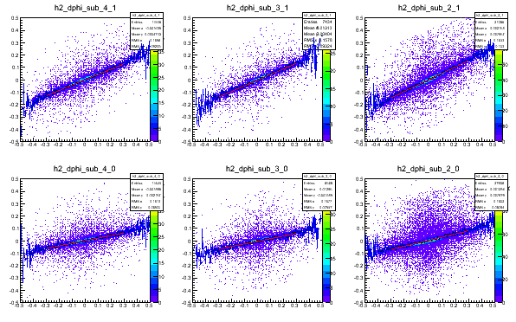
dphi_n vs dphi_m

Slide 12
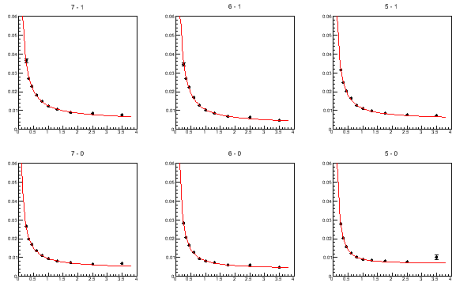
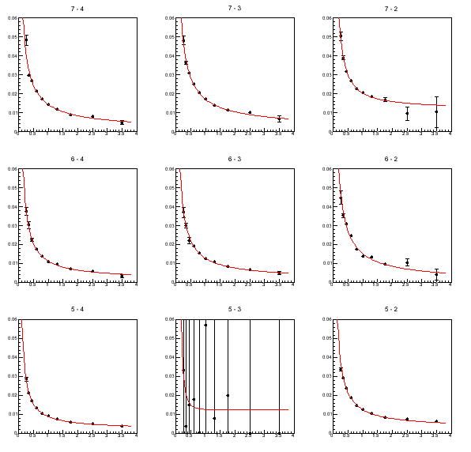
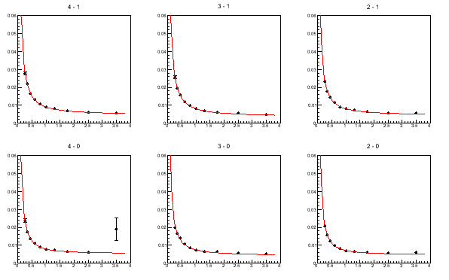
Sigma vs pT for each combination

Slide 13
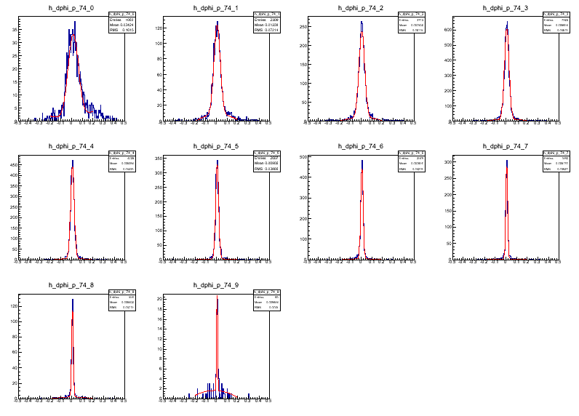
B2(4)-B3(7)

Slide 14
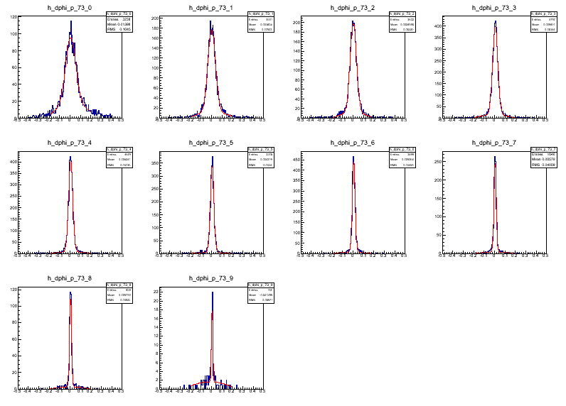
B2(3)-B3(7)

Slide 15
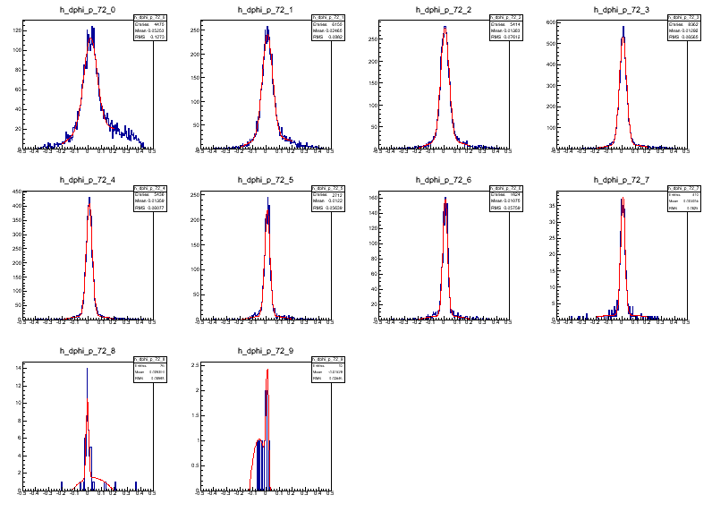
B2(2)-B3(7)

Slide 16
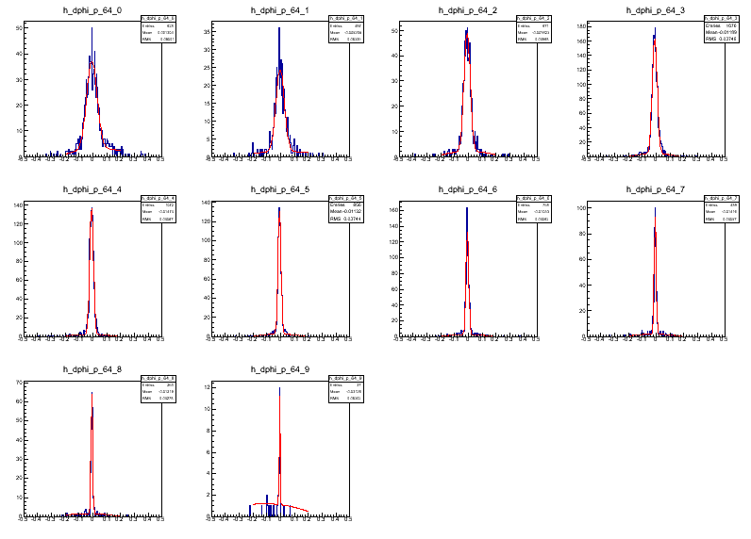
B2(4)-B3(6)

Slide 17
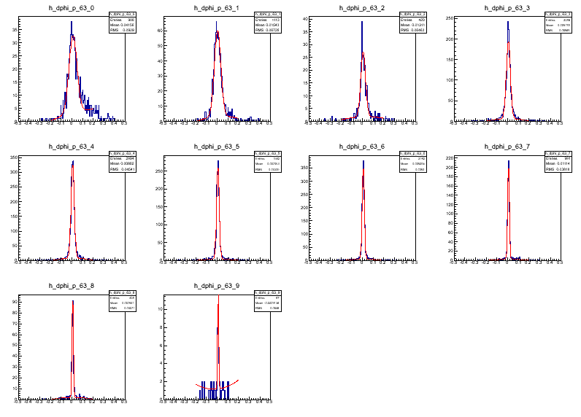
B2(3)-B3(6)

Slide 18
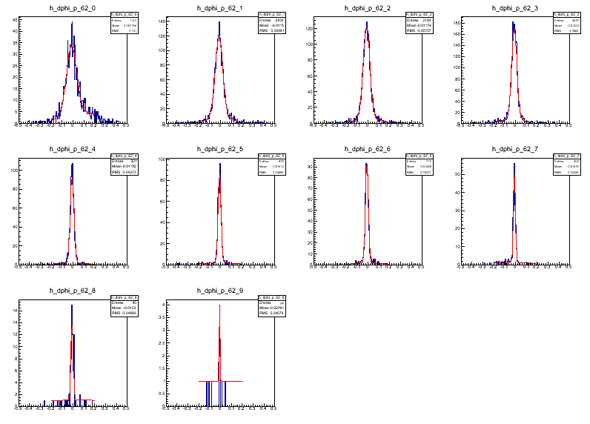
B2(2)-B3(6)

Slide 19
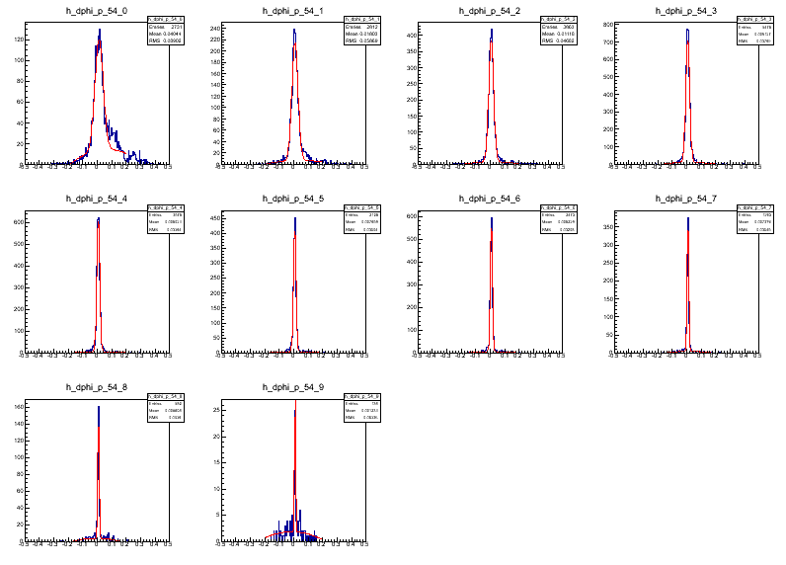
B2(4)-B3(5)

Slide 20
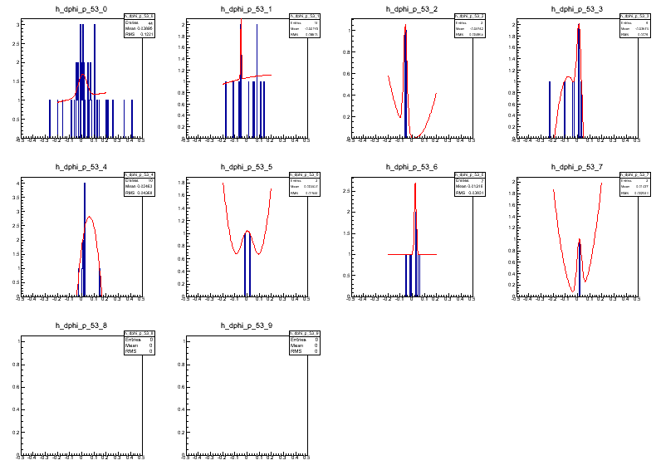
B2(3)-B3(5)

Slide 21
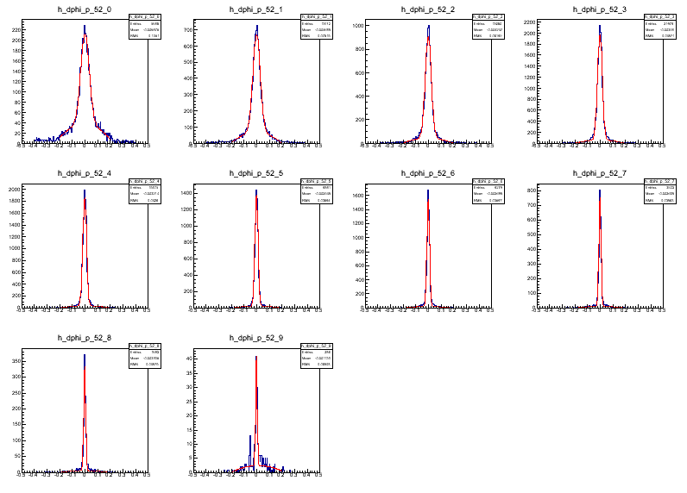
B2(2)-B3(5)

Slide 22
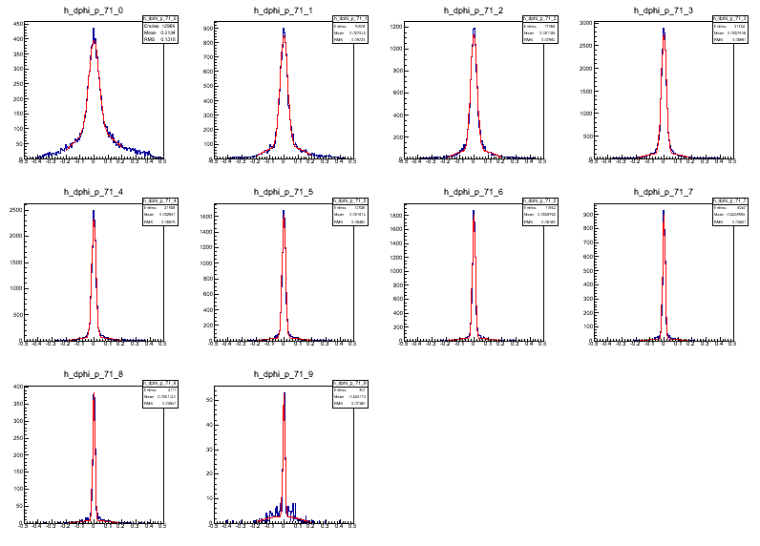
B1-B3(7)

Slide 23
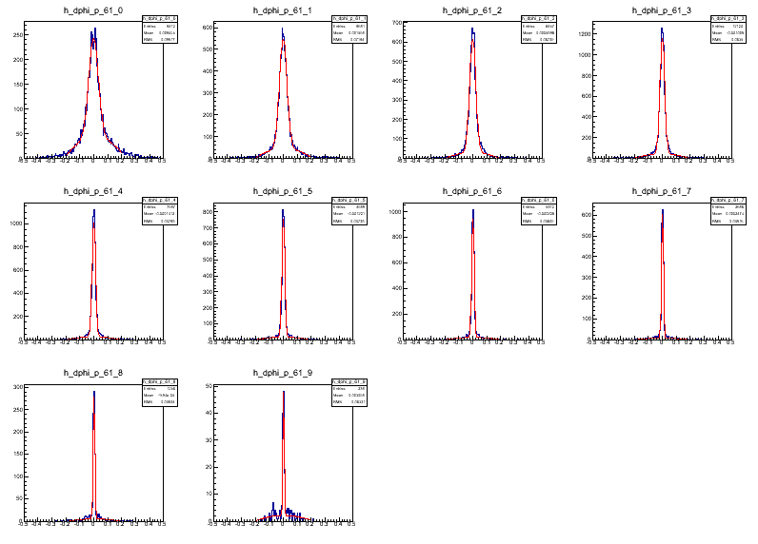
B1-B3(6)

Slide 24
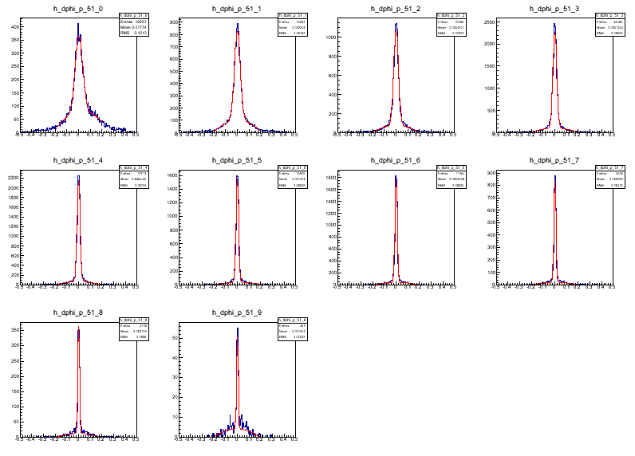
B1-B3(5)

Slide 25
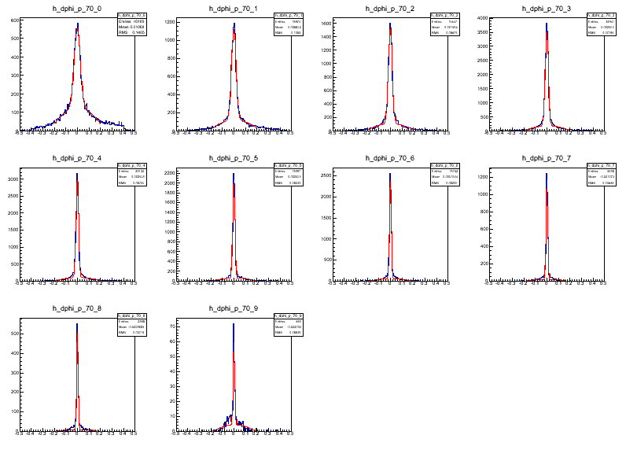
B0-B3(7)

Slide 26
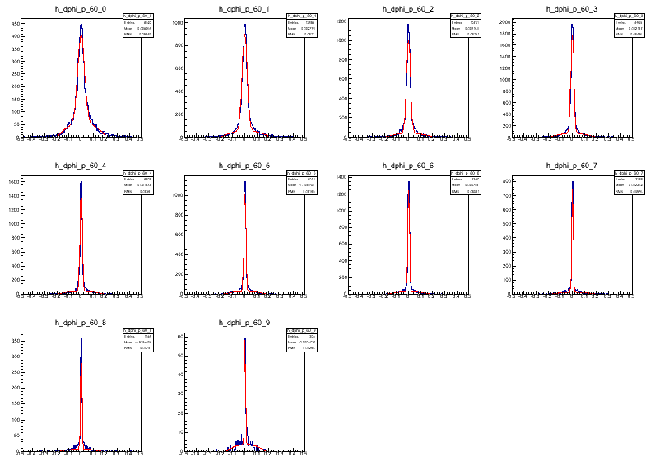
B0-B3(6)

Slide 27
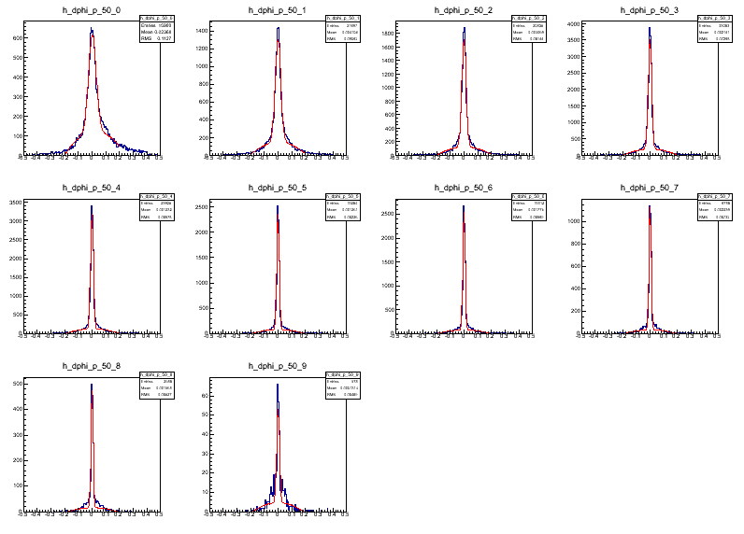
B0-B3(5)

Slide 28
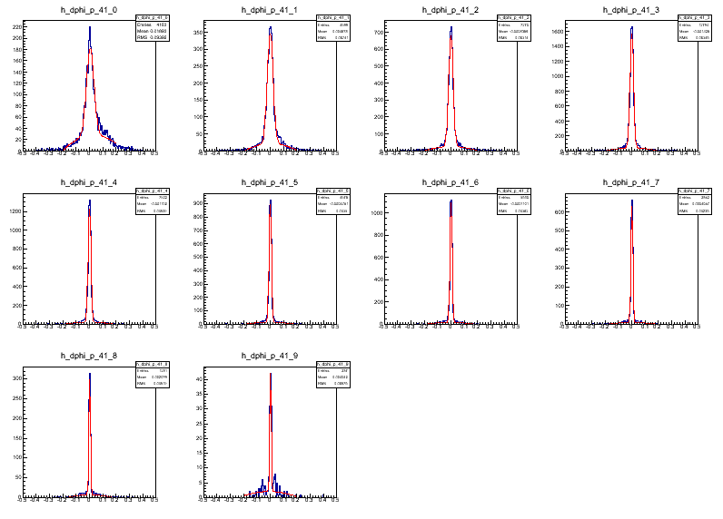
B1-B2(4)

Slide 29
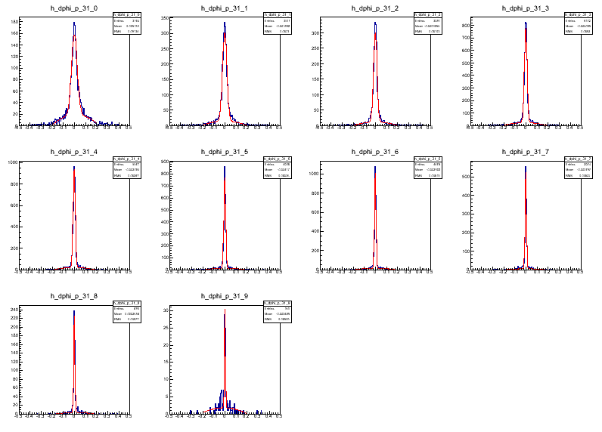
B1-B2(3)

Slide 30
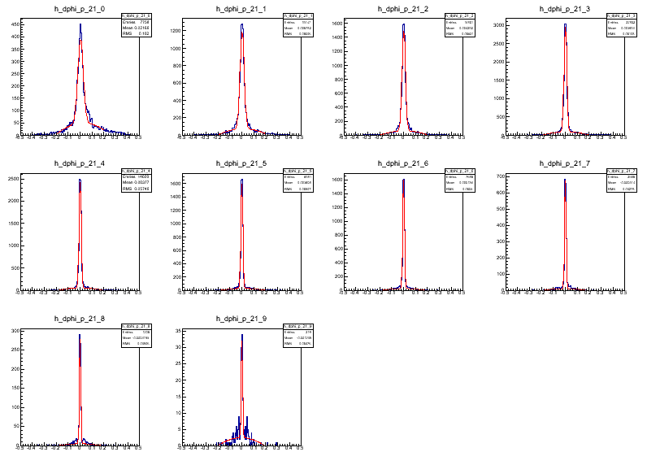
B1-B2(2)

Slide 31
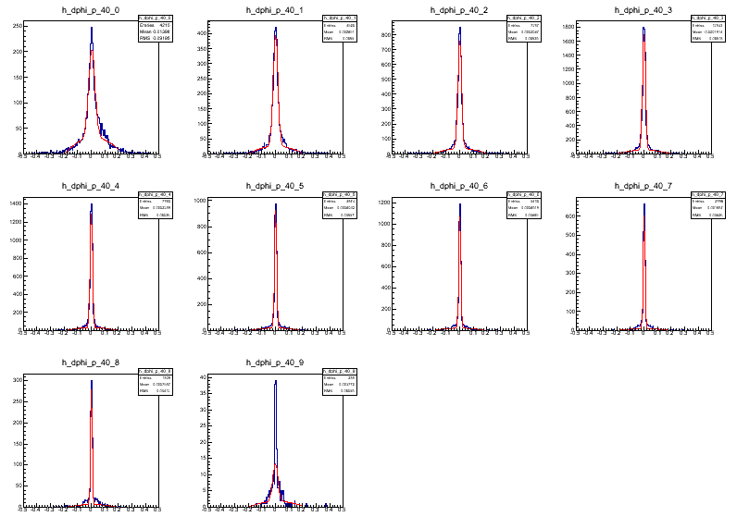
B0-B2(4)

Slide 32
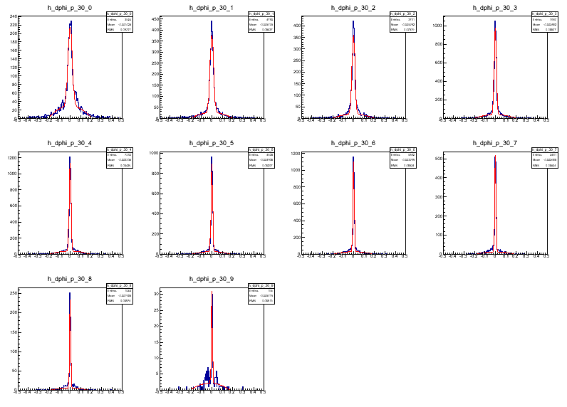
B0-B2(3)

Slide 33
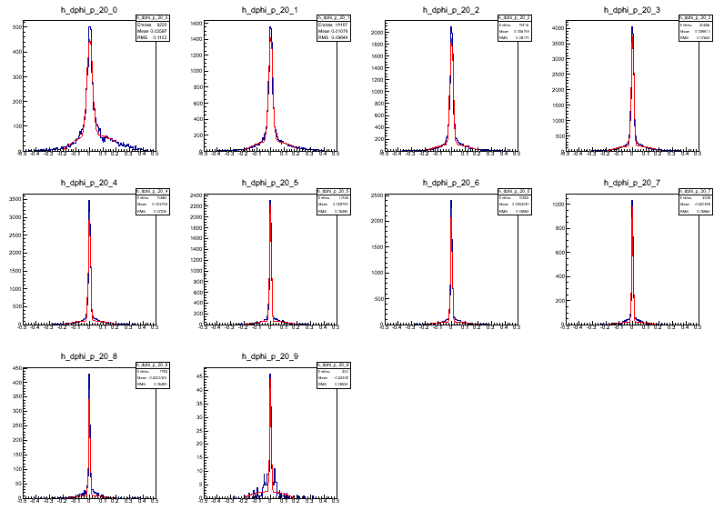
B0-B2(2)

Slide 34
B0-B1

