Slide 1
Estimation of Background
in DCA
10th Feb 2012
Maki KUROSAWA

Slide 2
Estimation of Background For DCA Distribution
DC tracks were rotated plus minus 3 degrees in theta and phi direction randomly.
SVX track is associated with rotated DC track.
Cut condition is same as the condition that Hachiya-san is using.
pm 3 deg
Central track
SVX hit cluster
9mm
Outer most sub-layer on B3
17 cm

Slide 3
Residual Distribution on B1, B2 and B3 w and w/o Rotation
|Tilt angle of DC| : 0 degree
Barrel 1 Barrel 2 Barrel 3
[ cm ]
[ cm ]
[ cm ]
|Tilt angle of DC| : 3 degree
Barrel 1 Barrel 2 Barrel 3

Slide 4
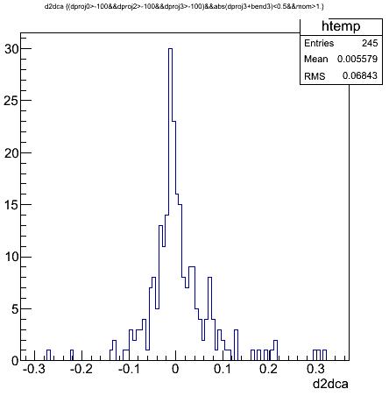
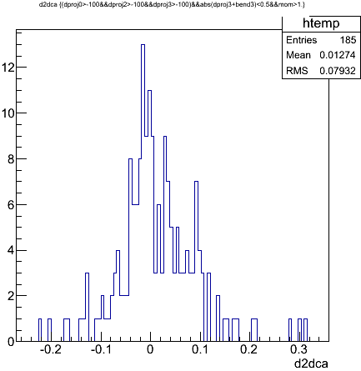
DCA Distribution
|Tilt angle of DC| : 0 degree
|Tilt angle of DC| : 3 degree
[ cm ]
[ cm ]
True + Background
Background

