Slide 1
QA of Analysis Variables
(DCA)
31st May 2012
Maki KUROSAWA

Slide 2
QA Item
Chi2/NDF
DCA distribution (All)
DCA resolution run-by-run. (MB/Central)
BG(DCA>0.6mm)/Core(DCA<0.3mm) seg.-by-seg. (MB/Central)
Mixed(0.3mm<DCA<0.6mm)/Core(DCA<0.3mm) seg.-by-seg. (MB/Central)
DCA distribution (Electron)
Same as above run-by-run (not seg-by-seg)
DCA fine tuning (Alignment)
Study DCA vs phi0 : Find ad-hoc corrections as function of phi0 and pT for each run.
Study DCA vs Z : Find ad-hoc corrections for each run.
Notes:
Hadron → electron
run-by-run → すべての segment を足し合わせる。
Track 数/event 画家割ってないか。
Reaction flattering が終われば問題ないか。
どういうスタンドアローンはPurity は高くなければならない。
s/n がランごとに変わるといやである。チップが死んでいくと。
RUN 中にアクセプタンスが変わると嫌。
Purity と統計があればよい。
Reaction plane 自体がくるくる回るから（reaction plane に依存した穴があれば問題になる）
Flattering がうまくいけば問題ない。
あるN次以上でディテクターの穴が flattering に
高次までフーリエ級数を展開しすぎると統計のばらつきまでフラットにしてしまう。
Fitting : 補正係数を決めなければならない。 Multiple scattering が補正係数に影響する。 だから補正係数はMomentum 依存がある。
Fit の結果と residual fitdp3 (dproj3) (B3)
DCA sigma : theta for east and west

Slide 3
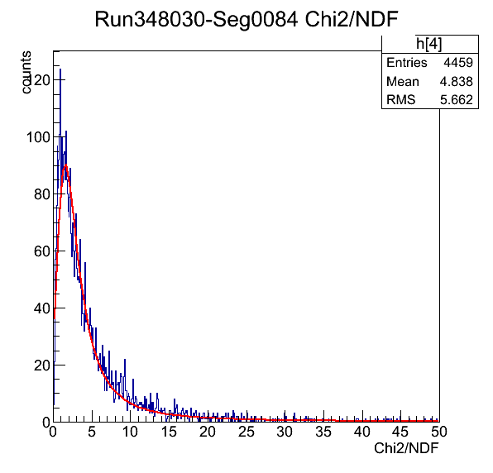
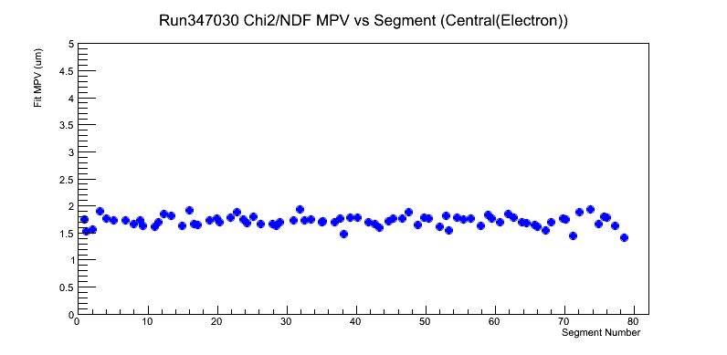
Chi2/NDF Distribution run-by-run and seg-by-seg
Create plot of (MPV vs Run number) and (MPV vs Seg number).
run-by-run
Run346973
Jun 2nd 2011
Fit MPV (um)
Counts
Run346670
Jun 1st 2011
Runnum
seg-by-seg
Fit MPV (um)
Chi2/NDF
Segnum

Slide 4
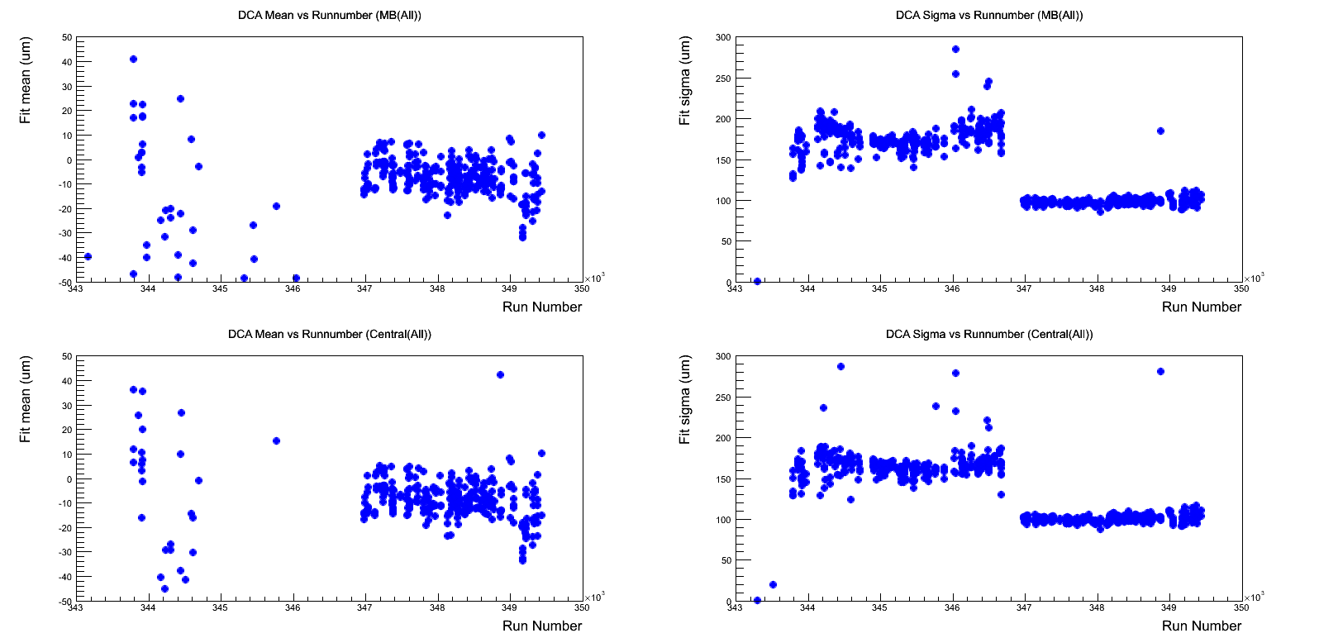
Mean and Sigma of DCA Distribution (All) run-by-run
Create plot of (Mean vs Run number) and (Sigma vs Run number) for every run.
All segments were accumulated for one run.
Minimum Bias (200<bbcq)
Minimum Bias (200<bbcq)
Fit Mean (um)
Fit Sigma (um)
Mean : -10 μm
Sigma : 100 μm
Runnum
Runnum
Central (1000<bbcq)
Central (1000<bbcq)
Fit Mean (um)
Fit Sigma (um)
Runnum
Run346670
Jun 1st 2011
Runnum
Apply correction for DCA distribution

Slide 5
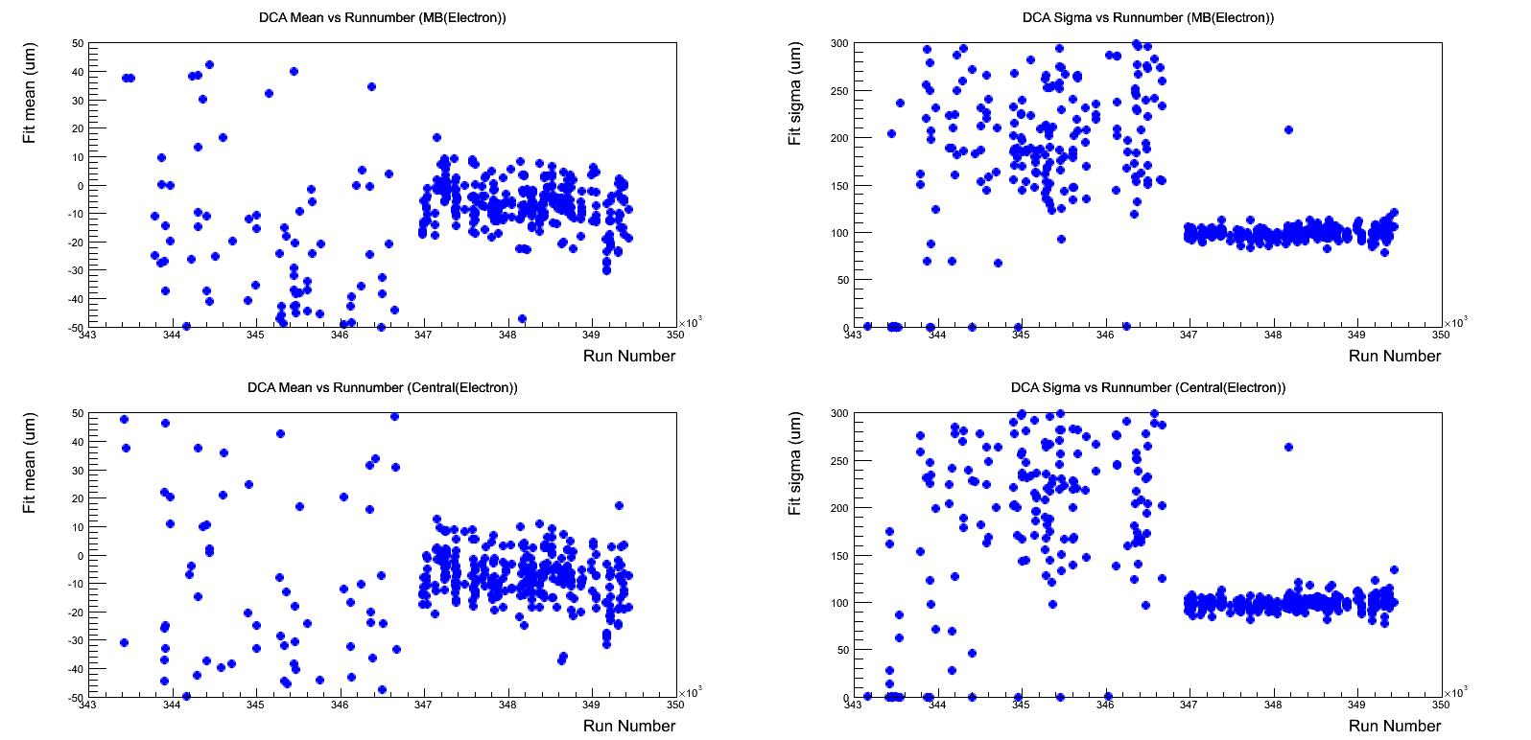
Mean and Sigma of DCA Distribution (Electron) run-by-run
Create plot of (Mean vs Run number) and (Sigma vs Run number) for every run.
All segments were accumulated for one run.
Minimum Bias (200<bbcq)
Minimum Bias (200<bbcq)
Fit Mean (um)
Fit Sigma (um)
Mean : -10 μm
Sigma : 100 μm
Runnum
Runnum
Central (1000<bbcq)
Central (1000<bbcq)
Fit Mean (um)
Fit Sigma (um)
Runnum
Runnum
Apply correction for DCA distribution

Slide 6
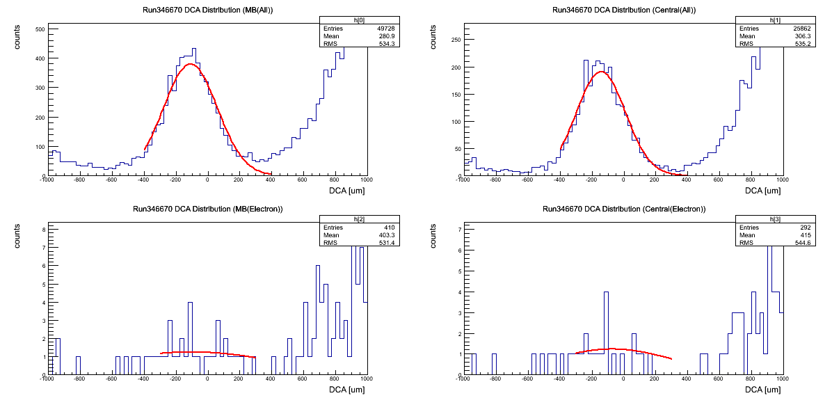
DCA Distribution Before Run346670 (Jun 1st 2011)
Minimum Bias (200<bbcq)
Minimum Bias (200<bbcq)
All
All
Central (1000<bbcq)
Central (1000<bbcq)
Electron
Electron

Slide 7
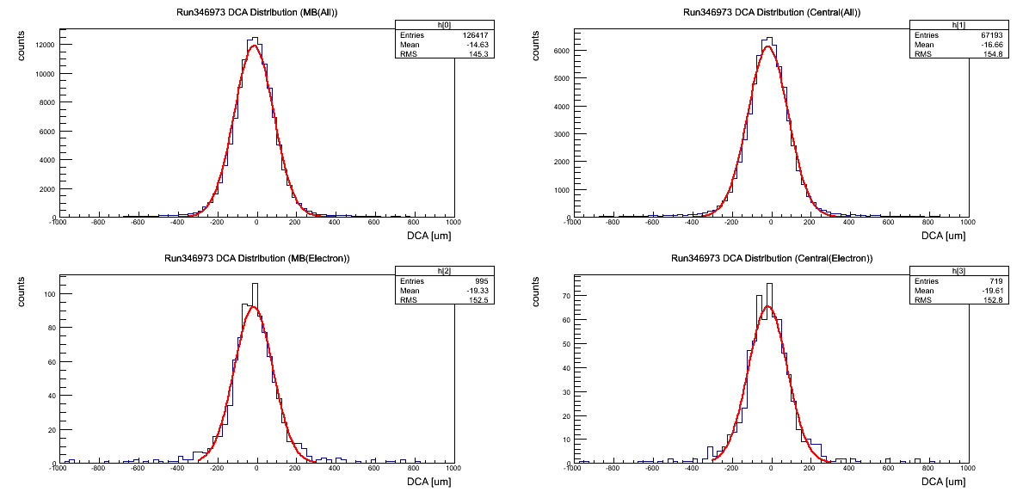
DCA Distribution After Run346973 (Jun 2nd 2011)
Minimum Bias (200<bbcq)
Minimum Bias (200<bbcq)
All
All
Central (1000<bbcq)
Central (1000<bbcq)
Electron
Electron

Slide 8
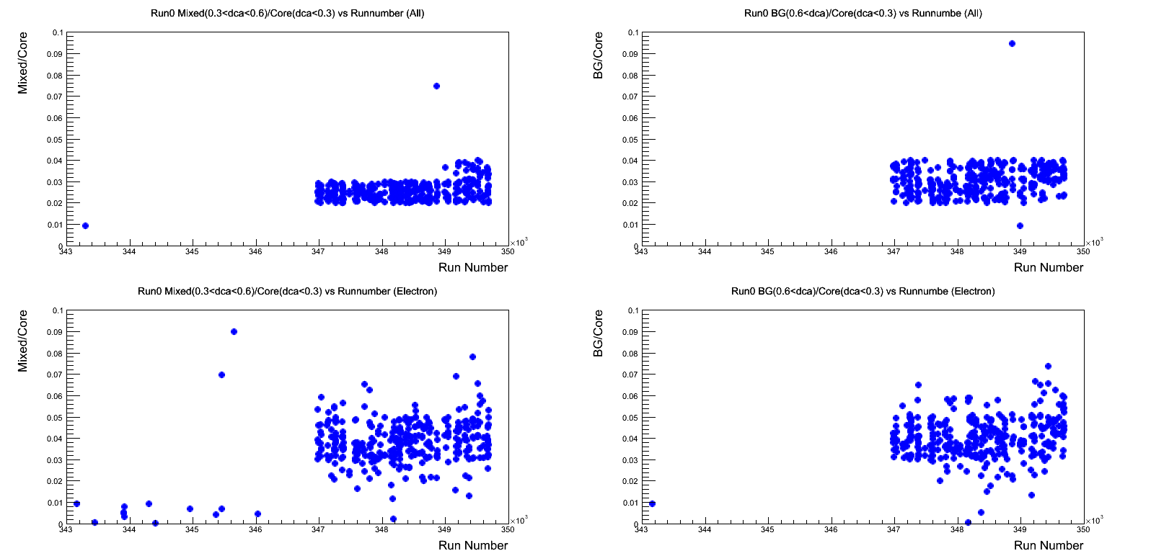
Mixed/Core and BG/Core (All and Electron) run-by-run
Create plot of (Mixed(0.3<abs(dca)<0.8mm)/Core(abs(dca)<0.3mm) vs Run number) and
(BG(0.8mm<abs(dca))/Core(abs(dca)<0.3mm) vs Run number) for every run.
All segments were accumulated for one run.
Mixed/Core (All)
BG/Core
BG/Core (All)
Mixed/Core
Runnum
Runnum
Mixed/Core (Electron)
BG/Core
BG/Core (Electron)
Mixed/Core
Runnum
Runnum

Slide 9
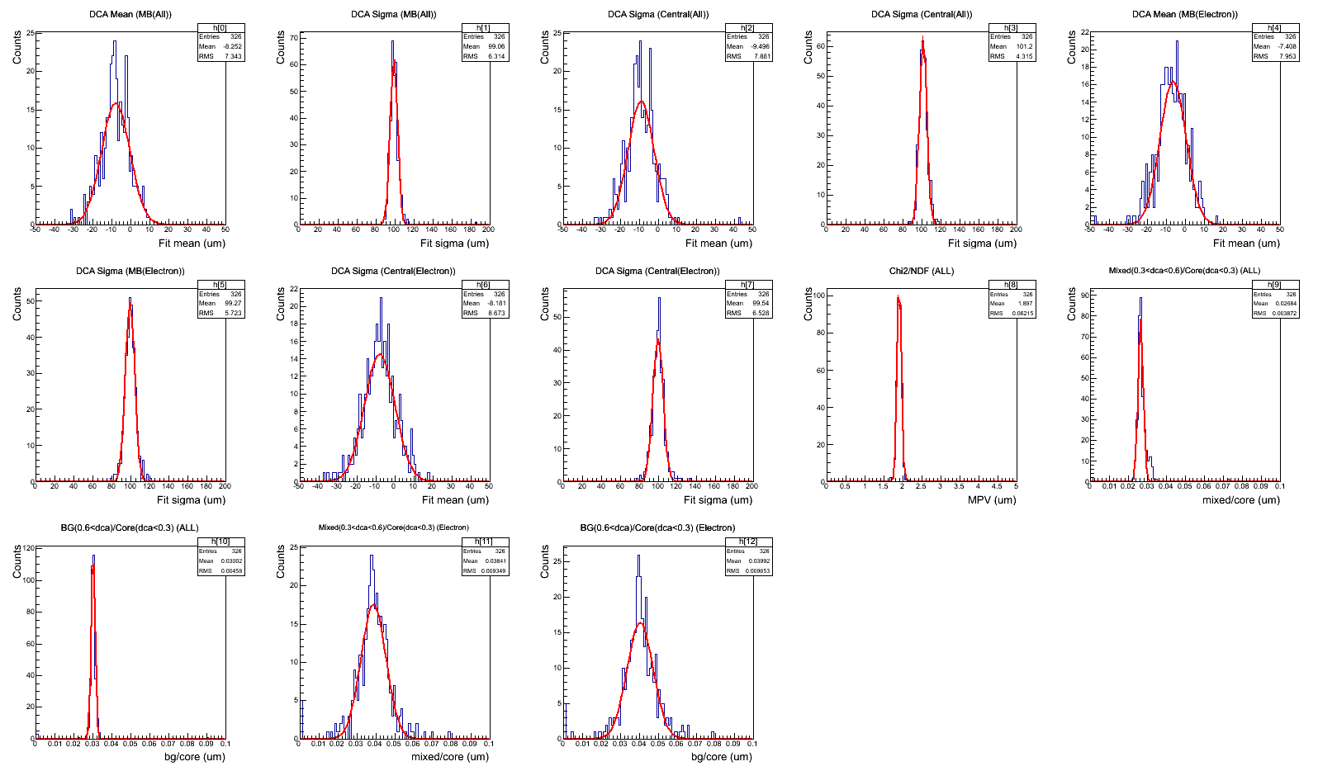
Good Run Selection
Each distribution (DCA mean distribution, DCA sigma distribution…) was fitted with gaussian.
Selection : each sigma is within 3 sigma.
DCA Mean (MB(All))
DCA Sigma (MB(All))
DCA Mean (CNT(All))
DCA Sigma (CNT(All))
DCA Mean (MB(Electron))
DCA Sigma (MB(Electron))
DCA Mean (CNT(Electron))
DCA Sigma (CNT(Electron))
Chi2/NDF (All)
Mixed/Core (All)
BG/Core (All)
Mixed/Core (Electron)
Sigma/Core (Electron)
Accumulated
(run343000-350000)

Slide 10
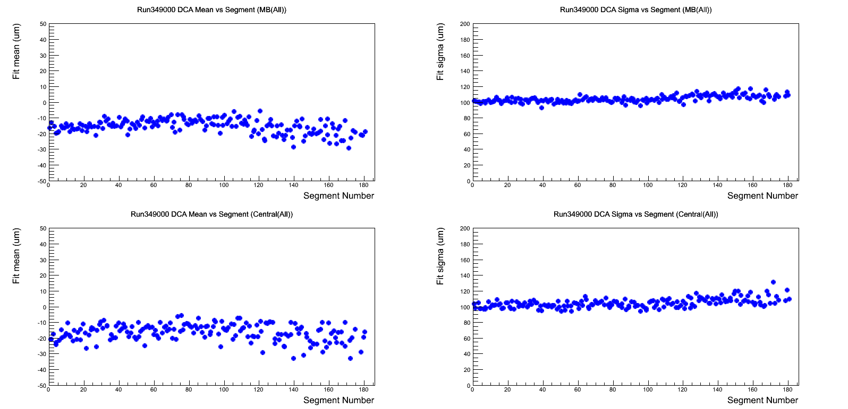
Mean and Sigma of DCA Distribution (All) seg-by-seg
Create plot of (Mean vs Segment) and (Sigma vs Segment) for every run.
RUN 349000
Minimum Bias (200<bbcq)
Minimum Bias (200<bbcq)
Fit Mean (um)
Fit Sigma (um)
Sigma : 100 μm
Mean : -15 μm
Segment
Segment
Central (1000<bbcq)
Central (1000<bbcq)
Fit Mean (um)
Fit Sigma (um)
Segment
Segment
Apply correction for DCA distribution
Mean plot shape has always slope for run number < 3489044.

Slide 11
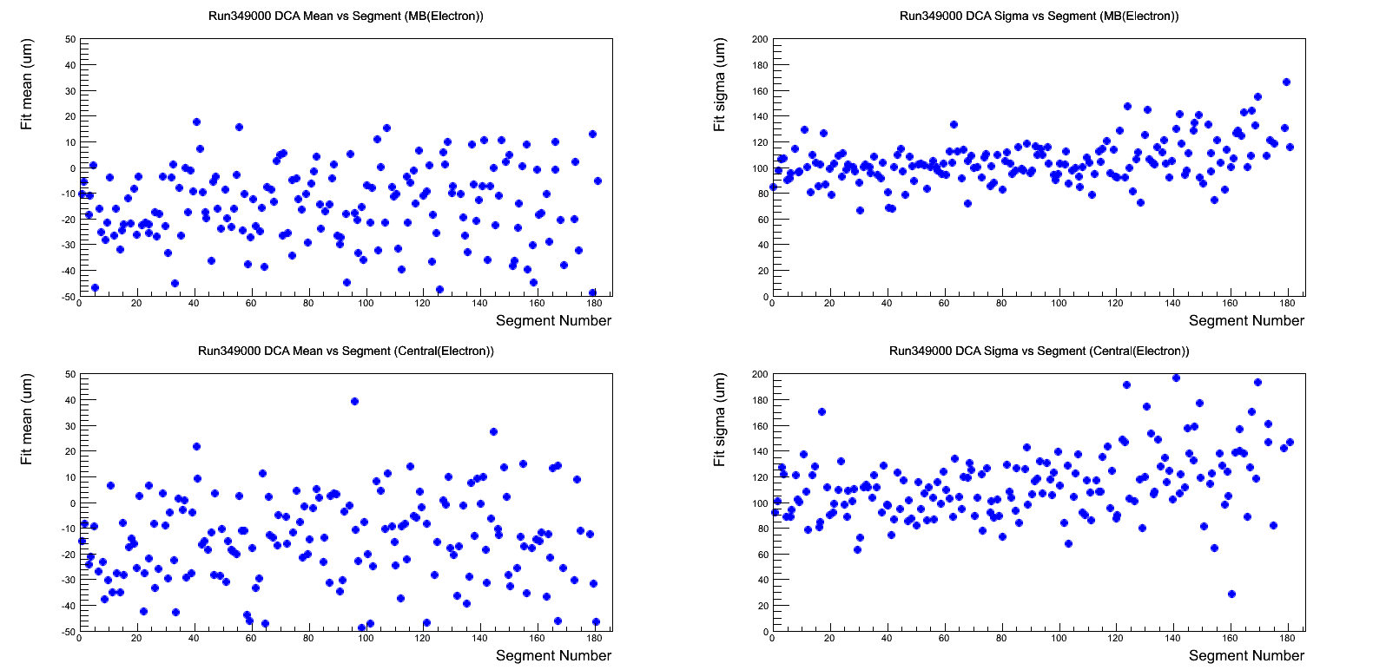
Mean and Sigma of DCA Distribution (Electron) seg-by-seg
Create plot of (Mean vs Segment) and (Sigma vs Segment) for every run.
RUN 349000
Minimum Bias (200<bbcq)
Minimum Bias (200<bbcq)
Fit Mean (um)
Fit Sigma (um)
Sigma : 100 μm
Mean : -15 μm
Segment
Segment
Central (1000<bbcq)
Central (1000<bbcq)
Fit Mean (um)
Fit Sigma (um)
Segment
Segment
Apply correction for DCA distribution

Slide 12
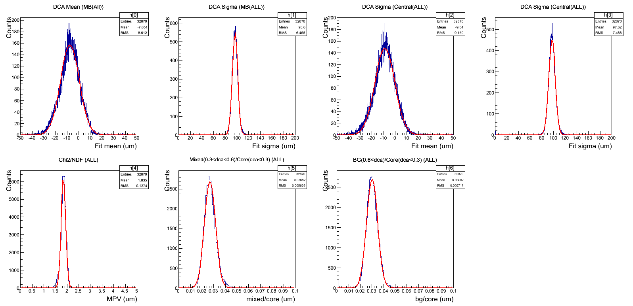
Good Segment Selection
Each distribution (DCA mean distribution, DCA sigma distribution…) was fitted with gaussian.
Selection : each sigma is within 3 sigma.
DCA Mean (MB(All))
DCA Sigma (MB(All))
DCA Mean (CNT(All))
DCA Sigma (CNT(All))
Chi2/NDF (All)
Mixed/Core (All)
BG/Core (All)
Accumulated
(run347000-350000)

Slide 13
BACK UP SLIDES

