Slide 1
zero field runs analysis run12 p+p 200GeV
Hidemitsu Asano

Slide 2
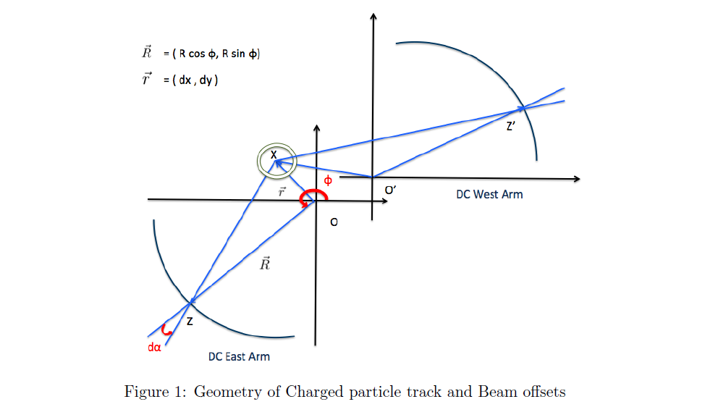
Beam offset measured by DCH
Thanks to Ciprian and Okada-san
α
R: average radius of the DCH
R= 220cm
(dx,dy) : beam offset
>Plot α vs φ
>Fit with [0]*sin(φ)+[1]*cos(φ)
Where
[0] = dx/R,[1]= -dy/R for west
[0] = dx/R, [1]= dy/R for east
ref : AN923

Slide 3
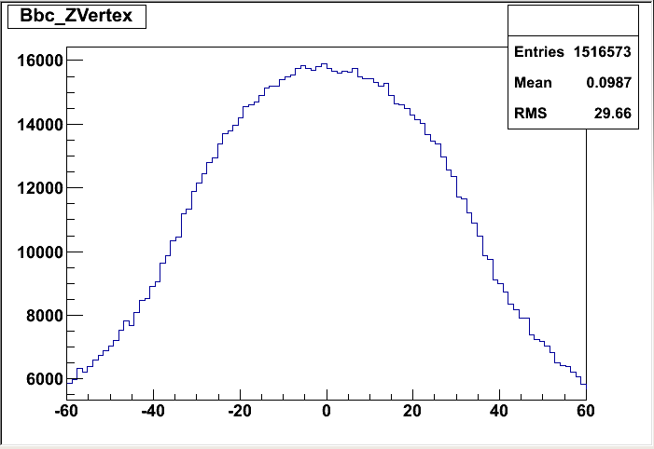
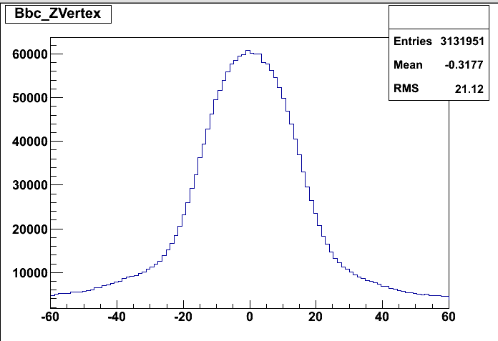
setup
zero field run DSTs
/phenix/zdata02/phnxreco/run12_200GeV_ZF_pro90_agg
trigger selection : other trigger (: probably narrow trigger ? )
***_MB_****.root
***_OT_****.root

Slide 4
cut parameter for west arm
|emcdphi| <0.016
-8 < emcdz < 11
ecore >0.3
|pc3dphicut| <0.04
|pc3dzcut| <20
|zvtx|<10
quality : 63 or 31
n0<1

Slide 5
run 358908 (west)
alpha
phi
still problematic region. DCH internal alignment has not been fixed yet.
temporary solution : remove from those data

Slide 6
run 358908 fit (west arm)
alpha
phi
fitting function : [0]*sin(φ)+[1]*cos(φ)
xoffset : 0.089 +- 0.004 (cm)
yoffset: -0.194 +- 0.002 (cm)

Slide 7
cut parameter for east arm
-0.014 < emcdphi <0.020
-10 < emcdz < 10
ecore >0.3
|pc3dphicut| <0.04
|pc3dzcut| <20
|zvtx|<10
quality : 63 or 31
n0<1

Slide 8
run 358908 (east)
alpha
phib = atan2(y,-x)
large dead area ….

Slide 9
run 358908 fit (east arm)
xoffset: 0.002+- 0.003 (cm)
yoffset: -0.133 +- 0.002 (cm)
うーん

Slide 10
summary
残りのランも頑張る。

Slide 11
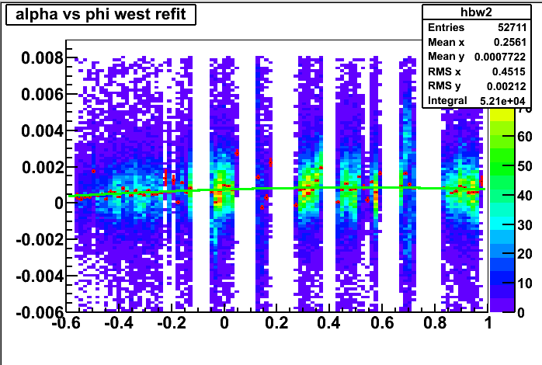
run 359326 west
west xoffset: 0.0925434 +- 0.00435534
west yoffset: -0.168369 +- 0.00232814

Slide 12
run 359326 east
east xoffset: 0.0100128 +- 0.0032843
east yoffset: -0.107615 +- 0.00221705

Slide 13
run 361245 west
west xoffset: 0.0949498 +- 0.00428764
west yoffset: -0.160906 +- 0.00243146

Slide 14
run 361245 east
east xoffset: 0.00853018 +- 0.00310736
east yoffset: -0.104059 +- 0.00214997

Slide 15
run 361652 west

Slide 16
run 361652 east

