Slide 1
Software Update
Takashi HACHIYA
RIKEN

Slide 2
CCJ copy
Delayed by mis-communication, but started.
P+p production
500GeV production will do first
200GeV production,
a few days for EMCAL calibration
Will start from next Wednesday

Slide 3
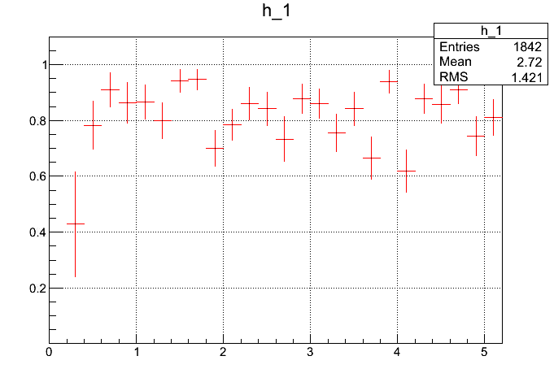
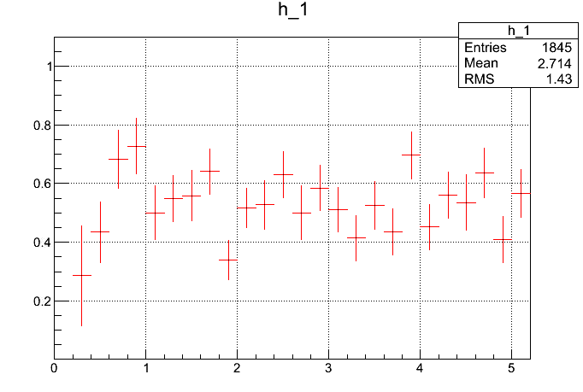
CNT Track Efficiency
Sim (ideal)
Sim (realistic hot/dead)
pT(GeV/c)
pT(GeV/c)

Slide 4
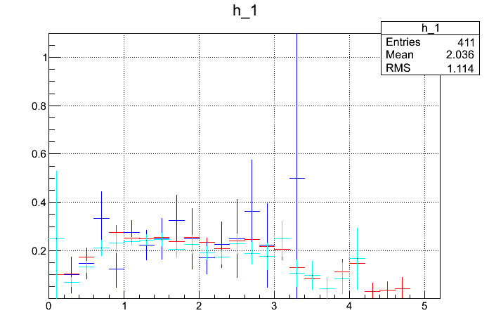
Efficiency vs pT in data (run349610)
MB
BBC<200
BBC>1200
pT(GeV/c)
VTXのGood領域を選択しても、 Eff=N_VTX/N_CNT = 25%程度
どのCentralityでも同じEfficiency。 Centrality依存なし。
カット条件は以下
-5<zvtx<0+dcqual>=4+|emcdphi|<0.02+|emcdz|<8+|pc3dphi|<0.01+|pc3dz|<5
+|phi0-0.2)<0.8+0<zed<40 (fiducial)
+nhit>=3+B0+B1+chi2/ndf<5+|d2dca|<0.06 (association)

