Slide 1
VTX update
Takashi HACHIYA for the VTX group

Slide 2
Current Status of DCA analysis
Data QA and p+p production
CNT and VTX QA are on going.
Lei, Jason, Maki, Ryohji, Hidemitsu, Hiroshi and Maya.
Working hard to get the calibration parameters for p+p 200GeV (run12)
Rachid, John, Hidemitsu and Maya
DCA analysis using charged tracks (not electrons)
smaller backgrounds
Most of the particles come from the primary vertex.
No conversions
Electron DCA is not included in this slide.
DCA calculation (track fitting) is improved
New method is implemented.
The current fitting method (used in the production) is very simple and ignored the multiple scattering effect. The updated method include the multiple scattering.

Slide 3
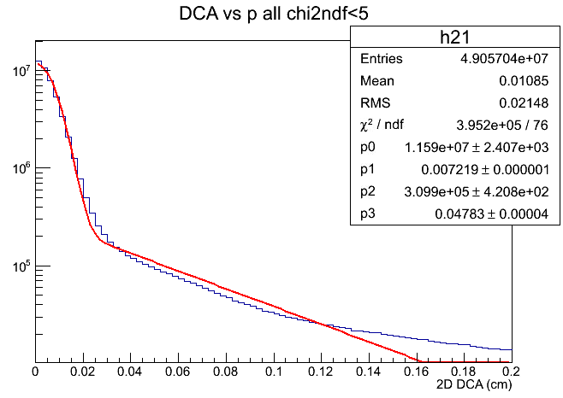
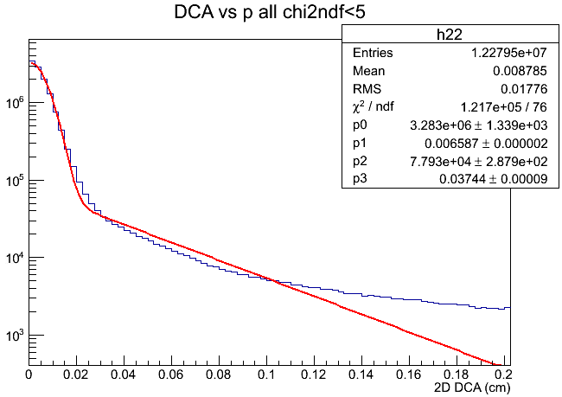
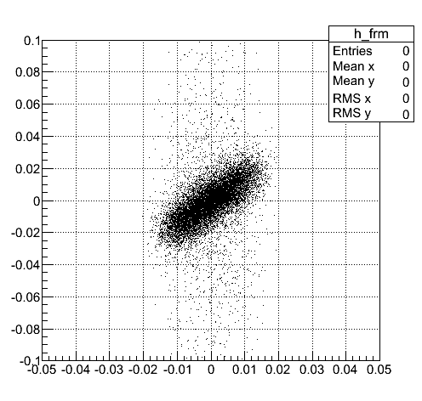
DCA resolution (Charged particle)
Central Arm tracks are matched to VTX and their DCA are measured
P>1 GeV/c
P>2 GeV/c
Gaussian sigma is extracted by gaus+exp fit
P>1 GeV/c 72μm
P>2 GeV/c 66μm
In this current fitting method, a correlation effect from the multiple scattering is included (left plot). This makes the resolution worse. We correct this effect
DCA(cm)
Fitdp1(cm)

Slide 4
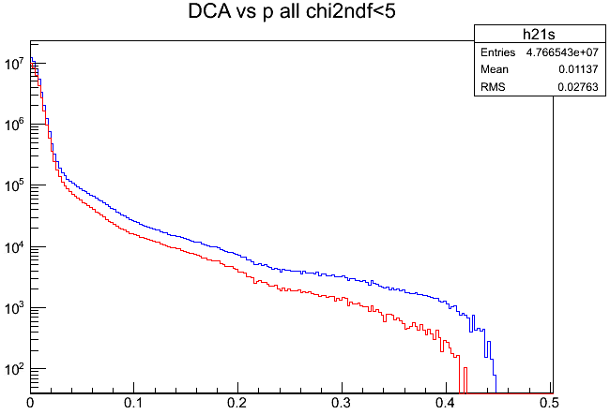
DCA distribution for charged particles
Cut off at DCA ~ 4mm due to search window size
There are 2 issues
Background at large DCA (DCA>0.3 cm)
Partially reproduced by “5 degree rotation” method (shown in red)
A bump at around DCA=0.2 cm in the 5 deg BG
After the fake track DCA distribution is subtracted, there is a exponential-like component
What is this?
strange particle decays (Ks, Lambdas, etc)?
FG
BG(5dgree)
2D DCA (cm)
DCA with chi2/ndf<5
with chi2/ndf<3
2D DCA (cm)

Slide 5
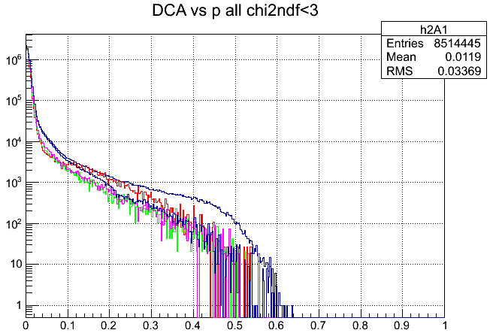
DCA for several centrality bins
MB
MB. 5deg subtracted
100<bbcq<200
200<bbcq<300
300<bbcq<400
2D-DCA(cm)
By comparing the green, pink and blue (subtracted) histograms, there is an exponential tail in addition to the Gaussian peak at DCA=0
No centrality dependence → must be physics effect
Likely due to decays of short lived particles (strangeness)
K0 short + Lambda
The red histogram (very peripheral) has different shape. This is due to bias in “primary vertex” position (See next slide)

Slide 6
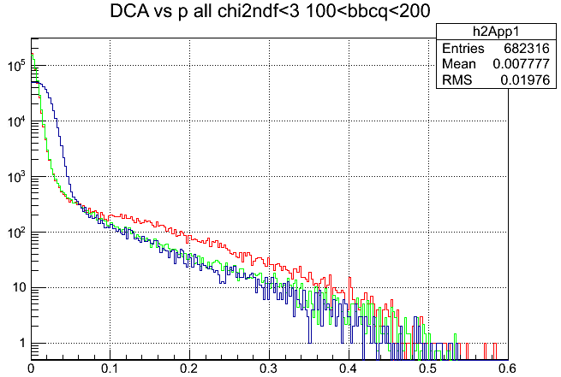
Primary vertex bias for Bbcq<200
Red: DCA from prim. Vtx (100<bbcq<200)
Green: DCA from prim vtx (200<bbcq<300)
Blue: DCA from beam center (100<bbcq<200)
2D-DCA(cm)
Green DCA shape is consistent with blue DCA, but red DCA is growing at large DCA compared with the blue.
The standalone tracking windows opens wider winder for bbcq<200
SATracks are used to find the primary vertex. This change might make the bias
Comparison between Green and Blue
DCA from beam center does not have any bias of vtx finding.

Slide 7
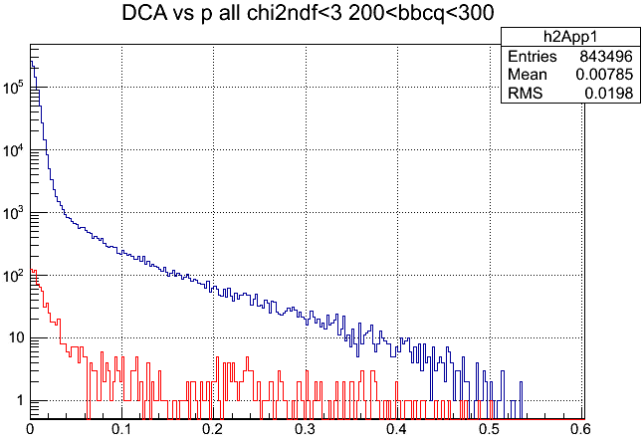
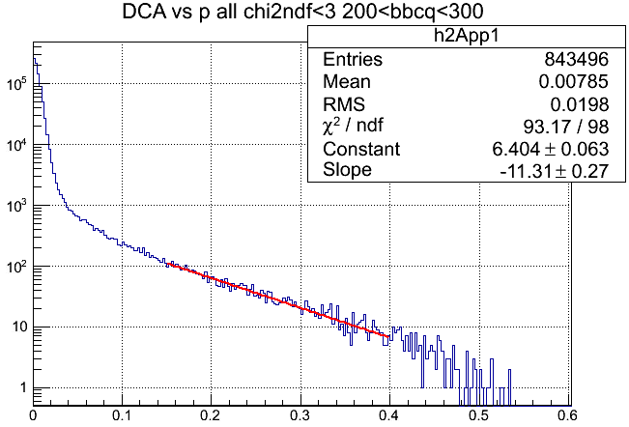
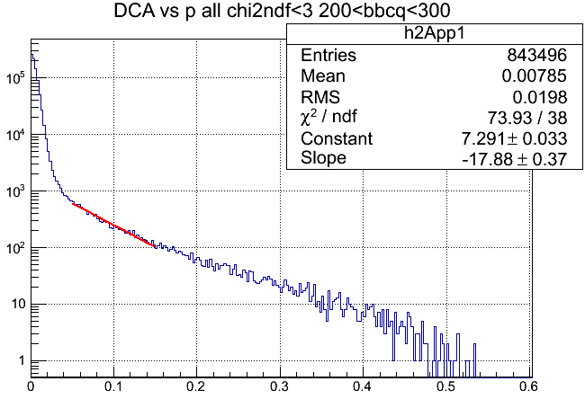
DCA in Peripheral 200<bbcq<300
DCA
BG (5 degree)
DCA(cm)
DCA slope at large DCA in peripheral
No background is subtracted since it is small
Slope at DCA = 3mm is ~ 1mm
Slope near the core is more steeper.
We checked if K0s and Lambda can reproduce the DCA distribution
Showing in next page.

Slide 8
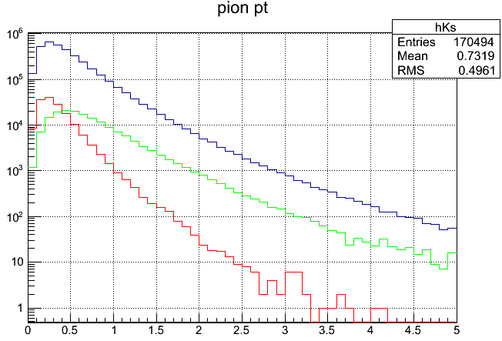
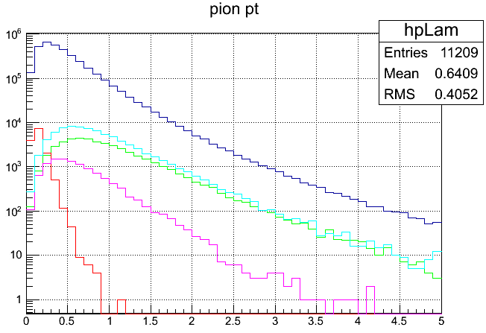
pT distribution of Ks and Lambda decays (Pythia)
K0s (Pythia)
Lambda(Pythia)
注：p はpbarを含まないが、Λはantiを含む。Pi from Λはpi+とpi-の和
pi+ + pi-
pi+ + pi-
proton
K0s
lambda
pi from lambda
pi+ + pi- from Ks decay (25mm)
p from lambda
Particle ratio in Pythia
(Pi+ + Pi- from K0s)/(All Pi+ + Pi-) ~ 1%
P from Lambda/(all pi+ + pi-) ~ 0.5%
Pi from Lambda is softer than p.
More Ks and Lambda in AuAu due to radial flow, strangeness enhancement, and recombination effects.
Realitstic paritcle composition of AuAu should be used for quantitative comparison

Slide 9
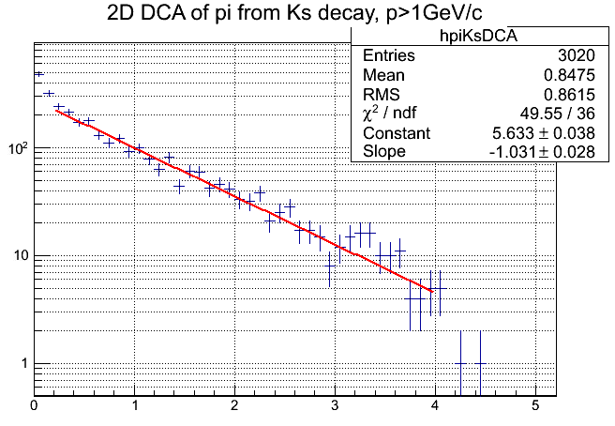
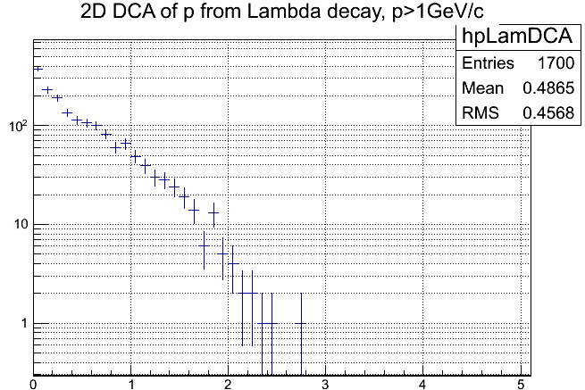
DCA from K0s and Lambda decays
Simulation
DCA from K0s and Lambda decays.
K0s and Lambda are calculated by Pythia
No detector and tracking effect is included
K0s and Lambda make large DCA components.
Lambda is steeper than K0s
K0s slope is ~1mm
Compare the DCA slope between data and Pythia
Slope is similar (consistent) with K0s and Lambda decays in peripheral
Slope at large DCA is consistent with K0s decay
Slope at DCA=0.1cm is steeper. This is due to the Lambda contribution
Relative yield of DCA
DCA(K0s+Lambda) / DCA(all) = DCA(0.5-4mm) / DCA(0-4mm) = 1.78%
1.78 % is roughly consistent with K0s (1%)+ Lambda(0.5%) decay
From this study, we found that wider DCA distribution is consistent with K0s + Lambda decays
We must check this using full PISA simulation
K0s
DCA(mm)
Lambda
DCA(mm)

Slide 10
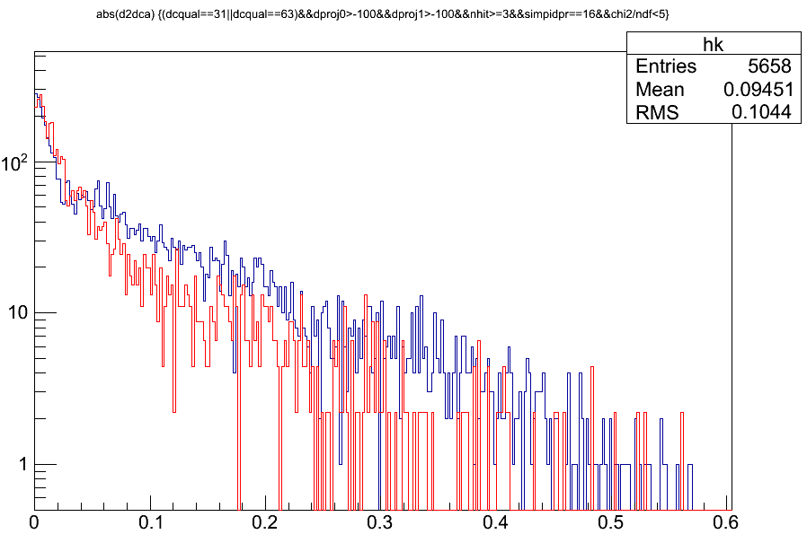
PISA simulation is started. DCA from k0s and Lambda decays in PISA simulation
Simulation
Flat pT(0.2-10GeV/c)
Flat |Zvtx|<5cm
Gaussian Sigma(Rvtx)<70um
Single + GEANT(PISA)
Normalization
Arbitrarily match the peak entry between red and blue
Track cut
DCQualty==31||63
NHIT>=3
B0&B1 hit
Chi2/ndf<5
K0s
Lambda
DCA (cm)
This looks :
Lambda DCA is slightly wider than K0s around 0
DCA tail of K0s is longer than Lambda
Consistent with Pythia simulation. Need more statistics

Slide 11
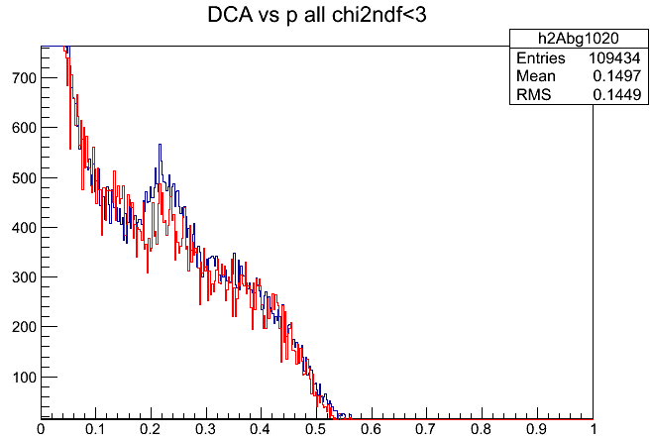
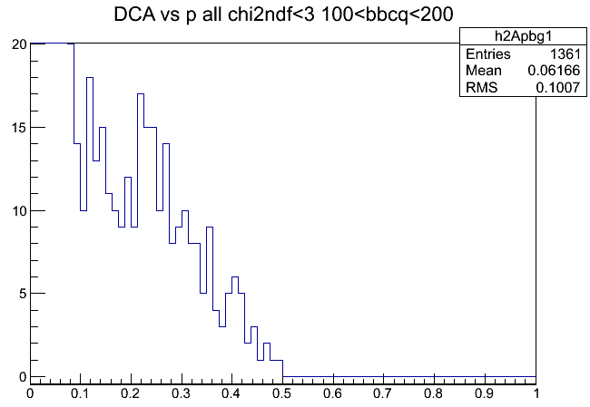
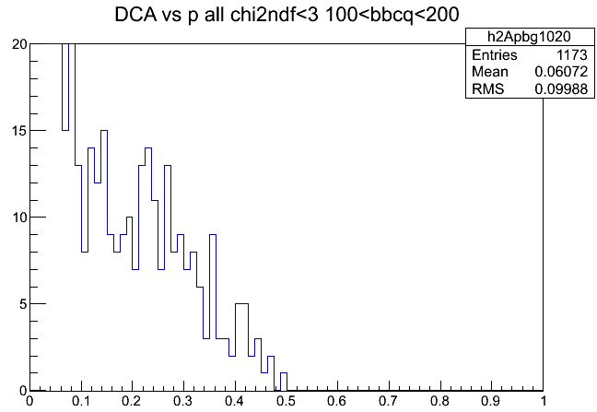
2 Background shape(5deg background)
Peripheral
1<P<2GeV/c
Min. bias
Blue 1.0-2.0 GeV/c
Red p>2 GeV/c
Peripheral
P>1GeV/c
There is a peak at DCA=2.5mm
This peak in pT=1-2GeV/c is stronger than that in pT>2GeV/c
This peak in peripheral is stronger than that in MB
From this comparison, it seems that the peak comes from the real signal.
Now on investigating this.
Possible explanation :
Particles from decays is in the association window after even 5 degree rotation.
Particles from primary vertex does not enter the window after 5 degree rotation.

Slide 12
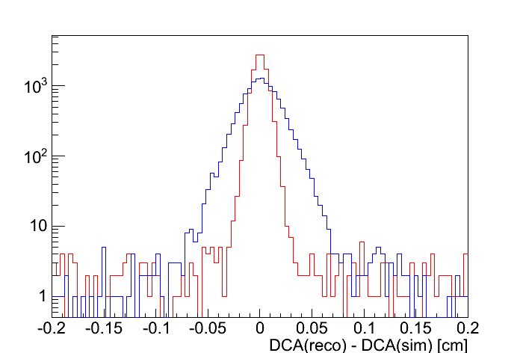
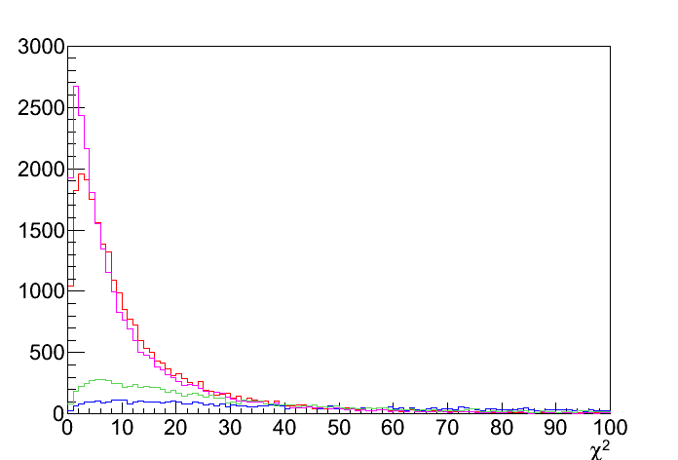
2D-DCA using the updated DCA calculation
Ryohji is working to improve the track fitting (CNT-VTX association)
Ryohji’s slide at VTX meeting
2D-DCA distribution
chi2 dist. (pT>1GeV/c & nhit>2)
new code
old code
new real
new fake
old real
old fake
DCA resolution is improved by new code.
171μm → 66μm (no chi² cut)
Chi2 distribution is improved
New DCA distribution is narrower than the old since the MS effect is corrected.
New method is applied in the recalibrator in the analysis.
Now developing the recalibrator module.

Slide 13
Summary
We are studying the DCA distribution using charged tracks.
DCA resolution is 60-70um
Large DCA tail is naively explained by K0s + Lambda decays
Need to study in more quantitative using PISA simulation and realistic particle composition in Au+Au.
A bump structure in the BG is under investigation.
Track fitting is improved
New fitting is implemented by Ryohji
We started the electron DCA distribution
It is more difficult than the hadron DCA to understand since there are a lot of conversion electrons.
We will update soon
We plan to make the standard tool for DCA analysis in near future.

Slide 14
backup

Slide 15
DCA correlated with dphi
DCA vs fitdp1
DCA(cm)
Fitdp1(cm)
DCA is correlated with dphi
This is due to multiple scattering.
The fitting method should be updated to include the MS effect.
DCA should be flat with respect to dphi.

Slide 16
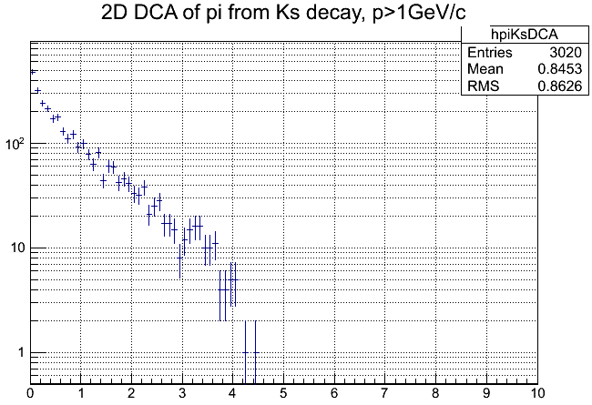
Ks decays (Pythia)
このＳＩＭではK/pi比が1GeV/cで0.2くらい。このときKs崩壊のpiはpiの１％強である。
Decayのスロープは1mm程度である
このPYTHIAでは適当にＪｅｔをつくっている。ＨＩデータと比べるときはちゃんともとのｐＴの違い、particle ratioなどを補正しなければならない。
pi+ + pi-
K0s
pi+ + pi- from Ks decay (25mm)
Rxy<25mmを要求していることによるカットオフ

Slide 17
Lambda decays
Lambda decay のｐはpionの０．５％くらいある勘定になる。
しかしこのsimulationでのLamda/pi比はたぶん小さすぎる。Heavy ionではhigh pT のbaryonはもっと多く発生するのである。
Lamba/pの比も大きくなっているはずである
それを考慮すれば、lambdaからのｐのfractionはこのsimulation の数倍になるはず。2%くらいになってもおかしくない
注：p はpbarを含まないが、Λはantiを含む。Pi from Λはpi+とpi-の和
pi+ + pi-
proton
lambda
pi from lambda
p from lambda

Slide 18
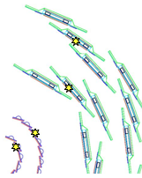
Track Fitting
Ryohji’s slide at VTX meeting
I made a fitting code for SvxCentralTrack
This is for alternative for the fitting code with Kalman filter in case the fitting code with Kalman filter will not be ready for recalibrator.
Basic idea is the same as the fitting code for SvxSegment, multi-circle fitting. In addition, phi0 and the0 of CNT are used to take into account matching of CNT.
For SvxSegment, only intermediate hit points are used in the multiple scattering term in chi2. But for SvxCentralTrack, the first hit is also used.
phi0 is updated using DCA by the same way as of momentum recalibrator.
Δθxy
Δθxy
SvxSegment
SvxCentralTrack
Δθxy
Δθxy
Δθxy

Slide 19
Setup
Simulation : HIJING (min. bias)
Simulation study
compared chi²s calculated by old and new codes for the same tracks.
chi² =
x-local, z-local : 2 axes on sensor plane.
real track : all associated hits are from the same simulation track.

Slide 20
Possible explanation of the peak
Decay 粒子の場合、5度回転のあとのsearch windowに入ってしまうのだろうと思われる。しかし簡単な説明はまだできていない。
Bbcq<200でforegroundの振る舞いがことなっているのは、bbcq<200ではsearch windowを拡大していることと関係があるように思われる。これについては秋元氏に聞く必要がある。
たぶんＤｅｃａｙがみえているのだが、定量的に確認するには、ちゃんとＭＣをする必要がある。

