Slide 1
Software Update
Takashi HACHIYA

Slide 2
Update
Copying the data to CCJ
Not start yet.
The special account was expired and must have waited to be updated.
Changed the ftp software from DOEGrid to OpenScienceGrid
Now waiting OSG certificate
Will start tomorrow hopefully.
Need to let people know how we can create the account
Preparation for p+p 200GeV production
I promised it finish by less than 1 week.
They are waiting for us to be ready.
Not ready yet
Offset calibration is failed many times since there is a confusion in the offset direction.
The job for the Beam center calibration is running to get the calibration histogram
Hot & dead map is under determination
1st version for Pixel: failed. made for wrong run range.
1st version for strip: on going.

Slide 3
QA for Au+Au
Need to monitor their progress.
How we can use the QA result
Determining the run range for each parameter
Need to merge these run range for the Physics analysis.
Recalibrator
EMC matching
RICH ?
Momentum
Track fitting (implemented by Akimoto-kun)
Need to resurrect the cluster from the compact CNT
Reaction Plane

Slide 4
HHJ meeting
I showed Akiba-san’s and Akimoto-kun’s results
Hadron DCA can be reproduced by the strangeness decays (K0s and Lambda)
HHJ convenors requested :
To show how the background shape can be reproduced in the not only peripheral, but the central event (0-5%)
Centrality dependence
Electron DCA
Analysis
Hadron DCA :
Background peak at DCA~2mm,
compare with the BG from event mixing. Asked Lei to make the BG distribution
Compare with the BG from 10 degree.
Estimate the DCA from K0s and Lambda decays in the central event.
Electron DCA:
Checking large DCA component from conversion in peripheral and central

Slide 5
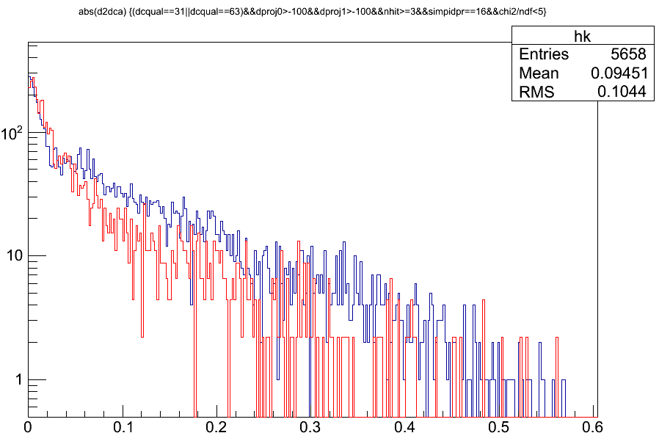
DCA from k0s and Lambda decays in single simulation
Simulation
Flat pT(0.2-10GeV/c)
Flat |Zvtx|<5cm
Gaussian Sigma(Rvtx)<70um
Single + GEANT(PISA)
Normalization
Arbitrarily match the peak entry between red and blue
Track cut
DCQualty==31||63
NHIT>=3
B0&B1 hit
Chi2/ndf<5
K0s
Lambda
DCA (cm)
This looks :
Lambda DCA is slightly wider than K0s around 0
DCA tail of K0s is longer than Lambda
Shimomura-san and I are working to make the simulation data

Slide 6
Simulation work
Hadron Simulation
K0s -> pi+pi
Lambda -> p + pi
Electron simulation
Pi0 -> Dalitz decays
Pi0 -> Conversion
Ke3
D0/D+/Ds -> electron
B0/B+ -> electron

