Slide 1
Software Update
Takashi Hachiya
RIKEN

Slide 2
Analysis Meeting
Reported
Calibration is almost done for the pp 200GeV production
2days for the ladder by ladder alignment
Others(hot&dead, offset and beam center ) are done basically.
(Need to check the pixel hot dead made by JohnC)
Many runs are dead in the run by run live area plot
Copy data to CCJ
Successfully certificated.
But due to some problem, the transfer is failed.
RCF and CCJ guys are trying to figure out what the problem is.
P+p mini-production
Is requested to check the stability and time consumption for re-tracking of SATrack, but not started yet.
Asked about the VTX code
If the projected point is in the dead area, is it better not to look for the closest hit at the layer
How much can the primary vertex be reconstructed in p + p.
Ask Akimoto-kun to check using the data.
FVTX group want to use the VTX hit position for the FVTX reconstruction.

Slide 3
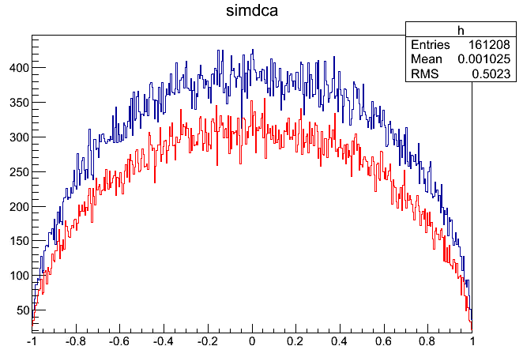
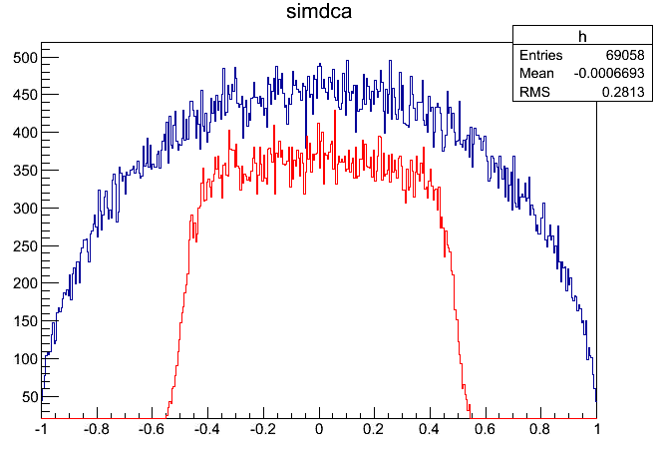
debug in Tracking at large DCA
Trackingにバグあり。
|DCA|>0.5cmを測定できない問題があった。
バグの箇所を発見し、デバッグ&テストを行う
SvxCentralTrackReco::LinkCluster中で、SvxClusterContainerによるクラスタリスト取得時、dphi=0.2を使っていたために、B0で0.5㎝(0.2*2.5㎝)のカットが入ってしまっていた。
修正方法として、B0を検索するときだけ、1㎝になるよう、dphi=0.4に変更する。
ただし、現在のコードでもDCA<0.4㎝において問題ないことが分かっているので、当面変更しないことにする。
Data:
Pi+/Pi- single simulation
Flat pT
|R| <1cm (DCA)
SIMDCA
DCA(reco, B0)
Current algorighm
DCA(cm)

Slide 4
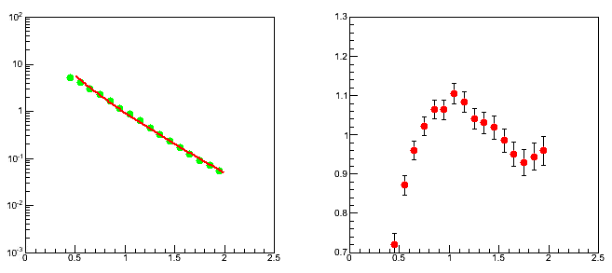
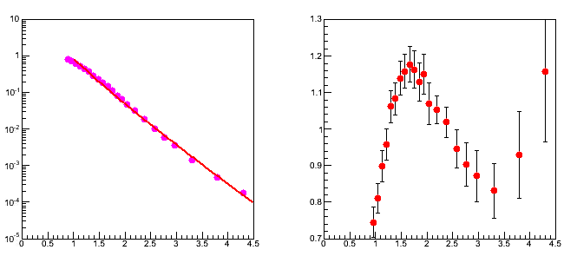
K0s and Lambda Simulation
Imput pT distribution
MB in Au+Au (as follows:)
K0s : average of K+ and K-
Lambda : mT scaling from proton
Input pT shape is obtained by fitting with expo.
Simulation
200k event (single particle)
X-Y vtx: 70um sigma,
Z: 5cm
Phi = 2pi, |y|<0.5
pT>1GeV/c
0.5*(K+ + K-)
Lambda(scaled)

Slide 5
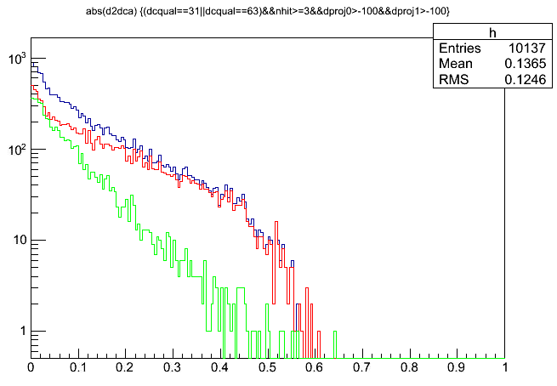
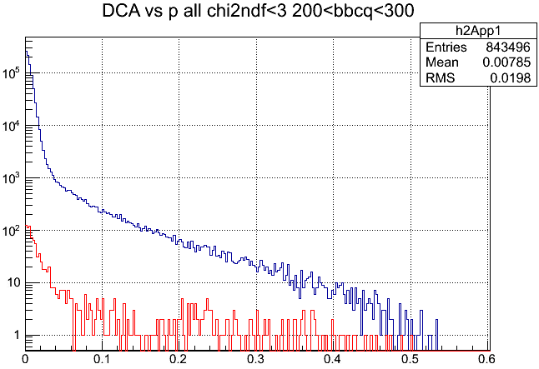
DCA distribution from Simulation
Ntrack generated:
K0S: 20000*10
Lambda: 20000*6
Combined
K0s
Lambda
DCA
BG (5 degree)
DCA(cm)
DCA(cm)
DCA distribution is not normalized
DCA shape at DCA>0.5mm is similar with data

Slide 6
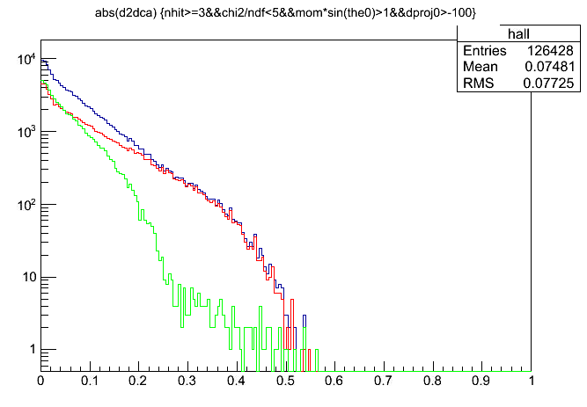
DCA distribution from Simulation 2
Ntrack generated:
K0S: 200000*19
Lambda: 200000*18
Combined
K0s
Lambda
DCA
BG (5 degree)
DCA(cm)
DCA(cm)
DCA distribution is not normalized
DCA shape at DCA>0.5mm is similar with data

Slide 7
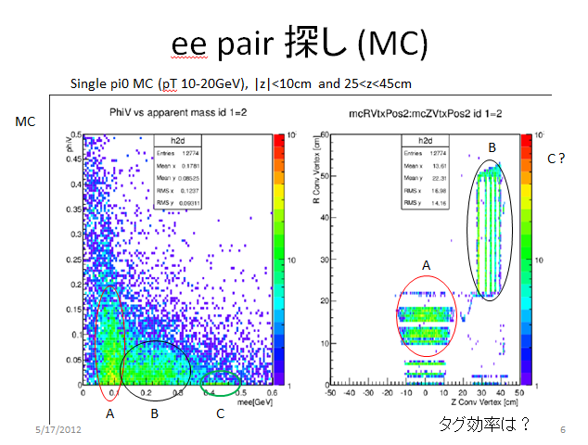
Background study
Study how the conversion makes DCA tail.
Photon tag by Inv-Mass, then check the DCA shape and residual shape
Use pi0 simulation
Made by Shimomura-san
Inv-Mass of electron pairs and phiv
岡田さんスライド

Slide 8
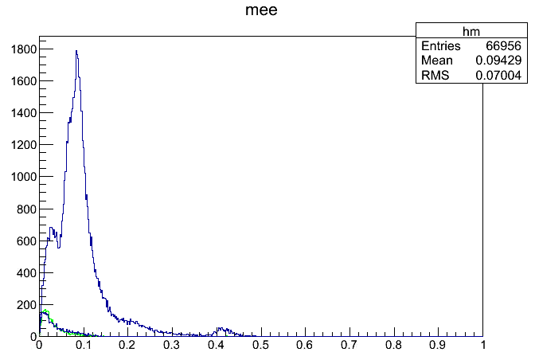
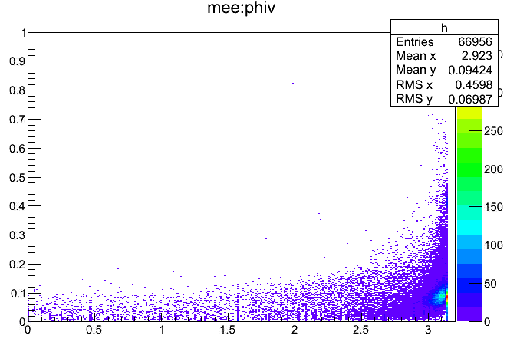
Mee from Pi0 simulation
Mee
Mee(phiv<2)
Mee(Dalitz)
Single pi0 simulation
Made by Shimomura-san
Inv-Mass of electron pairs and phiv
Phiv : angle between the B-field vector and a normal vector of the decay plane. In case of conversion, should be 0. but pi in the plot. I think this is due to the reverse field.
60<Mee<120MeV, the peak is made by the conversion on the VTX
No Dalitz peak around Mee~0 compared with run2 and run4

Slide 9
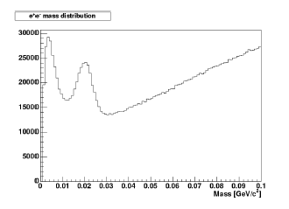
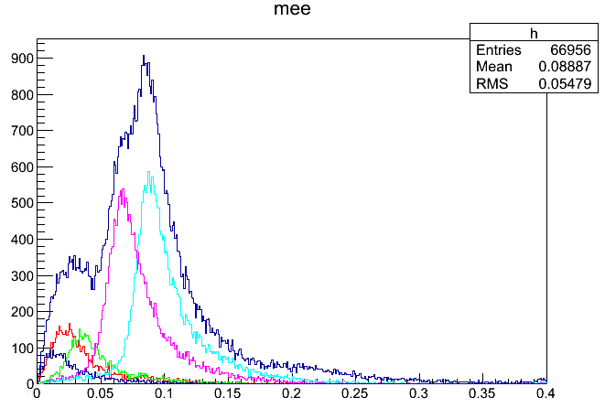
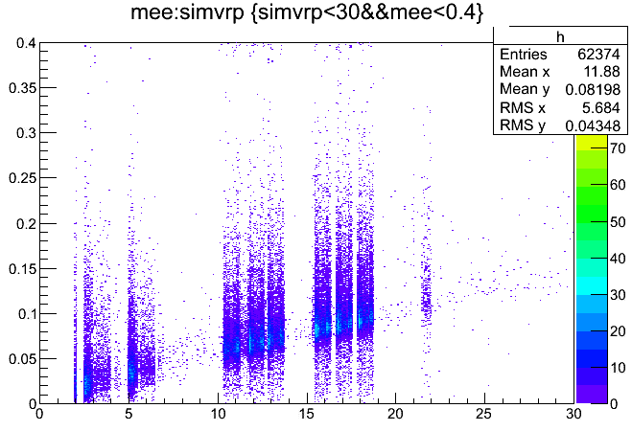
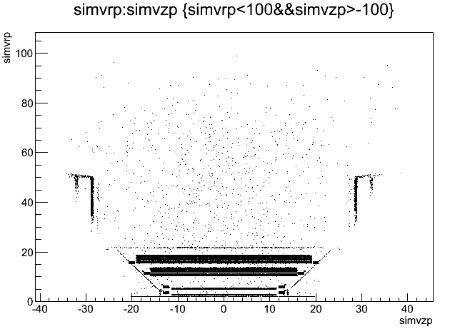
Low mass Mee
Data in run4
Kajihara-kun’s Dthesis
Pi0sim
Dalitz
Total
Dalitz
Conv at B0
Conv at B1
Conv at B2
Conv at B3
BP conversion
Pi0sim
Pi0sim
Mee(GeV/c2)
R(cm)

Slide 10
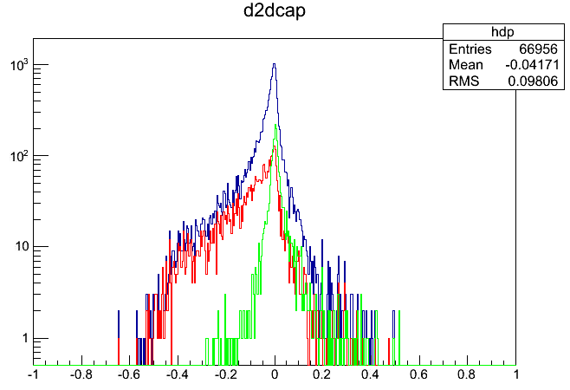
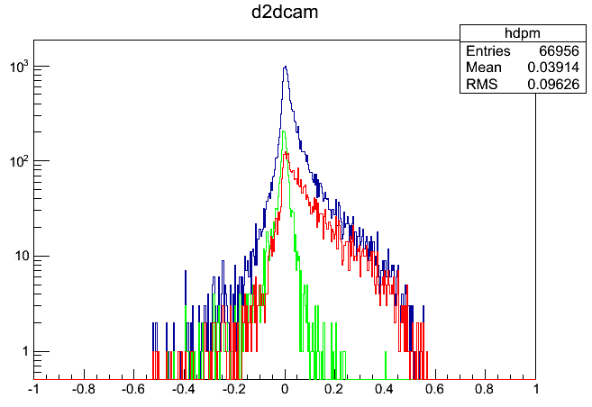
DCA distribution in pi0 sim.
e+
DCA
DCA(Dalitz)
DCA(60-120MeV)
e-
DCA
DCA(Dalitz)
DCA(60-120MeV)
DCA(cm)
DCA(cm)
DCA distribution
Nentry is Npair. Should be Ntrack

Slide 11
解釈
秋葉さんスライド

Slide 12
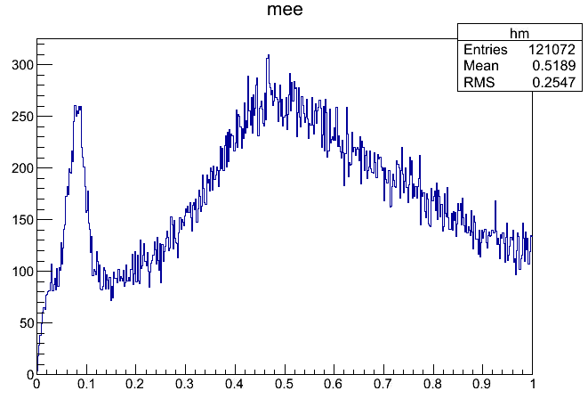
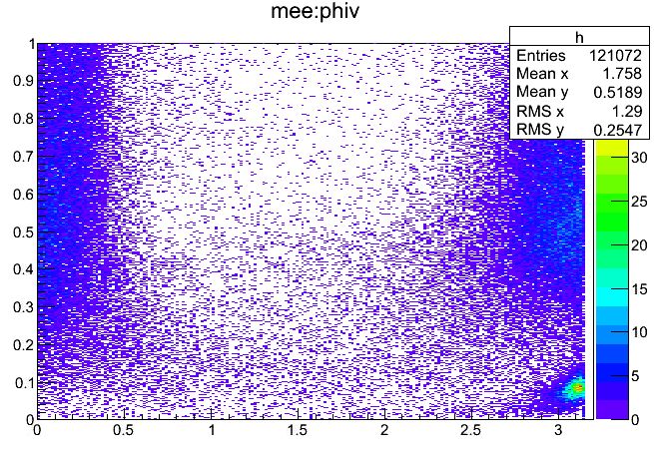
Mee and phiv in data
Check Mee and phiv using data (electron ntuple)
The analysis code for the ntuple and compactCNT is made
Clear peak at 60<Mee<120MeV

Slide 13
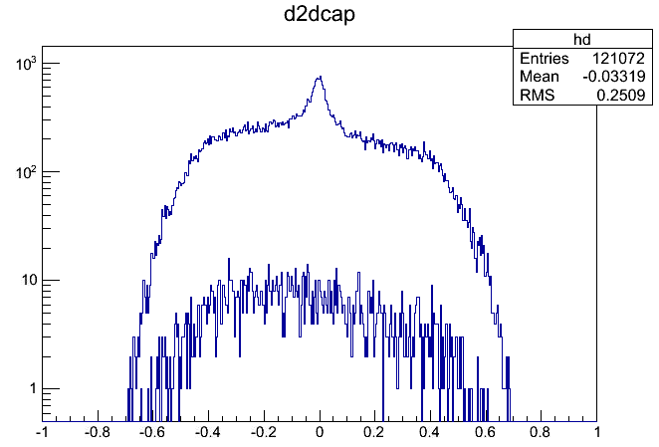
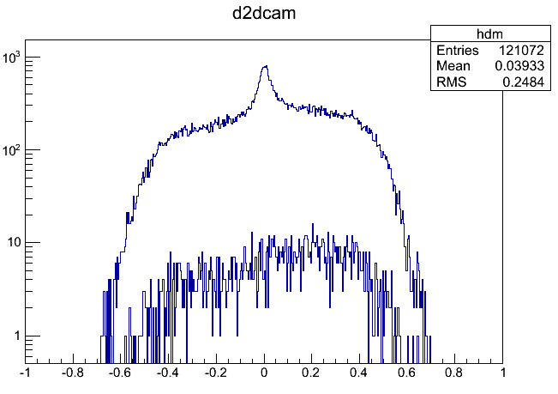
2D DCA in DATA
e+
Mee(60-120MeV) & phiv>3
e-
Mee(60-120MeV) & phiv>3
エントリ数はペア数。 Track数にする必要あり。

Slide 14
まとめと今後
Simulation生成について
MBのpT分布を使って、Simulationを作成した。
Pi0のpT分布をFitして、Simulationを作成する予定
Conversion解析について
Meeを解析し、ConversionをTagできることが分かった。
Ntuple, CompactCNTの両方で解析コードを作成
TagしたConversionを使って、
DCA分布、dphi, dz分布をチェックし、データ中でBGを削除できるカットを探す。
ConversionトラックをデータにEmbedすることで同様の解析を行う。
Conversion BGのYieldをStudyする。
Sashaが来ているのでEmbeddingの方法を聞く

