Slide 1
Memory growth problem
Hidemitsu Asano

Slide 2
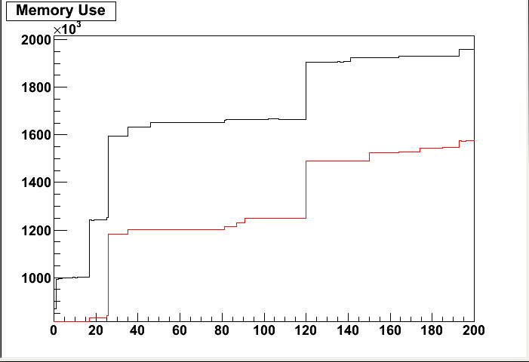
In pro.90 lib (Run11 AuAu200GeV)
-run 347128 (AuAu200GeV)
-process 20k event
byte
with QA
without QA
#event/100
QA modules add some offsets to memory consumption.
There are strange jumps. We already had this problem in pro90. lib
valgrind and insure said nothing about this.
(Eventually) We had no crash in run11 200GeV production.

Slide 3
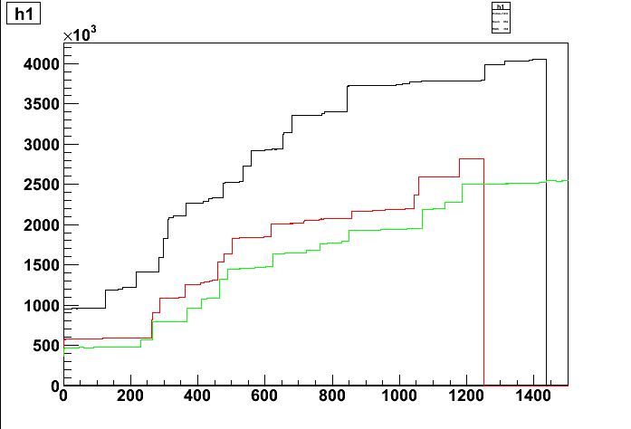
In pp 200GeV
RUN 363228-0000, Achim’s output
with SVX ,with QA
RUN 363227-0000, Achim’s output
with SVX , without QA
RUN 363227-0000, Hidemitsu’s output
without SVX ,without QA
Those jumps are generated by other subsystem.
# of events / prdf is around 230K in pp200GeV (~120K in AuAu 200GeV)
2 problems
-other subsystem generates those jumps.
-QA module also consume memory.

Slide 4
plan of next trial
SvxSelectClusters-in SvxRpSumXYReco-out SvxRpEventQA-out SvxFillHistoBeampro-out SvxAlignment_QA-in
SvxStripClusterQA,SvxQAForProduction-in SvxStripEventQA-out SvxCntQA-out

