Slide 1
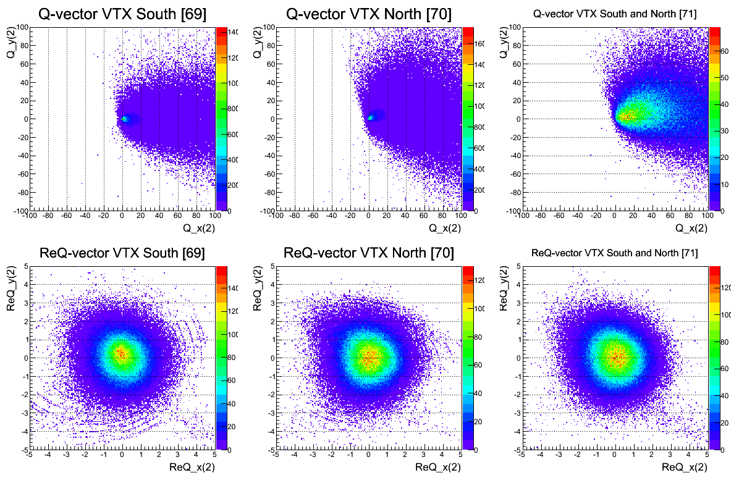
Re-centering Calibration (RUN 349667 360K Events)
VTX South
VTX North
VTX North + South
Before re-centering
After re-centering

Slide 2
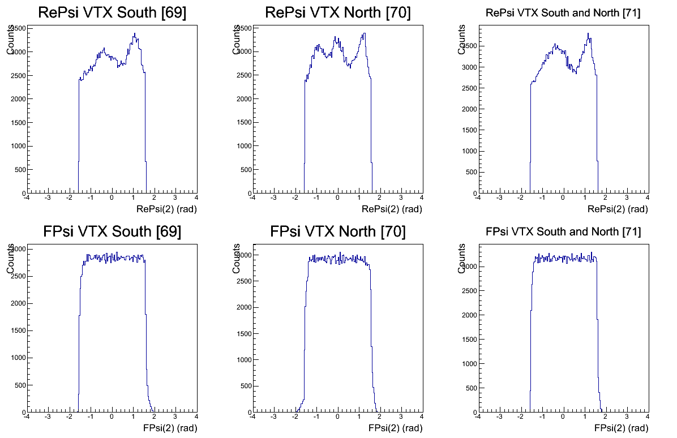
Flattening Calibration (RUN 349667 360K Events)
k th of Fourier expansion : ~8
VTX South
VTX North
VTX North + South
Before flattening
After flattening

Slide 3
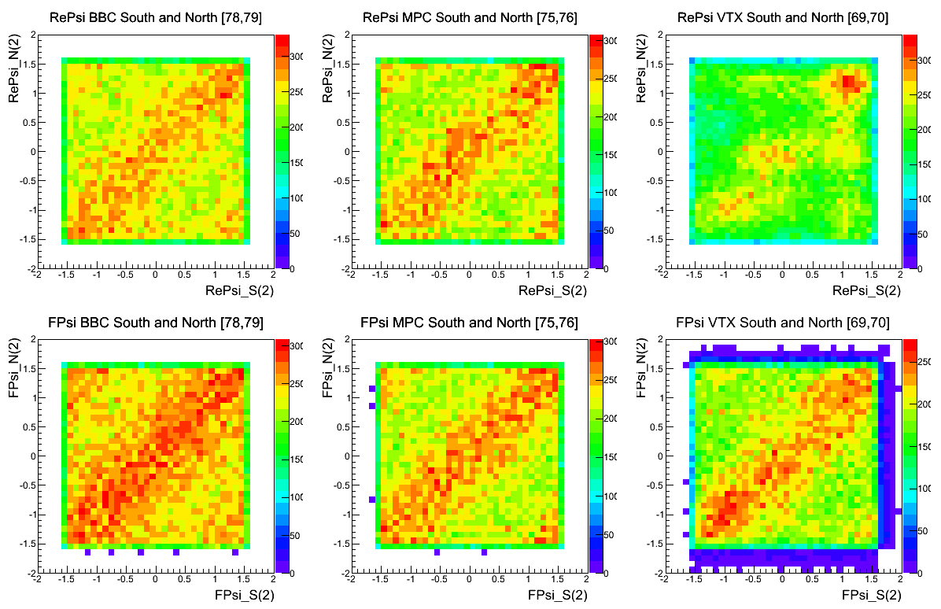
Correlation btw S and N of BBC/MPC/VTX (RUN 349667 360K Events)
BBC
MPC
VTX
Before calibration
After calibration

Slide 4
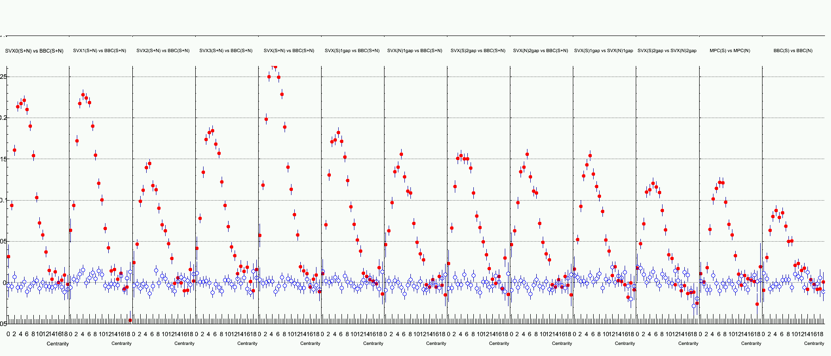
Event Plane Resolution (RUN 349667 360K Events)
Correlation between VTX(SN) and BBC(SN)
VTX SN
(Barrel 0)
vs
BBC SN
VTX SN
(Barrel 1)
vs
BBC SN
VTX SN
(Barrel 2)
vs
BBC SN
VTX SN
(Barrel 3)
vs
BBC SN
VTX SN
(All)
vs
BBC SN
VTX S
vs
BBC SN
(eta gap 1)
VTX N
vs
BBC SN
(eta gap 1)
VTX S
vs
BBC SN
(eta gap 2)
VTX N
vs
BBC SN
(eta gap 2)
VTX S
vs
VTX N
(eta gap 1)
VTX S
vs
VTX N
(eta gap 2)
MPC S
vs
MPC N
BBC S
vs
BBC N
0.3
0.2
0.1
0.0
Centrality : 10% span (0 ~ 9)

Slide 5
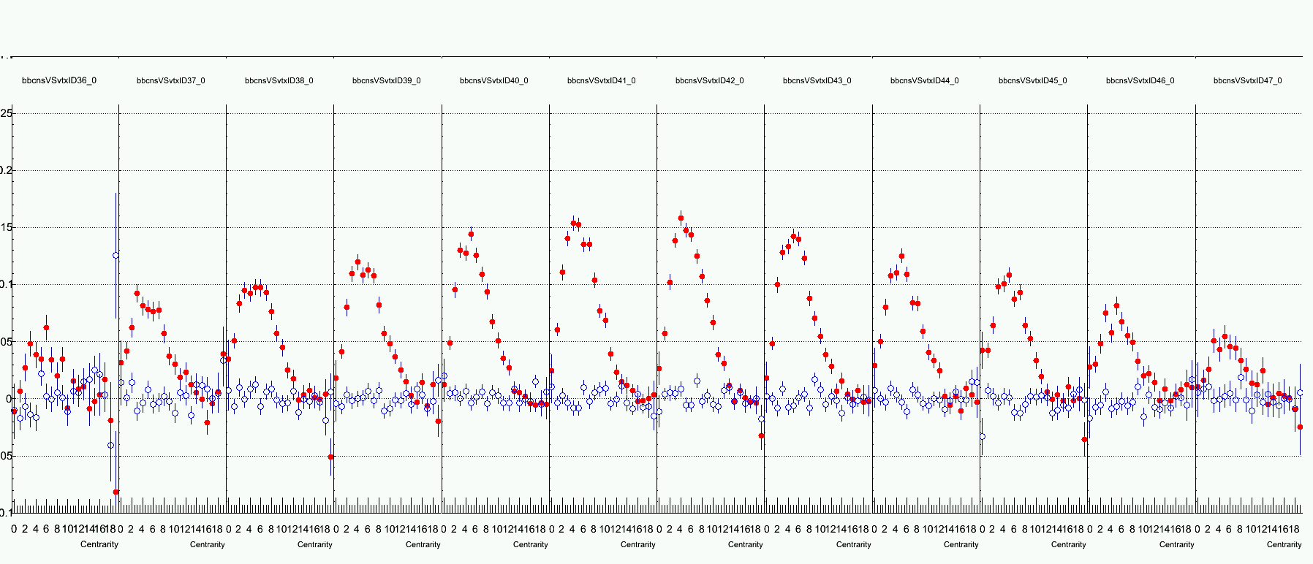
Event Plane Resolution (RUN 349667 360K Events)
Correlation between VTX(SN) and BBC(SN) for each psuedorapidity region.
-3<η<-2.5 -2.5<η<-2. -2<η<-1.5 -1.5<η<-1. -1.<η<-0.5 -0.5<η<0. 0.<η<0.5 0.5<η<1. 1.<η<1.5 1.5<η<2. 2.<η<2.5 2.5<η<3.
0.2
0.1
0.0
Centrality : 5% span (0 ~ 19)

Slide 6
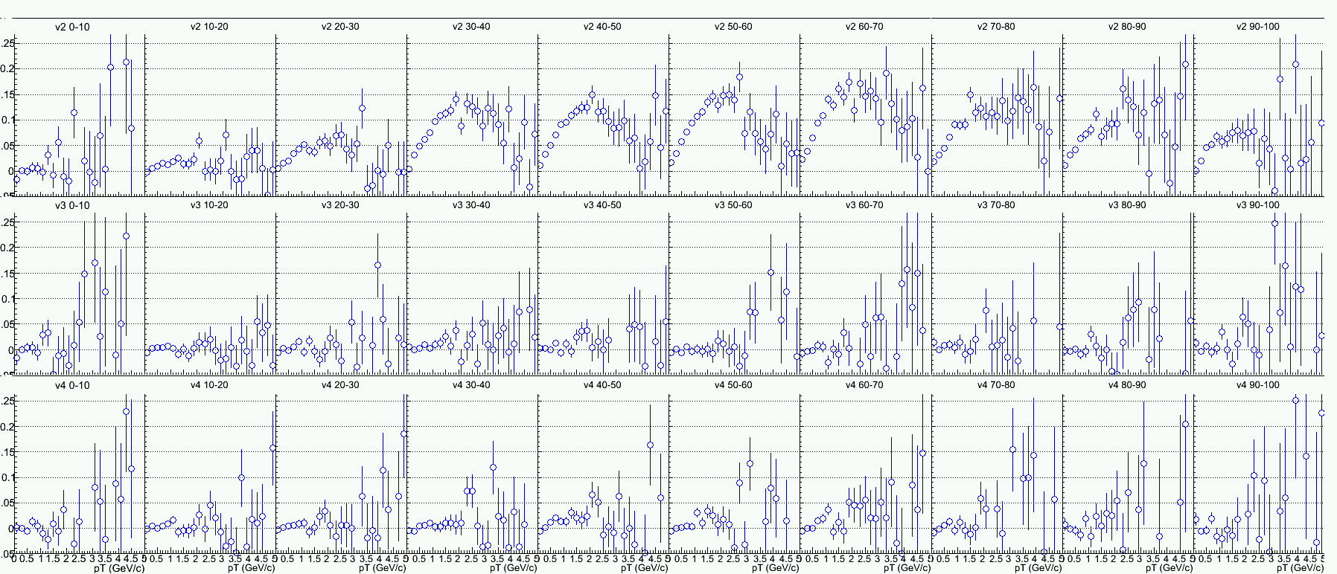
Vn Distribution (RUN 349667 360K Events)
Reaction plane : VTX(S+N)
Centrality
0-10%
Centrality
10-20%
Centrality
20-30%
Centrality
30-40%
Centrality
40-50%
Centrality
50-60%
Centrality
60-70%
Centrality
70-80%
Centrality
80-90%
Centrality
90-100%
v2
v3
v4
Centrality : 10% span (0 ~ 9)

Slide 7
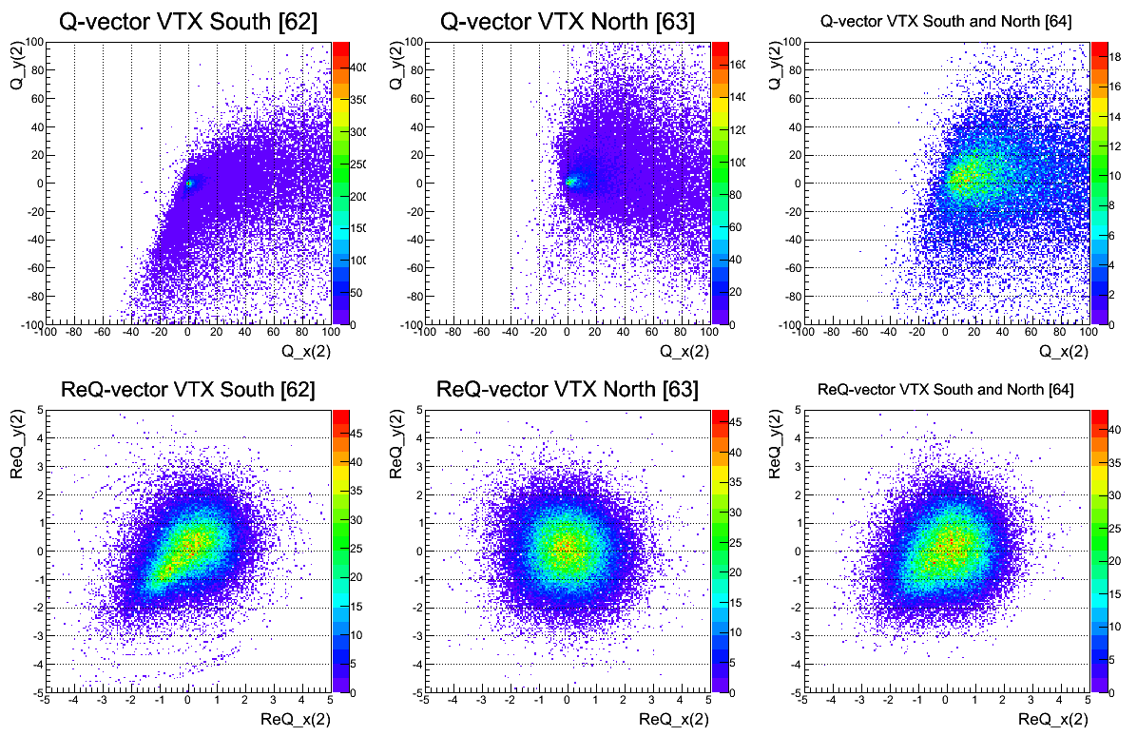
Re-centering Calibration (RUN 348875 100K Events)
VTX South
VTX North
VTX North + South
Before re-centering
After re-centering

Slide 8
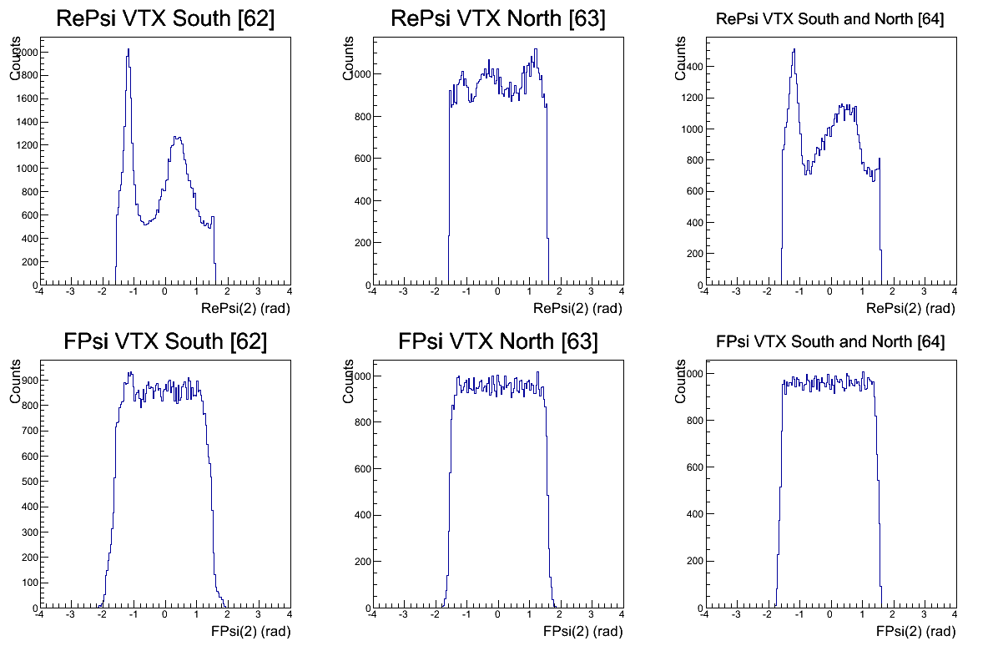
Flattening Calibration (RUN 348875 100K Events)
k th of Fourier expansion : ~8
VTX South
VTX North
VTX North + South
Before flattening
After flattening

Slide 9
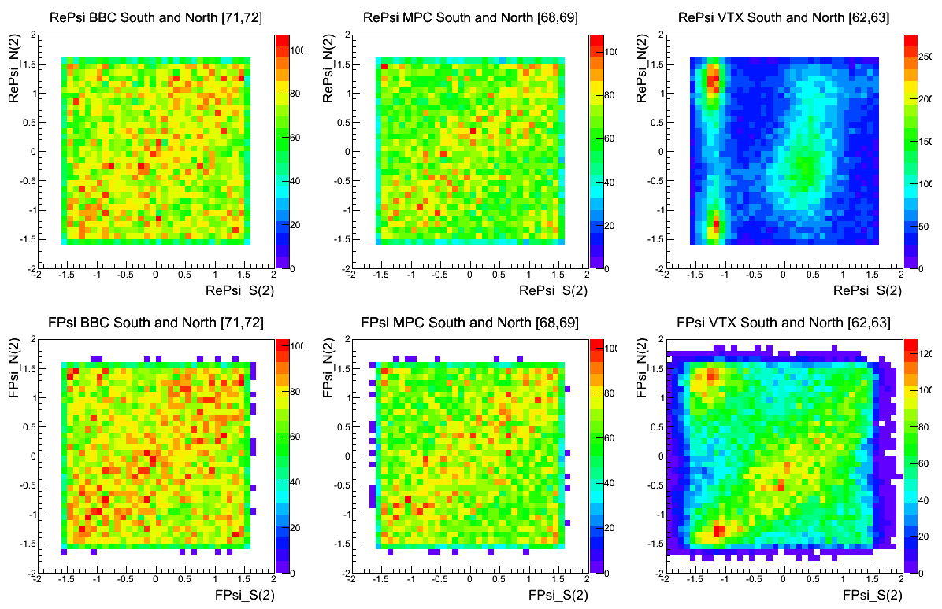
Correlation btw S and N of BBC/MPC/VTX (RUN 348875 100K Events)
BBC
MPC
VTX
Before calibration
After calibration

Slide 10
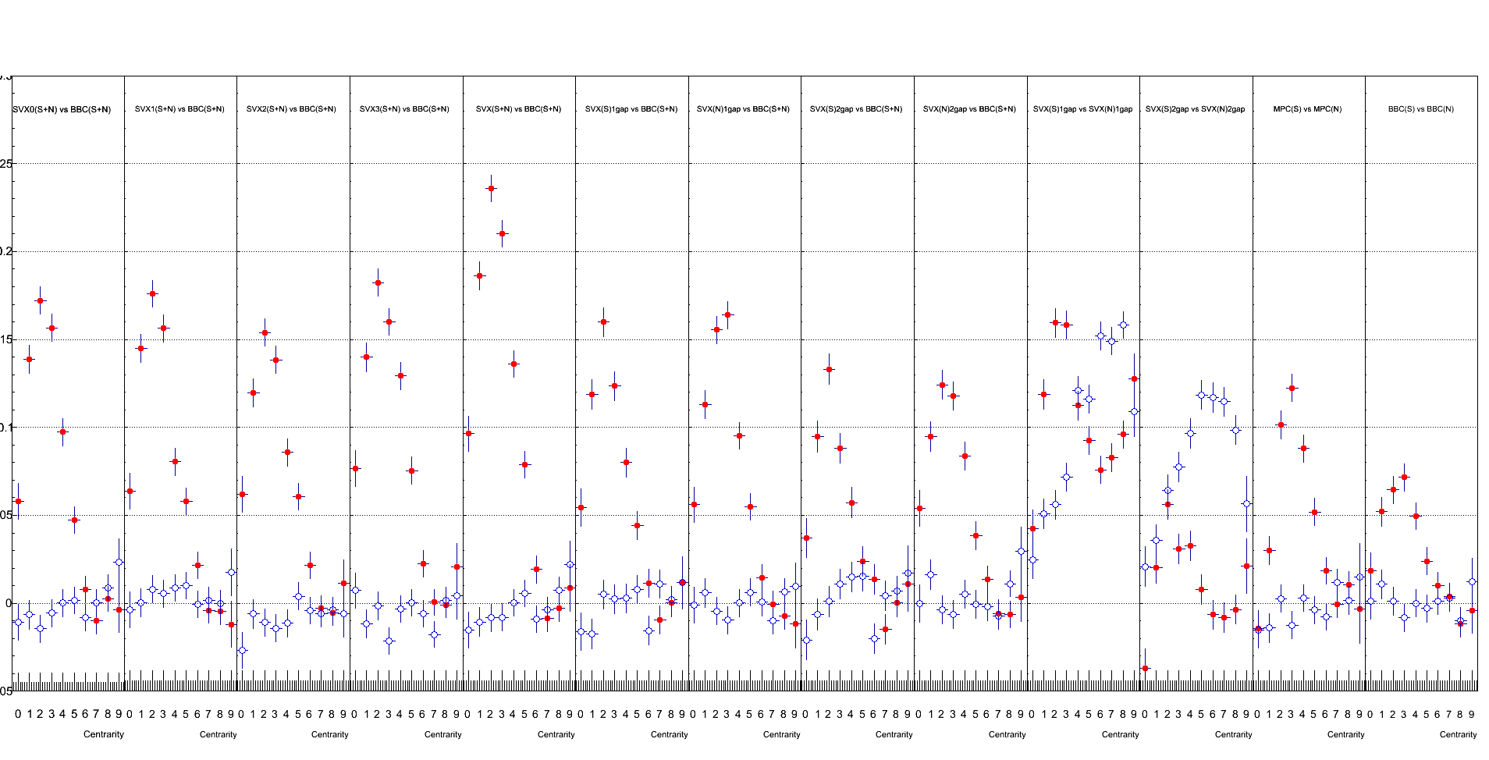
Event Plane Resolution (RUN 348875 100K Events)
Correlation between VTX(SN) and BBC(SN)
VTX SN
(Barrel 0)
vs
BBC SN
VTX SN
(Barrel 1)
vs
BBC SN
VTX SN
(Barrel 2)
vs
BBC SN
VTX SN
(Barrel 3)
vs
BBC SN
VTX SN
(All)
vs
BBC SN
VTX S
vs
BBC SN
(eta gap 1)
VTX N
vs
BBC SN
(eta gap 1)
VTX S
vs
BBC SN
(eta gap 2)
VTX N
vs
BBC SN
(eta gap 2)
VTX S
vs
VTX N
(eta gap 1)
VTX S
vs
VTX N
(eta gap 2)
MPC S
vs
MPC N
BBC S
vs
BBC N
0.3
0.2
0.1
0.0
Centrality : 10% span (0 ~ 9)

Slide 11
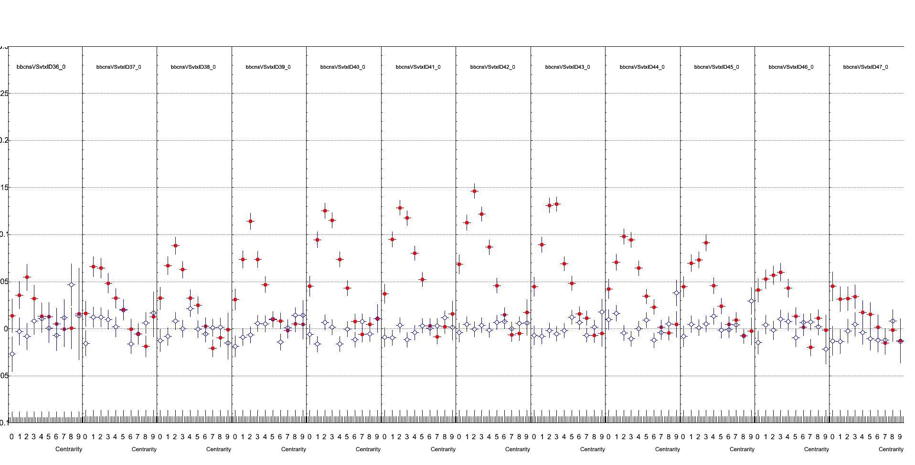
Event Plane Resolution (RUN 348875 100K Events)
Correlation between VTX(SN) and BBC(SN) for each psuedorapidity region.
-3<η<-2.5 -2.5<η<-2. -2<η<-1.5 -1.5<η<-1. -1.<η<-0.5 -0.5<η<0. 0.<η<0.5 0.5<η<1. 1.<η<1.5 1.5<η<2. 2.<η<2.5 2.5<η<3.
0.2
0.1
0.0
Centrality : 10% span (0 ~ 9)

