Slide 1
Reaction Plane Calibration
Add 12 event classes for SVX detector. → Done
Generate calibration parameters for Q-vector and flattening run by run → on-going
Status of centrality calibration
The calibrations for run-343031-347349 are good to use.
The calibrations for remained runs will be ready end of this week.
Check the calibration parameters are useful.
Generate QA plots
<cos nΨ> and <sin nΨ> plot run-by-run
<cos nΨ> and <sin nΨ> plot seg-by-seg

Slide 2
QA : <cos nΨ>, <sin nΨ> (SVX) Distribution Run349373-9000
Scatter plots between <cos nΨ>, <sin nΨ> and centrality.
Average of cos and sin term should be zero.
<cos(n(Ψ_{SVX}))>
<sin(n(Ψ_{SVX}))>
Psi -SVX (S)
Psi -SVX (N)
Psi -SVX (SN)
<cos(2(Ψ_{SVX(S)}))>
<sin(2(Ψ_{SVX(S)}))>
Centrality Centrality Centrality Centrality Centrality Centrality
<cos(3(Ψ_{SVX(S)}))>
<sin(3(Ψ_{SVX(S)}))>
Centrality Centrality Centrality Centrality Centrality Centrality

Slide 3
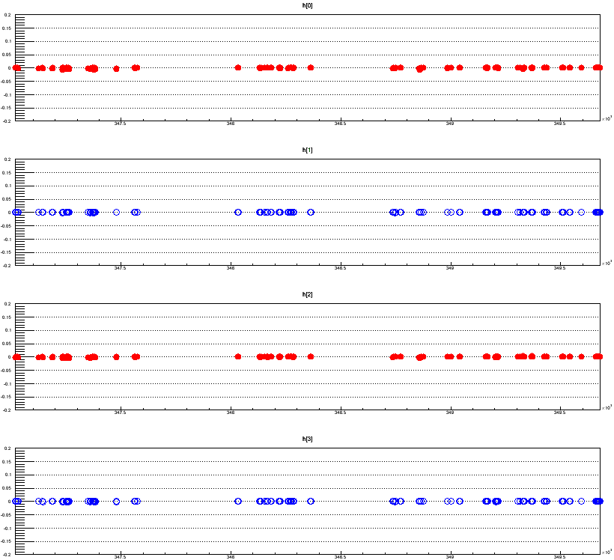
QA : <cos nΨ>, <sin nΨ> (SVX-SN) Distribution Run-by-Run
Average of cos and sin term should be zero.
v2
<cos(2(Ψ_{SVX(SN)}))>
cos term
v3
<cos(3(Ψ_{SVX(SN)}))>
v2
<sin(2(Ψ_{SVX(SN)}))>
sin term
v3
<sin(3(Ψ_{SVX(SN)}))>
run number

Slide 4
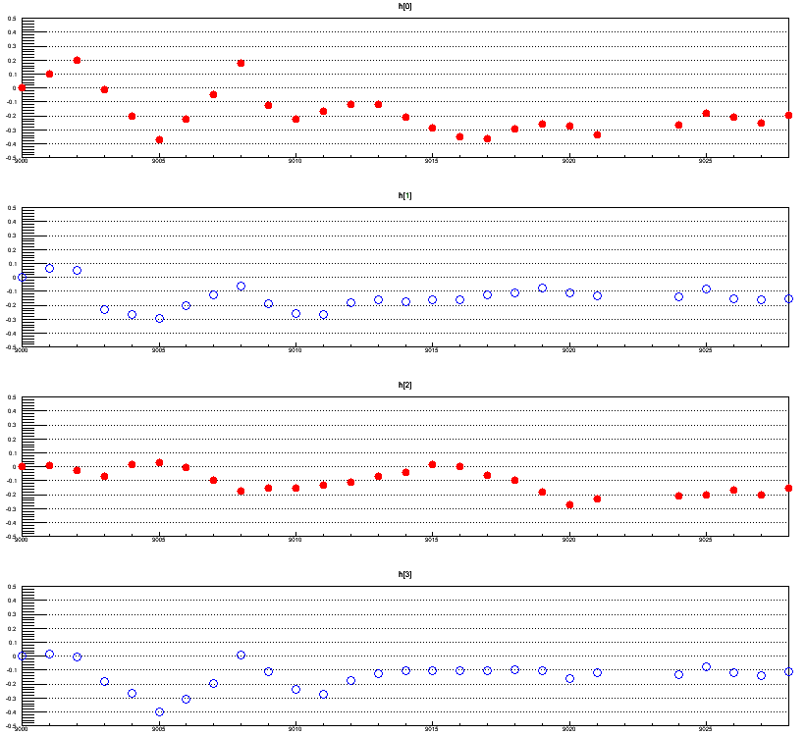
QA : <cos nΨ>, <sin nΨ> (SVX-SN) Distribution Segment-by-Segment
Average of cos and sin term should be zero.
v2
Run349679
<cos(2(Ψ_{SVX(SN)}))>
cos term
9000
9005
9010
v3
9020
<cos(3(Ψ_{SVX(SN)}))>
v2
<sin(2(Ψ_{SVX(SN)}))>
sin term
v3
<sin(3(Ψ_{SVX(SN)}))>
segment number

Slide 5
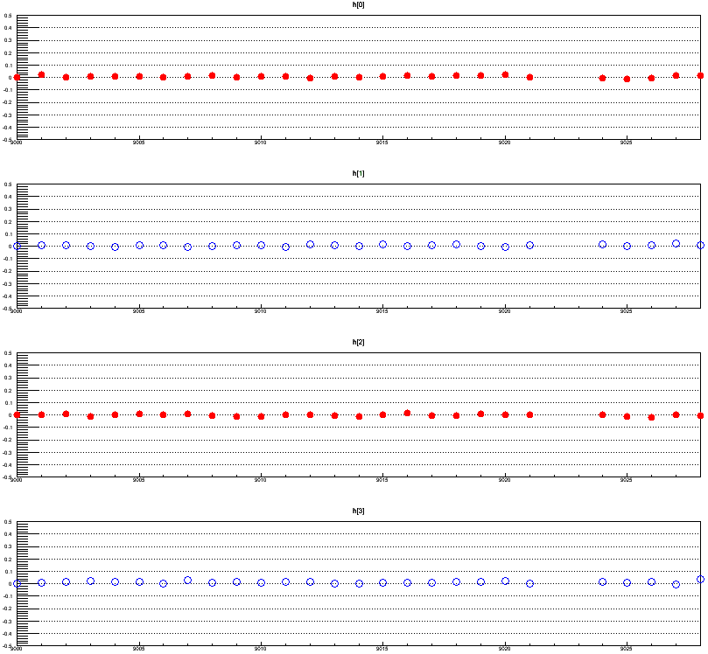
QA : <cos nΨ>, <sin nΨ> (BBC-SN) Distribution Segment-by-Segment
Average of cos and sin term should be zero.
v2
Run349679
0.5
<cos(2(Ψ_{SVX(SN)}))>
- 0.5
v3
cos term
<cos(3(Ψ_{SVX(SN)}))>
v2
<sin(2(Ψ_{SVX(SN)}))>
sin term
v3
<sin(3(Ψ_{SVX(SN)}))>
segment number

Slide 6
Results from QA Testing for Calibration Parameters
calibration parameter の決定に使用した segment 以外の segment をQAした場合、 <cos nPsi>, <sin nPsi> 分布が ０にならない。
Calibration parameter は segment ごとに生成する必要がある。
Q-vector : parameter[27][6][20][10][4] → 129,600 parameters (Float)
Flattening : parameter[39][6][20][10][16] → 748,800 parameters (Float)
→ Total 4MB/segment
Total number of segments : ~8,000 segments → Total 32GB
→ データベースに入れないでテキストファイルのまま使用する。

Slide 7
To Do List
蜂谷
黒澤
1) 全 segment に対する calibration parameters の生成。
Centrality の calibration の結果を待たずに開始する。
QA plot のチェック。
今週末までに終わる予定。
Calibration parameter generate 用 code の commit。
2) ASCI file から読み込むように Re-calibrator module の変更と CVS commit。
3) 解析コードの開発
charged hadron
electron

Slide 8
BACKUP SLIDES

Slide 9
Calibration Parameters for Reaction Plane
Reaction Plane (calculated by using cluster hits of all layers for SVX)
Number of event class for the calibration of Q-vector is 27.
Qx_mean, Qx_RMS, Qy_mean, Qy_RMS : number of parameters is 4 for each class.
Number of event class for the calibration of flattening parameter is 39.
A₁ ~ A₈ and B₁ ~ B₈ : number of parameters is 16 for each class.
Number of class for centrality is 20 (5 % step, totally 20 class).
Number of class for z-vertex is 10 (2 cm step, totally 10 class).
Number of harmonics is 6.
Parameters in calibration database
Q-vector : parameter[27][6][20][10][4] → 129,600 parameters (Float)
Flattening : parameter[39][6][20][10][16] → 748,800 parameters (Float)
Above calibration parameter set will be prepared run by run.

Slide 10
Reaction Plane Class for Q-Vector and Flattening Calibration
Q-Vector calibration
 | South |  |  |  |  |  |  | North
eta region | -3<=eta<-2.5 | -2.5<=eta<-2 | -2<=eta<-1.5 | -1.5<=eta<-1 | -1<=eta<-0.5 | -0.5<=eta<0 | 0<=eta<0.5 |  | 0.5<=eta<1 | 1<=eta<1.5 | 1.5<=eta<2 | 2<=eta<2.5 | 2.5<=eta<3 | all eta
SVX | 0 | 1 | 2 | 3 | 4 | 5 | 6 |  | 7 | 8 | 9 | 10 | 11 | 12
 | north | south | north + south
MPC | 13 | 14 | 15
BBC | 16 | 17 | 18
SMD | 19 | 20 | 21
 | subsample1 | subsample2 | subsample3 | subsample4 | total
CNT | 22 | 23 | 24 | 25 | 26
Totally 27 class for Q-vector calibration
Flattening calibration
 | South |  |  |  |  |  |  | North
eta region | -3<=eta<-2.5 | -2.5<=eta<-2 | -2<=eta<-1.5 | -1.5<=eta<-1 | -1<=eta<-0.5 | -0.5<=eta<0 | 0<=eta<0.5 |  | 0.5<=eta<1 | 1<=eta<1.5 | 1.5<=eta<2 | 2<=eta<2.5 | 2.5<=eta<3 | all eta
SVX | 0 | 1 | 2 | 3 | 4 | 5 | 6 |  | 7 | 8 | 9 | 10 | 11 | 12
 | 13
 |  |  |  |  | 14
 | 15
 |  |  |  |  |  | 16
 | 17 |  |  |  |  |  | 18
 | 19 |  |  |  |  |  |  |  | 20
 | 21 |  |  |  |  |  |  |  | 21
 | 22 |  |  |  |  |  |  |  |  | 23
 | 24 |  |  |  |  |  |  |  |  | 24
 | north | south | north + south
MPC | 25 | 26 | 27
BBC | 28 | 29 | 30
SMD | 31 | 32 | 33
 | subsample1 | subsample2 | subsample3 | subsample4 | total
CNT | 34 | 35 | 36 | 37 | 38
Totally 39 class for Flattening calibration
→ generate 39 reaction planes

Slide 11
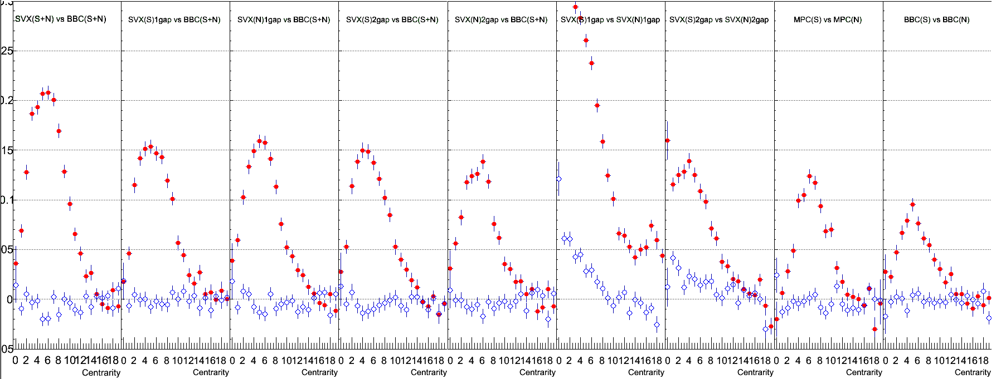
Event Plane Resolution (RUN 349679-9005)
<cos(2(Φ_{A}-Φ_{B}))>
<sin(2(Φ_{A}-Φ_{B}))>
VTX SN
Vs
BBC SN
eta gap 1
VTX S
Vs
VTX N
eta gap 1
VTX S
Vs
VTX N
eta gap 2
Need to generate calibration parameters for all segments?

Slide 12
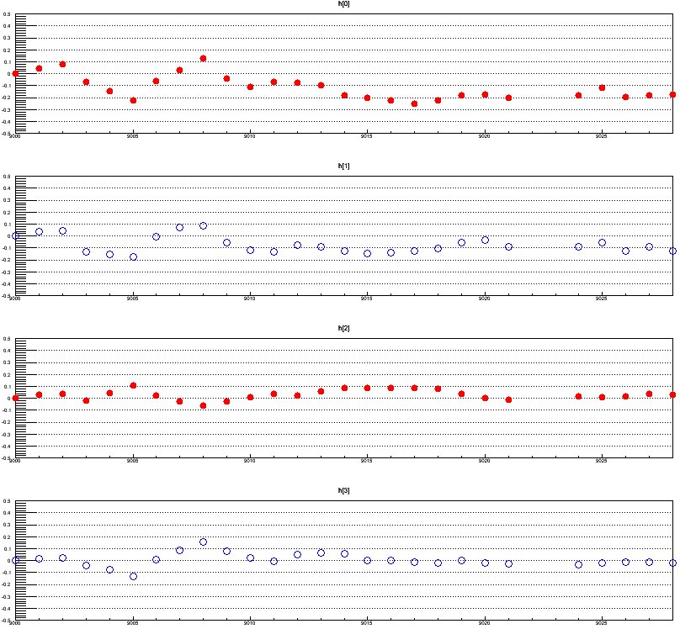
QA : <cos nPsi>, <sin nPsi> (SVX-S) Distribution Segment-by-Segment
Average of cos and sin term should be zero.
v2
<cos(2(Φ_{SVX(S)}))>
cos term
v3
<cos(3(Φ_{SVX(S)}))>
v2
<sin(2(Φ_{SVX(S)}))>
sin term
v3
<sin(3(Φ_{SVX(S)}))>
Need to generate calibration parameters for all segments.
segment number

Slide 13
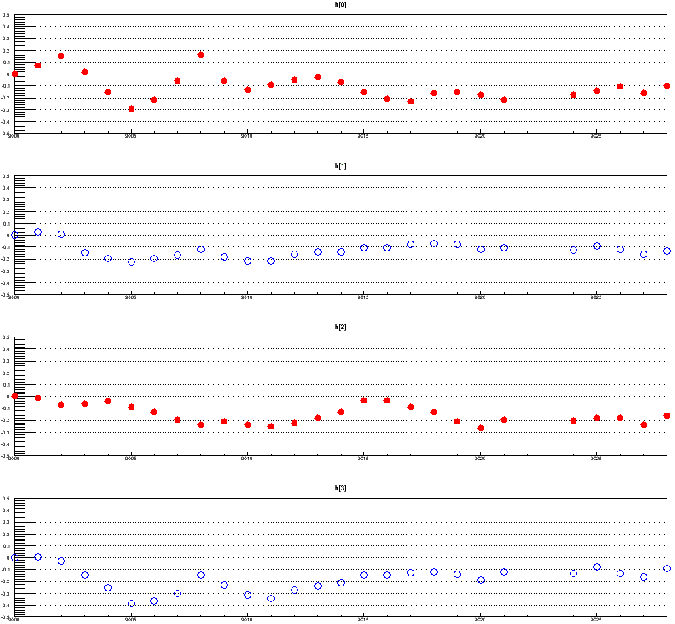
QA : <cos nPsi>, <sin nPsi> (SVX-N) Distribution Segment-by-Segment
Average of cos and sin term should be zero.
v2
<cos(2(Φ_{SVX(N)}))>
cos term
v3
<cos(3(Φ_{SVX(N)}))>
v2
<sin(2(Φ_{SVX(N)}))>
sin term
v3
<sin(3(Φ_{SVX(N)}))>
Need to generate calibration parameters for all segments.
segment number

Slide 14
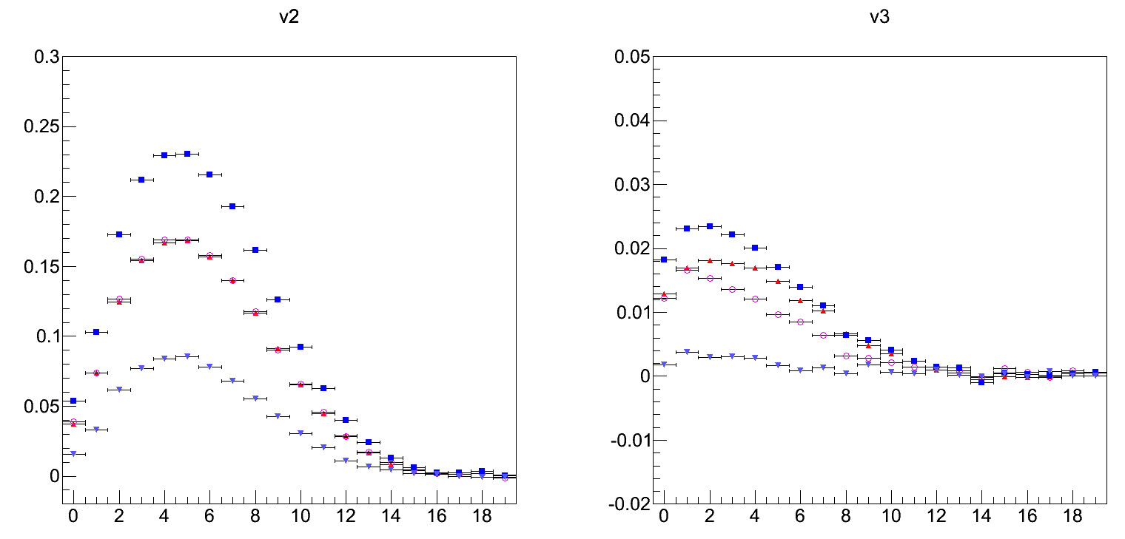
Psi Correlation for v2 and v3 (AuAu 200GeV 100 Segments)
svx(SN)-bbc(S)
svx(SN)-bbc(N)
svx(SN)-bbc(SN)
bbc(S)-bbc(N)
svx(SN)-bbc(S)
svx(SN)-bbc(N)
svx(SN)-bbc(SN)
bbc(S)-bbc(N)
<cos(2(Φ_{A} - Φ_{B}))>
<cos(3(Φ_{A} - Φ_{B}))>
Centrality
Centrality

Slide 15
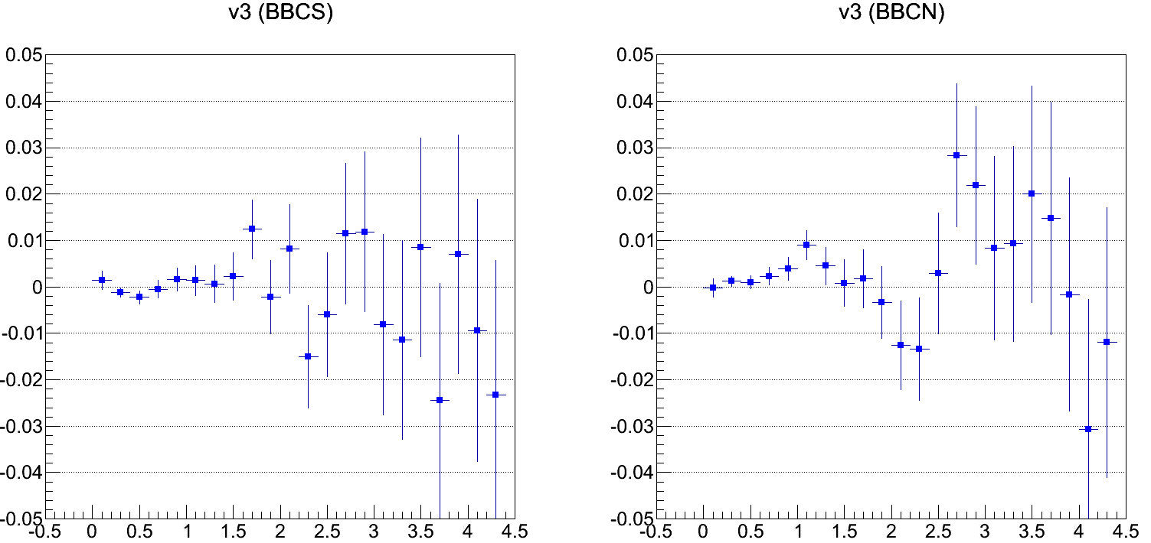
Raw V3 Distribution (AuAu 200GeV run349206-9000)
Centrality : 25%
pT (GeV/c)
pT (GeV/c)

