Slide 1
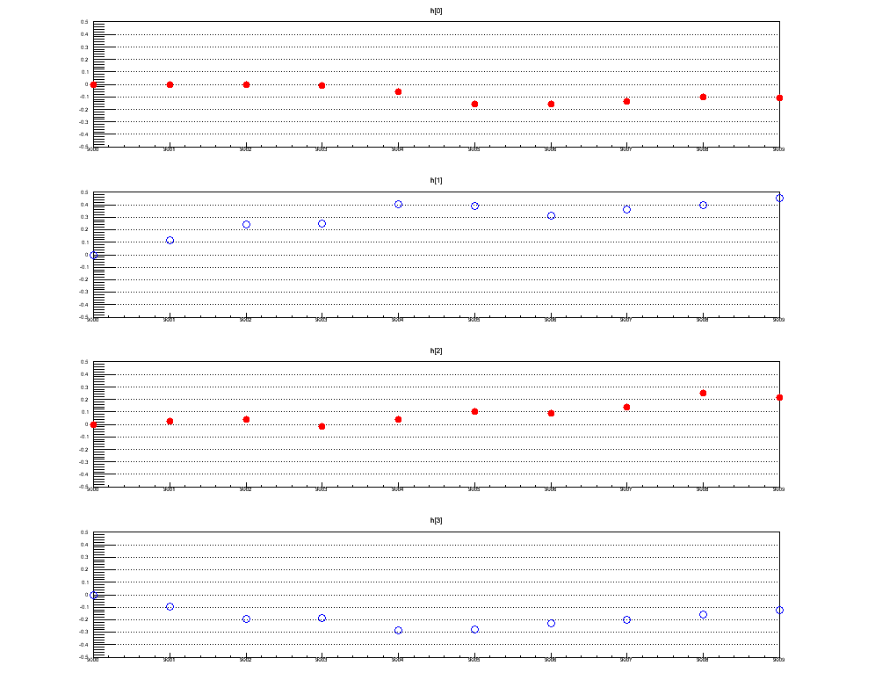
QA : <cos nΨ>, <sin nΨ> (SVX-SN) Distribution Segment-by-Segment
Use calibration parameters that are created by using segment 9000.
v2
Implement EventKiller Module
Run349667
0.5
<cos(2(Ψ_{SVX(SN)}))>
-0.5
9002
9004
9006
9008
cos term
9000
v3
<cos(3(Ψ_{SVX(SN)}))>
v2
<sin(2(Ψ_{SVX(SN)}))>
sin term
v3
<sin(3(Ψ_{SVX(SN)}))>
segment number

Slide 2
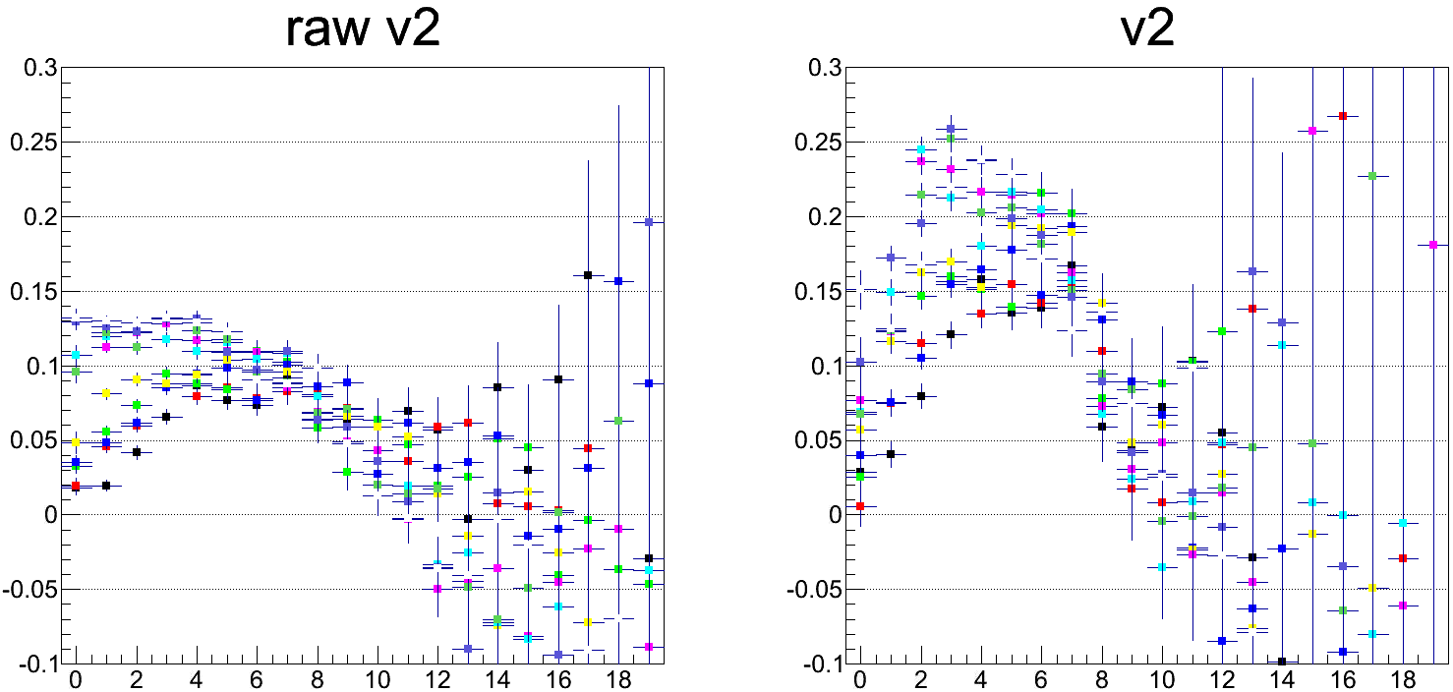
Raw V2 and Corrected V2 Distribution (Run349667)
Use calibration parameters that are created by using segment 9000.
Reaction plane : SVX-SN Egap-1
Track : CNT
2 < pT GeV/c < 3
9000
9001
9002
9003
9004
9005
9006
9007
9008
9009
centrality
centrality
Raw v2 for each segment were unstable.

Slide 3
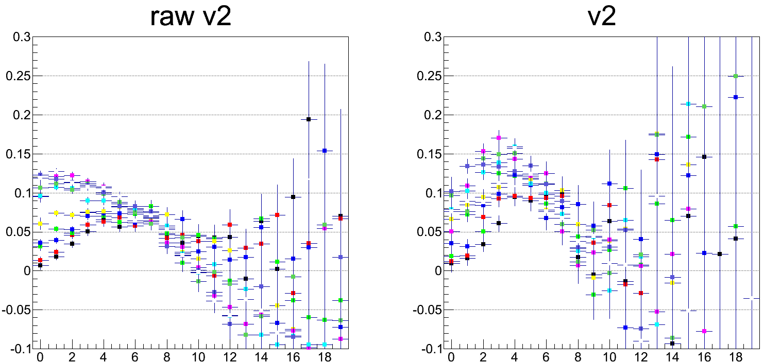
Raw V2 and Corrected V2 Distribution (Run349667)
Use calibration parameters that are created by using segment 9000.
Reaction plane : SVX-SN Egap-2
Track : CNT
2 < pT GeV/c < 3
9000
9001
9002
9003
9004
9005
9006
9007
9008
9009
centrality
centrality
Raw v2 for each segment were unstable.

Slide 4
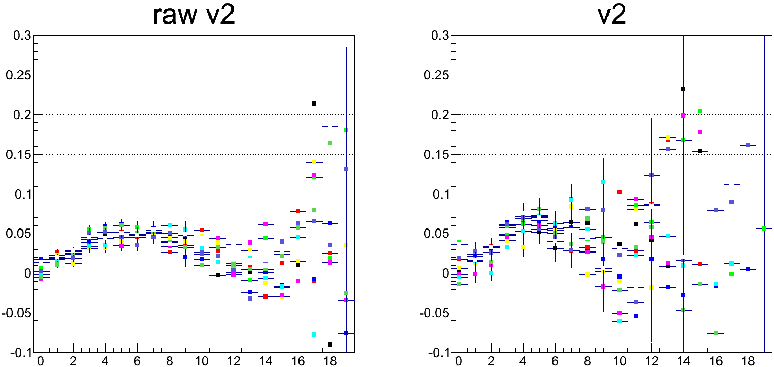
Raw V2 and Corrected V2 Distribution (Run349667)
Use calibration parameters that are created by using segment 9000.
Reaction plane : BBC-SN
Track : CNT
2 < pT GeV/c < 3
9000
9001
9002
9003
9004
9005
9006
9007
9008
9009
centrality
centrality
Raw v2 for each segment were unstable.

Slide 5
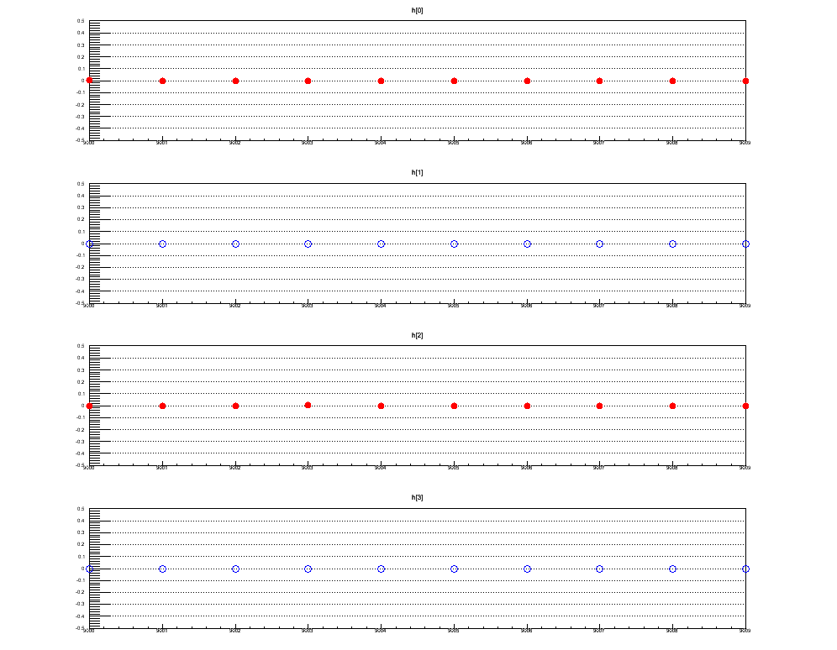
QA : <cos nΨ>, <sin nΨ> (SVX-SN) Distribution Segment-by-Segment
Useed calibration parameters that are created segment by segment.
v2
Run349679
0.5
<cos(2(Ψ_{SVX(SN)}))>
-0.5
9002
9004
9006
9008
cos term
9000
v3
<cos(3(Ψ_{SVX(SN)}))>
v2
<sin(2(Ψ_{SVX(SN)}))>
sin term
v3
<sin(3(Ψ_{SVX(SN)}))>
segment number

Slide 6
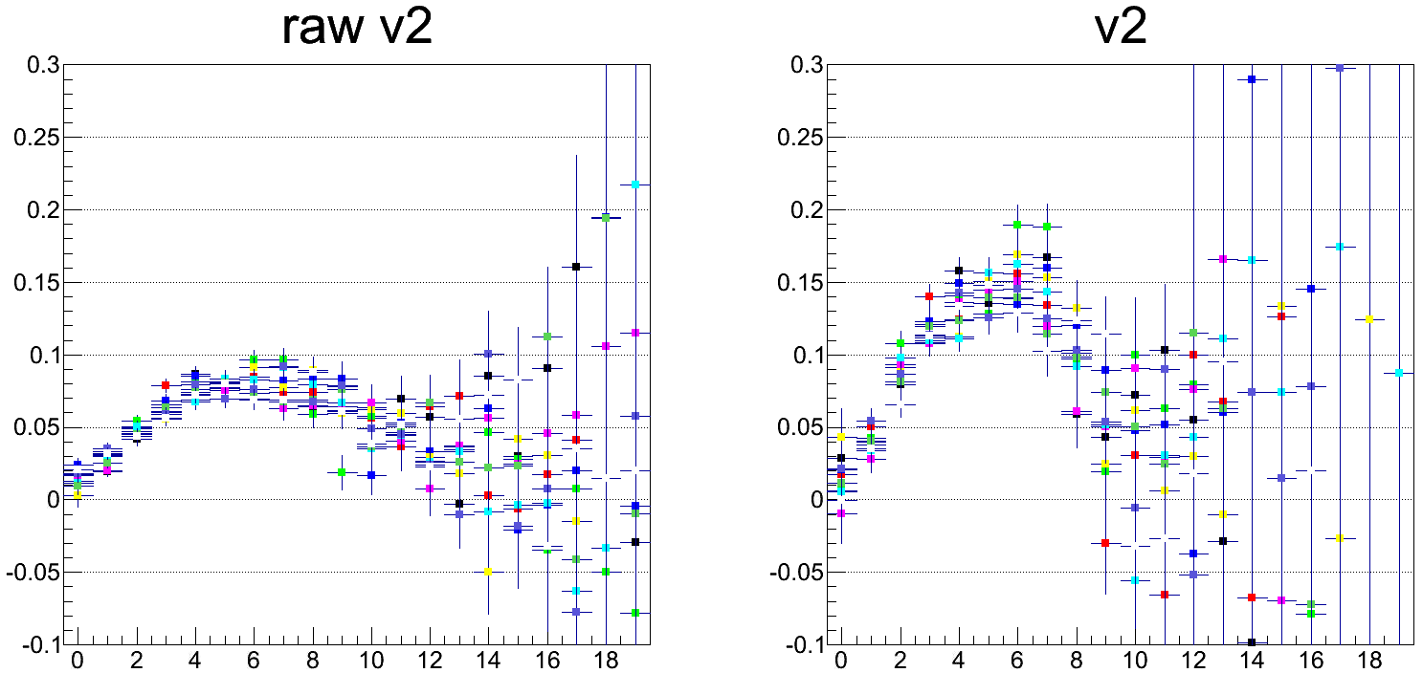
Raw V2 and Corrected V2 Distribution (Run349667)
Use calibration parameters that are created segment by segment.
Reaction plane : SVX-SN Egap-1
Track : CNT
2 < pT GeV/c < 3
9000
9001
9002
9003
9004
9005
9006
9007
9008
9009
centrality
centrality
Raw v2 for each segment were unstable.

Slide 7
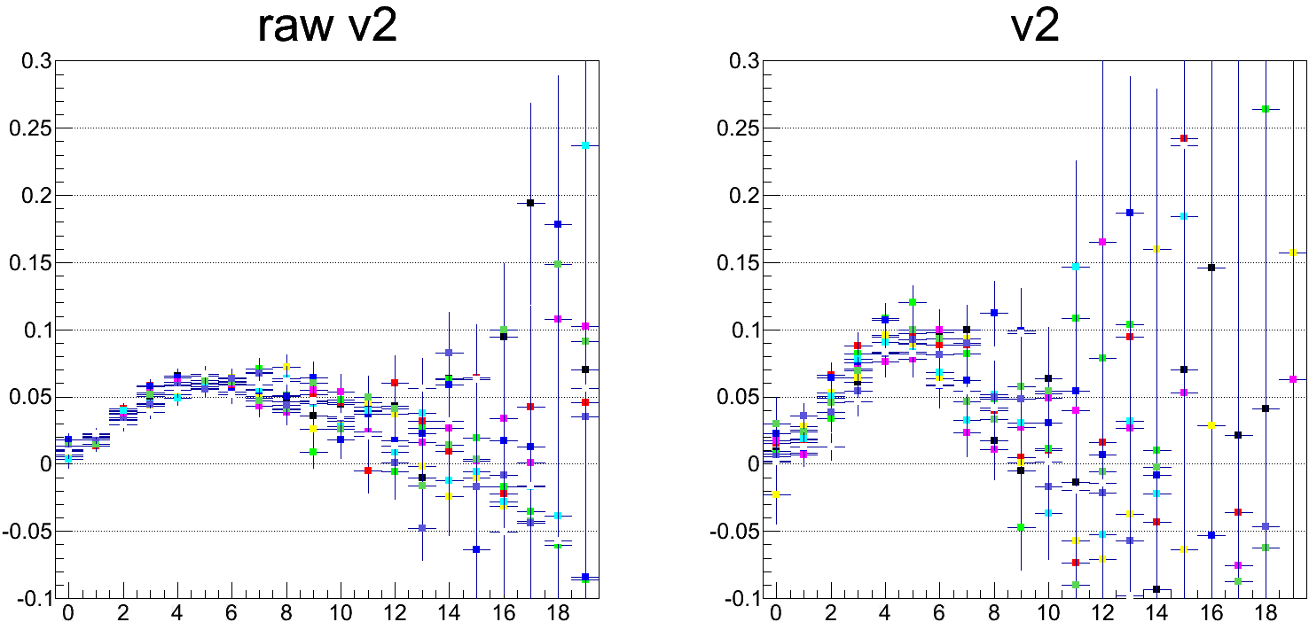
Raw V2 and Corrected V2 Distribution (Run349667)
Use calibration parameters that are created for each segment
Reaction plane : SVX-SN Egap-2
Track : CNT
2 < pT GeV/c < 3
9000
9001
9002
9003
9004
9005
9006
9007
9008
9009
centrality
centrality

Slide 8
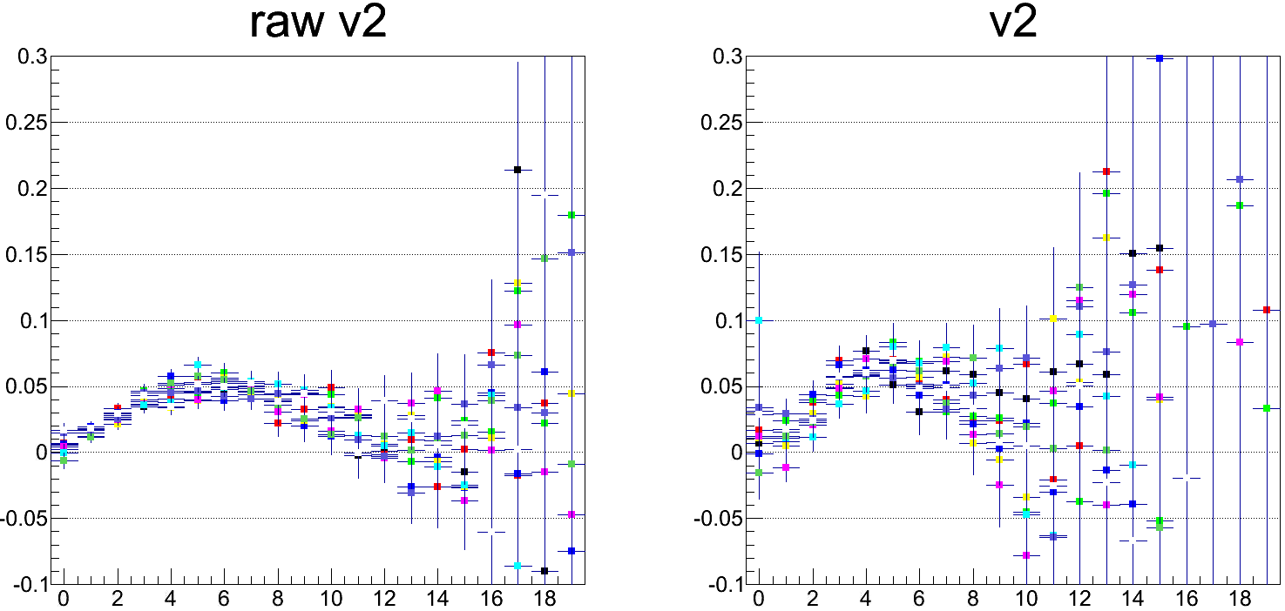
Raw V2 and Corrected V2 Distribution (Run349667)
Use calibration parameters that are created for each segment.
Reaction plane : BBC-SN
Track : CNT
2 < pT GeV/c < 3
9000
9001
9002
9003
9004
9005
9006
9007
9008
9009
centrality
centrality
Raw v2 for each segment were unstable.

Slide 9
BACKUP SLIDES

Slide 10
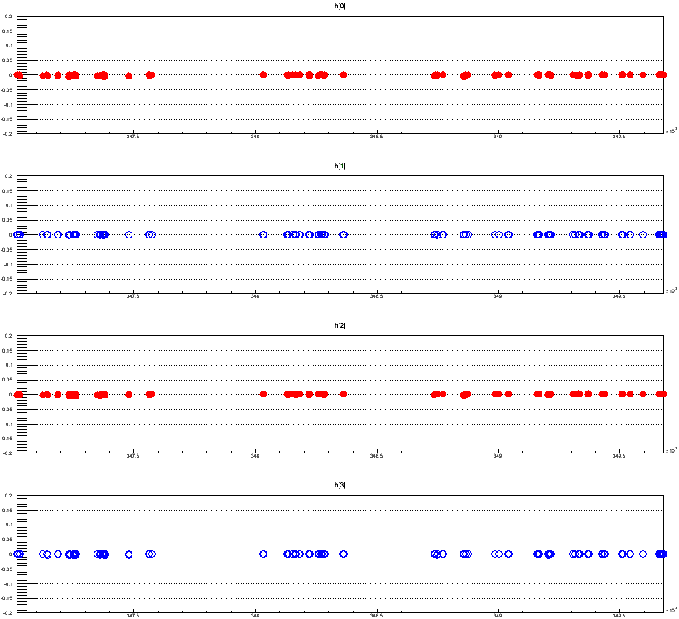
QA : <cos nPsi>, <sin nPsi> (SVX-SN) Distribution Run-by-Run
Average of cos and sin term should be zero.
v2
<cos(2(Φ_{SVX(SN)}))>
cos term
v3
<cos(3(Φ_{SVX(SN)}))>
v2
<sin(2(Φ_{SVX(SN)}))>
sin term
v3
<sin(3(Φ_{SVX(SN)}))>
run number

Slide 11
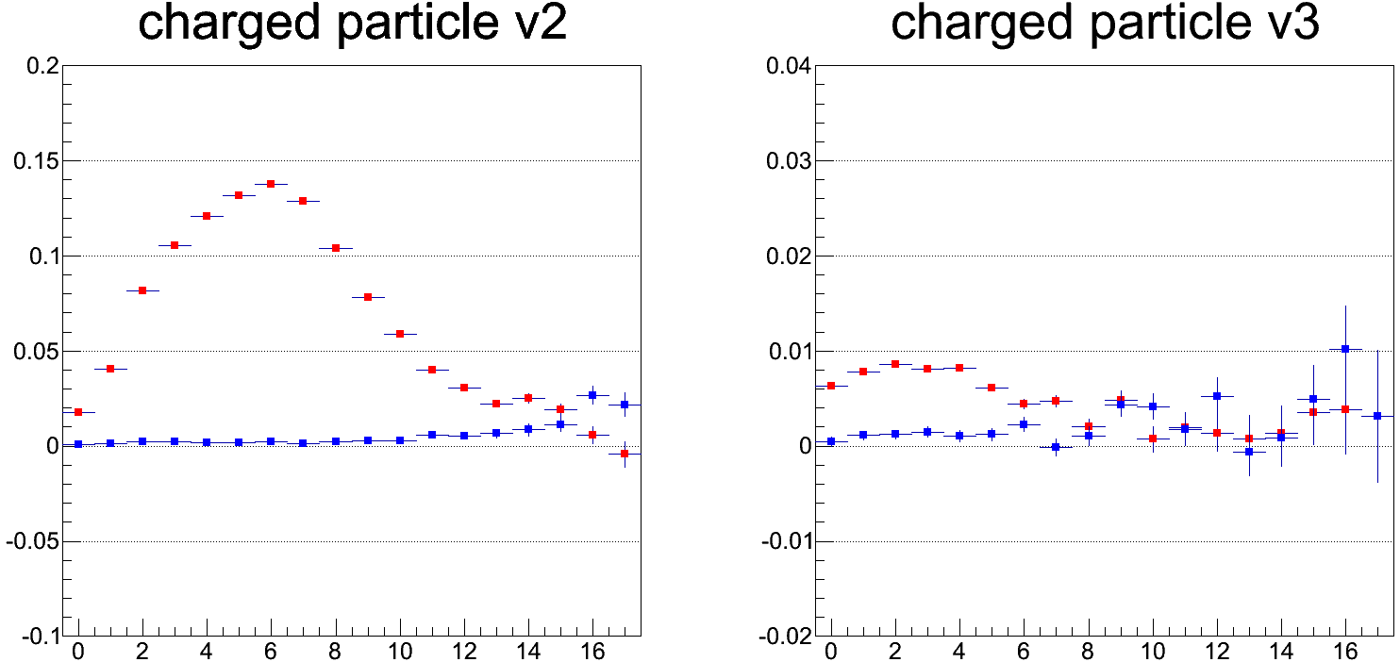
V2 and V3 Distribution (5% of all Data)
Use calibration parameters that are created for each segment
Reaction plane : SVX-SN Egap-1
Track : CNT
1GeV < pT
Cosine term
Sine term
centrality
centrality

Slide 12
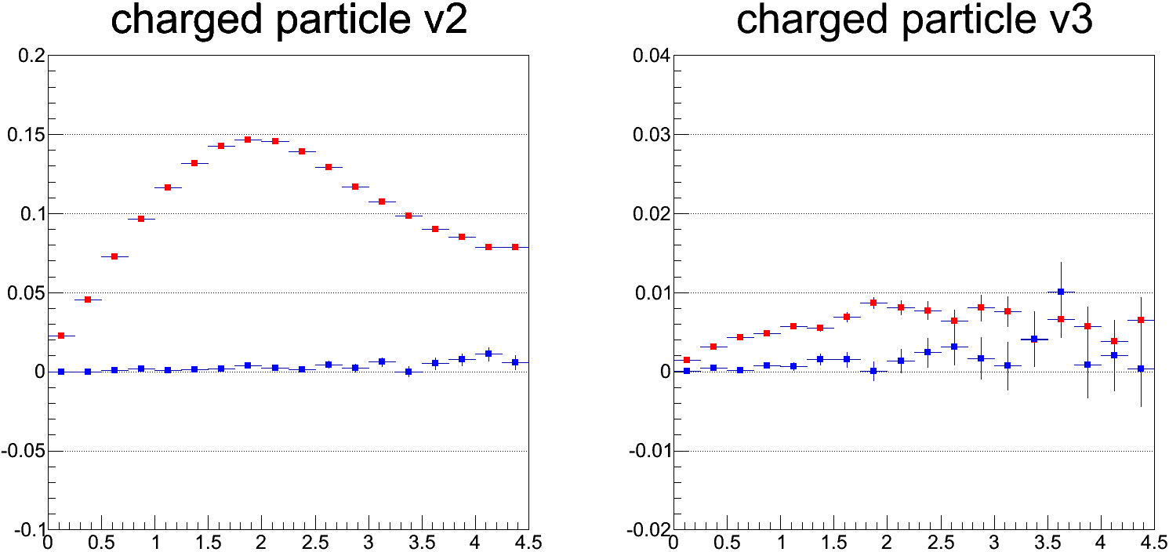
V2 and V3 Distribution (5% of all Data)
Use calibration parameters that are created for each segment
Reaction plane : SVX-SN Egap-1
Track : CNT
Centrality 20~40%
Cosine term
Sine term
pT (GeV/c)
pT (GeV/c)

Slide 13
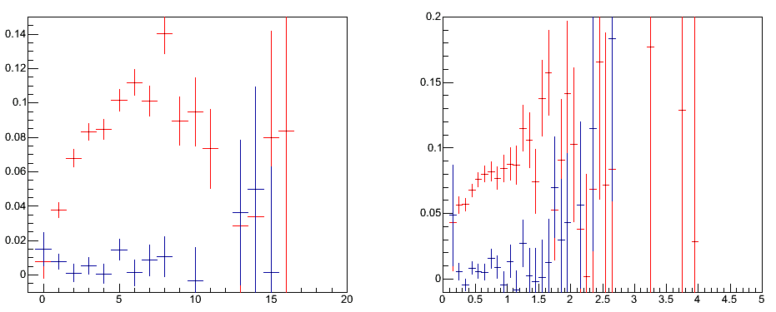
v2 of Electrons from Prim. Vtx
v2 Electrons from Prim Vtx
v2 Electrons from Prim Vtx
<cos(2*(phi – RP)>
<sin(2*(phi – RP)>
v2
v2
<cos(2*(phi – RP)>
<sin(2*(phi – RP)>
0 Centrality 92%
pT(GeV/c)
Electron from PrimVertex
VTX association : B0 and B1 hit, nhit>2, chi2/ndf<5
|XY-DCA|<300μmm
|Z-DCA|<1cm to reduce background (but might be too large)
Hachiya-san’s slide

Slide 14
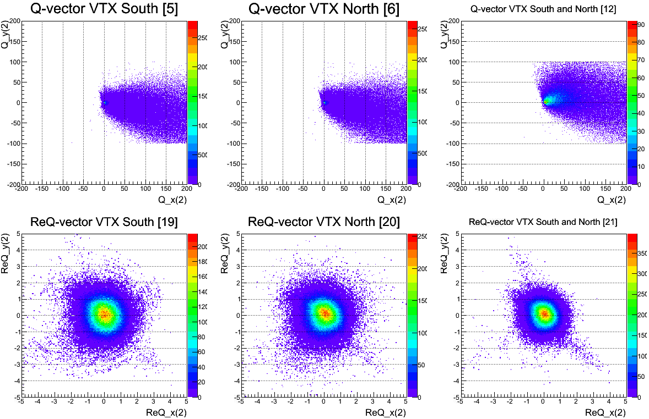
Re-centering Calibration (RUN 349667-9000 360K Events)

Slide 15
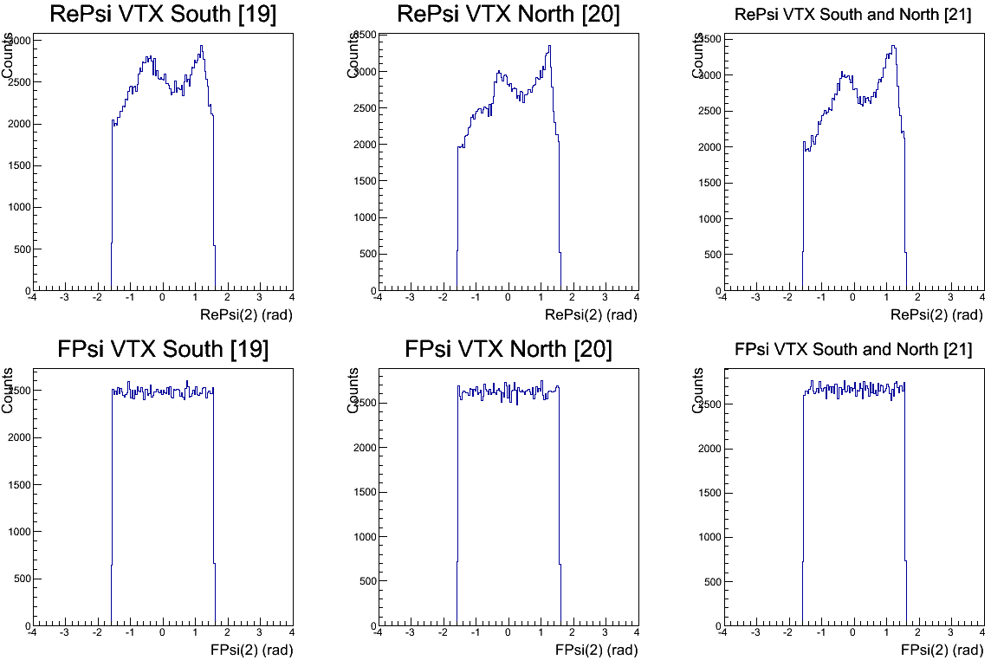
Flattening Calibration (RUN 349667 360K Events)
k th of Fourier expansion : ~8
VTX South
VTX North
VTX North + South
Before flattening
After flattening

Slide 16
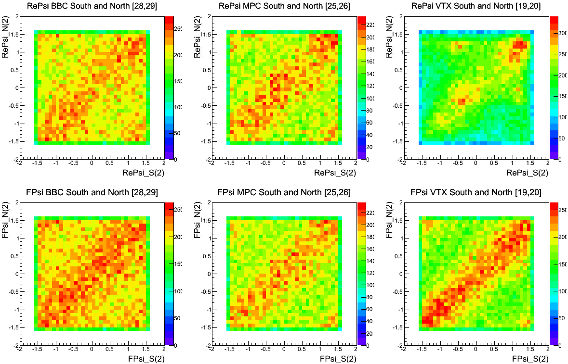
Correlation btw S and N of BBC/MPC/VTX (RUN 349667 360K Events)
BBC
MPC
VTX
Before calibration
After calibration

Slide 17
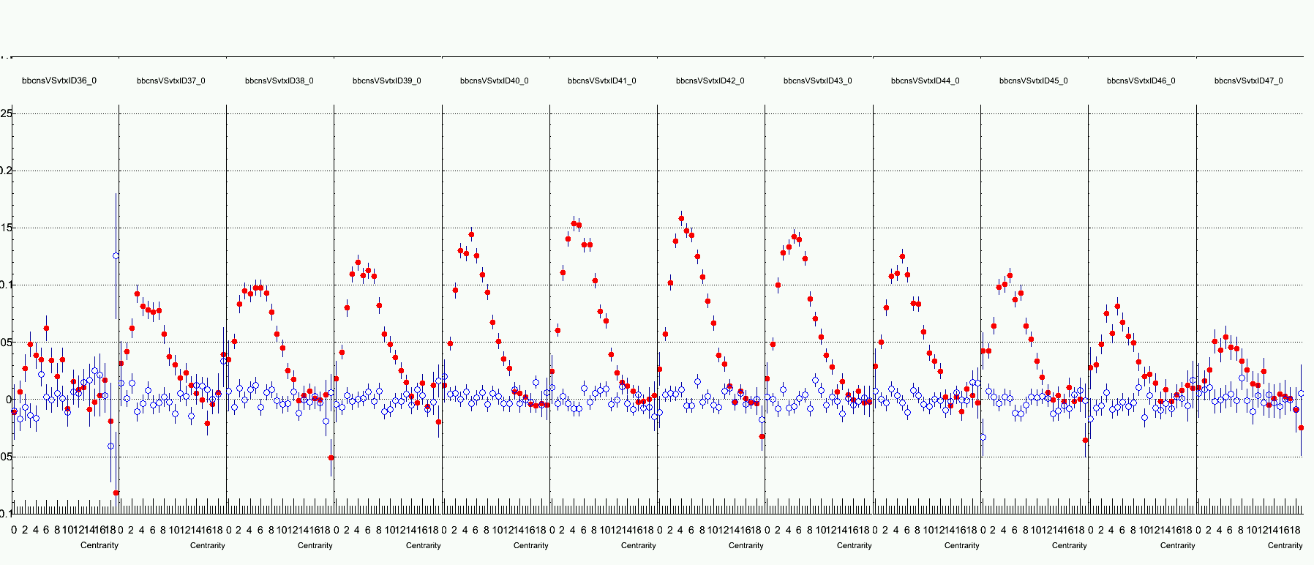
Event Plane Resolution (RUN 349667 360K Events)
Correlation between VTX(SN) and BBC(SN) for each psuedorapidity region.
<cos(2(Ψ_{SVX} - Ψ_{BBC}))>
<sin(2(Ψ_{SVX} - Ψ_{BBC}))>
-3<η<-2.5 -2.5<η<-2. -2<η<-1.5 -1.5<η<-1. -1.<η<-0.5 -0.5<η<0. 0.<η<0.5 0.5<η<1. 1.<η<1.5 1.5<η<2. 2.<η<2.5 2.5<η<3.
0.2
0.1
0.0
Centrality : 5% step (0 ~ 19)

Slide 18
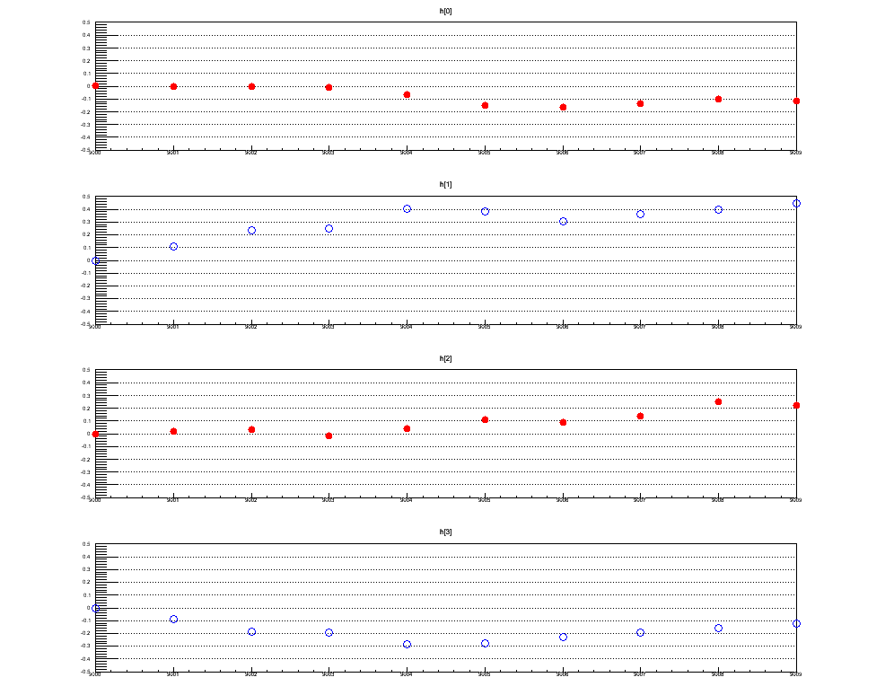
QA : <cos nΨ>, <sin nΨ> (SVX-SN) Distribution Segment-by-Segment
Use calibration parameters that are created by using segment 9000.
v2
Run349667
0.5
<cos(2(Ψ_{SVX(SN)}))>
-0.5
9002
9004
9006
9008
cos term
9000
v3
<cos(3(Ψ_{SVX(SN)}))>
v2
<sin(2(Ψ_{SVX(SN)}))>
sin term
v3
<sin(3(Ψ_{SVX(SN)}))>
segment number

Slide 19
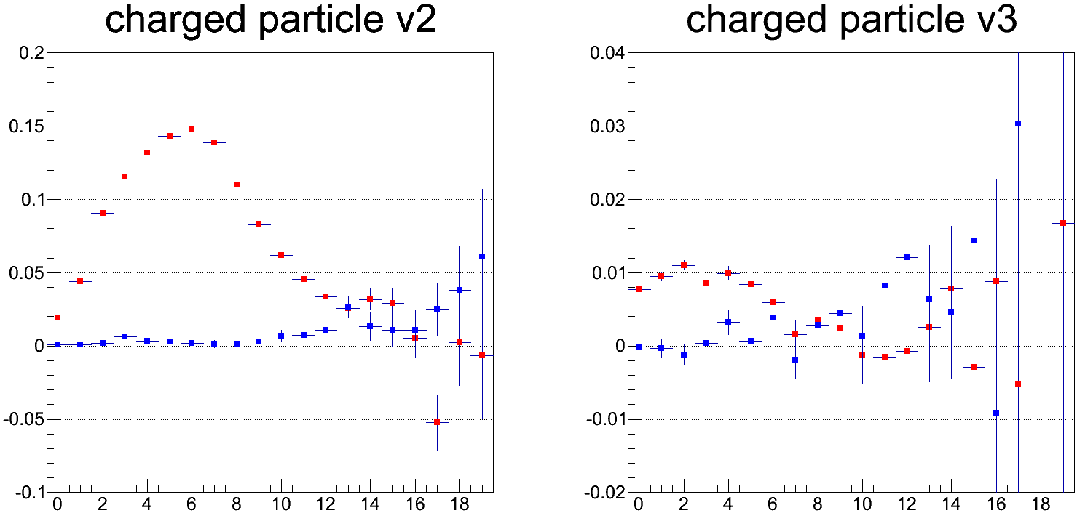
V2 and V3 Distribution (5% of all Data)
Use calibration parameters that are created for each segment
Reaction plane : SVX-SN Egap-2
Track : CNT
Centrality 20~25%
Cosine term
Sine term
centrality
centrality

Slide 20
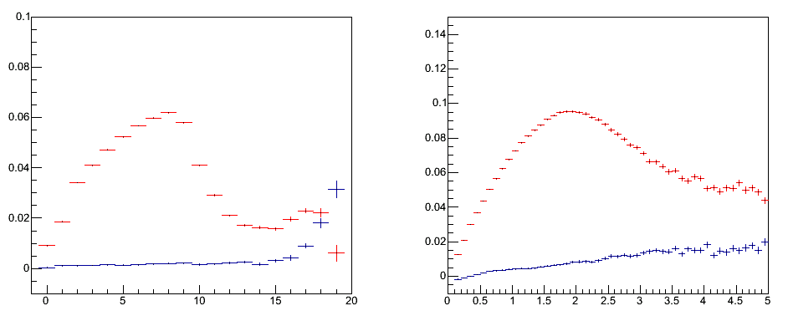
v_n measurement
v_n(n=2, 3) of Charged hadrons and electrons is measured.
v_n = <cos(phi(CNT) – RP(VTX))>/σ(RP(VTX)
Particle is measured by CNT
VTX reaction plane (VTX S+N) shown by Maki and Hiroshi is used
Recentering and Flattening calibration is done
200file(*300k events) analyzed.
CNT_MB is used
hadron
hadron
Min. Bias
<cos(2*(phi – RP)>
<sin(2*(phi – RP)>
<cos(2*(phi – RP)>
<sin(2*(phi – RP)>
v2
v2
0 Centrality 92%
pT(GeV/c)

Slide 21
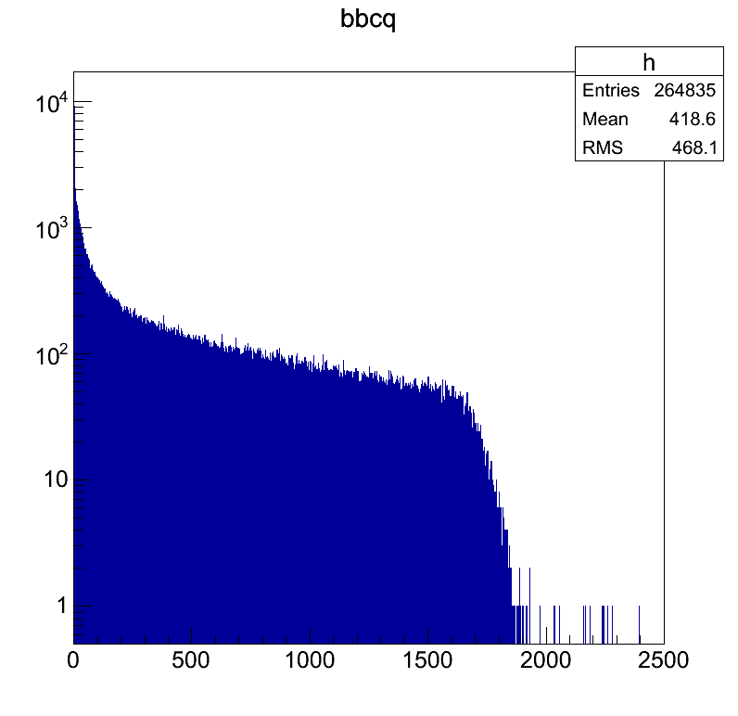
Centrality Definition
Run347357-349680
Counts
5000 bins, 20 steps
bbcns

Slide 22
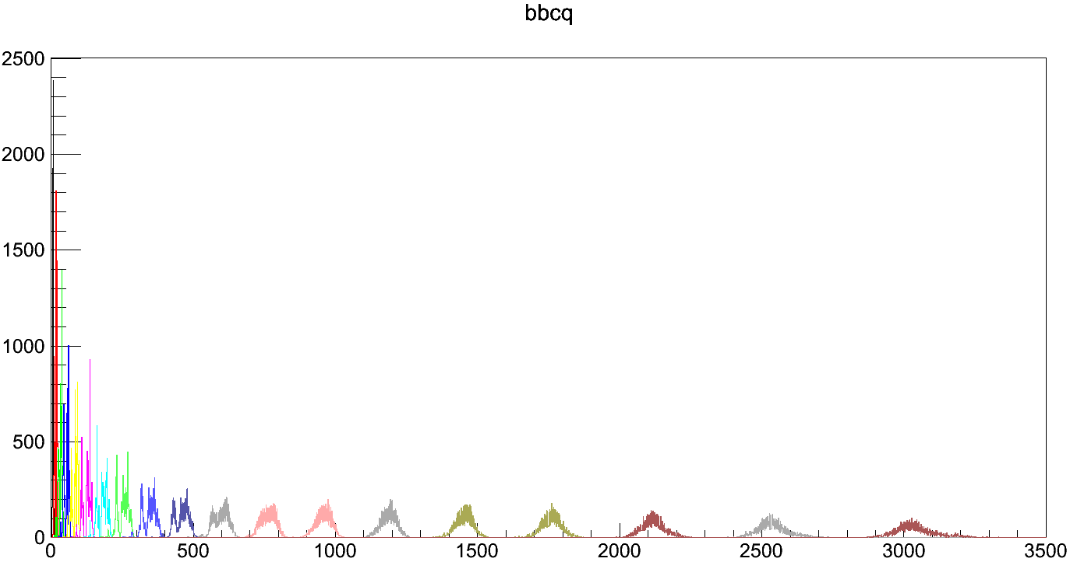
bbcns = (bbcns full scale)*bins/5000
= 2500*3160/5000 = 1580
bins

Slide 23
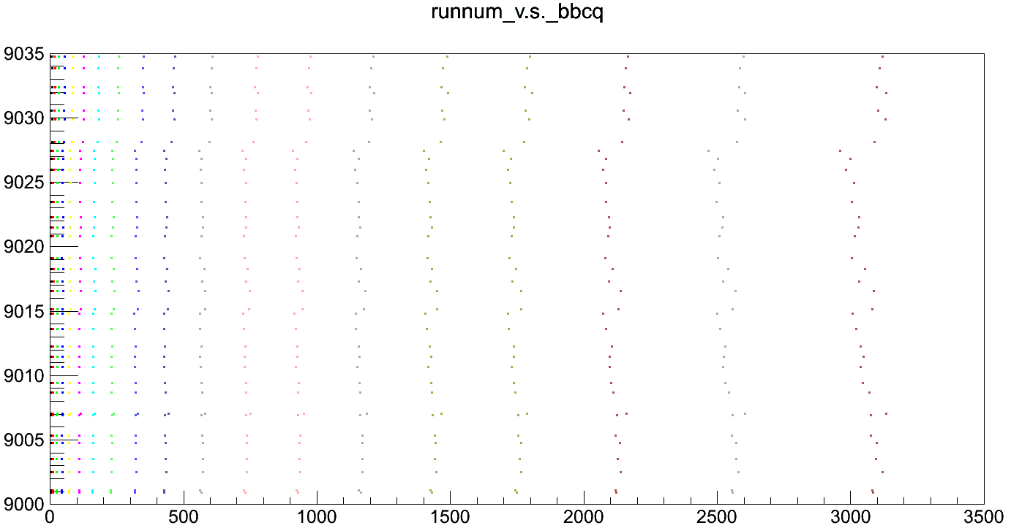
run349639

Slide 24
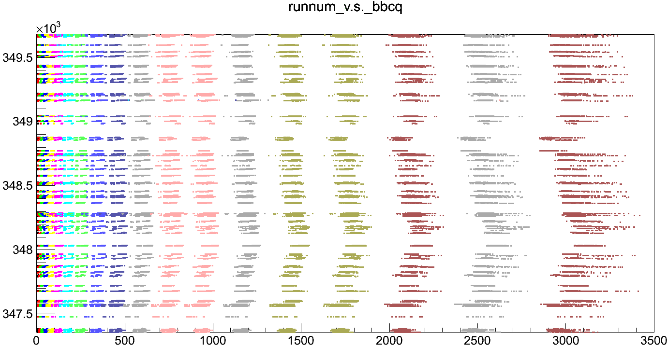

Slide 25
Run349667-9004 (Calib_para_349667-9000.dat)

Slide 26
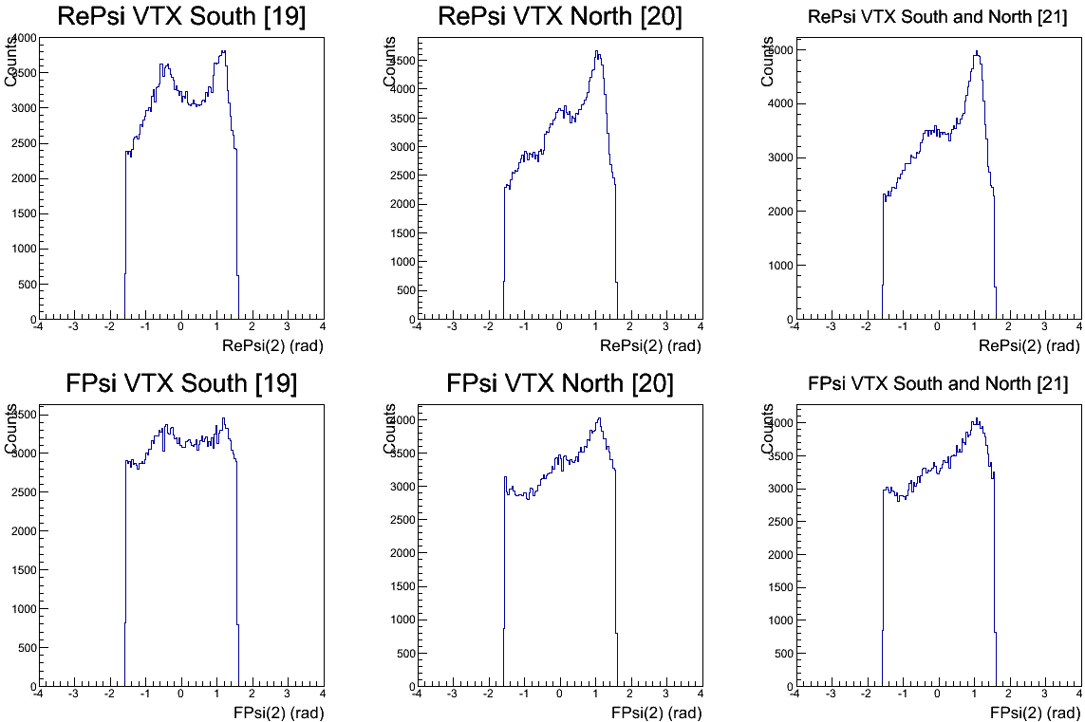
Run349667-9004 (Calib_para_349667-9000.dat)

Slide 27
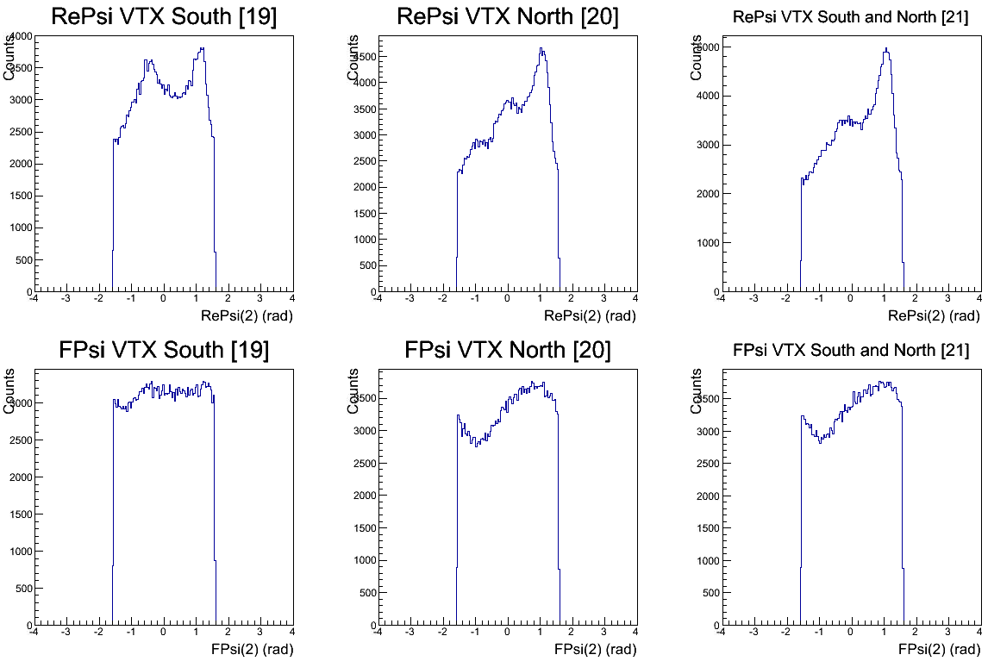
Run349667-9004 (Calib_para_349667-9004.dat)

Slide 28
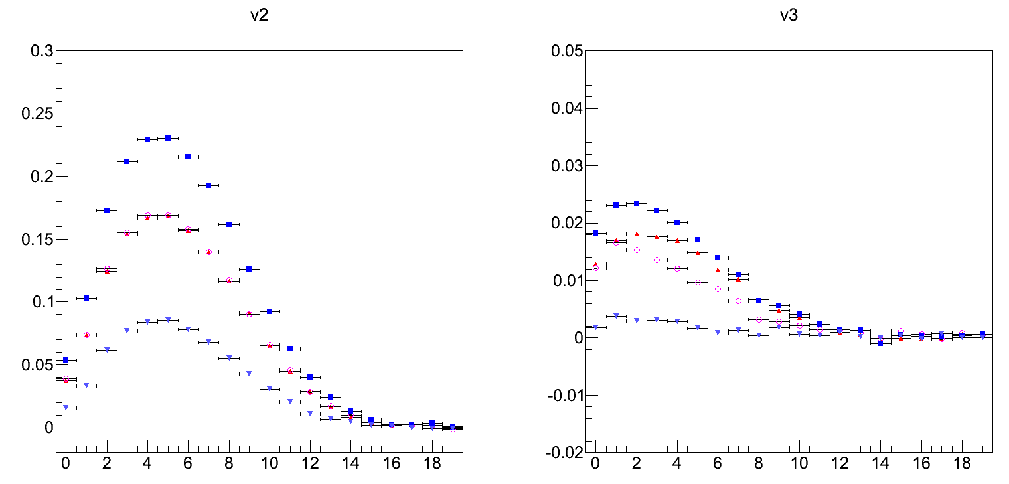
Psi Correlation for v2 and v3 (AuAu 200GeV 100 Segments)
svx(SN)-bbc(S)
svx(SN)-bbc(N)
svx(SN)-bbc(SN)
bbc(S)-bbc(N)
svx(SN)-bbc(S)
svx(SN)-bbc(N)
svx(SN)-bbc(SN)
bbc(S)-bbc(N)
<cos(2(Φ_{A} - Φ_{B}))>
<cos(3(Φ_{A} - Φ_{B}))>
Centrality
Centrality

Slide 29
Plan
Start to generate calibration parameters after finishing of centrality calibration.
Resolution of reaction plane will be generated segment by segment for
BBC S/N/SN : σ(BBC_S) = σ(BBC_N)
MPC S/N/SN : σ(MPC_S) = σ(MPC_N)
SVX S/N/SN Eta gap 1
SVX S/N/SN Eta gap 2

Slide 30
Summary
Calibration parameters for reaction plane were generated.
Calibration of centrality was finished today.
Start to generate calibration parameters.

