Slide 1
Cluster-Shell Competition driven by LS and Tensor Interactions
International Symposium on Perspective in Isospin Physics
--- Role of Non-central interactions in structure and dynamics of unstable nuclei---
a satellite meeting of the 20th International Conference on Few-Body Problems in Physics
Hiroshi MASUI
Kitami Institute of Technology
Collaborator: Naoyuki Itagaki (YITP, Kyoto)

Slide 2
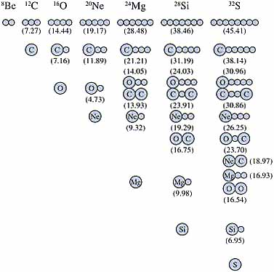
Introduction
Ikeda diagram
“A Cluster state
appears near
its threshold”

Slide 3
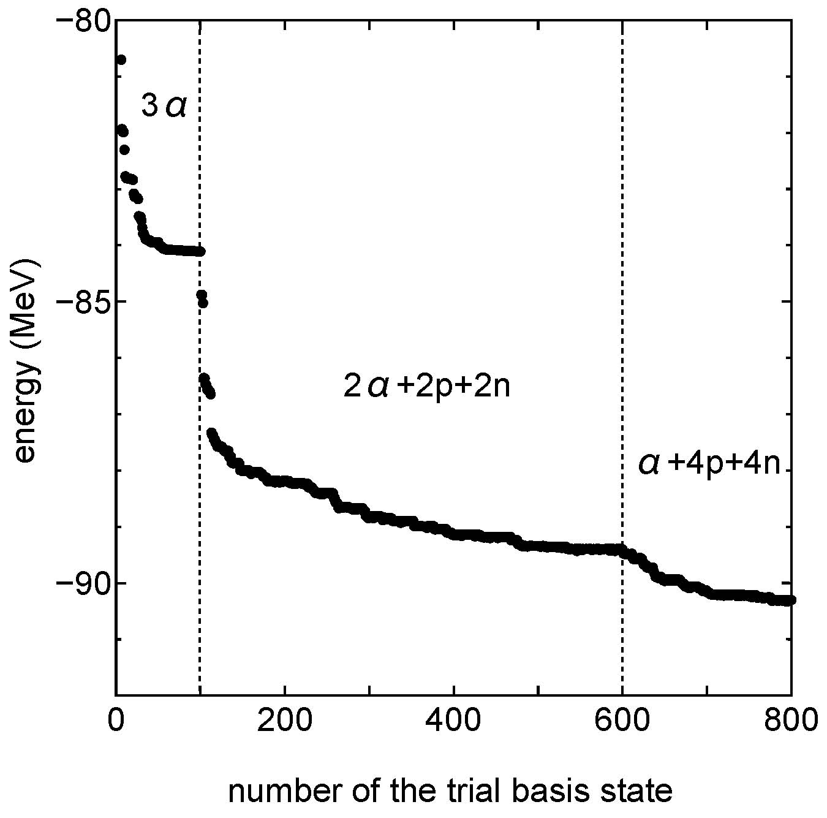
Introduction
“Cluster-shell competition”
α
α
α
n
n
n
α
α
α
p
α
p
p
p
n
p
p
n
n
Dissolution of α
Non-central force
N. Itagaki, S. Aoyama, S. Okabe, K. Ikeda, PRC70 (2004), 054307.

Slide 4
Dissolution of α
Simplified modeling with a few parameters
Non-central force:
Spin-Orbit
Tensor
We transform the Gaussian center parameter z as
“Simplified Method to include the Spin-Orbit interaction (SMSO)”
[1] N. Itagaki, H.M, M. Ito, S. Aoyama, PRC71(2005), 064307.

Slide 5
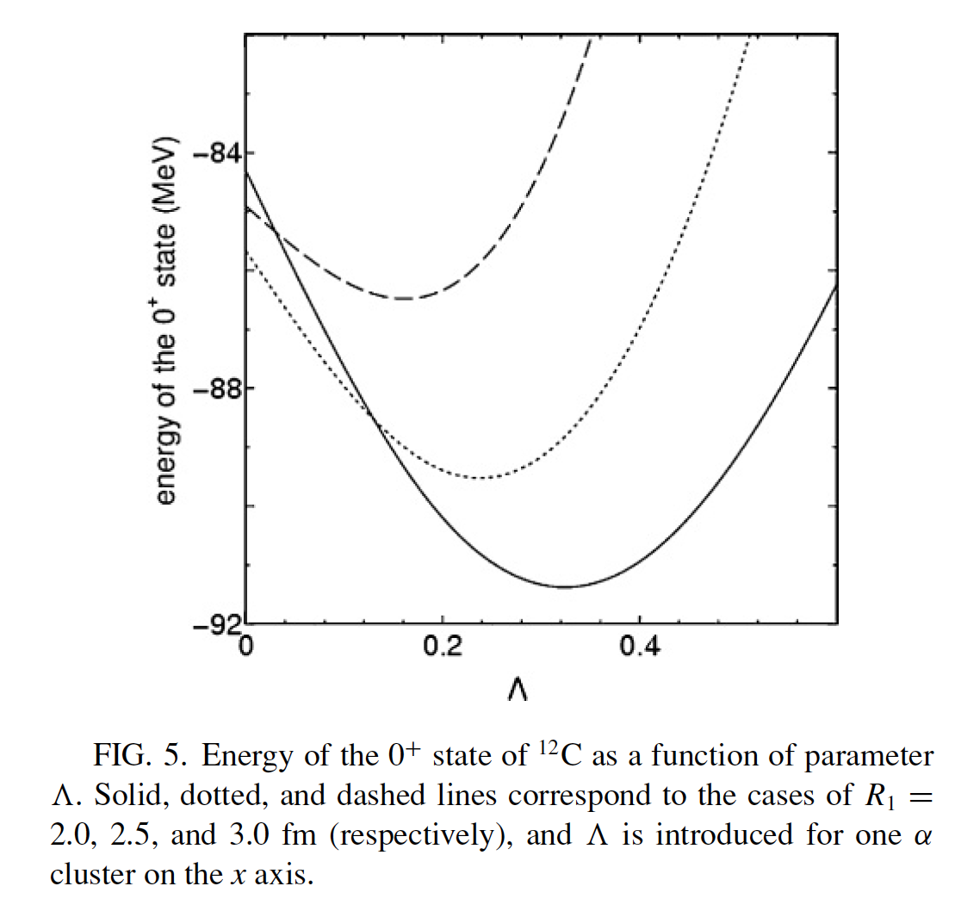
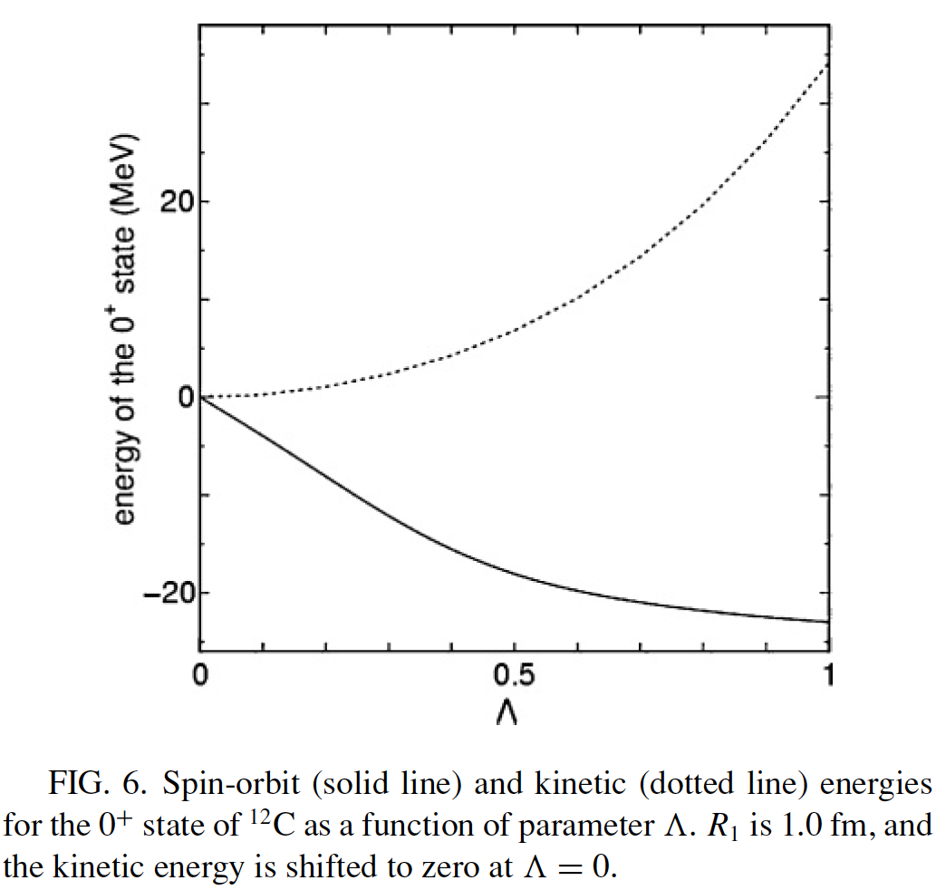
SMSO calculation for ¹²C
N. Itagaki, H.M, M. Ito, S. Aoyama, PRC71(2005), 064307.
α
R₁
Parameters
n
R₁
Λ
α
p
p
n
R₁=3.0
T
2.5
2.0
V_{LS}

Slide 6
(1) C-isotopes with SMSO
(2) Clustering and Tensor force

Slide 7
(1) C-isotopes with SMSO
H. M and N. Itagaki, Phys. Rev. C75 (2007), 054309.
Isotope dependence of the cluster-shell competition
¹²C(SMSO) + neutrons
Structure of ¹⁶C
Energy levels
B(E2) value
3α-cluster state

Slide 8
Formalism
Hamiltonian and interactions
A-body Hamltonian
NN-int.: Central + LS + Tensor

Slide 9
Wave function
Spin and Parity projected
Fully anti-symmetized
Localized Gaussian
For real Z: “Blink-Bloch” w.f.
We introduce a complex value for Z

Slide 10
Dissolution of α
Simplified modeling with a few parameters
Non-central force:
Spin-Orbit
Tensor
We transform the Gaussian center parameter z as
“Simplified Method to include the Spin-Orbit interaction (SMSO)”
[1] N. Itagaki, H.M, M. Ito, S. Aoyama, PRC71(2005), 064307.

Slide 11
Concept of the “Cluster-Shell Competition”
2 variables for describing the competition
α-α distance: R₁
Dissolution parameter: Λ
α
α
R₁
n
α
α
α
p
p
n
Evolution of the clusters
α
α
α
α
Λ=0 : (0s)⁴
Λ=1: rY₁₁(Ω) 〜 0p

Slide 12
SMSO + randomly distributed neutrons
z
α
α-cluster : (0s)⁴
α
n
α
“SMSO”
n
Simplified Method to Include
the Spin-Orbit Interaction
y
n
R₂
n
α
n
Randomly distributed
x
R₁
α
Weight:
R₂ : 1.5 (fm)

Slide 13
To gain the LS-attraction
¹⁴C (0p_{1/2}-close)
z
S_{z}
α
n
3
:
1
n
n
y
Parameters
α
α
n
x
(fm)
Central: Volkov No.2
M=0.61, B=H=0.125
S_{z}=0
+ S_{z}=1
LS: G3RS
Mixing of S_{z}=1 Base
V₀=2000 (MeV)

Slide 14
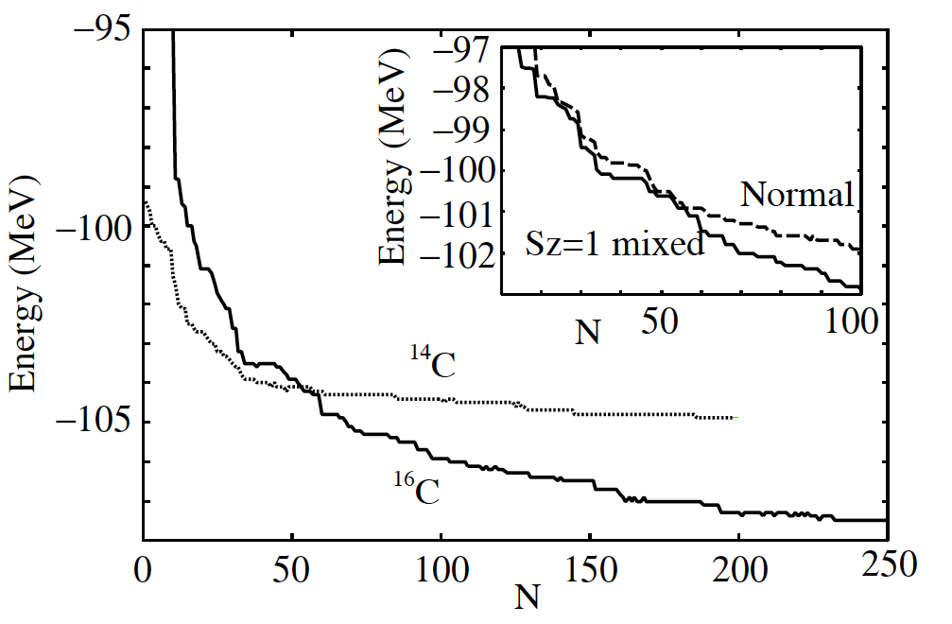
Results

Slide 15
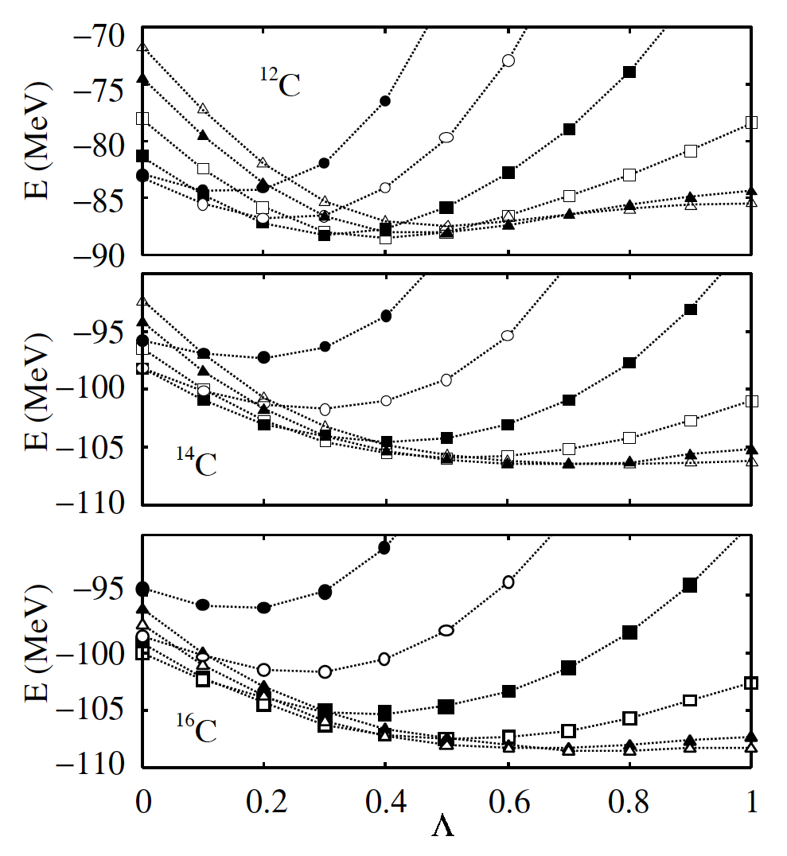
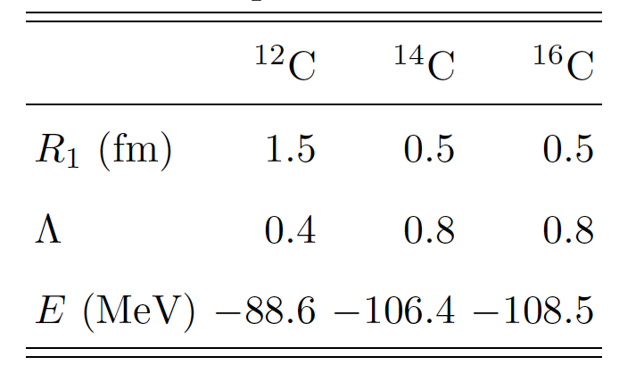
α
R₁
n
α
p
p
n
Cluster
Shell

Slide 16
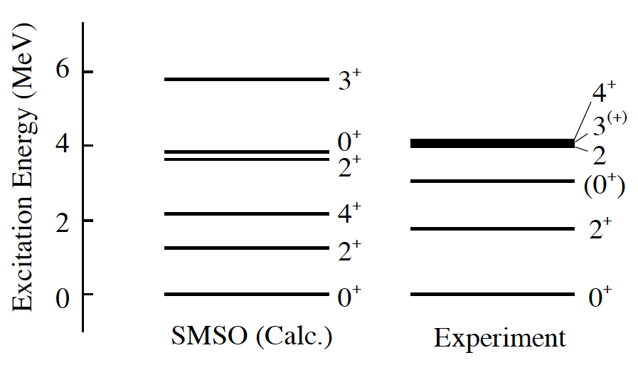
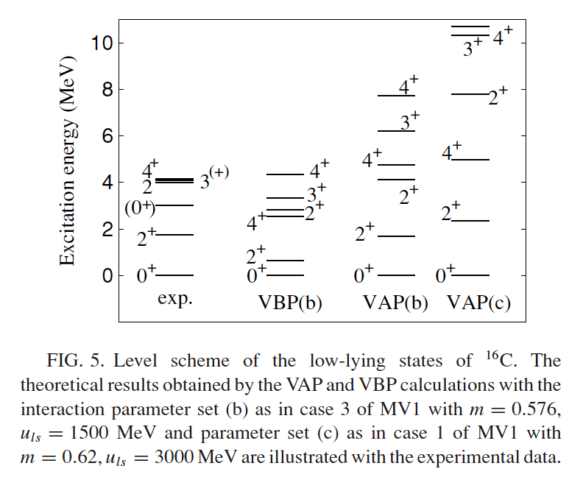
Levels of ¹⁶C
VAP-like
VBP-like
Y. Kanada-En’yo, PRC71 (2005), 014310.
Parity
0⁺
Angular-mon. porj.

Slide 17
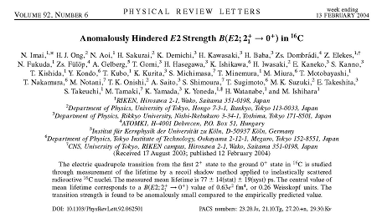
B(E2) value of ¹⁶C
N. Imai et al., PLB92, 062501(2004)
Anomalously small B(E2) value
2⁺
Ex = 1.77 (MeV)
B(E2; 2⁺ →0⁺) = 0.63 e²fm⁴
0⁺

Slide 18
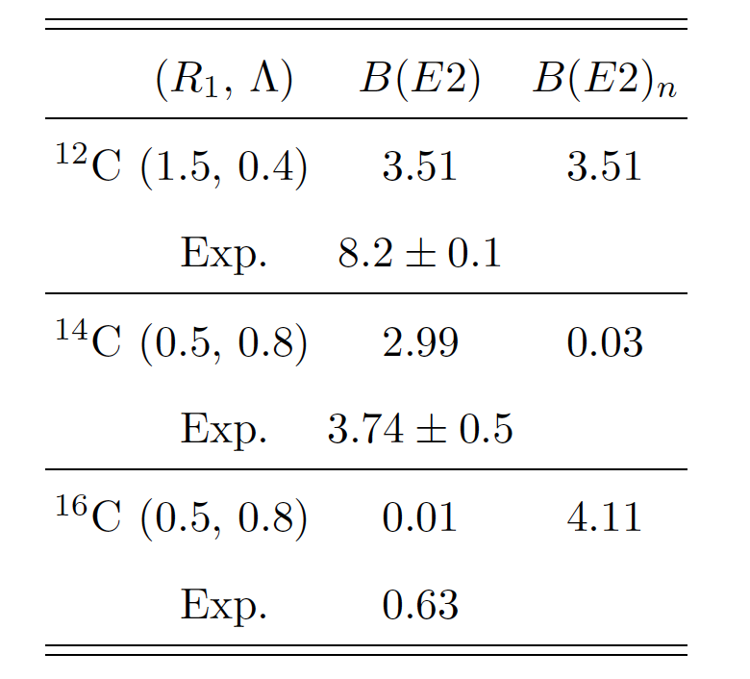
B(E2; 2⁺→0⁺)
(e²fm⁴)
¹²C
(3α-clusters)
R₁: 2.5 fm, Λ = 0
7.00 e²fm⁴
Proton-deformation
Neutron-deformation
B(E2)_{n}: Protons ⇔ Neutrons

Slide 19
Comparison
B(E2; 2⁺→0⁺)
(e²fm⁴)
¹²C
¹⁴C
¹⁶C
AMD [1]
6.8
5.9
1.4
¹⁴C+2n [2]
1.51
(e_{n}=0.159)
SMSO(Present)
3.51
2.99
0.01
Experiment [3, 4]
8.2±0.1
3.74±0.5
0.63±0.12
[1] Y. Kanada-En’yo, PRC71 (2005), 014310.
[2] W. Horiuchi and Y. Suzuki, PRC73 (2005), 037304.
[3] N. Imai et al., PRL92 (2004), 062501.
[4] S. Raman et al., At. Data Nucl. Data Tabl. 36, (1987).

Slide 20
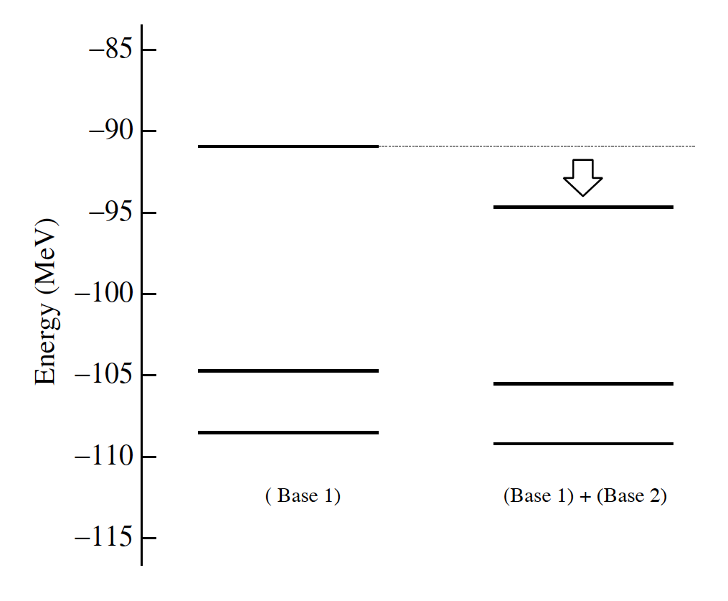
3α-cluster state of ¹⁶C
Cluster-like
Shell-model-like
R₁
Λ
Base 1
0.5
0.8
Base 2
2.5
0.0

Slide 21
Summary 1
“Cluster-shell competition described by a few parameters”
Isotope dependence of the cluster-shell competition
¹²C
¹⁴C
¹⁶C
R₁
¹²C
Shrinkage of 3α-clusters due to the valence neutrons
Λ
Dissolution of an α-cluster

Slide 22
Summary 2
Structure of ¹⁶C
a. Energy levels
Almost good
For excited states, an improvement is needed
b. B(E2) value
Too small (0.01 e²fm⁴)
Neutron 2⁺
Interaction?
(R₁, Λ) = (0.5, 0.8)
c. 3α-cluster state
Appears in the 3rd 0⁺
“Crystalization”
N. Itagaki, et al. PRL92 (2004), 054307.

Slide 23
(2) Clustering and tensor force
Levels of ¹⁵C with SMSO
¹⁴C(SMSO) + neutrons
Cluster-shell competition in the level scheme
Energy levels
Role of the tensor force and clustering

Slide 24
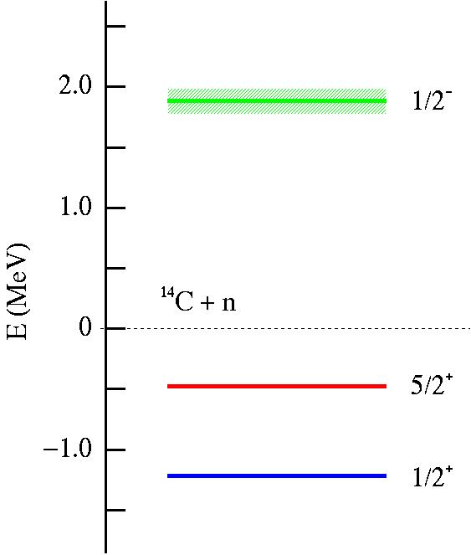
Levels of ¹⁵C
A naive picture
Last valence neutron
1s_{1/2}
0d_{5/2}
¹⁴C
0p_{1/2}
NOT a “spherical” ¹⁴C
0p_{3/2}
0s_{1/2}

Slide 25
Dissolution of α : Λ
SMSO (Simplified Modeling for Spin-Orbit interaction)
Spin-Orbit
We transform the Gaussian center parameter z as
“Cluster-shell competition”
[1] N. Itagaki, H.M, M. Ito, S. Aoyama, PRC71(2005), 064307.
[2] H. Masui and N. Itagaki, Phys. Rev. C75 (2007), 054309.
α−α distance: R₁
α
R₁
α
α

Slide 26
SMSO + SMT
S=1 , T=0
Simple Method to include
the Tensor interaction
S=1 , T=0

Slide 28
SMSO(¹⁴C) + a randomly distributed neutron
z
α
α-cluster : (0s)⁴
α
R₂
n
n
“SMSO”
p
p
R₁
n
Simplified Method to Include
the Spin-Orbit Interaction
n
y
n
n
p
p
n
n
Randomly distributed
x
α
Weight:
R₂ : 1.5 (fm)

Slide 29
Interactions
Central
Minnesota: u=0.93
LS
Minnesota: V_{ls} = 591 (MeV)
Tensor
“Furutani” fource
Parameter for the paket width
(fm)

Slide 30
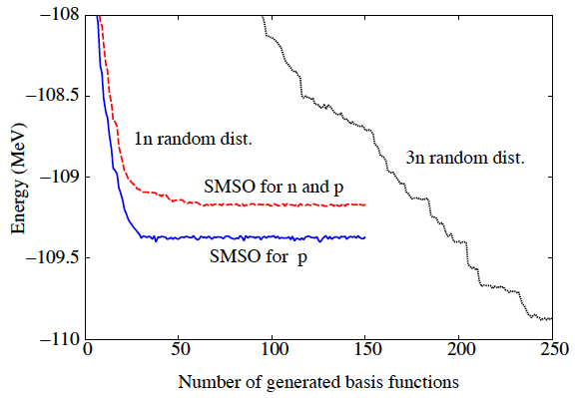
Model space and the convergence
¹²C+3n
Very slow convergence
¹⁴C+n
SMSO for n and p
SMSO for p
Reasonable convergence

Slide 31
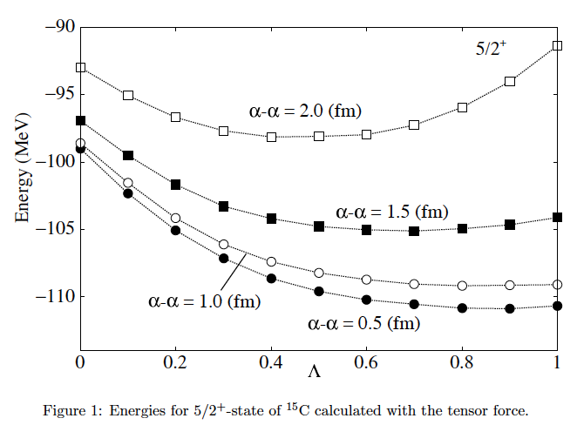
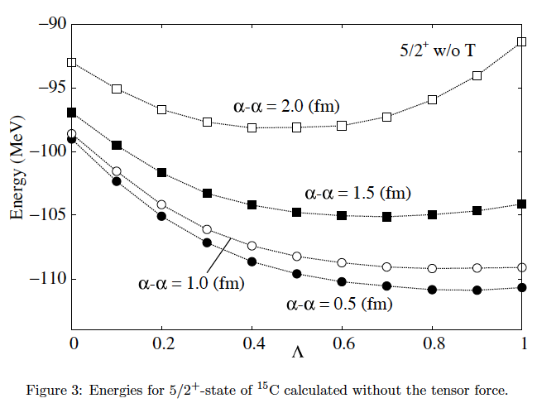
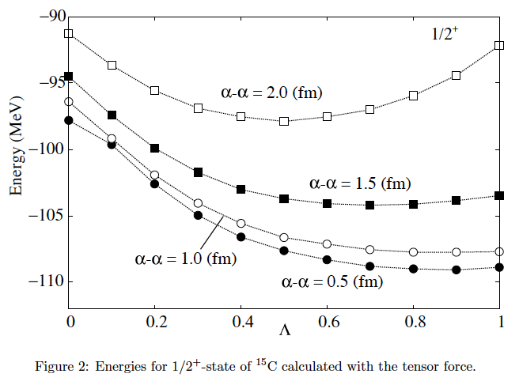
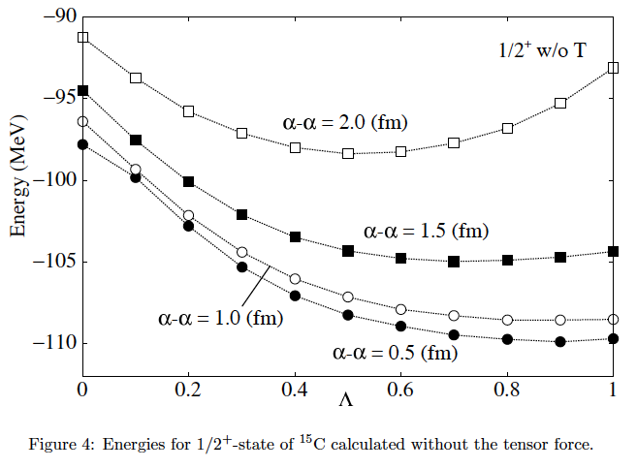

Slide 33
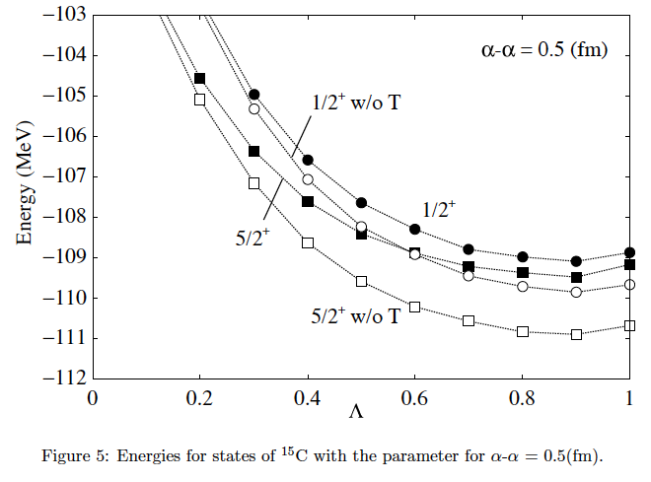
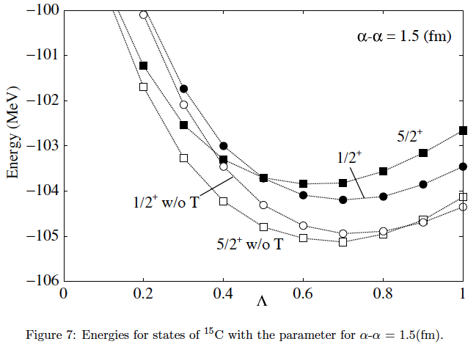
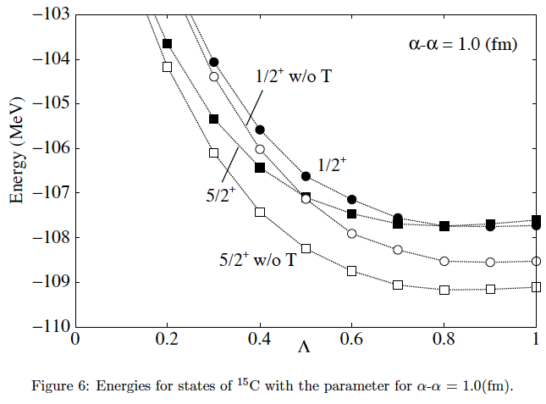
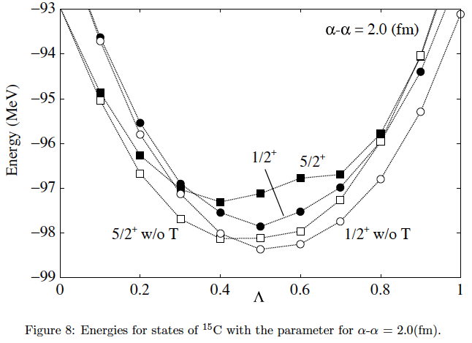

Slide 36
Energy
(1) with T
(2)without T
(1)−(2)
α-α distance
5/2⁺
-97.3
-98.1
0.8
2.0
1/2⁺
-97.9
-98.4
0.5
α-α distance
5/2⁺
-103.8
-105.1
1.3
1.5
1/2⁺
-104.2
-104.9
0.7
α-α distance
-107.7
-109.2
1.5
5/2⁺
1.0
-108.5
1/2⁺
-107.7
0.8
α-α distance
5/2⁺
-109.5
-110.9
1.4
0.5
1/2⁺
-109.1
-109.9
0.8
(MeV)
(MeV)
(MeV)

Slide 37
Repulsion for 5/2+
Tensor force for particles in two orbits
j< - j’>
Attractive
j> - j’>
Repulsive
T. Otsuka, T. Suzuki, R. Fujimoto, H. Grawe and Y. Akaishi, Phys. Rev. Lett. 95, 232502 (2005).
1s_{1/2}
For ¹⁵C
0d_{5/2}
j>
¹⁴C
0p_{1/2}
Repulsive
0p_{3/2}
j’>
0s_{1/2}

Slide 38
SMSO(¹⁴C) + 3 randomly distributed neutrons
¹⁷C
z
α
α-cluster : (0s)⁴
n
α
R₂
n
n
“SMSO”
p
p
R₁
n
Simplified Method to Include
the Spin-Orbit Interaction
n
y
n
n
p
p
n
n
n
Randomly distributed
x
α
Weight:
R₂ : 1.5 (fm)

Slide 39
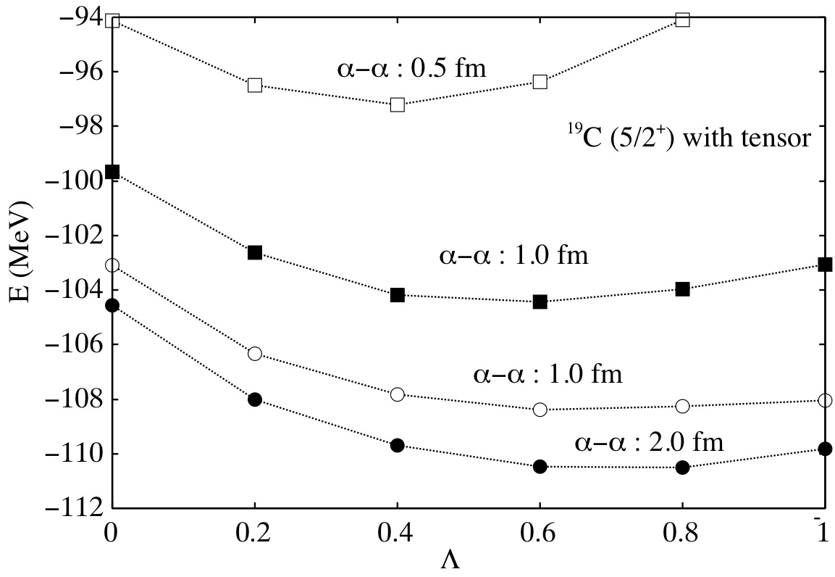
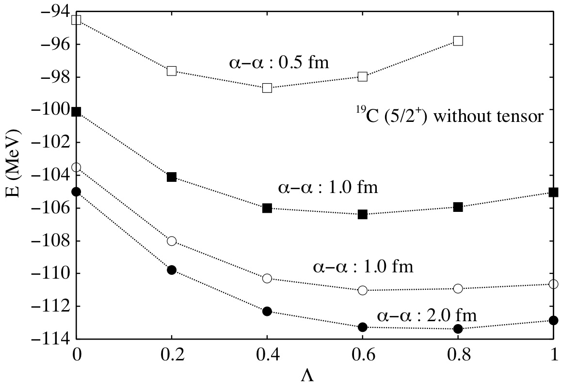
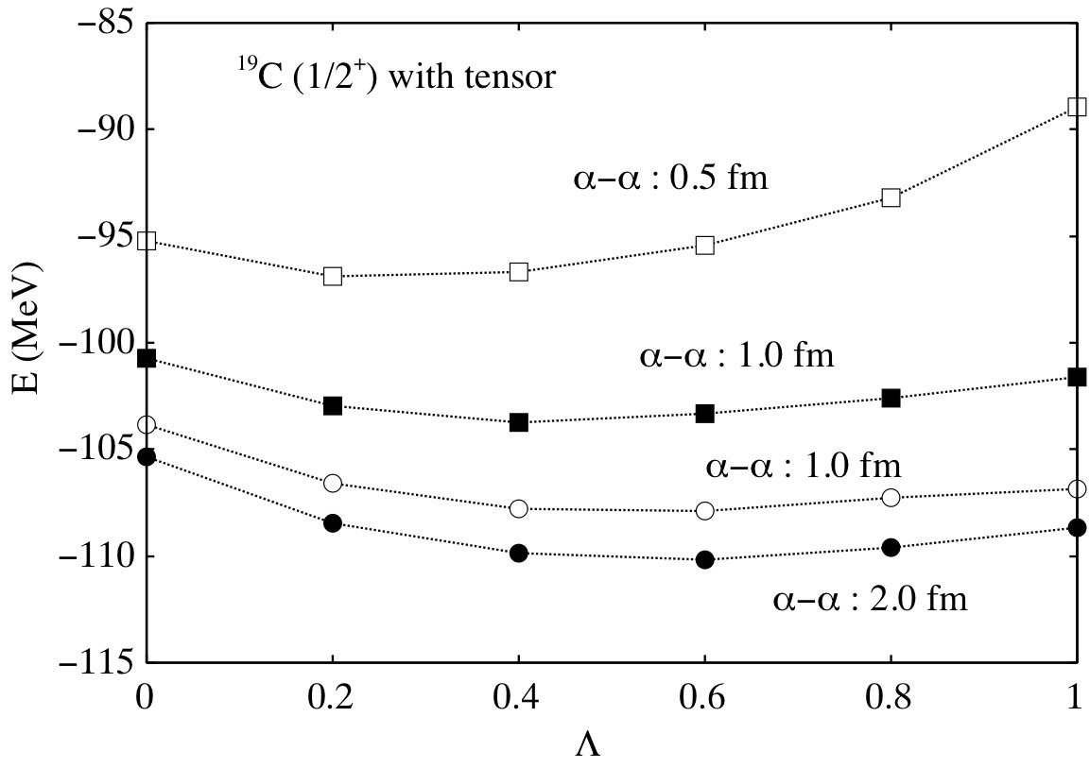
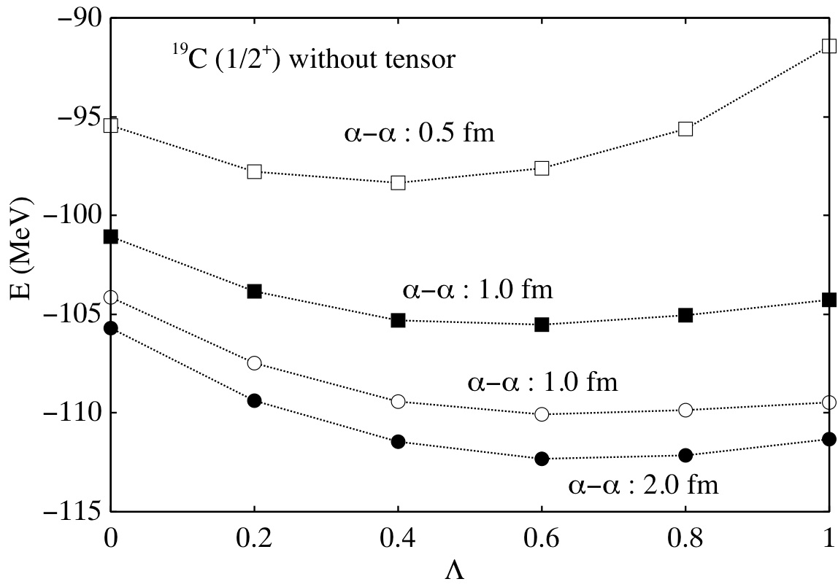
Preliminary

Slide 40
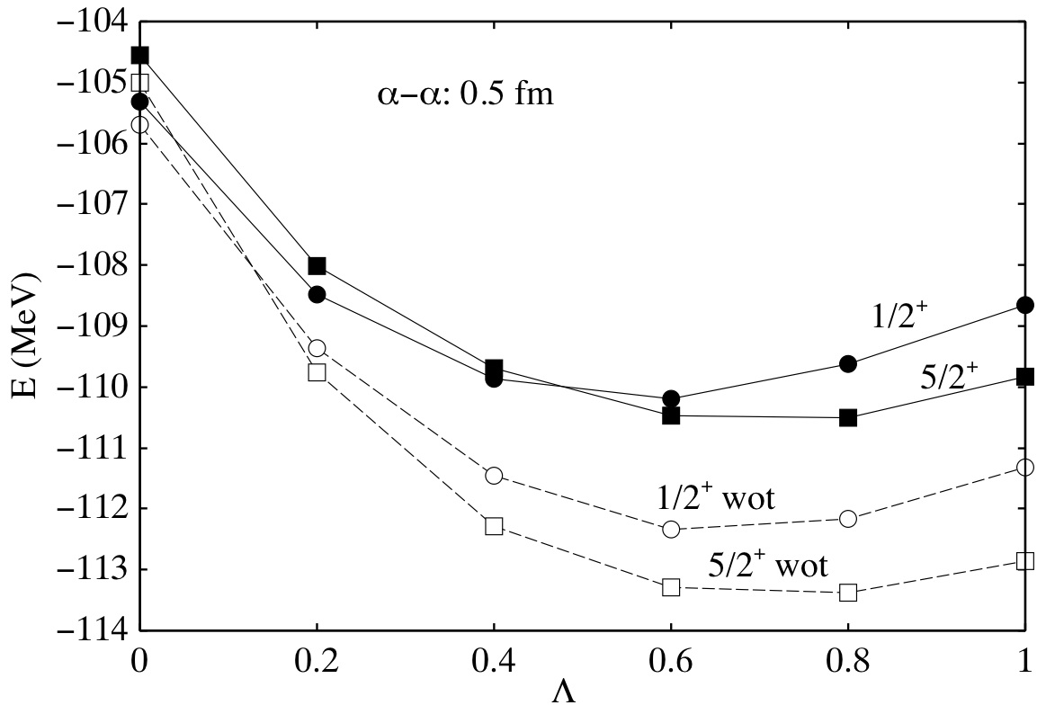
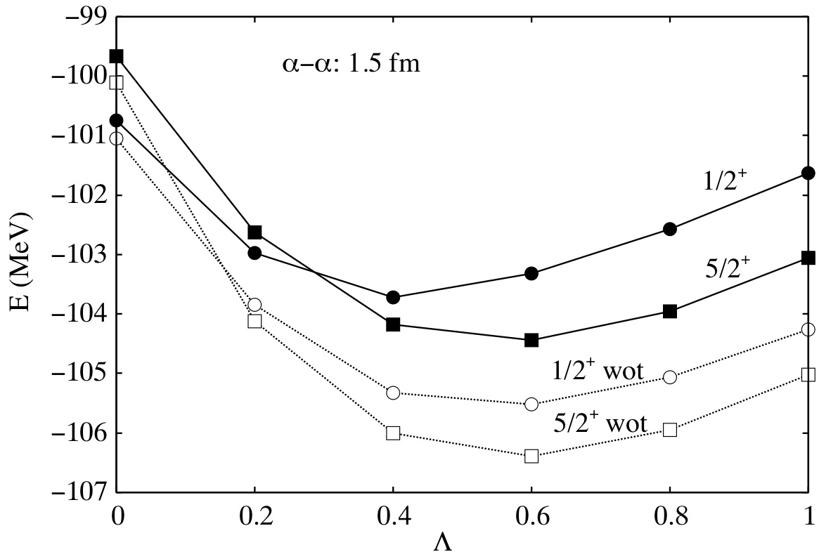
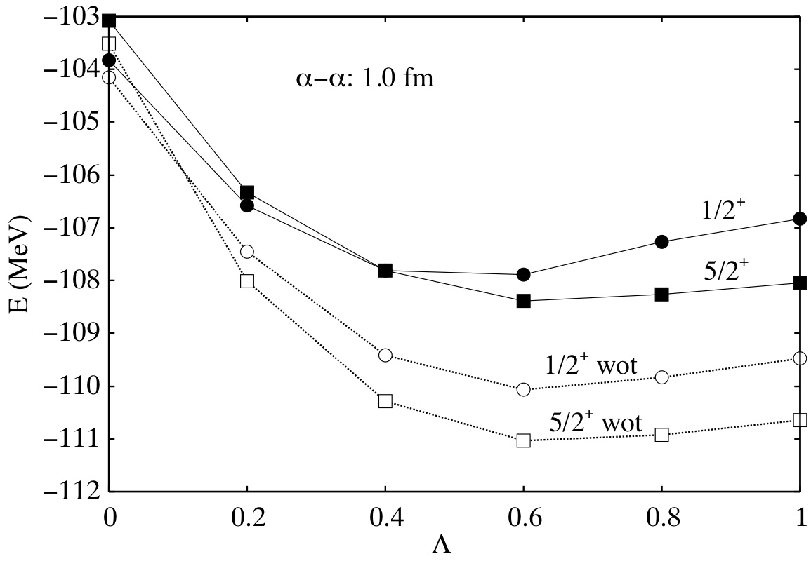
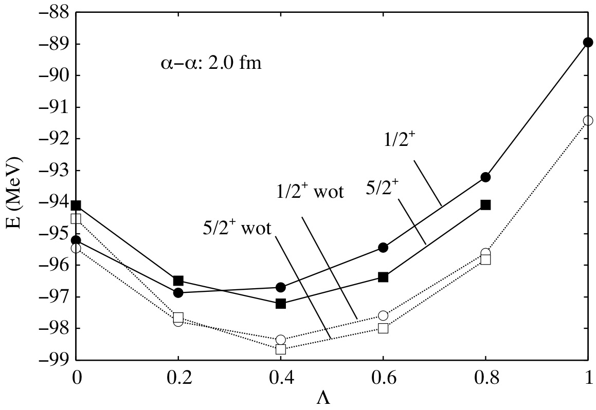
Preliminary

Slide 41
Summary 1
“Cluster-shell competition in ¹⁵C”
Levels: 5/2⁺ and 1/2⁺
Cluster
Shell
α-α distance
Large
Small
Small
Large
Optimum Λ
Energy difference:
E(5/2⁺) − E(1/2⁺)
Positive
Negative
5/2⁺
1/2⁺
1/2⁺
5/2⁺

Slide 42
Summary 2
Role of the tensor force
Generally, push up the energy
For 5/2⁺ : Strong
For 1/2⁺ : Weak
This effect makes the level inversion

