Slide 1
(p,n) reaction on N=Z unstable nuclei in inverse kinematics
-- towards new spin-isospin physics --
Masaki Sasano
Spin-Isospin laboratory
RIKEN Nishina Center

Slide 2
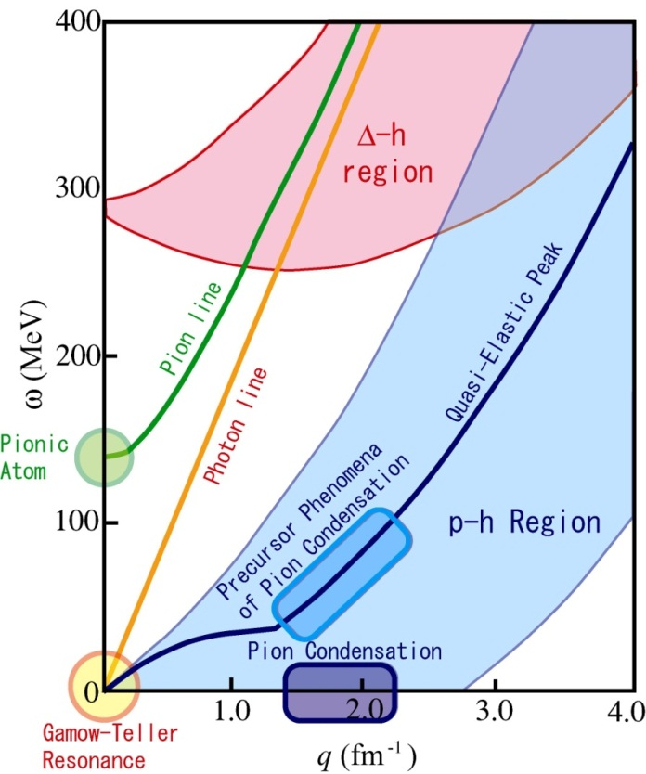
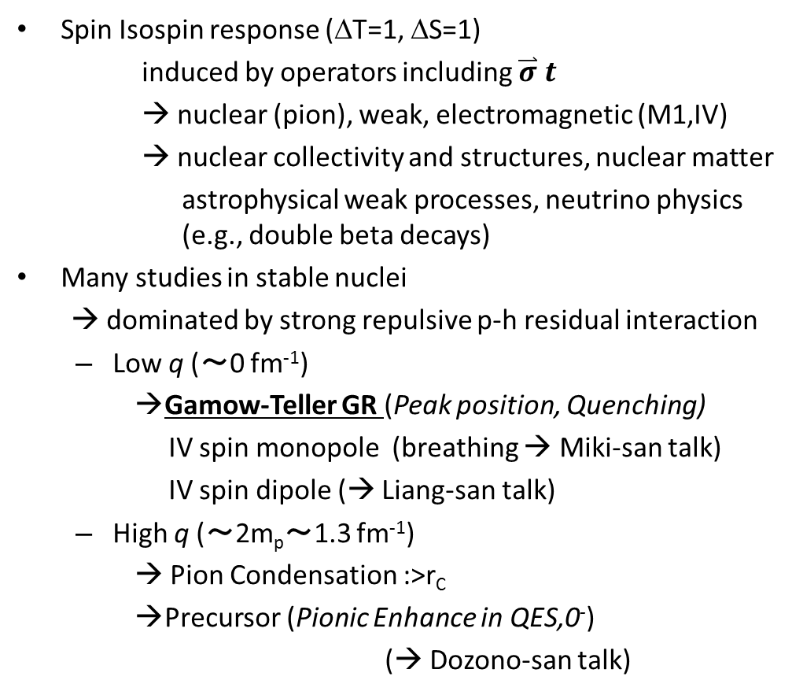

Spin Isospin Physics
Spin Isospin response (ΔT=1, ΔS=1)
induced by operators including $\overset{⃑}{σ}$ $t_{}$
→ nuclear (pion), weak, electromagnetic (M1,IV)
→ nuclear collectivity and structures, nuclear matter
astrophysical weak processes, neutrino physics (e.g., double beta decays)
Many studies in stable nuclei
→ dominated by strong repulsive p-h residual interaction
  Low q (～0 fm⁻¹)
    Gamow-Teller GR (Peak position, Quenching)
    IV spin monopole (breathing → Miki-san talk)
    IV spin dipole (→ Liang-san talk)
  High q (～2m_{p}～1.3 fm⁻¹)
    → Pion Condensation :>r_{C}
    Precursor (Pionic Enhance in QES,0⁻)
    (→ Dozono-san talk)
Propagation
→ response
Neutron
hole
Proton
particle
$\overset{⃑}{σ}$ $t_{−}$
This talk
Basic questions:
Does this understanding holds for unstable?
Effect due to particle-particle residual interactions

Slide 3
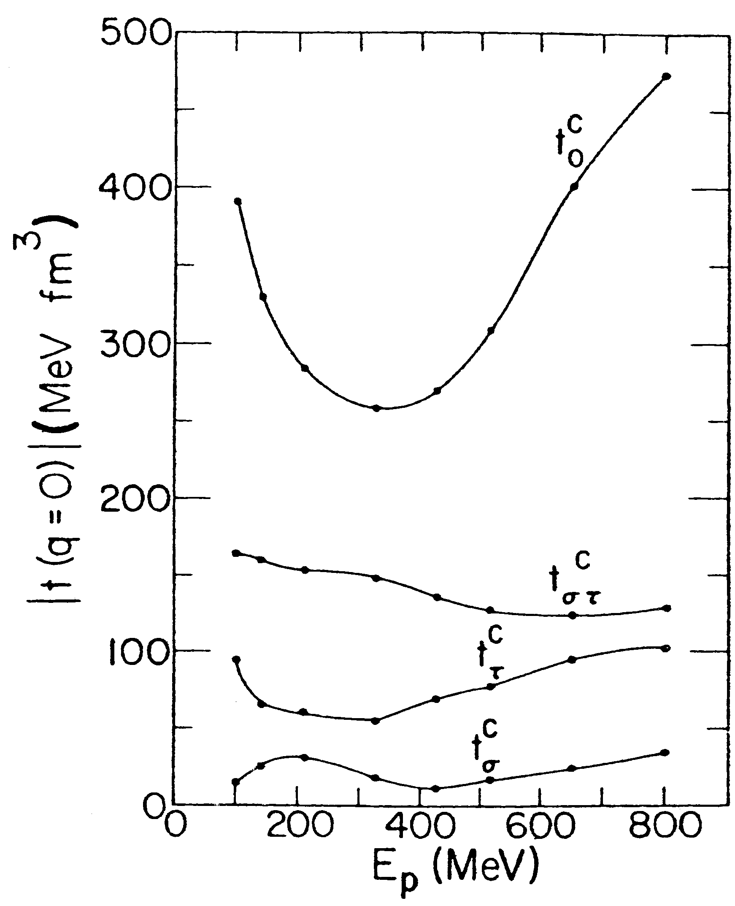
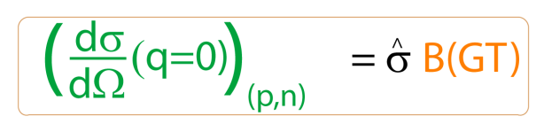
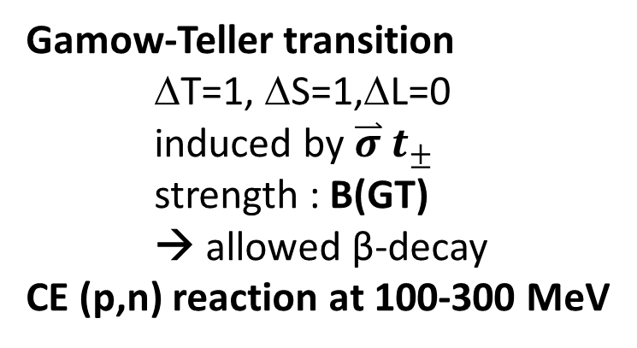
Charge-Exchange (CE) (p,n) reaction: a tool for studying Gamow-Teller strengths
Gamow-Teller transition
ΔT=1, ΔS=1,ΔL=0
induced by $\overset{⃑}{σ}$ $t_{±}$
strength : B(GT)
→ allowed β-decay
CE (p,n) reaction at 100-300 MeV
Cannot access by β-decay
CE
β-decay
energy
A,Z
A,Z±1
Proportionality between Gamow-Teller strength (B(GT)) and cross section
calibrated with transitions for which B(GT) is known from β-decay
ΔB(GT) ~ 10% → Can determine B(GT) distribution up to a high energy (a few tens MeV)
This powerful probe has been applied only to stable nuclei or to a few low-lying states in unstable light nuclei
Notes:
Gamow-teller transition is one of the most basic excitation modes in nuclei,
Which is characterized by isospin flip, spin flip, and no angular momentum transfer.
It’s strength is B(GT), which is directly connected with a half-life of the beta-decay.
However, the energy region beta can access is limited by the decay Q-value.
Thus, the charge exchange reaction such as the (p,n) reaction has been used as a powerful probe to obtain the B(GT) distribtuion up to a high
Excitati on energy region beta decay cannot access.
Here, to determine the B(GT) values from the measured cross sections, one can employ the proportionaliy relation between
B(GT) and the 0-degrees cross section which is calibrated with transitions for which B(GT) is known from beta-decay.

Slide 4
The first case, ⁵⁶Ni a key nucleus in Fe region
p_{1/2} p_{1/2}
p_{1/2} p_{1/2}
⁵⁶Ni (Z=N=28)
independent particle model
→ ⁵⁶Ni is doubly magic
Large p-n residual interaction
→ ⁵⁶Ni is not magic
GT strength from ⁵⁶Ni
→ key to bench mark nuclear model used for weak rates in the Fe region (⁵⁶Ni is one of the largest sources of electron capture)
p_{3/2} p_{3/2}
p_{3/2} p_{3/2}
GT
f_{5/2} f_{5/2}
f_{5/2} f_{5/2}
GT
28
20
f_{7/2} f_{7/2}
f_{7/2} f_{7/2}
20
sd sd
sd sd
p p
p p
s s
s s
N P
N P
f7/2 70% in ⁵⁶Ni (GXPF1A, KB3G)
(e.g., Honma et al., Phys. Rev. C 69, 034335 (2004))
Experimentally, challenging!
Notes:
Furthermore, 56ni is a key nucleus in fe region, because it consists of 28 neutrons and 28 protons, which is doubly magic in the independent particle model.
But, actually, because large p-n residual interaction, 56ni is no magic. Only 70% of 56ni ground state comes from f72.
Thus, the GT strength from 56ni is key to bench mark nuclear model used weak rates in the fe region.
However, such a study has been experimentally chanllenging.

Slide 5
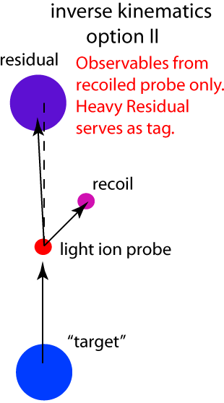
Existing CE studies using RI beams
³⁴P(⁷Li,⁷Be+gamma)
(Zegers et al., Phys. Rev. Lett. 104, 212504 (2010)
¹²B(⁷Li,⁷Be+gamma)¹²Be
(Meharchand et al., to be published)
beam residue analyzed by S800
excitation energy is limited by particle decay threshold
¹H(¹⁴Be,¹³B+n)n
(Satou et al., Phys. Lett. B 697 (2011) 459-462.
Invariant mass method with single neutron detection + gammas from residue
Only low-lying states
For high-lying states, multi nucleons
CE reactions with RI beams are currently limited to low lying states,
and to light nuclei
Notes:
Actually, there has been only a few chareg-exchange studies which have been performed with rare isotope beams in inverse kinematics.
For example, in studies of charge-exchange (li,be) reaction, beam residue is momentum analyzed by S800, and thus exciation energy is limited by particle decay threshold.
Another example is the (p,n) reaction performed by employing the invariant mass method , where signle neutron and gammas from the beam residues are detected.
In this case, the studies are limited to only relatively low-lying states below one neutron emissions, and for high-lying states, multi nucleons must be detected.
In both cases, ce reaction with ri beams are currently llimited to low-lyinsg staes and to light nuclei.

Slide 6
Our experimental method for (p,n) in inverse kinematics
Missing mass spectroscopy
by the detection of the recoil neutron
Advantages
Efficient!
RI beam (10 ^6 pps) + Liq. H (100mg/cm^2)
~ stable p beam (160 nA) + 100 mg/cm^2 (A~100)
(after taking account detection eff. and acc.)
Simple!
All kinematic information
from measurement of the neutron
(two-body kinematics)
Extensive!
Can be applied to any mass region and to any excitation energy
New!
Branching ratio of the particle decay
(Heavy fragments as tag for each decay branch)
The first experiment was done at NSCL, MSU by M. Sasano, R. Zegers, G. Perdikakis et al..
Notes:
In our method, this limiations is overcome by employing the missing mass spectroscopy, where the kinematics is reconstructed only from the recoil neutron whose neutron energy is measured.
This method has advantages as following;
First of all, the target can be thick, because recoil neutron does not lose its energy inside the target.
Thus, it makes it possible to achive a relatively high luminosity event with unstable beams with low intensitiies.
Since all kinetic information is obtained from measurement of the neutron, measurment and analysis are simple compared to invariant mass method.
In addition, in this method, heavy beam fragments are particle identified by using S800 and servers as tag for CE reaction with different particle decay channel, giving brancghing ratio.
Owing to these advangates, this method can be applied to any mass region and to any excitation energy region.

Slide 7
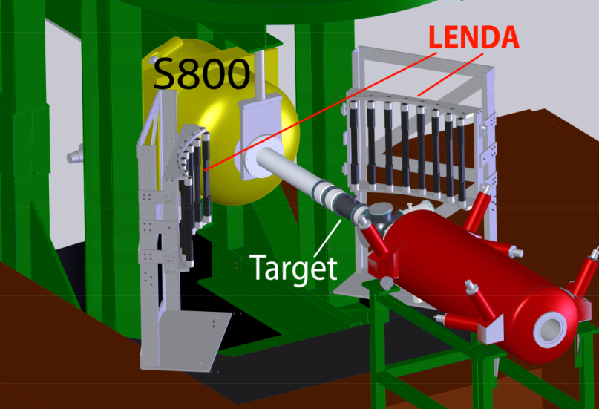
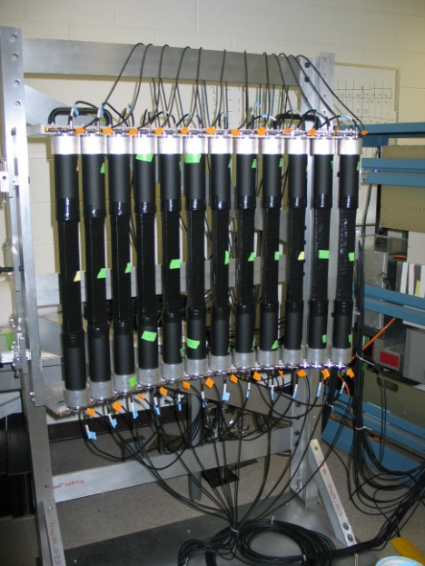
The first exp. at NSCL
M. Sasano, G. Perdikakis, R. Zegers,
et al., PRL107, 202501 (2011).
n
RI beam
Low Energy Neutron
Detector Array (LENDA)
neutron detection
Plastic scintillator
24 bars 2.5x4.5x30cm
150 keV < E_{n} < 10 MeV
ΔE_{n} ~ 5% Δθ_{n} < 2º
efficiency 15-40%
Flight path : 1 m
Perdikakis et al, submitted to NIM.
Notes:
The hydrogen target was surrounded by the neutron detectors LENDA, where a low energy neutron with energyies from 150 keV up to 10 MeV are detected with the detection efficiecy typically from 15-40% depending on the neutron energy. The flight path length is 1 m, the neugron energy resolution is 5%.
The right figure shows the kinetics curve of the (p,n) reactin, which shows the relation between the neutron energy and the laboratory angle of the recoil neutron.
The solid line corresponds to the states from the ground states to 30 MeV with 5 MeV steps.
The red dotted lines correpond to the scatteringles in the center of mass system from 2 to 10 degrees with 2 degrees steps.
Blue shaded areas correspond to the acceptance of the LENDA. The bars on the left and right sides with respect to the beam line are shown with negative and positive laboratory angle values.

Slide 8
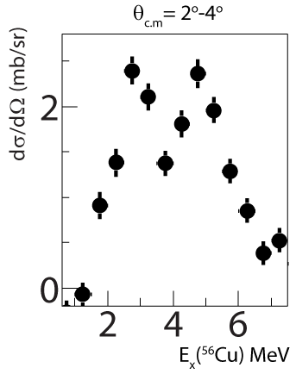
Cross sections
⁵⁶Ni(p,n)
⁵⁵Ni
⁵⁶Cu
⁵⁶Cu
⁵⁶Ni
GT component dominates the region below 8 MeV.
→ Scale the spectrum before smearing

Slide 9
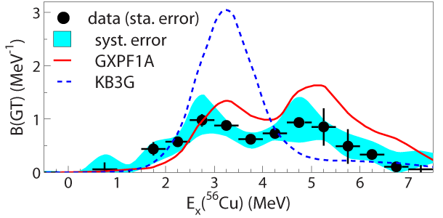
GT strengths from ⁵⁶Ni(p,n) at 110 MeV/u
Use the extracted ΔL=0 component in combination with unit cross section to extract Gamow-Teller strength [B(GT)].
Compare with large-scale shell-model calculations
PRL107, 202501 (2011).
GXPF1A: Honma et al. : constrained by data in full pf-shell
KB3G: Poves et al. : less constraints – used in database for weak rates for astrophysical purposes.
Difference between KB3G and GXPF1A:
KB3G weaker spin-orbit and pn-residual interactions
KB3G lower level density

Slide 10
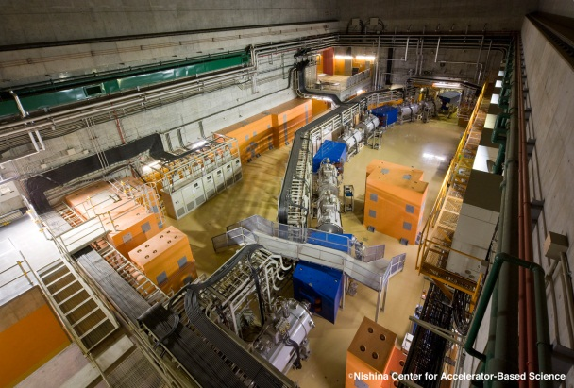
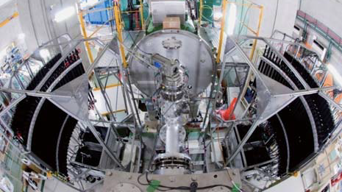
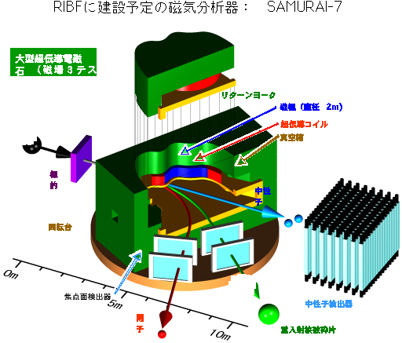
(p,n) study of RIKEN RIBF
RIKEN RIBF
Beam :
⁸He, ¹¹Li, ¹⁴Be, ^{70,72}Ni, ¹³²Sn at RIKEN RIBF
with enough intensity (> 10^4 pps )
with the best beam energy (200 MeV)
←→ NSCL cannot access neutron drip line
Neutron detection:
60 scintillator bars
←→24 bars
Residue tag :
Measure all decay particles in one setting
←→ only a part of decay particles
BigRIPS
WINDS
SAMURAI
RIKEN RIBF is a powerful facility for the (p,n) measurement in inverse kinematics
The first exp. at RIKEN for ¹²Be by Yako et al.

Slide 11
Applications
Possible to probe
any Ex on any A/Z
(beam intensity 10⁴⁻⁵ pps)
Ex
GTGR, SDR
EC/beta-decays
Neutral weak currents,
e.g., Synthesis of Mn in Poplution III star
⁵⁶Ni(ν,νp)⁵⁵Co → ⁵⁵Fe →⁵⁵Mn
GXPF1 >> KB3G (a factor of 3)
T. Suzuki et al., Phys. Rev. C79,
061603(R) (2009).
R-process
SDR
r-process?
(ν,ν,)
GTGR
EC, beta-decays
Proton rich
Neutron rich
⁶He, ¹¹Li, ¹⁴Be,
^{70,72}Ni, ¹³²Sn
at RIKEN RIBF

Slide 12
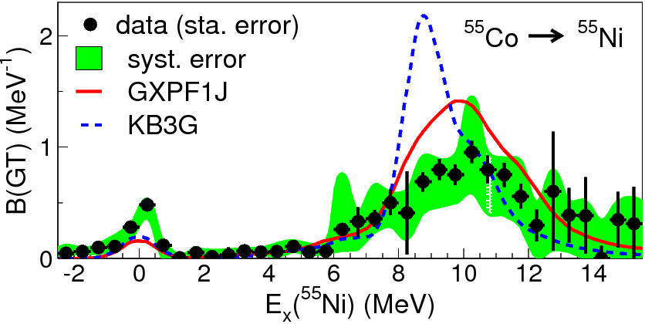
Questions: GT strengths from ⁵⁶Ni and ⁵⁵Co
Sasano et al.,
PRL107, 202501 (2011).
Remove one neutron
from parent & daughter
GXPF1A & KB3G
→ similar ground state prop.:
f7/2 70% in ⁵⁶Ni
, but large diff. in B(GT) of N=Z nuclei
Preliminary.
Point:
Along N=Z, B(GT) is sensitive to some part of interaction and showing two peaks.
Question:
What picture can intuitively explain the origin of the two peaks?
What interactions are underlying?

Slide 13
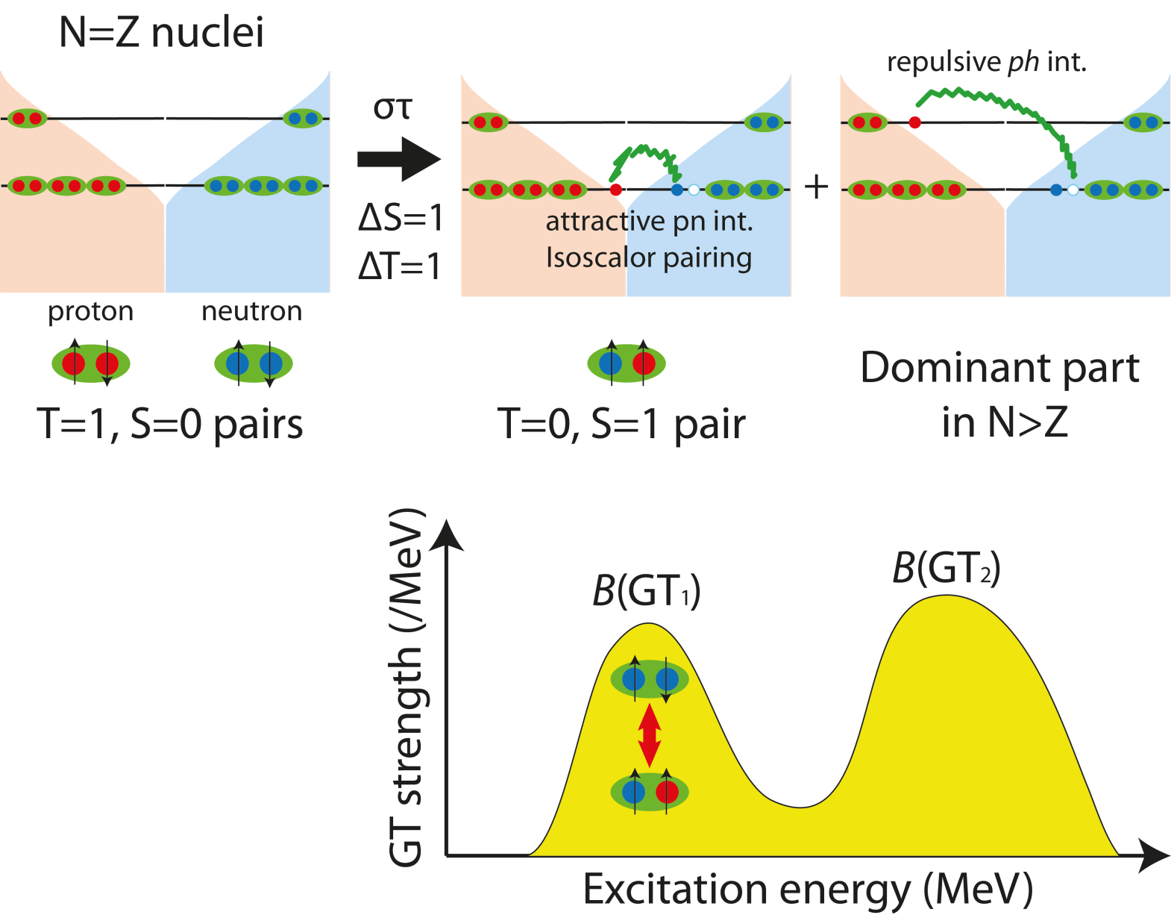
A new picture of GT resonance
Initial ground state
Filled with pp/nn (isovector) pair
GT transition
breaking a pair
Final state
particle-hole: repulsive
→ pushed up to higher energy
(well studied in stable nuclei)
particle-particle (pn): attractive
→ pushed down to lower energy
In collaboration with H. Sagawa, C. L. Bai et al. Details will be discussed by Bai-san.
The states in the lower peak is expected to form a T=0, S=1 pair (identical proton and neutron orbits)

Slide 14
Approach
Strength of
particle-particle
pn pair
(unknown)
Depth of the valley
(Deeper
→ more pn pairs)
Strength of
particle-hole
(well known in stable nuclei)
Different nuclei
→ Deeper valley → more pn pairs
→ Control effect of pn interaction
Enhance the relative strength of T=0 pair to particle-hole contribution
Needs to measure other two nuclei along N=Z and combine them with ⁵⁶Ni

Slide 15

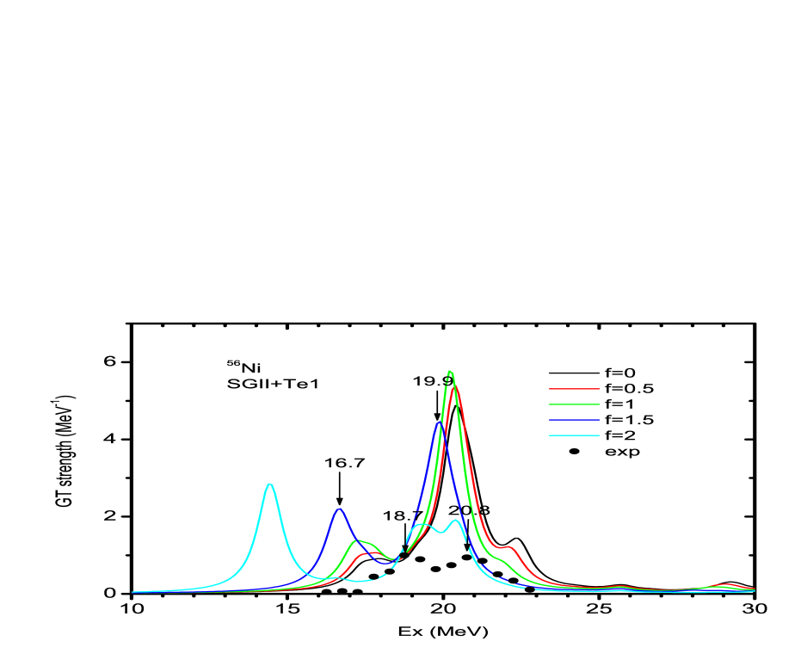
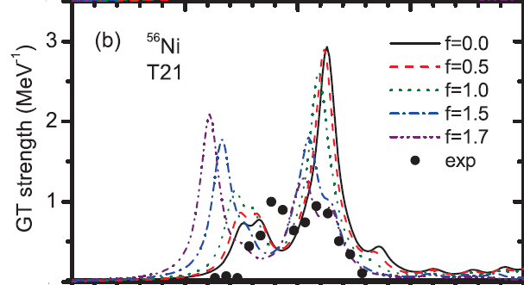
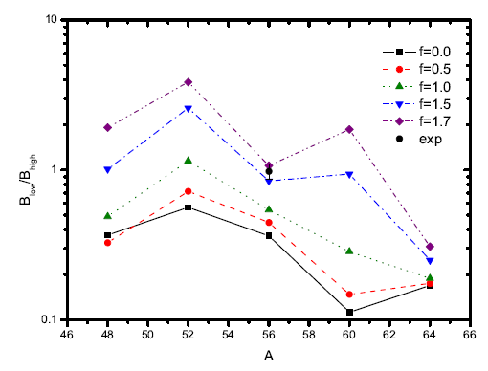
pn (T=0) effect along N=Z
Bai, Sagawa, et al., submitted to PRL
QRPA
Particle-particle
(pn pair) dominant
Particle-hole
dominant
Ex(MeV, from ⁵⁶Ni)
Proposing to measure B(GT)
on ⁴⁸Cr and ⁶⁴Ge
(4 neutrons and protons away from⁵⁶Ni)
for a wide (0-20 MeV) Ex region
→
Confirm the picture;
(nn → pn vibration )
Determine the strength of the pn pairing
B(GT1)/B(GT2)
Different pn strength
⁴⁸Cr
⁵⁶Ni
⁶⁴Ge
Mass number (A=2N=2Z)

Slide 16
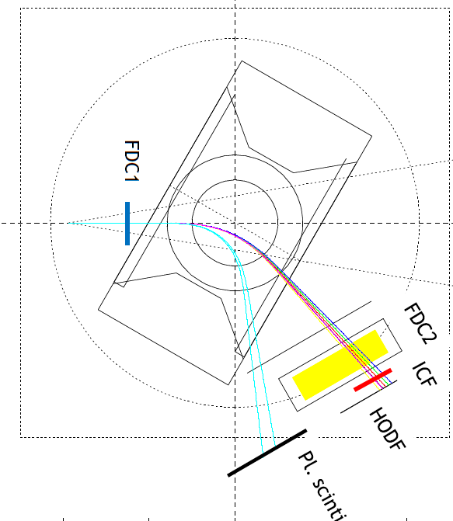
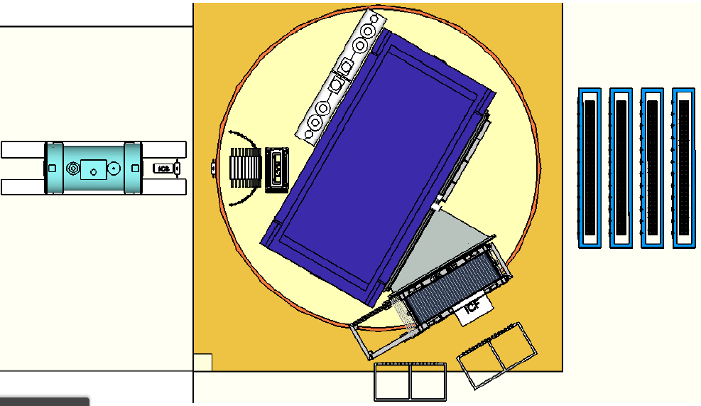
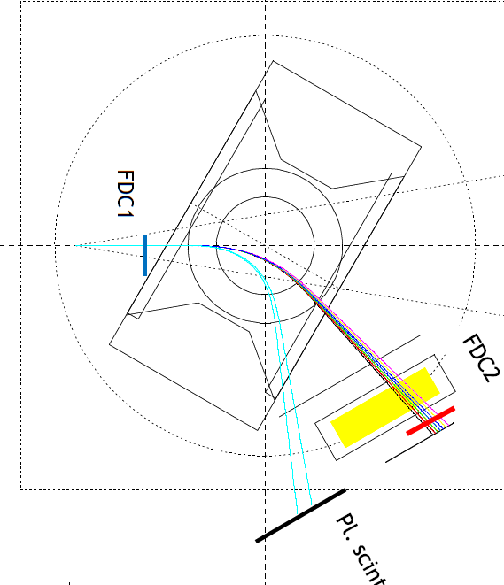
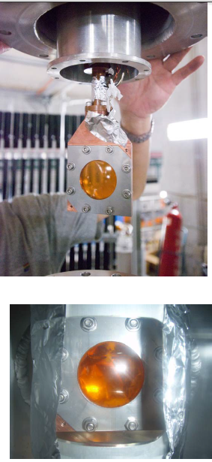
Experimental setup
Primary beam:
⁷⁸Kr@345 MeV/u, 3 pnA on Be (3 mm^{t})
w/ Al and C wedge at F1&F5
Secondary beams: 190 MeV/u
⁴⁸Cr (72%), ⁴⁷V(28%) w/ 2x10⁴ pps
⁶⁴Ge(57%), ⁶³Ga(43%) w/ 2x10⁴ pps
dp/p=+-0.5% (F1 slit)
fast neutrons
~ 200 MeV
Eff. 70%
Coverage : 40%
Trajectories
for charged particles from ⁴⁸Cr(p,n)
⁶⁴Ge(p,n)
NEBURA
ONE SETTING!
LH2 20 mm^{t}
40 mm phi
Heavy fragments
^{47,48}Mn, ^{46,47}Cr, ⁴⁶V, ⁴⁵Ti
⁶⁴As, ⁶³Ge, ⁶²Ga, ⁶¹Zn, ⁶⁰Cu, ⁴⁸Cr
Proton → just for b.g. study
Mass res. : 0.2, charge res.: 0.2

Slide 17
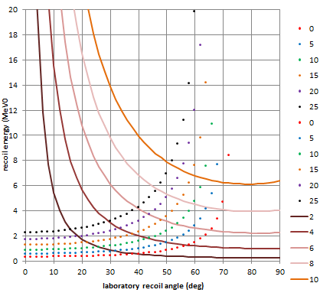
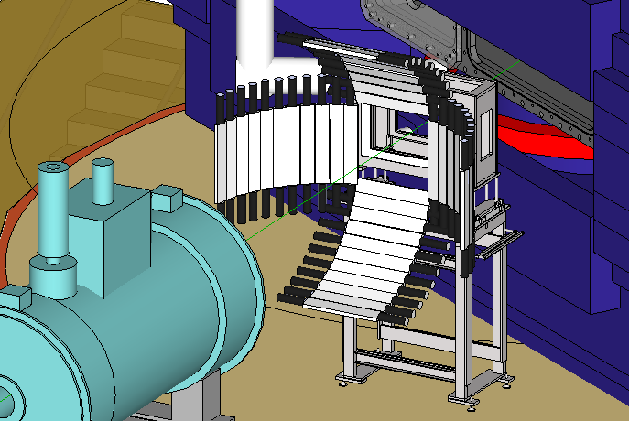
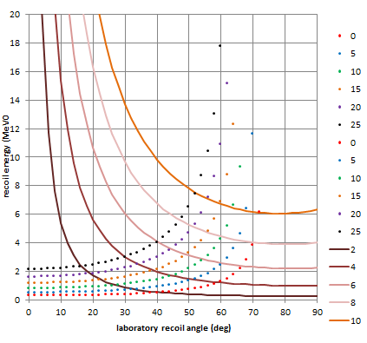
Slow neutron detector (WINDS)
⁶⁴Ge(p,n)⁶⁴As
⁴⁸Cr(p,n)⁴⁸Mn
Neutron det.
for 20 – 80 degs
(2-degs steps)
Covers : 0 – 20 MeV & 1 – 20 degrees in c.m.s.
The excitation energy resolution :
1 MeV ( << energy interval of the two peaks)
Overall (intrinsic + coverage) efficiency :
10—30% at forward angles (GEANT3 simulation)
Using these facilities/equipments, we will be able to perform the new (p,n) method in the most efficient way in the world!
→ Experiments were proposed in NPPAC11 and 4 days beam time for ⁴⁸Cr approved.

Slide 18
Summary
B(GT) on unstable nuclei → new effects, understanding structures, astrophysical applications
As shown in the ⁵⁶Ni case, N=Z nuclei are key for understanding nuclear structures as well as for constraining astrophysical calculation inputs.
An intuitive picture of a new excitation mode converting the nn (isovector, S=0) pairs into pn (isoscalar, S=1) pairs will be searched and confirmed from the measured strengths on ⁴⁸Cr (and ⁶⁴Ge) in conjunction with the existing data on ⁵⁶Ni.
We will be able to perform the study in a very efficient way by using;
  Neutron Detectors, WINDS
  The SAMURAI spectrometer
  A thick liquid Hydrogen target
  with a secondary beam at the best energy (200MeV) provided by the RIBF.

Slide 19
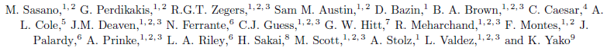
Collaboration
⁵⁶Ni(p,n) @ MSU
⁴⁸Cr, ⁶⁴Ge(p,n) @ RIKEN RIBF
T. Uesaka, J. Zenihiro, M. Dozono, H. Matsubara, T. Motobayashi, K. Yoneda, H. Sato, Y. Shimizu, H. Otsu, M. Nishimura, H. Sagawa, H. Sakai, N. Inabe,T. Kubo (RIKEN Nishina Center) , T. Kobayashi (Tohoku University), T. Nakamura, Y. Kondo (Tokyo Institute of Technology), K. Yako, S. Shimoura, S. Ota, S. Kawase, Y. Kubota, M. Takaki, S. Michimasa, K. Kisamori, C. Lee, H. Tokieda (CNS, University of Tokyo), R. G. T. Zegers, S. Noji (NSCL, Michigan State University),
T. Wakasa (Kyushu University), H. Sagawa (Aizu/RIKEN), C. L. Bai (Tituan Univ.)

