Slide 1
Study of the Isovector Spin Monopole Resonance via the (t,³He) Reactions at 300MeV/u
Kenjiro Miki (RCNP)

Slide 2
Collaborators
University of Tokyo
K. M. (→ Now in RCNP)
Hideyuki SAKAI
Kentaro YAKO
Shumpei NOJI
CNS, Univ. of Tokyo
Tomohiro UESAKA
Susumu SHIMOURA
Shin'ichiro MICHIMASA
Shinsuke OTA
Akito SAITO
Yoshiko SASAMOTO
Hiroyuki MIYA
Hiroshi TOKIEDA
Shoichiro KAWASE
RIKEN Nishina Center
Masaki SASANO
Hidetada BABA
Tetsuya OHNISHI
Hiroyuki TAKEDA
Naoki FUKUDA
Daisuke KAMEDA
Yoshiyuki YANAGISAWA
Toshiyuki KUBO
Kyoto University
Takahiro KAWABATA
University of Aizu
Hiroyuki SAGAWA
Michigan State Univ.
Remco G.T. ZEGERS
Sichuan University
Chunlin BAI
Univ. of Notre Dame
Georg P.A. BERG

Slide 3
1. Introduction

Slide 4
Giant resonances
Giant resonance
Collective motion of nuclei
Exhaust major part of sum-rule strength (e.g. >50%)
Related to bulk property of nuclei
Grouped by quantum number changes ΔL, ΔS and ΔT
isoscalar ΔT=0
isovector ΔT=1
ΔS=0
ΔS=1
ΔS=0
ΔS=1
n
isovector
spin
monopole
resonance
(IVSMR)
d
ΔL=0
p,n
p
p
(monopole)
n
ISGMR
ISSMR
IVGMR
IVSMR
ΔL=1
p
n
p
n
(dipole)
ISSDR
IVGDR
IVSDR
n
n
ΔL=2
p,n
p
p
(quadrupole)
ISGQR
ISSQR
IVGQR
IVSQR

Slide 5
Isovector Spin Monopole Resonance
the isovector spin monopole resonance (IVSMR)
IVSMR(β ⁺)
μ =+1
IVSM operator :
Quantum number :
ΔL=0, ΔS=1, ΔT=1, Δn=1 (2ℏω)
hole
transfer
p
p
n
particle
n
Significance
Shed light on the role of the spin-isospin degrees of freedom in nuclear matter → unexplored region
Test of the microscopic description of the nuclear structure → the effective N-N interaction in nuclei, especially the στ channel
Model independent sum-rule (future)
→ Neutron skin thickness → Selection of EoS of neutron matter
Status of experimental study
- Some signatures have been reported.
- But none of them clearly identify IVSMR.
Data are scarce especially for IVSMR(β⁺).

Slide 6
Identification of the IVSMR
IVSMR
Isovector (ΔT=1)
Spin-flip (ΔS=1)
Monopole (ΔL=0)
2ℏω excitation (Δn=1)
Comparison between:
(t,³He) reaction
and
(n,p) reaction
at the intermediate energy

Slide 7
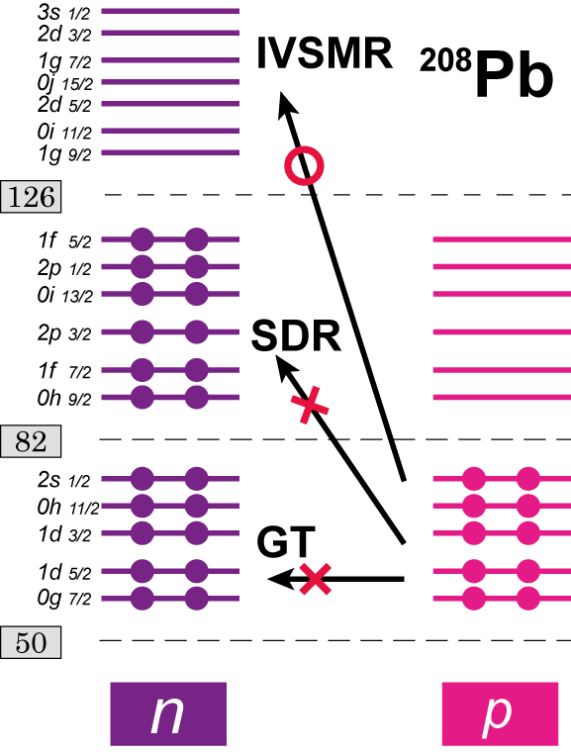
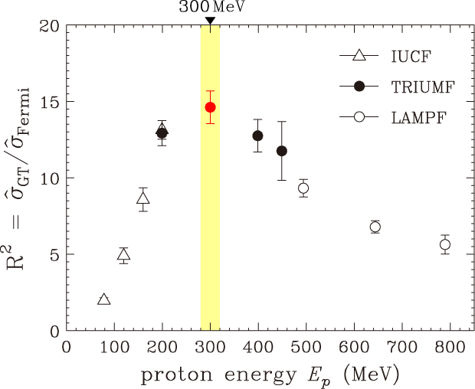
Identification of ΔT=1 and ΔS=1
IVSMR
Isovector (ΔT=1)
Spin-flip (ΔS=1)
Monopole (ΔL=0)
2ℏω excitation (Δn=1)
Isovector (ΔT=1)
(t,³He),(n,p) …charge-exchange
Spin-flip (ΔS=1)
Incident energy dependence of σ_{ΔS=1}/ σ_{ΔS=0}
(+SQR)
Selectively excite β ⁺ modes
IVSMR can be dominant in the β⁺ direction,
because most of GT,(SDR) are Pauli-blocked.
Selectively excite spin-flip modes.
W.G.Love , M.A.Franey : PRC 24 (1981) 1073

Slide 8
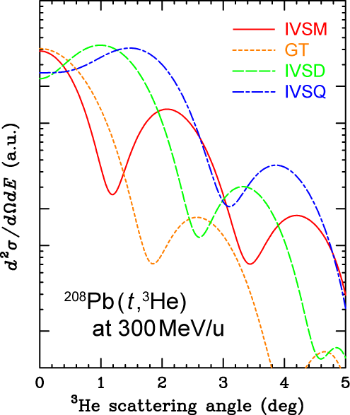
Identification of ΔL=0
IVSMR
Isovector (ΔT=1)
Spin-flip (ΔS=1)
Monopole (ΔL=0)
2ℏω excitation (Δn=1)
Multipole decomposition analysis (MDA) Angular distribution →characteristic dependence on ΔL
Forward peaking
ΔL=0
ΔL=1
ΔL=2
σ^{exp} is decomposed
into each ΔL component
by fitting the calculated cross section.
ΔL=0 component can be precisely extracted
because it has a unique forward-peaking nature.

Slide 9
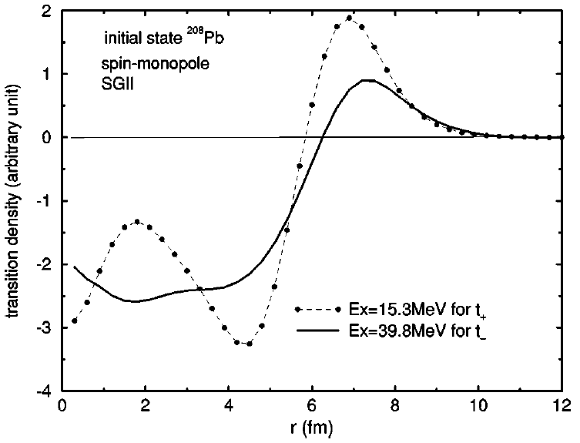
Identification of Δn=1
IVSMR
Isovector (ΔT=1)
Spin-flip (ΔS=1)
Monopole (ΔL=0)
2ℏω excitation (Δn=1)
Separation of GT(Δn=0) and IVSM(Δn=1)
(t,³He) -- IVSMR (large) + GT
(n,p) -- IVSMR (small) + GT
Different sensitivity on IVSMR → absorption effect
IVSMR should appear as a difference.
The transition density of IVSMR has a radial node.
Cross section
MeanFreePath
5 fm(transparent)
p & n (σ~small)
1.5 fm(absorptive)
³He & t (σ~large)
Radius r (fm)
Owing to the different sensitivity,
IVSM can be distinguished from GT.

Slide 10
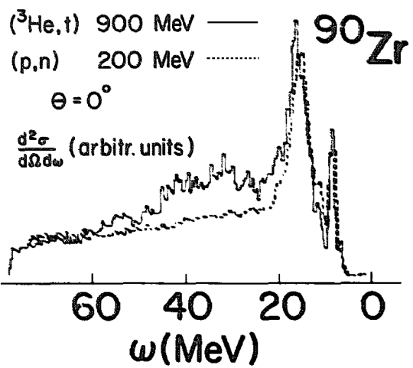
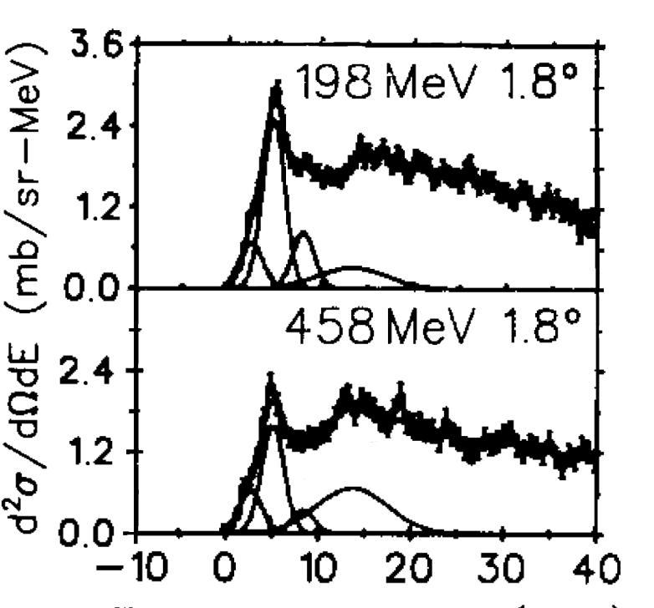
Previous Experiment
Brockstedt et. al.
NPA530(1991)571
IVSMR (β ⁻ ) ?
⁹⁰Zr(³He,t) .vs. ⁹⁰Zr(p,n)
Enhancement for (³He,t) → Signature of IVSMR Similar structure also for ⁵⁴Fe, ²⁰⁸Pb Good example of absorption effect
But, other excitations can also be enhanced. → ΔL=0 must be extracted via the multipole decomposition analysis.
(³He,t)
(p,n)
Absorptive
Transparent
Need to compare the extracted ΔL=0 components
Moinester et. al.
PLB230(1989)41
IVSMR (β ⁺) ?
²⁰⁸Pb(n,p) 458MeV .vs. 198MeV
A bump at 15MeV, but not uniquely identified as the IVSMR.
transparent
-- low statistical accuracy
-- insufficient absorption effect
absorptive
Other pioneering works:
Guillot et. al. , PRC73(2006)014616 ← KVI
Guess et. al. , PRC83(2011)064318 ← NSCL
?
Not exclusively identify the IVSMR(β⁺)

Slide 11
This experiment
Purpose : Identify the IVSMR (β ⁺) exclusively
Experiment : ²⁰⁸Pb,⁹⁰Zr(t,³He) reaction @ 300MeV/u
Performed at RI Beam Factory (RIBF) at RIKEN Triton at 300MeV/u → Feasible only at RIBF
Double-differential cross section spectra were measured at 0 < Ex < 40MeV and at 0 < θ < 4deg.
Analysis/Discussion :
ΔL=0 component was extracted via the multipole decomposition analysis.
Through the comparison with the previous (n,p) spectra, the IVSMR is exclusively identified.
Comparison between:
(t,³He) reaction
and
(n,p) reaction
at the intermediate energy
This work (at 300MeV/u)
Already measured
at RCNP and TRIUMF

Slide 12
2. Experiment

Slide 13
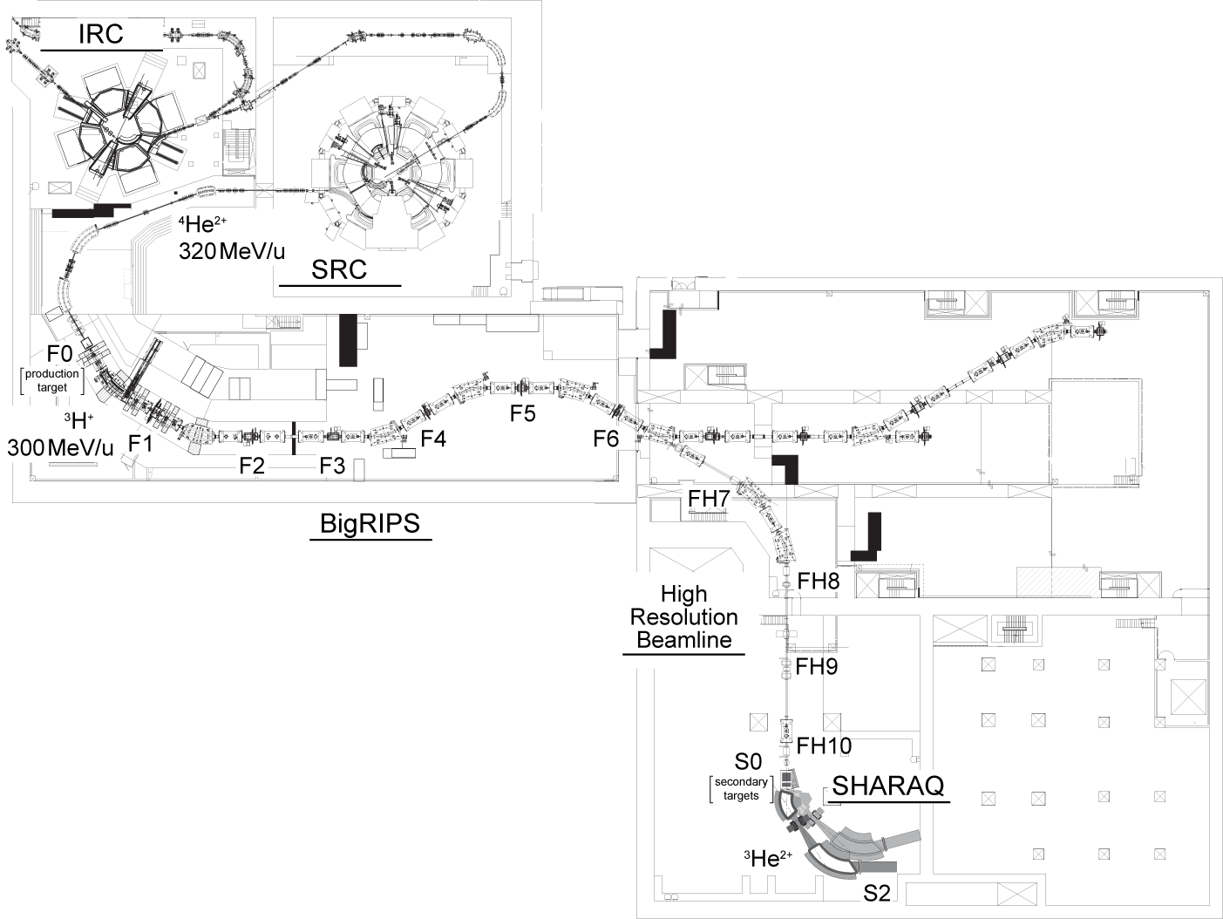
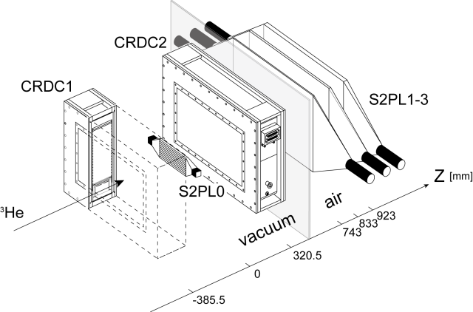
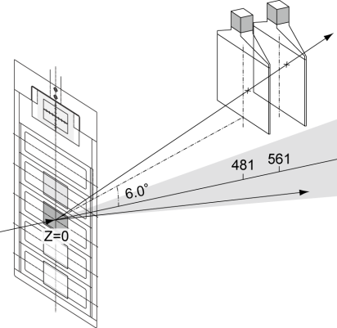
Experiment
RI Beam Factory (RIKEN)
⁴He²⁺
320MeV/u
300pnA
Production
Target
⁹Be 4cm
Achromatic transport
³H⁺
300MeV/u
10⁷pps
Beam tuning, Calibration of Ion Optics
PPAC, MWDC, Plastic
Purity > 99%
Momentum Slit
|Δp/p| = 1/2600 (0.6MeV)
Angular Collimator
|θ_{F2}|<15mrad
Secondary Target
²⁰⁸Pb,⁹⁰Zr,CH₂
³He²⁺
CRDC, Plastic

Slide 14
Experimental Conditions
Beam
Primary : ⁴He 320MeV/u 300pnA Secondary : triton 300MeV/u 1x10⁷pps
Purity > 99%
Measured Spectra
²⁰⁸Pb(t ,³He) ²⁰⁸Tl
⁹⁰Zr (t ,³He) ⁹⁰Y
CH₂(t ,³He)
Resolution (FWHM)
ΔE = 2.5MeV - Spread of secondary beam – 1.8MeV - Energy loss in target – 1.6MeV
Δθ = 0.5deg
- Spread of secondary beam – 8mrad
- Multiple scattering in target – 5mrad
Error bars
Statistical accuracy – 3% (for 0.15msr ・1MeV –bin)
Systematic accuracy – 7%
@
0 ≲ E_{x} ≲ 40MeV
0 ≲ θ ≲ 4°

Slide 15
3. Results/Discussion

Slide 16
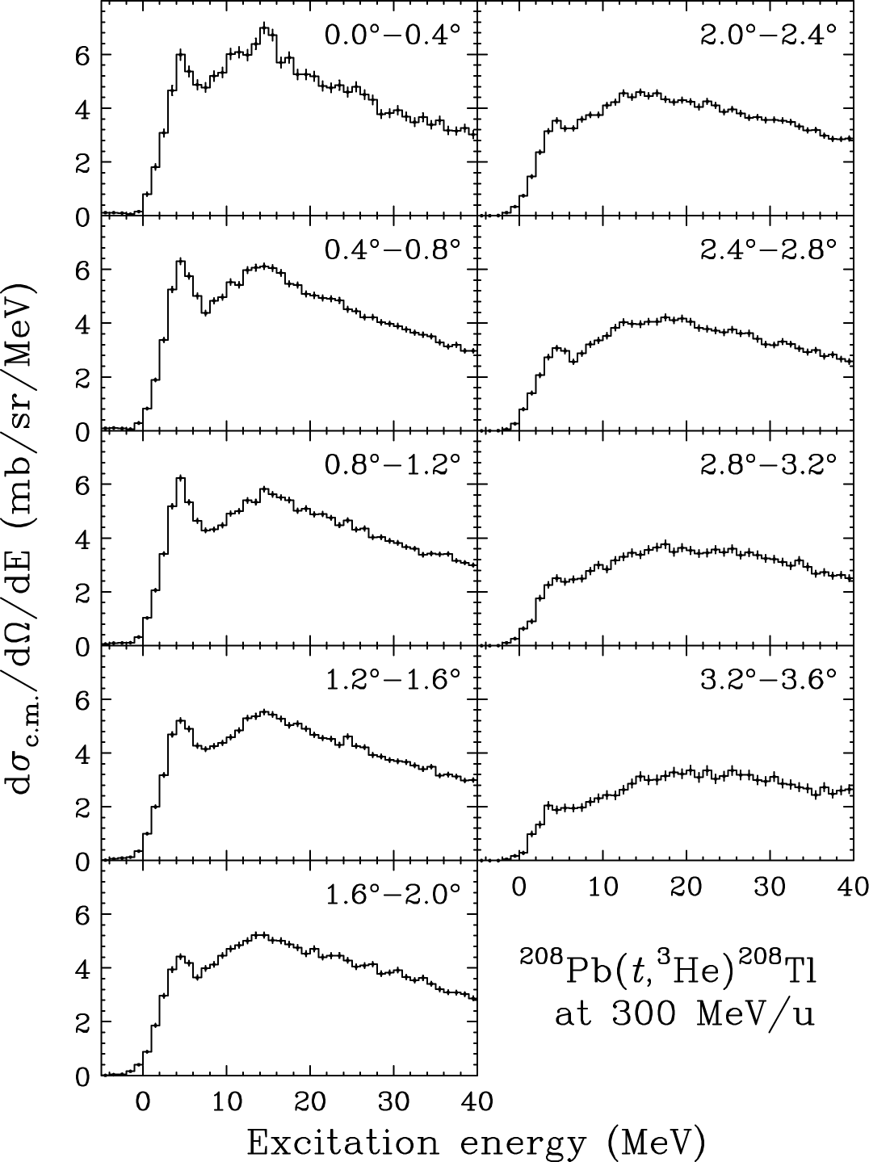
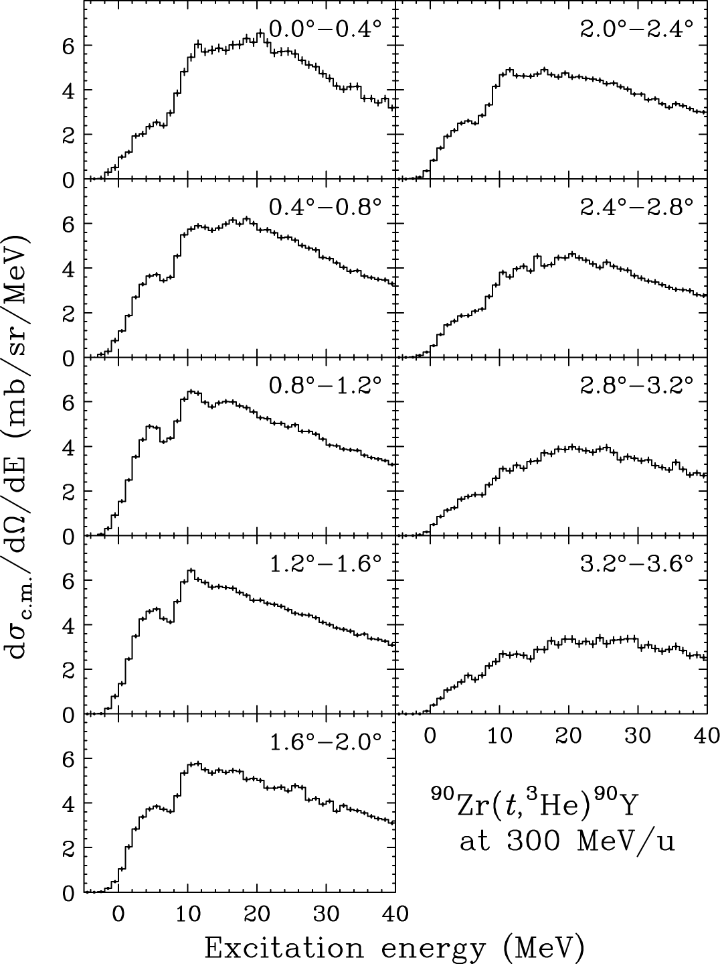
Measured double-differential cross section
²⁰⁸Pb(t,³He)
⁹⁰Zr(t,³He)

Slide 17
Multipole Decomposition Analysis (MDA)
Angular distribution calc. – DWBA (FOLD)
1p1h configuration
²⁰⁸Pb -- (particle) sdgi shell : (hole) sdg shell
⁹⁰Zr -- (particle) sdg, pfh shell : (hole) sd, pf shell
Single particle wave function
Woods-Saxon Potential
N-N interaction
Franey-Love effective t-matrix 325 MeV
Optical Potential
Double folding of CEG07b (G-Matrix interaction)
χ² fitting
DWBA calculation
ΔJ^{π} = 1⁺ (ΔL=0)
0⁻ ,1⁻ ,2⁻ (ΔL=1)
3⁺ (ΔL=2)
4⁻ (ΔL=3)
5⁺ (ΔL=4)
χ² fitting to the experimental angular distribution
→Determine each ΔL component

Slide 18
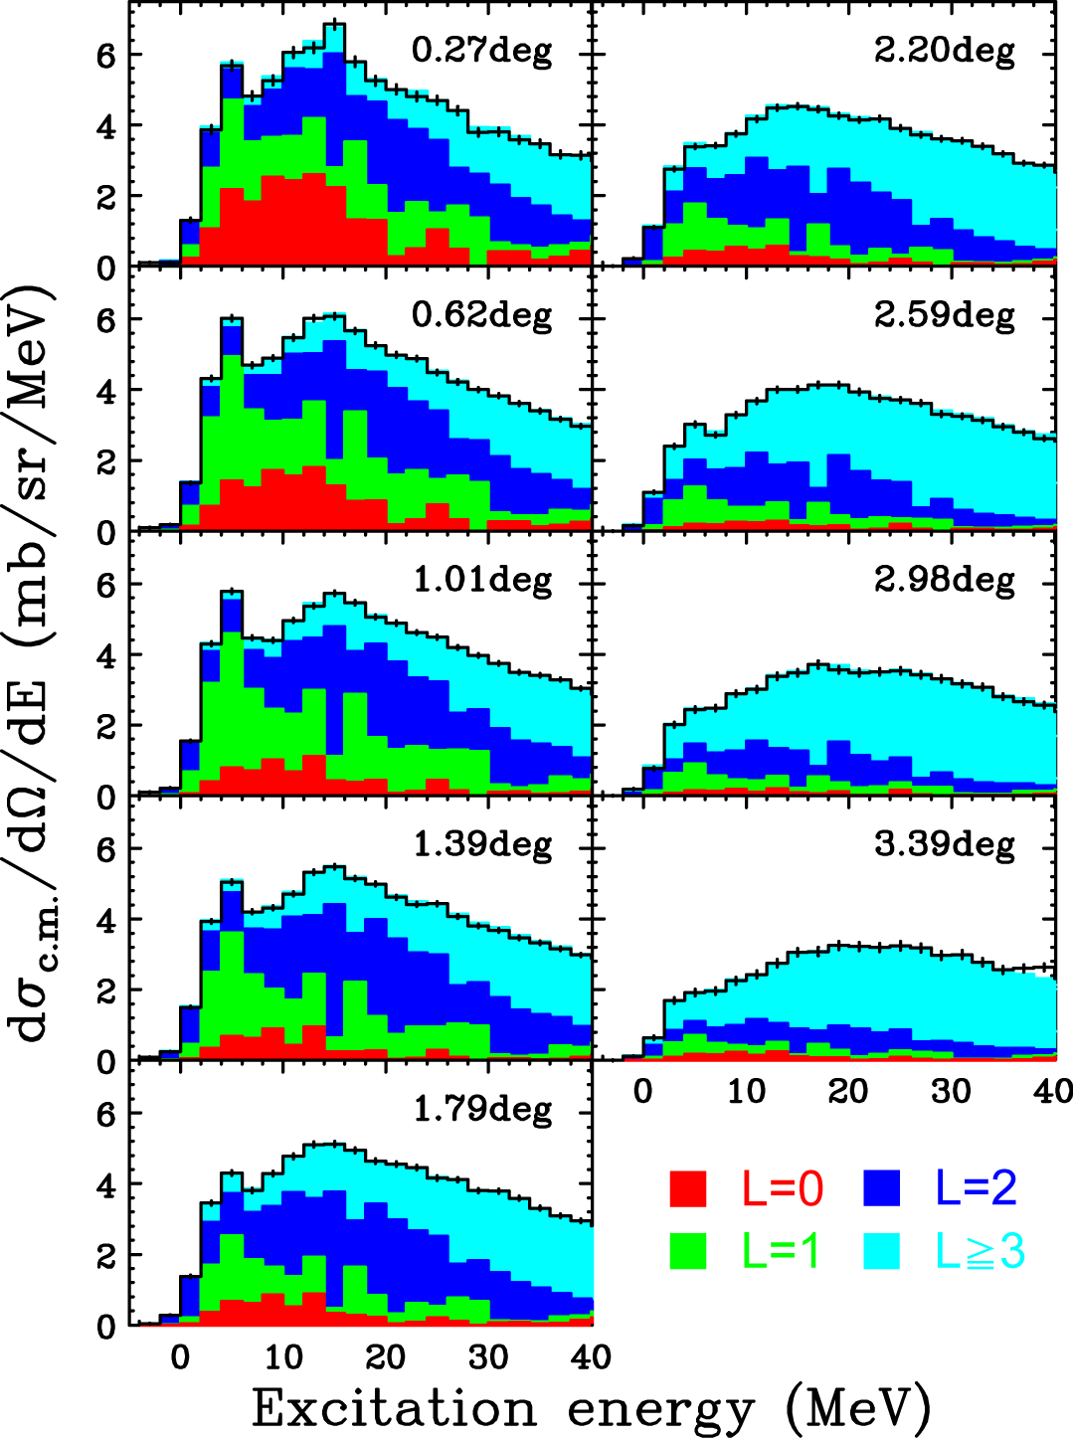
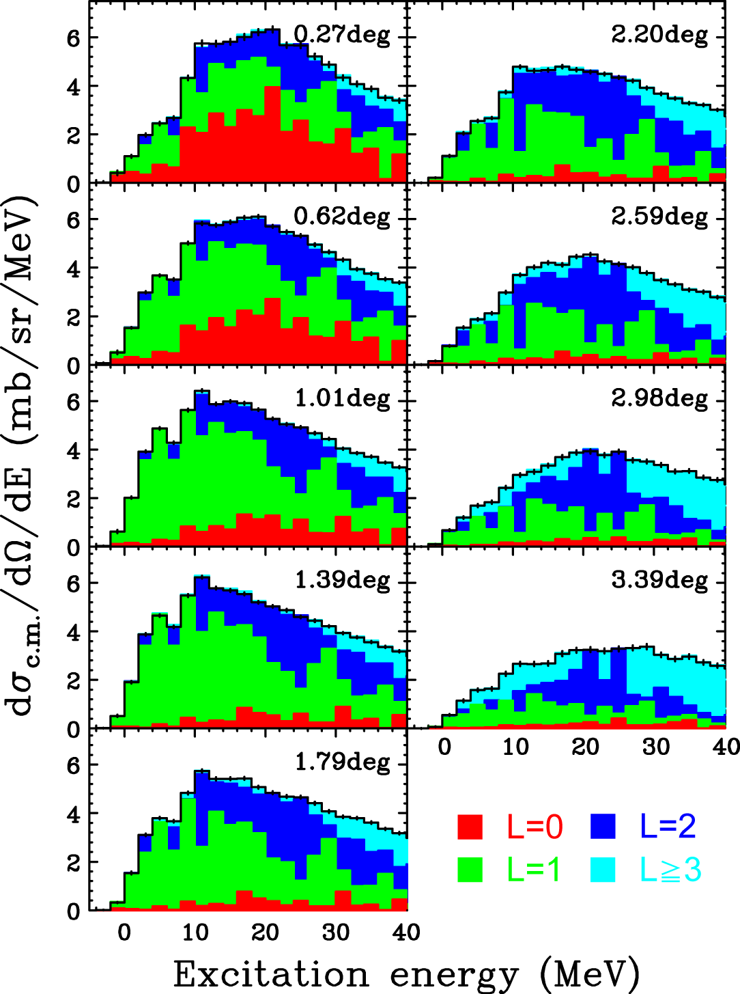
Results of MDA
²⁰⁸Pb(t,³He)
⁹⁰Zr(t,³He)

Slide 19
Results of MDA
²⁰⁸Pb(t,³He)
⁹⁰Zr(t,³He)
Red region corresponds to
ΔL=0, ΔS=1, ΔT=1
Still need to extract Δn=1

Slide 20
Identification of the IVSMR
Δn=1 : Comparison between (t,³He) and (n,p)
(t,³He)_{ΔL=0} = GT + IVSMR(Large)
(n,p)_{ΔL=0} = GT + IVSMR(Small)

Slide 21
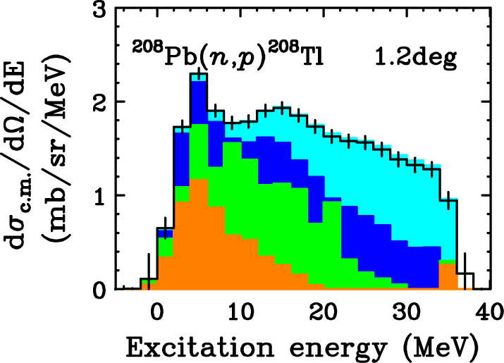
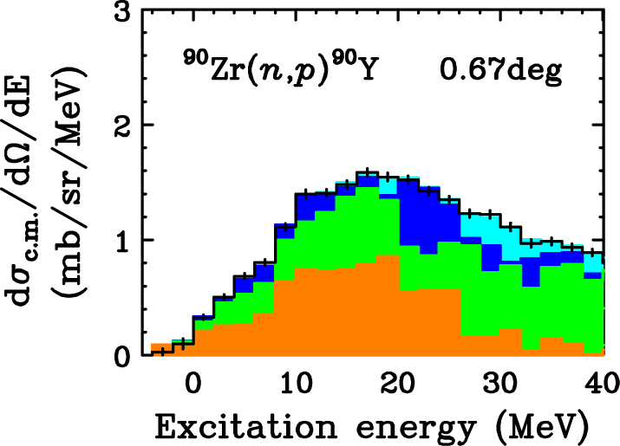
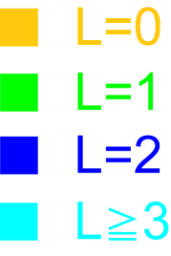
Identification of the IVSMR
Δn=1 : Comparison between (t,³He) and (n,p)
(t,³He)_{ΔL=0} = GT + IVSMR(Large)
(n,p)_{ΔL=0} = GT + IVSMR(Small)
Reanalyze previous (n,p) data by FOLD-MDA
[ The same condition as (t,³He) analysis]
Raywood et.al. (TRIUMF)
NPA 625(1997)675
Yako et.al. (RCNP)
PLB 615(2005)193

Slide 22
Identification of the IVSMR
Δn=1 : Comparison between (t,³He) and (n,p)
(t,³He)_{ΔL=0} = GT + IVSMR(Large)
(n,p)_{ΔL=0} = GT + IVSMR(Small)
²⁰⁸Pb | 1.57
⁹⁰Zr | 1.83
Normalize
GT component
NPA530(1991)571
Reanalyze previous (n,p) data by FOLD-MDA
[ The same condition as (t,³He) analysis]
Raywood et.al. (TRIUMF)
NPA 625(1997)675
Yako et.al. (RCNP)
PLB 615(2005)193

Slide 23
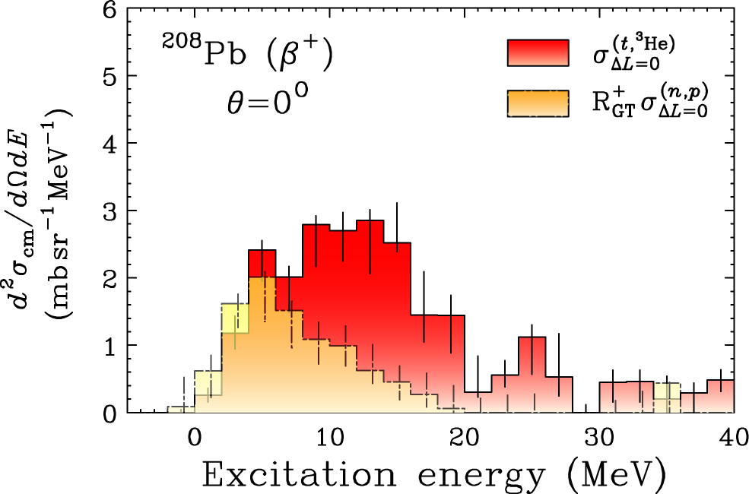
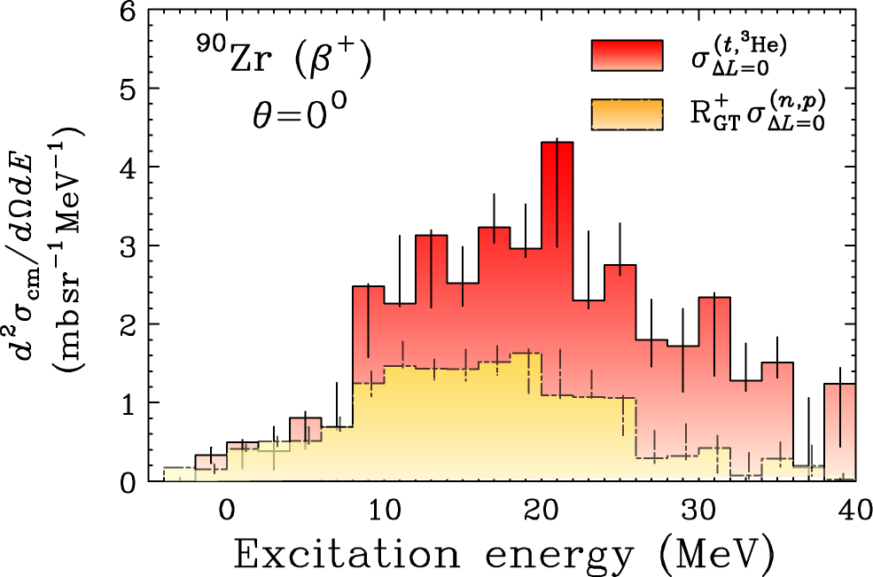
Identification of the IVSMR
Δn=1 : Comparison between (t,³He) and (n,p)
(t,³He)_{ΔL=0} = GT + IVSMR(Large)
(n,p)_{ΔL=0} = GT + IVSMR(Small)
²⁰⁸Pb | 1.57
⁹⁰Zr | 1.83
Normalize
GT component
NPA530(1991)571
(t,³He) .vs. (n,p)
(TRIUMF data)
(RCNP data)
Large enhancement for (t,³He) → Clearest identification of the IVSMR(β⁺)

Slide 24
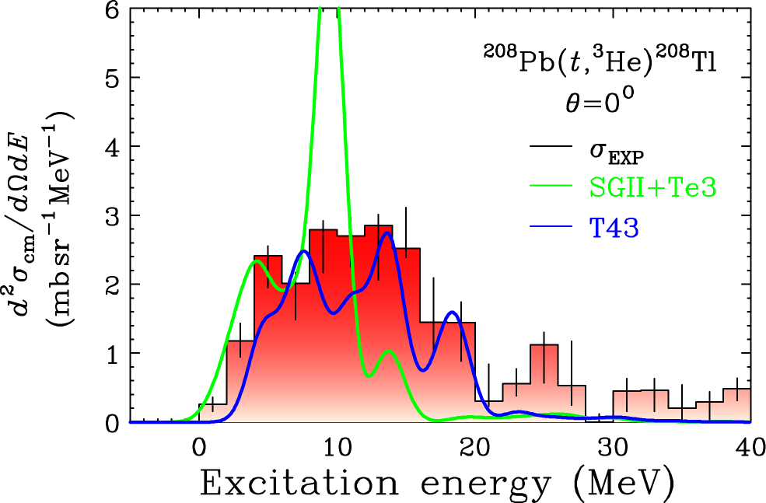
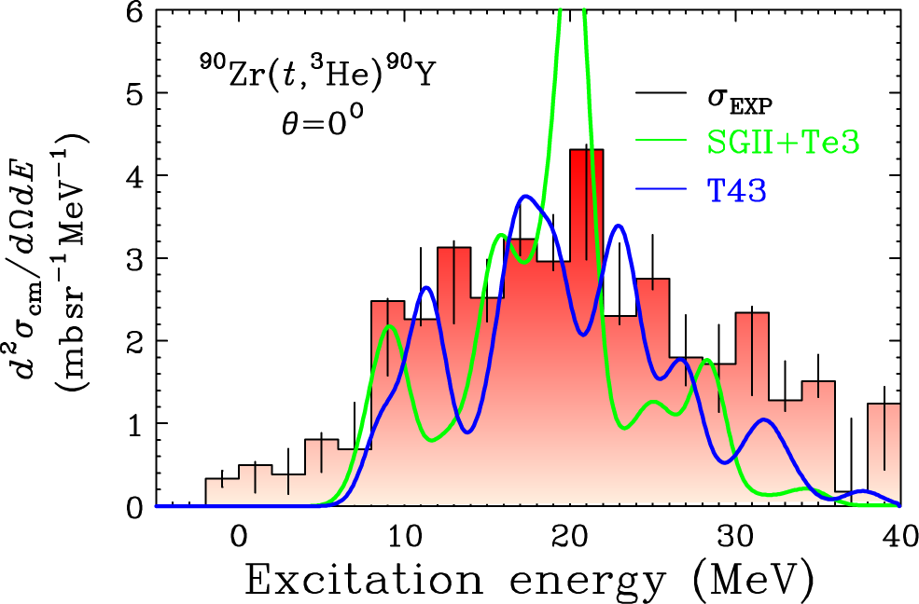
Comparison with Theory (HF-QRPA+DWBA)
Theory – DWBA calc. by the program FOLD
Target wave function (J^{π}=1⁺ states) self-consistent HF-RPA : Bai, Sagawa et. al.
Effective interactions : SGII+Te3 and T43
SGII+Te3 Shows concentration of the cross section in a narrow region. Does not reproduce the exp. Data.
T43 Reproduce the overall distribution well.
 | Exp. (mb/sr) | Theo.(T43) (mb/sr) | Exp./Theo. (%)
²⁰⁸Pb | 48 ± 5 | 31 | 160
⁹⁰Zr | 77 ± 8 | 51 | 151
σ_{integ.}
T43 provides a good description.
Further theoretical study is now in progress.
(C.L.Bai, H.Sagawa and K.Miki)

Slide 25
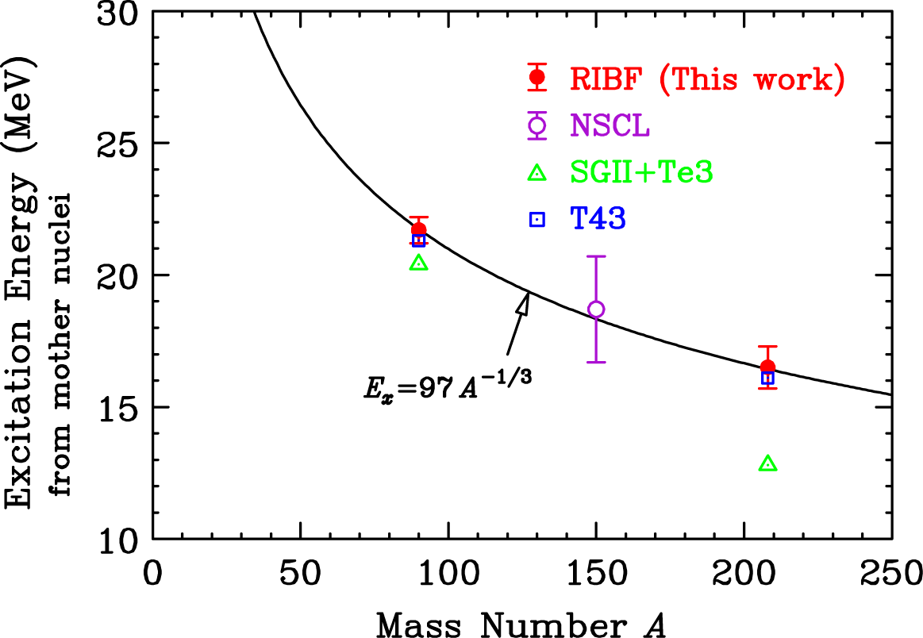
Systematics of ΔL=0 cross section
Average energy of ΔL=0 cross section
T43 calc. well reproduces our results.
Fitting with A^{-1/3} dependence → E_{x} = 97A^{-1/3}
Larger than typical value : 2ℏω = 80A^{-1/3}
→
Implying the repulsive nature of the spin-isospin channel

Slide 26
Comment on Tensor ?
Large amount of GT?
Red → IVSM
Orange → contains GT
(TRIUMF data)
(RCNP data)
Exp : 10% ←→ Theo. : ~0%

Slide 27
Conclusion
The isovector spin monopole resonance (IVSMR) is very important. It is closely related to the fundamental property of nuclei.
The double-differential cross sections for the ²⁰⁸Pb, ⁹⁰Zr(t,³He) reactions at 300MeV were measured at 0 ≦ E_{x} ≦ 40 MeV and 0 ≦ θ ≦ 4 deg.
The MDA was applied to both of our (t,³He) and previous (n,p) spectra, and the ΔL=0 components were extracted. From their comparison, the IVSMR was distinguished from GT. This results provide the clearest identification of the IVSMR(β⁺).
The measured ΔL=0 cross section was well reproduced by the HF-QRPA+DWBA calculation with the effective interaction T43.
The average energy of ΔL=0 cross section at 0deg was given by 97A^{-1/3}. Represents the repulsive nature of the spin-isospin channel.

Slide 28
supplimentary

Slide 29
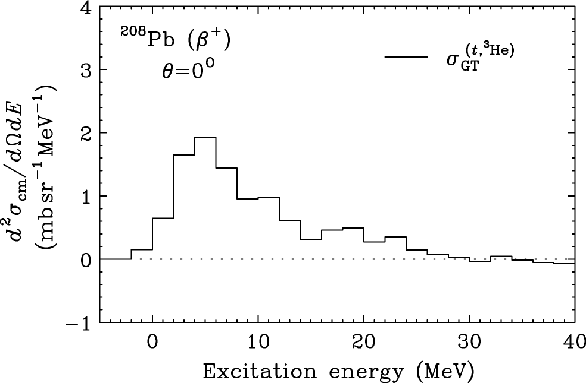
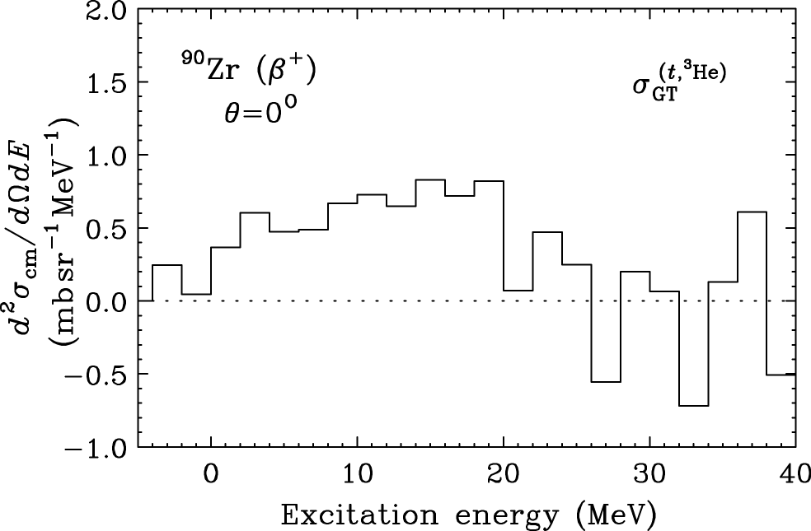
GT Cross Section
We have been seriously concerned about the large amount of GT cross sections
21.02 mb/sr
13.27 mb/sr
Unit cross section
1.91*1.57
= 3.0 mb/sr
3.4*1.83
= 6.2 mb/sr
B(GT)
7.0
2.1
wo F(q,ω)
Tensor
Tensor
w/o with
T21 0.37 0.649
T32 0.49 0.66
T43 0.655 0.671
T54 0.78 0.71
SGII+Te1 0.798 0.84
SGII+Te2 0.798 0.721
SGII+Te3 0.798 0.748
w/o with
T21 0.439 0.443
T32 0.471 0.463
T43 0.495 0.485
T54 0.53 0.507
SGII+Te1 0.488 0.506
SGII+Te2 0.488 0.479
SGII+Te3 0.488 0.484
Theory
(Bai-san,Sagawa-san)

Slide 30
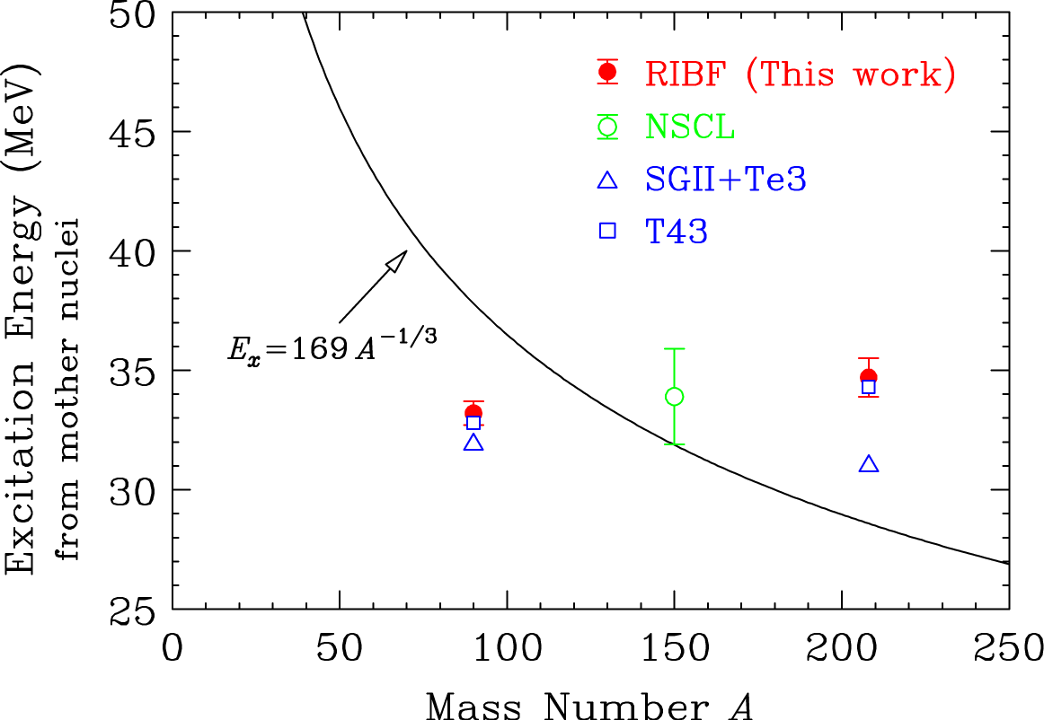
Systematics of ΔL=0 cross section
Average energy of ΔL=0 cross section
Add Coulomb energy difference E_{coul} = Ex(IAS)
Fitting with A^{-1/3} dependence → E_{x} = 169A^{-1/3}
(But needs additional terms.)
Still Larger than typical value : 2ℏω = 80A^{-1/3}
Cf. isovector monopole (T=1, Tz=0)
E_{x} = 170A^{-1/3}

