Slide 1
Reaction Plane Calibration
21th Jul 2012
Maki KUROSAWA for VTX

Slide 2
Reaction Plane Calibration Status
Currently, calibration parameters were generated aggregated run by run and segment by segment.
1) Run-by-run : calibration parameters were generated from segment number 9000.
This calibration parameter set was applied for other segment files.
2) Seg-by-seg : calibration parameters were generated segment by segment.
Each segment file has own calibration parameters.
Checked <cos nΨ> and <sin nΨ> of segment number dependency in both case.
Status
 | <cos nΨ> and <sin nΨ> | Raw v2 and v2
run-by-run (case 1) | Seg. Dependence unstable | Seg. Dependence unstable
seg-by-seg (case 2) | Seg. Dependence stable | Seg. Dependence stable

Slide 3
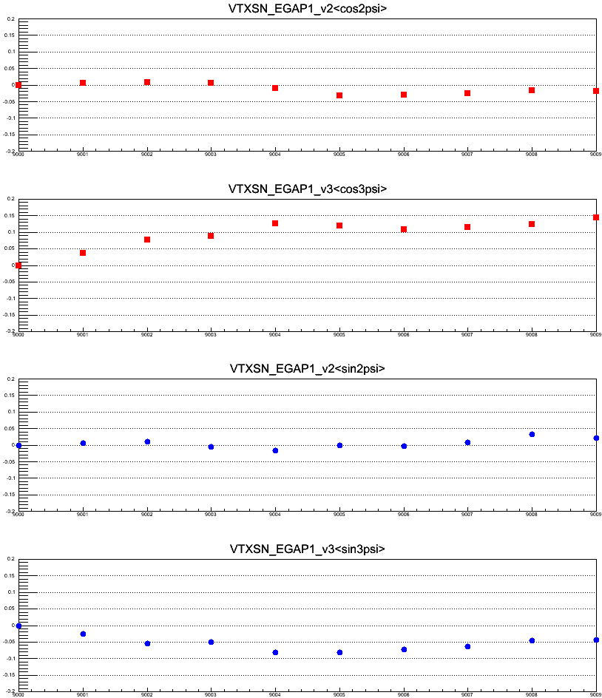
QA : Segment Dependence of <cos nΨ>, <sin nΨ> (SVX-SN)
Use calibration parameters that are created by using segment 9000.
v2
Run349667
0.2
<cos(2(Ψ_{SVX(SN)}))>
-0.2
9002
9004
9006
9008
cos term
9000
v3
<cos(3(Ψ_{SVX(SN)}))>
v2
<sin(2(Ψ_{SVX(SN)}))>
sin term
v3
<sin(3(Ψ_{SVX(SN)}))>
segment number

Slide 4
QA : Segment Dependence of <cos nΨ>, <sin nΨ> (SVX-SN)
Use calibration parameters that are created by using segment 9000.
v2
Run349667
0.2
<cos(2(Ψ_{SVX(SN)}))>
-0.2
9002
9004
9006
9008
cos term
9000
v3
<cos(3(Ψ_{SVX(SN)}))>
Ncluster_egap2
segment number

Slide 5
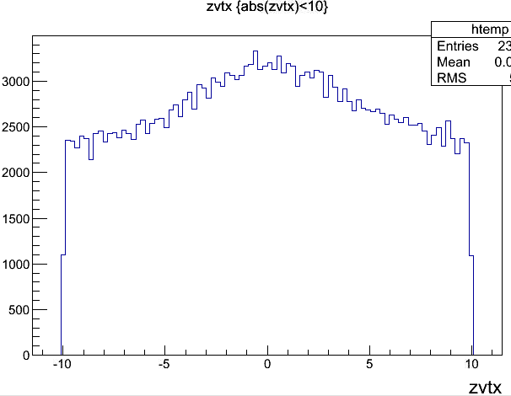
QA : ZVTX Dependence of Q_weight (number of clusters for SVX)
counts
counts
counts
-10cm 10cm
cm

Slide 6
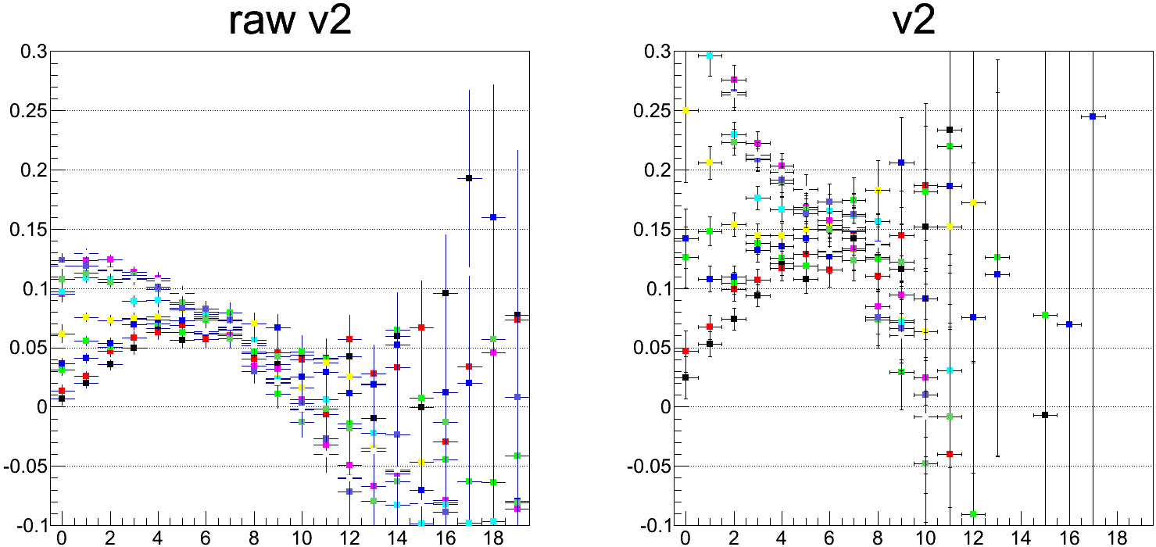
Raw V2 and Corrected V2 Distribution (Run349667)
Use calibration parameters that are created by using segment 9000.
Reaction plane : SVX-SN Egap-2
Track : CNT
2 < pT GeV/c < 3
9000
9001
9002
9003
9004
9005
9006
9007
9008
9009
centrality
centrality
Raw v2 for each segment are unstable.

Slide 7
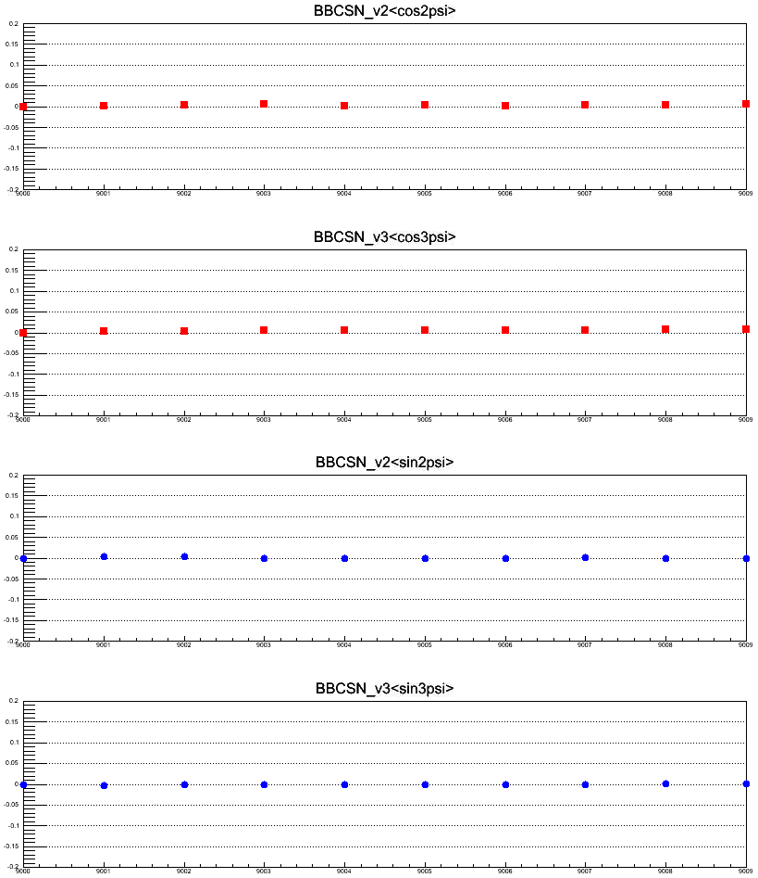
QA : Segment Dependence of <cos nΨ>, <sin nΨ> (BBC-SN)
Use calibration parameters that are created by using segment 9000 (~360k events).
v2
Run349667
0.2
<cos(2(Ψ_{SVX(SN)}))>
-0.2
9002
9004
9006
9008
cos term
9000
v3
<cos(3(Ψ_{SVX(SN)}))>
v2
<sin(2(Ψ_{SVX(SN)}))>
sin term
v3
<sin(3(Ψ_{SVX(SN)}))>
segment number

Slide 8
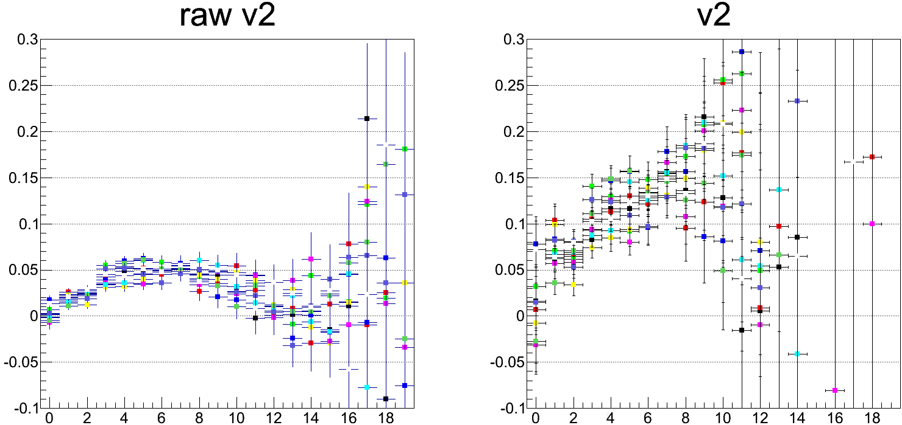
Raw V2 and Corrected V2 Distribution (Run349667)
Use calibration parameters that are created by using segment 9000.
Reaction plane : BBC-SN
Track : CNT
2 < pT GeV/c < 3
9000
9001
9002
9003
9004
9005
9006
9007
9008
9009
centrality
centrality
Raw v2 for each segment are stable.

Slide 9
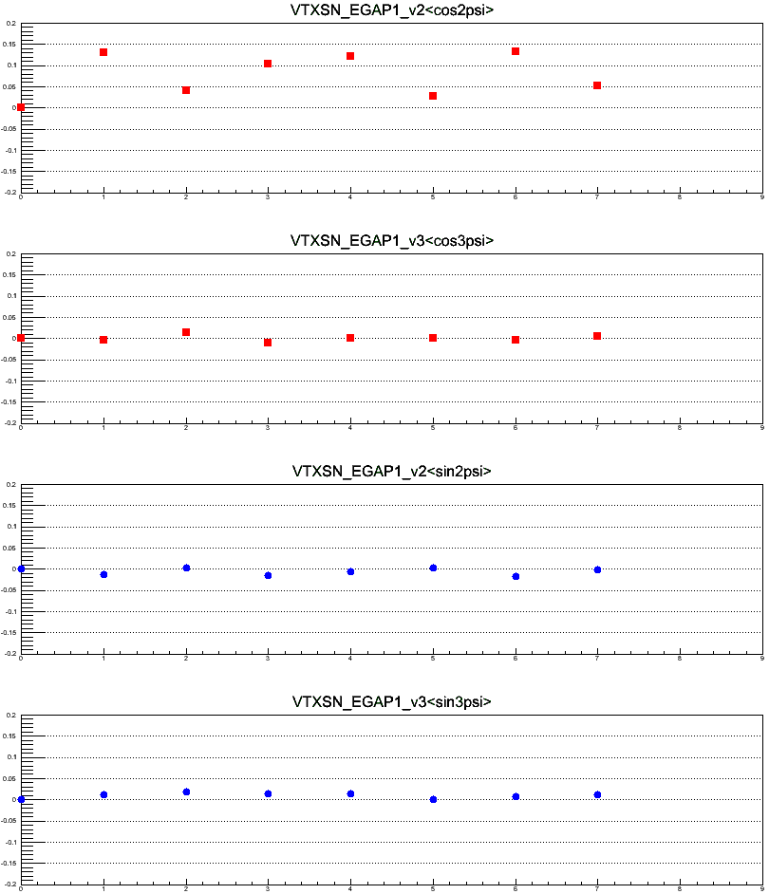
QA : Segment Dependence of <cos nΨ>, <sin nΨ> (SVX-SN)
Use calibration parameters that are created by using segment 9000-0 (36k events).
v2
Run349667
0.2
<cos(2(Ψ_{SVX(SN)}))>
-0.2
9000-2
9000-4
9000-6
9000-8
cos term
9000-0
<cos(3(Ψ_{SVX(SN)}))>
v2
<sin(2(Ψ_{SVX(SN)}))>
sin term
v3
<sin(3(Ψ_{SVX(SN)}))>
segment number

Slide 10
QA : Segment Dependence of <cos nΨ>, <sin nΨ> (SVX-SN)
Use calibration parameters that are created by using segment 9000-0.
v2
Run349667
0.2
<cos(2(Ψ_{SVX(SN)}))>
-0.2
9000-2
9000-4
9000-6
9000-8
cos term
9000-0
<cos(3(Ψ_{SVX(SN)}))>
v2
Ncluster_egap2
segment number

Slide 11
Segment by Segment

Slide 12
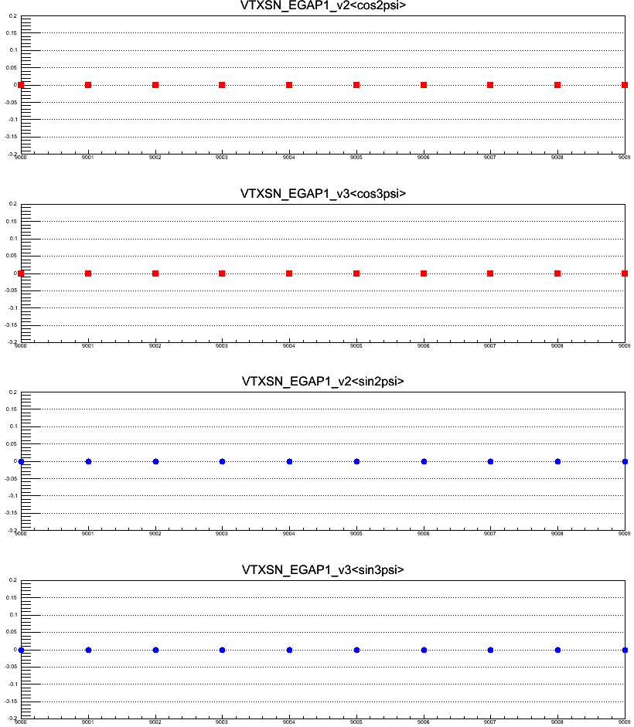
QA : Segment Dependence of <cos nΨ>, <sin nΨ> (SVX-SN)
Useed calibration parameters that are created segment by segment.
v2
Run349679
0.2
<cos(2(Ψ_{SVX(SN)}))>
-0.2
9002
9004
9006
9008
cos term
9000
v3
<cos(3(Ψ_{SVX(SN)}))>
v2
<sin(2(Ψ_{SVX(SN)}))>
sin term
v3
<sin(3(Ψ_{SVX(SN)}))>
segment number

Slide 13
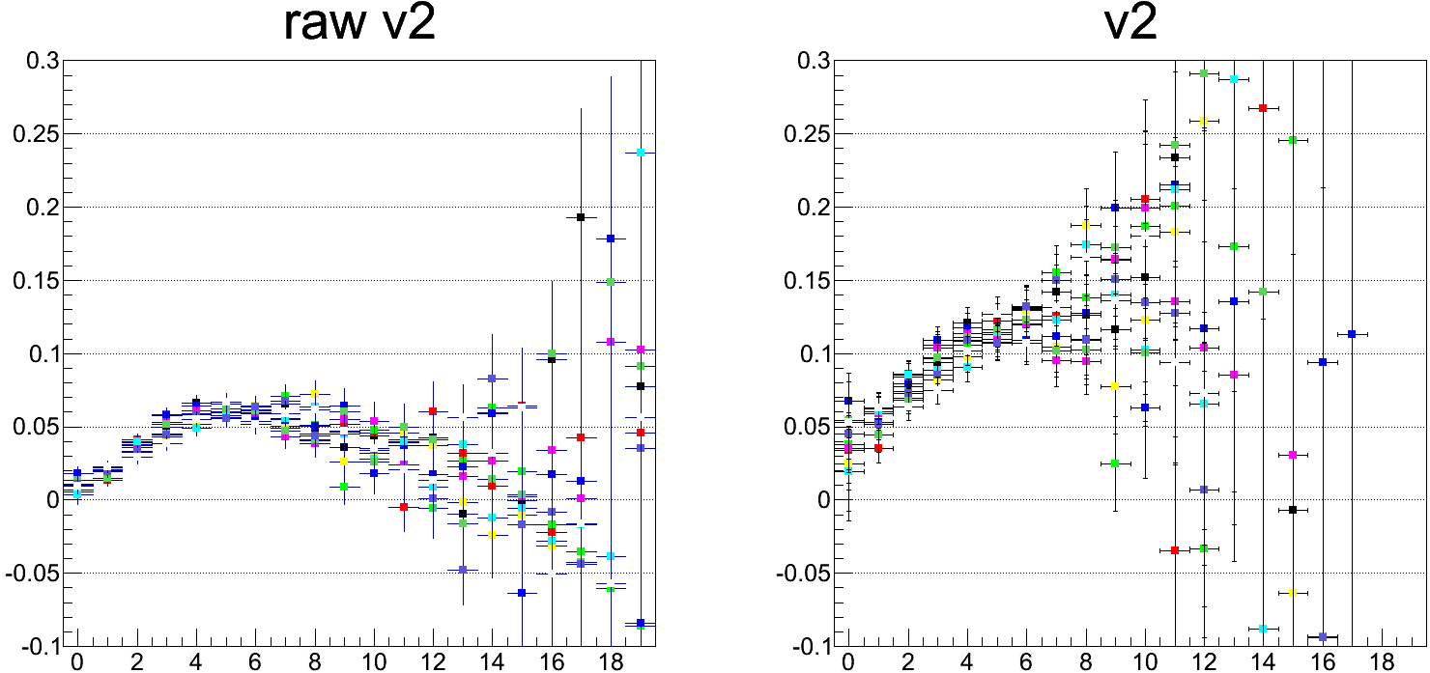
Raw V2 and Corrected V2 Distribution (Run349667)
Use calibration parameters that are created for each segment
Reaction plane : SVX-SN Egap-2
Track : CNT
2 < pT GeV/c < 3
9000
9001
9002
9003
9004
9005
9006
9007
9008
9009
centrality
centrality
Raw v2 for each segment are stable.

Slide 14
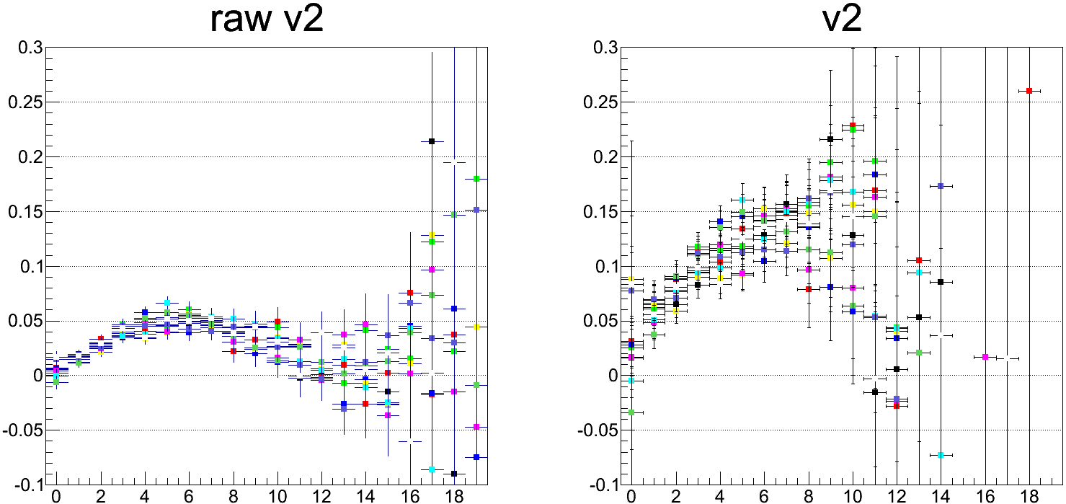
Raw V2 and Corrected V2 Distribution (Run349667)
Use calibration parameters that are created for each segment.
Reaction plane : BBC-SN
Track : CNT
2 < pT GeV/c < 3
9000
9001
9002
9003
9004
9005
9006
9007
9008
9009
centrality
centrality
Raw v2 for each segment are stable.

Slide 15
BACKUP SLIDES

Slide 16
Reaction Plane Class
 | South |  |  |  |  |  |  | North
eta region | -3<=eta<-2.5 | -2.5<=eta<-2 | -2<=eta<-1.5 | -1.5<=eta<-1 | -1<=eta<-0.5 | -0.5<=eta<0 | 0<=eta<0.5 |  | 0.5<=eta<1 | 1<=eta<1.5 | 1.5<=eta<2 | 2<=eta<2.5 | 2.5<=eta<3 | all eta
SVX | 0 | 1 | 2 | 3 | 4 | 5 | 6 |  | 7 | 8 | 9 | 10 | 11 | 12
 | 13
 |  |  |  |  | 14
 | 15
 |  |  |  |  |  | 16
 | 17 |  |  |  |  |  | 18
 | 19 |  |  |  |  |  |  |  | 20
 | 21 |  |  |  |  |  |  |  | 21
 | 22 |  |  |  |  |  |  |  |  | 23
 | 24 |  |  |  |  |  |  |  |  | 24
 | north | south | north + south
MPC | 25 | 26 | 27
BBC | 28 | 29 | 30
SMD | 31 | 32 | 33
 | subsample1 | subsample2 | subsample3 | subsample4 | total
CNT | 34 | 35 | 36 | 37 | 38
cos
Totally 39 class for Flattening calibration
→ generate 39 reaction planes

Slide 17
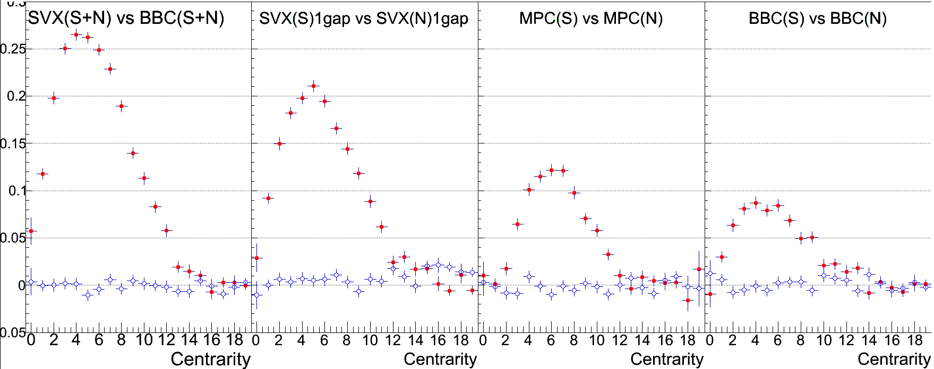
Ψ Correlation for SVX, MPC and BBC (RUN 349667 360K Events)
Resolution is 25% at 20% centrality between SVX(SN) and BBC(SN)
SVX (SN)
Vs
BBC (SN)
SVX (S)
Vs
SVX (N)
MPC (S)
Vs
MPC (N)
BBC (S)
Vs
BBC (N)
<cos(2(Ψ_{A} - Ψ_{B}))>
<sin(2(Ψ_{A} - Ψ_{B}))>

