Slide 1
Reaction Plane Calibration for VTX
27th Jul 2012
Maki KUROSAWA for VTX
RBRC

Slide 2
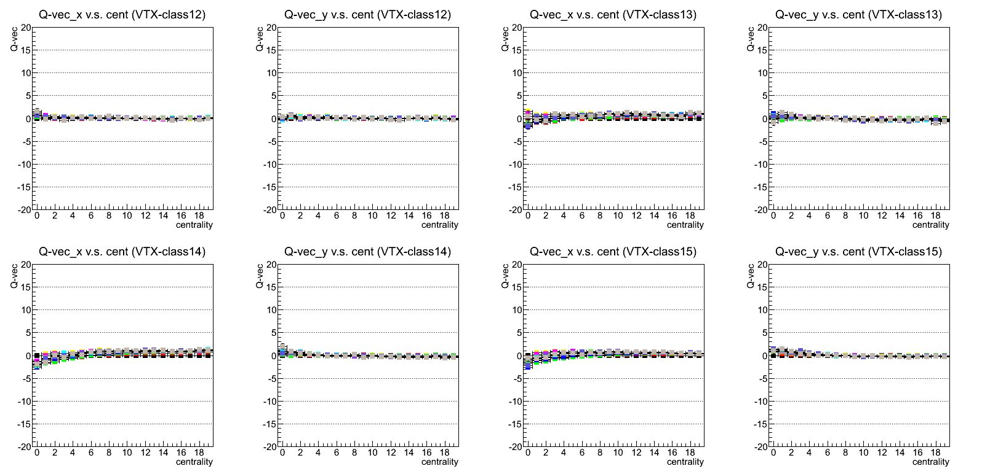
Reaction Plane Calibration for VTX (Option 1)
 | -3<=eta<-2.5 | -2.5<=eta<-2 | -2<=eta<-1.5 | -1.5<=eta<-1 | -1<=eta<-0.5 | -0.5<=eta<0 | 0<=eta<0.5 | 0.5<=eta<1 | 1<=eta<1.5 | 1.5<=eta<2 | 2<=eta<2.5 | 2.5<=eta<3 |  | all eta
layer0 | 0 | 1 | 2 | 3 | 4 | 5 | 6 | 7 | 8 | 9 | 10 | 11 |  | 48
layer1 |  | 12 | 13 | 14 | 15 | 16 | 17 | 18 | 19 | 20 | 21 |  |  | 49
layer2 |  |  | 22 | 23 | 24 | 25 | 26 | 27 | 28 | 29 |  |  |  | 50
layer3 |  |  |  | 30 | 31 | 32 | 33 | 34 | 35 |  |  |  |  | 51
Only Q-vector on Barrel 0 were used.

Slide 3
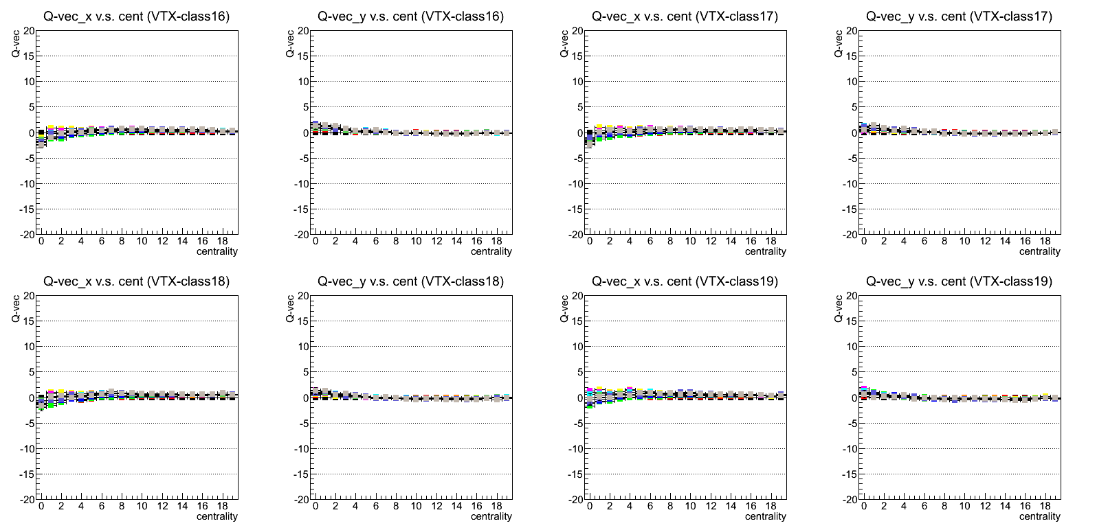
Reaction Plane Calibration for VTX (Option 1)
 | -3<=eta<-2.5 | -2.5<=eta<-2 | -2<=eta<-1.5 | -1.5<=eta<-1 | -1<=eta<-0.5 | -0.5<=eta<0 | 0<=eta<0.5 | 0.5<=eta<1 | 1<=eta<1.5 | 1.5<=eta<2 | 2<=eta<2.5 | 2.5<=eta<3 |  | all eta
layer0 | 0 | 1 | 2 | 3 | 4 | 5 | 6 | 7 | 8 | 9 | 10 | 11 |  | 48
layer1 |  | 12 | 13 | 14 | 15 | 16 | 17 | 18 | 19 | 20 | 21 |  |  | 49
layer2 |  |  | 22 | 23 | 24 | 25 | 26 | 27 | 28 | 29 |  |  |  | 50
layer3 |  |  |  | 30 | 31 | 32 | 33 | 34 | 35 |  |  |  |  | 51
Only Q-vector on Barrel 0 were used.

Slide 4
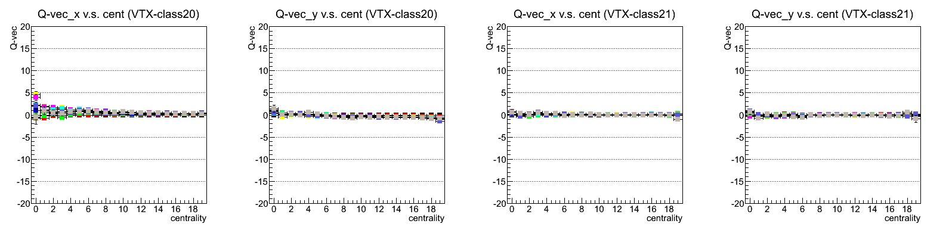
Reaction Plane Calibration for VTX (Option 1)
 | -3<=eta<-2.5 | -2.5<=eta<-2 | -2<=eta<-1.5 | -1.5<=eta<-1 | -1<=eta<-0.5 | -0.5<=eta<0 | 0<=eta<0.5 | 0.5<=eta<1 | 1<=eta<1.5 | 1.5<=eta<2 | 2<=eta<2.5 | 2.5<=eta<3 |  | all eta
layer0 | 0 | 1 | 2 | 3 | 4 | 5 | 6 | 7 | 8 | 9 | 10 | 11 |  | 48
layer1 |  | 12 | 13 | 14 | 15 | 16 | 17 | 18 | 19 | 20 | 21 |  |  | 49
layer2 |  |  | 22 | 23 | 24 | 25 | 26 | 27 | 28 | 29 |  |  |  | 50
layer3 |  |  |  | 30 | 31 | 32 | 33 | 34 | 35 |  |  |  |  | 51
Only Q-vector on Barrel 0 were used.

Slide 5
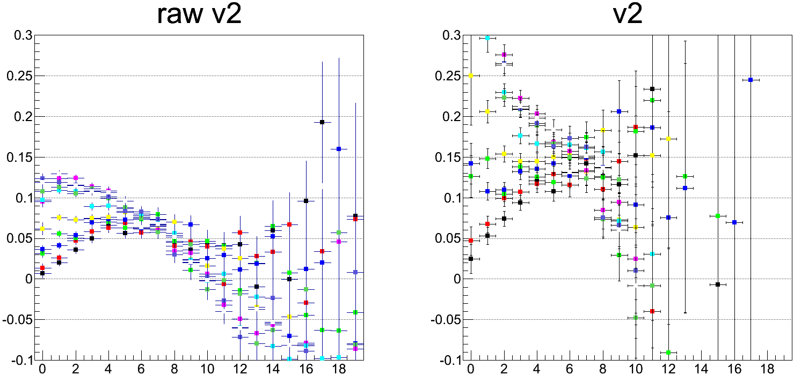
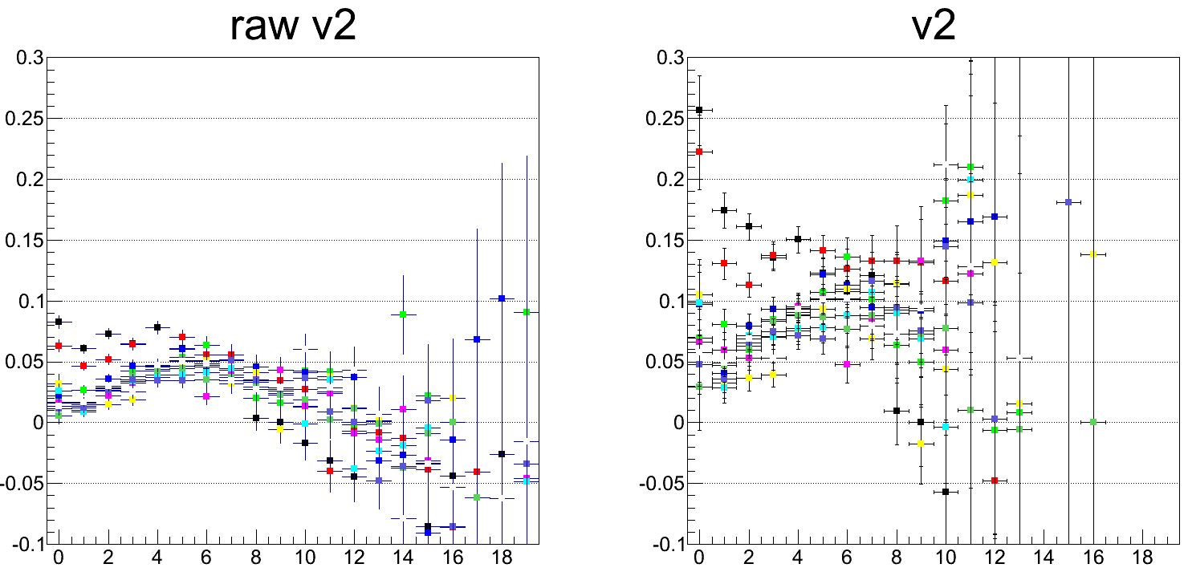
Reaction Plane Calibration for VTX (Option 1)
Use calibration parameters that are created by using segment 9000.
Reaction plane : SVX-SN Egap-2
Track : CNT
2 < pT GeV/c < 3
9000
9001
9002
9003
9004
9005
9006
9007
Original
9008
9009
centrality
centrality
0.0-0.5M
0.5-1.0M
1.0-1.5M
Qvector on B1
Segment 9007
was used to generate calibration parameters
1.5-2.0M
2.0-2.5M
3.0-3.5M
3.5-4.0M
4.0-4.5M
4.5-5.0M
5.0-5.5M
centrality
centrality

Slide 6
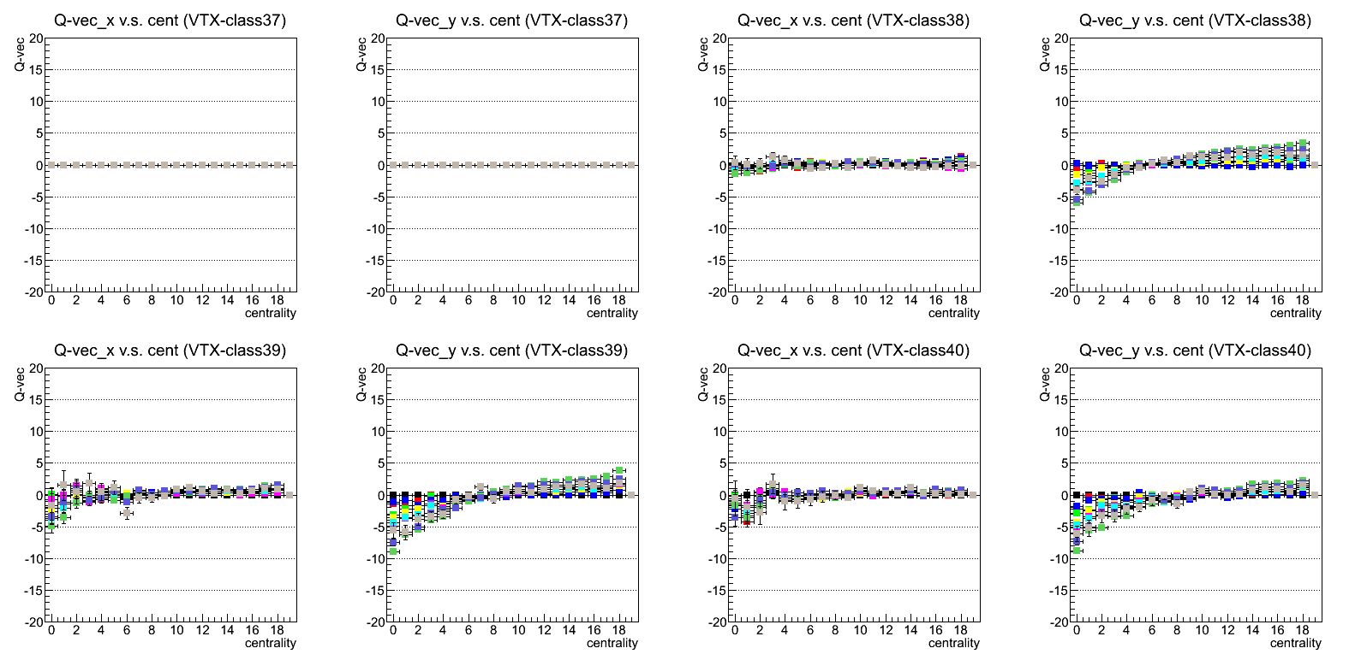
Reaction Plane Calibration for VTX (Option 2)
 | -3<=eta<-2.5 | -2.5<=eta<-2 | -2<=eta<-1.5 | -1.5<=eta<-1 | -1<=eta<-0.5 | -0.5<=eta<0 | 0<=eta<0.5 | 0.5<=eta<1 | 1<=eta<1.5 | 1.5<=eta<2 | 2<=eta<2.5 | 2.5<=eta<3 |  | all eta
Segment |  |  | 53 | 54 | 55 | 56 | 57 | 58 | 59 | 60 |  |  |  | 61
Only Q-vector from VTX track segment were used.
class 53
class 54
class 55

Slide 7
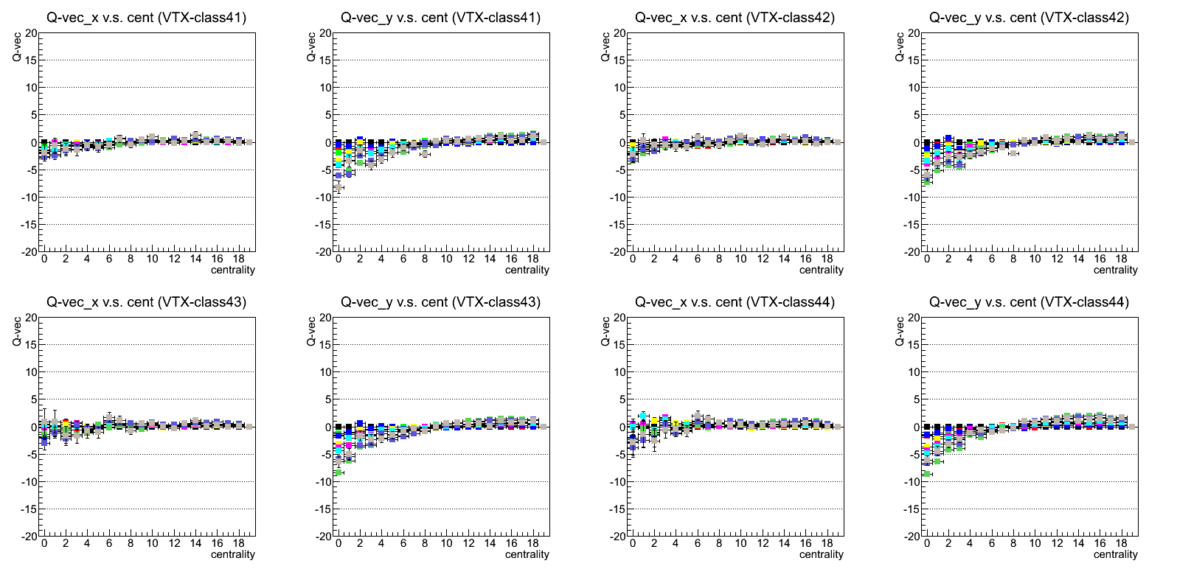
Reaction Plane Calibration for VTX (Option 2)
 | -3<=eta<-2.5 | -2.5<=eta<-2 | -2<=eta<-1.5 | -1.5<=eta<-1 | -1<=eta<-0.5 | -0.5<=eta<0 | 0<=eta<0.5 | 0.5<=eta<1 | 1<=eta<1.5 | 1.5<=eta<2 | 2<=eta<2.5 | 2.5<=eta<3 |  | all eta
Segment |  |  | 53 | 54 | 55 | 56 | 57 | 58 | 59 | 60 |  |  |  | 61
Only Q-vector from VTX segment were used.

Slide 8
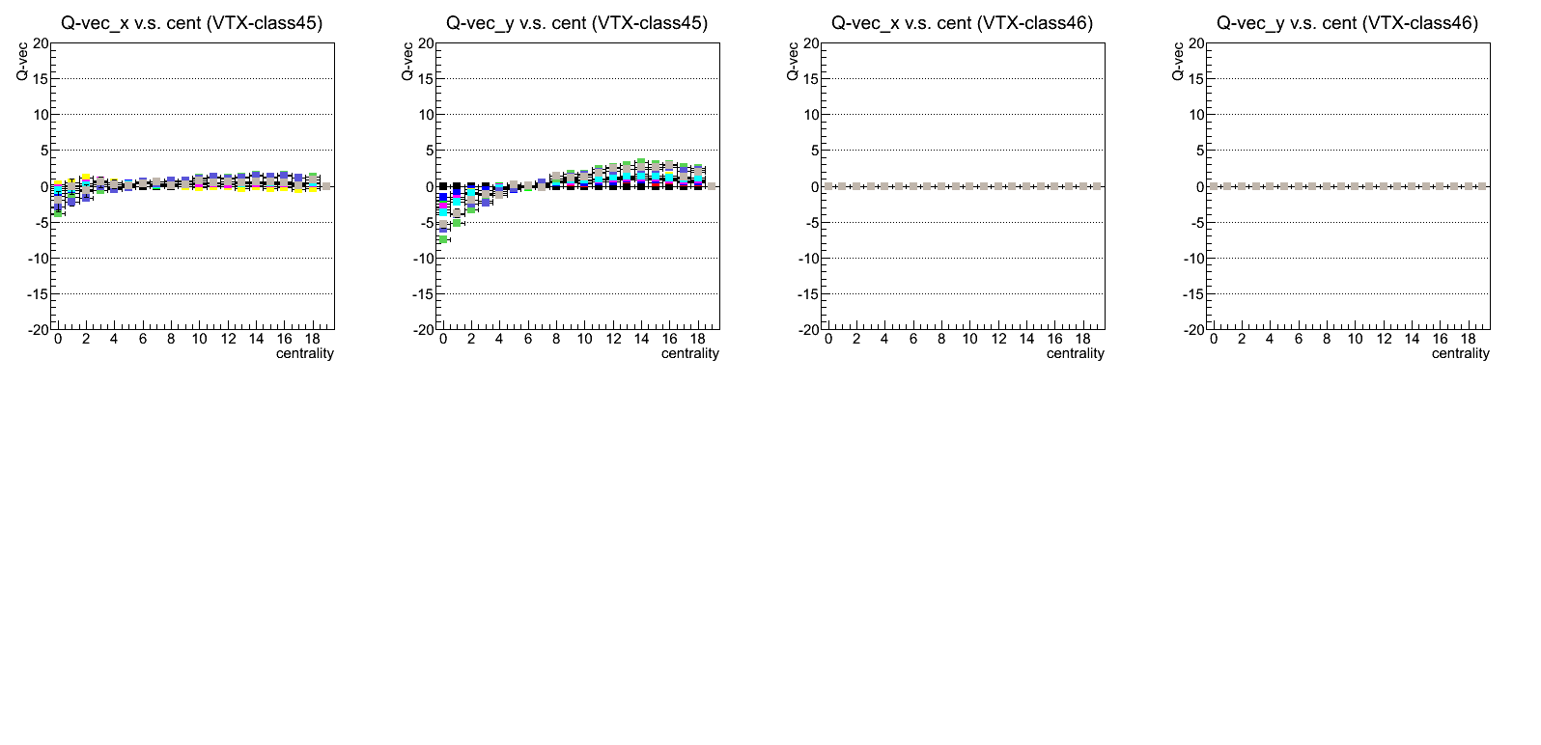
Reaction Plane Calibration for VTX (Option 2)
 | -3<=eta<-2.5 | -2.5<=eta<-2 | -2<=eta<-1.5 | -1.5<=eta<-1 | -1<=eta<-0.5 | -0.5<=eta<0 | 0<=eta<0.5 | 0.5<=eta<1 | 1<=eta<1.5 | 1.5<=eta<2 | 2<=eta<2.5 | 2.5<=eta<3 |  | all eta
Segment |  |  | 53 | 54 | 55 | 56 | 57 | 58 | 59 | 60 |  |  |  | 61
Only Q-vector from VTX segment were used.

Slide 9
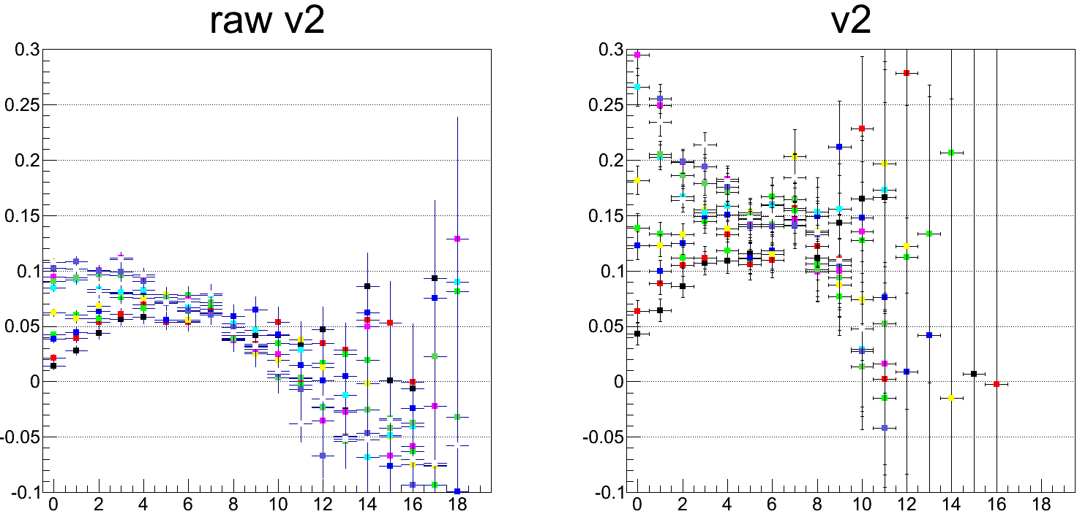
Reaction Plane Calibration for VTX (Option 2)
Use calibration parameters that are created by using segment 9000.
Reaction plane : SVX-SN Egap-2
Track : CNT
2 < pT GeV/c < 3
9000
9001
9002
9003
9004
9005
9006
9007
Original
9008
9009
centrality
centrality
0.0-0.5M
0.5-1.0M
1.0-1.5M
1.5-2.0M
2.0-2.5M
3.0-3.5M
3.5-4.0M
Track Segment
4.0-4.5M
4.5-5.0M
5.0-5.5M
centrality
centrality

Slide 10
Hadron V2 and V3 Distribution (BBC) 8% of all Data
634 Aggregated Segment Files (~355M events)
V2 and v3 as a function of pT for charged hadrons with
isolation cut : -200μm < diff < 400μm (layer 0 and layer 3)
: -200μm < diff < 600μm (layer 1)
: -400μm < diff < 800μm (layer 2)
DCA cut : |DCA-XY| < 200um
V_n
V2 cos
V3 cos
AN689
V2 sin
V3 sin
pT (GeV/c)
pT (GeV/c)
pT (GeV/c)

Slide 11
Hadron V2 and V3 Distribution (VTX-Egap2) 8% of all Data
634 Aggregated Segment Files (~355M events)
V2 and v3 as a function of pT for charged hadrons with
isolation cut : -200μm < diff < 400μm (layer 0 and layer 3)
: -200μm < diff < 600μm (layer 1)
: -400μm < diff < 800μm (layer 2)
DCA cut : |DCA-XY| < 200um
V_n
V2
V3
AN689
V2 cos
V3 cos
AN689
V2 sin
V3 sin
pT (GeV/c)
pT (GeV/c)
pT (GeV/c)

