Slide 1
PHENIX vn Analysis VTX
29th Jul 2012
Maki KUROSAWA
for VTX
RBRC

Slide 2
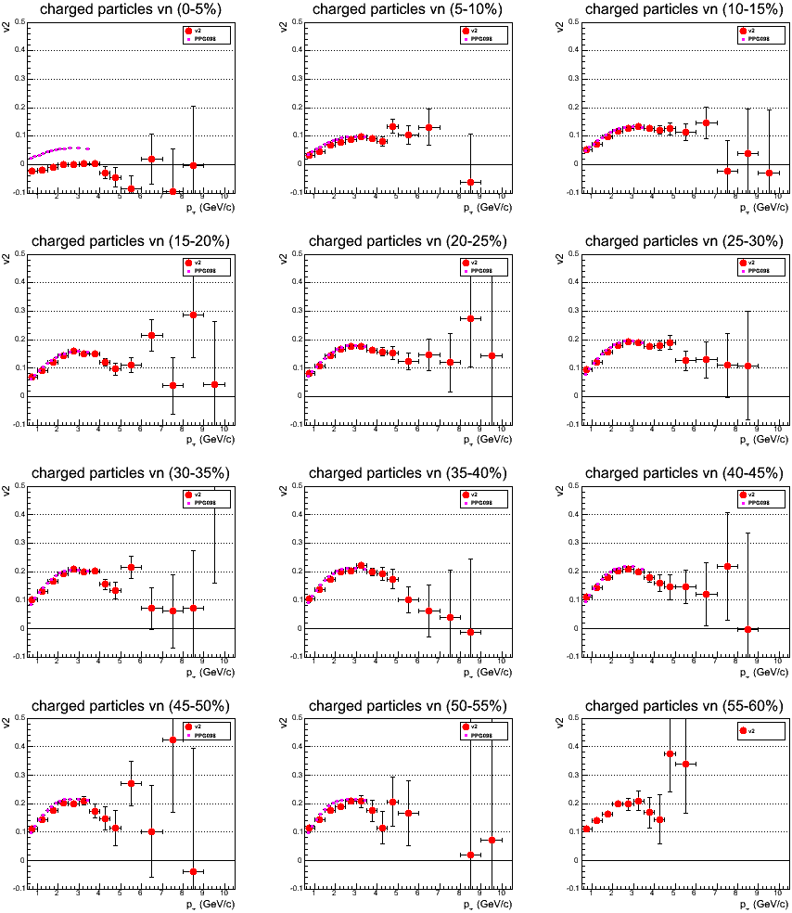
Charged Hadron v2 (40% of all Data)
PPG098

Slide 3
Charged Hadron v2 and v3 (40% of all Data)

Slide 4
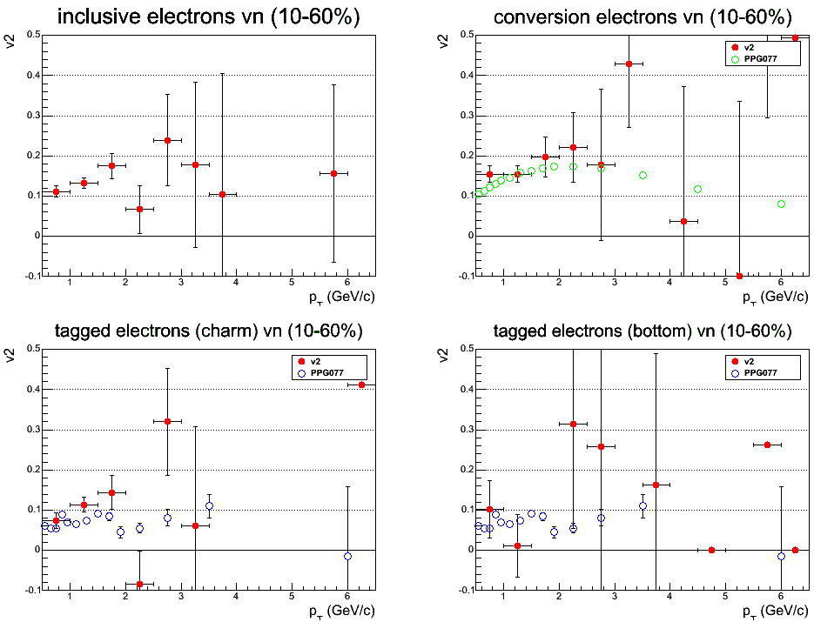
Electron v2 (40% of all Data)
Inclusive + VTX
Conv. tag |DCA| < 300μm
PPG077
Photonic electron
PPG077
Heavy Flavor electron
|DCA| < 200μm
200 μm < |DCA| < 700μm

Slide 5
BACK UP SLIDES

Slide 6
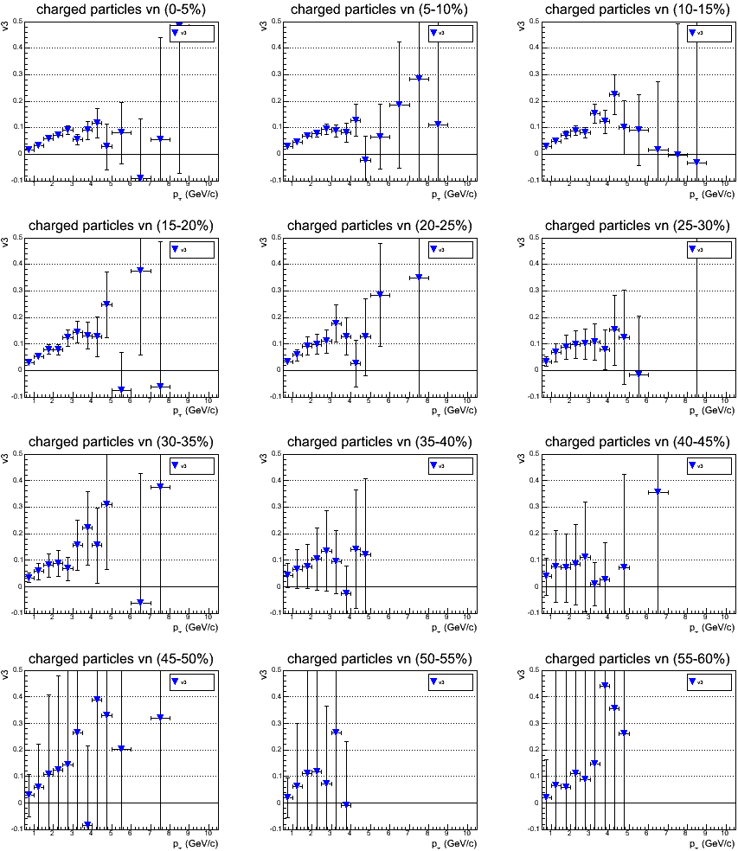
Charged Hadron v3 (40% of all Data)

Slide 7
Hadron V2 and V3 Distribution (BBC) 8% of all Data
634 Aggregated Segment Files (~355M events)
V2 and v3 as a function of pT for charged hadrons with
isolation cut : -200μm < diff < 400μm (layer 0 and layer 3)
: -200μm < diff < 600μm (layer 1)
: -400μm < diff < 800μm (layer 2)
DCA cut : |DCA-XY| < 200um
V_n
V2 cos
V3 cos
AN689
V2 sin
V3 sin
pT (GeV/c)
pT (GeV/c)
pT (GeV/c)

Slide 8
Hadron V2 and V3 Distribution (VTX-Egap2) 8% of all Data
634 Aggregated Segment Files (~355M events)
V2 and v3 as a function of pT for charged hadrons with
isolation cut : -200μm < diff < 400μm (layer 0 and layer 3)
: -200μm < diff < 600μm (layer 1)
: -400μm < diff < 800μm (layer 2)
DCA cut : |DCA-XY| < 200um
V_n
V2
V3
AN689
V2 cos
V3 cos
AN689
V2 sin
V3 sin
pT (GeV/c)
pT (GeV/c)
pT (GeV/c)

