Slide 1


The LHCf experiment
Very forward photon & neutron measurement
Hiroaki MENJO
(KMI, Nagoya University, Japan)
On behalf of the LHCf collaboration
Mini-workshop, RIKEN, 03 Oct. – 04 Oct. 2012

Slide 2
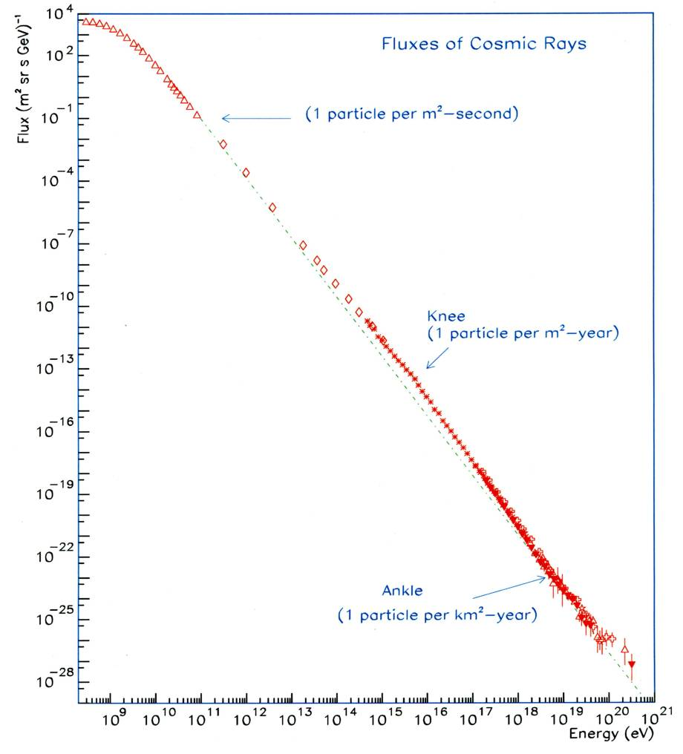
Contents
Large Hadron Collider
Introduction
The LHCf experiment
-An LHC forward experiment-
Operation in 2010
  - Luminosity Measurement
  - Background
Analysis & Results
  Forward photon energy spectra
  at 900GeV and 7TeV p-p
  Performance
  for neutron measurement
Summary
-The most powerful accelerator on the earth-
Ultra High Energy Cosmic Rays
What is the most powerful accelerator in the Universe ?
-
SppS
Tevatron
LHC

Slide 3
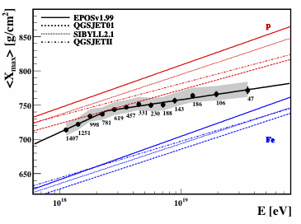
Introduction
HECRs
Extensive air shower observation
longitudinal distribution
lateral distribution
Arrival direction
Air shower development
Astrophysical parameters
Spectrum
Composition
Source distribution
X_{max} distribution measured by AUGER
PROTON
X_{max}
the depth of air shower maximum.
An indicator of CR composition
IRON
Uncertainty of hadron interaction models
>
10¹⁸
10¹⁹
Error of <X_{max}> measurement
Auger Coll. ICRC2011

Slide 4






The LHCf collaboration
T.Iso, Y.Itow, K.Kawade, Y.Makino, K.Masuda, Y.Matsubara, E.Matsubayashi, G.Mitsuka, Y.Muraki, T.Sako
            Solar-Terrestrial Environment Laboratory, Nagoya University, Japan
H.Menjo Kobayashi-Maskawa Institute, Nagoya University, Japan
K.Yoshida Shibaura Institute of Technology, Japan
K.Kasahara, Y.Shimizu, T.Suzuki, S.Torii
Waseda University, Japan
T.Tamura Kanagawa University, Japan
M.Haguenauer Ecole Polytechnique, France
W.C.Turner LBNL, Berkeley, USA
O.Adriani, L.Bonechi, M.Bongi, R.D’Alessandro, M.Grandi, P.Papini, S.Ricciarini, G.Castellini
INFN, Univ. di Firenze, Italy
K.Noda, A.Tricomi INFN, Univ. di Catania, Italy
J.Velasco, A.Faus IFIC, Centro Mixto CSIC-UVEG, Spain
A-L.Perrot CERN, Switzerland

Slide 5
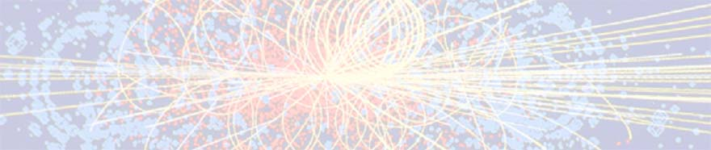
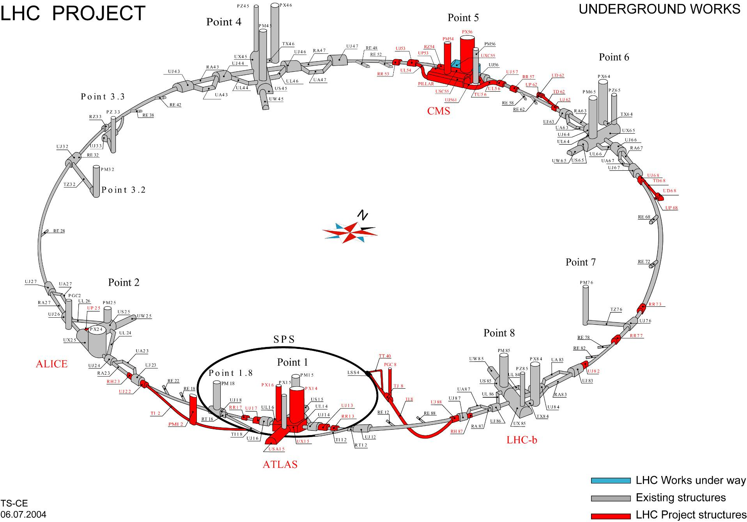
The Large Hadron Collider (LHC)
pp 7TeV+7TeV ➔ E_{lab} = 10¹⁷eV
pp 3.5TeV+3.5TeV ➔ E_{lab} = 2.6x10¹⁶eV
pp 450GeV+450GeV ➔ E_{lab} = 2x10¹⁴eV
2014-
Key parameters
for air shower developments
Total cross section
↔ TOTEM, ATLAS, CMS
Multiplicity
↔ Central detectors
Inelasticity/Secondary spectra
↔ Forward calorimeters
LHCf, ZDCs
CMS/TOTEM
ALICE
LHCb/MoEDAL
ATLAS/LHCf
Notes:
So the calibration of the hadron interaction models at high energy is indispensable.
The dominant contribution to the energy flux is very forward region. So knowledge of the energy distribution of particles emitted in the very forward region in hadron interaction is very important. However so far only UA7 experiment has obtained data in the energy range exceeding 10 to14th eV.
Now the largest and highest energy accelerator “LHC” is under construction at CERN.
At the LHC interaction point, 7TeV-7TeV proton will collide. It correspond to 10to17th eV in the laboratory system.
It is 3 orders more than that of the UA7 experiment and near the range of ultra high energy cosmic rays

Slide 6
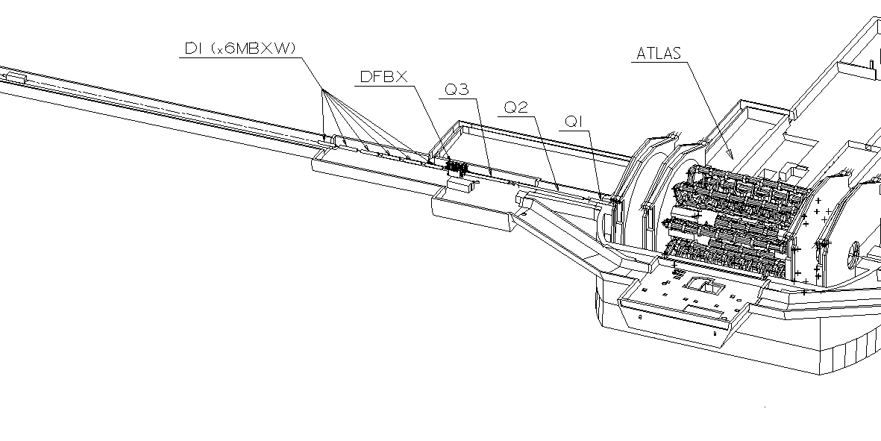
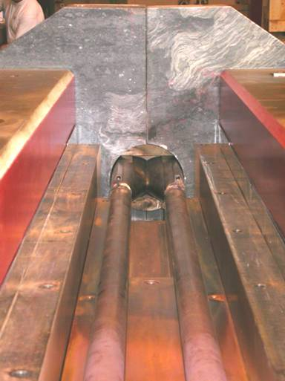
The LHCf experiment
LHCf Detector(Arm#1)
ATLAS
140m
Two independent detectors at either side of IP1 ( Arm#1, Arm#2 )
Beam pipe
Protons
Charged particles (+)
Neutral particles
Charged particles (-)
TAN -Neutral Particle Absorber-
transition from one common beam pipe to two pipes
Slot : 100mm(w) x 607mm(H) x 1000mm(T)
96mm

Slide 7
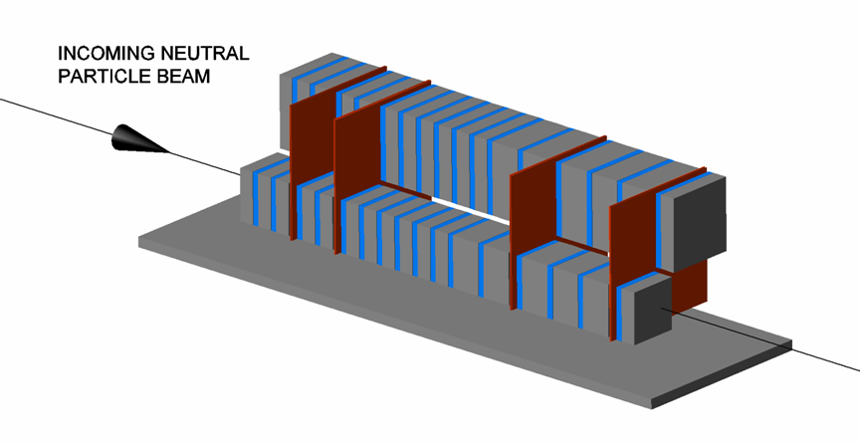
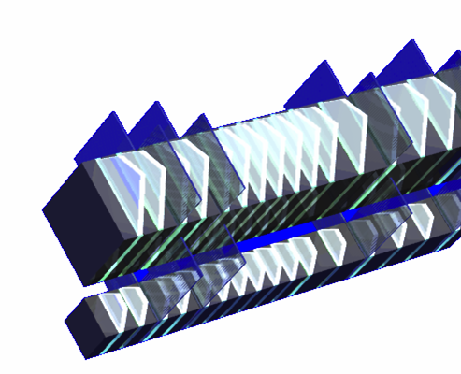
The LHCf Detectors
Sampling and Positioning Calorimeters
W (44 r.l , 1.7λ_{I} ) and Scintillator x 16 Layers
4 positioning layers
XY-SciFi(Arm1) and XY-Silicon strip(Arm#2)
Each detector has two calorimeter towers,
which allow to reconstruct π⁰
Expected Performance
Energy resolution (> 100GeV)
< 5% for photons
30% for neutrons
Position resolution
< 200μm (Arm#1)
40μm (Arm#2)
Arm2
32mm
25mm
Front Counter
thin scintillators with 80x80mm²
To monitor beam condition.
For background rejection of
beam-residual gas collisions
by coincidence analysis
40mm
Arm1
20mm
Notes:
The Arm#1 and Arm#2 , each detector has two sampling and imaging calorimeters.
The each calorimeter are made of 44 r.l. tungsten layer and 16 scintillator layers and 4 position sensitive layers.
The position sensitive layers of Arm#1 are made of XY pair of scintillating fiber bundles.
The position sensitive layers of Arm#2 are made of XY silicon strip detectors.
Two independent calorimeters allow to reconstruct neutral pion from pair photons.
The energy resolution is less than 5% for photons with more than 100GeV and about 30 % for neutrons.
The position resolution of Scintillating fibers in Arm1 is less than 200 um.
And position resolution of silicon detectors in Arm2 is about 40um.

Slide 8
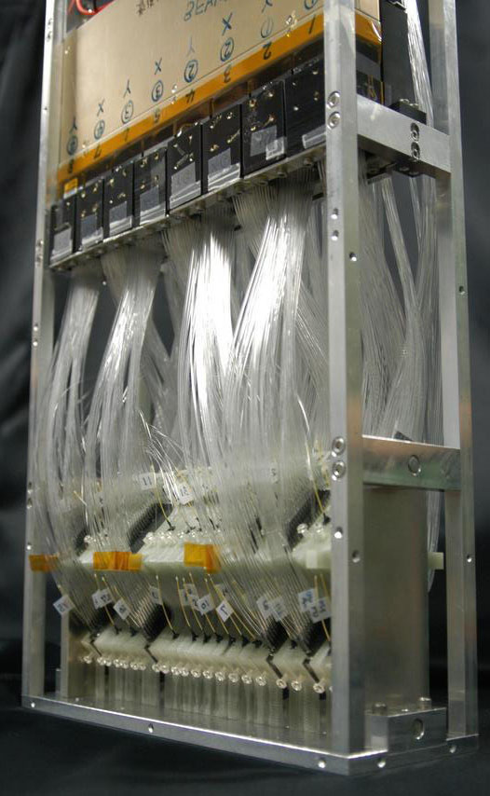
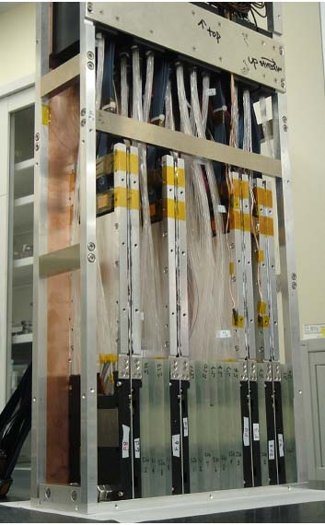
Arm#1
Arm#2
620mm
620mm
280mm
92mm
90mm
280mm
Notes:
These are photos of the real LHCf detectors.
The LHCf detectors are really compact to insert to inside of narrow experimental slot of TAN.
There are calorimeter towers inside of light green materials on bottom of the detectors.

Slide 9
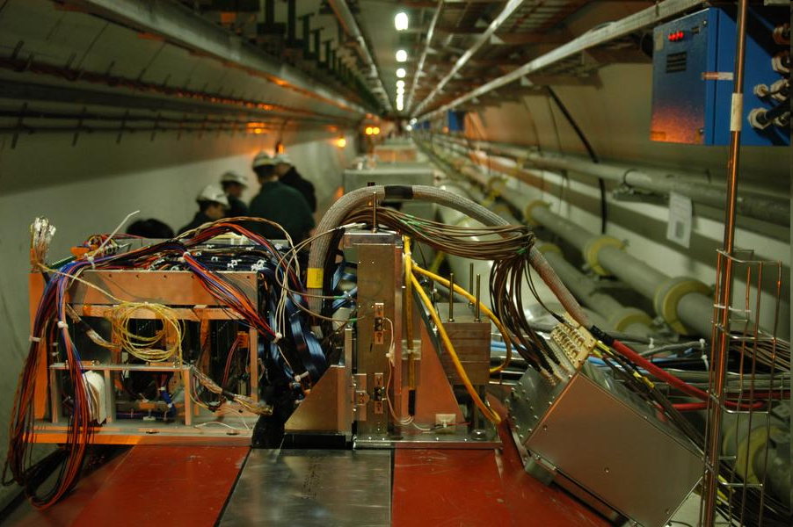
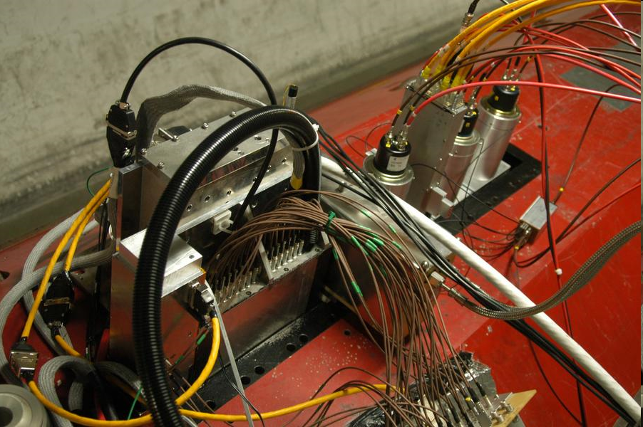
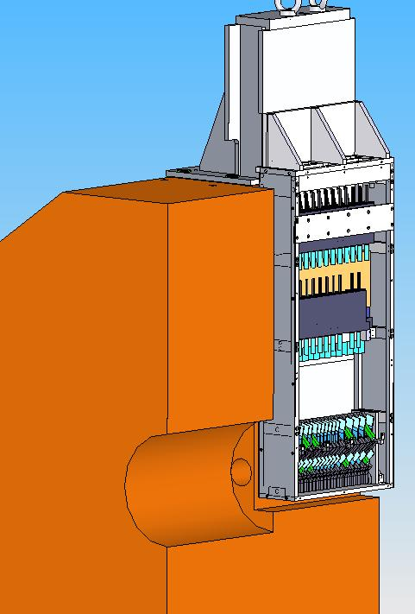
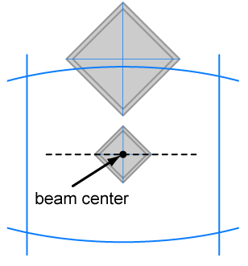
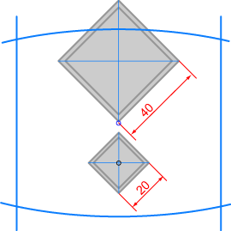
IP1,ATLAS
Arm1
Arm2
η
Shadow of beam pipes
between IP and TAN
8.4
8.7
∞
∞
@ 140μrad crossing angle
neutral beam axis
Transverse projection of Arm#1
@ zero crossing angle
Notes:
This is photos of our detectors installed in the LHC ring.
The red one is the surface of TAN located 140m far from IP1.
we can see our electronics boxes on TAN but detector were completely in experimental slots of TAN.
Behind of our detectors, Luminosity monitor BRAN and ATLAS ZDC has been installed.

Slide 10
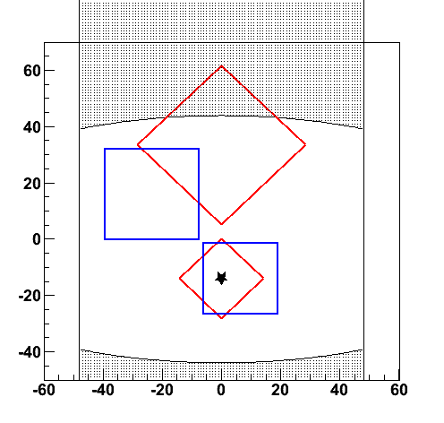
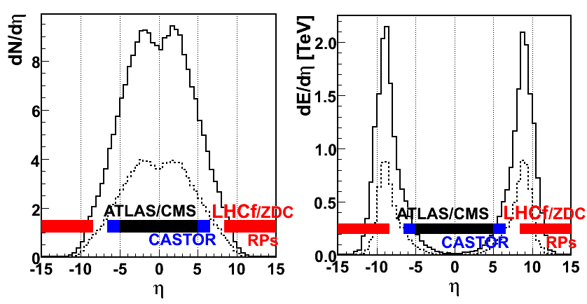
LHCf can measure
Front view of calorimeters
@ 100μrad crossing angle
η
Energy spectra and
Transverse momentum distbution of
beam pipe shadow
8.5
Gamma-rays (E>100GeV,dE/E<5%)
Neutral Hadrons (E>a few 100 GeV, dE/E~30%)
π⁰ (E>600GeV, dE/E<3%)
at pseudo-rapidity range >8.4
∞
Multiplicity@14TeV
Energy Flux @14TeV
Low multiplicity !!
High energy flux !!
simulated by DPMJET3
Notes:
Next, I present what we can measure.
We can measure energy spectra and transverse momentum distribution of gamma-ray with more than 100GeV
and neutral hadrons it’s mainly neutrons with more than a few hundreds GeV, and neutral pions with more than 700GeV
at rapidity range from 8.4 to infinity.
because we don’t have own central detectors and LHCf trigger is completely independent on ATLAS trigger,
so LHCf can measure only inclusive spectra . However we are recording ATLAS event ID number event by event,
so it is possible to identify coincidence events with ATLAS event and to analyze with ATALS in future.

Slide 11
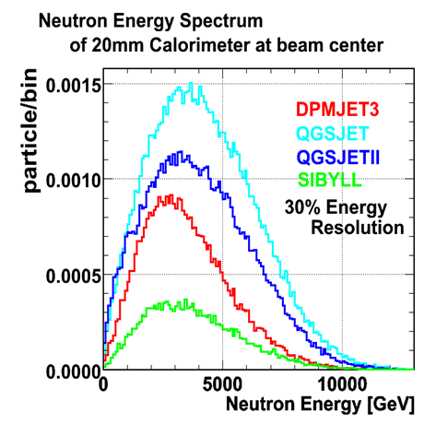
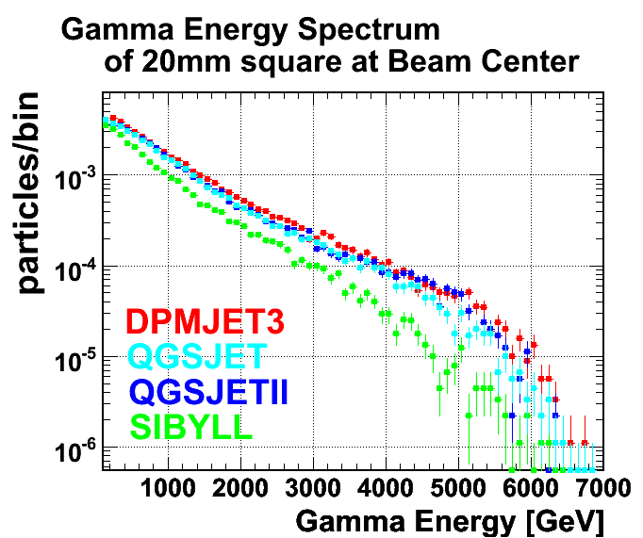
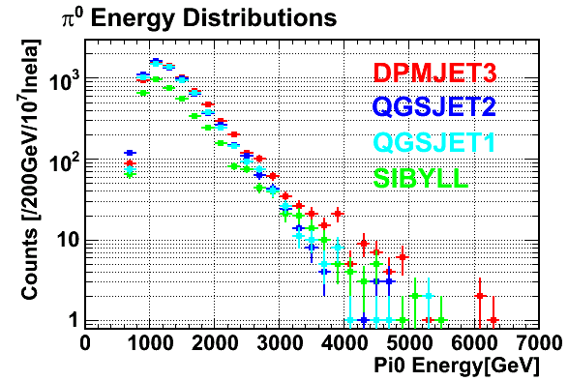
LHCf can
Expected spectra
by hadron interaction models
at 7TeV+7TeV
Neutron
Gamma-rays
Different interaction model gives
different production spectra
in the forward region.
It means the LHCf can discriminate
the interaction models.
π⁰
(Note : Spectra of QGSJET1 & 2 are wrong.)
Notes:
Next, I present what we can measure.
We can measure energy spectra and transverse momentum distribution of gamma-ray with more than 100GeV
and neutral hadrons it’s mainly neutrons with more than a few hundreds GeV, and neutral pions with more than 700GeV
at rapidity range from 8.4 to infinity.
because we don’t have own central detectors and LHCf trigger is completely independent on ATLAS trigger,
so LHCf can measure only inclusive spectra . However we are recording ATLAS event ID number event by event,
so it is possible to identify coincidence events with ATLAS event and to analyze with ATALS in future.

Slide 12
Status of the LHCf experiment
2009
First full data taking with √s = 900 GeV p-p collisions.
2010
Physics programs with √s = 900 GeV and
7 TeV p-p collisions has been completed.
2012
Upgrade the Arm1 detector.
Calibration of detectors with beams at SPS (Aug.)
2013
Operation with p-Pb collisions (Nov.)
Upgrade the Arm2 detector
2014 (2015?)
Operation with √s = 14 TeV p-p collisions
2015 ?
Operation at RHIC
Phase I operation.
Forward Photons
Forward π⁰
(Neutrons, Keons etc.)
Future operations
Nuclear effect
Energy dependency

Slide 13
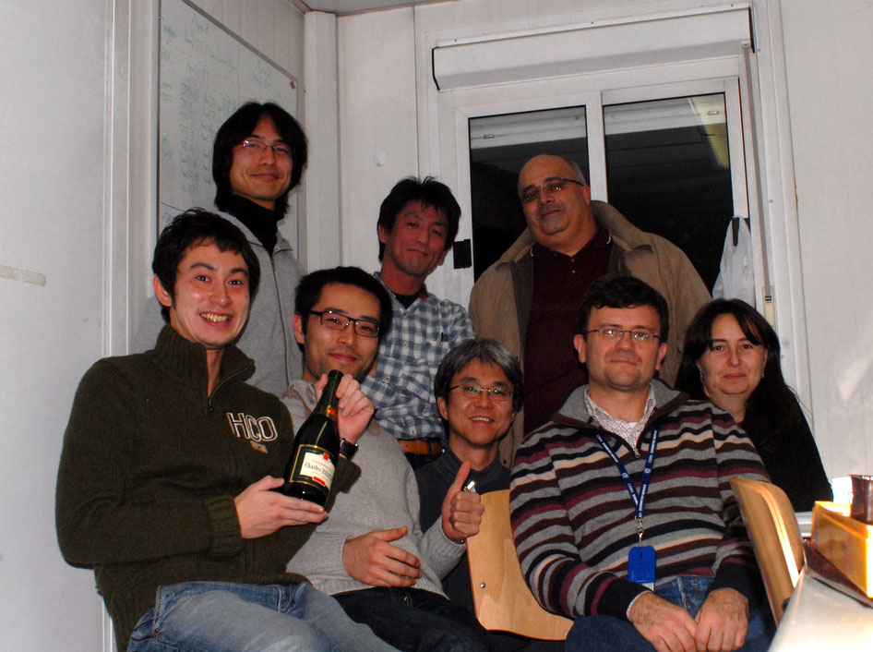
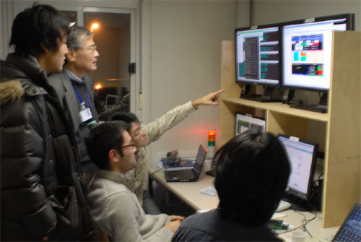
Dec. 2009 in the LHCf control room
Operation

Slide 14
Data taking in 2010
At 450GeV+450GeV
Int. number of recorded events
10⁸
Showering
02 May – 27 May in 2010
~15 hours for physics
~44,000 and ~63,000
shower events in Arm1 and Arm2
π⁰
At 3.5TeV+3.5TeV
30 Mar. – 19 July in 2010
~ 150 hours for physics with several setup
With zero crossing angle and with 100μrad crossing angle.
~2x10⁸ and ~2x10⁸ shower events in Arm1 and Arm2
DAQ specification
Max. DAQ rate | 1000 Hz (Arm1), 800 Hz (Arm2)
Trigger | Any 3 successive layers dE > dE_{th} (Shower events.)
Trigger Efficiency | 100% for 50GeV photons @ normal gain mode 100% for 30GeV photons @ high gain mode.

Slide 15
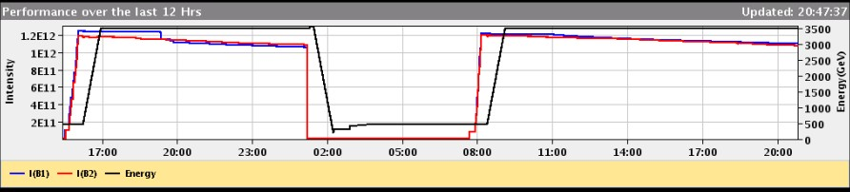
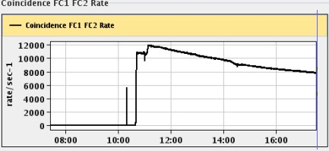
Luminosity monitoring by FC
from LHC Vistor page
Ramping up beam energy
(~1 hours)
Beam energy
intensity of beam1
intensity of beam2
Filling bunches
(~0.5 hours)
Adjusting beams
Coincidence rate of Arm1 & 2 FC’s

Slide 16
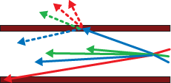

Backgrounds
Simulation @ p-p √s=14TeV
Secondary - Beam Pipe
The background events dominate
in the lower energy region (<100GeV).
S/N (E>100GeV) > 100.
Beam - Gas Interaction
Two side coincidence
π⁰ analysis
Background rejection
by vertex selection.
The energy spectrum of beam-gas background
is similar to the single spectrum (p-p collisions.)
Amount of BKG can be estimated
by using non-crossing bunch (next page.)

Slide 17
Beam-gas Background @ LHC
The beam-gas background can be measured
by using non-Xing bunches at IP1.
Xing bunches : Collision(Signal) + BKG
Non-Xing bunches : BKG
@√s=900GeV, 2010
@√s=7TeV, 2010
> 10
x10³

Slide 18
Analysis & Results
- Photons
- (Neutrons)
“ Measurement of zero degree single photon energy spectra
for √s = 7 TeV proton-proton collisions at LHC “
O. Adriani, et al., PLB, Vol.703-2, p.128-134 (09/2011)
“Measurement of zero degree inclusive photon energy spectra
for √s = 900 GeV proton-proton collisions at LHC“
O. Adriani, et al., Submitted to PLB.,CERN-PH-EP-2012-048

Slide 19
Analysis for the photon spectra
DATA
  15 May 2010 17:45-21:23, at Low Luminosity 6x10²⁸cm⁻²s⁻¹
  0.68 nb-1 for Arm1, 0.53nb-1 for Arm2
MC
  DPMJET3.0４, QGSJETII03, SYBILL2.1, EPOS1.99
  PYTHIA 8.145 with the default parameters.
  10⁷ inelastic p-p collisions by each model.
Analysis Procedure
  Energy Reconstruction from total energy deposition
  in a tower with some corrections, shower leakage out etc.
  Particle Identification
  by shape of longitudinal shower development.
  Cut multi-particle events.
  Two Pseudo-rapidity selections, η>10.94 and 8.81<η<8.9.
  Combine spectra between the two detectors.

Slide 20
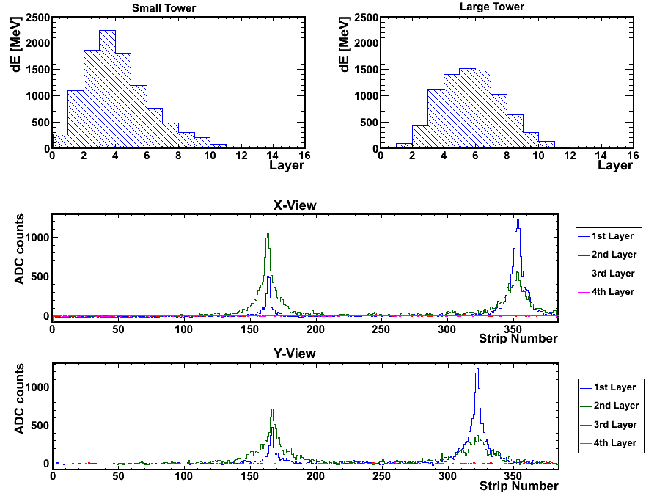
Event sample
Longitudinal development measured by scintillator layers
25mm Tower
32mm Tower
Total Energy deposit
➔Energy
Shape
➔PID
➔600GeV
photon
➔420GeV
photon
Lateral distribution measured by silicon detectors
X-view
Hit position,
Multi-hit search.
Y-view
π⁰ mass reconstruction from two photon.
Systematic studies

Slide 21
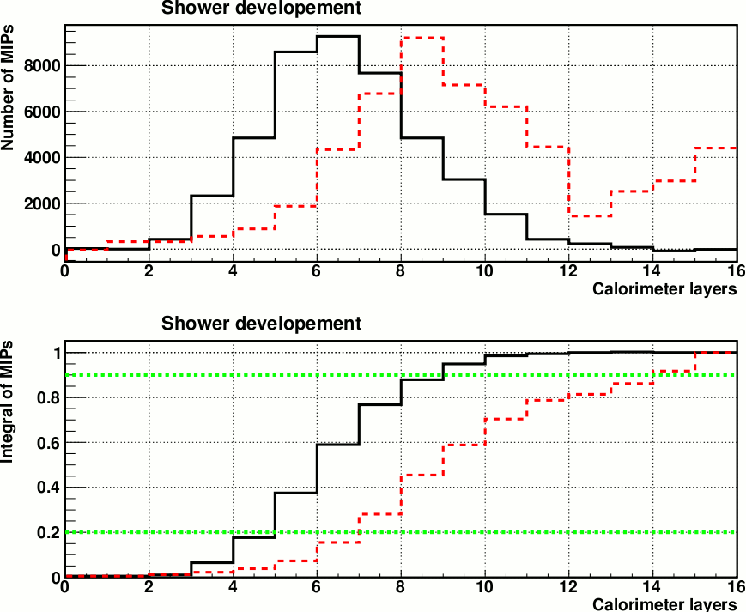
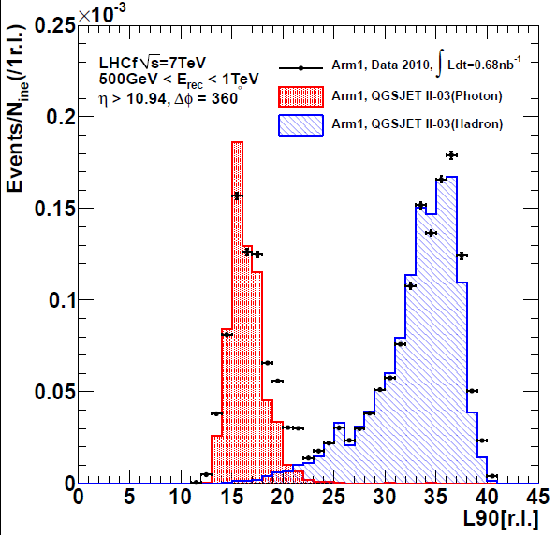
Particle Identification
Event selection and correction
  Select events <L_{90%} threshold and multiply P/ε
  ε (photon detection efficiency) and P (photon purity)
  By normalizing MC template L_{90%} to data,
  ε and P for certain L_{90%} threshold are determined.
Calorimeter Depth
Elemag: 44r.l.
Hadronic: 1.7λ
L_{90%} Distribution
dE
Photon
Hadron
Calorimeter layers
Integral of dE
Calorimeter layers

Slide 22
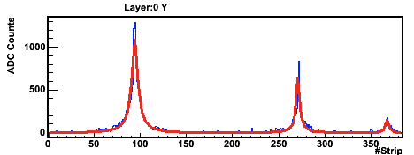
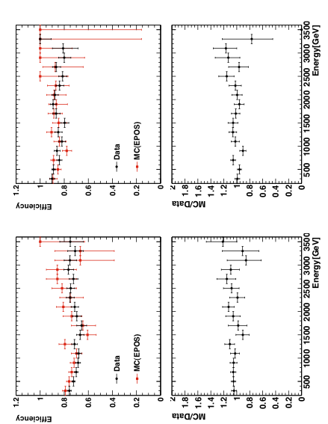
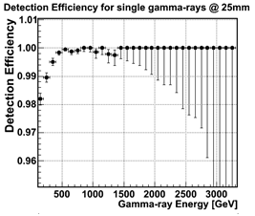
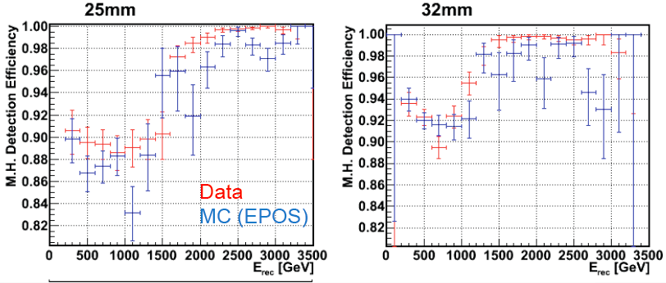
Multi-hit identification
Event cut of multi-peak events,
  Identify multi-peaks in one tower by position sensitive layers.
  Select only the single peak events for spectra.
An example of multi peak event
Double hit detection efficiency
Small tower
Large tower
Arm1
Single hit detection efficiency
Arm2

Slide 23
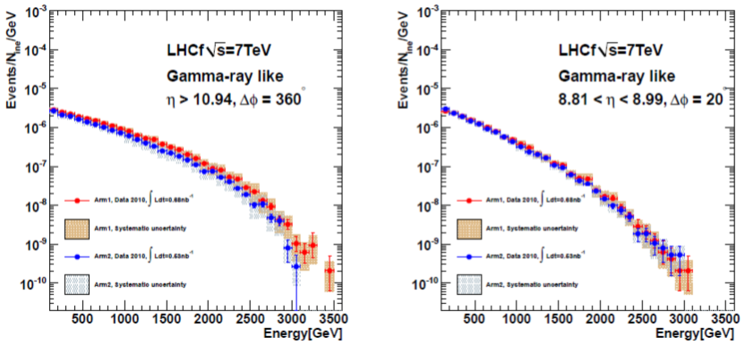
Photon spectra at √s = 7 TeV p-p
8.81<η<8.9
Pseudo-rapidity,
η>10.94 and 8.81<η<8.9
The spectra of two detectors are consistent within the errors.
η>10.94
Arm1
Arm2
Arm1 detector
Arm2 detector

Slide 24
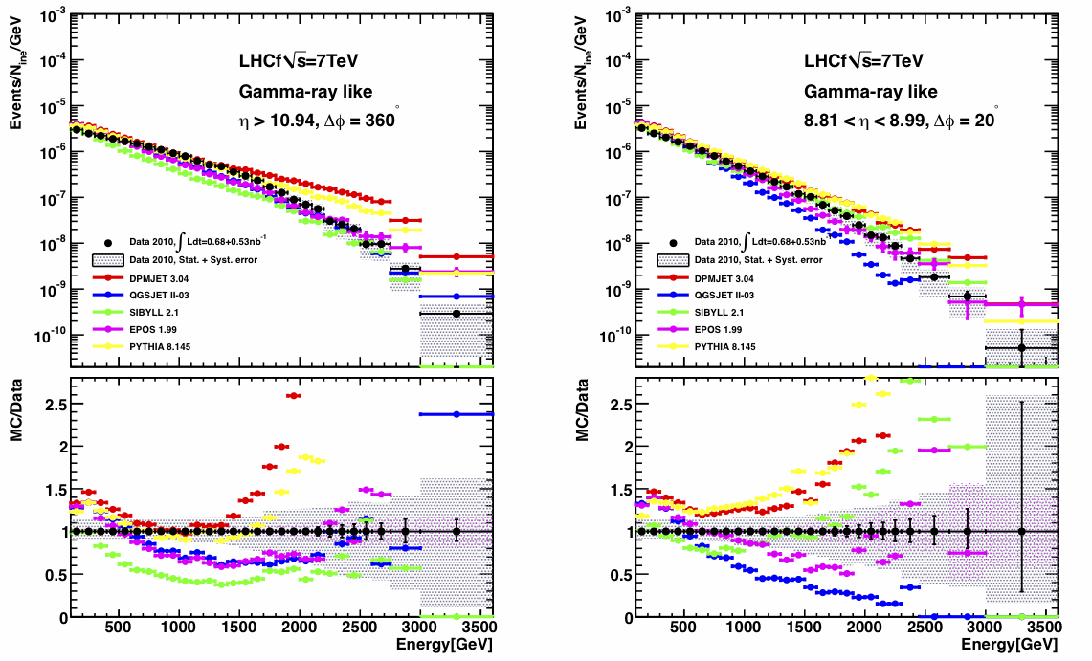
Photon spectra at √s = 7 TeV p-p
Data
DPMJET 3.04
QGSJETII-03
SIBYLL 2.1
EPOS 1.99
PYTHIA 8.145
Sys.+Stat.
No model can reproduce the LHCf data perfectly.
DPMJET and PYTHIA are in good agreement E_{γ}<1.5TeV, but harder in E>1.5TeV.
QGSJET and SIBYLL shows reasonable agreement of shapes in high-η but not in low-η
EPOS has less η dependency against the LHCf data.

Slide 25
Photon spectra at √s = 900 GeV p-p
Data
DPMJET 3.04
QGSJETII-03
SIBYLL 2.1
EPOS 1.99
PYTHIA 8.145
Sys.+Stat.
MC/Data
Both of Data and MC show little η dependency.
The tendencies of MC against Data are very similar to one of 7 TeV in η > 10.94.

Slide 26
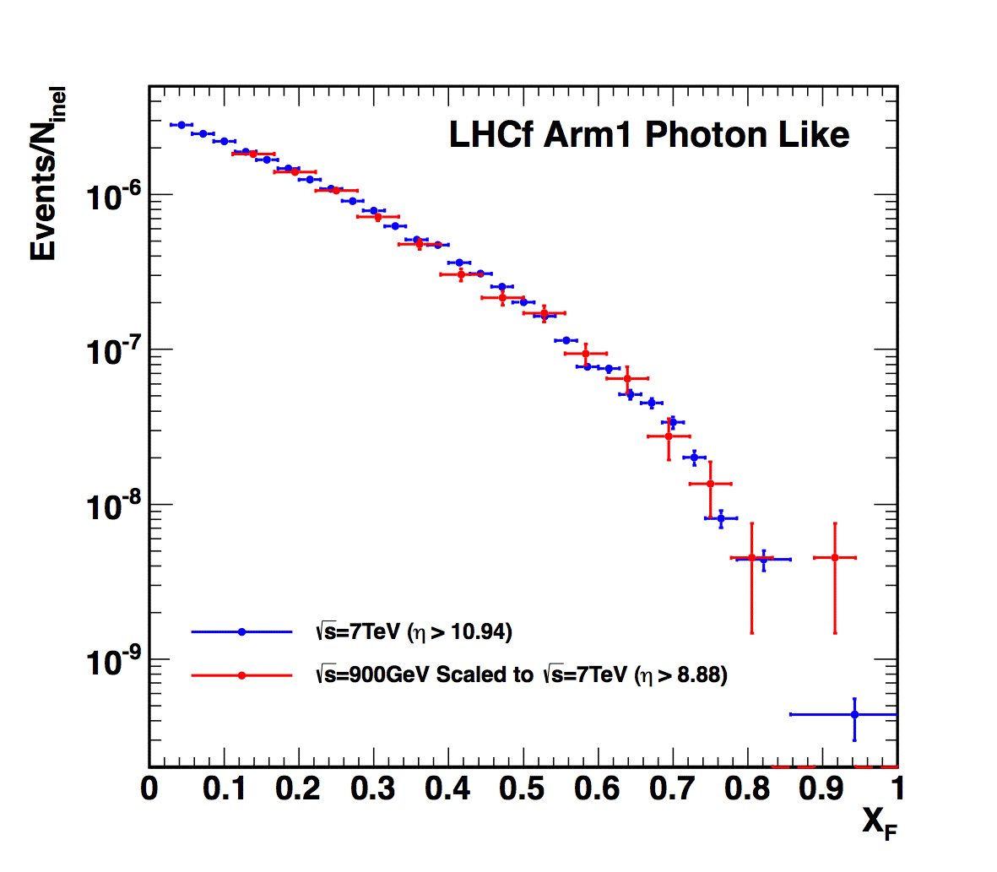
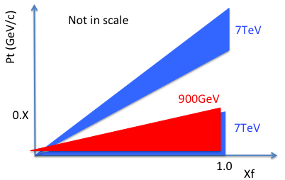

DATA : Comp. 900GeV/7TeV
Coverage of 900GeV and 7TeV
results in Feynman-X and P_{T}
XF spectra : 900 GeV data vs. 7 TeV data
Preliminary
900GeV vs. 7TeV
with the same P_{T} region
small-η
Data 2010 at √s=900GeV
(Normalized by the number
of entries in X_{F} > 0.1)
Data 2010 at √s=7TeV (η>10.94)
Note : No systematic error is considered
in both collision energies. 21% of the luminosity determination error allows vertical shift.
Good agreement of X_{F} spectrum shape between 900 GeV and 7TeV. ➔weak dependence of <pT> on ECMS

Slide 27
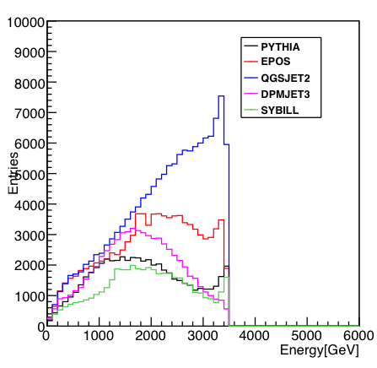
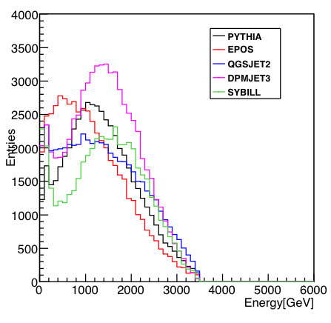
Neutron analysis
Leading baryon
➔ measurement of Inelasticity
Large difference of expected energy
spectra in the forward region
between models.
MC true (η > 10.94)
MC smeared (η > 10.94)
Smeared by
35% resolution

Slide 28
Performance studies for neutrons are on going.
Energy Resolution
30-35% @ > 1TeV
Detection Efficiency
~ 70% @ >500 GeV
Arm1
Arm2
Position Resolution
1.5mm @ 1TeV n

Slide 29
Summary
LHCf has measured the energy and transverse momentum spectra
at the very forward region of √s = 900GeV and √s =7TeV p-p collisions in 2010.
We showed the spectra of very forward photons at √s = 900 GeV and
7 TeV p-p collisions and π⁰s at √s = 7 TeV p-p collisions. No model can produce data perfectly but the data are located in the middle of the model predictions.

Slide 30
Backup slides

Slide 31
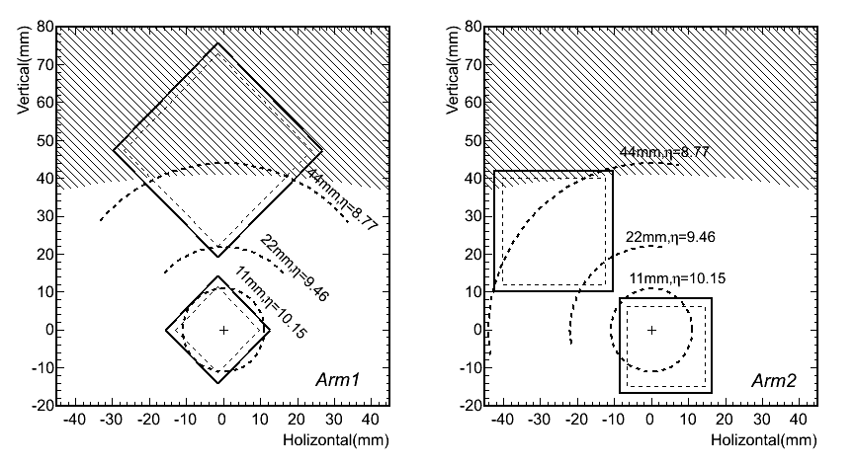
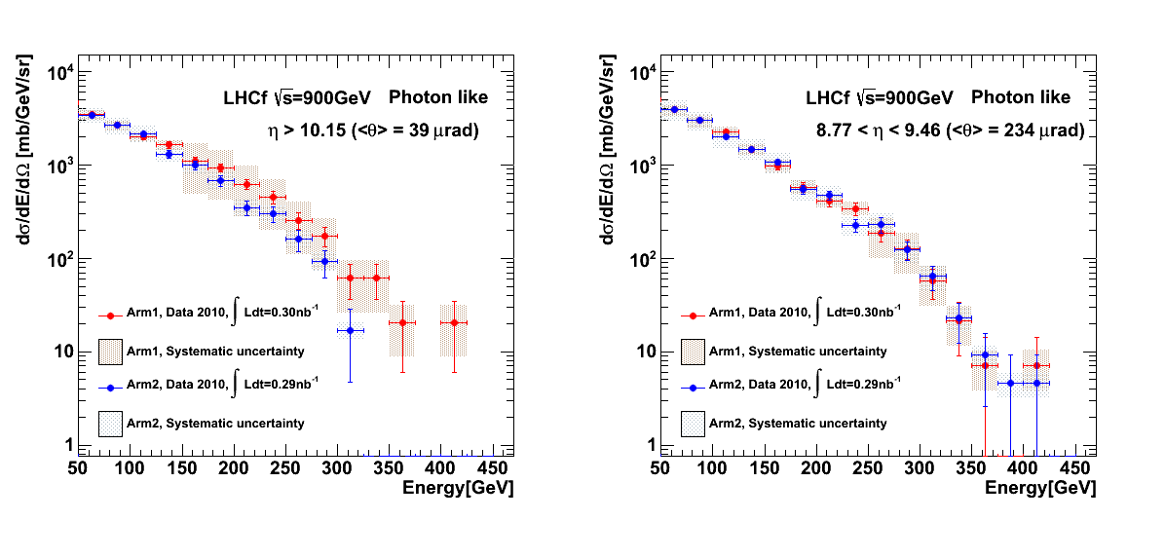
900GeV photon analysis
Cross section of LHCf detectors
Two pseudo-rapidity ranges
- η>10.15
- 8.77<η<9.46
Arm1 and Arm2 data show
an overall good agreement
within their systematic uncertainties.
Beam pipe shadow
Beam pipe shadow
Arm1
Arm2
Arm1 data vs Arm2 data

