Slide 1
RHIC計画とLHCf-AA
Takashi SAKO
STE lab./KMI, Nagoya University
From Large Hadron Collider forward
to Longisland Hadron Collider forward (by R.Tanaka, LAL)

Slide 2
Targets of LHCf
As high as possible energy => LHC
As wide as possible energy range => RHIC, LHC
As (reasonably) wide as possible angle => RHIC, LHC
As ‘CR-atmosphere’ as possible (p-N, N-N, Fe-N; N can be O or C) => RHIC, LHC

Slide 3
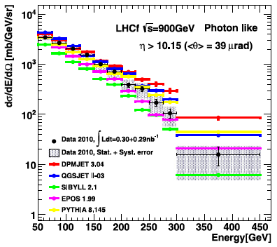
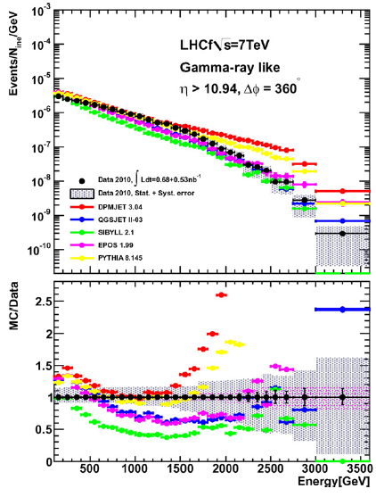
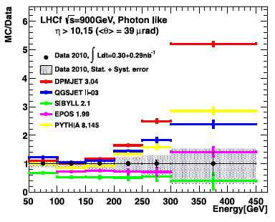
Photons at LHC 0.9 and 7TeV
Photon spectrum at 0.9TeV collisions
Photon spectrum at 7TeV collisions

Slide 4
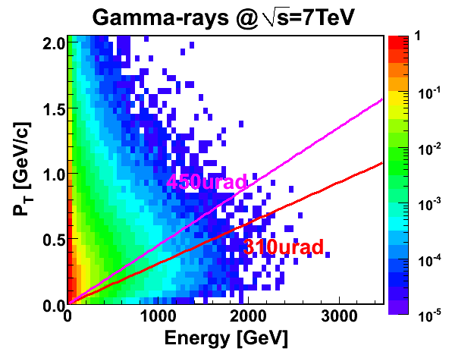
Phase space at LHC
η=7.60
η=5.99
η=6.91
η=8.40
η=8.77
450

Slide 5
Phase space at LHC
η=7.60
η=5.99
η=6.91
η=8.40
η=8.77
η=8.77
450GeV

Slide 6
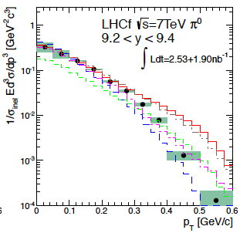
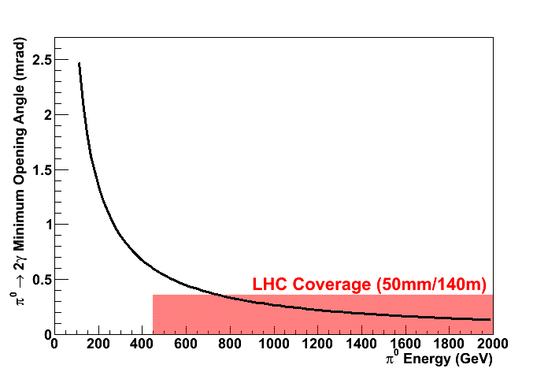
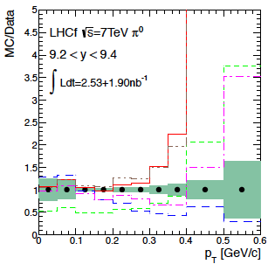
Parent of photons, π⁰
γ E=E₀/2
θ_{min}
π⁰ of E=E₀
γ E=E₀/2
No π⁰ detectable at LHC 900GeV
π⁰ spectrum at 7TeV collisions

Slide 7
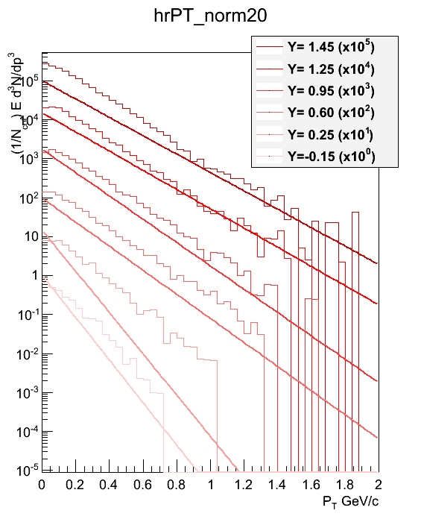
π⁰ at SppS UA7 (630GeV)
Pare et al.
PYTHIA8 (histos) vs UA7 fit
PYTHIA8 does not reproduce UA7
Can we confirm/update/improve UA7?

Slide 8
1st motivation
Large model-to-model difference exists in photon spectrum even at 900GeV collisions.
  LHCf phase space for 900GeV is too small
  LHCf cannot identify π⁰ in the 900GeV collisions
  630GeV π⁰ data is not well implemented
  Still worth studying forward photons and π⁰ <1TeV @ RHIC???

Slide 9

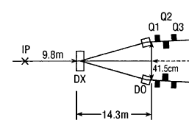
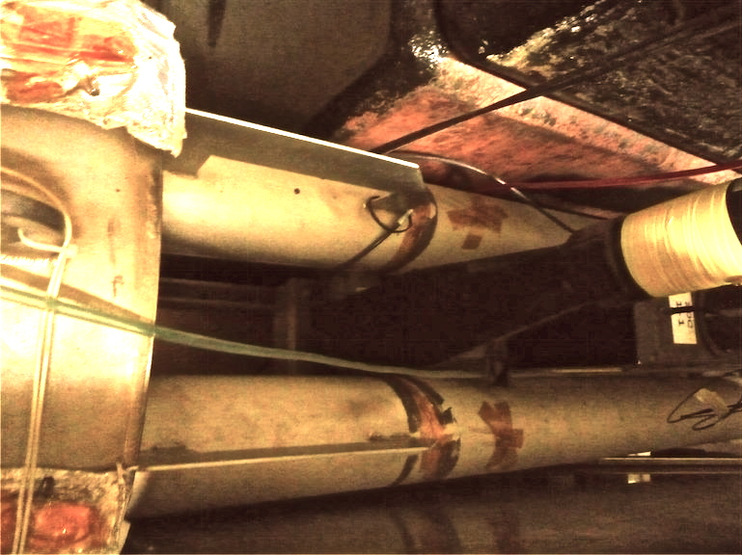
Installation slot
η=5.99
検出器
10cm
η=7.97
Perfect for LHCf detector (92mm×280mm×620mm)
Beam-pipe shadow allows measurement η>6
η=6 => p_{T} = 1.25GeV/c at E=250GeV
close to the LHC 7TeV condition (next slide)
Wider acceptance for π⁰
RHIC 500GeV and LHC 7-14TeV p-p collisions provide uniform dataset for model improvement in a wide energy range
ビーム軸

Slide 10
Phase space at LHC and RHIC
η=7.60
η=5.99
η=6.91
η=8.40
η=6
η=8.77
η=8.77
450GeV
250GeV

Slide 11
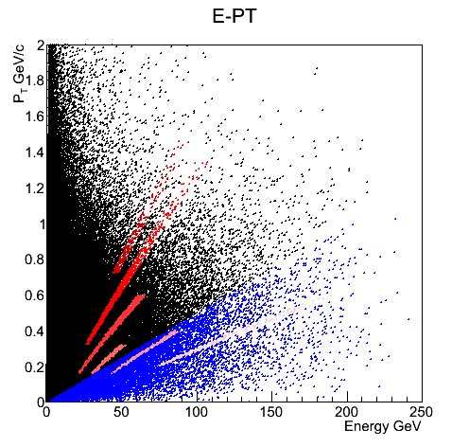
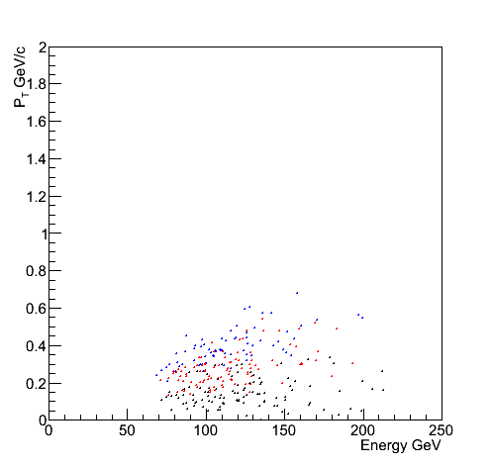
Pi0 by PYTHIA8 (500GeV p-p)
w/o detector geometry
w/ detector geometry
(colors for different detector position)
All pi0 UA7 coverage (630GeV) η>6 (roughly LHCf at RHIC)

Slide 12
2nd motivation
So far, no anomaly is observed at LHC p-p collisions, but we know the CR models can not describe the observed muon density.
p-p to A-A (or p-A) conversion is not trivial (nuclear effect) => Any hint here???
Cosmic rays are not Pb, not Au, not Cu, not U
Atmosphere is not proton, not Pb, …
CR-Air collisions are
  (p, He, C, N, O, …, Fe) and (N, O)
  Light ion collisions give direct answer to CR physics
  Maybe pioneering in the collider society (?)

Slide 13
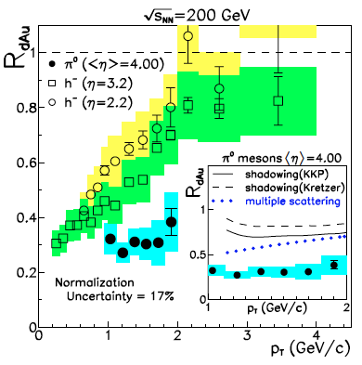
RHIC d-Au √s_{NN} = 200GeV; forward meson
η=2.2
η=3.2
η=4.0
(The STAR Collaboration, PRL 97 (2006) 152302)
Strong suppression of forward meson production is observed
Except d in RHIC d-Au、only heavy ions like Pb and Au are used in the colliders
p-Pb at LHC, p(d)-light ions will be interesting

Slide 14
p-N collisions(p-remnant side) at √s_{NN} = 200GeV (by T.Suzuki)
Neutrons
pi0
Model-to-model difference reflects the difference in p-p collisions

Slide 15
p-N/p-p (neutron)
DPMJET3
QGSJET2
EPOS

Slide 16
(p-N/p-p)/(p-N/p-p)_{DPMJET3}
Neutron
pi0
QGSJET-II (red and magenta) uses very similar nuclear effect to DPMJET3, ratio~1
EPOS (blue and light blue) predicts strong suppression in forward
These are difference between three models, but not theoretical uncertainty

Slide 17
Summary
LHCf detector can fit the RHIC forward installation slot.
p-p forward is not understood even <1TeV
  RHIC 500GeV p-p collisions enable a similar phase-space coverage to the LHC 7-14TeV p-p collisions. (better than LHC 900GeV)
Light ion collision is waited by CR community
  RHIC may be able to provide the world-first light ion collisions for astroparticle physics.

Slide 18
Technical issue
No big problem was pointed out in the meeting in Dec 2011
except BG not associated with collision, that must be understood.

