Slide 1
Longitudinal Spin Physics at PHENIX
RIKEN/RBRC
Itaru Nakagawa

Slide 2
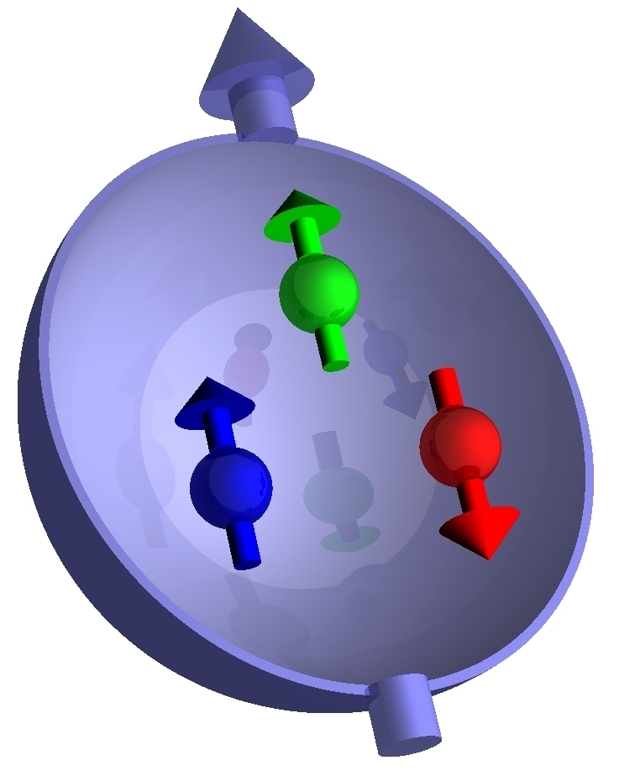
Spin Structure of Proton
(In very naïve picture)
Proton Spin
Valence Quark Spin
proton

Slide 3
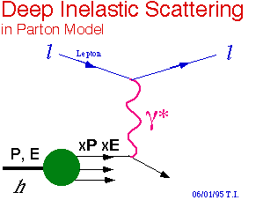

Quark Polarization
Momentum fraction x (Bjorken x_{BJ})
Momentum fraction x
Where is the rest of proton spin?

Slide 4
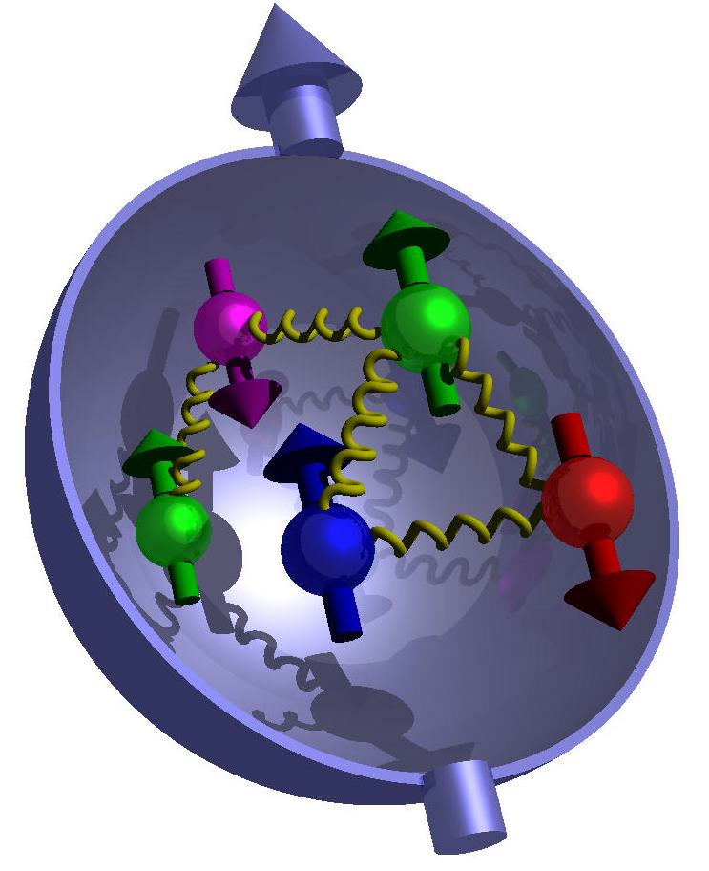
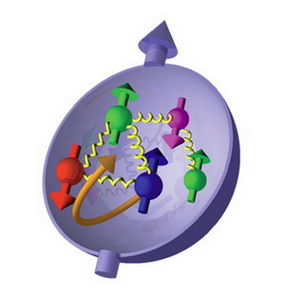
Complete Picture of Proton Spin
Valence Quark
Gluon + Sea Quark
Angular Momentum

Slide 5

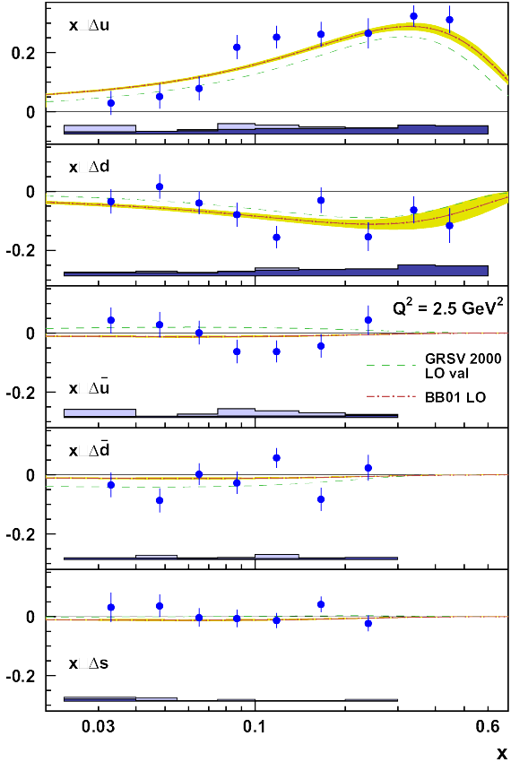
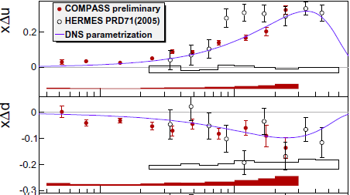
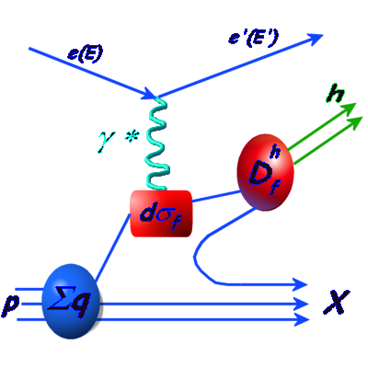
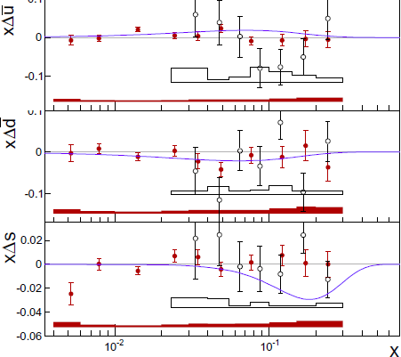

Polarized Semi-DIS
Flavor Tagging
valence
Q
Sea
Fragmentation Function
(Model Dependence)
Proton Structure
pQCD
e⁺e⁻
z=E_{h}/ν

Slide 6
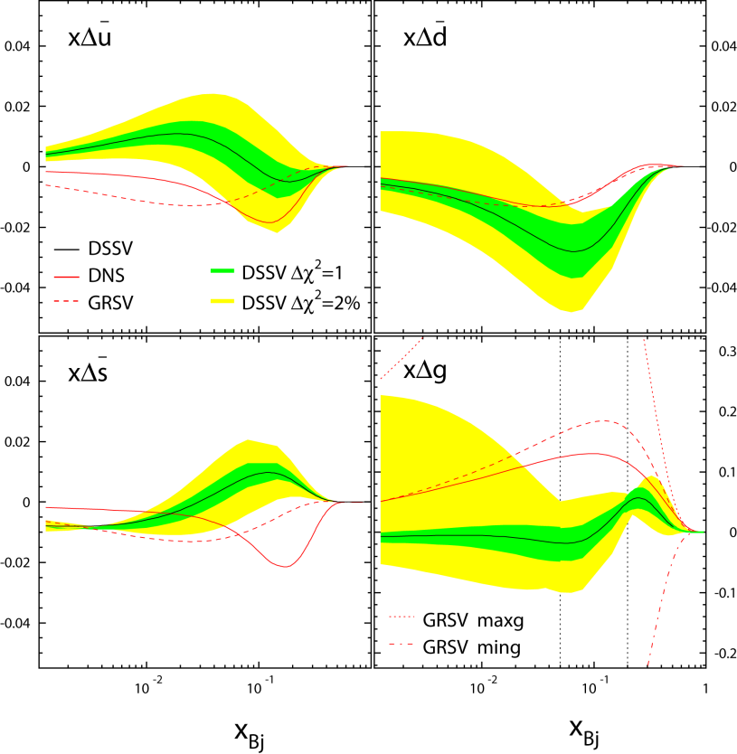
DSSV Global Analysis
de Florian et al., PRL101, 072001 (2008)
Valence Quark
pQCD based theory fits DIS/SIDS Data up to 2008
Sea Quark
Gluon
Valence Quark
-> well measured.
Sea Quark, gluon
-> not well known

Slide 7

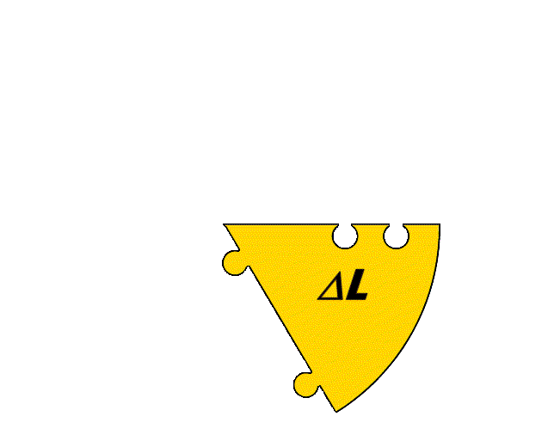
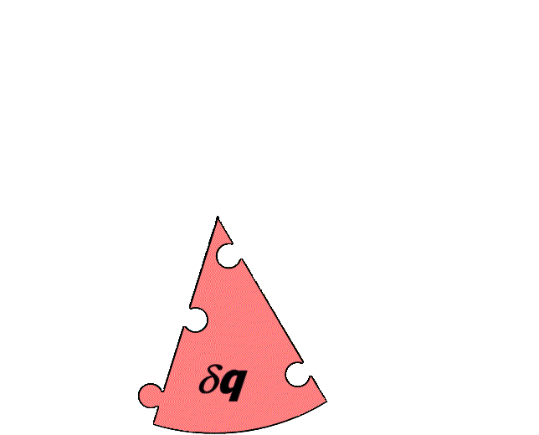
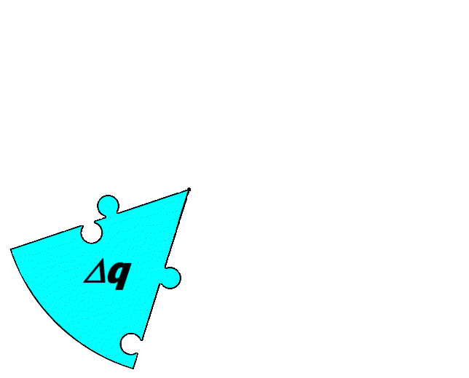
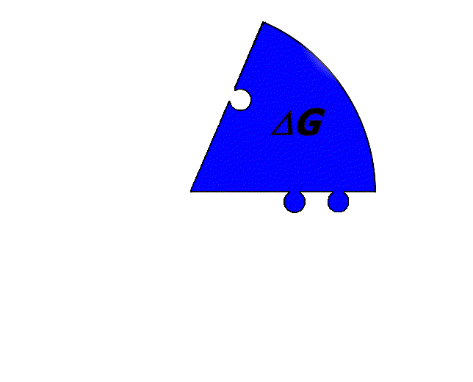
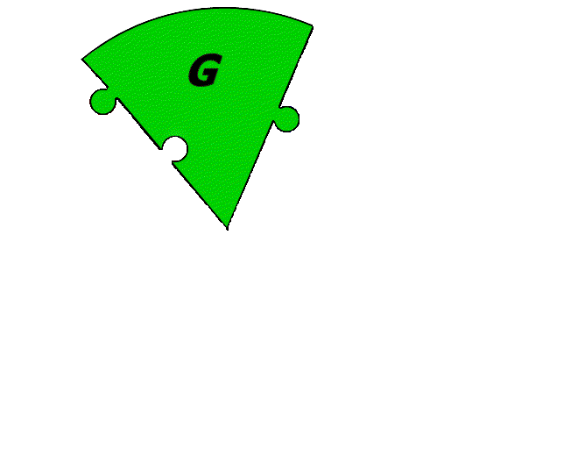
Longitudinal Spin Sum Rule
Longitudinal Spin Sum Rule
Valence + Sea Quark Spin
Gluon Spin
Quark + Gluon Angular Momentum
Challenge to Measure Each Pieces Compose Proton Spin

Slide 8
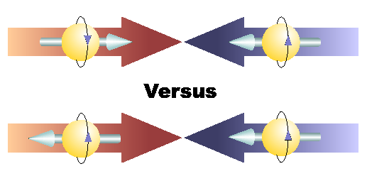
Longitudinal Spin Physics @ PHENIX
(spin vector parallel to momentum direction)
observable
helicity
+
+
p
p
-
+
p
p
Helicity Dependent Asymmetry

Slide 9
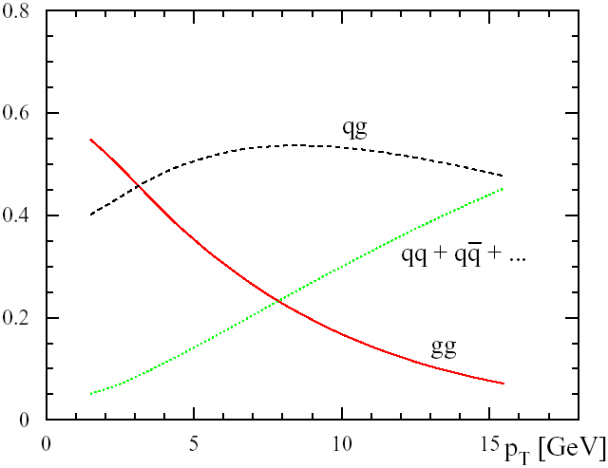
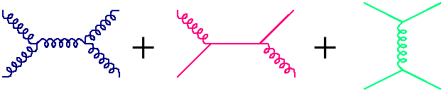
Interpretation of observed asymmetry
Fractional Contribution to π⁰ production
|η|<0.35
<- Small x
g
g
q
g
q
q
Gluon in Leading Order unlike DIS/SIDIS, but
Observables are combination of gluon, valence+sea quark contributions

Slide 10

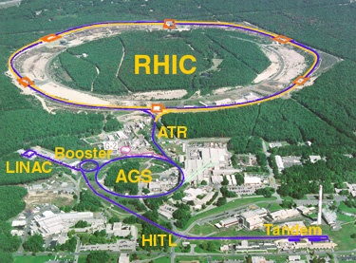
The Relativistic Heavy Ion Collider
accelerator complex
at Brookhaven National Laboratory
Brahms
pp2pp
PHENIX
STAR

Slide 11
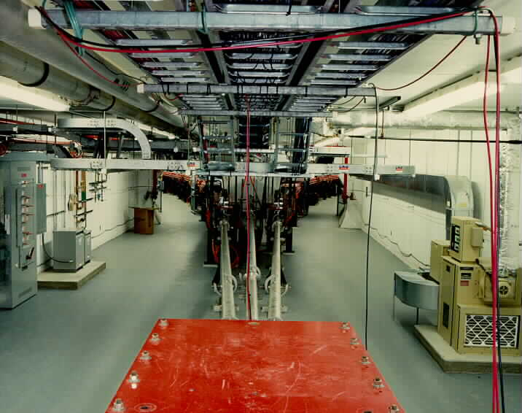
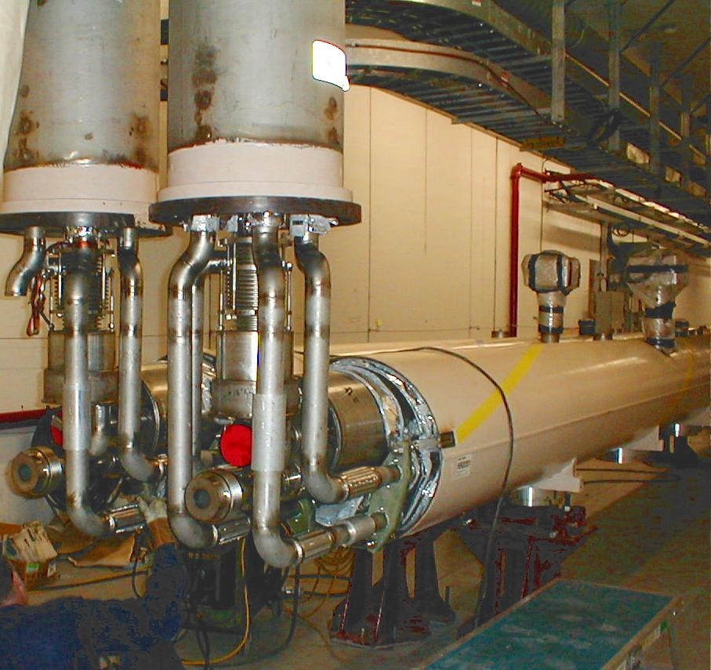
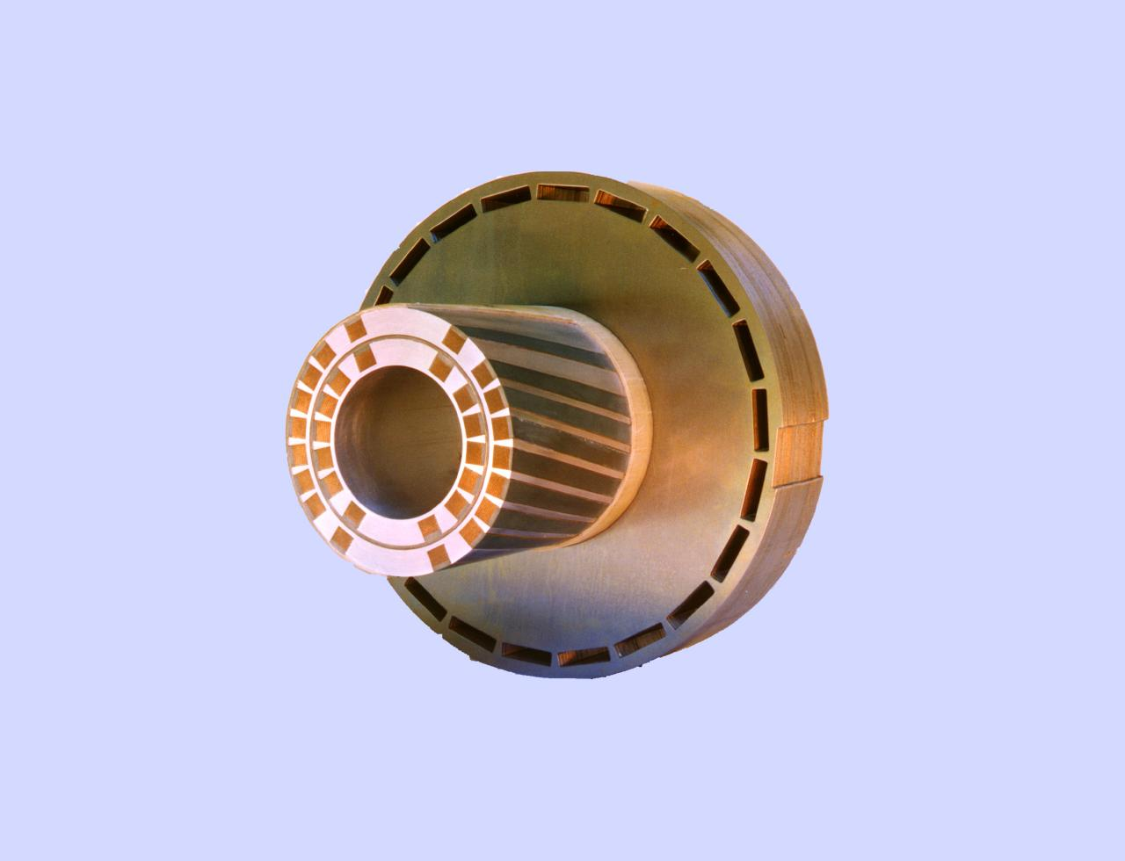
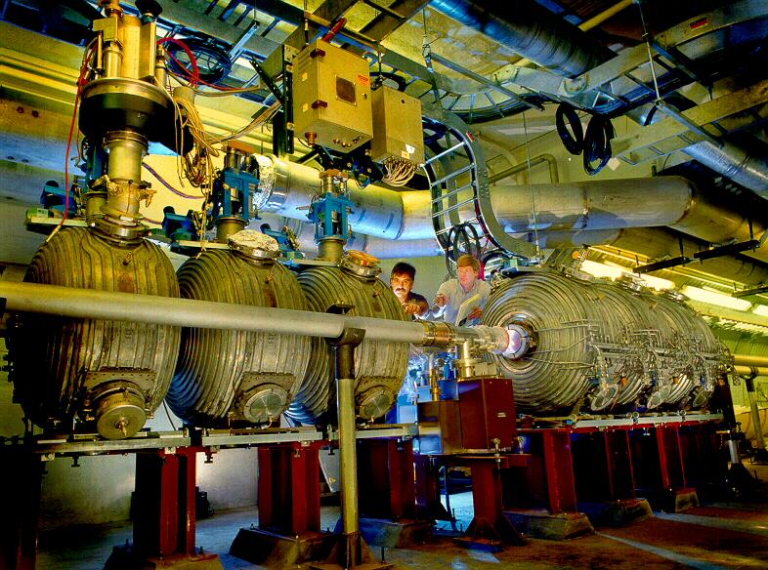
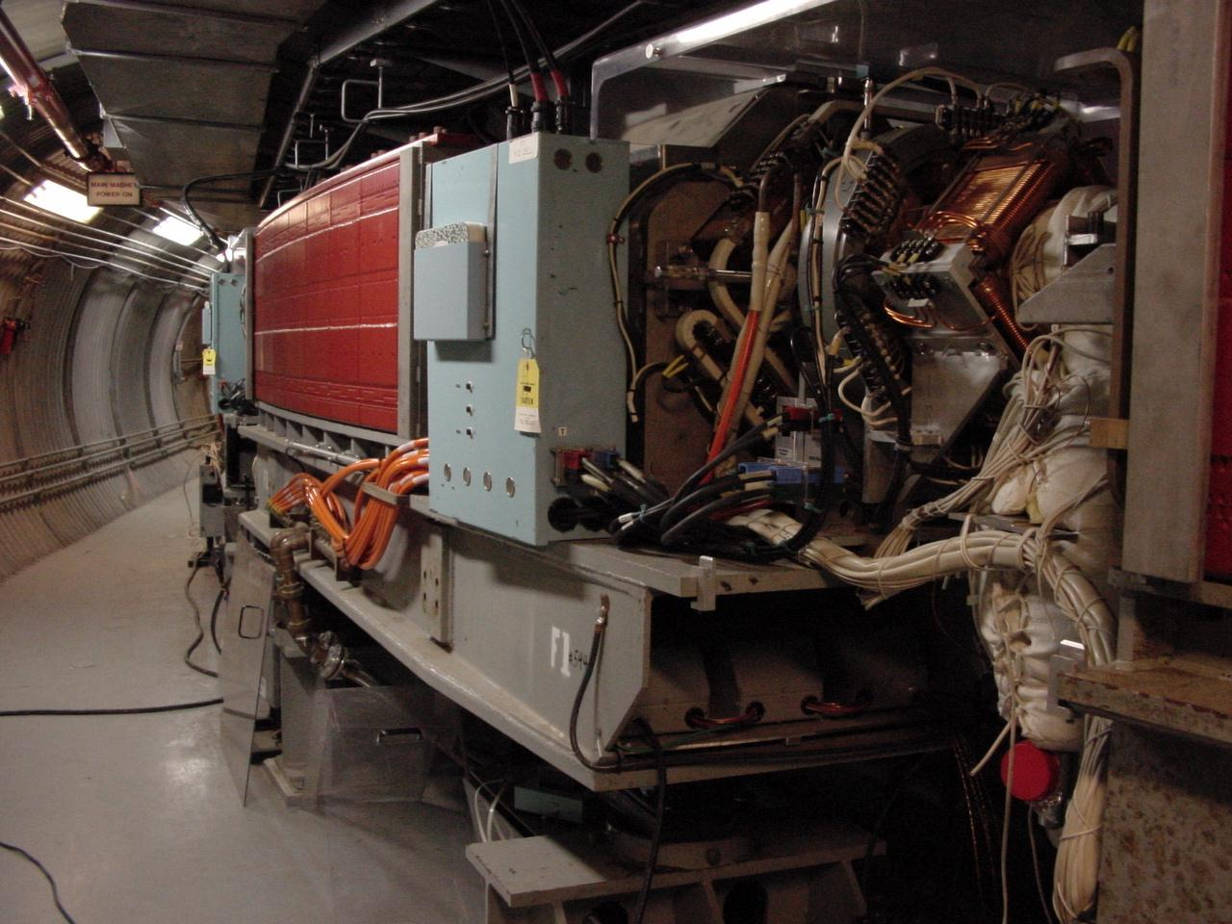
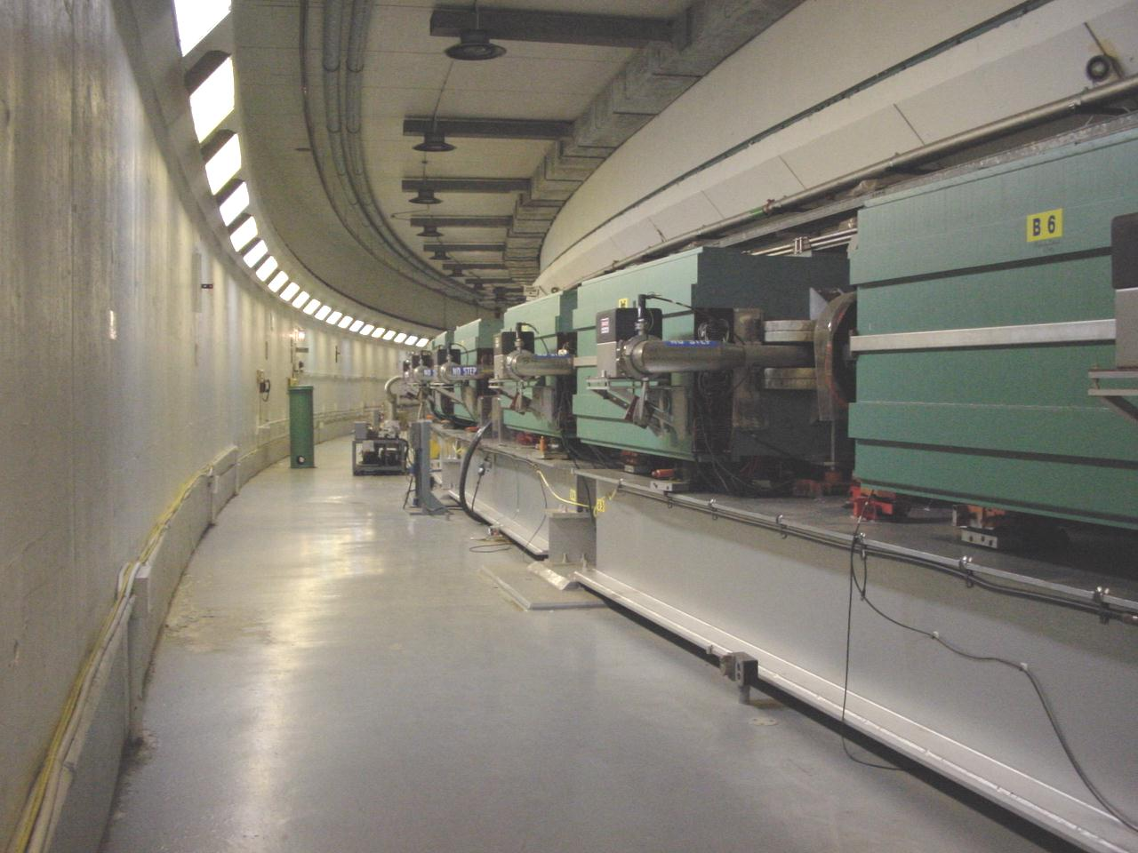
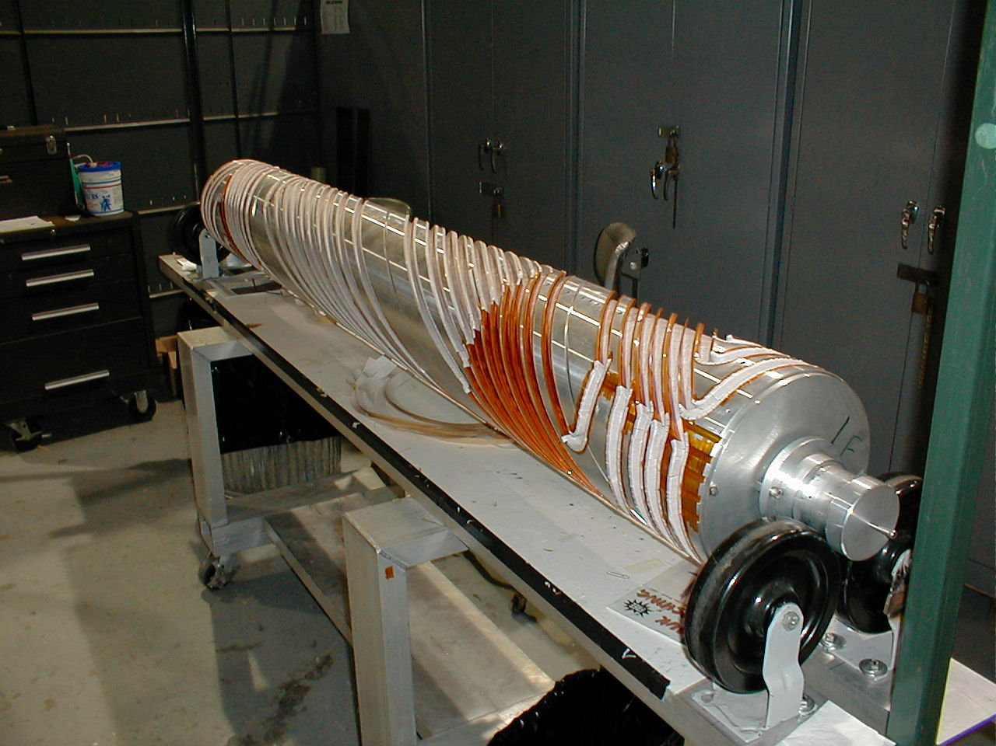
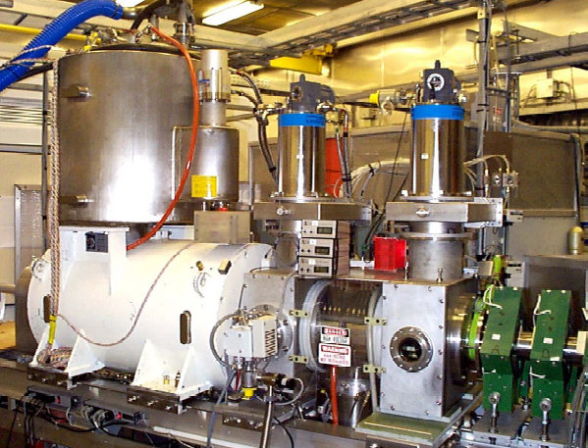
BRAHMS(p)
Absolute Polarimeter (H jet)
RHIC pC Polarimeters
Siberian Snakes
PHENIX (p)
Spin flipper
STAR (p)
Spin Rotators
(longitudinal polarization)
Spin Rotators
(longitudinal polarization)
Solenoid Partial Siberian Snake
LINAC
BOOSTER
Pol. H⁻ Source
Helical Partial
Siberian Snake
200 MeV Polarimeter
AGS
AGS Polarimeters
Strong AGS Snake
11
SpinFest, August 7, 2008

Slide 12
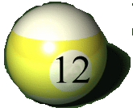
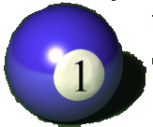
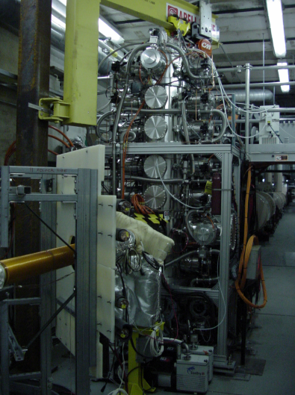
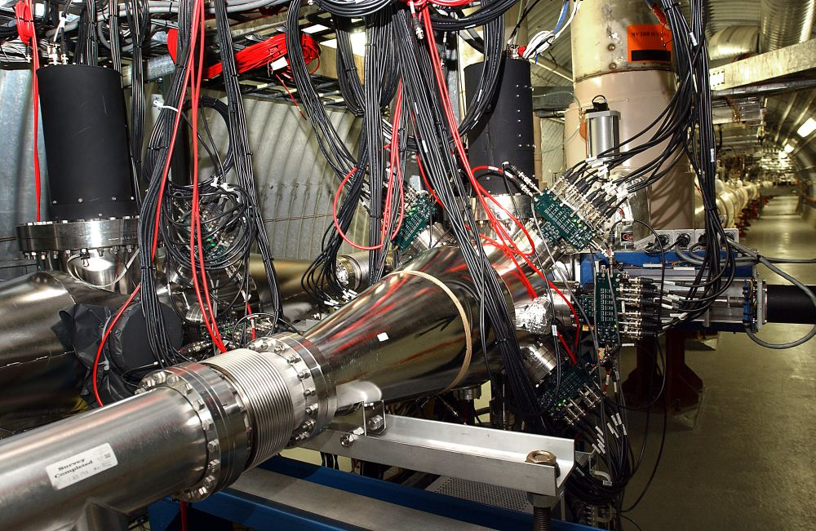
How do we know the polarization?
Measure left vs. right asymmetry
A_{N}(pC)~1%
Hydrogen Gas Jet Polarimeter
Carbon Ribbon Target
Polarized Proton
Polarization : 50 ~ 60%
Recoil Carbon
Carbon Polarimeter
Notes:
12

Slide 13
RHIC p+p accelerator complex
RHIC pC “CNI” polarimeters
absolute pH
polarimeter
BRAHMS
& PP2PP
PHOBOS
v vv
RHIC
Siberian
Snakes
PHENIX
STAR
Siberian Snakes
Spin Rotators
5% Snake
LINAC
BOOSTER
AGS pC “CNI” polarimeter
Pol. Proton Source
AGS
200 MeV polarimeter
Rf Dipoles
Coulomb-Nuclear
Interference
20% Snake

Slide 14
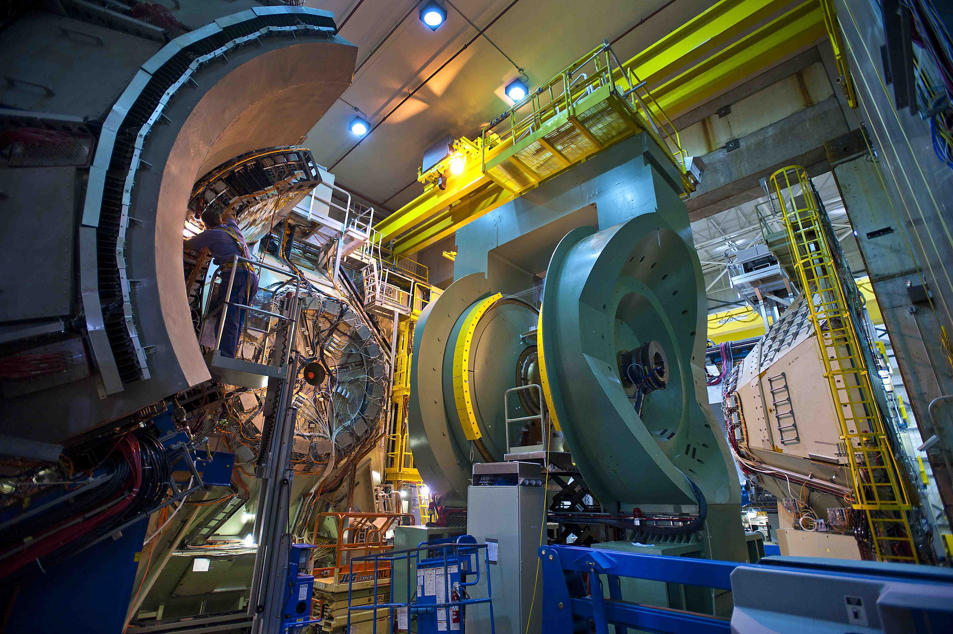
PHENIX Detector

Slide 15
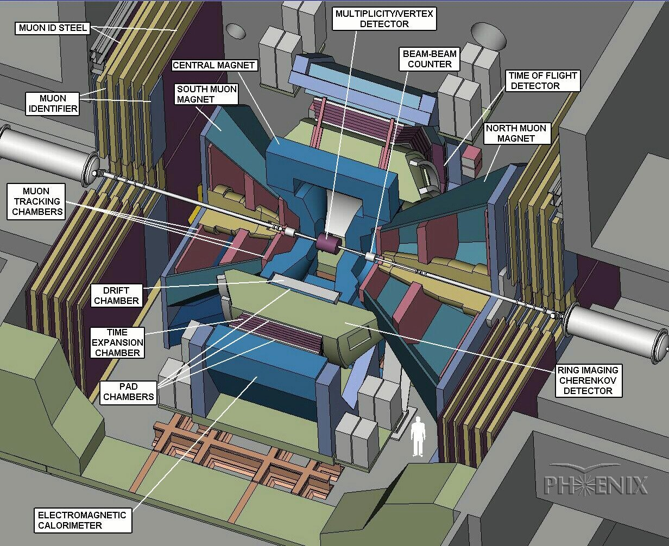

Slide 16
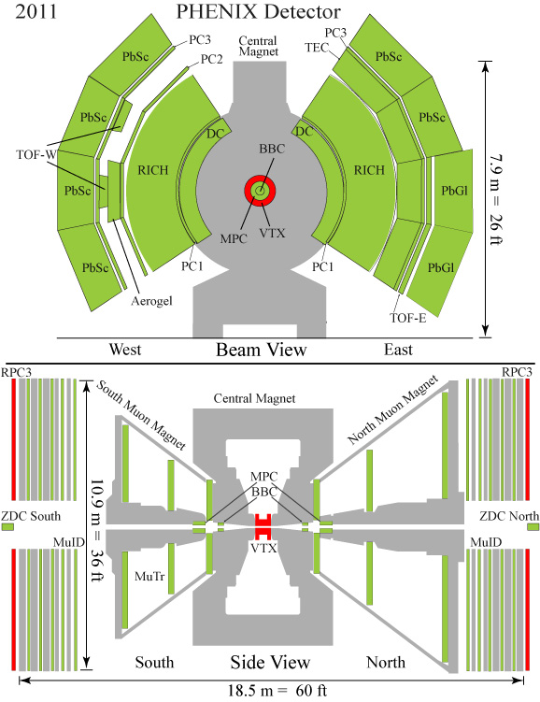
The PHENIX Detector
Philosophy
  high resolution & high-rate at the cost of acceptance
  trigger for rare events
Central Arms
  |η| < 0.35, Δφ ~ π
  Momentum, Energy, PID
Muon Arms
  1.2 < |η| < 2.4
  Momentum (MuTr)
Muon Piston Calorimeter
  3.1 < |η| < 3.9
γ
γ
h⁺
η,π⁰
μ
MPC

Slide 17
ΔG
DouBle Helicity A_{LL}
Observable | Advantage
π⁰ | Statistics
Direct - γ | Less model dependent
π⁰ - π⁰ correlation | Kinematic constraint
charged π | ΔG sign
heavy flavor (decay e⁻ ) | Lower x, g-g dominant
MPC cluster | Lower x

Slide 18
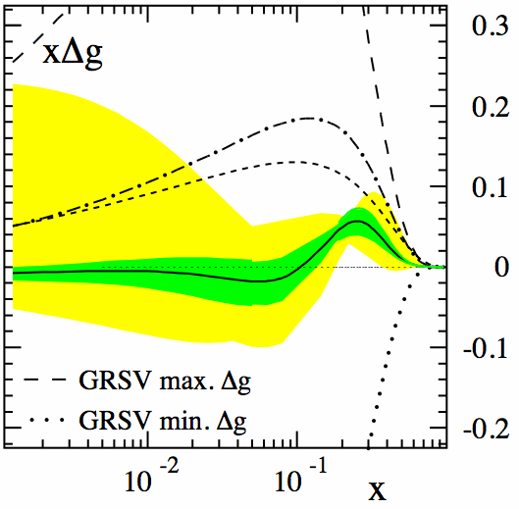

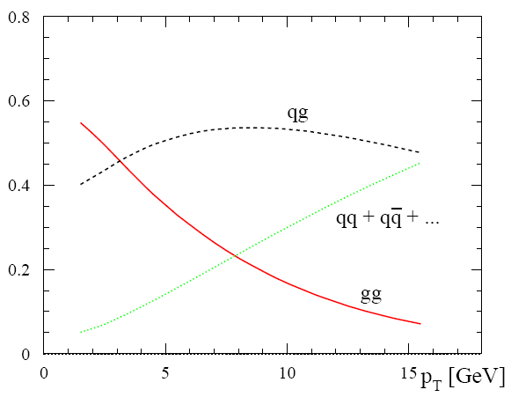
Central Arm π⁰
RHIC data
[1]
0.02<x<0.2
Statistically Abundant
0.02 < x < 0.2
glue-glue subprocess at small P_{T}
Fractional Contribition to π⁰ production
(η is similar)
Phys. Rev. Lett. 101, 072001(2008)

Slide 19
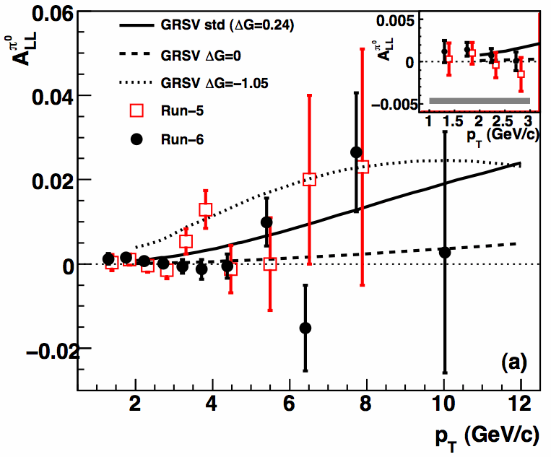
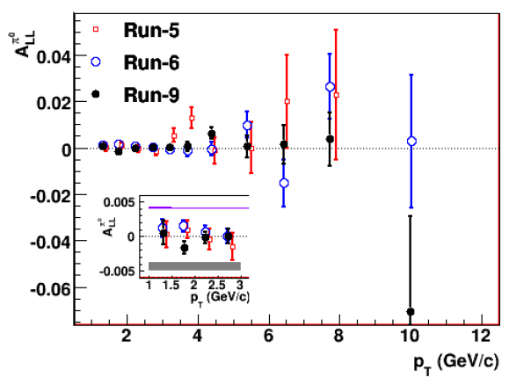
Relative Luminosity :
Run | <P> | L
Run5 | 50% | 2.5
Run6 | 56% | 6.5
Run9 | 57% | 14
π⁰ A_{LL}
Improved Statistics Year by Year
Run5, Run6 Consistent with zero
Systematic Error Becomes Serious at small P_{T}
What’s the impact of Run9 data?

Slide 20
DSSV Interpretation of π⁰ A_{LL}
D. De Florian et al.
Progress in Particle and Nuclear Physics 67 (2012) 251
Run5+Run6+Run9 Combined data constrain ΔG
Small x region more sensitive to gluon Polarization
Combined Global Fit with STAR Jet Results

Slide 21
Impact on ΔG
DSSV
DSSV+ : COMPASS + RUN5,6 RHIC
DSSV++ : RUN9 RHIC
First Observation
of non-zero ΔG!

Slide 22
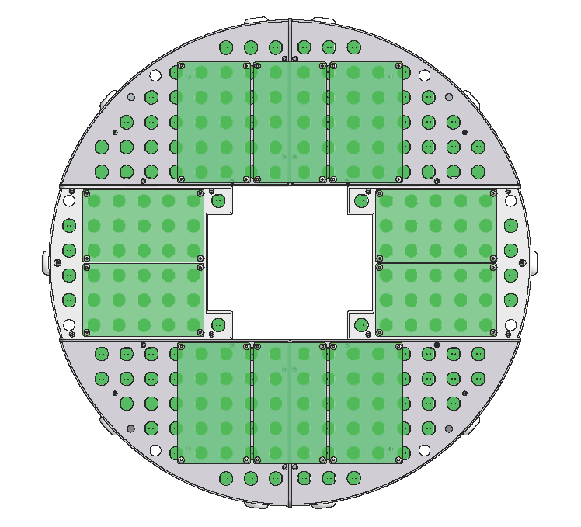
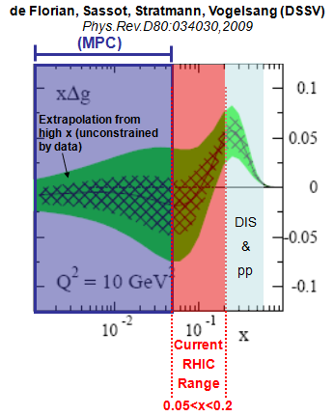
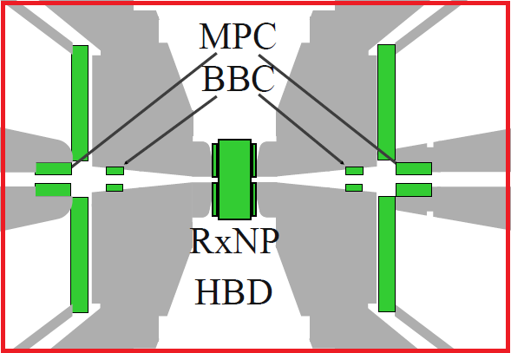
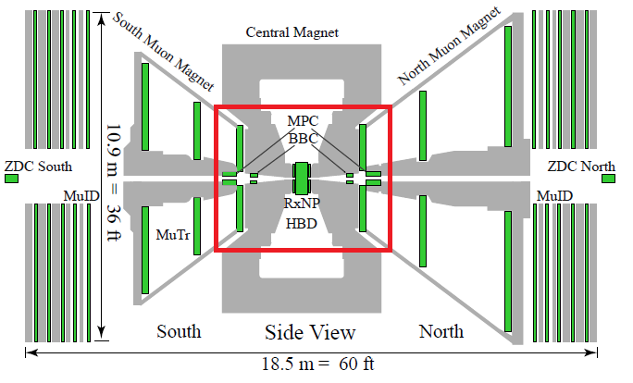
Exploring Lower-x by Forward MPC
Muon Piston Calorimeter 3.1<|η|<3.9
Low P_{T} Reconstructed π⁰
High PT Merged π⁰
cluster

Slide 23
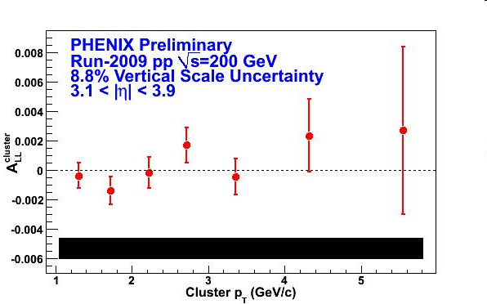
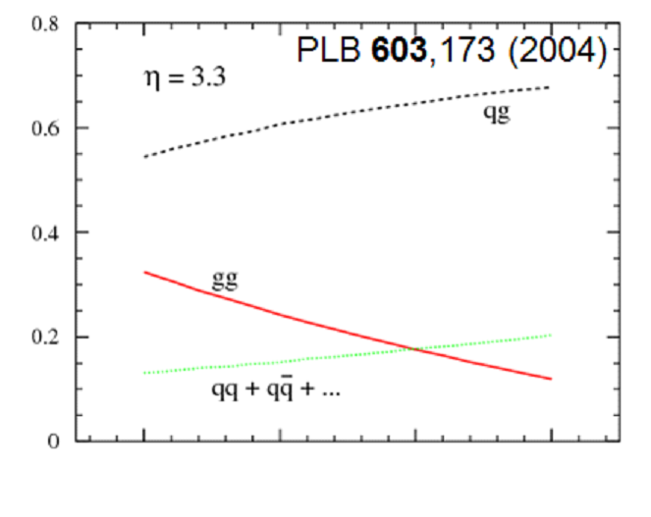
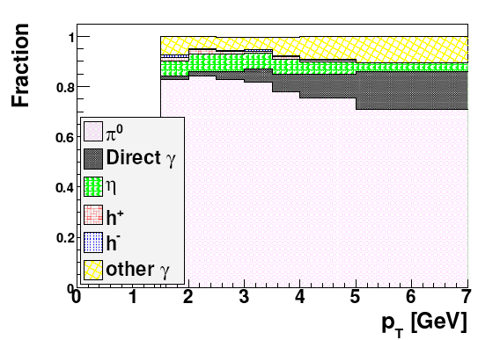
Cluster A_{LL}
Dominated by π⁰
p_{T} (GeV/c) 2 3
Still consistent with zero at lower x
Systematic error starts to defeat statistics
Good control of relative luminosity required for better precision

Slide 24
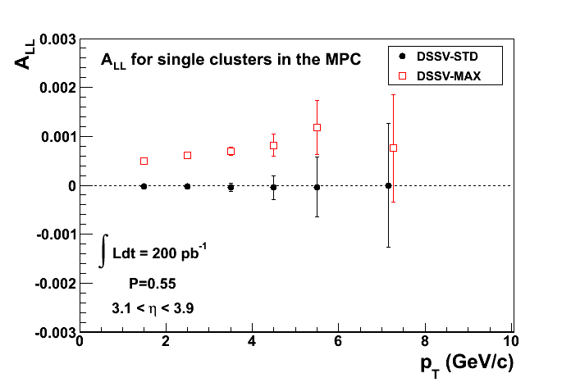
A_{LL}(MPC) Cluster for Run13
RHIC data

Slide 25
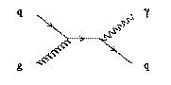
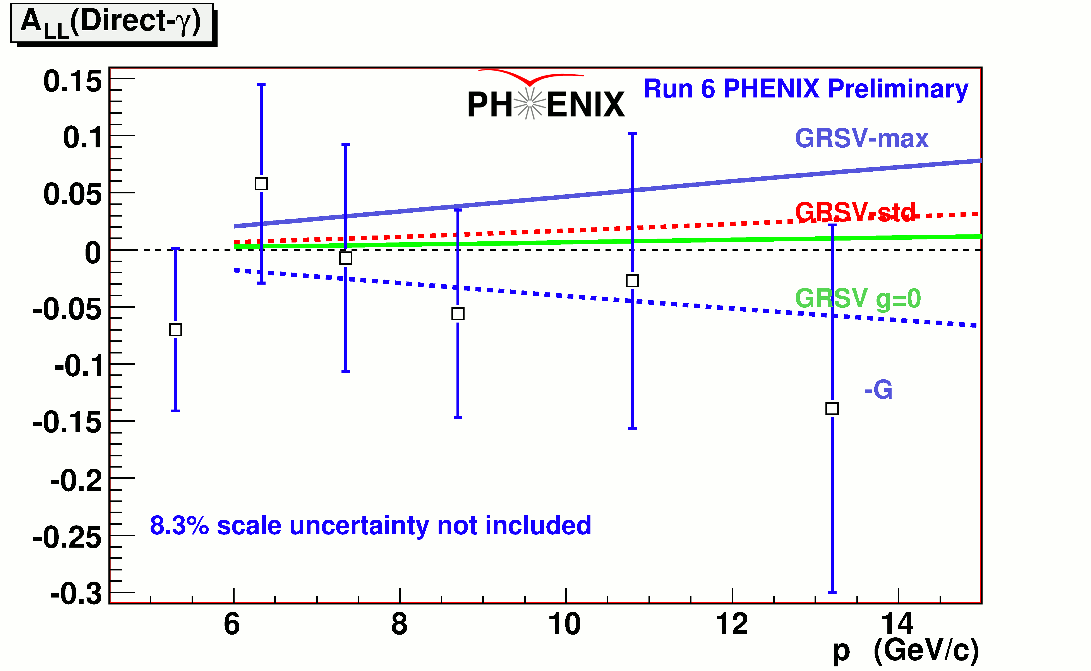
Direct Photon
Fragmentation Function
-> Model Uncertainty
Fragmentation Function Free
Clean Probe
MPC-EX (low-x) to separate pi0 vs. γ

Slide 26
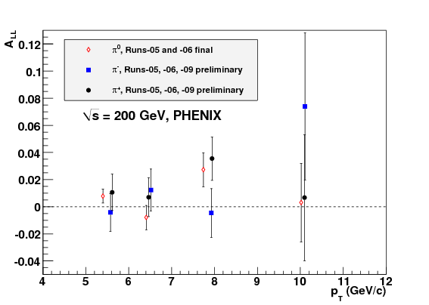
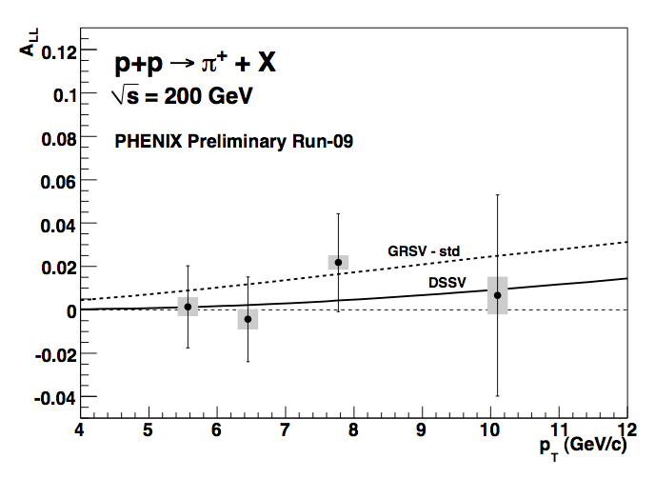
Preliminary Charged pion A_{LL}
π± charge asymmetry is
sensitive to sign of Δg(x, Q²) :
  D_{u}^{π+} >D_{u}^{π0} >D_{u}^{π-} , Δu>0
  D_{d}^{π+} <D_{d}^{π0} <D_{d}^{π-} , Δd<0
For positive Δg :
A^{π+} _{LL} >A^{π0} _{LL} >A^{π-} _{LL}
p_{T} range of this analysis covers <x_{g}>~0.1
Notes:
Charged pions can also be identified at mid-rapidity via tracks, and studying their relative asymmetries can tell us something directly about the sign of delta G.
In the neutral pion asymmetry, the sensitivity that one gets to the sign of delta G from quark-gluon interactions cannot be broken down by flavor.
Howevrer, comparing the asymmetry for positive pions vs negative pions allows us to do just this for the following reason.
Since pi+ is preferentially fragmented into by u quarks and pi- preferentially fragmented into by d quarks, we know that the quark-gluon component of the pi+ sample is heavily dominated by up-gluon interactions, while the pi- sample is dominated by down-gluon interactions.
Therefore, if we find that ALL pi+>pi0>pi- or pi- then the dG must be positive to match the corresponding positive term from delta sigma
Conversely if pi-<pi0<pi+ then we can deduce the dG<0
Here we show the result when combining the 2009 data with the 2005 and 2006 datasets. On the left is the pi+ result, and on the right is the pi- result. In each case we show this plotted with the GRSV-std and DSSV predictions.

Slide 27
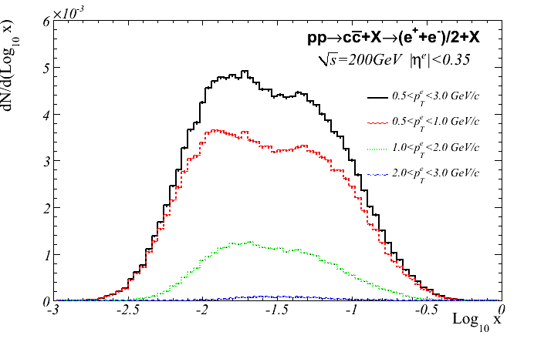






Heavy Flavor Decay Electrons
$$c, \overline{c}→e+X$$
signal
Signal electron
$$π^{0}$$
backgrounds
Subprocess fraction at NLO
e
arXiv : 0911.2146
HBD

Slide 28


Heavy Flavor Measurements
Contaminated many background processes -> (Estimated by Simulation)
Silicon Vertex for Heavy Flavor Separation
Silicon Vertex Detector

Slide 30
Longitudinal Analysis topics
longitudinal | Run 9 |  | Run 11 | Run 12 | Run13
 | 200 GeV | 500 GeV | 500 GeV | 500 GeV | 500GeV
π⁰/η | Andrew
γ | ⊗
π⁺/π⁻ | ⊗
h⁺/h⁻/jet | (⊗)
π⁰-π⁰ central | Kimiaki
π⁰-h± central
h-h forward
π⁰/cluster forward | ⊗ | Scott |  | ⊗
e/μ (heavy flavor) | Katsuro |  | ⊗
J/ψ forward |  |  | Xiaorong | Aaron,Imran
W→e |  | Kenichi | Mikhail, Ciprian |  | Sadeela（Umass), Inseok (SNU)
W→μ |  |  | Hide | Sanghwa, Chong、Abraham(NMSU) | Daniel(UIUC),Hari(GSU), Mike(UCR)

Slide 31
Summary
Many Attractive and Interesting Research Going on in PHENIX Spin Program.
You Are More Than Welcome to Join!

Slide 32

Heavy Quark Measurement
Direct Method
Reconstruct the parent meson from their
daughter particles.
Hard to reconstruct in high multiplicity
Indirect Method
Measure leptons(electrons) from semi-leptonic decays of D/B.
Standard method in PHENIX
VTX can improve both Indirect and Direct method
by DCA measurement.

Slide 33
Distance of Closest Approach (DCA)
Collision happens
D meson is emitted from the event vertex
This D meson will decays in flight. Decay products are scattered at secondary vertex.
Electron is measured by VTX. The track is reconstructed.
DCA = Distance of Closest Approach of a reconstructed track to the event vertex
e
ν
K
Secondary
Vertex
D
DCA
beam
beam
Event
Vertex

Slide 34

DCA : Flight path length of Signal and Background
Back Ground
π0 cτ = 25.1 nm
η for Γ = 1.30 ± 0.07 keV
ω for Γ = 8.49 ± 0.08 MeV
ρ for Γ = 149.1 ± 0.8 MeV
φ for Γ = 4.26 ± 0.04 MeV
j/ψ for Γ = 28.6 ± 2.2 MeV
K+/-e3 cτ = 3.712 m
K0S cτ = 2.6842 cm
K0L cτ = 15.34 m
γ conv @ material
Signal
D0 cτ = 122.9 μm
D+ cτ = 311.8 μm
B0 cτ = 457.2 μm
B+ cτ = 491.1 μm
Emitted from Zvtx
Far from Zvtx
With 50um resolution, VTX separate D and B and reject BG contribution

Slide 35




PHENIX Silicon Vertex Trackers (VTX & FVTX)
  Side view
To be installed in 2011!
Installation Completed!
2 Pixel layers
2 Stripixel layers
  Beam view

Slide 36
Physics Motivation
Measurement in p + p, d + Au and Au + Au Collisions
  Single Muons measurements:
    Precision heavy flavor and hadron measurements.
    Separation of c and b in semi-leptonic decays via decay kinematics.
    Improve W background rejection.
  Dimuons measurements:
    Separation of ψ’ from J/ψ at forward rapidity.
    B→J/ψ, golden channel to measure B cross section.
    First Drell-Yan measurement at RHIC.
Physics FVTX Can Access:
  Energy loss mechanism in hot dense medium (Heavy flavor R_{AA,} v₂)
  Cold nuclear effects ( Heavy flavor R_{dAu})
  Gluon polarization ΔG/G (Heavy flavor A_{LL})
  Sivers function, higher twist (Heavy flavor A_{N})
  Crucial test of QCD universality (Drell-Yan A_{N})
Notes:
Then, go to details of physics goals with FVTX, what we are going to achieve in pp dAu and AuAu collisions? In single muon …

Slide 37

W measurement Run13 Projections
Goal : 250 pb⁻¹ on tape (-30<z_{vtx}<30cm)
Delivered Luminosity
Improving Performance of RHIC

Slide 38



Further Sea Quark Measurement w/ DY
S/B contributions
w/o vertex detector
J/Ψ
Drell Yan
High-mass DY
ϒ-states
Low-mass DY
beauty
charm
Invariant mass (GeV)
VTX
FVTX (S)
FVTX (N)
VTX
Extract DY events from heavy flavors
using FVTX

Slide 39
Summary
Presented latest ΔG and Δq measurements from PHENIX
High statistics π⁰ provides strict limit on present knowledge of ΔG
Different probes constrain ΔG from various angles (purity, sign, low-x, etc…)
First measurement of forward W A_{L}. Improving our knowledge on Δq in conjunction with W->e data.
Higher statistics and smaller systematic in future measurements

Slide 40
backup

Slide 41
References
[1]

Slide 42


Global Fit including Run9 π⁰ A_{LL}
By S.Taneja et al (DIS2011)
ala DSSV with slightly different uncertainty evaluation approach
DSSV
DSSV + PHENIX Run9 π⁰ A_{LL}
No node …
Uncertainties decreased
A node at x~0.1 ?

Slide 43
Charged pion Cross Section
Charge separated fragmentation functions are not well constrained in DSS FFs
In good agreement with STAR

Slide 45

HBD Analysis for Heavy Flavor Decay e⁻

Slide 46
HBD Signal Occupancy

Slide 47


ΔG Extraction from A_{LL}^{HFe}
Open charm production dominates in p_{T} range of 0.50 < pT < 1.25 GeV/c (J/ψ <2%, b quark<5%)
pQCD prediction for A_{LL}^{open charm} obtained from CTEQ6M PDFs + PYTHYA + LO hard scattering cross section
A_{LL}^{open charm} ~|∆g/g(x, µ)|²
|∆g(x, µ)| = C g(x, µ) is assumed
Results:
|∆g/g(⟨logx⟩,µ)|² <3.3 ×10 ⁻² (1σ) and 10.9 ×10 ⁻² (3σ)

Slide 48
Central W Analysis

Slide 49
Spin Puzzle
Quark Spin
Spin Puzzle

Slide 50

ΔG Extraction from A_{LL}^{HFe}
arXiv:1209.3278
Submitted to PRD
This results largely benefited from using HBD in eliminating photo-conversion and Dalitz decay background.
Decay electrons include J/ψ , bottom production and other vector meson as well as open charm contributions.
Open charm production dominates in p_{T} range of 0.50 < pT < 1.25 GeV/c
(J/ψ <2%, b quark<5%)
|∆g/g(⟨logx⟩,µ)|² <3 ×10 ⁻² (1σ)
( 0.01 ~ x ~ 0.08)

Slide 51





More Challenging Attempt : π⁰-π⁰ correlation
Constrains event kinematics further
Cost Statistics, need high P⁴L
Invariant mass [GeV]
Invariant mass [GeV]
Notes:
Need update Kimiaki’s Plot.

Slide 52


510 GeV - A_{LL}(MPC)

Slide 53
ΔG Measurement at PHENIX

