Slide 1
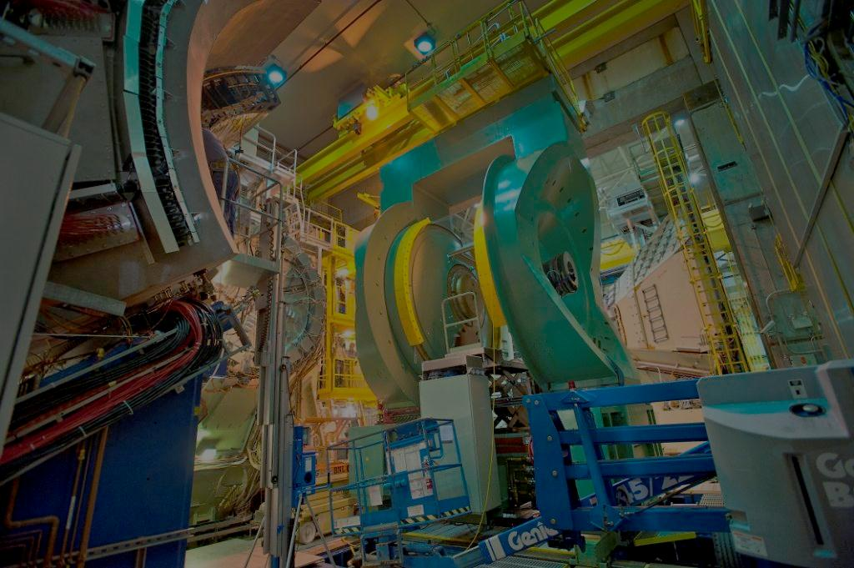
W-boson Measurement at PHENIX
Kiyoshi Tanida (Seoul National University)
Nov. 27, 2012
Korea-Japan PHENIX collaboration workshop @ Ehwa University

Slide 2
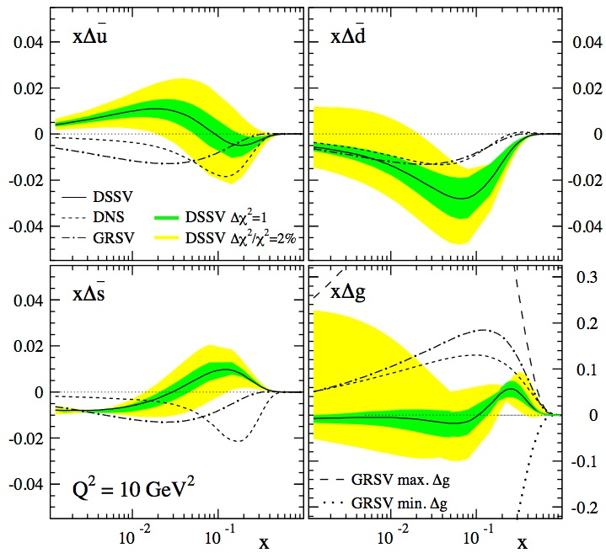
Motivation
Quark spin in proton
  Total is rather well known from DIS, β-decay, etc.
  However, flavor-by-flavor polarization, especially for anti-quark is not well known.
DSSV: PRL 101, 072001 (2008)

Slide 3
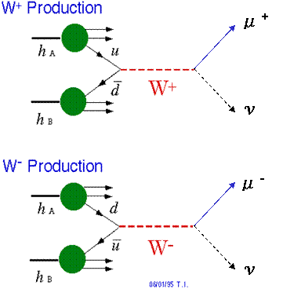
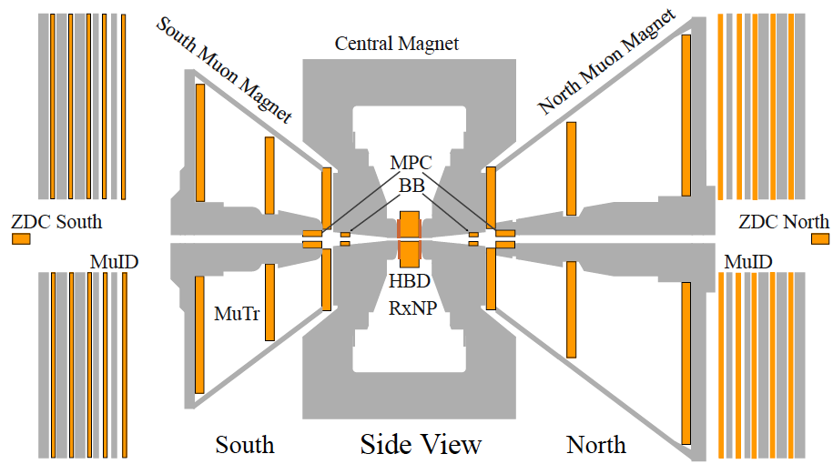
What can we do?
μ±
No fragmentation
High Q² (set by W mass)
Fixed helicity & flavor
Really clean in theory

Slide 5
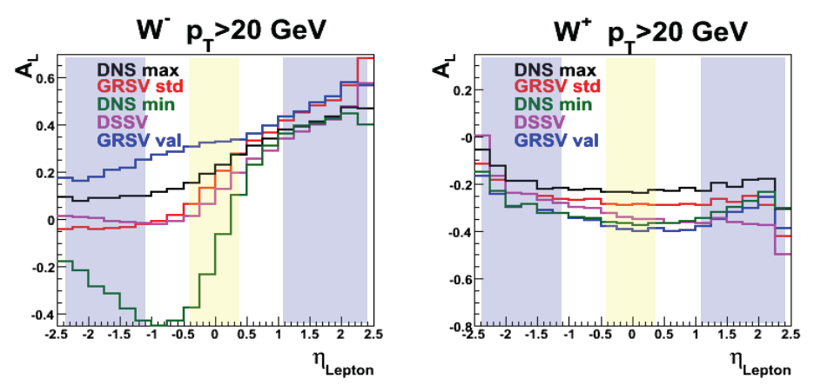
Expected asymmetry from theory
Uncertainty of PDF mostly appears around η∼1.

Slide 6

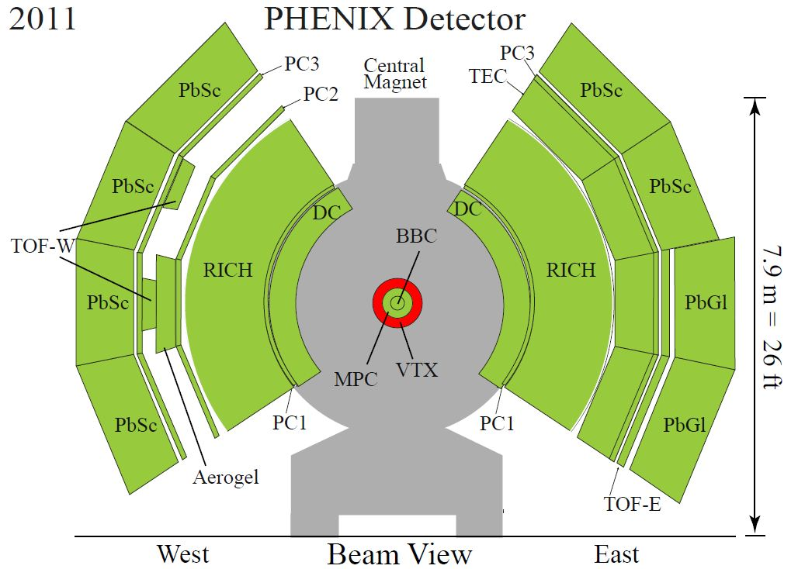
W → e in Central Arm
e
ν
Detect high energy e in EMCal
Matching with momentum
Isolation cut

Slide 7
Data Set
First data in 2009
Improvements in both luminosity and polarization
Expected signal: Jacobian peak in p_{T} spectrum
Backgrounds
  Photon conversions, cosmic rays, hadrons, ...
Year | √s (GeV) | ∫Ldt (pb⁻¹) | Pol. (%) | P²L (pb⁻¹)
2009 | 500 | 8.6 | 39 | 1.3
2011 | 500 | 16 | 48 | 3.7
2012 | 510 | ~30 | ~52 | ~8.1

Slide 8
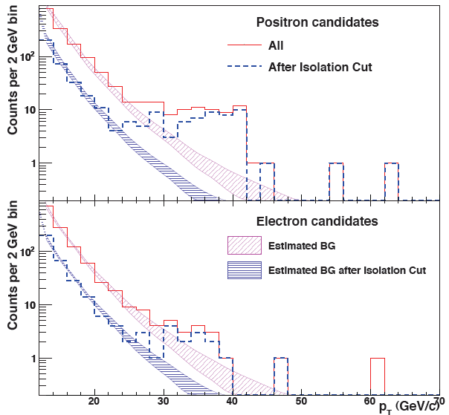
Result from Run 9
BG estimated in
p_{T} < 20 GeV
Clear Jacobian peak for W→e
with good S/N
Fewer counts in
e⁻ channel as expected
Phys. Rev. Lett. 106, 062001 (2011)

Slide 9
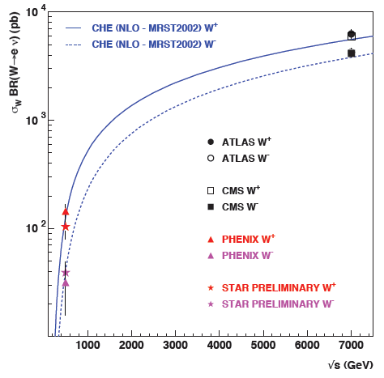
Run9 cross section
Good match with theory

Slide 10
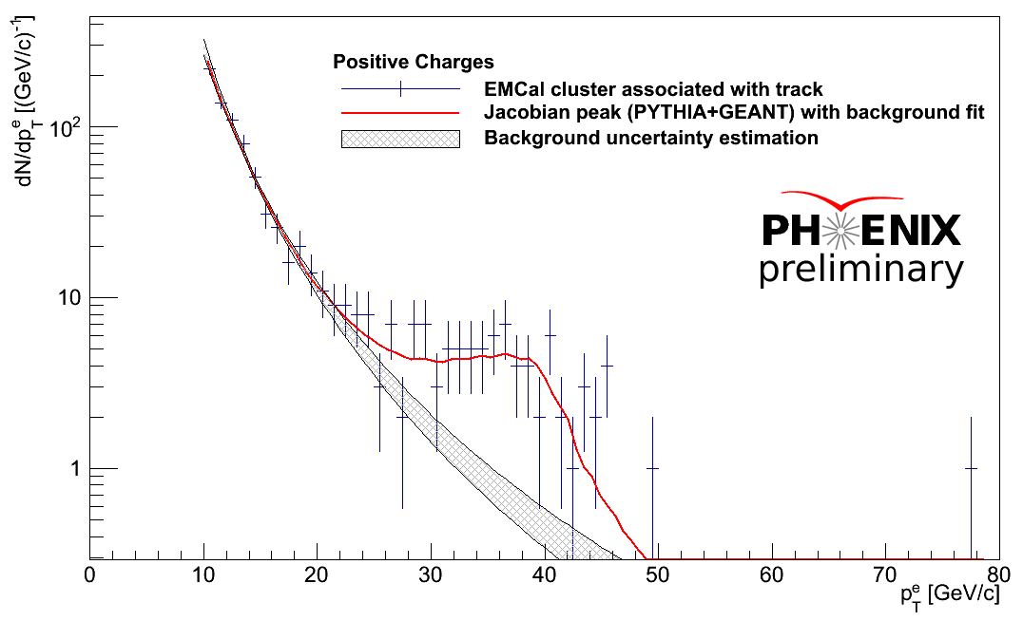
Run 11 data
e⁺

Slide 11
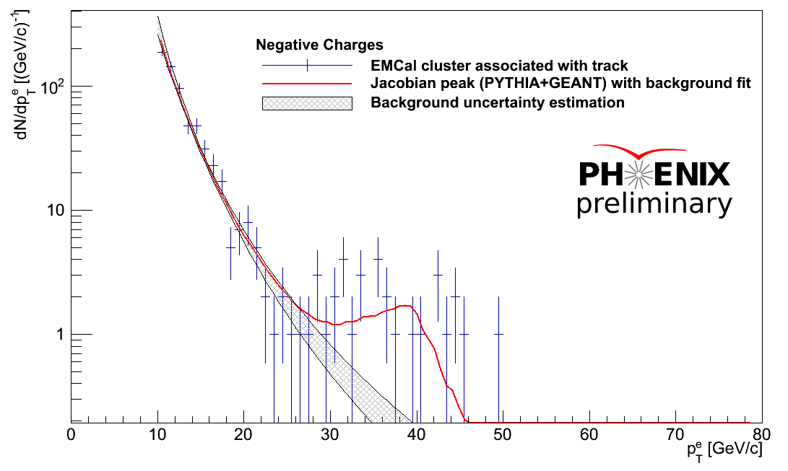
Run 11 data
e⁻

Slide 12
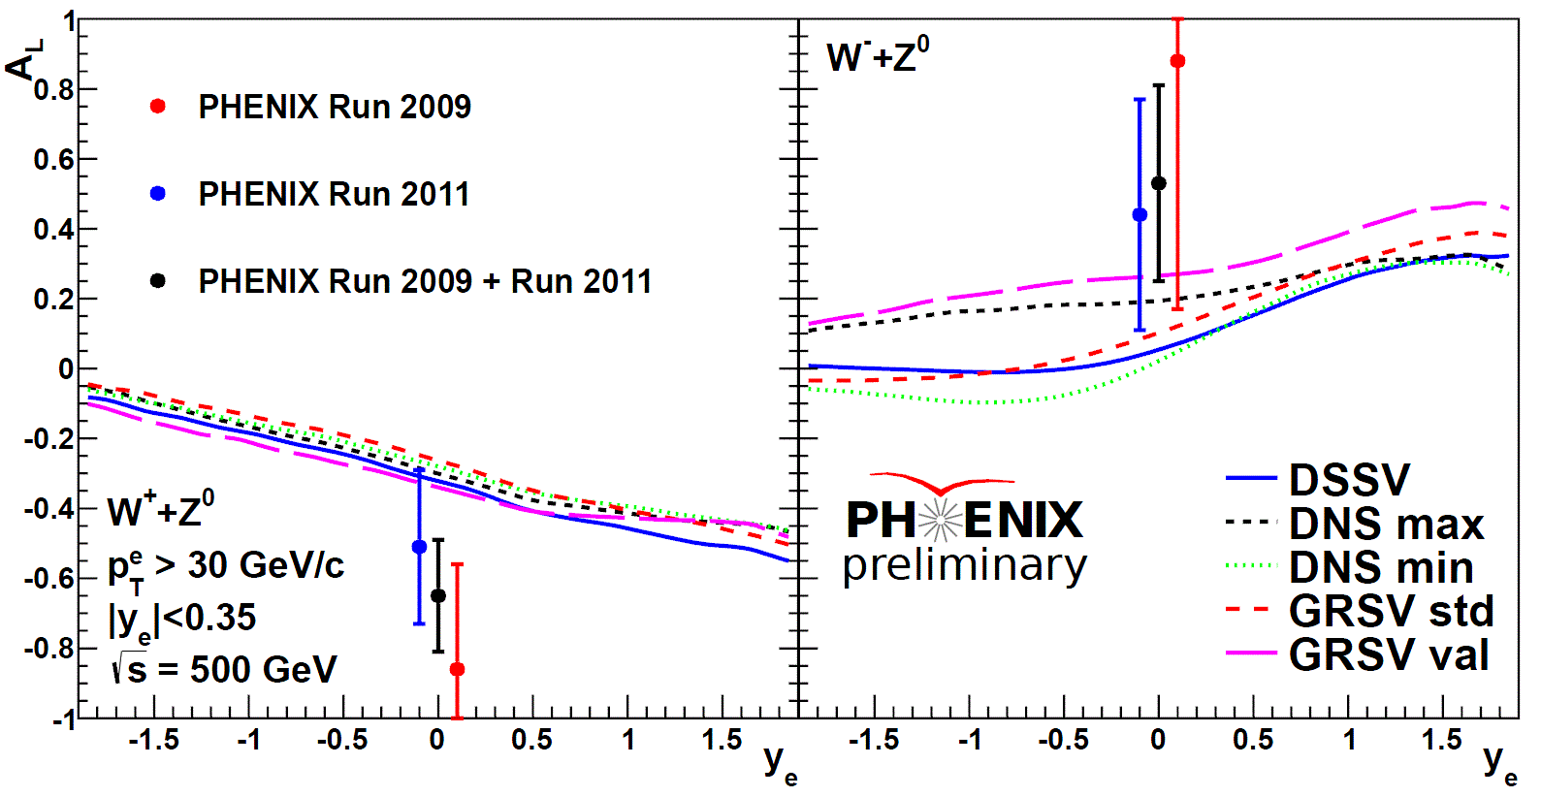
W asymmetry
Good agreement, though the uncertainty is still large

Slide 13
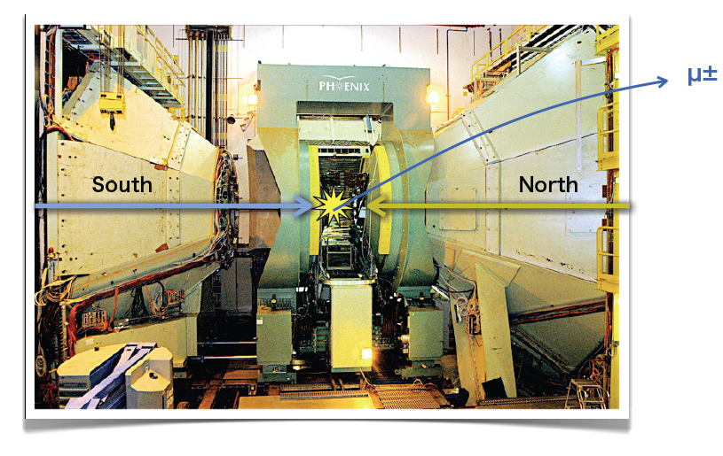
W → μ in Forward Arm
Signal: high-P_{T} single muon, almost straight in magnets

Slide 14
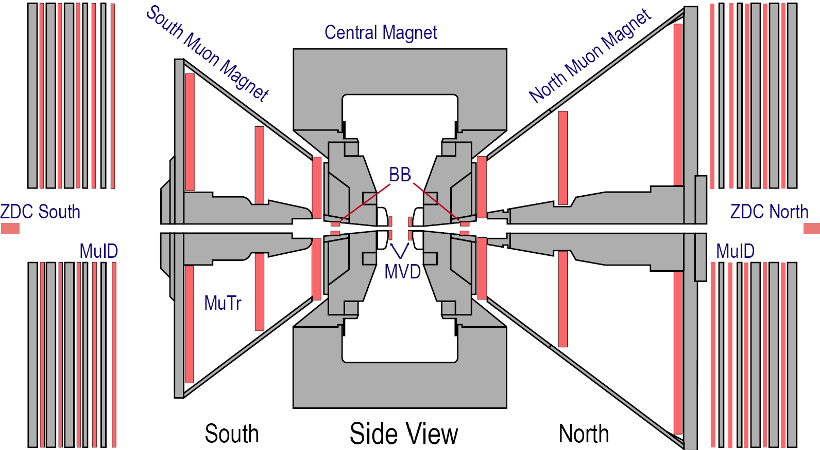
Original Muon System (before 2008)
Muon Tracking Chambers
  3 stations of Cathode strip chambers
  Each station has multiple planes for redundancy
  Slow read out -> No trigger
Muon Identifier
  5 layers of Iarocci tubes in x and y
  80 cm of steel plate absorber (total)
  Provides trigger p_{μ} > 2 GeV
B
MuID
MuTr
π
St#1
μ
St#2
St#3
Same configuration in South
14

Slide 15
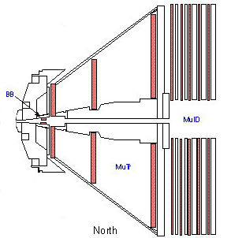
Muon Trigger Upgrade
MuTr
New front-end electronics
for trigger
→ RIKEN, SNU, etc.
R3
R1(a+b)
RPC
Extra tracking points,
timing cut
Korea U., UIUC, etc.
Talk by next speaker
r=3.40m
MuTr

Slide 16
How New Trigger Works?
Momentum Dependent Trigger
B
Search for a Stiff Track ONLINE! -> MuTRG-FEE
Good Timing Resolution -> RPC
16

Slide 17
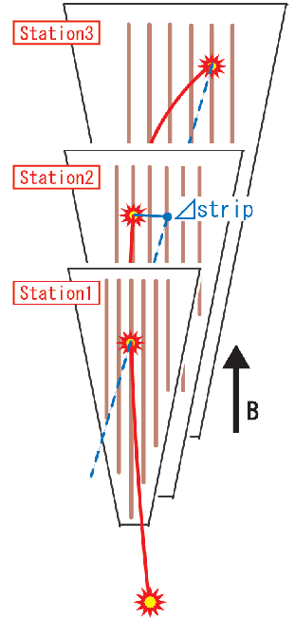
New electronics
Resistive Plate Counter
(RPC) (Φ segmented)
Trigger events with straight track
(e.g. Δstrip <= 1)
SG1
Level 1
Trigger
Board
Trigger
RPC
FEE
MuTRG
Amp/Discri.
Transmit
Data
Merge
Trigger
5%
Optical
MuTRG
MRG
MuTRG
ADTX
1.2Gbps
2 planes
Trigger
RPC / MuTRG data are
also recorded on disk.
MuTr
FEE
95%
B
Interaction Region
Rack Room

Slide 18
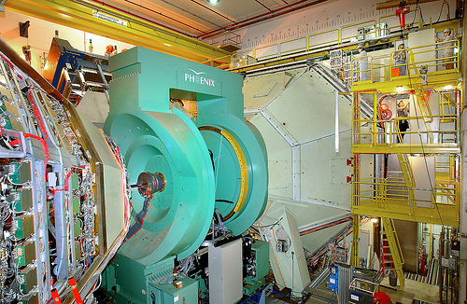
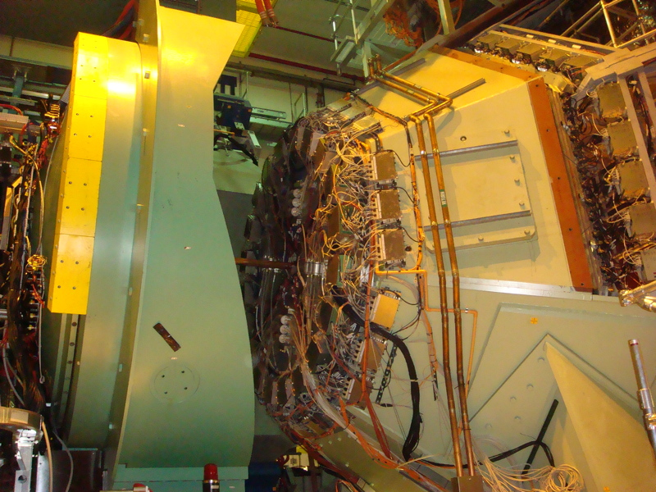
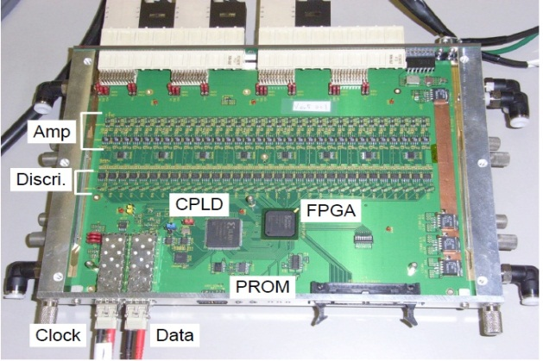
New electronics
RIKEN, SNU, ...
⬆ Before Install
2008 Install➔
Notes:
Installed 2nd and 3rd Layers as well, which are hiding behind the shade or back.

Slide 19
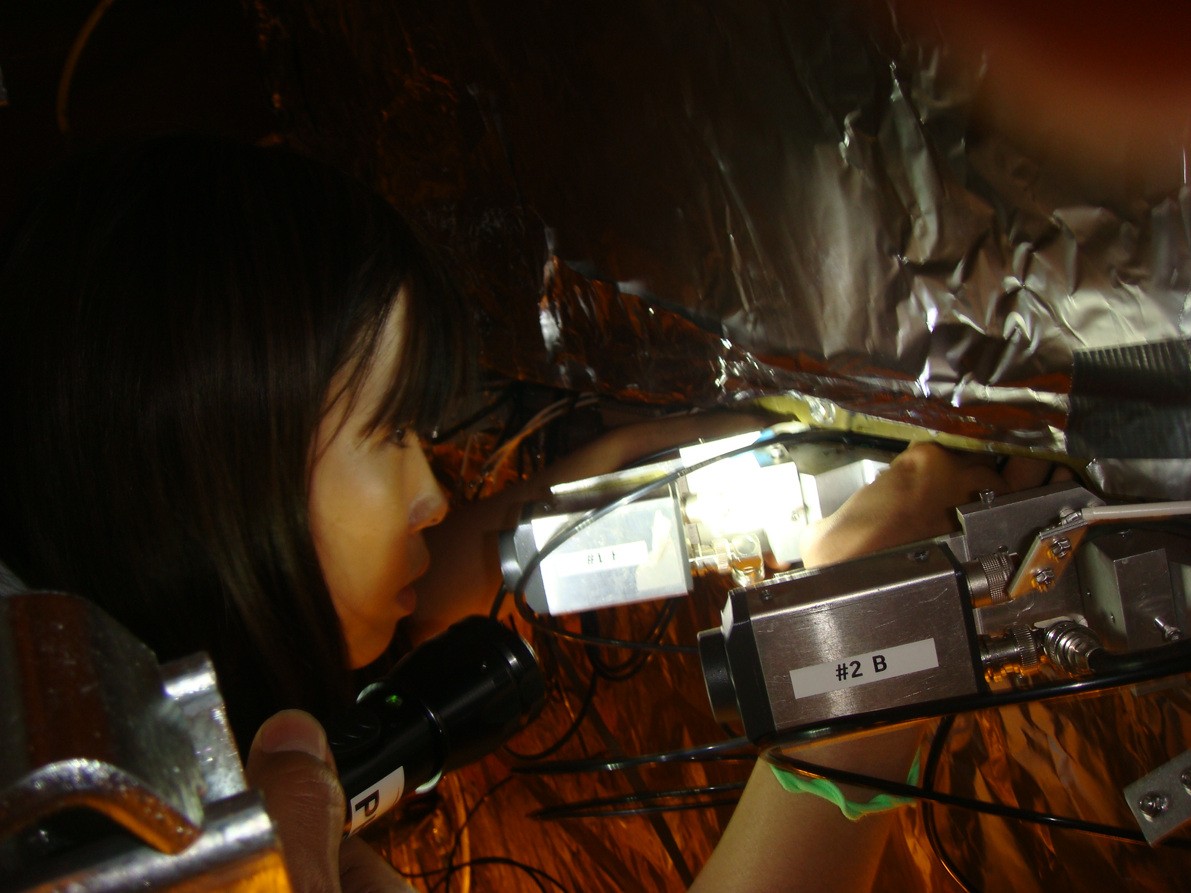
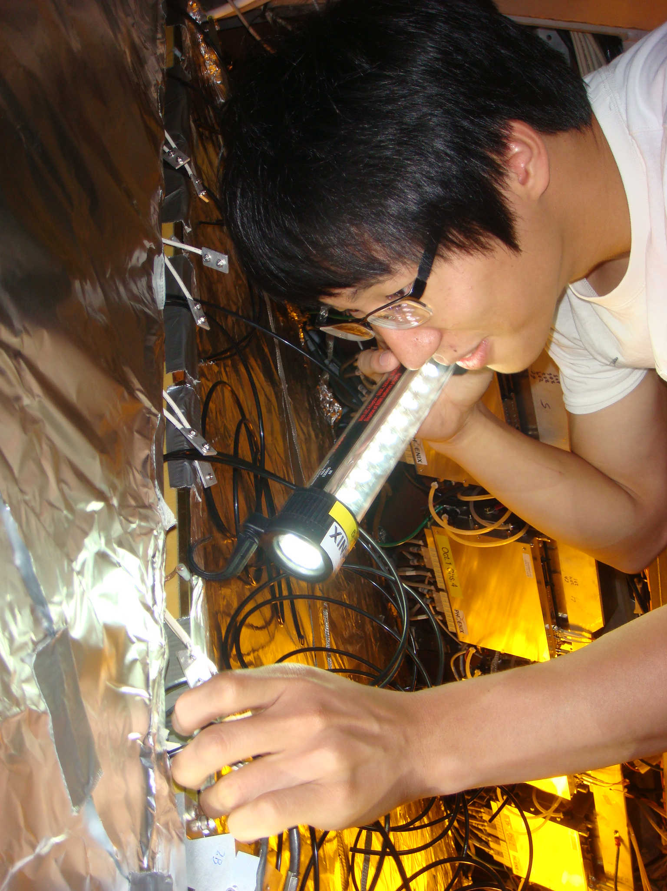
SNU students working...
Sanghwa Park
Inseok Yoon

Slide 20
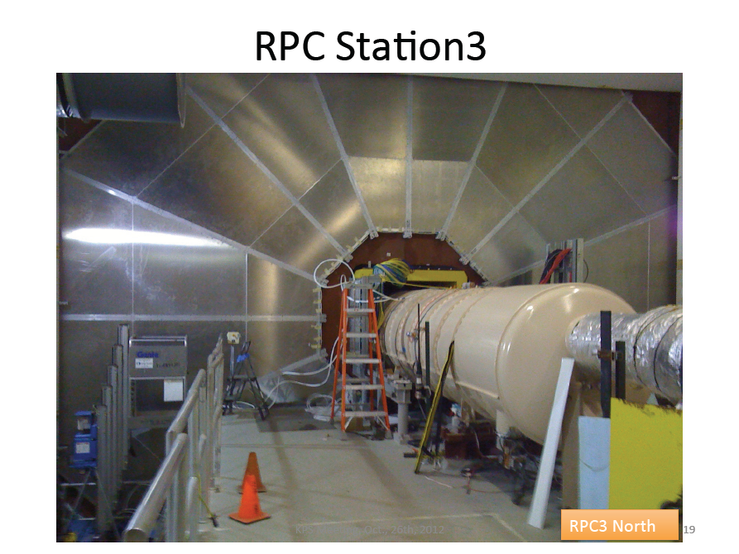
Talk by next speaker
Korea U. etc.

Slide 21
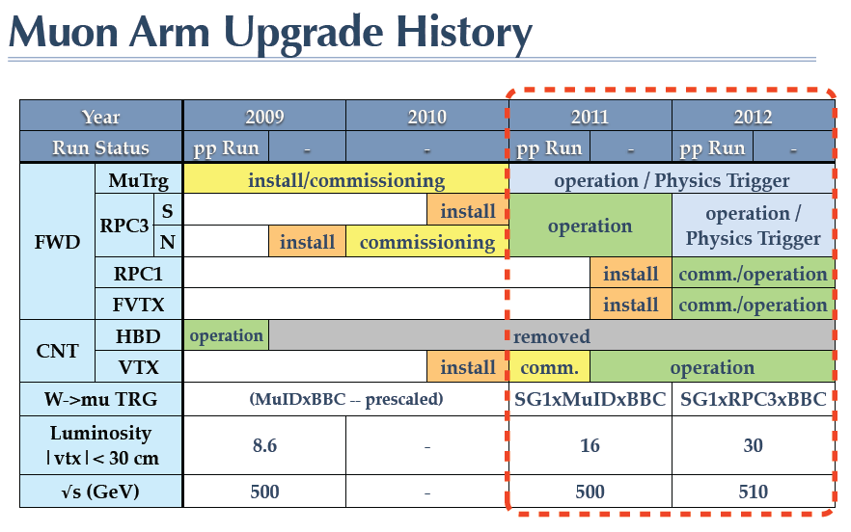

Slide 22
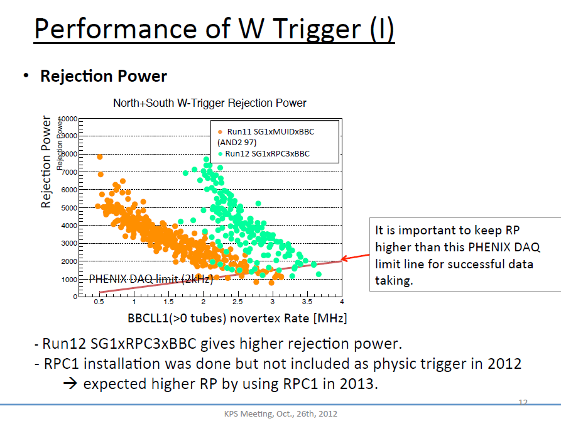
Work done by
Sanghwa Park
(SNU/RIKEN)

Slide 23
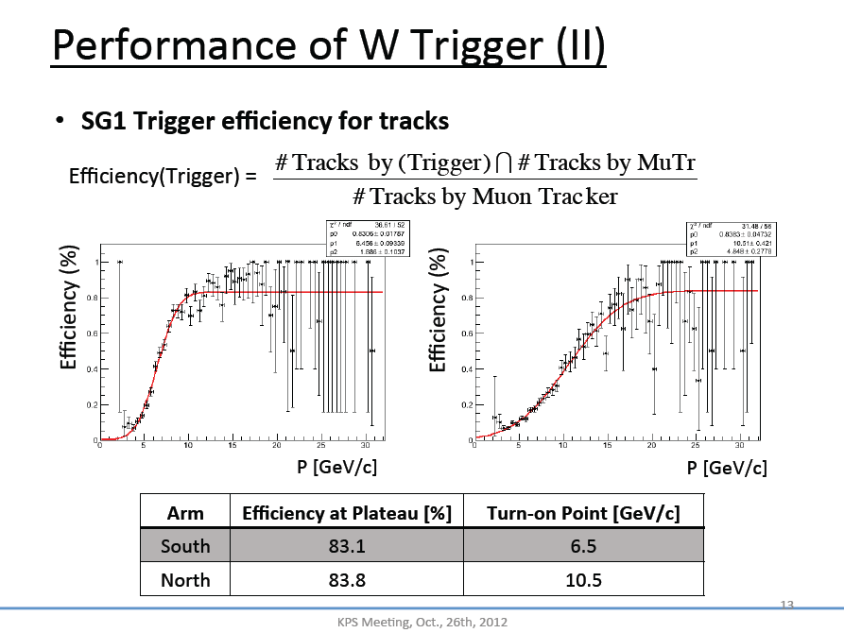
Work done by
Sanghwa Park
(SNU/RIKEN)

Slide 24
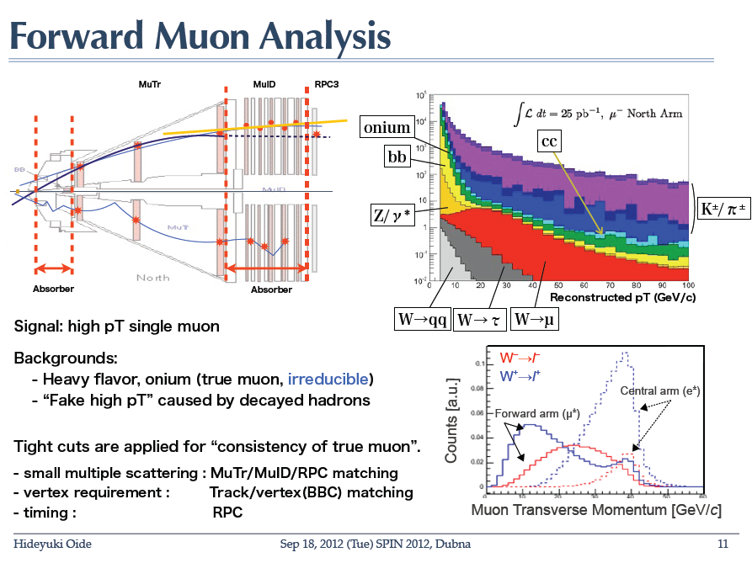

Slide 25
S/N estimation
Efficiency corrections
W/Z cross section employed RHICBOS NLO
S/B estimation from fixed W/Z cross section (RHICBOS NLO)
S/B ~ 1/3
Background estimation in data driven manner
Resolution Improvement for better S/N

Slide 26
A_{L}^{W} Results
First Forward W Asymmetry Results!
More to come!
 | Run11 | Run12
Luminosity | 25 | 50

Slide 27
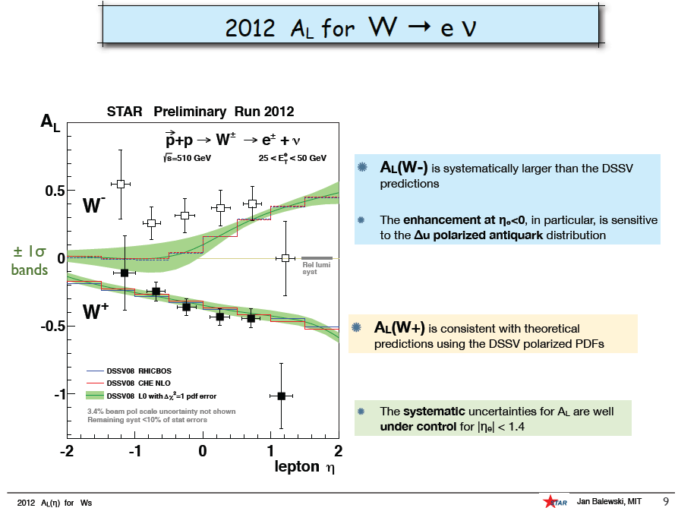
STAR result
We are behind in analysis

Slide 28
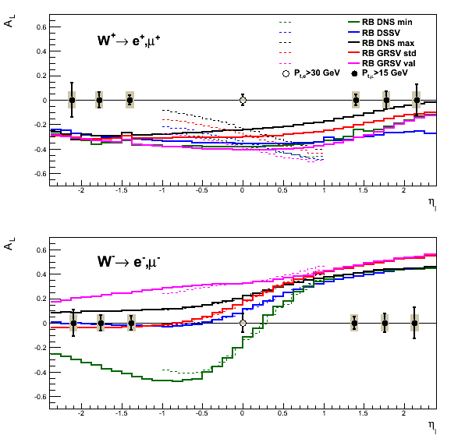
Projection for Run13
Goal : 250 pb⁻¹
on tape

Slide 29
Summary
W measurement
  Flavor separated polarized PDF
  Theoretically clear: fixed flavor/chirality, no fragmentation
Measurements in PHENIX
  Central arm: electron
  Forward: muon
Preliminary results
  Consistent with theories, though the statistical uncertainties are still large
Future
  We are expecting large statistics in Run13
  → Significant improvement of polarized-PDF for anti-quarks

