Slide 1
VTX stability study
Hidemitsu Asano

Slide 2
QA files for stability study
-QA modules
SvxQAForProduction
SvxStripClusterQA
histograms are generated segment by segment (not aggregated)
-idea-
calculates number of clusters/event sensor by sensor and finds unstable sensors run by run
datasets : run11 AuAu 200GeV

Slide 3
example B0L0 run347128
sensor 0
sensor 1
sensor 2
sensor 3
sensor 4
sensor 5
unstable !
pixel hit rate = (# of clusters) / (# of bbc events within +- 10cm )
stripixel hit rate = (# of clusters) / (# of bbc events within +-15cm )

Slide 4
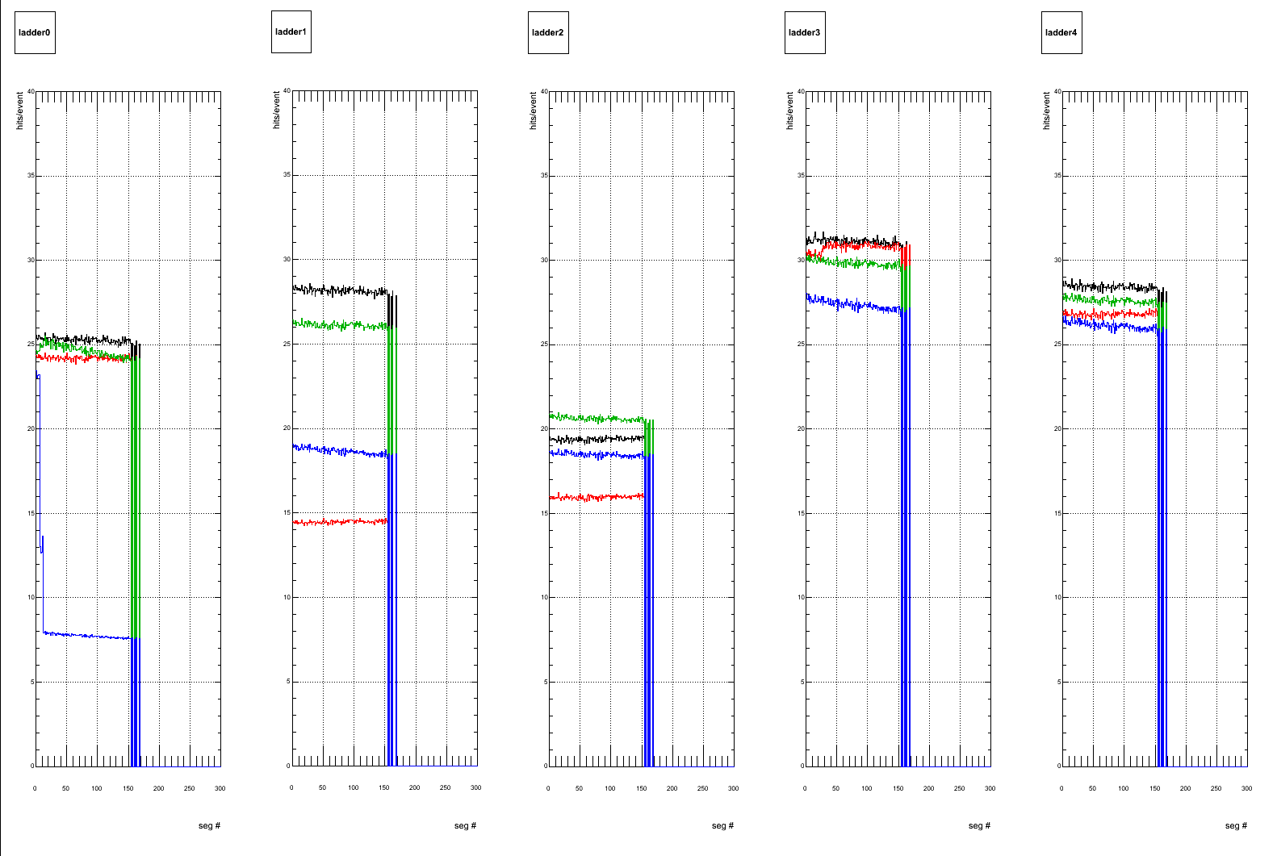
B0 west
run 347128

Slide 5
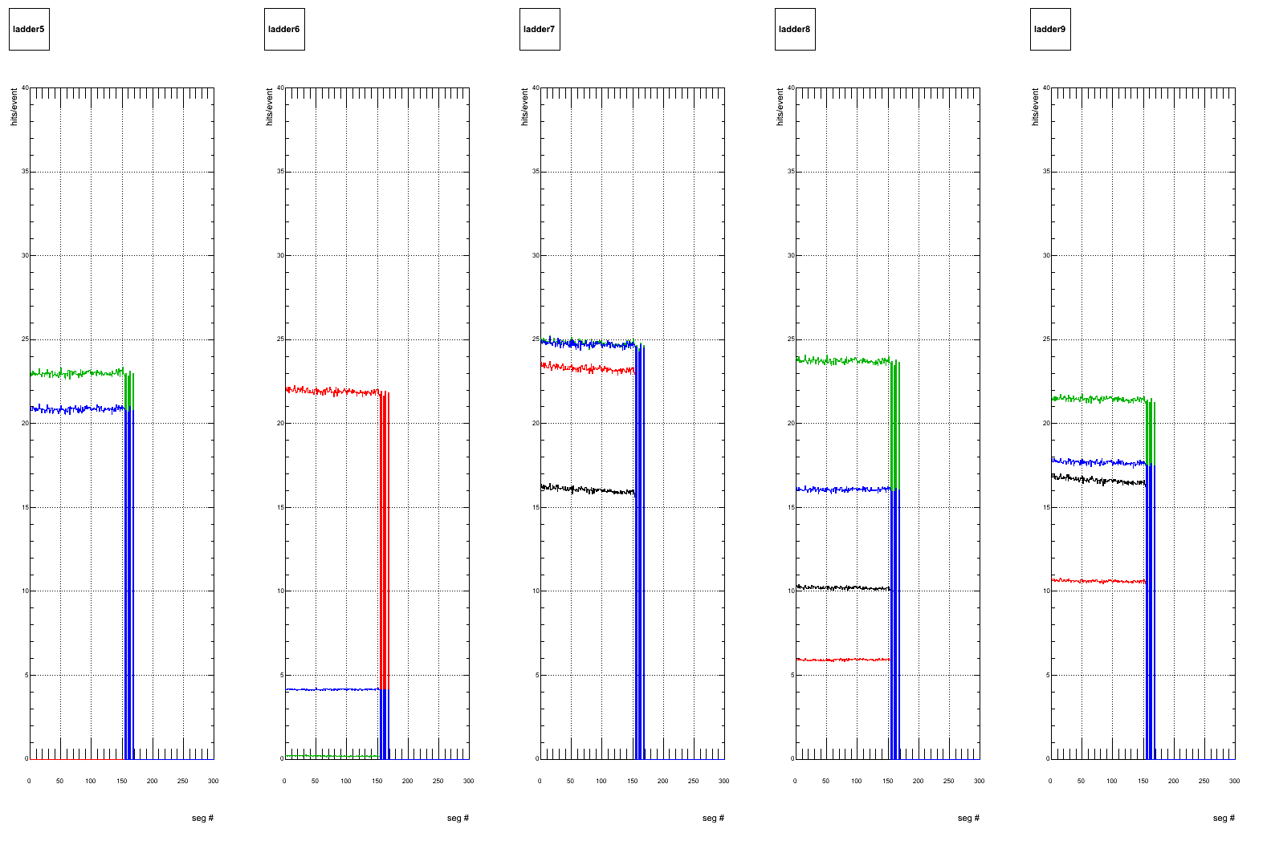
B0 east

Slide 6
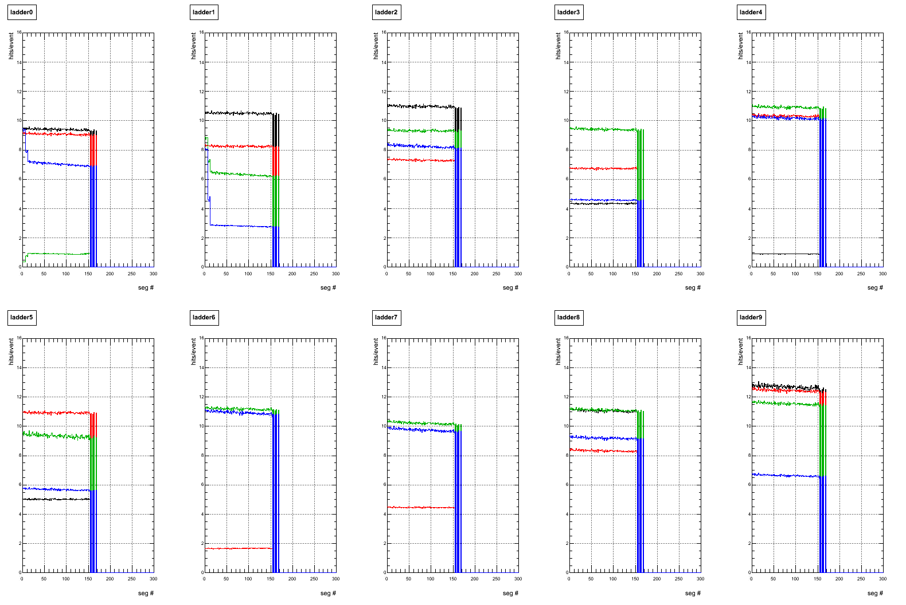
B1 west

Slide 7
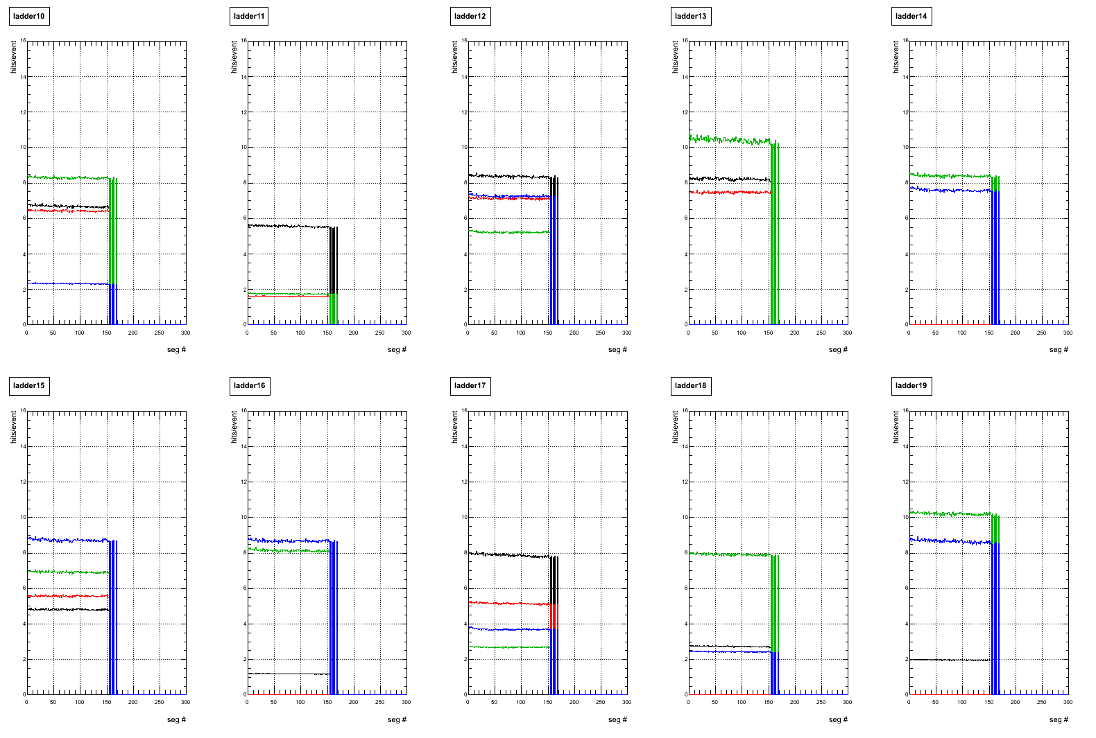
B1 east

Slide 8
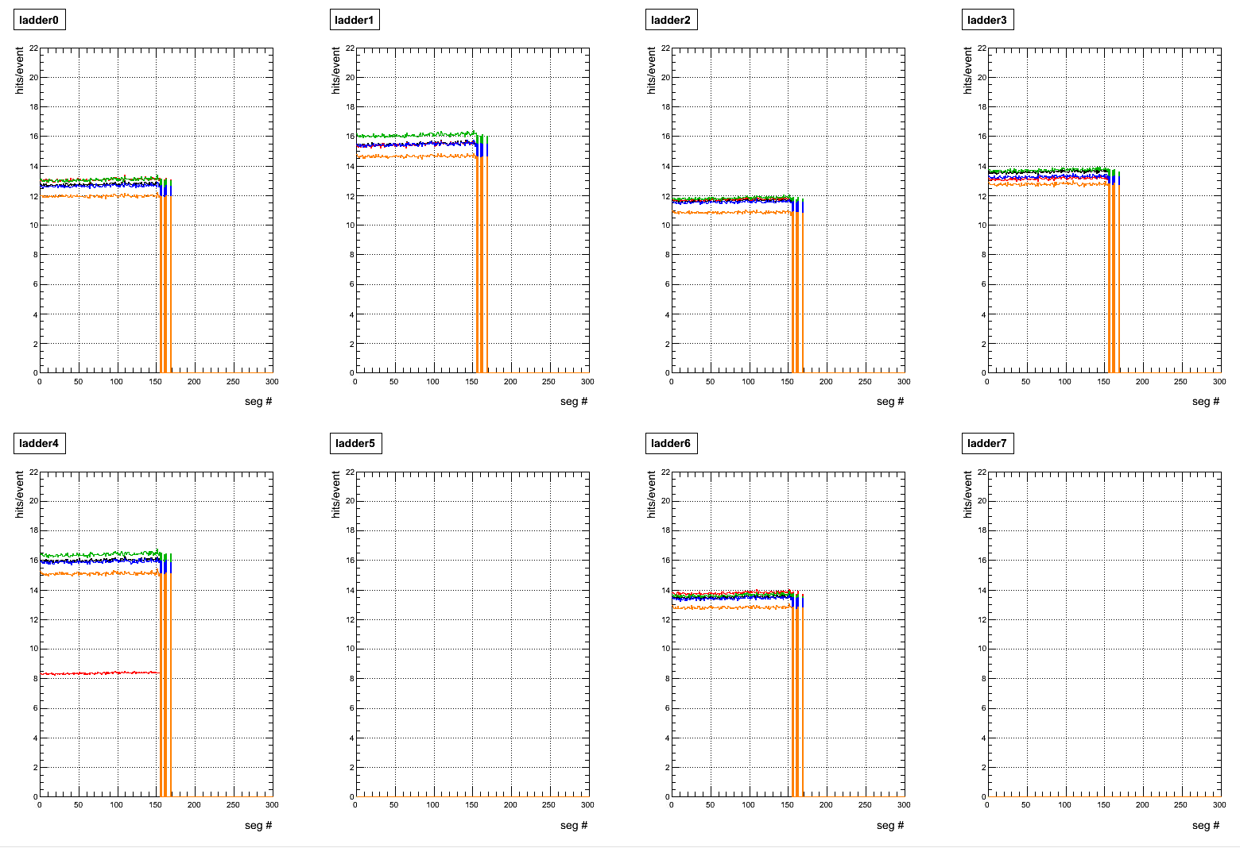
B2 west

Slide 9
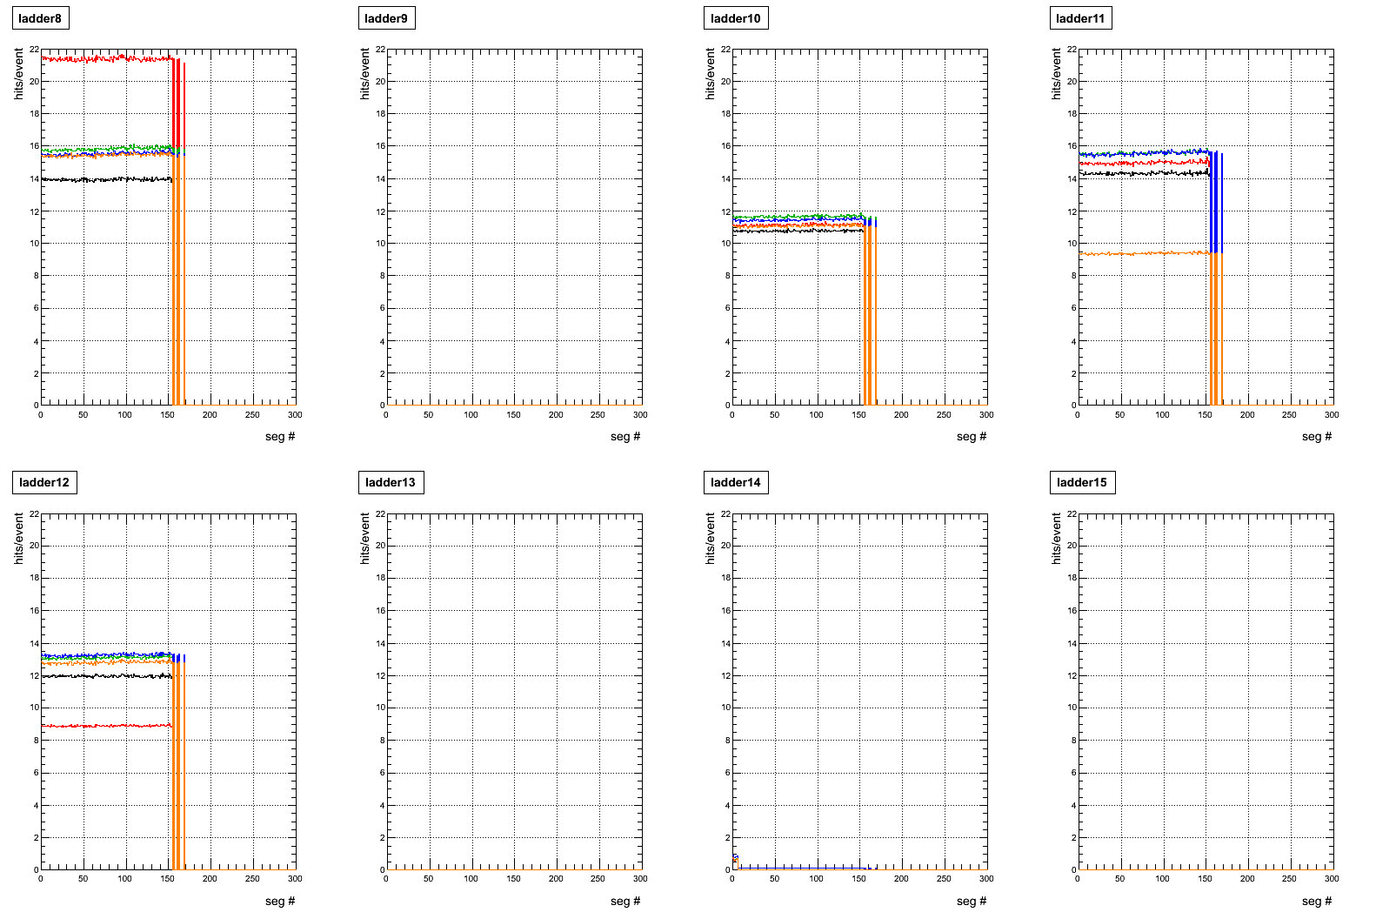
B2 east

Slide 10
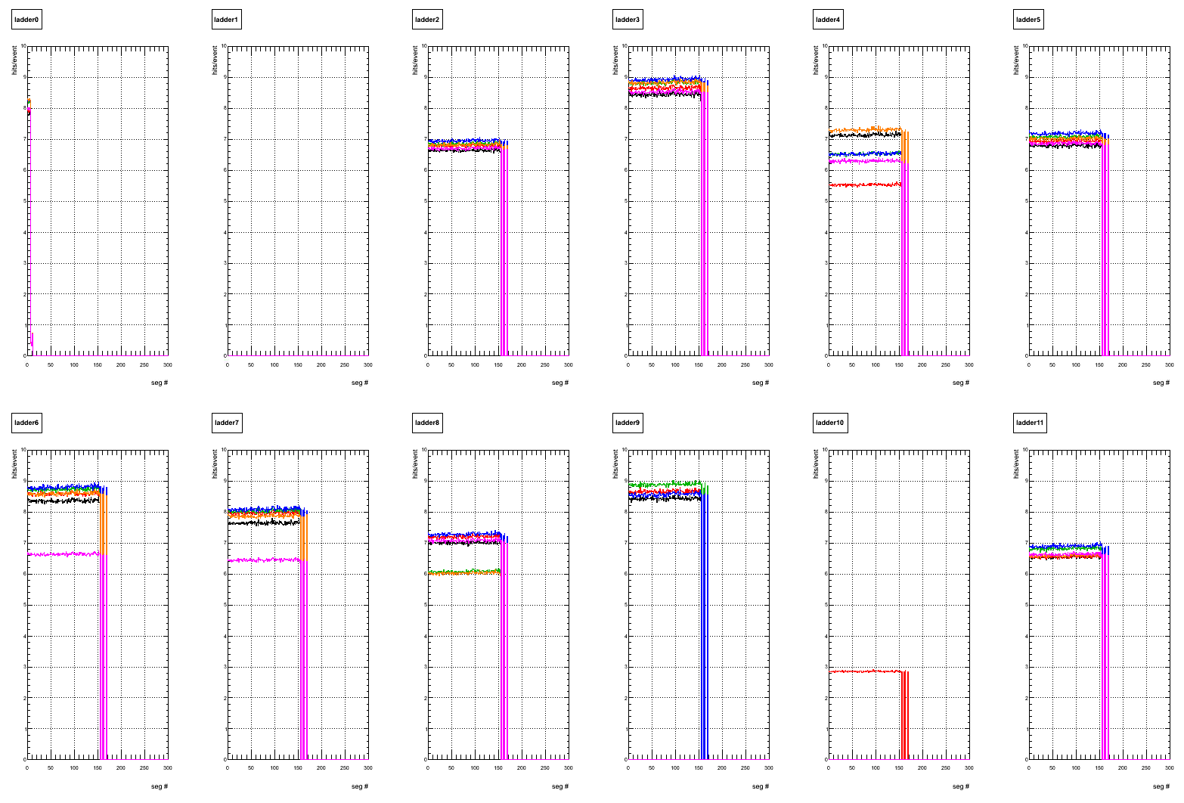
B3 west

Slide 11
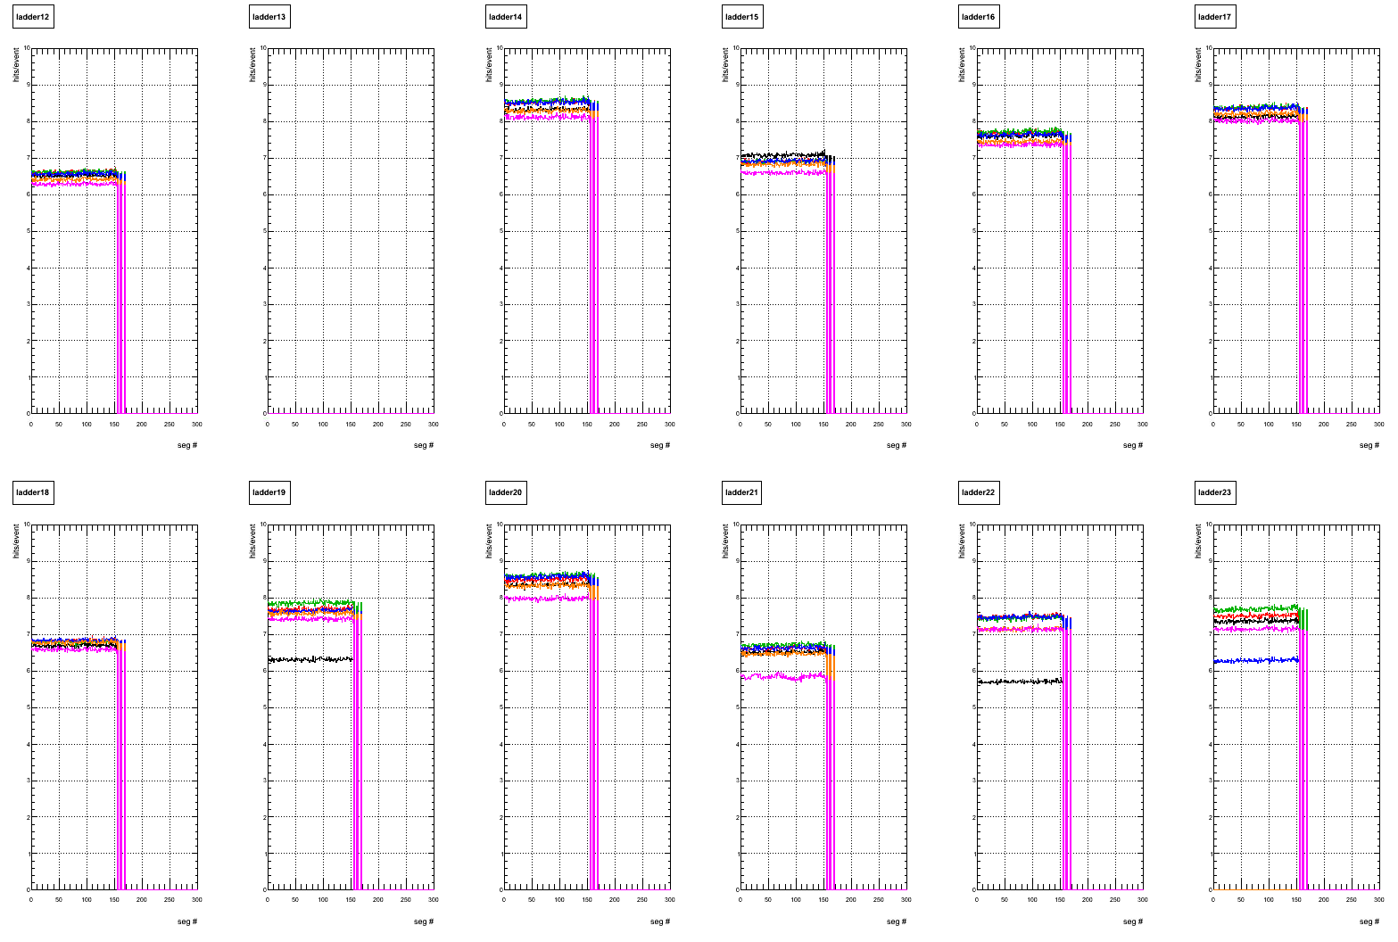
B3 east

Slide 12
unstable flag for each sensor
1. use segment # 0000 – # 0004 and calculate average hit rate sensor by sensor. (=firsthitrate)
2. scan hit rate for all segment (sensor by sensor)
if ( hit rate < 0.80*firsthitrate || 1.03*firsthitrate < hit rate )
badsegment++;
….
if(badsegment>2) the sensor is marked as “unstable”

Slide 13
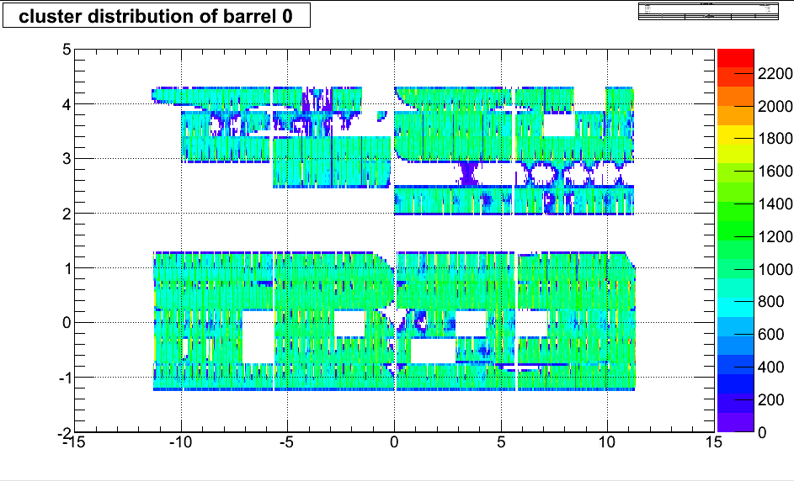
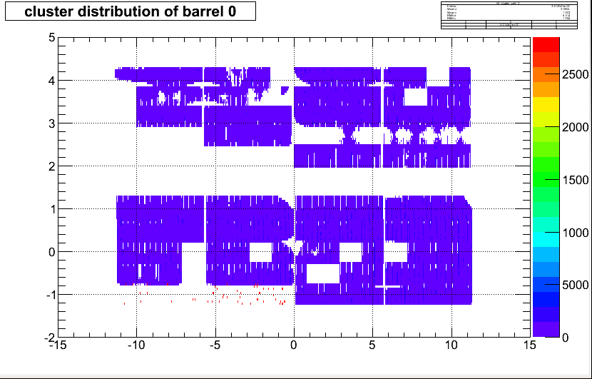
marked as unstable sensor
run 347128
phi
z
segment #0000
segment #0100

Slide 14
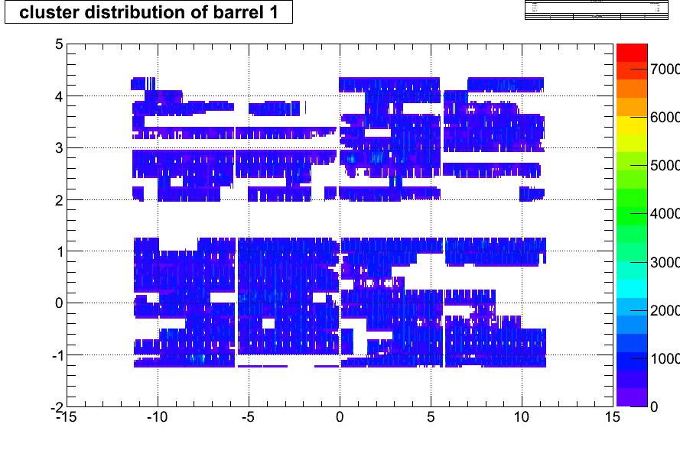
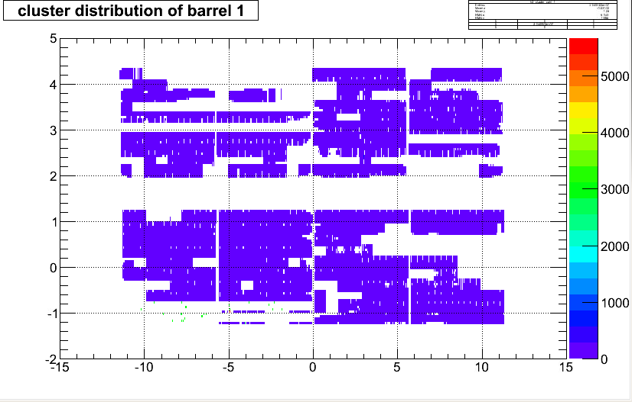
phi
z
segment #0000
segment #0100

Slide 15
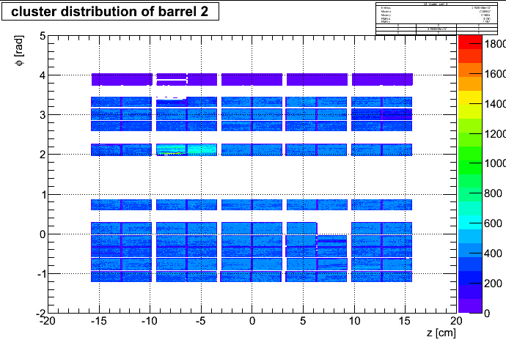
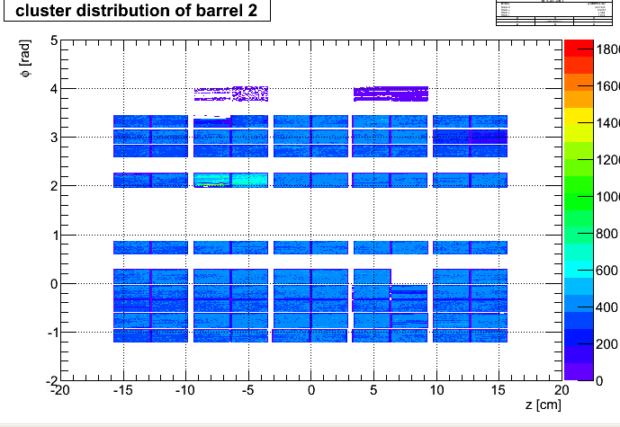
segment #0000
segment #0100

Slide 16
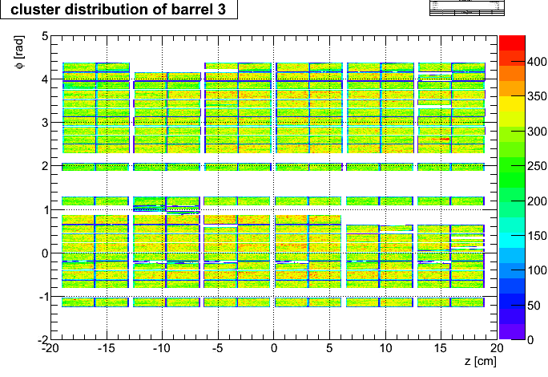
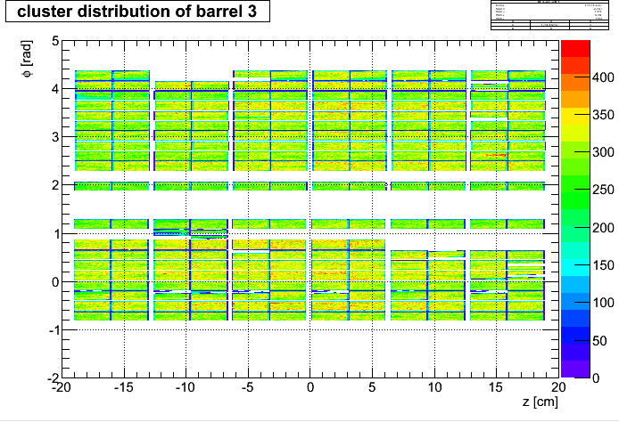
segment #0000
segment #0100

Slide 17
outlook
-plan
optimize threshold for unstable sensor flag and scan all data.
unstable sensor flag will be determined run by run
Those unstable sensor flag will be used for RP(VTX) analysis .

Slide 18
backup

Slide 19
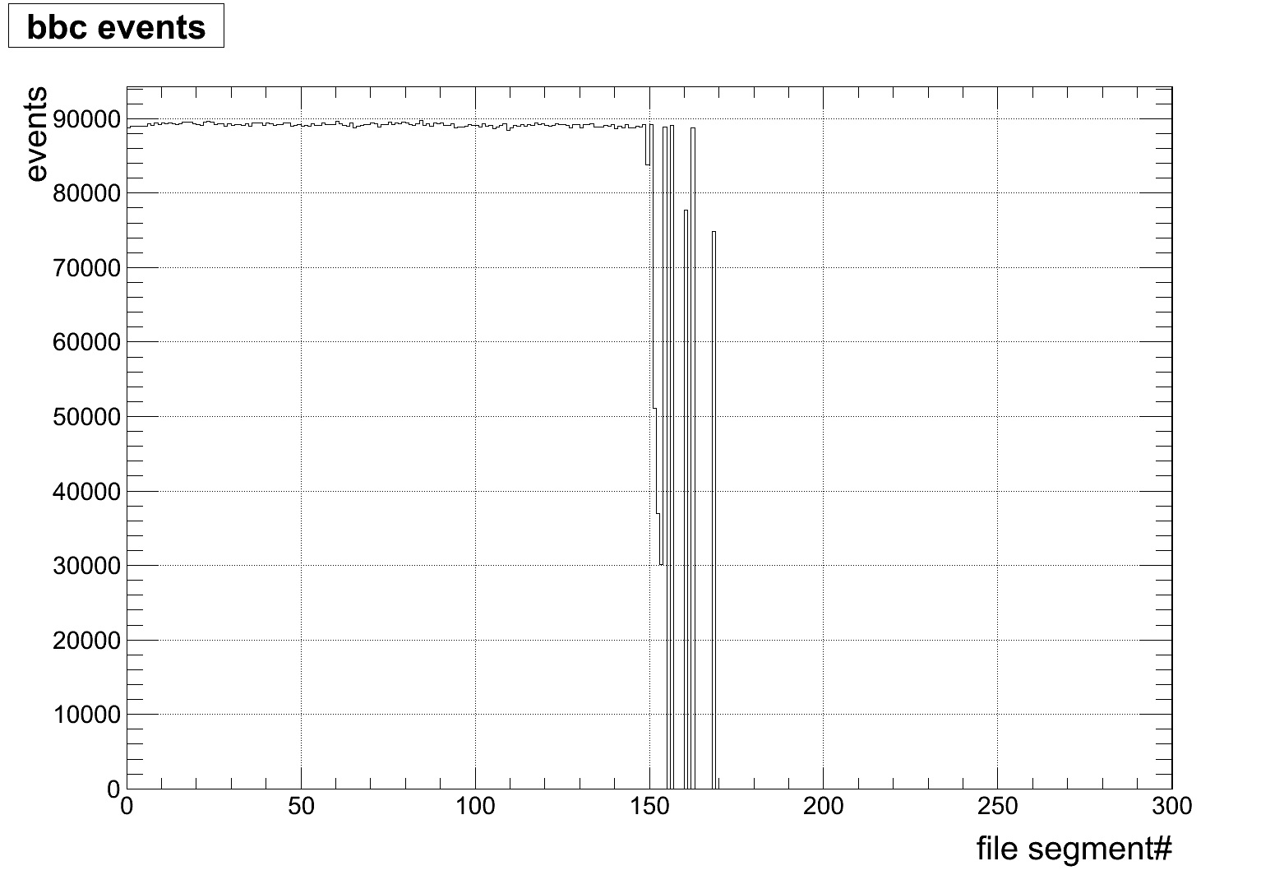

Slide 20
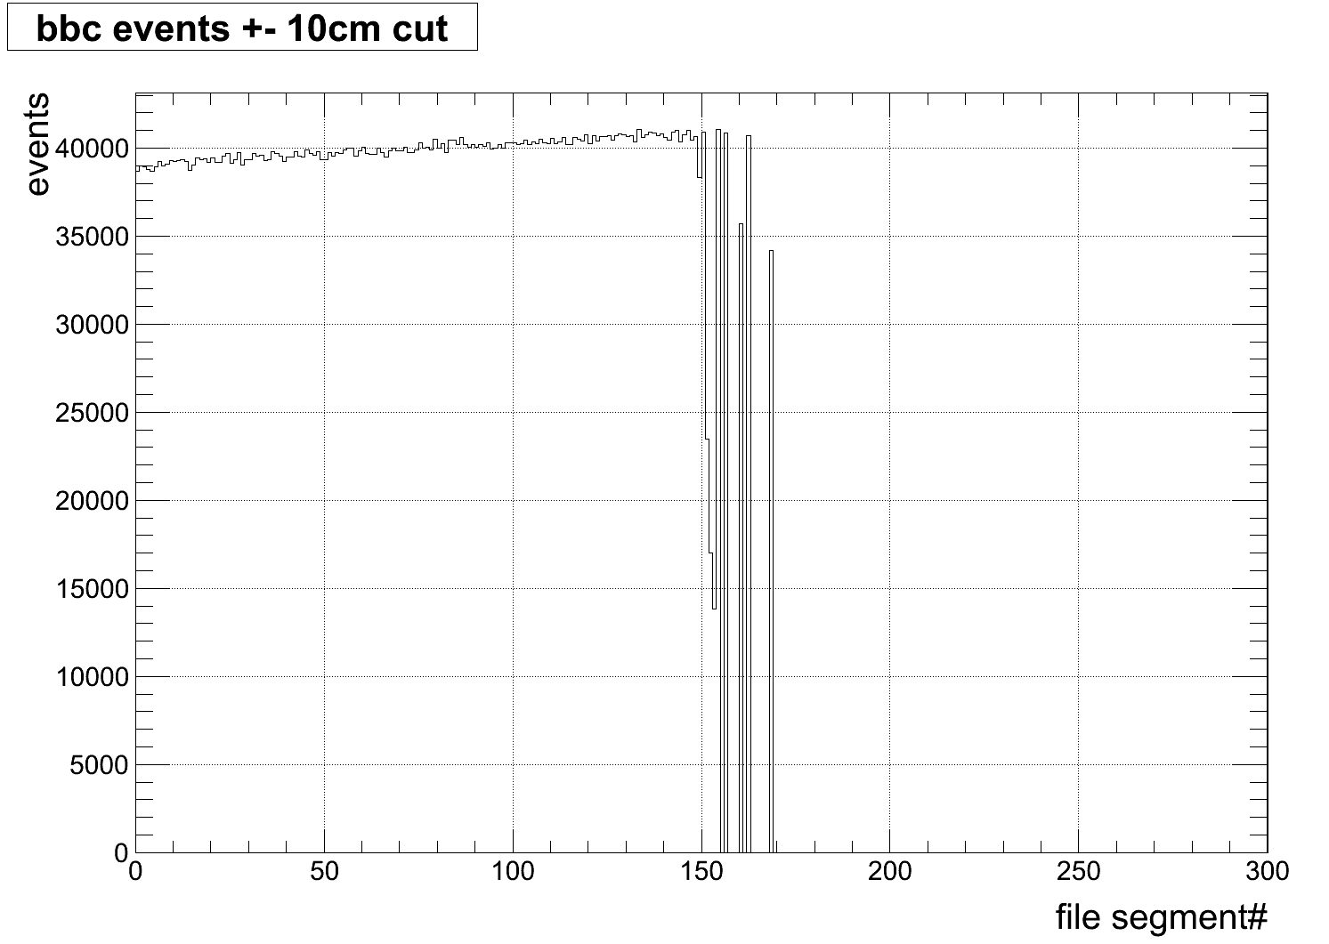

Slide 21
